Slide 1

Fall Protection in Residential Construction
Presented by
Philadelphia Area Project on Occupational Safety and Health
Notes:
Narrative:
Welcome to our fall protection training. During our time together today we’ll be talking about setting up jobs safely while working at heights. *
Share a bit about yourself and your motivation for doing this work, think of the following and share:
How long have you been doing health and safety trainings?
Do you have experience working in construction?
Do you have a personal experience with injuries or illnesses on the job that make you care about health and safety?
What’s your connection to this work?
In general, participants will see you as being able to facilitate this training if off the bat you share your experience and motivation for this work.
*In the notes section, all non-italicized words should be stated – in the trainers’ words. Italicized words are instructions or thoughts and ideas for trainer to convey to participants.

Slide 2
Slide about course disclaimer
This material was produced under a 2014 Susan Harwood Training Grant #SH26308-SH4 from the Occupational Safety and Health Administration (OSHA), U.S. Department of Labor. It does not necessarily reflect the views or policies of the U.S. Department of Labor, nor does mention of trade names, commercial products or organizations imply endorsement by the U.S. Government.
Notes:
We receive a grant from OSHA to facilitate these trainings, but we’re not part of the government
Per the requirements of the grant funding, there is some paperwork that we are required to do, so we’ll ask you to fill that out at different times. If you haven’t done so already, please complete the white sheet in your folder and I’ll collect them when you’re done.

Slide 3

Introductions
Name
Type of work
Years doing work
Why this work?
Notes:
Please tell us your name, the type of work you do, how long you’ve been doing this work, and if you’d like to share why you do this work that’d be great!
Get a sense of whether people are working on roofs, scaffolds, ladders, other surfaces, etc.

Slide 4

WHAT IS PHILAPOSH ?
The Philadelphia Area Project on Occupational Safety and Health.
Founded in 1975.
Non Profit Organization serving the Tri-State area whose sole mission is to promote safety and health in the workplace.
Notes:
This training is being provided by PHILAPOSH, the Philadelphia Area Project on Occupational Safety and Health.
Summarize this and the next slide.

Slide 5
WHAT DOES PHILAPOSH DO?
Supports construction workers!
  We’re a resource for you
Provides training
  OSHA certified 10 and 30 hour in Construction and General Industry
Sponsors an annual event on Workers Memorial Day on April 28th
  Researches fatalities in region

Slide 6
Learning Objectives
Review impact of work injuries and illnesses
Explain what OSHA does
Identify fall hazards
Present OSHA requirements for fall protection with special emphasis on roofs, scaffolds, ladders, and stairways
Review employer and employee rights and responsibilities regarding safety at work
Notes:
While we’re together today, we’ll be reviewing the impact of work injuries and illnesses, talk a bit about OSHA as a resource, and identify fall hazards. While I’ll be talking about the OSHA requirements for fall protection I want to be clear that you can do even better than the requirements and that we’re talking about safety as a broad concept not just as a legal requirement.
We’ll end our time talking about worker and employer rights and responsibilities.

Slide 7
What is OSHA?
What do they do?
Occupational Safety and Health Administration
Federal agency responsible for worker safety and health protection.
Notes:
Who here has heard of OSHA? Who can tell us what they do?
Likely people will talk about OSHA being an agency that fines you, that they’re unfair, etc. Use this to actually talk more about OSHA. For example, when people say they fine you, you can say – well, yes since OSHA was established to protect workers, they make sure to inspect workplaces to ensure they’re up to code.
OSHA is housed in the U.S. Department of Labor.

Slide 8
What are some specific things OSHA does?
Develops and enforces mandatory job safety and health standards
Maintains a reporting and recordkeeping system to monitor job-related injuries and illnesses
Provides FREE consultation to small businesses
“Writes contracts for employers”
A-C
All of the above
Notes:
Free consultation program: Goto osha.gov and small business tab: give info about this, I’ll show this on the next slide.
Remember, since we all pay taxes in one form or another those taxes fund OSHA. Use OSHA as a resource instead of waiting until they fine you!

Slide 9
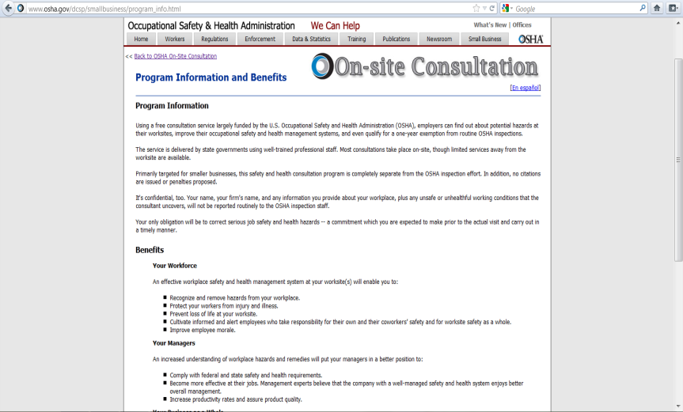
FREE Consultation Program
Notes:
This program is totally separate from enforcement, meaning they can’t fine you for not following the law. The whole point of this program is that OSHA understands that small businesses don’t have the same kind of money as large commercial contractors. So, if you want OSHA to come to your jobsite and let you know that you’re setting things up according to the law, give them a call.
REMEMBER, DON’T EXPECT THEM TO SHOW UP TOMORROW. CALL THEM WITH TIME, FOR A JOB YOU KNOW YOU HAVE IN A MONTH OR 6 WEEKS FROM NOW.

Slide 10
Has OSHA Made A Difference?
YES!
Since 1970 OSHA has:
Helped cut the work-related fatality rate by more than half (65%)
Worked with employers and employees to reduce workplace injuries and illnesses by 67%
This happened while employment in the United States nearly doubled!
Source: http://www.osha.gov/oshstats/commonstats.html
Notes:
In four decades, OSHA and our state partners, coupled with the efforts of employers, safety and health professionals, unions and advocates, have had a dramatic effect on workplace safety. Since 1970, workplace fatalities have been reduced by more than 65 percent and occupational injury and illness rates have declined by 67 percent. At the same time, U.S. employment has almost doubled. Worker deaths in America are down — from about 38 worker deaths a day in 1970 to 12 a day in 2012. Worker injuries and illnesses are down — from 10.9 incidents per 100 workers in 1972 to fewer than 3.5 per 100 in 2011 (https://www.osha.gov/oshstats/commonstats.html).
After going through this slide, ask people to raise their hands if they or someone they know has been injured at work. Then say, “We are ALL affected by this.”

Slide 11
On average, how many workers die every day from job injuries?
12
Notes:
Narrative:
This is the number of workers dying daily from work in both 2012 and 2013 (based on preliminary data for 2013).
Worker deaths in America are down — from about 38 worker deaths a day in 1970 to 13 a day in 2010 (http://www.osha.gov/oshstats/commonstats.html)
Former Secretary of Labor Hilda Solis’s 9/20/12 press release shows same number for preliminary 2011 data: http://www.dol.gov/opa/media/press/opa/OPA20121943.htm and from the chart from the Census of Fatal Occupational Injuries: http://www.bls.gov/iif/oshwc/cfoi/cfch0010.pdf and 2012 the number was 4628 which translates to roughly 12 workers a day
2013 Preliminary Data shows a lower yearly number than 2012: 4405 people sustained fatal work injuries in 2013, which still translates to approximately 12 workers a day dying on the job but is 5% below the final count for 2012. (http://www.bls.gov/iif/oshwc/cfoi/cfch0012.pdf)
Note: this number is across all industries and for the entire country.

Slide 12
In 2013….
Approximately 4,400 people were killed at work*
    Nearly 300 workers were killed in the tri-state area
Greatest number of workers killed in construction compared to all industries - ~800*
3 million non-fatal workplace injuries in private industry and public sector º (2012 data)
* http://www.bls.gov/iif/oshwc/cfoi/cfch0012.pdf, º http://bls.gov/news.release/pdf/osh.pdf
Notes:
Statistics come from Preliminary results of the 2012 Census of Fatal Occupational Injuries (CFOI) shows a fatal work injury rate of 4,405, page 1: http://www.bls.gov/iif/oshwc/cfoi/cfch0012.pdf
Tri-state (NJ, PA, DE) data comes from CFOI preliminary 2012 page 20: http://www.bls.gov/iif/oshwc/cfoi/cfch0012.pdf, preliminary data shows 290 deaths in tri-state region
796 construction workers killed on the job in 2013, page 14: http://www.bls.gov/iif/oshwc/cfoi/cfch0012.pdf
Non-fatal injury stats from BLS workplace injury and illness: http://www.bls.gov/news.release/pdf/osh.pdf
This is why OSHA is around! And, we’re so focused on construction because of the fact that the highest number of workers killed in any industry is in construction. Are you surprised by these numbers?

Slide 13
Costs for Businesses
Estimated at $250 billion for all injuries and illnesses
Notes:
This number comes from a 2011 article by J. Paul Leigh: Economic Burden of Occupational Injury and Illness in the United States
In Milbank 12/22/11. (http://onlinelibrary.wiley.com/doi/10.1111/j.1468-0009.2011.00648.x/full). This number is an inflation adjusted number for 2007, based on an earlier collaborative article in 2000, which used 1992 data.
Not only do injuries affect our communities, but for business owners they’re also a big expense.

Slide 14
Definition of Residential Construction
In order to be classified as residential construction, two elements must be met:
  The end-use of the structure being built must be as a home, i.e., a dwelling; and
  The structure being built must be constructed using traditional wood frame construction materials and methods.
    The limited use of steel I-beams to help support wood framing does not disqualify a structure from being considered residential construction.
Notes:
Slide directly from http://www.osha.gov/doc/residential_fall_protection/ppt/index.html

Slide 15
Slide about why fall protection training is needed
Why Do We Need a
Fall Protection
Training Program
Specifically for
Residential Construction?
Notes:
Ask group. Try to tease out the following:
Residential projects are much smaller and quicker than commercial
This often leads to less money and the belief that if it’s a quicker job then you don’t need fall protection or that the small costs just don’t cover it

Slide 16
Roofers on residential projects don’t get hurt.
True or False?
False:
“Almost every week, we see a worker killed from falling off a residential roof.”
- Assistant Secretary of Labor for OSHA Dr. David Michaels, 12/22/10
Notes:
From News Release, titled “US Labor Department's OSHA acts to protect residential roofing workers
Agency rescinds Clinton-era directive and gives workers more safeguards against falls”
(http://www.osha.gov/pls/oshaweb/owadisp.show_document?p_table=NEWS_RELEASES&p_id=19005)
Here’s another big reason why we need a residential construction fall protection program. How many weeks are there in a year? (52) The last few years there’s been approximately 50 workers who died falling off a residential roof! That’s way too many!

Slide 17
A worker must fall a long distance to be killed.
True or False?
False
The height doesn’t matter, it’s how hard you hit your head. Half of those who died from falls fell from 25 feet or less.
Notes:
Source: Massachusetts Department of Public Health
Fatality Assessment and Control Evaluation (FACE) Project (http://www.mass.gov/eohhs/docs/dph/occupational-health/falls-construction-sites.pdf)

Slide 18
Older, more experienced workers don’t fall.
True or False?
False:
The average age of residential construction workers who have fallen to their deaths is 43.
Notes:
Source: http://www.mass.gov/eohhs/docs/dph/occupational-health/falls-construction-sites.pdf

Slide 19
There are not many safe alternatives available for workers to prevent or protect them from a fall.
True or False?
False:
There are many and we will present a few in the following presentation.

Slide 20
Identifying Fall Hazards in Residential Construction
  Scaffolds and aerial lifts
  Roofs
  Ladders and stairs
Notes:
We’ll be looking at fall hazards on scaffolds, roofs, ladders and stairs, and lifts by taking a look at some pictures.

Slide 21
During each stage of a residential build workers will encounter fall hazards associated with:
Site preparation and Excavation
Foundation Work
Flooring Work
Framing
Siding, brick work, and masonry
Roof work
Notes:
How many other sub-contractors are on site? Does that create additional fall hazards? For example, you may be a framer, but there may be excavation work being done too.

Slide 22
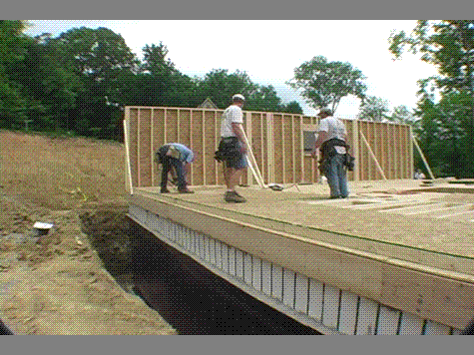
Picture of fall hazard
Backs are to the fall hazard. Need some sort of fall protection
(i.e. GUARDRAIL, personal fall arrest system, or restraint system)
Notes:
Narrative:
What are the hazards you see in this photo? These workers are assembling the exterior walls on top of the floor.
Try to elicit the following:
There is no fall protection
There is an open trench – which doesn’t look like it’s shored up and the workers could fall right into it.
This photo is shown first because it highlights the importance of planning. If this job had been better planned, the trench would have been filled in first, before the workers started assembling the walls. While that doesn’t mean they couldn’t fall from 2 feet, you are greatly decreasing the hazard of falling in a trench.

Slide 23
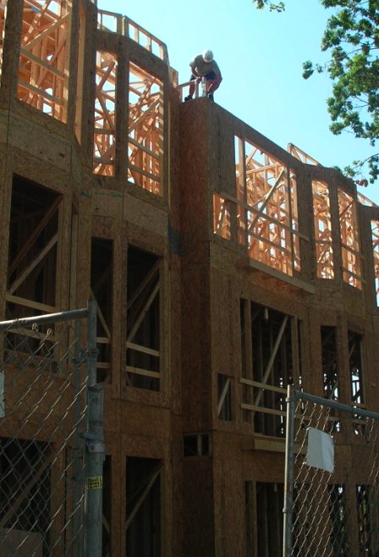
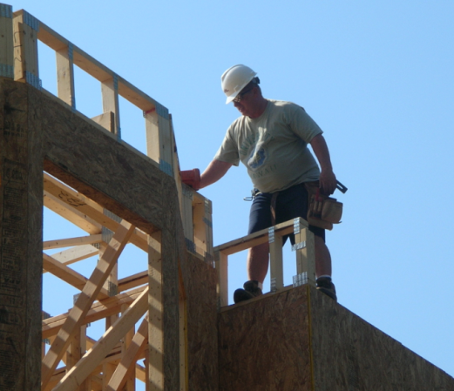
Picture of fall hazard
1926.501(b)(13)
Notes:
Narrative:
What hazards do you see?
If not mentioned:
Here we see a foreman carpenter doing framing work on the edge of a working surface that is 6 or more feet above the next lower level. The picture on the left shows the larger view of the work being done, with the picture on the right a close up of the worker. As you can see there is no conventional or alternative fall protection. All framing standards are in 1926.501(b)(13)
To note: on the second story, the windowsills are below 39” so guardrails are required. As you can see pictured here, the guard rails are installed on the inside of the windows with both a toprail and midrail.

Slide 24
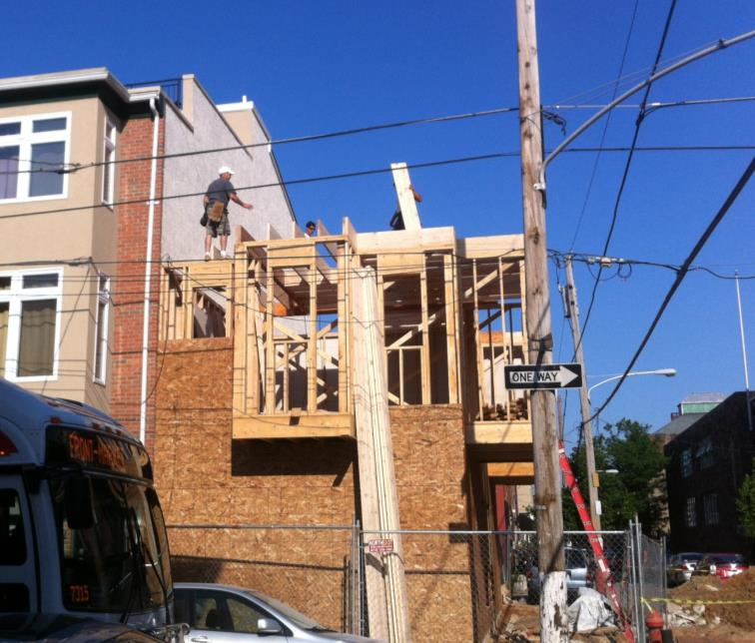
Picture of fall hazard around power lines
Open sided floors 6’ OR HIGHER MUST HAVE FALL PROTECTION
Power lines not insulated
Notes:
What hazards do you see here?
Ensure what’s written in the green box is mentioned.
At this point in the training, it’s a good idea to have participants complete the pre-test on the green sheet of paper. Do it before showing the next slides, which give the answer to the first question.
Ask people to take out the green sheet in their folder and complete it to the best of their ability. Tell them that this is really a measure of you as a trainer – to see if they’ll know all the answers by the end of the training – not of their current knowledge.
If the group seems to have low literacy skills, you may decide to read the questions aloud and have people just mark the answers on their sheet.
Take about 8 minutes to complete the pre-test and then collect them and ask if there are any burning questions. Be clear that you will go through all the answers during the training.

Slide 25
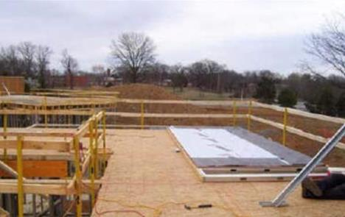
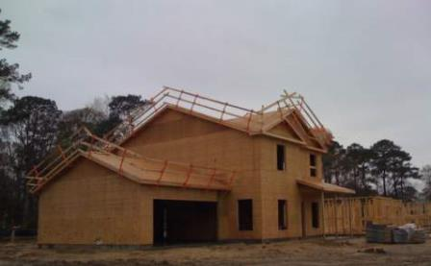
What are examples
of fall protection?
A
Guardrails
B
Notes:
So, I keep saying fall protection. The first question on your pre-test asked you the types of fall protection. What were they?
Participants might not share the answers in the order of the slides, but be flexible with the order they give.
If you want to share some detail about pictures in this slide:
A pre-fabricated wall panel positioned for installation behind a fully protected area -- potential fall to the exterior of the structure has been eliminated. Also, stairwell is protected by guardrails -- eliminating falls to the interior also.
B) Here are guardrails that were either positioned prior to, or after, sheathing and left in place for the follow along trades to do their job.
Proper coordination can lead to one system serving the needs of several trades.
From: http://www.osha.gov/doc/residential_fall_protection/ppt/index.html

Slide 26
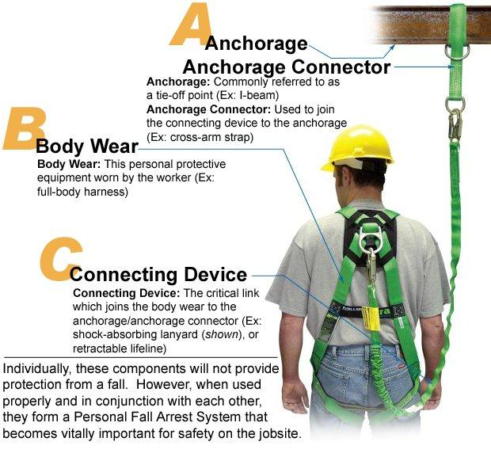
Personal Fall Arrest System
Notes:
If participants say a harness is one type of fall protection, bring out the harness and ask for a participant to put it on. Once it’s on, ask whether this participant would be protected from a fall wearing the harness. You will probably be told that the worker needs to be tied off. So, then have another worker attach the lanyard to the D ring on the harness and then to an anchor point. Make sure that you teach about the shock absorber and that it needs to go next to the workers’ body to absorb the shock.
Once that is complete, tell everyone that
These are the parts of the Personal Fall Arrest System (PFAS). If you wrote harness, that’s incorrect because it’s missing the parts that tie the worker off and protect them from hitting the ground. For today, we will only be using the words PFAS to ensure we all are thinking about the whole system. This was the answer to the first question: PFAS!
Remember, in addition to these three parts, you must have a plan of how to remove/evacuate a worker from a PFAS should they fall in this system.

Slide 27
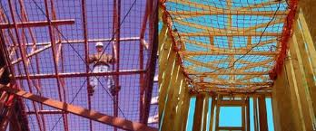
Safety Nets
Safety Nets
Notes:
Has anyone ever seen safety nets used in residential construction? They’re more typical to commercial, but they can be used. They are different from the nets used to catch materials.
You will keep hearing me say, fall protection. When I say fall protection is required on a job, I just mean that you have to choose one of these three types of fall protection. You choose which makes sense for you and the job you’re doing.

Slide 28
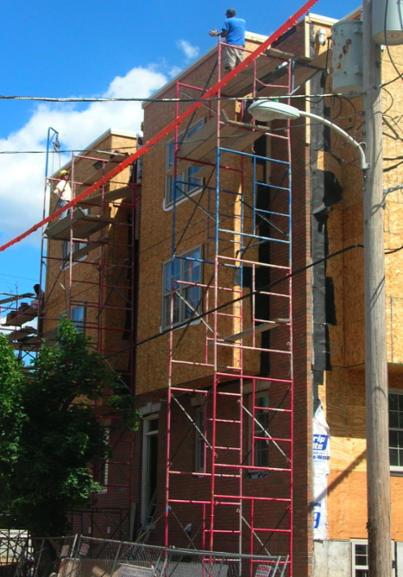
Scaffolding
Any temporary elevated working surface must comply with OSHA scaffold standards

Slide 29
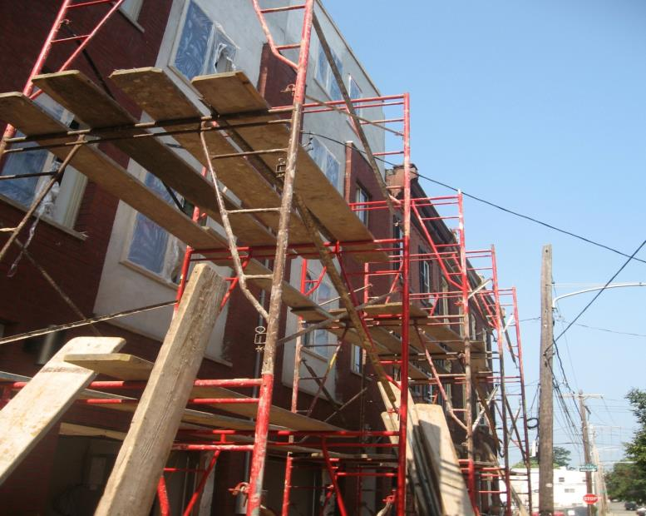
Picture of fall hazard
Scaffold must be fully planked
Clean area of scraps and combustibles
Work at least 10 feet from uncovered power lines or any conductive material being handled
Notes:
What are the hazards?
Just ensure those marked and in the box are mentioned.

Slide 30
Working Safely
Insulated Lines
Uninsulated Lines
1926.451(f)(6)
Voltage | Minimum Distance | Alternatives
Less than 300 volts. | 3 feet (0.9 m)
300 volts to 50 kv. | 10 feet (3.1 m)
More than 50 kv | 10 feet (3.1 m) plus .4 inches (1.0 cm) for each 1 kv over 50 kv. | 2 x length of line insulator, but never less than 10 ft (3.1 m).
Voltage | Minimum Distance | Alternatives
Less than 50 kv | 10 feet (3.1 m).
More than 50 kv | 10 feet (3.1 m) plus .4 inches (1.0 cm) for each 1 kv over 50 kv. | 2 x length of line insulator, but never less than 10 ft (3.1 m).
Notes:
1925.451(f)(6): The clearance between scaffolds and power lines shall be as follows: Scaffolds shall not be erected, used, dismantled, altered, or moved such that they or any conductive material handled on them might come closer to exposed and energized power lines than as follows on the charts. Exception to paragraph (f)(6): Scaffolds and materials may be closer to power lines than specified above where such clearance is necessary for performance of work, and only after the utility company, or electrical system operator, has been notified of the need to work closer and the utility company, or electrical system operator, has deenergized the lines, relocated the lines, or installed protective coverings to prevent accidental contact with the lines.

Slide 31
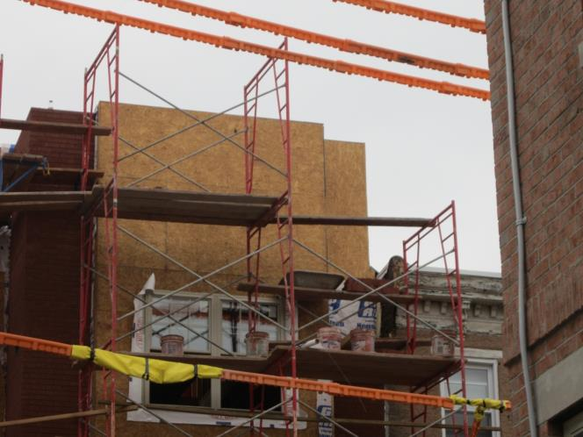
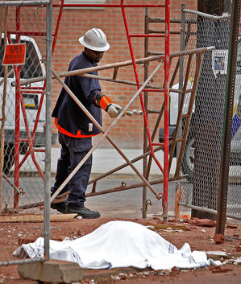
Picture of scaffold electrocution hazard
Age: 30 years
Date of Death: April 30, 2012
Location: Philadelphia, PA
Cause of Death: Electrocution which caused fall off scaffold
Photo credit: philly.com
Notes:
Narration:
On April 30, 2012 Andres Cano was working on building new homes on the corner of 20th and Parrish streets in Philadelphia. He was carrying a bucket on unguarded scaffolding, when the bucket came in contact with either the scaffolding or electrical wires which proceeded to electrocute him and caused him to fall off the scaffolding resulting in his death. The picture at the bottom left shows a PECO worker testing to see if an electric current is running through the scaffold. They learned that it was energized, and Andres Cano’s co-workers told us that they waited 6 hours to recover his body until the scaffolding was de-energized.
Photo credit at bottom right: http://www.philly.com/philly/news/breaking/20120430_Construction_worker_dies_after_contact_with_live_wire.html

Slide 32
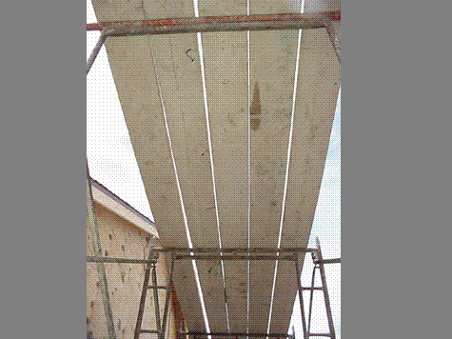
Working Safely
Planking is complete between the uprights with no more than 1 inch gaps between the planks.
1926.451(b)(1)(i)
Notes:
Narrative:
This planking is complete between the uprights with no more than 1 inch gaps between the planks.

Slide 33
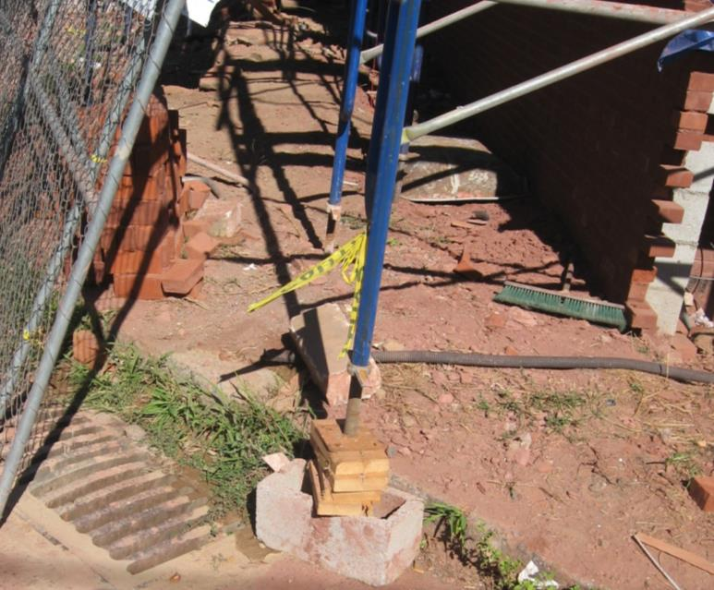
Picture of scaffold hazard
Scaffold must have a base plate and a mud sill
Stacked bricks and concrete blocks are not an appropriate surface support for scaffolds
Notes:
1926.451(c)(2)
Ensure that hazards in box are elicited.

Slide 34
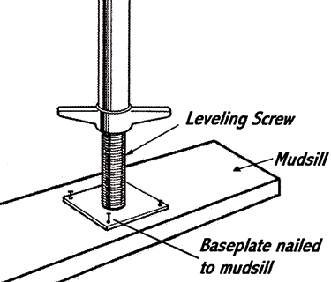
Working Safely

Slide 35
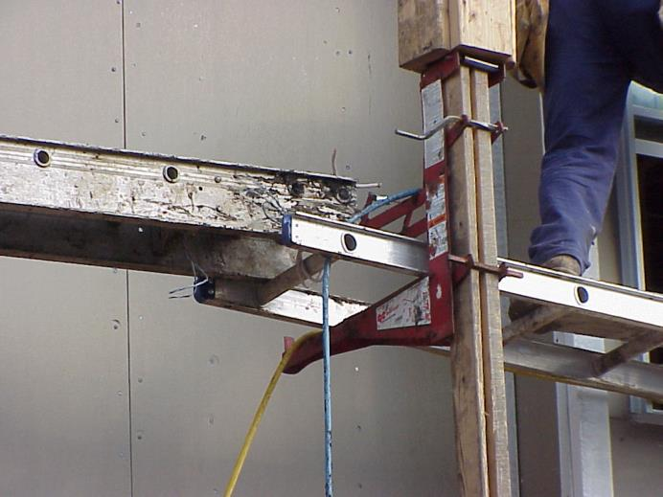
Picture of plank hazard
Planks should overlap 6” and no more than 18”
Should not use two ladders
A ladder is not appropriate walking/working surface
Notes:
Do not use ladder as a plank. Overlapping of planks as mentioned can be found in 1926.451(b)(4) & (b)(5)(ii)

Slide 36
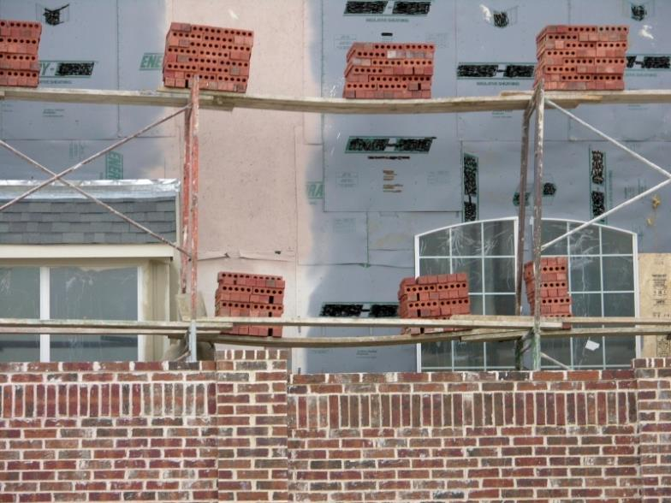
Picture of plank hazards
Not fully planked
No guardrails
Missing structural components
Do not pile heavy materials so that the planks sag

Slide 37
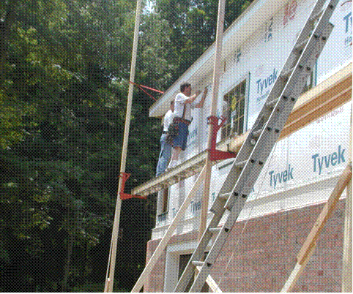
Picture of scaffold hazards
Workers on this scaffold are not
protected from falls
Once above 10 feet, these workers
must be protected from a fall.
1926.451(g)
Notes:
Narrative:
The workers on this scaffold are also not protected from falls. Once above 10 feet on scaffolds, workers must have Fall protection (such as guardrails or a personal fall arrest system). Both options would work for this scaffold, which is a pump jack scaffold. But, on a ladderjack scaffold, only a PFAS can be used. Ladderjack scaffolds are limited to a maximum height of 20 feet and step ladders should not be used to increase the working height on any scaffold. Also, OSHA regulations require that platforms on ladder jack, top plate, roof bracket, and pump jack scaffolds be at least 12 inches wide.

Slide 38
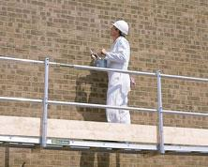
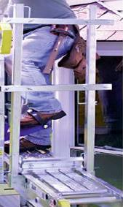
Working Safely
Working Safely
A
Pump jack scaffolds have guardrails with toe boards.
B
Notes:
Narrative:
A) This pump jack has a top rail, mid rail, and toe board.
B) We can see a side view of the pump jack which includes the requirements of a guardrail: top rail, mid rail, and toe board.
NOTE: If mesh or a screen is used, it must follow the requirements of 1926.451(g)(4)(v) “When screens and mesh are used, they shall extend from the top edge of the guardrail system to the scaffold platform, and along the entire opening between supports”, which means the mesh or screen needs to be connected between a toe board and top rail – so basically they are taking the place of a midrail.

Slide 39
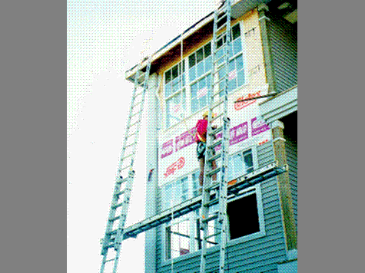
Working Safely
Worker is using a full body harness that is attached to a rope grab device and a vertical lifeline that has been attached to an anchor point on the roof.
Notes:
Narrative:
Another safe alternative to use when working on scaffolds more than 10 feet in height is to wear a personal fall arrest system. This worker is using a full body harness that is attached to a rope grab device, and a vertical lifeline that has been attached to an anchor point on the roof. The advantage of using the rope grab instead of a shock absorbing lanyard is that it allows the worker to use a stationary anchor point and adjust the length of the vertical lifeline as the work proceeds upward. Also, if the worker falls, the distance will be much shorter than if he was using a shock absorbing lanyard.
U.S. Department of Labor-OSHA. March 1998. PUMP JACK/LADDER JACK SCAFFOLD PHOTO COMPLIANCE GUIDE

Slide 40
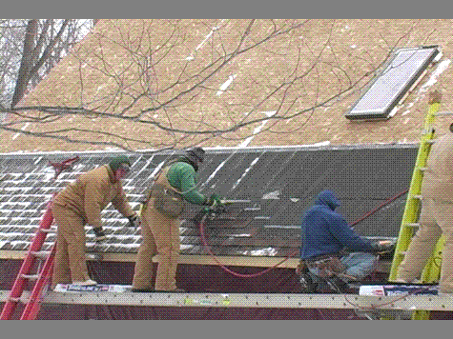
Picture of scaffolding hazards
Fall hazard
Scaffolding reaching 10 ft or more, must have guardrails or worker must have a personal fall arrest system.
Notes:
Narrative:
Weatherproofing a roof often requires work beginning at the eave, and progressing upwards toward the peak. These workers are standing on a ladderjack scaffold without fall protection. Once a scaffolding platform is 10 feet or more above the ground, workers must be protected by either a guardrail or a personal fall arrest system.

Slide 41
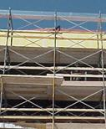
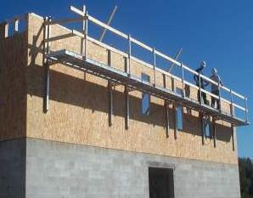
Working Safely
Using 2x4s with cross braces for guardrails
Called a wall bracket, or top plate, scaffold system.
Some contractors are using these systems for rolling trusses, cutting rafter tails and hanging fascia.
Notes:
Narrative:
In the second picture of using cross braces and 2x4s for guardrails, it should be noted that the crossbrace may only be used as a toprail or a midrail, but not as both.

Slide 42
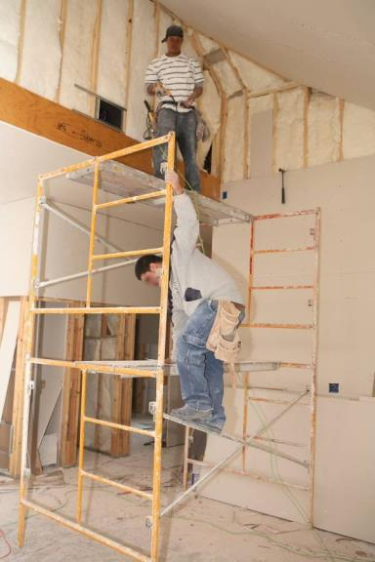
Picture of scaffold hazard
Make sure all scaffold parts are in place and used correctly.
Never climb on cross-braces.
The baker’s scaffold pictured has built-in ladder and can be used as a ladder.
Rolling scaffolds must have their wheels locked when workers are on them

Slide 43
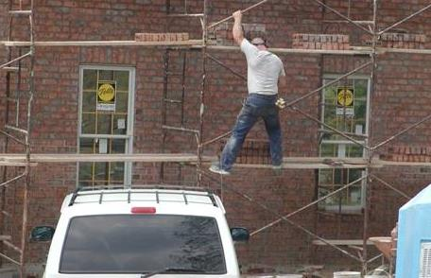
Picture of scaffold hazard
Climbing cross-bracing is not permitted
Climbing cross braces is not permitted.
1926.451(e)(1)
Notes:
Narrative:
Safe access onto and off of a scaffold is required. Here we can see a worker improperly using the cross-bracing to climb the welded frame scaffold. This is not permitted.
Not only is this worker at a great risk of falling, but he is also endangering the safety of the other bricklayers on the scaffolding by possibly causing the entire system to collapse.

Slide 44
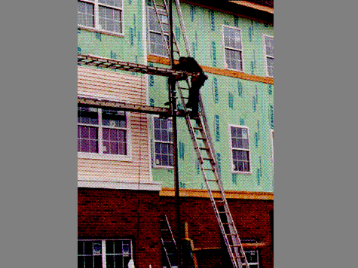
Working Safely
Ladder being used to access the pumpjack scaffold is arranged so that the worker can step onto the scaffold directly from the ladder.
Notes:
Narrative:
The ladder being used here to access the pumpjack scaffold is arranged so that the worker can step onto the scaffold directly from the ladder. Notice that the scaffold does not have a midrail as part of a complete guardrail system.

Slide 45
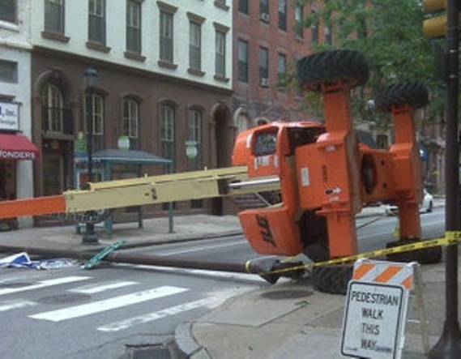
Picture of aerial lift tipped over
DO NOT drive with aerial lift platform elevated.
Notes:
DO NOT drive with aerial lift platform elevated. Take the time to lower the lift and reposition it.
Plan your work to limit the number of times the lift must be moved.
Do not exceed the vertical or horizontal reach limits or the specified load capacity of the lift.

Slide 46
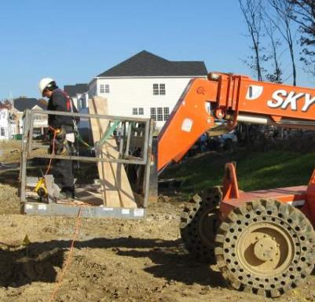
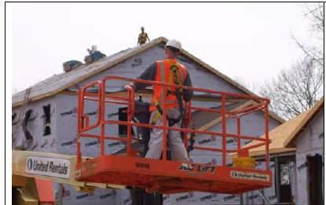
Working Safely
All-terrain Forklift with basket attachment
Extensible Boom Aerial Lift
Notes:
Narrative:
Here are examples of working safely in lifts.
The manufacturer must specifically state in operating procedures an attachment can be utilized.

Slide 47
Small Group Activity
Look at the pictures and identify the fall hazards in the pictures
Notes:
If participants work on roofs or ladders and not only on scaffolding, best to wait to do the small group activity until covering roofs and ladders (after slide 74). If participants work on roofs, pull pictures from the roof section of these slides to do this activity. If the following four slides correspond to the work participants do, use those or some combination.
Alternatively: if participants work together and have a specific job they were cited on or a common setup for their work, have them draw the job and come up with a solution.
Also, this activity should be done at a point when participants are potentially seeming like their energy is going down, so pay attention to that in deciding when to do this section.
Once you decide when to insert this activity, divide participants into small groups of 3-5 people. Groups should either have copies of photos most similar to the work they do or have paper and a pen with which to draw one of their jobs and come up with a solution. Tell participants they have 10 minutes to identify all hazards and come up with solutions. After this point, let them know that they should check out the equipment in the room – the PFASs, scaffolding with guardrail system, etc. Tell them that if any of this equipment is part of their solution, you want them to set up someone in their group as if they were in the photo/drawing. Next tell them that you want them to present their picture/drawing to the group with the setup. Have participants take 10-15 minutes to get themselves set up and decide who’s presenting. Then, have each group present to the larger group.

Slide 48
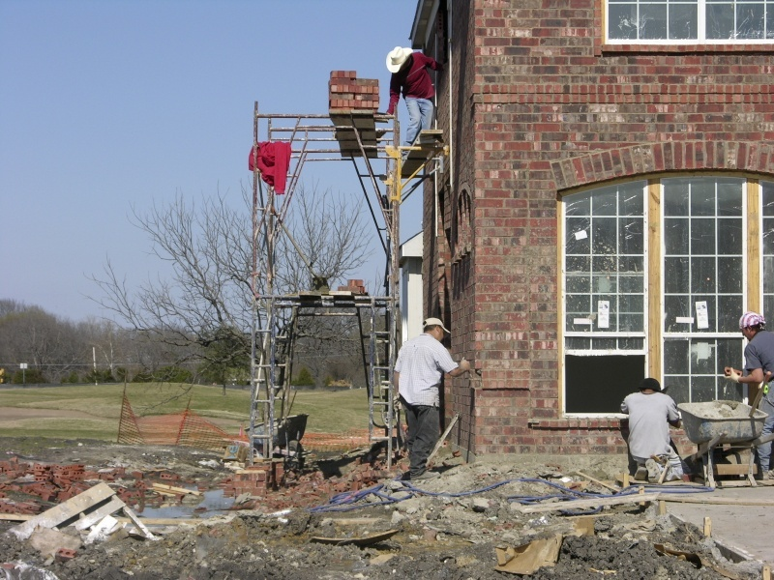
Picture of fall hazard
Notes:
Hazards:
Fall hazard (and no FP)
Not fully planked scaffold
Uneven ground
Potentially no mud sill or base plate on even ground
Ladder needed to access scaffold
Needs to be some sort of toeboard to protect materials from falling, otherwise need to be make a controlled access zone)
Hard hats
Housekeeping

Slide 49
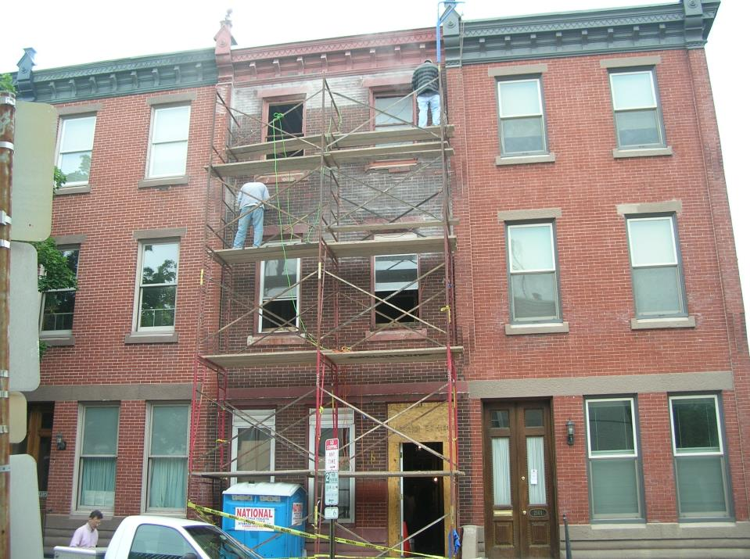
Picture of fall hazards
Notes:
Hazards:
Scaffold isn’t fully planked
Fall hazard (no FP)
No guardrails (could use cross members to help create guardrails)
No PFAS
Not fully planked
No ladder to access scaffold
Housekeeping issue, materials everywhere

Slide 50
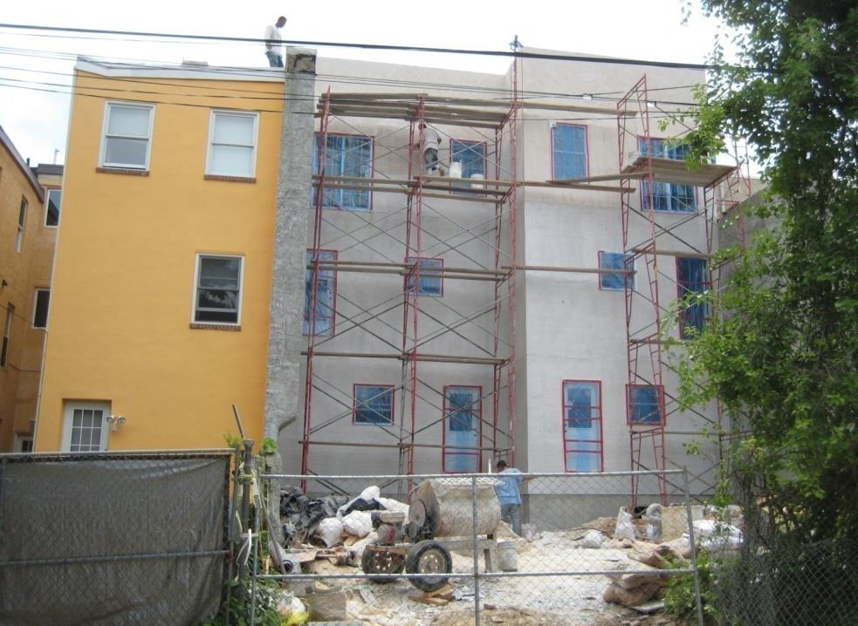
Picture of fall hazards
Notes:
Hazards:
Fall hazard for worker on roof
Improper scaffold (planks between separate scaffolding)
Trash creating trip hazards
Not wearing hardhats to protect from falling objects
Cross braces can only be used as either a midrail or a toprail if the crossing point of two braces is between 20”-30” (can function as midrail) or between 38”-48” inches (can function as toprail) [1926.451(g)(4)(xv)], inadequate guardrails
Inadequate Fall protection
Inadequate planking

Slide 51
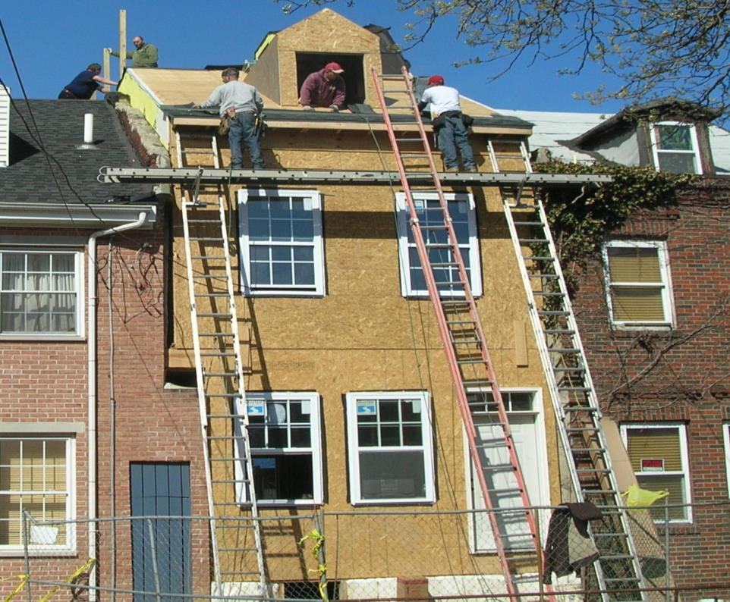
Picture of fall hazards
Notes:
Roof Hazards
· No fall protection provided from an unprotected roof edge (2 workers on roof)
Height of window appears that there should be a railing on window so that worker doesn’t fall out
Scaffold Hazards
· No fall protection on ladder jack scaffold. On ladder jack, must use PFAS as fall protection – 1926.452(g)(1)(i)
Ladder holding jack does not appear well placed to prevent slipping. Ladders used to support ladder jacks shall be placed, fastened, or equipped with devices to prevent slipping 1926.452(k)(4)
Ground Level
· No head protection provided
Training
· Lack of fall protection training
· Lack of scaffold safety training
· Lack of PPE training

Slide 52
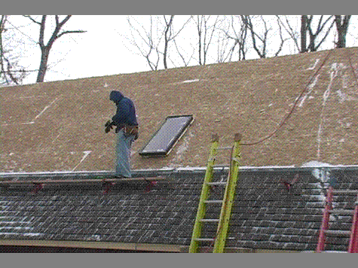
Roofing
Fall hazard
Skylights must be covered or protected.
Covers must be capable of supporting at least 2 times the maximum expected load, must be secured and should be marked with the word “hole” or “cover”.
1926.501(b)(4)(i)
Notes:
Narrative:
What are the hazards you see?
Highlight that the covers was on the pre-test
Not only is this worker in danger of falling off the roof, he is also in danger of falling through the skylight. Skylights and other roof openings must be covered or protected to prevent workers from falling through them. Covers for these openings must be capable of supporting at least 2 times the maximum expected load; they must be secured to prevent accidental movement; and they should be marked with the word “hole” or “cover”.

Slide 53
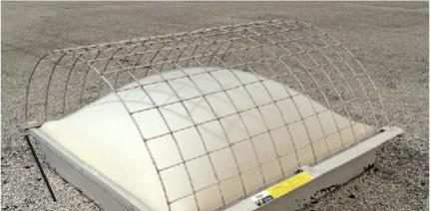
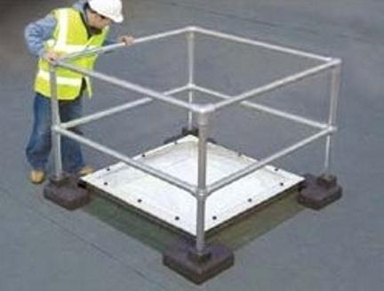
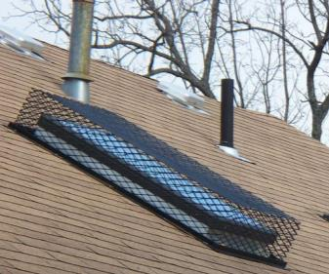
Working Safely
A
C
B
Notes:
Narrative:
1926.501(b)(4) states:
(i) Each employee on walking/working surfaces shall be protected from falling through holes (including skylights) more than 6 feet (1.8 m) above lower levels, by personal fall arrest systems, covers, or guardrail systems erected around such holes. (Emphasis added). When a cover is used to meet this requirement, it must conform to the criteria in Section 1926.502(i). One of those requirements is in 1926.502(i)(2), which states: . . . covers shall be capable of supporting, without failure, at least twice the weight of employees, equipment, and materials that may be imposed on the cover at any one time. Under these provisions, employees must be protected with personal fall arrest systems, covers that meet the criteria in 1926.502(i), or guardrails. However, if the skylight itself meets the cover criteria { in 1926.502(i)(2)}, as a matter of enforcement policy, OSHA will treat the skylight itself as a cover.
Covers must also be secured and marked.
Pictured here are examples of a cover and guardrail system:
A) Skylight screens for acrylic dome skylights. Clamp-on design for EZ install and no skylight penetrations.
B) Cage for a sloped roof skylight from CCI Securities.
C) Kee Dome, is a free-standing, fall-protection solution for use around skylights, roof lights and dome lights up to 7' x 7'. Bases are "green" recycled rubber. Both are from: Safety Rail Source (http://safetyrailsource.com/Skylight_Rails_and_Screens/skylight_rails_and_screens_model_selection_sheet.htm)

Slide 54
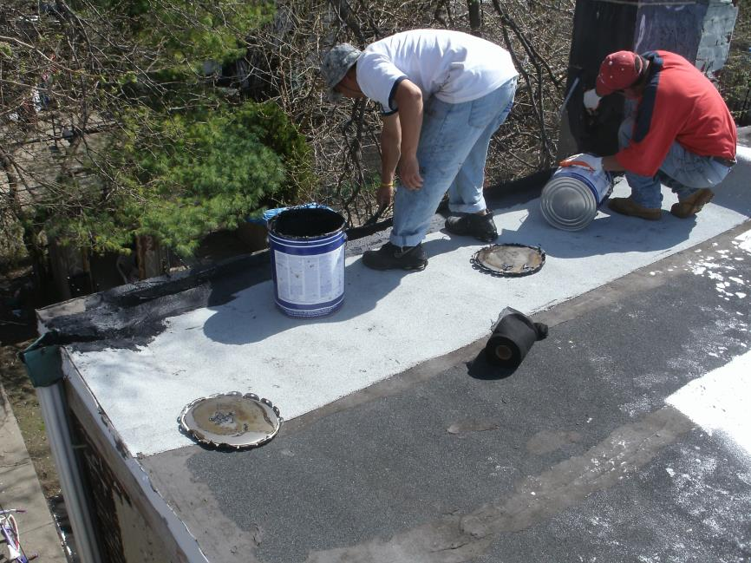
Picture of fal hazard
NEED pic of roofing work!
Fall hazard
1926.501(b)(10)
Notes:
Narrative:
What’s going on here?
Pictured are two roofers working from an unprotected flat roof 6’ or more above the next level without conventional or alternative methods of fall protection. One alternative method by OSHA standards would be a safety monitoring system, but a safety monitor cannot be engaged in any other work besides trying to ensure that people don’t fall. In this picture that couldn’t work because both workers are engaged in roofing work.

Slide 55
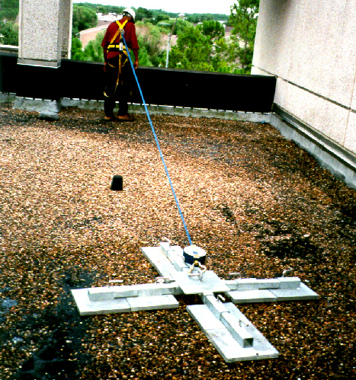
Working Safely
Notes:
Narrative:
Here is an example of a non-penetrating anchor system. This anchor system is broken up into smaller lighter segments so that in can be brought up to the roof.
What do you think of this?
Would you feel safe using this?
Make sure to keep bringing up the idea that there are so many types of equipment and that you choose the equipment that feels safest and best for your work.

Slide 56
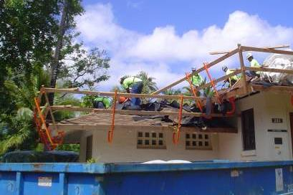
Working Safely
Notes:
Guardrails in place for re-roofing activities

Slide 57
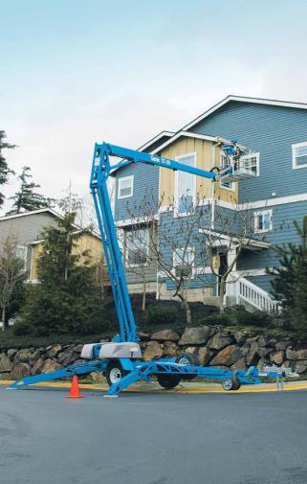
Working Safely
Safe alternative that can be used during roofing work.
Wear appropriate Fall Protection
(lanyard & harness)
Tie off to an anchorage point built
into the aerial lift.
Notes:
Narrative:
Another safe alternative that can be used during roofing work is an aerial lift which can be rented or purchased.

Slide 58
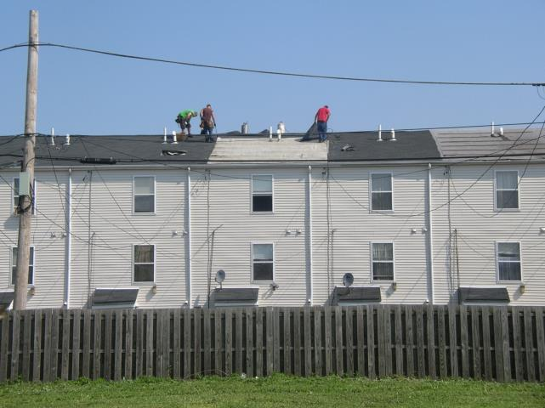
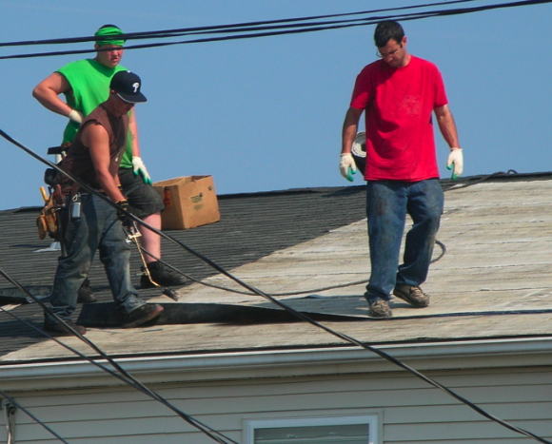
Picture of fall hazards
1926.501(b)(13)
Notes:
Narrative:
What’s happening here?
Workers are performing roofing operations from an unprotected roof edge 20’ above the next level or ground level without conventional or alternative methods of fall protection. They are not utilizing a safety monitoring system because all workers are engaged in roofing work.

Slide 59
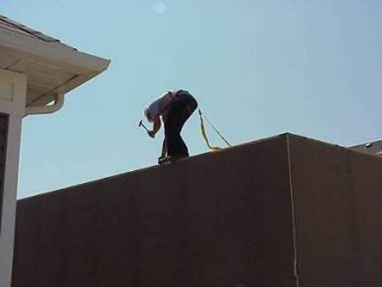
Working Safely
Worker is using a Personal Fall Arrest System
Notes:
Narrative:
Personal Fall Arrest System. There are several different types of anchor points currently available that can be used.
Just a belt is illegal.

Slide 60
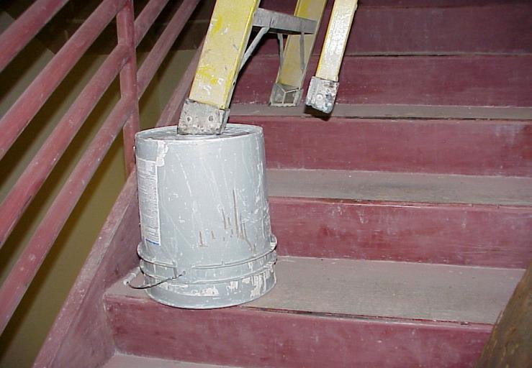
Ladders
Put ladder on a stable base before using it. This is not a stable base.
Notes:
This a-frame ladder is not being used appropriately.

Slide 61
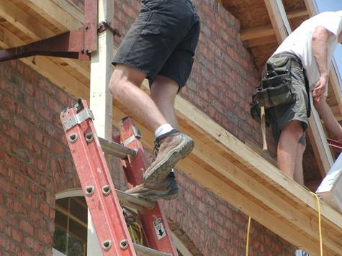
Picture of ladder hazard
Ladder’s side rails must be supported to stabilize the ladder.
Notes:
Narrative:
When using an extension ladder for access, the ladder’s side rails must be supported. Leaning the top rung of the ladder against the 4X4 post does not provide side rail support to stabilize the ladder, and puts the worker at risk of falling.
Also, there is no FP on the pump jack. What could be used to prevent falls here? PFAS or guardrails.

Slide 62
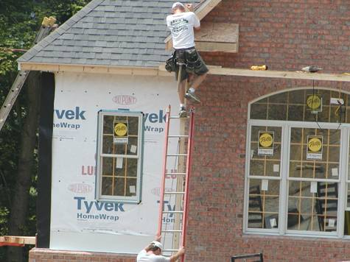
Picture of ladder hazard
Ladder must extend 36 inches (3ft) above the walking/working surface.
Notes:
Narrative:
The ladder must extend a minimum of 36 inches above the walking surface. Here we can see the worker holding onto the top of the pumpjack support post as he steps off the platform onto the top rung of the extension ladder.

Slide 63
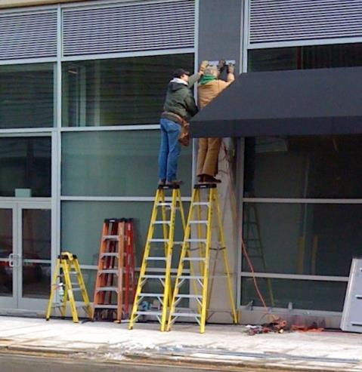
Picture of ladder hazards
Make sure ladder or work platform is high enough to reach the work safely.
The top or the top step SHALL NOT be used as a step
Notes:
1926.1053(b)(13)

Slide 64

Picture of ladder hazard
Need a taller ladder.
The top or the TOP STEP SHALL NOT BE USED AS A STEP
Notes:
1926.1053(b)(13)

Slide 65

Working Safely
Extended above walking/working surface
Ladder properly secured.
Notes:
Narrative:
This ladder is extended sufficiently above walking/working surface (at least 3 ft above) and is properly secured.

Slide 66

Working Safely
Ladder properly secured.

Slide 67

Picture of ladder hazard
Should not climb or descend ladders while carrying supplies, tools, etc.
Maintain 3-point contact.
Notes:
Narrative:
Three point contact means at least ¾ arms and legs need to be touching the ladder for support. This could be 2 hands, one foot as climbing or 2 feet and one hand. Standards that apply: 1926.1053(b)(21) use at least one hand to grasp the ladder and 1926.1053(b)(22)
Employees shall not carry any object or load that could cause the employee to lose balance or fall. This means that workers cannot carry supplies because they will not be able to maintain 3-point contact.
What could they use to carry up materials?
Instead pulley systems or other systems must be employed to get materials to where needed.

Slide 68

Picture of ladder hazard
Ladder is not on a stable level surface.
Ladder is not angled properly.
Notes:
Narrative:
Should be angled on a 4:1 ratio. Standard that applies, 1926.1053(b)(20) user shall face the ladder.

Slide 69


Working Safely
Extension ladders should be at a 4:1 pitch
For every 4’ up in height (D), pull the ladder 1’ out from structure (1/4 D)
Notes:
Narrative:
An easy trick to figure out whether your ladder is extended at the correct pitch is to follow the example of the picture at the right. Here, the worker has his toes next to the foot of the ladder and is extending his arms directly out in front of him at chest height. If his hands then touch the step of the ladder easily at chest level, the ladder is at the correct 4:1 pitch.

Slide 70

Picture of ladder hazard
Job-Made Ladders
Maximum Length
24’
Ladders that extend
to landing must have
walk-through top
section.
Must have parallel,
level, uniformly
spaced rungs.

Slide 71

Stairs
There is no guardrail on the landing and no guardrail or handrail on the stairway
Notes:
Narrative:
Many of the finishing details, such as installing light fixtures, ceiling fans, vents, and other items, may expose workers to fall hazards. The worker at the top of the stairs is installing molding around a stair landing and balcony that has not yet been protected. Until the permanent railing is installed, this worker must be protected from falling. Also notice that there is no handrail for workers to use when they are on the stairs, or a guardrail to protect them from falling.
Standards that apply:1926.501(b)(13) fall protection from the landing 6’ or more above the next level and 1926.1052(c)(1)(ii) stairways having 4 or more risers or rising more than 30”, whichever is less, shall be equipped with (i) at least one handrail: and (ii) One starrail system along each unprotected side or edge.

Slide 72

Working Safely
Stairway Protection
Stairs must have railings:
  With 4 or more treads.
  More than 30 inches high
Notes:
Narrative:
A temporary guardrail system protects workers accessing the different levels of the home. The toprail of the guardrail system also serves as a stairrail. This guardrail system is also used to protect employees from the unprotected side of the landing at the top of the staircase.

Slide 73

Picture of fall hazard
Could fall through opening
Notes:
Narrative:
Unprotected staircases and large openings in floors are common fall hazards present during residential flooring. When employees are working around these openings, the openings must be controlled. The simplest solutions would be to install a guardrail or a hole cover to eliminate the risk of a fall. A cover is required to be secured and marked.

Slide 74
SUMMARY
Place ladder on stable surface
Face the ladder during work
Should maintain three points of contact
Ladder should extend 3 ft (36 inches) above work surface
Use the correct ladder for the job or ladder should be secured
Use 4:1 ratio – Every 4’ up angle ladder 1’ out
Secure ladder in place

Slide 75
Controlling Hazards

Slide 76
Hierarchy of Hazard Controls
The less human effort for fall protection, the more
effective the fall protection.
EFFECTIVENESS
HUMAN EFFORT
Most Effective
Least Effort
Eliminate
Engineered
Administrative Control
PPE
Least Effective
Most Effort
Notes:
Not all fixes or solutions for hazards are the same. There’s a hierarchy of most effective to least effective changes and as you can see from this slide the effectiveness is related to how much workers have to think about the fixes made to hazards.
The most effective way to control – another way to say fix hazards – is to eliminate it. If it doesn’t exist workers don’t have to think about the hazard cause it’s not there. (Might be useful to give an example here).
At the bottom you see PPE – and this slide is saying that using personal protective equipment take a lot of human effort and is the least effective. What are examples of PPE? Why do they take so much effort? What type of fall protection is considered PPE?
Talk about how a PFAS has so many parts and all parts need to be set up correctly to work. It takes a ton of human effort! Review that guardrails are an engineering control so fall higher on this hierarchy.

Slide 77

Guardrails
Toprail 42” plus or minus 3”
Midrail
21” plus or minus 3”
Toprails must be able to withstand a force of 200 lbs and midrails must be able to withstand a force of 150 lbs.
Toeboard
3 ½”
Notes:
1926.502(b)(4)

Slide 78

Guardrails
Another safe alternative is to pre-install guardrails on
window and door openings prior to raising the wall sections.
Notes:
Narrative:
Another safe alternative is to pre-install guardrails on window and door openings prior to raising the wall sections. While this does not protect the worker until the wall is secured, it reduces the amount of time that the employee is exposed to a fall once it is in place. The guardrail shown here was installed prior to lifting the wall.
Workers should have safety straps in case the wall falls over.
No fall protection or restraint system being used
What type of fall protection or restraint might work here?

Slide 79


Guardrails
B
A
B
Notes:
A pre-fabricated wall panel positioned for installation behind a fully protected area -- potential fall to the exterior of the structure has been eliminated. Also, stairwell is protected by guardrails -- eliminating falls to the interior also.
B) Here are guardrails that were either positioned prior to, or after, sheathing and left in place for the follow along trades to do their job.
Proper coordination can lead to one system serving the needs of several trades.
From: http://www.osha.gov/doc/residential_fall_protection/ppt/index.html

Slide 80


Personal Fall Arrest System (PFAS)
System used to
arrest (stop) your
fall
Consists of anchor,
full body harness &
lanyard

Slide 81





Retractables and Lanyards
These are used to connect a body harness to a safety line and to an anchor point.
Anchor point:
  Connected to the snap hook of the lanyard , which is connected to the “D” ring on the back of body harness in between the shoulders, should be able to support 5,000 pounds
Protect the equipment from possible cuts.
Retractables.

Slide 82
Questions
Why is an anchorage so important for someone that is using a personal fall arrest system?
On a personal fall arrest system what do connectors do?
What is the minimum tensile strength of a D-ring?
Notes:
Answers:
Without the anchorage, the PFAS won’t stop someone from falling!
Connect the harness to the lanyard and anchor points
5,000 lbs

Slide 83

Picture of worker using fall protection
The strap used in combination with a full-body harness and appropriate lanyard will protect worker while working at the edge
Notes:
Narrative:
The strap can be installed on top of the plywood or OSB sheathing. This anchor used in combination with a full-body harness and the appropriate lanyard will allow workers to perform this task safely. This system will also protect workers while leaning over the edge of a platform into a hoisting area.

Slide 84

Picture of worker cutting an anchor point off a roof
Anchor point can
be quickly
installed to an
interior rafter with
nails.
It can be cut &
removed quickly .
Notes:
Narrative:
This worker is wearing a personal fall arrest system consisting of a full body harness, a lanyard, and a disposable anchor point located at the roof peak. The single worker anchor point can be quickly installed to an interior rafter with nails and it can be cut and removed quickly with a utility knife.

Slide 85

Picture of fall arrest system
Total
18 ½ ft.
from anchorage
Things to look for with a fall arrest system:
You don’t have a swing fall hazard
It arrests your fall
Free fall distance
Prevents worker from striking lower level
Notes:
Narrative:
When setting up a fall arrest system, you have to take into consideration fall distance so as to ensure that worker will not hit lower level.
Use the example of a participant by asking someone who tried on the PFAS how tall they are. Then ask people to add the deceleration, lanyard, and safety factor. Say, if X person were working on a first story roof would they hit the ground in this setup? YES! So, take all this into consideration when setting everything up!
The fourth piece of the PFAS is how you’re going to get a worker out of it. Who’s job is that as the worker can lose blood flow if they’re waiting too long!

Slide 86

Picture of worker using fall arrest system
A rope grab attached to an anchor point provides the worker with fall protection and will minimize the fall distance.
Notes:
Narrative:
When disassembling a guardrail, the guardrail no longer protects the worker from falling. A rope grab attached to an anchor point provides the worker with fall protection and will minimize the fall distance.

Slide 87
Small Group Activity
Go back to your pictures
Take one of the hazards and think about ways to fix them using the Hierarchy of Controls

Slide 88
Employer and Employee Rights and Responsibilities
Notes:
For this section, use the slides as your guide but don’t simply read off of them. Get yourself familiar with the content so you can easily share and answer questions.

Slide 89
What does OSHA Require of Employers?
Determine which standards apply to your workplace
Follow the OSHA standards and requirements
Train workers and effectively enforce
Provide a place of employment which is free of recognized hazards that are causing or are likely to cause death or serious physical harm
Notes:
OSHA standards cover:
- General Industry
- Construction
- Maritime
Some agricultural activities
Longshoring and Shipyard industries

Slide 90
GENERAL FALL PROTECTION TRAINING
The employer shall provide training by a
COMPETENT PERSON to each worker who might be
exposed to fall hazards.
Competent Person
Someone who is capable of identifying existing and predictable hazards in the surroundings or working conditions which are unsanitary, hazardous, or dangerous to employees and who has *authorization to take prompt corrective measures to eliminate them.
Qualified Person
Someone that is knowledgeable and has expertise. KNOWS THE NORMS
Notes:
1926.32(f)

Slide 91
GENERAL FALL PROTECTION TRAINING
The training shall include:
  Nature of fall hazards and how to recognize these hazards;
  Correct procedures for erecting and maintaining, disassembling and inspecting fall protection systems to be used.
Training requirement standard 1926.503

Slide 92
Slide about training requirement standard
  Role of each employee in safety monitoring system where specifically permitted and in fall protection plans;
  Use and operation of guardrail systems, personal fall arrest systems, safety net systems, safety monitoring systems, controlled access zones and other protection to be used;
  Limitations on use of mechanical equipment during roofing work on low-sloped roofs;
  Correct handling and storage of equipment and materials and erection for overhead protection;
  The standards contained in this subpart
Training requirement standard 1926.503

Slide 93
RETRAINING IS REQUIRED WHEN THERE ARE:
Changes in the types of fall protection systems or equipment used.
Changes in the workplace rendering previous training obsolete.
Inadequacies in an affected worker’s knowledge or use of fall protection systems or equipment indicate that the worker has not retrained the requisite understanding or skill.
Training requirement standard 1926.503

Slide 94
CERTIFICATION OF TRAINING
Employer must maintain written
certification records for training.

Slide 95
Recordkeeping and Reporting
Employers of 11 or more employees must maintain records of occupational injuries and illnesses
  All employers must display the OSHA poster, and report to OSHA within 8 hours any accident that results in a fatality or in-patient hospitalization, amputation, or loss of an eye within 24 hours
Notes:
Recordkeeping regulations are contained in 29 CFR Part 1904.
Some low-hazard employers (for example, retail trade, finance, insurance, real estate) are not required to keep records.
While the 1904 regulation exempts many employers from keeping records at all times, these employers are not exempted from all of the 1904 requirements.
Employers that are partially exempt from the recordkeeping requirements because of their size (10 or less employees) or industry must continue to comply with:
1904.39, Reporting fatalities and multiple hospitalization incident
1904.41, Annual OSHA injury and illness survey (if specifically requested to do so by OSHA)
1904.42, Bureau of Labor Statistics (BLS) Annual Survey (if specifically requested to do so by BLS)
The new recordkeeping requirements (effective in federal plan states as of 1/1/15), require that any in-patient hospitalization, amputation or loss of an eye be reported to OSHA within 24 hours. Previously, it only needed to be reported if 3 or more people were hospitalized. (https://www.osha.gov/recordkeeping2014/index.html)

Slide 96
What are employers’ responsibilities and rights?
Providing a safe and healthful workplace free of recognized hazards
Following the OSHA standards
Providing training, medical examinations and recordkeeping
OSH Act gives rights, particularly during and after an OSHA inspection
Notes:
OSHA maintains confidentiality of employers’ trade secrets.
Both employers and employees may submit information or comments to OSHA on the issuance, modification, or revocation of OSHA standards and request a public hearing
For more information, consult OSHA publications
-- No. 2056, All About OSHA and
-- No. 3000, Employers Rights and Responsibilities Following An OSHA Inspection.

Slide 97
What are workers’ rights?
Identify and correct problems in workplaces, working with their employers whenever possible
Complain to OSHA about workplace conditions threatening their health or safety in person, by telephone, by fax, by mail or electronically through OSHA’s web site
Whistleblower Protection: Section 11(c) of the OSH Act - right to seek safe and healthful job conditions without being disciplined or fired
(see OSHA Workers' web page for more information)
Notes:
VERY IMPORTANT:
If you haven’t already stated that OSHA protects those who work in this country (except for some public workers in some states), not matter their legal status or whether or not they are a U.S. citizen. So, all of these are rights for all workers covered by OSHA.
Also, state that there is an agreement between the Department of Labor – where OSHA is housed – and the Department of Immigration that they can’t share information if a worker is filing a complaint. This is to help reduce workers’ fear about reporting if they are undocumented.

Slide 98
What are workers’ responsibilities?
Read the OSHA poster
Follow the employer’s safety and health rules and wear or use all required gear and equipment
Follow safe work practices for your job, as directed by your employer
Report hazardous conditions to a supervisor or safety committee
Report hazardous conditions to OSHA, if employers do not fix them
Cooperate with OSHA inspectors
(see OSHA Workers' web page for more information)
Notes:
OSHA Worker's web page:
www.osha.gov/as/opa/worker/index.html

Slide 99
Workplace Inspections
Establishments covered by the OSH Act
are subject to inspection by OSHA
compliance safety and health officers (CSHO's)
Most inspections are conducted without
advance notice
Notes:
Inspection Priorities:
- Imminent Danger (any condition where there is a reasonable certainty that a danger exists that can be expected to cause death or serious physical harm immediately, or before the danger can be eliminated through normal enforcement procedures)
- Fatalities and Catastrophes (resulting in hospitalization of 3 or more employees)
- Employee Complaints/Referrals
- Programmed High-Hazard Inspections
- Follow-ups to previous inspections

Slide 100
Employer may Qualify for "Focused Inspection"
Has to meet certain conditions
Inspector will "focus" on these four hazard areas:
  Falls
  Struck by
  Caught in/between
  Electrical
Notes:
See: www.osha-slc.gov/SLTC/construction_ecat/index.html
Effective October 1, 1994, all construction inspections shall have opening conferences consistent with current agency procedures, and then shall proceed as follows:
During all inspections, CSHO's shall determine whether or not there is project coordination by the general contractor, prime contractor, or other such entity that includes:
an adequate safety and health program/plan that meets the guidelines set forth below, and
a designated competent person responsible for and capable of implementing the program/plan.
If the above general contractor, prime contractor, or other such entity meets both of these criteria, then a focused inspection shall be made. When either of these criteria is not met, then the inspection shall proceed in accordance with previously established procedures for comprehensive inspections as stated in CPL 2.103, September 26, 1994, Field Inspection Reference Manual (FIRM), chapter II section A.1.b.
The leading hazards are:
falls, (e.g., floors, platforms, roofs)
struck by, (e.g., falling objects, vehicles)
caught in/between (e.g., cave-ins, unguarded machinery, equipment)
electrical (e.g., overhead power lines, power tools and cords, outlets, temporary wiring)

Slide 101

Picture of OSHA web page
Notes:
Narration:
This is the OSHA web page: osha.gov As you can see at the top of the web page there are tabs to help you find different information. If you’re a worker, click on the second tab: workers. Here you can find more information about your rights, ways to contact OSHA, and file a complaint. The small business tab will be useful to many of you small contractors who want to find out whether you’re following the standards. This is a great resource, use it! It’s in English and Spanish

Slide 102
OSHA Emergency Hot-Line
1-800-321-OSHA
Report workplace safety or health fatalities or the hospitalization, amputation or loss of an eye of an employee
Report a workplace hazard
File a complaint about a workplace hazard
Request information on OSHA
Request an OSHA publication
Notes:
Imminent danger is any condition where there is reasonable certainty a danger exists that can be expected to cause death or serious physical harm immediately or before the danger can be eliminated through normal enforcement procedures. OSHA gives top priority to imminent danger situations.
When a call is made to the hot line number, it is important to give as much information as is known about the emergency, including:
Complete description of the hazard
Name and location of the establishment
Duration of the hazard (Is it still going on? When will it end?)
Type of operation
Contact phone number (company or personal)
See Fact Sheet No. OSHA 95-44

Slide 103
Summary
OSHA helps save lives and prevent injuries
OSHA balances a cooperative approach with traditional enforcement
OSHA standards are the enforceable requirements for worker safety and health
Inspections are OSHA’s way to ensure compliance
OSHA offers various means of assistance

Slide 104
ACKNOWLEDGEMENTS
This presentation includes materials produced under Susan Harwood grants from the Occupational Safety and Health Administration, U.S. Department of Labor :
SH16604SH7 and SH19487-09-60-F- 42 awarded to Philadelphia Area Project on Occupational
Safety and Health (PhilaPOSH)
46F4-HT10 awarded to the Texas Engineering Extension Service,
OSHA Training Institute Southwest Education Center
46C3-HT19 awarded to ResidentialFallSafe.org a West Virginia
University Safety and Health extension website.
46F4-HT01 awarded to Associated Builders and Contractors – Central
Texas Chapter
46A3-HT15 awarded to University of Massachusetts-Lowell, Department of Work Environment, Safety training materials for Hispanic workers, www.HispanicWorkSafe.org
SH-20995-10 awarded to the National Association of Home Builders (NAHB) Research Center
It does not necessarily reflect the views or policies of the U.S. Department of Labor, nor does mention of trade names, commercial products, or organizations imply endorsement by the U.S. Government.

Slide 105
ACKNOWLEDGEMENTS Con’t
In addition to:
Oregon Department of Consumer & Business Services, Occupational
Safety & Health Division, manual entitled “Fall Protection: Options for Specialty
Contractors” produced by the OR-OSHA and Technical Resources section and developed
by OR OSHA’s 502 Fall Protection Committee
Massachusetts Department of Public Health Fatality Assessment and Control Evaluation (FACE) Project, pamphlet entitled “Falls: The Leading Killer on Construction Sites”
Philly.com news article entitled “Construction worker dies after contact with live wire”, 4/30/12
Bureau of Labor Statistics, 2010 and 2011 Census of Fatal Occupational Injuries
J. Paul Leigh “Economic Burden of Occupational Injury and Illness in the United States” in Milbank Quarterly, Volume 89, Issue 4, pages 728-772 December 2011
It does not necessarily reflect the views or policies of the U.S. Department of Labor, nor does mention of trade names, commercial products, or organizations imply endorsement by the U.S. Government.

