Slide 1

Fall Protection in Residential Construction
Presented by
Philadelphia Area Project on Occupational Safety and Health

Slide 2
OSHA Disclaimer
This material was produced under a 2014 Susan Harwood Training Grant #SH26308-SH4 from the Occupational Safety and Health Administration (OSHA), U.S. Department of Labor. It does not necessarily reflect the views or policies of the U.S. Department of Labor, nor does mention of trade names, commercial products or organizations imply endorsement by the U.S. Government.

Slide 3

WHAT IS PHILAPOSH ?
The Philadelphia Area Project on Occupational Safety and Health.
Founded in 1975.
Non Profit Organization serving the Tri-State area whose sole mission is to promote safety and health in the workplace.

Slide 4

Introductions
Name
Type of work done
What work are you interested in doing?

Slide 5
Learning Objectives
Review impact of work injuries and illnesses
Explain what OSHA does
Identify fall hazards
Present OSHA requirements for fall protection with special emphasis on roofs, scaffolds, ladders, and stairways
Review employer and employee rights and responsibilities regarding safety at work

Slide 6
What is a job hazard?
Anything that can cause a person to become injured, ill, or stressed

Slide 7
Small Group Conversation
What kinds of hazards exist in the type of work you’re learning?
What are some of the options you have to make the work safer?
Who can you talk to about the hazards?
Notes:
Break up participants into groups of 3-5 people, and have one person take on the role of scribe. Then ask groups for feedback, and have at least two groups contribute answers to each question and depending on time have additional groups respond.

Slide 8
What is OSHA?
What do they do?
Occupational Safety and Health Administration
Federal agency responsible for worker safety and health protection.
Notes:
Have each group try together to answer one of each of the following questions on pages 9-12.

Slide 9
What are some specific things OSHA does?
Develops and enforces mandatory job safety and health standards
Maintains a reporting and recordkeeping system to monitor job-related injuries and illnesses
Provides FREE consultation to small businesses
Writes contracts for employers
A-C
All of the above
Notes:
Free consultation program: Goto osha.gov and small business tab: give info about this.

Slide 10
On average, how many workers die every day from job injuries?
12
Notes:
Narrative:
This is the number of workers dying daily from work in both 2012 and 2013 (based on preliminary data for 2013).
Worker deaths in America are down — from about 38 worker deaths a day in 1970 to 13 a day in 2010 (http://www.osha.gov/oshstats/commonstats.html)
Former Secretary of Labor Hilda Solis’s 9/20/12 press release shows same number for preliminary 2011 data: http://www.dol.gov/opa/media/press/opa/OPA20121943.htm and from the chart from the Census of Fatal Occupational Injuries: http://www.bls.gov/iif/oshwc/cfoi/cfch0010.pdf and 2012 the number was 4628 which translates to roughly 12 workers a day
2013 Preliminary Data shows a lower yearly number than 2012: 4405 people sustained fatal work injuries in 2013, which still translates to approximately 12 workers a day dying on the job but is 5% below the final count for 2012. (http://www.bls.gov/iif/oshwc/cfoi/cfch0012.pdf)

Slide 11
In 2013….
Approximately 4,400 people were killed at work*
    Nearly 300 workers were killed in the tri-state area
Greatest number of workers killed in construction compared to all industries - ~800*
3 million non-fatal workplace injuries in private industry and public sector º (2012 data)
* http://www.bls.gov/iif/oshwc/cfoi/cfch0012.pdf, º http://bls.gov/news.release/pdf/osh.pdf
Notes:
Statistics come from Preliminary results of the 2012 Census of Fatal Occupational Injuries (CFOI) shows a fatal work injury rate of 4,405, page 1: http://www.bls.gov/iif/oshwc/cfoi/cfch0012.pdf
Tri-state (NJ, PA, DE) data comes from CFOI preliminary 2012 page 20: http://www.bls.gov/iif/oshwc/cfoi/cfch0012.pdf, preliminary data shows 290 deaths in tri-state region
796 construction workers killed on the job in 2013, page 14: http://www.bls.gov/iif/oshwc/cfoi/cfch0012.pdf
Non-fatal injury stats from BLS workplace injury and illness: http://www.bls.gov/news.release/pdf/osh.pdf
This is why OSHA is around! Discuss being paralyzed for the rest of your life, calls that get at Philaposh from injured workers who can’t pay bills. Affects entire family, community. Add an image of someone who has been paralyzed at work and situation before showing this slide.

Slide 12
Why Do We Need a
Fall Protection
Training Program
Specifically for
Residential Construction?
Notes:
Make sure the following points come up in the discussion with this slide and the following slide.
Falls is the leading cause of deaths in the construction industry
Most fatalities occur when employers fall from open sided floors and through floor openings
Fall from as little as 4-6 feet can cause serious lost time accidents and sometimes death
Open-sided floors and platforms 6 feet or more in height must be guarded
-From slide 2 of OSHA Construction 10 hour fall protection slides (http://www.osha.gov/dte/outreach/construction_generalindustry/const_outreach_tp.html)

Slide 13
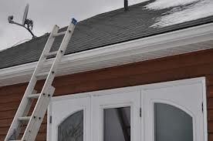
“Almost every week, we see a worker killed from falling off a residential roof.”
- Assistant Secretary of Labor for OSHA Dr. David Michaels, 12/22/10
Notes:
From News Release, titled “US Labor Department's OSHA acts to protect residential roofing workers
Agency rescinds Clinton-era directive and gives workers more safeguards against falls”
(http://www.osha.gov/pls/oshaweb/owadisp.show_document?p_table=NEWS_RELEASES&p_id=19005)

Slide 14
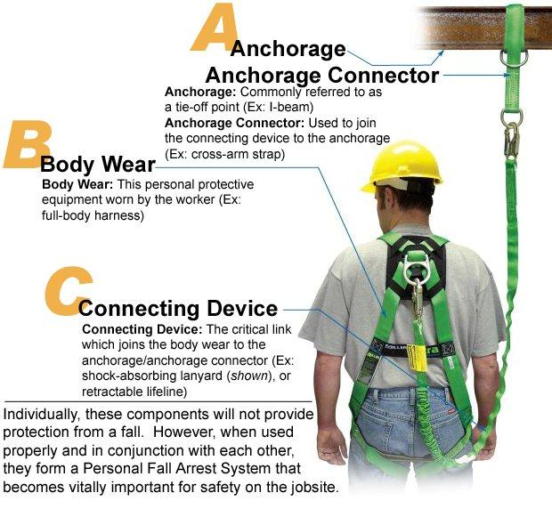
System
Personal Fall Arrest System
Notes:
These are the parts of the Personal Fall Arrest System (PFAS).

Slide 15
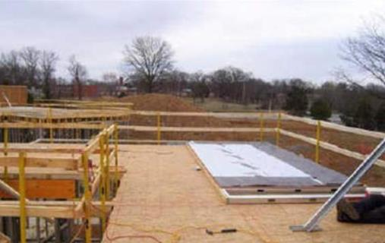
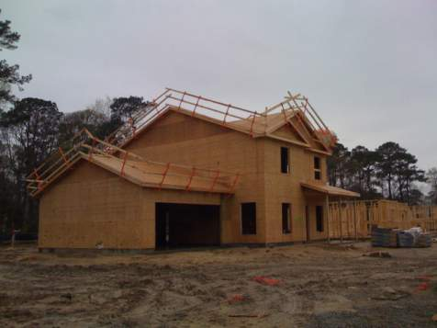
Guardrails
B
A
B
Notes:
A pre-fabricated wall panel positioned for installation behind a fully protected area -- potential fall to the exterior of the structure has been eliminated. Also, stairwell is protected by guardrails -- eliminating falls to the interior also.
B) Here are guardrails that were either positioned prior to, or after, sheathing and left in place for the follow along trades to do their job.
Proper coordination can lead to one system serving the needs of several trades.
From: http://www.osha.gov/doc/residential_fall_protection/ppt/index.html

Slide 16
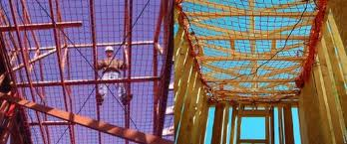
Safety Nets
Safety Nets

Slide 17
Identifying Fall Hazards in Residential Construction
  Scaffolds
  Roofs
  Ladders and stairs

Slide 18
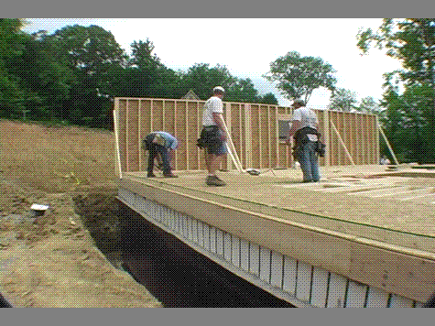
FALL HAZARD
Backs are to the fall hazard. Need some sort of fall protection
(i.e. guardrail, personal fall arrest system, or restraint system)
Notes:
Narrative:
These workers are assembling the exterior walls on top of the floor. They have their backs to a real fall hazard and there is no fall protection being used.
This slide highlights the importance of planning ahead of time. If there had been more planning, then they could have filled in the excavation so a fall hazard didn’t exist or could’ve set up some sort of fall protection.

Slide 19
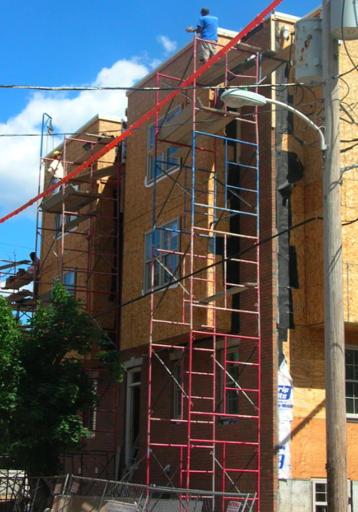
Scaffold
Any temporary elevated working surface must comply with OSHA scaffold standards
Notes:
Info on attaching and securing scaffolding

Slide 20
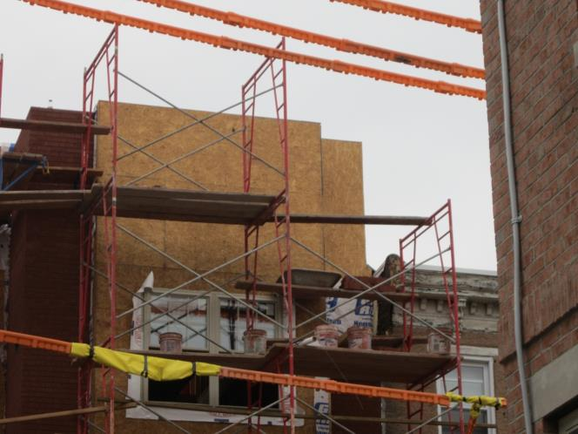
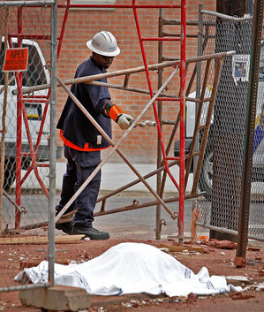
Fatality
Age: 30 years
Date of Death: April 30, 2012
Location: Philadelphia, PA
Cause of Death: Electrocution which caused fall off scaffold
Photo credit: philly.com
Notes:
Narration:
On April 30, 2012 Andres Cano was working on building new homes on the corner of 20th and Parrish streets in Philadelphia. He was carrying a bucket on unguarded scaffolding, when the bucket came in contact with either the scaffolding or electrical wires which proceeded to electrocute him and caused him to fall off the scaffolding resulting in his death. The picture at the bottom left shows a PECO worker testing to see if an electric current is running through the scaffold. They learned that it was energized, and Andres Cano’s co-workers told us that they waited 6 hours to recover his body until the scaffolding was de-energized.
You need to work 10 feet from uninsulated, not covered, lines and 3 feet from covered lines. If you have to work closer than that, the energy company has to move the lines.
Photo credit at bottom right: http://www.philly.com/philly/news/breaking/20120430_Construction_worker_dies_after_contact_with_live_wire.html

Slide 21
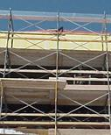
Working Safely
Notes:
The 2x4s pictured here could have been added to the scaffold on which Andres Cano was working to prevent him from falling off the scaffold.

Slide 22
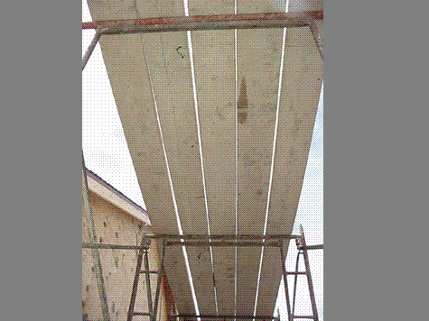
Working Safely
Planking is complete between the uprights with no more than 1 inch gaps between the planks.
1926.451(b)(1)(i)
Notes:
Narrative:
This planking is complete between the uprights with no more than 1 inch gaps between the planks.

Slide 23
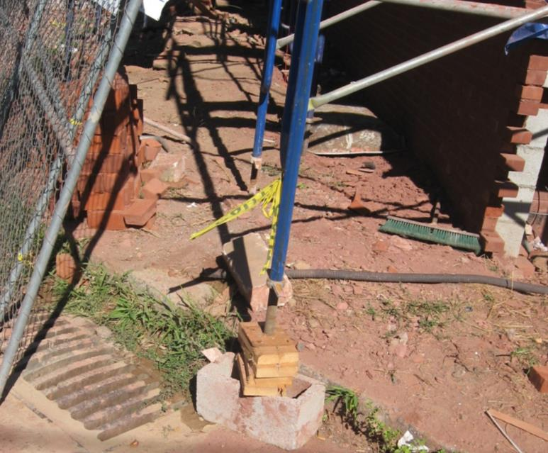
Improper Scaffold
Scaffold must have a base plate and a mud sill
Stacked bricks and concrete blocks are not an appropriate surface support for scaffolds
Notes:
1926.451(c)(2)

Slide 24
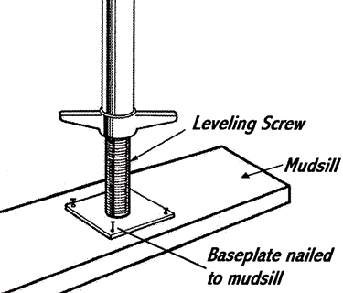
Working Safely

Slide 25
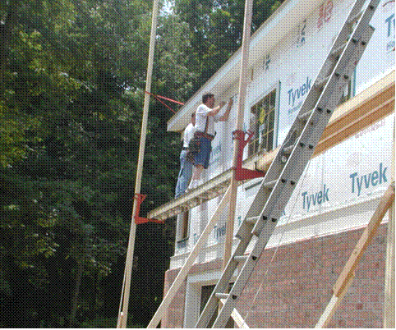
Scaffold without protection
Workers on this scaffold are not
protected from falls
Once above 10 feet, these workers
must be protected from a fall.
1926.451(g)
Notes:
Narrative:
The workers on this scaffold are also not protected from falls. Once above 10 feet on scaffolds, workers must have Fall protection (such as guardrails or a personal fall arrest system). Both options would work for this scaffold, which is a pump jack scaffold. But, on a ladderjack scaffold, only a PFAS can be used. Ladderjack scaffolds are limited to a maximum height of 20 feet and step ladders should not be used to increase the working height on any scaffold. Also, OSHA regulations require that platforms on ladder jack, top plate, roof bracket, and pump jack scaffolds be at least 12 inches wide.

Slide 26
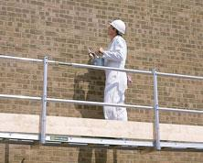
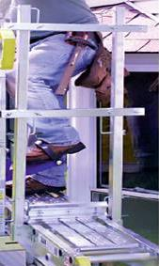
Working Safely
Working Safely
A
Pump jack scaffolds have guardrails with toe boards.
B
Notes:
Narrative:
A) This pump jack has a top rail, mid rail, and toe board.
B) We can see a side view of the pump jack which includes the requirements of a guardrail: top rail, mid rail, and toe board.
NOTE: If mesh or a screen is used, it must follow the requirements of 1926.451(g)(4)(v) “When screens and mesh are used, they shall extend from the top edge of the guardrail system to the scaffold platform, and along the entire opening between supports”, which means the mesh or screen needs to be connected between a toe board and top rail – so basically they are taking the place of a midrail.

Slide 27
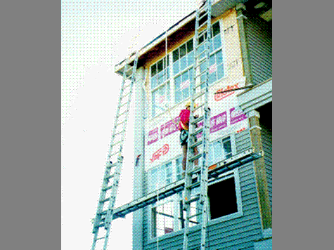
Working Safely
Worker is using a full body harness that is attached to a rope grab device and a vertical lifeline that has been attached to an anchor point on the roof.
Notes:
Narrative:
Another safe alternative to use when working on scaffolds more than 10 feet in height is to wear a personal fall arrest system. This worker is using a full body harness that is attached to a rope grab device, and a vertical lifeline that has been attached to an anchor point on the roof. The advantage of using the rope grab instead of a shock absorbing lanyard is that it allows the worker to use a stationary anchor point and adjust the length of the vertical lifeline as the work proceeds upward. Also, if the worker falls, the distance will be much shorter than if he was using a shock absorbing lanyard.
U.S. Department of Labor-OSHA. March 1998. PUMP JACK/LADDER JACK SCAFFOLD PHOTO COMPLIANCE GUIDE

Slide 28
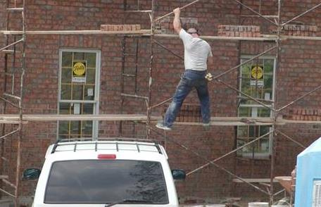
Not permitted
Climbing cross-bracing is not permitted
Climbing cross braces is not permitted.
1926.451(e)(1)
Notes:
Narrative:
Safe access onto and off of a scaffold is required. Here we can see a worker improperly using the cross-bracing to climb the welded frame scaffold. This is not permitted.
Not only is this worker at a great risk of falling, but he is also endangering the safety of the other bricklayers on the scaffolding by possibly causing the entire system to collapse.

Slide 29
Small Group Activity
Look at the pictures and identify the fall hazards in the pictures

Slide 30
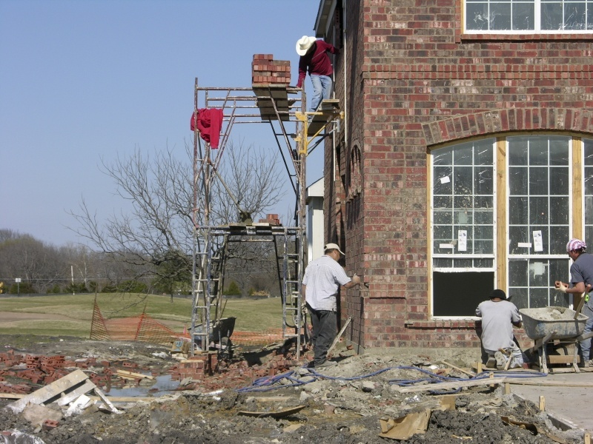
Picture of fall hazard
Notes:
Hazards:
Fall hazard (and no FP)
Not fully planked scaffold
Uneven ground
Potentially no mud sill or base plate on even ground
Ladder needed to access scaffold
Needs to be some sort of toeboard to protect materials from falling, otherwise need to be make a controlled access zone)
Hard hats
Housekeeping

Slide 31
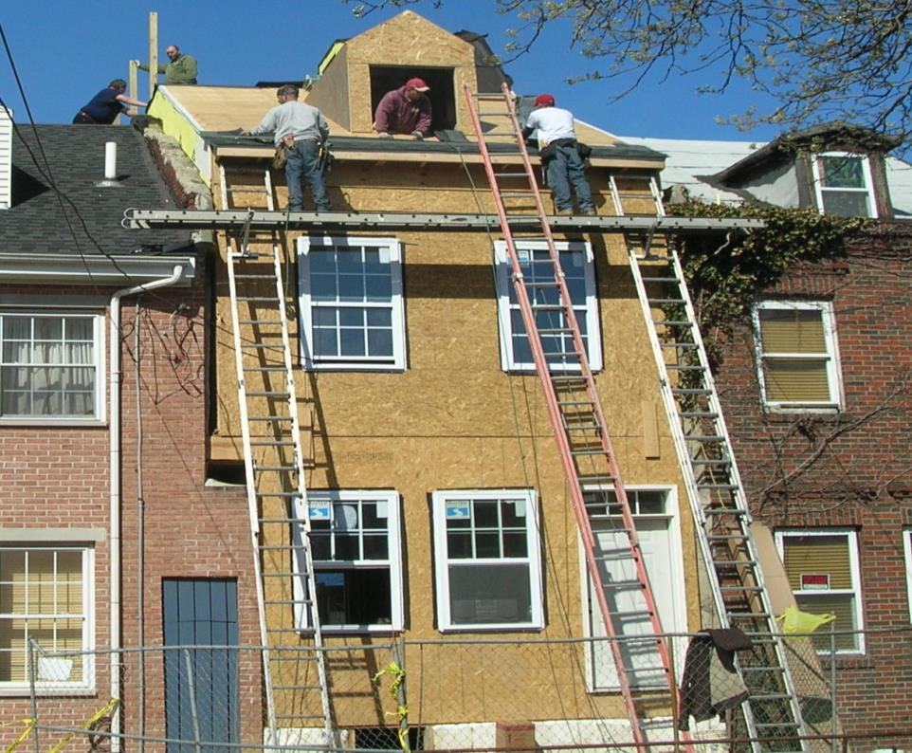
Picture of fall hazards
Notes:
Roof Hazards
· No fall protection provided from an unprotected roof edge (2 workers on roof)
Height of window appears that there should be a railing on window so that worker doesn’t fall out
Scaffold Hazards
· No fall protection on ladder jack scaffold. On ladder jack, must use PFAS as fall protection – 1926.452(g)(1)(i)
Ladder holding jack does not appear well placed to prevent slipping. Ladders used to support ladder jacks shall be placed, fastened, or equipped with devices to prevent slipping 1926.452(k)(4)
Ground Level
· No head protection provided
Training
· Lack of fall protection training
· Lack of scaffold safety training
· Lack of PPE training

Slide 32
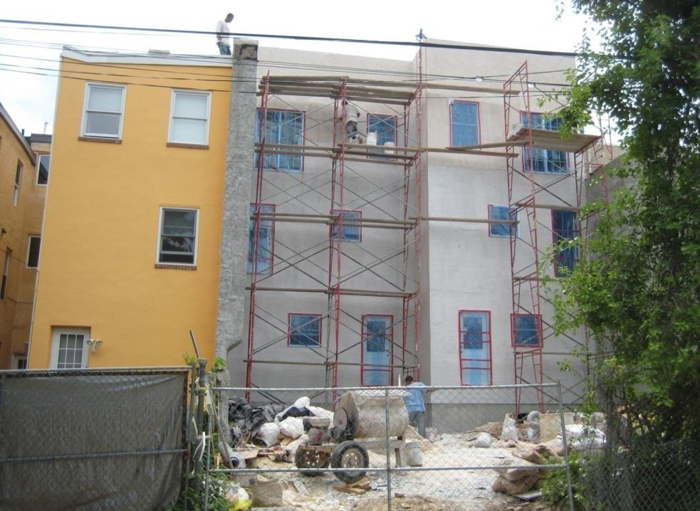
Picture of fall hazards
Notes:
Roof Hazards
· No fall protection provided from an unprotected roof edge @ 35’ above ground level
Scaffold Hazards
· Inadequate fall protection provided from the fabricated frame scaffold 26’ above ground level (Crossbracing is inadequate fall protection)
Cross braces can only be used as either a midrail or a toprail if the crossing point of two braces is between 20”-30” (can function as midrail) or between 38”-48” inches (can function as toprail) [1926.451(g)(4)(xv)], inadequate guardrails
· Inadequate planking
Ground Level
· Housekeeping
· No head protection provided
Training
· Lack of fall protection training
· Lack of scaffold safety training
· Lack of PPE training

Slide 33
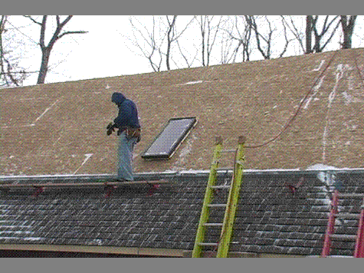
Roofing
Fall hazard
Skylights must be covered or protected.
Covers must be capable of supporting at least 2 times the maximum expected load, must be secured and should be marked with the word “hole” or “cover”.
1926.501(b)(4)(i)
Notes:
Narrative:
Not only is this worker in danger of falling off the roof, he is also in danger of falling through the skylight. Skylights and other roof openings must be covered or protected to prevent workers from falling through them. Covers for these openings must be capable of supporting at least 2 times the maximum expected load; they must be secured to prevent accidental movement; and they should be marked with the word “hole” or “cover”.
Also in violation of 1926.501(b)(11) for no fall protection while working from a sloped roof

Slide 34
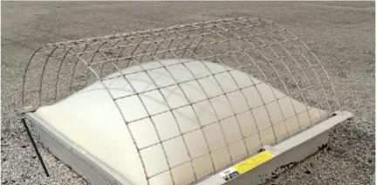
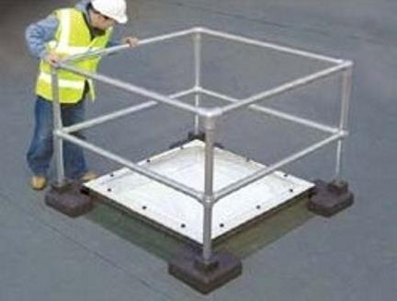
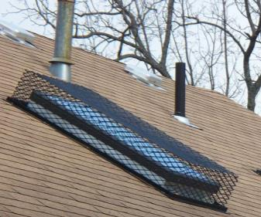
Working Safely
A
C
B
Notes:
Narrative:
1926.501(b)(4) states:
(i) Each employee on walking/working surfaces shall be protected from falling through holes (including skylights) more than 6 feet (1.8 m) above lower levels, by personal fall arrest systems, covers, or guardrail systems erected around such holes. (Emphasis added). When a cover is used to meet this requirement, it must conform to the criteria in Section 1926.502(i). One of those requirements is in 1926.502(i)(2), which states: . . . covers shall be capable of supporting, without failure, at least twice the weight of employees, equipment, and materials that may be imposed on the cover at any one time. Under these provisions, employees must be protected with personal fall arrest systems, covers that meet the criteria in 1926.502(i), or guardrails. However, if the skylight itself meets the cover criteria in 1926.502(i)(2), as a matter of enforcement policy, OSHA will treat the skylight itself as a cover.
Covers must also be secured and marked.
Pictured here are examples of a cover and guardrail system:
A) Skylight screens for acrylic dome skylights. Clamp-on design for EZ install and no skylight penetrations.
B) Cage for a sloped roof skylight from CCI Securities.
C) Kee Dome, is a free-standing, fall-protection solution for use around skylights, roof lights and dome lights up to 7' x 7'. Bases are "green" recycled rubber. Both are from: Safety Rail Source (http://safetyrailsource.com/Skylight_Rails_and_Screens/skylight_rails_and_screens_model_selection_sheet.htm)

Slide 35
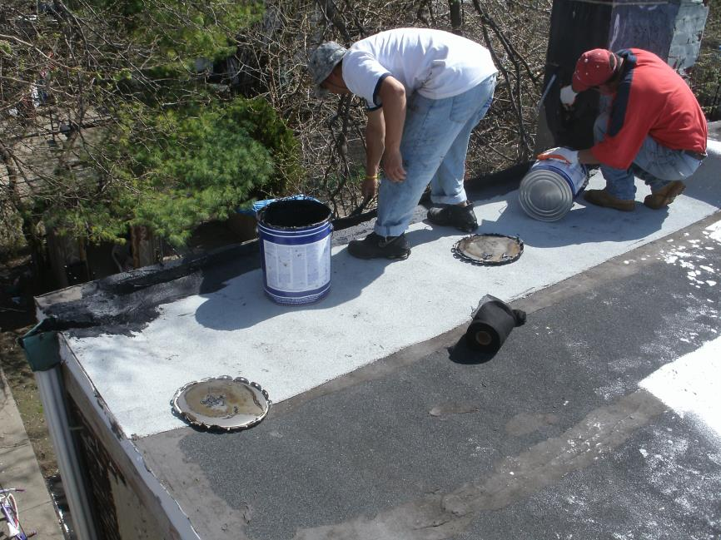
Picture of fall havard
NEED pic of roofing work!
Fall hazard
1926.501(b)(10)
Notes:
Narrative:
Pictured are two roofers working from an unprotected flat roof 6’ or more above the next level without conventional or alternative methods of fall protection. One alternative method by OSHA standards would be a safety monitoring system, but a safety monitor cannot be engaged in any other work besides trying to ensure that people don’t fall. In this picture that couldn’t work because both workers are engaged in roofing work.

Slide 36
Using the Equipment
Each small group will be given a picture
Each group will have to determine the type of fall protection they need to do this job safely
The group must then collect the fall protection they need and put it together in the manner in which it should be used

Slide 37
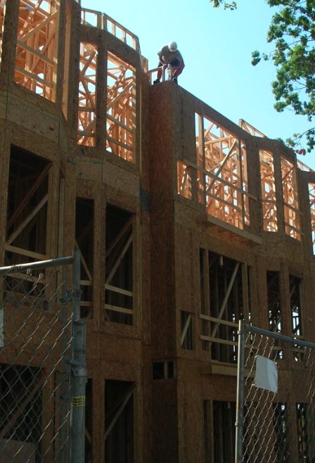
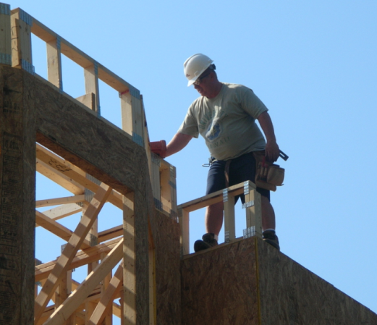
Picture of fall hazard
1926.501(b)(13)
Notes:
Narrative:
Here we see a foreman carpenter doing framing work on the edge of a working surface that is 6 or more feet above the next lower level. The picture on the left shows the larger view of the work being done, with the picture on the right a close up of the worker. As you can see there is no conventional or alternative fall protection. All framing standards are in 1926.501(b)(13)
To note: on the second story, the windowsills are below 39” so guardrails are required. As you can see pictured here, the guard rails are installed on the inside of the windows with both a toprail and midrail.

Slide 38
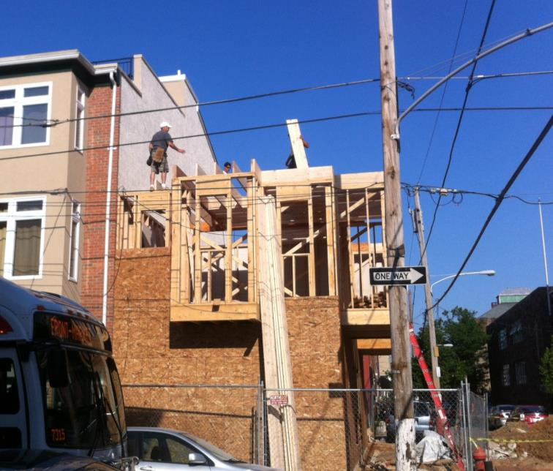
Picture of fall hazard
Open sided floors 6’ or higher must have fall protection
Power lines not insulated

Slide 39
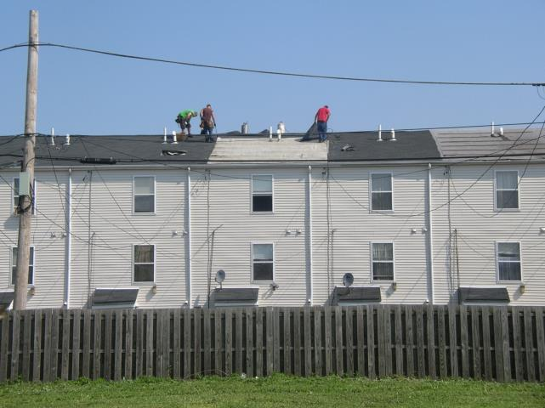
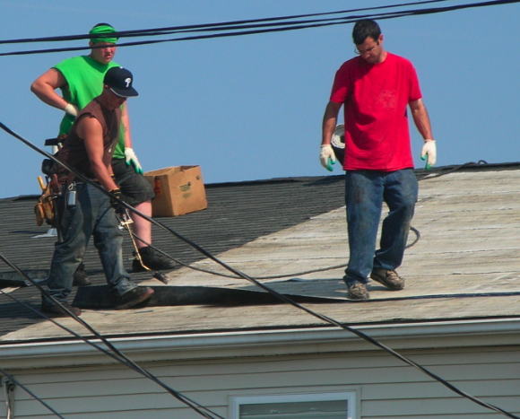
Picture of fall hazards
1926.501(b)(13)
Notes:
Narrative:
Workers are performing roofing operations from an unprotected roof edge 20’ above the next level or ground level without conventional or alternative methods of fall protection. They are not utilizing a safety monitoring system because all workers are engaged in roofing work.

Slide 40
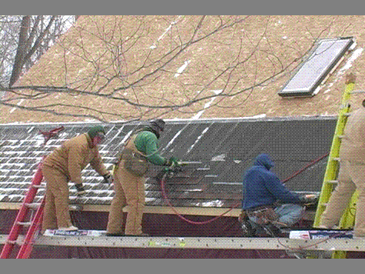
Picture of fall hazards of a plank
Notes:
Narrative:
Weatherproofing a roof often requires work beginning at the eave, and progressing upwards toward the peak. These workers are standing on a ladderjack scaffold without fall protection. Once a scaffolding platform is 10 feet or more above the ground, workers must be protected by either a guardrail or a personal fall arrest system.

Slide 41
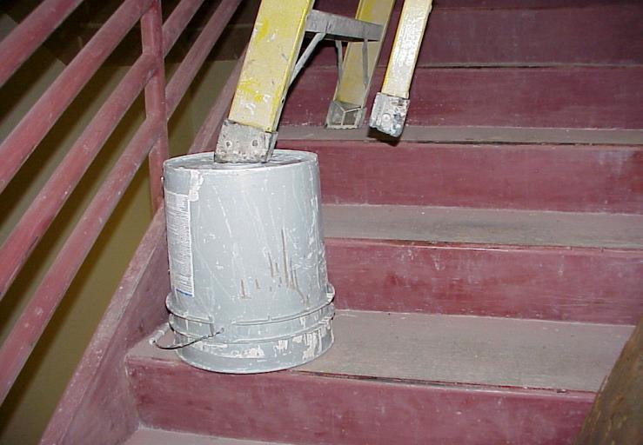
Ladders
Put ladder on a stable base before using it. This is not a stable base.
Notes:
This a-frame ladder is not being used appropriately.

Slide 42
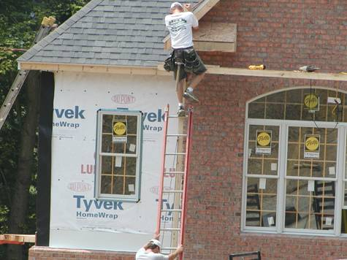
Picture of fall hazard on a ladder
Ladder must extend 36 inches (3ft) above the walking/working surface.
Ladder’s side rails must be supported to stabilize the ladder.
Notes:
Narrative:
The ladder must extend a minimum of 36 inches above the walking surface. Here we can see the worker holding onto the top of the pumpjack support post as he steps off the platform onto the top rung of the extension ladder.

Slide 43
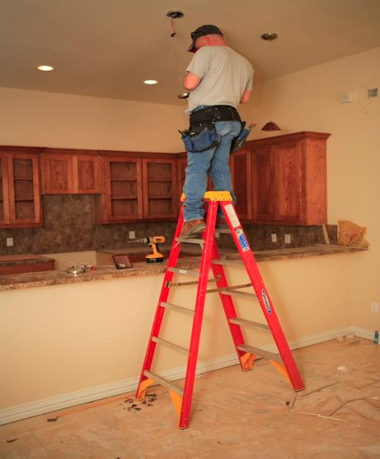
Picture of fall hazard on a ladder
Need a taller ladder.
The top or the top step shall not be used as a step
Notes:
1926.1053(b)(13)

Slide 44
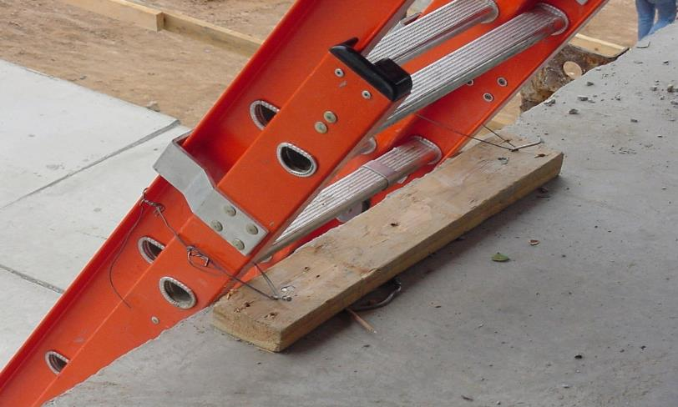
Picture of ladder hazard
Working Safely
Extended above walking/working surface
Ladder properly secured.
Notes:
Narrative:
This ladder is extended sufficiently above walking/working surface (at least 3 ft above) and is properly secured.

Slide 45
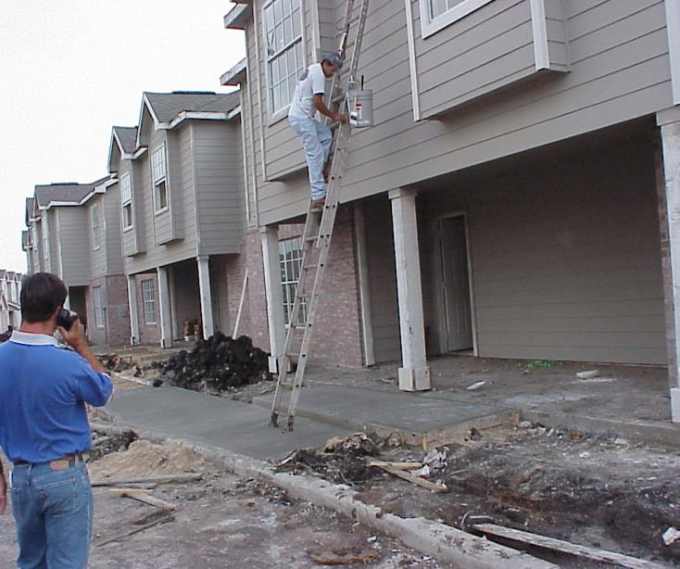
Picture of ladder hazard
Should not climb or descend ladders while carrying supplies, tools, etc.
Maintain 3-point contact.
Notes:
Narrative:
Three point contact means at least ¾ arms and legs need to be touching the ladder for support. This could be 2 hands, one foot as climbing or 2 feet and one hand. Standards that apply: 1926.1053(b)(21) use at least one hand to grasp the ladder and 1926.1053(b)(22) employees shall not carry any object or load that could cause the employee to lose balance or fall. This means that workers cannot carry supplies because they will not be able to maintain 3-point contact. Instead pulley systems or other systems must be employed to get materials to where needed.

Slide 46
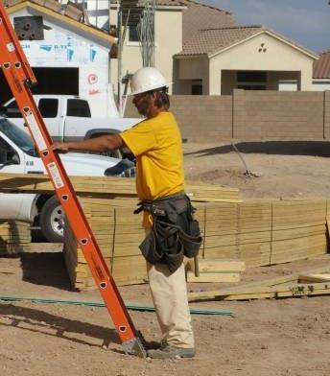
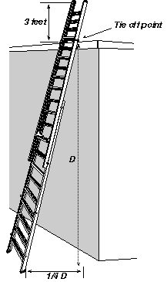
Working Safely
Extension ladders should be at a 4:1 pitch
For every 4’ up in height (D), pull the ladder 1’ out from structure (1/4 D)
Notes:
Narrative:
An easy trick to figure out whether your ladder is extended at the correct pitch is to follow the example of the picture at the right. Here, the worker has his toes next to the foot of the ladder and is extending his arms directly out in front of him at chest height. If his hands then touch the step of the ladder easily at chest level, the ladder is at the correct 4:1 pitch.

Slide 47
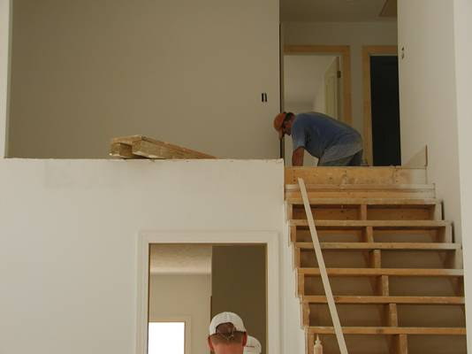
Stairs
There is no guardrail on the landing and no guardrail or handrail on the stairway
Notes:
Narrative:
Many of the finishing details, such as installing light fixtures, ceiling fans, vents, and other items, may expose workers to fall hazards. The worker at the top of the stairs is installing molding around a stair landing and balcony that has not yet been protected. Until the permanent railing is installed, this worker must be protected from falling. Also notice that there is no handrail for workers to use when they are on the stairs, or a guardrail to protect them from falling. Standards that apply:1926.501(b)(13) fall protection from the landing 6’ or more above the next level and 1926.1052(c)(1)(ii) stairways having 4 or more risers or rising more than 30”, whichever is less, shall be equipped with (i) at least one handrail: and (ii) One starrail system along each unprotected side or edge.

Slide 48
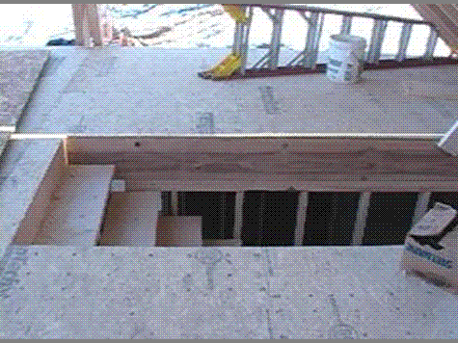
Picture of fall hazard
Could fall through the opening
Notes:
Narrative:
Unprotected staircases and large openings in floors are common fall hazards present during residential flooring. When employees are working around these openings, the openings must be controlled. The simplest solutions would be to install a guardrail.

Slide 49
SUMMARY
Place ladder on stable surface
Face the ladder during work
Should maintain three points of contact
Ladder should extend 3 ft (36 inches) above work surface
Use the correct ladder for the job or ladder should be secured
Use 4:1 ratio – Every 4’ up angle ladder 1’ out
Secure ladder in place

Slide 50
Controlling Hazards

Slide 51
Hierarchy of Hazard Controls
The less human effort for fall protection, the more
effective the fall protection.
EFFECTIVENESS
HUMAN EFFORT
Most Effective
Least Effort
Eliminate
Engineered
Administrative Control
PPE
Least Effective
Most Effort
Notes:
Injuries and illnesses occur because workers are exposed to hazards on their jobs.
Identify the safety and health hazards at the workplace.
Eliminate or otherwise control the hazards using the “Hierarchy of Controls.”
Fix the job, not the worker.

Slide 52
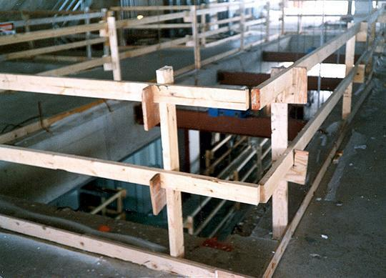
Picture of guardrails
Guardrails
Toprail 42” plus or minus 3”
Midrail
21” plus or minus 3”
Toprails must be able to withstand a force of 200 lbs and midrails must be able to withstand a force of 150 lbs.
Toeboard
3 ½”
Notes:
1926.502(b)(4)

Slide 53
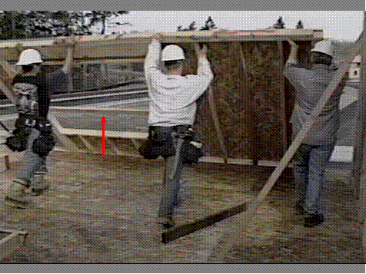
Picture of guarddails
Guardrails
Another safe alternative is to pre-install guardrails on
window and door openings prior to raising the wall sections.
Notes:
Narrative:
Another safe alternative is to pre-install guardrails on window and door openings prior to raising the wall sections. While this does not protect the worker until the wall is secured, it reduces the amount of time that the employee is exposed to a fall once it is in place. The guardrail shown here was installed prior to lifting the wall.
Workers should have safety straps in case the wall falls over.
No fall protection or restraint system being used
What type of fall protection or restraint might work here?

Slide 54
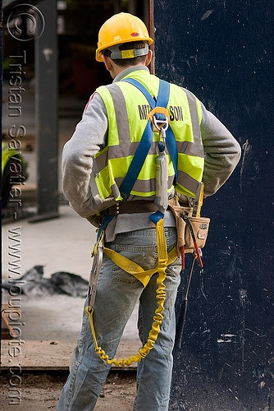
Picture of personal fall arrest system
Personal Fall Arrest System (PFAS)
System used to
arrest (stop) your
fall
Consists of anchor,
full body harness &
lanyard

Slide 55
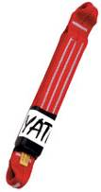
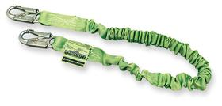
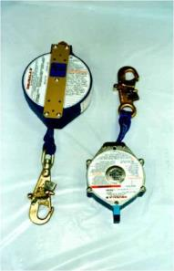
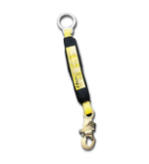
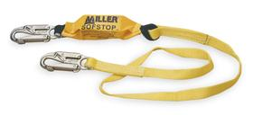
Picture of retractables and lanyards
Retractables and Lanyards
These are used to connect a body harness to a safety line and to an anchor point.
Anchor point:
  Connected to the snap hook of the lanyard , which is connected to the “D” ring on the back of body harness in between the shoulders, should be able to support 5,000 pounds
Protect the equipment from possible cuts.
Retractables.

Slide 56
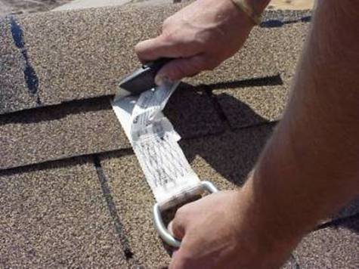
Picture of a worker cutting an anchor pint off a roof
Anchor point can
be quickly
installed to an
interior rafter with
nails.
It can be cut &
removed quickly .
Notes:
Narrative:
This worker is wearing a personal fall arrest system consisting of a full body harness, a lanyard, and a disposable anchor point located at the roof peak. The single worker anchor point can be quickly installed to an interior rafter with nails and it can be cut and removed quickly with a utility knife.

Slide 57

Picture of a fall arrest system
Total
18 ½ ft.
from anchorage
Things to look for with a fall arrest system:
You don’t have a swing fall hazard
It arrests your fall
Free fall distance
Prevents worker from striking lower level
Notes:
Narrative:
When setting up a fall arrest system, you have to take into consideration fall distance so as to ensure that worker will not hit lower level.

Slide 58
Rights and Responsibilities

Slide 59
Slide about employers’ responsibilities and rights
What are employers’ responsibilities and rights?
Providing a safe and healthful workplace free of recognized hazards
Following the OSHA standards
Providing training, including on fall protection, & retraining if systems/equipment change
Provide medical examinations and recordkeeping
OSH Act gives rights, particularly during and after an OSHA inspection
Notes:
OSHA maintains confidentiality of employers’ trade secrets.
Both employers and employees may submit information or comments to OSHA on the issuance, modification, or revocation of OSHA standards and request a public hearing
For more information, consult OSHA publications
-- No. 2056, All About OSHA and
-- No. 3000, Employers Rights and Responsibilities Following An OSHA Inspection.

Slide 60
Slide about workers rights
What are workers’ rights?
Identify and correct problems in workplaces, working with their employers whenever possible
Complain to OSHA about workplace conditions threatening their health or safety in person, by telephone, by fax, by mail or electronically through OSHA’s web site
Whistleblower Protection: Section 11(c) of the OSH Act - right to seek safe and healthful job conditions without being disciplined or fired
(see OSHA Workers' web page for more information)

Slide 61
Slide about workers’ responsibilities
What are workers’ responsibilities?
Read the OSHA poster
Follow the employer’s safety and health rules and wear or use all required gear and equipment
Follow safe work practices for your job, as directed by your employer
Report hazardous conditions to a supervisor or safety committee
Report hazardous conditions to OSHA, if employers do not fix them
Cooperate with OSHA inspectors
(see OSHA Workers' web page for more information)
Notes:
OSHA Worker's web page:
www.osha.gov/as/opa/worker/index.html

Slide 62

Picture of OSHAs web page
Notes:
Narration:
This is the OSHA web page: osha.gov As you can see at the top of the web page there are tabs to help you find different information. If you’re a worker, click on the second tab: workers. Here you can find more information about your rights, ways to contact OSHA, and file a complaint. The small business tab will be useful to many of you small contractors who want to find out whether you’re following the standards. This is a great resource, use it!

Slide 63
Slide of OSHA emergency hot-line
OSHA Emergency Hot-Line
1-800-321-OSHA
Report workplace safety or health fatalities or the hospitalization, amputation or loss of an eye of an employee
Report a workplace hazard
File a complaint about a workplace hazard
Request information on OSHA
Request an OSHA publication
Notes:
Imminent danger is any condition where there is reasonable certainty a danger exists that can be expected to cause death or serious physical harm immediately or before the danger can be eliminated through normal enforcement procedures. OSHA gives top priority to imminent danger situations.
When a call is made to the hot line number, it is important to give as much information as is known about the emergency, including:
Complete description of the hazard
Name and location of the establishment
Duration of the hazard (Is it still going on? When will it end?)
Type of operation
Contact phone number (company or personal)
See Fact Sheet No. OSHA 95-44

Slide 64
Slide of summary
Summary
OSHA helps save lives and prevent injuries
OSHA balances a cooperative approach with traditional enforcement
OSHA standards are the enforceable requirements for worker safety and health
Inspections are OSHA’s way to ensure compliance
OSHA offers various means of assistance

Slide 65
ACKNOWLEDGEMENTS
This presentation includes materials produced under Susan Harwood grants from the Occupational Safety and Health Administration, U.S. Department of Labor :
SH16604SH7 and SH19487-09-60-F- 42 awarded to Philadelphia Area Project on Occupational
Safety and Health (PhilaPOSH)
46F4-HT10 awarded to the Texas Engineering Extension Service,
OSHA Training Institute Southwest Education Center
46C3-HT19 awarded to ResidentialFallSafe.org a West Virginia
University Safety and Health extension website.
46F4-HT01 awarded to Associated Builders and Contractors – Central
Texas Chapter
46A3-HT15 awarded to University of Massachusetts-Lowell, Department of Work Environment, Safety training materials for Hispanic workers, www.HispanicWorkSafe.org
SH-20995-10 awarded to the National Association of Home Builders (NAHB) Research Center
It does not necessarily reflect the views or policies of the U.S. Department of Labor, nor does mention of trade names, commercial products, or organizations imply endorsement by the U.S. Government.

Slide 66
ACKNOWLEDGEMENTS Con’t
In addition to:
Oregon Department of Consumer & Business Services, Occupational
Safety & Health Division, manual entitled “Fall Protection: Options for Specialty
Contractors” produced by the OR-OSHA and Technical Resources section and developed
by OR OSHA’s 502 Fall Protection Committee
Massachusetts Department of Public Health Fatality Assessment and Control Evaluation (FACE) Project, pamphlet entitled “Falls: The Leading Killer on Construction Sites”
Philly.com news article entitled “Construction worker dies after contact with live wire”, 4/30/12
Bureau of Labor Statistics, 2010 and 2011 Census of Fatal Occupational Injuries
J. Paul Leigh “Economic Burden of Occupational Injury and Illness in the United States” in Milbank Quarterly, Volume 89, Issue 4, pages 728-772 December 2011
It does not necessarily reflect the views or policies of the U.S. Department of Labor, nor does mention of trade names, commercial products, or organizations imply endorsement by the U.S. Government.

