Slide 1

Fall Prevention – Part 2 of 2

Slide 2
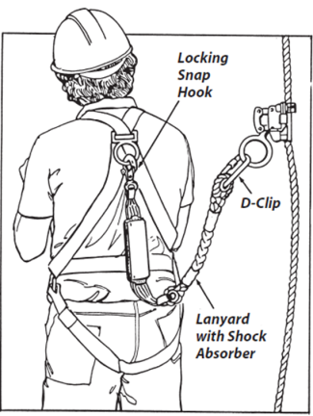
Personal Fall Arrest Systems
“Personal fall arrest system” means a system used to arrest an employee in a fall from a working level. It consists of an anchorage, connectors, a body belt or body harness and may include a lanyard, deceleration device, lifeline, or suitable combinations of these.

Slide 3
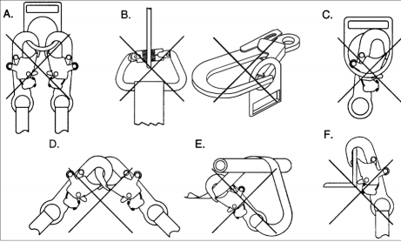
Connectors

Slide 4
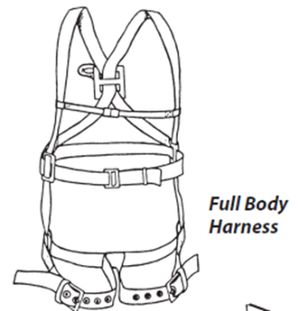
Full Body Harness
A full body harness is required for fall arrest. Safety harnesses distribute fall-arrest impact through the thighs and buttocks. Safety belts (waist belts) are no longer permitted for use as personal fall arrest equipment. In a fall arrest, they can cause serious damage to internal organs such as the spleen and pancreas.

Slide 5
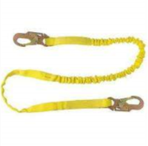
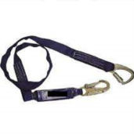
Lanyards
Lanyards connect the harness directly to an anchorage such as a rope grab or horizontal static line.
Lanyards should be either rope or synthetic web straps specifically manufactured for such use.
Lanyards should have spliced eyes with thimbles and be fitted with locking snap hooks or D-clips for attachment to other components (Figure 1.16).
Lanyards with shock absorbers are strongly recommended. Never shorten a lanyard by tying knots in it. Knots seriously reduce rope strength. Also, lanyards are not to be looped over an object and then tied back to itself, unless permitted by the manufacturer.

Slide 6
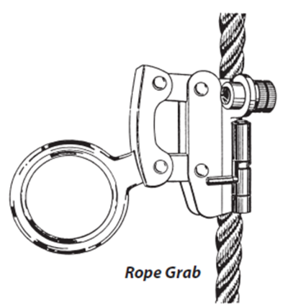
Rope Grabs
Mechanical rope grabs are used to attach lanyards to vertical lifelines. Most rope grabs employ a device that locks on the lifeline when the lanyard is sharply tugged or pulled. Rope grabs must be installed in the right direction. Most grabs are marked with an arrow to indicate correct orientation.

Slide 7
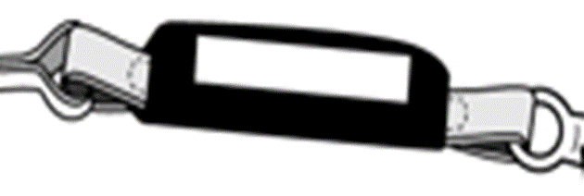
Shock Absorbers
Shock absorbers are strongly recommended for use in fall- arrest systems. They are absolutely necessary with wire rope lifelines. Shock absorbers can reduce fall-arrest loads by as much as 50%
Some shock absorbers are built into the lanyard. Most are made of webbing material with tear-away stitching designed to gradually absorb a fall-arrest load.
The tear-away type also gives clear indication that fall arrest has occurred and that the system should be replaced. This results in better quality control for field equipment. Any fall arrest component involved in a fall arrest should be taken out of service to prevent reuse. It’s done the job it was designed to do!

Slide 8
Anchors
§1926.502(d) Personal Fall Arrest Systems
Anchorages used for attachment of personal fall arrest equipment shall be independent of any anchorage being used to support or suspend platforms and capable of supporting at least 5,000 pounds (22.2 kN) per employee attached, or shall be designed, installed, and used as follows:
  as part of a complete personal fall arrest system which maintains a safety factor of at least two; and
  under the supervision of a qualified person.

Slide 9
Attaching Anchors
OSHA requires that anchors for PFAS be able to hold at least 5,000 pounds of weight per person, or maintain a safety factor of at least two (twice the impact load) under the supervision of a qualified person. Always follow the anchor manufacturer’s instructions or consult a qualified person when installing anchors to ensure they are strong enough to hold the sudden weight of a falling worker. OSHA believes that anchorages available on the market will meet the strength requirements if they are installed as per the manufacturer’s instructions, with the right number of properly sized nails or screws through the roof sheathing and into one or more roof trusses.
Page 32

Slide 10
§1926.502(d) Personal Fall Arrest Systems
Personal fall arrest systems, when stopping a fall, shall:
  limit maximum arresting force on an employee to 900 pounds (4 kN) when used with a body belt;
  limit maximum arresting force on an employee to 1,800 pounds (8 kN) when used with a body harness;
  be rigged such that an employee can neither free fall more than 6 feet (1.8 m), nor contact any lower level;
  bring an employee to a complete stop and limit maximum deceleration distance an employee travels to 3.5 feet (1.07 m); and,
  have sufficient strength to withstand twice the potential impact energy of an employee free falling a distance of 6 feet (1.8 m), or the free fall distance permitted by the system, whichever is less.

Slide 11
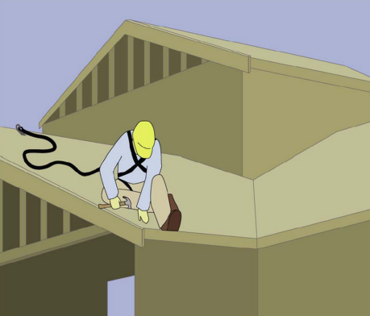
Lifelines
Vertical lifelines must be capable of sustaining a 5000 pound load used by only one worker at a time free of cuts, abrasions, and other defects protected from chafing and abrasion long enough to reach the ground (or a safe landing level above ground) and must be knotted at the bottom to prevent the grab from sliding off the end anchored to a fixed support capable of sustaining a 5000 load.

Slide 12
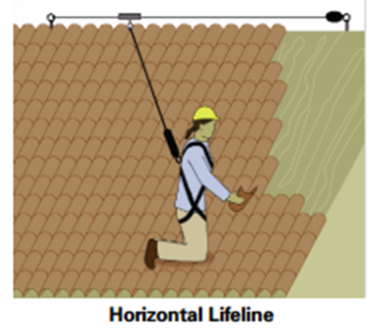
Horizontal Lifeline:
An engineered horizontal lifeline system, when used as part of a PFAS, is another way to increase the area in which a worker is protected. Install the system following the manufacturer’s instructions and under the supervision of a qualified person. Horizontal lifelines must be designed to maintain a safety factor of at least two (twice the impact load). For requirements for horizontal lifelines, refer to 29 CFR 1926.502(d)(8).
Page 30

Slide 13
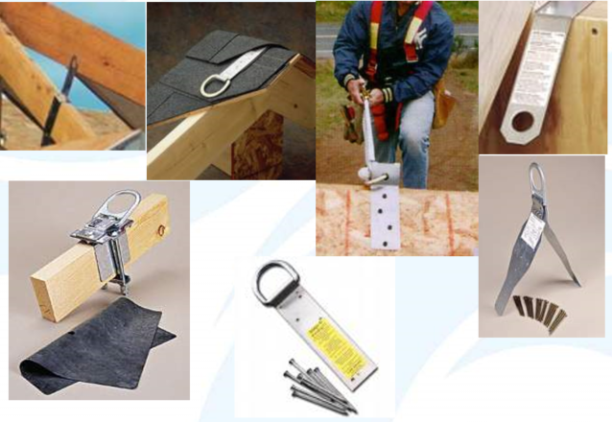
Lifeline Anchors
Page 31

Slide 14
Using Fall Arrest Systems Safely
Ensure that personal fall arrest systems will, when stopping a fall:
Limit maximum arresting force to 1,800 pounds.
Be rigged such that an employee can neither free fall more than 6 feet nor contact any lower level.
Bring an employee to a complete stop and limit maximum deceleration distance to 3½ feet.
Have sufficient strength to withstand twice the potential impact energy of a worker free falling a distance of 6 feet, or the free fall distance permitted by the system, whichever is less
Remove systems and components from service immediately if they have been subjected to fall impact, until inspected by a competent person and deemed undamaged and suitable for use.
Promptly rescue employees in the event of a fall, or assure that they are able to rescue themselves.
Inspect systems before each use for wear, damage, and other deterioration, and remove defective components from service.
Do not attach fall arrest systems to guardrail systems or hoists.
Rig fall arrest systems to allow movement of the worker only as far as the edge of the walking/working surface, when used at hoist areas.

Slide 15
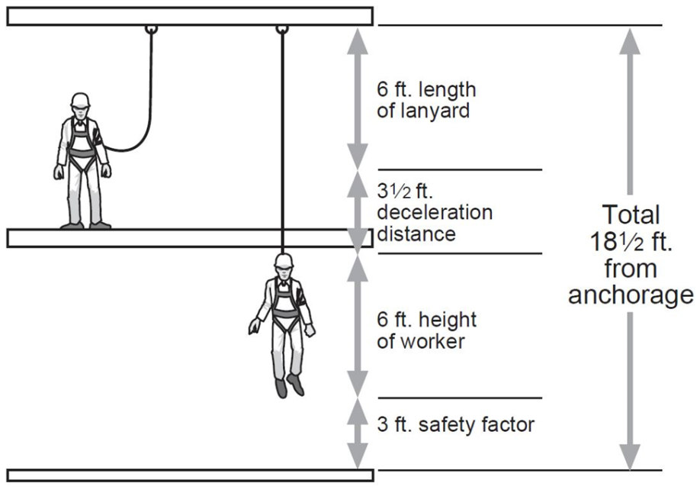
Distance of Fall
Page 33

Slide 16
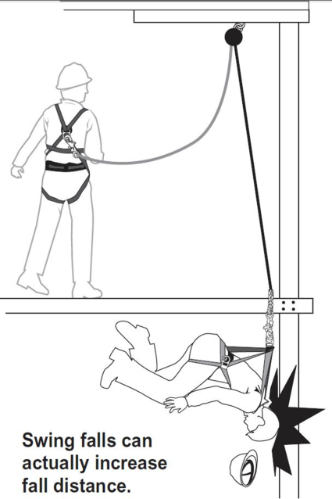
Example of Swing Fall problem
Page 35

Slide 17
Inspection and Maintenance of Personal Fall Arrest Systems
To maintain their service life and high performance, all belts and harnesses shall be inspected frequently. Visual inspection before each use is required as is a routine inspection by a competent person. If any of the conditions listed below are found the equipment shall be removed from service and replaced before being used.
Page 36

Slide 18
Harness Inspection
Belts and Rings: For harness inspections begin at one end, hold the body side of the belt toward you, grasping the belt with your hands six to eight inches apart. Bend the belt in an inverted "U." Watch for frayed edges, broken fibers, pulled stitches, cuts or chemical damage. Check D-rings and D-ring metal wear pads for distortion, cracks, breaks, and rough or sharp edges. The D-ring bar should be at a 90 degree angle with the long axis of the belt and should pivot freely.
Attachments of buckles and D-rings should be given special attention. Note any unusual wear, frayed or cut fibers, or distortion of the buckles. Rivets should be tight and unremovable with fingers. Body side rivet base and outside rivets should be flat against the material. Bent rivets will fail under stress.
Inspect frayed or broken strands. Broken webbing strands generally appear as tufts on the webbing surface. Any broken, cut or burnt stitches will be readily seen.
Tongue Buckle: Buckle tongues should be free of distortion in shape and motion. They should overlap the buckle frame and move freely back and forth in their socket. Rollers should turn freely on the frame. Check for distortion or sharp edges.
Friction Buckle: Inspect the buckle for distortion. The outer bar or center bars must be straight. Pay special attention to corners and attachment points of the center bar.
Page 36

Slide 19
Lanyard Inspection
When inspecting lanyards, begin at one end and work to the opposite end. Slowly rotate the lanyard so that the entire circumference is checked. Spliced ends require particular attention. Hardware should be examined under procedures detailed below.
Hardware
Snaps: Inspect closely for hook and eye distortion, cracks, corrosion, or pitted surfaces. The keeper or latch should seat into the nose without binding and should not be distorted or obstructed. The keeper spring should exert sufficient force to firmly close the keeper. Keeper locks must provide the keeper from opening when the keeper closes.
Thimbles: The thimble (protective plastic sleeve) must be firmly seated in the eye of the splice, and the splice should have no loose or cut strands. The edges of the thimble should be free of sharp edges, distortion, or cracks.
Steel Lanyards: While rotating a steel lanyard, watch for cuts, frayed areas, or unusual wear patterns on the wire. The use of steel lanyards for fall protection without a shock-absorbing device is not recommended. Do not use steel lanyards in the presence of electrical hazards.
Web Lanyard: While bending webbing over a piece of pipe, observe each side of the webbed lanyard. This will reveal any cuts or breaks. Due to the limited elasticity of the web lanyard, fall protection without the use of a shock absorber is not recommended.
Rope Lanyard: Rotation of the rope lanyard while inspecting from end to end will bring to light any fuzzy, worn, broken or cut fibers. Weakened areas from extreme loads will appear as a noticeable change in original diameter. The rope diameter should be uniform throughout, following a short break-in period. When a rope lanyard is used for fall protection, a shock-absorbing system should be included.
Page 37

Slide 20
Shock-Absorbing Packs Inspection
The outer portion of the shock-absorbing pack should be examined for burn holes and tears. Stitching on areas where the pack is sewn to the D-ring, belt or lanyard should be examined for loose strands, rips and deterioration.

Slide 21
Visual Indication of Damage to Webbing and Rope Lanyards
Heat - In excessive heat, nylon becomes brittle and has a shriveled brownish appearance. Fibers will break when flexed and should not be used above 180 degrees Fahrenheit.
Chemical - Change in color usually appears as a brownish smear or smudge. Transverse cracks appear when belt is bent over tight. This causes a loss of elasticity in the belt.
Ultraviolet Rays - Do not store webbing and rope lanyards in direct sunlight, because ultraviolet rays can reduce the strength of some material.
Molten Metal or Flame - Webbing and rope strands may be fused together by molten metal or flame. Watch for hard, shiny spots or a hard and brittle feel. Webbing will not support combustion, nylon will.
Paint and Solvents - Paint will penetrate and dry, restricting movements of fibers. Drying agents and solvents in some paints will appear as chemical damage.
Page 38

Slide 22
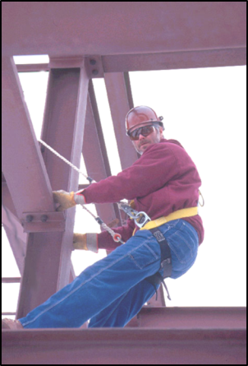
Positioning Device Systems
This system holds the worker in place while keeping his/her hands free to work. Whenever the worker leans back, the system is activated. However, the personal positioning system is not specifically designed for fall arrest purposes. The only time a body belt may be used where there may be a fall is when an employee is using a "positioning device." In §1926.500 of the construction standards for fall protection, a "positioning device system" is defined as a body belt or body harness system rigged to allow an employee to be supported on an elevated vertical surface, such as a wall (or a pole), and work with both hands free while leaning. Therefore, in construction work, a positioning device may be used only to protect a worker on a vertical work surface. These devices may permit a fall of up to 2 feet (0.6 m). They may be used in concrete form work, installation of reinforcing steel, and certain telecommunications work. Since construction workers in bucket trucks, scissor lifts and boom-type elevating work platforms are on a horizontal surface, a positioning device may not be used for those workers.
Page 39

Slide 23
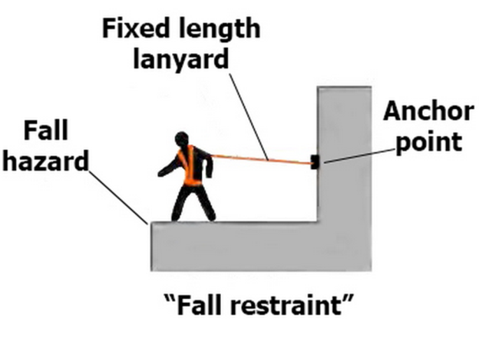
Restraint Systems
A restraint system prevents a worker from being exposed to any fall. If the employee is protected by a restraint system, either a body belt or a harness may be used. When a restraint system is used for fall protection from an aerial lift or a boom-type elevating work platform, the employer must ensure that the lanyard and anchor are arranged so that the employee is not potentially exposed to falling any distance.
While fall restraint systems are not mentioned in OSHA’s fall protection rules, OSHA will accept a properly utilized fall restraint system in lieu of a personal fall arrest system when the restraint system is rigged so that the worker can- not get to the fall hazard. In effect, (if properly used) the system tethers a worker in a manner that will not allow a fall of any distance. A fall restraint system is comprised of a body belt or body harness, an anchorage, connectors, and other necessary equipment. Other components typically include a lanyard, and may also include a lifeline and other devices.

Slide 24
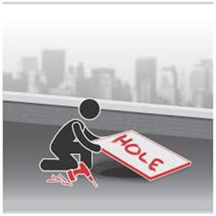
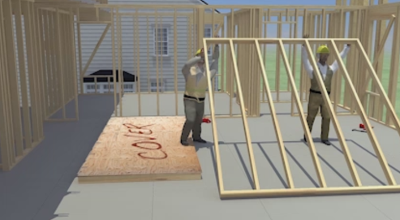
Hole Covers
Cover or guard floor holes as soon as they are created during new construction.
For existing structures, survey the site before working and continually audit as work continues. Guard or cover any openings or holes immediately.
Construct all floor hole covers so they will effectively support two times the weight of employees, equipment, and materials that may be imposed on the cover at any one time.
Secure all floor hole covers to prevent accidental displacement by the wind, equipment, or employees.
All covers shall be color coded or they shall be marked with the word “Hole” or “Cover”.
Page 42

Slide 25
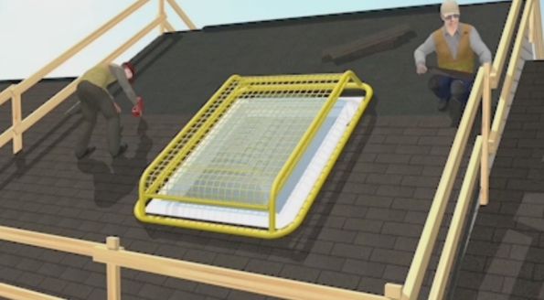
Walking / Working Surfaces
Each employee on walking/working surfaces shall be protected from tripping in or stepping into or through holes (including skylights) by personal fall arrest systems, covers, or guardrail systems erected around such holes.
Employees are to also be protected from stepping in or tripping over holes where there is no hazard of falling all the way through the hole. In general as long as the opening meets the definition of a hole it must be protected

Slide 26
Protection from Falling Objects
1926.502(j) as follows:
"Protection from falling objects." Falling object protection shall comply with the following provisions:
-Toeboards, when used as falling object protection, shall be erected along the edge of the overhead walking/working surface for a distance sufficient to protect employees below.
-Toeboards shall be capable of withstanding, without failure, a force of at least 50 pounds (222 N) applied in any downward or outward direction at any point along the toeboard.
-Toeboards shall be a minimum of 3 1/2 inches (9 cm) in vertical height from their top edge to the level of the walking/working surface. They shall have not more than 1/4 inch (0.6 cm) clearance above the walking/working surface. They shall be solid or have openings not over 1 inch (2.5 cm) in greatest dimension.
-Where tools, equipment, or materials are piled higher than the top edge of a toeboard, paneling or screening shall be erected from the walking/working surface or toeboard to the top of a guardrail system's top rail or midrail, for a distance sufficient to protect employees below.
-Guardrail systems, when used as falling object protection, shall have all openings small enough to prevent passage of potential falling objects.
-During the performance of overhand bricklaying and related work:
-No materials or equipment except masonry and mortar shall be stored within 4 feet (1.2 m) of the working edge.
-Excess mortar, broken or scattered masonry units, and all other materials and debris shall be kept clear from the work area by removal at regular intervals.
-During the performance of roofing work:
-Materials and equipment shall not be stored within 6 feet (1.8 m) of a roof edge unless guardrails are erected at the edge.
-Materials which are piled, grouped, or stacked near a roof edge shall be stable and self-supporting.
-Canopies, when used as falling object protection, shall be strong enough to prevent collapse and to prevent penetration by any objects which may fall onto the canopy
Page 44

Slide 27
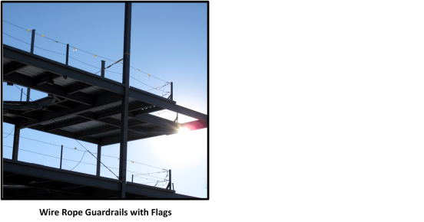
Custody of Fall Protection
Reference: 29 CFR 1926.760(e)
Fall protection provided by the steel erector shall remain in the area where steel erection activity has been completed, to be used by other trades, only if the controlling contractor or its authorized representative:
Has directed the steel erector to leave the fall protection in place; and
Has inspected and accepted control and responsibility of the fall protection prior to authorizing persons other than steel erectors to work in the area.

Slide 28
Warning Line Systems
Page 46
Reference 1926.502(f)
"Warning line systems." Warning line systems [See 1926.501(b)(10)] and their use shall comply with the following provisions:
The warning line shall be erected around all sides of the roof work area.
When mechanical equipment is not being used, the warning line shall be erected not less than 6 feet (1.8 m) from the roof edge.
When mechanical equipment is being used, the warning line shall be erected not less than 6 feet (1.8 m) from the roof edge which is parallel to the direction of mechanical equipment operation, and not less than 10 feet (3.1 m) from the roof edge which is perpendicular to the direction of mechanical equipment operation.
Points of access, materials handling areas, storage areas, and hoisting areas shall be connected to the work area by an access path formed by two warning lines.
When the path to a point of access is not in use, a rope, wire, chain, or other barricade, equivalent in strength and height to the warning line, shall be placed across the path at the point where the path intersects the warning line erected around the work area, or the path shall be offset such that a person cannot walk directly into the work area.
Warning lines shall consist of ropes, wires, or chains, and supporting stanchions erected as follows:
The rope, wire, or chain shall be flagged at not more than 6-foot (1.8 m) intervals with high-visibility material;
The rope, wire, or chain shall be rigged and supported in such a way that its lowest point (including sag) is no less than 34 inches (.9 m) from the walking/working surface and its highest point is no more than 39 inches (1.0 m) from the walking/working surface;
After being erected, with the rope, wire, or chain attached, stanchions shall be capable of resisting, without tipping over, a force of at least 16 pounds (71 N) applied horizontally against the stanchion, 30 inches (.8 m) above the walking/working surface, perpendicular to the warning line, and in the direction of the floor, roof, or platform edge;
The rope, wire, or chain shall have a minimum tensile strength of 500 pounds (2.22 kN), and after being attached to the stanchions, shall be capable of supporting, without breaking, the loads applied to the stanchions as prescribed in paragraph (f)(2)(iii) of this section; and
The line shall be attached at each stanchion in such a way that pulling on one section of the line between stanchions will not result in slack being taken up in adjacent sections before the stanchion tips over.
No employee shall be allowed in the area between a roof edge and a warning line unless the employee is performing roofing work in that area.
Mechanical equipment on roofs shall be used or stored only in areas where employees are protected by a warning line system, guardrail system, or personal fall arrest system.

Slide 29
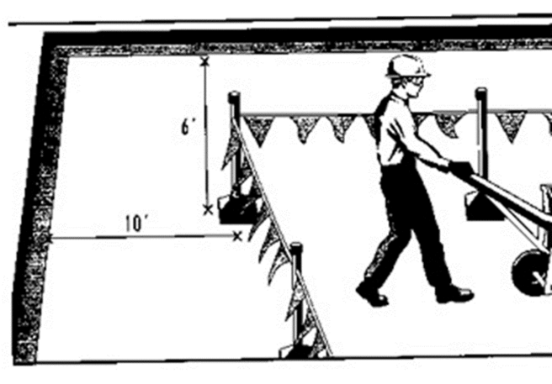
Warning Line Systems

Slide 30
Safety Monitoring Systems
"Safety monitoring systems." Safety monitoring systems [See 1926.501(b)(10) and 1926.502(k)] and their use shall comply with the following provisions:
The employer shall designate a competent person to monitor the safety of other employees and the employer shall ensure that the safety monitor complies with the following requirements:
The safety monitor shall be competent to recognize fall hazards;
The safety monitor shall warn the employee when it appears that the employee is unaware of a fall hazard or is acting in an unsafe manner;
The safety monitor shall be on the same walking/working surface and within visual sighting distance of the employee being monitored;
The safety monitor shall be close enough to communicate orally with the employee; and
The safety monitor shall not have other responsibilities which could take the monitor's attention from the monitoring function.
Mechanical equipment shall not be used or stored in areas where safety monitoring systems are being used to monitor employees engaged in roofing operations on low-slope roofs.
1926.502(h)(3)
No employee, other than an employee engaged in roofing work [on low-sloped roofs] or an employee covered by a fall protection plan, shall be allowed in an area where an employee is being protected by a safety monitoring system.
Each employee working in a controlled access zone shall be directed to comply promptly with fall hazard warnings from safety monitors.

Slide 31
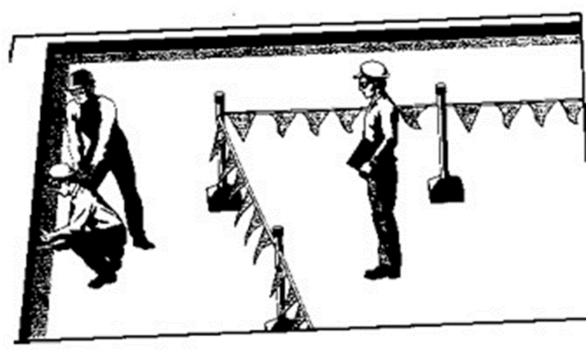
Safety Monitoring Systems

Slide 32
Controlled Access Zone
Page 48
Reference 1926.502(g)
"Controlled access zones." Controlled access zones [See 1926.501(b)(9) and 1926.502(k)] and their use shall conform to the following provisions.
When used to control access to areas where leading edge and other operations are taking place the controlled access zone shall be defined by a control line or by any other means that restricts access.
When control lines are used, they shall be erected not less than 6 feet (1.8 m) nor more than 25 feet (7.7 m) from the unprotected or leading edge, except when erecting precast concrete members.
When erecting precast concrete members, the control line shall be erected not less than 6 feet (1.8 m) nor more than 60 feet (18 m) or half the length of the member being erected, whichever is less, from the leading edge.
The control line shall extend along the entire length of the unprotected or leading edge and shall be approximately parallel to the unprotected or leading edge.
The control line shall be connected on each side to a guardrail system or wall.
When used to control access to areas where overhand bricklaying and related work are taking place:
The controlled access zone shall be defined by a control line erected not less than 10 feet (3.1 m) nor more than 15 feet (4.5 m) from the working edge.
The control line shall extend for a distance sufficient for the controlled access zone to enclose all employees performing overhand bricklaying and related work at the working edge and shall be approximately parallel to the working edge.
Additional control lines shall be erected at each end to enclose the controlled access zone.
Only employees engaged in overhand bricklaying or related work shall be permitted in the controlled access zone.
Control lines shall consist of ropes, wires, tapes, or equivalent materials, and supporting stanchions as follows:
Each line shall be flagged or otherwise clearly marked at not more than 6-foot (1.8 m) intervals with high-visibility material.
Each line shall be rigged and supported in such a way that its lowest point (including sag) is not less than 39 inches (1 m) from the walking/working surface and its highest point is not more than 45 inches (1.3 m) [50 inches (1.3 m) when overhand bricklaying operations are being performed] from the walking/working surface.
Each line shall have a minimum breaking strength of 200 pounds (.88 kN).
On floors and roofs where guardrail systems are not in place prior to the beginning of overhand bricklaying operations, controlled access zones shall be enlarged, as necessary, to enclose all points of access, material handling areas, and storage areas.
On floors and roofs where guardrail systems are in place, but need to be removed to allow overhand bricklaying work or leading edge work to take place, only that portion of the guardrail necessary to accomplish that day's work shall be removed.

Slide 33
Controlled Decking Zone (CDZ).
Reference Subpart R – Steel Erection, Controlled Decking Zone’s (CDZ) located in 1926.760(c)
1926.760(c)
A controlled decking zone may be established in that area of the structure over 15 and up to 30 feet above a lower level where metal decking is initially being installed and forms the leading edge of a work area. In each CDZ, the following shall apply:
-Each employee working at the leading edge in a CDZ shall be protected from fall hazards of more than two stories or 30 feet (9.1 m), whichever is less.
-Access to a CDZ shall be limited to only those employees engaged in leading edge work.
-The boundaries of a CDZ shall be designated and clearly marked. The CDZ shall not be more than 90 feet (27.4 m) wide and 90 (27.4 m) feet deep from any leading edge. The CDZ shall be marked by the use of control lines or the equivalent. Examples of acceptable procedures for demarcating CDZ's can be found in Appendix D to this subpart.
-Each employee working in a CDZ shall have completed CDZ training in accordance with § 1926.761.
-Unsecured decking in a CDZ shall not exceed 3,000 square feet (914.4 m ²).
-Safety deck attachments shall be performed in the CDZ from the leading edge back to the control line and shall have at least two attachments for each metal decking panel.
-Final deck attachments and installation of shear connectors shall not be performed in the CDZ.
Page 49

Slide 34
Fall Protection Plans
Reference 1926.502(k)
"Fall protection plan." This option is available only to employees engaged in leading edge work, precast concrete erection work, or residential construction work (See 1926.501(b)(2), (b)(12), and (b)(13)) who can demonstrate that it is infeasible or it creates a greater hazard to use conventional fall protection equipment. The fall protection plan must conform to the following provisions.
The fall protection plan shall be prepared by a qualified person and developed specifically for the site where the leading edge work, precast concrete work, or residential construction work is being performed and the plan must be maintained up to date.
Any changes to the fall protection plan shall be approved by a qualified person.
A copy of the fall protection plan with all approved changes shall be maintained at the job site.
The implementation of the fall protection plan shall be under the supervision of a competent person.
The fall protection plan shall document the reasons why the use of conventional fall protection systems (guardrail systems, personal fall arrest systems, or safety nets systems) are infeasible or why their use would create a greater hazard.

Slide 35
Fall Protection Plans
The fall protection plan shall include a written discussion of other measures that will be taken to reduce or eliminate the fall hazard for workers who cannot be provided with protection from the conventional fall protection systems. For example, the employer shall discuss the extent to which scaffolds, ladders, or vehicle mounted work platforms can be used to provide a safer working surface and thereby reduce the hazard of falling.
The fall protection plan shall identify each location where conventional fall protection methods cannot be used. These locations shall then be classified as controlled access zones and the employer must comply with the criteria in paragraph (g) of this section.
Where no other alternative measure has been implemented, the employer shall implement a safety monitoring system in conformance with 1926.502(h).
The fall protection plan must include a statement which provides the name or other method of identification for each employee who is designated to work in controlled access zones. No other employees may enter controlled access zones.
In the event an employee falls, or some other related, serious incident occurs, (e.g., a near miss) the employer shall investigate the circumstances of the fall or other incident to determine if the fall protection plan needs to be changed (e.g. new practices, procedures, or training) and shall implement those changes to prevent similar types of falls or incidents
Pages 50 and 51

Slide 36
Walking/Working Surfaces Strength and Integrity
The employer must determine if the walking/working surfaces on which its employees are to work have the strength and structural integrity to support the employees safely. Employees must only be allowed to work on any surface only when it has been determined that it is safe to do so.
Examples of walking/working surfaces which need to be evaluated
Roofs & Roofing Supports
Hole Covers (including Skylights)
Scaffolds & Shoring
Piping Systems
Stairways & Ladders
Formwork & Reinforcing Steel
Ramps, Runways, and other Walkways
Concrete Columns & Structures
Steel & Metal Decking
Sidewalks, Pavements, and other Appurtenant Structures

Slide 37
Housekeeping
Wrong
Right

Slide 38
Unprotected Sides & Edges
“Unprotected sides and edges” means any side or edge (except at entrances to points of access) of a walking/working surface, e.g., floor, roof, ramp, or runway where there is no wall or guardrail system at least 39 inches (1.0 m) high.
Each employee on a walking/working surface (horizontal and vertical surface) with an unprotected side or edge which is 6 feet (1.8 m) or more above a lower level shall be protected from falling by the use of guardrail systems, safety net systems, or personal fall arrest systems.
Page 53

Slide 39
Leading Edges
“Leading edge” means the edge of a floor, roof, or formwork for a floor or other walking/working surface (such as the deck) which changes location as additional floor, roof, decking, or formwork sections are placed, formed, or constructed. A leading edge is considered to be an "unprotected side and edge" during periods when it is not actively and continuously under construction.
1926.501(b)(2)(i) Each employee who is constructing a leading edge 6 feet (1.8 m) or more above lower levels shall be protected from falling by guardrail systems, safety net systems, or personal fall arrest systems. Exception: When the employer can demonstrate that it is infeasible or creates a greater hazard to use these systems, the employer shall develop and implement a fall protection plan which meets the requirements of paragraph (k) of 1926.502.

Slide 40
Hoist Areas
1926.501(b)(3) Hoist areas." Each employee in a hoist area shall be protected from falling 6 feet (1.8 m) or more to lower levels by guardrail systems or personal fall arrest systems. If guardrail systems, [or chain, gate, or guardrail] or portions thereof, are removed to facilitate the hoisting operation (e.g., during landing of materials), and an employee must lean through the access opening or out over the edge of the access opening (to receive or guide equipment and materials, for example), that employee shall be protected from fall hazards by a personal fall arrest system.

Slide 41
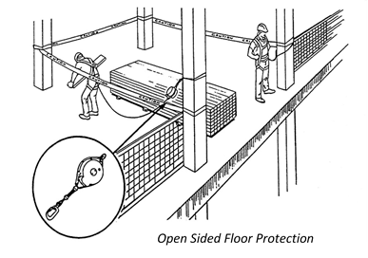
Example of Open Sided Floor Protection

Slide 42
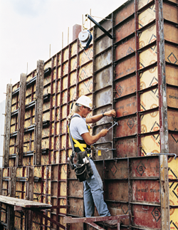
Formwork & Reinforcing Steel
"Formwork" means the total system of support for freshly placed or partially cured concrete, including the mold or sheeting (form) that is in contact with the concrete as well as all supporting members including shores, reshores, hardware, braces, and related hardware.
"Formwork and reinforcing steel." Each employee on the face of formwork or reinforcing steel shall be protected from falling 6 feet (1.8 m) or more to lower levels by personal fall arrest systems, safety net systems, or positioning device systems.

Slide 43
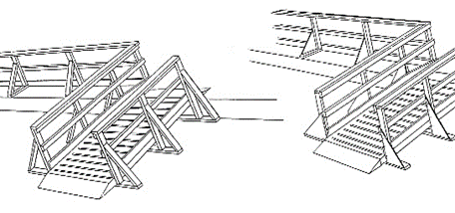
Ramps, Runways/Walkways
“Ramps” means an inclined walking or working surface that is used to gain access to one point from another.
“Runways/Walkways” means a portion of an elevated platform used only for access and not as a work level.
1926.451(e)(5)(i) Ramps and walkways 6 feet (1.8 m) or more above lower levels shall have guardrail systems which comply with subpart M of this part -- Fall Protection;
1926.451(e)(5)(ii) No ramp or walkway shall be inclined more than a slope of one (1) vertical to three (3) horizontal (20 degrees above the horizontal).
1926.451(e)(5)(iii) If the slope of a ramp or a walkway is steeper than one (1) vertical in eight (8) horizontal, the ramp or walkway shall have cleats not more than fourteen (14) inches (35 cm) apart which are securely fastened to the planks to provide footing.
1926.501(b)(6) "Ramps, runways, and other walkways." Each employee on ramps, runways, and other walkways shall be protected from falling 6 feet (1.8 m) or more to lower levels by guardrail systems.
Page 54

Slide 44
Excavations
“Excavation” means any man-made cut, cavity, trench, or depression in an earth surface, formed by earth removal.
“Trench” (Trench excavation)” means a narrow excavation (in relation to its length) made below the surface of the ground. In general, the depth is greater than the width, but the width of a trench (measured at the bottom) is not greater than 15 feet (4.6 m). If forms or other structures are installed or constructed in an excavation so as to reduce the dimension measured from the forms or structure to the side of the excavation to 15 feet (4.6 m) or less (measured at the bottom of the excavation), the excavation is also considered to be a trench.
Walkways shall be provided where employee or equipment required or permitted to cross over excavations. Guardrails which comply with 29 CFR 1926.502(b) shall be provided where walkways are 6 feet or more above lower levels.
1926.501(b)(7)(i) Each employee at the edge of an excavation 6 feet (1.8 m) or more in depth shall be protected from falling by guardrail systems, fences, or barricades when the excavations are not readily seen because of plant growth or other visual barrier; 1926.501(b)(7)(ii) Each employee at the edge of a well, pit, shaft, and similar excavation 6 feet (1.8 m) or more in depth shall be protected from falling by guardrail systems, fences, barricades, or covers.

Slide 45
Dangerous Equipment
“Dangerous equipment” means equipment (such as pickling or galvanizing tanks, degreasing units, machinery, electrical equipment, and other units) which, as a result of form or function, may be hazardous to employees who fall onto or into such equipment.
Regardless of height, if a worker can fall into or onto dangerous machines or equipment (such as a vat or acid or a conveyor belt) employers must provide guardrails and toe-boards to prevent workers from falling and getting injured.
Page 55

Slide 46
Overhand Bricklaying
“Overhand bricklaying and related work” means the process of laying bricks and masonry units such that the surface of the wall to be jointed is on the opposite side of the wall from the mason, requiring the mason to lean over the wall to complete the work. Related work includes mason tending and electrical installation incorporated into the brick wall during the overhand bricklaying process.
Where a mason performs overhand bricklaying and related work 6 feet above lower levels, the requirements for fall protection systems can be satisfied by the use of guardrail systems, safety net systems, personal fall arrest systems, or by creating a controlled access zone in which only employees engaged in overhand bricklaying or related work, works. However controlled access zones are not permitted where the mason is reaching more than 10 inches below the level of the walking/working surface on which he is working. In that instance conventional fall protection such as a guardrail system, safety net system, or personal fall arrest system is required to be used.

Slide 47
Roofing Work on Low-sloped Roofs
“Roofing work” means the hoisting, storage, application, and removal of roofing materials and equipment, including related insulation, sheet metal, and vapor barrier work, but not including the construction of the roof deck.
“Low-slope roof” means a roof having a slope less than or equal to 4 in 12 (vertical to horizontal).
29 CFR 1926 (b)(10) Roofing work on Low-slope roofs. Except as otherwise provided in paragraph (b) of this section, each employee engaged in roofing activities on low-slope roofs, with unprotected sides and edges 6 feet (1.8 m) or more above lower levels shall be protected from falling by guardrail systems, safety net systems, personal fall arrest systems, or a combination of warning line system and guardrail system, warning line system and safety net system, or warning line system and personal fall arrest system, or warning line system and safety monitoring system. Or, on roofs 50-feet (15.25 m) or less in width (see appendix A to subpart M of this part), the use of a safety monitoring system alone [i.e. without the warning line system] is permitted.

Slide 48
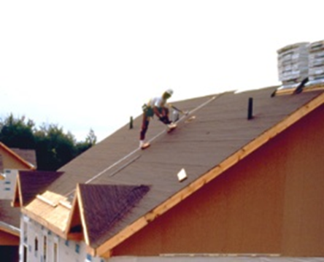
Steep Roofs
“Steep roof” means a roof having a slope greater than 4 in 12 (vertical to horizontal).
1926.501(b)(11) "Steep roofs." Each employee on a steep roof with unprotected sides and edges 6 feet (1.8 m) or more above lower levels shall be protected from falling by guardrail systems with toeboards, safety net systems, or personal fall arrest systems.

Slide 49
Precast Concrete Erection
"Precast concrete" means concrete members (such as walls, panels, slabs, columns, and beams) which have been formed, cast, and cured prior to final placement in a structure.
1926.501(b)(12) "Precast concrete erection." Each employee engaged in the erection of precast concrete members (including, but not limited to the erection of wall panels, columns, beams, and floor and roof "tees") and related operations such as grouting of precast concrete members, who is 6 feet (1.8 m) or more above lower levels shall be protected from falling by guardrail systems, safety net systems, or personal fall arrest systems, unless another provision in paragraph (b) of this section provides for an alternative fall protection measure. Exception: When the employer can demonstrate that it is infeasible or creates a greater hazard to use these systems, the employer shall develop and implement a fall protection plan which meets the requirements of paragraph (k) of 1926.502.
Note: There is a presumption that it is feasible and will not create a greater hazard to implement at least one of the above-listed fall protection systems. Accordingly, the employer has the burden of establishing that it is appropriate to implement a fall protection plan which complies with 1926.502(k) for a particular workplace situation, in lieu of implementing any of those systems.
Page 57

Slide 50
Residential Construction
OSHA’s interpretation of residential combines two elements, both of which must be satisfied for a project to fall under the definition of “residential construction”.
The end-use of the structure being built must be as a home, i.e., a dwelling, and;
The structure being built must be constructed using traditional wood frame construction materials and methods.
Traditional wood frame construction materials and methods will be characterized by
Framing materials: Wood (or equivalent cold-formed sheet metal stud) framing, not steel or concrete; wooden floor joists and roof structures.
Exterior wall structure: Wood (or equivalent cold-formed sheet metal stud) framing or masonry brick or block.
Methods: Traditional wood frame construction techniques.
NOTE: The limited use of structural steel in a predominantly wood-frame home, such as a steel I-beam to help support wood framing, does not disqualify a structure from being considered residential construction.
Employees working six (6) feet or more above lower levels must be protected by conventional fall protection methods listed in 1926.501(b)(13) ( i.e., guardrail systems, safety net systems, or personal fall arrest systems ) or alternative fall protection measures allowed by other provisions of 29 CFR 1926.501(b) for particular types of work.
An example of an alternative fall protection measure allowed under 1926.501(b) is the use of warning lines and safety monitoring systems during the performance of roofing work on low-sloped roofs. (4 in 12 pitch or less). (See 1926.501(b)(10))
OSHA allows the use of an effective fall restraint system in lieu of a personal fall arrest system. To be effective, a fall restraint system must be rigged to prevent a worker from reaching a fall hazard and falling over the edge. A fall restraint system may consist of a full body harness or body belt that is connected to an anchor point at the center of a roof by a lanyard of a length that will not allow a worker to physically reach the edge of the roof.
When the employer can demonstrate that it is infeasible or creates a greater hazard to use required fall protection systems, a qualified person must develop a written site-specific fall protection plan in accordance with 1926.502(k) that, among other things, specifies the alternative fall protection methods that will be used to protect workers from falls.
Page 58

Slide 51
Wall Openings
“Wall openings” are where the outside bottom edge of the wall opening is 6 feet (1.8 m) or more above lower levels and the inside bottom edge of the wall opening is less than 39 inches (1.0 m) above the walking/working surface.
29 CFR 1926 (b)(14) Wall openings. Each employee working on, at, above, or near wall openings (including those with chutes attached) where the outside bottom edge of the wall opening is 6 feet (1.8 m) or more above lower levels and the inside bottom edge of the wall opening is less than 39 inches (1.0 m) above the walking/working surface, shall be protected from falling by the use of a guardrail system, a safety net system, or a personal fall arrest system.

Slide 52
Walking/Working Surfaces not otherwise Addressed
“Walking/working surface” means any surface, whether horizontal or vertical on which an employee walks or works, including, but not limited to, floors, roofs, ramps, bridges, runways, formwork and concrete reinforcing steel but not including ladders, vehicles, or trailers, on which employees must be located in order to perform their job duties.
29 CFR 1926 (b)(15) Walking/working surfaces not otherwise addressed. Except as provided in §1926.500(a)(2) or in §1926.501 (b)(1) through (b)(14), each employee on a walking/working surface 6 feet (1.8 m) or more above lower levels shall be protected from falling by a guardrail system, safety net system, or personal fall arrest system.

Slide 53
Stairs and Ladders
General Requirements
These rules specify when employers must provide stairways and ladders. In general, the standards require the following:
When there is a break in elevation of 19 inches (48 cm) or more and no ramp, runway, embankment or personnel hoist is available, employers must provide a stairway or ladder at all worker points of access.
When there is only one point of access between levels, employers must keep it clear of obstacles to permit free passage by workers. If free passage becomes restricted, employers must provide a second point of access and ensure that workers use it.
When there are more than two points of access between levels, employers must ensure that at least one point of access remains clear. In addition, employers must install all stairway and ladder fall protection systems required by these rules and ensure that their worksite meets all requirements of the stairway and ladder rules before employees use stairways or ladders. See 29 CFR 1926.1050-1060 for the details of the standard.
Note: The standard does not apply to ladders specifically manufactured for scaffold access and egress, but does apply to job-made and manufactured portable ladders intended for general purpose use. Rules for ladders used on or with scaffolds are addressed in 29 CFR 1926.451 Subpart L.
Page 60

Slide 54
Rules for Ladders
All Ladders
The following rules apply to all ladders:
Maintain ladders free of oil, grease and other slipping hazards.
Do not load ladders beyond their maximum intended load nor beyond their manufacturer’s rated capacity.
Use ladders only for their designed purpose.
Use ladders only on stable and level surfaces unless secured to prevent accidental movement.
Do not use ladders on slippery surfaces unless secured or provided with slip-resistant feet to prevent accidental movement. Do not use slipresistant feet as a substitute for exercising care when placing, lashing or holding a ladder upon slippery surfaces.
Secure ladders placed in areas such as passageways, doorways or driveways, or where they can be displaced by workplace activities or traffic to prevent accidental movement. Or use a barricade to keep traffic or activity away from the ladder.
Keep areas clear around the top and bottom of ladders.
Do not move, shift or extend ladders while in use.
Use ladders equipped with nonconductive side rails if the worker or the ladder could contact exposed energized electrical equipment.
Face the ladder when moving up or down.
Use at least one hand to grasp the ladder when climbing.
Do not carry objects or loads that could cause loss of balance and falling.
Page 61

Slide 55
In addition, the following general requirements apply to all ladders, including ladders built at the jobsite:
Double-cleated ladders or two or more ladders must be provided when ladders are the only way to enter or exit a work area where 25 or more employees work or when a ladder serves simultaneous two-way traffic.
Ladder rungs, cleats and steps must be parallel, level and uniformly spaced when the ladder is in position for use.
Rungs, cleats and steps of portable and fixed ladders (except as provided below) must not be spaced less than 10 inches (25 cm) apart, nor more than 14 inches (36 cm) apart, along the ladder’s side rails.
Rungs, cleats and steps of step stools must not be less than 8 inches (20 cm) apart, nor more than 12 inches (31 cm) apart, between center lines of the rungs, cleats and steps.
Rungs, cleats and steps at the base section of extension trestle ladders must not be less than 8 inches (20 cm) nor more than 18 inches (46 cm) apart, between center lines of the rungs, cleats and steps. The rung spacing on the extension section must not be less than 6 inches (15 cm) nor more than 12 inches (31 cm).
Ladders must not be tied or fastened together to create longer sections unless they are specifically designed for such use.
When splicing side rails, the resulting side rail must be equivalent in strength to a one-piece side rail made of the same material.
Two or more separate ladders used to reach an elevated work area must be offset with a platform
or landing between the ladders, except when portable ladders are used to gain access to fixed ladders.
Ladder components must be surfaced to prevent snagging of clothing and injury from punctures or lacerations.
Wood ladders must not be coated with any opaque covering except for identification or warning labels, which may be placed only on one face of a side rail.

Slide 56
Specific Types of Ladders
Do not use single-rail ladders.
Use non-self-supporting ladders at an angle where the horizontal distance from the top support to the foot of the ladder is approximately one-quarter of the working length of the ladder.
Use wooden ladders built at the jobsite with spliced side rails at an angle where the horizontal distance is one-eighth of the working length of the ladder.
In addition, the top of a non-self-supporting ladder must be placed with two rails supported equally unless it is equipped with a single support attachment.

Slide 57
Stepladders
Do not use the top or top step of a stepladder as a step.
Do not use cross bracing on the rear section of stepladders for climbing unless the ladders are designed and provided with steps for climbing on both front and rear sections.
Metal spreader or locking devices must be provided on stepladders to hold the front and back sections in an open position when ladders are being used.

Slide 58
Portable Ladders

Slide 59
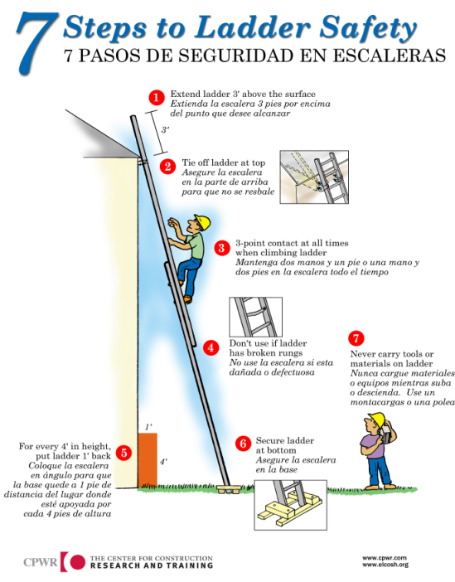
7 steps to Ladder Safety
Page 63

Slide 60
Fixed Ladders
Page 64
If the total length of the climb on a fixed ladder equals or exceeds 24 feet (7.3 m), the ladder must be equipped with ladder safety devices; or self-retracting lifelines and rest platforms at intervals not to exceed 150 feet (45.7 m); or a cage or well and multiple ladder sections with each ladder section not to exceed 50 feet (15.2 m) in length. These ladder sections must be offset from adjacent sections and landing platforms must be provided at maximum intervals of 50 feet (15.2 m). In addition, fixed ladders must meet the following requirements:
Fixed ladders must be able to support at least two loads of 250 pounds (114 kg) each, concentrated between any two consecutive attachments. Fixed ladders also must support added anticipated loads caused by ice buildup, winds, rigging and impact loads resulting from using ladder safety devices. Individual rung/step ladders must extend at least 42 inches (1.1 m) above an access level or landing platform either by the continuation of the rung spacings as horizontal grab bars or by providing vertical grab bars that must have the same lateral spacing as the vertical legs of the ladder rails.
Each step or rung of a fixed ladder must be able to support a load of at least 250 pounds (114 kg) applied in the middle of the step or rung.
Minimum clear distance between the sides of individual rung/step ladders and between the side rails of other fixed ladders must be 16 inches (41 cm).
Rungs of individual rung/step ladders must be shaped to prevent slipping off the end of the rungs.
Rungs and steps of fixed metal ladders manufactured after March 15, 1991, must be corrugated, knurled, dimpled, coated with skid-resistant material or treated to minimize slipping.
Minimum perpendicular clearance between fixed ladder rungs, cleats, and steps and any obstruction behind the ladder must be 7 inches (18 cm), except that the clearance for an elevator pit ladder must be 4.5 inches (11 cm).
Minimum perpendicular clearance between the centerline of fixed ladder rungs, cleats and steps, and any obstruction on the climbing side of the ladder must be 30 inches (76 cm). If obstructions are unavoidable, clearance may be reduced to 24 inches (61 cm), provided a deflection device is installed to guide workers around the obstruction.
Step-across distance between the center of the steps or rungs of fixed ladders and the nearest
edge of a landing area must be no less than 7 inches (18 cm) and no more than 12 inches (30 cm). A landing platform must be provided if the step-across distance exceeds 12 inches (30 cm).
Fixed ladders without cages or wells must have at least a 15-inch (38 cm) clearance width to the nearest permanent object on each side of the centerline of the ladder.
Fixed ladders must be provided with cages, wells, ladder safety devices or self-retracting lifelines where the length of climb is less than 24 feet (7.3 m) but the top of the ladder is at a distance greater than 24 feet (7.3 m) above lower levels.
Side rails of through or side-step fixed ladders must extend 42 inches (1.1 m) above the top level or landing platform served by the ladder. Parapet ladders must have an access level at the roof if the parapet is cut to permit passage through it. If the parapet is continuous, the access level is the top of the parapet.
Steps or rungs for through-fixed-ladder extensions must be omitted from the extension; and the extension of side rails must be flared to provide between 24 inches (61 cm) and 30 inches (76 cm) clearance between side rails.
When safety devices are provided, the maximum clearance distance between side rail extensions must not exceed 36 inches (91 cm).
Fixed ladders must be used at a pitch no greater than 90 degrees from the horizontal, measured from the back side of the ladder.

Slide 61
Cages for Fixed Ladders
The requirements for cages for fixed ladders are as follows:
Horizontal bands must be fastened to the side rails of rail ladders or directly to the structure, building or equipment for individual-rung ladders. Vertical bars must be on the inside of the horizontal bands and must be fastened to them.
Cages must not extend less than 27 inches (68 cm), or more than 30 inches (76 cm) from the centerline of the step or rung and must not be less than 27 inches (68 cm) wide.
Insides of cages must be clear of projections.
Horizontal bands must be spaced at intervals not more than 4 feet (1.2 m) apart measured from centerline to centerline.
Vertical bars must be spaced at intervals not more than 9.5 inches (24 cm), measured centerline to centerline.
Bottoms of cages must be between 7 feet (2.1 m) and 8 feet (2.4 m) above the point of access to the bottom of the ladder. The bottom of the cage must be flared not less than 4 inches (10 cm) between the bottom horizontal band and the next higher band.
Tops of cages must be a minimum of 42 inches (1.1 m) above the top of the platform or the point of access at the top of the ladder. There must be a way to access the platform or other point of access.
Page 65

Slide 62
Wells for Fixed Ladders
The requirements for wells for fixed ladders are as follows:
Wells must completely encircle the ladder.
Wells must be free of projections.
Inside faces of wells on the climbing side of the ladder must extend between 27 inches (68 cm) and 30 inches (76 cm) from the centerline of the step or rung.
Inside widths of wells must be at least 30 inches (76 cm).
Bottoms of wells above the point of access to the bottom of the ladder must be between 7 feet (2.1 m) and 8 feet (2.4 m).

Slide 63
Ladder Safety Devices and Related Support Systems for Fixed Ladders
The connection between the carrier or lifeline and the point of attachment to the body belt or harness must not exceed 9 inches (23 cm) in length. In addition, ladder safety devices and related support systems on fixed ladders must conform to the following:
All safety devices must be able to withstand, without failure, a drop test consisting of a 500-pound weight (226 kg) dropping 18 inches (41 cm).
All safety devices must permit the worker to ascend or descend without continually having to hold, push or pull any part of the device, leaving both hands free for climbing.
All safety devices must be activated within 2 feet (.61 m) after a fall occurs and limit the descending velocity of an employee to 7 feet/second (2.1 m/sec) or less.

Slide 64
Requirements for Mounting Ladder Safety Devices for Fixed Ladders
The requirements for mounting ladder safety devices for fixed ladders are as follows:
Mountings for rigid carriers must be attached at each end of the carrier, with intermediate mountings spaced along the entire length of the carrier, to provide the necessary strength to stop workers’ falls.
Mountings for flexible carriers must be attached at each end of the carrier. Cable guides for flexible carriers must be installed with a spacing between 25 feet (7.6 m) and 40 feet (12.2 m) along the entire length of the carrier, to prevent wind damage to the system.
Design and installation of mountings and cable guides must not reduce the strength of the ladder.
Side rails and steps or rungs for side-step fixed ladders must be continuous in extension.

Slide 65
Defective Ladders
Ladders needing repairs are subject to the following rules:
Portable ladders with structural defects—such as broken or missing rungs, cleats or steps, broken or split rails, corroded components or other faulty or defective components—must immediately be marked defective or tagged with "Do Not Use" or similar language and withdrawn from service until repaired.
Fixed ladders with structural defects—such as broken or missing rungs, cleats or steps, broken or split rails or corroded components— must be withdrawn from service until repaired.
Defective fixed ladders are considered withdrawn from use when they are immediately tagged with "Do Not Use" or similar language, or marked in a manner that identifies them as defective, or blocked—such as with a plywood attachment that spans several rungs.
Ladder repairs must restore the ladder to a condition meeting its original design criteria before the ladder is returned to use.

Slide 66
Wooden Ladders
Never paint wooden ladders. Paint hides signs of deterioration and may accelerate rotting by trapping moisture in the wood.
Coat them with a clear, non-toxic wood preservative or varnish. Inspect them frequently for splits, shakes, and cracks in the side rails and rungs, warping or loosening of rungs, loosing of metal hardware, and deformation of metal parts.
Page 67

Slide 67
Aluminum Ladders
Treat aluminum ladders with care. They are more susceptible to damage than wooden ladders. Because they conduct electricity well, never use aluminum ladders where electrical contact is possible.
Check side rails and rungs regularly for dents, bends, and loose rungs. If repair by a qualified person is not possible, the ladder must be destroyed.

Slide 68
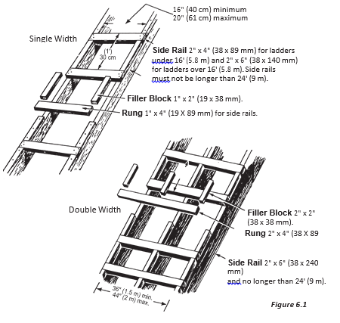
Job-Built Ladders
Wood used for job-built ladders should be straight-grained and free of loose knots, sharp edges, splinters, and shakes. The ladder should not be longer than 24 feet in working length. Used by many workers, job-built ladders deteriorate rapidly. They should be inspected every day and, if defective, repaired immediately or taken out of service and destroyed
Page 67

Slide 69
Ladder Use
Page 68
Check ladder for defects before use.
Clear scrap and material away from the base and top of ladder.
Secure the top and base against movement.
Set the ladder on a firm, level surface. On soft, uncompacted or rough soil, use a mud sill.
Make sure that rails on ladders extend at least 3 feet above the landing. This allows for secure grip while stepping on or off.
A ladder used as a regular means of access must;
Extend 3 feet above the landing or floor
Have a clear toe space of at least 10 inches behind every rung
Have sufficient clearance from obstructions on the climbing side
Be located so that an adequate landing area is clear of obstructions at the top and bottom
Be secured at the top and bottom to prevent movement.
Set straight or extension ladders one foot out for every 4 feet up, depending on length of ladder (Figure 6.3).
Before setting up ladders, always check for overhead power lines.
Do not position ladders against flexible or moveable surfaces.

Slide 70
Ladder Use (cont.)
Always face the ladder when climbing up or down and while working from it.
Maintain 3- point contact when climbing up or down. That means two hands and one foot or two feet and one hand on the ladder at all time.
Keep your center of gravity between the side rails. Your belt buckle should never be outside the side rails.
When climbing up or down, do not carry tools or materials in your hands. Use a hoist rope instead.
Keep boots clean of mud, grease, or any slippery materials which could cause loss of footing (Figure 6.5).
Never erect ladders on boxes, carts, tables, or other unstable surfaces.
Never use ladders horizontally as scaffolds planks, runaways, or for any other purpose for which they have not been designed.
Stand no higher than the third or fourth rung from the top. Maintain knee contact for balance.
Do not splice short ladders together to make a long ladder. The side rails will not be strong enough for the extra loads.
Do not use ladders for bracing. They are not designed for this type of loading.
Do not set up ladders in doorways, passageways, driveways, or any other location where they can be struck or knocked over.
Never rest a ladder on its rungs. Ladders must rest on their side rails.
To erect long, awkward or heavy ladders, get help to avoid injury from overexertion.

Slide 71
Inspection and Maintenance
Ladders shall be inspected by a competent person for visible defects on a periodic basis and after any occurrence that could affect their safe use.
Ladders should only be repaired by qualified persons.
Defective ladders must be taken out of service and both locked and tagged for repair or scrapped.
Inspect ladders for structural rigidity.
Inspect non-skid feet for wear, imbedded material, and proper pivot action on swivel feet.
Replace frayed or worn ropes on extension ladders with types and sizes equal to manufacturer’s original rope.
Check aluminum ladders for dents and bends in side rails, steps, and rungs.
Do not use metal pipe to replace rungs.
Check wooden ladders for cracks, slits, and rot.
Check all ladders for grease, oil, caulking, imbedded stone and metal, or other materials th at could make them unsafe

Slide 72
Ladder Safety Checklist
To prevent falls from ladders, make sure you have the following controls in place:
Use only ladders that are in good condition and designed to handle the climbing job that needs to be done.
Train employees on proper ladder use.
Make proper ladder use a performance requirement for the job.
Require employees to complete a ladder inspection before each use.
Page 70

Slide 73
Criteria for Ladder Purchase and Care
Check OSHA standards for the type of ladder you are using.
Use only Underwriter’s Laboratory approved ladders (will have the UL seal).
Protect wood ladders with a clear sealer, such as varnish, shellac, linseed oil or wood preservative because paint can hide defects.

Slide 74
Temporary Stairs
The following requirements apply to stairways used temporarily during construction. Except during construction of the stairway,
Do not use stairways with metal pan landings and treads if the treads and/or landings have not been filled in with concrete or other materials unless the pans of the stairs and/or landings are temporarily filled in with wood or other materials. All treads and landings must be replaced when worn below the top edge of the pan.
Do not use skeleton metal frame structures and steps (where treads and/or landings will be installed later) unless the stairs are fitted with secured temporary treads and landings.
Note: Temporary treads must be made of wood or other solid material and installed the full width and depth of the stair
Page 71

Slide 75
Stair Rails
The following general requirements apply to all stair rails:
Stairways with four or more risers or rising more than 30 inches (76 cm) in height— whichever is less—must be installed along each unprotected side or edge. When the top edge of a stair rail system also serves as a handrail, the height of the top edge must be no more than 37 inches (94 cm) nor less than 36 inches (91.5 cm) from the upper surface of the stair rail to the surface of the tread.
Stair rails installed after March 15,1991, must be not less than 36 inches (91.5 cm) in height.
Top edges of stair rail systems used as handrails must not be more than 37 inches (94 cm) high nor less than 36 inches (91.5 cm) from the upper surface of the stair rail system to the surface of the tread. (If installed before March 15, 1991, not less than 30 inches [76 cm]).
Stair rail systems and handrails must be surfaced to prevent injuries such as punctures or lacerations and to keep clothing from snagging.
Ends of stair rail systems and handrails must be built to prevent dangerous projections, such as rails protruding beyond the end posts of the system.

Slide 76
Stair Rails
In addition,
Unprotected sides and edges of stairway landings must have standard 42-inch (1.1 m) guardrail systems.
Intermediate vertical members, such as balusters used as guardrails, must not be more than 19 inches (48 cm) apart.
Other intermediate structural members, when used, must be installed so that no openings are more than 19 inches (48 cm) wide.
Screens or mesh, when used, must extend from the top rail to the stairway step and along the opening between top rail supports.

Slide 77
Handrails
Requirements for handrails are as follows:
Handrails and top rails of the stair rail systems must be able to withstand, without failure, at least 200 pounds (890 n) of weight applied within 2 inches (5 cm) of the top edge in any downward or outward direction, at any point along the top edge.
Handrails must not be more than 37 inches (94 cm) high nor less than 30 inches (76 cm) from the upper surface of the handrail to the surface of the tread.
Handrails must provide an adequate handhold for employees to grasp to prevent falls.
Temporary handrails must have a minimum clearance of 3 inches (8 cm) between the handrail and walls, stair rail systems and other objects.
Stairways with four or more risers, or that rise more than 30 inches (76 cm) in height—whichever is less—must have at least one handrail.
Winding or spiral stairways must have a handrail to prevent use of areas where the tread width is less than 6 inches (15 cm).
Page 72

Slide 78
Midrails
Midrails, screens, mesh, intermediate vertical members or equivalent intermediate structural members must be provided between the top rail and stairway steps to the stair rail system. When midrails are used, they must be located midway between the top of the stair rail system and the stairway steps.

Slide 79
Aerial Lifts – OSHA Fact Sheet
An aerial lift is any vehicle-mounted device used to elevate personnel, including:
Extendable boom platforms,
Aerial ladders,
Articulating (jointed) boom platforms,
Vertical towers, and
Any combination of the above.
Aerial lifts have replaced ladders and scaffolding on many job sites due to their mobility and flexibility. They may be made of metal, fiberglass- reinforced plastic, or other materials. They may be powered or manually operated, and are considered to be aerial lifts whether or not they can rotate around a primarily vertical axis.
Many workers are injured or killed on aerial lifts each year.
OSHA provides the following information to help employers and workers recognize and avoid safety hazards they may encounter when they use aerial lifts.

Slide 80
Hazards Associated with Aerial Lifts
The following hazards, among others, can lead to personal injury or death:
Fall from elevated level,
Objects falling from lifts,
Tip-overs,
Ejections from the lift platform,
Structural failures (collapses),
Electric shock (electrocutions),
Entanglement hazards,
Contact with objects, and
Contact with ceilings and other overhead objects.

Slide 81
Training for Aerial Lifts
Only trained and authorized persons are allowed to operate an aerial lift. Training should include:
Explanations of electrical, fall, and falling object hazards;
Procedures for dealing with hazards;
Recognizing and avoiding unsafe conditions in the work setting;
Instructions for correct operation of the lift (including maximum intended load and load capacity);
Demonstrations of the skills and knowledge needed to operate an aerial lift before operating it on the job;
When and how to perform inspections; and
Manufacturer’s requirements.

Slide 82
Aerial Lift Retraining
Workers should be retrained if any of the following conditions occur:
An accident occurs during aerial lift use,
Workplace hazards involving an aerial lift are discovered, or
A different type of aerial lift is used.
Employers are also required to retrain workers who they observe operating an aerial lift improperly.

Slide 83
What to Do Before Operating an Aerial Lift
Pre-start Inspection
Prior to each work shift, conduct a pre-start inspection to verify that the equipment and all its components are in safe operating condition. Follow the manufacturer’s recommendations and include a check of:
Vehicle components
Proper fluid levels (oil, hydraulic, fuel and coolant);
Leaks of fluids;
Wheels and tires;
Battery and charger;
Lower-level controls;
Horn, gauges, lights and backup alarms;
Steering and brakes.

Slide 84
Lift components
Operating and emergency controls;
Personal protective devices;
Hydraulic, air, pneumatic, fuel and electrical systems;
Fiberglass and other insulating components;
Missing or unreadable placards, warnings, or operational, instructional and control markings;
Mechanical fasteners and locking pins;
Cable and wiring harnesses;
Outriggers, stabilizers and other structures;
Loose or missing parts;
Guardrail systems.
Do not operate any aerial lift if any of these components are defective until it is repaired by a qualified person. Remove defective aerial lifts from service (tag out) until repairs are made.

Slide 85
Work Zone Inspections for Aerial Lifts
Employers must assure that work zones are inspected for hazards and take corrective actions to eliminate such hazards before and during oper- ation of an aerial lift. Items to look for include:
Drop-offs, holes, or unstable surfaces such as loose dirt;
Inadequate ceiling heights;
Slopes, ditches, or bumps;
Debris and floor obstructions;
Overhead electric power lines and communication cables;
Other overhead obstructions;
Other hazardous locations and atmospheres;
High wind and other severe weather conditions, such as ice; and
The presence of others in close proximity to the work.

Slide 86
What to Do While Operating an Aerial Lift
Fall Protection:
Ensure that access gates or openings are closed.
Stand firmly on the floor of the bucket or lift platform.
Do not climb on or lean over guardrails or handrails.
Do not use planks, ladders, or other devices as a working position.
When using an extensible or articulating boom platform, use a body harness or a restraining belt with a lanyard attached to the boom or bucket. Note: This regulation does not apply to scissors lifts.
Do not belt-off to adjacent structures or poles while in the bucket.
Page 75

Slide 87
Operation/Traveling/Loading:
Do not exceed the load-capacity limits. Take the combined weight of the worker(s), tools and materials into account when calculating the load.
Do not use the aerial lift as a crane.
Do not carry objects larger than the platform.
Do not drive with the lift platform raised (unless the manufacturer’s instructions allow this).
Do not operate lower level controls unless permission is obtained from the worker(s) in the lift (except in emergencies).
Do not exceed vertical or horizontal reach limits.
Do not operate an aerial lift in high winds above those recommended by the manufacturer.
Do not override hydraulic, mechanical, or electrical safety devices.

Slide 88
Operation/Traveling/Loading:
Do not exceed the load-capacity limits. Take the combined weight of the worker(s), tools and materials into account when calculating the load.
Do not use the aerial lift as a crane.
Do not carry objects larger than the platform.
Do not drive with the lift platform raised (unless the manufacturer’s instructions allow this).
Do not operate lower level controls unless permission is obtained from the worker(s) in the lift (except in emergencies).
Do not exceed vertical or horizontal reach limits.
Do not operate an aerial lift in high winds above those recommended by the manufacturer.
Do not override hydraulic, mechanical, or electrical safety devices.

Slide 89
Overhead Protection:
Be aware of overhead clearance and overhead objects, including ceilings.
Do not position aerial lifts between overhead hazards if possible.
Treat all overhead power lines and communica- tion cables as energized, and stay at least 10 feet (3 meters) away.
Ensure that the power utility or power line workers de-energize power lines in the vicinity of the work.

Slide 90
Stability in the Work Zone:
Set outriggers on pads or on a level, solid surface.
Set brakes when outriggers are used.
Use wheel chocks on sloped surfaces when it is safe to do so.
Set up work zone warnings, such as cones and signs, when necessary to warn others.
Insulated aerial lifts offer protection from electric shock and electrocution by isolating you from electrical ground. However, an insulated aerial lift does not protect you if there is another path to ground (for instance, if you touch another wire). To maintain the effectiveness of the insulating device, do not drill holes in the bucket.

Slide 91
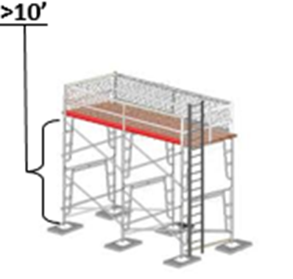
Scaffolding
1926.451(g)(1) Each employee on a scaffold more than 10 feet (3.1 m) above a lower level shall be protected from falling to that lower level. Paragraphs (g)(1)(i) through (vii) of this section establish the types of fall protection to be provided to the employees on each type of scaffold. Paragraph (g)(2) of this section addresses fall protection for scaffold erectors and dismantlers.
Note to paragraph (g)(1): The fall protection requirements for employees installing suspension scaffold support systems on floors, roofs, and other elevated surfaces are set forth in subpart M of this part.

Slide 92
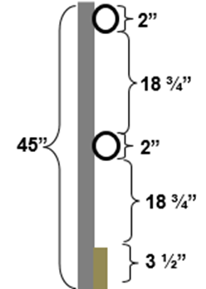
1926.451(g)(4)(ii) Toprails
1926.451(g)(4)(ii) The top edge height of toprails or equivalent member on supported scaffolds manufactured or placed in service after January 1, 2000 shall be installed between 38 inches (0.97 m) and 45 inches (1.2 m) above the platform surface. The top edge height on supported scaffolds manufactured and placed in service before January 1, 2000, and on all suspended scaffolds where both a guardrail and a personal fall arrest system are required shall be between 36 inches (0.9 m) and 45 inches (1.2 m). When conditions warrant, the height of the top edge may exceed the 45-inch height, provided the guardrail system meets all other criteria of paragraph (g)(4).

Slide 93
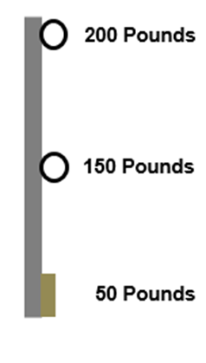
Toprail, Midrails, Capacity
1926.451(g)(4)(vii) Each toprail or equivalent member of a guardrail system shall be capable of withstanding, without failure, a force applied in any downward or horizontal direction at any point along its top edge of at least 100 pounds (445 n) for guardrail systems installed on single-point adjustable suspension scaffolds or two-point adjustable suspension scaffolds, and at least 200 pounds (890 n) for guardrail systems installed on all other scaffolds.
1926.451(g)(4)(ix) Midrails, screens, mesh, intermediate vertical members, solid panels, and equivalent structural members of a guardrail system shall be capable of withstanding, without failure, a force applied in any downward or horizontal direction at any point along the midrail or other member of at least 75 pounds (333 n) for guardrail systems with a minimum 100 pound toprail capacity, and at least 150 pounds (666 n) for guardrail systems with a minimum 200 pound toprail capacity.
1926.451(h)(4)(i)(ii) Capable of withstanding, without failure, a force of at least 50 pounds (222 n) applied in any downward or horizontal direction at any point along the toeboard; and have not more than 1/4 inch (0.7 cm) clearance above the walking/working surface

Slide 94
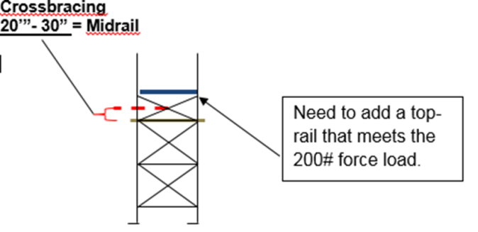
Crossbracing
1926.451(g)(4)(xv) Crossbracing is acceptable in place of a midrail when the crossing point of two braces is between 20 inches (0.5 m) and 30 inches (0.8 m) above the work platform or as a toprail when the crossing point of two braces is between 38 inches (0.97 m) and 48 inches (1.3 m) above the work platform. The end points at each upright shall be no more than 48 inches (1.3 m) apart.

Slide 95
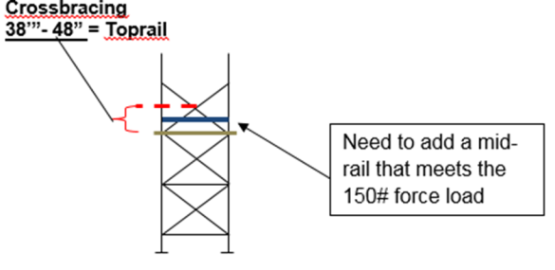
1926.451(g)(4)(xv) Crossbracing
1926.451(g)(4)(xv) Crossbracing is acceptable in place of a midrail when the crossing point of two braces is between 20 inches (0.5 m) and 30 inches (0.8 m) above the work platform or as a toprail when the crossing point of two braces is between 38 inches (0.97 m) and 48 inches (1.3 m) above the work platform. The end points at each upright shall be no more than 48 inches (1.3 m) apart.

Slide 96
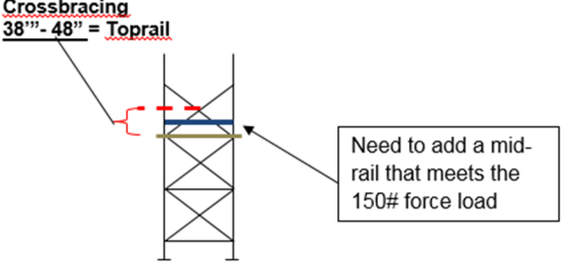
1926.451(g)(4)(xv) Crossbracing is acceptable in place of a midrail
1926.451(g)(4)(xv) Crossbracing is acceptable in place of a midrail when the crossing point of two braces is between 20 inches (0.5 m) and 30 inches (0.8 m) above the work platform or as a toprail when the crossing point of two braces is between 38 inches (0.97 m) and 48 inches (1.3 m) above the work platform. The end points at each upright shall be no more than 48 inches (1.3 m) apart.
Crossbracing can be used as a top-rail, mid-rail, or neither, but never both*

Slide 97
Disclaimers
GENERAL DISCLAIMER
This material is not a substitute for any provision of the Occupational Safety and Health Administration (OSHA) or any standards issued by OSHA. If at any time it is discovered that the materials presented vary from Federal or State OSHA regulations, American National Standards Institute (ANSI), state laws or local ordinances, it is understood that those regulations, laws and ordinances will take precedence over the materials presented herein. In some cases, the information given may imply a higher level of protection than required in some Federal or State OSHA regulations. The mention of any products or materials by brand name in no way constitutes endorsement. Any products or materials not mentioned within this manual that may be considered acceptable as protective devices, equipment, or practices is not intentional and should not rule out their acceptability as employee or environmental protection.
OSHA DISCLAIMER
This material was produced under grant number Susan Harwood Grant # SH26315-SH4 during Grant Year 2014 from the Occupational Safety and Health Administration, U.S. Department of Labor. It does not necessarily reflect the views or policies of the U.S. Department of Labor, nor does mention of trade names, commercial products, or organizations imply endorsement by the U.S. Government.
Finally, this Managing Fall Protection Hazards Handbook is intended to be used as a training aid and for general information only; the creator assumes no responsibility for any loss or damage resulting from its use.

