Slide 1



Non-Ferrous Founders’ Society Safety & Health Training Program
Hazard Communication/GHS Training Program
The Hazard Communication Standard and the Non-Ferrous Foundry
© 2015 All Rights Reserved

Slide 2
HazCom and the Non-Ferrous Foundry
What is the Globally Harmonized System of Classification and Labeling of Chemicals (GHS)?
What is the goal of GHS?
What are the employer responsibilities under GHS?
What are Safety Data Sheets?
What are pictograms?
Notes:
In this section, we will learn:
What is the Globally Harmonized System of Classification and Labeling of Chemicals (GHS);
What is the goal of GHS;
What are the employer responsibilities under GHS;
What are Safety Data Sheets;
What are Pictograms.

Slide 3
HazCom and the Non-Ferrous Foundry
Hazard Communication Standard is the OSHA rule regarding the RIGHT of all employees to have access to information regarding substances in the workplace
Employer responsibilities under the Hazard Communication standard:
Notification of employers/employees of chemicals and their potential hazards
Identification of these hazards through Safety Data Sheets and Labels
Communication through training regarding hazards and how to protect against them
Notes:
The Hazard Communication Standard is the Occupational Safety and Health Administration rule on the RIGHT of all employees to have access to information on the potential hazardous or toxic effects of substances that they may come into contact with during work related activities.
It also gives the EMPLOYER the responsibility for collecting and communicating this information to the workforce. To simplify for a moment, the Hazard Communication Standard or RIGHT TO KNOW has three (3) basic RESPONSIBILITIES:
1. NOTIFICATION of employers and employees of chemicals and their potential hazards
2. IDENTIFICATION of these hazards through the Safety Data Sheet (SDS) and Label
3. COMMUNICATION through training and understanding of the hazards and how to protect against them

Slide 4
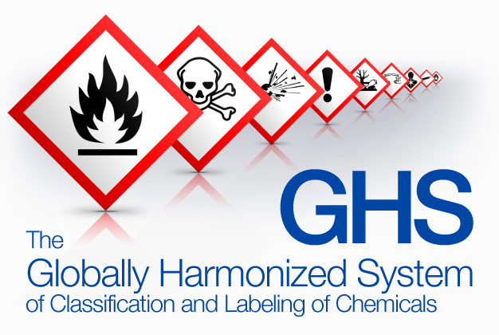
HazCom and the Non-Ferrous Foundry
GHS provides a common and coherent way to:
Classify the chemicals used in the workplace, and;
Communicate the hazard information on labels and safety data sheets with symbols and terms that will be used on both domestic and foreign products and chemicals
Notes:
Understanding these Safety Data Sheets and Labels is very important. In order to make these tools more uniform in our global economy, the Hazard Communication Standard (HCS) uses the Globally Harmonized System of Classification and Labeling of Chemicals (GHS). This system of classifying and identifying hazards gives a common and coherent way to:
◆ Classify the chemicals used in the workplace; and
◆ Communicate the hazard information on labels and safety data sheets with symbols and terms that will be used on both domestic and foreign products and chemicals.

Slide 5
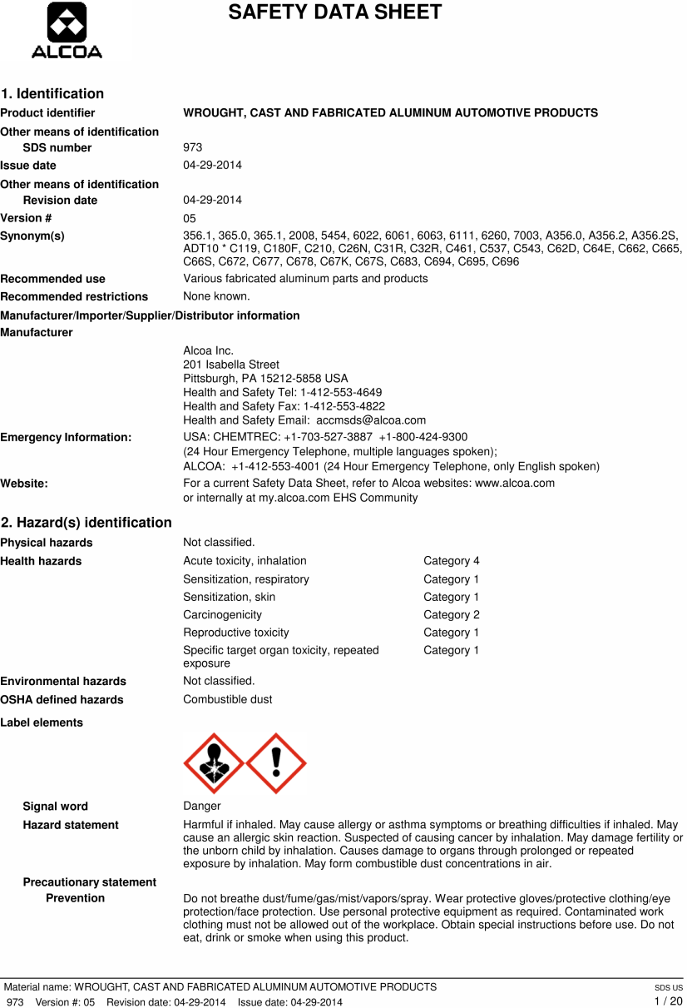
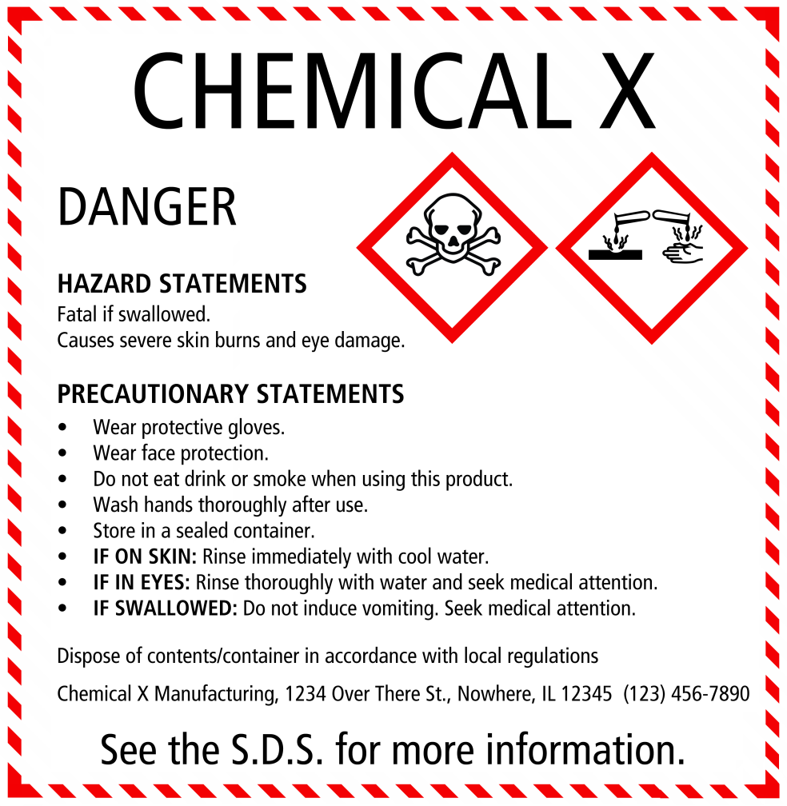
Notification of Hazards
Notes:
One of the most important goals of the Hazard Communication Standard is NOTIFICATION of the chemicals and hazards that may be present. Notification is the responsibility of the manufacturer or the distributor of the material or product that contains a hazardous or toxic substance. The manufacturer or distributor must know what is in the product and its potential dangers. The manufacturer or supplier then is required to notify the purchaser or user of any hazards associated with his product through the SAFETY DATA and the LABELS which must be placed on all shipments and containers for his products. The SDS and the labels are the way we can IDENTIFY the chemicals and potential hazards in our workplace.

Slide 6

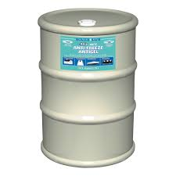
Employer Responsibilities
Employers must:
Ensure Safety Data Sheets (SDS) for materials are up to date and available to workers
Evaluate SDSs to be sure safety measures are taken to protect workers
Make sure labels are placed on material containers, bins or storage areas
Notes:
The Employer is responsible for being sure that there are SAFETY DATA SHEETS (SDS) for chemicals and that they are kept up to date in a location where management and workers have easy access to them. The employer must evaluate these SDS's to be sure that precautions or safety measures are taken to protect workers from potential harm.
The SDS will also provide data on how to safely store the chemical, how to dispose of the material after use or how to handle an accidental spill or fire safely and in accordance with federal EPA, state or local regulations.
The employer must also make sure that LABELS, which carry the required information on the material, are placed on any containers, bins, or storage areas in the plant.

Slide 7
Employer Responsibilities
Employers must:
Communicate to workers their rights under the GHS standard
Train workers how to read and understand labels and Safety Data Sheets
Train workers on what safety precautions or PPE is required when working with substances
Ensure outside contractors provide SDS, labels and other information to employees whenever outside hazards are brought on-site
Notes:
Employers must also COMMUNICATE to workers their rights under the standard, how to read and understand the labels and SDS, and other aspects of the program. Workers must be trained on what safety precautions or personal protective equipment is required when working with these substances and how management will enforce these work rules. The employer must also COMMUNICATE with any outside supplier or contractor who may bring hazardous chemicals onto the company site. The outside contractor must provide any information, SDS or labels needed to be sure that Company workers are protected from these outside hazards brought on site.

Slide 8
Safety Data Sheets (SDS)
16 sections in a standardized format
1) Identification
2) Hazard(s) Identification
3) Composition/Information on ingredients
4) First-aid measures
5) Fire-fighting measures
6) Accidental release measures
7) Handling and Storage
8) Exposure control/personal protection
Notes:
The Safety Data Sheet is the most detailed source of information. The SDS has sixteen sections in a standardized format (every SDS will have these same sections in the same order)
1. Identification
2. Hazard(s) identification
3. Composition/information on ingredients
4. First-aid measures
5. Fire-fighting measures
6. Accidental release measures
7. Handling and storage
8. Exposure control/personal protection

Slide 9
Safety Data Sheets (SDS)
16 sections in a standardized format
9) Physical and chemical properties
10) Stability and reactivity
11) Toxicological information
12) Ecological information*
13) Disposal considerations
14) Transport information
15) Regulatory information
16) Other information
Notes:
The Safety Data Sheet is the most detailed source of information. The SDS has sixteen sections in a standardized format (every SDS will have these same sections in the same order)
9. Physical and chemical properties
10. Stability and reactivity
11. Toxicological information
12. Ecological information*
13. Disposal considerations*
14. Transport information*
15. Regulatory information
16. Other information

Slide 10

Safety Data Sheets (SDS)
SDS are kept up-to-date by the company
A SDS must be available for every product or material in use at the workplace with a potential harmful or toxic effect on humans
Be sure you know WHERE the SDS are located
SDS must be in a location where there is access at ALL TIMES while people are working
Notes:
SAFETY DATA SHEETS are kept up-to-date by the Company and a Safety Data Sheet must be available for every product or material in use at the workplace which has been identified by the manufacturer as having a potential harmful or toxic effect on humans. Be sure you know WHERE these SDS are located in YOUR plant and how to get access to them. They will be in a location or place where there is access at ALL TIMES while there are people working in the plant.

Slide 11

Pictograms
Standardized symbols or graphics
Used to symbolize health/ physical and environmental hazard information
Will be present on both Safety Data Sheets (SDS) and Labels.
Notes:
An important addition to the SDA has been the use of PICTOGRAMS to alert workers to the type of hazards that may be present. Pictograms are standardized symbols or graphics that must be used in the official shape and colors so that they can be easily recognized. Since this is a NEW addition to Safety Data Sheets, not ALL of them may have these new symbols until June of 2015. As new product and materials come into the plant, the new SDS and Labels will be used and will replace the older type. These GHS pictograms are used to symbolize health, physical and environmental hazard information that are associated with the chemical or product and can warn workers of hazards without using words. These pictograms will be on both the Safety Data Sheets and Labels. There are NINE Pictograms that may be used:

Slide 12

Skull and Crossbones
Acute Toxicity
(fatal or toxic)
Notes:
Acute Toxicity (fatal or toxic)
A chemical with this symbol is acutely (very) toxic if it comes into contact with skin or if inhaled or ingested (if you eat or drink it). These chemicals are so toxic that contact may even be fatal.
Under this system, ACUTE Health Hazards:
Happen quickly
Are associated with high, brief exposure
For Examples:
Carbon monoxide poisoning
Cyanide inhalation
These two chemicals have they can be FATAL even when the exposure is brief – if the level of exposure is at the TOXIC dose level.
In comparison, there are CHONIC Health Hazards. These hazards may be caused by chemical exposures that do not cause immediate, obvious harm or make a person feel sick right away. Workers may not see, feel, or smell the danger. Their effects are long, continuous and follow repeated long-term exposure; such as
Lung cancer from cigarette smoking
Black lung from coal mine dust

Slide 13

Health Hazard
Carcinogen
Mutagenicity
Reproductive Toxicity
Respiratory Sensitizer
Target Organ Toxicity
Aspiration Toxicity
Notes:
A substance or mixture with this pictogram has one or more of the following effects:
It is carcinogenic (causes cancer)
Affects fertility and the unborn child
Causes mutations
Is a respiratory sensitizer, (may cause allergy, asthma or breathing difficulties when inhaled
Is toxic to specific organs
Aspiration hazards (may be fatal or harmful if swallowed) or if it enters the airways

Slide 14

Exclamation Mark
Irritant (skin and eye)
Skin Sensitizer
Acute Toxicity
Narcotic Effects
Respiratory Tract Irritant
Hazardous to Ozone Layer (Non-Mandatory)
Notes:
This pictogram means one or more of the following:
Acutely toxic (harmful)
Causes skin sensitization, skin and eye irritation
Respiratory irritant
Narcotic, causes drowsiness or dizziness
Hazardous to the ozone layer

Slide 15

Flame
Flammables
Pyrophorics
Self-Heating
Emits Flammable Gas
Self-Reactives
Organic Peroxides
Notes:
This symbol warns against flammable gases, aerosols, liquids and solids:
Self-heating substances and mixtures
Pyrophoric liquids and solids that may catch fire when in contact with air
Substances and mixtures which, in contact with water, emit flammable gases
Self-reactive substances or organic peroxides that may cause fire when heated

Slide 16

Corrosion
Skin Corrosion/Burns
Eye Damage
Corrosive to Metals
Notes:
Whenever you use a chemical with this pictogram on it, be aware that it contains a substance that is corrosive and can cause severe burns to your skin and eye damage.
It is also corrosive to metals.
Acids and Caustic materials are Corrosives

Slide 17

Gas Cylinder
Gases Under Pressure
Notes:
Chemicals with this pictogram are one of the below:
Gas under pressure that may explode when heated
Refrigerated gas that may cause cryogenic burns or injuries
Dissolved gases
REMEMBER: Even normally safe gases can be dangerous when pressurized. Always properly secure and store Compressed Gas Cylinders if they are EMPTY or FULL

Slide 18

Exploding Bomb
Explosives
Self-Reactives
Organic Peroxides
Notes:
This symbol refers to explosives, self-reactive substances and organic peroxides that may cause explosion when heated.

Slide 19

Flame Over Circle
Oxidizers
Notes:
If you see this pictogram on the label it means you are dealing with oxidizing gases, solids and liquids. These are substances which can cause or intensify fire and explosion.

Slide 20

Environment (non-mandatory)
Aquatic Toxicity
Notes:
This pictogram warns that a substance is hazardous to the environment and causes
aquatic toxicity. This is NOT a required warning on an OSHA Label but its use is voluntary.

Slide 21
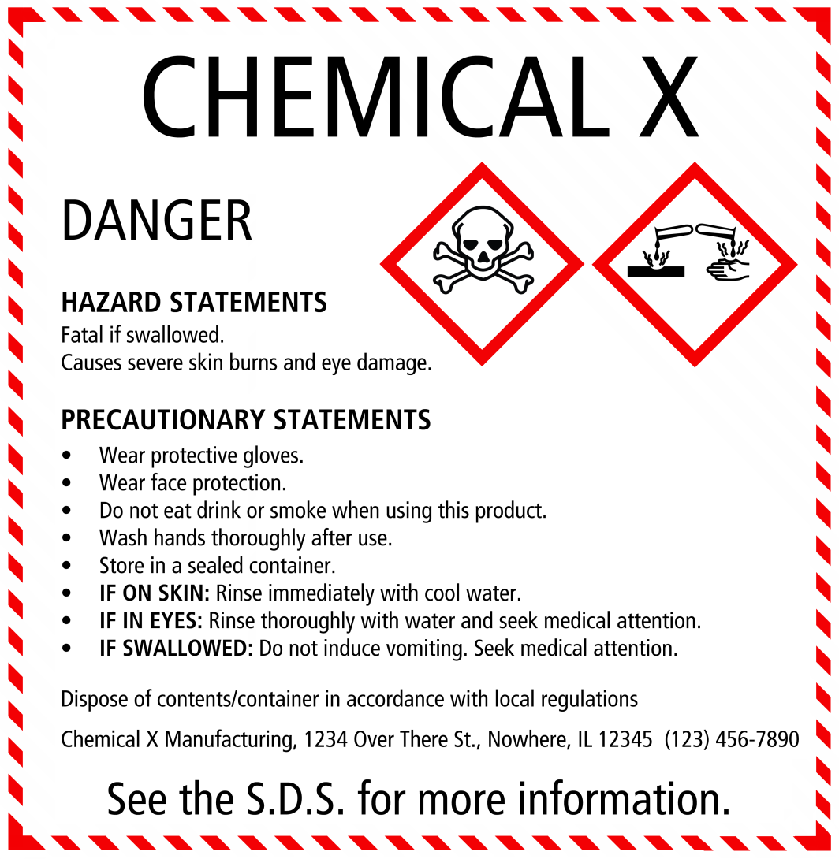
Multiple Symbols/Hazards
Notes:
It is important to remember that any chemical or product may have MORE THAN ONE SYMBOL or HAZARD associated with its use. Be sure you are familiar with their meanings since most foundries use chemicals or materials that require one or more of these pictograms to warn of potential dangers.

Slide 22

Signal Words
DANGER
Higher severity of hazards than WARNING!
WARNING
Lower severity of hazards than DANGER!
Notes:
You should also look for Signal Words on Labels and SDS as a quick alert to whether a hazard is present and how dangerous the hazard may be.
There are ONLY TWO Signal words that are used to emphasize hazards and indicate relative level of severity (danger) of the hazard
They are:
Danger
or
Warning
"Danger" is used for the more severe hazards, while "warning" is used for less severe hazards.

Slide 23
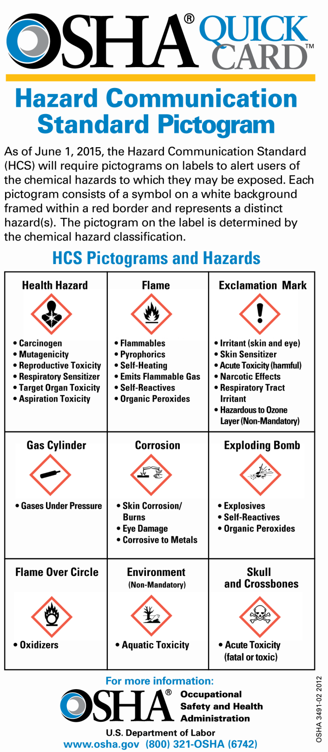

Slide 24
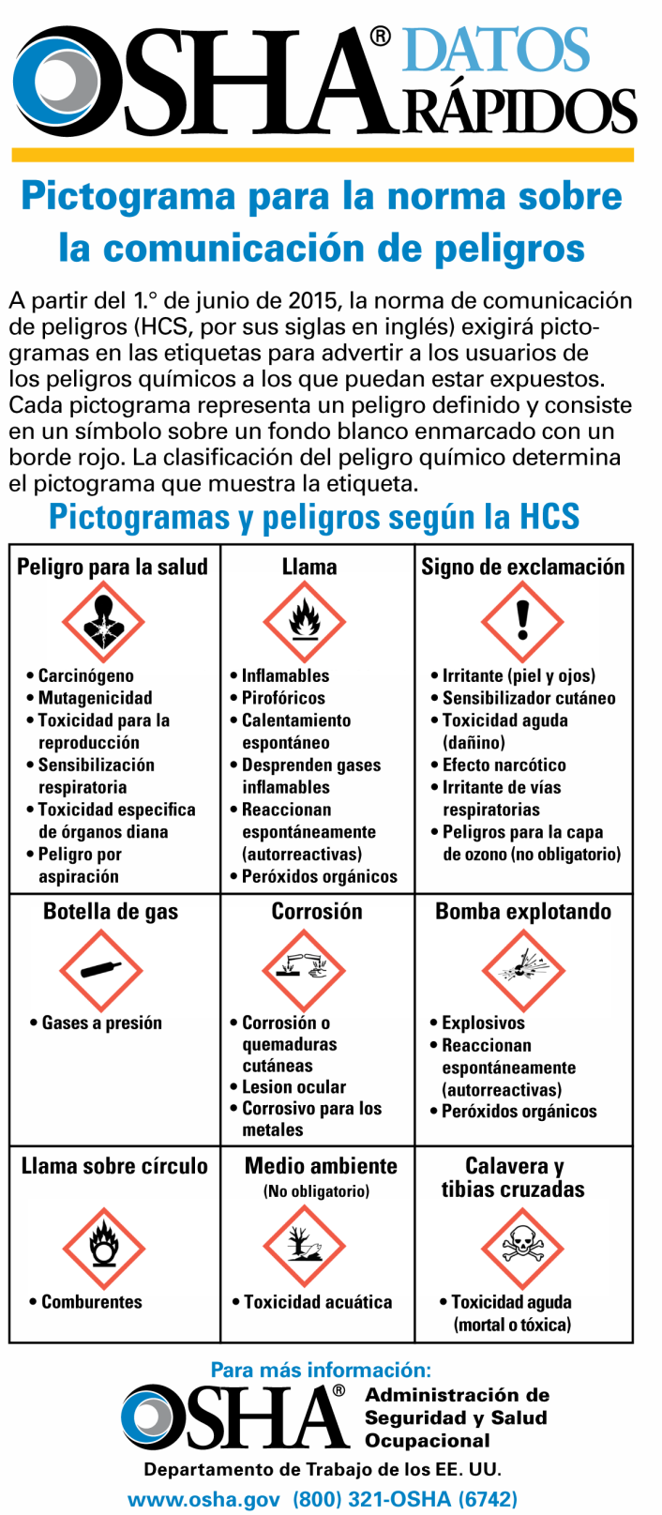

Slide 25

Acknowledgements
This material was produced under grant number SH-26318-SH4 from the Occupational Safety and Health Administration, U.S. Department of Labor. It does not necessarily reflect the views or policies of the U.S. Department of Labor, nor does mention of trade names, commercial products, or organizations imply endorsement by the U.S. Government

Slide 26

Non-Ferrous Founders’ Society Safety & Health Training Program
For further information about this or other training modules:
Non-Ferrous Founders’ Society
1480 Renaissance Drive, Suite 310
Park Ridge, IL 60068 847/299-0950 http://www.nffs.org

