Slide 1



Non-Ferrous Founders’ Society Safety & Health Training Program
Hazard Communication/GHS Training Program
Safety Data Sheets (SDS)
© 2015 All Rights Reserved

Slide 2
Safety Data Sheet Overview
What is a Safety Data Sheet?
What are the 16 sections of a SDS?
What information is on a SDS, and why is it important?
Notes:
In this section, we will learn:
What is a Safety Data Sheet (SDS)?
What are the 16 sections of a SDS?
What information is on a SDS, and why is it important?

Slide 3
Safety Data Sheet (SDS)
Hazard Communication Program helps employees handle chemicals safely
Helps identify what is in the materials and products you work with, and the hazards associated with them
OSHA requires:
Chemical manufacturers/importers must evaluate the hazards of the chemicals they produce or import, and provide safety data sheets (SDS) to inform their customers
All employers with hazardous chemicals in their workplaces must have labels and MSDS/SDS available for exposed workers, and train them to handle the chemicals.
Workers must receive this training upon initial assignment, before working with the chemicals, and whenever a new chemical hazard is introduced into their work area.
Notes:
The OSHA Hazard Communication Standard has requirement to help us handle chemicals safely in the workplace. The standard makes sure that we know what is in the materials and products we work with and the hazards that may be associated with them.
OSHA requires :
Chemical manufacturers/importers must evaluate the hazards of the chemicals they produce or import, and prepare labels and material safety data sheets or safety data sheets (SDS) to inform the hazard information to their customers; (MSDS- forms will be REPLACED by the newer Safety Data Sheets by June of 2015)
All employers with hazardous chemicals in their workplaces must have labels and MSDS/SDS available for exposed workers, and train them to handle the chemicals.
Workers must receive this training upon initial assignment, before working with the chemicals, and whenever a new chemical hazard is introduced into their work area.

Slide 4
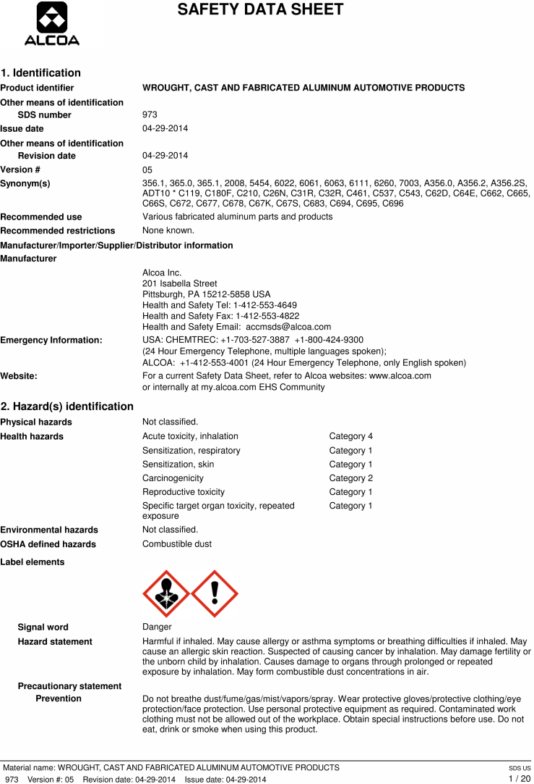
16 Sections of a SDS
The NEW Safety Data Sheet (SDS) has sixteen (16) sections- ALL Safety Data Sheets must have all these sections in this order.
1. Identification
2. Hazard(s) identification
3. Composition/information on ingredients
4. First-aid measures
5. Fire-fighting measures
6. Accidental release measures
7. Handling and storage
8. Exposure control/personal protection
9. Physical and chemical properties
10. Stability and reactivity
11. Toxicological information
12. Ecological information*
13. Disposal considerations*
14. Transport information*
15. Regulatory information
16. Other information
Notes:
The new SDS uses a uniform 16-section format for all Chemicals and Products, and the new Labels will also be more uniform in the words and symbols used to describe hazards.
The NEW Safety Data Sheet (SDS) has sixteen (16) sections- ALL Safety Data Sheets must have all these sections in this order..
1. Identification
2. Hazard(s) identification
3. Composition/information on ingredients
4. First-aid measures
5. Fire-fighting measures
6. Accidental release measures
7. Handling and storage
8. Exposure control/personal protection
9. Physical and chemical properties
10. Stability and reactivity
11. Toxicological information
12. Ecological information*
13. Disposal considerations*
14. Transport information*
15. Regulatory information
16. Other information
A standard or uniform SDS makes it easier to find and understand SDS!

Slide 5

Section 1: Identification
Section 1 includes:
Product identifier used on label
Other means of identification
Recommended use of chemical and restrictions on use
Name, address, telephone number of manufacturer, importer or other responsible party
Emergency phone number
Notes:
Section 1 of the SDS gives the necessary information on the NAME of the product or the chemical, the company who made or sold it and how to get more information on the product in case of an emergency.
This section will include:
Product identifier used on label
Other means of identification
Recommended use of chemical and restrictions on use
Name, address, telephone number of manufacturer, importer or other responsible party
Emergency phone number

Slide 6
Section 2: Hazards Identification
Section 2 includes:
Classification of hazardous chemical according to new categories
Signal words (Warning or Danger), hazard statements, symbols and precautionary statements
Notes:
Section 2 of the SDS will be Hazards Identification. This section must includes some new terms that may not have appeared on the older MSDS:
Classification of hazardous chemical according to new categories
Signal word (Warning or Danger) , hazard statement(s) (for example, Flammable Liquid), symbol(s) and precautionary statement(s)
Hazard symbols may be provided as graphical reproductions or it may give the name of the symbol, such as a flame, skull and crossbones- (pictographs)

Slide 7
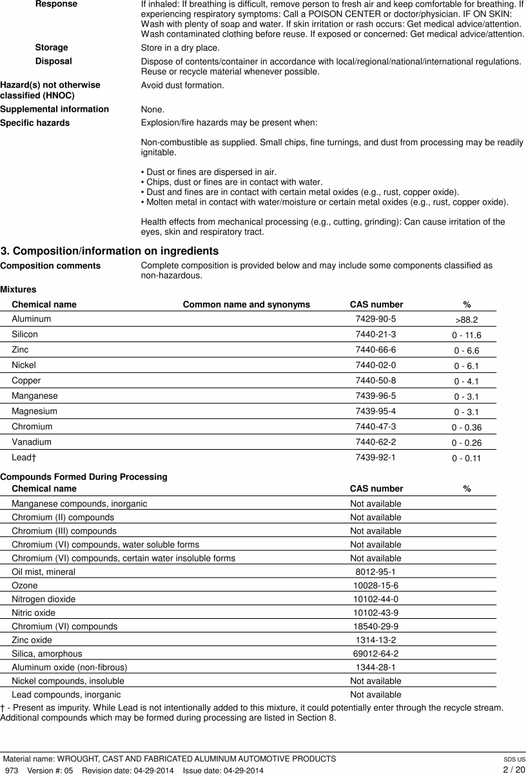
Section 2: Hazards Identification
Section 2 includes:
Unclassified hazards
Specific hazards
Notes:
Section 2 of the SDS will be Hazards Identification. This section must includes some new terms that may not have appeared on the older MSDS:
Unclassified hazards (such as combustible dust or dust explosion hazard)
If there is ingredient with unknown acute toxicity that is used in the product in a mixture and it is present in a concentration greater or equal to 1 percent, the SDS must state the percent of there is x (here they must give the percent) percent of product consists of ingredient(s) of unknown toxicity
Here is a sample of Section 2 for aluminum alloys- there is a lot of important information in this section on the possible hazards and how to properly handle this material and protect from these hazards. Many of the warnings or statements in this section will be more fully handled in other sections of the SDS.

Slide 8
Section 3: Composition
Section 3 includes:
Chemical name of ingredients and their common name
CAS number and other unique identifiers
Chemical name and concentration of ingredients
Notes:
Section 3 of the SDS will give the Composition of the product – WHAT is in it! This section includes the:
Chemical name of ingredients and their Common name and synonym
CAS number and other unique identifiers (the CAS is a number that is UNIQUE for each chemical so that no matter what name is given in any language, the number is the same!)
The chemical name and concentration or concentration ranges of all ingredients, which are classified as health hazards
If the Company claims that the ingredients are a TRADE SECRET, then there must be a statement that the specific chemical identity and/or percent of composition has been withheld as a trade secret
Here is a sample of Section 3 for an ALUMINUM ALLOY - a mixture of aluminum and other metals:

Slide 9
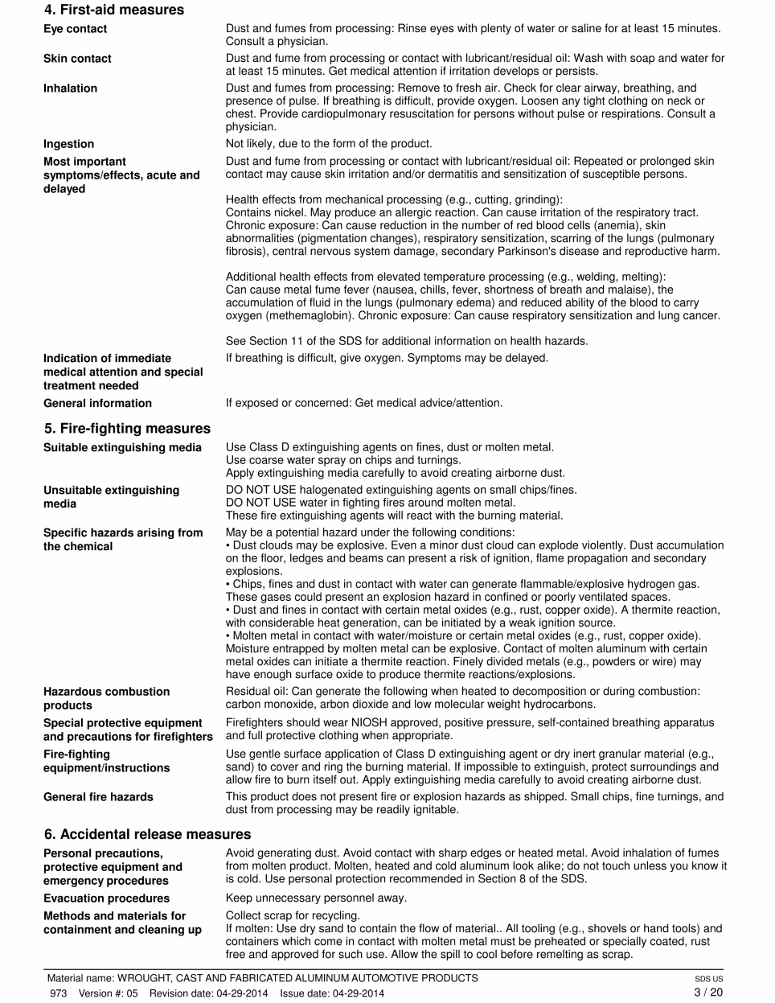
Section 4: First Aid Measures
Section 4 includes:
First Aid information, including an explanation on how the chemical can be dangerous, and the ‘route(s)’ of exposure
A description on the symptoms or effects of exposure
Notes:
Section 4 is another important source of information for workers since it gives information on First Aid- what to do if there is injury from touching, breathing or eating the chemical. It will explain how the chemical could be hazardous by the “route” of exposure, such as inhalation (breathing it), skin and eye contact (touching it or getting the material on your skin or in your eye), or ingestion (eating or swallowing the chemical). This section also describes the most important symptoms or effects if you are exposed to the chemical, both acute (immediate) and delayed (symptoms may appear hours or even years after exposure) If there is exposure, the SDS will give information on what immediate medical attention and special treatment may be needed.

Slide 10
Section 5: Fire-Fighting Measures
Section 5 includes:
Fire fighting methods and media
Specific hazards arising from the product combustion
Special protective equipment required and specific precautions
REMEMBER:
Only employees trained in the use of fire extinguishers may use this equipment to put out a fire!
Notes:
Section 5 is about Fire Fighting. This section is important to the local fire department since it will inform them of the proper (and unsuitable) extinguishing media. This section will also identify specific hazards that could be generated or result from the combustion or burning of the product. For example, will burning the material release hazardous gases? Could it cause and explosion? It will inform fire fighters of any special protective equipment and precautions that are needed. This can be most important in an Aluminum or Magnesium foundry, since under certain conditions these metals can present a fire hazard. In contrast, if the material is a Brass alloy or mixture, the firefighting measures will be different since the potential hazards will be different!
Remember: Most foundries do NOT have Fire Brigades, and employees are not expected to fight any fire that can not be put out with a fire extinguisher. ONLY EMPLOYEES TRAINED IN THE USE OF FIRE EXTINGUISHERS MAY USE THIS EQUIPMENT TO PUT OUT A FIRE.

Slide 11
Section 6: Accidental Release Measures
Section 6 includes:
Directions on what must be done in the event of a spill
Personal precautions, protective equipment and emergency procedures used in the clean up of a release
Environmental precautions and dangers to the environment
Notes:
Section 6 gives Accidental Release Measures. These are the directions on what must be done if there is a spill or release of the chemical what Personal Precautions, Protective Equipment and Emergency Procedures must be used in a clean up of a release. The SDS will also give Environmental Precautions on any dangers to the environment from a release.

Slide 12
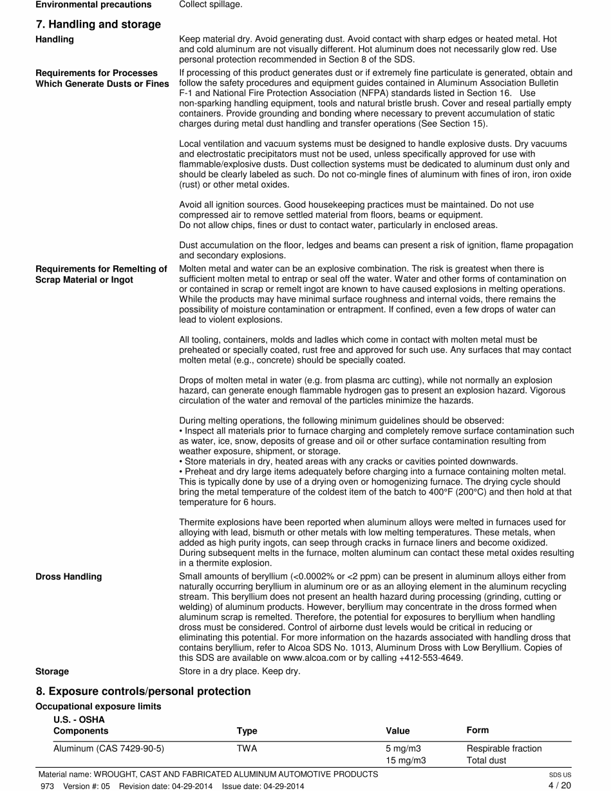
Section 7: Handling and Storage
Section 7 includes:
Directions on what must be done in the event of a spill
Personal precautions, protective equipment and emergency procedures used in the clean up of a release
Environmental precautions and dangers to the environment
Notes:
Section 7 gives instructions on Handling & Storage also advises on the Personal precautions, protective equipment, and emergency procedures for normal handling and storage at the facility. Methods and materials for containment and clean up for normal spills or every day and handling are covered in this section. Large spills or spills beyond the normal must be handled ONLY by specially trained workers.

Slide 13
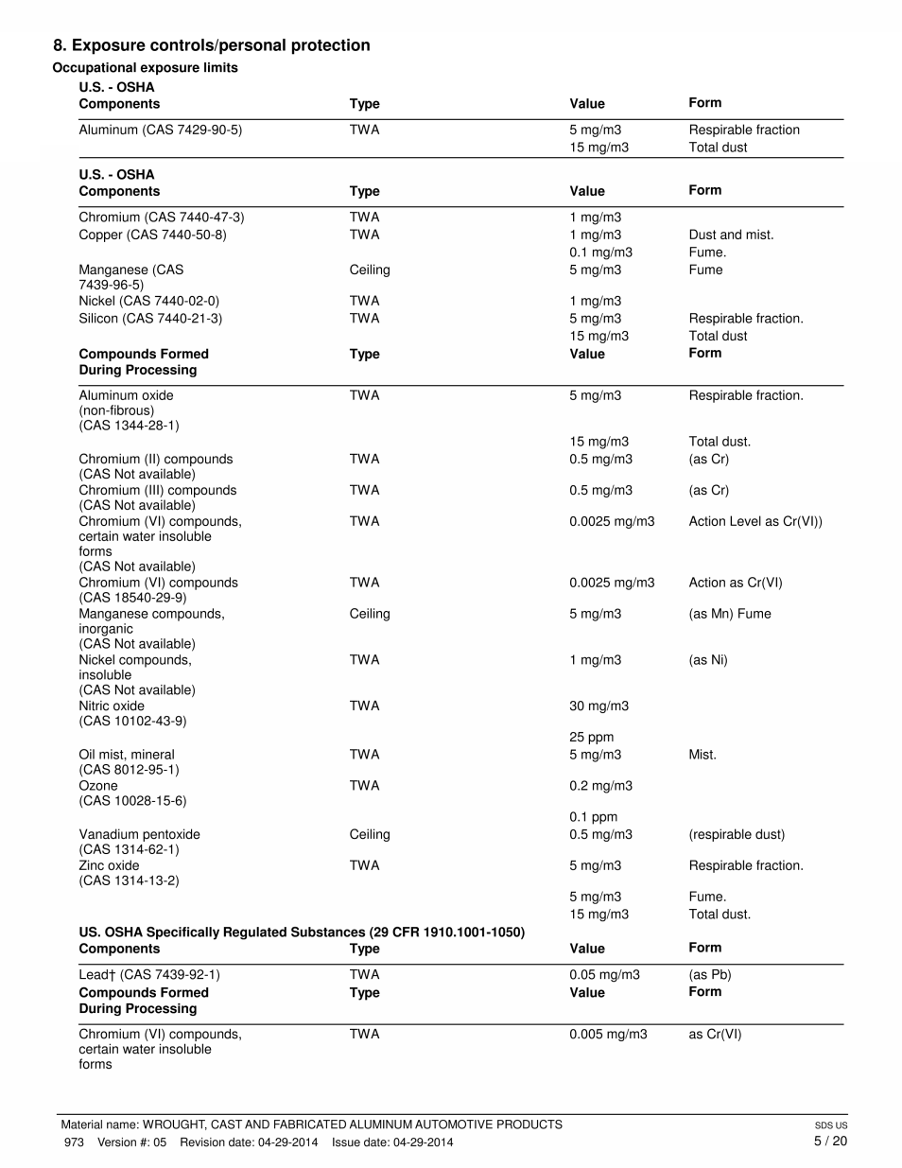
Section 8: Exposure Controls/Personal Protection
Section 8 includes:
OSHA Permissible Exposure Limits (PELs)
Personal protective equipment and engineering controls required
Notes:
Section 8 is a very important part of the SDS since it concerns Exposure Limits, Personal Protective Equipment and Engineering Controls. There will be a listing of the OSHA PEL (permissible exposure limits) and any other exposure limit used or recommended by the chemical manufacturer, importer or employer preparing the SDS. These are the limits that are considered to be safe for workers. Any exposures above these limits must be eliminated or controlled. If workers must be exposed to these chemicals for any reason, personal protective equipment MUST be used to protect against the hazard until the exposure is reduced to a safe level. Appropriate engineering controls and Individual protection measures, such as Personal Protective Equipment are included in this section.

Slide 14
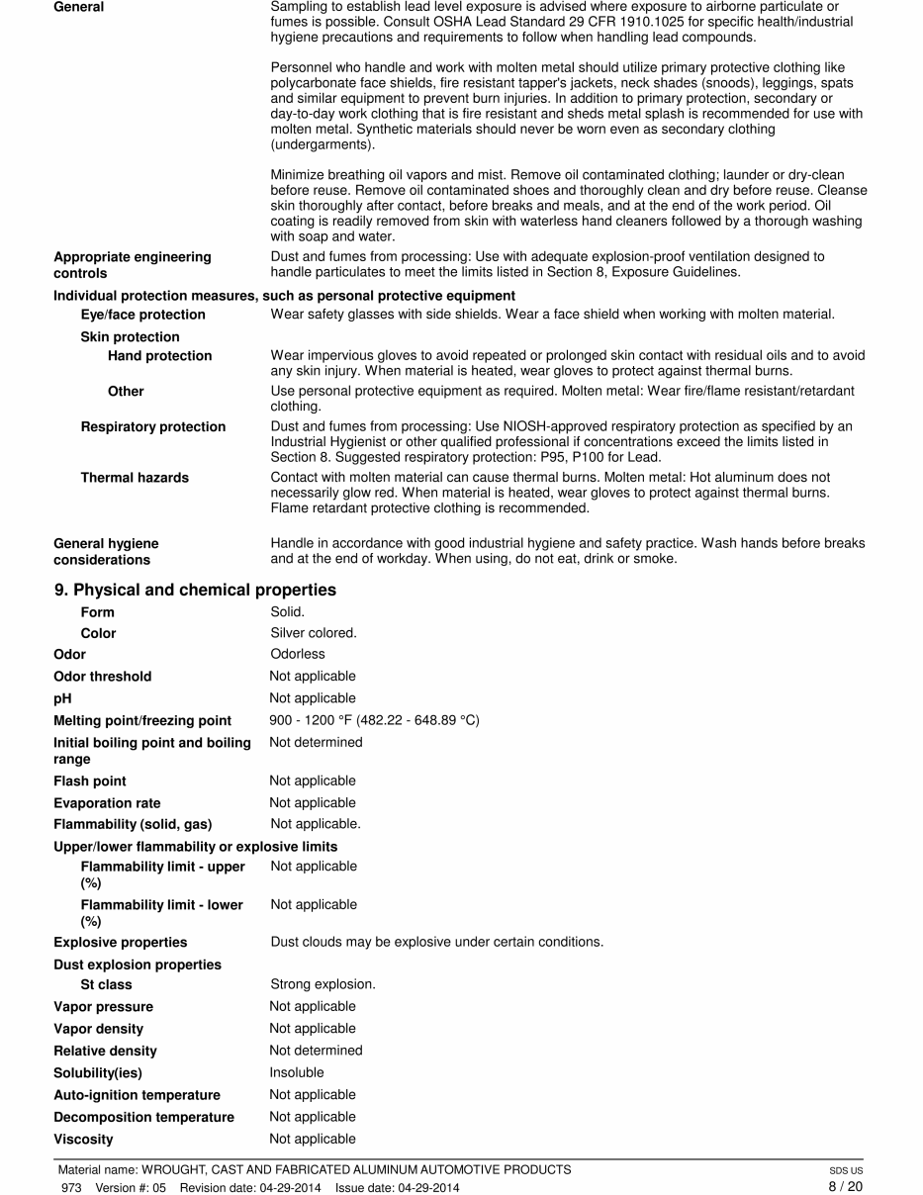
Section 9: Physical and Chemical Properties
Section 9 includes:
Physical and Chemical Properties of the product including:
Appearance
Odor
pH
Melting/Freezing Point
Boiling Point and Boiling Range
Flash Point
Evaporation Rate
Flammability
Notes:
Section 9 concerns the Physical and Chemical Properties of the product. This is important since it informs us if a product is a possible fire or explosion hazard, or could cause chemical burns. This section will include
Appearance (physical state – solid, liquid, gas -, color, etc)
Odor
pH
Melting point/freezing point
Initial boiling point and boiling range
Flash point
Evaporation rate
Flammability (solid, liquid, gas)
Odor and Flash Point may not be important for a metal such as an aluminum alloy. However, Odor and Flash Point will be very important for common materials such as Gasoline and some of the Core Room chemicals that may be used at your foundry.

Slide 15
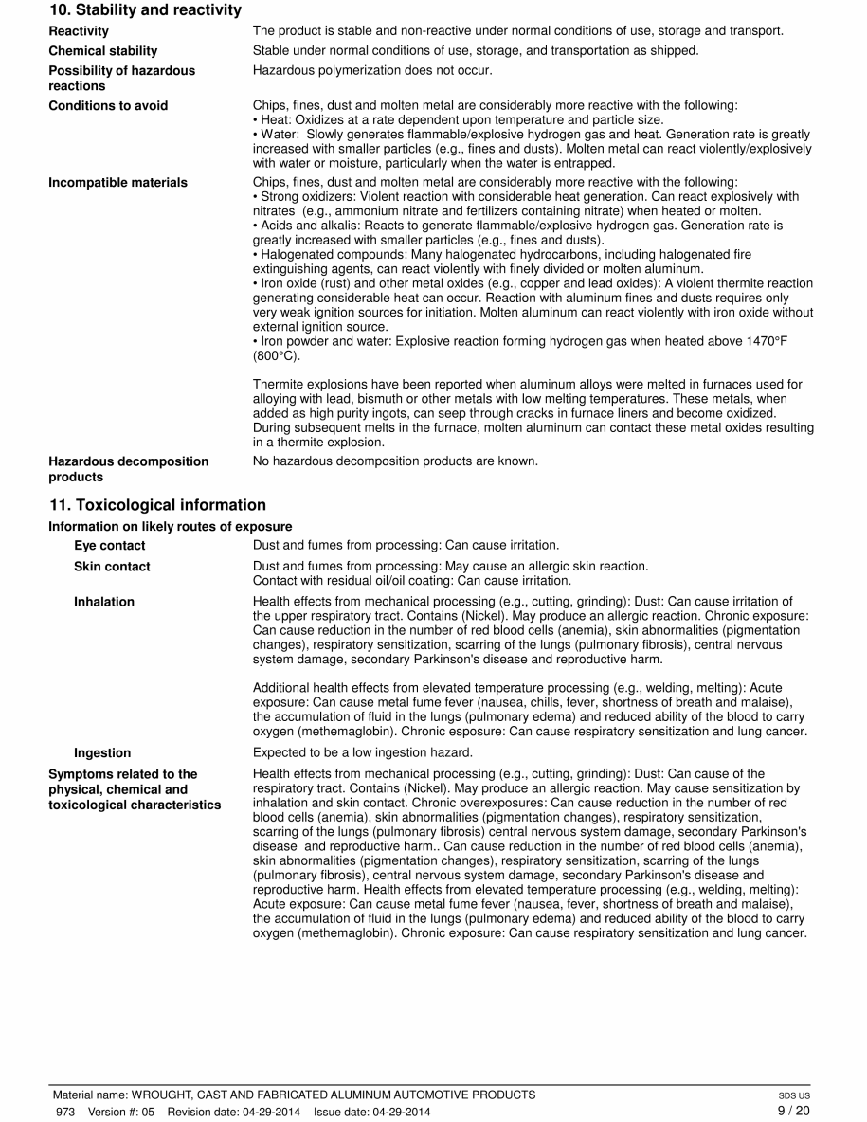
Section 10: Stability and Reactivity
Section 10 includes:
Reactivity of the product
Stability of the product
Incompatible materials
Conditions to avoid (such as heat)
Hazardous decomposition products
Notes:
Section 10 also concerns the physical properties of the product – its Stability and Reactivity. Chemicals that are not stable or are reactive MUST be handled and stored with great care and only by persons who have been properly trained in how to safely work with them.
Materials that are not stable can sometimes be hazardous is dropped or handles improperly. Reactive materials change when mixed with another chemical. Sometimes this change results in heat or the release of a new hazardous chemical (two very common products in the household are REACTIVE – items that contain Chorine such as bleach and Ammonia - mixing the two together can create new chemicals- hydrochloric acid and chloramines – and they are VERY toxic)
If the chemical or product is not stable or if it is reactive, there will be information on incompatible materials (what other products, chemicals or condition such as heat should not be stored near this product or come into contact with it) and what Hazardous decomposition products could be produced if the product is not properly stored or handled.
The proper handling and storage of chemicals and products in the foundry is VERY important -especially where HOT metals and sources of ignition are present. Most metals, such as this Aluminum Alloy are not reactive or unstable as a SOLID ingot

Slide 16
Section 11: Toxicological Information
Section 11 includes:
Health (toxicological) information and data, including:
Likely exposure routes
Symptoms related to the physical, chemical and toxicological characteristics
Delayed and immediate effects
Chronic effects from short and long term exposure
Numerical measures of toxicity
Notes:
Section 11 concerns the HEALTH effects, or Toxicological Information. The information here may be detailed and lengthy, but it includes data that is vital to protecting the health of those who work with the product. This section will include a description of various toxicological effects and the data used to identify those effects, including:
Likely exposure routes (inhalation, ingestion, skin and eye contact)
Symptoms related to the physical, chemical and toxicological characteristics
Delayed and immediate effects and chronic effects from short and long term exposure
Numerical measures of toxicity (such as acute toxicity estimates)
Most aluminum alloys do not contain lead, but if they do even in small amounts, this section may contain a warning! There are also warnings on how the metal may have different effects depending on how it is used. For example, it may be hazardous if turned into a metal fume, but not if in its solid form and used as a cooking pot or soda can.

Slide 17
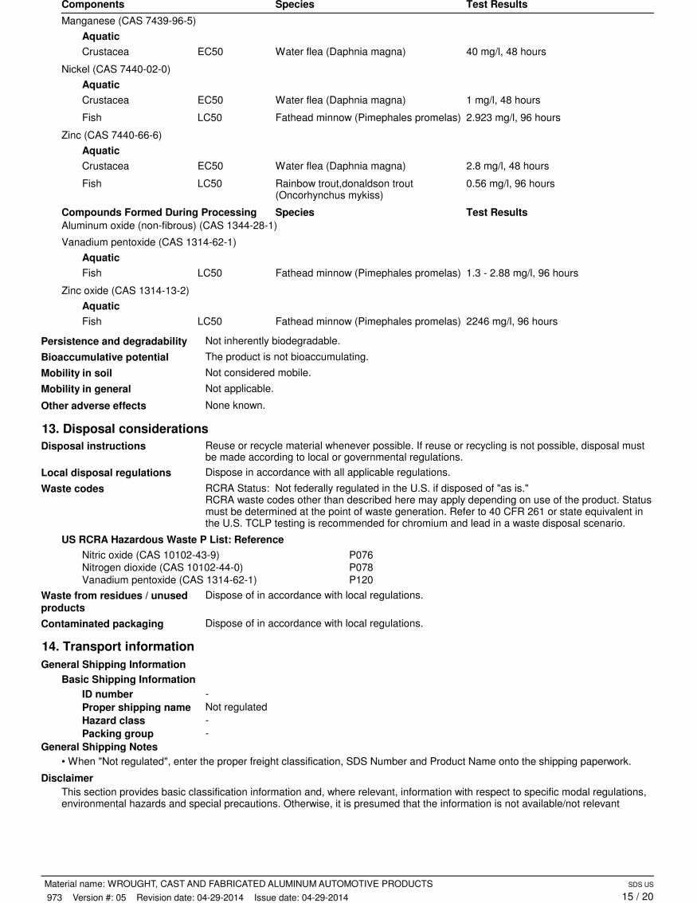
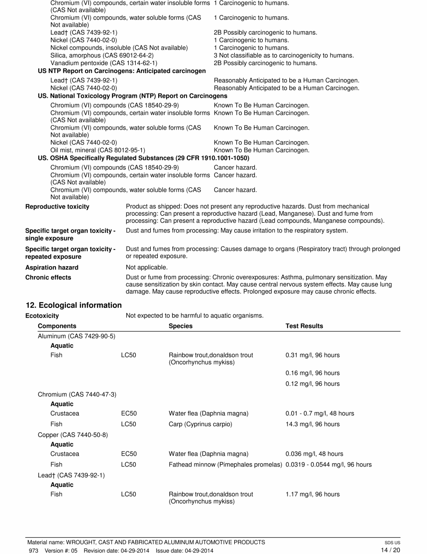
Section 12: Ecological Information
Section 12 includes:
Ecotoxicity
Persistence and degradability
Bioaccumulative Potential
Mobility in soil
Other adverse effects
Notes:
Section 12 includes Ecological Information – how the product could affect our environment. It is non-mandatory – that means it is not required, but is voluntary.Many companies use this section to provide needed information on how to meet the environmental and transportation regulations of the United States of America and any other foreign country that might purchase the product.
The information here would include;
Ecotoxicity (aquatic and terrestrial, - how it could be toxic to the land or waters)
Persistence and degradability – does it break down in the environment or not
Bioaccumulative potential – does it build up in the tissues of plants or animals
Mobility in soil- does is move in the soil with rain water or ground water
Other adverse effects

Slide 18
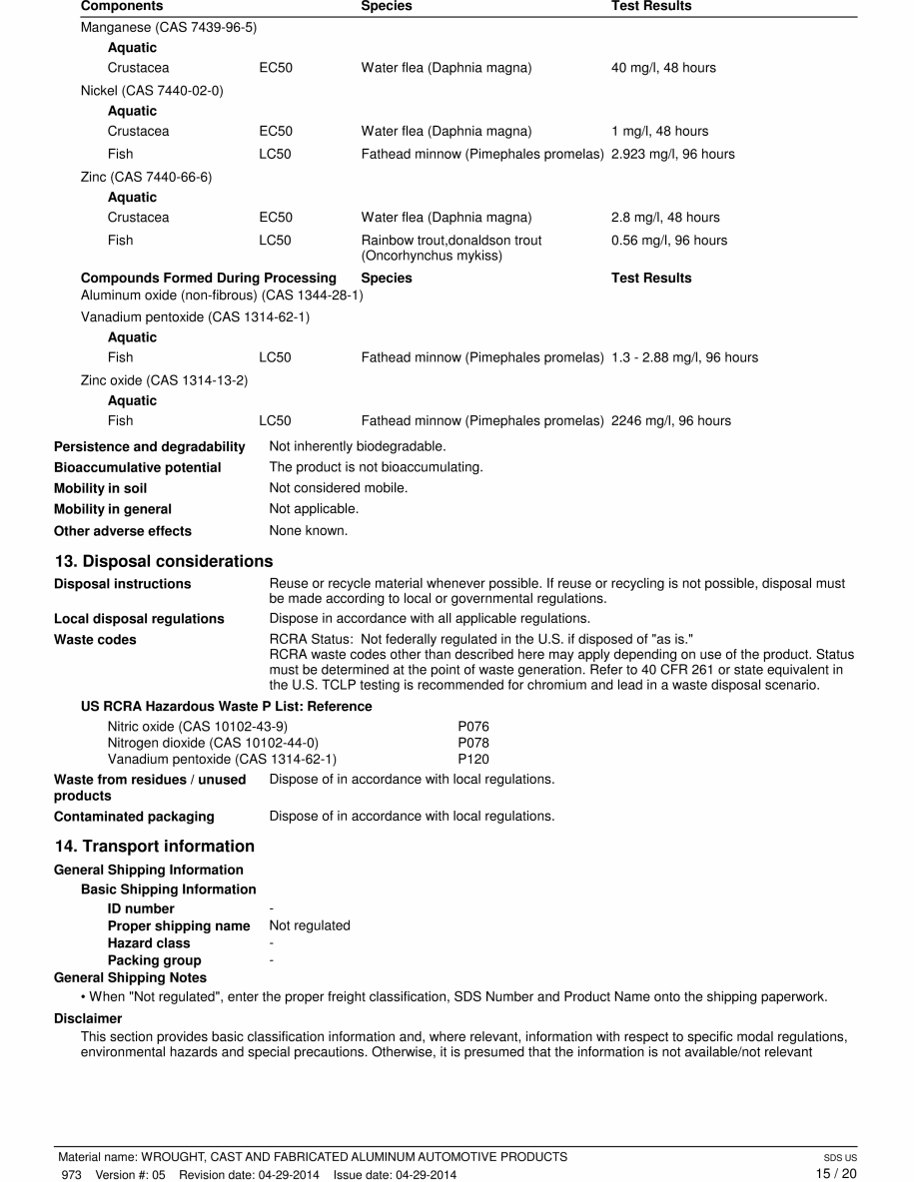
Section 13: Disposal Considerations
Section 13 includes:
Concerns about the environment and the safe handling of the chemical
A description of the waste residues
Information on safe handling along with proper methods of disposal
Information dependent on state rules for disposal
Notes:
Concerns about the environment and safe handling of the chemical are the topic of Section 13: Disposal Considerations. Many of these rules are not OSHA regulations, but safe handling of the material is important to workers and to the environment for everyone. To be sure we dispose of the material safely when it is no longer useful or needed, this section will include a description of waste residues and information on safe handling along with proper methods of disposal of waste material or contaminated packaging (if required). Since most states will have their own rules on disposal of waste, most SDS will refer the user to the rules that apply to state where the company that is disposing of the material is located.

Slide 19

Section 14: Transport Information
Section 14 includes:
Special labels are required for certain hazardous materials
Department of Transportation (DOT) hazard class or packing group
Special requirements for transporting and moving the chemical
Notes:
Section 14 also concerns issues that may apply to outside workers or the general public: Transportation Information There are special labels and handling required for certain hazardous materials that are shipped by land, water or air in this country. These hazardous materials are required to have a “UN” number and the proper shipping name displayed so that the hazard is known in case of an emergency. If there is a Department of Transportation (DOT) Transport hazard class or Packing group assigned to the material, it will be given in this section. If the material is an environmental hazard such as a marine pollutant it will be shown here along with any special requirement when transporting or moving the chemical either within or outside the foundry. See this example for Aluminum in a SOLID form. If a company ships its product outside of the United States, it may also list the Shipping Numbers or label information needed by the country that will receive the product.

Slide 20
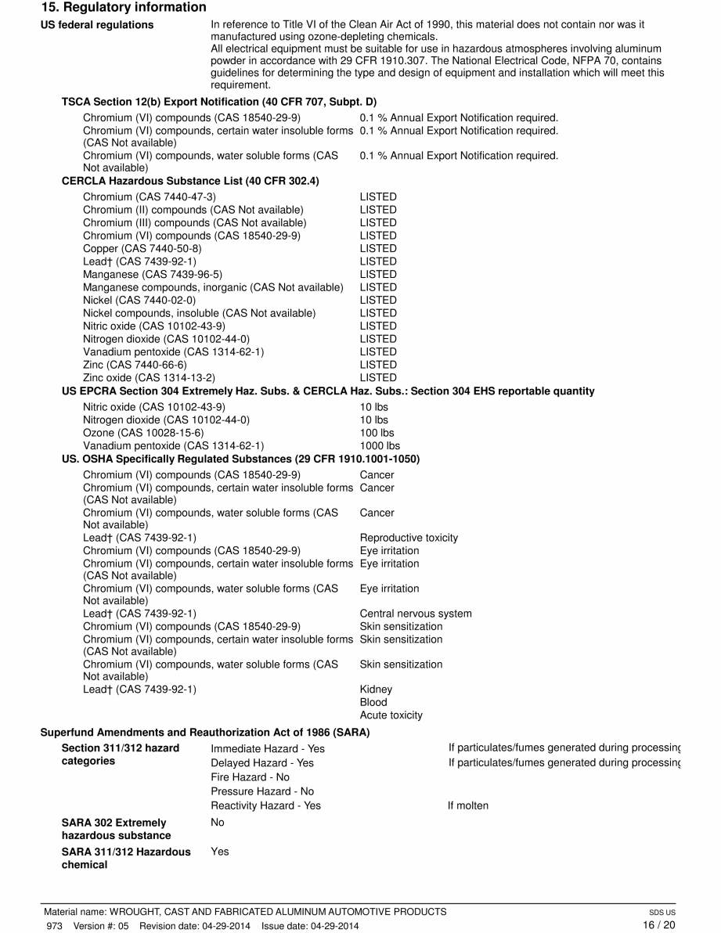
Section 15: Regulatory Information
Section 15 includes:
More regulatory information that is NOT required by OSHA (e.g. EPA requirements related to the product)
Notes:
Section 15 contains more Regulatory Information that is not OSHA required. Here other (not OSHA) government agencies or foreign country regulations that apply to Safety, Health and the Environment may be listed. This SDS for Aluminum Alloy – a mixture of Aluminum and other metals, lists what chemicals are also regulated by the Environmental Protection Agency under their “Right to Know” rules. For example, this section shows if the product could cause damage to the oceans or seas. It may also show the regulations for other countries, such as Canada.

Slide 21
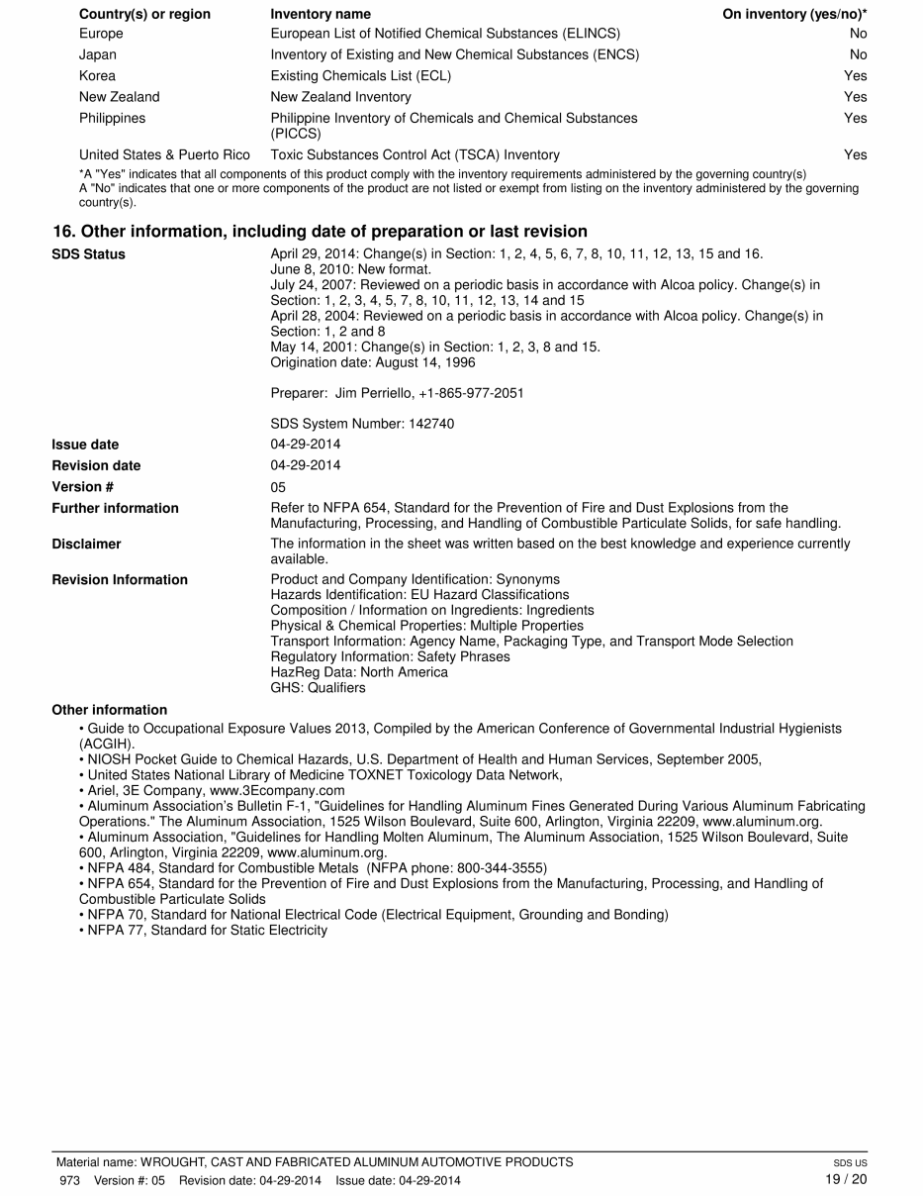
Section 16: Other Information
Section 16 includes:
Other information that might be important but not contained in an earlier section
SDS preparation date or date of last revision should also be listed here
Notes:
The last section, Section 16 is for any Other Information that might be important, but may not fit into one of the earlier sections. For example, it might show the rating(s) for the product under one of the systems commonly used in industry. This example shows the National Fire Protection Association (NFPA) standards that may also apply to this aluminum alloy.

Slide 22

Acknowledgements
This material was produced under grant number SH-26318-SH4 from the Occupational Safety and Health Administration, U.S. Department of Labor. It does not necessarily reflect the views or policies of the U.S. Department of Labor, nor does mention of trade names, commercial products, or organizations imply endorsement by the U.S. Government

Slide 23
Non-Ferrous Founders’ Society Safety & Health Training Program
For further information about this or other training modules:
Non-Ferrous Founders’ Society
1480 Renaissance Drive, Suite 310
Park Ridge, IL 60068 847/299-0950 http://www.nffs.org

