Slide 1



Non-Ferrous Founders’ Society
Safety & Health Training Program
Hazard Communication/GHS Training Program
Labels
© 2015 All Rights Reserved

Slide 2
Labels Overview
What information is required to be on product labels?
What do the GHS labels look like?
How can you identify the types and severity of hazards related to a product from its label?
Notes:
In this section, we will learn:
What information is required on product labels;
What do GHS labels look like; and
How can you identify the types and severity of hazards related to a product from its label.

Slide 3
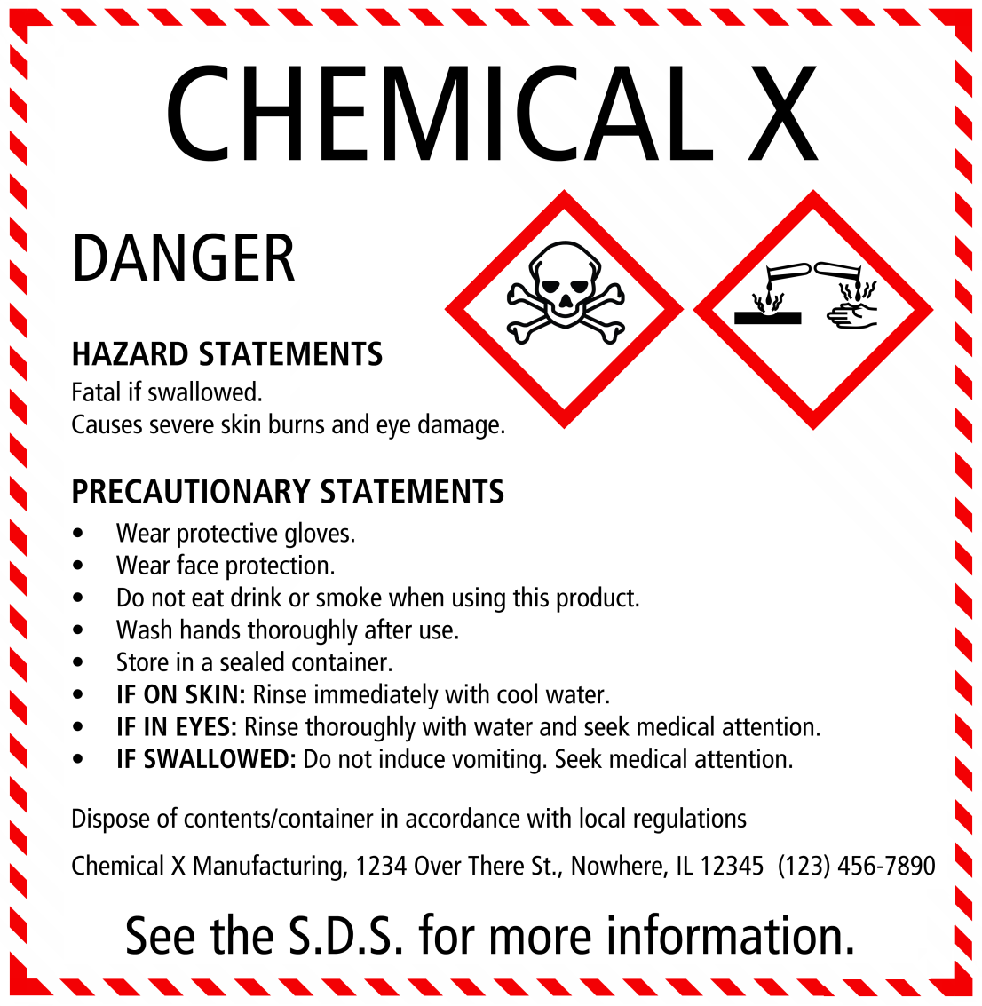
Labels are Important!
Labels tell us what we need to know to safely handle, store and work with a product
Notes:
Labels are important. They tell us what we are working with, who made it, what chemicals are in it, what dangers or hazards it may present to workers, how to store and handle it safely, what protective equipment to use, and how to dispose of it when we no longer need it.

Slide 4
GHS HazCom requires LABELS
The GHS Hazard Communication standard requires LABELS that carry necessary information, including:
  Who made/distributed the product
  What chemicals are in the product
  Hazards/Warnings on the dangers associated with the product
  Precautions that must be taken when handling the product
Notes:
The Hazard Communication Standard requires that containers of chemicals have LABELS that carry necessary information on WHO made or distributed the product, what CHEMICALS are in the product, HAZARDS and WARNINGS on the dangers associated with the chemical, and what PRECAUTIONS – such as protective equipment like gloves or glasses that might be needed when handling the chemicals.

Slide 5
Required Labels Elements
Information should be in the same order for all labels
Labels MUST include:
Product Identifier
Supplier Identifier
Chemical Identity
Hazard Pictograms *
Signal Words *
Hazard Statements *
Precautionary Information
The items with * are hazard warning and MUST be located together on the label!
Notes:
The information should be in the same order for all labels . Terms used to describe hazards and warning symbols should all also be uniform to keep the message clear as possible.
The Label MUST have the following Elements
Product identifier
Supplier identifier
Chemical identity
Hazard pictograms*
Signal words*
Hazard statements*
Precautionary information
All of these elements are very important in understanding the product and how to safely use it. Please notice that the items marked with an * are all hazard warnings. These three elements MUST be located together on the label.

Slide 6
Signal Words
DANGER
  Higher severity of hazards than WARNING!
WARNING
  Lower severity of hazards than DANGER!
Notes:
There are ONLY TWO Signal words that are used to emphasize hazards on the label. They indicate the relative level of severity of the hazard They are:
“Danger” or “Warning”
The signal word “Warning” means that the severity of hazards of the chemicals are less than those chemicals classified with the signal word “Danger”
Both of these signal words are important - but it is important to remember that DANGER is a sign that this product or chemical must be handled carefully with all the necessary equipment and protection.

Slide 7
Hazard Statements
Examples of hazard statements:
  “Keep away from fire, sparks and heated surfaces” This may be a chemical that is flammable.
  “Do not use in areas without adequate ventilation” This product may give off vapors or gasses that could build up and cause a hazard to workers in the area.
  “Use CO2, dry chemical, or foam”
  Indicates the equipment necessary to extinguish the product if it is on fire.
  “Wear safety goggles and gloves”
  Directions on what types of protective equipment should be used when using the product or chemical.
Notes:
The label will also have one or more Hazard Statements to alert workers of potential dangers. Here are some examples of required hazard statements:
“Keep away from fire, sparks and heated surfaces” – this may be a chemical that is a flammable. These chemicals must be protected from contact with molten metal, electric sparks, or other possible sources of ignition.
“Do not use in areas without adequate ventilation” – this product may give off vapors or gases that could build up and cause a hazard to the workers in the area. For example, we know that it is dangerous to run a gas or fuel fired engine in a confined space like a garage. Dangerous levels of carbon monoxide can build up and become a serious hazard.
“Use CO2, dry chemical, or foam” (for fighting fires) The type of fire fighting equipment is very important in a foundry. The same material used to put out a wood fire may NOT be suitable for a Hot metal fire or electrical fire. Remember, ONLY workers trained to properly select and use a fire extinguisher are permitted to use them – and then only to put out a minor fire. All other fires will be fought by the local fire department.
“Wear safety goggles and gloves” There may be directions on what types of Personal Protective Equipment should be used when using the product or chemical. Be sure you are TRAINED in the use of this equipment and always use the PROPER equipment.

Slide 8
Signal Words/
Hazard Statements
Signal Word: WARNING
  Hazard Statement: “May displace oxygen and cause rapid suffocation”
Signal Word: WARNING
  Hazard Statement: “May form combustible dust concentrations in the air”
Notes:
If a chemical is a Simple Asphyxiant (the chemical takes the place of oxygen and can cause suffocation= Carbon Monoxide is an example) the label might have the following:
Signal Word: Warning
Hazard Statement: “May displace oxygen and cause rapid suffocation”
If the chemical is a Combustible Dusts (aluminum dust can be combustible from some operations in the foundry)
Signal Word: Warning
Hazard Statement: “May form combustible dust concentrations in the air”

Slide 9
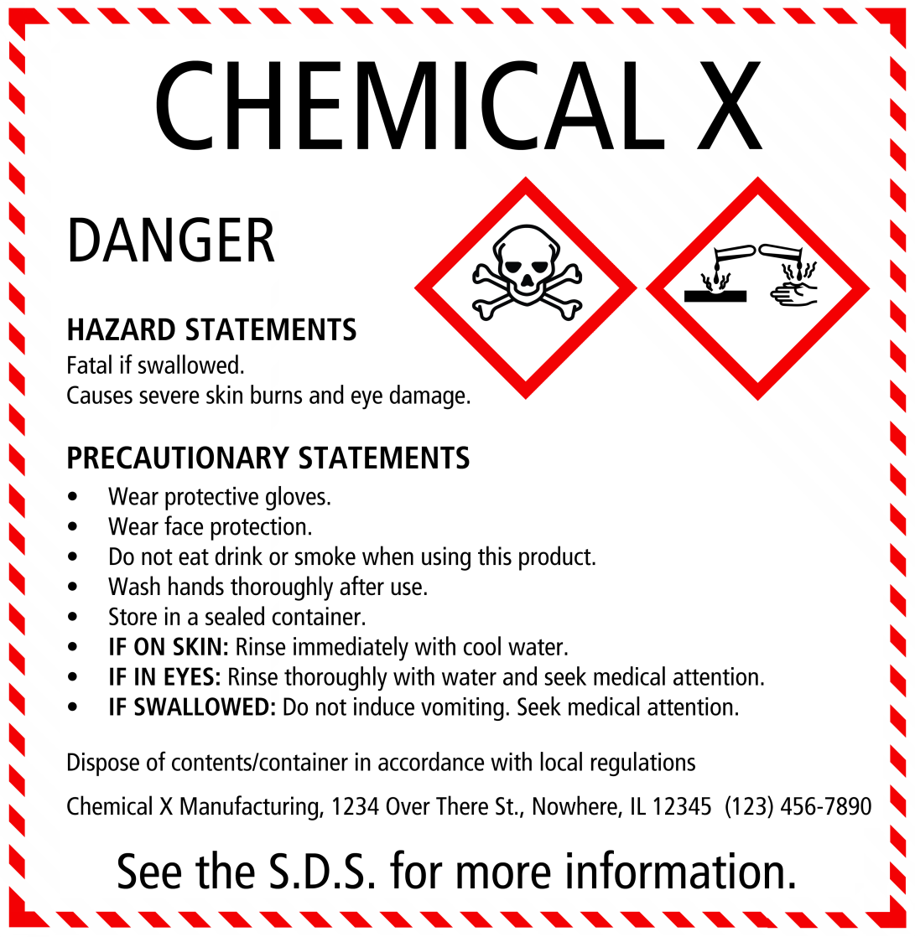
PICTOGRAMS
Standardized
Only ‘official’ pictograms may be used
Must be in official shape and colors
Labels must contain one or more of these pictograms
Notes:
There will be graphics or pictograms on the label. These will be standardized -- only the “official” pictograms may be used and they MUST be in the official shape and colors so that they can be easily recognized. These pictograms are used to convey health, physical and environmental hazard information. Labels for hazardous chemicals must contain one or more of these pictograms that are associated with the hazards of the chemical.

Slide 10








PICTOGRAMS
Flame Over Circle
Flame
Exploding Bomb
Skull and Crossbones
Corrosion
Gas Cylinder
Health Hazard
Exclamation Mark
Notes:
These eight pictograms above will be used where appropriate for all labels. Be sure you know WHAT they mean.

Slide 11

PICTOGRAMS
Environment
(Non-Mandatory)
Notes:
This 9th pictogram is not mandatory -- but can be used to indicate a warning that the material can be a hazard to water life

Slide 12
Product Identification
Have to identify the product by name/number
Allow workers to find the Safety Data Sheet (SDS) for the product
Notes:
To know WHAT the product or chemical is – and so we can match it with a Safety Data Sheet, we have to have some way to IDENTIFY the product or material. This may include the company’s name for the product (for example, Speedy Bright Metal Cleaner) and number (such as a metal alloy number) and the name of the chemical or chemicals in the product.

Slide 13
Hazard Grouping
3 elements will be grouped together to show type of hazard and level of danger associated with the product
  Signal Word
  Hazard Statement
  Pictogram
Notes:
Remember there will be three elements grouped together that will alert workers to the type of hazard and the level of danger that is associated with the product.
Here are examples showing the use of a
SIGNAL WORD
HAZARD STATEMENT
PICTOGRAM

Slide 14
Precautionary Measures
Precautions to take when storing, handling or using product
Notes:
The label will also list necessary Precautionary Measures – what precautions we must take whenever storing, handling or using the product or material in order to minimize or prevent adverse effects from exposure.
There may be general precautionary statements such as:
If medical advice is needed, have product container or label at hand.
Keep out of reach of children.
Read label before use.

Slide 15
Precautionary Measures
Some products will have more specific warnings on how to use or handle material such as:
  Keep away from heat and flames
  Do not allow contact with air
  Use only non-sparking tools
Notes:
Some products will have more specific warnings on how to use or handle the material such as:
Keep away from heat, hot surfaces, sparks, open flames and other ignition sources. No smoking
Do not spray on an open flame or other ignition source.
Do not allow contact with air.
Do not allow contact with water
Protect from moisture.
Keep container tightly closed.
Use only non-sparking tools.

Slide 16
Precautionary Measures
Storage instructions may be on the label as well!
Notes:
There may also be instructions on how to safely store the chemical or product such as:
Store in a dry place.
Store in a well ventilated place.
Store in a closed container.
Protect from sunlight.
Store in a well ventilated place. Keep container tightly closed.
Reading and understanding these Precautionary Statements is essential if we are going to be able to safely handle the chemicals in the foundry!

Slide 17
Precautionary Measures
There may be guidance on how to handle exposure to the product on the label
Notes:
If there is exposure to the chemical, there may be precautionary statements to give guidance on how to handle the exposure:
Do NOT induce vomiting.
Brush off loose particles from skin.
Remove person to fresh air and keep comfortable for breathing.
Take off immediately all contaminated clothing.
If eye irritation persists get medical advice/attention.
In case of fire: Use … to extinguish.

Slide 18
Product Disposal
It may be important to know how to dispose of waste or unwanted materials
Notes:
It may also be important to know how to dispose of waste or unwanted material:
Dispose of contents/container to … [… in accordance with local/regional/national/international regulations

Slide 19
Manufacturer/Distributor Contact Information
Label will show the company that made or distributes the product
Notes:
The label will also show the company that made or distributes the product. We may need to know this if more detailed information is needed to respond to a spill or if someone is exposed to the chemical in a way that causes physical harm.

Slide 20
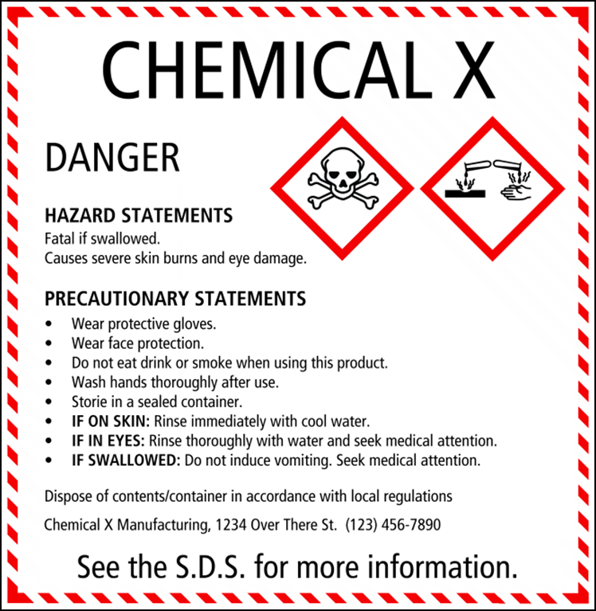
Other Label Information
Labels must remain with the product
Must label new containers whenever product is removed from shipping container
Do not have to label containers that will be used up within 1 shift and under control of employee for entire shift
May label storage areas or pallets of materials instead
Notes:
We can see that labels are important sources of information on the products and materials we use in the foundry. Therefore they must remain with the product. If the material stays in the container it was shipped to the foundry, we must make sure the label remains on the container and is not covered or damaged so that it can be seen and read.
If we take the material out of the container and put it into another container, the new container must also be labeled. We need to make sure that anyone who handles or comes into contact with the chemical is able to see or read the label. One type of containers that does not have to be labeled is when a worker takes some of the product and puts it into a container that he or she will use up in one shift and will keep control of the product and not allow another worker to be exposed to the unlabeled material. In the foundry there are also some types of materials that are not in containers and may not be able to have labels on the product itself. For example, large scrap piles may have a label on the wall in the area. Pallets of ingots will also not have labels on each ingot. Instead, there will be one label on the pallet. This label will stay with the pallet until all of the ingots are gone.

Slide 21

Acknowledgements
This material was produced under grant number
SH-26318-SH4 from the Occupational Safety and Health Administration, U.S. Department of Labor. It does not necessarily reflect the views or policies of the U.S. Department of Labor, nor does mention of trade names, commercial products, or organizations imply endorsement by the U.S. Government

Slide 22

Non-Ferrous Founders’ Society
Safety & Health Training Program
For further information about this or other training modules:
Non-Ferrous Founders’ Society
1480 Renaissance Drive, Suite 310
Park Ridge, IL 60068
847/299-0950
http://www.nffs.org

