Slide 1



Non-Ferrous Founders’ Society
Safety & Health Training Program
Hazard Communication/GHS Training Program
Air Contaminants in the Non-Ferrous Foundry
© 2015 All Rights Reserved

Slide 2
Air Contaminants in the
Non-Ferrous Foundry
What airborne hazards are present in the foundry?
What are fumes, dusts, gases and vapors, and how are they different?
What types of air contaminants might you be exposed to while working in a nonferrous foundry?
How can you work safely when exposed to air contaminants in the foundry?
Notes:
In this section, we will learn:
What airborne hazards are present in the foundry;
What are fumes, dusts, gases and vapors, and how are they different;
What types of air contaminants you might be exposed to while working in a nonferrous foundry;
How you can work safely when exposed to air contaminants in the foundry.

Slide 3
Non-Ferrous Foundry Hazards
Burns from molten metal and hot surfaces
Explosions from compressed gases or combustible dusts
Burns from acids or caustic chemicals
Some hazards are more difficult to see, such as dust, fumes and gases in the air
The kinds and degrees of danger encountered will depend on the chemicals and metals used, and the foundry process
Notes:
Nonferrous foundries make castings that are safely used to carry our water and cook our food. Power our cars and airplanes. But making these castings requires the use of materials and processes that can be a hazard to foundry workers. These hazards can be burns from molten metal and hot surfaces, explosions from compressed gases or combustible dusts that are not properly handled or stored, or burns from acids or caustic chemicals that can get on the skin or in the eyes.
Some hazards are more difficult to see or detect. Dusts, fumes and gases may be in the air and can cause harm to workers when they are present in the work place over time.
The kinds of dangers and form and degree of the danger will depend upon the chemicals and metals we use and the foundry process or operation that is used.

Slide 4
Types of Non-Ferrous Foundries
Non-Ferrous foundries melt and cast metals that do not contain significant amounts of iron
Two major types of non-ferrous foundries:
  Brass and Bronze foundries – these foundries melt alloys of metal that have COPPER as a main ingredient
  Aluminum foundries – these foundries melt alloys of metal that have ALUMINUM as the only or main ingredient
Other types of more specialized non-ferrous foundry exist, such as Magnesium, Tin, Gold and Silver
Notes:
We can begin to learn about these potential hazards by reviewing the metals and materials that are commonly used in the foundry. Nonferrous foundries melt and cast metals that do not contain significant amounts of iron. The two major types of nonferrous foundries are:
Brass and Bronze foundries- these foundries melt alloys of metal that have COPPER as a main ingredient
Aluminum foundries- these foundries melt alloys of metal that have ALUMINUM as the only or main ingredient
There are other nonferrous foundries that are more specialized. They may have MAGNESIUM or TIN as their main ingredient. Gold and Silver may also be cast, but usually in more specialized ways that are suitable to the high value of the metal.

Slide 5
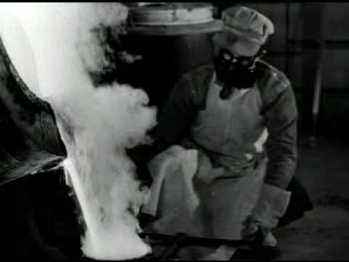
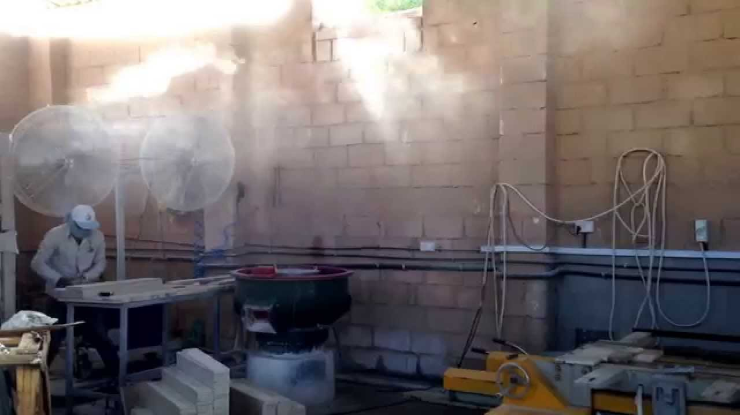
Non-Ferrous Foundry Hazards
When we melt metals, we create METAL FUMES
When metal is cut, ground or cleaned, it can create METAL DUSTS
Metal fumes and dusts can be hazardous to workers if inhaled or ingested
The types of hazards from FUMES and DUSTS will depend on what is in them
Dusts and Fumes from the same metal can be very different, especially in Brass and Bronze foundries
Notes:
The metals in the foundry are not normally hazardous in their solid form. However when we MELT the metals or alloys, we create METAL FUMES that are released into the air. These fumes can be hazardous if workers breathe them into their lungs or ingest them accidentally.
When the metal casting is cut or ground or cleaned, it can release into the air small pieces or particles called DUSTS. These small particles may also be breathed in or eaten accidentally.
The types of hazards from FUMES or DUSTS will depend on what is in them. It is very important to understand that the dusts and fumes from the SAME metal can be VERY different. This is especially true for BRASS and BRONZE foundries.

Slide 6
Fumes and Dusts
Fumes are small solids created when vapor condenses in the air
Dusts are solid matter small enough to be dispersed in the air
Dusts will contain the same amount of ingredients as the source
For example, a brass alloy with 85% copper, 5% lead, 5% zinc and 5% antimony will create a dust with the same chemistry
Notes:
FUMES are small solids that are created when the metal is heated to a temperature that results in it becoming a vapor that then condenses in the air. In the foundry, this vapor generally reacts with the oxygen in the air to create metal oxides of very small particle size.
DUSTS are solid matter small enough to be dispersed in air. Common sources of airborne dust in the foundry are a result of Grinding, Cut Off, and other Finishing operations.
Since the DUST particles are merely smaller pieces of the larger casting or ingot, the amount of each ingredient will be the same for both the dust and the source of the dust. For example, if we are grinding a brass alloy that is 85% copper, 5% lead, 5% Zinc and 5% antimony, the percent of these metals should be the same in both the casting and the dust that is created from cutting or grinding it. (of course, there may be additional chemicals present, such as dust from the grinding wheel, as well)
Fumes will not contain the same amount of ingredients as the source as we will see in the next slide.

Slide 7
Fumes and Dusts
A brass alloy with the same 85% copper, 5% lead, 5% zinc and 5% antimony will create metal FUMES with a very different chemistry
Fumes are created when metal reaches its boiling point and begins to vaporize
Boiling point for Copper is 4653 degrees Fahrenheit, Zinc is 788 degrees Fahrenheit
At normal bronze melting/pouring temperatures (less than 3000 degree F) copper does not vaporize but zinc and some other metals (lead) do
Notes:
When we look at the FUME that was created from melting the same alloy of 85% copper, 5% lead, 5% Zinc and 5% antimony, we will see that the amount of metal is VERY DIFFERENT in the fume.
Why? Because the fume is created as the metal reaches a high enough temperature to allow the fume to be boiled off. Different metals have different boiling points. With our example, for instance, the fume we collect from the melting process is MOSTLY ZINC with very little COPPER content (even though copper makes up most of the original alloy content.)
The BOILING POINT for Copper is 4653 degrees Fahrenheit. The BOILING POINT for Zinc is is 788 degrees Fahrenheit. Since we rarely reach 3000 degrees normally in the melting process for brass, the Copper does not vaporize, but the Zinc and other metals (including LEAD) do.

Slide 8
Fumes and Dusts
A worker in the melting and pouring areas may have different types of exposures when compared to a worker in the cut-off or grinding departments
Fume particles will have different amounts of metals in them, and fume particles are usually smaller in size compared to dust
This may be important when we learn how the hazard enters the body and what effect it may have
Notes:
So in the brass and bronze foundry, a worker in the melting and pouring areas will have different types of exposures when compared to a worker who cuts off or grinds the castings. Fume particles will have different amounts of metals in them, and fume particles are usually smaller in size compared to dust particles.
This may be important when we learn how the hazard enters the body and what effect it may have if it is breathed in or swallowed. Some metals, like LEAD are hazardous if it is either breathed in or swallowed.

Slide 9
Fumes and Dusts
The difference between dust and fumes can be very important in other ways
Aluminum dusts can make a combustible dust hazard
Aluminum fumes are an oxide of aluminum and is not as combustible as plain aluminum
Copper dust is not considered as hazardous as copper fume
Be sure to check the labels and SDS to know what metals are in your work area!
Notes:
The difference between dusts and fumes can be very important in other ways. Aluminum dust, small particles of aluminum that can be suspended in the air, can make a combustible dust hazard- resulting in an explosion or aluminum fire. Caution and special care is required in storing and handling aluminum dust. Aluminum fume is an oxide of aluminum, and is not as combustible as aluminum dust.
On the other hand, in the brass foundry copper dust is not considered as hazardous as copper fume. In fact, the permissible amount of fume in the air is one tenth the allowable amount of copper dust in the air.
Be sure to check the label and SDS to know what metals are in your work area!

Slide 10
Fumes and Dusts
Other hazards, such as silica, may not be dangerous if swallowed but is harmful if it is breathed in
Warnings and information on hazards are found in the Safety Data Sheets and on the product labels
Notes:
Other hazards, such as silica – the sand that most foundries use to make molds, may not be dangerous if it is swallowed, but is harmful to the lungs it is breathed in.
Warnings and information on hazards are found in the Safety Data Sheet and the Label.

Slide 11
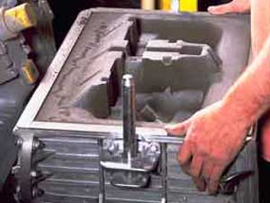
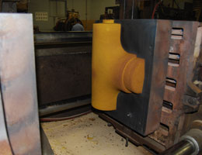
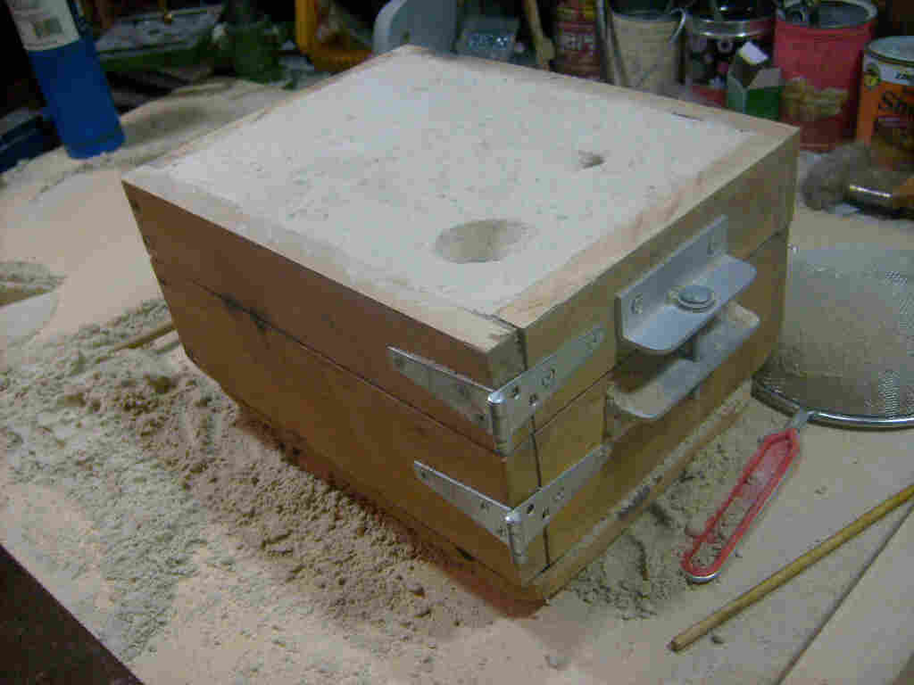
Gases and Vapors
Molds made with sand, clay and water are called green sand molds.
Cores are almost always made from sand that is bound together with chemicals
Some molds are also made with chemical binders
Gases and Vapors are given off by chemically bonded sands used to make cores and molds
Types of chemical gases and vapors given off will depend on the chemicals used
Notes:
Molds that are made with sand, clay and water are called green sand molds. These materials are found in the earth and are used in their “natural’ chemical form. Cores are almost always made from sand that is bound together with chemicals that are changed when they are added together or are heated. Some molds are also made with chemicals in this way, and these are often called chemically bonded molds. There are gases and vapors that are given off by chemically bonded cores and molds both during their manufacture, as well as when these item come into contact with molten metal. The types of chemicals that are given off will depend upon the chemicals used to bind the sand together and keep the mold strong enough to hold the molten metal.

Slide 12
Gases and Vapors
Gases and Vapors are given off by chemically bonded sands can vary in how hazardous they are, and what part of the body they could harm
These chemicals are listed in the SDS along with how they can affect workers
Examples include formaldehyde and isocyanates
Notes:
The chemicals that are given off by these chemical processes in core making and some mold making can vary in how hazardous they are to people, and what part of the body they could harm. These chemicals that may be generated are listed in the SDS along with how they can affect workers and how to protect against these potential hazards.
Some of the chemicals that are often found in or are created when we use the core making or chemically bonded sand mold chemicals are formaldehyde and isocyanates. These are chemicals that can be serious health hazards in the workplace - even in small amounts. These chemicals can also be harmful if they are splashed on the skin or into the eyes. Some of these chemicals are also flammable and can be a fire hazard. Once again, the information we need to know if there are health or safety hazards is on the SDS – and we can also find out how to safely handle and handle the products.

Slide 13
Metals
Metals commonly used in nonferrous foundries:
  Aluminum
  Antimony
  Copper
  Lead
  Zinc
Metals that may be present but are not as common:
  Beryllium
  Cadmium
  Chromium
  Iron
  Magnesium
  Nickel
Lead, Cadmium and Chromium have special requirements for safe use!
Notes:
Lets take a closer look at the METALS that are commonly used in nonferrous foundries:
Aluminum
Antimony
Copper
Lead
Zinc
Metals that may be present but are not as common include
Beryllium
Cadmium
Chromium
Iron
Magnesium
Nickel
Lead, Cadmium and some forms of Chromium also have special requirements for safe use.

Slide 14
Metals
OSHA regulations require employers to test for these metals in work areas
OSHA regulations set the maximum amount of metals that may be in the air, called Permissible Exposure Limits (PELs)
Foundries must keep levels of these metals below the PEL or they must implement engineering controls/other measures until exposure is below the PEL
Notes:
There are OSHA regulations that require employers to test for these metals in the work areas where they may be present. OSHA regulations also set the amount of these metals that may be in the air. These limits are called Permissible Exposure Limits or PEL’s. Foundries must keep their levels of these metals in the air below the Permissible Exposure Limits, or they must implement engineering controls or other measures until employee exposure levels are below the PEL.

Slide 15
Metals
Air sampling results are compared to the PEL
If employee exposure is at or above the PEL:
  Programs will be established to protect workers
  Programs will be written and updated regularly
  More testing may be required on a set schedule
  Workers who are exposed will be trained in how to safely work with the metal and what health effects can result from overexposure
  Special clothing and other personal protective equipment will be required
  Rules on where workers can smoke, eat and drink may be established, as well as rules on washing hands, showering and storing work clothes
  Certain medial tests may also be provided
Notes:
The results of the air sampling tests are then compared to the Permissible Exposure Limit. It there is exposure at or above allowable levels, programs will be established to protect workers. These programs will be written and updated regularly. More testing may be required on a set schedule. Workers who are exposed will be trained in how to safely work with the metal and what health effects can result from over exposures. Special clothing and other Personal Protective Equipment will be required and work areas. Rules on where workers can smoke, eat and drink may be established as well as rules on washing hands, showering, and storing work clothes.
Certain medical tests will also be provided to be sure that workers are not having and health effects from working with these metals.

Slide 16
Written Programs for Metals
If your foundry uses any LEAD, CADMIUM or HEXVALENT CHROMIUM, and workers are above the action level, there will be a written program to control the metals import and use, and will detail current worker exposure levels
Written program will also outline how the training, engineering controls, testing, work practices, medical test and other aspects of the policy are carried out in the foundry
Notes:
If your foundry uses any of these three metals – LEAD, CADMIUM or HWEXVALENT CHROMIUM - and workers have exposures to them at a level that requires action, there will be a written program that outlines the way that the metal is brought into the foundry, how and where it is used, and what the current exposure levels are for workers. The program will also outline how the training engineering controls, testing, work practices, medical testing and other aspects of the policy are carried out in the foundry.

Slide 17
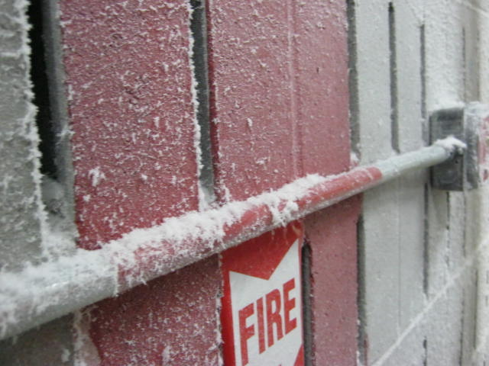

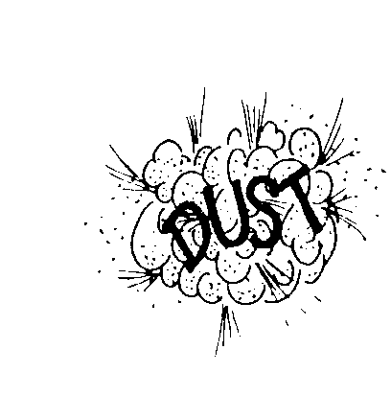
Aluminum Combustible Dust
Aluminum may be more hazardous than copper alloys when it is in the dust or finely divided form where is can be a combustible dust
If dust gets into the air in a sufficient amount and there is a source of ignition, the dust can burn or cause an explosion
SOURCE
OF IGNITION
Notes:
While metals such as aluminum may not have the same level of health hazards when compared to Lead or Cadmium, this Aluminum may be more hazardous than copper alloys when it is in the dust or finely divided form. In this form, the metal can be a combustible dust. This means that it the dust gets into the air in a sufficient amount and there is a source of ignition – something that can cause a spark or fire- the dust could burn or cause an explosion.
Aluminum fires are also dangerous since they should not be put out or extinguished with water. The use of water can spread or make the fire worse.

Slide 18
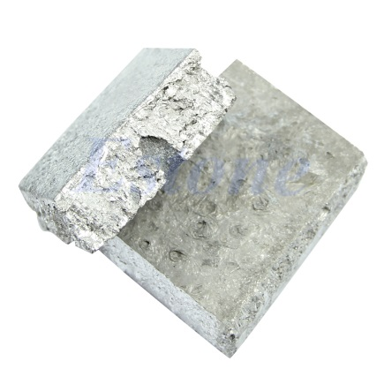
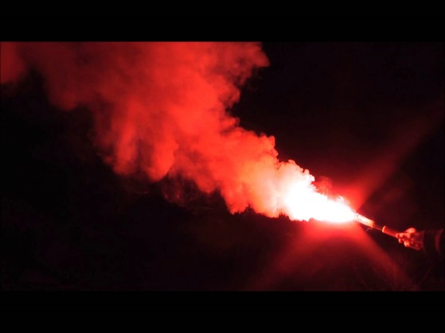
Magnesium
Not as commonly used in the foundry
Highly flammable, especially when powdered or shaved into thin strips
Difficult to extinguish
Commonly used in flares and incendiary weapons
Notes:
Magnesium is a metal that is not as commonly used in the foundry. Magnesium is a highly flammable metal, especially when powdered or shaved into thin strips. When it is in a larger or more massive form it is difficult to ignite. Once it is ignited or catches fire, it is difficult to extinguish. This is why this metals is used in flares and was used in making incendiary weapons .

Slide 19
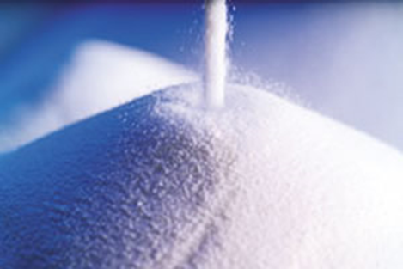

Silica
Mineral made up of 1 silicon atom and 2 oxygen atoms
Formation of silica in nature is very common
Can be found in beach sand, rocks and in soil
Notes:
SILICA
Silica is a mineral compound made up of one silicon atom and two oxygen atoms. Since
Oxygen is the most abundant element in the earth's crust and Silicon is the second most abundant, the formation of the silica in nature is very common. It can be found in every state on beaches as sand, in rocks from mountains and in the soil itself.

Slide 20
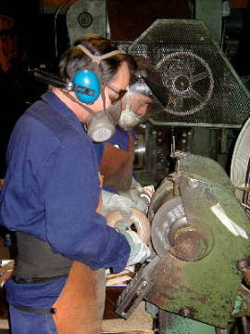
Silica
Basic component of soil, sand, granite and many other minerals
Quartz is the most common form of crystalline silica
Cristobalite and tridymite are two other forms of crystalline silica, not often found in the nonferrous foundry
All 3 forms may become respirable size particles when workers chip, cut, drill or grind objects that contain silica
Notes:
Crystalline silica is a basic component of soil, sand, granite, and many other minerals. Quartz is the most common form of crystalline silica. Cristobalite and tridymite are two other forms of crystalline silica. These two forms of silica are not found often in the nonferrous foundry. All three forms may become respirable size particles (small enough in size to reach the lungs when you breath in the dust) when workers chip, cut, drill, or grind objects that contain crystalline silica.

Slide 21
Silica
Silicone is NOT THE SAME as Silicon, and do not have the same effect on the human body
Some foundries do not use silica sand to make molds, other non-silica materials such as olivine and zircon can be used
Many times the cores in these foundries are still made with silica sand
The Safety Data Sheet and Labels for these sands will tell us if it is silica or another type of sand
Notes:
There are other compounds that contain silicon and their names are quite similar to our ears—for example, silicone, but they are not the same thing and do not have the same effect on the human body.
Some foundries do not use silica sand in making molds. Sands made from glass, or non silica materials such as olivine and zircon can be used. Many times, however, the cores used in these foundries are made from silica sand The Safety Data Sheet and Labels for these sands will tell us if it is silica or another type of sand.

Slide 22
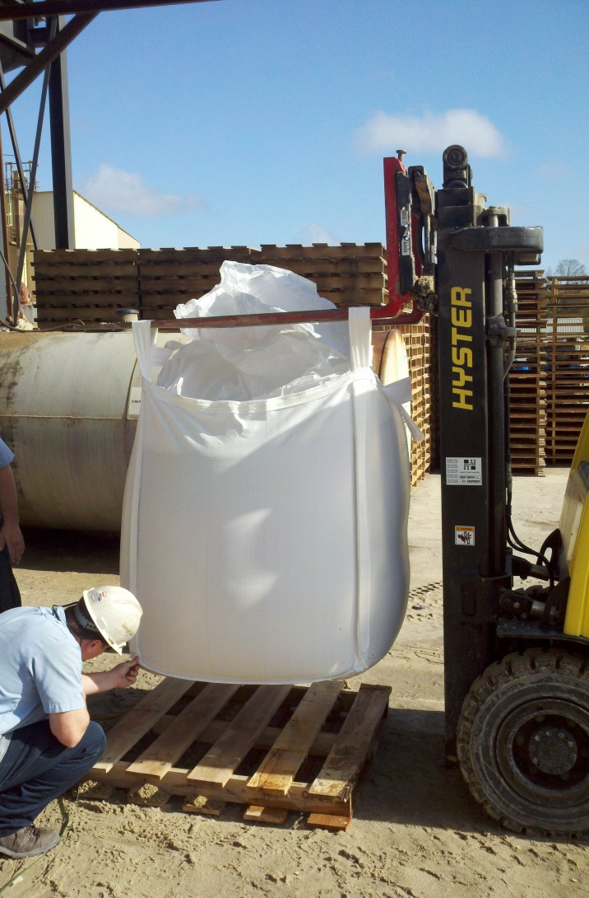
Silica
Some foundries purchase their sand in bags, the labels for the sand will be on every bag
If sand is brought to the foundry in bulk, there will be no label since there is no container
A label is sent to the foundry and should be placed in the sand storage area
Notes:
Some foundries purchase their sand in bags. The labels for the sand will be on every bag. However, if sand is brought to the foundry in bulk by rail or truck, there will be no label visible since there is no container. A label is sent to the foundry and should be placed in the sand storage area or nearby so that workers can easily see and read the label.

Slide 23
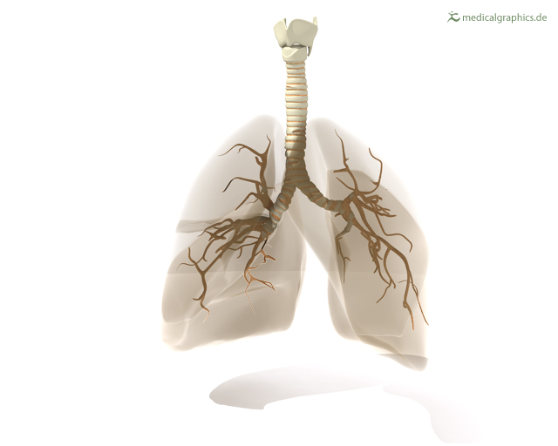
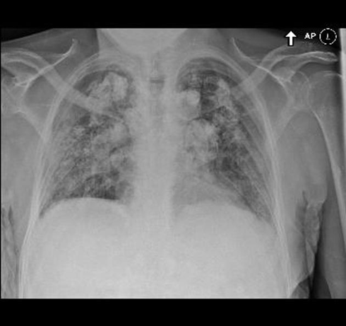
Silicosis
People who work with silica can develop Silicosis
Respirable silica dust enters the lungs and causes scar tissue, reducing the lung’s ability to take in oxygen
There is no cure for silicosis
Crystalline silica has been classified a human lung carcinogen
Notes:
People who work with silica that becomes airborne in small particles can develop a disease of the lungs called silicosis if they breathe in the silica in large mounts or over years of exposure. The respirable silica dust enters the lungs and causes the formation of scar tissue,. This scarring of the lungs reduces the lungs’ ability to take in oxygen. There is no cure for silicosis. Crystalline silica has also been classified as a human lung carcinogen.

Slide 24
PELs for Crystalline Silica, Cristobalite and Tridymite
TABLE Z-3 Mineral Dusts
Substance | mppcf ª | mg/m³
Silica: Crystalline
Quartz (Respirable) . . . . . . . . . . . . . . . . . . | 250^{b} %SiO₂+5 | 10 mg/m^{3 e} %SiO₂+2
Quartz (Total Dust) . . . . . . . . . . . . . . . . . . | . . . . . . . . . | 30 mg/m³ %SiO₂+2
Cristobalite: Use ½ the value calculated from the count or mass formulae for quartz. Tridymite: Use ½ the value calculated from the formulae for quartz.
Notes:
The Occupational Safety and Health Administration sets Permissible Exposure Limits (PEL’s) for crystalline, cristobalite and tridymite silica shown here.

Slide 25
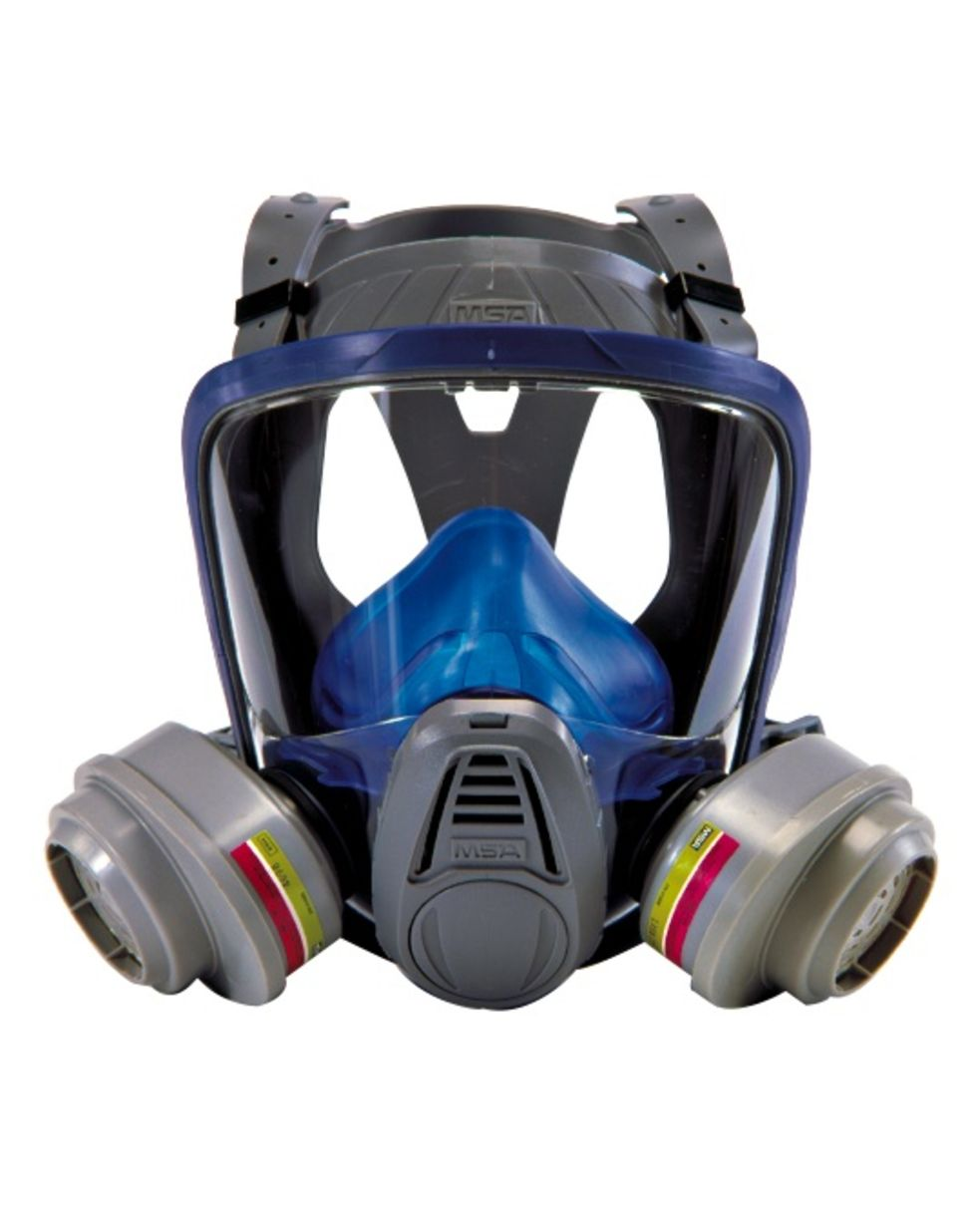
Engineering Controls and Work Practices
Engineering controls and good work practices can control airborne silica dust levels to below the PEL in most cases
If measures are not effective, respirators will be required and are effective in protecting the worker’s lungs
Notes:
Engineering controls and good work practices can control the creation of airborne silica dust to levels below these permissible exposure limits in most cases. If these measures are not effective in protecting workers, respirators will be required and are effective in protecting the workers lungs.

Slide 26
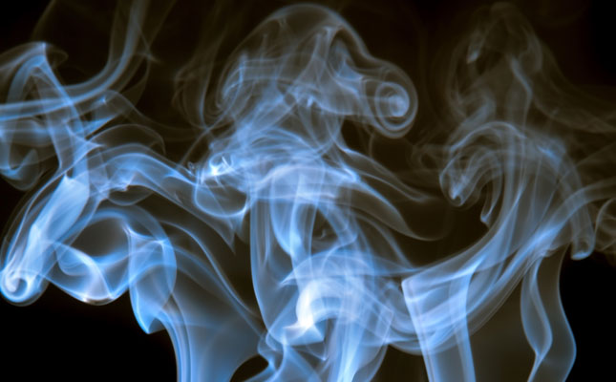
Gases and Vapors
Not all chemicals in the air are in the solid form
Gases or vapors can also be potential hazards in the foundry
Notes:
No all chemicals in the air are in the solid form. Gases or vapors (vapors are gases that are given off by a liquid or a solid.) can be potential hazards in the foundry.

Slide 27
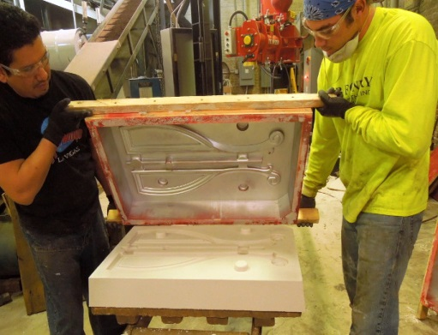
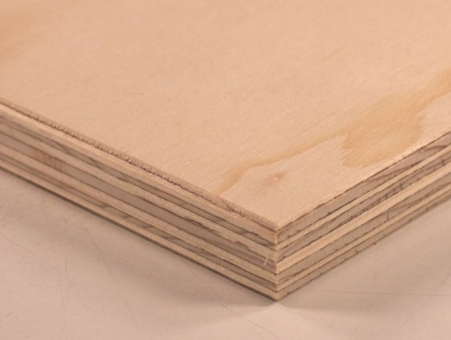
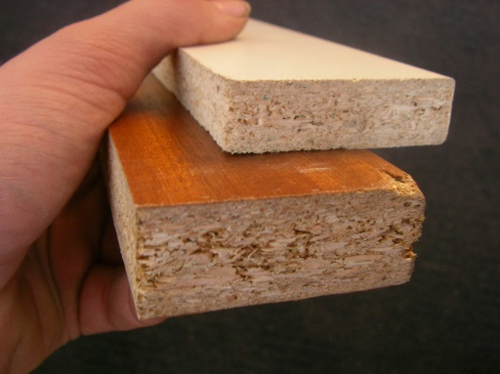
Formaldehyde
Formaldehyde is a chemical given off in SOME core making and no-bake molding systems
Colorless, strong-smelling gas
Commonly used as a preservative and is found in may products such as particle board, household products, glues, fiberboard, and plywood
Notes:
Formaldehyde is a chemical that is given off in SOME core making and chemically bonded molding systems. Formaldehyde is a colorless, strong-smelling gas that has been commonly used as a preservative in medical labs and is found in many products such as particle board, household products, glues, fiberboard, and plywood.

Slide 28
Formaldehyde
Formaldehyde is a sensitizing agent and can cause an immune system response when a person is exposed
Subsequent exposure(s) can cause a more serious response
Classified as a cancer hazard
Ingestion can be fatal
Long term exposure to low levels can cause asthma-like problems and skin irritation
Notes:
Formaldehyde is a sensitizing agent. This means that it can cause the cause an immune system response once a person is exposed to it. If a person becomes sensitized , an acute(a high level) exposure is highly irritating to the eyes, nose, and throat and can cause coughing and wheezing. If the person is exposed again, the response can be more serious and result in a severe allergic reactions of the skin, eyes and respiratory tract. It is also classified as a a cancer hazard.
Ingestion (eating or drinking) formaldehyde can be fatal, and long-term exposure to low levels in the air or on the skin can cause asthma-like respiratory problems and skin irritation such as dermatitis and

Slide 29
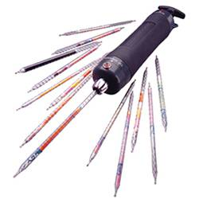
Formaldehyde
OSHA standard requires air sampling
If sampling shows exposure levels at or above the Permissible Exposure Limit (PEL), feasible engineering and work practice controls must be used to reduce employee exposure below the PEL
PEL = 0.75 ppm (8 hour TWA)
STEL = 2 ppm (max. 15 minute period)
Action Level = 0.5 ppm (8 hour TWA)
Formaldehyde Air
Sampling Equipment
Notes:
The OSHA Formaldehyde standard require employers to identify all workers who may be exposed to formaldehyde by doing air samples to see if exposures are at or above standards set to keep workers safe. If the tests show the levels of Formaldehyde are at or above the Permissible Exposure Limit, the company must use feasible engineering and work practice controls to reduce these levels to below the permitted level.
• The permissible exposure limit (PEL) for formaldehyde in the workplace is 0.75 parts formaldehyde per million parts of air (0.75 ppm)measured as an 8-hour time-weighted average (TWA).
• The standard includes a second PEL in the form of a short-term exposure limit (STEL) of 2 ppm which is the maximum exposure allowed during a 15-minute period.
• The action level – which is the standard’s trigger for increased industrial hygiene monitoring and initiation of worker medical surveillance – is 0.5 ppm when calculated as an 8-hour TWA.

Slide 30
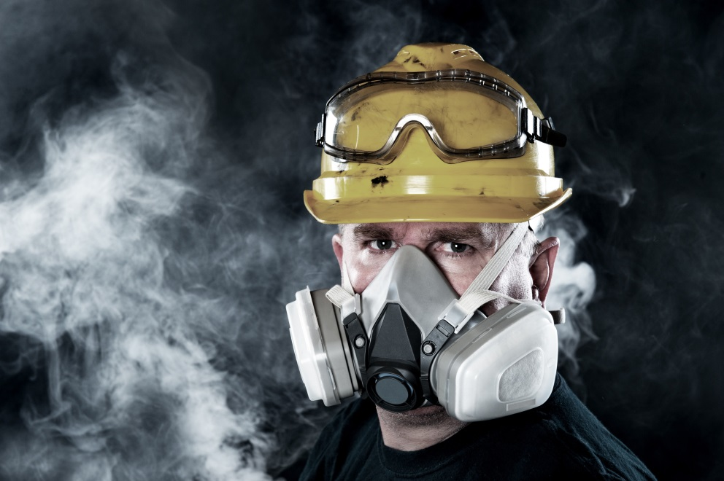
Formaldehyde
Workers will be given respirators and other protective equipment need when controls cannot reduce exposure to acceptable levels
Medical surveillance and training will be
provided for all workers at or above the action level
All elements of the Formaldehyde program must be in a written document maintained by the company
Notes:
If these controls efforts cannot reduce exposure to the acceptable level, workers will be given respirators and any other protective equipment needed such as impervious clothing, gloves, aprons, and chemical splash goggles. There will also be medical testing (medical surveillance) and training for all workers exposed to formaldehyde at or above the action level.
All of the elements of the Formaldehyde program must be in a written document that is kept up to date by the company,

Slide 31
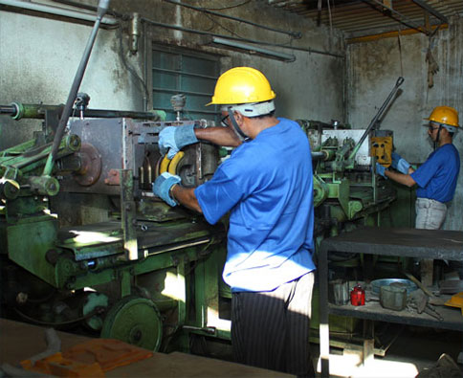
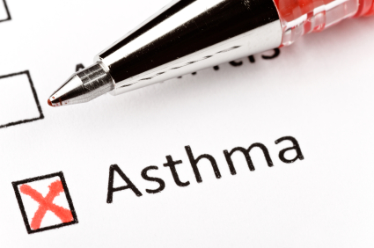
Isocyanates
Isocyanates may be released to the air from core making or chemically bonded sand molding processes
Isocyanates react with other chemical compounds containing alcohol to produce polyurethane polymers, found in products such as polyurethane foams and paints
Worker exposure to Isocyanates can cause Asthma
Isocyanates are one of the most common chemical causes of work-related Asthma
Notes:
One substance that may be released to the air from the core making or chemically bonded sand molding process are ISOCYANATES.
Isocyanates are compounds that react with other chemical compounds containing alcohol to produce polyurethane polymers and are the raw materials that make up all polyurethane products. These are substances that are found in many widely used products such as polyurethane foams, spandex fibers, and polyurethane paints. They may also be used in the foundry to make molds and cores. The health hazard that concerns exposure of workers to Isocyanates in the air is Asthma. Isocyanates are one of the most common chemical causes of work-related asthma Work-related asthma is a lung disease caused or made worse by exposures to substances in the workplace.

Slide 32
Isocyanates
Exposure can include inhalation and skin contact
Asthma symptoms may start at work, or may be delayed and not appear until several hours after leaving work
May cause Asthma in people who have never had it, and may worsen the condition for people with existing Asthma
Health effects of exposure also includes irritation of skin and mucous membranes, chest tightness, and difficulty breathing
Some compounds (not all isocyanates) are classified as potential human carcinogens
Notes:
Exposure can include inhalation (breathing in the substance) and skin contact. Asthma symptoms may start while the person is at work or they may be delayed and not appear until several hours after leaving work. These symptoms may show up with no clear pattern. People who never had asthma can develop asthma due to workplace exposures. People who have had asthma for years may find that their condition get worse due to workplace exposures.
The health effects of isocyanate exposure include irritation of skin and mucous membranes, chest tightness, and difficult breathing. Isocyanates include some compounds (not all isocyanates) classified as potential human carcinogens and known to cause cancer in animals.

Slide 33
Isocyanates
Isocyanates are a GROUP of chemicals, and not all of the substances in this group have the same effect on the body
It is important to CHECK THE SDS to see which isocyanate(s) may be present and WHAT actions should be taken if there is a potential hazard
Notes:
Since Isocyanates are a GROUP of chemicals and not all of the substances in this group have the same effect on the body. It is important to CHECK THE SDS to see which isocyanate may be present and WHAT actions should be taken if there is a potential hazard.

Slide 34
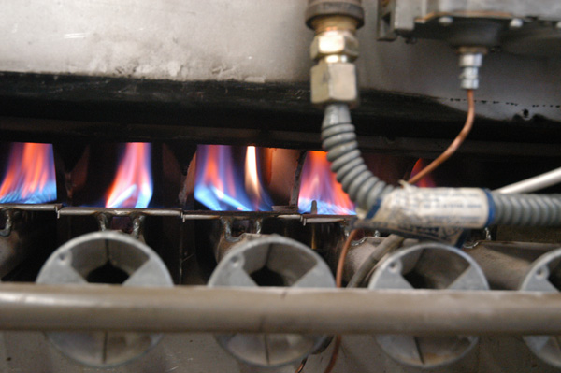
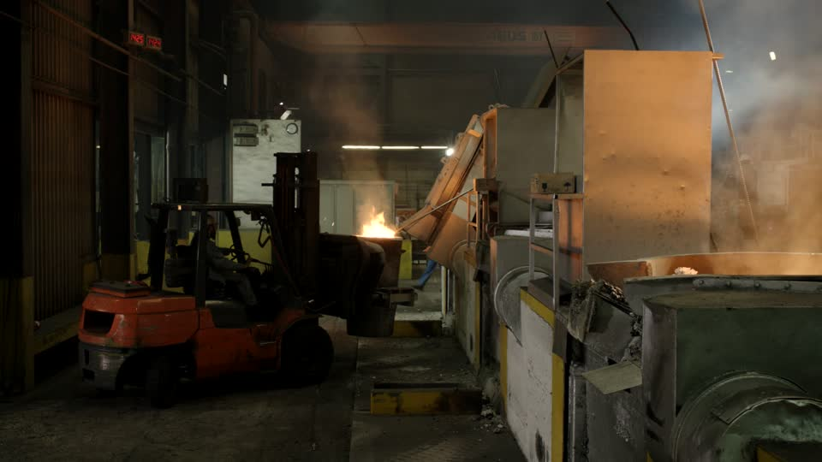
Carbon Monoxide (CO)
Present whenever there is combustion, such as around a gas or oil fired furnace
Poisonous, colorless, odorless and tasteless gas
Produced from incomplete burning of natural gas, gasoline, kerosene, oil, propane, coal or wood
Furnaces that use these fuels produce CO, but the most common source in the foundry is the internal combustion engine
Notes:
Another common potentially dangerous gas present wherever there is combustion- such as around a gas or oil fired furnace is Carbon monoxide.
Carbon monoxide (CO) is a poisonous, colorless, odorless, and tasteless gas. This can be a problem since you will not be able to smell it if it is present. This may also be a problem since CO is often mixed with other gases that do have an odor. So, you can breath in carbon monoxide right along with gases that you can smell and not even know that CO is present.
CO is a produced from the incomplete burning of natural gas and any other material containing carbon such as gasoline, kerosene, oil, propane, coal, or wood. Furnaces that use these fuels produce CO, but one of the most common sources of exposure in the workplace is the internal combustion engine.

Slide 35
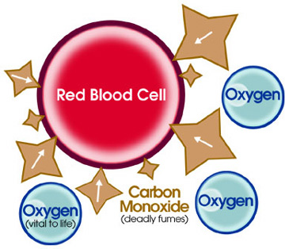


Carbon Monoxide
Most dangerous when it is breathed in, the CO takes the place of oxygen in the blood
Large amounts of CO can overcome you in minutes without warning
Symptoms start as tightness across the chest, headache, fatigue, dizziness, drowsiness or nausea
Symptoms may get worse and include vomiting, confusion, collapse, loss of consciousness and muscle weakness
Acute poisoning could result in permanent damage to parts of the body that require a lot of oxygen, such as the heart and the brain
Notes:
Carbon Monoxide is dangerous because when you breath it in, the CO takes the place of oxygen in the blood and deprives the heart, brain, and other vital organs of oxygen.
Large amounts of CO can overcome you in minutes without warning—causing you to lose consciousness and suffocate.
The symptoms may start as tightness across the chest, headache, fatigue, dizziness, drowsiness, or nausea. If exposure continues over time or at high CO levels, the symptoms may get worse and include vomiting, confusion, and collapse, loss of consciousness and muscle weakness. By this point, people CO poisoning can be reversed if caught in time. But if the level of exposure was very high or very long, acute poisoning could result in permanent damage to the parts of your body that require a lot of oxygen (for example the heart and brain) . Significant reproductive risk is also linked to CO.

Slide 36
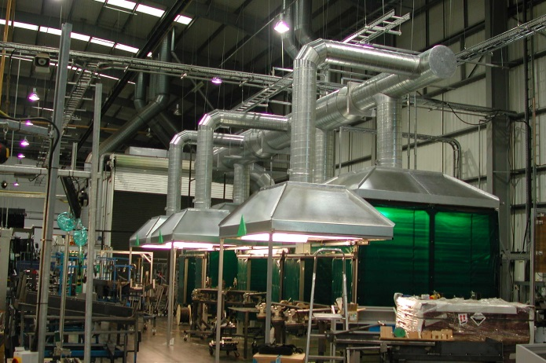
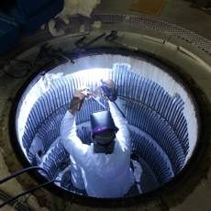
Carbon Monoxide
Preventing CO buildup may require a good ventilation system
Home and work equipment and appliances that can produce CO must be kept in good working order to ensure they run safely and to reduce CO formation
Gasoline-powered engines or tools should never be used in poorly ventilated areas
Notes:
Preventing the buildup of Carbon Monoxide may require a good ventilation system that will remove CO from those work areas where the CO may be present in dangerous levels. At home or at work equipment and appliances (e.g., water heaters, space heaters, cooking ranges) that can produce CO must be kept in good working order to be sure they run safely and to reduce CO formation.
Gasoline-powered engines or tools should never be used in poorly ventilated areas – at home or in the work place.

Slide 37
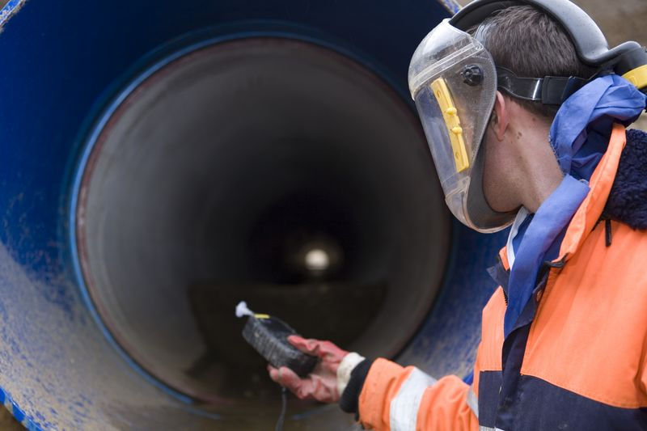
Carbon Monoxide
If a worker must enter a CONFINED SPACE where CO may be present, the confined space MUST be tested to see if there is enough oxygen present before any worker is allowed to enter
Notes:
As a part of the company CONFINED SPACE PROGRAM, if workers must enter a confined space where of CO may be present, the confined space MUST be tested to see if there is enough oxygen present before any worker is allowed to enter.

Slide 38
Carbon Monoxide
SDS for fuels will show CO may be produced wht the fuel is burned
No label on moving equipment such as a fork lift
Can be present wherever organic fuels are burned
Notes:
The SDS for fuels will show that Carbon Monoxide may be produced when the fuel is burned but the label will not be on moving equipment such as a fork lift or automobile. Be aware that this odorless, tasteless gas can be present whenever organic fuels such as coke, coat, natural gas, kerosene, or wood are burned.

Slide 39
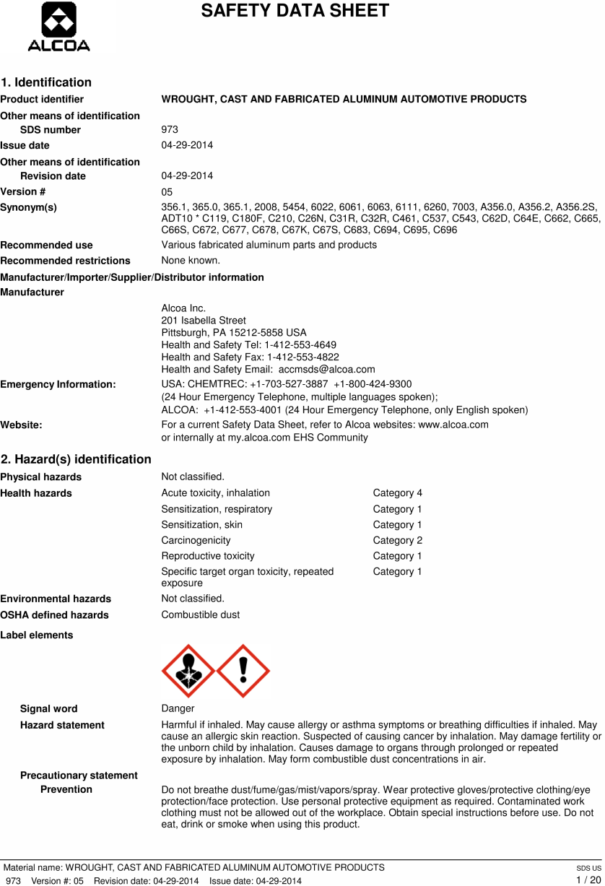
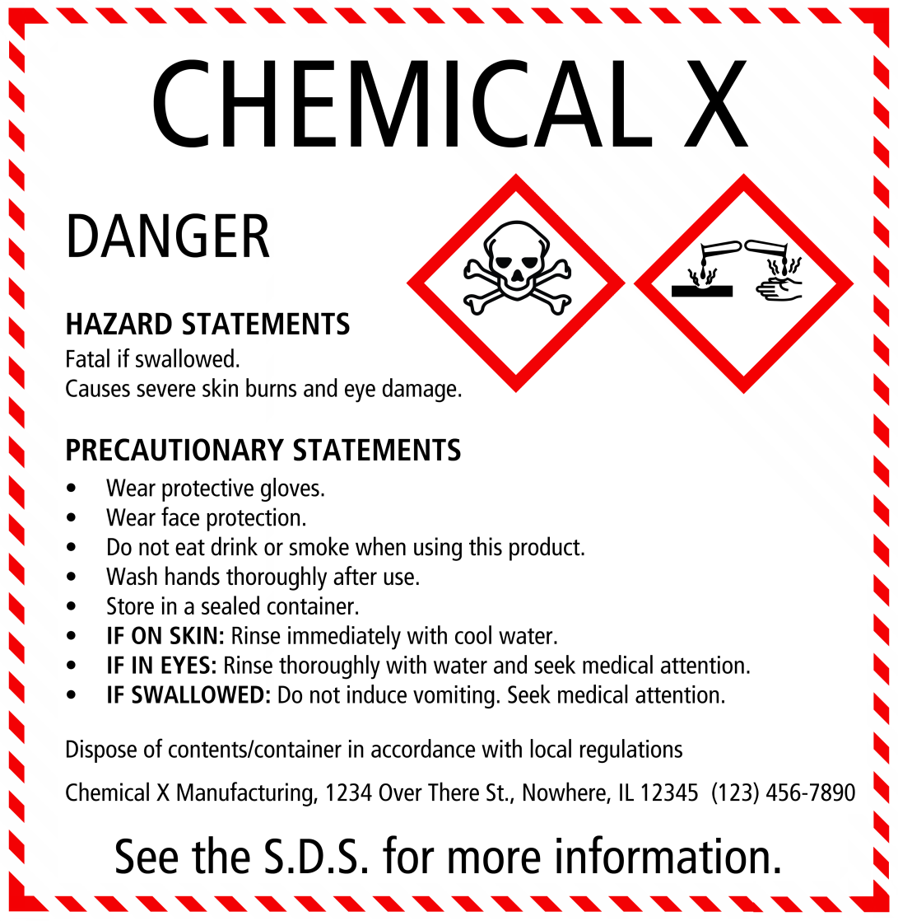
SDS and Labels are LIFESAVERS!
Notes:
Be sure you know where the Safety Data Sheets are located for your job and check labels!! They can be lifesavers.

Slide 40

Acknowledgements
This material was produced under grant number
SH-26318-SH4 from the Occupational Safety and Health Administration, U.S. Department of Labor. It does not necessarily reflect the views or policies of the U.S. Department of Labor, nor does mention of trade names, commercial products, or organizations imply endorsement by the U.S. Government

Slide 41

Additional Training Modules Available For:
  Foundry Air Contaminants
  Foundry Electrical Safety/Arc Flash (bi-lingual)
  Workplace Emergency Planning
  Lead Hazards (bi-lingual)
  Lockout/Tagout (bi-lingual)
  Machine Guarding

Slide 42
Non-Ferrous Founders’ Society
Safety & Health Training Program
For further information about this or other training modules:
Non-Ferrous Founders’ Society
1480 Renaissance Drive, Suite 310
Park Ridge, IL 60068
847/299-0950
http://www.nffs.org

