Slide 1



Non-Ferrous Founders’ Society Safety & Health Training Program
Hazard Communication/GHS Training Program
Section 7: HazCom/GHS and the Brass and Bronze Foundry
© 2015 All Rights Reserved

Slide 2
HazCom/GHS and the Brass and Bronze Foundry
What are some of the hazards that exist in a brass and bronze foundry?
What are some common manufacturing process/materials in the brass and bronze foundry, and what hazards can these processes/materials present to the foundry worker?
What are some of the Personal Protective Equipment (PPE) items that workers should wear in a brass and bronze foundry?
Notes:
In this section we will learn:
What are some of the hazards that exist in a brass and bronze foundry?
What are some common manufacturing process/materials in the brass and bronze foundry, and what hazards can these processes/materials present to the foundry worker?
What are some of the Personal Protective Equipment (PPE) items that workers should wear in a brass and bronze foundry?

Slide 3
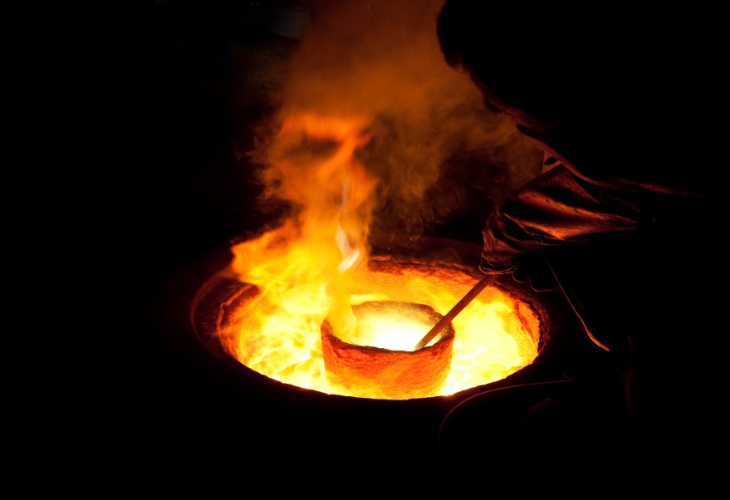
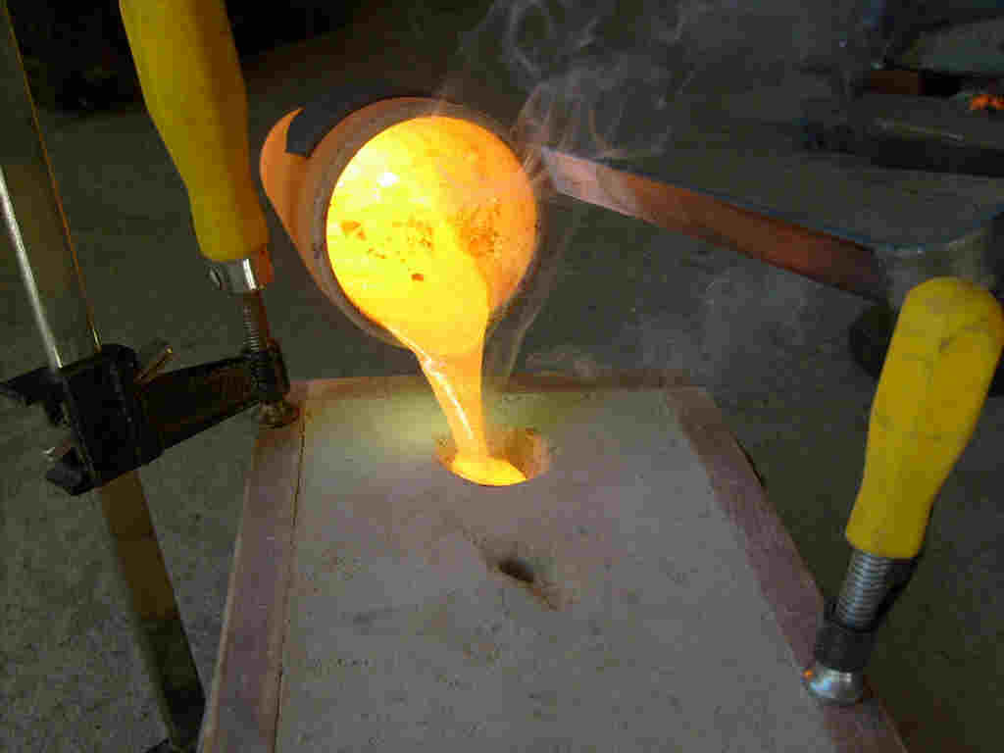
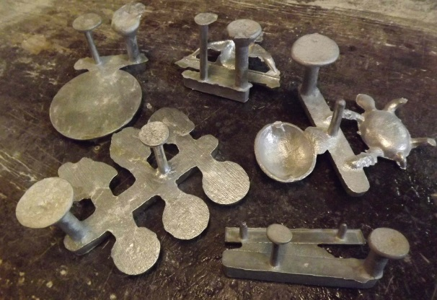
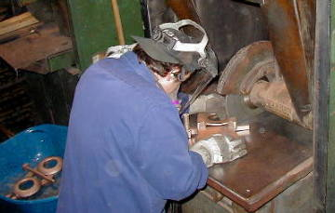
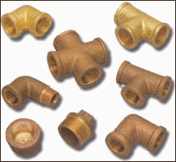
Non-Ferrous Foundry Hazards
Notes:
Brass and Bronze foundries make castings from copper mixed with other metals by heating the metal until it is in the liquid or molten state and then pouring the molten metal into a mold. After the metal cools it becomes a solid again and takes the shape of the void or interior of the mold. This shape, the casting, is then removed and may be further processed or “finished” to remove unwanted metal or molding material that has remained on the surface.

Slide 4
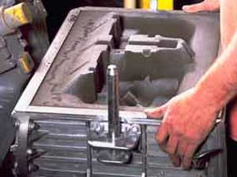
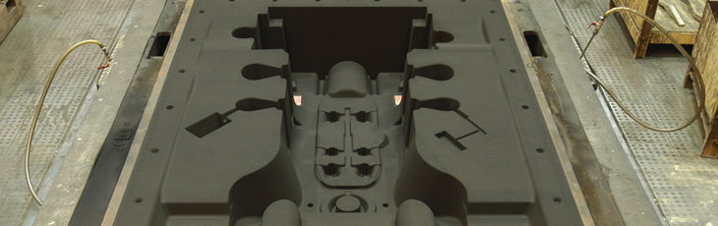
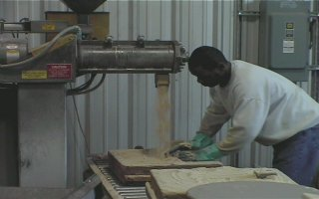
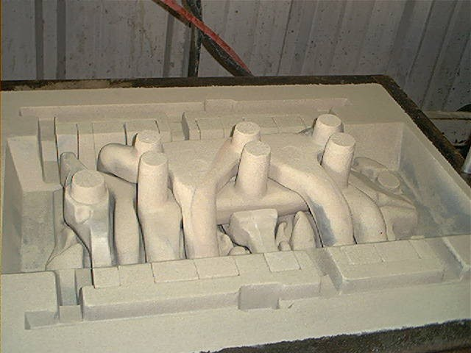
Green Sand/No Bake Molding
Notes:
The methods of molding used by nearly all brass and bronze foundries is called sand molding. Sand mold foundries use silica or other sands that are mixed with ingredients that make the sand grains stick together to form the mold. If the ingredients used to make the mold are clay and water based, the process is called green sand molding. If other chemicals are used, the process may be called chemically bonded or no bake molding.

Slide 5
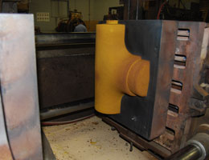
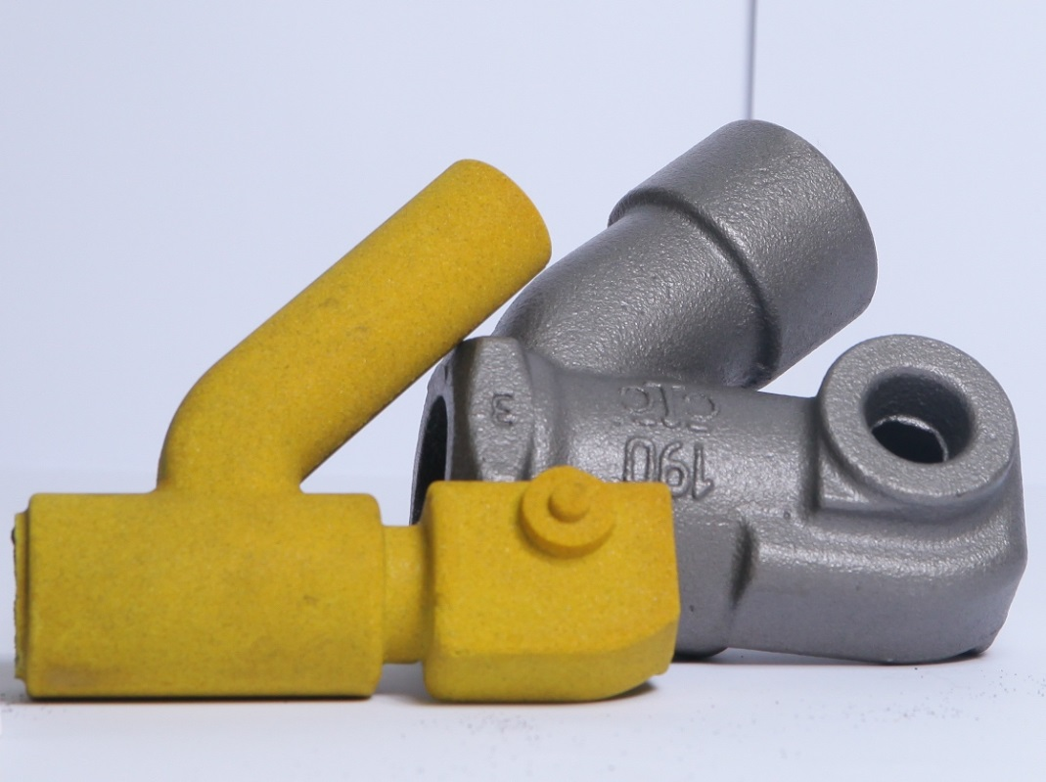
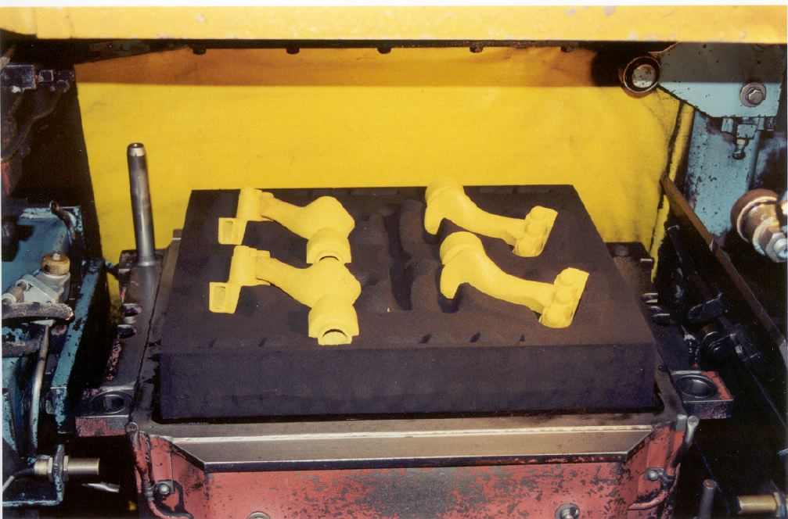
Cores
Notes:
If the casting made in a sand mold has a complex shape or needs a hollow interior, a CORE may be used. This core is usually made from chemically bonded sand, and is placed in the mold before the hot metal is poured into the mold. When the casting has cooled and the core is removed, a hollow cavity remains in the casting.

Slide 6
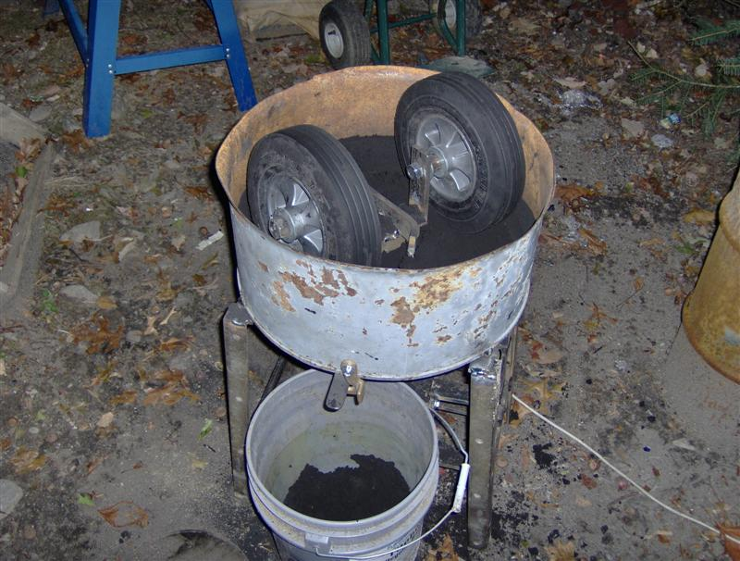
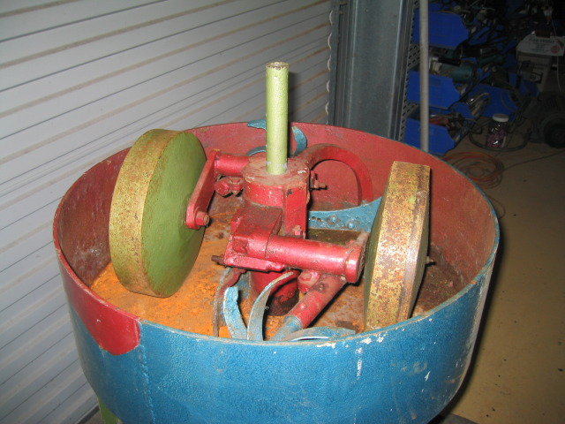
Sand Molding
Sand must be mixed with clay and water in a MULLER and then delivered to the molders
Can be manual or automated systems for feeding the sand systems
If manually loaded, there is a potential exposure to dust from silica and bentonite clay that is added
In automated systems, workers should not be exposed to these dusts
Notes:
In a green sand system, the sand must be mixed with clay and water and delivered to the molding machines. Chemically bonded sand systems also use mixers, but of a very different type, to mix the sand and the chemicals needed to bond the sand grains together. Sand mixers or mullers are the equipment that is used to make this molding sand. If workers must manually load the dry materials into the system, there is a potential for exposure to dust from both the silica and the bentonite clay used to hold the sand grains together. If the system is automated, workers should not be exposed to dust from the process. These systems are usually installed with hoods and ductwork that draws dust away from the workers area and sends it out to an air pollution control device.

Slide 7
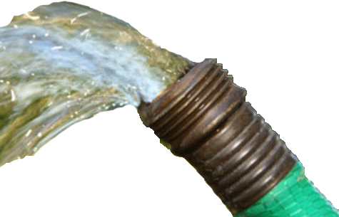
Sand Molding
Once water is added to the system, the amount of dust should be quite low
However, workers who clean out these system can generate excessive dust
Notes:
Once the water is added in the mixer, the amount of dust generated should be quite low. However, if workers must clean out these systems, the cleaning process can generate excessive dust.

Slide 8

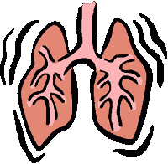
Dust Hazards
Sand can break down into very small pieces or DUST
These particles can become airborne and get into worker breathing zones
Silica sand dust can cause lung damage when workers breathe it in at unsafe levels over time
Small Particles of Silica
Notes:
One of the problems with this sand system is that the moving and handling of the sand can break the sand grains down in size to very small pieces or particles, called dust. These particles can be so small they become airborne and get into the breathing zone of workers. If silica sand is used, this dust can be SILICA dust- a chemical that can cause lung damage or cancer when workers breathe it in at unsafe levels over time.

Slide 9
Permissible Exposure Limits (PEL) for 3 Types of Silica
3 types of Silica
Crystalline Silica
Cristobalite
Tridymite
The PEL for each type of silica are shown in table Z-3 to the left
TABLE Z-3 Mineral Dusts
Substance | mppcf ª | mg/m³
Silica: Crystalline
Quartz (Respirable) . . . . . . . . . . . . . . . . . . | 250^{b} %SiO₂+5 | 10 mg/m^{3 e} %SiO₂+2
Quartz (Total Dust) . . . . . . . . . . . . . . . . . . | . . . . . . . . . | 30 mg/m³ %SiO₂+2
Cristobalite: Use ½ the value calculated from the count or mass formulae for quartz. Tridymite: Use ½ the value calculated from the formulae for quartz.
Notes:
The Occupational Safety and Health Administration sets Permissible Exposure Limits (PEL’s) for three types of silica: crystalline, cristobalite and tridymite. These limits are currently being studied to determine if they need to be updated, but at the present time the allowable levels are shown in table Z-3 provided here.

Slide 10
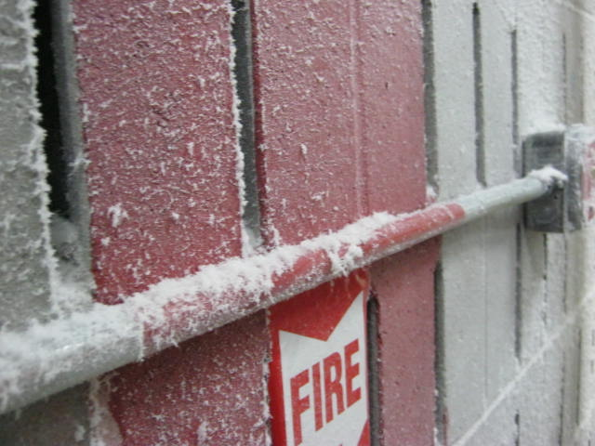
Permissible Exposure Limits (PEL) for 3 Types of Silica
Most brass/bronze foundry sand systems meet these PELs
The temperature of the metal when poured is not high enough to dry out the sand so that dust becomes airborne
Dust may be created when sand must be manually moved or handled, or when heavy equipment runs over sand
Dust allowed to accumulate can be released by wind, air or when the structure is shaken
Notes:
Most brass foundry sand systems meet these permissible limits at the present time. This is because the temperature of the metal as it is poured into the mold is not high enough to dry out the sand so that the dust becomes airborne. However, dust can be created if there are upset conditions and the sand must be manually moved or handled. If heavy equipment runs over the sand it can be broken down and become airborne. Sand that is allowed to buildup on rafters or other surfaces can also release dust if there is a burst of wind, air or the structure is shaken.

Slide 11
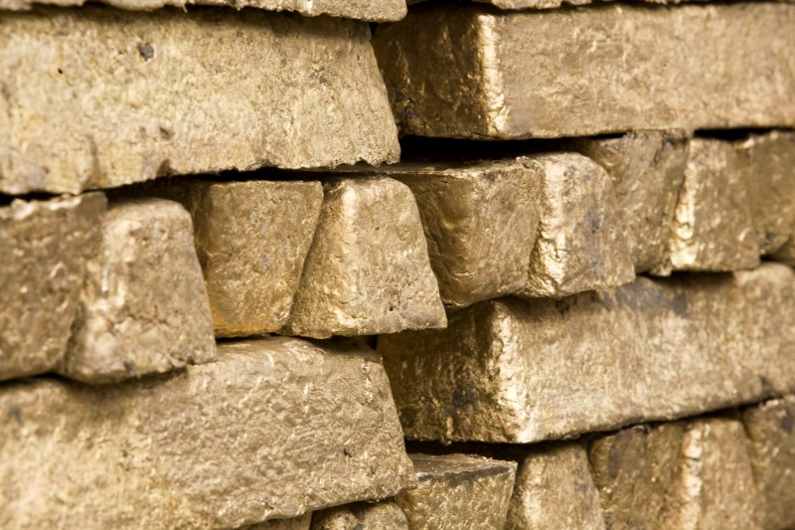
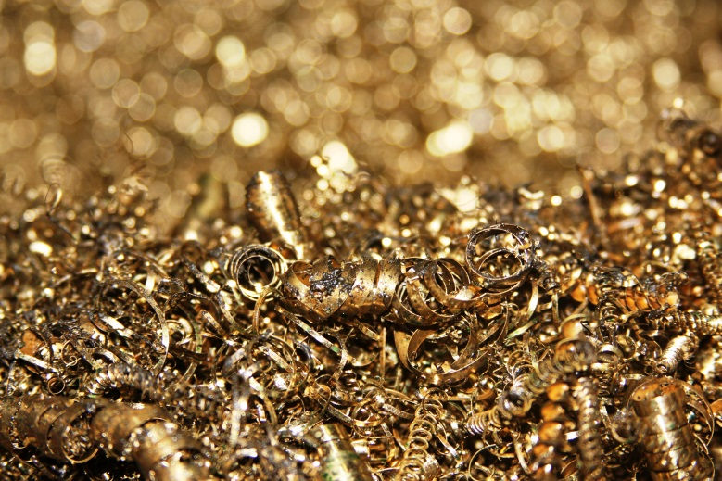
MELTING
Most brass and bronze foundries buy INGOTS with guaranteed chemistry
Some foundries will buy and melt SCRAP metal
Scrap will come in various sizes and may have a range of metal content
Notes:
The copper alloy (brass or bronze) comes into the foundry in a solid form Most nonferrous foundries buy INGOTS of brass or bronze since they these ingots have guaranteed amounts of the desired metal. Some foundries will buy and used scrap metal. This scrap will come in various sizes and may have a range of metal content for each metal in the scrap.

Slide 12
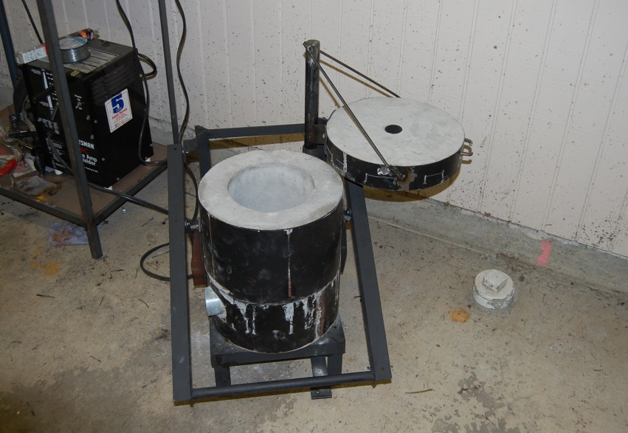
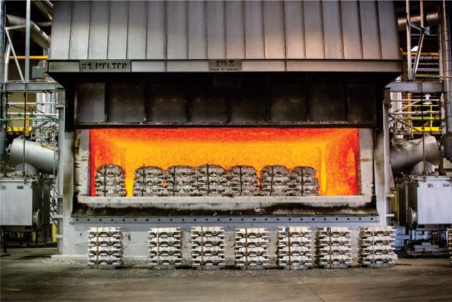
MELTING
Most foundries will return defective castings to the melting process
Metal removed from the casting may also be returned for remelt
Furnaces can be large or small
The source of energy can be electricity, natural gas, propane or oil
Notes:
Most foundries will return to the melting process any castings that were found to be defective. The pieces of metal that are removed from the casting that fed the metal may also be returned for remelt.
Furnaces can be large or small depending on the needs of the foundry. The source of energy can be electricity, natural gas, propane gas, or oil.

Slide 13

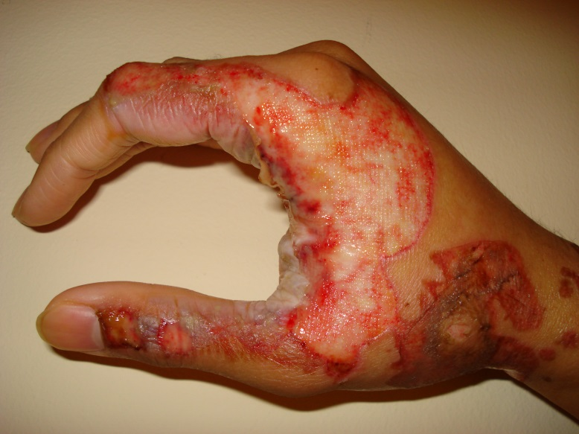
MELTING
When copper alloys are melted, the process can create metal FUMES
Engineering controls (ventilation hoods) are used to keep the amount of fume at safe levels
Work practices may also be used
BURNS are always a danger when working near hot metal
PPE must always be worn!
Notes:
When furnaces melt the copper alloys, the process can create metal FUMES. Engineering controls, hoods that draw air and fume away from the furnace and into an air pollution control system, are installed to keep the amount of fume to safe levels. Work practices may also be established to reduce the amount of fume that becomes airborne.
In addition to the potential exposure to fumes, there is always the danger of serious BURNS whenever someone works near hot metal. Proper Personal Protective Equipment must always be used whenever working around hot metal.

Slide 14
Personal Protective Equipment
Recommended minimum basic clothing requirements for any employee working near the melting and pouring areas are:
100% cotton socks and undergarments
100% cotton or wool outer garments
For employees in a hazardous zone (near a furnace or ladle containing molten metal) additional specific clothing and PPE is recommended based on the conditions, such as:
The temperatures, amount and type of molten metal in the furnace, ladle and/or mold
The level of the metal and area of the body that could be impacted by a splash, runout, spark, flame or hot surface
How close is the worker to molten metal and hot surfaces
Notes:
Guidance from a joint effort of a foundry association and OSHA has made these recommendations for all foundries:
Recommended minimum basic clothing requirements for any employee working near the melting and pouring areas are:
• 100% cotton socks and undergarments
• 100% cotton or wool outer garments
For employees in a hazardous zone (such as near a furnace or ladle containing molten metal or other known hazards) additional specific clothing and PPE is recommend based on the conditions in the foundry. Factors that should be considered include:
• The temperatures, amount and the type of molten metal in furnace, ladle and/or mold and the temperatures
• The level of the metal and area of the body that could be impacted by a splash, runout, sparks, flames, or hot surfaces (is the molten metal poured or present above the waist? Above the head?) and how close is the worker to molten metal and hot surfaces (for example, work inside hazard zone around induction furnaces).

Slide 15
Personal Protective Equipment
DO NOT LIST:
Do Not wear Nomex* because all molten metals tend to stick to the fabric
Do Not wear polyester, nylon and other manmade materials that can melt and readily ignite
DO LIST:
Do wear proper costs, jackets, aprons, cape, sleeves, bibs leggings and/or chaps as needed
Do wear pants or leggings that cover the top of the boot to prevent molten metal/sparks from entering the boot
Do wear spats or leggings that cover the lacings if laced boots are worn
Do wear long pants, long sleeve shirts are recommended
Do evaluate the need for spats, leggings and chaps for pouring operations
Do wear clothing that does not trap molten metal/sparks
Do wear any other PPE needed to protect body parts exposed to heat or metal
Notes:
The type of fabric that is worn in the area of molten metal is very important. It is recommended that in Aluminum foundries:
DO NOT LIST
• Do not wear Nomex* because all molten metals tend to stick to the fabric.
• Do not wear polyester, nylon, and other manmade materials that can melt and readily ignite.
DO LIST
• Proper Coats , Jackets, Aprons , Cape, sleeve(s) and bib, Leggings and/or Chaps needed
• Wear pants or leggings that cover the top of the boot to prevent molten metal and sparks from entering the boot. Never tuck pant legs inside the boot.
• If laced boots are worn, spats or leggings that cover the lacings must be used whenever molten metal or sparks could lodge in the tongue area.
• Wear long pants -- long sleeve shirts are recommended.
• For pouring operations the use of spats, leggings, and chaps should be evaluated.
• Wear clothing that does not trap molten metal and sparks (i.e. no cuffs, open pockets, loose legging tops, etc.).
• Wear any other PPE needed to protect body parts that are exposed to heat or metal .

Slide 16
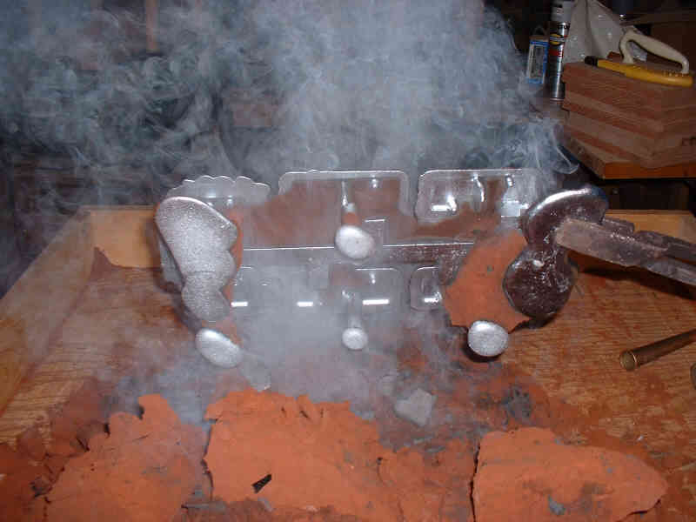
Shakeout
Once the metal is poured into the mold, it must cool and then be removed
There should be no sand on the surface with permanent mold, though the casting will be HOT!
In a sand foundry, the sand mold is broken to remove the casting
Potential hazard from small particles of silica released during shakeout
Notes:
Once the molten metal is poured into the mold, it must cool and then be removed. When the casting is removed, the sand mold should begin to break apart or will be broken to remove the casting. This process is often called shake out. The potential hazard in this operation is the release of small particles of silica that could become airborne and be breathed in.

Slide 17
Respirators
If workers are exposed to airborne silica above the PEL, engineering controls or other measures must be taken to reduce the amount of silica dust to a safe level
Until these measures are put into place, or safe levels can not be achieved, RESPIRATORS must be worn by exposed workers
Respirators are effective, if they are the RIGHT type of respirator and WORN and MAINTAINED properly
If your company requires the use of respirators, a written program is needed along with training and fit testing
Medical questionnaire must be completed for everyone in the program to be sure that the respirator can be safely worn
Notes:
If workers are exposed to airborne silica above the allowable levels as set by OSHA, engineering controls or other measures must be taken to reduce the amount of silica dust to a safe level. Until these measures are put into place or if there are reasons that these safe levels can not be achieved on a regular basis, Respirators must be worn by any workers who are over exposed. Respirators are effective in providing protection, but they must be the RIGHT type of respirator and must be WORN and MAINTAINED properly. If your company requires the use of respirators, a written program is needed along with training and fit testing for those who wear them. A medical questionnaire must be completed for everyone in the program to be sure that the respirator can be safely worn.

Slide 18

Other Potential Airborne Hazards from Mold and Core Making
If molds or cores are made with CHEMICALLY BONDED SAND, the mixing and heating process can release gases and vapors that may be hazardous
The Safety Data Sheet (SDS) will list chemicals that may be a problem either as ingredients, as a result of mixing two ingredients, or as a result of pouring hot metal into the mold and breaking down the chemicals in the mold/core
One substance that may be released is ISOCYANATES
Notes:
If molds or cores are made with CHEMICALLY BONDED SAND, the mixing and heating process can release gases and vapors that may be hazardous. The Safety Data Sheet will list the chemicals that may be a problem either as ingredients or as a result of mixing two ingredients – this is when two chemicals REACT and create a new chemical or condition such as heat - or as a result of pouring the hot metal into the mold and breaking down the chemicals in the mold or core. The hot metal will burn the chemicals and may create a new hazard. One substance that may be released to the air from the core making or chemically bonded sand molding process are ISOCYANATES.

Slide 19
ISOCYANATES
Some commonly used chemical binders used to hold sand together contain ISOCYANATES
ISOCYANATES are chemical compounds that react with other chemicals to make a new chemical with new characteristics
In the foundry, we mix a RESIN and a CATALYST with sands to make a mold or core
ISOCYANATES in some core making systems include Toluene Diisocyantes (TDI) or Methylene Biphenyl Isocyanate (MDI)
If these chemicals are present in your foundry, they will be shown on the Safety Data Sheet (SDS)
Workers exposed to these chemicals can develop ASTHMA
Notes:
Some commonly used chemical binders used to hold the sand together contain ISOCYANATES.
Isocyanates are chemical compounds that react with other chemical compounds to make a new chemical with new characteristics. In the foundry, we can mix a RESIN with a CATALYST with sands to make a mold or core. Both the resin and the catalyst are liquids, but when we mix them together, they REACT and begin to thicken and then they “set” to become solid.
One of the ingredients in SOME – but not ALL core making systems includes isocyanates, usually Toluene Diisocyanates (TDI) or Methylene biphenyl isocyanate (MDI). If these chemicals are in the products used at your foundry, they will be shown on the Safety Data Sheet!
We need to be aware of Isocyanates because workers exposed to these chemicals in the air can develop Asthma.

Slide 20

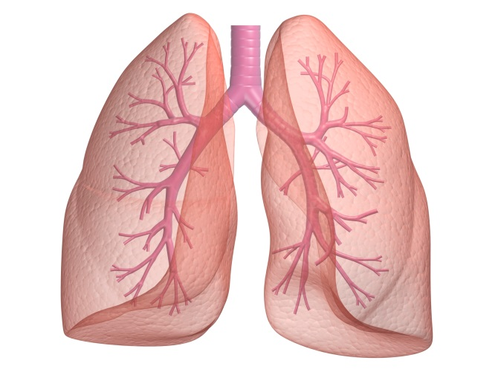
ASTHMA
People who never had asthma can develop it due to workplace exposures to ISOCYANTES
People with asthma may find that their condition gets worse due to workplace exposures to ISOCYANATES
Some people can also become sensitized to the chemical
Some ISOCYANATES (but not all) are classified as potential human carcinogens
It is important to check the Safety Data Sheet (SDS) to see which Isocyanates may be present and WHAT actions should be taken if there is a potential hazard
Notes:
People who never had asthma can develop asthma due to workplace exposures. People who have had asthma for years may find that their condition get worse due to workplace exposures.
Some people can also become sensitive to the chemical and develop a skin rash if it gets on the body. There are some Isocyanates (but NOT all isocyanates) that are classified as potential human carcinogens –chemicals that may cancer.
Since Isocyanates are a GROUP of chemicals and not all of the substances in this group have the same effect on the body, it is important to CHECK THE SDS to see which isocyanate may be present and WHAT actions should be taken if there is a potential hazard.

Slide 21
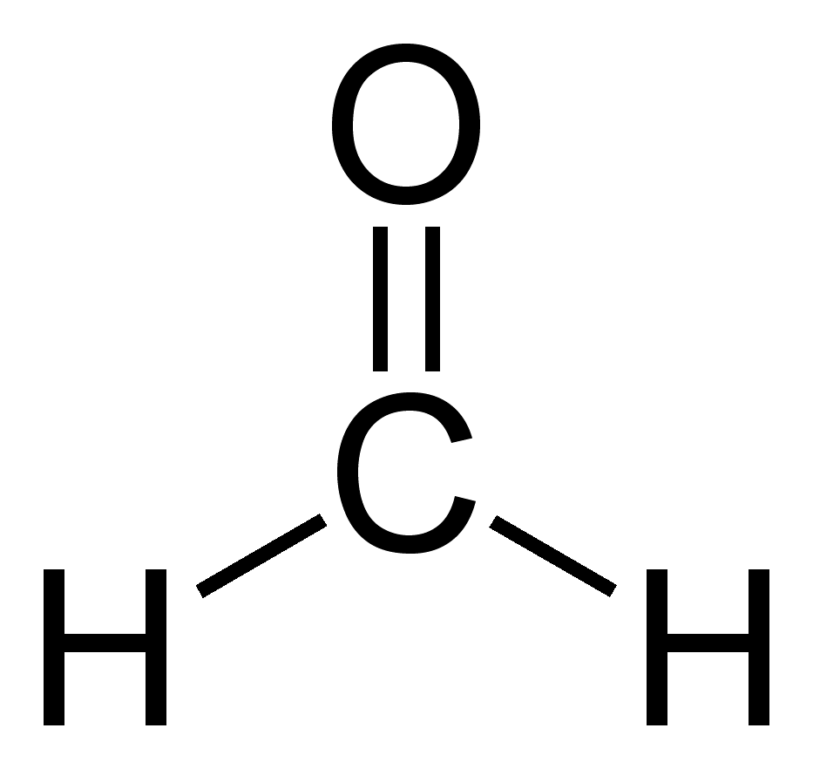
FORMALDEHYDE
One chemical that MAY be in some products used to bind sand together is FORMALDEHYDE
If this chemical is present in the product or is created when used, the Safety Data Sheet (SDS) will show us!
Notes:
One chemical that MAY be in some products used to bind sand together but more often is a result of MIXING the chemicals or the DESTRUCTION or burning of the chemicals when the hot metal is poured into the mold is FORMALDEHYDE.
If this chemical is present in the product or is created when it is used , the Safety Data Sheet will show us!

Slide 22
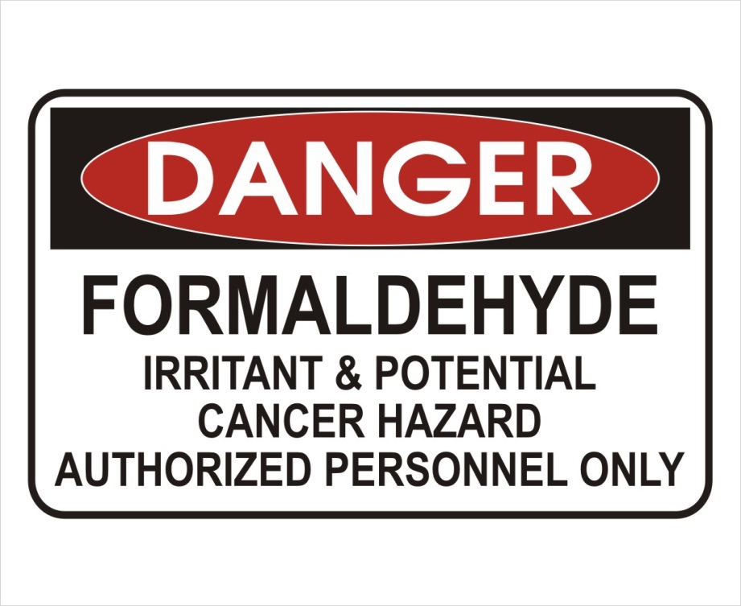
FORMALDEHYDE
A colorless, strong-smelling gas
A sensitizing agent
Classified as a cancer hazard
Eating or drinking FORMALDEHYDE can be fatal
Long term exposure to low levels can cause asthma and skin irritation
Notes:
Formaldehyde is a colorless, strong-smelling gas and is another chemical that is a sensitizing agent. This means that it can cause the cause an allergy like response once a person is exposed to it. Formaldehyde is also classified as a cancer hazard. Eating or drinking formaldehyde can be fatal. Long-term exposure to low levels in the air or on the skin can cause asthma-like respiratory problems and skin irritation such as dermatitis.

Slide 23
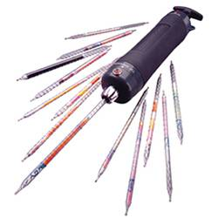
FORMALDEHYDE
If FORMALDEHYDE is present in the workplace, OHSA requires employers to identify all workers who may be exposed by doing AIR SAMPLING to see if exposures are above the PEL set to keep workers safe
Formaldehyde Air Sampling Equipment
Notes:
If formaldehyde is present in the workplace, the OSHA Formaldehyde standard require employers to Identify all workers who may be exposed to formaldehyde by doing air samples to see if exposures are at or above standards set to keep workers safe.

Slide 24
FORMALDEHYDE
It tests show levels of FORMALDEHYDE are at or above the PEL, the company must use feasible engineering and work practice controls to reduce these levels
The PEL for FORMALDEHYDE is 0.75 parts per million measured as an 8-hour Time Weighted Average (TWA)
A second PEL in the form of a short-term exposure limit (STEL) of 2 parts per million which is the maximum exposure allowed during a 15-minute period
Notes:
If the tests show the levels of Formaldehyde are at or above the Permissible Exposure Limit, the company must use feasible engineering and work practice controls to reduce these levels to below the permitted level. The permissible exposure limit (PEL) for formaldehyde in the workplace is 0.75 parts formaldehyde per million parts of air (0.75 ppm) measured as an 8-hour time-weighted average (TWA).
The standard includes a second PEL in the form of a short-term exposure limit (STEL) of 2 ppm which is the maximum exposure allowed during a 15-minute period.

Slide 25
FORMALDEHYDE
All elements of a FORMALDEHYDE program must be in a written document kept up to date by the foundry
OSHA standard includes an ACTION LEVEL of 0.5 parts per million (8 hour TWA). Tests at or above this level require more air sampling, along with training and medical surveillance of the affected workers
If control efforts cannot reduce exposure to acceptable levels, workers will be given respirators and other PPE needed, such as clothing, gloves, aprons, and chemical splash goggles
Notes:
All of the elements of the Formaldehyde program must be in a written document that is kept up to date by the foundry.
The OSHA Formaldehyde standard also includes an action level of – is 0.5 ppm when calculated as an 8-hour TWA. If tests show that formaldehyde is in the at levels that meet or above this action level, there more air sampling will be required along with training and medical surveillance of the affected workers.–
If these controls efforts cannot reduce exposure to the acceptable level, workers will be given
Respirators and any other protective equipment needed such as impervious clothing, gloves, aprons, and chemical splash goggles.

Slide 26
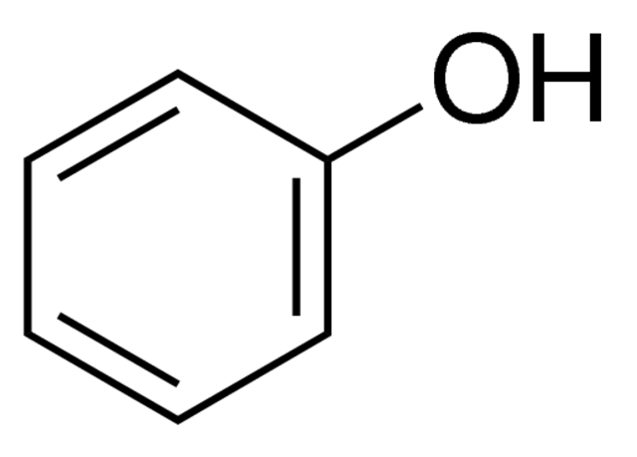
PHENOL
One other chemical commonly found in many core making processes is PHENOL
PHENOL has an odor that is unpleasant to many people
At low levels, PHENOL may be irritating to the eyes, nose and throat
At high concentrations, PHENOL can cause dermatitis or chemical burns
Notes:
One other chemical commonly found in many core making processes is PHENOL. Phenol is a chemical that is used in many ways – from making plastics to use as a disinfectant and ingredient in medications and cosmetics. However, as for many chemicals, the proper amount and use of Phenol is useful and safe, but too much improperly used may be harmful.
At low levels in the foundry, Phenol may be irritating to the eyes, nose and throat. It has an odor that is unpleasant to many people. Sine Phenol is mildly acidic, at high dosages or concentrations it can cause dermatitis or chemical burns.

Slide 27
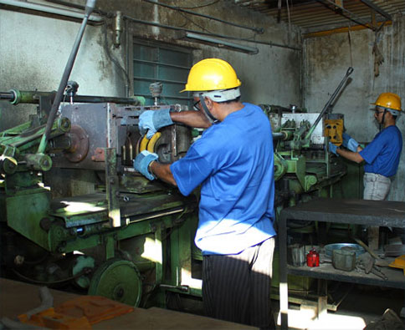
PHENOL
PHENOL is most often used in the core room in solid form
The amount of PHENOL is usually quite small, but the Safety Data Sheet will report if it is present and how much is used in the product
Notes:
Phenol is most often used in the foundry in the core room in the solid form. The amount of Phenol is usually quite small, but the Safety Data Sheet will report if this chemical is present and how much is used in the product.

Slide 28
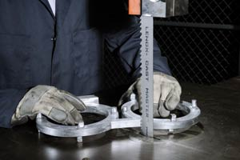
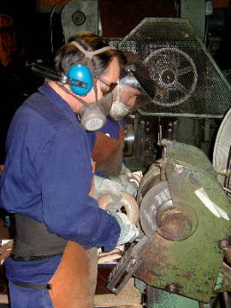
Cleaning and Finishing
Band saws may be used to separate castings from the gates and runners
Excess metal may also be removed with hand held or stationary grinders
Belt sanders may finish the surface of the casting
Blast systems use abrasive materials to produce the external finish on castings
Notes:
Once the casting is removed from the mold, it may require removal of unwanted metal or sand that has adhered to the surface. Cut off saws may be used to separate castings from the gates and runners – the hollow system in the mold that delivers the metal to the mold where the casting shape is located.
Excess metal may also be removed with hand held or stationary grinders. Castings may also be placed in a blast system where abrasive materials are used to produce the final external finish of the metal piece.

Slide 29
Cleaning and Finishing
If any silica sand remains on the casting, it could become airborne and present the same hazards as in sand system operations
The finishing/grinding processes may also remove very small particles of aluminum from the casting
If the particles are small enough, they can become airborne and be breathed by workers
Notes:
In these processes, if there is any silica sand remaining on the casting, it could become airborne and present the same hazards described in the sand system operations. Airborne silica can cause lung damage and is a potential lung carcinogen.
The grinding and finishing processes may also remove very small particles of aluminum from the casting. If these particles are small enough, they can become airborne and be breathed in by workers in the area.

Slide 30
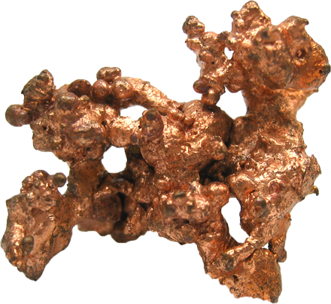
Copper
Copper is the main ingredient in brass and bronze castings
Copper is a naturally occurring metallic element and an essential nutrient
Not enough copper in bodies can lead to anemia, osteoporosis and defects in connective tissue
Too much copper in high dosages over a short period can cause temporary gastrointestinal distress such as nausea, vomiting and abdominal pain
Notes:
Copper is the main ingredient in brass and bronze castings. It is the main metal used in the pipes and fittings that deliver water to our homes and the wires that carry power to our devices. Copper is a naturally-occurring metallic element and is present in all animals and plants – in fact copper is an essential nutrient for humans and animals in small amounts. If humans do not have enough copper in their bodies, this deficiency can lead to anemia, low numbers of white blood cells, osteoporosis in infants and children, and defects in connective tissue that can result in skeletal problems.
However, too much copper in high dosages over a short time period can cause temporary gastrointestinal distress with symptoms such as nausea, vomiting, and abdominal pain.

Slide 31
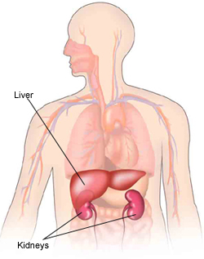
Copper
Mammals (including humans) have efficient mechanisms to regulate copper in the body
This protects against chronic or lower exposures that occur over an extended time period
However, at high enough levels, chronic overexposure to copper can damage the liver and kidneys
Notes:
Mammals (including humans) have efficient mechanisms to regulate the copper that is stored in the body. In this way we are generally protected from excess copper levels. This protects against chronic or lower exposures that occur over an extended time period. However, if the at high enough levels, chronic overexposure to copper can damage the liver and kidneys.

Slide 32
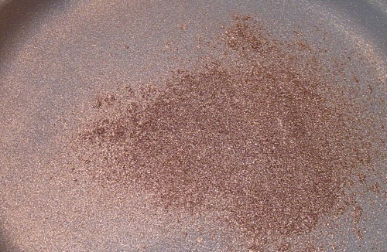
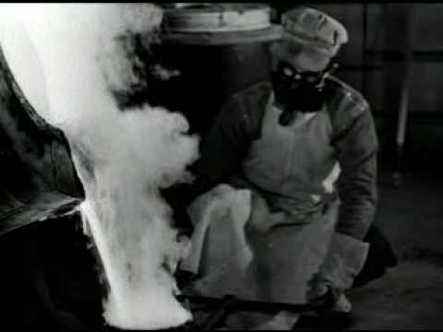
Permissible Exposure Limits (PEL) for Copper Dusts and Fumes
Copper has two exposure limits:
Dusts
Fumes
The PEL for Copper DUST is 1 mg/m³.
The PEL for Copper Fume is 0.1 mg/m³
Notes:
OSHA has two exposure limits, one for Dust and another for Fume. For DUST, the allowable level is 1 mg/m³ However, if the Copper is in the FUME form, the Permissible Exposure Limit is only 0.1 mg/m³ since fume particles are so much smaller and could be more easily enter the body and be absorbed.

Slide 33
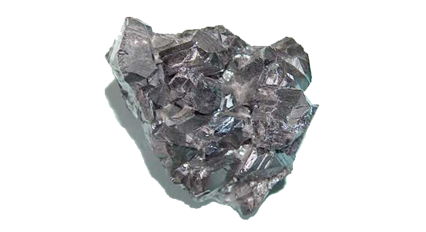
Zinc
One of the most common elements in the Earth’s crust
Bluish-white metal has many uses, such as coating steel and as an alloying element in the foundry
People with too little zinc can have a loss of appetite, decreased taste/smell and decreased immune function
Essential for the proper development of the young
Notes:
ZINC is another commonly used metal in brass and bronze alloys. Zinc is one of the most common elements in the Earth's crust. Zinc is found in the air, soil, and water and it is present in all foods. This bluish-white metal has many uses in our modern world as well, such as a coating on steel and as an alloying element in the foundry.
Zinc is another metal like copper that is essential to our good health. People with too little zinc in their bodies can develop a loss of appetite, decreased sense of taste and smell, decreased immune function, slow wound healing, and skin sores. Zinc is also essential to the proper development of the young. Too little zinc in the diet may also cause poorly developed sex organs and retarded growth in young men. If a pregnant woman does not get enough zinc, her babies may have birth defects.

Slide 34
Zinc
Enters the body through ingestion (eating or drinking) or by breathing it into the lungs
If workers breath in large amounts of zinc, they can develop “metal fume fever” – a flu like illness that lasts for a day or two with head ache, fever and chills as symptoms.
Usually short term that reverses once exposure to zinc stops
Permissible Exposure Limit (PEL) for Zinc is 5 mg/m³.
Notes:
Zinc enters the body through ingestion (eating or drinking) or breathing it in. If workers breath in large amounts of zinc (as zinc dust or fumes) they can develop a disease called metal fume fever, a flu like illness that lasts for a day or two with head ache, fever and chills as symptoms. This is usually a short term problem that is generally reversible once exposure to zinc stops.
The OSHA Permissible Exposure Limit for these Zinc fumes is 5 mg/m³.

Slide 35
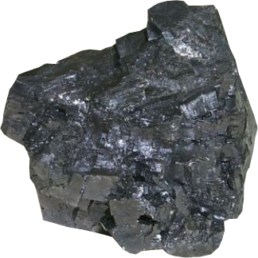
Lead
Present is SOME, but not all, Copper alloys
One of the first metals used by humans; caused the first recorded disease in a worker
Used in most automobile batteries and as an alloy with other metals.
Alloy in brass and bronze in varying amounts from less than 1% to over 10%
Notes:
One metal that is present in SOME Copper alloys but not all is LEAD. Lead is another metal that is found in nature in the Earth’s crust. Lead was one of the first metals used by humans and caused the first recorded disease in a worker - lead colic in a 4th century BC metal worker.
Today, lead is used in most automobile batteries and as an alloy with other metals, in making some types of ammunition, pipes, cable covering, building material, solder, radiation shielding, collapsible tubes, and stabilizers in plastics. It can be an alloy in brass and bronzes in varying amounts from less than one percent to over 10 per cent.
Lead enters our body mostly by breathing it in or ingestion (eating or drinking).
Employers are required to protect workers from lead exposure under OSHA lead standards covering general industry (1910.1025), The lead standards establish a permissible exposure limit (PEL) of 50 µg/m3 of lead over an eight-hour time-weighted-average for all employees covered. The standards also set an action level of 30 µg/m3, at which an employer must begin specific compliance activities.

Slide 36
Lead
Enters the body through ingestion (eating or drinking) or by breathing it into the lungs
Employers are required to protect workers from lead exposure by OSHA
The Permissible Exposure Limit (PEL) is 50 µg/m³ of lead over an 8 hour time weighted average
An Action Level has also been established at 30 µg/m³, at which an employer must begin specific compliance activities
Notes:
Lead enters our body mostly by ingestion (eating or drinking) or by breathing it into the lungs.
Employers are required to protect workers from lead exposure under OSHA lead standards covering general industry (1910.1025), The lead standards establish a permissible exposure limit (PEL) of of lead over an eight-hour time-weighted-average for all employees covered. The standards also set an action level of 30 µg/m3, at which an employer must begin specific compliance activities.

Slide 37
Lead Program
If you have LEAD in your foundry, a special LEAD PROGRAM will include:
Testing the air for lead
Training employees who may be exposed
Medical tests including periodic blood lead tests for some employees
Special work clothing for exposed employees
Special work rules in lead areas including no smoking, drinking, or eating in these areas and no dry sweeping of floors or surfaces that may have lead on them
Clean and contaminated areas for clothes worn into the plant and those worn in the work areas
Respirators for areas above the Permissible Exposure Limit
Rules to keep lead away from lunch rooms and to keep the lead from being taken home after work
Engineering Controls to keep the amount of lead in the air to below the allowable levels
Notes:
If there is exposure to Lead at your plant, there will be a special LEAD PROGRAM established that will include:
Testing the air for lead
Training employees who may be exposed
Medical tests including periodic blood lead tests for some employees
Special work clothing for exposed employees
Special work rules in lead areas including no smoking, drinking, or eating in these areas and no dry sweeping of floors or surfaces that may have lead on them
Clean and contaminated areas for clothes worn into the plant and those worn in the work areas
Respirators for areas above the Permissible Exposure Limit
Rules to keep lead away from lunch rooms and to keep the lead from being taken home after work
Engineering Controls to keep the amount of lead in the air to below the allowable levels
The written Lead Program, if required in your foundry, will include these measures as well as others that may be needed to meet the standard and protect workers.

Slide 38
Lead
Chronic (Long Term) exposure to Lead can be associated with:
Poor kidney function
High blood pressure
Nervous system and neurobehavioral effects
Cognitive dysfunction later in life
Chronic exposure to Lead at higher levels have been found to cause:
Damage to sperm/semen quality
Lower reaction times
Attention deficit
Notes:
Scientific studies indicate that chronic (long term) exposure to lead can be associated with:
poor kidney function
high blood pressure
nervous system and neurobehavioral effects
cognitive dysfunction later in life
Pregnant women need to be especially careful since high levels of lead in the blood can have serious impact on the developing babies.
Chronic exposures at higher levels have been found to potentially n cause damage to sperm/semen quality and delayed conception. High Lead exposure have also been associated with effects such as cognitive aging and deficits in visuomotor dexterity, lower reaction times and attention deficit. Workers with high blood lead have shown symptoms such as headache, fatigue, sleep disturbance, joint pain, myalgia, anorexia, and constipation.
While much less common today, workers can be exposed to high lead levels (when blood leads are over 60 µg/dL) can suffer from acute effects such as convulsions, coma, and in some cases, death, to more chronic conditions such as anemia, peripheral neuropathy, interstitial kidney fibrosis, and severe abdominal cramping.

Slide 39

Lead
Workers with high blood lead levels have shown symptoms such as headache, fatigue, sleep disturbance, joint pain, myalgia, anorexia, and constipation
Workers with VERY high blood lead levels can suffer from conditions including anemia, peripheral neuropathy, interstitial kidney fibrosis, severe abdominal cramping, convulsions, coma and death
Notes:
Workers with high blood lead have shown symptoms such as headache, fatigue, sleep disturbance, joint pain, myalgia, anorexia, and constipation.
While much less common today, workers can be exposed to high lead levels (when blood leads are over 60 µg/dL) can suffer from acute effects such as convulsions, coma, and in some cases, death, to more chronic conditions such as anemia, peripheral neuropathy, interstitial kidney fibrosis, and severe abdominal cramping.

Slide 40
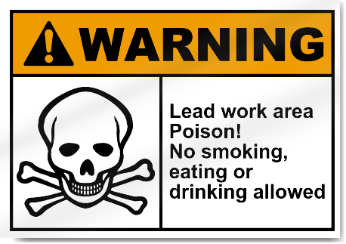
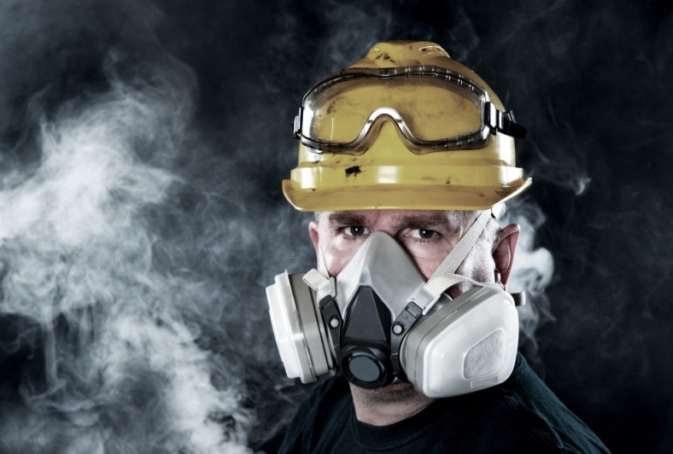
Lead
The use of respirators, proper washing of hands and face before eating, smoking or drinking and following ALL of the Lead Program Rules is important!
These measures PROTECT workers from lead exposure
The medical surveillance program & blood testing help to be sure these measures are protecting people from the effects of LEAD
Notes:
The use of respirators, proper washing of hands and face before eating, smoking, or drinking and following ALL of the Lead Program rules is important. These measures PROTECT workers from lead exposure, and the medical surveillance program and blood lead testing help to be sure that these measures are doing their job in protecting people from the effects of lead.

Slide 41
Cadmium and Beryllium
Used in some foundries to make special castings
Not used is most nonferrous foundries
Special rules and programs are required by OSHA for these metals
Will be listed on Safety Data Sheets
Notes:
Two other metals that are used in some nonferrous foundries to make special castings are cadmium and beryllium. While these metals are NOT used in most nonferrous foundries, they also have special rules and programs required by OSHA. If these metals are used in your foundry, they will be listed on the Safety Data Sheet.

Slide 42
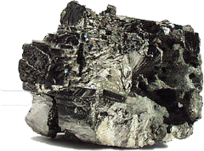
Beryllium
Lightweight, hard metal found in nature
Good conductor of electricity and heat and is non-magnetic
Applications include jet brake pads, aerospace components, ceramic manufacturing, semiconductors, jet engine blades, rocket covers, atomic energy applications, dental alloys, sporting goods and much more!
Notes:
Beryllium is another metal that is found in nature, It is extremely lightweight and hard, is a good conductor of electricity and heat, and is non-magnetic. These properties make beryllium useful for many industrial uses, including jet brake pads, aerospace components; ceramic manufacturing, semi-conductor chips, ignition modules, jet engine blades, rocket covers ; atomic energy applications (heat shields, nuclear reactors, nuclear weapons); dental alloys (crowns, bridges, dental plates); and sporting goods (golf clubs, bicycle frames).
The current OSHA PELs for beryllium are 2 micrograms/m3 as an 8-hour TWA, 5 micrograms/m3as a ceiling not to be exceeded for more than 30 minutes at a time, and 25 micrograms/m3as a peak exposure never to be exceeded.

Slide 43
Beryllium
OSHA Permissible Exposure Limit (PEL) for Beryllium is:
2 µg/m³ as an 8-hour TWA
A ceiling of 5 µg/m³ not to be exceeded for more than 30 minutes a time
25 µg/m³ as a peak exposure limit never to be exceeded
Notes:
The current OSHA PELs for beryllium are 2 micrograms/m3 as an 8-hour TWA, 5 micrograms/m3as a ceiling not to be exceeded for more than 30 minutes at a time, and 25 micrograms/m3as a peak exposure never to be exceeded.

Slide 44
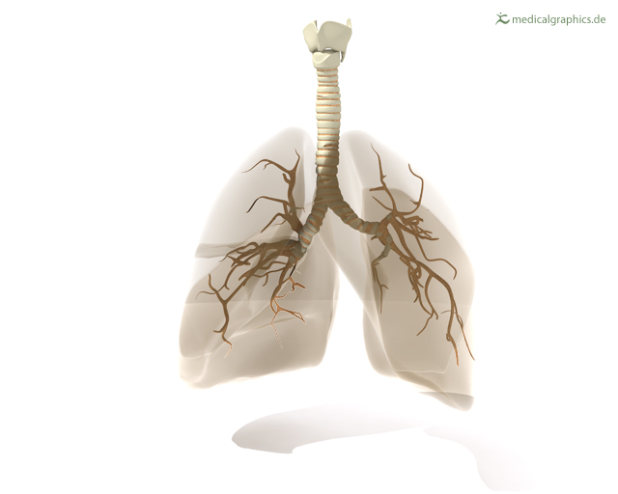
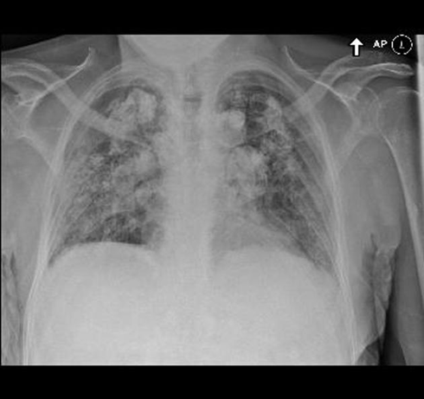
Chronic Beryllium Disease (CBD)
Primarily affects the lungs
Very slow onset
Symptoms include
Unexplained cough
Shortness of breath
Fatigue
Weight loss/loss of appetite
Fever
Night Sweats
Workers may have the disease for a long time without knowing it
Only develops in workers who have become SENSITIZED to Beryllium
Notes:
Chronic beryllium disease (CBD) primarily affects the lungs. It may occur among people who are breath in the dust or fumes from beryllium metal, metal oxides, alloys, ceramics or salts . Chronic beryllium disease usually has a very slow onset, and even very small amounts of exposure to beryllium can cause the disease in some people. Chronic beryllium disease can develop while workers are still on the job or it may not develop until many years after a person has stopped working in the beryllium industry.
Workers with advanced Chronic beryllium disease may show one or more of the following symptoms: unexplained cough; shortness of breath, especially with activity; fatigue; weight loss or loss of appetite; fever; or night sweats. However, because the disease may develop slowly over a period of many years, workers may have the disease for a long time without knowing it.
Chronic beryllium disease only develops in workers who have become sensitized to beryllium. A sensitized worker is someone who has developed an allergic reaction to beryllium. A worker may become sensitized at any point during job exposure, or in some cases he or she may not become sensitized until after leaving a job where there was beryllium exposure.
Acute beryllium disease (where there is high exposure over a short period of time) usually has a quick onset and has symptoms that resemble pneumonia or bronchitis. The acute form of the disease is believed to occur as a result of exposures well above the current OSHA Permissible Exposure Limit. This form of beryllium disease is now reported to be rare.
Workers exposed to beryllium have been found to have higher than normal risks of lung cancer. The International Agency for Research on Cancer (IARC), the expert cancer agency of the World Health Organization, has concluded that exposure to beryllium can cause lung cancer in humans.
This is one metal that can also be a concern when it comes into contact with your skin. A skin disease, that is characterized by poor wound healing and a rash or wart-like bumps can occur as a result of the skin being exposed to beryllium dust.

Slide 45
Acute Beryllium Disease (ABD)
Usually has a quick onset
Symptoms resemble pneumonia or bronchitis
Believed to occur as a result of exposures well above the OSHA Permissible Exposure Limit
This form of beryllium disease in now reported to be rare
Notes:
Acute beryllium disease (where there is high exposure over a short period of time) usually has a quick onset and has symptoms that resemble pneumonia or bronchitis. The acute form of the disease is believed to occur as a result of exposures well above the current OSHA Permissible Exposure Limit. This form of beryllium disease is now reported to be rare.

Slide 46
Beryllium Hazards
Workers exposed to beryllium have higher than normal risks of lung cancer
Exposure to Beryllium can cause lung cancer in humans
Contact with skin can also present a hazard
Skin disease, including poor wound healing and a rash or wart-like bumps, can occur as a result of contact with Beryllium dust
Notes:
Workers exposed to beryllium have been found to have higher than normal risks of lung cancer. The International Agency for Research on Cancer (IARC), the expert cancer agency of the World Health Organization, has concluded that exposure to beryllium can cause lung cancer in humans.
This is one metal that can also be a concern when it comes into contact with your skin. A skin disease, that is characterized by poor wound healing and a rash or wart-like bumps can occur as a result of the skin being exposed to beryllium dust.

Slide 47
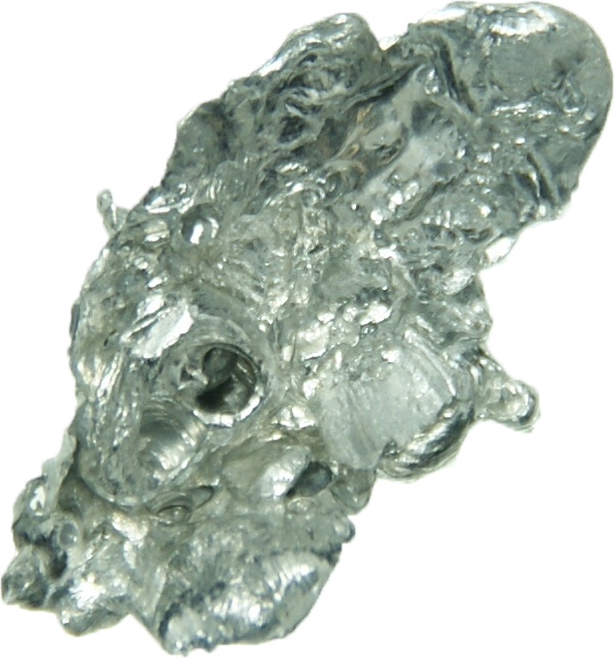
Cadmium
Soft, malleable, bluish white metal found in zinc ores
Most Cadmium today is obtained from zinc byproducts and recovered from spent nickel-cadmium batteries
Used as a paint pigment in early 1800s
An important metal in the production of rechargeable batteries, alloys, coatings, solar cells, plastic stabilizers, and pigments
Notes:
Cadmium (Cd) is a soft, malleable, bluish white metal found in zinc ores. Most of the cadmium produced today is obtained from zinc byproducts and recovered from spent nickel-cadmium batteries. In the early 1800’s cadmium was used as a paint pigment because of its ability to produce brilliant yellow, orange, and red colors. Cadmium became an important metal in the production of nickel-cadmium (Ni-Cd) rechargeable batteries and common industrial uses for cadmium today are in batteries, alloys, coatings (electroplating), solar cells, plastic stabilizers, and pigments.
Cadmium and its compounds are highly toxic and exposure to this metal is known to cause cancer. This metal targets the body's cardiovascular, renal, gastrointestinal, neurological, reproductive, and respiratory systems. OSHA has a Cadmium standard that includes foundries under its regulation 1910.1027.

Slide 48
Cadmium
Cadmium and its compounds are HIGHLY toxic
Exposure to Cadmium is known to cause cancer
Targets the body’s cardiovascular, renal, gastrointestinal, neurological, reproductive and respiratory systems
OSHA has a Cadmium standard that includes foundries (29CFR1910.1027)
Notes:
Cadmium and its compounds are highly toxic and exposure to this metal is known to cause cancer. This metal targets the body's cardiovascular, renal, gastrointestinal, neurological, reproductive, and respiratory systems. OSHA has a Cadmium standard that includes foundries under its regulation 1910.1027.

Slide 49
Cadmium Program
If you have CADMIUM in your foundry, a special CADMIUM PROGRAM will include:
Testing the air for Cadmium
Training employees who may be exposed
Medical tests including periodic tests for some employees
Special work clothing for exposed employees
Special work rules in Cadmium areas including no smoking, drinking, or eating in these areas and no dry sweeping of floors or surfaces that may have Cadmium on them
Clean and contaminated areas for clothes worn into the plant and those worn in the work areas
Respirators for areas above the Permissible Exposure Limit
Rules to keep Cadmium away from lunch rooms and to keep the Cadmium from being taken home after work
Engineering Controls to keep the amount of Cadmium in the air to below the allowable levels
Notes:
If there is exposure to Cadmium at your plant, there will be a special CADMIUM PROGRAM established that will include:
1) Testing the air
2) Training employees who may be exposed
3) Medical tests including periodic tests for some employees
4) Special work clothing for exposed employees
5) Special work rules in cadmium areas including no smoking, drinking, or eating in these areas and no dry sweeping of floors or surfaces that may have Cadmium on them
6) Clean and contaminated areas for clothes worn into the plant and those worn in the work areas
7) Respirators for areas above the Permissible Exposure Limit
8) Rules to keep cadmium away from lunch rooms and to keep the Cadmium from being taken home after work
9) Engineering Controls to keep the amount of cadmium in the air to below the allowable levels
The written Cadmium Program, if required in your foundry, will include these measures as well as others that may be needed to meet the standard and protect workers.

Slide 50
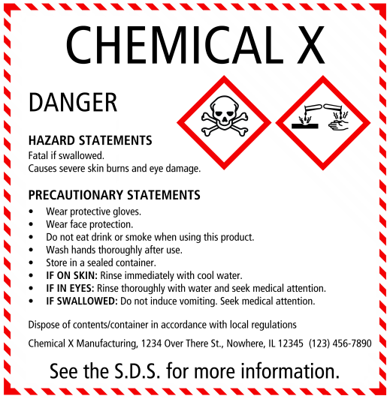
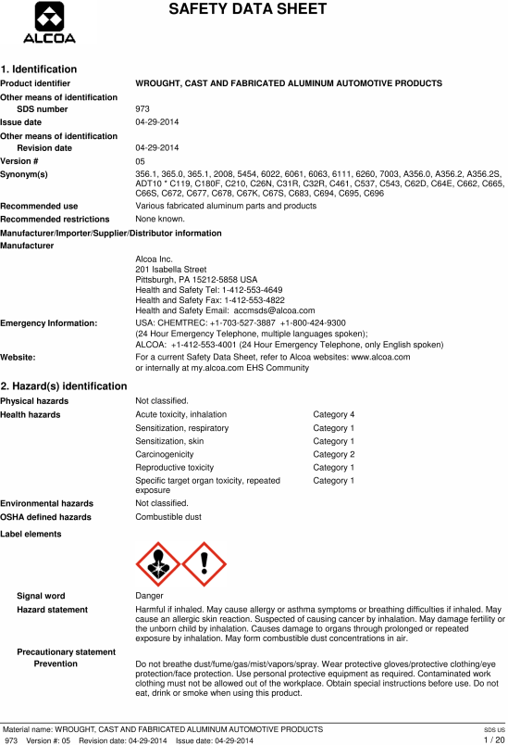
Be Informed!
The place where YOU work may not have all of these metals or chemicals in your department
The way we know WHAT we work with and HOW it can affect us begins with reading and understanding the SAFETY DATA SHEET and product LABELS!
Notes:
The place where YOU work may not have all of these metals or chemicals in your department. The way that we know WHAT we work with and HOW it can affect us begins with reading and understanding the Safety Data Sheet and Labels.

Slide 51
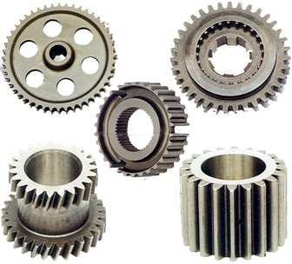


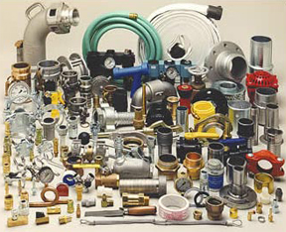
Work Safely!
We can safely make the Brass and Bronze castings that are so important to daily life by understanding the chemicals and processes we use in the foundry!
Notes:
Brass and Bronze castings are very important to our modern world. These castings are used in our homes, in our cars and electronics and at our workplace. We can make the castings safely by understanding the chemicals and processes we use in the Brass and Bronze foundry!

Slide 52

Acknowledgements
This material was produced under grant number SH-26318-SH4 from the Occupational Safety and Health Administration, U.S. Department of Labor. It does not necessarily reflect the views or policies of the U.S. Department of Labor, nor does mention of trade names, commercial products, or organizations imply endorsement by the U.S. Government

Slide 53

Non-Ferrous Founders’ Society Safety & Health Training Program
For further information about this or other training modules:
Non-Ferrous Founders’ Society
1480 Renaissance Drive, Suite 310
Park Ridge, IL 60068 847/299-0950 http://www.nffs.org

