Slide 1


Non-Ferrous Founders’ Society
Safety & Health Training Program
Hazard Communication/GHS Training Program
Train-the-Trainer Webinar
© 2015 All Rights Reserved

Slide 2
WHY train your employees?
Employees need to know what types of hazards are in YOUR foundry, how to recognize them and what is necessary to protect against these hazards. Employees also need to know what programs are in place at your foundry and how to get access to any information or equipment needed.

Slide 3
WHY use this Program?
These training modules were developed to assist you by providing effective and updated Hazard Communication Training that is aligned with the Globally Harmonized System (GHS).
The training modules in this program were developed for non-ferrous foundries. However, they may be adapted for use ingot makers and ferrous foundries with the addition of materials that apply to these industries.

Slide 4
Background
NFFS received a Susan B. Harwood Grant in October, 2014 to provide training on the new GHS hazard communication requirements to the non-ferrous foundry industry
“Updated Hazard Communication training program aligned with GHS requirements, emphasizing hazard identification and exposure prevention for metals, silica and isocyanates”
Program and materials funded by OSHA under grant number SH-26318-14-60-F-17

Slide 5
The Training Modules
The program includes 7 training modules:
  Module 1: Worker’s Rights Under OSHA
  Module 2: GHS/HazCom and the Non-Ferrous Foundry
  Module 3: Safety Data Sheets
  Module 4: Labels
  Module 5: Air Contaminants in the Non-Ferrous Foundry
  Module 6: Aluminum Foundries
  Module 7: Brass and Bronze Foundries

Slide 6
The Training Modules
The modules can be presented to workers individually or in groups
Five of the modules (1-5) are applicable to both Aluminum and Copper alloy foundries
There is also a module developed specifically for Aluminum foundries (6) and a different module for Copper alloy foundries (7)
Written materials are also available to trainers on how to use the training modules to train their own employees

Slide 7
Please Note!
You can modify this material, or add to it, to reflect the conditions and operations in your foundry. Be sure to update and use the available PowerPoint slides with the written content as the base of your training program. Copies of the slides and written narrative are designed as a ‘take-away’ for employees to use as an information resource and for future referral.

Slide 8
Train-The-Trainer
Train-the-Trainer Guidance Document
  Directory of Training Modules Available
  Introduction to the Train-the-Trainer Program
  The Training Process – Step by Step
  Module 1: Workers’ Rights
  Module 2: GHS/HazCom and the Non-Ferrous Foundry
  Module 3: Safety Data Sheets
  Module 4: Labels
  Module 5: Air Contaminants in the Non-Ferrous Foundry
  Module 6: Aluminum Foundries
  Module 7: Brass and Bronze Foundries
  Additional Trainer Resources

Slide 9
The Training Process – Step by Step
Log in to the website to access the training modules and trainer resources:
    www.nffs.org/NFFStar/ghs
Download and read the Train-the-Trainer Guidance Document to prepare in advance of training your foundry employees
Download the relevant training modules for your foundry
Print copies of the employee handouts for each training module to be presented for each employee to be trained

Slide 10
The Training Process – Step by Step
Print copies of the pre- and post- training examination for each employee to be trained, as well as an attendance roster with each employee’s name and a space for each employee’s signature
It is important for the trainer to read the written content for each slide of each training module to be presented. You must UNDERSTAND the content to be presented PRIOR to presenting the content to your employees!

Slide 11
The Training Process – Step by Step
Conduct the training program
  Welcome the training program participants
  Introduce the training topic(s), and make general introductory comments
  Explain that you will request a pre- and post- exam from each attendee to ensure that the training has been effective for all employees. Specifically mention that the quiz is to measure the effectiveness of the training materials, and will not be used to make judgements about the effectiveness of a particular employee

Slide 12
The Training Process – Step by Step
Conduct the training program (continued)
  Distribute the pre-exam to all training attendees
  Collect the pre-examination when attendees are finished
  Present the selected training modules, using the written comments provided with each slide, to help guide your training
  Ensure you provide opportunity for attendees to ask questions, and try to provide a meaningful answer in response

Slide 13
The Training Process – Step by Step
Conduct the training program (continued)
  Complete each training module to be presented
  Distribute the post-exam to all training attendees
  Analyze the training program effectiveness
    Grade the pre-exam and post-exam for each training program participant
    Calculate the average pre-exam and post-exam score

Slide 14
The Training Process – Step by Step
Conduct the training program (continued)
  Provide the training data back to NFFS
    Submit data at www.nffs.org/NFFStar/GHS/report
      Company Name (optional)
      Location (city,state)
      Which training modules were presented
      Pre-Exam and Post-Exam AVERAGE score

Slide 15
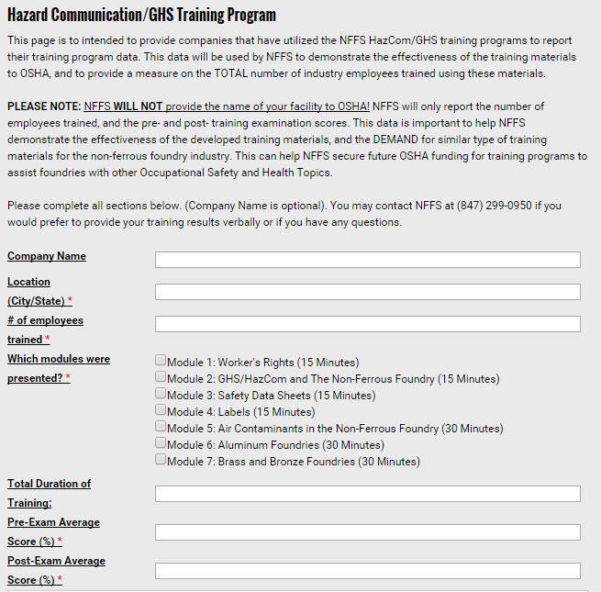

Slide 16
The Training Process – Step by Step
This data will be used by NFFS ONLY to demonstrate the effectiveness of the training materials, and to provide a measure on the total number of industry employees trained using these materials
NFFS will only report the number of employees trained, and the pre- and post- examination average score. This data is important to help NFFS secure future OSHA funding for training programs to assist foundries with other Occupational Safety and Health Topics

Slide 17
Non-Ferrous Founders’ Society
Safety & Health Training Program
Hazard Communication/GHS Training Program
Section 1: Worker’s Rights under OSHA
© 2015 All Rights Reserved

Slide 18
Module 1: Workers’ Rights Under OSHA
It is important for employees to know their rights under the OSHA regulations
An effective foundry safety and health program will provide the means for workers to convey their concerns to management

Slide 19
Module 1: Workers’ Rights Under OSHA
Trainers should review the module before presentation and have on hand:
  A Copy of the OSHA Poster. A copy can be downloaded from the internet at https://www.osha.gov/Publications/osha3165.pdf
  A PRINTED copy of the OSHA Poster can be purchased on line at https://www.osha.gov/pls/publications/publication.athruz?pType=Types&pID=6
  The OSHA web page on Workers’ Rights is found at https://www.osha.gov/workers/index.html
  An OSHA booklet on workers’ rights can be downloaded at https://www.osha.gov/Publications/osha3021.pdf

Slide 20
Employer Responsibilities
Employers have the responsibility to…
Provide their employees with a workplace that does not have serious hazards and follow all relevant OSHA safety and health standards;
Inform employees about chemical hazards through training, labels, alarms, color-coded systems, chemical information sheets and other methods;
Keep accurate records of work-related injuries and illnesses;
Perform tests in the workplace, such as air sampling, required by some OSHA standards;
Provide hearing exams or other medical tests required by OSHA standards;

Slide 21
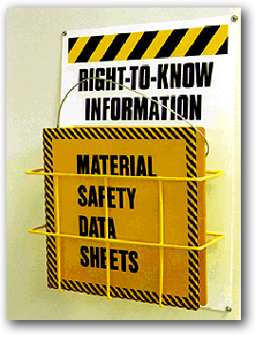
Workers’ Rights
Under the OSH Act
Workers have the right to…
Ask OSHA to inspect their workplace
Use their rights under the law without retaliation and discrimination;
Receive information and training about hazards, methods to prevent harm, and the OSHA standards that apply to their workplace. The training must be in a language you can understand;
Notes:
Do you know any of your rights as a worker under the OSH Act?

Slide 22

If OSHA standards are not met in the workplace…
So what else can I do? You have the
right to file a complaint!
How do I file a complaint with OSHA?
  File a complaint yourself or have a representative file one for you and ask OSHA to inspect your workplace
  Go to www.osha.gov and download the correct form, fill it out, and send it to the nearest OSHA office or
  Call 1-800-321-OSHA (6742) to ask them to send you the form
  Tell OSHA to keep your identity confidential

Slide 23

During The Inspection
You have the right to:
Go along with the inspection in your area (This helps the inspector identify problems)
Talk privately with the OSHA inspector
Call the inspector
Find out the results of the OSHA inspection

Slide 24

Can I be discriminated against for exercising my health and safety rights?
Employers cannot punish you in any way for:
  Reporting an injury or illness;
  Complaining to your employer, union, OSHA or other agencies about safety and health problems;
  Filing safety and health grievances;
  Participating in safety and health committees; or
  Participating in OSHA inspections and other OSHA-related activities.
  If you have been fired, demoted, transferred or discriminated against in any way for using your rights under the law, you must file a complaint with OSHA within 30 days.

Slide 25
Non-Ferrous Founders’ Society
Safety & Health Training Program
Hazard Communication/GHS Training Program
Module 2: GHS/HazCom and
the Non-Ferrous Foundry
© 2015 All Rights Reserved

Slide 26
Module 2: GHS/HazCom and the Non-Ferrous Foundry
This module applies to all type of foundries and can be used to introduce new employees to the Hazard Communication Program
Effective for retraining existing employees in the types of hazards they work with and how to recognize and protect against these hazards

Slide 27
Module 2: GHS/HazCom and the Non-Ferrous Foundry
Trainers should review the module before presentation and have on hand:
  A Copy of the OSHA Hazard Communication Standard
    https://www.osha.gov/FedReg_osha_pdf/FED20120326.pdf
  A copy of your company written Hazard Communication Program

Slide 28
Module 2: GHS/HazCom and the Non-Ferrous Foundry
Trainers should be certain to provide the following information that is specific to YOUR foundry:
Where the written Hazard Communication Program is located, and how an employee can gain access to it;
Where the Safety Data Sheets for affected workers are located and how an employee can gain access to them;
Person(s) responsible for maintaining the HazCom program;
How to get answers to any questions concerning chemicals used in the foundry or safe work practices;
You may find it useful to have sample Safety Data Sheets and Labels available as examples for your training participants

Slide 29
Module 2: GHS/HazCom and the Non-Ferrous Foundry
Additional resources for trainers:
  OSHA Hazard Communication Standard (1910.1200)
  OSHA Briefs on Hazard Communication, SDS and Labels
  Guide to The Globally Harmonized System of Classification and Labelling of Chemicals (GHS) – https://www.osha.gov/dsg/hazcom/ghs.html
  Pictograms that can be downloaded from the internet for each of the nine hazard classifications. Download for free in .eps, .jpg or .png format at https://www.osha.gov/dsg/hazcom/pictograms/index.html
Additional resources for trainees:
  OSHA Quick Cards for Hazard Communication https://www.osha.gov/pls/publications/publication.athruz?pType=types&pID=6

Slide 30
HazCom and the
Non-Ferrous Foundry
What is the Globally Harmonized System of Classification and Labeling of Chemicals (GHS)?
What is the goal of GHS?
What are the employer responsibilities under GHS?
What are Safety Data Sheets?
What are pictograms?
Notes:
In this section, we will learn:
What is the Globally Harmonized System of Classification and Labeling of Chemicals (GHS);
What is the goal of GHS;
What are the employer responsibilities under GHS;
What are Safety Data Sheets;
What are Pictograms.

Slide 31

HazCom and the
Non-Ferrous Foundry
GHS provides a common and coherent way to:
  Classify the chemicals used in the workplace, and;
  Communicate the hazard information on labels and safety data sheets with symbols and terms that will be used on both domestic and foreign products and chemicals
Notes:
Understanding these Safety Data Sheets and Labels is very important. In order to make these tools more uniform in our global economy, the Hazard Communication Standard (HCS) uses the Globally Harmonized System of Classification and Labeling of Chemicals (GHS). This system of classifying and identifying hazards gives a common and coherent way to:
◆ Classify the chemicals used in the workplace; and
◆ Communicate the hazard information on labels and safety data sheets with symbols and terms that will be used on both domestic and foreign products and chemicals.

Slide 32
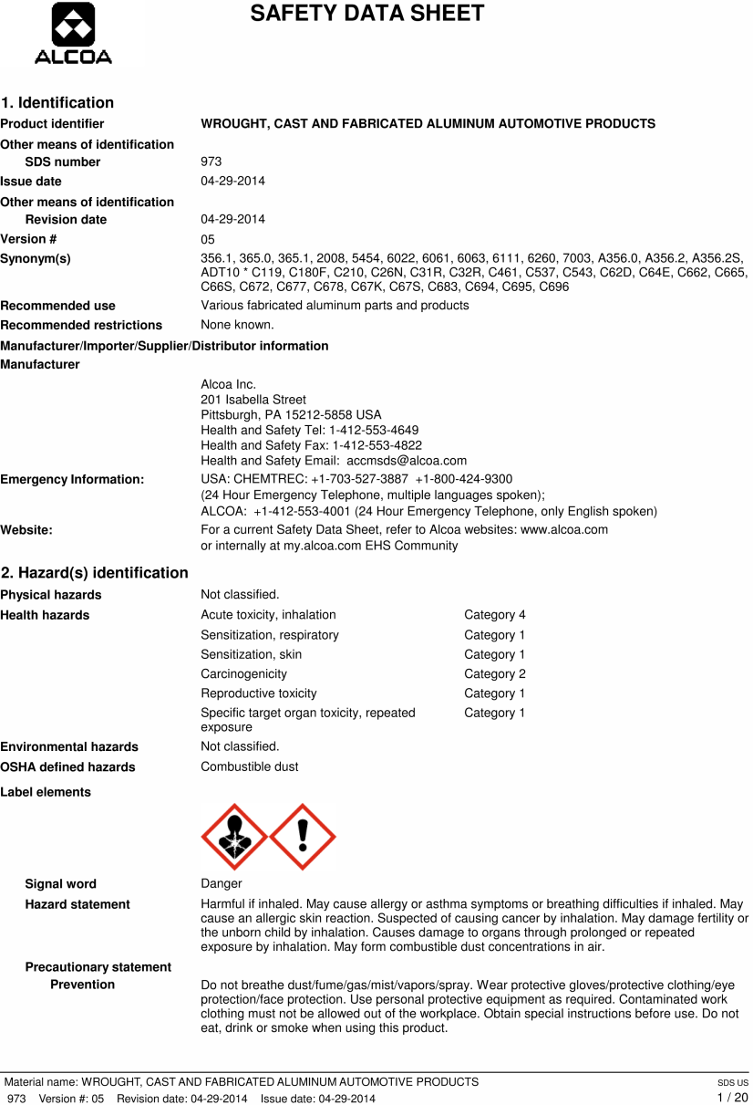
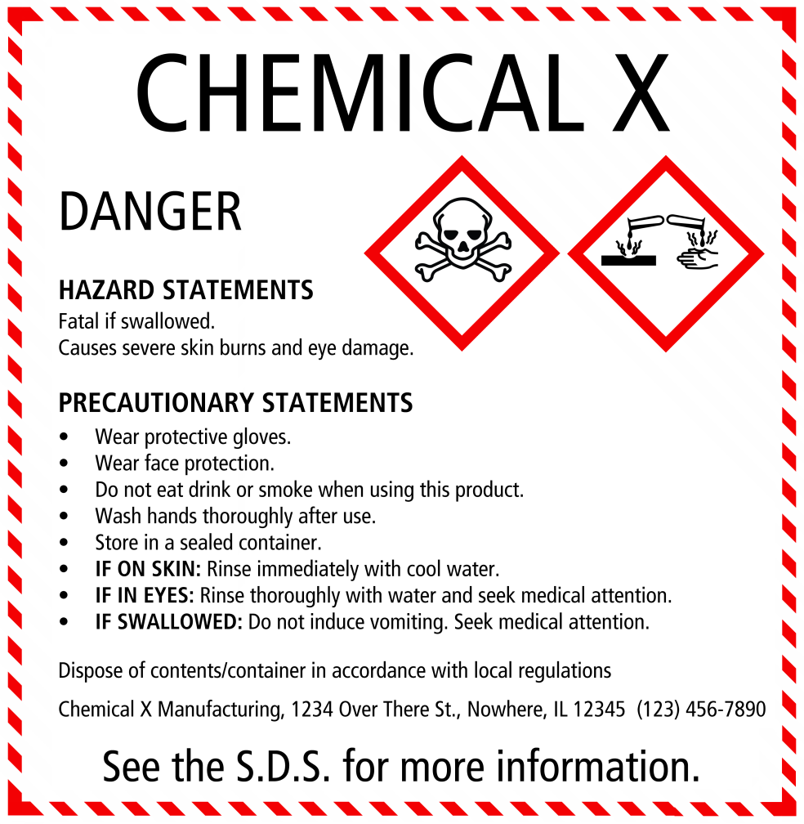
Notification of Hazards
Notes:
One of the most important goals of the Hazard Communication Standard is NOTIFICATION of the chemicals and hazards that may be present. Notification is the responsibility of the manufacturer or the distributor of the material or product that contains a hazardous or toxic substance. The manufacturer or distributor must know what is in the product and its potential dangers. The manufacturer or supplier then is required to notify the purchaser or user of any hazards associated with his product through the SAFETY DATA and the LABELS which must be placed on all shipments and containers for his products. The SDS and the labels are the way we can IDENTIFY the chemicals and potential hazards in our workplace.

Slide 33
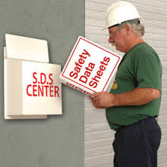
Safety Data Sheets (SDS)
SDS are kept up-to-date by the company
A SDS must be available for every product or material in use at the workplace with a potential harmful or toxic effect on humans
Be sure you know WHERE the SDS are located
SDS must be in a location where there is access at ALL TIMES while people are working
Notes:
SAFETY DATA SHEETS are kept up-to-date by the Company and a Safety Data Sheet must be available for every product or material in use at the workplace which has been identified by the manufacturer as having a potential harmful or toxic effect on humans. Be sure you know WHERE these SDS are located in YOUR plant and how to get access to them. They will be in a location or place where there is access at ALL TIMES while there are people working in the plant.

Slide 34

Pictograms
Standardized symbols or graphics
Used to symbolize health/ physical and environmental hazard information
Will be present on both Safety Data Sheets (SDS) and Labels.
Notes:
An important addition to the SDA has been the use of PICTOGRAMS to alert workers to the type of hazards that may be present. Pictograms are standardized symbols or graphics that must be used in the official shape and colors so that they can be easily recognized. Since this is a NEW addition to Safety Data Sheets, not ALL of them may have these new symbols until June of 2015. As new product and materials come into the plant, the new SDS and Labels will be used and will replace the older type. These GHS pictograms are used to symbolize health, physical and environmental hazard information that are associated with the chemical or product and can warn workers of hazards without using words. These pictograms will be on both the Safety Data Sheets and Labels. There are NINE Pictograms that may be used:

Slide 35

Skull and Crossbones
Acute Toxicity
(fatal or toxic)
Notes:
Acute Toxicity (fatal or toxic)
A chemical with this symbol is acutely (very) toxic if it comes into contact with skin or if inhaled or ingested (if you eat or drink it). These chemicals are so toxic that contact may even be fatal.
Under this system, ACUTE Health Hazards:
Happen quickly
Are associated with high, brief exposure
For Examples:
Carbon monoxide poisoning
Cyanide inhalation
These two chemicals have they can be FATAL even when the exposure is brief – if the level of exposure is at the TOXIC dose level.
In comparison, there are CHONIC Health Hazards. These hazards may be caused by chemical exposures that do not cause immediate, obvious harm or make a person feel sick right away. Workers may not see, feel, or smell the danger. Their effects are long, continuous and follow repeated long-term exposure; such as
Lung cancer from cigarette smoking
Black lung from coal mine dust

Slide 36

Signal Words
DANGER
  Higher severity of hazards than WARNING!
WARNING
  Lower severity of hazards than DANGER!
Notes:
You should also look for Signal Words on Labels and SDS as a quick alert to whether a hazard is present and how dangerous the hazard may be.
There are ONLY TWO Signal words that are used to emphasize hazards and indicate relative level of severity (danger) of the hazard
They are:
Danger
or
Warning
"Danger" is used for the more severe hazards, while "warning" is used for less severe hazards.

Slide 37
Non-Ferrous Founders’ Society
Safety & Health Training Program
Hazard Communication/GHS Training Program
Module 3: Safety Data Sheets (SDS)
© 2015 All Rights Reserved

Slide 38
Module 3: Safety Data Sheets
This module applies to all type of foundries and can be used to train new employees how to read and understand a Safety Data Sheet (SDS)
Effective for retraining existing employees in the Safety Data Sheet and how it may differ in format and terms from the older Material Safety Data Sheets (MSDS)
It is VERY important that trainers explain that the SDS is a vital part of the Hazard Communication program to provide necessary information, alerts and/or warning to prepare employees to safely work with materials/processes in the foundry

Slide 39
Module 3: Safety Data Sheets
Trainers should review the module before presentation and have on hand:
  A Copy of the OSHA Hazard Communication Standard
    https://www.osha.gov/FedReg_osha_pdf/FED20120326.pdf
  A copy of your company written Hazard Communication Program
  Copies of the Safety Data Sheets for the foundry, or samples of the SDS if there are too many

Slide 40
Module 3: Safety Data Sheets
Trainers should be certain to provide the following information that is specific to YOUR foundry:
Where the Safety Data Sheets are located, and how an employee can gain access to them;
Person(s) responsible for maintaining the SDS;
How to get answers to any questions concerning chemicals used in the foundry or safe work practices;
Copies of the OSHA Quickcard on SDS and/or materials that illustrate the Pictograms that may be used on SDS
Trainers MUST be able to explain the significance of the signal words WARNING and DANGER, as well as the purpose and meaning of Hazard Statements and Precautionary Statements

Slide 41
Module 3: Safety Data Sheets
Additional resources for trainers:
  OSHA Hazard Communication Standard (1910.1200)
  OSHA Briefs on Hazard Communication, SDS and Labels
  Guide to The Globally Harmonized System of Classification and Labelling of Chemicals (GHS) – https://www.osha.gov/dsg/hazcom/ghs.html
  Pictograms that can be downloaded from the internet for each of the nine hazard classifications. Download for free in .eps, .jpg or .png format at https://www.osha.gov/dsg/hazcom/pictograms/index.html

Slide 42
Module 3: Safety Data Sheets
Additional resources for trainees:
  OSHA Safety Data Sheet Quick Cards
  https://www.osha.gov/Publications/HazComm_QuickCard_SafetyData.html
  OSHA Pictogram Quick Cards
  https://www.osha.gov/Publications/HazComm_QuickCard_Pictogram.html
You can also POST a copy of these cards in locations where they can be seen and read by affected employees

Slide 43
Safety Data Sheet Overview
What is a Safety Data Sheet?
What are the 16 sections of a SDS?
What information is on a SDS, and why is it important?
Notes:
In this section, we will learn:
What is a Safety Data Sheet (SDS)?
What are the 16 sections of a SDS?
What information is on a SDS, and why is it important?

Slide 44

16 Sections of a SDS
The NEW Safety Data Sheet (SDS) has sixteen (16) sections- ALL Safety Data Sheets must have all these sections in this order.
  1. Identification
  2. Hazard(s) identification
  3. Composition/information on ingredients
  4. First-aid measures
  5. Fire-fighting measures
  6. Accidental release measures
  7. Handling and storage
  8. Exposure control/personal protection
  9. Physical and chemical properties
  10. Stability and reactivity
  11. Toxicological information
  12. Ecological information*
  13. Disposal considerations*
  14. Transport information*
  15. Regulatory information
  16. Other information
Notes:
The new SDS uses a uniform 16-section format for all Chemicals and Products, and the new Labels will also be more uniform in the words and symbols used to describe hazards.
The NEW Safety Data Sheet (SDS) has sixteen (16) sections- ALL Safety Data Sheets must have all these sections in this order..
1. Identification
2. Hazard(s) identification
3. Composition/information on ingredients
4. First-aid measures
5. Fire-fighting measures
6. Accidental release measures
7. Handling and storage
8. Exposure control/personal protection
9. Physical and chemical properties
10. Stability and reactivity
11. Toxicological information
12. Ecological information*
13. Disposal considerations*
14. Transport information*
15. Regulatory information
16. Other information
A standard or uniform SDS makes it easier to find and understand SDS!

Slide 45

Section 1: Identification
Section 1 includes:
Product identifier used on label
Other means of identification
Recommended use of chemical and restrictions on use
Name, address, telephone number of manufacturer, importer or other responsible party
Emergency phone number
Notes:
Section 1 of the SDS gives the necessary information on the NAME of the product or the chemical, the company who made or sold it and how to get more information on the product in case of an emergency.
This section will include:
Product identifier used on label
Other means of identification
Recommended use of chemical and restrictions on use
Name, address, telephone number of manufacturer, importer or other responsible party
Emergency phone number

Slide 46
Section 2: Hazards Identification
Section 2 includes:
Classification of hazardous chemical according to new categories
Signal words (Warning or Danger), hazard statements, symbols and precautionary statements
Notes:
Section 2 of the SDS will be Hazards Identification. This section must includes some new terms that may not have appeared on the older MSDS:
Classification of hazardous chemical according to new categories
Signal word (Warning or Danger) , hazard statement(s) (for example, Flammable Liquid), symbol(s) and precautionary statement(s)
Hazard symbols may be provided as graphical reproductions or it may give the name of the symbol, such as a flame, skull and crossbones- (pictographs)

Slide 47
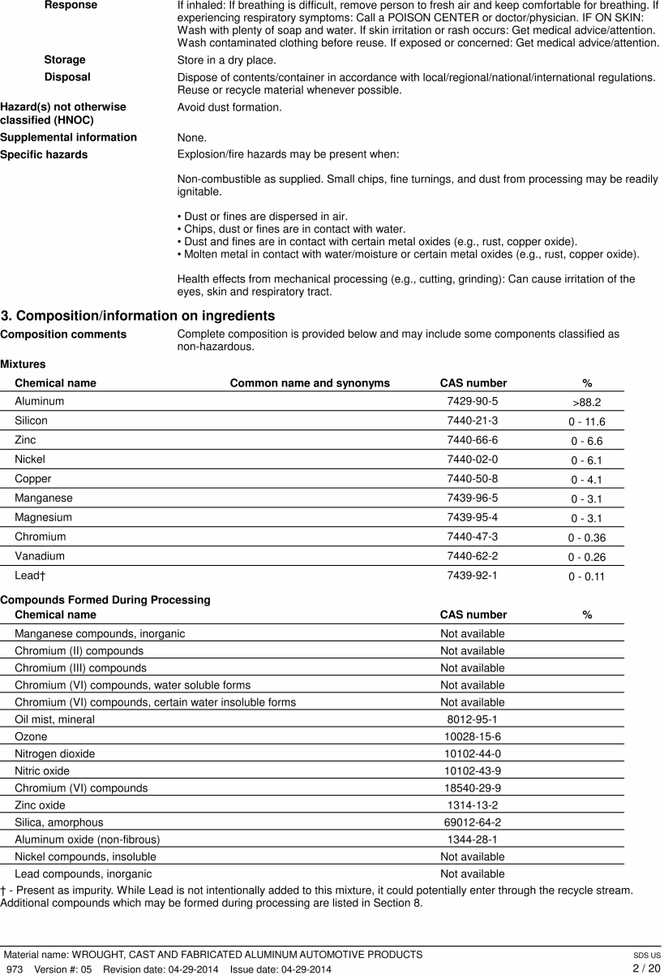
Section 3: Composition
Section 3 includes:
Chemical name of ingredients and their common name
CAS number and other unique identifiers
Chemical name and concentration of ingredients
Notes:
Section 3 of the SDS will give the Composition of the product – WHAT is in it! This section includes the:
Chemical name of ingredients and their Common name and synonym
CAS number and other unique identifiers (the CAS is a number that is UNIQUE for each chemical so that no matter what name is given in any language, the number is the same!)
The chemical name and concentration or concentration ranges of all ingredients, which are classified as health hazards
If the Company claims that the ingredients are a TRADE SECRET, then there must be a statement that the specific chemical identity and/or percent of composition has been withheld as a trade secret
Here is a sample of Section 3 for an ALUMINUM ALLOY - a mixture of aluminum and other metals:

Slide 48
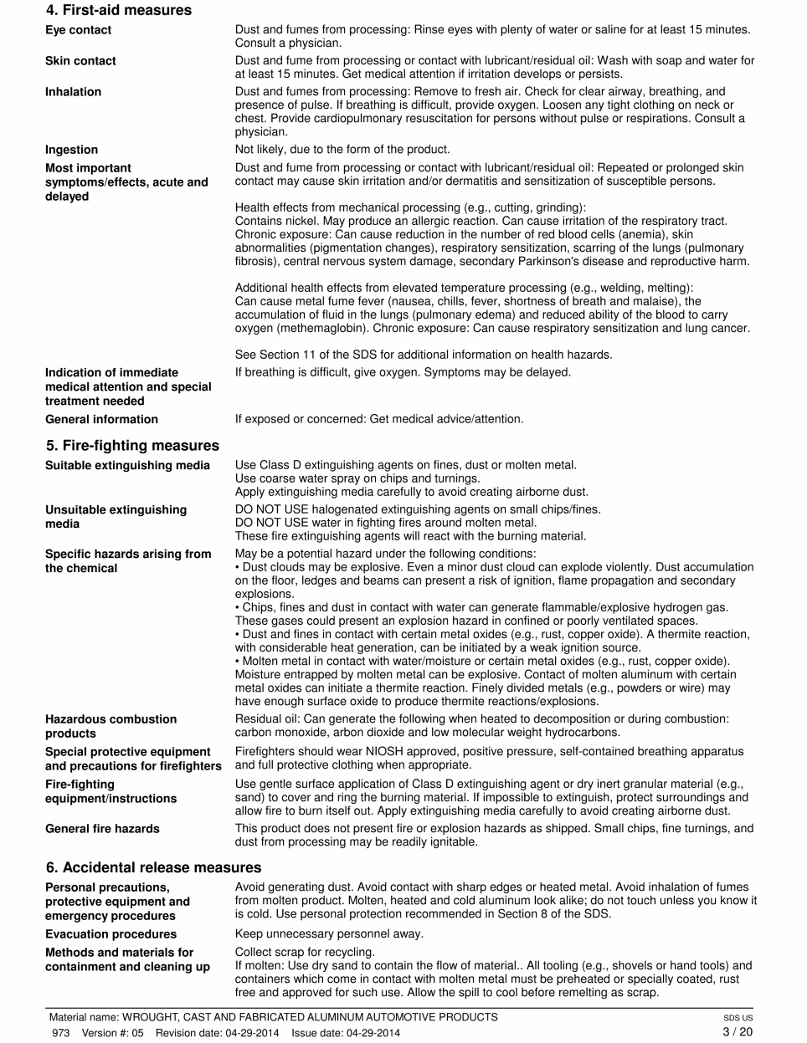
Section 4: First Aid Measures
Section 4 includes:
First Aid information, including an explanation on how the chemical can be dangerous, and the ‘route(s)’ of exposure
A description on the symptoms or effects of exposure
Notes:
Section 4 is another important source of information for workers since it gives information on First Aid- what to do if there is injury from touching, breathing or eating the chemical. It will explain how the chemical could be hazardous by the “route” of exposure, such as inhalation (breathing it), skin and eye contact (touching it or getting the material on your skin or in your eye), or ingestion (eating or swallowing the chemical). This section also describes the most important symptoms or effects if you are exposed to the chemical, both acute (immediate) and delayed (symptoms may appear hours or even years after exposure) If there is exposure, the SDS will give information on what immediate medical attention and special treatment may be needed.

Slide 49
Non-Ferrous Founders’ Society
Safety & Health Training Program
Hazard Communication/GHS Training Program
Module 4: Labels
© 2015 All Rights Reserved

Slide 50
Module 4: Labels
This module applies to all type of foundries and can be used to train new employees how to read and understand a Label
Effective for retraining existing employees in Labels and how they may differ in format and terms from the older format for labels
It is VERY important that trainers explain that the Label is a vital part of the Hazard Communication program to provide necessary information, alerts and/or warning to prepare employees to safely work with materials/processes in the foundry

Slide 51
Module 4: Labels
Trainers should review the module before presentation and have on hand:
  A copy of your company written Hazard Communication Program
  Copies of Labels used on materials in the foundry

Slide 52
Module 4: Labels
Trainers should be certain to provide the following information that is specific to YOUR foundry:
Person(s) responsible for ensuring all materials are Labeled;
How to get answers to any questions concerning labels on chemicals used in the foundry, or safe work practices;
Copies of the OSHA Quickcard on Labels and Pictograms that may be used on Labels
Trainers MUST be able to explain the significance of the signal words WARNING and DANGER and the pictograms, as well as the purpose and meaning of Hazard Statements and Precautionary Statements

Slide 53
Module 4: Labels
Additional resources for trainers:
  OSHA Hazard Communication Standard (1910.1200)
  OSHA Briefs on Hazard Communication, SDS and Labels
  Guide to The Globally Harmonized System of Classification and Labelling of Chemicals (GHS) – https://www.osha.gov/dsg/hazcom/ghs.html
  Pictograms that can be downloaded from the internet for each of the nine hazard classifications. Download for free in .eps, .jpg or .png format at https://www.osha.gov/dsg/hazcom/pictograms/index.html

Slide 54
Module 4: Labels
Additional resources for trainees:
  OSHA Label Quick Cards
  https://www.osha.gov/Publications/HazComm_QuickCard_labels.html
  OSHA Pictogram Quick Cards
  https://www.osha.gov/Publications/HazComm_QuickCard_Pictogram.html
You can also POST a copy of these cards in locations where they can be seen and read by affected employees

Slide 55
Labels Overview
What information is required to be on product labels?
What do the GHS labels look like?
How can you identify the types and severity of hazards related to a product from its label?
Notes:
In this section, we will learn:
What information is required on product labels;
What do GHS labels look like; and
How can you identify the types and severity of hazards related to a product from its label.

Slide 56
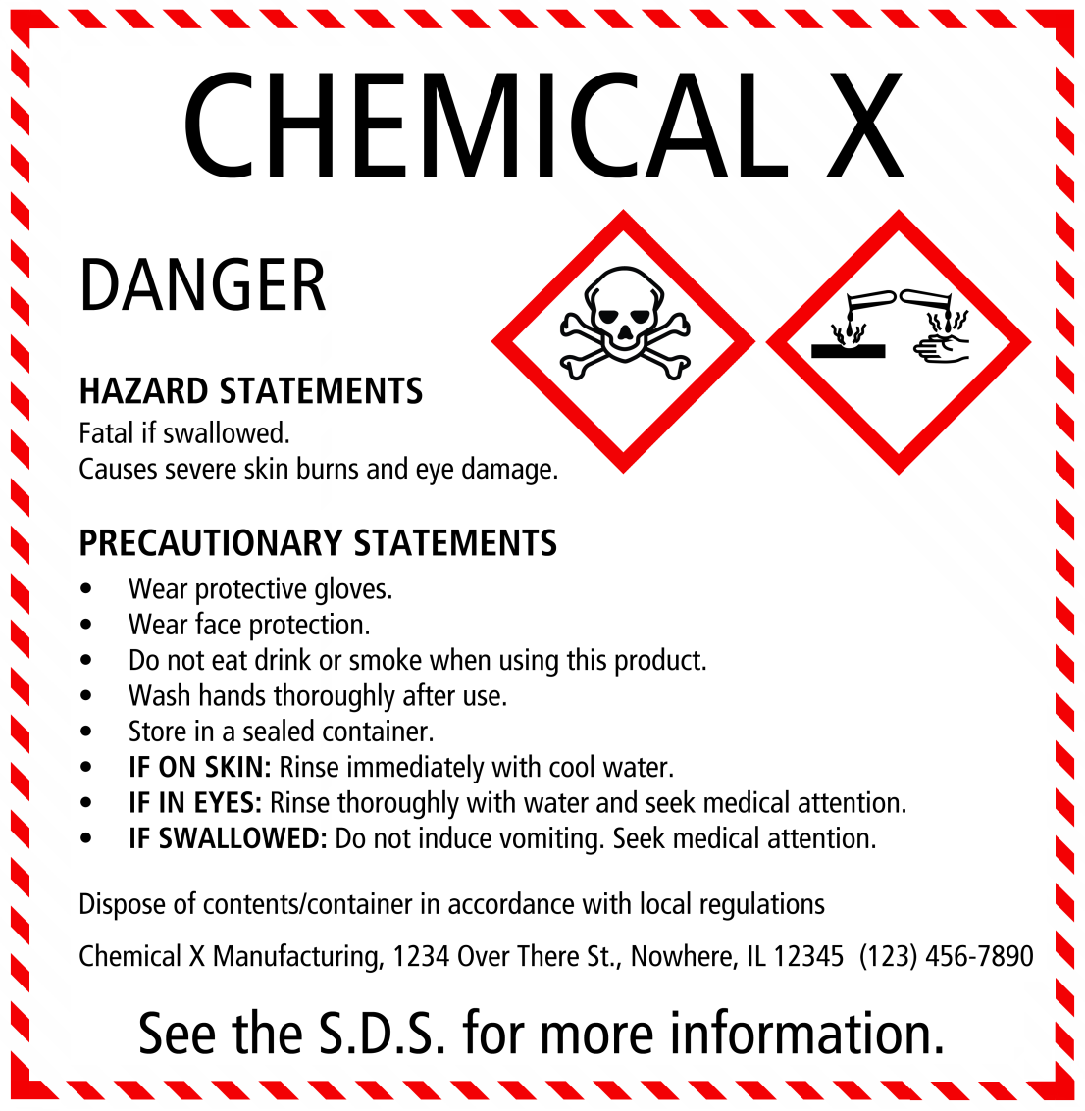
Labels are Important!
Labels tell us what we need to know to safely handle, store and work with a product
Notes:
Labels are important. They tell us what we are working with, who made it, what chemicals are in it, what dangers or hazards it may present to workers, how to store and handle it safely, what protective equipment to use, and how to dispose of it when we no longer need it.

Slide 57
Required Labels Elements
Information should be in the same order for all labels
Labels MUST include:
Product Identifier
Supplier Identifier
Chemical Identity
Hazard Pictograms *
Signal Words *
Hazard Statements *
Precautionary Information
The items with * are hazard warning and MUST be located together on the label!
Notes:
The information should be in the same order for all labels . Terms used to describe hazards and warning symbols should all also be uniform to keep the message clear as possible.
The Label MUST have the following Elements
Product identifier
Supplier identifier
Chemical identity
Hazard pictograms*
Signal words*
Hazard statements*
Precautionary information
All of these elements are very important in understanding the product and how to safely use it. Please notice that the items marked with an * are all hazard warnings. These three elements MUST be located together on the label.

Slide 58
Signal Words
DANGER
  Higher severity of hazards than WARNING!
WARNING
  Lower severity of hazards than DANGER!
Notes:
There are ONLY TWO Signal words that are used to emphasize hazards on the label. They indicate the relative level of severity of the hazard They are:
“Danger” or “Warning”
The signal word “Warning” means that the severity of hazards of the chemicals are less than those chemicals classified with the signal word “Danger”
Both of these signal words are important - but it is important to remember that DANGER is a sign that this product or chemical must be handled carefully with all the necessary equipment and protection.

Slide 59
PICTOGRAMS
Standardized
Only ‘official’ pictograms may be used
Must be in official shape and colors
Labels must contain one or more of these pictograms
Notes:
There will be graphics or pictograms on the label. These will be standardized -- only the “official” pictograms may be used and they MUST be in the official shape and colors so that they can be easily recognized. These pictograms are used to convey health, physical and environmental hazard information. Labels for hazardous chemicals must contain one or more of these pictograms that are associated with the hazards of the chemical.

Slide 60
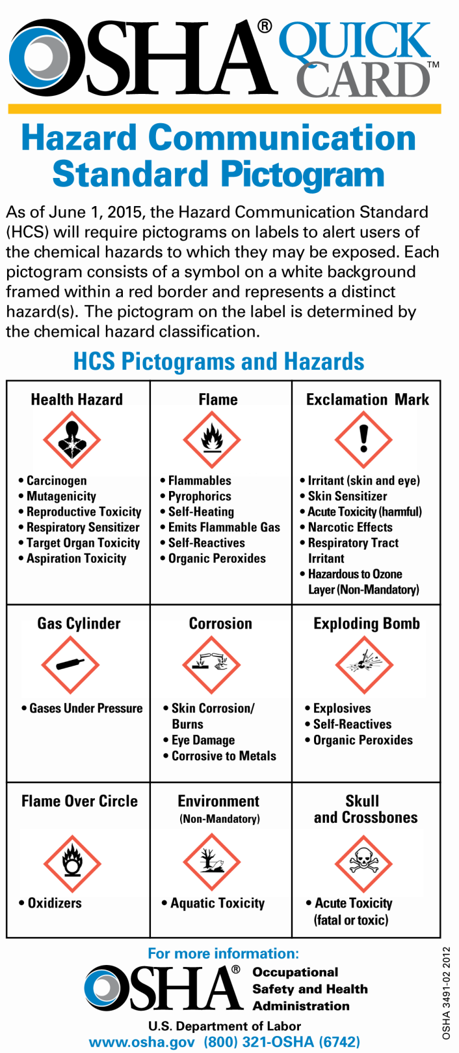

Slide 61
Non-Ferrous Founders’ Society
Safety & Health Training Program
Hazard Communication/GHS
Training Program
Module 5: Air Contaminants in
the Non-Ferrous Foundry
© 2015 All Rights Reserved

Slide 62
Module 5: Air Contaminants in the Non-Ferrous Foundry
This module includes materials on the air contaminants that are commonly found in the non-ferrous foundry industry
Introduces the types and forms of air contaminants and can be used to introduce new employees to the topic as well as retrain existing employees in the types of hazards that may be present in their place of work
Note: Not all foundries will have all of the air contaminants described in this module. Trainers should be prepared to identify the air contaminants and processes that are found in their foundry’s work environment

Slide 63
Module 5: Air Contaminants in the Non-Ferrous Foundry
Trainers should review the module before presentation and have on hand:
  An outline of areas in the foundry where air sampling has shown overexposures
  A copy of the company Personal Protective Equipment Program, including Respiratory Protection (if applicable)
  Person(s) responsible for Air Sampling and the Personal Protective Equipment program
  How to get answers to any questions concerning chemicals used at the foundry, air sampling, or safe work practices
  Trainers will also find it useful to have current air sampling test results available

Slide 64
Module 5: Air Contaminants in the Non-Ferrous Foundry
Additional resources for trainers:
  OSHA regulations on Air Contaminants – including standards for specific chemicals (cadmium, hexavalent chromium, formaldehyde, isocyanates, lead)
  OSHA Chemical Sampling Information guidance

Slide 65
Air Contaminants in the
Non-Ferrous Foundry
What airborne hazards are present in the foundry?
What are fumes, dusts, gases and vapors, and how are they different?
What types of air contaminants might you be exposed to while working in a nonferrous foundry?
How can you work safely when exposed to air contaminants in the foundry?
Notes:
In this section, we will learn:
What airborne hazards are present in the foundry;
What are fumes, dusts, gases and vapors, and how are they different;
What types of air contaminants you might be exposed to while working in a nonferrous foundry;
How you can work safely when exposed to air contaminants in the foundry.

Slide 66
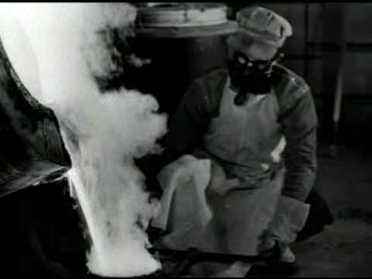
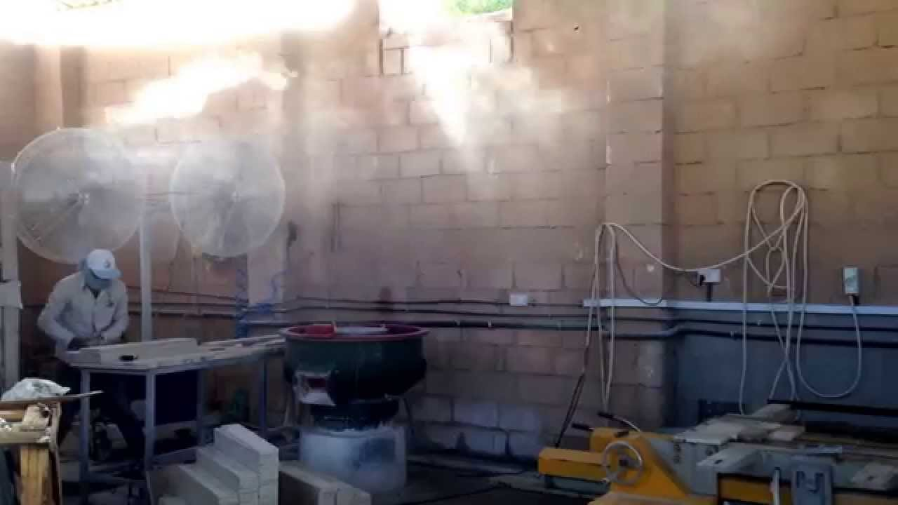
Non-Ferrous Foundry Hazards
When we melt metals, we create METAL FUMES
When metal is cut, ground or cleaned, it can create METAL DUSTS
Metal fumes and dusts can be hazardous to workers if inhaled or ingested
The types of hazards from FUMES and DUSTS will depend on what is in them
Dusts and Fumes from the same metal can be very different, especially in Brass and Bronze foundries
Notes:
The metals in the foundry are not normally hazardous in their solid form. However when we MELT the metals or alloys, we create METAL FUMES that are released into the air. These fumes can be hazardous if workers breathe them into their lungs or ingest them accidentally.
When the metal casting is cut or ground or cleaned, it can release into the air small pieces or particles called DUSTS. These small particles may also be breathed in or eaten accidentally.
The types of hazards from FUMES or DUSTS will depend on what is in them. It is very important to understand that the dusts and fumes from the SAME metal can be VERY different. This is especially true for BRASS and BRONZE foundries.

Slide 67
Fumes and Dusts
A brass alloy with the same 85% copper, 5% lead, 5% zinc and 5% antimony will create metal FUMES with a very different chemistry
Fumes are created when metal reaches its boiling point and begins to vaporize
Boiling point for Copper is 4653 degrees Fahrenheit, Zinc is 788 degrees Fahrenheit
At normal bronze melting/pouring temperatures (less than 3000 degree F) copper does not vaporize but zinc and some other metals (lead) do
Notes:
When we look at the FUME that was created from melting the same alloy of 85% copper, 5% lead, 5% Zinc and 5% antimony, we will see that the amount of metal is VERY DIFFERENT in the fume.
Why? Because the fume is created as the metal reaches a high enough temperature to allow the fume to be boiled off. Different metals have different boiling points. With our example, for instance, the fume we collect from the melting process is MOSTLY ZINC with very little COPPER content (even though copper makes up most of the original alloy content.)
The BOILING POINT for Copper is 4653 degrees Fahrenheit. The BOILING POINT for Zinc is is 788 degrees Fahrenheit. Since we rarely reach 3000 degrees normally in the melting process for brass, the Copper does not vaporize, but the Zinc and other metals (including LEAD) do.

Slide 68
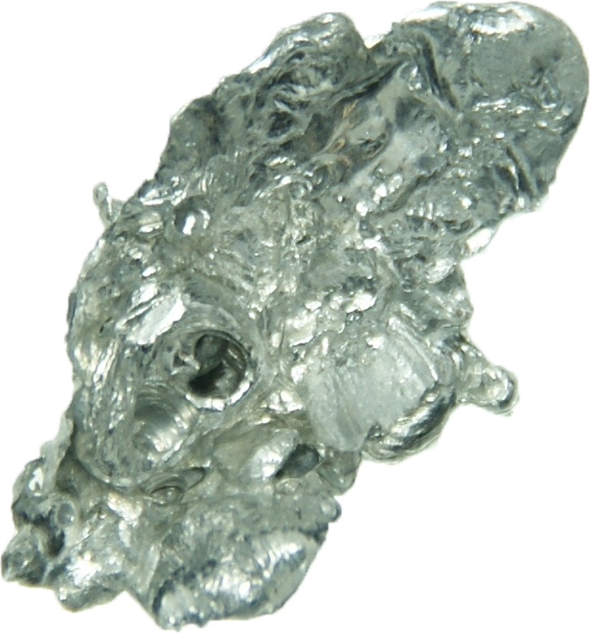
Cadmium
Cadmium and its compounds are HIGHLY toxic
Exposure to Cadmium is known to cause cancer
Targets the body’s cardiovascular, renal, gastrointestinal, neurological, reproductive and respiratory systems
OSHA has a Cadmium standard that includes foundries (29CFR1910.1027)
Notes:
Cadmium and its compounds are highly toxic and exposure to this metal is known to cause cancer. This metal targets the body's cardiovascular, renal, gastrointestinal, neurological, reproductive, and respiratory systems. OSHA has a Cadmium standard that includes foundries under its regulation 1910.1027.

Slide 69


Be Informed!
The place where YOU work may not have all of these metals or chemicals in your department
The way we know WHAT we work with and HOW it can affect us begins with reading and understanding the SAFETY DATA SHEET and product LABELS!
Notes:
The place where YOU work may not have all of these metals or chemicals in your department. The way that we know WHAT we work with and HOW it can affect us begins with reading and understanding the Safety Data Sheet and Labels.

Slide 70
Non-Ferrous Founders’ Society
Safety & Health Training Program
Hazard Communication/GHS Training Program
Section 6: HazCom/GHS and the
Aluminum Foundry
© 2015 All Rights Reserved

Slide 71
Module 6: GHS/HazCom and the Aluminum Foundry
This module addresses the air contaminants commonly found in ALUMINUM FOUNDRIES, including potential hazards from the presence of Combustible Dust
Not all Aluminum Foundries will have all of the air toxic substances discussed, and not all foundries will use all of the processes discussed
1 major difference can be the presence of silica sand in some foundries compared with those foundries that do not use silica sand

Slide 72
Module 6: GHS/HazCom and the Aluminum Foundry
Trainers should review the module before presentation
Trainers should be prepared to discuss the hazards that may be present at YOUR foundry
The air contaminants present in your foundry are determined by the materials and processes used
Trainers should demonstrate how the Safety Data Sheets are used to identify potential air contaminants

Slide 73
Module 6: GHS/HazCom and the Aluminum Foundry
Additional resources for trainers:
  OSHA regulations on Air Contaminants – including standards for specific chemicals (cadmium, hexavalent chromium, formaldehyde, isocyanates, lead)
  OSHA Chemical Sampling Information guidance
  Aluminum
    Background and training materials
    https://www.osha.gov/SLTC/metalsheavy/aluminum.html
  Combustible Dust
    An OSHA QuickCard on Combustible Dust
    https://www.osha.gov/Publications/OSHA_3674.pdf
    The OSHA Hazard Communication Guidance for Combustibe Dust
    https://www.osha.gov/Publications/3371combustible-dust.html
    OSHA Safety and Health Information Bulletin: Combustible Dust in Industry: Preventing and Mitigating the Effects of fire and Explosions
    https://www.osha.gov/dts/shib/shib073105.html

Slide 74
Module 6: GHS/HazCom and the Aluminum Foundry
Additional resources for trainers:
  Formaldehyde Standard
    OSHA Regulations
    https://www.osha.gov/pls/oshaweb/owadisp.show_document?p_table=STANDARDS&p_id=10030
  Formaldehyde
    OSHA Safety and Health Topics Page
    https://www.osha.gov/SLTC/formaldehyde/index.html
    OSHA Fact Sheet on Formaldehyde
    https://www.osha.gov/OshDoc/data_General_Facts/formaldehyde-factsheet.pdf
  Isocyanates
    OSHA Safety and Health Topics Page
    https://www.osha.gov/SLTC/isocyanates/index.html

Slide 75
Module 6: GHS/HazCom and the Aluminum Foundry
Additional resources for trainers:
  Silica
    OSHA Silica Website
    https://www.osha.gov/dte/library/silicosis/si_gi.html
    OSHA .pdf brochure
    https://www.osha.gov/dte/library/silicosis/si_gi.pdf
    OSHA Safety and Health Topics Page:
    https://www.osha.gov/dsg/topics/silicacrystalline/index.html

Slide 76
HazCom/GHS and the Aluminum Foundry
What are some of the hazards that exist in an Aluminum Foundry?
What are some common manufacturing process/materials in the Aluminum Foundry, and what hazards can these processes/materials present to the foundry worker?
What are some of the Personal Protective Equipment (PPE) items that workers should wear in an Aluminum Foundry?
Notes:
In this section we will learn:
What are some of the hazards that exist in an Aluminum Foundry;
What are some common manufacturing processes/materials in the Aluminum Foundry, and what hazards can these processes/materials present to the foundry worker?
What are some of the Personal Protective Equipment (PPE) items that workers should wear in an Aluminum foundry?

Slide 77
Permissible Exposure Limits (PEL) for 3 Types of Silica
3 types of Silica
  Crystalline Silica
  Cristobalite
  Tridymite
The PEL for each type of silica are shown in table Z-3 to the left
Table Z-3 Mineral Dusts
Substance | mppcfª | mg/m³
Silica: Crystalline
Quartz (Respirable) ………….. | 250^{b} -------------- %SiO₂+5 | 10 mg/m³ -------------- %SiO₂+2
Quartz (Total Dust)) ………….. | ……………… | 10 mg/m³ -------------- %SiO₂+2
Cristobalite: Use ½ the value calculated from the count or mass formulae for quartz. Tridymite: Use ½ the value calculated from the formulae for quartz.

Slide 78

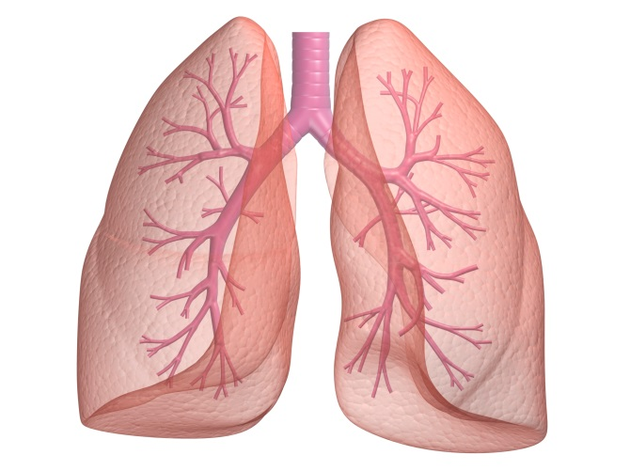
ASTHMA
People who never had asthma can develop it due to workplace exposures to ISOCYANTES
People with asthma may find that their condition gets worse due to workplace exposures to ISOCYANATES
Some people can also become sensitized to the chemical
Some ISOCYANATES (but not all) are classified as potential human carcinogens
It is important to check the Safety Data Sheet (SDS) to see which Isocyanates may be present and WHAT actions should be taken if there is a potential hazard
Notes:
People who never had asthma can develop asthma due to workplace exposures. People who have had asthma for years may find that their condition get worse due to workplace exposures.
Some people can also become sensitive to the chemical and develop a skin rash if it gets on the body. There are some Isocyanates (but NOT all isocyanates) that are classified as potential human carcinogens –chemicals that may cancer.
Since Isocyanates are a GROUP of chemicals and not all of the substances in this group have the same effect on the body, it is important to CHECK THE SDS to see which isocyanate may be present and WHAT actions should be taken if there is a potential hazard.

Slide 79

FORMALDEHYDE
One chemical that MAY be in some products used to bind sand together is FORMALDEHYDE
If this chemical is present in the product or is created when used, the Safety Data Sheet (SDS) will show us!
Notes:
One chemical that MAY be in some products used to bind sand together but more often is a result of MIXING the chemicals or the DESTRUCTION or burning of the chemicals when the hot metal is poured into the mold is FORMALDEHYDE.
If this chemical is present in the product or is created when it is used , the Safety Data Sheet will show us!

Slide 80

PHENOL
One other chemical commonly found in many core making processes is PHENOL
PHENOL has an odor that is unpleasant to many people
At low levels, PHENOL may be irritating to the eyes, nose and throat
At high concentrations, PHENOL can cause dermatitis or chemical burns
Notes:
One other chemical commonly found in many core making processes is PHENOL. Phenol is a chemical that is used in many ways – from making plastics to use as a disinfectant and ingredient in medications and cosmetics. However, as for many chemicals, the proper amount and use of Phenol is useful and safe, but too much improperly used may be harmful.
At low levels in the foundry, Phenol may be irritating to the eyes, nose and throat. It has an odor that is unpleasant to many people. Sine Phenol is mildly acidic, at high dosages or concentrations it can cause dermatitis or chemical burns.

Slide 81

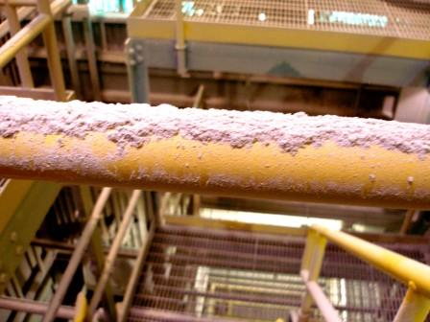
Combustible Dust
Workers in these areas need to be trained on the explosion hazards of combustible dusts and on the protection measures to avoid them
The foundry has an emergency action plan, including details on how to respond to a combustible dust explosion!
Other engineering controls and equipment modifications may be required after the company has evaluated the potential hazard and how to prevent fires/explosions
Notes:
Workers in these areas need to be trained on the explosion hazards of combustible dusts and on the Protection Measures to avoid them.
The facility has an emergency action plan, and how to respond to a combustible dust explosion should be included!
Other engineering controls and equipment modifications may also be required after the company has evaluated the potential hazard and how to prevent fires and explosions.

Slide 82
Non-Ferrous Founders’ Society
Safety & Health Training Program
Hazard Communication/GHS Training Program
Section 7: HazCom/GHS and the
Brass and Bronze Foundry
© 2015 All Rights Reserved

Slide 83
Module 7: GHS/HazCom and the Brass and Bronze Foundry
This module addresses the air contaminants commonly found in Brass and Bronze foundries, including potential hazards from the presence of Combustible Dust
Not all Copper Foundries will have all of the air toxic substances discussed, and not all foundries will use all of the processes discussed
Major differences include foundries that pour alloys that contain LEAD and foundries that use SILICA sand compared with those foundries that do not use these materials, for example

Slide 84
Module 7: GHS/HazCom and the Brass and Bronze Foundry
Trainers should review the module before presentation
Trainers should be prepared to discuss the hazards that may be present at YOUR foundry
The air contaminants present in your foundry are determined by the materials and processes used
Trainers should demonstrate how the Safety Data Sheets are used to identify potential air contaminants

Slide 85
Module 7: GHS/HazCom and the Brass and Bronze Foundry
Additional resources for trainers:
  OSHA regulations on Air Contaminants – including standards for specific chemicals (cadmium, hexavalent chromium, formaldehyde, isocyanates, lead)
  OSHA Chemical Sampling Information guidance
  Copper
    Background and training materials
    https://www.osha.gov/SLTC/metalsheavy/copper.html
  Formaldehyde Standard
    OSHA Regulations
    https://www.osha.gov/pls/oshaweb/owadisp.show_document?p_table=STANDARDS&p_id=10030

Slide 86
Module 7: GHS/HazCom and the Brass and Bronze Foundry
Additional resources for trainers:
  Formaldehyde
    OSHA Safety and Health Topics Page
    https://www.osha.gov/SLTC/formaldehyde/index.html
    OSHA Fact Sheet on Formaldehyde
    https://www.osha.gov/OshDoc/data_General_Facts/formaldehyde-factsheet.pdf
  Isocyanates
    OSHA Safety and Health Topics Page
    https://www.osha.gov/SLTC/isocyanates/index.html
  Lead Standard
    OSHA Regulations
    https://www.osha/gov/pls/oshaweb/owadisp.show_document?p_table=STANDARDS&p_id=10030

Slide 87
Module 7: GHS/HazCom and the Brass and Bronze Foundry
Additional resources for trainers:
  Lead
    OSHA QuickCard related to Lead
    https://www.osha.gov/Publications/OSHA3680.pdf
    OSHA Safety and Health Topics webpage
    https://www.osha.gov/SLTC/lead/
  Silica
    OSHA Silica Website
    https://www.osha.gov/dte/library/silicosis/si_gi.html
    OSHA .pdf brochure
    https://www.osha.gov/dte/library/silicosis/si_gi.pdf
    OSHA Safety and Health Topics Page:
    https://www.osha.gov/dsg/topics/silicacrystalline/index.html

Slide 88
HazCom/GHS and the Brass and Bronze Foundry
What are some of the hazards that exist in a brass and bronze foundry?
What are some common manufacturing process/materials in the brass and bronze foundry, and what hazards can these processes/materials present to the foundry worker?
What are some of the Personal Protective Equipment (PPE) items that workers should wear in a brass and bronze foundry?
Notes:
In this section we will learn:
What are some of the hazards that exist in a brass and bronze foundry?
What are some common manufacturing process/materials in the brass and bronze foundry, and what hazards can these processes/materials present to the foundry worker?
What are some of the Personal Protective Equipment (PPE) items that workers should wear in a brass and bronze foundry?

Slide 89
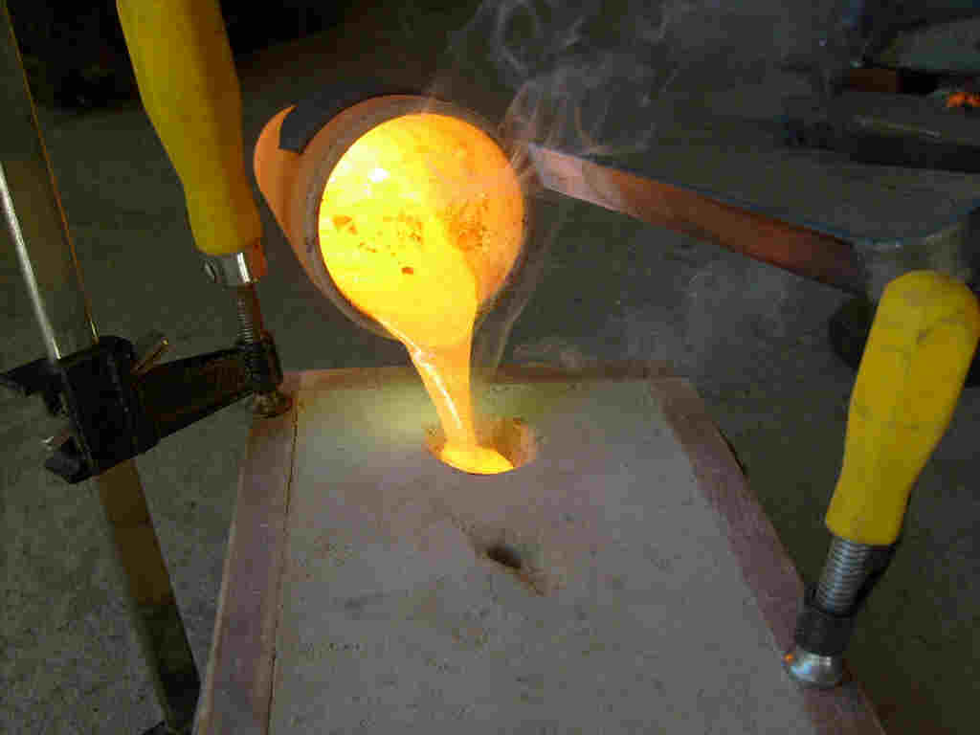
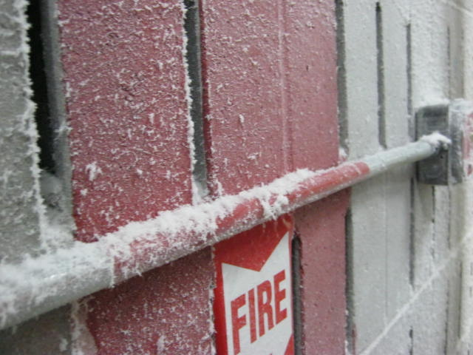
Permissible Exposure Limits (PEL) for 3 Types of Silica
Most brass/bronze foundry sand systems meet these PELs
The temperature of the metal when poured is not high enough
to dry out the sand so that dust becomes airborne
Dust may be created when sand must be manually moved or handled, or when heavy equipment runs over sand
Dust allowed to accumulate can be released by wind, air or when the structure is shaken
Notes:
Most brass foundry sand systems meet these permissible limits at the present time. This is because the temperature of the metal as it is poured into the mold is not high enough to dry out the sand so that the dust becomes airborne. However, dust can be created if there are upset conditions and the sand must be manually moved or handled. If heavy equipment runs over the sand it can be broken down and become airborne. Sand that is allowed to buildup on rafters or other surfaces can also release dust if there is a burst of wind, air or the structure is shaken.

Slide 90

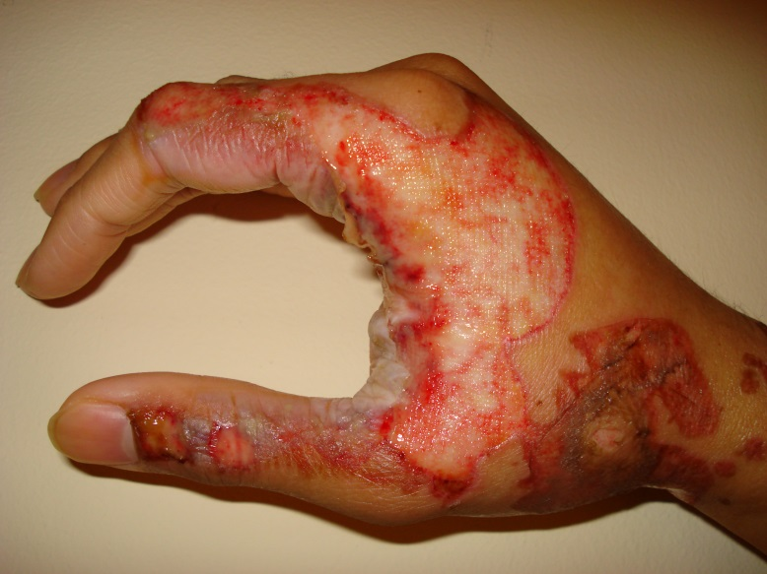
MELTING
When copper alloys are melted, the process can create metal FUMES
Engineering controls (ventilation hoods) are used to keep the amount of fume at safe levels
Work practices may also be used
BURNS are always a danger when working near hot metal
PPE must always be worn!
Notes:
When furnaces melt the copper alloys, the process can create metal FUMES. Engineering controls, hoods that draw air and fume away from the furnace and into an air pollution control system, are installed to keep the amount of fume to safe levels. Work practices may also be established to reduce the amount of fume that becomes airborne.
In addition to the potential exposure to fumes, there is always the danger of serious BURNS whenever someone works near hot metal. Proper Personal Protective Equipment must always be used whenever working around hot metal.

Slide 91
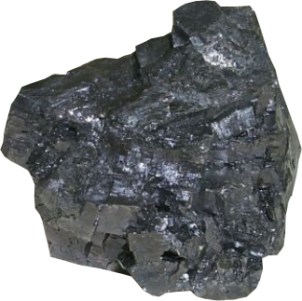
Lead
Enters the body through ingestion (eating or drinking) or by breathing
it into the lungs
Employers are required to protect workers from lead exposure by OSHA
The Permissible Exposure Limit (PEL) is 50 µg/m³ of lead over an 8 hour time weighted average
An Action Level has also been established at 30 µg/m³, at which an employer must begin specific compliance activities
Notes:
Lead enters our body mostly by ingestion (eating or drinking) or by breathing it into the lungs.
Employers are required to protect workers from lead exposure under OSHA lead standards covering general industry (1910.1025), The lead standards establish a permissible exposure limit (PEL) of of lead over an eight-hour time-weighted-average for all employees covered. The standards also set an action level of 30 µg/m3, at which an employer must begin specific compliance activities.

Slide 92
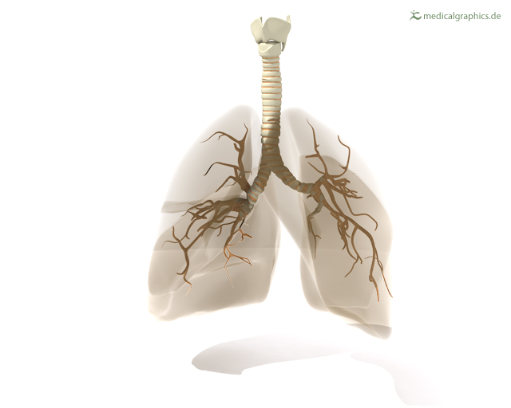
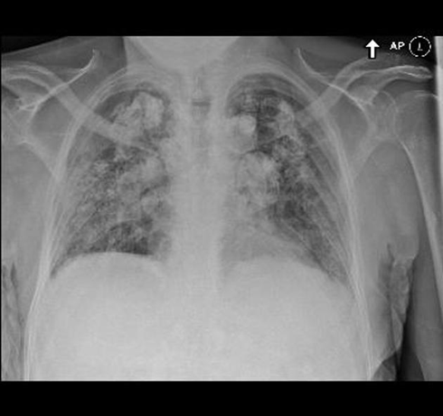
Chronic Beryllium Disease (CBD)
Primarily affects the lungs
Very slow onset
Symptoms include
  Unexplained cough
  Shortness of breath
  Fatigue
  Weight loss/loss of appetite
  Fever
  Night Sweats
Workers may have the disease for a long time without knowing it
Only develops in workers who have become SENSITIZED to Beryllium
Notes:
Chronic beryllium disease (CBD) primarily affects the lungs. It may occur among people who are breath in the dust or fumes from beryllium metal, metal oxides, alloys, ceramics or salts . Chronic beryllium disease usually has a very slow onset, and even very small amounts of exposure to beryllium can cause the disease in some people. Chronic beryllium disease can develop while workers are still on the job or it may not develop until many years after a person has stopped working in the beryllium industry.
Workers with advanced Chronic beryllium disease may show one or more of the following symptoms: unexplained cough; shortness of breath, especially with activity; fatigue; weight loss or loss of appetite; fever; or night sweats. However, because the disease may develop slowly over a period of many years, workers may have the disease for a long time without knowing it.
Chronic beryllium disease only develops in workers who have become sensitized to beryllium. A sensitized worker is someone who has developed an allergic reaction to beryllium. A worker may become sensitized at any point during job exposure, or in some cases he or she may not become sensitized until after leaving a job where there was beryllium exposure.
Acute beryllium disease (where there is high exposure over a short period of time) usually has a quick onset and has symptoms that resemble pneumonia or bronchitis. The acute form of the disease is believed to occur as a result of exposures well above the current OSHA Permissible Exposure Limit. This form of beryllium disease is now reported to be rare.
Workers exposed to beryllium have been found to have higher than normal risks of lung cancer. The International Agency for Research on Cancer (IARC), the expert cancer agency of the World Health Organization, has concluded that exposure to beryllium can cause lung cancer in humans.
This is one metal that can also be a concern when it comes into contact with your skin. A skin disease, that is characterized by poor wound healing and a rash or wart-like bumps can occur as a result of the skin being exposed to beryllium dust.

Slide 93
ADDITIONAL RESOURCES FOR TRAINERS AND EMPLOYEES
A
Air Contaminants Regulations 1910.1000 https://www.osha.gov/pls/oshaweb/owadisp.show_document?p_table=STANDARDS&p_id=9991
Air Sampling/Chemical Sampling Information- Guidance on methods of testing the Air for the presence of hazardous chemicals may be found at:
https://www.osha.gov/dts/chemicalsampling/toc/toc_chemsamp.html
Aluminum Background and training materials: OSHA Safety and Health Topics page on Aluminum: https://www.osha.gov/SLTC/metalsheavy/aluminum.html
B
Beryllium Background and training materials:
OSHA Safety and Health Topics page on Beryllium
https://www.osha.gov/SLTC/beryllium/index.html
OSHA Hazard Information Bulletins: Preventing Adverse Health Effects From Exposure to Beryllium on the Job
https://www.osha.gov/dts/hib/hib_data/hib19990902.html
C
CADMIUM STANDARD in OSHA regulations can be found at:
https://www.osha.gov/pls/oshaweb/owadisp.show_document?p_table=STANDARDS&p_id=10035
Cadmium Background and training materials:
OSHA Safety and Health Topics page on Cadmium
https://www.osha.gov/SLTC/cadmium/index.html
CHROMIUM (Hexavalent) Standard in OSHA Regulations can be found at: https://www.osha.gov/pls/oshaweb/owadisp.show_document?p_table=STANDARDS&p_id=13096
Hexavalent Chromium Safety and Health Topic can be found at:
https://www.osha.gov/SLTC/hexavalentchromium/index.html

Slide 94
ADDITIONAL RESOURCES FOR TRAINERS AND EMPLOYEES
COMBUSTIBLE DUST background materials and Guidance:
An OSHA Quickcard on Combustible Dust is available on the internet at: https://www.osha.gov/Publications/OSHA_3674.pdf
The OSHA Hazard Communication Guidance for Combustible Dust can be found at: https://www.osha.gov/Publications/3371combustible-dust.html
OSHA’s Safety and Health Information Bulletin: Combustible Dust in Industry: Preventing and Mitigating the Effects of Fire and Explosions can be found at:
https://www.osha.gov/dts/shib/shib073105.html
Copper Background and training materials:
OSHA Safety and Health Topics page on COPPER
https://www.osha.gov/SLTC/metalsheavy/copper.html
F
FORMALDEHYDE STANDARD in OSHA regulations can be found at:
https://www.osha.gov/pls/oshaweb/owadisp.show_document?p_table=STANDARDS&p_id=10030
Formaldehyde Background and training materials:
OSHA Safety and Health Topics page on Formaldehyde
https://www.osha.gov/SLTC/formaldehyde/index.html
OSHA Fact sheet on Formaldehyde may be found at:
https://www.osha.gov/OshDoc/data_General_Facts/formaldehyde-factsheet.pdf

Slide 95
ADDITIONAL RESOURCES FOR TRAINERS AND EMPLOYEES
H
Hazard Communication Standard background and instructional material
Hazard Communication: Steps to an Effective Hazard Communication Program for Employers That Use Hazardous Chemicals Fact Sheet (https://www.osha.gov/Publications/OSHA3696.pdf)
(OSHA FS-3696 – 2014) (English: PDF*)
Hazard Communication Standard: Labels and Pictograms – Brief
https://www.osha.gov/Publications/OSHA3636.pdf
(OSHA BR-3636 - 2013) (English: PDF*)
Hazard Communication Standard: Safety Data Sheets - Brief
https://www.osha.gov/Publications/OSHA3514.pdf
I
Isocyanates Background and training materials:
OSHA Safety and Health Topics page on Isocyanates
https://www.osha.gov/SLTC/isocyanates/index.html
L
LEAD STANDARD in OSHA regulations can be found at:
https://www.osha.gov/pls/oshaweb/owadisp.show_document?p_table=STANDARDS&p_id=10030
Lead Background and training materials:
The OSHA Quickcard related to Lead may be found at:
https://www.osha.gov/Publications/OSHA3680.pdf
OSHA Safety and Health Topics page on Lead
https://www.osha.gov/ / SLTC lead/

Slide 96
ADDITIONAL RESOURCES FOR TRAINERS AND EMPLOYEES
P
PERSONAL PROTECTIVE EQUIPMENT REGULATIONS can be found at:
https://www.osha.gov/law-regs.html and includes the following sections:
1910 Subpart I - Personal Protective Equipment
  1910.132 - General requirements.
  1910.133 - Eye and face protection.
  1910.134 - Respiratory Protection.
    1910.134 App A - Fit Testing Procedures (Mandatory).
    1910.134 App B-1 - User Seal Check Procedures (Mandatory).
    1910.134 App B-2 - Respirator Cleaning Procedures (Mandatory).
    1910.134 App C - OSHA Respirator Medical Evaluation Questionnaire (Mandatory).
    1910.134 App D - (Mandatory) Information for Employees Using Respirators When not Required Under Standard.
  1910.135 - Head protection.
  1910.136 - Foot protection.
  1910.137 - Electrical protective devices.
  1910.138 - Hand Protection.
    1910 Subpart I App A - References for further information (Non-mandatory)
    1910 Subpart I App B - Non-mandatory Compliance Guidelines for Hazard Assessment and Personal Protective Equipment Selection.
The OSHA Safety Topic on Personal Protective Equipment provides additional resources and training materials on this topic and can be found at:
https://www.osha.gov/SLTC/personalprotectiveequipment/hazards_solutions.html

Slide 97
ADDITIONAL RESOURCES FOR TRAINERS AND EMPLOYEES
PICTOGRAMS
GHS Pictograms can be downloaded for use at:
https://www.osha.gov/dsg/hazcom/pictograms/index.html
These Pictograms are available in the EPS, JPG and PNG formats for you use without cost.
OSHA POSTER
The OSHA Poster is available on line at:
https://www.osha.gov/Publications/osha3165.pdf
A PRINTED copy of the OSHA Poster can be purchased on line at:
https://www.osha.gov/pls/publications/publication.athruz?pType=Types&pID=6
Q
OSHA QUICKCARDS
Here is a listing of OSHA Quick Cards that may apply to your foundry. We have highlighted the Hazard Communications Quick Cards with bold print:
https://www.osha.gov/pls/publications/publication.athruz?pType=Types&pID=6
Carbon Monoxide Poisoning Quickcard™
(OSHA 3282 - 2005) (English: HTML PDF*)
(OSHA 3282 - 2005) (Spanish: HTML PDF*)
Combustible Dust: Precautions for Firefighters to Prevent Dust Explosions
(OSHA 3674 - 2013) (English: PDF*)
Confined Spaces: Permit-Required Confined Spaces Quickcard™
(OSHA 3214 - 2011) (English: HTML PDF*)
(OSHA 3214 - 2011) (Spanish: HTML PDF*)
Hazard Communication Safety Data Sheets
(OSHA 3518 - 2012) (Spanish: HTML PDF* )

Slide 98
ADDITIONAL RESOURCES FOR TRAINERS AND EMPLOYEES
Hazard Communication Safety Data Sheets
(OSHA 3493 - 2012) (English: HTML PDF* )
Hazard Communication Standard Labels
(OSHA 3492 - 2012) (English: PDF* )
(OSHA 3492 - 2012) (Spanish: PDF* )3
Hazard Communication Standard Pictogram Quickcard
(OSHA 3491 - 2012) (English: PDF* )
(OSHA 3491 - 2012) (Spanish: PDF* )
Hazard Communication Standard: Comparison of NFPA 704 and HazCom 2012 Labels QuickCard
(OSHA 3678 - 2013) (English: PDF*)
Heat Stress Quickcard™
Exposure to heat can cause illness and death. Learn of precautions your employer should take any time temperatures are high and the job involves physical work. 2 pages
(OSHA 3154 - 2014) (English: PDF* )
(OSHA 3417 - 2011) (Spanish: PDF* )
(OSHA 3389 - 2011) (Vietnamese: PDF* )
Hydrogen Sulfide QuickCard™
(OSHA 3300 - 2005) (English: HTML PDF* )
(OSHA 3300 - 2005) (Spanish: HTML PDF* )
Lead: If You Work Around Lead, Don’t Take it Home! Quickcard
(OSHA 3736 - 2014) (Spanish: PDF* )

Slide 99
ADDITIONAL RESOURCES FOR TRAINERS AND EMPLOYEES
Lead: If You Work Around Lead, Don’t Take it Home! Quickcard
(OSHA 3680 - 2014) (English: PDF* )
(OSHA 3651 - 2013) (English: PDF*)
Mercury: Avoiding Exposure from Fluorescent Bulbs Quickcard
(OSHA 3536 - 2012) (English: PDF* )
Respirators Quickcard™
(OSHA 3280 - 2005) (English: HTML PDF*)
(OSHA 3600 - 2012) (Portuguese: PDF*)
(OSHA 3280 - 2005) (Spanish: HTML PDF*)
R
OSHA REGULATIONS
OSHA General Industry Standards can be accessed on the internet at:
https://www.osha.gov/law-regs.html is the portal for OSHA Law & Regulations
To get a printed copy of OSHA Publications:
OSHA has various publications, standards, technical assistance, and compliance tools to help you, and offers extensive assistance through workplace consultation, voluntary protection programs, grants, strategic partnerships, state plans, training, and education. OSHA's Safety and Health Program Management Guidelines (Federal Register 54:3904-3916, January 26, 1989) detail elements critical to the development of a successful safety and health management system. This and other information are available on OSHA's website.
For one free copy of OSHA publications, send a self-addressed mailing label to OSHA Publications Office, P.O. Box 37535, Washington, DC 20013-7535; or send a request to our fax at (202) 693-2498, or call us at (202) 693-1888.
To order OSHA publications online at www.osha.gov, go to Publications and follow the instructions for ordering.

Slide 100
ADDITIONAL RESOURCES FOR TRAINERS AND EMPLOYEES
S
Silica Background and training materials:
OSHA Silica Website: https://www.osha.gov/dte/library/silicosis/si_gi.html
OSHA .pdf brochure: https://www.osha.gov/dte/library/silicosis/si_gi.pdf
OSHA Safety and Health Topics page: https://www.osha.gov/dsg/topics/silicacrystalline/index.html
W
Workers’ Rights
The OSHA web page on Workers Rights is found at
https://www.osha.gov/workers/index.html
An OSHA booklet on workers rights (Employee Workplace Rights) can be downloaded at https://www.osha.gov/Publications/osha3021.pdf
A copy of the OSHA regulation on workers’ rights to access to medical and environmental testing records can be found at https://www.osha.gov/pls/oshaweb/owadisp.show_document?p_table=STANDARDS&p_id=10027

Slide 101
The Highlights
NFFS GHS/HazCom Website
  www.nffs.org/ghs
    Trainer Resources
    Download training modules
    Obtain the written GHS/HazCom training record
Link to the online training reporting page
  www.nffs.org/nffstar/ghs/report

Slide 102
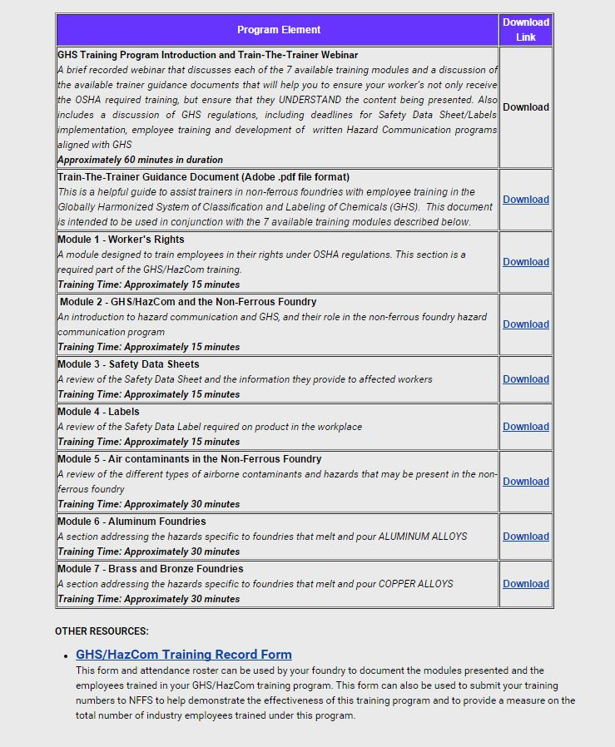

Slide 103
Acknowledgements
This material was produced under grant number
SH-26318-SH4 from the Occupational Safety and Health Administration, U.S. Department of Labor. It does not necessarily reflect the views or policies of the U.S. Department of Labor, nor does mention of trade names, commercial products, or organizations imply endorsement by the U.S. Government

Slide 104
Non-Ferrous Founders’ Society
Safety & Health Training Program
For further information about this or other training modules:
Non-Ferrous Founders’ Society
1480 Renaissance Drive, Suite 310
Park Ridge, IL 60068
847/299-0950
http://www.nffs.org

