Slide 1
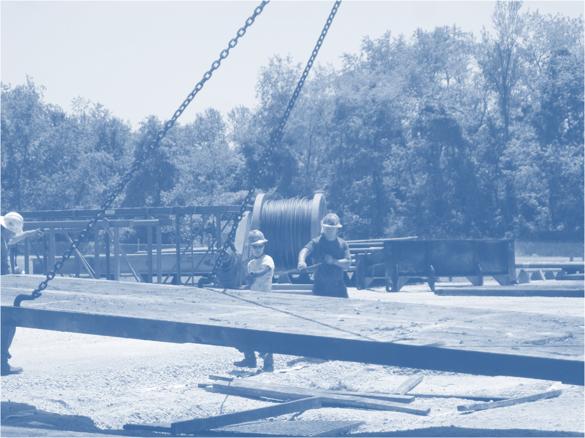
Susan Harwood Training Program Grant
Susan Harwood Training Program Grant
On-Site Motorized Vehicle Safety
This material was produced under grant number SH-26327-SH4 from the Occupational Safety and Health Administration, U.S. Department of Labor. It does not necessarily reflect the views or policies of the U.S. Department of Labor, nor does mention of trade names, commercial products, or organizations imply endorsement by the U.S. Government.

Slide 2
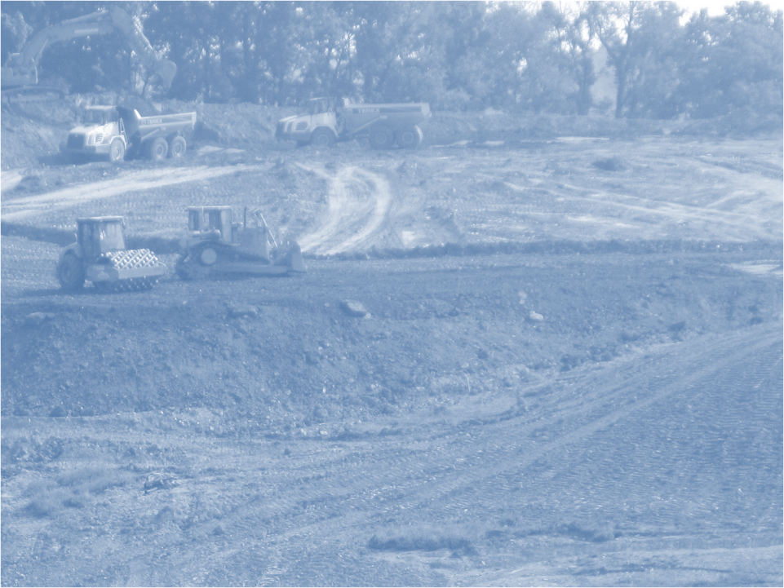
Heavy Equipment

Slide 3
Heavy Equipment Hazards
Being struck by or run over by equipment
Equipment rollovers
Making contact with power lines
Defective equipment
Not using the equipment according to the manufacturer’s instructions
Getting caught in moving parts
Being crushed by elevated components which fall
Equipment fires
Falls
Hearing loss
Loading and unloading equipment

Slide 4
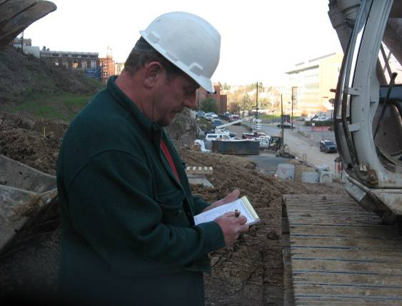
Operator completing his daily Inspection
inspections of heavy equipment are essential for safe operation
this operator is completing his daily inspection

Slide 5
Pulling Equipment from Service
Reasons to pull a piece of equipment from service and tag
inoperative backup alarm or horn
defective or missing fire extinguisher
defective or missing seat belt
brake problems
broken or missing mirrors
cracked, broken, or missing glass
defective doors or latches that prevent operator exit
fluid leaks that could affect safe operation
any other safety or health hazard likely to cause serious harm

Slide 6
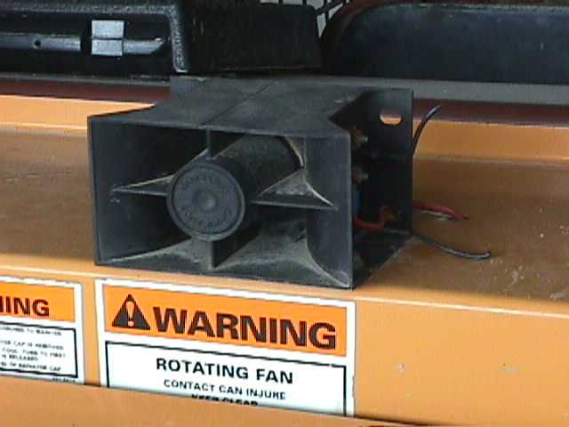
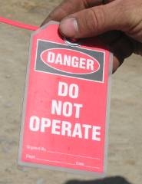
Backup Alarm disabled
this disabled backup alarm was discovered during a preshift inspection
Corrective Action: this machine should be pulled from service, tagged, and repaired
Notes:
This photograph shows a backup alarm in which the wires have been cut to disable its function. This problem was found during a preshift inspection and could have saved
a serious accident from happening that day (i.e. – a worker getting backed over).
Also shown is a “do not operate” tag that should be used (hung from the steering wheel) when the piece of equipment is not suitable for use. The piece of equipment should not be used until the necessary repair is made.

Slide 7
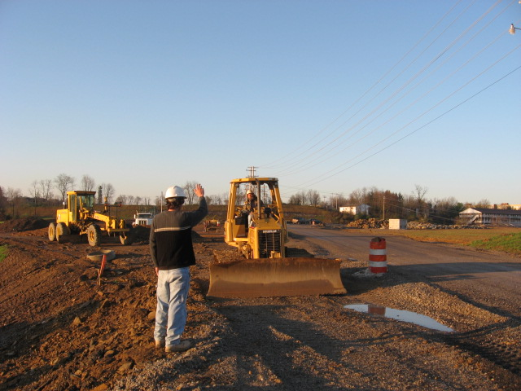
Signal operator before approaching
operators may not always see a worker approaching them
approach equipment only after making eye contact and signaling the operator; wait for their approval

Slide 8
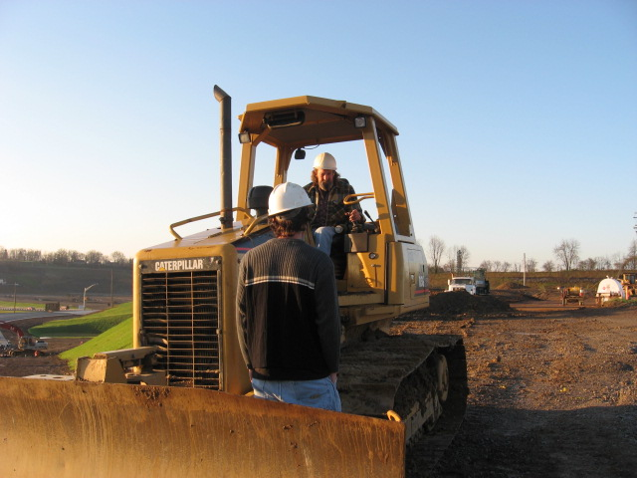
Safe position to talk to operator
while the equipment is running, this worker is in an unsafe position talking with the operator
Corrective Action: never enter into the direct path of moving equipment (or equipment that may move unintentionally)

Slide 9
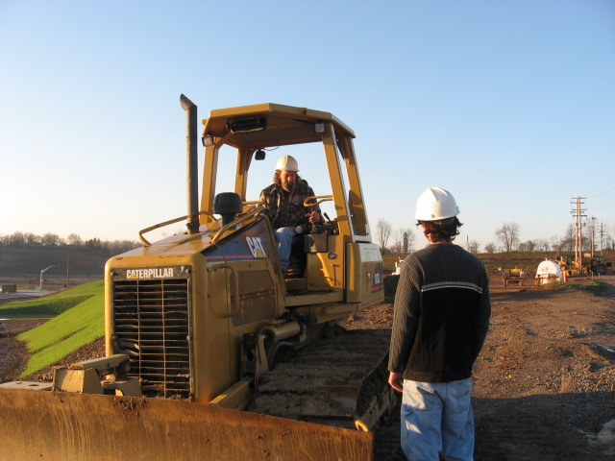
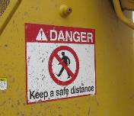
Safer position to talk to operator
this is a much safer place to be

Slide 10
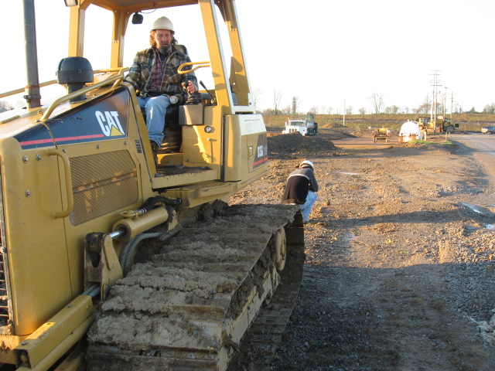
Stay out of the operator’s blind spot
this worker is in the direct path of travel and can’t be seen
Corrective Actions: never forget that equipment has blind spots; work defensively
Notes:
This photograph shows a worker crouched down behind a dozer. The operator may not be able to see this worker. Also, even if the backup alarm was functioning, the worker may be tuning it out or may not be able to hear exactly how close the dozer is to him.

Slide 11
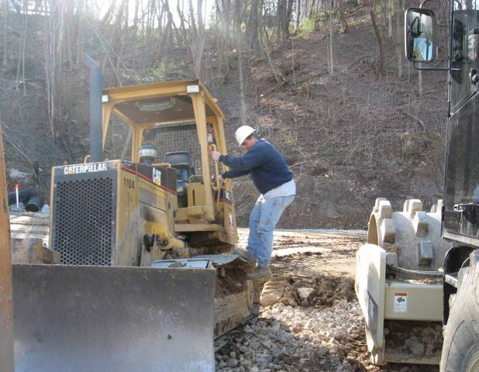
Improper Parking
improper parking can result in out-of-control and runaway equipment which is a hazard to both the operator and ground workers
when getting off the equipment, make sure to set the brake, place the transmission in park, and ground all attachments
Notes:
Notice that this operating is properly using three points of contact as he is getting off his equipment. Operators should always refer to the manufacturer’s manual on the proper steps to ensure proper and safe parking.

Slide 12
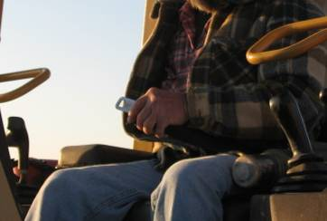
Equipment Rollover
equipment rollovers often result in the operator being ejected and crushed
simply making seatbelt use a habit may save your life

Slide 13
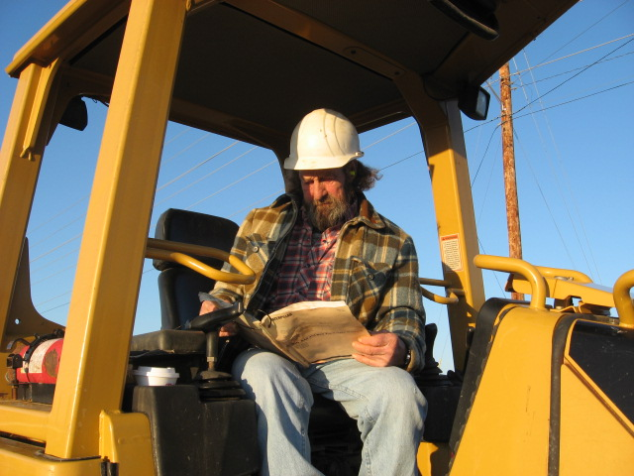
Use the Operator’s Manual
valuable safety-related information can be found in the operator’s manual
this operator is taking a moment to review the safe operation of his piece of equipment
Notes:
All heavy equipment must have the operator’s manual present for review by the operator. Operators need to take the time necessary to review the safety precautions within. Notify your supervisor if the manual is not present.

Slide 14
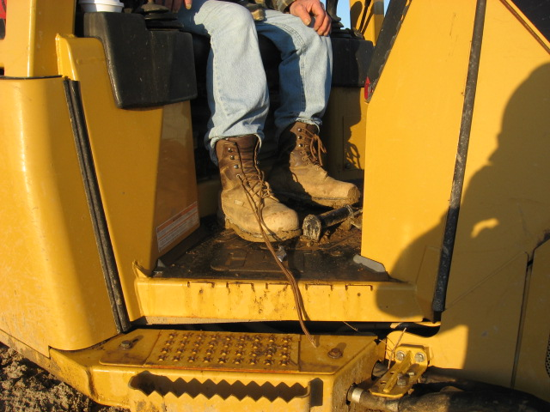
Untied Shoelaces
untied laces can get caught in moving parts, on pedals, or cause a fall
Corrective Actions: double tie your laces; check them occasionally

Slide 15
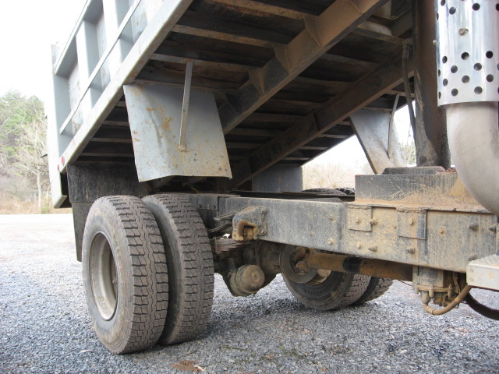
Chock and Block
unsupported machine components can drop unexpectedly
Corrective Actions: use the support provided by the manufacturer; if a support is not provided, crib, chock, or block; never place any part of your body, even for a moment, under any suspended load or elevated piece of equipment
Notes:
Chocking and blocking should be done according to the manufacturer’s recommendations.

Slide 16
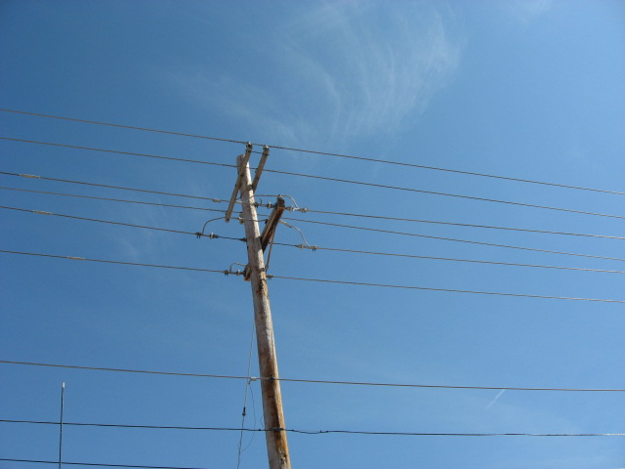
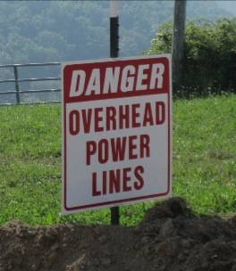
Stay away form Powerlines
you, your equipment, and materials must stay at least 10’ from powerlines
you should be told by your supervisor when a greater approach distance is required due to higher voltages
Notes:
up to 50 kV 10 feet
over 50 kV to 200 kV 15 feet
over 200 kV to 350 kV 20 feet
over 350 kV to 500 kV 25 feet
over 500 kV to 750 kV 35 feet
over 750 kV to 1,000 kV 45 feet
over 1,000 kV as established by the utility owner/operator or registered professional engineer who is a qualified person with respect to electrical power transmission and distribution
Overhead and buried power lines at your site are especially hazardous because they carry extremely high voltage.
Look for overhead power lines and buried power line indicators. Post warning signs.
Contact the utility company for buried power line locations.
Unless you know for certain otherwise, assume that overhead lines are energized.
Have power lines de-energized and grounded at the worksite when working near them is necessary. Other protective measures include guarding or insulating the lines.
Use non-conductive wood or fiberglass ladders when working near power lines.

Slide 17
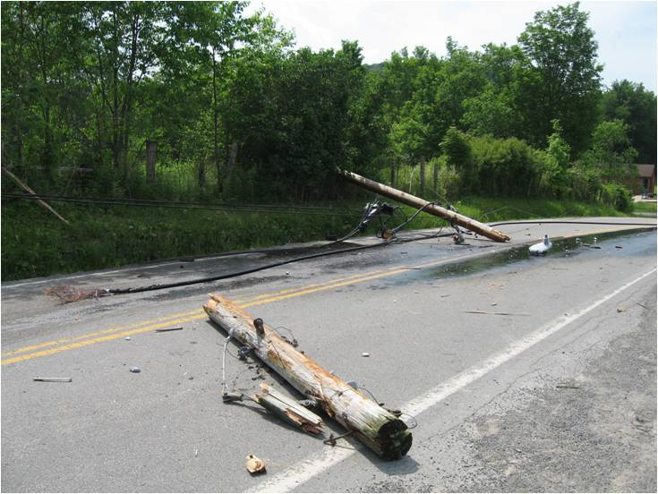
Watch for low hanging powerlines
this photograph was taken after a truck loaded with heavy equipment caught these lines and tore them down
ensure that the load being hauled is low enough to clear power lines

Slide 18
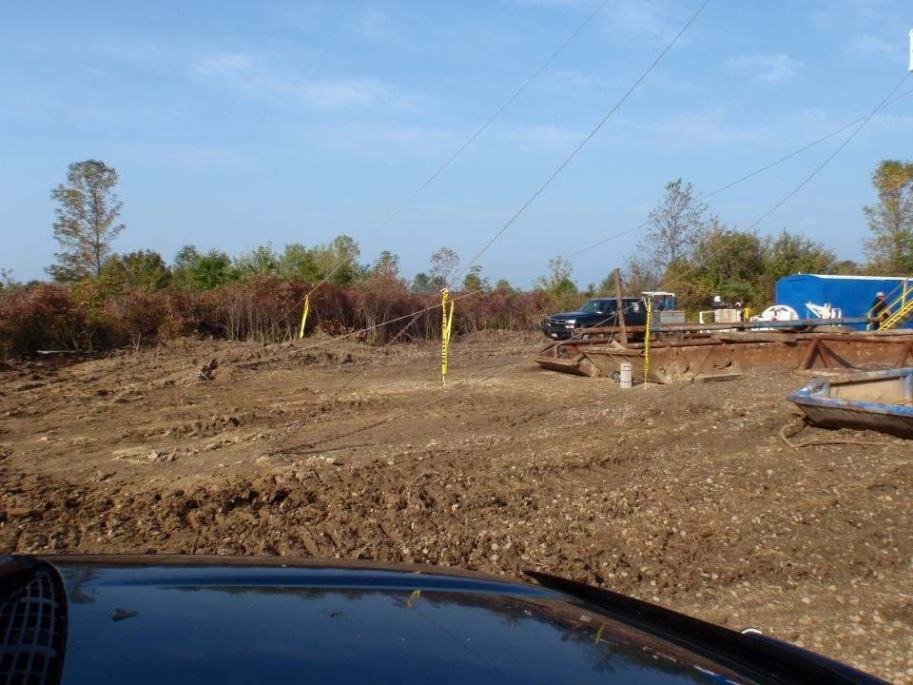
Guy Wires visible
guy wires from the rig must be visibly marked
Rigging Guy wires
although this was a good start, these guy wires need several more flags per wire for visibility
Notes:
These wires have been flagged with one piece of caution tape per wire. This is not enough. The main issue is that trucks and heavy equipment may run into these wires causing damage to the equipment and, possibly, the rig.
The wires need to be flagged several more times on each wire and at various heights.

Slide 19
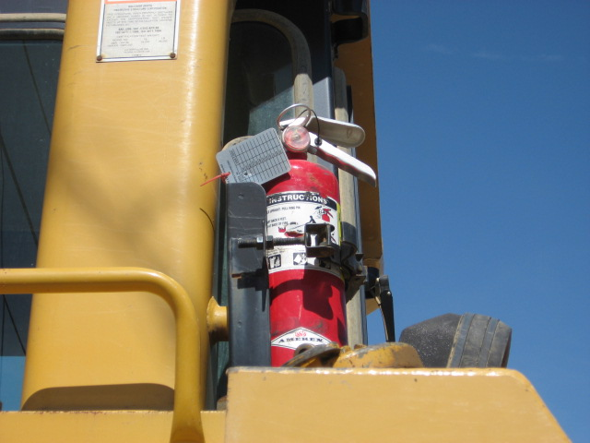
Have a fire extinguisher
a fire extinguisher should be mounted on every piece of heavy equipment
ensure that every piece of equipment has an extinguisher and that it is inspected periodically

Slide 20
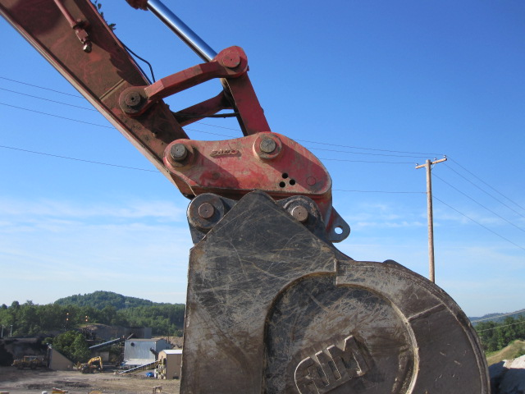
Missing Safety Pin
this attachment lacks a safety pin; the attachment could come off and strike a ground worker
Notes:
This photograph shows an attachment (a bucket) on an excavator without the safety pin installed. This could cause the attachment to disconnect during use and strike a worker or other object. The 3 holes that you can see are holes needed for different attachments. For this bucket attachment 1 safety pin needs to be installed in the bottom, left hole (as the photograph is oriented here).

Slide 21
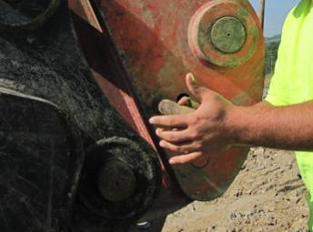
Using the safety Pin

Slide 22
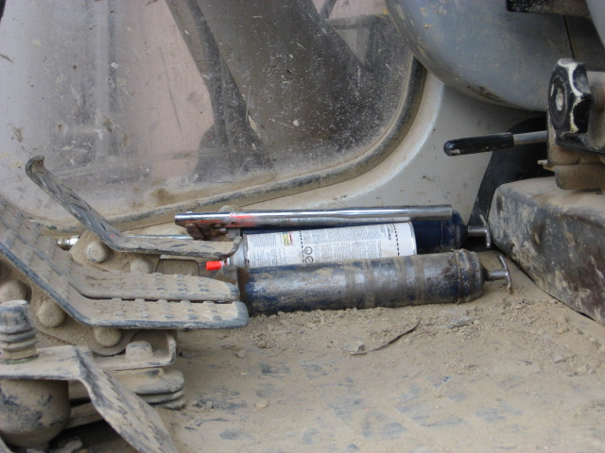
Unsecured Items
unsecured items in the cab can end up under pedals, interfere with safe operation, or can hit a worker in the event of a rollover
Corrective Actions: keep unnecessary items out of cab; secure those that must be there
Notes:
This photograph shows some unsecured items in the cab of a piece of heavy equipment. These can become projectiles in the event of a rollover. They can toss around in the cab and cause serious injury to the operator if hit with one of them. Also, these items can get stuck under pedals and interfere with other operations within the cab.
These unnecessary items must not be kept in the cab. Necessary items that need to remain in the cab, for example, a fire extinguisher, need to be secured.

Slide 23
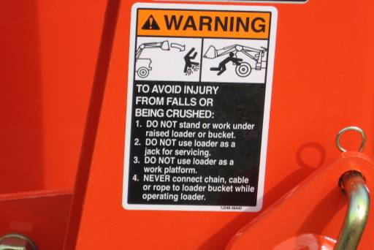
Warning label
take the time to read and follow all warning labels, many workers would be alive if they had

Slide 24
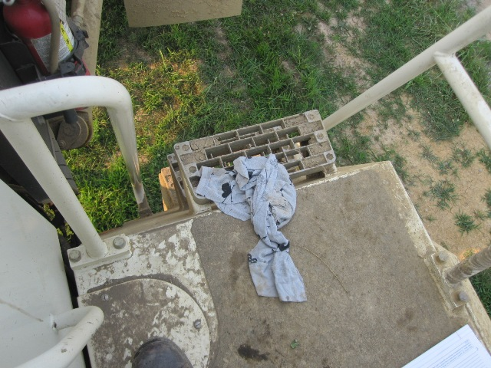
Items that create fall hazards
rags and other items can create serious fall hazards in and around equipment access points
Corrective Action: keep steps and other equipment access areas clear and clean
Notes:
This photograph shows a rag that has been thrown down on the steps to get off the equipment. Items like these can easily cause a fall while an operator is attempting to exit the equipment.
The area within the cab as well as any walking platforms or steps need to be kept clear and as clean as possible.

Slide 25
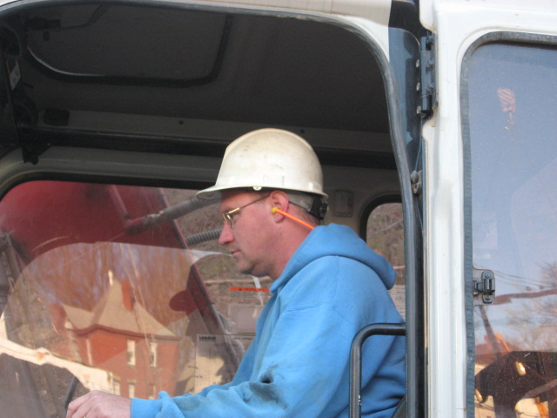
Loud Environments
most equipment makes enough noise to eventually damage your hearing
this worker is protecting his hearing in a loud environment
Notes:
This photograph shows a worker who is wearing hearing protection because of the noisy environment.

Slide 26
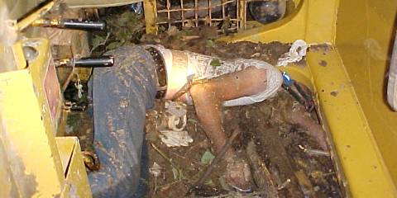
Case Study
An operator decided wearing his seat belt was unimportant. When his dozer slid down a steep bank ending up on its side, his head was crushed by the dozer’s rollover protective structure.
Notes:
A bull dozer operator was doing some final grading near the edge of a steep drop-off. Evidence suggests he lost track of his position in reference to the drop-off. He backed off the bank and rolled the dozer which landed on its side in a stream bed.
Ask the class for 3-4 things that may have contributed to this worker losing his life.
Possible Answers: Not wearing his seat belt. Not knowing his position. Any others?
As the class for 3-4 recommendations for preventing a similar incident.
Possible Answers: Always wear your seat belt. Construct and maintain a berm or warning markers near drop offs. Any others?

Slide 27
Always Remember
Do a pre-shift inspection every day
Do not run a piece of equipment with defects that may affect safe operation
Ensure there is a fully charged extinguisher on the piece of equipment
Make sure the manufacturer’s operating manual is on the machine
Operate equipment according to the manufacturer’s instructions and obey all warning labels
Seat belts are to be used all of the time

Slide 28
Always Remember
Hearing protection is required while operating equipment
Cabs are to be free of all unsecured tools or other loose items
Operate equipment so no hazards are created for yourself and other workers
Be aware of blind spots, the swing radius of equipment, and overhead powerlines
Never place any part of your body, even for a moment, under any suspended load or elevated piece of equipment

Slide 29
Always Remember
When getting off the machine, you must set the parking brake, set the transmission in park, and ground all moving parts
Approach equipment only after making eye contact and signaling the operator; wait for their approval
Never place yourself within the swing radius or path of moving components (especially under)
Never stand directly between wheels or on tracks when talking to the operator

Slide 30
Memory Check
What is the best way to protect yourself from injury in the event of a rollover?
wear heavy clothing and a hard hat
wear your seat belt
hold on tight
take your hands and feet off the controls
Notes:
The correct answer is b. wear your seat belt.

Slide 31
Memory Check
As an operator, how often should you inspect your piece of heavy equipment?
the first day of the work week
once a month
each day prior to operation
never, the mechanics will do that
Notes:
The correct answer is c. each day prior to operation.

Slide 32
Memory Check
What should you do with a piece of heavy equipment when the backup alarm is not functioning properly?
operate it with caution
operate it as usual
pull it from service
pull it from service, tag, and repair it
Notes:
The correct answer is d. pull it from service, tag, and repair it.

Slide 33
Memory Check
What should a ground worker do before approaching a piece of equipment and its operator?
make eye contact
signal the operator
wait for their approval
all of the above
Notes:
The correct answer is d. all of the above.

Slide 34
Struck-By

Slide 35
Objectives
After this course you should be able to
identify the most common struck-by hazards
take the necessary steps to avoid those hazards
identify the most common caught-between hazards
identify the most common heavy equipment hazards

Slide 36
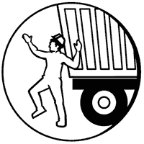
What is a Struck-By?
A struck-by is an accident in which any part of the body is struck by an object that is in motion, whether moving, swinging, flying, falling, etc.

Slide 37
Struck-By Hazards
Site clearing
Moving pipe and casing
Using tongs and spinning chain
Falling overhead objects
Working around mobile equipment
Loads being moved
Improper use of hand tools
Whipping pressurized lines
Using elevators
Using turnbuckles and load strapping

Slide 38
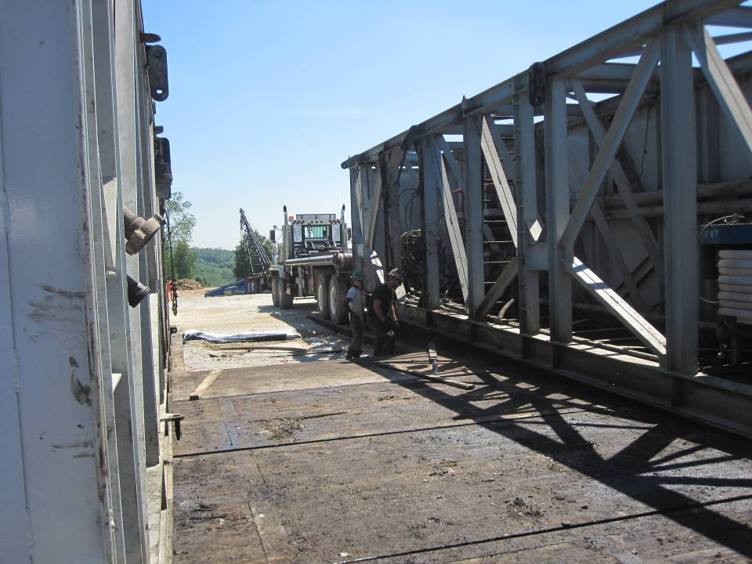
Be aware of the hazards around you
while the rig is being set up at the site, workers can get struck by a crane, load, truck, forklift, tool, etc.
it’s important that the worker is knowledgeable of the hazards present and is aware at all times of equipment around them
Notes:
This photograph shows workers in the process of setting up a rig, laying one of the substructures or “subs” down. Many tasks are going on at once during a rig setup, so a worker must use caution to prevent getting struck by a crane, load, truck, forklift, tool, or other piece of equipment or materials.

Slide 39
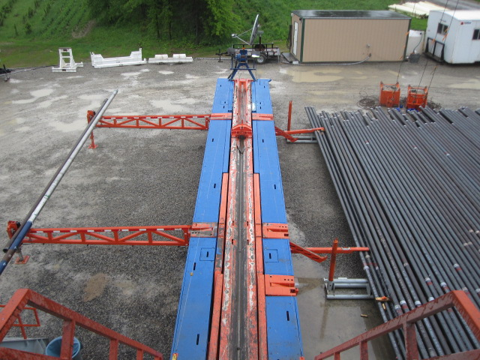
Struck by swinging pipe
a worker can get struck by moving, swinging, or falling drill pipe
Susan Harwood Training Program Grant
stand clear of this area when pipe is being lifted to the rig floor
Notes:
This photograph shows a catwalk which is the item that moves pipe from ground level up to the rig floor. When this action is taking place, workers at ground level should stand clear of the catwalk and workers on the rig floor that aren’t directly involved in the task should stand clear of the area where the pipe is raised. The pipe has a chance of falling onto a worker or shifting or swinging into a worker.

Slide 40
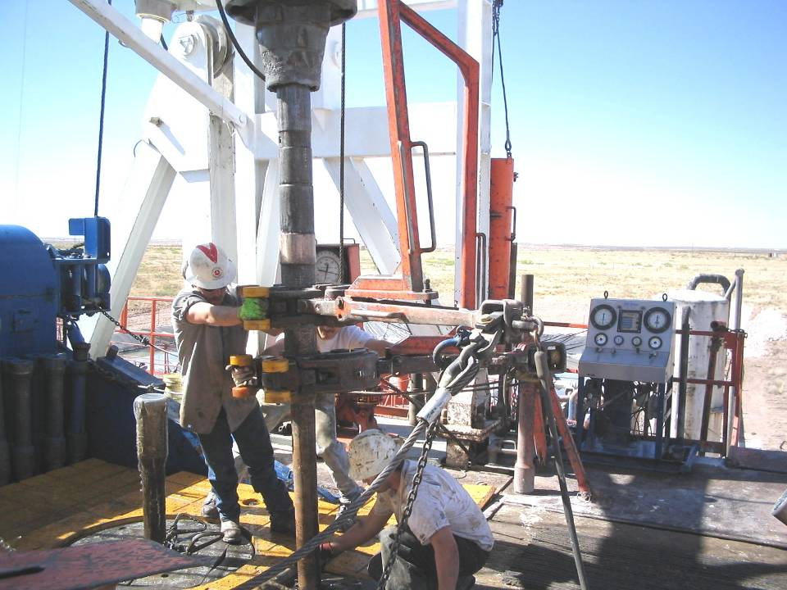
Beware of swinging chains
while tripping in/out, a worker can get struck by tongs or spinning chain
always determine and stand clear of the swing radius of these items when possible [see next slide]
Notes:
This photograph shows workers using tongs. Workers should stand clear of the swing radius of the tongs and spinning chain to prevent getting struck by these items. A diagram of the tong swing radius is on the next slide.

Slide 41
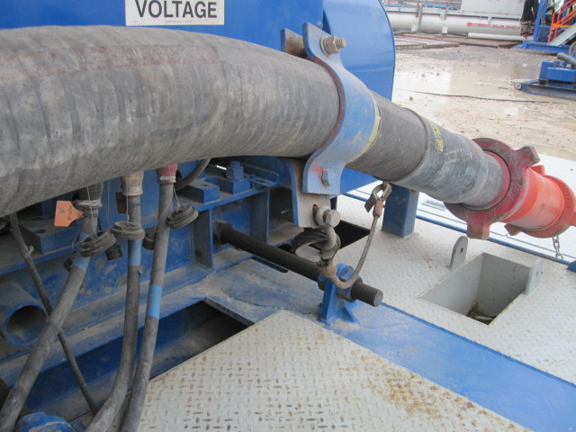
Struck by High Pressure Lines
if connections break free, high-pressure lines and hoses can quickly become struck-by hazards
ensure that lines and hoses are properly secured, connections are not worn, and whip-checks are installed
Notes:
This photograph shows a high-pressure line that has had a whip-check installed on it. Workers installing these lines and hoses should ensure that they are properly and securely connected including ensuring that the right size hammer union is used, that those connections aren’t worn, and that whip-checks are installed.

Slide 42
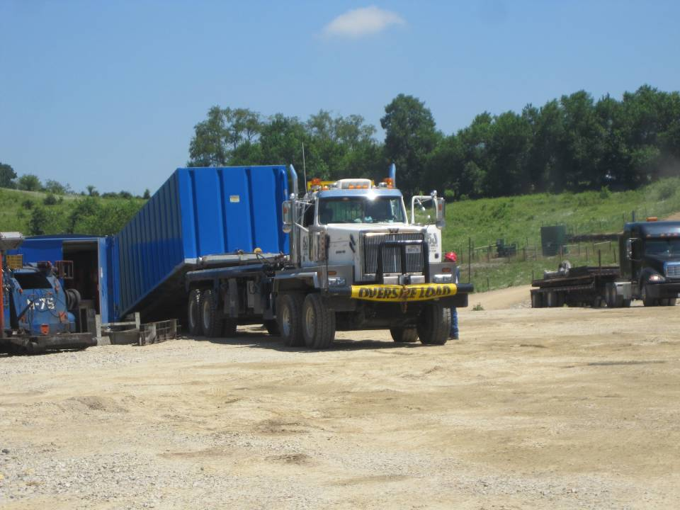
Cables may snap
cable used to rig this load up may suddenly snap, slicing anything in its path
as much as possible, stand clear of the cable while it is under stress
Notes:
This photograph shows a load being lowered into place by a tandem truck during a rig setup.

Slide 43
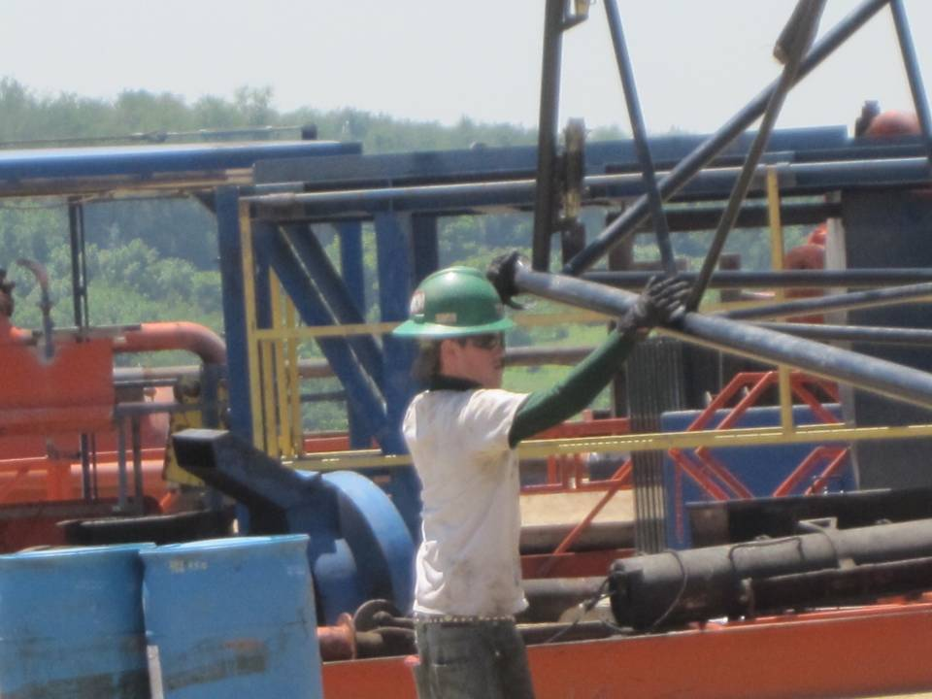
Shifting Loads
this load could shift or fall suddenly striking or falling on the worker
Corrective Action: a tag line would be ideal here; take the time to set one up before the lift

Slide 44
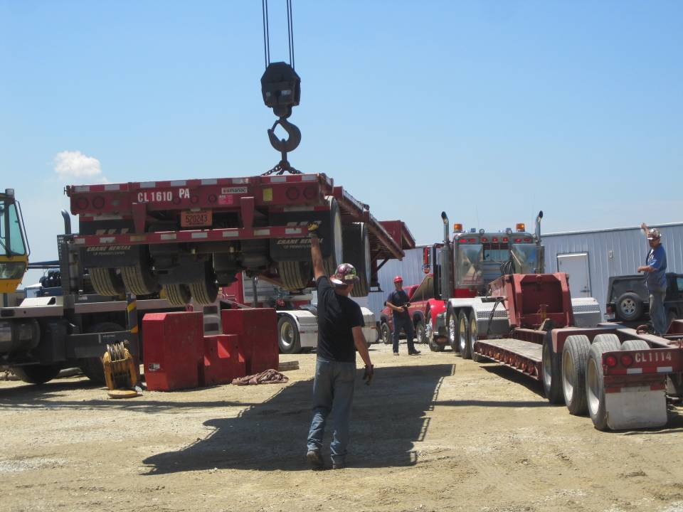
Where a Tag line should be used
this is another example of where a tag line should be used

Slide 45
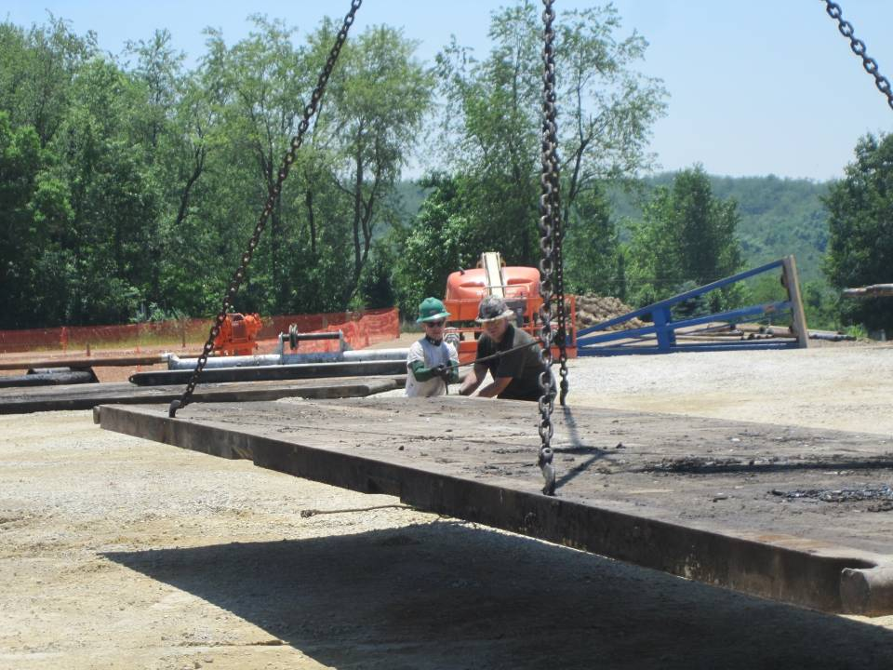
Use Tag line on the Load
if they attached the tag line to the load rather than the rigging, these employees would be correctly using a tag line

Slide 46
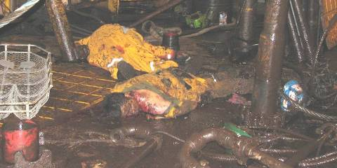
Case Study
The crown sheave shaft came out of one of its mounts releasing the sheaves, the drilling line, and 165,000-pound drilling string, and the blocks fell to the drilling floor.
Notes:
The tie-back string/elevators were 4.9 feet above the rotary table. The string weight was 165, 000 lbs. At 18:50 hrs, a loud noise was heard. The traveling assembly fell a short distance and got caught/trapped in the stands of pipe that were racked back in the derrick. The drill line parted in 4 different locations and dropped to the rig floor. The falling drill line was the primary cause of the deaths and injuries.
Ask the class for 3-4 things that may have contributed to these workers losing their lives.
Possible Answers: Improper safety oversight. Defective equipment. Any others?
As the class for 3-4 recommendations for preventing a similar incident.
Possible Answers: Implement an active safety program. Inspect equipment frequently. Maintain rig. Limit time on the rig floor to only the time necessary to do your job. Any others?

Slide 47
Always Remember
Secure or remove any loose equipment before setting up or breaking down a rig
Be aware of and do not enter the swing radius of tongs and/or spinning chain
Be cautious around mobile equipment
Take damaged tools out of service
Report any struck-by hazards to your supervisor immediately

Slide 48
Memory Check
How should a person on the ground control a suspended load being moved?
use a pole with a hook on the end
grab the rigging
grab only the load
use a tag line
Notes:
The correct answer is d. use a tag line.

Slide 49
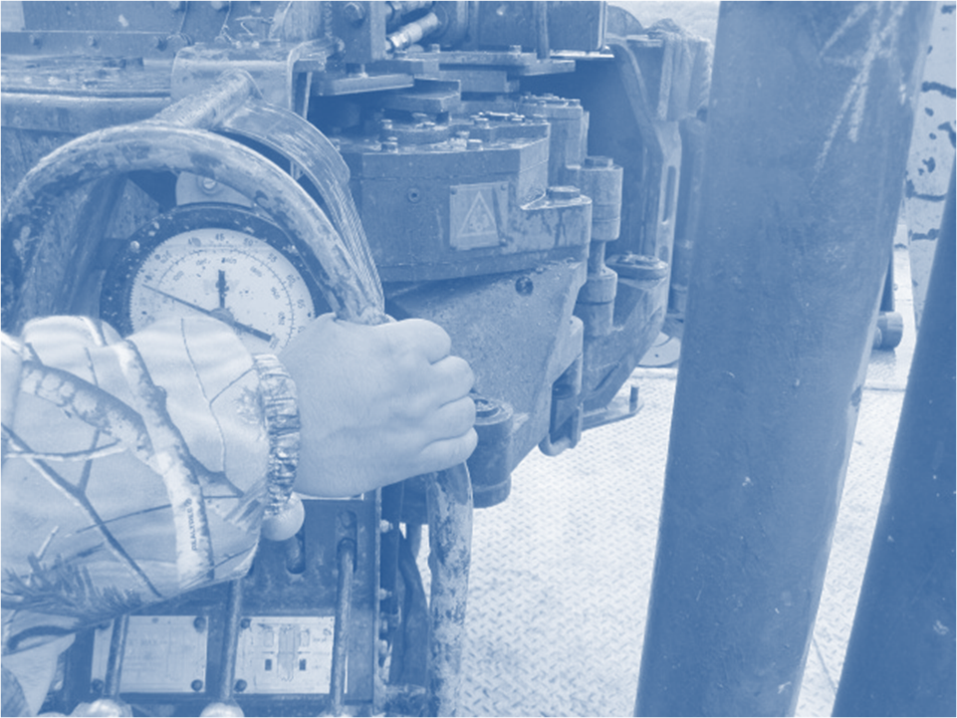
Caught-Between

Slide 50

What is a Caught-Between?
A caught-between is an accident in which the whole body or part of the body is pinched or crushed between objects

Slide 51
Caught-Between Hazards
Moving pipe and casing
Using tongs and spinning chain
Working around mobile equipment
Unguarded moving parts
Working under suspended loads
Improper use of hand tools
Wearing loose clothing
Using elevators
Using slips

Slide 52
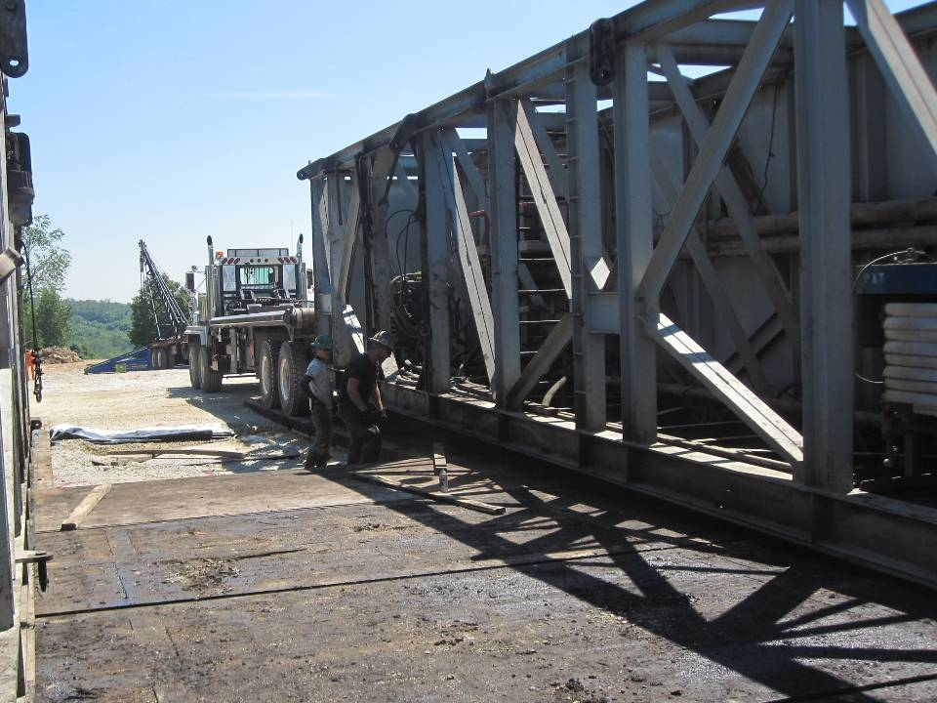
Crushing Hazards
crushing hazards can exist when setting up the rig
always stand clear; keep hands and other body parts away
Notes:
This photograph shows the substructure or “a sub” being lowered into position by a tandem truck which is being guided by the two workers. This stage is early in the process of a rig setup. With all the pieces of the rig being moved around, workers must be careful not to stand or put any part of their body under a suspended load. For increased visibility during rig moves, it is recommended that workers wear high-visibility vests.

Slide 53
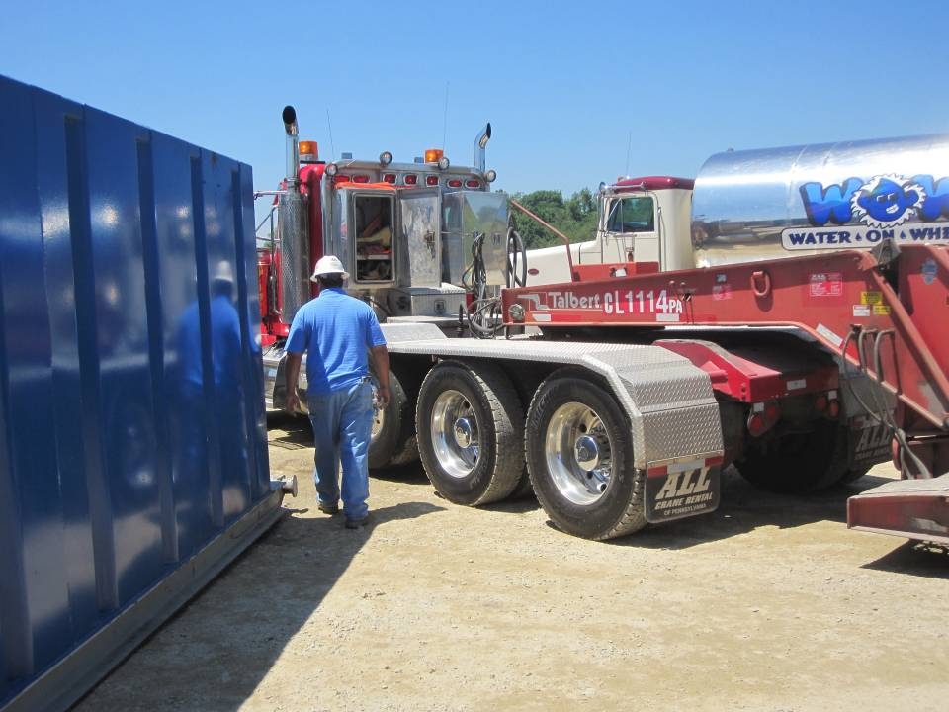
Beware of taking short cuts
this worker is cutting through a bad spot while the truck is moving
Corrective Actions: never take chances like this when the space is this limited; wait until the truck parks
Notes:
This photograph shows a worker walking between a truck and a structure while the truck is moving. The truck could make a sharp turn and pin the worker to the
structure. Many times space is limited on site. Workers must use caution when walking near mobile equipment.
This worker should wait until the truck is parked before walking through this space.

Slide 54
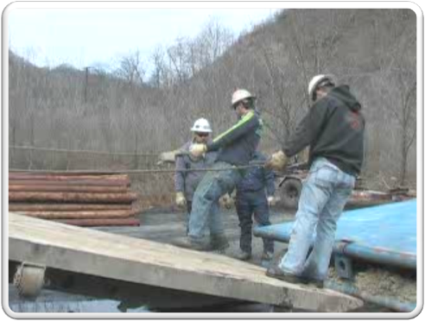
Hazard that could Crush workers legs
the bed of the truck and the sled could come together crushing these two workers’ legs
Corrective Action: ensure that the truck is in park and the parking brake is set
Notes:
This video shows workers rigging up a sled to pull it up onto the bed of the truck. They are standing between the truck bed and the sled to do this.
Workers should ensure that the truck is in park and that the parking brake is set. Also, the load that they are rigging up, in this case a sled, should be set on level ground and other measures should be taken to ensure it will not move while the workers rig it up.

Slide 55
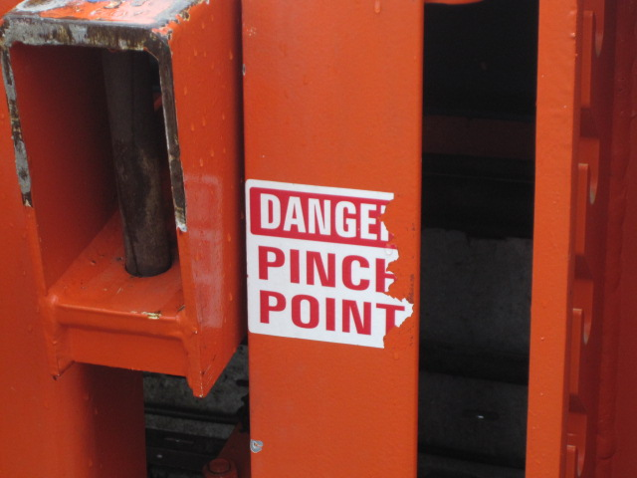
Observe all Warning Signs
observe all warning signs and use caution around pinch point areas
Notes:
This photograph shows a pinch point sign on a catwalk. However, it is damaged and needs replaced.
Workers should observe and take note of pinch point areas. Workers should use caution around these areas to keep from getting their hands or fingers caught in pinch points.

Slide 56
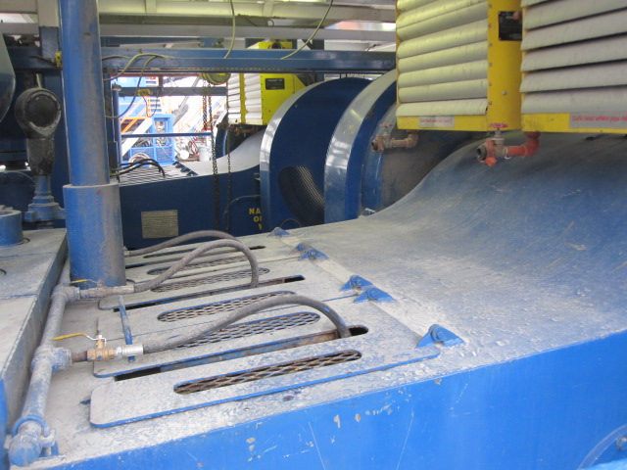
Pinch Points
mechanical equipment has moving parts that can become pinch points
it is important that all the guards are in place to reduce pinch points
Notes:
This photograph shows guards over the moving parts of the mud pumps, which pump the drilling fluid through the system. The guards keep workers and falling objects out of the piston moving inside. Any moving part that is below 7 feet from a walking/working surface that creates hazards such as ingoing nip points or rotating parts must be guarded.
The next photograph shows another example of machine guarding.

Slide 57
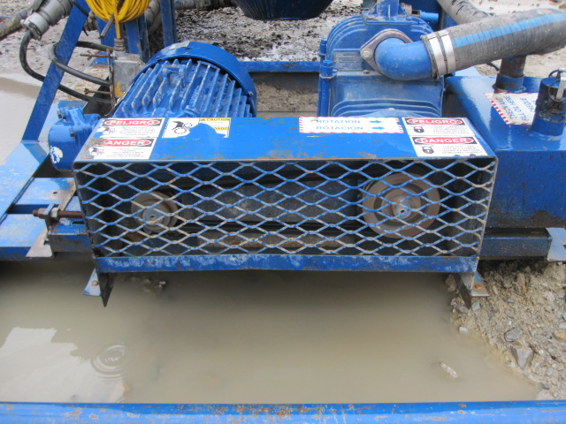
Belts and Pulleys are common Pinch Points
belts and pulleys of machines are common pinch points
ensure that the guarding is installed; do not place hands in the area while machine is operating
Notes:
This photograph shows a properly guarded pulley system on a machine [1910.212(a)(1)]. Unless a worker was actually trying to get injured, this guarding will prevent a worker from getting their fingers or hands caught between the belt and pulley as it is rotating.

Slide 58
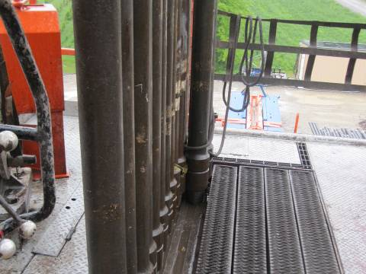
Pinching and Crushing Fingers moving pipe
Susan Harwood Training Program Grant
hands and fingers can get caught while maneuvering stands of pipe
what can a worker do to keep hands from getting pinched or crushed?
Notes:
This photograph shows stands of pipe that are ready to become part of the drill string. Workers must maneuver these stands in and out of place during the tripping in and out phases.
What are some techniques a worker can use to keep hands and fingers from getting pinched between stands of pipe while maneuvering them? See next slide for best answer to this question.

Slide 59
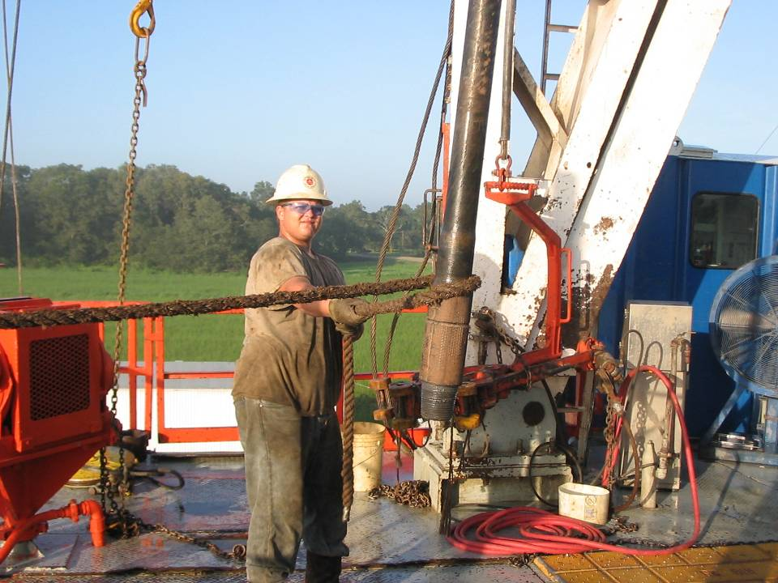
Using Tag lines keeps hand safe
this worker is using a tag line, keeping his hands free from crushing hazards
when your hands get to the end of the tagline, there should be a knot for grip
Notes:
This photograph shows a worker maneuvering a stand of pipe into position using a tag line. This will greatly increase control of the pipe and reduce the chance of slipping or tripping or mashing of fingers and hands. See the next slide for an example of what could happen when you are not careful.

Slide 60
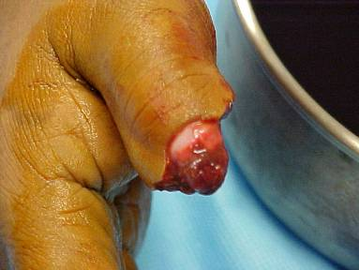
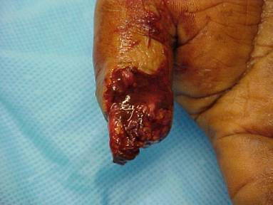
Severed fingers
here’s what could happen

Slide 61
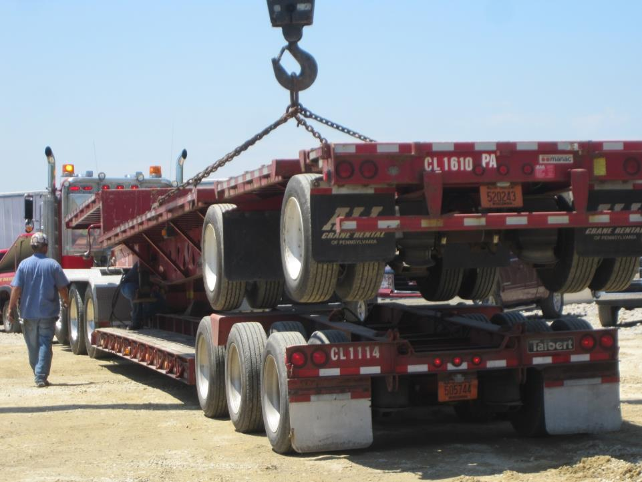
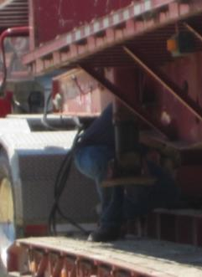
Do not work under a suspended load
Corrective Action: do what needs to be done before the load is suspended or use blocking
Notes:
This photograph was taken of a worker who was making some adjustments under the suspended load while double stacking trailers during rig setup. There should be no reason to be under a suspended load at any time!
This worker can either do what needs to be done prior to the lift being made or use blocking to support the load in case it falls for any reason.

Slide 62

Case Study
A dump truck driver was attempting to repair a leaking brake line. When the hydraulics failed, the dump bed came down and pinned him to the chassis.
Notes:
A 21-year-old dump-truck driver (the victim) died after being caught between the frame and dump body of a dump truck while performing routine lubrication. The victim was working for an excavation contractor at pad on the day of the incident. The victim's foreman drove by the area. He found the victim caught between the frame and dump body of the truck. The foreman called out for help and then called 911 from his cell phone. An excavator operator working nearby responded to the foreman's call for help and climbed into the cab of the truck and raised the bed. Emergency medical services (EMS) and law enforcement personnel responded within 10 minutes. EMS personnel transported the victim by ambulance to a local hospital where he was pronounced dead.
Ask the class for 3-4 things that may have contributed to this worker hurting his back.
Possible Answers: Worker under an elevated bed. A defective piece of equipment. Any others?
As the class for 3-4 recommendations for preventing a similar incident.
Possible Answers: Never work under an elevated piece of equipment. Always use the body prop. Any others?

Slide 63
Always Remember
Use caution around heavy equipment
Be aware of your hand placement
Keep hands free when possible
Never work under a suspended load
Don’t choke up on tools
Ensure machine guarding is in place
Use caution around pinch points
Never wear loose clothing

Slide 64
Memory Check
How many seconds is it acceptable to stand under a suspended load?
0
1
2
3
Notes:
The correct answer is a. 0. It is unacceptable at any time to place yourself under a suspended load.

Slide 65
Memory Check
Which of the following is the best way to prevent pinch point injuries?
post pinch point signs to warn workers
whenever possible, guard the pinch point so no part of the body can enter the pinch point area
have an employee stand guard at each pinch point
let the toolpusher know the locations of all pinch points
Notes:
The correct answer is b. whenever possible, guard the pinch point so no part of the body can enter the pinch point area.

Slide 66
Your Employer Is Responsible For
Providing appropriate PPE
Identifying and correcting any struck-by, caught-between, or heavy equipment hazards
Responding to and correcting hazards pointed out by you, the worker
Using caution when working around potential caught-between hazards on the rig

Slide 67
You Are Responsible For
Wearing the appropriate PPE
Operating and working around mobile equipment carefully, keeping in mind that such equipment has blind spots
Correcting the hazards you are able to correct
Reporting to your supervisor the hazards you are unable to correct

