Slide 1
Thinking Outside of the Box
Activities for Training Events:
  Pre/Post Quiz - Review
  Small Group “Real Life Examples” and Discussion
  Created Scenario’s Root Cause Analysis Small Group Workshops
  Post course Evaluation
Notes:
This slide is a place holder for a warm up activities that can be held at the start of and during the training event:
A Pre and Post training (15-30 minutes)- Using the quizzes included in the handouts and completed at the beginning and end of the session will serve two functions: 1.) as used as a metric to determine impact and 2.) used as an interactive discussion and group makeup review tool for the instructor to determine what is the demographic of the class they are teaching to: (Installers, O&M/Pumpers, Designers and or Regulators).
Using the handout included in the “Instructors Guide”, at the end of each session, break the groups into 2-4 people and have them each write or describe an experience that they had personally for the segment (ie: Falls, Struck By, etc.). Then have them share their experience with their group. The instructor can then move around through the groups and invite them to share their stories with the entire group overall. This exercise can take up to 15-30 minutes.
Created Scenario’s – Root Cause Analysis: 15 – 30 minutes depending on group size– Using the prepared examples for each segment or the instructor may create/add them for each segment, have small groups (up to 5) each work through and present solutions. The instructor should try to relate their effort and presentation to the following:
What was the accident/fatality?
What were the contributing factors? (employer responsibilities: procedures, training, etc.) (employee responsibilities: housekeeping, equipment, maintenance, failure to use established procedures, behaviors, etc.), Environmental and other contributors to the scenario)
How could they have been recognized in advance in the workplace setting
How will “lessons learned” be incorporated into the workplace going forward (safety program focus, equipment replacement, requirements prior to working, training, employee testing, experience minimums.
A course overall assessment of the program as a feedback loop for improvement.

Slide 2
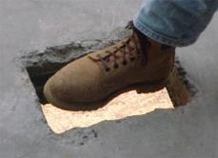
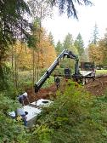
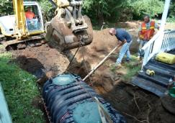
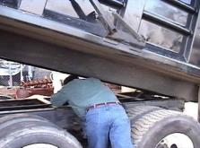
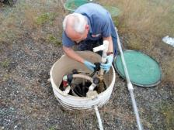
“Safety in the Workplace”
Washington On-Site Sewage Association
“Voice of the Industry”
FOCUS FOUR HAZARDS SAFETY TRAINING – Part 1
Notes:
Introduction of topic to class, the speaker.
Depending on class size, the Instructor should have participants introduce themselves and the industry segment they work in.
The ideal class size for interactive participation is 25.
Introduction of Focus Four topics:
NOTES for use:
This targeted training is a strategic effort to reduce injuries and raise awareness to workplace hazards and injuries related to falls, caught in-between/struck by and electrocution, utilizing “in person” training with instructors that have a background in the Onsite industry, training experience that will focus on highlighting common workplace activities and associated hazards that can be mitigated or eliminated through behavior modification and incorporated into small business safety and training programs.
.In this industry, class participants educational levels will range widely depending on the local demographic, sophistication of local/state rulemaking on certification/licensing requirements and will range from college graduates to high school/GED’s or less. The focus audience of this training are workers in the wastewater and associated Onsite industry. Generally, they are described as small business owners and employees with less than 250 employees that design, install, repair and maintain decentralized wastewater systems (septic systems) that are capable of producing 240- 100,000 gpd of wastewater. Typically, this infrastructure is located and/owned privately but in some cases may also include work activities on community systems. The training intends to provide training to small business that experience a higher level of young workers, limited proficiency, minorities and other hard to reach workers.
After the Instructor introduces themselves and depending on class size, a presentation technique that is recommended for attendees of 25 or less, is to allow each participant to tell who they are but may be effectively used in larger groups with experienced trainers and advanced presentation techniques. This activity is intended to be an “ice breaker” and set’s the style and tone of the learning event to be interactive
The key learning objectives follow:
At the end of each training session of the Focus Four, participants will be able to identify specific hazards that relate to their industry segment.
Demonstrate an understanding of how to minimize or eliminate the exposures through modification of work practices in specific tasks
Provide feedback on experience and sharing personal stories of events and near misses in the Focus Four categories
Describe what they have changed personally or in supervisory roles that would mitigate or prevent accidents in the Focus Four categories
Each of the slides in this presentation provides comments and Instructor’s speaking points and perspectives to current application in the industry. The developer’s of this training resource encourage modification of this editable resource that will make it both industry and region specific to reflect local regulatory practice and information from other state approved OSHA plans outside the initial development.

Slide 3

OSHA Susan Harwood Grant
This material was produced under grant number
SH-27631- SH5
From the Occupational Safety and Health Administration, U.S. Department of Labor. It does not necessarily reflect the views or policies of the U.S. Department of Labor, nor does mention of trade names, commercial products, or organizations imply endorsement by the U.S. Government.
Notes:
Recognition slide for grant from OSHA

Slide 4
Credits ─ Sources of Information
U.S. Bureau of Labor Statistics (BLS)
Federal OSHA
WISHA (Washington Industrial Safety and Health Administration)
WOSSA (Washington Onsite Sewage Association)
Oregon-OSHA
OSHA/Kansas
OSHA Missouri
Notes:
Credit to source information for the development of the material.
The Instructor should also make a connection to the audience depending on where (what State) the training is occurring. Principally, to make the point that some states have OSHA approved plans and comments to the differences that may exist.
All of the OSHA Requirements are recognized through State approved plans as minimum requirements.

Slide 5
Disclaimer
This training resource has been produced and does not necessarily reflect the views or policies of the U.S. Department of Labor, and mention of trade names, commercial products, or organizations is not an endorsement by the U.S. Government.
Photos shown in this presentation may depict situations that are not in compliance with applicable OSHA requirements.
The intent of this training is to raise awareness in the Onsite and related Onsite industries in the Focus Four Hazards.
It should NOT be assumed that the discussion contained herein constitute a thorough review of the applicable standards or are intended to provide compliance based training.
Notes:
Housekeeping comments to note the limitations of the presentation. Local county and state regulations may impact the application of rule and states with approved plans from OSHA may have additional restrictions that are more restrictive.

Slide 6
Pre Course Quiz #1
Notes:
After the introductions, the instructor should have the participants take the “pre-course” quiz. This can be set up as an interactive exercise and have participants “share” and discuss answers. Afterward the instructor should review the answers with the group and encourage discussion.

Slide 7
Learning Objectives
What are the OSHA Focus Four Hazards?
  Falls
  Struck-by
  Caught-in/between
  Electrocution
Training includes a review of Focus Four:
  Definitions
  Statistics
  Typical Industry and Related Examples
  Your Shared Examples
Notes:
This is an industry specific training on job site exposures and safety for employers and workers in the Onsite Sewage wastewater industry.
Briefly discuss in the following slides, the Focus Four statistics as it relates to the nationwide Onsite workforce, and review those numbers in relation to similar hazards encountered by OSS (onsite systems) service providers. The training will cover the four focus areas of hazards that are especially important on OSS Onsite sites.
Safety doesn’t happen by accident…it’s a choice. From the highest level in an organization to the lowest level in the organization. Because the relative size of companies in the OSS industry is small (>10) employee’s, personal behaviors, teamwork, and company culture play an important role in safe attitudes in the workplace.

Slide 8
Learning Objectives
  Recognize Employer and Employee responsibilities
  Practice Root Cause Analysis Exercises
  Identify and describe major industry exposures for each of the Focus Four Hazards in the Onsite Industry
  Discuss worker behaviors impact on unsafe decisions
  Describe actions you can do to protect yourself
Notes:
Outline the slides the Focus Four learning objectives. The training covers the major four focus areas of hazards that are especially important on OSS Onsite sites. The training doesn’t attempt to show and cover every potential exposure, but provides examples of each of the Focus Four exposures in different setting from potentially low impact (slipping on wet grass and falling to ground to the worst case potential of a fatality during routine tasks of maintenance on equipment.
The intent is to raise awareness, develop critical thinking skills that will allow the learner to appropriately assess the workplace, tasks to be performed and the impact of changing conditions that can help them do their jobs safely, by thinking about doing it differently when needed.
For each of the four hazards, emphasize how recognition, prevention, and training will identify ways that fatalities and injuries can be reduced, what they can do through personal responsibility and what the employer’s responsibilities are under the OSHA rules to keep the workplace safe.

Slide 9
Employer Responsibilities - Summary
Provide a workplace free from serious recognized hazards and comply with standards, rules and regulations issued under the OSH Act.
Examine workplace conditions to make sure they conform to applicable OSHA standards.
Make sure employees have and use safe tools and equipment and properly maintain this equipment.
Establish or update operating procedures and communicate them so that employees follow safety and health requirements.
Notes:
This slide outlines the basic employer responsibilities of an OSHA or state approved Program

Slide 10
Employer Responsibilities – Summary
Employers must provide safety training in a language and vocabulary workers can understand.
Employers with hazardous chemicals in the workplace must develop and implement a written hazard communication program and train employees on the hazards they are exposed to and proper precautions (and a copy of safety data sheets must be readily available).
Use color codes, posters, labels or signs to warn employees of potential hazards.
Notes:
This slide outlines methods that the employer can use to meet their responsibilities under an OSHA or state approved Program

Slide 11
Employer Responsibilities – Summary
Provide medical examinations and training when required by OSHA standards.
Post, at a prominent location within the workplace, the OSHA poster (or the state-plan equivalent) informing employees of their rights and responsibilities.
Report to the nearest OSHA office all work-related fatalities within 8 hours, and all work-related inpatient hospitalizations, all amputations and all losses of an eye within 24 hours.
Notes:
This slide outlines methods that the employer can use to meet their responsibilities under an OSHA or state approved Program

Slide 12
Employer Responsibilities – Summary
Provide employees, former employees and their representatives access to the Log of Work-Related Injuries and Illnesses (OSHA Form 300).
Keep records of work-related injuries and illnesses.
  Note: Employers with 10 or fewer employees and employers in certain low-hazard industries are exempt from this requirement.
Notes:
This slide outlines methods that the employer can use to meet their responsibilities under an OSHA or state approved Program

Slide 13
If you are a worker, you have the right to:
Request an OSHA inspection for workplace hazards, violations of OSHA standards, or violations of the OSH Act;
Have an authorized employee representative accompany the OSHA compliance officer on the workplace inspection;
Meet informally with the OSHA compliance officer (in private, if preferred);
Be notified by your employer of any citations issued for alleged violations of standards at the workplace, and of your employer's requests for variances or for changes in the abatement period;
Notes:
This slide outlines the basic employee rights and responsibilities of an OSHA or state approved Program

Slide 14
Worker Responsibilities and Rights
Receive information from your employer about hazards and safety measures applicable to the workplace, OSHA standards relevant to your job, and the record of accidents and illnesses in the workplace;
Observe the monitoring and measuring of toxic substances in the workplace if you are exposed, and to have access to any records of your exposure.
Contest the abatement time set in any citation issued to your employer by OSHA;
Notes:
This slide outlines the basic employee rights and responsibilities of an OSHA or state approved Program

Slide 15
Worker Responsibilities and Rights
Refuse to work in an imminent danger situation, under certain conditions;
File a complaint with OSHA if you believe that you have been dismissed, demoted, or otherwise discriminated against for exercising rights under OSHA;
File a complaint with Federal OSHA authorities if your State agency fails to administer a State program as effectively as required by OSHA;
Notes:
This slide outlines the basic employee rights and responsibilities of an OSHA or state approved Program

Slide 16
What You Are Responsible For…
Identify major exposures for each of the Focus Four Hazards for your workplace.
Understand how using Root Cause Analysis to evaluate hazards in your workplace can reduce your exposure.
Identify decisions you can make to protect yourself.
Understand what your Employer’s responsibilities are to help keep you safe.
Notes:
For each of the four hazards, emphasize the responsibility the employee plays in getting work done: hazard recognition, personal responsibility, situational awareness, prevention, and training all identify ways that fatalities and injuries can be reduced.

Slide 17
What You Are Responsible For…
Pay Attention!!! (Situational Awareness)
Learn to recognize Risks
Make Good Decisions
Use Appropriate PPE
Follow Procedures
Notes:
For each of the four hazards, emphasize the responsibility the employee plays in getting work done: hazard recognition, personal responsibility, situational awareness, prevention, and training all identify ways that fatalities and injuries can be reduced.

Slide 18
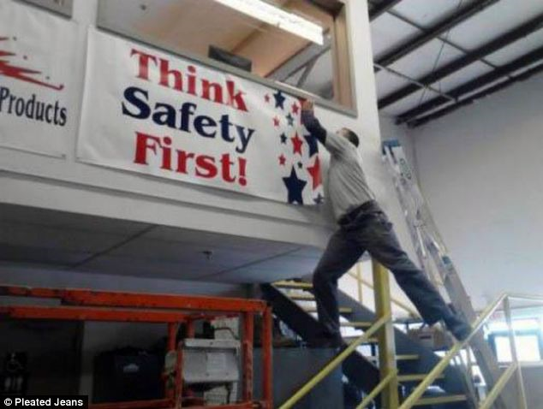
Keep these factors in mind to help prevent injuries from falls:
Notes:
Bridge to topic slide – Darwin Awards.
You can identify risks in the workplace, but you can’t always identify the risk “takers”.
Sometimes, left to their own devices workers solve problems that the employer wouldn’t approve.
“Don’t be this guy!”

Slide 19
Why are the Focus Four Hazards Important?
2014 worker fatalities = 4,251
Notes:
This information is compiled from the Bureau of Labor Statistics….the message here is the trend is increasing fatalities in Construction from previous years.

Slide 20
Focus Four Fatalities are 79% of All Fatalities
Source: Bureau of Labor Statistics
Notes:
2355 Total Fatalities further broken down as a percentage of the 2005 statistic
805 Fall
253 Electrical
570 Struck by
228 Caught in between
499 All Others (includes transportation, inhalation, chemicals, fires, and other related fatalities)

Slide 21
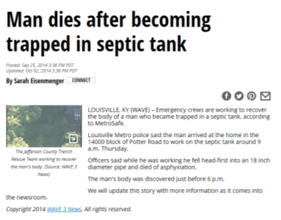
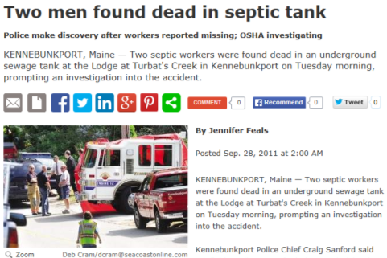
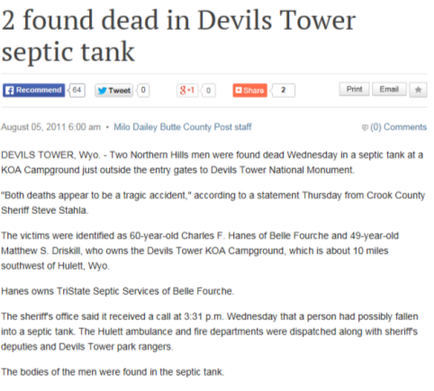
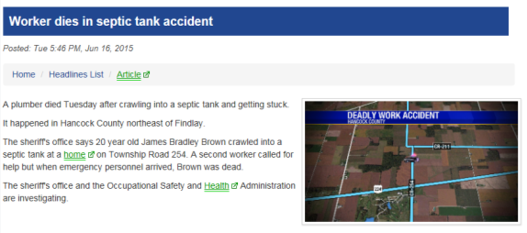
Fatalities
Notes:
Summary slide to raise awareness of that the fall exposure work in and around Septic Tanks can be and has been fatal. The onsite industry’s general attitude persistently is, “it won’t happen to me”.
A field study of service companies in Washington demonstrated that compliance is low both in the requirements of having a written program as well as significant gaps in CSE protocols for exposure identification, continuous air quality monitoring and consistent use of non-entry retrieval equipment.
The key relationship to the Focus Four is that non compliance with the CSE requirements can set up a situation outside of the traditional thinking of Falls. If the atmosphere causes a person to pass out, the next result is a fall…if they are on a ladder trying to escape, they fall… if they are standing in liquid and pass out from heat exhaustion, they fall and drown.

Slide 22
Our Industry does a Great Job at Firefighting
Reactive Management
(Fire Fighting)
When a problem occurs, you simply REACT to it.
The “problem” was never rooted out before it occurred.
It may have been preventable if the root cause had been identified.
Proactive Management
When using a PROACTIVE approach to problem solving, you eliminate potential exposures out of the work flow.
Preventable exposures are identified in advance using safety management tools like JSA’s (job safety analysis).
Notes:
Our OSS industry is renowned for firefighting…In reality, it is the nature of small business and limited resources to approach safety in this manner.
This discussion will set up the root cause analysis exercises in each of the modules.

Slide 23
Employer Management Tools
JSA’s – Job Safety Analysis
Policies and Procedures
Training
Emergency Response/Rescue Planning
Maintenance
Inspections, Internal/External Audits
Compliance and Enforcement
Accident Investigation (Root Cause Analysis)
Notes:
What you measure, you can manage….systems of work like those listed in the slide, provide a consistent method to identify, establish and implement policies and procedures that minimize and/or manage exposures in the workplace

Slide 24

Fixing Problems instead of Fixing Blame
It’s Hard to fix a problem that you don’t know about!
Notes:
What you see is often only the tip of the ice berg, you can only manage risk if your safety program encourages identification of work flows and field procedure that are dangerous….this image demonstrates the point of being able to identify “near misses” before they become fatalities.

Slide 25
Root Cause Analysis and Methodology
How do you get started?
Establishing What You Want to Measure
Accident Reporting and Investigation
Fault Tree Analysis Tools
Notes:
These slides provide an exercise and method on root cause analysis for fatality scenarios that will be used in each of the Focus Four as class exercises in the 8 hour program to develop critical thinking skills of participants
The Five Why’s
Applying What We Learn:
Root Cause Investigation of a Focus Four Fatalities
Group Exercise
Reporting back to the Group

Slide 26
Root Cause Analysis….Another Tool in the Box
A methodical approach to problem solving that identifies the root cause of problems to help understand the underlying causes.
A “Causal Factor” is something that affects the outcome, but is not a root cause.
Removing a “Root Cause” from the work flow will prevent the accident from happening in the future.
Notes:
Understanding root cause methods as an investigative or predictive process. If the employer or worker can identify and remove a poor practice that increases risk, incident exposures will ultimately be reduced and the frequency and severity of accidents in the workplace will be mitigated when properly used and applied.
Examples:
Falls – root cause: improper foot wear…..causal factor: Rain, snow, working on a slope hauling a heavy hose
Struck By – root cause: no hard hat inside a tank doing repair….causal factor: unrecognized slope conditions, loose soil, frost…to warming temperatures in rocks and soil that become dislodged.
Caught in – root cause: loose clothing while working on moving equipment without guards….causal factor: unbuttoned shirt sleeves. Root cause: working under rotating equipment with out LO/TO procedures being accomplished.
Electrocution – root cause: working on equipment that is energized…causal factor: unlicensed electrician doing work does not understand exposure. Root Cause: not using LO/TO procedures.

Slide 27

Root Cause Analysis is NOT….
Notes:
Looking for blame will not help a team understand the “how” of an accident. When a fatality is involved, emotions, pressure from outside are made worse. Having a process in place to allow you to do an investigation will help you understand the gaps in the work processes that contributed to the incident.

Slide 28
Examples:
Falls – root cause: improper foot wear…..causal factor: Rain, snow, working on a slope hauling a heavy hose
Struck By – root cause: no hard hat inside a tank doing repair….causal factor: unknown slope conditions, loose soil, frost…to warming temperatures
Caught in – root cause: loose clothing while working on moving equipment without guards….causal factor: unbuttoned shirt sleeves
Electrocution – root cause: working on equipment that is energized…causal factor: unlicensed electrician doing work does not understand exposure
Notes:
Understanding root cause methods as an investigative process to identify and removes a poor practice that increases incident exposures will ultimately reduce the frequency and severity of accidents in the workplace when properly used and applied.

Slide 29
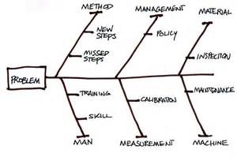
Organizing the Information
What are the core issues involved?
Method
Management
Material
People
Measurement
Machine
Change the parameters
Notes:
This is just one of a number of Fault Tree analysis tools or process that continues to identify all of the causal actions that contribute to an exposure until you can clearly understand what the root cause is and actions taken to mitigate the exposure.

Slide 30
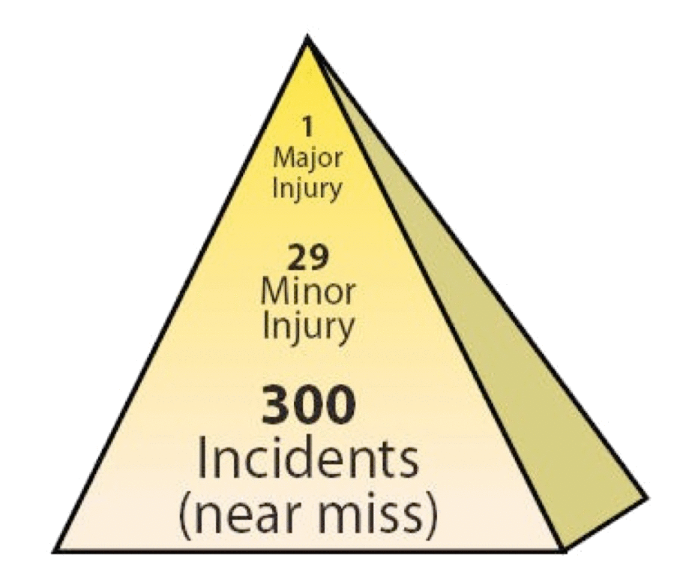
What Do You Measure and Why?
Vehicle Accidents and Property Loss
Occupational Illness’
Injuries with Lost Time Off
Near Misses
Notes:
OSHA Safety Pyramid, but based on the Heinrich “Safety Pyramid” and theory that is essentially a mathematical approach to safety management. If you can adequately identify and respond to “near miss” incidents and incorporate the lessons learned at the bottom of the triangle into work process’, procedures, PPE selection and employee training and workplace compliance to standards, your ability to reduce the exposure of workers to a major injury or fatality is significantly increased.

Slide 31
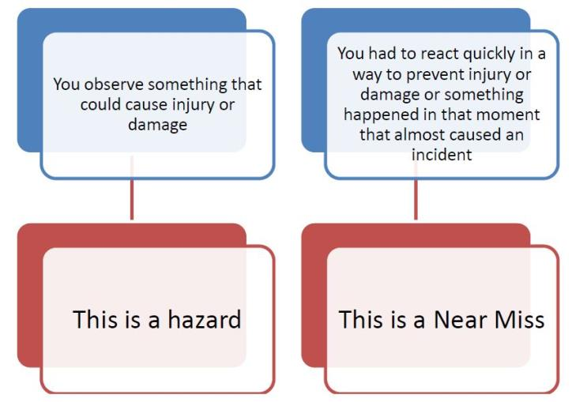
What Is the Difference?
Notes:
Employee “fear” of reporting an unsafe condition is typically a business owner issue. Maybe an employee reported something or asked a question and was rebuked…more than a time or two and they quit asking the questions.
Lack of understanding can be both an employer and employee issue… Employer’s that don’t understand or know about excavation rules can put their companies employee’s at risk. Employee’s that don’t understand or haven’t received training on excavation rules put in place for their safety may make decisions that put them at risk. Worse, the idea of “positive reinforcement for “negative” behaviors, reinforces this mentality when “nothing” happens and they get away with a poor practice.

Slide 32
Common Cause of Accidents by Workers
Rushing
  Rushing affects decision making
  Falls
2. Eyes not on Path
  Slips, trips and fall’s
  Struck by
3. Eyes not on Task
  Caught in/Between accidents
  Electrocution
4. Line of Fire
  Mostly “struck by” accidents
  Electrical “Arcing”
Notes:
When setting up to evaluate and assess accident prevention in the workplace, you need to consider why accidents happen. These four areas or combinations are examples of root causes.
Shows the relationship between outcomes and four unsafe behaviors by the Worker:
Rushing
Eyes not on Path
Eyes not on Task
Line of fire

Slide 33
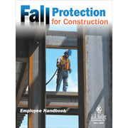
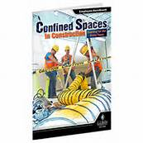


Root Cause Accidents by Employers
Policy and procedures
Process Management
PPE Choices
Training for current employees
Training for new hires
Resistance to change
Resistance to spending money
Notes:
Having Management systems in place provide a consistent approach to identifying and managing worker and business needs to do the job, and to do it safely.
It is not uncommon for small business in the OSS industry to be overwhelmed by the requirements under OSHA or state approved plans. Items 6 and 7 are justification tactics that are commonly used to push back on not starting or implementing items 1-6 in a consistent manner.
“Where do I start?” is another response from small business owners who are willing to begin a program to manage these needs.
Both the OSHA website and many of the state approved plan websites have “basic” outlines of a variety of tools and safety programs that are available for small business owners to download and complete to begin the process of implementing their safety programs.

Slide 34
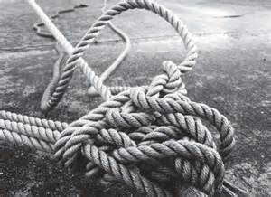
Reducing Accidents = Finding Root Causes
Keep Asking “WHY” until you get an answer you can no longer ask “WHY” about.
Notes:
Fault tree analysis unwinds the knot until you can clearly understand what the root cause is.
The next slide (video) tells a real life story of an accident that was a “struck by” incident, complicated by a confined space entry not resulting in a fatality…but only barely. Following is information for the Instructor to provide for the root cause activity with the participant groups.
The Job: Repair a cracked 3,000 + gallon tank servicing multiple homes in a trailer park/facility
Workers: 4 workers were on the job: 1- Supervisor (entrant), 1- Attendant, 2 Technicians
CSE Protocol:
Equipment was provided and used (tripod and harness)
CSE team did not use a “formal” procedure or “checklist” form to assess the immediate workplace (tank entry).
Training was not in place or limited. Entrant had means to check air quality, but the nature of the work was a cracked wall repair.
CSE assessment was incomplete to the recognized hazards (concrete tank structural integrity).
Workplace description:
Riser to top of tank was 12’ DEEP
Top of tank to tank floor was another 8+ FEET (total depth approx. 20 feet)
3,000 gallon tank had a rising horizontal crack from approximately 4’ from tank floor extending across for several feet and was pouring in water
Fishbone root cause assessment Issues:
Management; CSE policy and procedure was incomplete
Management: No rescue plan in place
Management: No site documentation (as-builts) were made available to employee
Training for hazard recognition and CSE was incomplete (man – training)
Equipment – limited to testing for air quality
Man – 2 employee’s were talking with (distracting) the attendant
Material – Concrete Tank was installed 20+ years ago and prior to any engineering construction standards
Method – Step missed – area water table at 5’ FEET was not considered in the hazard evaluation of a compromised, un-engineered tank that was empty and the sidewall pressure of water and soil at depth
Method – Step used – SOP used of a Roto-Hammer to prepare for injection and wall repair was inappropriate under these conditions

Slide 35
Root Cause Analysis - Activity
Crack repair in a Septic Tank
What is the Problem?
Root Causes?
Method
Management
Material
People (man)
Measurement
Machine
Notes:
The root cause in this accident scenario was that the company confined space entry protocol was understood to be limited to atmospheric testing and controls rather than identification and evaluation of other hazards (external stress from high water table, compromised structure, work practices using a roto hammer, lack of an as-built, and no alternate escape route).
The instructor should allow the group to break-out into their small groups to work through the process, discuss and make their determinations.
The point of the exercise is to learn/practice using the root cause analysis methodology.
This exercise will be completed in each of the Focus Four and the instructor should look for improvement in understanding and application of the use of root cause analysis methods.
The instructor should point out that the application of the methodology in evaluation of work tasks before they take place (proactive JSA) is appropriate to the work place as a preventative measure.

Slide 36
Activity – Root Cause Analysis of Tank Repair
What are the core issues involved?
Method
Management
Material
People
Measurement
Machine
Notes:
The instructor will use this slide as a visual aid during the feedback discussion with the small groups.
Depending on the size of the class, the instructor should recognize feedback from each small group and any additional comments from any participant.

Slide 37
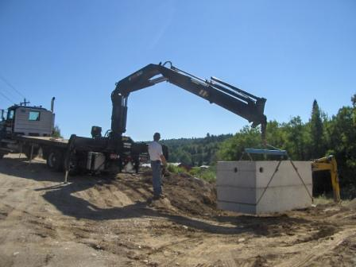
Fatalities & Citations
79% of all fatalities are related to the Focus Four Hazards
85% of all citations and 90% of dollars applied as fines are related to the Focus Four Hazards
Notes:
2 main statistics from Federal OSHA data for OSHA fiscal year 2005, Fatalities and Citations.
This photo illustrates how some or all of the hazards discussed can occur during the same operation, and why the Focus Four exposures are dangerous.
Operator behind equipment (operating remote) in “line of fire” potential, truck angle on slope potentially compromises the tank weight ratio’s and boom extension.
Getting participation: Instructor can ask audience “what are the exposures here?” and “does anyone have a personal experience”
This provides the instructor feedback on if the key learning points are getting across to hazard recognition (pro-active).

Slide 38
Top 10 Focus Four Citations
Subpart | Citations | Total Dollar Value | Description
1926.451 | 8,410 | $7,682,185 | Scaffolding
1926.501 | 5,728 | $7,176,729 | Fall Protection Scope/Applications/Definitions
1926.1053 | 2,122 | $964,811 | Ladders
1926.651 | 1,794 | $2,104,067 | Excavations, General Requirements
1926.503 | 1,581 | $823,501 | Fall Protection Training Requirements
1926.20 | 1,560 | $868,881 | Onsite, General Safety and Health Provisions
1926.100 | 1,519 | $792,414 | Head Protection
1926.453 | 1,379 | $1,285,758 | Manually Propelled Mobile Ladder Stands and Scaffolds
1926.404 | 1,313 | $644,886 | Electrical, Wiring Design and Protection
1926.652 | 1,264 | $3,117,087 | Excavations, Requirements for Protective Systems
1926.405 | 1,157 | $344,814 | Elec. Wiring Methods, Components and Equip, General Use
Citation statistics from Federal OSHA data for OSHA fiscal year 2005
Notes:
It is a busy chart, but these top ten OSHA citations relate to the four basic hazards of electrical struck-by, caught-in-between and falls. Other citations not related to the focus four have been removed from the list.
The Instructor can highlight just one or two of the key citations as it relates to audience make up but should not read the entire slide…key discussion points are frequency, cost and type of injury.

Slide 39

Falls
Notes:
Introduction to Falls slide

Slide 40
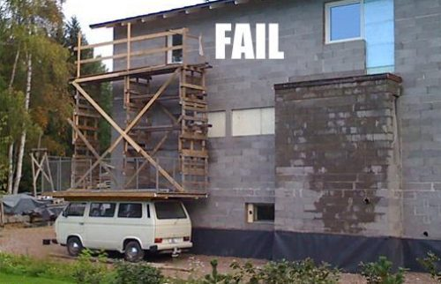
Most Common Fall Hazards
Unprotected:
Roof Edges
Roof/Floor Openings
Improper scaffolding
Unsafe Portable Ladders
Notes:
This slide highlights most common fall hazards. The instructor should relate this to the class based on the make up of designers, installers, O&M service providers and/or regulators that do field work.
The two main points to emphasize are:
For business owners – Workers left to their own devices to accomplish the work, may make decisions that the owner wouldn’t allow.
For Workers – hazard recognition, having the right tools for the job and making decisions that are smart behaviors

Slide 41
Primary Causes of Fall-Related Fatalities
Unprotected sides, edges and holes
Improperly constructed walking/working surfaces
Improper use of access equipment
Failure to properly use PFAS (personal fall arrest system)
Slips and Trips (housekeeping)
Notes:
Examples include tank/trench excavations, working on top of pump trucks, vehicle exit, untidy worksite (multiple lids open on a septic/pump tank at the same time), PFAS on confined space entries (also used as non-entry rescue equipment) during tank repairs, and larger vessels like digesters.
Instructor should call for examples from the audience that are specific to the industry. Availability and use of a “Flip Chart” would be useful to capture comments and ideas. When each segment activity (Septic Feud) is going on, reference back to the flip chart list will reinforce the groups feedback and participation.
Falls:
29- Falling into septic tank or trench: Loose edge/uneven ground
28- Falling after tripping on lid or tank ring/slippery ground
13- Falling into septic tank
12- Falling after tripping on something at the worksite (Housekeeping), tools, materials, lids
11- Falling climbing in or out of equipment/pump trucks/vehicles

Slide 42
Top Fall Protection Citations
Scaffolding General
Fall Protection Scope
Ladders
Fall protection training
Manually propelled scaffolds - Lifts
Citation statistics from Federal OSHA data for OSHA fiscal year 2005
Notes:
As it relates to the OSS industry, fall protection, ladders and fall protection training are most noted….
General Requirements: 1926.451
Duty to have Fall protection: 1926.451
General: requirements for ladders: 1926.1053
Training requirements: 1926.503
Aerial lifts: 1926.453
This slide can be informational to point out that all of these exposures have an enforceable compliance rule associated with them. The Instructor can also bring focus from the “general” to the “specifics” on any of these elements by describing an industry specific relationship, ie: Scaffolding and manually propelled scaffolds and lifts has a low frequency use, if any in the industry, but fall protection and associated training would be specific speaking points.

Slide 43
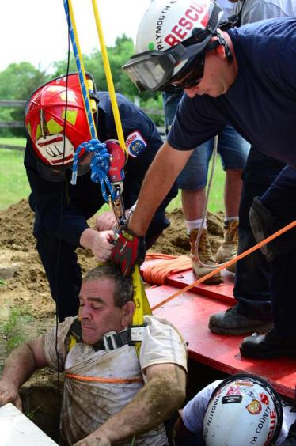
Fall hazards are present at most worksites.
“A fall hazard is anything at your worksite that could cause you to lose your balance or lose bodily support and result in a fall.”
Any walking or working surface can be a potential fall hazard.
Fall Hazard Definition
Notes:
Work activity in photo: rescue from a Confine Space Entry of a tank.
Fall hazards occur in nearly all areas Onsite is performed, and on most of the equipment (scaffolds, ladders, heavy equipment, for example) used in our industry.
More often than not, the solution requires a combination of systems and well-trained employees – there is no “one size fits all” solution to fall protection.
One thing that is true – hazard recognition and awareness along with the correct equipment or procedures will minimize or eliminate the exposure– try to prevent the fall wherever possible. Simply “tying off” creates its own set of hazards.
Getting participation: Instructor can ask audience “what are the exposures here?” (note the position of the chest harness against the victims throat being rescued – is this a problem?, did the PPE not fit in the first place?)

Slide 44
Fall Accidents
4/12/2014 Age: 64 Fatal? No
FALL: Employee was attempting to climb into the bucket on an aerial lift. The boom of the aerial lift was not in the down position and so the employee had to climb onto the bucket. The bucket swiveled and the employee fell, hitting parts of the truck and landing on the ground on his back.
The injured employee suffered 2 fractured vertebrae, and soft tissue damage.
Notes:
From Oregon OSH 2014 report: http://www.orosha.org/standards/fatals/pdf/descriptions/acc_fatal_cal-yr14.pdf
Instructor may work through with group or groups the root cause analysis worksheet as previously.
Instructor should look for and recognize improvement of the use of the methodology for root cause understanding.

Slide 45
Activity – Root Cause Analysis of a Fall
What are the core issues involved?
Method
Management
Material
People
Measurement
Machine
Notes:
Fault tree analysis unwinds the knot until you can clearly understand what the root cause is.

Slide 46
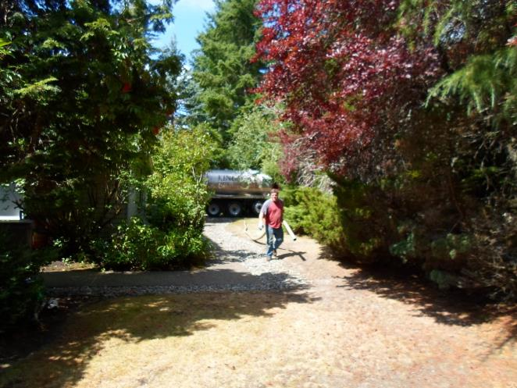
Fall Hazards – Basic Service
What are the exposures here?
What choices do you need to consider?
Notes:
The saying is that “complacency breeds contempt”.
Workers in the industry that have done this thousands of times, (exposing and digging out a tank access and lids) …tripping/slipping on surface may result in a fall and a broken wrist but can also happen lugging heavy sections of hose. Asking the learners about body position and (summer) foot wear will generate some discussion.
The next several slides introduce the “same old” task, but with changing conditions of weather.
Discussion points for the slide:
Clear weather
Flat ground
Two walking surfaces
Footwear (boot year round are appropriate, not tennis shoes)
Consideration of changes in weather, season, topography

Slide 47
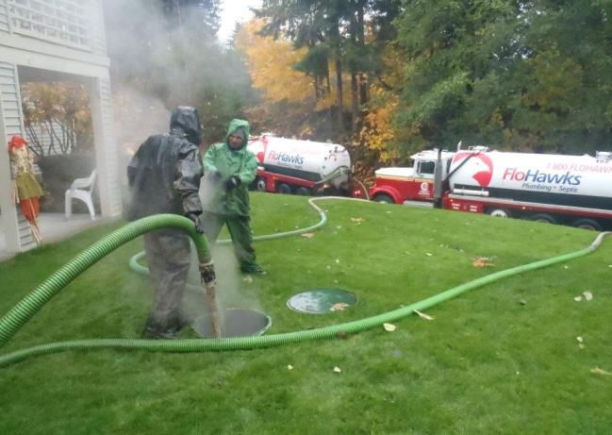
Fall Hazards – Basic Service
What are the exposures here?
Same Basic Job, but what changed?
What choices do you need to consider?
Notes:
Discussion points for the slide:
Rainy weather
Slope
Walking surfaces (long wet grass)
Footwear
Consideration of changes in weather, season, topography

Slide 48
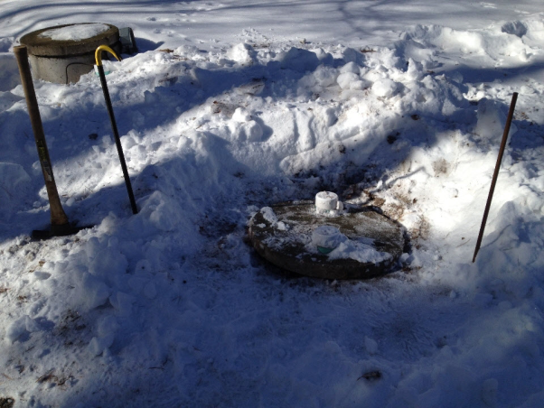
Fall Hazards – Basic Service
When Conditions Change…
What are the exposures here?
What choices do you need to consider?
Notes:
Snow, and changing conditions….tripping/slipping on surface may result in a fall and a broken wrist, but note that a full Septic tank generates heat and when the insulating layers of snow are removed, the conditions may change immediately at the tank lid….the next task on this wet slippery surface is to lift a 75lb lid and move it to the side. Asking the learners about body position and type of foot wear will generate some discussion. Encourage discussion: Slipping and then falling into the tank is the worst case scenario.
Critical thinking skills: A key point to emphasize in this task is that while the work task hasn’t appreciably changed, the conditions have….this will be in contrast in upcoming slides to the thought process that will explore when the tasks are essentially the same, but the worksite is different….and then goes on to discussion when both elements are in play.

Slide 49
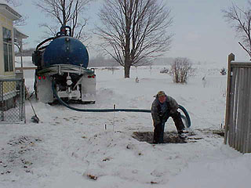
Fall Hazards – Basic Service
When Conditions Change…
What are the exposures here?
What choices do you need to consider?
Notes:
See comments on previous slide….add to the conditions: Person working alone – falls into tank. In addition to the fall is the potential for engulfment and/or drowning.

Slide 50
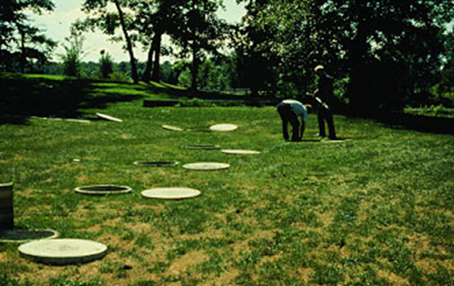
Fall Hazards System Inspection
What are the exposures?
What kind of injuries might you expect?
Notes:
Activity: OSS inspection:
Fall hazards exposures at a site your inspecting may present different exposures. Working in and around septic tanks in our industry can also combine to multiply the exposure. Having all the lids open presents multiple fall exposures. What changes if it is wet/raining/snowing/cold and the ground surrounding the excavation is unstable or saturated?
A simple inspection “procedural” change would be to open the lids on the tanks and let them vent, but then put them back over the holes and only work on a single component at a time.

Slide 51
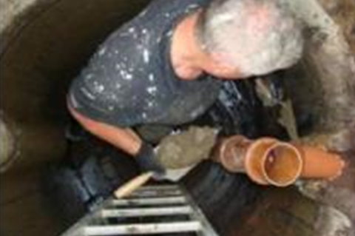
Fall Hazards – Operations and Maintenance
Fall hazards on equipment your installing or repairing, may present exposures.
What are some things that could cause a fall in this situation?
Notes:
Activity: Baffle Repair
This is a common occurrence…
The Instructor can work through this scenario as an exercise, capture comments on a flip chart, or directly engage the participants in an active problem solving scenario. The experience of the group that have “been there” and “done that” should emerge pretty quickly, and the discussion will benefit the participants with practical solutions of shared experience.
To put it in context to the participants, some key points to recognize if offered from the discussion:
Limited work space
no three point contact
no harness or retrieval (CSE violation) method.
Work toward identifying things they man not see in the picture, but likely exist in their work experience: Is it a wet environment? Are the ladder rungs often wet? What kind of footwear would be an appropriate choice to prevent slipping and falling off the ladder? Would a harness connected to the ladder be a good idea? If so, would the ladder need to be rated to the OSHA ladder standards?

Slide 52
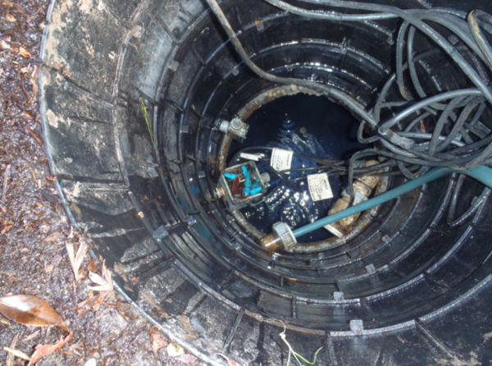
Fall Hazards – Operations and Maintenance
How would you approach getting at components in this access riser?
What changes if it is wet, raining, and the ground around the excavation is saturated?
Notes:
How does this situation present solvable problems from the previous slide and discussion?
Activity: Inspection: Could be for O&M, Repair, Installation
If the riser segments in the photo are only 8”, the height to any of the components is a 4 foot reach….how would you get a pump disconnected and out of this workspace? What are the other hazards you have to address before you even begin (LO/TO and isolation of electrical energy). What if the Breaker box is in the garage…and the property owner isn’t home?) This is a common occurrence…
The Instructor can work through this scenario as an exercise, capture comments on a flip chart, or directly engage the participants in an active problem solving scenario. The experience of the group that have “been there” and “done that” should emerge pretty quickly, and the discussion will benefit the participants with practical solutions of shared experience.

Slide 53
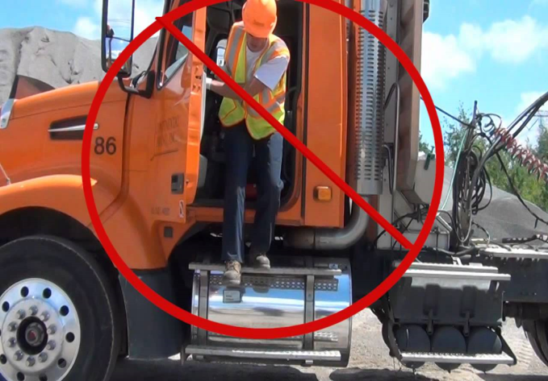
Fall Hazards - Equipment
Getting in and out of service vehicles, trucks present fall hazards.
Different equipment present additional hazards due to weather, wet conditions and accumulation of dirt, oil and grease on contact surfaces.
Notes:
Activity: entry and exiting vehicles or equipment
Fall hazards are present when working on or moving from elevated surfaces. Pump Truck operators are in and out of their trucks numerous times a day. Excavator operators are the same, but the contact surface are not under a standard like vehicles are. Three point contact at all times is the best way to avoid these kinds of accidents. Comment to time of year, weather conditions and time of day (low light). It will be addressed again later in the “struck by” section of the presentation, but it may be worth while to recognize the issue of traffic and traffic controls (note the reflective vest in the picture).

Slide 54
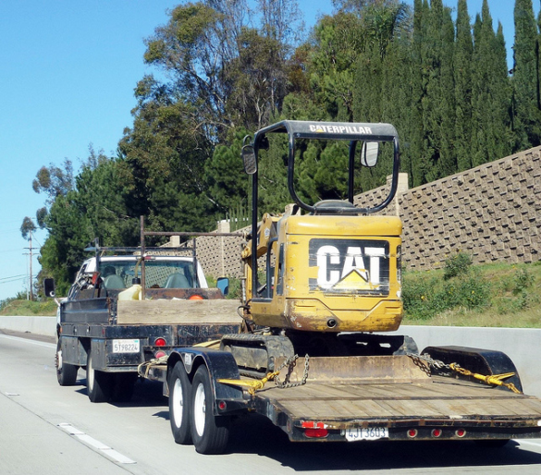
Fall Hazards - Equipment
Getting up and down off of equipment trailers, trucks present fall hazards.
Different equipment present additional hazards due to weather, wet conditions and accumulation of dirt, oil and grease on contact surfaces.
Select offloading area to minimize exposure
Notes:
Activity: Transporting equipment
Fall hazards after slips, trips climbing on and off equipment may increase when a solid three point contact cannot be accomplished. Potential for ankle, knee and back injuries exist when jumping off of P/U tailgates, flatbeds, etc.. “Staging areas” are rarely defined on our industry Onsite sites, so it is dependent on the contractor to select level, flat ground for loading and offloading equipment when possible. Depending on what the piece is, additional consideration is made for close work in residential areas and overhead wires (electrical) exposures.

Slide 55
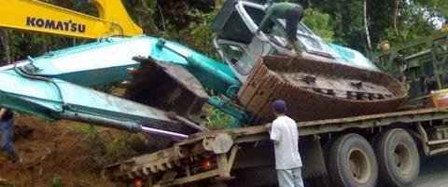
Fall Hazards - Equipment
What could possibly go wrong?
Notes:
Activity: Transporting equipment
Accidents happen….in the heat of the moment, safe decision making needs to be maintained or even intensified. You can make a bad situation worse….The person climbing on an unstable, unsecured load is at great risk. The worker standing at the tail of the flat bed: 1 – Doesn’t need to be there, 2 – is at risk from a serious “struck by” event by standing in the “line of fire” of the Komatsu in the picture that appears to be either trying to stabilize the tipped excavator or in the effort to “right” the excavator, will try to lift and/or swing the boom to the right and reposition the other piece of equipment….

Slide 56
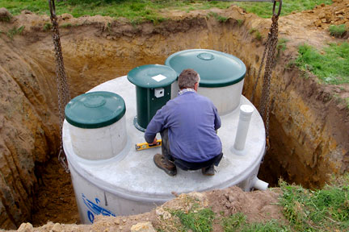
Fall Hazards - Excavations
What are the obvious exposures?
Can you name two others?
What could be done differently?
Notes:
Activity: Tank Installations
Fall hazards exposures on equipment your installing may present new exposures. Working in and around septic tanks in our industry can also combine to multiply the exposure. Stepping across and down onto this tank is easy enough, but what is different when the worker now tries to get out? What changes if it is wet/raining/snowing/cold and the ground surrounding the excavation is unstable or saturated? Are there any “struck by” potentials here? (chains connected to a spreader bar)
Solutions requires a combination of approaches and well-trained employees – there is no “one size fits all” solution to fall protection.
Try to eliminate fall potentials whenever possible, but when you can’t, take a minute or two and pay attention to what could happen.

Slide 57
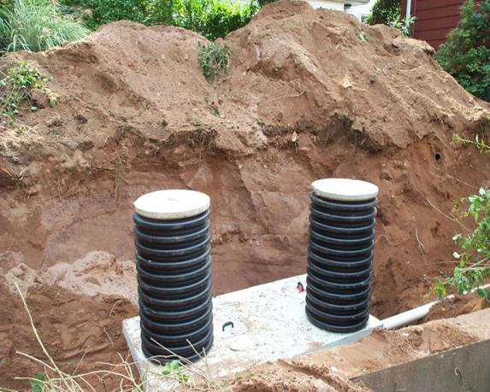
Fall Hazards - Excavations
What are the obvious exposures?
Can you name two others?
What could be done differently?
Notes:
Activity: Tank Installation.
Fall hazards exposures on equipment your installing may present new exposures. Working in and around septic tanks in our industry can also combine to multiply the exposure. Stepping across and down onto this tank is easy enough, but what changes to the slope stability on the far side if it is wet/raining/snowing/cold and the ground surrounding the excavation is unstable or saturated?
Try to eliminate fall potentials whenever possible, but when you can’t, take a minute or two and pay attention to what could happen.

Slide 58
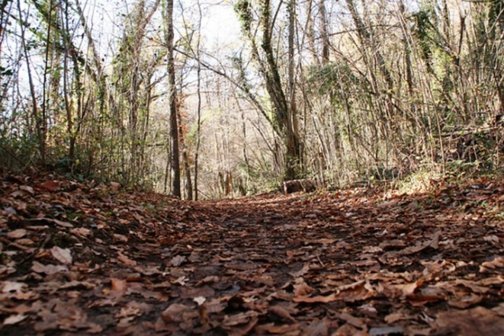
Soil Logs may present special hazards.
Often they are left open for days or weeks
They are inspected at different intervals by the designer and then the regulator
Fall Hazards - Excavations
Notes:
Activity: Soil test pit (Soils) inspection
Fall hazards in pre-Onsite site development need to be flagged. These excavations are commonly put in and there is often a delay between when they are dug, inspected by the designer/soil scientist for application loading rates and then verified by the regulator. This picture represents a situation where a soil log had been dug on site in the fall and right in a pathway to the property, and then left open for the regulator to come and inspect later. Several weeks went by before the regulator made it back to the site and the 5’ foot deep excavation had filled with water with rainfall and runoff, and fall leaves had obscured the excavation.
The regulator narrowly missed falling into the excavation and could have subsequently drowned (unable to swim), was working alone (unable to get help) on a remote site.
OSHA excavation protection is well defined along with state approved plans that also give guidance. These requirements are often side stepped because of conflicting regulations (in this case, local health code on inspection requirements are not harmonized with OSHA/state rules.
Note to Instructor: In some states nationally, soil absorption “perc” holes are used in lieu of excavation of a soil test pits.

Slide 59
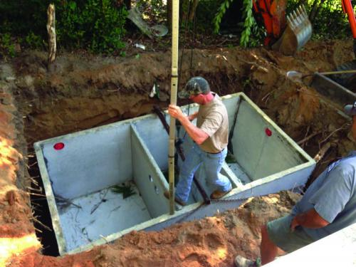
Fall Hazards - Installations
Is this a good idea?
What changes when the worker now tries to get out?
What changes if it is wet/raining snowing or just heavy frost?
Notes:
Activity: Installation and leveling of septic tank.
Installation of septic tanks in our industry can also combine to multiply the exposure. Stepping across and down onto this tank is easy enough, but what is different when the worker now tries to get out?
What changes if it is wet/raining/snowing/cold and the ground surrounding the excavation is open to becoming a fall along with being caught in/or between? Does the potential of the severity of the accident increase?
The Instructor can work through this scenario as an exercise, capture comments on a flip chart, or directly engage the participants in an active problem solving scenario. The experience of the group that have “been there” and “done that” should emerge pretty quickly, and the discussion will benefit the participants with practical solutions of shared experience.

Slide 60
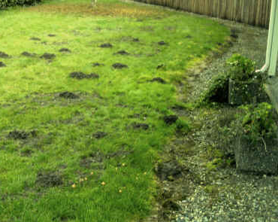
Fall Hazards - Terrain
Take a moment to make some observations of the work area.
Could weather doing
that could affect potential for falls?
What are the typical injuries that you
might expect?
Notes:
Fall hazards occur in nearly all areas that Onsite is performed, and visual ques are best in this situation to alert the service provider to pay special attention to where they walk. Work activities are somewhat dependent on service provider.
Designers may be on sites to evaluate disposal components, installers for staking and excavation and operations and maintenance individuals for onsite system inspection. T
This kind of a site can be further aggravated by weather conditions, saturated soils, etc. Slips trips and falls that could result in anything from ankle sprains to broken bones could occur.

Slide 61
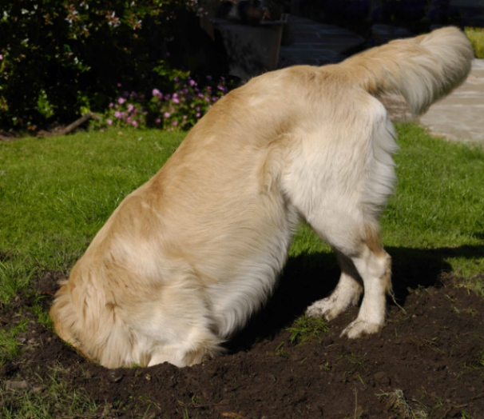
Fall Hazards - Terrain
Fall and trip hazards that are created by family pets and domestic farm animals also need awareness
Notes:
Fall hazards occur can also be created by family pets. Not limited to dogs, the rural nature of onsite systems can also present other farm animals from goats to horses and cows. Like the previous slide, the important thing to communicate to the learners, is to pay attention, observe the worksite and make sure that they are able to identify these various exposures.
As with any of these discussion slides the Instructor can invite the attendee’s to share a story or experience to keep them engaged.

Slide 62
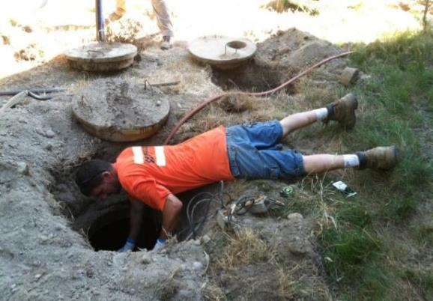
Fall Hazards – Repairs
Being aware of body position for different work tasks can help prevent putting yourself into situations that can be deadly.
If you fall headfirst into
a septic tank what the
least that will happen
to you?
The worst…?
Notes:
Activity: Repair or maintenance
Falling hazards not only include “falling from”, “falling down” but “falling in”. Worker body position and balance contribute to the likelihood of a fall event for any variety of reasons. If it can happen it likely will happen sooner or later. Industry has examples of workers falling head first into system tank components and getting stuck upside down for several hours!
If a hand slips, if the worker overly extends his reach the likely result will be a fall inside the tank. This picture also represents some other safety issues that the Instructor may or may not want to bring into the presentation at this point. (Confined space entry violations)
The Worst? Drowning upside down in the contents of a septic tank…what could be worse than that?...broken neck quadriplegic, long term illness from aspirating grossly contaminated raw human waste? There’s nothing good in this picture…
Another concept to introduce to the class: Behavioral – Positive reinforcement for negative behaviors – the idea of repeatedly doing inappropriate “at risk” tasks and then nothing “bad” happens, results in justification tactics by the worker or employer to continue to approach work tasks with little perception to the real risks.

Slide 63
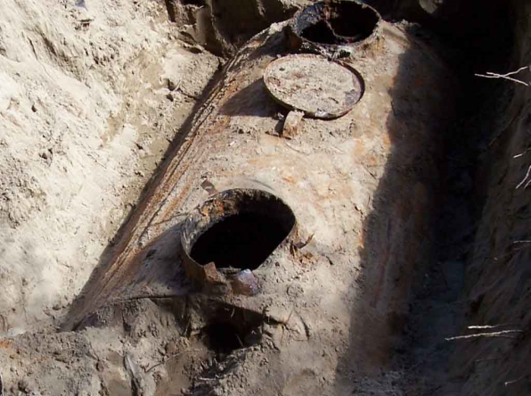
Fall Hazards – Repairs
Identify this hazard ahead of time with Record Documents.
Know the age of system
Look for depressions around tank location
Approach cautiously
Notes:
Activity: Inspection/component failure
Across the country there are hundreds of THOUSANDS single wall steel tanks that were installed in the last 75 years. You could order them out of the Sears and Roebuck catalog and have them delivered. In typical configurations, the top 12’-20’ of the tank would not see water, but would see all of the sewer gasses and resulting oxidation and rusting of the steel from the gasses converting to acid (low pH) and breaking down the tank from the inside. Shallow installs, ground probing present not only very real hazards, but very invisible ones (buried).
When a worker breaks through the surface and fall into one of these tanks, the injury is compounded by “struck by” cuts and abrasions followed by immersion in raw human waste…and all that means. Post accident infections can be severe and difficult to treat, if you don’t drown outright.
The frequency of this situation will vary from location to location around the country based on local and state regulations and how they address replacement requirements on these tanks when discovered. Some states and local health jurisdictions (Washington State), replacement are mandatory when they are identified.

Slide 64
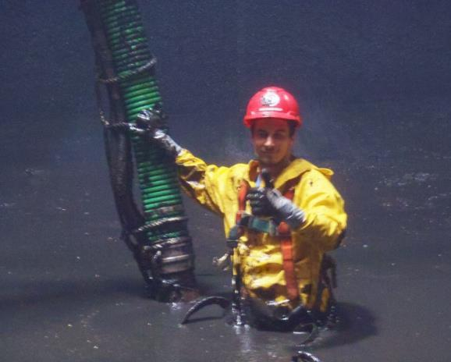
Fall Hazards – Other
When work site changes…
Situational awareness?
What choices do you need to consider?
Notes:
Activity: Pumping out a Sludge Digester
This slide presents an opportunity to shift the discussion to work tasks that are done on system components and maintenance that is upscale in scope as well as put the “fall” exposure into a different perspective.
This picture is of a worker pumping out a large scale “digester” and put the Focus Four Exposures into a different context. When the work changes, the exposures are essentially the same. But some of the auxiliary exposures (like slipping and falling under the surface) are exponentially increased along with the potential severity (drowning, inability to rescue).
While CSE regulations allow for an employee to disconnect from non-entry self rescue equipment in circumstances where it would be more dangerous to be connected (internal structure), steps need to be taken to mitigate the risk. Simply “tying off” creates its own set of hazards.
Instructor can challenge participants to think through what would be the best PPE here? Waders? Life jacket? Some other kind of flotation device?
Highlight on “fit for use”….

Slide 65
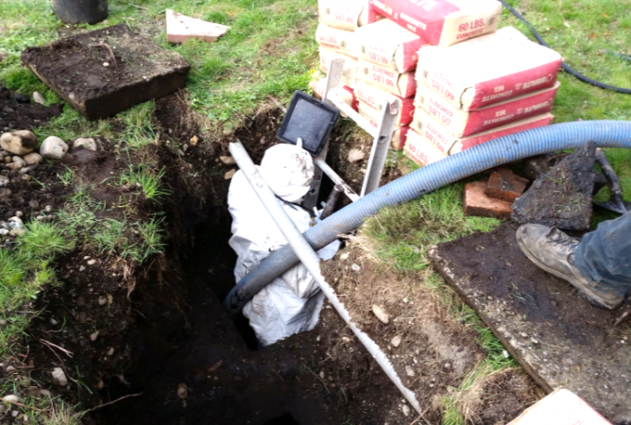
Fall Hazards – Confined Space Entry
When work tasks change…
What are the
rules here?
Situational Awareness?
Notes:
Activity: CSE (Confined Space Entry) Cracked Floor Tank repair (2 compartment)
Fall hazards occur in nearly all areas Onsite is performed, and on most of the equipment (ladders, heavy equipment, for example) used in our industry.
As the work becomes more complicated (tank repairs in place) the solution requires a combination of systems and well-trained employees – there is no “one size fits all” solution to fall protection.
One thing that is true – an ounce of prevention is worth a pound of cure – Generally the understanding for compliance under CSE (confined space entry) rules, complicate the Focus Four Falls application and exposures.

Slide 66
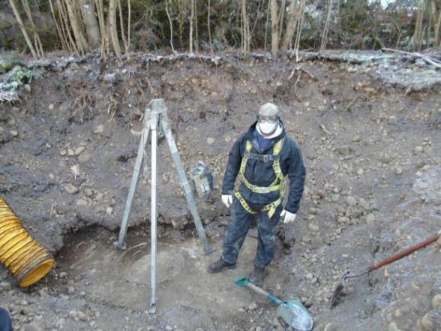
Fall Hazards – Confined Space Entry
When the work site changes…and more
rules come into play,
how do you adapt?
What are the
Exposures here?
Situational Awareness?
Notes:
Activity: CSE for cracked tank repair w/ “Non-Entry Rescue Equipment”
Cracked tanks repair is common in the industry. The worker opens up and pumps the tank, dumps in bags of concrete, adds water and climbs in to spread it around. Other techniques for sidewall repair include drilling (an already compromised structure) and then under pressure, pumping a water reactive mixture into the holes.
A whole new set of rules come into play: CSE (confined space entry) that are generally non-existent in the industry and presents significant exposures to fall potential in addition to non compliance exposure for companies financially and libel.
The Instructor can ask a general question “with a show of hands” …”how many of you have fall protection available and use it when entering tanks to do work?”

Slide 67
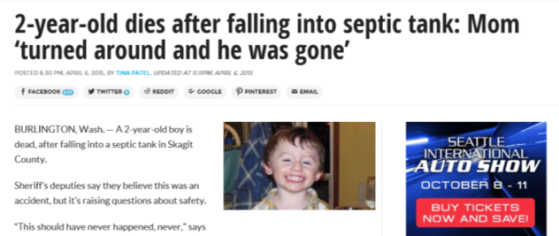
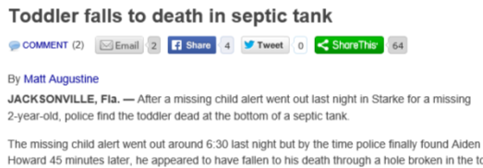
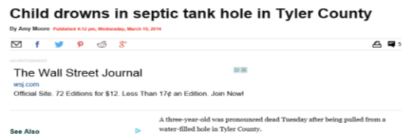
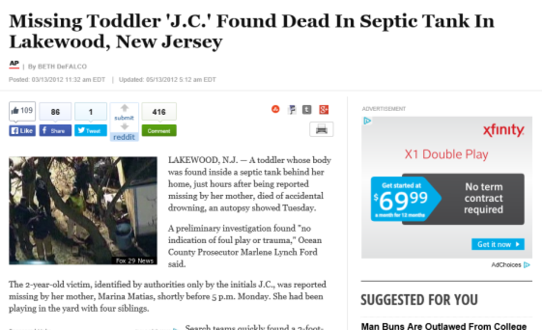
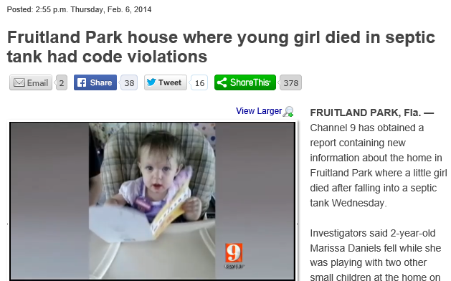

Falls – Other…
Notes:
Optional Slide: Summary slide to raise awareness of the need to ensure site safety for occupants by ensuring tank components are secure before leaving the site. No one in the industry wants the responsibility of the death of a child because they didn’t carry a few extra screws in their tool bag to make sure lids (risers) were secure.

Slide 68
Employer Responsibilities
Develop a written fall protection plan.
Identify potential fall hazards prior to each project and during daily walk-arounds. Pay attention to hazards associated with routine and non-routine tasks.
Eliminate the need for fall protection where possible by rescheduling the task, isolating the task or changing the task.
Ensure that fall protection equipment is appropriate to the task, in good condition and used properly.
Notes:
This slide outlines the basic employer responsibilities of an OSHA or state approved Fall Protection Program

Slide 69
Employer Responsibilities
Conduct general fall prevention training on a regular basis.
Train workers on the specific fall hazards identified and on the required personal protective equipment.
Conduct regular inspections of fall protection equipment in accordance with the manufacturer’s recommendations and OSHA’ requirements.
Notes:
This slide outlines the basic employer responsibilities of an OSHA or state approved Fall Protection Program

Slide 70
Worker Responsibilities
Use fall protection equipment if required. Assure it is right for the task, fits properly and is in good condition.
Inspect fall protection equipment and devices before each use.
Make sure that tank access holes are protected or secured at the worksite.
Choose the correct ladder for the task, read the instructions and be sure that the ladder is in good condition. Check for surrounding hazards, stable footing and the proper angle.
Contact your supervisor if you see fall hazards or have any questions about fall prevention. Do not work until unsafe conditions have been corrected.
Notes:
This slide outlines the basic employee responsibilities of an OSHA or state approved Fall Protection Program

Slide 71
Activity
  Write Down Two Fall Exposures That You Have In Your Workplace
  Write Down a Fall That Happened to You in Your Workplace.
  Write Down What You Recommend To Minimize or Prevent Them.
Notes:
The Instructor, using the appropriate sheet in the workbook handout, should set up this activity and give the participant 3-5 minutes to identify the first three things that come to their mind and write them down in their handout. The next step will be to give them 3-5 minutes to write down how they will minimize them.
Next step is to break them into small groups and have them share the answers and discuss. 5-10 minutes
Appropriate answers to minimize the exposure include: Find another way to do it that eliminates the exposure, Use appropriate PPE (may be specific: harness and tripod, hardhat, footwear), Eyes on task, Not walking backward, Only open component lids that are being worked on, etc.), Training.
An alternate to the activity would be to have them do the first step and then break into teams and problem solve together and use the combined experience of the small group to share experience.

Slide 72
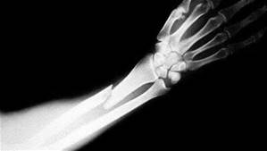
Struck-by
Notes:
Introduction to Struck-by Topic

Slide 73
Primary Causes of Struck-by Fatalities
Flying Objects
  Equipment failure under tension
Falling Objects
  Rigging Failure
  Loose or Shifting Materials
  Equipment tipping over or Malfunction
  Lack of Overhead Protection
Vehicle and Equipment Strikes
  Backing Incidents
  Workers on Foot
Notes:
Examples include: rigging equipment on concrete septic/pump tanks delivered to the jobsite, loose material adjacent to tank excavations without spoil piles being at least 2’ back from edge during placement. Hard hats (PPE) not worn or available, jobsite equipment and traffic (note to comment on jobsites with multiple activities and different subcontractors). Jetter hoses pre-emptively coming out of pipes and swinging around uncontrolled.
It is important to make comment on not only the field activity, but to include some discussion on storage and shop workspaces. Ensuring that shelving is secured and adequate for load carrying (pipe, pump’s, concrete bags, valves, power equipment, welders, cutting tools and grinders are all included in workplace evaluations.
Instructor should call for examples from the audience that are specific to the industry. Availability and use of a “Flip Chart” would be useful to capture comments and ideas. When each segment activity (Septic Feud) is going on, reference back to the flip chart list will reinforce the groups feedback and participation.
Struck By:
13- Equipment, excavator, tools
10- Pipe (materials)
09- Trees/loose branches (soil logs, woods)
08- Loose hoses/ hoses under pressure (pumper, jetter)
06- Release of chain tension on loads

Slide 74
Top Struck-By Citations
Head Protection
Eye and face protection
Criteria for PPE (Subpart B – Power Transmission and Distribution)
Material Handling Equipment
Concrete & Masonry
Citation statistics from Federal OSHA data for OSHA fiscal year 2005
Notes:
This slide can be informational to point out that all of these exposures have an enforceable compliance rule associated with them in addition to any specific examples that may be called out.
All elements of this slide have a corollary in the Onsite industry workplace and can be discussed.

Slide 75
Struck-By Hazards – Definition
“Struck-by” Hazards are produced by forcible contact or impact between the injured person and an object or piece of equipment.
Notes:
Introduction to “Struck by Hazards” and definition.
Instructor can call out the obvious (ladder), but also excavation and engulfment potential (minimum 2’ setback on spoils from excavation edge) and the lack of personal PPE (hard hat) by the worker.
Introduction of themes: Carelessness? Lack of knowledge? Lack of Training? Lack of Procedures?

Slide 76
Struck By Accident
10/26/2014 Age: 32 Fatal? No
Struck by: Maintenance worker was using a right angle grinder with a cut off wheel to cut a 1 1/4 inch square tube made of mild steel. The grinder apparently walked up the steel and kicked back cutting the workers right forearm 6 to 7 inches.
Worker had surgery to repair veins and arm. Worker was hospitalized overnight.
He was transferred on 10/28/14 to evaluate repair and blood flow to arm.
Notes:
From Oregon OSH 2014 report: http://www.orosha.org/standards/fatals/pdf/descriptions/acc_fatal_cal-yr14.pdf

Slide 77
Struck-By Hazards – Root Cause Analysis
What are the core issues involved?
Method
Management
Material
People
Measurement
Machine
Notes:
Fault tree analysis unwinds the knot until you can clearly understand what the root cause is.

Slide 78
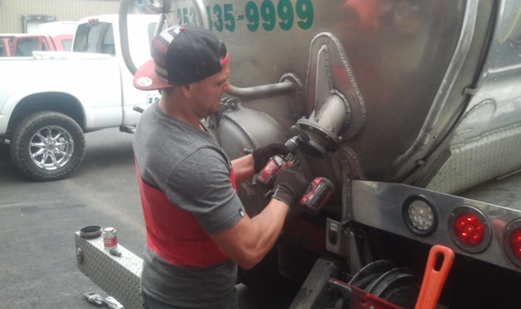
Struck-By Hazards- Hand Tools
Exposures:
Impact to the
face and eyes
Root Cause?
“Line of Fire”
Alternatives?
Notes:
Activity: Pump truck vehicle maintenance:
This worker is using a steel brush on a male aluminum threaded 3” nipple.
Exposures are: debris in the face and eye’s from the breakdown of the wire brush and pressure on the threads (heat).
PPE: none
Additional exposures include aerosolized dust and debris from the activity. Swab testing of the male nipple and threads yielded pathogen contamination that was also an exposure added to the dust and material breakdown of the wire brush.
When asking participants what the “root cause” of an accident in this scenario would be, answers like “lack of safety glasses” is a partial answer another might be the worker in the “Line of fire”.
The real root cause is the method: The task of cleaning up the threads is pretty simple here. Could it be done differently ie: a hand held wire brush instead of a power tool?
The pipe threads will be dressed with some kind of thread tape or pipe dope to prevent leaking, and the time to clean it to service ability would be nominal.
The objective with discussion and feedback is to begin to get the participants thinking about the safest way to approach a work task, not the fastest or easiest or cheapest or “that’s the way we’ve always done it”.

Slide 79
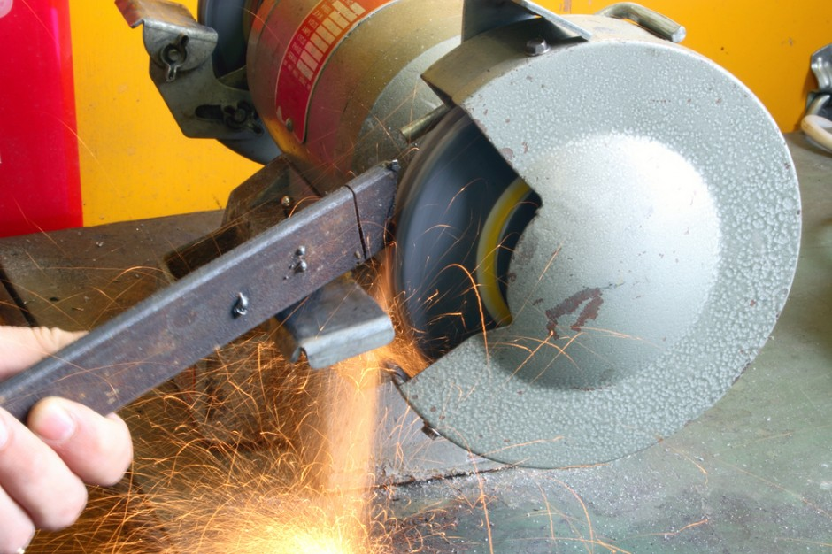
Struck-By Hazards – Abrasive Wheel Machinery
Notes:
Introduction of themes:
Lack of Maintenance (safety guard removed)?
Lack of knowledge?
Lack of Training?
Lack of Procedures?
Root cause? – May be any of the above, but if an accident occurred due to the disintegration of the grinding wheel the “ Line of fire, (no situational awareness)” by side loading the wheel by the metal being worked on.
This slide also sets the stage for a brief discussion on the level of detail that OSHA rule goes to.
It is demonstrated by asking the participants what the “Minimum stand-off distance of the grinding platform to the wheel” is.

Slide 80
Struck-By Hazards – Abrasive Wheel Machinery
1910.215(a)(4) Work rests.
On offhand grinding machines, work rests shall be used to support the work. They shall be of rigid construction and designed to be adjustable to compensate for wheel wear.
Notes:
Code reference – reminder that there are rules in place

Slide 81
Struck-By Hazards – Abrasive Wheel Machinery
1910.215(a)(4)
Work rests shall be kept adjusted closely to the wheel with a maximum opening of one-eighth inch to prevent the work from being jammed between the wheel and the rest, which may cause wheel breakage.
The work rest shall be securely clamped after each adjustment. The adjustment shall not be made with the wheel in motion.
Notes:
Code reference – reminder that there are rules in place

Slide 82
Struck-By Hazards
Exposures?
Bodily injury from being struck by the object being cut or grinded.
Eye injuries from flying debris (for example, chips, metal particles, or a wheel that disintegrates).
Hearing damage from excessive noise while grinding.
Respiratory issues from inhaling dust.
Notes:
A properly conducted JSA (job safety analysis) would identify these key issues

Slide 83
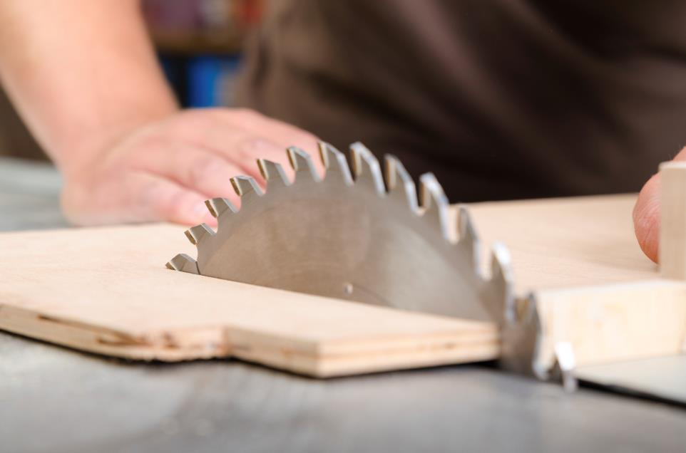
Struck-By Hazards – Shop Tools
Notes:
Introduction to a group discussion to hazard recognition, but also to introduce the concept of behavioral affects on work tasks.
Instructor could ask the obvious question on “what is wrong in the picture”
“What are two things that could prevent a struck by exposure?
1.) Blade Guard
2.) Do not push the work into the blade with your hands (use a block of wood).
Additional discussion can anchor the behavioral aspect by asking how many have a table saw in the shop or at home, and follow on with the question of how many “still have a blade guard” on it…show of hands!

Slide 84
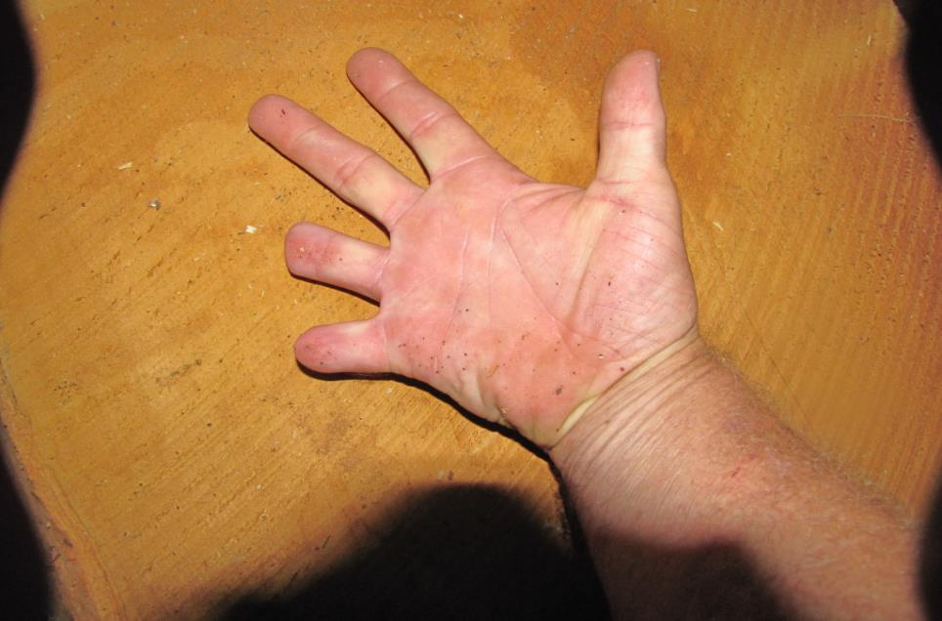
Struck-By Hazards – Shop Tools
Notes:
The result of not paying attention: Root Cause?
1.) Eyes not on task?
2,) Rushing?
3.) Line of fire?
All three?

Slide 85

Struck-By Hazards- Brush Clearing for Soil Logs
Exposures:
Impact to the face, eyes and body
Root Cause?
“Line of Fire”
Alternatives?
Notes:
Activity: Brush Clearing:
When asking participants what the “root cause” of an accident in this scenario would be, answers like “situational awareness” is at least part of the answer (site awareness)/evaluation).
The root cause is the worker if an accident occurred would be being in the “Line of fire”.
The task of cleaning brush is pretty simple here.
Awareness and experience on the learning curve contribute to minimizing the exposure. Recognizing “widow makers” or dead fall’s and the stored energy of vegetative species like “vine maple” that don’t break but bend and load before they break helps.
The objective with discussion and feedback is to begin to get the participants thinking about the safest way to approach a work task, not the fastest or easiest or cheapest or “that’s the way we’ve always done it”.
Situational awareness beyond the reach of the equipment is important.

Slide 86
Struck By Accidents – Root Cause Analysis
4/25/2014 Age: 42 Fatal: No
AN EQUIPMENT OPERATOR WAS IMPALED THROUGH THE BUTTOCKS: An employee was operating a John Deere caterpillar when two trees broke loose from the hillside above him and slid through the back of the machine.
The operator was impaled by one of the trees.
Notes:
From Oregon OSH 2014 report: http://www.orosha.org/standards/fatals/pdf/descriptions/acc_fatal_cal-yr14.pdf

Slide 87
Struck-By Accidents– Root Cause Analysis
What are the core issues involved?
Method
Management
Material
People
Measurement
Machine
Notes:
Fault tree analysis unwinds the knot until you can clearly understand what the root cause is.

Slide 88

Struck-By Hazards – Confined Space Entry
Exposures:
Falling objects
Root Cause?
“Line of Fire”
Alternatives to reducing the exposure?
Notes:
This work scenario was seen in the previous section, and is here again to reinforce how the severity of an accident is multiplied when more than one element of the Focus Four comes into play.
Exposures are: Struck by; Rock and dirt falling in on the worker (once he is down inside the tank) from his helper kicking things in, excavation of material off of tank inadequate, and made worse by the point loading of approximately 15 bags (900lbs) of cement, which would also fall in and onto the worker if the underlying dirt failed….resulting in a fall potential.
Note to the discussion of changes: This is the common practice so as to minimize handling. Saturated soils from rain or a failed system and sewage on ground could further erode the stability of the underlying materials that the cement bags are stacked on.
PPE: No Hard hat
Additional exposures include aerosolized dust when cutting the bags and dumping them into the tank bottom to effect the repair
This slide has simple animation for the Instructor. It builds on the earlier discussion of root cause analysis and will lays some groundwork for discussion on individual responsibility for safety.

Slide 89

Struck-By Hazards
Exposures:
Falling objects
Root Cause?
“Line of Fire”
Alternatives?
Notes:
This work scenario was seen in the previous slide, and is a continuation to reinforce how the severity of an accident is multiplied when more than one element of the Focus Four comes into play.
Exposures are: All of the issues presented in the previous slide, but now the worker for some unknown reason has also clambered down into the hole and is standing above the worker in the confined space of the tank. He is standing on an internal 3” wall of the two compartment tank. It’s dry on this day, but it is an unnecessary exposure to the worker below who may not even be aware of it.
PPE: Lack of a hard hat as appropriate PPE may be nonconsequential in this scenario…it is a worker training issue or at least a communication issue between the worker as an “attendant” on a confined space entry and the entrant knowing their respective roles.

Slide 90

Struck-By Hazards
This is the area above the worker.
If it was you in the tank, what would you want different?
Notes:
The result is an increase of the “struck by” Focus Four exposures by workers trying to accommodate their customer demands.
Answers to the questions in the slide include:
Tools dropped or kicked in from above
Materials from the excavation (rocks, dirt, etc.)
Hard hat
Attendant monitoring the area above the CSE entrance
barrier protection around the entrance (serving the same purpose as a kick plate on an elevated surface in a shop)
House keeping in and around the worksite

Slide 91

Struck-By Hazards
Identify the hazards for the worker in
this picture.
Name ONE thing
that would help protect him.
Notes:
Similar discussion as previous slide
The result is an increase of the “struck by” Focus Four exposures by workers trying to accommodate their customer demands.
Answers:
Tools dropped or kicked in from above
Materials from the excavation (rocks, dirt, etc.)
Hard hat
Attendant monitoring the area above the CSE entrance
Barrier protection around the entrance (serving the same purpose as a kick plate on an elevated surface in a shop)

Slide 92

Struck-By Hazards
What is the root cause of the
“Struck By”
accident that is about to happen?
Line of Fire
Notes:
The term “baptism by sewage” is common in the industry, and a relatively common experience that can be demonstrated by a show of hands of participants with O&M service providers in the audience.
Situational awareness (not double checking to ensure that valves are closed, and dog-ears locked in position)
Rushing
Both are contributing to an event potential.
The instructor can engage those who raise their hands to the question with both or either:
What happened?
What do you do differently?

Slide 93

Image
Notes:
Instructor:
While not the same worker in the last picture, this is a real life situation that is common.
Ask participants Root Cause:
(line of fire), and…probably some combination of other elements of Root Cause: Eyes not on task, Rushing,
Was it preventable? How?
If it was, How?
The worker had a suction line going into a digester that started leaking due to friction on the side of the access and hose surging. When he shut off the pump and disconnected the hose to replace it, he didn’t ensure that the hose had “de-energized” the residual pressure in the hose resulting in the bath.
Root cause is really a lack of recognition of the stored energy by an experienced worker and lack of recognition to use a LO/TO protocol to ensure a safe repair procedure.
Since the hose was already leaking (relieving pressure), all he had to do was wait and observe the hose to see when the energy was relieved….line of fire.

Slide 94


Struck-By Hazards
How does this turn into an accident?
Notes:
High pressure water hoses can cut off body parts when control is lost,
When used in drainfield for cleaning drainfield legs, getting hit with the jetter hose end whipping around if it is pulled out.
Instructor:
Ask group how a “struck by” accident happens.
Ask group (show of hands) how many have had a jetter hose “get away from them”?
Ask them how this might be avoided (turning off jetter before it comes out of pipe).
It is common to mark the jetter hose with some indicator approx. 8’ (feet) back from the tip that can be identified to indicate when to shut off pressure.
A subsequent struck by incident by this company that ended up with a live hose strike and injection of water into the workers chest cavity was caused by a disconnect in communication by the maintenance department that had cut off several feet of hose and didn’t understand the field practice of using electrical tape to indicate the 8’ mark. The repaired hose, with tape now at 5-6’ was pulled out by the employee as normal, but with the shortened length, the hose came out prematurely striking the worker under the armpit in the chest area.

Slide 95

Struck-By Hazards
What could possibly go wrong?
Notes:
Installer on this project might have done better to contact the design engineer and ask for a trench re-locate. This may or may not present an immediate struck by hazard, but if conditions were just a little different, what could happen: Previous weather had 3-4 days of rain, soil type is in play, and add a 15 mph wind…
Another consideration is, if the potential exposure to the public in the future under different weather conditions…soaking persistent rain and wind.
What if the final construction site her is a community playground or soccer field?

Slide 96

Struck-By Hazards
What are the exposures here?
Not a deep enough excavation to worry about.
Line of fire??
Extra care with multiple pieces of equipment
Notes:
Instructor can engauge participants to identify what is right and what is needed in this work area.
Level ground, decent weather, communication with operator in left hand of picture, no overhead exposures, but, operator in the excavator behind the stick man, cannot see him if he is also digging (see loaded bucket).
Situational awareness by the ground man needs to be very high.

Slide 97

Struck-By Hazards
What’s right about this tank drop?
No one is in the line of fire
No one is the hole
Notes:
Instructor can ask participants to point out good practice and at risk practice.
Good practice includes:
No one inside of the tank excavation
Hazards include:
Delivery truck very close to excavation – what is done different under different soils conditions, saturating rain, etc.
Importantly, the tank service company has a requirement to register and inspect its lifting cables on an appropriate frequency.
Do we think this is commonly done in industry?

Slide 98
Struck By Hazards
10/23/2014 Age: 18 Fatal? No
Struck by: While the victim was exiting an excavation during the setting of a concrete manhole, the concrete manhole being lifted up out of the excavation, came loose and struck the victim, causing serious injury.
Continue to Part 2
Notes:
From Oregon OSH 2014 report: http://www.orosha.org/standards/fatals/pdf/descriptions/acc_fatal_cal-yr14.pdf

