Slide 1
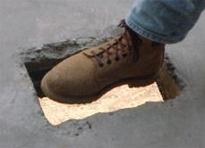
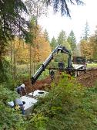
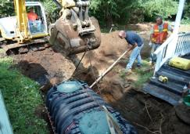
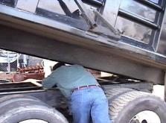
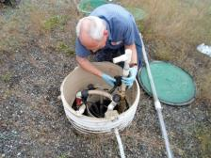
“Safety in the Workplace”
Washington On-Site Sewage Association
“Voice of the Industry”
FOCUS FOUR HAZARDS SAFETY TRAINING – Part 2
Notes:
Introduction of topic to class, the speaker.
Depending on class size, the Instructor should have participants introduce themselves and the industry segment they work in.
The ideal class size for interactive participation is 25.
Introduction of Focus Four topics:
NOTES for use:
This targeted training is a strategic effort to reduce injuries and raise awareness to workplace hazards and injuries related to falls, caught in-between/struck by and electrocution, utilizing “in person” training with instructors that have a background in the Onsite industry, training experience that will focus on highlighting common workplace activities and associated hazards that can be mitigated or eliminated through behavior modification and incorporated into small business safety and training programs.
.In this industry, class participants educational levels will range widely depending on the local demographic, sophistication of local/state rulemaking on certification/licensing requirements and will range from college graduates to high school/GED’s or less. The focus audience of this training are workers in the wastewater and associated Onsite industry. Generally, they are described as small business owners and employees with less than 250 employees that design, install, repair and maintain decentralized wastewater systems (septic systems) that are capable of producing 240- 100,000 gpd of wastewater. Typically, this infrastructure is located and/owned privately but in some cases may also include work activities on community systems. The training intends to provide training to small business that experience a higher level of young workers, limited proficiency, minorities and other hard to reach workers.
After the Instructor introduces themselves and depending on class size, a presentation technique that is recommended for attendees of 25 or less, is to allow each participant to tell who they are but may be effectively used in larger groups with experienced trainers and advanced presentation techniques. This activity is intended to be an “ice breaker” and set’s the style and tone of the learning event to be interactive
The key learning objectives follow:
At the end of each training session of the Focus Four, participants will be able to identify specific hazards that relate to their industry segment.
Demonstrate an understanding of how to minimize or eliminate the exposures through modification of work practices in specific tasks
Provide feedback on experience and sharing personal stories of events and near misses in the Focus Four categories
Describe what they have changed personally or in supervisory roles that would mitigate or prevent accidents in the Focus Four categories
Each of the slides in this presentation provides comments and Instructor’s speaking points and perspectives to current application in the industry. The developer’s of this training resource encourage modification of this editable resource that will make it both industry and region specific to reflect local regulatory practice and information from other state approved OSHA plans outside the initial development.

Slide 2
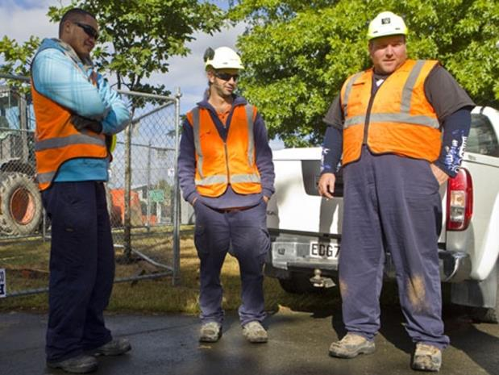
Struck-By Hazards – Traffic Controls
When is reflective gear required?
Guidance Manual on Uniform Traffic Control Devices (MUTCD)
This is what you look like to each other
Notes:
All workers near active traffic, in high rights-of-way, working around moving Onsite equipment or in areas where visibility is limited should wear high visibility clothing.
Clothing should include reflective stripes.
You should refer to the Manual on Uniform Traffic Control Devices (MUTCD) for further guidance.

Slide 3
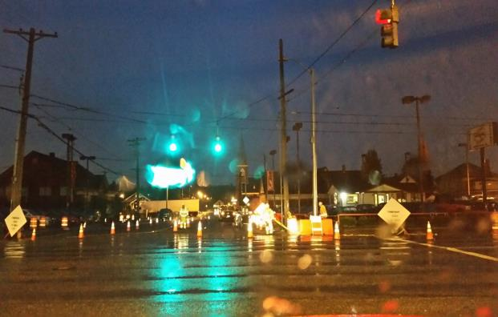
Struck-By Hazards – Traffic Controls
This is what you look like to a driver at 20mph coming off an intersection.
What if the driver is reaching for their coffee?
What if the driver is texting?
Notes:
All workers near active traffic, in high rights-of-way, working around moving Onsite equipment or in areas where visibility is limited should wear high visibility clothing.
Clothing should include reflective stripes.
Highlight the importance of personal responsibility and SITUATIONAL AWARENESS.
You may rely buy cannot depend on your traffic controller (sign holder – “Slow”) to protect you.
Keep an eye on the time of day…workflow traffic through the intersection/area. This picture was taken at approx. 7:20AM in early December.
Know sunrise/sunset times
Have communication set up with other workers if you must turn your back on traffic.
You should refer to the Manual on Uniform Traffic Control Devices (MUTCD) for further guidance.
Refer to the Dept. of Transportation http://safety.fhwa.dot.gov/wz/

Slide 4
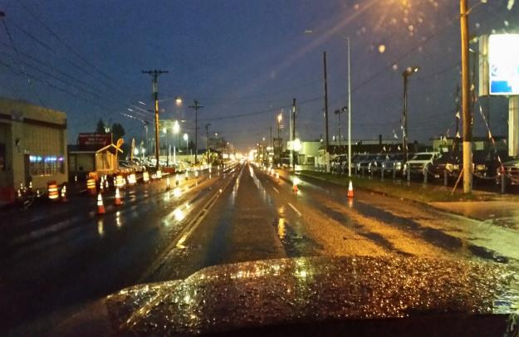
Struck-By Hazards – Traffic Controls
This is what you look like to a driver in low light.
What missing?
Traffic signage
Speed change
Lane change
Notes:
All workers near active traffic, in high rights-of-way, working around moving Onsite equipment or in areas where visibility is limited should wear high visibility clothing.
Low light
Winter
Rain
Road conditions poor
Ice/freezing conditions
Dependence on vehicle operator awareness
7:15 AM traffic commute
5:30 PM traffic commute
Refer to the Manual on Uniform Traffic Control Devices (MUTCD) for further guidance.
Refer to the Dept. of Transportation http://safety.fhwa.dot.gov/wz/

Slide 5
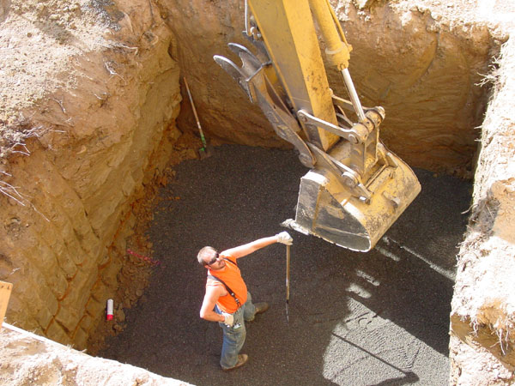
Struck-By Hazards
Exposures?
Debris from surface
Hit by bucket
No way out???
Notes:
Instructor can ask class to identify exposures:
Excess material in bucket, in swing radius of bucket with no eye contact with operator, engulfment with no protection in excavation and a hard hat would be a good idea.
This scenario also violate the excavation/CSE standards with no means of egress.

Slide 6
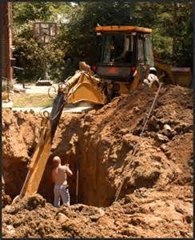
Struck-By Hazards
Exposures?
Limited line of sight to operator
Material on edge of excavation
No way out
Notes:
Instructor can ask class to identify exposures:
Excess material on edge of excavation, in swing radius of bucket with no eye contact with operator, engulfment with no protection in excavation and a hard hat would be a good idea.

Slide 7
Struck-By Hazards – Engulfment
Exposures?
Material from above
Equipment
Ladder
Root Cause?
Notes:
Instructor can call out the obvious (ladder), but also excavation and engulfment potential (minimum 2’ setback on spoils from excavation edge) and the lack of personal PPE (hard hat) by the worker.
Introduction of themes: Carelessness? Lack of knowledge? Lack of Training? Lack of Procedures? Is this the business owner or a worker?
If the owner, what kind of example is he setting for his employee’s when he is not on the project?
Root cause? – Line of fire, (no situational awareness or understanding of the exposure)

Slide 8
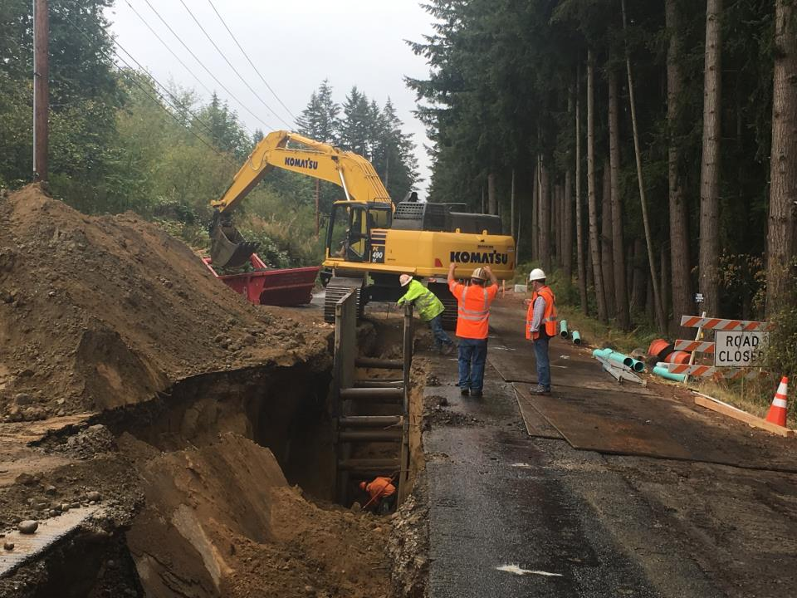
Struck-By Hazards – Engulfment
Exposures?
Material from above
Equipment
Ladder
Root Cause?
Notes:
Work Activity: This is a utility project taken on by a construction company that normally installs OSS and the scope of work is outside of the companies experience.
2,100 feet of sewer pipe laid at an average depth of 22 feet in the roadway in sand.
Instructor should ask for what is right and wrong in the picture to help participants evaluate exposures.
Is the “competent person” onsite making changes to the workflow appropriately?
Clearly the continued caving of ground from spoil pile loading is excessive.
The worker in the excavation does not have a means of egress per the code (note the ladder to the right of the picture.)

Slide 9
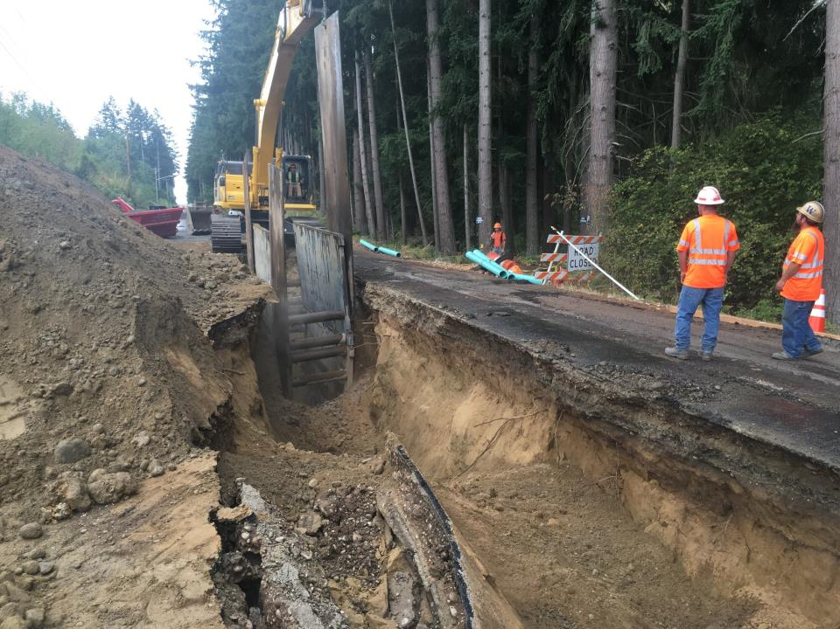
Struck-By Hazards – Engulfment
Exposures?
Material from above
Equipment
Ladder
Root Cause?
Notes:
Instructor can call out the obvious (ladder), but also excavation and engulfment potential (minimum 2’ setback on spoils from excavation edge) and the lack of personal PPE (hard hat) by the worker.
The additional sheets of steel were pounded into place to allow movement of the trench boxes forward.
Instructor should engage the participants to gauge their understanding of excavation and trench requirements under the rule to prevent exposures to engulfment.

Slide 10
Activity
Write Down Two “Struck By” Exposures That You Have In Your Workplace
Write Down a “Struck By” That Happened to You in Your Workplace.
Write Down What You Recommend To Minimize or Prevent Them.
Notes:
The Instructor should set up this activity and give the participant 3-5 minutes to identify the first three things that come to their mind and write them down in their handout. The next step will be to give them 3-5 minutes to write down how they will minimize them.
Last step is to break them into small groups and have them share the answers and discuss. 5-10 minutes
Appropriate answers to minimize the exposure include: Find another way to do it that eliminates the exposure, Use appropriate PPE (may be specific: harness and tripod, hardhat, footwear), Eyes on task, Not walking backward, Only open component lids that are being worked on, etc.), Training.
An alternate to the activity would be to have them do the first step and then break into teams and problem solve together and use the combined experience of the small group to share experience.

Slide 11

Caught-In or Between Hazards
Notes:
Introduction to Caught in/between slide (placeholder, looking for a better graphic)

Slide 12
Caught-In or Between Hazards
According to OSHA, caught-in or -between hazards are defined as:
Injuries resulting from a person being:
Squeezed
Caught or Crushed,
Pinched, or compressed between two or more objects, or between parts of an object.
Notes:
Definition of caught-in or between hazards.

Slide 13
Major Types of Caught-In or Between Hazards
Buried In or By
Pinned Between
Unguarded Parts
Notes:
Examples would include drainfield Onsite, tank excavations, soil logs, unstable ground (wet), soil type for equipment (track vs. rubber tire), skid steers (high center of gravity), greasing equipment (excavators, hydraulics), sewage, grinder pumps. Unsecured shelving in a shop with heavy material or inventory on it.
Instructor should call for examples from the audience that are specific to the industry. Availability and use of a “Flip Chart” would be useful to capture comments and ideas. When each segment activity (Septic Feud) is going on, reference back to the flip chart list will reinforce the groups feedback and participation.

Slide 14
Primary Causes of Caught-In or Between Fatalities
Tank installations
Rotating Equipment
Unguarded Parts
Equipment Rollovers
Equipment Maintenance
Tools
Notes:
Examples would include drainfield Onsite, tank excavations, soil logs, unstable ground (wet), soil type for equipment (track vs. rubber tire), skid steers (high center of gravity), greasing equipment (excavators, hydraulics), sewage, grinder pumps. Unsecured shelving in a shop with heavy material or inventory on it.
Instructor should call for examples from the audience that are specific to the industry. Availability and use of a “Flip Chart” would be useful to capture comments and ideas. When each segment activity (Septic Feud) is going on, reference back to the flip chart list will reinforce the groups feedback and participation.

Slide 15
Caught-In or Between Hazards
The key difference between a Caught event and a Struck event is whether the impact of the object alone caused the injury.
When the impact alone creates the injury, the event should be recorded as Struck. When the injury is created more as a result of crushing injuries between objects, the
event should be recorded as Caught.
Notes:
Refines the definition to clarify the difference between this and struck by hazards

Slide 16
Top Caught-In or Between Citations
Excavations - General Requirements
Excavations – Protective Systems
Wood Working Equipment
Hand and Power Tools
Citation statistics from Federal OSHA data for OSHA fiscal year 2005
Notes:
This slide can be informational to point out that all of these exposures have an enforceable compliance rule associated with them in addition to any specific examples that may be called out.
All elements of this slide except for wood working equipment, have a corollary in the Onsite industry workplace and can be discussed.

Slide 17
Root Cause Analysis - Activity
Caught In/Between– Engulfment
What is the Problem?
Root Causes?
Method
Management
Material
People (man)
Measurement
Machine
Notes:
Instructor can speak to the change in group progress in application of the method and based on the participants performance continue to develop the critical thinking skills when used.

Slide 18
Vide o
Show a video
Notes:
Like the other video, this is a story of bad decision making by a business owner (installer) under pressure from the General contractor.
This testimonial is more about decision making under outside pressure and results.
It is common if there is a high percentage of installers/site development contractors for many near misses or even direct knowledge of experience involving a fatality.
As in the previous video an option is to listen to it initially, and then after a discussion, listen to it a second time in context to the root cause analysis.

Slide 19
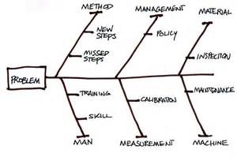
Organizing the Information
What are the core issues involved?
Method
Management
Material
People
Measurement
Machine
Notes:
The victim in the video blames his decision on pressure, but it is more likely that behavioral issue are more at play.
In the initial comments, he see’s himself as a “risk taker” …”hard jobs, steep slopes, we love them!”
In his view, it is what differentiates himself and his company from his competition.
Risk acceptance is fine in a business model, but you also are obligated to ensure that you and your company has the proper training, skills, equipment and willingness to operate appropriately in these work environments.
The instructor should look for examples in small groups that have accurately identified these issues and highlight them to all participants.

Slide 20
How a Fatality Investigation works
2010 – Small Business Fatality – HVAC firm (LLC) was cited for 42 safety and health violations after starting and investigation of a worker fatality when he was crushed by a large steel frame weighing approximately 1,500 lbs.
Penalties assessed: ????
$ 127,200
Notes:
Activity: Understanding the value in proactive vs reactive approaches to workplace safety and management.

Slide 21
How a Fatality Investigation works
What are the core issues involved?
Method
Management
Material
People
Measurement
Machine
Notes:
Instructor can use this scenario as a group discussion or continue to break the class into small groups, depending on time and instructors perception of participants grasp on the use of the methodology.

Slide 22
How a Fatality Investigation works
Findings: One “Serious” safety violations related to the fatality
“Failing to exercise caution or planning when moving heavy, unstable loads in a vertical position”
Notes:
This is the agencies findings. Root cause method would characterize this as methods and procedures.

Slide 23
How a Fatality Investigation works
Findings: 29 “Other Serious” safety violations related to the workplace.
Equipment lacking
Seatbelts
Guards
Lifting equipment not fit for use
Electrical exposures/no LO/TO procedures
Lack of training
Notes:
This is the agencies findings. Root cause method would characterize this as methods and procedures.

Slide 24
How a Fatality Investigation works
Findings: 7 “Less than Serious” safety violations related to the workplace.
Failing to notify the agency within 8 hours
Improperly stored flammables
Fire extinguishers not checked monthly/annually
Daily inspections of fork lifts not done
Labeling of liquefied propane gas cylinders not done or labeling to identify the hazardous nature of the chemical
Notes:
The finding on the investigation continue. In relation to the root cause analysis, several of these would be causal and several (flammables storage and fire extinguishers) unrelated to the actual fatality but indicative to the safety (or lack of) culture in the small business.

Slide 25
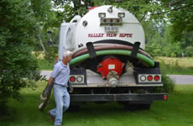
Caught-In or Between Hazards
Have audible back-up alarms
Have a spotter to direct the operator if visibility is restricted
Keep adequate clearance behind the vehicle
Always pay attention to backing equipment
Notes:
Instructor Notes:
Pump truck operators will run with 1 or 2 men depending on the job and the company policy. When there are two employee’s, it is common for one to act as a spotter or guide to the driver backing in to the site. Virtually always at a very low speed, it is still critical for the spotter to always maintain line of sight contact with the driver and maintain enough spacing between the spotter and the vehicle to allow for an exit in the event of a slip, trip or fall. It will take the driver a moment to react, make a determination to stop or just look in the other mirror, anticipating the spotter has moved to the other side of the vehicle.

Slide 26
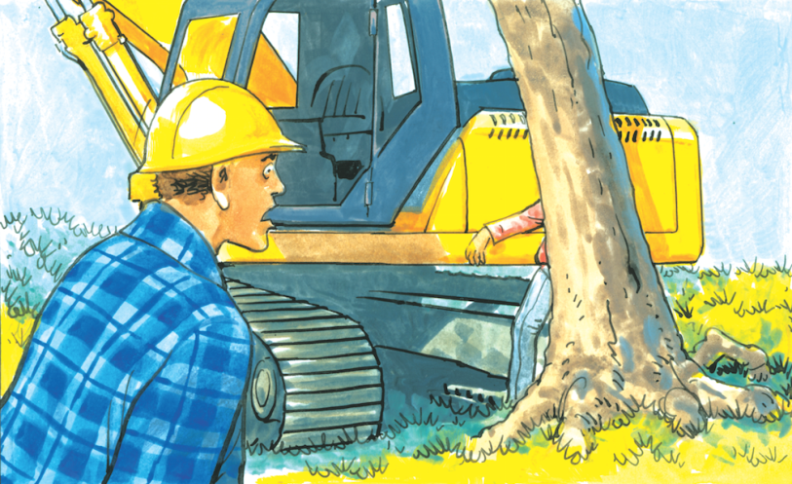
Caught-In or Between Hazards
Notes:
Introduction to potential fatalities based on excavation equipment on site

Slide 27
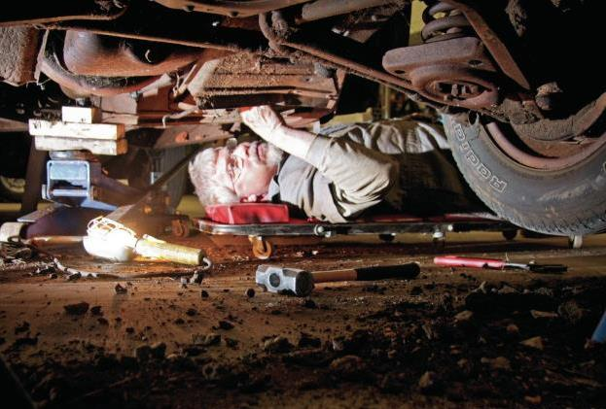
Caught-In or Between Hazards
Workers under equipment that is insufficiently supported
Notes:
Instructor can have the participants work through the worst practice of this vehicle maintenance.
Obviously, NEVER work under equipment supported only by jacks or their own hydraulics.
All equipment must be properly shut down, parking brakes set and be adequately blocked before maintenance workers can work around or under equipment.
A discussion on worker behavior and risk recognition and situational awareness would be beneficial.

Slide 28
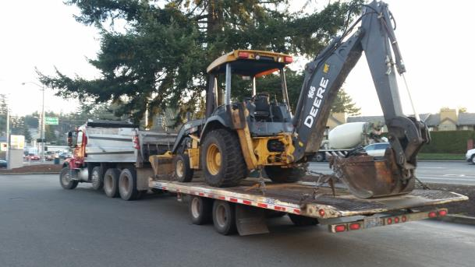
Caught-In or Between Hazards
Trailer secure and on a level surface
Inspect the deck for debris, blocking or chains
Be sure equipment is properly secured
Notes:
Instructor can ask participants if they think this equipment load out is good/bad and offer feedback.
Risks to accidents include many tip-overs occur during the loading or unloading of equipment.
Equipment can also slide off trailers or loading ramps.

Slide 29
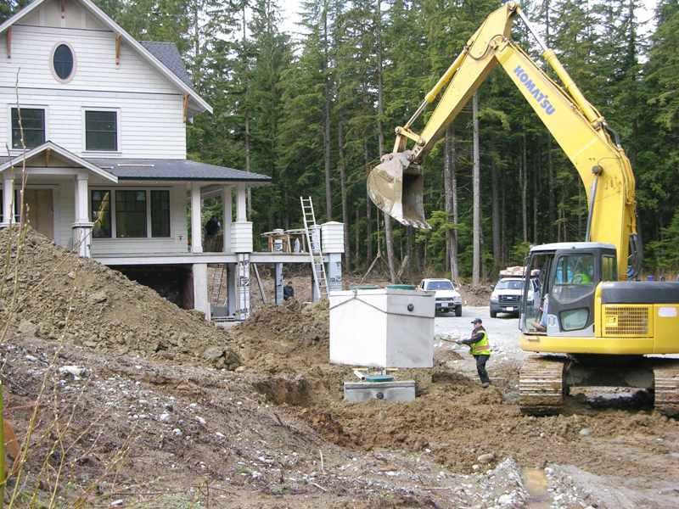
image
Notes:
Level ground, decent weather, equipment available that can more than handle the load, no overhead exposures, opera...tor can see worker well….as good a set up as you can get.
Instructor can ask participants what they would change.
Key observations include:
If lifting devices (chains) are rated?
Is the excavator set properly for the pick?
Could the worker on the ground have an exposure based on his position?

Slide 30
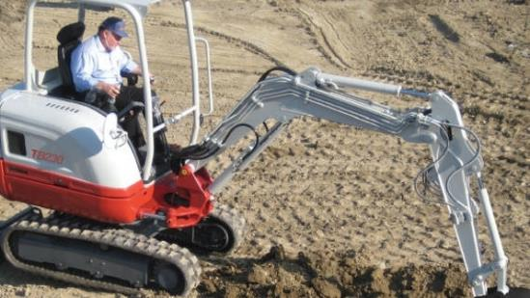
Caught-In or Between Hazards
Is there a roll-over hazard here?
Always wear the seat belt
Only ride in the seat provided
No riding in buckets, on fenders or on steps
Notes:
Instructor: This picture sets the discussion for the next series of slides…While seat belt use should be routine, it often isn’t.
What is the difference between good habits and good behaviors…

Slide 31
Caught-In or Between Hazards
6/27/2014 Age: 67 Fatal? Yes
CRUSHED BY: An employee was rolled over by a tractor truck while in the process of hooking up a low-boy trailer.
Notes:
From Oregon OSH 2014 report: http://www.orosha.org/standards/fatals/pdf/descriptions/acc_fatal_cal-yr14.pdf

Slide 32
Organizing the Information
What are the core issues involved?
Method
Management
Material
People
Measurement
Machine
Notes:
Fault tree analysis unwinds the knot until you can clearly understand what the root cause is.

Slide 33
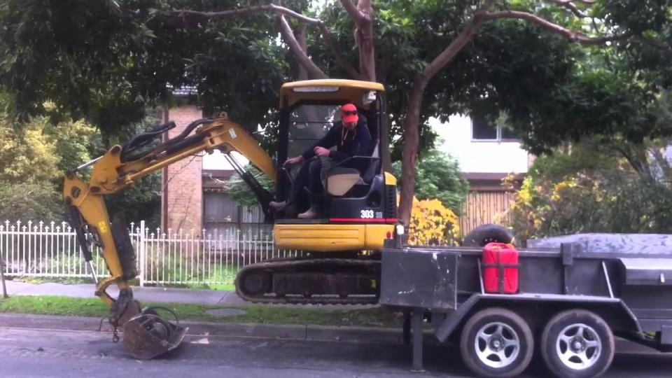
Caught-In or Between Hazards
Notes:
Different trailers have different set ups…This presents several potential problems…
Do you need some traffic controls?
Is the trailer secure? (note legs down, but wheels not chocked)…if still connected to a vehicle, is the parking brake set?
How does this unloading procedure change if you’re on a hill, or a construction site or uneven ground?
Is seatbelt use a good idea or “just in certain situations”?

Slide 34
Caught-In or Between Hazard
10/8/2014 Age: 53 Fatal? No
Caught in or between:
Employee was driving a Ford 350 pickup with flatbed trailer attachment to pick up a piece of rented equipment. The employee backed up the truck and got out to check behind the unit for clearance and the truck began to roll backward. The employee attempted to reach in at the brake pedal and the open drivers' door struck the employee knocking him to the ground. The left front tire rolled up on the employees' right leg. A witness moved the vehicle off the injured employee and 911 was called to respond.
Notes:
From Oregon OSH 2014 report: http://www.orosha.org/standards/fatals/pdf/descriptions/acc_fatal_cal-yr14.pdf

Slide 35
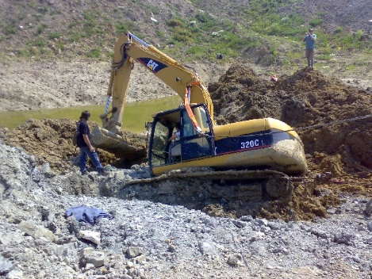
Caught-In or Between Hazards
What could possibly go wrong?
Notes:
Instructor can lead participants through this discussion…the slide is animated for the first and third bullet point…and the NO! and Yes! Animations will guide the presentation of the analysis of the situation.
Will an action to prevent one Focus Four exposure, lead to the unintended consequence of exposing the worker to another of the Focus Four exposures?
Ie: if the operator cannot stabilize the equipment for whatever reason, and the helper cables or chains the equipment to something else (see photo with cable off to the right out of picture). Is what he is connecting it to able to actually accomplish the need to act as an anchor?
What is the weight rating of the cable/chain used and what is the load being put on the safety line? Is there a real possibility that it could part and then strike the operator or anyone in the swing radius creating a “struck by” fatality (no hardhat on observer).
If one “underrated or unknown” cable/chain is attached, will two unknowns make any difference?
When exiting the equipment, do you evaluate getting the operator off without injury by a fall or jumping?
Is this an “eye’s not on path” or a “eyes not on task” accident? (both)

Slide 36
Caught-In or Between Hazards
What do you want to do when this happens?
Stabilize the equipment with the boom and bucket?
Does the operator have an injury or death exposure?
What do you need to consider?...Others?
Notes:
Discussion continues

Slide 37
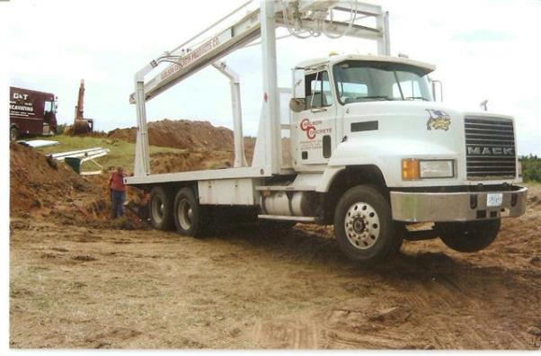
Caught-In or Between Hazards
When delivering tanks what do you need to consider?
Soft Ground
Delivery Angle
Guiding the tank to line up
Notes:
Instructor should discuss: Soil conditions, Soil type, ground saturation, recent weather (rain/snow), High water tables can all contribute to this kind of hazard. Add to that two or three men on the edges of the excavation trying to guide the delivery into the hole and line it up with other pipes, center and level it.

Slide 38
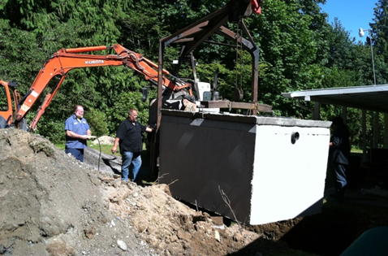
Caught-In or Between Hazards
What are the exposures here?
Tight working area
Who’s in the “”Line of fire??
Communication is tough with worker behind tank
No one is in the line of fire.
Notes:
Activity: Tank install
Experienced workers need to paying extra attention in this situation with tight spaces. Delivery driver operating remote can see only one of the workers. Line of sight communication is lacking and presents a very real Caught in or Between fatality potential. The mass of the tank and the speed of the remote controls are hard to stop and hard to reverse.

Slide 39
Caught-In or Between Hazards
In some tank installations, it is necessary to get the mastic down to seal and in place.
This is a high risk activity the way it is being done.
How could it be done differently?
Notes:
Discussion slide:
Depending on the group make up and size, the Instructor could pose this as an interactive discussion question or break the group into smaller groups and have them do a full analysis of the work task and other workspace considerations and exposures (excavation/engulfment/egress) and report to the group how they would minimize the exposure and do it differently.

Slide 40
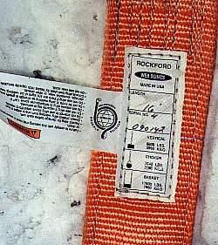
Caught-In or Between Hazards
Slings must be inspected before each use
Slings should have tags that indicate capacities
Notes:
Discussion slide:
All nylon and chain slings must have legible tags.
Riggers must understand wire rope sling capacities.
All riggers must know how to inspect slings and properly rigged loads.
Depending on the use of the previous slide for an activity, the Instructor should note to the group and discuss the variation in “slings” on tank delivery trucks and the requirements, inspection and maintenance elements required by the company delivering the tanks.

Slide 41
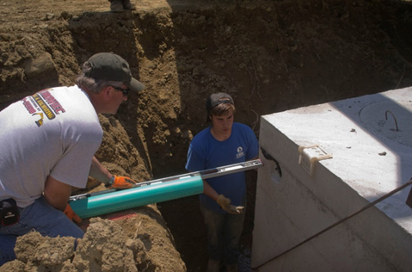
Caught-In or Between Hazards
Notes:
Discussion slide:
Engulfment issues, is this normal practice for the employer? Would the workers still do it this way if it was raining, or ground saturated?
Message: Workers should never be in this situation

Slide 42
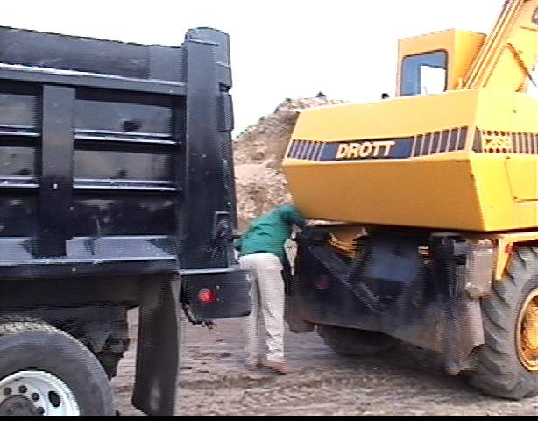
Caught-In or Between Hazards
This worker is out of the driver’s mirror view
This is an example of poor personal responsibility and situational awareness by the worker
Notes:
Discussion slide:
Workers should never get into blind spots of operators and should never get between pieces of equipment unless the equipment is secured.
Instructor can also bring back into the discussion worker behaviors that lead to this exposure: Complacency, Lack of Training, Low situational awareness, new hire?

Slide 43
Caught-In or Between Hazards
7/22/2014 Age: 54 Fatal? Yes
THE VICTIM WAS STRUCK BY A LOADED DUMP TRUCK: The victim was working as a ground member on a crew that was doing a chip sealing project.
The victim was struck by a loaded dump truck that backed onto him.
Notes:
From Oregon OSH 2014 report: http://www.orosha.org/standards/fatals/pdf/descriptions/acc_fatal_cal-yr14.pdf
Instructor option:
Use the root cause analysis to work through the assessment in small groups or in general class.

Slide 44
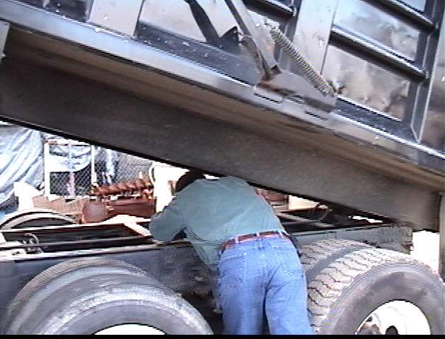
Caught-In or Between Hazards
A truck driver was working between the frame and dump box of a dump truck
The dump box dropped suddenly, crushing his head
Notes:
This has been a common cause of fatality.
Truck boxes should always be independently blocked.

Slide 45
Caught-In or Between Hazards
1/27/2014 Age: 33 Fatal? No
EMPLOYEE GOT HIS LEFT ARM CAUGHT ON A SHAFT AND BROKE IT:
Employee was working underneath a rotating shaft caught his clothes on the shaft and twisted his arm up breaking it.
Notes:
From Oregon OSH 2014 report: http://www.orosha.org/standards/fatals/pdf/descriptions/acc_fatal_cal-yr14.pdf
Instructor option:
Use the root cause analysis to work through the assessment in small groups or in general class.

Slide 46
Organizing the Information
What are the core issues involved?
Method
Management
Material
People
Measurement
Machine
Notes:
Fault tree analysis unwinds the knot until you can clearly understand what the root cause is.

Slide 47
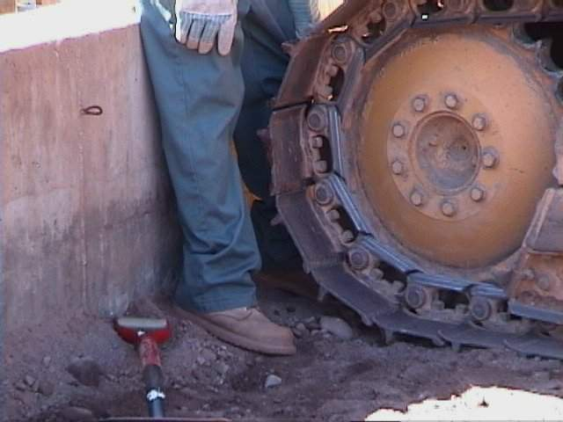
Caught-In or Between Hazards
Notes:
Near misses should be discussed. It is a common pre-curser to many Focus Four Hazards that result in accidents and/or fatalities.
You can have a strong safety program, ground control procedures, training in place and completed, worker experience and then one or two of the “root cause” issues of accidents like “rushing” and being in the “line of fire” come together.
The additional employee attitude that adds to the potential are “rationalization tactics” that have been internalized by the worker along with “positive reinforcement” for negative behaviors (they’ve done this before and not had anything “bad” happen”)
It doesn’t diminish the reality of the exposure or reduce the potential severity…they simply “got away with it” today. It can be deadly…

Slide 48
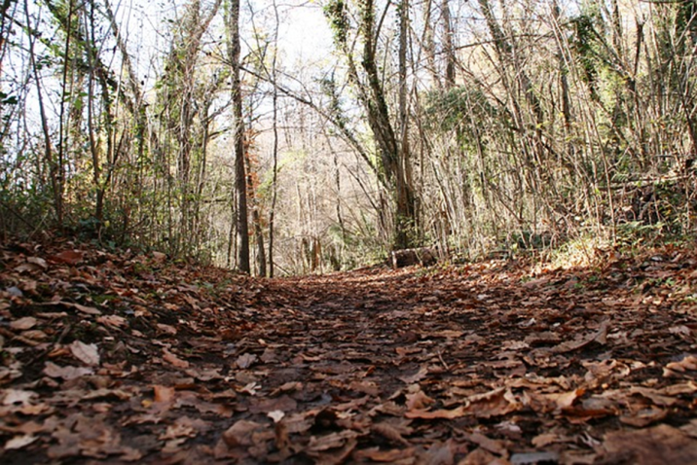
Soil Logs may present special hazards. Often they are left open for days or weeks They are inspected at different intervals by the designer and then the regulator
Fall Hazards/ Caught-In - Excavations
Notes:
Activity: Soil excavations(Soils) inspection
Fall hazards in pre-Onsite site development need to be flagged. These excavations are commonly put in and there is often a delay between when they are dug, inspected by the designer/soil scientist for application loading rates and then verified by the regulator.
This picture represents a situation where a soil log had been dug on site in the fall and right in a pathway to the property, and then left open for the regulator to come and inspect later. Several weeks went by before the regulator made it back to the site and the 5’ foot deep excavation had filled with water with rainfall and runoff, and fall leaves had obscured the excavation.
The regulator narrowly missed falling into the excavation and would have subsequently drowned (unable to swim), was working alone (unable to get help) on a remote site. OSHA excavation protection is well defined along with state approved plans that also give guidance. These requirements are often side stepped because of conflicting regulations (in this case, local health code on inspection requirements are not harmonized with OSHA/state rules.
Note to Instructor: In some states nationally, soil absorption “perc” holes are used in lieu of excavation of a soil log.

Slide 49
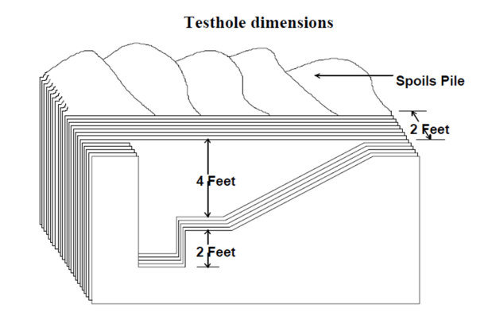
Caught-In or Between Hazards
This picture represents a graphic published from a Local Health Jurisdiction to represent a soil “test pit” for evaluation of the disposal component.
Does it meet the trench excavation requirements?
Notes:
Instructor discussion:
Does it meet the OSHA trench excavation requirements?
Short answer is no…the Instructor can entertain discussion on why it’s used and why it’s out of compliance to gauge the participant knowledge of trench safety under OSHA and OSHA approved state plan.
It is important to keep in mind that this configuration’s intent is to evaluate soil and determine soil type for a disposal component. It has literally nothing to do with excavation or trench requirements for safety under the rule

Slide 50

Caught-In or Between Hazards
Simple Slope
All simple slope excavations 20 feet or less in depth shall have a maximum allowable slope of 1 ½:1
Figure N-11
Simple Configurations
for Type C Soil
Notes:
Instructor discussion:
Use the root cause analysis to work through the assessment in small groups or in general class.
This would be the crossover to excavation/trench requirements for a typical soil log excavation. Depending on location, local or state health code, these excavations can be left open for extended periods of time (weeks, months and worst case years), depending on the development schedule of the property.
This is a very real and an extreme hazard not only for the workers immediately involved, but for the general public. It is an engulfment (or as previously discussed in Falls), a potential drowning hazard.

Slide 51
Caught-In or Between Hazards
Soil weighs about 100 – 140 lb/cu.ft.
Each foot of depth adds more pressure side pressure
Once the pressure exceeds the ability of the soil to support itself, failure is possible
120
120
120
120
120
Notes:
Instructor discussion:
Discuss the weight of soil.
It only takes a small amount such as 1 cu.ft. to cause a serious injury.
2 cu.ft. (200 lbs) can be enough to heavily restrict a buried victim’s ability to breathe.

Slide 52
Basic Requirements CFR 1926.650-654
Caught-In or Between Hazards
Work must be supervised by a “Competent Person”
Protection is required over 5 feet deep or if there is a possibility of a cave-in
Excavations must be inspected daily and/or with changes
Access/Egress is required over 4 feet deep
A rescue plan must be in place
Notes:
Instructors should review OSHA’s complete excavation standard and be ready to discuss various issues noted in slide.

Slide 53
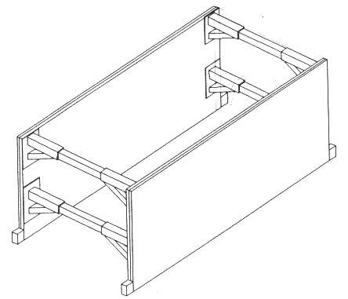
Trench Shields or Boxes
Caught-In or Between Hazards
Engineered for Type C soils
Can be used with all classes of soils
Shields can be moved horizontally with workers inside
Worker must stay inside shields
Notes:
Instructor discussion:
Trench shields are commonly used for pipe installation work.
When used properly, shields can be much safer, effective and cheaper than sloping methods.
A minimum of two shields should always be available to extend the work area or to help work through intersecting utilities.
Trench boxes must be at least 18" above the ground.

Slide 54
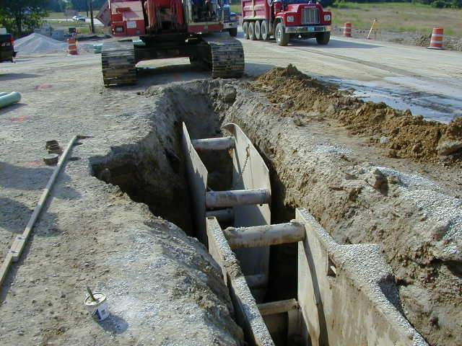
Do Not Do
Notes:
Instructor discussion:
Trench boxes should not be installed less than the excavation

Slide 55
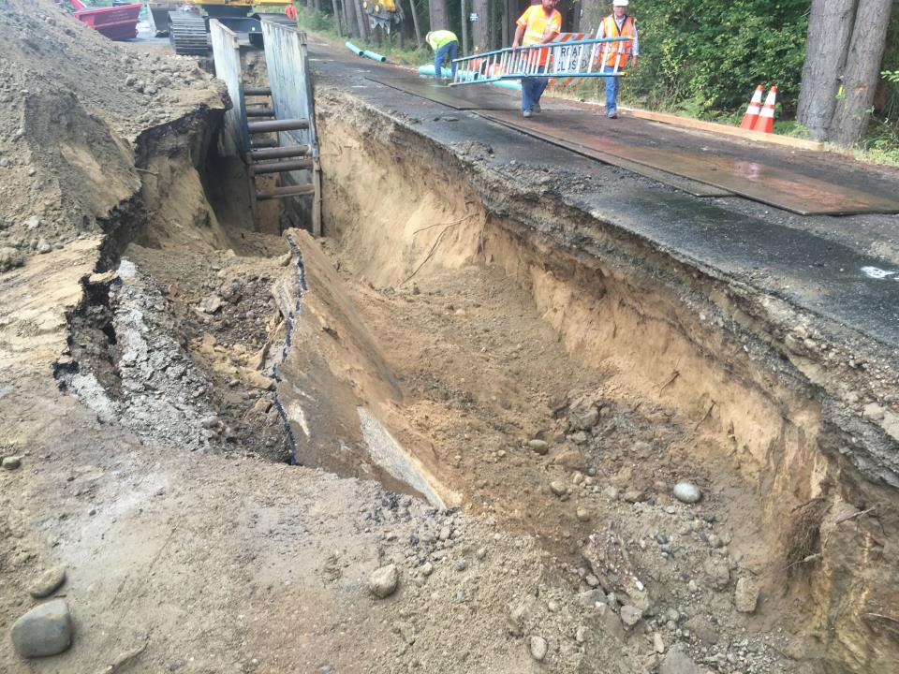
Identify the Hazards
Notes:
Instructor discussion:
Ask the participants to identify the hazards.

Slide 56
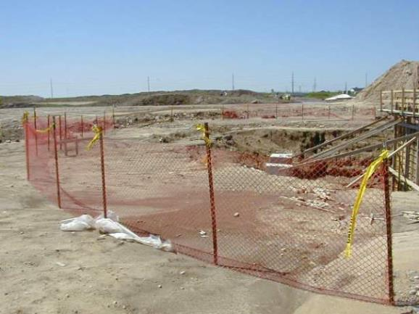
Barricade Requirements of Excavations
Caught-In or Between Hazards
Excavations must be barricaded or marked if they are not readily visible
Notes:
Instructor discussion:
Under the trench rule, inspection, and barricading (protection) is the responsibility of the contractor that created the excavation.
The method is left to the user, but it must be effective.

Slide 57
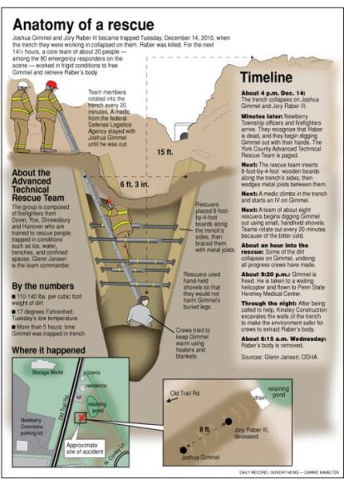
Rescue Capability
Caught-In or Between Hazards
A rescue plan must be in place
Rescue of a buried worker is a slow and tedious process
Notes:
Instructor discussion:
Most local fire departments are not fully trained or equipped to perform excavation rescue operations.
Excavation rescue must be done extremely carefully as the operations themselves can:
cause additional cave-ins, endangering both the trapped victim and rescuers
create more soil pressure on a buried victim
injure the victim more severely.

Slide 58
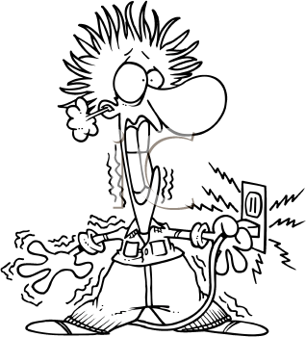

Electrocution
Notes:
Introduction to Focus Four Electrocution slide

Slide 59
Primary Causes of Electrocution Fatalities - OSHA
Contact with Overhead Powerlines
Contact with unmarked buried Powerlines
Contact with Live Circuits in Panels
Poorly Maintained Cords and Tools
Lightning Strikes
Notes:
All relative to the Onsite industry. Examples include: Excavators in both new Onsite and existing Onsite during repairs of OSS (onsight systems). Tight working spaces, and un-marked subsurface electrical out of the right of way.
Note to Instructor: Comment on site awareness for outbuildings (shops, garages) that have power and looking for unmarked sources. Non-licensed installation, replacement or modification in the industry is quite common as is DIY homeowner electrical extensions to out buildings.
It is also important to note that there is a high probability that prior, and subsequent maintenance activities on electrical components (pumps, floats, alarms and control panel) may have been installed by OSS certified by non licensed individuals for electrical work.
Most field activities and hand tools today have transitioned to battery operated equipment, but depending on the installation (new Onsite site w/o power) it would not be uncommon to see corded hand tools operating from an extension cord and run off of a generator….in the rain. Use of corded tools in shops would benefit from regular inspection.
Lightning strikes would be rare, and the majority of work is done outside, but paying attention to weather would be preventative.
Instructor should call for examples from the audience that are specific to the industry. Availability and use of a “Flip Chart” would be useful to capture comments and ideas. When each segment activity (Septic Feud) is going on, reference back to the flip chart list will reinforce the groups feedback and participation.

Slide 60
Top Electrical Citations
Electrical, Wiring Design and Protection
Elec. Wiring Methods, Components and Equipment, General Use
Electrical, General Requirements
Electrical, Safety-Related Work Practices, General Requirements
Citation statistics from Federal OSHA data for OSHA fiscal year 2005
Notes:
This slide is informational to point out that all of these exposures have an enforceable compliance rule associated with them in addition to any specific examples that may be called out.
All elements of this slide have a corollary in the Onsite industry workplace and can be discussed.

Slide 61
Definition of Electrocution
Electrocution results when a person is exposed to a lethal amount of electrical energy.
An electrical hazard can be defined as a serious workplace hazard that exposes workers to the following:
Burns
Electrocution
Shock
Arc Flash/Arc Blast
Fire
Explosion
Notes:
BESAFE is the acronym highlighted in bold. Most of the electrical exposures are 110 volts and generally do not exceed 220v in the majority of applications.
Burns to the hands/fingers in OSS components with contact in: Control panels, Alarm panels, Junction boxes in/on risers, Float controls and pumps. Additional exposures that are common are found in the shop and other workplaces with typical building and corded electrical tools.

Slide 62
Burns - Definitions
An electrical burn is a burn that results from electricity passing through the body causing rapid injury.
Electrical burns differ from thermal or chemical burns in that they often cause more subdermal damage.
They can exclusively cause surface damage, but more often tissues deeper underneath the skin have been severely damaged.
Electrical burns are difficult to accurately diagnose, and many people underestimate the severity of their burn.
Notes:
BESAFE is the acronym highlighted in bold. Most of the electrical exposures are 110 volts and generally do not exceed 220v in the majority of applications.
Burns to the hands/fingers in OSS components with contact in: Control panels, Alarm panels, Junction boxes in/on risers, Float controls and pumps. Additional exposures that are common are found in the shop and other workplaces with typical building and corded electrical tools.

Slide 63
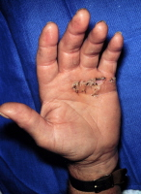
Risk of Electrocution
Voltages greater than 50 V across dry unbroken human skin may cause heart fibrillation with electric currents in body tissue that happen to pass through the chest area.
Living human tissue can be protected from damage by the insulating characteristics of dry skin up to around 50 volts. If the skin is wet, that all changes.
Notes:
Instructor discussion continues

Slide 64
Primary Exposure to Electrocution Hazards in Onsite?
What are some specific examples in the Onsite industry?
Unlicensed Installation of Control Panels
Unlicensed Installation and Replacement of Floats
Unlicensed Installation and Replacement of Pumps
Lack of access to Fuse Panels and Controls for LO/TO on a service call
Notes:
Unique electrical exposure to the Onsite Industry: Unlicensed work by industry service providers and contractors is the single greatest exposure to injury and potential fatalities for the Focus Four Electrocution exposure.
Un-isolated energy sources and working on hot components or not ensuring that all energy has been isolated with LO/TO procedures presents a huge risk to workers.
This issue is exacerbated by the fact that service industry workers that work on these systems, post installation have additional exposure to an exceptionally high frequency of electrical work that was initially done by unlicensed electricians.
Another frequent complaint in the industry (and part of the “justification tactics” to go off the reservation) is the lack of knowledge by licensed electricians on wiring the controls for these engineered systems vs. their experience with residential or commercial frame wiring for lights, utilities, HVAC and appliances.
Lightning strikes would be rare, and the majority of work is done outside, but paying attention to weather would be preventative.
Instructor should call for examples from the audience that are specific to the industry. Availability and use of a “Flip Chart” would be useful to capture comments and ideas. When each segment activity (Septic Feud) is going on, reference back to the flip chart list will reinforce the groups feedback and participation.

Slide 65
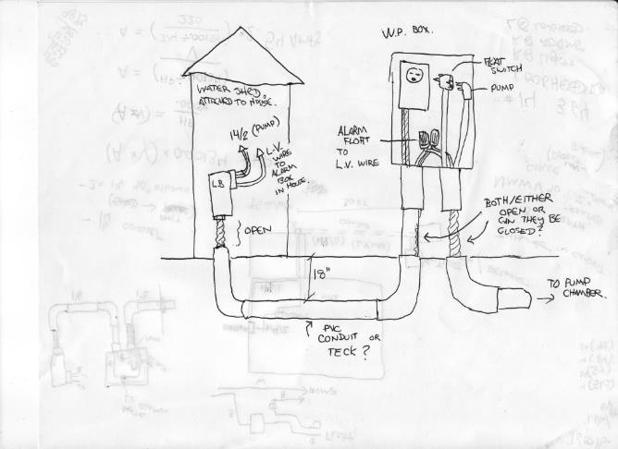
Electrical Hazards
Electrical wiring Diagrams can be helpful when diagnosing systems!
Good?
Better?
Best?
Notes:
Instructor discussion:
Electrical diagrams if available at all can look like this or worse. Wiring done by unlicensed contractors and/or homeowners, not inspected to code, can present a unique risk.
More complicated systems, and wiring schemes complicate the issue for troubleshooting by unlicensed OSS inspectors/Pumpers/Installers.

Slide 66
Electrical Death Root Cause Exercise
BRIEF DESCRIPTION OF ACCIDENT One employee was climbing a metal ladder to hand an electric drill to the journeyman installer on a scaffold about five feet above him. When the victim reached the third rung from the bottom of the ladder he received an electric shock that killed him.
Notes:
Instructor discussion:
Review with the class the results of their thinking on the root causes of the fatality. If the group is broken into smaller discussion groups, have each of them share the results of their thinking and likely causes.

Slide 67
Organizing the Information
What are the core issues involved?
Method
Management
Material
People (Man)
Measurement
Machine
Notes:
Fault tree analysis unwinds the knot until you can clearly understand what the root cause is.

Slide 68
Electrical Death Root Cause Exercise
17 year old worker
Apprentice
Time on Job – 1 month
Safety Program: Partial
Training: Some
Worksite Inspected Regularly - No
Notes:
Instructor discussion:
Explain the Exercise and have them use the Root Cause analysis worksheet in the participant guide.

Slide 69
Electrical Death Investigation Results
The investigation revealed that the extension cord had a missing grounding prong and that a conductor on the green grounding wire was making intermittent contact with the energizing black wire thereby energizing the entire length of the grounding wire and the drill's frame. The drill was not double insulated.
Notes:
Investigation root causes indicate unsuitable tools in the workplace (maintenance) and modification to the plug…speculation on a personal tool migrating to the workplace.
In our industry, this is common. In upcoming slides the focus of this discussion will be emphasized by the Instructor.
Workers/Owners should evaluate all their tools that can/may be used around electrical components and consider removing and replacement with like tools that are electrical rated.
Ie: Screwdrivers, battery operated drill sets, knives, side cutter’s, any types of pliers (needle nose, etc.)

Slide 70
As a result of its investigation, OSHA issued citations for violations of construction standards.
1. Use approved ground fault circuit interrupters or an assured equipment grounding conductor program to protect employees on construction sites [29 CFR 1926.404(b)(1)].
2. Use equipment that provides a permanent and continuous path from circuits, equipment, structures, conduit or enclosures to ground [29 CFR 1926.404(d)(6)].
3. Inspect electrical tools and equipment daily and remove damaged or defective equipment from use until it is repaired [29 CFR 1926.404(b)(iii)(c)].
Notes:
Instructor should point out the specificity of the rule to these types of incidents. A key point is that these rules, evolved over time (since the 70’s) due primarily to a response to serious of fatal injuries.

Slide 71
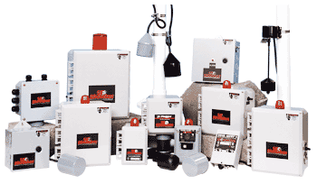
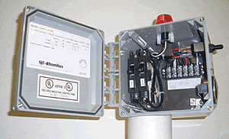
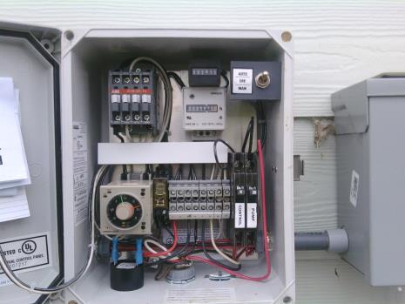
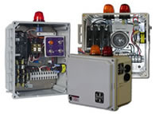
Electrical Hazards
Notes:
Lots of features, lots of functions…pressure time dosing 4-12 time per day, Mounds, Sand Filters, Glen-Don, Drip, micro-dosing a hundred times a day, etc.
Virtually all of the pump and control panels available for managing time dosing and flows from the source facility provide wiring schematics. After installation, these are typically found tucked away in the actual control box or in many cases, have a waterproof applique’ with wiring schematics attached to the inside door for pumps, floats and other controls (alarms).
Several but not all control manufacturer’s have “intrinsically safe” protections designed into the electrical control panel. It is important to know which ones do and which ones don’t if you’re going to troubleshoot the system.
Control panels can be a LO/TO point that reliably isolates energy to field components, but given the actual practice in the field, always check at the component to ensure it is not energized.

Slide 72
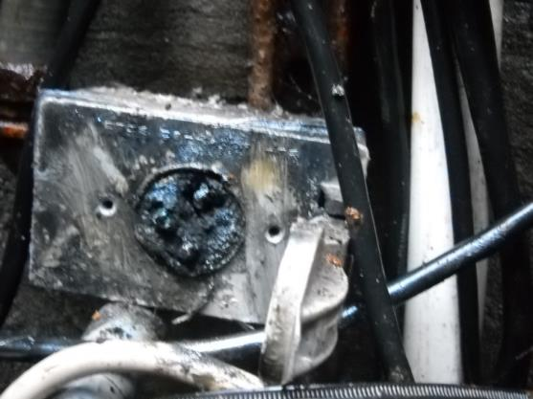
Electrical Hazards
Provided by the homeowner… with additional information.
Well, My Grandfather never had his system pumped for XXX years! I don’t know what the problem is!
Notes:
Jobs like this may have been done at installation or in places that regulatory control (final inspection/system start up) is limited. It could also be a DIY (do it yourself) fix by a system owner who doesn’t understand that these types of components are not “fit for use” in the harsh environment of the septic tank.
The key point is that the next worker on the job, really needs to take a moment, use appropriate tools to evaluate if elements are charged, if there are shorts to other system components and think through the plan prior to starting work.

Slide 73
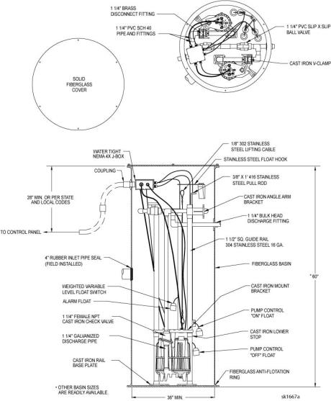
Electrical Hazards
Provided by the Manufacturer
Typically found inside the door of the control panel
Notes:
Virtually all of the pump and control panels available for managing time dosing and flows from the source facility provide wiring schematics. After installation, these are typically found tucked away in the actual control box or in many cases, have a waterproof applique’ with wiring schematics attached to the inside door for pumps, floats and other controls (alarms).
Several but not all control manufacturer’s have “intrinsically safe” protections designed into the electrical control panel. It is important to know which ones do and which ones don’t if you’re going to troubleshoot the system.
Control panels can be a LO/TO point that reliably isolates energy to field components, but given the actual practice in the field, always check at the component to ensure it is not energized.

Slide 74
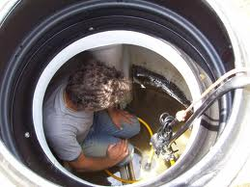
Electrocution Hazards
Ensure isolation of energy on new installations and existing OSS components.
On Repairs or Installation of electrical components make sure to use proper LO/TO measures.
If access is limited is there somewhere else can you can isolate the energy?
Notes:
The primary protection against the hazards of working with electricity is to de-energize circuits wherever possible.
This work should be performed by trained, qualified personnel who have been provided with the appropriate personal protective equipment.
Once the circuit has been de-energized, it should be tested to ensure that no electrical energy remains.
The Instructor should familiarize themselves with local and state rule. Some states, like Missouri at the time of this writing (11/24/16) had no state licensing requirements and electrical licensing requirements were limited to some of the larger cities.
This exacerbates the electrical exposure issues in the OSS industry dramatically.

Slide 75
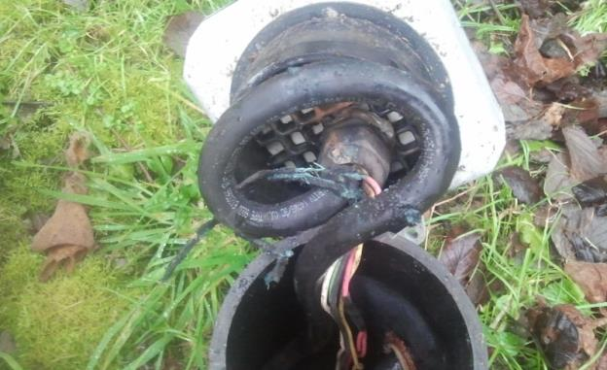
Electrocution Hazards Fire
TRUST but VERIFY!
Before work begins, always double check to make sure the circuit is off with appropriate testing equipment.
Notes:
The primary protection against the hazards of working with electricity is to de-energize circuits wherever possible.
This work should be performed by trained, qualified personnel who have been provided with the appropriate personal protective equipment.
Once the circuit has been de-energized, it should be tested to ensure that no electrical energy remains.

Slide 76
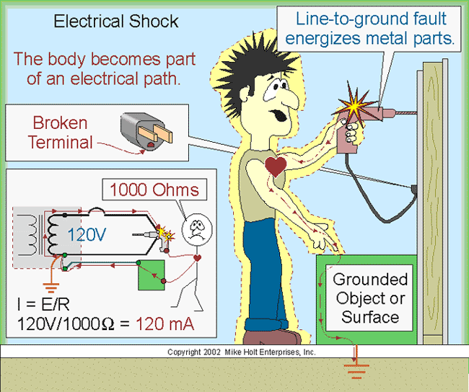
Electric Shock
Electric shock is the physiological reaction or injury caused by electric current passing through the body.
It occurs upon contact of a body part with any source of electricity that causes a sufficient current through the skin, muscles, or hair.
Notes:
Most of the electrical applications in OSS are 110 volts and generally do not exceed 220v in the majority of applications, but they do exist in larger systems, multiple pump arrangements.
Voltages greater than 50 V applied across dry unbroken human skin can cause heart fibrillations if they produce electric currents in body tissues that happen to pass through the chest area. The voltage at which there is the danger of increases depending on the conductivity of dry human skin. Living human tissue can be protected from damage by the insulating characteristics of dry skin up to around 50 volts. If the same skin becomes wet, if there are wounds, then even voltage sources below 40 V can be lethal

Slide 77
Electrical Harm
PATH: Harm is related to the path by which current passes through the body.
Notes:
Instructor should describe how even small levels of amperage can cause serious injuries by affecting the electrical system of the body and affecting the heart rhythm.
Critical information is to relate to the participants the relationship of Volts and Amps on the chart and the severity of the injury up to and including a fatality. It is noted that virtually all of the voltages that the OSS industry work with are in the last category of 15/20 amps

Slide 78
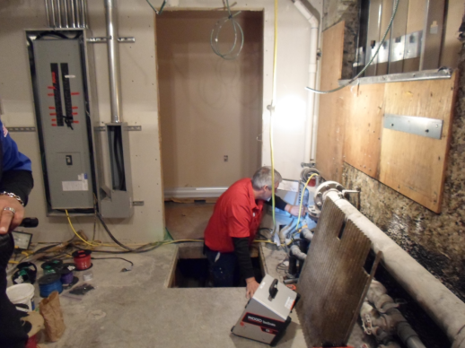
Protecting Yourself From Electrical Hazards
Most electrical accidents result from one of the following factors:
Unsafe equipment or installation
Unsafe work area
Unsafe work practices
Notes:
The primary protection against the hazards of working with electricity is to de-energize circuits wherever possible.
This work should be performed by trained, qualified personnel who have been provided with the appropriate personal protective equipment.
Once the circuit has been isolated, it should be tested to ensure that no electrical energy remains.
This licensed electrician’s job was to test the pump function in the tank he was standing in. The tank had approximately 18 inches of water in the bottom and he was standing on some 6 (unstable work surface) inch piping above the water.
Three factors colluded to create an unsafe situation. The installation of the panel was below his knees at floor level by a previous contractor, the area was under construction and had several electrical traces that were live. The worker made a decision of convenience due to his height at 6’2”.
Post evaluation of the work determined that all of the exposures could have been mitigated with a decision to not enter the tank, keep the entrance grate in place and cover with a rubber mat and finally for the worker to simply kneel down on the rubber mat to do his testing procedure.
The decisions that he made and put him at risk were simply a matter of convenience for him to be able to look into the panel. He couldn’t raise it, so he lowered himself!

Slide 79
Electrical Hazards PPE and Tools
What protection does personal equipment offer?
Employees who work directly with electricity should use the personal protective equipment required for the jobs.
Equipment may include rubber insulating gloves, hoods, sleeves, matting, blankets and industrial protective helmets designed to reduce electric shock hazard. All help reduce the risk of electrical accidents.
Notes:
PPE discussion
Proper selection of tools and the need for a procedure to inspect them regularly.
Instructor should engage participants on discussion of “fit for use” regarding most commonly used PPE in electrical work but also reinforce PPE selection as regards:
Nitrile Gloves
Safety Glasses, side shields
Use of dust masks in contaminated areas vs use of dust masks that are N-95 rated for protection against biologic hazards.
Tools (electrical)

Slide 80
Electrical Hazards PPE and Tools
Proper tools help protect workers against electric hazards.
It's important to maintain tools regularly to prevents them from deteriorating and becoming dangerous.
Check each tool before using it. If you find a defect, immediately remove it from service and tag it so no one will use it until it has been repaired or replaced.
When using a tool to handle energized conductors, check to make sure it is designed and constructed to withstand the voltages and stresses to which it has been exposed.
Notes:
PPE discussion
Proper selection of tools and the need for a procedure to inspect them regularly.

Slide 81
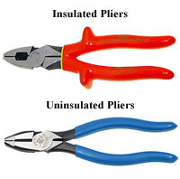
Electrical Hazards PPE and Tools
Notes:
Instructor can ask the group what’s in their tool kits….If you’re only going to have one set of these, which would it be?
In our industry, this is common. In upcoming slides the focus of this discussion will be emphasized by the Instructor.
Workers/Owners should evaluate all their tools that can/may be used around electrical components and consider removing and replacement with like tools that are electrical rated.
Ie: Screwdrivers, battery operated drill sets, knives, side cutter’s, any types of pliers (needle nose, etc.)

Slide 82
Employer Responsibilities
All employees should be trained to be thoroughly familiar with the safety procedures for their particular jobs.
When working on electrical equipment some basic procedures to follow are to:
De-energize the equipment and use lockout and tag procedures to ensure that the equipment remains de-energized.
Use insulating protective equipment, and maintain a safe distance from energized parts.
Use appropriately insulated tools for electrical work
Notes:
The primary protection against the hazards of working with electricity is:
This work should be performed by trained, qualified personnel who have been provided with the appropriate personal protective equipment.
To de-energize circuits and use LO/TO procedures appropriately.
Once the circuit has been isolated, it should be tested to ensure that no electrical energy remains.
Ensure that tool used are insulated and “fit for use”

Slide 83
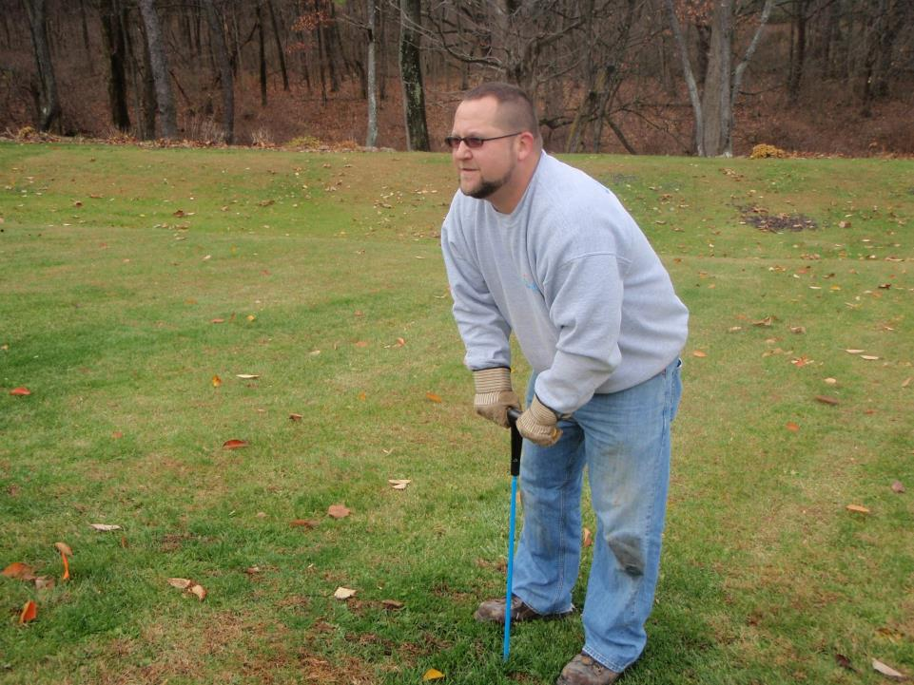

Electrical Hazards - Inspection
Keep Poking….You’ll find that tank yet!!
Issues of electrical fires and failure of UV lights is well documented.
There is also the potential of electric shock from loose wire nuts or exposed conductors.
Notes:
Activity: OSS component locate with steel rod…Electrocution hazard
Instructor can bring discussion on these points:
Unknown wiring inside the property line to outbuildings may present a hazard. Homeowner may be able to provide information, but only if they are home to speak to the service person on site.
Identified power during the locate should be turned off at the source (control box) until the locate is complete.
Awareness, selection of a probe with insulated handle and gloves rated for electrical protection would be better choices.

Slide 84

Electrical Hazards – Inspection
Wiring like this must be protected in closed boxes
There is the potential of electric shock from loose wire nuts or exposed conductors
The hole in the bottom of the junction box is not really there to let water out!
Notes:
Electrical junction boxes for the floats is intended to be waterproof.
It is common (and even a joke often repeated), that you drill a hole in the bottom of the junction box to let the water out (assuming that the system will flood sooner or later).
When properly installed, with proper sized wiring, and lock nuts, they should perform as designed. Alternative installations put the junction box outside of the riser which presents a slightly different set of issues for access for service providers. Lot’s of opinions on “best practice” for installation and subsequent issues.
Proper wire nuts that are designed for harsh and wet environments (including sewer gas) are critical for proper installations. It is not uncommon for service providers to find these with household wire nuts and any variety of electrical tape which are not suitable for the environment and posing a hazard in the future.

Slide 85

Electrical Hazards – Installation – ARC Potential
Typically lasts less than a second
Has extremely high radiant (heat) energy.
Is explosive in nature (exerts great force).
Can ignite or melt conventional work clothing.
Notes:
With a relatively high turnover rate of both installation company employee’s (economy, seasonality), this basic information of a typical power pole configuration is relevant.
The instructor should ask the group what is the minimum standoff distance of equipment from overhead power lines.
The typical answer ranges from 6-8 feet…but the key learning point is that it “depends”. The operator needs to know what the power line wattage. Minimum is 10’ in most residential service applications. Additional distance is required if Kv increases.

Slide 86

Electric field
Notes:
Weather conditions can affect free air voltages (dry, windy)…
Consider it’s affect on stand off distance from power lines.

Slide 87

Electrical Hazards - Ensure Adequate Clearance
Install flag warnings at proper distances
If it is difficult for an operator to see the power lines, designate a spotter
If you cannot maintain adequate clearances, have the power company insulate, move or de-energize the line
Notes:
Instructor should discuss the various methods.
Also discuss the fact that it may take a power company several weeks to de-energize or move a line.
Therefore proper pre-planning is a MUST.

Slide 88

Electrical Hazards - Overhead Powerlines
Notes:
Discuss the work flow procedures on site. If the installation company is receiving a delivery, planning presents a unique opportunity to minimize the electrocution hazard. Typically, these Septic Tank Boom trucks that deliver concrete tanks operate remotely from the ground with the operator behind the truck.
Identify the hazards and PPE: Appropriate PPE (foot wear) for grounding,

Slide 89

Electrical Hazards – Underground Powerlines
Notes:
Instructor should engage participants in a QA if O&M service providers are present.
This scenario presents a unique electrocution hazard. When access for pumper trucks that service OSS have limited line of sight, landscaping and restricted turn radius, it represents a scenario that has happened in our industry.
Temporarily parking in the street and doing a site walk around in these conditions may prevent an accident that will create an electrocution hazard for the operator and or property owner when they come out to ask how you knocked the power out in the house….if its been raining…the restricted area gets larger quickly depending on soil types and saturation levels.
The driver should stay in the vehicle if he suspects an impact with an electrical component and their vehicle and can make a determination of what was just hit.
They would then identify the hazards and PPE, Appropriate PPE (foot wear) for grounding or take appropriate steps to call for assistance.

Slide 90

Electrical Hazards – Underground Powerlines
Industry polls indicate that misidentified locates for utilities approach 25%
Arc Hazards increase and have damaged equipment and put operators at risk.
Stop! Assess the situation before you try to get off the equipment.
Jump clear – when getting off.
Notes:
Either in new or existing construction, this presents a unique electrocution hazard. Excavation activities during construction (new) can present a changing environment. Operators don’t always know if underground utilities have been installed. Temporary power is often established and the operator should have locate information if needed. Doing a site walk around in these conditions may prevent an accident that will create an electrocution hazard for the operator and or other contractor employees onsite….if its been raining…the restricted area gets larger quickly depending on soil types and saturation levels.
Temporary power sources should be inspected prior to work to understand any hazard conditions that exist.
The operator should stay in the vehicle if he can make a determination of what was just hit.
Identify the hazards and PPE: Appropriate PPE (foot wear) for grounding, training and procedures for exiting equipment in a hot zone.

Slide 91
If Contact Occurs
Stay on the machine if possible
Warn all others to stay away
Notify power company immediately
Attempt to move away but assure line is not “connected”
Notes:
Power distribution systems many times have storm trip circuits on them.
These are relays that will trip out for a period of time (Usually 3-30 seconds) to allow a faulted object such as a tree branch to fall away.
These relays will than reset and the line will be re-energized.
This may occur 2-3 times before a breaker actually trips and the power remains out until it is manually reset.

Slide 92

Electrical Damage to the Body
If you touch a power line, electricity will attempt to travel through your body
When electricity travels through the body, it heats up and burns body tissue internally
Electricity leaves the body violently, causing burns or even blowing an exit hole
Notes:
Discuss the devastating injuries these contact accidents create.

Slide 93

Bail Out Procedures
If you must get out, jump with your feet together
Do not touch the machine
Hop or shuffle out of the area
Notes:
Consensus in industry polling suggests that this is a last resort effort to get clear of the hazard. Worker decisions change when they are in a hazardous situation and working in remote locations (common in the OSS industry) and cell phone coverage is inadequate or non-existent. Pre-job activity planning should include hazard communication needs and arrangements for workers safety.

Slide 94
Summary
Since the inception of OSHA .
Workplace Fatalities are down 60% +
Illness and Injury are down 40%
This also considers that the workforce in the U.S. has more than doubled in size!
Notes:
Discuss these steps to provide continuous improvement and the concept of a “virtuous circle” feedback loop for workers and employers to continue to identify workplace hazards, training needs and employer policy and procedures for safe work practices and appropriate PPE selection and use.
These rules are not in place to be a burden on employers, but have used past experience and fatality or serious injury investigation to put in place rules to help the employer and worker remain safe.

Slide 95
Summary
Source: CDC (NIOSH)
Construction represents about 8% of the workforce, but….
Construction accounts for 44% of the occupational fatalities
Notes:
Discuss these steps to provide continuous improvement and the concept of a “virtuous circle” feedback loop for workers and employers to continue to identify workplace hazards, training needs and employer policy and procedures for safe work practices and appropriate PPE selection and use.

Slide 96
Staying Incident Free
Planning
Re-evaluate
Training
PDCA Cycle
Plan
Do
Check
Act
Lessons Learned
Inspection
Oversight
Notes:
Discuss these steps to provide continuous improvement and the concept of a “virtuous circle” feedback loop for workers and employers to continue to identify workplace hazards, training needs and employer policy and procedures for safe work practices and appropriate PPE selection and use in context to risk assessment and mitigation.

Slide 97

Summary
Focus Four Hazards are responsible for the majority of physical, financial, and emotional losses in Onsite — and they exist on nearly every jobsite.
Safety is everyone's responsibility
— ALL of the time.
Post Quiz #2
Notes:
Instructor should reinforce worker responsibility, hazard recognition and employer requirements under the OSH act. Final wrap up should end with answering any additional questions. The Instructor, depending on the use of this resource, and industry or training institution need, could also use this final slide as a participant polling tool to identify any additional exposures or hazards for inclusion into future revisions.

Slide 98

OSHA Susan Harwood Grant
This material was produced under grant number
SH-27631- SH5
From the Occupational Safety and Health Administration, U.S. Department of Labor. It does not necessarily reflect the views or policies of the U.S. Department of Labor, nor does mention of trade names, commercial products, or organizations imply endorsement by the U.S. Government.
Notes:
Recognition slide for grant from OSHA

