Slide 1
Hazard Identification & Control
STRUCK-BY / CAUGHT-BETWEEN
Build a Better Safety Training | Susan Harwood Grant

Slide 2
Disclaimer
This material was produced under grant number SH-27641-SH5 from the Occupational Safety and Health Administration, U.S. Department of Labor. It does not necessarily reflect the views or policies of the U. S. Department of Labor, nor does mention of trade names, commercial products, or organizations imply endorsement by the U. S. Government. The U.S. Government does not warrant or assume any legal liability or responsibility for the accuracy, completeness, or usefulness of any Information, apparatus, product, or process disclosed.

Slide 3
Pre-Test
A short 1-minute pretest on struck-by and caught-between hazards.

Slide 4
Struck-by / Caught-between
AGENDA & OBJECTIVES
Introduction
Discuss Struck-by/Caught-between Hazards
Identify Methods for Controlling Hazards
Review, OSHA (Worker Rights, Employer Responsibilities) Assessment

Slide 5
Part 1.
INTRO ACTIVITY

Slide 6
THINK-PAIR-SHARE
What are examples of struck-by and caught-between hazards?

Slide 7
16% of construction deaths are from struck-by and caught-between accidents.

Slide 8
75% of struck-by deaths involve heavy equipment such as trucks or cranes.

Slide 9
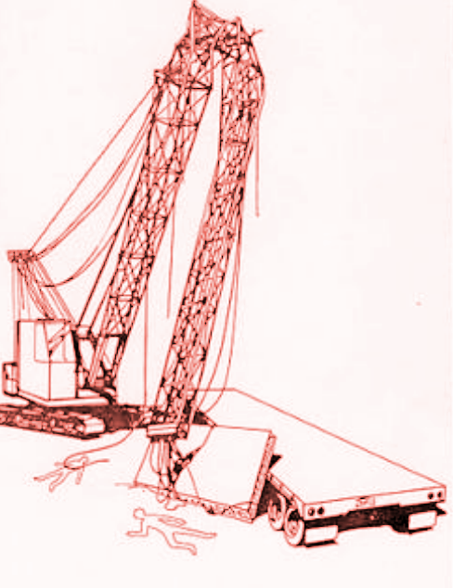
CASE STUDY
2 Workers Die from
Crane Collapse
Crane collapses killing 2 workers on construction site. The boom struck one of the employees on the head, causing instant death. A wire rope struck the other worker, causing internal injuries and death.

Slide 10
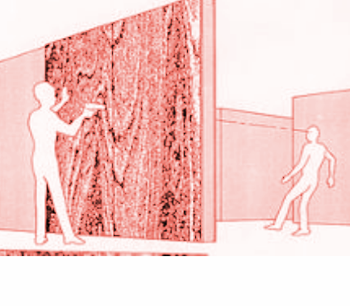
CASE STUDY
Carpenter killed
by flying nail to the head
A carpenter was killed when he was struck in the head by a nail that was fired from a powder actuated tool. The tool operator fired the gun causing the nail to pass through the hollow wall, killing the carpenter instantly.

Slide 11
Part 1.
STRUCK-BY / CAUGHT-BETWEEN

Slide 12
STRUCK-BY
Being struck by an object is one of the most common causes of death in the construction industry. A struck-by accident occurs when a person is forcefully struck by an object, wherein the force of contact is provided by the object.

Slide 13
STRUCK-BY HAZARDS
Flying Objects
When something has been thrown, hurled, or is being propelled across space
Falling Objects
When something falls from an elevation to a lower level
Swinging Objects
When materials are mechanically lifted, they have the potential to swing and strike workers
Rolling Objects
When an object which is rolling, moving, or sliding on the same level at which the worker is located

Slide 14
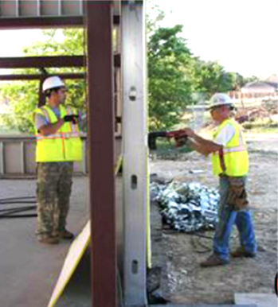
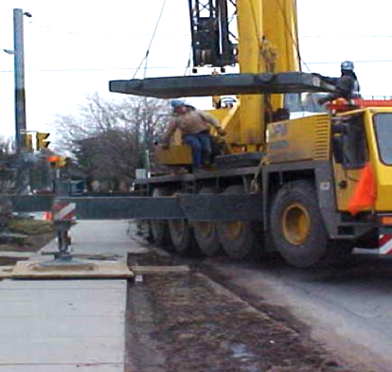
Workers in danger

Slide 15
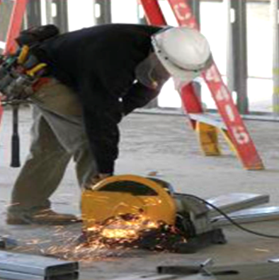
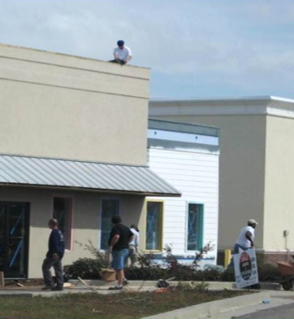
Workers in danger

Slide 16
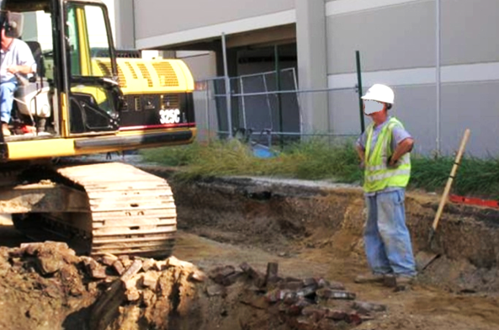
Worker in danger

Slide 17
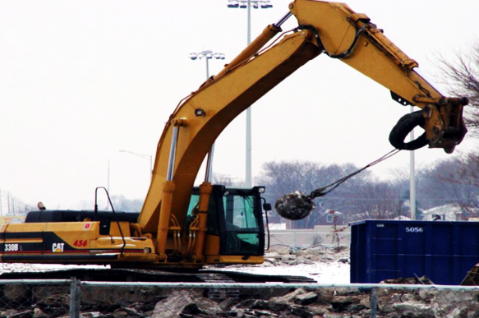
Tractor with a wrecking ball

Slide 18
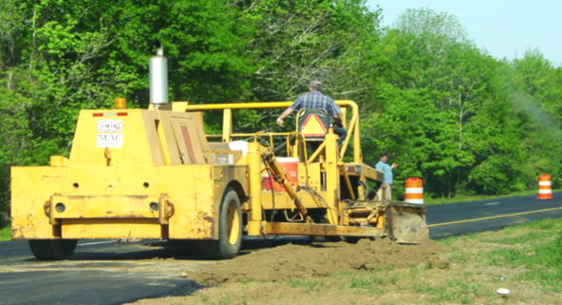
Workers fixing a road

Slide 19
CAUGHT-BETWEEN
Caught-between accidents occur when a person is crushed, pinched, or caught between a moving object and a stationary object, or between two moving objects. These accidents can result in amputated body parts and even death.

Slide 20
Caught-Between HAZARDS
Pinned-in / between
Being compressed or crushed between rolling, sliding, or shifting objects or equipment
Unguarded Parts
Being pulled into or caught in machinery and equipment with unguarded moving parts
Buried-in / Cave-ins
Unprotected excavations and trenches, leading to collapse of walls

Slide 21
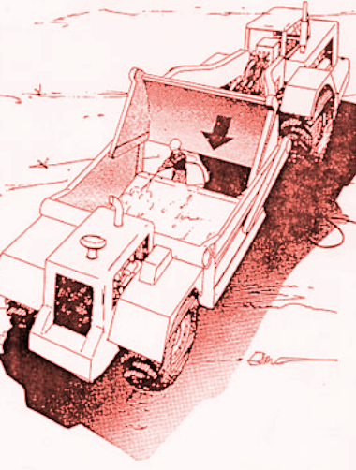
CASE STUDY 1
Worker Cut in Half by Equipment
A worker was cleaning a scraper. The bowl apron had been left in the raised position. The hydraulically controlled apron had not been blocked to prevent it from accidently falling. The apron did fall unexpectedly and the employee was caught between the apron and the cutting edge of the scraper bowl.

Slide 22
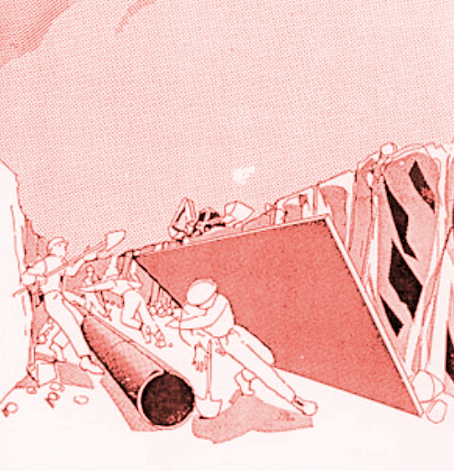
CASE STUDY 2
Worker Crushed by Steel Plate in Excavation
A steel plate used for shoring in a trench falls on and crushed employee. At the time the plate tipped over, a backhoe was being operated adjacent to the excavation.

Slide 23
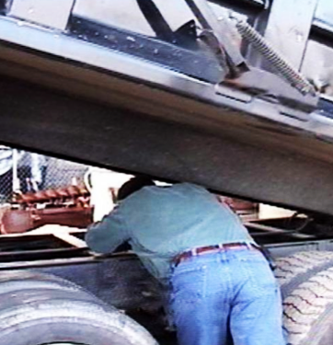
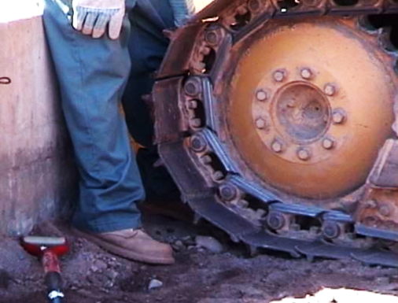
Workers in danger

Slide 24
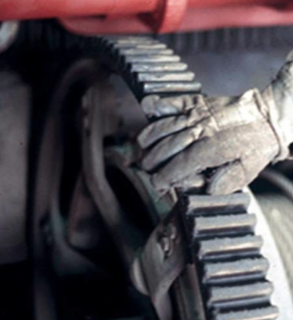
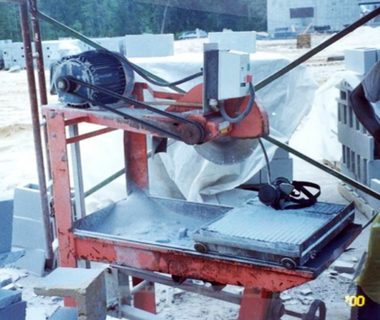
Dangerous equipment

Slide 25
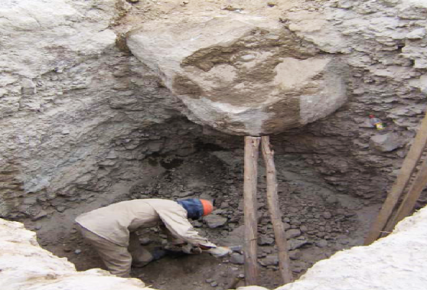
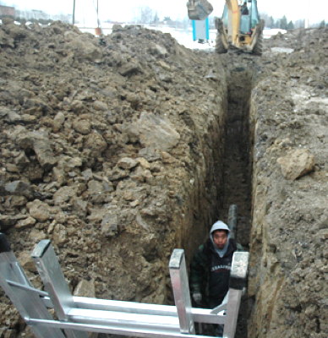
Workers in danger

Slide 26
Part 2.
STRUCK-BY HAZARD CONTROLS

Slide 27
CONTROLLING STRUCK-BY HAZARDS
◼ Job-site planning
◼ Barricades
◼ Safe working equipment
ENGINEERING
CONTROLS
ADMINISTRATIVE CONTROLS & PPE
Safe work practices ◼
Training on hazard recognition ◼
PPE ◼

Slide 28
HEAVY EQUIPMENT

Slide 29
MOTOR VEHICLES

Slide 30
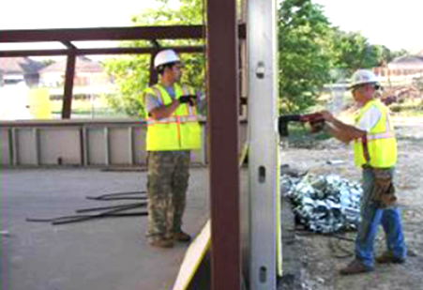
TOOLS

Slide 31
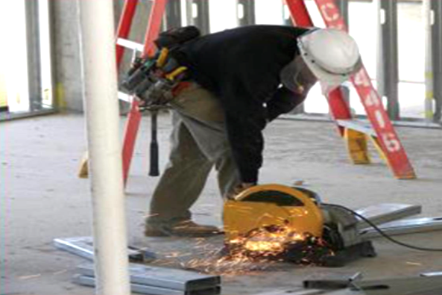
PPE

Slide 32
Part 2.
CAUGHT-BETWEEN HAZARD CONTROLS

Slide 33
CONTROLLING STRUCK-BY HAZARDS
◼ Machine Guarding
◼ Barricades
◼ Trench shielding/sloping
ENGINEERING
CONTROLS
ADMINISTRATIVE CONTROLS
Safe work practices ◼
Training on hazard recognition ◼
PPE ◼

Slide 34
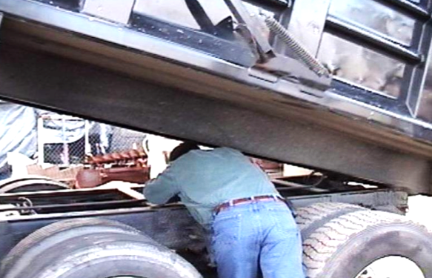
Worker in danger
GUARDS & BLOCKING

Slide 35
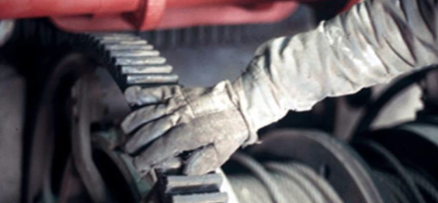
GUARDS & BLOCKING

Slide 36
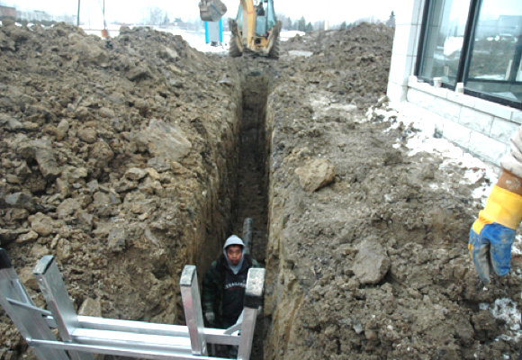
TRENCH PROTECTION

Slide 37
5-MINUTE ACTIVITY
In your groups review the video, then discuss how to prevent the accident.

Slide 38
Video 1
In your groups review the video, then discuss how to prevent the accident.

Slide 39
Video 2
In your groups review the video, then discuss how to prevent the accident.

Slide 40
Part 4.
REVIEW & OSHA RIGHTS

Slide 41
Struck-by / Caught-between
REVIEW OBJECTIVES
What are struck-by and caught-between hazards?
How can struck-by hazards be controlled?
How can caught-between hazards be controlled?

Slide 42
Next Steps
OSHA RIGHTS
Under OSHA, workers have these (and other) rights:
To be provided with safe and healthful workplaces
To be provided PPE free of charge, safety training on use of PPE and workplace hazards, all in a language you can understand
To file a complaint to have OSHA inspect their workplace
To not be retaliated against for exercising their rights under the law

Slide 43
Post-Test
A short 1-minute post-test on struck-by and caught-between hazards and controls

Slide 44
Hazard Identification & Control
STRUCK-BY / CAUGHT-BETWEEN
Build a Better Safety Training | Susan Harwood Grant

