Slide 1
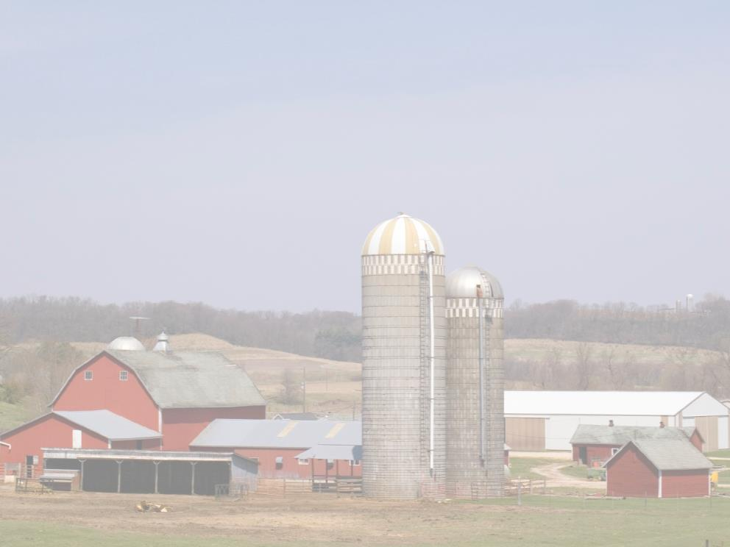
Youth Grain Safety
This material was produced under a grant (SH-27642-SH5) from the Occupational Safety and Health Administration, U.S. Department of Labor. It does not necessarily reflect the views or policies of the U.S. Department of Labor, nor does the mention of trade names, commercial products, or organization imply endorsement by the U.S. Government.

Slide 2
Program Objectives
At the conclusion of this presentation, participants will:
Be able to identify hazards associated with confined space work in the grain industry
Understand the process for confined space entry and lock out procedures
Know where to look for OSHA references and resources related to confined space entry in the grain industry

Slide 3
Statistics: Involvement in Farming in the U.S.
2.1 Million farmers
2% of the population
Reference: http://www.epa.gov/oecaagct/ag101/demographics.html
Notes:
5
Here in the US it include about 2% of the population and we are seeing a shift from the family farm to larger production units.
The spouse is working off the farm to bring revenue and insurance back to the farm.
Reference: http://www.epa.gov/oecaagct/ag101/demographics.html

Slide 4
Statistics of Injury/Mortality: U.S.
70,000 Disabling Injuries
568 Fatalities (2014)
24.9 deaths per 100,000 workers
Notes:
7
This data is nationwide for Agriculture
24.9 deaths per 100,000 workers for Agriculture
2014 CFOI-BLS

Slide 5
What is a Confined Space?
It is a space that:
Is large enough and so configured that an employee can enter and perform work;
Has limited or restricted means of entry and exit;
Is not designed for continuous human occupancy
Notes:
From the OSHA General Industry Standard 29 CFR 1910.146(b) definitions

Slide 6

Permit Required Confined Space OSHA Definition
A Permit-Required Confined Space – has one or more of the following:
Contains or has the potential to contain a hazardous atmosphere
Contains a material with the potential to engulf someone
Has an internal configuration that might cause an entrant to be trapped or asphyxiated by inwardly converging walls or by a floor that slopes downward and tapers to a smaller cross section
Contains any other recognized serious safety or health concerns
Notes:
Instructor Notes:
The definition for a “permit-required confined space” is more descriptive and specifically addresses the hazards that may be present such as toxic atmospheres and engulfment hazards. This definition is drawn from 29 CFR 1910.146(b) definitions (OSHA Confined Space Entry Standard).
What is meant by “permit-required”? It is the need for a written permit to be issued by the employer or management to the worker prior to accessing the space. Not all “confined spaces” are “permit-required confined spaces”.
Specialized training is required by OSHA regulations to enter a “permit-required confined space”, therefore, it is unlikely that a young or new worker will be assigned tasks inside this type of work space. Even if they volunteer, such entry is forbidden without proper training and appropriate supervision.
Participants should know that entering a “permit-required confined space” without a permit or proper authorization and procedures in place is illegal under the OSHA workplace safety and health regulations. In most commercial grain storage and handling operations, there are also safety policies in place regarding access to confined spaces. Violating this rules can result in disciplinary action or even being fired.
Used with permission from Purdue University, Susan Harwood grant SH23575SH3

Slide 7
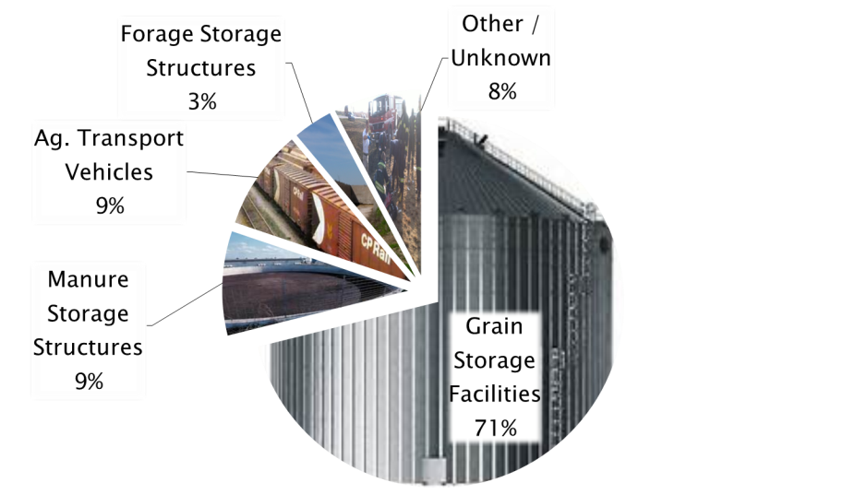
Why Focus on Grain Storage and Handling Facilities?
Notes:
Instructor Notes:
As already noted, over 1,700 incidents involving agricultural confined spaces have been documented. The actual number, due to incomplete reporting, is much higher. These cases primarily involved flowing agricultural material, manure storage and handling facilities, agricultural transport vehicles, such as grain wagons, and forage storage structures such as silos.
The data presented clearly indicate why so much attention is currently being given to grain storage and handling operations and why the focus of this curriculum is the effects of grain-related incidents on youth.
Notice that the vast majority of the documented cases, over 1,100, occur in grain storage, handling and processing facilities. The second most frequent type of incident involved manure storage structures and agriculture transport vehicles with each representing about 130 cases. There were also about 100 cases in which the site of the incident was unknown.
The remaining part of the presentation will focus on grain storage and handling facilities since they represent the vast majority of incidents. It will also cover grain transport vehicles since these incidents primarily involve children and youth.
Used with permission from Purdue University, Susan Harwood grant SH23575SH3

Slide 8
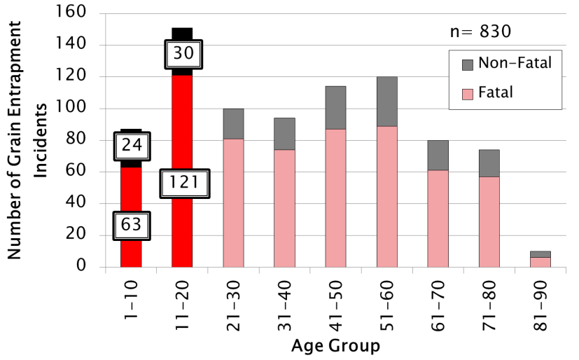
Age distribution of documented grain entrapments
Notes:
Instructor Notes:
In this graph all documented grain entrapment incidents with a known age group are summarized. Along the left side is the number of cases recorded and along the bottom are the age groups of the victims.
The red/pink bars represent all the fatal incidents recorded, while the black/grey bars represent the non-fatal incidents.
Notice that the age group 11-20 represent the largest segment of injuries and fatalities. Nearly one out of five incidents involve a child or youth under the age of 21.
Again, the goal here is not the numbers, but rather to communicate that participants in this class have a higher risk of injury or death than any other age group.
Used with permission from Purdue University, Susan Harwood grant SH23575SH3

Slide 9
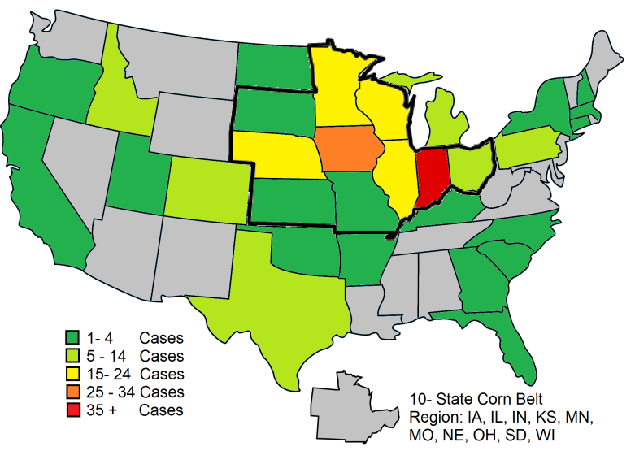
Distribution of Grain Entrapment Incidents By State for Age Group 1-20.
Notes:
Instructor Notes:
The majority of incidents involving those under the age of 21 occur in the Cornbelt. The states with the most documented cases over the past 40 years are:
Indiana
Iowa
Illinois
Nebraska
Minnesota
Wisconsin
Ask students why these six states account for most of the documented incidents. What do they have in common? They are all major corn producing states.
It should be noted that Indiana has more cases than any other state because Purdue University has been monitoring these incidents for over 40 years. If the other states had made similar efforts, it would be projected that states such as Iowa and Illinois would have had greater numbers of incidents because they produce more grain. Purdue has estimated that the number of documented incidents should be at least 30% higher if all incidents had been reported.
Used with permission from Purdue University, Susan Harwood grant SH23575SH3

Slide 10
Most Frequent Types of Flowing Grain/Feed Entrapments
Most Frequent Types of Flowing Grain/Feed Entrapments
Entrapment in a free flowing column of grain
Bridging/crusted horizontal surface entrapment
Collapse of vertically crusted grain surface (avalanche entrapment)
Entrapment in free standing pile of material (avalanche entrapment)
Entrapment in grain transport vehicle
Entrapment while using a grain vacuum machine
Entrapment due to unintended release of material or structural failure
Notes:
Instructor Notes: Used with permission from Purdue University, Susan Harwood grant SH23575SH3

Slide 11
1. Flowing Grain
1. Flowing Grain!
Notes:
Becoming entrapped in a free flowing column of grain or feed in the center of a grain bin is the most frequently documented cause of grain entrapment. A worker enters the bin, usually alone, in an attempt to break up crusted grain, unplug the well or remove residual grain from the walls and become drawn into the flowing grain. The grain flow towards the center of the bin and quickly pulls the victim beneath the surface until the victim comes to rest directly over the opening in the floor.
This type of flow is referred to as funnel flow.
The speed of the grain flow is determined by the capacity of the unloading system. An unload capacity of 1000-1500 bushels per hour can entrap and engulf a 200 pound man in just a few seconds.
The typical process of entrapment is generally as follows:
individual enters bin during unloading process to clear a plugged outlet or walk down the grain
as the bin empties, a rapidly moving column of grain forms over the floor outlet
the victim is drawn toward the center of the bin by flowing surface of the grain
central vertical column of grain acts somewhat like a fluid
the central column of grain flows at nearly the rate of the unloading auger
flow rate at top of a bin is so great that once a person is trapped in flow, escape is impossible
the victim is pulled to the floor directly over the outlet often plugging flow
The most immediate action needed in these cases is to stop the flow of grain at the outlet, before the victim is fully engulfed.
Entering a grain bin while the unloading equipment is operating is so hazardous it is illegal under the provisions of CFR 1910.272, the OSHA Grain Handling Standard.

Slide 12
1. Flowing Grain continued
1. Flowing Grain!
Notes:
The victim being the heaviest object in the bin sinks to the middle following the path of the grain to the auger. Slide is used with permission of GSI INC

Slide 13
2. Crusted Grain
2. Crusted Grain!
Notes:
These slide represent engulfment by crusted grain, where the grain is crusted at the top but fed out from the bottom of the bin. Slide is used with permission of GSI INC
The victim enters a bin in which the grain has become caked because of spoilage. It can form a hard crusted surface over the top of the grain mass that can appear to support the weight of the victim.
The surface, though appearing solid, can, in fact, be a thin crust concealing a void that has formed as grain was withdrawn from the bottom of the bin
Victim breaks through the crust and is quickly covered by the avalanche of grain into the cavity
Often the unloading equipment is still operating, which causes the victim to be pulled deeper into the grain
The victim is generally found directly over the outlet in the floor of the bin

Slide 14
2. Crusted Grain Continued
2. Crusted Grain!
Notes:
The victim walked across the crusted or bridged grain and it collapses upon them engulfing them. Slide is used with permission of GSI INC
The victim may have injuries from the fall, they are trapped, and when rescue makes entry they may drop more crusted grain on top of the victim.

Slide 15
3. Grain Avalanche
3. Grain Avalanche!
Notes:
Grain avalanche is the third way a victim can become entrapped by being inside the bin trying to loose the grain from the side of the bin. Slide is used with permission of GSI INC
Vertically crusted grain or grain that is free standing due to spoilage can break free and avalanche down on workers at its base. Grain that sticks to the inside of the bin walls is also considered vertically crusted grain.
Dry grain in good condition will pile at a 25-30 degree angle, but spoiled or caked grain can stand almost vertical.
When grain is removed from base of a caked mass, the potential for avalanche and engulfment increases.
This type of engulfment can take place inside bins where spoiled grain is clinging to walls.
Attempting to remove these chunks of grain by standing on the floor of the bin using a long pole can be extremely dangerous due to the avalanche effects of the grain when it breaks free of the wall.
No worker or first responder should ever enter a grain storage structure with overhanging grain stuck to the bin walls.
Falling chunks of crusted grain from off the walls of a bin or silo can cause crushing injuries to those underneath.

Slide 16
3. Grain Avalanche Continued
3. Grain Avalanche!
Notes:
When they loosen the out of condition grain it collapses upon them engulfing the victim. Slide is used with permission of GSI INC

Slide 17
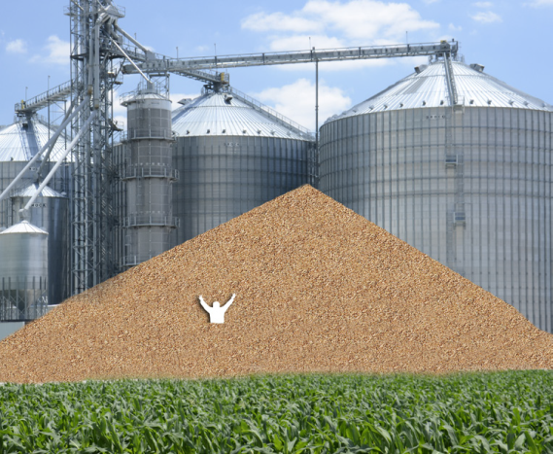
4. Entrapment in Free-Standing Pile of Grain
Notes:
Instructor Notes:
Entrapments and engulfment's in free standing piles of grain are rare, but have been some of the most difficult rescues to carry out due to the substantial amount of grain involved.
Walking on the surface of a free standing pile of grain can cause an avalanche of grain from above that is impossible to stop until it reaches its natural angle of repose.
Entrapments and engulfment's of this type are more common inside of large storage structures where residual grain can stand 10-20’ high along the walls. A worker at the base of the pile can become entrapped if something triggers a flow of grain towards the center of the structure. Once started this surface flow of grain is almost impossible to stop until the pile reaches it’s angle of repose.
Used with permission from Purdue University, Susan Harwood grant SH23575SH3

Slide 18
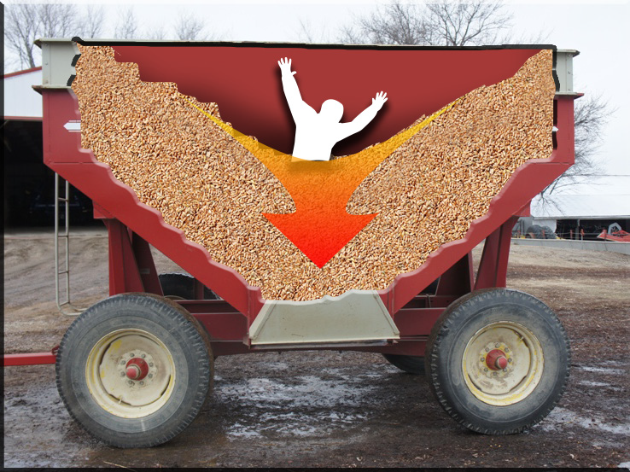
5. Entrapment in Grain Transport Vehicles
Notes:
Instructor Notes:
Review the following characteristics of entrapments in grain transport vehicles.
The risk of engulfment is present around any grain transport vehicles such as wagons, trucks, rail cars, and hopper wagons.
High-volume unloading capacity of modern grain handling equipment can bury someone in a vehicle in seconds. No one should be allowed to be transported inside any grain transport vehicle.
It’s not difficult to imagine someone being covered in seconds during an unloading process from a combine that can unload a 300 bushel hopper in less than 2 minutes.
Most victims of this type of suffocation, historically, have been children, nearly all boys with an average age of 11.
Most of these incidents are fatal due to the victim becoming wedged into the opening at the bottom of the vehicle.
In a few cases, unbalanced grain transport vehicles have flipped over on victims resulting in engulfment and suffocation. This type of incident has also occurred when grain became crusted in the vehicle causing the vehicle to become unbalanced when unloaded unevenly.
Used with permission from Purdue University, Susan Harwood grant SH23575SH3

Slide 19
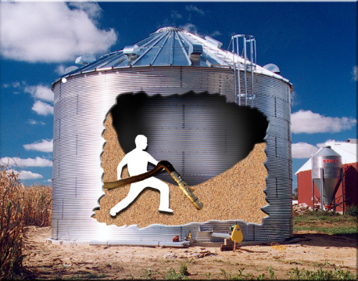
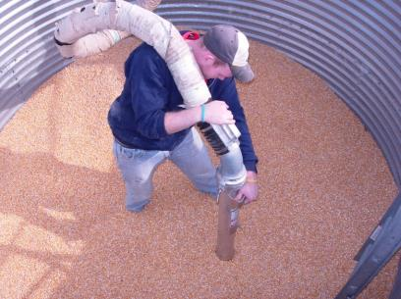
6. Entrapment While Using Grain Vacuum Machines
Notes:
Instructor Notes:
As alternative methods are being considered to remove residual grain from storage structures, the use of grain vacuum machines has increased. These machines are able to “suck up” grain at very high volumes (1000-2000 bushels per hour). If the operator places the inlet at his feet, the unit can literally suck the grain from beneath the victim causing him to be rapidly drawn into the grain.
These incidents are rare but increasing in frequency
More commonly found at commercial grain facilities
Involve the operator standing on the grain surface which is clearly discouraged by grain vacuum machine manufacturers
Entrapment can occur in seconds
Use of grain vacuums can generate substantial dust and noise
Reading and responding to a text message while the grain vacuum is in operation can be dangerous
The use of grain vacuum machines will be discussed in the hands-on portion of the class as an important rescue tool to remove grain from around an entrapped victim. Care should be taken during use of grain vacuum machines at rescue scenes to avoid secondary entrapment.
Used with permission from Purdue University, Susan Harwood grant SH23575SH3

Slide 20
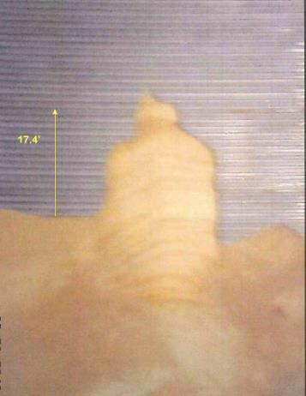
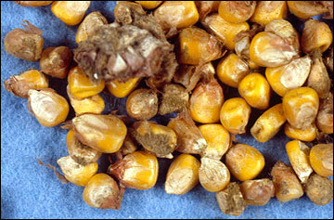
The Single Most Important Contributing Factors to Grain Entrapment is Out-of-Condition Corn
Notes:
Instructor Notes:
Excessive moisture in stored agricultural crops can lead to spoilage, crusting, bridging and free standing grain. This can also be caused by extensive insect infestation. The presence of any bridging, crusting, or free standing grain should be a clear warning of an extreme hazard to first responders.
Maintaining the proper moisture content in stored grain and feed is a significant step in reducing the risk of entrapment or engulfment. This is, however, outside the control of first responders.
Most grain in long term storage should be dried to no more than 14-15% moisture. Higher moisture levels will lead to rapid spoilage or out-of-condition grain due to biological decomposition. This is especially true at higher ambient temperatures. This out-of-condition grain will begin to crust or form chunks of grain that can be free standing or stick to the walls of the storage structure. It is these conditions that often led previous entrapment victims to enter the structure to remove crusted material from the walls or to break up chunks of grain plugging the outlet.
Ask participants what other hazards may be present when grain or feed goes out-of-condition. Moldy grain can generate billions of mold spores that can lead to allergic reactions and respiratory distress. Airborne dust can be a significant risk to first responders.
Used with permission from Purdue University, Susan Harwood grant SH23575SH3

Slide 21
Relevant Federal OSHA Standards
29 CFR 1910.146 – Permit-required confined space standard
Exempts agriculture
29 CFR 1910.272 – Grain handling standard
Covers all commercial grain storage and handling operations
Original focus on preventing grain dust explosions
Exempts farms, feedlots, and seed processing operations
Notes:
Instructor Notes:
Participants in this training are at an age that makes understanding or interpreting federal workplace safety and health rules almost impossible. In most cases they have difficulty even seeing the value or relevance of the rules.
What should be communicated to them in this training is that the OSHA Standards are not suggestions or just good work practices, but, in fact, are the law for the commercial grain industry and other industrial settings with confined spaces. Failure to comply with these laws can lead to being dismissed from the job, citations, fines, and in rare cases criminal charges, as well as injury and/or death.
One of the values of this training is that participants are getting a jump start on what will be expected of them if they go to work at a facility that must comply with the OSHA Standards, especially those related to confined spaces.
Time does not allow review of all the provisions of either 29 CFR 1910.146 or 29 CFR 1010.272 which are most relevant to the confined spaces and grain storage and handling facilities found in agricultural workplaces. Encourage participants to review the two standards at www.osha.gov.
Please note that this training does not qualify you to enter confined spaces.
Used with permission from Purdue University, Susan Harwood grant SH23575SH3

Slide 22
Agriculture Exemption
Enforcement Guidance for Small Farming Operations
The Appropriations Act exempts small farming operations from enforcement of all rules, regulations, standards or orders under the Occupational Safety and Health Act. A farming operation is exempt from all OSHA activities if it:
Employs 10 or fewer employees currently and at all times during the last 12 months; and
Has not had an active temporary labor camp during the proceeding 12 months.
Note: Family members of farm employers are not counted when determining the number of employees.
Important to check with your state OSHA since there are 22 states that match or exceed this OSHA Instruction
Source: OSHA Instruction CPL 02-00-051
Notes:
Agricultural Exemption - Appropriations Act
Enforcement Guidance for Small Farming Operations. The Appropriations Act exempts small farming operations from enforcement of all rules, regulations, standards or orders under the Occupational Safety and Health Act. A farming operation is exempt from all OSHA activities if it: Employs 10 or fewer employees currently and at all times during the last 12 months; and Has not had an active temporary labor camp during the proceeding 12 months.
Note: Family members of farm employers are not counted when determining the number of employees.
Important to check with your state OSHA since there are 22 states that match or exceed this OSHA Instruction
Consider giving an example from a state – California is typically more stringent
Source: OSHA Instruction CPL 02-00-051
**Note: Twenty-six states, Puerto Rico, and the Virgin Islands have OSHA-approved State Plans. Twenty-two State Plans (21 states and one U.S. territory) cover both private and state and local government workplaces. The remaining six State Plans (five states and one U.S. territory) cover state and local government workers only.

Slide 23
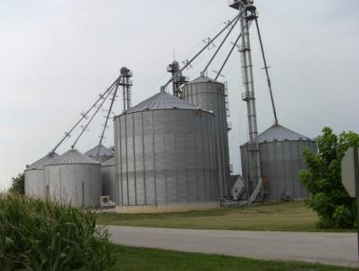
Exempt Facilities
The OSHA Grain Handling Standard (1910.272) currently exempts from compliance certain farming operations:
Farms with 10 or fewer employed
Feedlots
Operations that prepare seeds for future crops
The OSHA Permit-required Confined Spaces Standard (1910.146) generally exempts agricultural operations that:
Grow or harvest crops
Raise livestock or poultry
Notes:
Instructor Notes:
There has been considerable confusion regarding the application of OSHA standards to grain storage and handling facilities. The two most relevant standards, 29 CFR 1910.272 Grain Handling Standard and 29 CFR 1910.146 Permit-required Confined Space Standard, are not universally applicable to all grain facilities due to exemption provisions included in the standards. The reasons why these exemptions exist are complex and include political pressure placed by special interest groups on legislators when the standards were drafted and the potential cost of bringing existing facilities into compliance. In some cases, these exemptions don’t make sense. For example, a 100,000 bushel bin at a commercial, OSHA non-exempt, storage operation that employs any number of employees must comply with the provisions of CFR 1910.146 and CFR 1910.272, while a grain facility with the capacity of 500,000 bushels, and several employees across the highway from the first, but classified as a farm or feedlot that does not buy or sell grain, is exempt from compliance with the OSHA workplace grain handling standards. Whether or not the rules make sense is immaterial.
It should be noted that many incidents, especially non-fatal, at exempt facilities go unreported since there are no reporting requirements for these facilities.
Although the facilities may be exempt, OSHA encourages employers to comply with the standards. OSHA standards are minimal requirements.
Used with permission from Purdue University, Susan Harwood grant SH23575SH3

Slide 24
Non-Exempt Facilities Must Have
Confined space entry program and permit system
Appropriate confined space entry equipment
Lifeline and harnesses
Air monitoring equipment
Communication system
Emergency action plan
Documented training
Incident reporting policies in place
Notes:
Instructor Notes:
Again, non-exempt facilities under current OSHA standards includes almost all commercial grain storage and handling operations regardless of size.
Confined space entry permits, in most cases, must be filled out by trained entry employees and filed with the employer or management prior to entering the space.
Prior training is required to use lifeline, body harnesses, certain personal protective equipment, and retrieval equipment.
Air monitoring must include at a minimum an oxygen monitor and calibrated before each use.
Communications equipment must be tested at that facility at least annually and documented.
Emergency Action Plans must be communicated to employees, reviewed and updated regularly and include procedures for the facility operators and local responders.
Training must be documented and on file along with a training roster. In many cases, employees will need to sign up a register confirming that they have participated in the training.
Non-exempt operations are required to report to OSHA workplace injuries or incidents involving a fatality and 1 or more multiple workers admitted to the hospital. This is why there are such a high percentage of documented events at non-exempt facilities as compared to exempt farms.
Used with permission from Purdue University, Susan Harwood grant SH23575SH3

Slide 25
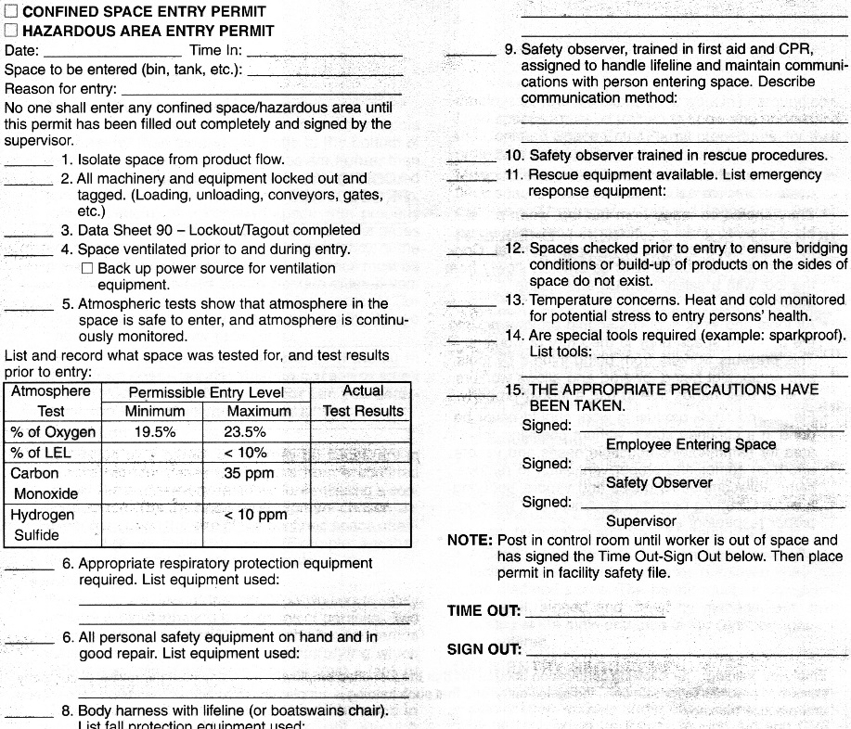
Permit-Required Confined Space Entry Procedure
Isolate the space
Ventilate the space
Test the atmosphere
Select PPE
Conduct Pre-Entry Briefing
Complete permit
Enter the space
Notes:
Per the OSHA Standard 1910.146

Slide 26

You Have the Right to Say NO!
As a young and beginning worker you have the right to:
Refuse to perform tasks that you are not trained or equipped to perform safely – without retaliation
Receive information and training about the hazards you are exposed to in the work place
Have access to and training regarding emergency action plans
Notes:
Instructor Notes:
Throughout these training materials, students will be reminded of their rights to safe working conditions. They need to be encouraged to speak up if they are uncomfortable about performing unfamiliar tasks that they believe or know pose a risk of serious harm.
Refusal to do work is conditional – see the OSHA link: https://www.osha.gov/right-to-refuse.html. At the link you will find:
Workers' Right to Refuse Dangerous Work
If you believe working conditions are unsafe or unhealthful, we recommend that you bring the conditions to your employer's attention, if possible.
You may file a complaint with OSHA concerning a hazardous working condition at any time. However, you should not leave the worksite merely because you have filed a complaint. If the condition clearly presents a risk of death or serious physical harm, there is not sufficient time for OSHA to inspect, and, where possible, you have brought the condition to the attention of your employer, you may have a legal right to refuse to work in a situation in which you would be exposed to the hazard. (OSHA cannot enforce union contracts that give employees the right to refuse to work.)
Your right to refuse to do a task is protected if all of the following conditions are met:
Where possible, you have asked the employer to eliminate the danger, and the employer failed to do so; and
You refused to work in "good faith." This means that you must genuinely believe that an imminent danger exists; and
A reasonable person would agree that there is a real danger of death or serious injury; and
There isn't enough time, due to the urgency of the hazard, to get it corrected through regular enforcement channels, such as requesting an OSHA inspection.
You should take the following steps:
Ask your employer to correct the hazard, or to assign other work;
Tell your employer that you won't perform the work unless and until the hazard is corrected; and
Remain at the worksite until ordered to leave by your employer.
If your employer retaliates against you for refusing to perform the dangerous work, contact OSHA immediately. Complaints of retaliation must be made to OSHA within 30 days of the alleged reprisal. To contact OSHA call 1-800-321-OSHA (6742) and ask to be connected to your closest area office. No form is required to file a discrimination complaint, but you must call OSHA.
This does not mean that they can pick and chose what their employer assigns to them, but rather have the judgment/maturity to ask questions and raise concerns about tasks they see as potentially dangerous.
Used with permission from Purdue University, Susan Harwood grant SH23575SH3

Slide 27







Personal Protective Equipment
Hard Hats
Eye Protection
Hearing Protection
Respirator
Protective Coveralls
Gloves
Footwear
Safety Harness
Once all the hazards are identified, the space has been ventilated and the atmosphere checked, determine what personal protective equipment will be necessary.

Slide 28

Personal Protective Equipment
Each entrant shall use a chest or full body harness or a boatswain’s chair, with a retrieval line attached to assist in removal.
Exception – Where the employer can demonstrate that the protection required is not feasible or creates a greater hazard, the employer shall provide an alternative means of protection which is demonstrated to prevent the employee from sinking further than waist-deep in the grain.
Notes:
Picture is from the National Education Center for Agricultural Safety. Permission given to use photo

Slide 29



Communication Equipment
Notes:
Instructor Notes:
Every worker in and around a grain storage and handling facility should be able to communicate with co-workers, especially in the event of an emergency. They also help make workers more efficient.
No one should ever enter any confined space in an emergency situation without the ability to communicate or be directly observed by an attendant outside the structure.
In some cases, standard wireless communication devices have been found to not function inside a steel storage bin.
Used with permission from Purdue University, Susan Harwood grant SH23575SH3

Slide 30

Gas Monitors
Visual and audible alarms
Specific detector heads may be incorporated based on your hazards
This one detects:
Oxygen content
Percent LEL
Carbon monoxide
Hydrogen sulfide
Notes:
Young workers should be trained in the operation and technical issues of the air gas monitor.
Please note that all gas monitors have the sensor for oxygen and LEL, the sensors for specific gases is what differs on the instruments.
Photo permission by RKI.
Mike Johnson
Marketing Manager
(510) 441-5656 | (800) 754-5165
Gas Detection for Life

Slide 31

Gas Monitors
Read oxygen level first to verify correct level between 19.5 percent to 23.5 percent or reading for LEL will be incorrect for the challenge gas/vapor
Notes:
No instrument is truly instantaneous- Some respond in 5 to 10 seconds, others require 30-60 seconds. Read the owners manual for the exact response time. Discuss importance of calibrating the gas monitor.
Photo permission by RKI.
Mike Johnson
Marketing Manager
(510) 441-5656 | (800) 754-5165
Gas Detection for Life

Slide 32
Air quality
Always test the air at different levels of the structure to make sure it is safe. The air might be clear at the top and deadly at the bottom.
GOOD AIR
BAD AIR
DEADLY AIR
Notes:
Picture is from the National Education Center for Agricultural Safety. Permission given to use photo

Slide 33
Lockout/Tagout
OSHA Regulation 29 CFR 1910.147
“Lockout” To physically insure that all mechanical or electrical systems, that can be energized or started up, or release stored energy, are secured, isolated, disabled, or rendered inoperative.
“Tagout” The placement of a device to indicate that the energy isolating device and the equipment being controlled may not be operated until the tagout device is removed.
Notes:
This is the OSHA regulations to Lock out Tag out
OSHA Regulation 29 CFR 1910.147
Every young and beginning worker in the grain industry needs to become aware of the importance of “Lockout/Tagout” procedures. Failure to use these procedures can lead to entrapment, engulfment, asphyxiation, entanglement, and electrocution during grain storage and handling operations.
The basic principle behind Lockout/Tagout procedures is the prevention of intentional or unintentional start up of any equipment of process while a worker is exposed to it. This is accomplished by use of individually keyed locks and signage that alerts co-workers that someone is exposed to the equipment or process and prevents him or her from energizing the equipment or starting up a process such as grain flow.
For example, a Lockout/Tagout procedure should be used anytime a worker enters a grain bin or attempts to unplug an inflow auger. This practice will prevent a co-worker arriving on the scene and energizing the unloading system exposing the worker inside the bin, and not visible, to be exposed to the energized equipment.

Slide 34
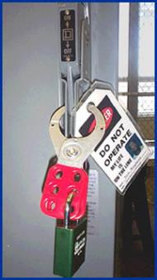
General Requirements
All mechanical, electrical, hydraulic and pneumatic energy which presents a danger to employees inside of the storage structures shall be de-energized and shall be disconnected, locked-out and tagged, blocked off, or otherwise prevented from operating from other equally effective means or methods.
Notes:
272
This would prevent the movement of manure
Picture from OSHA Lockout/Tagout ttps://www.osha.gov/dts/osta/lototraining/hottopics/ht-relche-1-4.html

Slide 35
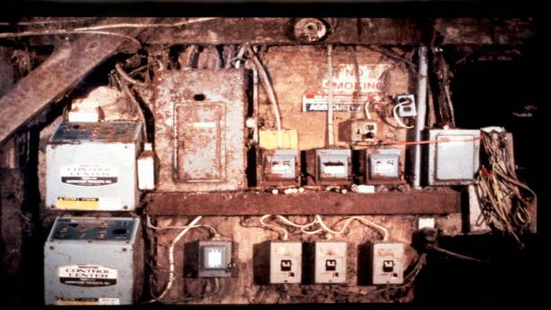

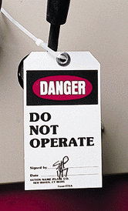
Lockout/Tagout. Where? How?
Lockout / Tagout
Where? How?
Notes:
Most farm electrical systems are not what you would call up to code. You may have to shut off power to the farm to be sure the pit is off.
OSHA Regulation 29 CFR 1910.147

Slide 36
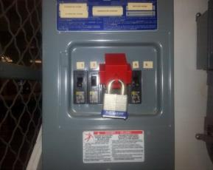
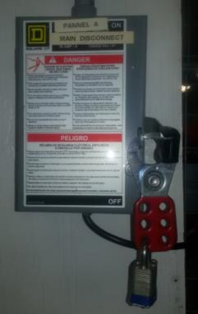
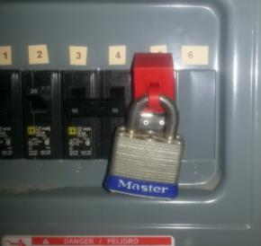
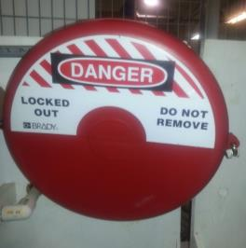
Electrical & Valves Lockout/Tagout
Electrical & Valves Lockout /Tagout
Notes:
Picture is from the National Education Center for Agricultural Safety. Permission given to use photo.
Every young and beginning worker in the grain industry needs to become aware of the importance of “Lockout/Tagout” procedures. Failure to use these procedures can lead to entrapment, engulfment, asphyxiation, entanglement, and electrocution during grain storage and handling operations.
The basic principle behind Lockout/Tagout procedures is the prevention of intentional or unintentional start up of any equipment of process while a worker is exposed to it. This is accomplished by use of individually keyed locks and signage that alerts co-workers that someone is exposed to the equipment or process and prevents him or her from energizing the equipment or starting up a process such as grain flow.
For example, a Lockout/Tagout procedure should be used anytime a worker enters a grain bin or attempts to unplug an inflow auger. This practice will prevent a co-worker arriving on the scene and energizing the unloading system exposing the worker inside the bin, and not visible, to be exposed to the energized equipment.
Having a Lockout/Tagout kit available for examination would be helpful.

Slide 37



Emergency & First-Response Preparation Include:
Posted emergency action plan
Employee training on emergency action plans
Appropriate placement of telephones, & radios
Posting of emergency phone numbers by each phone
Address and directions for finding all worksites
Pre-determined meeting place following an incident
Notes:
Instructor Notes:
Every employer involved in operating potentially hazardous equipment or facilities such as grain storage and handling operations or other types of agricultural confined spaces should have given consideration to preparing for the potential for emergencies. In fact, at non-exempt grain storage and handling facilities this measure is required under the OSHA rules. Preparation is a key component of emergency management. Trying to locate a phone number or identifying who should be called during an emergency can result in wasted time and greater potential for a minor incident becoming a much more serious one.
Key preparation measures should include:
Posting of an approved emergency action plan for the most probable types of emergencies.
Employee training on the site’s emergency action plan. (This may be required annually.)
Appropriate placement of telephones or other communication devices such as radios or cell phones. (Remember, some devices such as cell phones may not work inside of an agricultural confined space.)
Posting of emergency phone numbers by each phone or having emergency phone numbers preprogrammed into personal cell phones. (Remember, 911 may not be available in rural communities.)
Having the address and directions to each worksite posted by each phone. In many cases, callers will forget how to get to a specific site or give an incorrect address due to the confusion caused by an emergency situation.
Identification of a pre-determined meeting place where all employees can meet following an emergency situation. Young and beginning workers have been known to leave the site after an incident resulting in them being listed as missing. This can lead to unnecessary search and rescue efforts.
Used with permission from Purdue University, Susan Harwood grant SH23575SH3

Slide 38
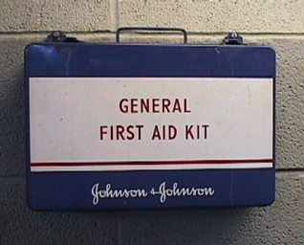
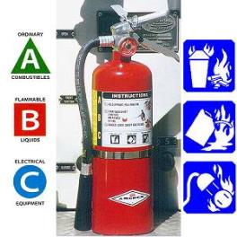
Emergency & First-Response Preparation Should Also Include:
Emergency warning system
Access to first-aid kit and eye wash stations
Appropriate placement of properly rated fire extinguishers
Labeled circuit breaker boxes and utility shut offs
Training of staff in first-aid and emergency specific types of response
Access to specialized emergency response protective equipment
Notes:
Instructor Notes:
Emergency and first-response preparation should include other measures designed to mitigate or reduce the impact of an emergency situation. Most of these steps are low cost and take little time to implement. Young and beginning workers should become familiar with all the emergency preparation measures that have been taken in the worksite. Encourage participants to speak up and ask for information and training on what has been done to enhance emergency preparedness. Other measures that most workplaces will have in place include:
Emergency warning system such as a horn or siren to alert employees in the event of an emergency
Access to first-aid kit and eye wash stations
Appropriate placement of properly rated fire extinguishers
Labeled circuit breaker boxes and utilize shut offs. This should include both electrical and gas shut off
Training of staff in first-aid and specific types of emergency response
Access to specialized emergency response protective equipment for the hazards found in the workplace
In an increasing number of workplaces, employees are directed to evacuate the work area if an emergency warning is sounded. A call is then made to local emergency response services who are better trained or equipped to handle the emergency. Young and beginning workers need to know how they fit in and be made aware of their responsibilities in the event of an emergency.
Used with permission from Purdue University, Susan Harwood grant SH23575SH3

Slide 39

Calling 911
Name:
Address or 911 number
Exact nature of the emergency
Do not hang up
Notes:
Instructor Notes:
When a call for emergency services is made, usually to 911, the dispatcher needs several important pieces of information to ensure that assistance is provided in a timely manner. It is extremely important that the caller stay on the line until the dispatcher is adequately informed. In some cases, 911 calls are made and the caller hangs up before an address is provided or the nature of the emergency is explained. In some communities, the 911 dispatcher knows the address and the callers identification. However, the caller’s home address may not be the site where the assistance is needed.
In most cases the 911 dispatcher will ask the following:
Name, first and last, of the call
Address where the incident has occurred, not necessarily the address of the caller
The exact nature of the emergency including the known number of victims and the nature of their injuries if known
It is important for the caller to know their location. So many farmers are renting and buying farms away from the home farm. It is important to write down the name , address, 911 address of each farm they own or rent. Copy this and put it in every vehicle that will go from farm to farm.
Remember, remind the participants to not hang up on the 911 dispatcher until the dispatcher has gotten all the information they need.
Photo courtesy of Dubuque County Iowa dispatch center. Used with permission.

Slide 40
Employee Rights and Responsibilities
You have the right to:
A safe and healthful workplace
Know about hazardous chemicals
Information about injuries and illnesses in your workplace
Complain or request hazard correction from employer
Notes:
40

Slide 41
Employee Rights and Responsibilities
You have the right to:
Training
Access to Hazard exposure and medical records
File a complaint with OSHA
Participate in an OSHA inspection
Be free from retaliation for exercising safety and health rights
Notes:
41

Slide 42
Employee Rights and Responsibilities
OSHA website: OSHA Website and OSHA offices: Call or Write (800-321-OSHA)
Compliance Assistance Specialists in the area offices
National Institute for Occupational Safety and Health (NIOSH) – OSHA’s sister agency
OSHA Training Institute Education Centers
Doctors, nurses, other health care providers
Public libraries
Other local, community-based resources
Notes:
42

Slide 43

OSHA Whistleblower Fact Sheet
Whistle Blower Fact Sheet (FS 3638)
Notes:
Review Employee Rights – OSHA Publication Fact Sheet (FS) 3638

Slide 44

Whistle Blower Protection Program
Notes:
With in OSHA is the whistle blower program
Website resources
22 statutes

Slide 45
Disclaimers
This material was produced under a grant (SH-27642-SH5) from the Occupational Safety and Health Administration, U.S. Department of Labor. It does not necessarily reflect the views or policies of the U.S. Department of Labor, nor does the mention of trade names, commercial products, or organization imply endorsement by the U.S. Government.
Notes:
Material possible from
US Dept of Health and Human Services
OSHA

Slide 46
Confined Space/Grain Bin Pre & Post Test
1. What one of the definitions is not for a “Confined Space”?
Is large enough and so configured that an employee can bodily enter and perform assigned work.
Has limited or restricted means for entry or exit (for example, tanks, vessels, silos, storage bins, hoppers, vaults, and pits are spaces that may have limited means of entry).
Contains a material with potential to engulf someone who enters the space.
Is designed for continuous employee occupancy.
2. Most grain in long term storage should be dried to ____% moisture
20-21%
12-13%
14-15%
25-26%
Notes:
Material possible from
US Dept of Health and Human Services
OSHA

Slide 47
Confined Space/Grain Bin Pre & Post Test
3. Nonexempt facilities must have
Communications
Air Monitoring equipment
Emergency action plan
All the above
4. What dangers do you have to be aware of with grain?
a. Flowing Grain
b. Crusted Grain
c. Grain Avalanche
d. All of the above
5. For a 165 lb. person trapped to their waist in grain it will take___ pounds of pressure to pull them out.
125 lbs
225 lbs
325 lbs
425 lbs
Notes:
Material possible from
US Dept of Health and Human Services
OSHA

Slide 48
Confined Space/Grain Bin Pre & Post Test
6. What state had the most youth grain bin deaths
a. Iowa
b. Illinois
c. Indiana
d. Nebraska
Agriculture leads all industries in deaths per 100,000 workers with what percentage?
31.1
26.8
C) 24.9
D) 12.6
8. Isolating the space includes which of the following?
Close Valves
Empty Space
Lock Out/ Tag Out
All of the above
Notes:
Material possible from
US Dept of Health and Human Services
OSHA

Slide 49
Confined Space/Grain Bin Pre & Post Test
9. What personal protective equipment should you wear?
a. Sandals
b. Music ear plugs
c. Ball cap
d. Respirator
10. What gas level is not usually detected by a 4 gas detector?
a. Oxygen
b. Carbon Monoxide
c. Carbon Dioxide
d. Hydrogen Sulfide
Notes:
Material possible from
US Dept of Health and Human Services
OSHA

