Slide 1
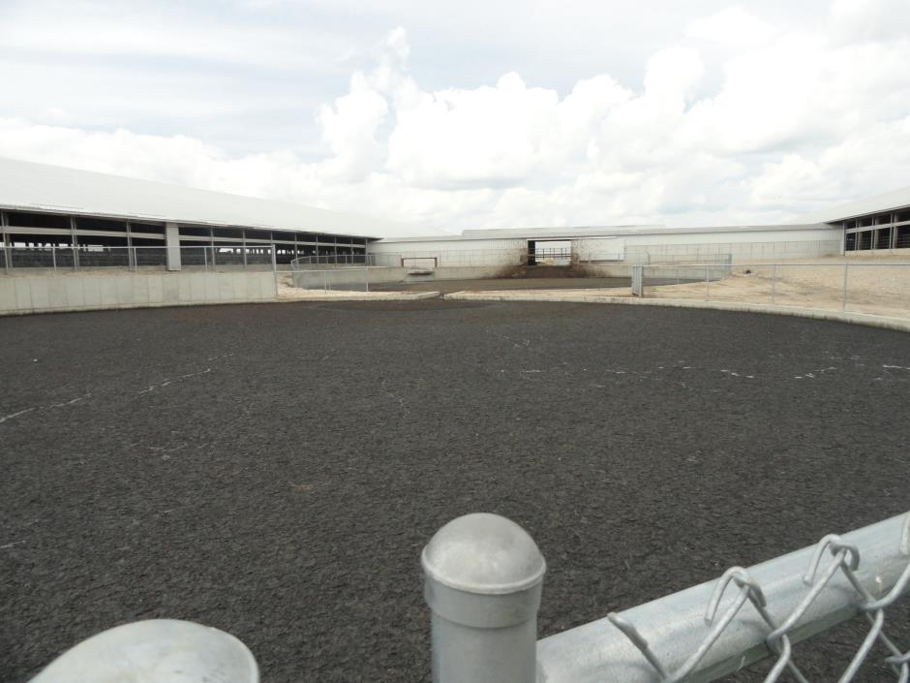
Manure Pit Safety for Youth
Manure Pit Safety for Youth
This material was produced under a grant (SH-27642-SH5) from the Occupational Safety and Health Administration, U.S. Department of Labor. It does not necessarily reflect the views or policies of the U.S. Department of Labor, nor does the mention of trade names, commercial products, or organization imply endorsement by the U.S. Government.
Notes:
Picture is from the National Education Center for Agricultural Safety. Permission given to use photo

Slide 2
Program Objectives
At the conclusion of this presentation, participants will:
Be able to identify hazards associated with confined space work associated with manure pits
Understand the process for confined space entry and lock out/tag out procedures
Know where to look for OSHA references and resources related to confined space entry in the agricultural industry

Slide 3
Statistics: Involvement in Farming in the U.S.
2.1 Million farmers
2% of the population
Reference: http://www.epa.gov/oecaagct/ag101/demographics.html
Notes:
5
Here in the US farm workers include about 2% of the population and we are seeing a shift from the family farm to larger production units.
The spouse is working off the farm to bring revenue and insurance back to the farm.
Reference: http://www.epa.gov/oecaagct/ag101/demographics.html

Slide 4
Statistics of Injury/Mortality: U.S.
70,000 Disabling Injuries
568 Fatalities (2014)
24.9 deaths per 100,000 workers
Notes:
7
This data is nationwide for Agriculture
24.9 deaths per 100,000 workers for Agriculture
2014 CFOI-BLS

Slide 5
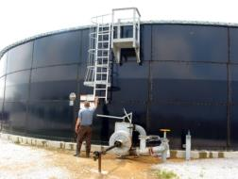
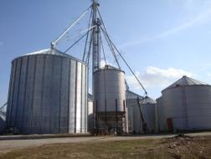
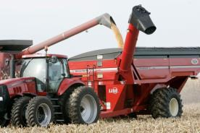
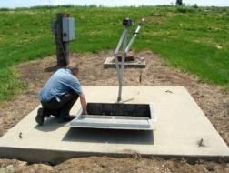
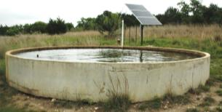
Types of Confined Spaces in Agriculture
Examples:
Grain & feed facilities
Silo
Manure storage facilities
Grain transport vehicle
Agricultural equipment
Septic tank
Liquid and fertilizer storage tank
Wells and cisterns
Fermentation tank
Other_________
Notes:
Instructor Notes:
There is no comprehensive listing of all types of confined spaces that could potentially be encountered on agricultural production sites or at grain storage and handling facilities.
The Department of Labor provides a list of examples of 23 industry types of confined spaces, but does not include spaces generally found in agriculture. As will be described later, agricultural workplaces are generally exempt from having to comply with the provisions of the OSHA Confined Space Entry Standards.
The general categories of agricultural confined spaces include:
Grain and feed storage facilities
Forage storage structures and silos
Manure storage structures
Agricultural grain transport vehicles
Agricultural equipment
Sewage and septic systems
Liquid storage structures for water, fuel, fertilizers, and pesticides
In ground structures – wells, cisterns, culverts, ditches
Biological processing and food storage equipment/facilities
Ask participants to identify specific examples of agricultural confined spaces that they are aware of where they live or work. If available, list identified spaces on the board.
Used with permission from Purdue University, Susan Harwood grant SH23575SH3

Slide 6
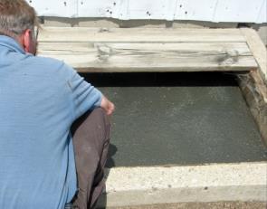
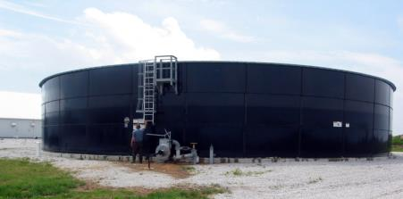
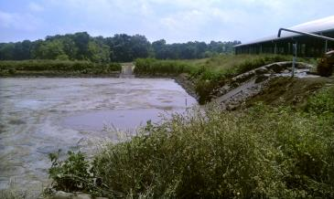
Manure Storage /Structures
Manure Storage /Structures
Below ground pit
Above ground storage tank
Lagoon
Notes:
Instructor Notes:
Manure storage facilities have accounted for several hundred incidents resulting in deaths and injuries, including at least two cases in which there were five fatalities in each incident. It is estimated that nearly one-third of all fatalities in manure storage facilities have been first responders, including both untrained employees or family members, and trained emergency personnel.
All manure releases toxic or flammable gases as it decomposes during storage. These include methane, carbon dioxide, hydrogen sulfide, and ammonia. Each has the potential of reducing the oxygen level below the acceptable level of 19% needed to sustain life. No one should enter a manure storage facility to perform any tasks or attempt a rescue without full respiratory protection and compliance with all permit-required confined space entry requirements.
Because of the generation of methane, there is a potential for fires and explosions to occur if the right concentrations develop. Before accessing any facility built over a manure storage structure, the facility should be well ventilated to ensure that methane levels are not excessive.
Used with permission from Purdue University, Susan Harwood grant SH23575SH3

Slide 7
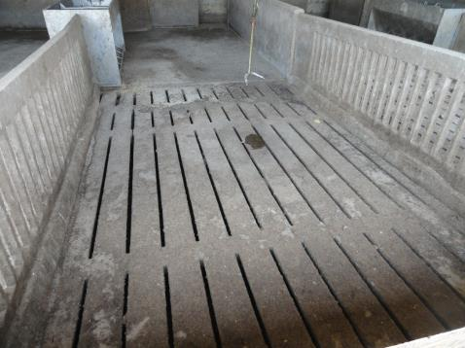
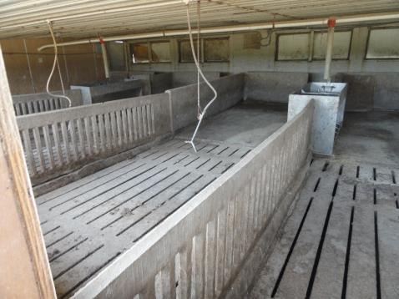
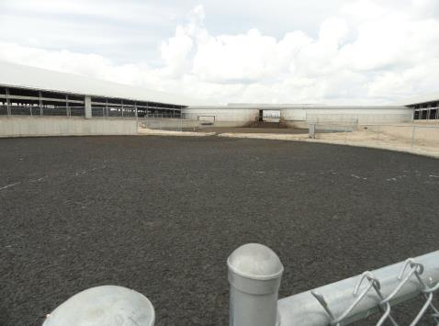
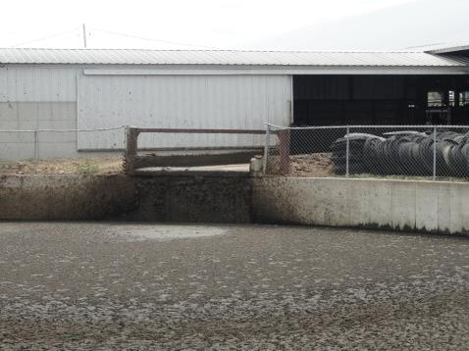
Confined Animal Feeding Operation and above ground manure storage facility
Notes:
These pictures show a (CAFO) Confined Animal Feeding Operation (top right and left photo)
Above ground manure storage facility (bottom left and right photo)
Picture is from the National Education Center for Agricultural Safety. Permission given to use photo

Slide 8
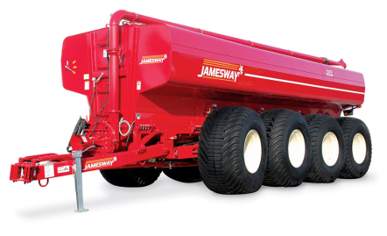
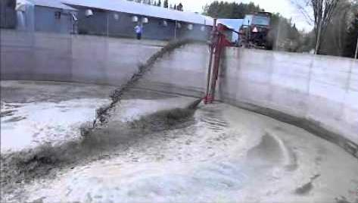
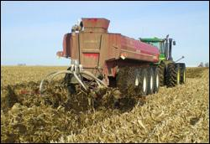
Manure
4500-9600 gallons. 51,150-106,500 lbs.
Notes:
Top left picture, Manure spreader
Top Right, Manure pump in action
Bottom left photo, new manure pump
Bottom right photo, spreading manure in the field
Permission granted from Jamesway Farm Equipment
12 Route 249 St-Francois-Xavier QC Canada J0B 2V0

Slide 9

You Have the Right to Say NO!
As a young and beginning worker you have the right to:
Refuse to perform tasks that you are not trained or equipped to perform safely – without retaliation
Receive information and training about the hazards you are exposed to in the work place
Have access to and training regarding emergency action plans
Notes:
Instructor Notes:
Throughout these training materials, students will be reminded of their rights to safe working conditions. They need to be encouraged to speak up if they are uncomfortable about performing unfamiliar tasks that they believe or know pose a risk of serious harm.
This does not mean that they can pick and chose what their employer assigns to them, but rather have the judgment/maturity to ask questions and raise concerns about tasks they see as potentially dangerous.
Used with permission from Purdue University, Susan Harwood grant SH23575SH3
Refusal to do work is conditional – see the OSHA link: https://www.osha.gov/right-to-refuse.html. At the link you will find:
Workers' Right to Refuse Dangerous Work
If you believe working conditions are unsafe or unhealthful, we recommend that you bring the conditions to your employer's attention, if possible.
You may file a complaint with OSHA concerning a hazardous working condition at any time. However, you should not leave the worksite merely because you have filed a complaint. If the condition clearly presents a risk of death or serious physical harm, there is not sufficient time for OSHA to inspect, and, where possible, you have brought the condition to the attention of your employer, you may have a legal right to refuse to work in a situation in which you would be exposed to the hazard. (OSHA cannot enforce union contracts that give employees the right to refuse to work.)
Your right to refuse to do a task is protected if all of the following conditions are met:
Where possible, you have asked the employer to eliminate the danger, and the employer failed to do so; and
You refused to work in "good faith." This means that you must genuinely believe that an imminent danger exists; and
A reasonable person would agree that there is a real danger of death or serious injury; and
There isn't enough time, due to the urgency of the hazard, to get it corrected through regular enforcement channels, such as requesting an OSHA inspection.
You should take the following steps:
Ask your employer to correct the hazard, or to assign other work;
Tell your employer that you won't perform the work unless and until the hazard is corrected; and
Remain at the worksite until ordered to leave by your employer.
If your employer retaliates against you for refusing to perform the dangerous work, contact OSHA immediately. Complaints of retaliation must be made to OSHA within 30 days of the alleged reprisal. To contact OSHA call 1-800-321-OSHA (6742) and ask to be connected to your closest area office. No form is required to file a discrimination complaint, but you must call OSHA.

Slide 10
Confined Space Entry
OSHA Regulation 29 CFR 1910.146
"Confined space" means a space that: (1) Is large enough and so configured that an employee can bodily enter and perform assigned work; and (2) Has limited or restricted means for entry or exit (for example, tanks, vessels, silos, storage bins, hoppers, vaults, and pits are spaces that may have limited means of entry.); and (3) Is not designed for continuous employee occupancy.
Notes:
OSHA Regulation 29 CFR 1910.146
General Industry Standards, such as 1910.146, 1910.147 and 1910.134, are not applicable to agriculture. Depending on the establishments business classification [Standard Industrial Classification (SIC) or North American Industry Classification System (NAICS) codes], these standards may or may not apply. However, OSHA could cite the General Duty Clause using the general industry standard, consensus standard, and/or industry practice as a reference, for an agriculture business if appropriate. In addition the employer could be liable in a court of law.

Slide 11

Permit Required Confined Space OSHA Definition
A Permit-Required Confined Space – has one or more of the following:
Contains or has the potential to contain a hazardous atmosphere
Contains a material with the potential to engulf someone
Has an internal configuration that might cause an entrant to be trapped or asphyxiated by inwardly converging walls or by a floor that slopes downward and tapers to a smaller cross section
Contains any other recognized serious safety or health concerns
Notes:
Instructor Notes:
The definition for a “permit-required confined space” is more descriptive and specifically addresses the hazards that may be present such as toxic atmospheres and engulfment hazards. This definition is drawn from 29 CFR 1910.146 (OSHA Confined Space Entry Standard).
What is meant by “permit-required”? It is the need for a written permit to be issued by the employer or management to the worker prior to accessing the space. Not all “confined spaces” are “permit-required confined spaces”.
Specialized training is required by OSHA regulations to enter a “permit-required confined space”, therefore, it is unlikely that a young or new worker will be assigned tasks inside this type of work space. Even if they volunteer, such entry is forbidden without proper training and appropriate supervision.
Participants should know that entering a “permit-required confined space” without a permit or proper authorization and procedures in place is illegal under the OSHA workplace safety and health regulations.
Used with permission from Purdue University, Susan Harwood grant SH23575SH3

Slide 12
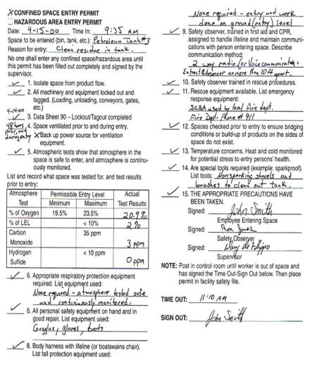
Complete Entry Permit Form
Permit must be correctly and completely filled out prior to entry.
Permit must be activated by Entry Supervisor’s signature to be valid.
No entry is allowed without a valid permit.
When work is completed, permit and evaluation form should be returned to your Safety Dept.
Cancelled permits must be kept on file for at least one year.
Notes:
Per the OSHA general industry standard 1910.146

Slide 13
Relevant Federal OSHA Standards
29 CFR 1910.146 – Permit-required confined space standard
Exempts agriculture
Notes:
Instructor Notes:
Participants in this training are at an age that makes understanding or interpreting federal workplace safety and health rules almost impossible. In most cases they have difficulty even seeing the value or relevance of the rules.
What should be communicated to them in this training is that the OSHA Standards are not suggestions or just good work practices, but, in fact, are the law for the commercial grain industry and other industrial settings with confined spaces. Failure to comply with these laws can lead to being dismissed from the job, citations, fines, and in rare cases criminal charges.
One of the values of this training is that participants are getting a jump start on what will be expected of them if they go to work at a facility that must comply with the OSHA Standards, especially those related to confined spaces.
Time does not allow review of all the provisions of either 29 CFR 1910.146 Encourage participants to review the standard at www.osha.gov.
Please note that this training does not qualify you to enter confined spaces, including permit-required confined spaces.
Used with permission from Purdue University, Susan Harwood grant SH23575SH3

Slide 14
Agriculture Exemption
Enforcement Guidance for Small Farming Operations
The Appropriations Act exempts small farming operations from enforcement of all rules, regulations, standards or orders under the Occupational Safety and Health Act. A farming operation is exempt from all OSHA activities if it:
Employs 10 or fewer employees currently and at all times during the last 12 months; and
Has not had an active temporary labor camp during the proceeding 12 months.
Note: Family members of farm employers are not counted when determining the number of employees.
Important to check with your state OSHA since there are 22 states that match or exceed this OSHA Instruction
Source: OSHA Instruction CPL 02-00-051
Notes:
Agricultural Exemption - Appropriations Act
Enforcement Guidance for Small Farming Operations. The Appropriations Act exempts small farming operations from enforcement of all rules, regulations, standards or orders under the Occupational Safety and Health Act. A farming operation is exempt from all OSHA activities if it: Employs 10 or fewer employees currently and at all times during the last 12 months; and Has not had an active temporary labor camp during the proceeding 12 months.
Note: Family members of farm employers are not counted when determining the number of employees.
Important to check with your state OSHA since there are 22 states that match or exceed this OSHA Instruction
Consider giving an example from a state – California is typically more stringent
**Note: Twenty-six states, Puerto Rico, and the Virgin Islands have OSHA-approved State Plans. Twenty-two State Plans (21 states and one U.S. territory) cover both private and state and local government workplaces. The remaining six State Plans (five states and one U.S. territory) cover state and local government workers only.
Source: OSHA Instruction CPL 02-00-051

Slide 15
Conduct a Pre-Entry Briefing
Entire crew must attend
Attendants, entrants, entry supervisor
Review hazards of entry and work
Review personal protective equipment (PPE)
Review procedure for contacting rescue
verify rescue is available
Complete all items for the permit

Slide 16
Enter the Space and Proceed with work:
An attendant shall be posted near the entrance for the duration of the work. They shall be in constant communication with the entrants while the job is in progress.
All entrants shall sign a sign-in-log when entering the space and sign out when exiting.
The attendant shall maintain the permit and sign in log for the duration of the work.

Slide 17
When the Job is Done:
Remove all personnel, tools, and debris from the space. Sign off the permit.
Close the space.
Cancel the permit.
Review the job with all personnel (hazards, problems, etc.)

Slide 18
General Requirements
The atmosphere within a pit or tank shall be tested for oxygen content prior to and during entry.
Additionally the atmosphere within a pit or tank shall be tested for the presence of combustible gases, vapors and toxic agents when the employer has reason to believe they may be present.
Notes:
272
Still will want to test oxygen level during your time in the space

Slide 19
General Requirements
If the oxygen level is less than 19.5%, or if combustible gas or vapor is detected in access of 10% of the lower flammable limit, or if toxic agents are present in excess of ceiling limits or present in concentrations that will cause health effects which prevent employees from effecting self-rescue or communication to obtain assistance, then the following apply:

Slide 20
General Requirements
A - Ventilation shall be provided until the unsafe condition or conditions are eliminated, and the ventilation shall be continued as long as there is a possibility of recurrence of the unsafe condition while the tank is occupied by employees.
B - If toxic or oxygen deficiency cannot be eliminated by ventilation, employees entering the tank shall wear an appropriate respirator. Respirator use shall be in accordance with the requirements of 29 CFR.1910.134.
Notes:
CFR.1910.134
Respirator standard is part of the General industry standard, however in a Agricultural establishment, OSHA would cite the General Duty Clause referencing the General Duty Standard.
General Industry Standards, such as 1910.146, 1910.147 and 1910.134, are not applicable to agriculture. Depending on the establishments business classification [Standard Industrial Classification (SIC) or North American Industry Classification System (NAICS) codes], these standards may or may not apply. However, OSHA could cite the General Duty Clause using the general industry standard, consensus standard, and/or industry practice as a reference, for an agriculture business if appropriate. In addition the employer could be liable in a court of law.

Slide 21
Lockout/Tagout
OSHA Regulation 29 CFR 1910.147
“Lockout” To physically insure that all mechanical or electrical systems, that can be energized or started up, or release stored energy, are secured, isolated, disabled, or rendered inoperative.
“Tagout” The placement of a device to indicate that the energy isolating device and the equipment being controlled may not be operated until the tagout device is removed.
Notes:
This is the OSHA regulations to Lock out Tag out
OSHA Regulation 29 CFR 1910.147

Slide 22
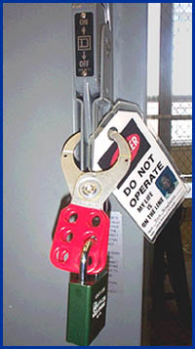
General Requirements
All mechanical, electrical, hydraulic and pneumatic energy which presents a danger to employees inside of the storage structures shall be de-energized and shall be disconnected, locked-out and tagged, blocked off, or otherwise prevented from operating from other equally effective means or methods.
Notes:
272
This would prevent the movement of manure
Picture from OSHA Lockout/Tagout ttps://www.osha.gov/dts/osta/lototraining/hottopics/ht-relche-1-4.html

Slide 23
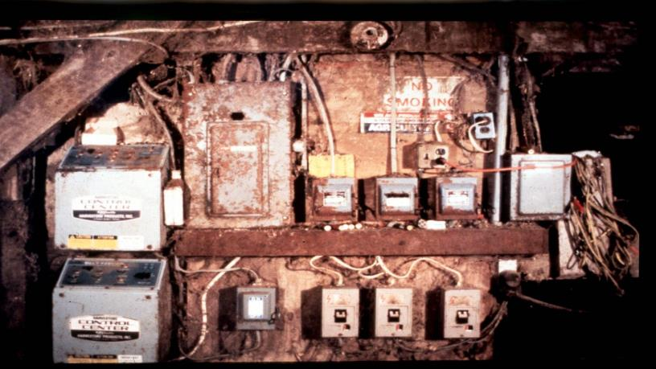
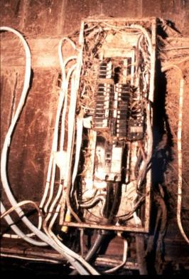
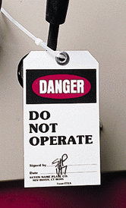
Lockout/Tagout. Where? How?
Lockout / Tagout
Where? How?
Notes:
Most farm electrical systems are not what you would call up to code. You may have to shut off power to the farm to be sure the pit is off.
OSHA Regulation 29 CFR 1910.147

Slide 24
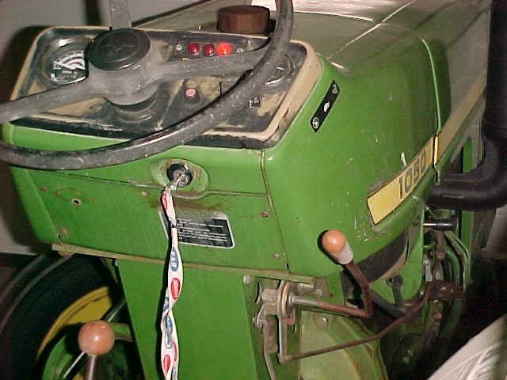
Tractor
Shut of the tractor and power equipment.
Keep ventilation fans operating.
Notes:
Picture is from the National Education Center for Agricultural Safety. Permission given to use photo

Slide 25
Confined Space - Hazards
O2
All living creatures require oxygen to live. One of the primary hazards of entering confined spaces is oxygen deficiency.
When oxygen is present in concentrations less than 19.5% the atmosphere is said to be oxygen deficient.
O2

Slide 26
Toxic Atmospheres
Toxic atmospheres can be caused by:
Product stored in a confined space.
Gases released by decomposing manure.
Decomposition of materials stored.
Gases released when cleaning.
Oxidation of metals
Work Performed in a confined space.
Welding, cutting, painting, scraping, sanding, etc.
Toxic materials adjacent to a confined space.
Notes:
Davis E Hill, EMT-P, Sr. Extension Associate, The Pennsylvania State University, www.agsafety.psu.edu

Slide 27
Oxygen Deficient Atmospheres
19.5% Minimum acceptable oxygen level.
15 –19% Decreased ability to work strenuously.
Impaired coordination.
12 –14% Respiration increases - Poor Judgment.
10 –12% Respiration increases – Lips Blue.
8 –10% Mental failure – Fainting, Nausea, Unconscious, Vomiting.
6 – 8% Possible recovery 4-5 minutes, 50 percent fatal after 6 minutes, fatal after 8 minutes
4 – 6% Coma in 40 seconds – Death.
Source: NIOSH Datasheet
Notes:
Source: NIOSH Datasheet

Slide 28
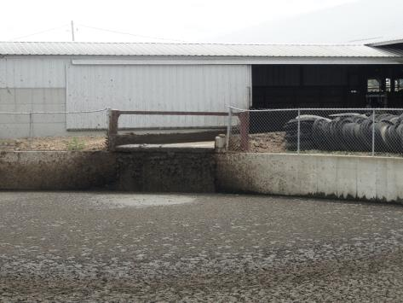
Oxygen Deficient Atmospheres
Hydrogen Sulfide
Carbon Dioxide
Ammonia
Carbon Monoxide
Methane
Notes:
Davis E Hill, EMT-P, Sr. Extension Associate, The Pennsylvania State University, www.agsafety.psu.edu
Picture is from the National Education Center for Agricultural Safety. Permission given to use photo

Slide 29
Hydrogen Sulfide (H2S)
Hydrogen sulfide (H₂S) is a highly toxic gas with a "rotten egg" odor at low concentrations [NIOSH/OSHA 1981].
At high concentrations, hydrogen sulfide can paralyze the olfactory senses [NIOSH 1979]. Because this gas is heavier than air, it can settle near the bottom of the manure pit. Hydrogen sulfide is a severe eye irritant and may cause tissue damage [NIOSH/OSHA 1981].
Notes:
NIOSH Alert / CDC: Preventing Deaths of Farm Workers in Manure Pits.

Slide 30
Hydrogen Sulfide
At low concentrations, gas can cause dizziness, headache, nausea, and irritation of the respiratory tract. At high concentrations, hydrogen sulfide can cause unconsciousness, respiratory failure, and death within minutes. In addition, hydrogen sulfide may be explosive at a wide range of concentrations in air--4.3% to 46% by volume [NIOSH 1985a].
Notes:
NIOSH Alert / CDC: Preventing Deaths of Farm Workers in Manure Pits.

Slide 31
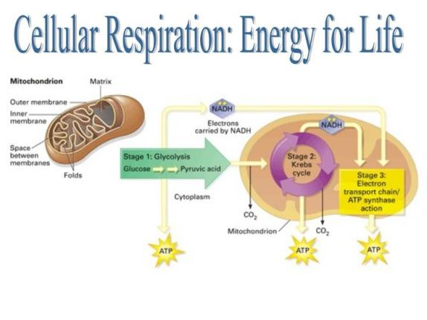
Hydrogen Sulfide
H2S poisons the mitochondria
Mitochondria loses the ability to use oxygen to create energy to power the cells of the body- most notably the brain
Notes:
Mitochondrian-
a small spherical or rodlike body, bounded by a double membrane, in the cytoplasm of most cells: contains enzymes responsible for energy production
mitochondria. (n.d.). Online Etymology Dictionary. Retrieved August 28, 2015, from Dictionary.com website: http://dictionary.reference.com/browse/mitochondria

Slide 32
Carbon Dioxide
Carbon dioxide (CO₂) is an odorless gas that is normally in the atmosphere [NIOSH/OSHA 1981]. Because this gas is heavier than air, it can settle near the bottom of the manure pit. At low concentrations, carbon dioxide can result in labored breathing, drowsiness, and headache. At high concentrations, carbon dioxide can displace enough oxygen to cause death by suffocation.
Notes:
NIOSH Alert / CDC: Preventing Deaths of Farm Workers in Manure Pits.

Slide 33
Ammonia (NH₃)
Ammonia (NH₃) has the sharp odor characteristic of household ammonia [NIOSH/OSHA 1981]. This gas can severely irritate the eyes, nose, throat, and lungs. Ammonia is lighter than air. Exposure to high concentrations can be fatal.
Notes:
NIOSH Alert / CDC: Preventing Deaths of Farm Workers in Manure Pits.
PEL permissible Exposure Limit

Slide 34
Ammonia
IDLH: 300 ppm
Physical Description: Colorless
Exposure Limits: NIOSH (REL) 35 OSHA (PEL) 50 ppm
Exposure Routes: inhalation, ingestion, ski or eye contact
Symptoms: irritation eyes, nose, throat; dyspnea (breathing difficulty), wheezing, chest pain; pulmonary edema; pink frothy sputum; skin burns, vesiculation; liquid: frostbite
Notes:
IDLH – Immediately Dangerous to Life and Health
REL – Recommended Exposure Limits
PEL – Permissible Exposure Limits

Slide 35
Carbon Monoxide (CO)
Odorless, cannot see or taste
By-product of combustion
Found in the operation of gas/oil furnaces, engines and small motors.
Notes:
Instructor notes: Carbon Monoxide is produced from combustion.
Think about shutting off tractors and other fuel powered equipment around the area. Wind direction.

Slide 36
Carbon Monoxide
IDLH: 1200 ppm
Exposure Limits: NIOSH REL- TWA 35 ppm, OSHA PEL- TWA 50 ppm
Physical Description: Colorless, odorless gas. Roughly the same specific gravity as oxygen
Exposure Routes: Inhalation, skin &/or eye contact. CO attaches to Hemoglobin taking a receptor from Oxygen.
Symptoms: Headache, Tachypnea, Nausea, Weakness, Exhaustion, Dizziness, Confusion, Hallucinations, Cyanosis, Depressed S-T segment of electrocardiogram, Angina, Syncope
Notes:
NIOSH Pocket Guide to Chemical Hazards
TWA – Time Weighted Average

Slide 37
Methane (CH4)
Methane (CH₄), is an odorless gas that is flammable or explosive at concentrations of 5% to 15% by volume of air [NIOSH 1985b]. At high concentrations, methane can displace enough oxygen to cause death by suffocation. Because this gas is lighter than air, it occurs near the top of the pit. Methane should be expected to be present in manure pits.
Notes:
NIOSH Alert / CDC: Preventing Deaths of Farm Workers in Manure Pits.

Slide 38
Methane
IDLH: 2100 ppm (10%LEL)
Physical Description: Colorless, odorless gas. [Note: A foul-smelling odorant is often added when used for fuel purposes. Shipped as a liquefied compressed gas.]
Exposure Limits: NIOSH (REL) 1000ppm OSHA (PEL) 1000ppm
Exposure Routes: inhalation, skin and/or eye contact (liquid)
Symptoms: dizziness, confusion, excitation, asphyxia; liquid: frostbite
Notes:
Source: NISOH pocket guide Methane
LEL – Lower Explosive Limit

Slide 39
Air monitoring
Air monitoring

Slide 40
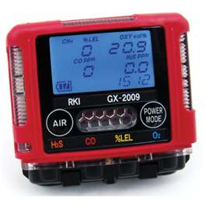
Multiple Gas Monitors
Visual and audible alarms
Specific detector heads may be incorporated based on your hazards
This one detects:
Oxygen content
Percent LEL
Carbon monoxide
Hydrogen sulfide
Notes:
Young workers should be trained in the operation and technical issues of the air gas monitor
Photo permission by RKI.
Mike Johnson
Marketing Manager
(510) 441-5656 | (800) 754-5165
Gas Detection for Life

Slide 41
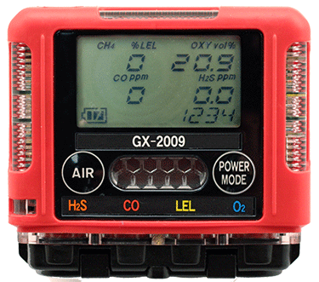
Gas Monitors
Read oxygen level first to verify correct level between 19.5 percent to 23.5 percent or reading for LEL will be incorrect for the challenge gas/vapor
Notes:
No instrument is truly instantaneous- Some respond in 5 to 10 seconds, others require 30-60 seconds. Read the owners manual for the exact response time. Discuss the importance of calibrating (and bump test) the gas monitor before each use.
Photo permission by RKI.
Mike Johnson
Marketing Manager
(510) 441-5656 | (800) 754-5165
Gas Detection for Life

Slide 42
Air quality
Always test the air at different levels of the structure to make sure it is safe. The air might be clear at the top and deadly at the bottom.
GOOD AIR
BAD AIR
DEADLY AIR
Notes:
Picture is from the National Education Center for Agricultural Safety. Permission given to use photo

Slide 43
Atmosphere Testing Shall Be Performed:
Prior to every entry when the space is vacant;
At least hourly for permit-required confined spaces.
More frequently, if conditions or suspicions warrant.
Notes:
Even if you exit the space for lunch or a break you need to retest before entry.

Slide 44
Test the Atmosphere
In this order:
Check for Oxygen Content:
At least 19.5% and less than 23.5%
Check for Combustibles:
Less than 10% of the LEL
Check for Toxic Gases:
Most commonly carbon monoxide (OSHA PEL 50 ppm)
or any other hazardous materials as determined by the use of the space.
Notes:
The 4 gas detector needs to be tested regularly. Bump test (Calibration) before every use. Follow manufactures recommendation.

Slide 45
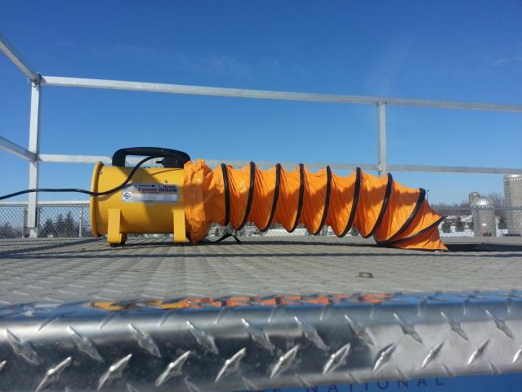
Ventilate the Space
Use mechanical ventilation
Fans
Ventilate at the rate of at least four (4) volumes per hour
Larger spaces require more ventilation
Make sure air supply is not contaminated
Ventilation air supply must be from fresh air uncontaminated with flammables, toxins, etc.
Gas powered fans can be Dangerous
Notes:
Picture is from the National Education Center for Agricultural Safety. Permission given to use photo

Slide 46



Communication Equipment
Notes:
Instructor Notes:
Every worker in and around a grain storage and handling facility should be able to communicate with co-workers, especially in the event of an emergency. They also help make workers more efficient.
No one should ever enter any confined space in an emergency situation without the ability to communicate or be directly observed by an attendant outside the structure.
In some cases, standard wireless communication devices have been found to not function inside a steel storage bin.
Used with permission from Purdue University, Susan Harwood grant SH23575SH3

Slide 47







Personal Protective Equipment
Hard Hats
Eye Protection
Hearing Protection
Respirator
Protective Coveralls
Gloves
Footwear
Safety Harness
Once all the hazards are identified, the space has been ventilated and the atmosphere checked, determine what personal protective equipment will be necessary.
Notes:
Picture is from the National Education Center for Agricultural Safety. Permission given to use photo

Slide 48
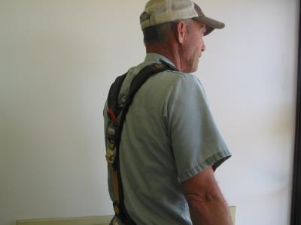
Personal Protective Equipment
Each entrant shall use a chest or full body harness or a boatswain’s chair, with a retrieval line attached to assist in removal.
Exception – Where the employer can demonstrate that the protection required is not feasible or creates a greater hazard, the employer shall provide an alternative means of protection which is demonstrated to prevent the employee from sinking further than waist-deep in the grain.
Notes:
Picture is from the National Education Center for Agricultural Safety. Permission given to use photo

Slide 49
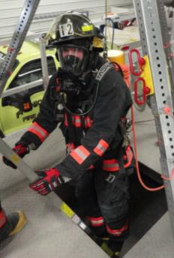
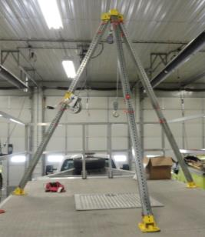
Definitions
Retrieval system
Equipment (including retrieval line, chest or full-body harness, wristlets, if appropriate, & lifting device or anchor) used for non-entry rescue of persons from permit spaces
Notes:
Picture is from the National Education Center for Agricultural Safety. Permission given to use photo

Slide 50
Definitions
Attendant
Individual stationed outside one or more permit spaces who monitors authorized entrants & performs all attendant’s duties assigned in employer’s permit space program

Slide 51
Duties of Attendants
Knows hazards that may be faced during entry
Aware of possible behavioral effects of hazard exposure in authorized entrants
Continuously maintains accurate count of authorized entrants
Remains outside permit space during entry operations until relieved by another attendant

Slide 52
Duties of Attendants
Communicates with authorized entrants
Monitors activities inside & outside space
Summons rescue & other emergency services
Performs non-entry rescues as specified by employer's rescue procedure
Performs no duties that might interfere with primary duty to monitor & protect authorized entrants

Slide 53
Medical Symptoms to watch for.
Falls
Shortness of Breath
Cardiac Emergencies
Headaches
Nervous system depression
Eye, nose, throat
irritation.
Nausea/Vomiting
Narcotic Effect
Convulsions
Impaired mental ability
Fluid on the lungs
Dizziness
Unresponsive
Fatigue
Notes:
NECAS

Slide 54
Enter the Space and Proceed with work:
An attendant shall be posted near the entrance for the duration of the work. He shall be in constant communication with the entrants while the job is in progress.
All entrants shall sign a sign-in-log when entering the space and sign out when exiting.
The attendant shall maintain the permit and sign in log for the duration of the work.

Slide 55
Confined Space Rescue
Means of emergency rescue
must be readily available
to the confined space
entry attendant for
emergency
extrication of
entrants.

Slide 56
Standby/Rescue Personnel
A worker who is assigned to remain outside a confined space must be:
In constant contact with the workers inside.
Know emergency procedures.
Be trained in the use of emergency rescue equipment and PPE.
60% of workers who die in confined spaces are would-be rescuers.
Notes:
NIOSH

Slide 57
Confined Space Rescue
The attendant should
attempt to remove the
entrant from the confined
space using tripods, hoist, and
lifelines. Attendants are NOT
TO ENTER CONFINED
SPACES. Lethal hazards may
be present within the confined
space. Only properly equipped
and trained emergency rescue
personnel may enter confined
spaces to make rescues.

Slide 58
Employee Rights and Responsibilities
You have the right to:
A safe and healthful workplace
Know about hazardous chemicals
Information about injuries and illnesses in your workplace
Complain or request hazard correction from employer
Notes:
58

Slide 59
Employee Rights and Responsibilities
You have the right to:
Training
Access to Hazard exposure and medical records
File a complaint with OSHA
Participate in an OSHA inspection
Be free from retaliation for exercising safety and health rights
Notes:
59

Slide 60
Employee Rights and Responsibilities
OSHA website: OSHA.gov Website and OSHA offices: Call or Write (800-321-OSHA)
Compliance Assistance Specialists in the area offices
National Institute for Occupational Safety and Health (NIOSH) – OSHA’s sister agency
OSHA Training Institute Education Centers
Doctors, nurses, other health care providers
Public libraries
Other local, community-based resources
Notes:
60

Slide 61

OSHA Whistleblower Fact Sheet
Whistle Blower Fact Sheet (FS 3638)
Notes:
Review Employee Rights – OSHA Publication Fact Sheet (FS) 3638

Slide 62

Whistle Blower Protection Program
Notes:
With in OSHA is the whistle blower program
Website resources
22 statutes

Slide 63
Pre & Post Test Questions
1. Which one of the definitions is not for a “Confined Space”?
Is large enough and so configured that an employee can bodily enter and perform assigned work.
Has limited or restricted means for entry or exit (for example, tanks, vessels, silos, storage bins, hoppers, vaults, and pits are spaces that may have limited means of entry).
Contains or has the potential to contain a hazardous atmosphere
Is not designed for continuous employee occupancy.
2. What is the minimum acceptable oxygen level?
16%
23.5%
19.5%
30%
3. Which gas is one of the 5 gases that may be found in or around a manure pit?
Hydrogen
Sodium
Argon
Carbon Dioxide
4. Medical issues arising from breath pit gases include
Fluid on the lungs
Fatigue
Convulsions
All the above
5. Hydrogen Sulfide is heavier that air.
True
False
Notes:
With in OSHA is the whistle blower program
Website resources
22 statutes

Slide 64
Pre & Post Test Questions
6. What gas smells like rotten eggs?
Carbon Monoxide
Methane
Ammonia
Hydrogen Sulfide
7. What position is in charge of “ Calling rescue and other emergency services”?
Entry person
Attendant
Family
Friend
8. What gas is produced from combustion?.
Hydrogen Sulfide
Carbon Monoxide
Methane
Carbon Dioxide
9. Which pit gas can paralyze the olfactory senses of the body?
a) Methane
b) Hydrogen Sulfide
c) Carbon Dioxide
d) Ammonia
10) Methane is explosive at what concentration?
a) 0-5%
b) 0-15 %
c) 5-15%
d) 15-30%
Notes:
With in OSHA is the whistle blower program
Website resources
22 statutes

Slide 65
Pre & Post Test Answer Key
1. C
2. C
3. D
4. A
5. A
6. D
7. B
8. B
9. B
10. C
Notes:
With in OSHA is the whistle blower program
Website resources
22 statutes

