Slide 1

Protecting Young Adults in the Agricultural Workforce
AgriSafe Network

Slide 2

The Disclaimer
This material was produced under grant
(SH- 27642-SH5) from the Occupational Safety and Health Administration, U.S. Department of Labor. It does not necessarily reflect the views or policies of the U.S. Department of Labor, nor does the mention of trade names, commercial products, or organization imply endorsement by the U.S. Government.

Slide 3

Objectives
At the conclusion of this program, participants will be able to:
Identify physical and psychological developmental factors to consider when training and employing young adults in the agricultural sector.
Define agricultural hazards and exposures that increase the risk of injury and illness among the young worker.
Describe regulatory standards that can promote a safe work environment for young employees.
Create action steps that can reduce agricultural injury and illness.

Slide 4

CDC/NIOSH Total Worker Health® Affiliate
Image Copyright@2016

Slide 5

A Few Facts:
U.S. farms contributed $166.9 billion (about 1%) to the GNP in 2013 (USDA)
Direct on-farm employment provided 2.6 million jobs in 2013 (USDA)
In 2014, 253,000 young workers between the ages of 16 and 24 were employed in agriculture (BLS data February 2015).
In 2014, 50,000 workers between the ages of 16 and 24 were female. (BLS 2015)
*Note the U.S. Census Bureau age group category – under 25.

Slide 6

MCN Report
A 2014 Migrant Clinicians Network report indicates there may be between 1 and 2.5 million hired workers in the U.S. and about half a million are under the age of 18. MCN reports that about one-half of these workers are authorized to work in the U.S.

Slide 7

Multiple Tasks
It is a fair statement to describe agricultural work as multi-disciplinary: doing more than one type of work in a day (shift); working varied hours and varied conditions.
Agricultural work involves:
ergonomics – potential for injury resulting from lifting, climbing, twisting, etc.
working with animals (large & small)
  potential for zoonotic disease exposure
  injuries resulting from bites and ‘struck by’ hazards
heavy machinery – potential for acute and chronic injury
hand tools – potential for vibration injury, eye injury, etc.
pesticide & other chemical exposures (also needle sticks)

Slide 8

You …The Employer
As an employer of young adult workers (usually referred to as between the ages of 16 – 24), you are not only hiring someone to do a particular job…
…. but also preparing workers in agriculture production for the future

Slide 9
You …The Employer
You are
providing mentoring and guidance
providing valued work experience
protecting young worker from work related illness, injury or death
Many young employees plan on working in agriculture throughout the life continuum.

Slide 10

Developmental Factors in Young Workers
Young people in the work force are still developing and maturing into their mid – twenties.
Physical development (muscle, bone, weight, height) are the more obvious factors
Teens and young adults tend to grow and develop physically at different rates

Slide 11
Developmental Factors in Young Workers
We may be much less aware of psychological/mental / neurological development
We often have a tendency to judge ability to perform a task on what we see
- Youth may appear to have all of the same physical capabilities as full grown adult

Slide 12

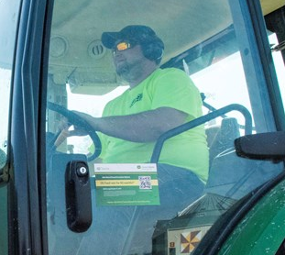
A Brain in Progress
According to recent findings, the human brain does not reach full maturity until at least the mid-20s (20 – 25 y/o)
http://www.nimh.nih.gov/health/publications/the-teen-brain-still-under-construction/index.shtml#pub7
http://hrweb.mit.edu/worklife/youngadult/brain.html

Slide 13

How young employees think
(cognitive growth &development)
Studies have shown that the brain’s ability to make decisions and make good judgement calls is still developing in the early twenties:
  Attention span – easily distracted
    other workers
    cell phones
    music (ear buds in )
  Cause & effect relationship not fully developed –
    how fast is safe/ how far from danger/ short cuts lead to mishaps
  Often impatient

Slide 14
How young employees think
(cognitive growth &development)
Ability to make good decisions may still be developing
  Time management
  Following instructions
May not be fully aware of ability/ inability – thinking they can do more than they really are capable of doing – Perceptive skills still developing
May have a distorted sense of immortality

Slide 15

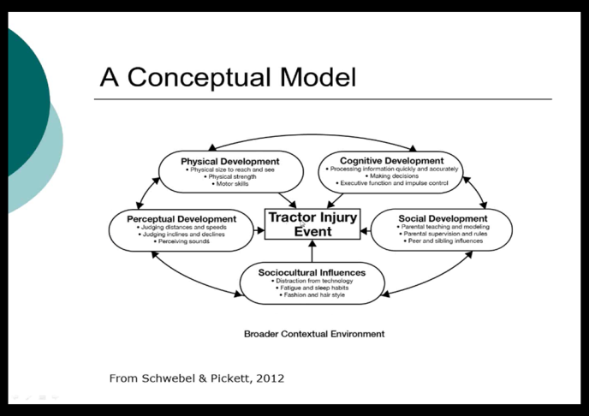
Developmental Factors
Perceptual and cognitive development may not reach adult levels until several years post adolescence.*
Notes:
*David C. Schwebel PhD & William Pickett PhD (2012): The Role of Child and Adolescent Development
in the Occurrence of Agricultural Injuries: An Illustration Using Tractor-Related Injuries, Journal of Agromedicine, 17:2,214-224
To link to this article: http://dx.doi.org/10.1080/1059924X.2012.655120

Slide 16

Time Constraints
For many young workers, we need to keep in mind that they likely come to the job with several other time commitments in their lives – especially if they are part time or seasonal workers.
- school
- family
- sports
- another part time job and work commitments at home
Notes:
AgriSafe Network photo

Slide 17
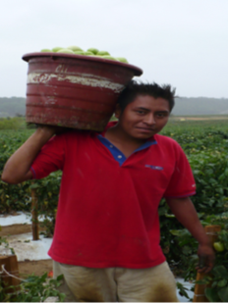
Cultural Diversity
Young workers can be culturally diverse:
Language
Clothing preferences
Food preferences
Religious customs
Familial roles
Gender roles
Acclimatization
Notes:
Photo courtesy of Migrant Clinicians Network

Slide 18
Is there any language barrier?
Many hired workers do not use English as their primary language.
Workers may not want to indicate they do not understand instructions.*
There may be a lack of instructions or safety materials in youth’s language.
Farmers also use their own language – make sure the employer uses language or terminology that hired youth understand.

Slide 19
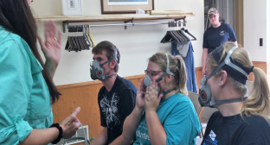
Is there any language barrier?
Solutions:
Keep slang terms to a minimum – or be sure they are understood
Provide written materials and training videos in worker’s first language
Require return demonstrations
Is a buddy system possible?
Notes:
Photos: Property of AgriSafe Network

Slide 20

Solutions – Be Creative:
Providing training
– utilize resources and experienced employees
Responsibilities should be appropriate to abilities
Giving ownership of a chore or task
  if an employee owns a task or chore, he/she is more likely to think through the process

Slide 21
Electronic Era
Many young workers are proficient in use of electronics and applications:
Pros – computer and social media savvy can potentially bring value to your operation
Cons- distractions can put them at a higher risk for injury
http://www.safetyandhealthmagazine.com/articles/print/10787-keep-young-workers-safe
Solutions:
Get to know employee strengths – then…
Give them ownership of tasks.
Use technology in their job when possible.
Notes:
AgriSafe Network photo

Slide 22
Personal growth in the workplace
Fostering young worker development includes:
Respecting the employee – at any age …
  This will help in developing respect and willingness to please you – the employer
Communication – “keep them in the loop”
Inclusiveness - when appropriate – ask their opinion/input Example: computer programming, mapping, etc.

Slide 23

Interpersonal / Social
Growth & Development
Safety behavior is based on:
Experience
What has been learned at home
  Level of emphasis on safe practices
  Age appropriate tasks
    Did parents take pride in the fact that he/she did grown up things at an early age?
Cultural orientation -
  salutations / greetings
  food preferences
  length of hair
  religious interpretation
  clothing preferences

Slide 24
Interpersonal / Social
Growth & Development
Mobile workers may have a fear of reporting illness or injury
Peer influence – cannot be underestimated!
Remember! Reward/praise employee for doing a good job!

Slide 25
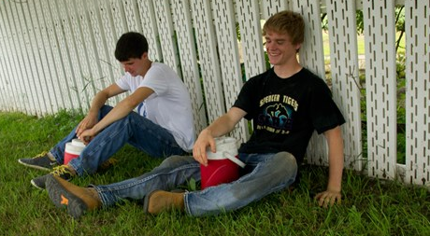
Physical Development in Young Adults
Teens and young adults are continuing to grow physically along with their emotional and psychological development
Notes:
AgriSafe Network photo

Slide 26
Musculoskeletal Development Factors in
Young Adult Workers
Musculoskeletal growth:
bone growth is more rapid than muscle development
can cause lack of coordination and limited muscle coverage over bones.
can result in joint instability (example: patella)

Slide 27

Sleep Deprivation
Young workers may be chronically sleep deprived – teens and young adults need more restorative sleep than young children.
  Lack of sleep can have an obvious effect on workplace awareness and function. Sleep deprivation can be affected by:
    biological circadian rhythms
    fatigue
    sleep habits
    media & technology
Notes:
*David C. Schwebel PhD & William Pickett PhD (2012): The Role of Child and Adolescent Development
in the Occurrence of Agricultural Injuries: An Illustration Using Tractor-Related Injuries, Journal of Agromedicine, 17:2,214-224
To link to this article: http://dx.doi.org/10.1080/1059924X.2012.655120
Photo – AgriSafe photo rights granted

Slide 28

Solutions to Sleep Deprived
Recognize this is an issue!
Employer/supervisor needs to recognize behaviors of sleep deprivation and make adjustments in work schedule or tasks if possible
Make sure young workers know they need to let you know if they are sleep deprived

Slide 29
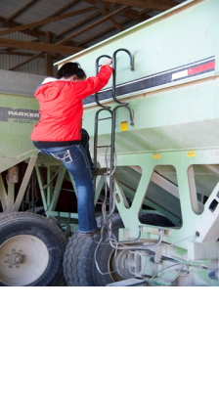
Mitigate Causative Factors
Injuries can manifest due to improper techniques
Solution: Teach and demonstrate proper use of equipment:
Ladders
  4 to 1 ratio –Up 4 feet out 1 foot
  Appropriate training
High & low elevations
  Fall protection, fall restraint; fall arrest
  Appropriate training
Tractors
  Face equipment
  3 points of contact
  Appropriate training
ATV’s
  PPE
  Appropriate training
  No seat – No Rider!
Require return demonstrations
Notes:
AgriSafe Network photo
www.compliance.gov

Slide 30

Mitigate Causative Factors
Injuries can manifest due to improper techniques
Teach and demonstrate proper use of equipment:
Lawn & garden
- Receive training
- Use appropriate PPE
Hand tools (include vibration injuries)
  - Receive training
  - Use appropriate PPE
Chain saws
- Receive training
- Use appropriate ppe
  Require return demonstrations
Notes:
AgriSafe Network photo

Slide 31
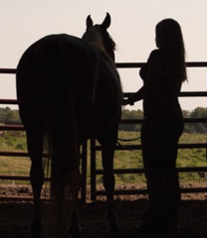
Animal Handling Injury Potential
Large animals – cattle, dairy, hogs
Small animals
Fowl
Horse related injuries – ropes, saddles, footwear
  saddleupSAFELY.org
Needle stick injuries i.e.: antibiotics/vaccinations
Solutions:
Conduct safe animal handling training that addresses the wide variety of hazards related to livestock work.
Have job specific health and safety information available.
Require return demonstrations

Slide 32

Heat Exposure Issues
Consider:
Workers may not be acclimated to heat conditions.
Workers may be a long distance from shade and water supplies.
Notes:
AgriSafe Network photo

Slide 33
Contributing Factors to Heat Related Illness
Dehydration
Intestinal illnesses
Decreased sodium intake
High caffeine or sugar intake
Alcohol consumption
Use of contraindicated prescription or over the counter (otc)medications
Use of illegal substances
Language or other communication barriers
Notes:
* Workers cannot wait until they are thirsty to drink water. Signs of dehydration – thirst; concentrated urine output

Slide 34
Heat Related Illnesses (HRI)
Heat Stress – an umbrella term used to describe a condition or process that can raise the deep core body temperature:
    Heat Exhaustion
    Heat Stroke – the most severe condition
    Heat Syncope
    Heat Cramps
    Heat Rash
Sources: OSHA Campaign to Prevent Heat Illnesses in Outdoor Workers / Using the Heat Index Guide

Slide 35
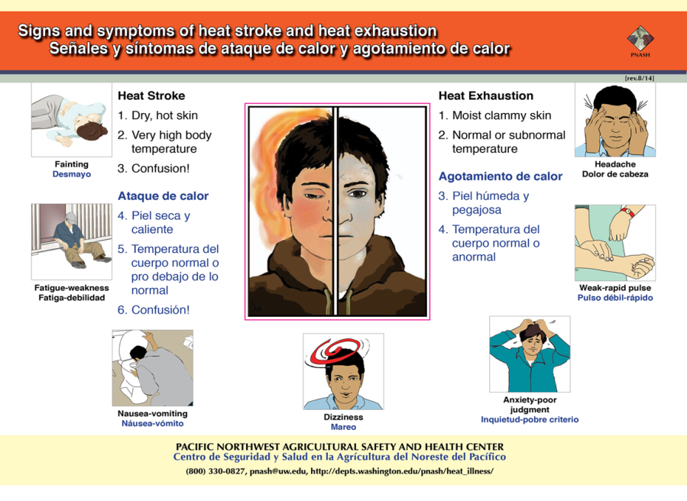
Signs and symptoms of heat stroke and heat exhaustion

Slide 36


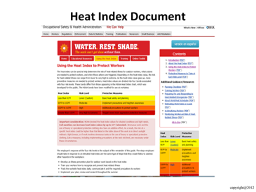
Water. Rest. Shade. (recommended resource) https://www.osha.gov/SLTC/heatillness/

Slide 37
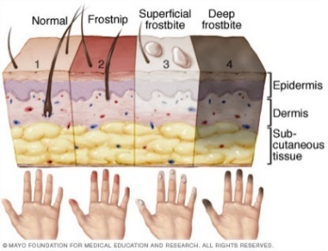

Cold Weather Conditions
Frost nip
Frost bite
Driving conditions
Solution for Cold Weather Issues
Look at the OSHA Quick Card https://www.osha.gov/Publications/OSHA3156.pdf

Slide 38
Chemical/Pesticide Exposures
Follow EPA and OSHA Standards
Employers must provide training as specified by the Environmental Protection Agency [EPA 170.130]
https://www.epa.gov/pesticide-worker-safety/worker-protection-standard-wps-comparison-chart
These changes will be fully in effect on January 2, 2017
This standard will include:
pesticide safety training
the 5 day grace period with abbreviated training will no longer exist *
ensure all workers and handlers are trained annually**
Handlers and early entry workers must be 18 years of age***
including training on the use of PPE
      Also in the OSHA standards 1910.132-138
Notes:
** and *** New WPS provision as of Sept. 2015

Slide 39
Follow EPA and OSHA Standards
  Pesticide handlers must wear the personal protective equipment (PPE) specified on the pesticide container label.
  Employer's responsibilities include [EPA 170.112]:
    Providing PPE to each worker.
    Cleaning and maintaining PPE.
    Ensuring that each worker wears and uses PPE correctly.
    Preventing heat stress if the work and PPE could cause it.
  Also in OSHA General Requirements - Standard (1910.132 – 138)
https://www.osha.gov/SLTC/youth/agriculture/chemicals.html
Remember: as an employer, you hold primary responsibility for the safety and health of workers and safe work practices!!

Slide 40

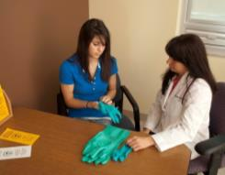
Chemical Exposure Training
Pesticides
  EPA regulations
  PPE & labeling
  Safety Data Sheet ( formerly called MSDS)
Other Chemicals
- Paints
- Sprays
- Pipeline cleaners
- Oils
- Other products
PPE & Labeling
-- Safety Data Sheet ( formerly called MSDS)
Train & Demonstrate the Use of:
  PPE
  Labeling / original containers
  Storage protocol
  Poison control
  Field entry/exit
Require return demonstrations
Notes:
AgriSafe Network photo

Slide 41

Environmental Protection Agency
Worker Protection Standard:
EPA’s Regulation aimed at reducing the risk of pesticides and injuries among agricultural workers and pesticide handlers.
Recognition and Management of Pesticide Poisonings Manual www.epa.gov

Slide 42


Revised Worker Protection Standard

Slide 43
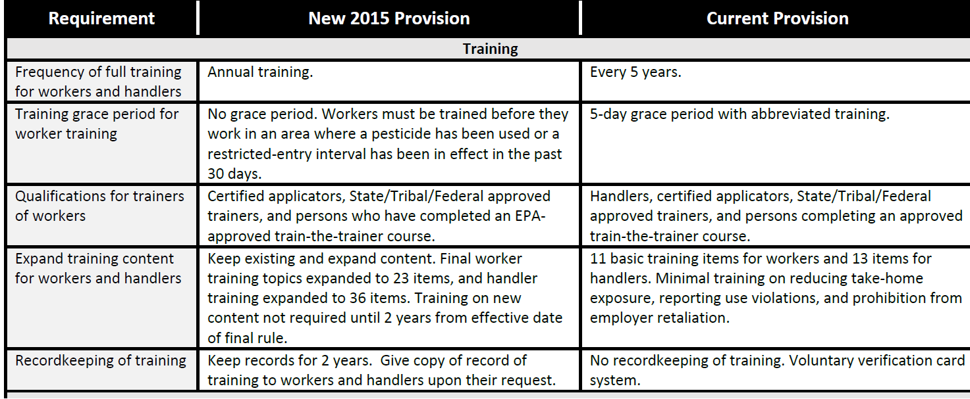
Revised Worker Protection Standard Details

Slide 44
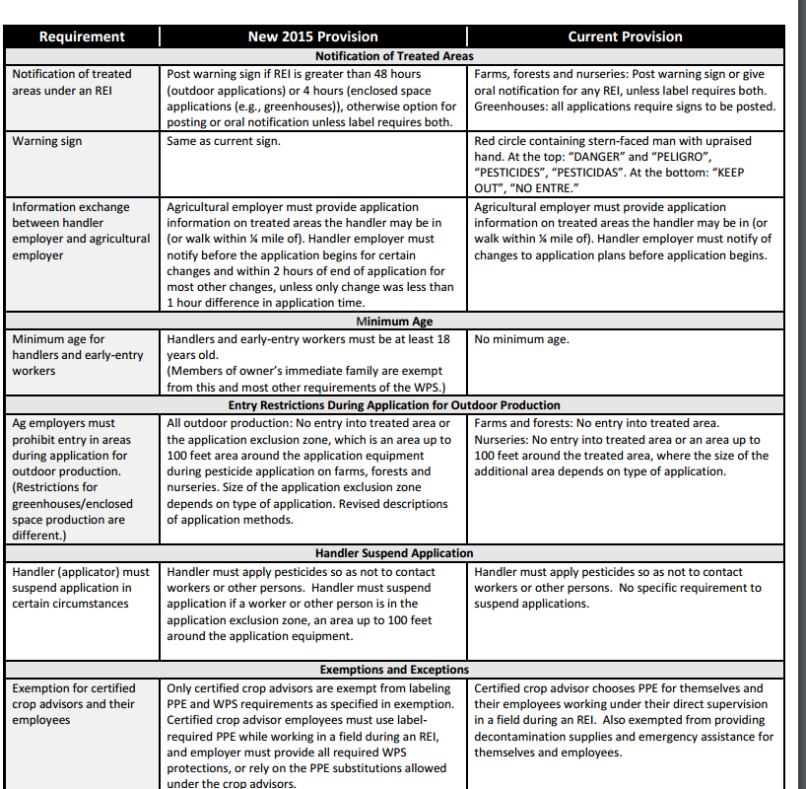
Revised Worker Protection Standard DetailsContinued

Slide 45
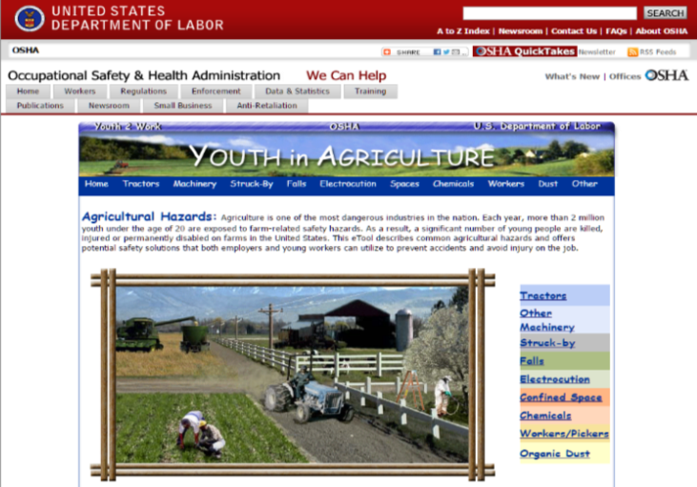
The OSHA Young Worker Program
The OSHA Young Worker Program has excellent materials to guide you in establishing a training program
This site describes hazards, solutions, and location of related standards.
Notes:
https://www.dol.gov/whd/regs/compliance/whdfs40.htm

Slide 46

The OSHA Young Worker Program
Continued

Slide 47

Youngworkers.org

Slide 48

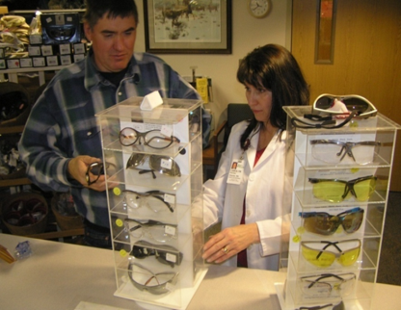
Personal Protective Equipment
Personal Protective Equipment
The last line of defense when a hazardous exposure cannot be eliminated or a barrier in place
In order to work, it has to fit!
  Young workers may have a difficult time putting on and taking off PPE equipment
  Make sure you have the right sizes for all workers (male and female)
  Most ppe is designed for adult males
Notes:
AgriSafe Network photo

Slide 49

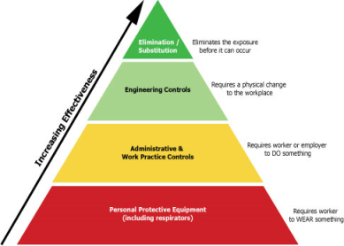
Eliminating or Mitigating Hazards
Eliminate – remove or design hazard out
        The first line of defense!
2. Substitute – replace hazard with a non- hazard
3. Engineering control – isolate/ diminish hazard
4. Administrative control – training, work schedule, signage
Personal protective equipment – may be only feasible
solution
www.osha.gov http://www.cdc.gov/niosh/twh/totalhealth.html

Slide 50
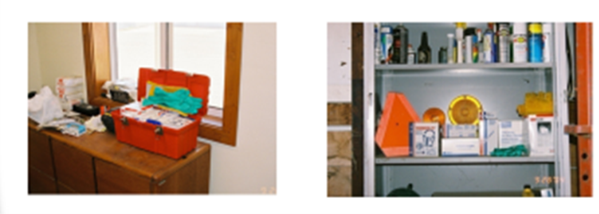
PPE Access and Storage
If you have several worksite locations:
Organize one main or central storage unit for supplies
  have multiple smaller PPE storage sites in accessible locations
  store personal protective equipment in dust and moisture proof containers
    Disposable face pieces that will be re-used by individuals should be in loose containers that will not retain moisture

Slide 51
Young Women in Agriculture
Women have anatomical and physiological differences that may place them at risk for farm injuries. Females are, on average, shorter than men and have more adipose tissue.
Females also have narrower shoulders, wider hips and proportionally have shorter legs and arms than their male counterparts
On average, upper body strength is 40% - 75% less in females than in males, while lower body strength is 5% - 30% less in females
Safety education and protective equipment is primarily geared toward men
Notes:
Source: articles obtained in PubMed literature search

Slide 52
Young Women in Agriculture
Women using pesticides have 1.5 x increased risk of:
  Longer menstrual cycles
  Missing a period
  Irregular cycles with break through bleeding
Safety education protective equipment is primarily geared toward men
Tools and equipment are made more for men as well
Notes:
https://www.cdph.ca.gov/programs/CBDMP/Documents/MO-CBDMP-Pesticides.pdf

Slide 53
OSHA Agriculture Standard
(29 CFR 1928)
Occupational Safety & Health Act of 1970 – Federal Laws & Regulations Affecting Agricultural Employers
8 sections
Purpose and Scope
Applicability & Standards
Followed by 6 specific Agriculture standards
Roll over protective structures (ROPS) for agricultural tractors
Protective frames for wheel-type agricultural tractors
Protective enclosures for wheel-type agricultural tractors
Guarding of farm field equipment, farmstead equipment, and cotton gins
Field Sanitation – refers to provision of drinking water, hand washing and toilet facilities for hand labor workers.
Cadmium – refers to exposure to toxic metal fumes; some phosphate sources in fertilizer may contain cadmium(*also identified under General Industry 29 CFR 1910.1027)
https://www.osha.gov/pls/oshaweb/owastand.display_standard_group?p_toc_level=1&p_part_number=1928

Slide 54
General Industry Standard
(29 CFR 1910)
If the hazard cannot be addressed in the Agriculture Standard (29 CFR 1928), OSHA defers to the
General Industry Standard(29 CFR 1910)
General Industry Applicable Standards
  Temporary Labor Camps
  Storage & Handling of Anhydrous Ammonia
  Logging Operations
  Slow Moving Vehicles
  DOT Markings
  Hazard Communication
  Cadmium (welding, grinding, painting)

Slide 55
General Duty Clause
Section 5 (a) (1)
If there is not a standard that is applicable to agriculture in the General Industry Standards - then go to the
General Duty Clause Section 5(a)(1)
  Each employer shall furnish to each employee a place of employment which is free from recognized hazards that are causing or are likely to cause death or serious harm
  Each employer shall comply with defined OSHA standards
https://www.osha.gov/pls/oshaweb/owadisp.show_document?p_table=OSHACT&p_id=3359

Slide 56
Other OSHA Standards related to Agriculture
      These are also 29 CFR 1910 Standards
General Requirements for Personal Protective Equipment
Respiratory Protection
Hearing Conservation & Noise Exposure
Eye & Face Protection
Slips, Trips, & Falls – refers to walking surfaces, working surfaces, ladders, and scaffolding.
Confined Space Entry – refers to definition of confined space, hazards, lock out/tag out

Slide 57
Hazard Communication Standard
Changes to the Occupational Safety and Health Administration's (OSHA) Hazard Communication Standard are bringing the United States into alignment with the Globally Harmonized System of Classification and Labeling of Chemicals (GHS)
The Hazard Communication Standard in 1983 gave the workers the ‘right to know' …but the new Globally Harmonized System gives workers the ‘right to understand.’
The revised standard requires that information about chemical hazards be conveyed on labels
Labels for a hazardous chemical must contain: • Name, Address and Telephone Number • Product Identifier • Signal Word • Hazard Statement(s) • Precautionary Statement(s) • Pictogram(s)
It is important to note that the OSHA pictograms do not replace the diamondshaped labels that the U.S. Department of Transportation (DOT) requires for the transport of chemicals
Notes:
*The first aid training standards generally apply throughout the industries they cover – which means it is usually expected that emergency care can be available in 3 – 4 minutes…if not, it is common practice to have someone trained in first aid and CPR(mandatory in logging and electrical power industry). In most agricultural settings – this is a different story – services may be several minutes or hours away.

Slide 58

OSHA Pictograms

Slide 59

Additional Standards related to Agriculture
Sanitation Standards –Sanitation standards require employers to provide potable water.
Medical Services & First Aid Standards - Medical Services and First Aid standards require that persons onsite be adequately trained.*
*The first aid training standards generally apply throughout the industries they cover – which means it is usually expected that emergency care can be available in 3 – 4 minutes…if not, it is common practice to have someone trained in first aid and CPR(mandatory in logging and electrical power industry). In most agricultural settings – this is a different story – services may be several minutes or hours away.
Notes:
*The first aid training standards generally apply throughout the industries they cover – which means it is usually expected that emergency care can be available in 3 – 4 minutes…if not, it is common practice to have someone trained in first aid and CPR(mandatory in logging and electrical power industry). In most agricultural settings – this is a different story – services may be several minutes or hours away.

Slide 60
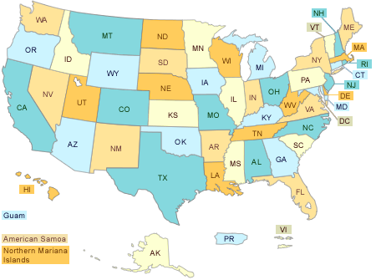
State to State Standards
All states have rules regarding the employment of young workers.
But only some states have separate minimum wage requirements. When federal and state rules are different, the rules that provide the most protection will apply. Be sure to find out about the rules in your state.
State to State Standards

Slide 61
Small Farm Exemption
The Appropriations Act exempts small farming operations from enforcement of all rules, regulations, standards or orders under the Occupational Safety and Health Act. A farming operation is exempt from all OSHA activities if it:
  Employs 10 or fewer employees currently and at all times during the last 12 months; and
  Has not had an active temporary labor camp during the preceding 12 months.
  Immediate family members are considered exempt
Source: OSHA Instruction CPL 02-00-051
Must still provide a safe work place

Slide 62

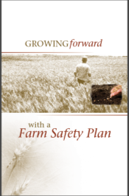
Education & Training
Assess worker’s level of understanding – know your audience
Consider peer – to – peer training
Clarify your expectations – Orientation Checklist
Identify areas of training
Allow sufficient time for training
  Would a buddy plan work in your operation?
Utilize visual aids/ demonstration/ return demonstration
Growing Forward - information and examples of planning templates
http://aghealth.usask.ca/resources/farmsafetyplan/Farm_Safety_Plan-Growing_Forward.pdf

Slide 63

Education & Training
Document all new and repeat training programs and attendance
Repeat trainings on a regular schedule – annually
Provide regular updates
Keep educational materials and all SDS information in an accessible location.
Maintain an ongoing Safety Training Action Plan
Practice what you preach! (example: talking to employees about a safe working environment while in a cluttered shop area or on a tractor without a ROPS is not a good idea).

Slide 64

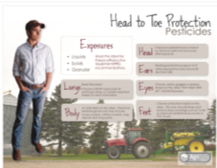





Recommended Resources www.agrisafe.org

Slide 65

AgriSafe Website

Slide 66
Recommended Resources
Occupational Safety & Health Administration
  https://www.osha.gov/SLTC/youth/agriculture/index.html
  https://www.dol.gov/whd/regs/compliance/whdfs40.htm
  https://www.osha.gov/SLTC/heatillness/
  https://www.osha.gov/stopfalls/
EPA Worker Protection Standard
  http://www.epa.gov/pesticide-worker-safety/agricultural-worker-protection-standard-wps
  https://www.epa.gov/pesticide-worker-safety/worker-protection-standard-wps-comparison-chart
Migrant Clinicians Network (MCN)
-- http://www.migrantclinician.org/
National Children's Center for Rural & Agricultural Health & Safety
http://www.marshfieldresearch.org/nccrahs
Young Workers.org Young Workers Project/U.C. Berkeley
- http://youngworkers.org/our-materials/employers/

Slide 67

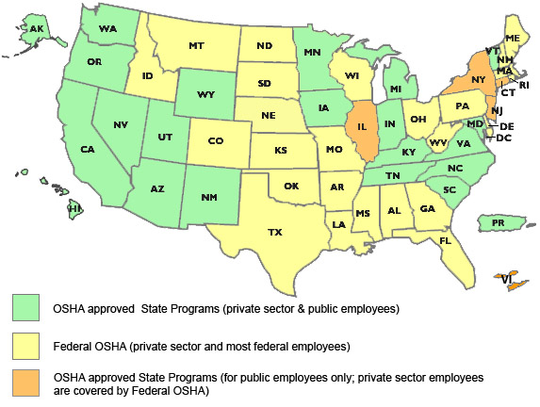
State to State
Important to check with your state OSHA since
there are 25 states that match or exceed this OSHA Instruction
Notes:
Many states have different OSHA Instruction
Could require more under each state plan – be sure to check with your state
State OSHA can be a resource

Slide 68

Employee Rights and Responsibilities
You have the right to:
  A safe and healthful workplace
  Know about hazardous chemicals
  Information about injuries and illnesses in your workplace
  Complain or request hazard correction from employer
Notes:
Review Employee Rights www.osha.gov

Slide 69
Employee Rights and Responsibilities
You have the right to:
  Training
  Access to hazard exposure and medical records
  File a complaint with OSHA
  Participate in an OSHA inspection
  Be free from retaliation for exercising safety and health rights
Notes:
Review Employee Rights www.osha.gov

Slide 70



OSHA Whistleblower Protection Program
Whistle Blower Protection Program

Slide 71

What is Your Action Plan??

Slide 72

Evaluation
It is the goal of AgriSafe to provide information and education that is vital and pertinent to your agricultural operation.
Please take a few minutes to honestly evaluate this program. Your input and suggestions will help us in our effort to continually improve our work on behalf of the agricultural community.
Notes:
Provide AgriSafe Network with valuable Evaluation information to help improve our presentations

Slide 73

Pre/Post Questions
Notes:
Review contact information

Slide 74
Pre/Post Questions
Notes:
Review contact information

