Slide 1

Purpose and Objectives
This material was produced under grant number SH-26333-SH4 from the Occupational Safety and Health Administration, U.S. Department of Labor. It does not necessarily reflect the views or policies of the U.S. Department of Labor, nor does mention of trade names, commercial products, or organizations imply endorsement by the U.S. Government.
Notes:
1
Course Purpose and Objectives
The purpose of this course is to reduce injuries due to Work-related Musculoskeletal Disorders (WMSDs).
At the completion of this lesson It is expected that all trainees will have the ability to:
Define WMSD
List at least 4 causes of WMSD
Identify at least 4 ways to reduce WMSD in their job
Identify the common symptoms of WMSD and take corrective action
Pass the test corresponding to the training material

Slide 2
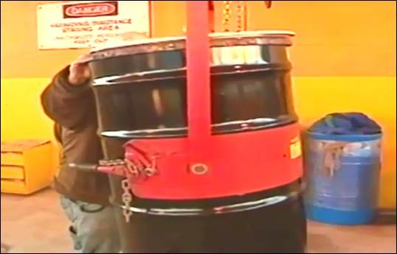
Topics
Notes:
Topics
Understanding OSHA
Defining Ergonomics
The Eight Risk Factors and Ways to Reduce These Risks
Early Symptom Recognition
Conclusion

Slide 3

OSHA
3
3
Notes:
3
3
3
On December 29th, 1970, the Occupational Safety and Health Administration (Federal OSHA) was founded. OSHA is responsible for spreading legally enforceable safety and health standards to protect workers on the job.
The Need for OSHA
Prior to 1970:
• More than 14,000 worker deaths annually
• 2.5 million workers disabled by work-related injuries
• Estimated 300,000 cases of work-related illness
Since 1970:
Work-related fatalities cut by 62%
Overall injury and illness rate reduced 67%
There were 4,405 workers who died on the job in 2013

Slide 4
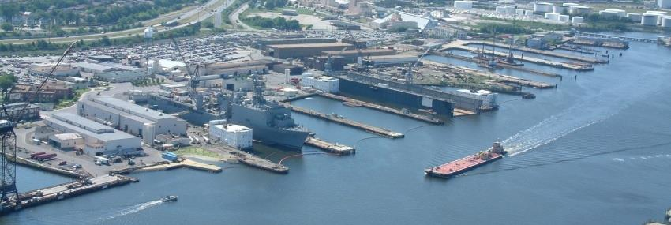
OSHA
Notes:
Employee’s Responsibilities and Rights
Responsibilities include:
Complying with OSHA standards
Wearing required PPE
Reporting hazards to supervisor
Complying with your organization’s rules and policies
Rights include:
Reviewing standards
Receiving training
Requesting an OSHA investigation (employer or OSHA) and receiving
feedback upon request
Reviewing the OSHA 300 Log

Slide 5

OSHA Employer’s Responsibility
5
Notes:
5
5
Employer’s Responsibility
Employers have certain responsibilities under the OSH Act of 1970. The following list is a summary of the most important ones.
Provide a workplace free from recognized hazards and comply with standards, rules and regulations issued under the OSHA Act
Examine workplace conditions to make sure they conform to OSHA standards
Make sure employees have and use safe tools and equipment and properly maintain this equipment
Use color codes, posters, labels or signs to warn employees of potential hazards
Establish or update operating procedures and communicate them so that employees follow safety and health requirements
Provide medical examinations and training when required by OSHA standards
Post, at a prominent location within the workplace, the OSHA poster (or the state-plan equivalent) informing employees of their rights and responsibilities.

Slide 6

OSHA – more Employer’s Responsibility
6
Notes:
6
6
More Employer’s Responsibility
Report to the nearest OSHA office within 8 hours any fatal accident or one that results in the hospitalization of 3 or more employees
Keep records of work-related injuries and illnesses. (Note: Employers with 10 or fewer employees and employers in certain low-hazard industries are exempt from this requirement)
Provide employees, former employees and their representative’s access to the Log of Work Related Injuries and Illnesses (OSHA Form 300)
Provide access to employee medical records and exposure records to employees or their authorized representatives
Provide to the OSHA compliance officer the names of authorized employee representatives who may be asked to accompany the compliance officer during an inspection
Not discriminate against employees who exercise their rights under the Act
Post OSHA citations at or near the work area involved. Each citation must remain posted until the violation has been corrected, or for three working days, whichever is longer. Post abatement verifications documents or tags
Correct cited violations by the deadline set in the OSHA citation and submit required abatement verification documentation

Slide 7

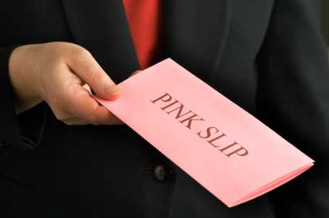
OSHA – No Retribution
Notes:
No Retribution
Section 11(c) (1) No person shall discharge or in any manner discriminate against any employee because such employee has filed any oral and written complaints.
Discrimination includes:
Firing or laying off
Blacklisting demoting
Denying overtime or promotion
Disciplining
Denial of benefits
Failure to hire or rehire
Intimidation
Reassignment affecting future promotions
Reducing pay or hours

Slide 8
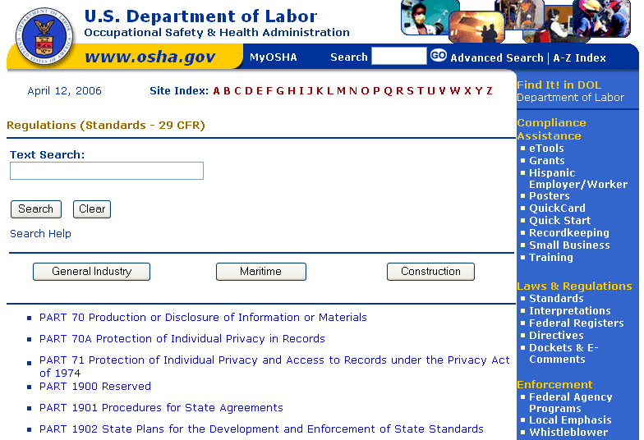
OSHA
Notes:
Resolve With Your Company – Follow your chain of command. Go to your Lead, Supervisor or Safety Technician. However, if this fails you should file a valid complaint.
Online - Go to the Online Complaint Form. Written complaints that are signed by workers or their representative and submitted to an OSHA Area or Regional office are more likely to result in onsite OSHA inspections.
Telephone - your local OSHA Regional or Area Office. OSHA staff can discuss your complaint and respond to any questions you have call 1-800-321-OSHA.
Download and Fax/Mail - Download the OSHA complaint form* [En Espanol*] (or request a copy from your local OSHA Regional or Area Office), complete it and then fax or mail it back to your local OSHA Regional or Area Office. Written complaints that are signed by a worker or representative and submitted to the closest OSHA Area Office are more likely to result in onsite OSHA inspections. Please include your name, address and telephone number so we can contact you to follow up. This information is confidential.

Slide 9
OSHA Exercise
Stump the class!
With a partner, write two questions from this section (pages 3 to 8) that you believe the rest of the class will be challenged in answering correctly. (Questions must be reasonable! If your instructor can’t answer, it doesn’t count!)
Notes:
Question One:
____________________________________________________________________________________________________________________________________________________________________________________________________________________________________________________________________
Question Two:
____________________________________________________________________________________________________________________________________________________________________________________________________________________________________________________________________

Slide 10
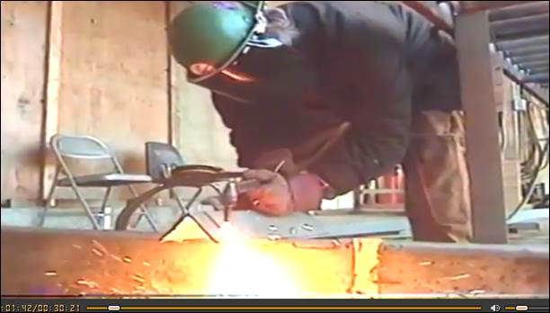
Shipyard Work
Notes:
Introduction
The shipyard work environment is very complex. Shipyards work on a variety of vessels including tankers, cargo carriers, fishing vessels, military ships, and barges. In addition, shipyards perform different types of work such as new ship construction, repair, maintenance, and demolition (shipbreaking). Shipyard work typically involves fabrication and forming of large steel plates, beams, and pipes, as well as painting and coating operations. In addition, there are outfitting activities such as electrical work, sheet metal work, and work on propulsion systems. Welding is also a common job in shipbuilding, requiring grinding and chipping of welds. Moreover, most shipyard employees work outdoors and are exposed to adverse conditions, such as extreme temperatures.
These work activities, and the environments where they take place, can increase the risk of Work-Related Musculoskeletal Disorders (WMSD)

Slide 11
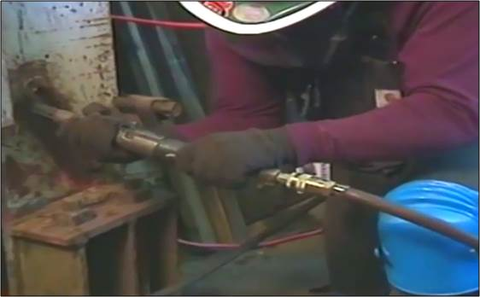
WMSD
Notes:
WMSD
Work-related musculoskeletal disorders (WMSDs) are a group of painful disorders of muscles, tendons, and nerves. Carpal tunnel syndrome, tendonitis, thoracic outlet syndrome, and tension neck syndrome are examples.
For the purpose of developing injury prevention strategies, many health and safety agencies include only disorders that develop gradually and are caused by the overuse of the above constituents of the musculoskeletal system. The traumatic injuries of the muscles, tendons and nerves due to accidents are not considered to be WMSDs or are considered separately.
Almost all work requires the use of the arms and hands. Therefore, most WMSD affect the hands, wrists, elbows, neck, and shoulders. Work using the legs can lead to WMSD of the legs, hips, ankles, and feet. Some back problems also result from repetitive activities.

Slide 12
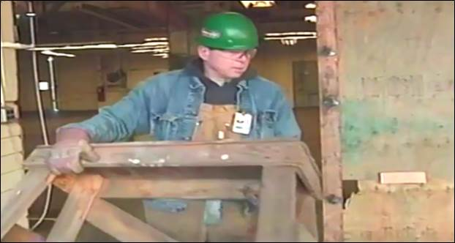
More On WMSD
Notes:
More on WMSD
Some WMSDs develop gradually over time as a result of intensive work. When the work environment requires employees to assume awkward or static body postures for a prolonged period of time, the employees may be at risk of developing WMSDs. Activities outside the workplace that involve substantial physical demands may also cause or contribute to WMSDs. In addition, the development of WMSDs may be related to genetic causes, gender, age, and other factors. Finally, there is evidence that reports of WMSDs may be linked to certain psychosocial factors such as job dissatisfaction, monotony, and limited job. Certain risk factors, that we will discuss shortly, in a job can result in a greater risk of injury. However, the presence of risk factors on a job does not necessarily mean that the employees will develop WMSDs.

Slide 13
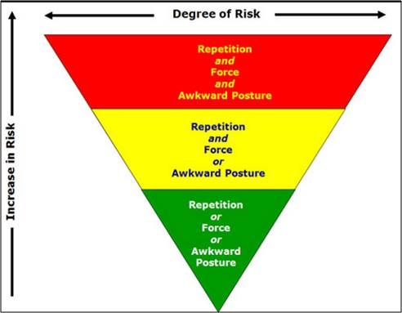
More On WMSD

Slide 14
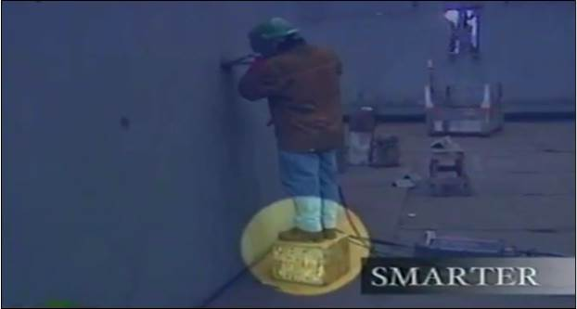
Defining Ergonomics
Notes:
What is Ergonomics?
To reduce the risks of WMSDs shipyard workers and management should implement the principles and practices of Shipyard Ergonomics.
Ergonomics is the science of "designing the job to fit the worker, not forcing the worker to fit the job." Ergonomics covers all aspects of a job, from the physical stresses it places on joints, muscles, nerves, tendons, bones and the like, to environmental factors which can effect hearing, vision, and general comfort and health.
Ergonomics considers body dimensions, mobility, and the body’s stress behavior.
Ergonomics is a practical and critical way to “work smarter not harder”.

Slide 15
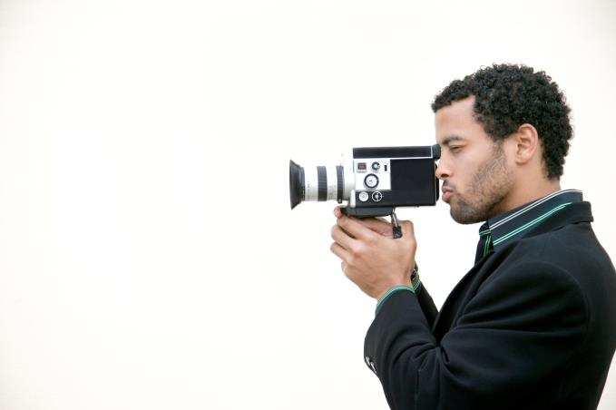
Defining Ergonomics
Notes:
Based on the Video
What is ergonomics?
____________________________________________________________
____________________________________________________________
What shipyard ergonomic practices did you see?
____________________________________________________________
____________________________________________________________
What are some of the injuries that can be reduced or eliminated by following ergonomic practices?
____________________________________________________________
_____________________________________________________________

Slide 16

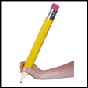
Defining Ergonomics
QUIZ!
16
Notes:
16
For each statement below circle T for True or F for False.

Slide 17
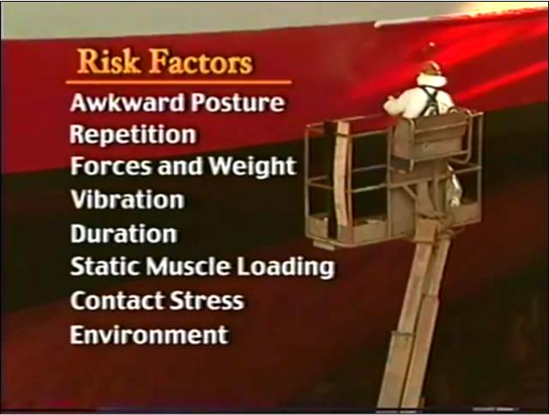
Risk Factors
Notes:
The Seven Risk Factors
It is important to understand the risks of the work that you do. Always keep an eye out for these risks factors and do what you can to eliminate them!
We will now take a look at each of these risk factors in detail.
Awkward Posture
Repetition
Forces and Weight
Vibration
Duration
Static Muscle Loading
Contact Stress
Environment

Slide 18
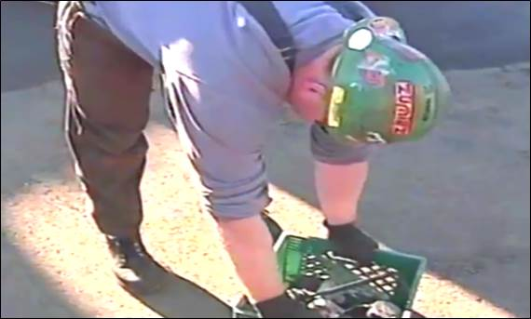
Awkward Position
Notes:
Awkward Position
Any body position can cause discomfort and fatigue if it is maintained for long periods of time. Standing, for example, is a natural body posture, and by itself poses no particular health hazards. However, working for long periods in a standing position can cause:
sore feet
general muscular fatigue
low back pain.
In addition, improper layout of work areas, and certain tasks can make workers use unnatural standing positions.
In addition to standing for long periods of time, lifting, particularly improper lifting, can put undue pressure on the back.

Slide 19
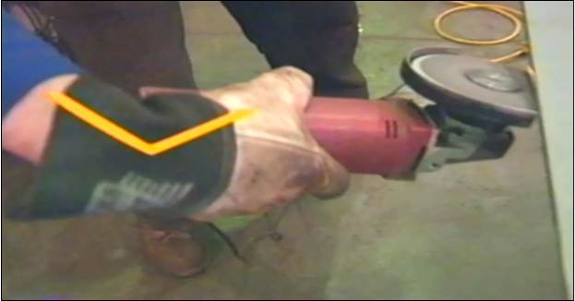
Awkward Position
Notes:
Awkward Position
A muscle’s force is reduced if it is put in a position that is too long or too short.
Muscles get tired faster if they are forced to work in a non-neutral position and tired muscles become overused more quickly than muscles that are rested.

Slide 20
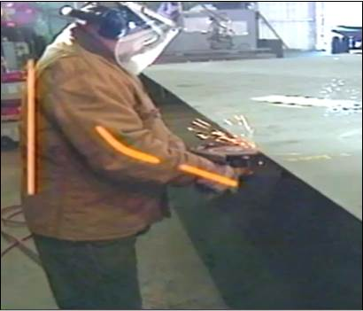
Neutral Positions (Power Zone)
Notes:
Neutral Position
The human body functions best in the neutral position also known as the “power zone.”

Slide 21
Awkward Positions
Notes:
Based on the Video
What does “preserve the curve” mean?
____________________________________________________________
____________________________________________________________
What is the first rule of lifting or lowering an object?
____________________________________________________________
____________________________________________________________
List some ways we can protect our back while doing our work.
____________________________________________________________
_____________________________________________________________

Slide 22
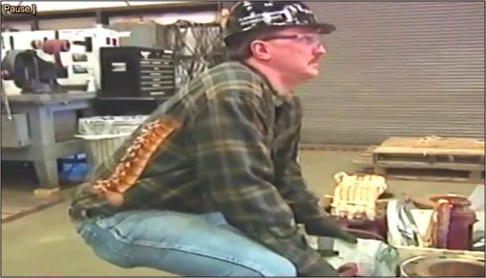
Proper Lifting
Notes:
Below are things you can do to prevent back injury while lifting or lowering an object

Slide 23
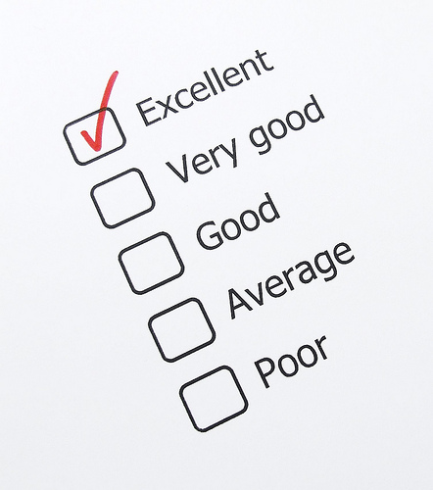
Proper Lifting Exercise
Notes:
Rate the person lifting, walking and lowering the object 1 (low) to 5 (high)

Slide 24
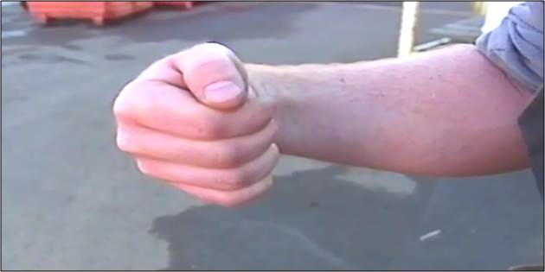
Other Awkward Positions

Slide 25
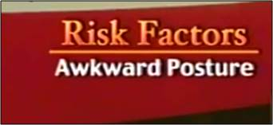
The Work You Do Exercise
Notes:
In the column to the left, list work that you do that is often done in an awkward position

Slide 26
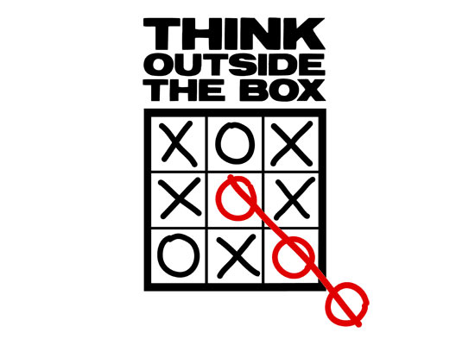
Implementation
Notes:
Examples
The following pages will illustrate and describe some recent shipyard ergonomic improvements.

Slide 27
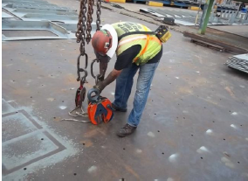
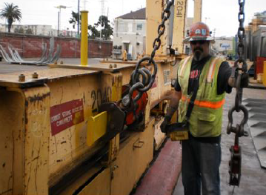
Rigging Attachments
Before
After

Slide 28
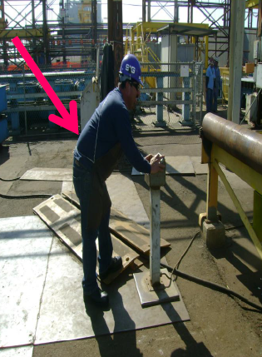
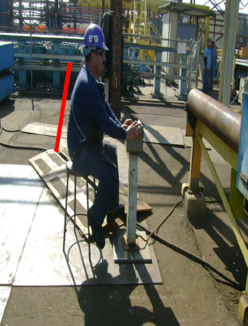
Working at a Bulldozer
Before
After

Slide 29
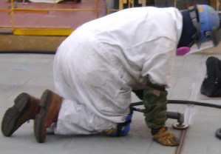
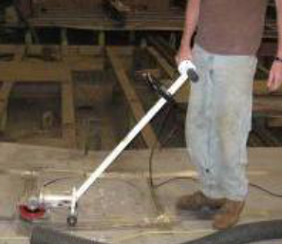
Manual Grinding
Before
After

Slide 30
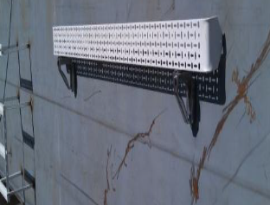
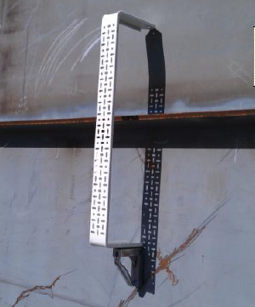
Installing MLP Trays
Before
After

Slide 31
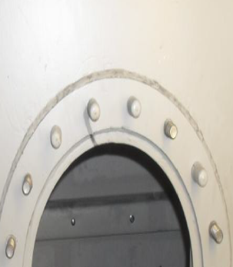
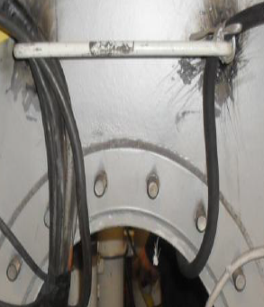
Hand Grab
Before
After

Slide 32
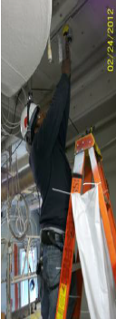
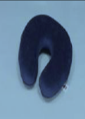
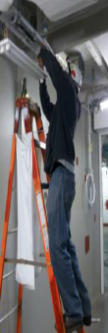
Working on the Overhead
Before
After

Slide 33
Your Turn! (Exercise)
Notes:
From page 25 list your ergonomic improvements to reduce the risk of awkward positioning.

Slide 34
Awkward Positioning
QUIZ!
34
Notes:
34
For each statement below circle T for True or F for False.

Slide 35
Repetition–Forces/Weight–Vibration
Notes:
Based on the Video
Which work better, warm or cold muscles?
____________________________________________________________
____________________________________________________________
What usually bears the brunt of our abuse?
____________________________________________________________
____________________________________________________________
Should we grasp tools tightly?
____________________________________________________________
_____________________________________________________________

Slide 36
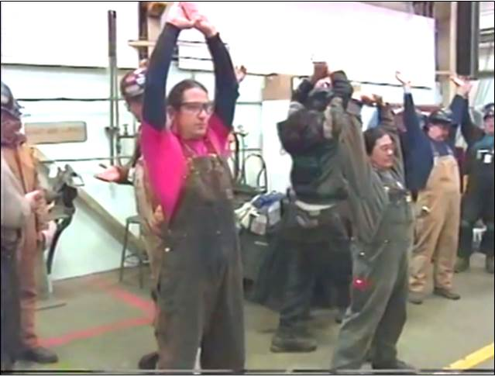
Repetition
Notes:
Repetition
Repetitive motion injuries are tissue injuries that occur as a result of repeating the same body movement. They are among the most common injuries in the United States. All of these disorders are made worse by the strains of daily living.
Simple everyday actions, such as throwing a ball, scrubbing a floor, or jogging, can lead to this condition.
The most common types of repetitive motion injuries are tendinitis and bursitis, injuries to tendons and bursae, respectively. These disorders are difficult to distinguish and often coexist.
Repetition Index

Slide 37
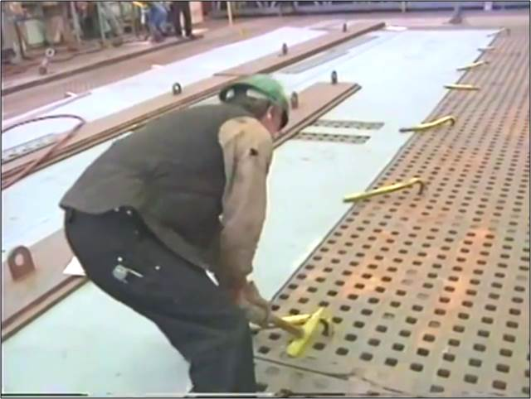
Forces and Weight
Notes:
Forces and Weight
Muscles can be overloaded to a certain point, that’s what makes you stronger. Strength increases when muscles repair themselves. Beyond this point, however, muscles get over used. We are all different, so each persons over-use point is different. We all suffer the consequences the same way, the muscles and joints bear the brunt of the abuse and potential for injury.
Common forceful exertions include:
Grasping
Sliding equipment and materials
Moving
Assembling
Holding
Resisting
To reduce the risk; avoid the lift if you can, reduce the weight, plan your work, organize your work, make simple changes or get help.

Slide 38
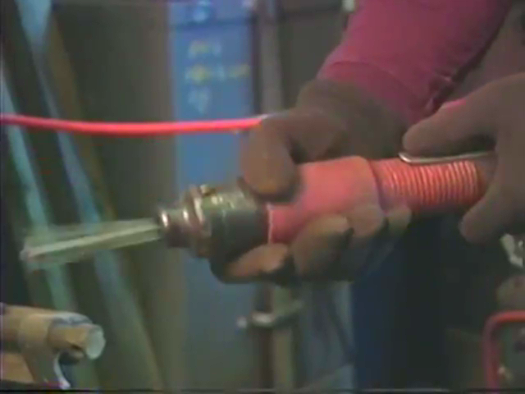
Vibration
Notes:
Hand-Arm Vibration Syndrome (HAVS)
Hand-arm vibration syndrome (HAVS) causes numbness and weakness in fingers, hands and arms, as a result of using vibrating tools.
It is not clear how vibration causes the condition. It is probably due to slight but repeated injury to the small nerves and blood vessels in the fingers. Over time these may gradually lose some of their function and cause symptoms.
The following steps are thought to help prevent HAVS:
Hold tools as loosely as possible, and in varying positions.
Ensure that tools are well-maintained.
Use tools correctly, and use the right tool for the job. The aim is not to need to use excessive grip, nor to use a tool for longer than necessary.
Take regular breaks of at least 10 minutes away from the tool. Short bursts of work are better than long periods of work without a break.
Keep warm while at work - especially your hands.

Slide 39
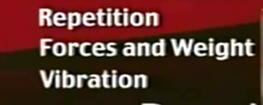
The Work You Do Exercise
Notes:
In the column to the left, list the work you do that relates to Repetition, Forces and Weight and Vibration

Slide 40
Implementation
Notes:
Examples
The following pages will illustrate and describe some recent shipyard ergonomic improvements.

Slide 41
Testing Water-Tight Bulk Heads
Before
After

Slide 42
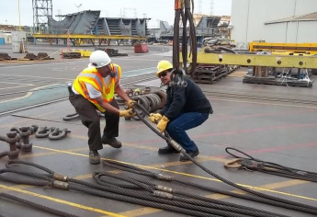
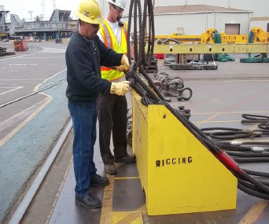
Rigging Slings
Before
After

Slide 43
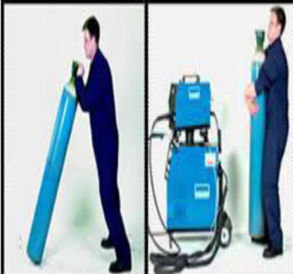
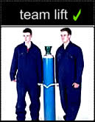
Cylinder Lifts
Before
After

Slide 44
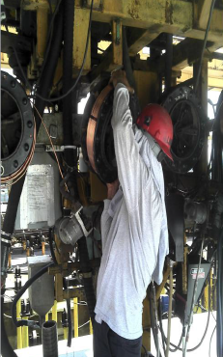
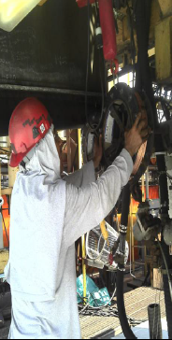
Welding Wire Spools
Before
After

Slide 45

Carrying Fire Bottles
Before
After

Slide 46
Moving Cable Jacks
Before
After

Slide 47
Turning Reels
Before
After

Slide 48
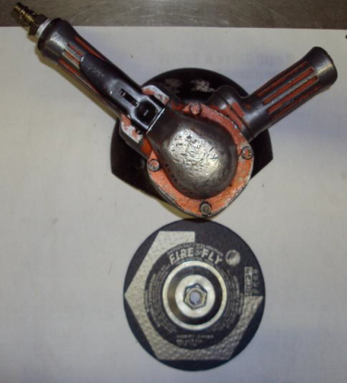
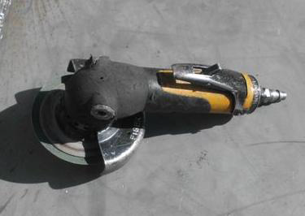
Overhead Grinding
Before
After

Slide 49
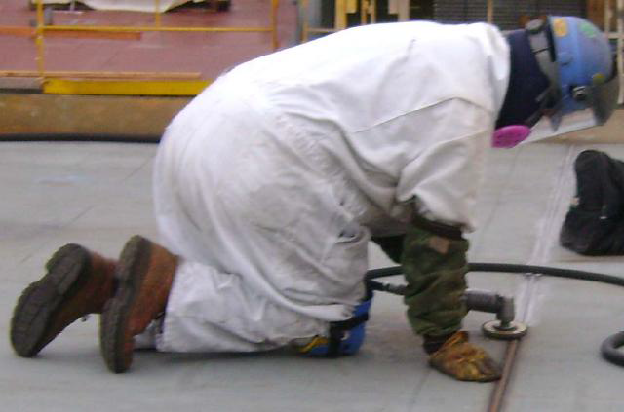
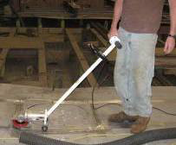
Walk-Behind Grinder
Before
After

Slide 50
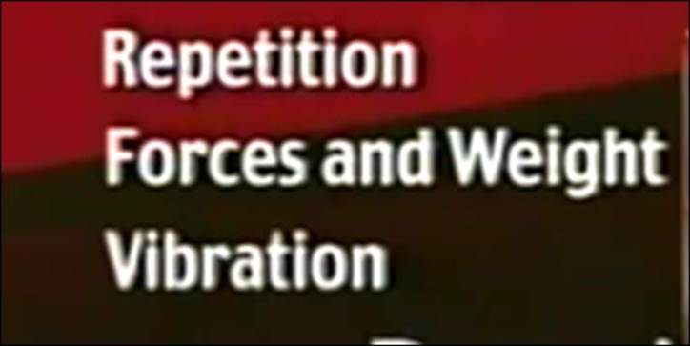
Your Turn! (Exercise)
Notes:
From page 39 list your ergonomic improvements to reduce the risk of Repetition, Forces and Weight and Vibration.

Slide 51
Repetition, Forces/Weight, Vibration
QUIZ!
51
Notes:
51
For each statement below circle T for True or F for False.

Slide 52
Duration – Static Muscle Loading – Contact Stress
Notes:
Based on the Video
What is duration?
____________________________________________________________
____________________________________________________________
What happens when you contract a muscle and don’t let it relax?
____________________________________________________________
____________________________________________________________
What causes contract stress?
____________________________________________________________
_____________________________________________________________

Slide 53
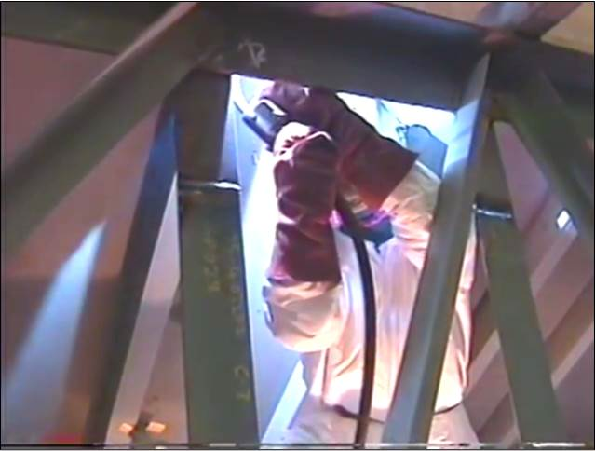
Duration
Notes:
Repetition
The duration of a job task is another ergonomic concern. Duration is defined as the length of time you perform a task during a work shift. The duration of the job task and the length of time our body is exposed to any of the risk factors we have been discussing, have a direct relationship to the potential for injury. The longer the exposure, the greater the risk of over-use. When workers do the same task for a long period of time or work long shifts fatigue becomes a factor and even more attention must be paid to the duration of the task.
Solutions:
Varying the task
Rotating the crew
Making work as easy and comfortable as possible
.

Slide 54
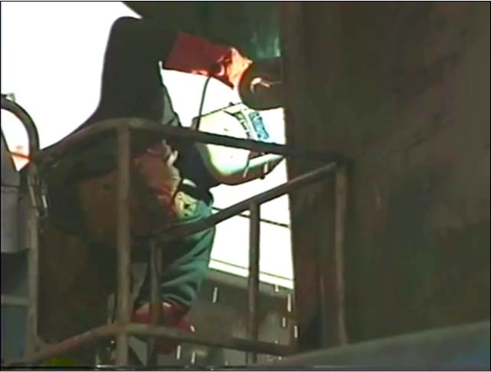
Static Muscle Loading
Notes:
Static Muscle Loading
Static postures (or "static loading") refer to physical exertion in which the same posture or position is held throughout the exertion. These types of exertions put increased loads or forces on the muscles and tendons, which contributes to fatigue. This occurs because not moving impedes the flow of blood that is needed to bring nutrients to the muscles and to carry away the waste products of muscle metabolism. Examples of static postures include gripping tools that cannot be put down, holding the arms out or up to perform tasks, or standing in one place for prolonged periods.
The effects on the body from doing tasks that require long reaches are exacerbated where the reaches must be maintained for more than a very few seconds. Holding extreme postures places very high static loads on the body, resulting in rapid fatigue.
Solutions:
Let up on the force
Change positions
Relax the muscle

Slide 55

Contact Stress
Notes:
Contact Stress
Contact Stress occurs when something hard or sharp comes into prolonged contact with your body. Its significance as an injury factor increases as the force increases and the size of the affected area decreases, concentrating the stress.
It could be caused by sharp edges or short tool handles.
Solutions:
Floor mats
Knee pads
Longer handled tools
Padded stools
Padded handled

Slide 56

The Work You Do Exercise
Notes:
In the column to the left, list the work you do that relates to Duration, Static Muscle Loading and Contact Stress

Slide 57
Implementation
Notes:
Examples
The following pages will illustrate and describe some recent shipyard ergonomic improvements.

Slide 58


The Wrapping Process
Before
After

Slide 59


Moving Cable Jacks
Before
After

Slide 60


Welders Recovering Flux
Before
After
1

Slide 61


Workers Sitting On Steel Plates
Before
After

Slide 62
Workers Moving Heavy Materials
Before
After

Slide 63


You Write The Text Below!
Before
After

Slide 64

Your Turn! (Exercise)
Notes:
From page 56 list your ergonomic improvements to reduce the risk of Duration, Static Muscle Loading and Contact Stress.

Slide 65
Duration, Static Muscle Loading, Contact Stress
QUIZ!
65
Notes:
65
For each statement below circle T for True or F for False.

Slide 66
Environment
Notes:
Based on the Video
What are some of the environmental considerations?
____________________________________________________________
____________________________________________________________
How does temperature impact the body (hot and cold)?
____________________________________________________________
____________________________________________________________
How could inadequate lighting impact the back and neck?
____________________________________________________________
_____________________________________________________________

Slide 67

Environment – Hard Surfaces
Notes:
Environment
Environmental considerations include:
Quality of flooring
Noise Levels
Temperature
Lighting
Hard Surfaces
Hard surfaces take their toll on knees, hips and lower back especially during work tasks characterized by long periods of standing.
Solutions:
Avoiding jumping on hard surfaces, lower yourself down
Use floor convers and/or mats
Vary the task or personnel
Wear proper footwear with shock Absorption.

Slide 68

Environment – Noise Levels and Temperature
Notes:
Environment
Noise Levels
Excessive noise levels could cause hearing loss and a distracting annoyance. The best solution is to reduce the noise. When this cannot be done it is required that you wear hearing protection.
Temperature
Temperature is another environmental stress factor. Cold temperatures inhibit muscles and tendons from working at their maximum capacity. Many of the risk factors previously discussed are aggravated by the cold. When work must be done in cold or wet conditions adequate insulation and/or foul weather gear become part of the workers PPE.
High temperatures, especially with high humidity, can cause fatigue and hear-related disorders. In these conditions it is imperative that workers drink a substantial amount of water and take breaks as necessary to avoid heat-related injury.

Slide 69

Environment – Improper Lighting
Notes:
Environment
Improper Lighting
Improper lighting is another risk factor. Lack of light or too much light can cause eye strain. Inadequate lighting can also cause strain on the back and neck as workers get closer to the work to see what they are doing. Our posture is often affected by our vision. The best place to position the work is where the worker can see it without having to bend or stretch.

Slide 70

The Work You Do Exercise
Notes:
In the column to the left, list the work you do that relates to your work environment?

Slide 71
Implementation
Notes:
Examples
The following pages will illustrate and describe some recent shipyard ergonomic improvements.

Slide 72


Building a Mast Stem
Before
After

Slide 73
Your Turn! (Exercise)
Notes:
From page 70 list your ergonomic improvements to reduce the risk of Duration, Static Muscle Loading and Contact Stress.

Slide 74

Environment Risk Factors
QUIZ!
74
Notes:
74
For each statement below circle T for True or F for False.

Slide 75
Early Symptoms – Conclusion
Notes:
Based on the Video
How do you know when you are at risk in suffering an overuse injury?
____________________________________________________________
____________________________________________________________
What are some guidelines to follow when you experience early symptoms?
____________________________________________________________
____________________________________________________________
What else have you learned?
____________________________________________________________
_____________________________________________________________

Slide 76

Early Symptoms
Notes:
Early Symptoms of WMSD
Pain is the most common symptom associated with WMSDs. In some cases there may be joint stiffness, muscle tightness, redness/swelling of the affected area. Some workers may also experience sensations of "pins and needles," numbness and skin color changes.
WMSDs may progress in stages from mild to severe.
Early stage: Aching and tiredness of the affected limb occur during the work shift but disappear at night and during days off work. No reduction of work performance.
Intermediate stage: Aching and tiredness occur early in the work shift and persist at night. Reduced capacity for repetitive work.
Late stage: Aching, fatigue, and weakness persist at rest. Inability to sleep and to perform light duties.
Not everyone goes through these stages in the same way. In fact, it may be difficult to say exactly when one stage ends and the next begins. The first pain is a signal that the muscles and tendons should rest and recover. Otherwise, an injury can become longstanding, and sometimes, irreversible. The earlier people recognize symptoms, the quicker they should respond to them.

Slide 77

Early Symptoms Continued
Notes:
What You Should Do!
The sooner you treat the symptoms of WMS the sooner they will go away.
Other actions you can take:
Ice the area
Stretch
Look for improvement opportunities!

Slide 78

Conclusion
Notes:
Conclusion
Overuse injuries are a constant hazard, but they can be controlled.
Take Action:
Be on the look out for risk factors
Pay attention to symptoms
Address symptoms
Look for improvement opportunities
Share your knowledge with others
Work Smarter…. Not Harder!

Slide 79

Questions?
Notes:
_____________________________________________________________________________________________________________________________________________________________________________________________________________________________________________________________________________________________________________________________________________________________________________________________________________________________________________________________________________________________________________________________________________________

