Slide 1

T
3
Train
The
Trainer
“Transferring skills and knowledge”
A Port of San Diego Ship Repair Association
Course for Shipyard Workers
This material was produced under grant SH-27645-SH5 from the Occupational Safety and
Health Administration, U.S. Department of Labor. It does not necessarily reflect the views or policies
of the U.S. Department of Labor, nor does mention of trade names, commercial products or
organizations imply endorsement by the U.S. Government.

Slide 2
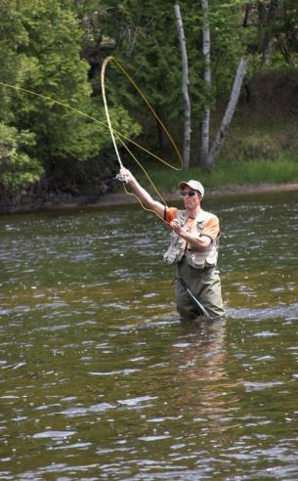
TRAIN THE TRAINER
“You can help a person catch a fish and feed them for a day or you can teach a person how to fish and they can feed themselves for a lifetime.”

Slide 3
EMPLOYEE DEVELOPMENT
“I believe the desire and ability of an organization to continuously learn from any source, anywhere, and rapidly convert this learning into action is its ultimate competitive advantage.”… Jack Welch, Former-CEO General Electric Company.
The skills and knowledge an organization possesses is fast becoming recognized as its most important asset. A key element of organizational excellence is the skill and knowledge its employees possess. To fully empower an individual, that individual must have the ability to be empowered. To hold employees accountable, they must be capable of performing the activity or the job.
The purpose of this course is to build upon your ability to train others.

Slide 4
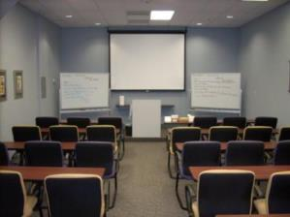
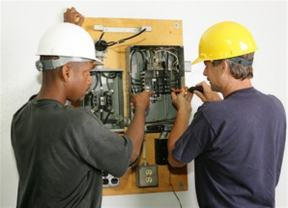
DEFINING TRAINING
“An organized activity designed to bring about change.”
CLASSROOM
ON-THE-JOB

Slide 5
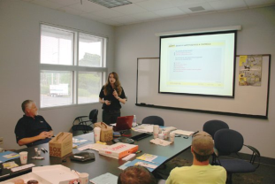

TRAINING TOPICS
Learning Principles
Training Development
Training in a Classroom

Slide 6

THINK OF SOMETHING YOU LEARNED!

Slide 7
COURSE OBJECTIVES
Upon completion of this training course, the
learners will have the ability to:
Demonstrate four qualities of a good trainer
List four things to prepare for training
Conduct a Training Needs Assessment
Put training into context
Write training objectives
Develop a detailed training outline
Develop methods for the trainee to practice
Create an effective learning environment
Use two types of classroom training media effectively
Use four participative training methods
Assess training effectiveness

Slide 8
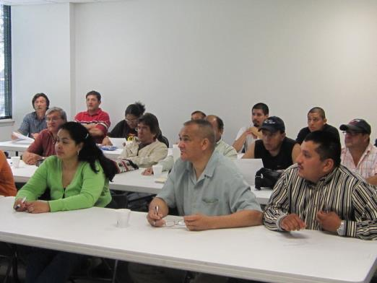
THE QUALITIES OF A GOOD TRAINER
“The mediocre teacher tells. The good teacher explains. The superior teacher demonstrates. The great teacher inspires.”
- William Arthur Ward

Slide 9
NUMBERS!
25
1
26
6
29
2
30
38
41
14
3
13
18
27
4
15
37
16
17
5
39
28
40
42
31
43
32
7
9
44
20
21
34
19
24
36
23
33
22
46
11
10
35
12
48
47
45
8

Slide 10
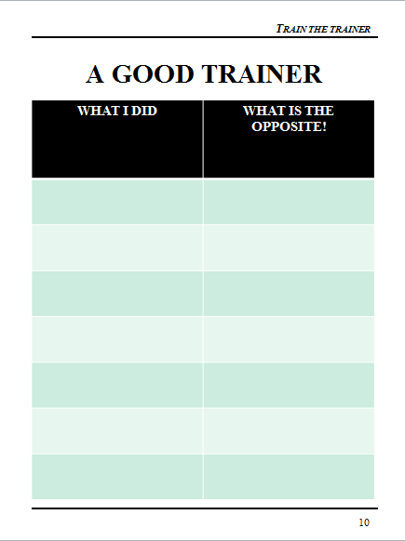
A GOOD TRAINER

Slide 11
TRAINER CHARACTERISTICS
Speaks clearly
Organized
Approachable
Patient
Uses a consistent approach
Reads their participant(s)
Knowledgeable
Confident
Prepared
Flexible
Good Listener
Doesn’t “downplay” task (this is easy)
Has a positive attitude
Makes others feel comfortable
Gives positive feedback

Slide 12
YOUR “TRAINER” RESPONSIBILITIES
As a trainer, please list below what you believe your responsibilities to be:
__________________________________________________________________________________________________________________________________________________________________________________________________________________________________________________________________________________________________________________________________________________________________________________________________________________________________________________________________________________________________________________________________________________________________
____________________________________________________________________________________
____________________________________________________________________________________

Slide 13
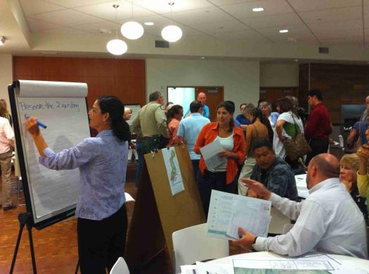
A KEY TRAINER RESPONSBILITY
Creating a Learning Environment!

Slide 14

CREATING A LEARNING ENVIRONMENT
Listen
Encourage Involvement
Have Patience
Transition Skill Right Away

Slide 15

CREATING A LEARNING ENVIRONMENT
Don’t…
Rush
Overwhelm
Doubt
Compare

Slide 16

PREPARING FOR TRAINING
“You can’t drive a car by looking in the rear view mirror.”
- Deming

Slide 17
PREPARATION KEY ELEMENTS
Know the Material/Task
Know skill/knowledge level of trainees
“Walk Through” the Task/Material
Establish the Physical Environment
Design and Use a Checklist
Anticipate Questions

Slide 18
SAMPLE CHECKLIST
Trainer’s Guide (Notes)
Trainee Books
Handout
Notepaper
Pens
LCD Projector
LCD Screen
Lap Top Computer with course and videos
All Cord(s)
Two Flipchart Stands
Two Flipchart Pads
Set of Flipchart Markers
Masking Tape
Feedback Handout

Slide 19
YOUR CHECKLIST
COURSE TITLE: _________________________
___________________________________________
___________________________________________
___________________________________________
___________________________________________
___________________________________________
___________________________________________
___________________________________________
___________________________________________
___________________________________________
___________________________________________
___________________________________________
___________________________________________
___________________________________________
___________________________________________
___________________________________________

Slide 20
WHAT PEOPLE REMEMBER!
Verbal
Read
Visual
Look at pictures
See and Hear
Watch and listen to a demonstration
Say or Write
Take notes
Kinesthetic (Experiential)
Simulate an experience
Do the real thing
Watch an event
Hear words
Watch a video
Explain a procedure

Slide 21
TRAINING DEVELOPMENT
Determine Training Needs
  Training Needs Assessment
Provide Context
  Course Overview
Put Into Digestible Chunks
  Course Outline
Practice, Practice, Practice!
  People learn by doing
Provide On-going Feedback
  Acknowledge your participants!

Slide 22
TRAINING NEEDS ASSESSMENT
Hard Copy – All or select number of employees
  Conducted in meetings, drop-box or mail in
Hard Copy – Focus Group
  Key 6-7 individuals
Electronic Survey
  Free or Pay

Slide 23

THE PROS AND CONS
HARD COPY
HARD COPY FOCUS-GROUP
ELECTRONIC

Slide 24
TRAINING ASSESSMENT COVER MEMO
Our company has been selected and is participating in a Training Program in partnership with the Port of San Diego Ship Repair Association and OSHA’s Susan Harwood Program.
In order to best determine which training to provide to our employees, we would appreciate if you would complete and return the attached Training Needs Assessment Form to:
Insert trainer name or POC here
on or before ______________________________.
We plan to have our training class during the month of January, 2016.
If you have any questions or comments, please let me know.
Thank you for your input.
Signed,
Trainer from your company

Slide 25
TRAINING ASSESSMENT METHOD ONE
Hard Copy – All or a select number of employees
    Expect 30% return
    Return to trainer, drop-box or point of contact for roll up
    Increases “buy-in”
    Can be done through an interview one-on-one or focus group (see next method)

Slide 26
TRAINING ASSESSMENT METHOD TWO
Hard Copy – Focus Group
Groups of 6-7
Allows discussion
Work Group representation
Faster implementation
Faster roll-up
Less buy-in from participants

Slide 27
TRAINING ASSESSMENT METHOD THREE
Electronic Surveys
Survey Monkey – commonly used
Results to trainer or POC
Results done within survey tool
Specifics to be found on Assessment Tool Websites

Slide 28
ELECTRONIC SURVEYS
Electronic surveys have many advantages over traditional surveys, including a reduction in cost and ease of analysis. Drawbacks to this type of data collection include the potential for selection bias and poorer response rates.
The fast, efficient and often 'free' electronic survey has many advantages over the traditional postal data collection method, including ease of analysis for what can be vast amounts of data. However, to capitalize on these benefits, researchers must carefully consider techniques to maximize response rates and minimize selection bias for their target population.

Slide 29
STRATEGIES
Easily accessible link
Stating the length
Stating the population
Sending up to three reminders
Personalizing each email
Adding the updated response rate to reminder emails
Stating the average time it would take to complete the survey in the title of the email

Slide 30
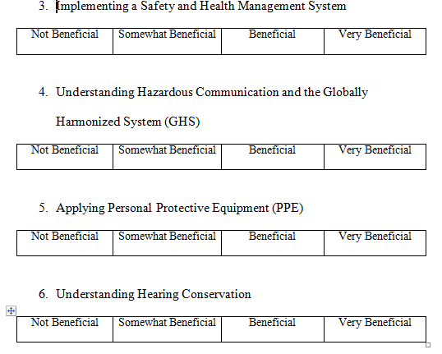
TRAINING NEEDS ASSESSMENT
Sample Assessment

Slide 31
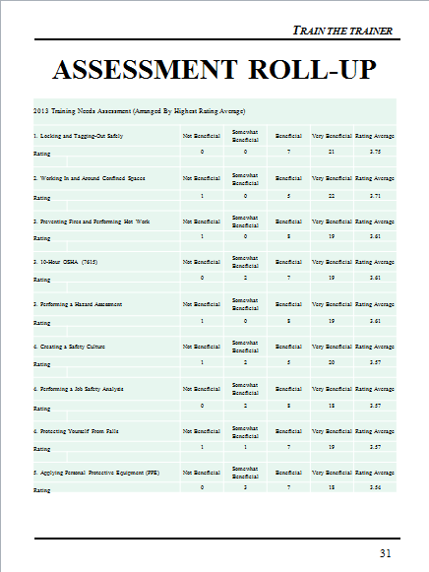
ASSESSMENT ROLL-UP

Slide 32
SAFETY TRAINING RESULTS
The top 8 safety training needs are listed below by highest average score. (Average score in parentheses.)
  1. Locking and Tagging-Out Safely (3.75)
  2. Working In and Around Confined Spaces (3.71)
  3. Preventing Fires and Performing Hot Work (3.61)
  4. 10-Hour OSHA (7615) (3.61)
  5. Performing a Hazard Assessment (3.61)
  6. Creating a Safety Culture (3.57)
  7. Performing a Job Safety Analysis (3.57)
  8. Protecting Yourself From Falls (3.57)

Slide 33
OBJECTIVES SO FAR
Demonstrate four qualities of a good trainer
  _____________________________________
  _____________________________________
  _____________________________________
  _____________________________________
List four things to prepare for training
  _____________________________________
  _____________________________________
  _____________________________________
  _____________________________________
Conduct a Training Needs Assessment
Describe: __________________________ ____________________________________________________________________________________________________________________________________________________

Slide 34

FROM THE TRAINER TO THE TRAINEE
  “The most important component of effective training is what your people take away from it.”
        - Dr. Jerry Mcardle

Slide 35
Context
    How does the task fit into the bigger picture?
    What happens before the task?
    What happens after the task?
    What could go wrong?
    Background/Importance
    Relevance to Trainee

Slide 36

TOO DETAILED TO START

Slide 37

BIGGER PICTURE

Slide 38
ELEMENTS OF A COURSE OVERVIEW
  Course Purpose
  Course Objectives
  Trainee Preparation
  Training Modules
  Background/Importance
  Relevance to Trainee

Slide 39
COURSE OVERVIEW
Installing a TRACKS Terminal
Course Purpose
At the end of this course you will be able to install a TRACKS Terminal
Course Objectives
After completing this course, without help,
you will be able to:
1. Describe Installation Process.
2. Identify all Tools and Materials Needed to
Install TRACKS Terminal.
3. Install the Terminal Unit.
4. Install the Antenna.
5. Install Electrical Hook-Ups.
6. Test Unit for Proper Functioning.
Trainee Preparation
Read installation instructions and be familiar with
the Installation Kit and where it will be mounted.
Training Modules
1. Installing the Terminal Unit.
2. Installing the Antenna.
3. Installing Electrical Hook-Ups.
Background/Importance
TRACKS
  Is an Internet-based service that provides location and status information on heavy equipment. It is a key product/service delivered by our company and sales are on the rise!
Training Relevance
Certification in this module is required for you to perform this task.

Slide 40
PURPOSE AND OBJECTIVES
What is the difference?
_____________________________________________________________________________________________________________________________________________________________________________________________________________________________________________________________________________________________________________________________________________

Slide 41
LEARNING OBJECTIVES
Establish clear-cut, competency-based learning objectives that describe what the learner will be able to do at the end of the training presentation.
What is a learning objective?
A learning objective is a statement describing a learning outcome, rather than a learning process or procedure. It describes results, rather than the means of achieving those results.
Why do we need to write objectives?
  They help the instructor design and select instructional content and procedures
  They provide clear expectations for the learner
  They help the instructor evaluate or assess the success of instruction

Slide 42
OBJECTIVE CRITERIA
  The objective states a time limit
  The objective specifies conditions of performance
  The objective identifies the performer(s)
  The objective contains one action verb
  The objective specifies an acceptable standard of performance

Slide 43
THE 5 CRITERIA
Listed below are the five criteria for writing effective training objectives.
“(1) At the end of the training session, (2) given lockout/tagout equipment and without help, (3) you will (4) perform (5) all of the steps of the chipper lockout/tagout procedure without error.“
  The objective states a time limit. "At the end of the training session“
  The objective specifies the conditions of performance. “given lockout/tagout equipment and without help“
  The objective identifies the performer. "you"
  The objective contains one or more action verbs. “perform“
  The objective specifies an acceptable standard of performance. "all steps, without error.“

Slide 44
OBJECTIVE EXERCISE
Group Exercise: From page 30 evaluate the objectives and rate below.
Course Objectives
After completing this course, without help,
you will be able to:
1. Describe Installation Process.
2. Identify all Tools and Materials Needed to
Install TRACS Terminal.
3. Install the Terminal Unit.
4. Install the Antenna.
5. Install Electrical Hook-Ups.
6. Test Unit for Proper Functioning.
Objective meets standards ____ Does not meet standards _____
Missing criteria number(s): 1 2 3 4 5

Slide 45
OBJECTIVE EXERCISE II
Group Exercise: Analyze each of the following objectives to determine if they measure up to the five criteria. If they do not, circle the number of the missing criteria.
  The objective states a time limit
  The objective specifies conditions of performance
  The objective identifies the performer(s)
  The objective contains one action verb
  The objective specifies an acceptable standard of performance
"Gain a greater awareness of our hazard communications program."
Objective meets standards ____ Does not meet standards _____
Missing criteria number(s): 1 2 3 4 5
“You will be able to rate, with justification, each element of the company’s hazard communications program."
Objective meets standards ____ Does not meet standards _____
Missing criteria number(s): 1 2 3 4 5
“At the end of the training session, given a simulated accident report, learners will be able to identify at least three possible root causes contributing to the accident.”
Objective meets standards ____ Does not meet standards _____
Missing criteria number(s): 1 2 3 4 5

Slide 46
ACTION WORDS
Action verbs describe observable/measurable behaviors. Use action verbs when writing objectives.
Comprehension:
Interpret information in one's own words
classify recognize
describe report
discuss restate
explain review
express select
identify sort
indicate tell
locate translate
Knowledge:
Recall information . . .. . . . . . . . . . . . . . .. . . . … . . . . . . . arrange name
define order
duplicate list
label match
relate recall
repeat reproduce
Application:
Use knowledge in a new situation
apply operate
choose prepare
practice dramatize schedule employ
sketch illustrate
solve interpret
use
Analysis:
Break down knowledge into parts and show relationships among parts
analyze appraise
discriminate calculate
distinguish categorize
examine compare
experiment contrast
inventory criticize
question diagram
Test
Synthesis:
Bring together parts of knowledge to form a whole and build relationships for new situations
arrange manage
assemble organize
collect plan
compose prepare
construct propose
create set up
design synthesize
formulate write
Evaluation:
Make judgments on basis of given criteria
appraise evaluate
argue judge
assess predict
attack rate
choose score
compare select
defend support
estimate value

Slide 47
SAMPLE OBJECTIVES
Training Objectives:
At the completion of this module, without help, the trainee will be able to:
Accurately describe the 6 key elements of an Emergency Action Plan
Accurately describe the 5 key elements of a Fall Protection Plan
Select the proper agency for a given action when presented with a list of agencies
Properly put on 3 types of fall protection equipment
Explain the three key elements of quality
Explain the key points of a quality assurance system
Explain the key points of ISO 9001

Slide 48
YOUR COURSE OVERVIEW
Course Title_______________________________
Course Purpose
After completing this module, you will be able to:
__________________________________________________________________________
__________________________________________________________________________
__________________________________________________________________________
Course Objectives
After completing this module, you will be able to:
1. ___________________________________________________________________
2. ___________________________________________________________________
3. ___________________________________________________________________
4. ___________________________________________________________________
Trainee Preparation
__________________________________________________________________________
__________________________________________________________________________
Training Modules
__________________________________________________________________________
__________________________________________________________________________
__________________________________________________________________________
__________________________________________________________________________
Background/Importance
__________________________________________________________________________
__________________________________________________________________________
__________________________________________________________________________
__________________________________________________________________________
Training Relevance
__________________________________________________________________________
__________________________________________________________________________
__________________________________________________________________________
__________________________________________________________________________

Slide 49
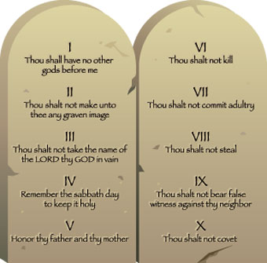
DIGESTIBLE CHUNKS
Adults Build On What They Know

Slide 50
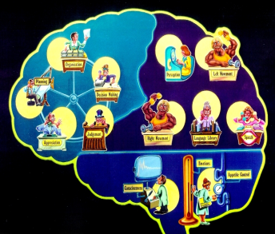
DIGESTIBLE CHUNKS
A manageable chunk of information is one that the learner can easily process and comprehend.
Research suggests that people can best process and remember no more than 5-9 pieces of
information at
one time.
The human
mind will
automatically
group items to
facilitate
memory.

Slide 51
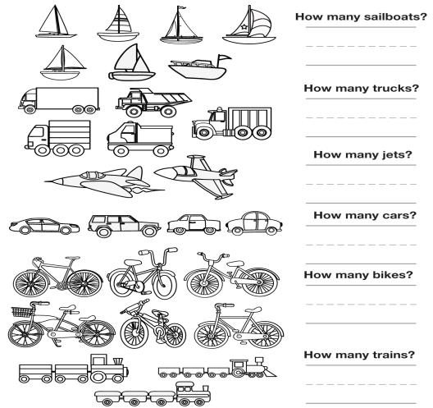
CHUNKING AND SEQUENCING
Information for each training objective should be put in digestible chunks and sequenced!

Slide 52
NUMBERS!
25
1
26
6
29
2
30
38
41
14
3
13
18
27
4
15
37
16
17
5
39
28
40
42
31
43
32
7
9
44
20
21
34
19
24
36
23
33
22
46
11
10
35
12
48
47
45
8

Slide 53

THE WHOLE THING!
Learn This Number
951453020822487

Slide 54

MANAGEABLE UNITS
Now… Learn This Number
Phone:
Address:
(951) 453-0208
22487

Slide 55
MANAGEABLE UNIT EXAMPLE
A writer was assigned to write a policy manual containing 25 policies. Because 25 exceeds the “chunking” limit of 5-9, the writer identified three categories of policies and divided the manual into the following sections:
Section I: Financial Policies
Section II: Safety Policies
Section III: Security Policies

Slide 56
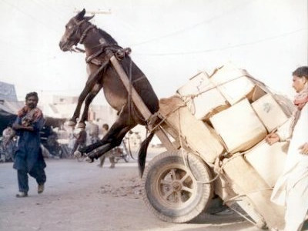
SEQUENCING
The sequencing of training content and material is almost as important as the content itself. It can defeat the purpose of a training program if not carefully thought out. Trainers should be concerned about the logical sequencing of training, because if the lesson does not unfold in a building, reinforcing way, learning will be less effective.
“Don’t put the cart before the horse!”

Slide 57
SEQUENCING STRATEGIES
Basic “strategies” to consider in sequencing safety training:
  1. Information should flow from the general to the specific - Move gradually to the many and varied specific on-the-job applications of the concepts discussed.
  2. Information should develop from the simple to the complex - The design should begin with a fairly simple conceptual overview of the subject to be learned.
  3. Training concepts should move from theory to practical application.
  4. Training may transition from known to unknown concepts, ideas, or processes.
  5. For On-the-Job Training (OJT), sequence the content so that it corresponds to the order in which the tasks are performed on the job.

Slide 58
THE ACANTHOPHOLIS
Acanthopholis (meaning "spiny scales") was an armored, quadrupedal (walked on four legs), plant-eating dinosaur from the early Cretaceous period. Its armor was rows of oval plates set into its skin, plus it had spikes jutting out of its neck and shoulder area along the spine. It was about 15 feet long (4 m) and weighed roughly 380 kg. Acanthopholis lived during the early Cretaceous Period, about 115-91 million years ago. This huge, heavy reptile was an herbivore (it ate only plants). It had to eat a huge amount of low-lying plant material to sustain itself so its gut must have been very large. It probably had a fermentation compartment to aid in the digestion of the tough plant material, producing prodigious amounts of gas. Acanthopholis was an ankylosaur, whose intelligence (as measured by its relative brain to body weight, or EQ) was low among the dinosaurs. Ankylosaur track ways were found in 1996 near Sucre, Bolivia, South America showing that these huge creatures could run at a "decent jog," according to Christian Meyer, a Swiss paleontologist working at the site. Speed estimates are made using the distance between the footprints, the animal's leg length, the pattern of the tracks, and other factors. Partial fossils have been found in England. Acanthopholis was named by the British biologist Thomas H. Huxley in 1865.

Slide 59
THE ACANTHOPHOLIS
There are about 30 facts regarding the Acanthopholis. Outline these facts using Manageable Units and Sequencing Strategies.

Slide 60
SAMPLE OUTLINE
Topic Two: Performance Alignment
The Performance Process
Establishing Trust ….No Surprises!
Planning For Performance
Establishing Expectations
  SMART Objectives
  Establishing the Bar
Measuring Performance
Providing On-Going Feedback (Coaching)
The Performance Discussion
  Setting
  Questioning
  Agreement
Action Planning
Using The Process (On-The-Job-Actions)

Slide 61
YOUR OUTLINE
________________________________________________________________________________________________________________________________________________________________________________________________________________________________________________________________________________________________________________________

Slide 62

PRACTICE, PRACTICE PRACTICE!
“An ounce of practice is worth more than tons of preaching.”
- Gandhi

Slide 63
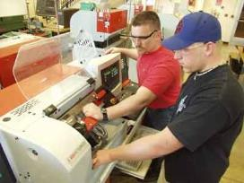

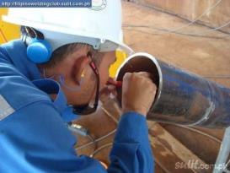
PRACTICE, PRACTICE, PRACTICE!
I do it normal…
I do it slow…
You do it with me…
Then off you go!

Slide 64
ON PRACTICE
Practice should be non-threatening (OK to mess up!)
  Simulated work is best
Practice activities should be set up for each task.
Be available for coaching and questions.
Let the learner decide if they have practiced enough.

Slide 65
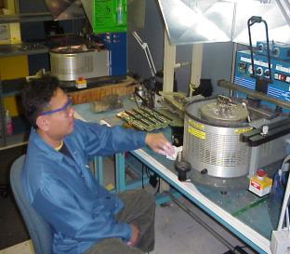
COMPETENCE
The ability to do a job to a specified standard or expectation.
Ability
  Knowledge
  Skills
  Confidence
  Attitude

Slide 66
DETERMINING COMPETENCE
Determine what “competence” means before you begin.
  Quality Standards
  Time Standards
  Waste Standards
Establish performance against standards.
  Written Pre-post Test (Knowledge)
  Measurable Observation (Skill)
  Both the trainer and the trainee must be confident that the trainee is competent.

Slide 67

SAMPLE COMPETENCE CHECKLIST

Slide 68

YOUR COMPETENCE CHECKLIST

Slide 69

PROVIDE ON-GOING FEEDBACK
“A person who feels competent…
is far more likely to perform competently...
and vice versa!”

Slide 70
ON-GOING FEEDBACK
Maintain Self-Esteem
Be Timely
Deliver It Positively
Provide It Often
Do Not Wait Until It Is Perfect
Encourage!

Slide 71

TRAINING IN A CLASSROOM
The physical environment
The power of questions
Use training media effectively
Participative training methods

Slide 72
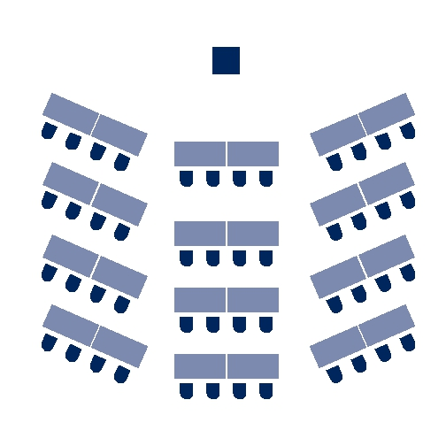
THE PHYSICAL ENVIRONMENT
Listening is purely a voluntary activity!

Slide 73
THE PHYSICAL ENVIRONMENT
List below what you believe to be the optimum physical environment for training.
1.____________________________________________________2.____________________________________________________
3.____________________________________________________
4.____________________________________________________
5.____________________________________________________
6.____________________________________________________
7.____________________________________________________
8.____________________________________________________
9.____________________________________________________
10.___________________________________________________
11.___________________________________________________
12.___________________________________________________
13.___________________________________________________
14.___________________________________________________
15.___________________________________________________
16.___________________________________________________

Slide 74
PHYSICAL ENVIRONMENT ELEMENTS
Temperature
Comfort of Chairs
Space
Distractions
Furniture Arrangement
Lighting
Restrooms

Slide 75
RATING THIS ENVIRONMENT
Temperature ____
Comfort of Chairs ____
Room Size & Dimensions ___
Screen or Chart Locations ___
Distractions ___
Furniture Layout ___
Lighting ___
Restrooms ___

Slide 76
ROOM CHECKLIST
Lighting
How is it controlled?
Is dimmer switch available?
All bulbs/fixtures working?
Windows have shades/blinds?
Do you know how to operate?
Electrical Outlets
Where are they?
Is an extension cord needed?
Do you need an adapter?
Microphone
Are there more than 40 people?
What type of microphone?
Did I practice using it?
Audience Comfort
Temperature Control?
Room dimensions?
Screen location?
Comfort of chairs?
Noise/distractions?
Restroom locations?
Room Set-up
Theater style?
U-shape style?
Herringbone style?
Classroom style?
Conference style?
Buzz style?
Stage
Practice walking/climbing?
Is there a lectern?
Are there lights?
Is it adjustable?

Slide 77
YOUR ENVIRONMENT
WHERE YOU WILL BE TRAINING ___________________________________________
How can the environment be improved?
___________________________________________
___________________________________________
___________________________________________
___________________________________________
___________________________________________
___________________________________________
___________________________________________
___________________________________________
___________________________________________
___________________________________________
___________________________________________
___________________________________________
___________________________________________

Slide 78

RULE OF THUMB ONE
Tell your audience what you're going to tell them. (Pre-Test)
Tell them. (A variety of training methods)
Then tell them what you told them. (Section Summaries)
Let them tell you! (Questioning, Post-Test)
Notes:
State:
Explain that during the course of this workshop you will be presenting 4 “Rules of Thumb” which are important points. This is the first. Introduce this slide by pointing out that they have probably heard the first three points before during a political speech or debate. Read each bullet. The information in parenthesis are some of the methods that were used in your training to achieve each bullet.
Ask:
If there are questions.
Target Response/Key Points
The last bullet in bold is perhaps the most important.

Slide 79


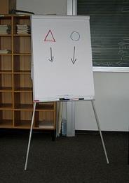
TYPES OF MEDIA
Video
Slides/Multi-media
Flipcharts

Slide 80

USING THE RIGHT MEDIA …RIGHT!
Not the goal!

Slide 81
DEVELOPING AND USING MEDIA
Presenters use media to both increase their persuasiveness and heighten audience retention.
Increase Persuasiveness
  Presenters using visual aids conduct meetings in 28% less time
  Proposals are approved twice as often
Heighten Retention
  Retention increases by about 10%
  Participants learn vocabulary twice as well
  People comprehend about 7% of information delivered verbally. They comprehend 87% when the information is delivered both verbally and visually.

Slide 82
WHAT PEOPLE REMEMBER!
Verbal
Read
Visual
Look at pictures
See and Hear
Watch and listen to a demonstration
Say or Write
Take notes
Kinesthetic (Experiential)
Simulate an experience
Do the real thing
Watch an event
Hear words
Watch a video
Explain a procedure

Slide 83


SLIDES WITH DISCUSSION
See and Hear
  Watch and listen to a demonstration
  Watch a video

Slide 84
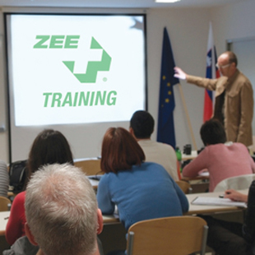

TAKING NOTES WHILE WATCHING A VIDEO
See and Hear
  Watch and listen to a demonstration
  Watch a video

Slide 85


THE PROS AND CONS
The Pros The Cons
VIDEO __________________________ ___________________________
      __________________________ ___________________________
POWERPOINT __________________________ ___________________________
      __________________________ ___________________________
FLIPCHARTS __________________________ ___________________________
      __________________________ ___________________________
HANDOUTS __________________________ ___________________________
      __________________________ ___________________________

Slide 86

REMEMBER!
With any type of projection device, the darker the room the clearer the picture.
However……
The darker the room the more difficult it is to see and hear you.
The darker the room the more difficult it is to take notes.
The darker the room the less audience participation you will receive.

Slide 87
YOUR MEDIA
Write below the media you are planning on using for your presentation and why you have selected that media.
________________________________________________________________________________________________________________________________________________________________________________________________________________________________________________________________________________________________________________________________________________________________________________________________________________________________________________________________________________________________________________________________________________________________________________________________________________________________________________________________________________________________________________________________________________________________________________________________________________________________________________________________________________________________________________________________________________________________________________________________________________________________________________________________________________________________________________________________________________________________________________________

Slide 88
PARTICIPATIVE
TRAINNG METHODS
Team Competition
Rewards
Pre-Post Testing
Graphics/Pictures
Individual Exercises
Demonstration
Summaries
Videos
Games
Questions
Every training method should
have a learning objective!
Notes:
State:
Explain that these were some of the methods used to transfer learning. This list came from going through the classes and identifying each method. Explain that you will be explaining each method as we move forward.
Ask:
No Questions
Target Response/Key Points
We often have more learning methods than we realize.
Reiterate: Every method should have a learning purpose. Different methods help keep attention, but each method should support your training objectives.

Slide 89

THE POWER OF QUESTIONS
“Judge a man by his questions rather than his answers.”
- Voltaire

Slide 90
OPEN QUESTIONS
Questioning Accomplishes:
  Gathering of information, sharing ideas, learning about a situation
  Obtaining specific information
  Encouraging people to think!!
  Guiding a conversation
  Providing general information or specific information
  Demonstrating that you value the thoughts and feelings of others.

Slide 91
TYPES OF OPEN QUESTIONS
What….this will focus the training on events
How….this will focus the training on the process or sequence of doing things
Why….this will require an explanation
Who can tell me about….
Please explain…
I would like your opinion regarding..
I am interested in your views of…
Tell me your feelings about...

Slide 92
THE DIFFERENCE
Let me tell you why you need to …
You shouldn’t do this because…
The best way to do this is…
My experience in this is…
If you use this tool, be sure to…
I am going to do this because…
Who can tell me why you need to …?
If I were to do this, what would happen?
What do you think is the best way to do this?
What is your experience in this?
How should you use this tool?
Why would I do this?

Slide 93

ANOTHER GOOD REASON TO QUESTION
It makes the trainer’s life a lot easier!

Slide 94
QUESTIONING
In the space provided below, write 5 statements regarding the
training you will be conducting. After finishing those 5
statements, turn them into open ended questions.
STATEMENTS QUESTIONS
____________________________________
____________________________________
____________________________________
____________________________________
____________________________________
____________________________________
____________________________________
____________________________________
____________________________________
____________________________________

Slide 95
TRAINING METHODS
Why use a variety of learning methods?
_________________________________________________________________________________________________________________________________________________________________________________________________________________________________________________________________________________________________________
Notes:
State:
Explain that this is the first “team” activity. Have each table, or group of 2-4 participants brainstorm this together.
While the teams work on this exercise, set up a flipchart to record team scores (see below).
Identify who has the most number of responses and ask them to read them. Give this team 10 points. Ask if any other teams have anything to add. Give those that responded a fruit snack. Explain that you will be using the team competition method for the rest of the workshop.
Ask:
If there are any questions.
Target Response/Key Points
Explain that these are two method that are used consistently in the training. 1) Team competition 2) rewards
Team 1
Team 2
Team 3
Team 4
10

Slide 96

USING DIFFERENT METHODS
Generates interest
People learn in different ways
People learn at different rates
People learn from different experiences
People learn from fun experiences
Notes:
State:
Read slide. Acknowledge those that are the same as the participant responses and point out any that are different.
Ask:
No Questions
Target Response/Key Points
Reiterate that these are the reasons for using a variety of training methods.

Slide 97

REWARDS
Participating
  Reading
  Answering questions
  Providing examples
  Encouraging others
  Offering suggestions
  Others?
Notes:
State:
Explain that this slide provides examples of when rewards (fruit snacks) were used. Read slide.
Ask:
If there are questions
Target Response/Key Points
Remember: You can not use grant funds for fruit snacks!

Slide 98
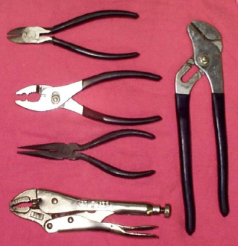
PRE-POST TEST
Circle the letter of the matches the pliers
A B C D E Slipjoint
15. A B C D E Needle nose
A B C D E Multi-groove / Channel Lock
A B C D E Diagonal
18. A B C D E Vise Grip / Locking
A
B
C
E
D
Notes:
State:
This is one example of part of a pre and/or post test. Explain that a variety of testing methods are used, such as; true/false, fill-in-the-blank, connect the picture to the description, put-in-order, etc.
Ask each team to complete the “quiz” on the slide together.
Allow 2 minutes to complete
Ask:
Who would like to share your answers. Pick the first hand that goes up. If they answer correctly give the team 10 points. If they answer incorrectly give the team fruit snacks for participating.
Target Response/Key Points
Learning can and should be fun!

Slide 99
RULE OF THUMB TWO
Seven Slide Rule
No more than seven slides/pages without a change in media.
Notes:
State:
Explain that this slide means that if you are just lecturing for more than 7 or 8 slides (about 10 minutes) you will lose your audience. If you show more that two videos in succession for over 10 minutes, you will lose your audience.
Ask:
If there are questions.
Target Response/Key Points
If your training materials are great and you are a great trainer it will not matter if your audience is not listening.

Slide 100
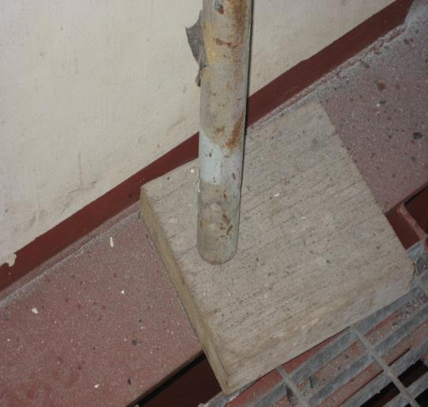

GRAPHICS/PICTURES
Notes:
State:
Explain that pictures are a powerful learning tool. A picture does speak a thousand words. Explain that photos are often used in training sessions to identify what is right and what is not. It is difficult to take your participants to the work site so this is one way of taking the work site to them.
Ask:
What’s wrong with this picture?
Target Response/Key Points
The leg of the scaffold should be held in the middle of the mud sill by a base plate (see next slide)
“What’s wrong with this picture” is a learning tool that teaches right from wrong but also generates discussion.

Slide 101
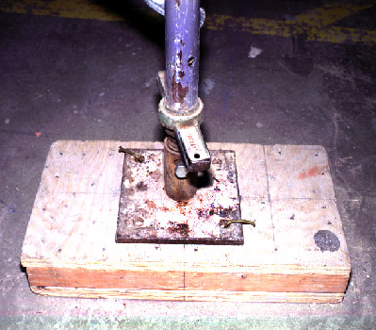
GRAPHICS/PICTURES
Mudsill
Base plate
Notes:
State:
Explain that this is correct.
This leads us to the next slide…
Ask:
No Questions
Target Response/Key Points
None

Slide 102
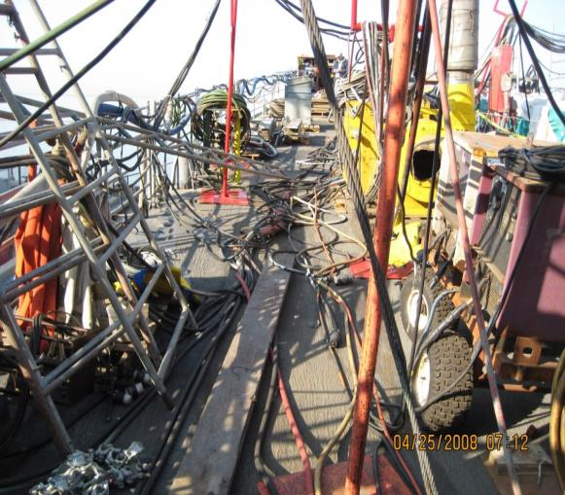
WHAT’S WRONG WITH THIS PICTURE?
dd
Notes:
State:
If time permits, ask the teams to list on a piece of paper “What’s wrong with this picture.”
Reward the team that has the most comprehensive list with 10 points or fruit snacks!
If time does not permit, just explain that this is an example of using the technique and in this photo there are about 10 things wrong with this picture.
Ask:
No Questions
Target Response/Key Points
Reiterate the “Power of the Picture.”

Slide 103

RULE OF THUMB THREE
If you show a negative picture, graphic or example always show the positive.
Notes:
State:
Read the slide.
Ask:
Why is this important?
Target Response/Key Points
What we see is often what we do. Plus it is difficult sometimes to “see” the opposite of what is being shown.

Slide 104
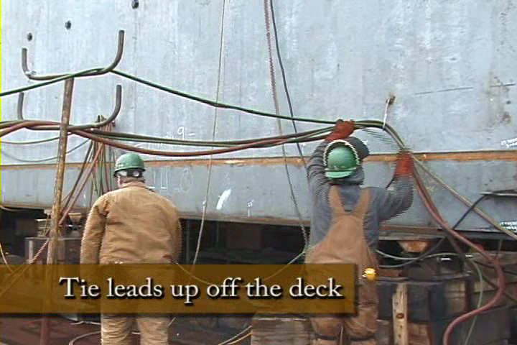
GOOD EXAMPLE!
Notes:
State:
This is an example of “What’s right with this picture.”
Ask:
If there are questions.
Target Response/Key Points
Now the participant knows how to correct a hazard the proper way.

Slide 105

INDIVIDUAL EXERCISE
Using the table below, list the work you perform in the left column,
the hazardous materials and/or chemicals you use to perform that
work in the middle column and the potential adverse health affects
in the right column.
Notes:
State:
Often team exercises are not effective. If you have participants from different organizations that do different jobs, a team exercise may not be effective, and may in fact be confusing. This is an example of an individual exercise.
Ask:
What is the purpose of this exercise?
Target Response/Key Points
To encourage participants to realize that the materials they frequently use, may in fact be harmful to them.

Slide 106
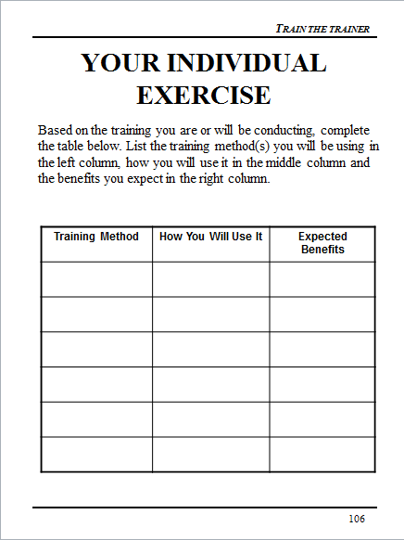
YOUR INDIVIDUAL EXERCISE
Based on the training you are or will be conducting, complete the table below. List the training method(s) you will be using in the left column, how you will use it in the middle column and the benefits you expect in the right column.
Notes:
State:
So far we have covered pre-post testing, team competition, rewards, and individual exercises. Please complete this individual exercise.
Provide about 3 minutes to complete.
Ask:
If anyone would like to share their information.
“What was the objective for this individual exercise.”
Target Response/Key Points
To encourage the participants to integrate additional training methods into their presentations.

Slide 107


DEMONSTRATION
For a fruit snack, who would demonstrate how to properly put in ear plugs?
Notes:
State:
Many people learn by “doing.” When possible I, or one of the participants, will demonstrate a skill. This can be incorporated into the team competition.
Ask:
Who would like to demonstrate putting in earplugs?
Ask the participants for feedback regarding their demonstration.
(Reward the volunteer with a fruit snack!)
Target Response/Key Points
Demonstrating a skill helps learning stick!

Slide 108
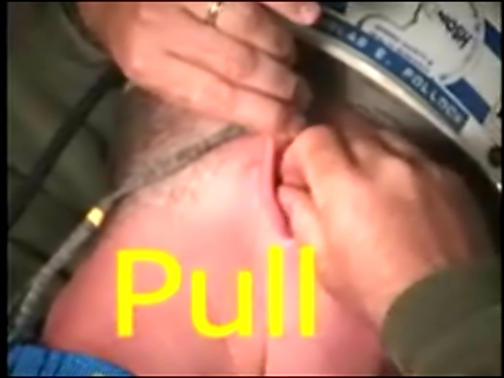
DEMONSTRATION
Notes:
State:
If the ear plugs were not put in correctly, demonstrate the correct way. If so, move on.
Ask:
No Questions
Target Response/Key Points
None

Slide 109

SECTION SUMMARIES
Draw a Line From the Type of Eye Protection
to the Key Feature It Possesses
Notes:
State:
At the end of key training sections, in this case the training module was addressing eye protection, we will often do a review of the training. In this method, using pictures, we are asking the participant to draw a line from the type of eye protection to the best description. Explain that often these summaries help make up the pre-post tests.
If time permits, allow participants to complete this exercise in teams. If not, move on.
Ask:
What is the purpose of this exercise?
Target Response/Key Points
To learn some different types of eye protection and to differentiate the purpose of each.

Slide 110

VIDEO EXERCISE
Step 1: Watch the video
Step 2: Discuss with your team
“what should have been done
differently” and list below
Step 3: Be prepared to share
your list with the class
_________________________________________________________________________________________________________________________________________________________________________________________________________________________________________________________________________________________________________________________________________________________________________________________________________________________________________________________
Notes:
State:
This is a 6 minute exercise.
Watch the video.
Discuss in your teams “What should have been done differently?”
Feedback to the class your findings
Reward what you consider the “best” answer with 10 points.
Reward all responses with a fruit snack.
Ask:
What did you like about this exercise?
What didn’t you like about this exercise?
Target Response/Key Points
Explain that this activity incorporated the following training methods:
Video
Team Competition
Rewards
Let the participants know that these videos are available on OSHA’s website.

Slide 111

RULE OF THUMB FOUR
When structuring a game or activity, assume the training participants have no idea what you are talking about (See Rule of Thumb One!).
Notes:
State:
It is very important to structure activities in detail. Activities take time and if they are structured incorrectly will cause confusion.
Ask:
If time permits, ask participants to share what they have learned in the past regarding structuring activities.
Target Response/Key Points
Do not rush introducing an activity. Go into detail each step that is expected.

Slide 112

GAMES
  Stump the Class
  Jeopardy
  Hangman
  Put-In-Order
Notes:
State:
These are some of the learning games we commonly use in training.
Read the list.
Explain that you will be discussing each of these, except for jeopardy, which we have been “playing” during our workshop.
Ask:
No Questions
Target Response/Key Points
None

Slide 113
STUMP THE CLASS
With a partner, write a questions from this section (Training Methods) that you believe the rest of the class will be challenged in answering correctly. (Questions must be reasonable! If your instructor can’t answer, it doesn’t count!)
________________________________________________________________________________________________________________________________________________________________________________________________________________________________________________________________________________________________________________________________________________
Notes:
State:
Read the slide and ask each team to write two “reasonable” questions from the material discussed so far.
This may be shortened by asking them to write one question.
Let them know that if they “Stump The Class” their team will be given 10 points.
Ask:
What is the purpose of this exercise?
Target Response/Key Points
Serves as a fun way to review material.
Encourages discussion between team mates.

Slide 114
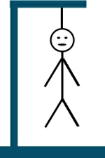
HANGMAN
s _ _ _ _ s _ _ _ _ R _ _ _
The three words above a “rule of thumb”. When you are ready to solve please raise your hand,
discuss with your team, give the answer and an explanation.
Notes:
State:
Hangman is a fun way to reinforce key points. You will need a flipchart and pad.
Explain that the team that solves the “puzzle” must also be able to explain three elements of the “puzzle”.
Explain that the words are a slide header that you recently discussed.
Go around the room and have each team give you a letter. When they give you a letter that fits the words on the slide fill them in. At any time a team can solve the puzzle instead of giving you a letter.
The team that solves the puzzle receives 10 points.
If they are incorrect or cannot provide you with 3 of the elements they will lose 10 points.
The words are Video Benefits.
Ask:
What was the purpose of this exercise?
Target Response/Key Points
A fun way to review key points of a learning objective.

Slide 115
PUT-IN-ORDER
Number the steps below in the correct order. Put the number 1 in the box in front of the first step, the number 2 in the box in front of the second step and so on.
The RA shall review accuracy of proposed tag out and sign block 10 of the TORS sheet (Tag-out record sheet).
The RA and the Watch / Duty Officer will sign block 14 of the WAF form once the system and or component has been verified to have been drained / de-energized / depressurized and cooled down when working with steam.
The ships Engineering Duty Officer will authorize the tag outs for engineering related systems.
Ship will prepare tags based on the WAF.
The RA shall conduct an independent review for the validation and accuracy of the tags, print name, badge, and company and sign block 7 of the hung tag and initial block 18b of the TORS.
Tags will be hung by the ships force representative first signer (Authorizing Officer).
A second qualified ships force representative shall conduct an independent review and sign tag.
The RA will have the Watch / Duty Officer Sign block 13 of the WAF form after verification of tags has been completed by the RA.
The ships Combat System Officer of the Watch will authorize tag outs for combat related systems.
Notes:
State:
This is an example of an exercise used in your Lock Out – Tag Out class. Explain that this is not an exercise that the participants will be completing.
Read the slide instructions and give the participants one minute or so to review.
Ask:
What are the benefits of this activity?
Target Response/Key Points
To learn the proper procedure of Tag Out on a Navy Vessel. It is much more likely to “stick” than simply reading the process because of the involvement and sharing required to complete.

Slide 116


QUESTIONING
Who can tell me the four “Rules of Thumb?”
_________________
_________________
_________________
_________________
Notes:
State:
Speaking of questions….
Ask:
Who can give me one rule of thumb?
Two?
Three?
Four?
Target Response/Key Points
Give the team that can give you the most “rules of thumb” 10 points!

Slide 117
STRESS REDUCERS
Fear: A distressing emotion aroused by an impending pain, danger or evil; or by the illusion of such. According to some surveys, presenting before a group
is a leading “fear creator”. No matter what nervous symptoms you experience before your audience, the secret is to control nervousness - not eliminate it.
Physical Stress Reducers
  Deep breathing
  Relaxation techniques
  Isometric exercises
  Moving and gesturing
  Eye contact
Psychological Reducers
  Acceptance
  Positive attitude
  Affirmation
  Visualization
  Worst/best case
  Preparation
  Practice

Slide 118
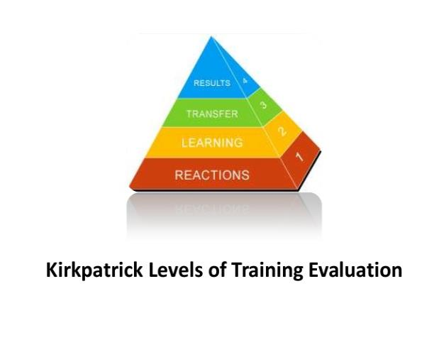
TRAINING EVALUATION
Notes:
What are the different levels of training evaluation required under the Susan Harwood Training Grant Program?
Level 1 – Training Session Reaction Evaluation
Level 1 evaluations measure a participants reaction to the training session and includes the trainee’s perceptions of the quality and usefulness of the training. The results should be used for the improvement of the training program. This type of evaluation can be accomplished through trainee satisfaction surveys regarding both the relevancy of the information taught and the teaching style of the instructor. Level 1 evaluations should be conducted for all training sessions and should be included as part of the training materials development validation process.
Level 2 – Learning Evaluation
Learning evaluations measure the skills, knowledge, or attitude that the trainee retains because of the training. This could be accomplished through pre- and/or post-training evaluations. Alternatively, trainees could be required to perform a new task that was taught during the training and the result evaluated. Level 2 evaluation should be conducted for all training and should be included as part of the training materials development validation process.
Level 3 – Training Impact Evaluations
Training impact evaluations gauge the effect of the training on the trainees’ ability to participate in safety and health activities in the workplace. Grantees should specify at least one measure that is closely linked to the expected outcomes of their planned activities. Examples of such measures could be:
Increases in workers’ involvement in workplace safety as demonstrated by reporting the pre-training level and the level at follow-up three to six months later,
Increases in the number of hazards reported as demonstrated by reporting the pre-training level and the three to six month follow-up level,
Increases in the number of workers participating on safety committees as demonstrated by reporting the pre-training level and the three to six month follow up level,
Increases in the number of reported accident near misses as demonstrated by reporting the pre-training level and the three to six month follow up level,
Increases in the number of formal complaints filed, trainee retention of knowledge, positive impacts of training activities on work practices, etc.
Training impact evaluations are typically conducted three to six months after the training and require the grantees to re-contact trainees by phone, in person, or by survey.

Slide 119
LEVELS OF EVALUATION
Level 1 – Training Session
  Reaction Sheets
Level 2 – Learning Evaluation
  Pre-Post Tests
Level 3 – Training Impact
  Behavior Change
Notes:
What are the different levels of training evaluation required under the Susan Harwood Training Grant Program?
Level 1 – Training Session Reaction Evaluation
Level 1 evaluations measure a participants reaction to the training session and includes the trainee’s perceptions of the quality and usefulness of the training. The results should be used for the improvement of the training program. This type of evaluation can be accomplished through trainee satisfaction surveys regarding both the relevancy of the information taught and the teaching style of the instructor. Level 1 evaluations should be conducted for all training sessions and should be included as part of the training materials development validation process.
Level 2 – Learning Evaluation
Learning evaluations measure the skills, knowledge, or attitude that the trainee retains because of the training. This could be accomplished through pre- and/or post-training evaluations. Alternatively, trainees could be required to perform a new task that was taught during the training and the result evaluated. Level 2 evaluation should be conducted for all training and should be included as part of the training materials development validation process.
Level 3 – Training Impact Evaluations
Training impact evaluations gauge the effect of the training on the trainees’ ability to participate in safety and health activities in the workplace. Grantees should specify at least one measure that is closely linked to the expected outcomes of their planned activities. Examples of such measures could be:
Increases in workers’ involvement in workplace safety as demonstrated by reporting the pre-training level and the level at follow-up three to six months later,
Increases in the number of hazards reported as demonstrated by reporting the pre-training level and the three to six month follow-up level,
Increases in the number of workers participating on safety committees as demonstrated by reporting the pre-training level and the three to six month follow up level,
Increases in the number of reported accident near misses as demonstrated by reporting the pre-training level and the three to six month follow up level,
Increases in the number of formal complaints filed, trainee retention of knowledge, positive impacts of training activities on work practices, etc.
Training impact evaluations are typically conducted three to six months after the training and require the grantees to re-contact trainees by phone, in person, or by survey.

Slide 120
LEVEL 1
Example Methods
  Written survey
  Cards – red, yellow, green (tally results)
  Group session (tally results)
Example Questions
  Was the learning environment conducive to learning?
  What thing could we have done to make the training better?
  How do you feel after participating in this training?
  On a scale of 1 (low) to 5 (high), how would you rate the trainer?
Notes:
Level 1 evaluations can be conducted through a number of methods. Common methods include written surveys, participant cards that are held up and tabulated by the instructor, or through group sessions where the group leader records the results.
Typical Level 1 evaluations typically contain five to 10 questions, and acquire information about the course format, learning environment, course methodology, if the course covered the appropriate topics, and instructor.

Slide 121
LEVEL 1 EXAMPLE RESULTS
Examples of How Results are Reported
  All participants were provided a Level 1 evaluation.
  93% of the class rated the learning environment conducive to training as green (green, yellow, red scale)
  Participants felt the training would have been better if the module on worker’s rights included ______
  Participants felt that after the training session they would be better able to approach their supervisor about a safety hazards
Examples of Modifications as a Result of the Level 1 Survey
  Based on Level 1 results from the first three training sessions, the instructor manual was modified to include _____
  Based on the Level 1 results from the initial training, module 1 was modified from a lecture to a hands-on activity
Notes:
This slide lists example results for Level 1 evaluations that should be reported in the close-out report. Examples include:
How many participated in the survey
% or number of respondents to each survey question
List of qualitative results
Any trends or changes to the training that occurred as a result of the Level 1 evaluation

Slide 122
FEEDBACK FORM

Slide 123
LEVEL 2
Example Methods
  Written pre and post training evaluations
  Oral pre and post training evaluations
  Group session (tally results pre and post training for comparison)
Knowledge Questions from Learning Objectives
  When is fall protection required?
  What are the three words for preventing illness related to heat?
  OSHA is a government agency that works on?
Notes:
Level 2 evaluations can be conducted through written or verbal pre and post training evaluations, or as a post training evaluation of the participants proficiency at completing a skill. Pre and post evaluation questions should be the same, so that the results are comparable. The results of the evaluations should be tabulated and reported in the close-out report; preferably on a question by question level.
Level 2 evaluation questions should be based on the course learning objectives. Typical Level 2 questions are multiple choice, fill-in-the-blank, extended answer, true/false, or demonstrating a proficiency in an activity.

Slide 124

SAMPLE POST-TEST
Shipyard Ergonomics
Pre-Test Post-Test
NAME: _________________________________DATE:_________________________
True or False: For each statement below, circle T or F

Slide 125
MIX IT UP!
True / False
Fill In The blank
Multiple Choice
Put-In-Order
Draw a Line To The Picture
Try to avoid subjective questions!

Slide 126
LEVEL 2 EXAMPLE RESULTS
Examples of How Results are Reported
  476 of the 499 participants participated in the pre and post training evaluations
  The evaluation consisted of 25 questions
  Pre training scores ranged from 33% to 68% and post training scores ranged from 65% to 98%
Examples of Modifications as a Result of the Level 2 Evaluation
  The training evaluation was modified from a individual to group format to increase participation
  Due to low test scores during our first 3 training sessions, the module on wearing PPE was modified for clarification
Notes:
This slide lists examples of Level 2 evaluation results that should be reported in the close-out report. Examples include:
How many participated in the evaluation
Overall pre and post training evaluation results
Question by question pre and post training evaluations
List of qualitative results
Any trends or changes to the training that occurred as a result of the Level 2 evaluation

Slide 127
DEVELOP A TEST FOR THIS CLASS SO FAR!
____________________________________________________________________________________________________________________________________________________________________________________________________________________________________________________________________________________________________________________________________

Slide 128
LEVEL 3
Example Methods
  Direct mail
  Online survey
  Focus Group
  Telephone survey/in-person interview
Example Questions
  Have any new occupational safety and health measures been implemented as a result of the training? If so, what?
  Have you shared anything you learned in the training with a co-worker or family?
  Has knowledge from the training been applied since you returned to your job? If so, how?
Notes:
Level 3 evaluations should be conducted three to six months following the training session. Each training participant should be offered the opportunity to participate in Level 3 evaluations. Typical response rates are less than 10%. Methods for survey distribution include direct mail, email, online, through focus groups, or through telephone and in-person surveys.
Level 3 evaluation questions should focus on safety and health measures that may have been implemented as a result of the knowledge conveyed during the training.

Slide 129
LEVEL 3 EXAMPLE RESULTS
Examples of How Results are Reported
  10% of the participants responded to the survey and/or participated in the focus groups
  As a result of the training, our company has developed a safety committee
  As a result of the training, our company has initiated completion of job hazard analysis for all positions
Examples of Modifications as a Result of the Level 3 Evaluation
  A one-hour refresher module was added to the Train-the-Trainer curriculum
  Based on feedback, training was expanded to the following states: Florida, Georgia, and Tennessee
Notes:
This slide lists examples of Level 3 results that should be reported in the close-out report. Examples include:
How many participated in the evaluation
Quantitative results
List of qualitative results
Any trends or changes to the training that occurred as a result of the Level 3 evaluation

Slide 130
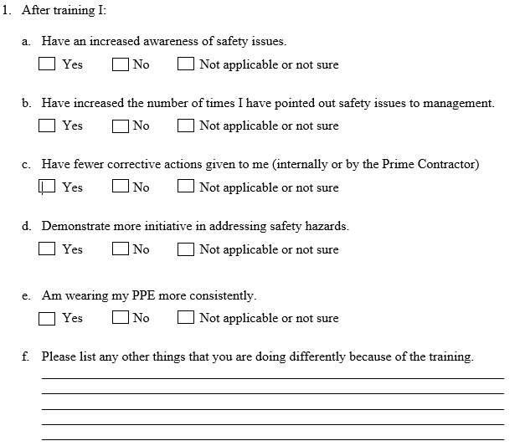
LEVEL 3
QUESTIONAIRE

Slide 131

QUESTIONS?!
Notes:
State:
(Tally up the “winners” based on the flipchart scores)
Have the participants give the winners a hand.
Explain to the winners that they just received their reward! for winning!
Also, give them each a fruit snack.
Ask:
If there are questions.
Target Response/Key Points
None

