Slide 1

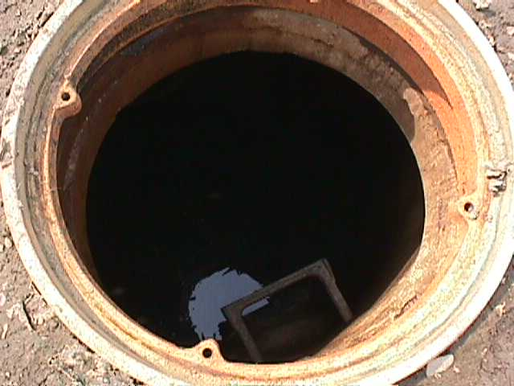
Confined space in construction
Confined Space in Construction
This material was produced under grant number SH-27662-SH5 from the Occupational Safety and Health Administration, U.S. Department of Labor. It does not necessarily reflect the views or policies of the U.S. Department of Labor, nor does mention trade names, commercial products, or organizations imply endorsement by the U.S. Government.

Slide 2
Objectives
Develop an understanding of the hazards of confined space entry
Understand the OSHA regulations for confined Space
Develop and understanding of risk analysis of confined space hazards
Develop an understanding of safe entry into confined spaces
Understand the need for confined space rescue

Slide 3

Construction Rule Background
"This rule will save lives of construction workers. Unlike most general industry worksites, construction sites are continually evolving, with the number and characteristics of confined spaces changing as work progresses. This rule emphasizes training, continuous worksite evaluation and communication requirements to further protect workers’ safety and health."
- Assistant Secretary of Labor for Occupational Safety and Health, Dr. David Michaels
Exceptions. This standard does not apply to:
Construction work regulated by §1926 subpart P—Excavations.
Construction work regulated by §1926 subpart S—Underground Construction, Caissons, Cofferdams and Compressed Air.
Construction work regulated by §1926 subpart Y—Diving.
Notes:
Septic Tanks
Sewage Digester
Pumping/Lifting Stations
Silo’s
Vats
Ducts
Utility Vaults
Boilers & Pipeling

Slide 4
OSHA Confined Space Resource Page
OSHA’s webpage contains information on the new regulation, compliance assistance documents, and other resources OSHA has to help employers and workers understand the rule. OSHA will continue to publish new guidance products in the coming months, and will post them here. Please check the website often for updates.
Construction workers often perform tasks in confined spaces - work areas that (1) are large enough for an employee to enter, (2) have limited means of entry or exit, and (3) are not designed for continuous occupancy. These spaces can present physical and atmospheric hazards that can be prevented if addressed prior to entering the space to perform work.
OSHA’s Confined Space page is a starting point for finding information about these spaces, the hazards they may present, and ways to safely work in them.
Notes:
Confined Space entry can take many forms. Workers must know and understand the hazards specific to each.

Slide 5
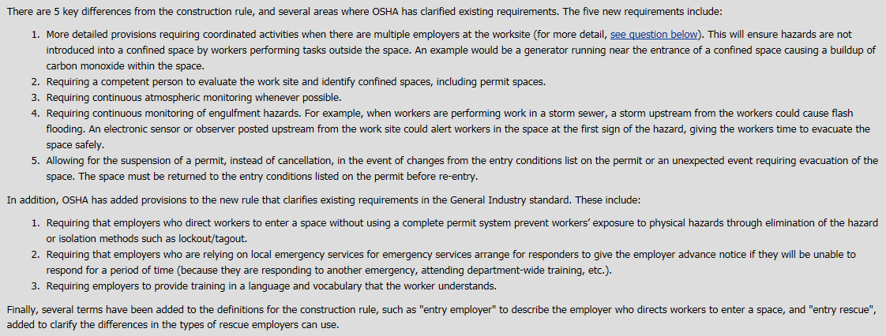
Revised Construction Rule
Notes:
Confined Spaces are one of the most dangerous workplace activities. Workers must be trained in the hazards specific to each entry and the protective measures to be taken to insure worker safety.

Slide 6
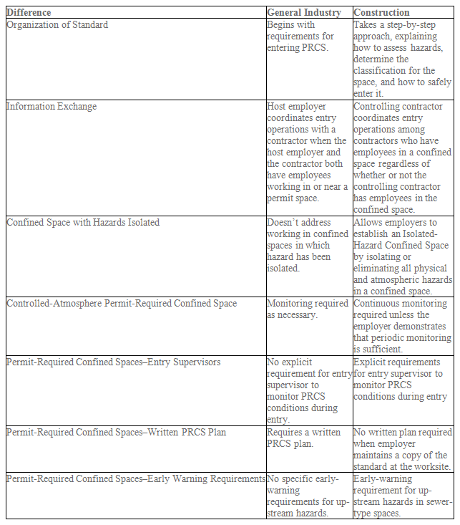
Important Differences 1910 vs. 1926
Notes:
Employers need to have an understanding of OSHA”s regulatory requirements. Construction and General Industry regulations need to be understood and followed.

Slide 7
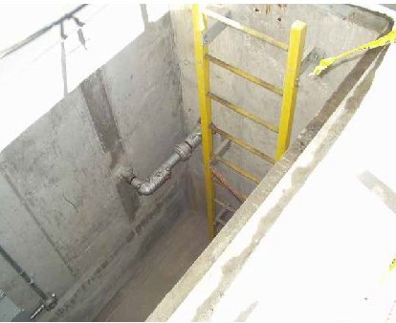
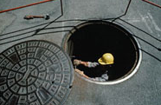
What is a Confined Space?
A space that is large enough and arranged in such a manner that employees can enter the space, has limited or restricted means of entry/exit and is not designed for continuous employee occupancy.
Notes:
Confined Space entry can take many forms. Workers must know and understand the hazards specific to each.

Slide 8
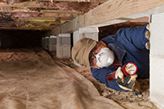
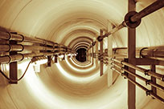
Permit-Required Confined Space:
A confined space that has any one of the following characteristics:
A hazardous atmosphere;
an inwardly converging, sloping, or tapering surfaces that could trap or asphyxiate an employee (for example, a space between walls that arrows towards the base, including, but not limited to, funnels and hoppers);
or an engulfment hazard or other physical hazard.
This definition is similar to the definition in the general industry standard, but includes more examples of dangerous configurations of confined spaces.
Notes:
Employers need to have an understanding of OSHA”s regulatory requirements. Construction and General Industry regulations need to be understood and followed.

Slide 9
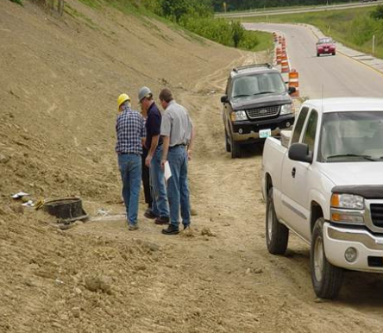
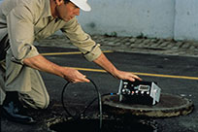
Continuous System-Permit-Required Confined Space:
A Permit-Required Confine Space that has all of the following characteristics: Is part of, and contiguous with, a larger confined space (for example, sewers);
the employer cannot isolate it from the larger confined space;
and is subject to a potential hazard release from the larger confined space that would overwhelm personal protective equipment and/or hazard controls, resulting in a hazard that is immediately dangerous to life and health.
Notes:
Employers need to have an understanding of OSHA”s regulatory requirements. Construction and General Industry regulations need to be understood and followed.

Slide 10
1926.1202 Definitions
Acceptable entry conditions means the conditions that must exist in a permit space, before an employee may enter that space, to ensure that employees can safely enter into, and safely work within, the space.
Attendant means an individual stationed outside one or more permit spaces who assesses the status of authorized entrants and who must perform the duties specified in §1926.1209.
Authorized entrant means an employee who is authorized by the entry supervisor to enter a permit space.
Competent person means one who is capable of identifying existing and predictable hazards in the surroundings or working conditions which are unsanitary, hazardous, or dangerous to employees, and who has the authorization to take prompt corrective measures to eliminate them.
Confined space means a space that:
(1) Is large enough and so configured that an employee can bodily enter it;
(2) Has limited or restricted means for entry and exit; and
(3) Is not designed for continuous employee occupancy.
Controlling Contractor is the employer that has overall responsibility for construction at the worksite.
Note. If the controlling contractor owns or manages the property, then it is both a controlling employer and a host employer.
Early-warning system means the method used to alert authorized entrants and attendants that an engulfment hazard may be developing. Examples of early-warning systems include, but are not limited to: alarms activated by remote sensors; and lookouts with equipment for immediately communicating with the authorized entrants and attendants.
Notes:
Confined Space entry can take many forms. Workers must know and understand the hazards specific to each.

Slide 11
1926.1202 Definitions
Entry means the action by which any part of a person passes through an opening into a permit-required confined space. Entry includes ensuing work activities in that space and is considered to have occurred as soon as any part of the entrant’s body breaks the plane of an opening into the space, whether or not such action is intentional or any work activities are actually performed in the space.
Entry Employer means any employer who decides that an employee it directs will enter a permit space.
Note. An employer cannot avoid the duties of the standard merely by refusing to decide whether its employees will enter a permit space, and OSHA will consider the failure to so decide to be an implicit decision to allow employees to enter those spaces if they are working in the proximity of the space.
Entry permit (permit) means the written or printed document that is provided by the employer who designated the space a permit space to allow and control entry into a permit space and that contains the information specified in §1926.1206 of this standard.
Entry rescue occurs when a rescue service enters a permit space to rescue one or more employees.
Entry supervisor means the qualified person (such as the employer, foreman, or crew chief) responsible for determining if acceptable entry conditions are present at a permit space where entry is planned, for authorizing entry and overseeing entry operations, and for terminating entry as required by this standard.
Notes:
Confined Space entry can take many forms. Workers must know and understand the hazards specific to each.

Slide 12
1926.1202 Definitions
Hazardous atmosphere means an atmosphere that may expose employees to the risk of death, incapacitation, impairment of ability to self-rescue (that is, escape unaided from a permit space), injury, or acute illness from one or more of the following causes:
  Flammable gas, vapor, or mist in excess of 10 percent of its lower flammable limit (LFL);
  Airborne combustible dust at a concentration that meets or exceeds its LFL;
  Atmospheric oxygen concentration below 19.5 percent or above 23.5 percent;
  Atmospheric concentration of any substance for which a dose or a permissible exposure limit is published in Subpart D—Occupational Health and Environmental Control, or in Subpart Z—Toxic and Hazardous Substances, of this part and which could result in employee exposure in excess of its dose or permissible exposure limit;
  Any other atmospheric condition that is immediately dangerous to life or health.
Host employer means the employer that owns or manages the property where the construction work is taking place.
Immediately dangerous to life or health (IDLH) means any condition that would interfere with an individual’s ability to escape unaided from a permit space and that poses a threat to life or that would cause irreversible adverse health effects.
Limited or restricted means for entry or exit means a condition that has a potential to impede an employee’s movement into or out of a confined space. Such conditions include, but are not limited to, trip hazards, poor illumination, slippery floors, inclining surfaces and ladders.
Notes:
Confined Space entry can take many forms. Workers must know and understand the hazards specific to each.

Slide 13
1926.1202 Definitions
Monitor or monitoring means the process used to identify and evaluate the hazards after an authorized entrant enters the space. This is a process of checking for changes that is performed in a periodic or continuous manner after the completion of the initial testing or evaluation of that space.
Non-entry rescue occurs when a rescue service, usually the attendant, retrieves employees in a permit space without entering the permit space.
Non-permit confined space means a confined space that meets the definition of a confined space but does not meet the requirements for a permit-required confined space, as defined in this subpart.
Oxygen deficient atmosphere means an atmosphere containing less than 19.5 percent oxygen by volume.
Permit-required confined space (permit space) means a confined space that has one or more of the following characteristics: (1) Contains or has a potential to contain a hazardous atmosphere; (2) Contains a material that has the potential for engulfing an entrant; (3) Has an internal configuration such that an entrant could be trapped or asphyxiated by inwardly converging walls or by a floor which slopes downward and tapers to a smaller cross-section; or (4) Contains any other recognized serious safety or health hazard.
Permit-required confined space program (permit space program) means the employer’s overall program for controlling, and, where appropriate, for protecting employees from, permit space hazards and for regulating employee entry into permit spaces.
Notes:
Confined Space entry can take many forms. Workers must know and understand the hazards specific to each.

Slide 14
1926.1202 Definitions
Prohibited condition means any condition in a permit space that is not allowed by the permit during the period when entry is authorized. A hazardous atmosphere is a prohibited condition unless the employer can demonstrate that personal protective equipment (PPE) will provide effective protection for each employee in the permit space and provides the appropriate PPE to each employee.
Qualified person means one who, by possession of a recognized degree, certificate, or professional standing, or who by extensive knowledge, training, and experience, has successfully demonstrated his ability to solve or resolve problems relating to the subject matter, the work, or the project.
Rescue means retrieving, and providing medical assistance to, one or more employees who are in a permit space.
Rescue service means the personnel designated to rescue employees from permit spaces.
Retrieval system means the equipment (including a retrieval line, chest or full body harness, wristlets or anklets, if appropriate, and a lifting device or anchor) used for nonentry rescue of persons from permit spaces.
Tagout means:(1) Placement of a tagout device on a circuit or equipment that has been deenergized, in accordance with an established procedure, to indicate that the circuit or equipment being controlled may not be operated until the tagout device is removed; and (2) The employer ensures that (i) tagout provides equivalent protection to lockout, or (ii) that lockout is infeasible and the employer has relieved, disconnected, restrained and otherwise rendered safe stored (residual) energy.
Notes:
Confined Space entry can take many forms. Workers must know and understand the hazards specific to each.

Slide 15
1926.1203 General Requirements
Before work at a worksite, each employer must ensure that a competent person identifies all confined spaces in which one or more of the employees it directs may work, and identifies each space that is a permit space, through consideration and evaluation of the elements of that space, including testing as necessary.
If the workplace contains one or more permit spaces, the employer who identifies, or who receives notice of, a permit space must:
  Inform exposed employees by posting danger signs or by any other equally effective means, of the existence and location of, and the danger posed by, each permit space;
  A sign reading “DANGER – PERMITREQUIRED CONFINED SPACE, DO NOT ENTER” or using other similar language would satisfy the requirement for a sign.
Before an employee enters the space, the internal atmosphere must be tested, with a calibrated direct-reading instrument, for oxygen content, for flammable gases and vapors, and for potential toxic air contaminants, in that order. Any employee who enters the space, or that employee’s authorized representative, must be provided an opportunity to observe the pre-entry testing required by this paragraph.
No hazardous atmosphere is permitted within the space whenever any employee is inside the space.
Notes:
Confined Space entry can take many forms. Workers must know and understand the hazards specific to each.

Slide 16
1926.1203 General Requirements
Continuous forced air ventilation must be used, as follows:
An employee must not enter the space until the forced air ventilation has eliminated any hazardous atmosphere;
  The forced air ventilation must be so directed as to ventilate the immediate areas where an employee is or will be present within the space and must continue until all employees have left the space;
  The air supply for the forced air ventilation must be from a clean source and must not increase the hazards in the space
The atmosphere within the space must be continuously monitored unless the entry employer can demonstrate that equipment for continuous monitoring is not commercially available or periodic monitoring is sufficient.
Any employee who enters the space, or that employee’s authorized representative, must be provided with an opportunity to observe the testing required by this paragraph.
The entry employer must document the basis for determining that all hazards in a permit space have been eliminated or isolated, through a certification. The certification must be made available to each employee entering the space or to that employee’s authorized representative.
Notes:
Confined Space entry can take many forms. Workers must know and understand the hazards specific to each.

Slide 17
1926.1203 General Requirements
Permit Space Entry Communication and Coordination:
Before entry operations begin, the host employer must provide the following information, if it has it, to the controlling contractor:
  The location of each known permit space;
  The hazards or potential hazards in each space or the reason it is a permit space; and
  Any precautions that the host employer or any previous controlling contractor or entry employer implemented for the protection of employees in the permit space.
Before entry operations begin, the controlling contractor must:
Obtain the host employer’s information about the permit space hazards and previous entry operations;
  and provide the following information to each entity entering a permit space
  and any other entity at the worksite whose activities could foreseeably result in a hazard in the permit space:
The information received from the host employer;
  Any additional information the controlling contractor has about the subjects listed in paragraph (h)(1) of this section; and
  The precautions that the host employer, controlling contractor, or other entry employers implemented for the protection of employees in the permit spaces.
After entry operations:
The controlling contractor must debrief each entity that entered a permit space regarding the permit space program followed and any hazards confronted or created in the permit space(s) during entry operations;
Notes:
Confined Space entry can take many forms. Workers must know and understand the hazards specific to each.

Slide 18
1926.1204 Permit-required confined space program
Each entry employer must:
Implement the measures necessary to prevent unauthorized entry;
Identify and evaluate the hazards of permit spaces before employees enter them;
Develop and implement the means, procedures, and practices necessary for safe permit space entry operations.
Provide equipment (specified in paragraphs §1926.1204(d)(1) through (d)(9)) at no cost to each employee, maintain that equipment properly, and ensure that each employee uses that equipment properly:
Evaluate permit space conditions
Provide at least one attendant outside the permit space into which entry is authorized
for the duration of entry operations;
If multiple spaces are to be assigned to a single attendant, include in the permit program the means and procedures to enable the attendant to respond to an emergency affecting one or more of those permit spaces without distraction from the attendant’s responsibilities under §1926.1209 of this standard;
Designate each person who is to have an active role (as, for example, authorized entrants, attendants, entry supervisors, or persons who test or monitor the atmosphere in a permit space) in entry operations, identify the duties of each such employee, and provide each such employee with the training required by §1926.1207 of this standard;
Notes:
Confined Space entry can take many forms. Workers must know and understand the hazards specific to each.

Slide 19
1926.1204 Permit-required confined space program
Develop and implement procedures for summoning rescue and emergency services (including procedures for summoning emergency assistance in the event of a failed non-entry rescue), for rescuing entrants from permit spaces, for providing necessary emergency services to rescued employees, and for preventing unauthorized personnel from attempting a rescue;
Develop and implement a system for the preparation, issuance, use, and cancellation of entry permits as required by this standard, including the safe termination of entry operations under both planned and emergency conditions;
Develop and implement procedures to coordinate entry operations, in consultation with the controlling contractor, when employees of more than one employer are working simultaneously in a permit space or elsewhere on the worksite where their activities could, either alone or in conjunction with the activities within a permit space, foreseeably result in a hazard within the confined space, so that employees of one employer do not endanger the employees of any other employer;
Develop and implement procedures (such as closing off a permit space and canceling the permit) necessary for concluding the entry after entry operations have been completed;
Review entry operations when the measures taken under the permit space program may not protect employees and revise the program to correct deficiencies found to exist before subsequent entries are authorized; and
Review the permit space program, using the canceled permits retained under paragraph §1926.1205(f), within 1 year after each entry and revise the program as necessary to ensure that employees participating in entry operations are protected from permit space hazards.
Notes:
Confined Space entry can take many forms. Workers must know and understand the hazards specific to each.

Slide 20
1926.1205 Permitting Process
Before entry is authorized, each entry employer must document the completion of measures required by paragraph §1926.1204(c) of this standard by preparing an entry permit.
Before entry begins, the entry supervisor identified on the permit must sign the entry permit to authorize entry.
The completed permit must be made available at the time of entry to all authorized entrants or their authorized representatives, by posting it at the entry portal or by any other equally effective means, so that the entrants can confirm that pre-entry preparations have been completed.
The duration of the permit may not exceed the time required to complete the assigned task or job identified on the permit in accordance with paragraph §1926.1206(b) of this standard.
The entry supervisor must terminate entry and take the following action when any of the following apply:
  Cancel the entry permit when the entry operations covered by the entry permit have been completed; or
  Suspend or cancel the entry permit and fully reassess the space before allowing reentry when a condition that is not allowed under the entry permit arises in or near the permit space and that condition is temporary in nature and does not change the configuration of the space or create any new hazards within it; and
  Cancel the entry permit when a condition that is not allowed under the entry permit arises in or near the permit space and that condition is not covered by subparagraph (e)(2) of this section.
The entry employer must retain each canceled entry permit for at least 1 year to facilitate the review of the permit-required confined space program. Any problems encountered during an entry operation must be noted on the pertinent permit so that appropriate revisions to the permit space program can be made.
Notes:
Confined Space entry can take many forms. Workers must know and understand the hazards specific to each.

Slide 21
1926.1206 Entry Permit
The entry permit that documents compliance with this section and authorizes entry to a permit space must identify:
The permit space to be entered;
The purpose of the entry;
The date and the authorized duration of the entry permit;
The authorized entrants within the permit space, by name or by such other means (for example, through the use of rosters or tracking systems) as will enable the attendant to determine quickly and accurately, for the duration of the permit, which authorized entrants are inside the permit space;
Means of detecting an increase in atmospheric hazard levels in the event the ventilation system stops working;
Each person, by name, currently serving as an attendant;
The individual, by name, currently serving as entry supervisor, and the signature or initials of each entry supervisor who authorizes entry;
The hazards of the permit space to be entered;
The measures used to isolate the permit space and to eliminate or control permit space hazards before entry;
Notes:
Confined Space entry can take many forms. Workers must know and understand the hazards specific to each.

Slide 22
1926.1206 Entry Permit
The entry permit that documents compliance with this section and authorizes entry to a permit space must identify:
The acceptable entry conditions;
The results of tests and monitoring performed under paragraph §1926.1204(e) of this standard, accompanied by the names or initials of the testers and by an indication of when the tests were performed;
The rescue and emergency services that can be summoned and the means (such as the equipment to use and the numbers to call) for summoning those services;
The communication procedures used by authorized entrants and attendants to maintain contact during the entry;
Equipment, such as personal protective equipment, testing equipment, communications equipment, alarm systems, and rescue equipment, to be provided for compliance with this standard;
Any other information necessary, given the circumstances of the particular confined space, to ensure employee safety; and
Any additional permits, such as for hot work, that have been issued to authorize work in the permit space.
Notes:
Confined Space entry can take many forms. Workers must know and understand the hazards specific to each.

Slide 23
1926.1207 Training
The employer must provide training to each employee whose work is regulated by this standard, at no cost to the employee, and ensure that the employee possesses the understanding, knowledge, and skills necessary for the safe performance of the duties assigned under this standard. This training must result in an understanding of the hazards in the permit space and the methods used to isolate, control or in other ways protect employees from these hazards, and for those employees not authorized to perform entry rescues, in the dangers of attempting such rescues.
Training required by this section must be provided to each affected employee:
  In both a language and vocabulary that the employee can understand;
  Before the employee is first assigned duties under this standard;
  Before there is a change in assigned duties;
  Whenever there is a change in permit space entry operations that presents a hazard about which an employee has not previously been trained; and
  Whenever there is any evidence of a deviation from the permit space entry procedures required by paragraph §1926.1204(c) of this standard or there are inadequacies in the employee’s knowledge or use of these procedures.
The training must establish employee proficiency in the duties required by this standard and must introduce new or revised procedures, as necessary, for compliance with this standard.
The employer must maintain training records to show that the training required by this standard has been accomplished. The training records must contain each employee’s name, the name of the trainers, and the dates of training. The documentation must be available for inspection by employees and their authorized representatives, for the period of time the employee is employed by that employer.
Notes:
Confined Space entry can take many forms. Workers must know and understand the hazards specific to each.

Slide 24
1926.1208 Duties of Authorized Entrants
The entry employer must ensure that all authorized entrants:
Are familiar with and understand the hazards that may be faced during entry, including information on the mode, signs or symptoms, and consequences of the exposure;
Properly use equipment as required by paragraph §1926.1204(d) of this standard;
Communicate with the attendant as necessary to enable the attendant to assess entrant status and to enable the attendant to alert entrants of the need to evacuate the space as required by paragraph §1926.1209(f) of this standard;
Alert the attendant whenever:
  There is any warning sign or symptom of exposure to a dangerous situation; or
  The entrant detects a prohibited condition; and
Exit from the permit space as quickly as possible whenever:
  An order to evacuate is given by the attendant or the entry supervisor;
  There is any warning sign or symptom of exposure to a dangerous situation;
  The entrant detects a prohibited condition; or
  An evacuation alarm is activated.
Notes:
Confined Space entry can take many forms. Workers must know and understand the hazards specific to each.

Slide 25
1926.1209 Duties of Attendants
The entry employer must ensure that each attendant:
Is familiar with and understands the hazards that may be faced during entry, including information on the mode, signs or symptoms, and consequences of the exposure;
Is aware of possible behavioral effects of hazard exposure in authorized entrants;
Continuously maintains an accurate count of authorized entrants in the permit space and ensures that the means used to identify authorized entrants under paragraph 1926.1206(d) of this standard accurately identifies who is in the permit space;
Remains outside the permit space during entry operations until relieved by another attendant;
Communicates with authorized entrants as necessary to assess entrant status and to alert entrants of the need to evacuate the space under paragraph §1926.1208(e);
Assesses activities and conditions inside and outside the space to determine if it is safe for entrants to remain in the space and orders the authorized entrants to evacuate the permit space immediately under any of the following conditions:
  If there is a prohibited condition;
  If the behavioral effects of hazard exposure are apparent in an authorized entrant;
  If there is a situation outside the space that could endanger the authorized entrants; or
  If the attendant cannot effectively and safely perform all the duties required under §1926.1209 of this standard;
Notes:
Confined Space entry can take many forms. Workers must know and understand the hazards specific to each.

Slide 26
1926.1209 Duties of Attendants
Cont. The entry employer must ensure that each attendant:
Summons rescue and other emergency services as soon as the attendant determines that authorized entrants may need assistance to escape from permit space hazards;
Takes the following actions when unauthorized persons approach or enter a permit space while entry is underway:
  Warns the unauthorized persons that they must stay away from the permit space;
  Advises the unauthorized persons that they must exit immediately if they have entered the permit space; and
  Informs the authorized entrants and the entry supervisor if unauthorized persons have entered the permit space;
Performs non-entry rescues as specified by the employer’s rescue procedure; and (j) Performs no duties that might interfere with the attendant’s primary duty to assess and protect the authorized entrants.
Notes:
Confined Space entry can take many forms. Workers must know and understand the hazards specific to each.

Slide 27
1926.1210 Duties of Entry Supervisors
The entry employer must ensure that each entry supervisor:
Is familiar with and understands the hazards that may be faced during entry, including information on the mode, signs or symptoms, and consequences of the exposure;
Verifies, by checking that the appropriate entries have been made on the permit, that all tests specified by the permit have been conducted and that all procedures and equipment specified by the permit are in place before endorsing the permit and allowing entry to begin;
Terminates the entry and cancels or suspends the permit as required by paragraph 1926.1205(e) of this standard;
Verifies that rescue services are available and that the means for summoning them are operable, and that the employer will be notified as soon as the services become unavailable;
Removes unauthorized individuals who enter or who attempt to enter the permit space during entry operations; and
Determines, whenever responsibility for a permit space entry operation is transferred, and at intervals dictated by the hazards and operations performed within the space, that entry operations remain consistent with terms of the entry permit and that acceptable entry conditions are maintained.
Notes:
Confined Space entry can take many forms. Workers must know and understand the hazards specific to each.

Slide 28
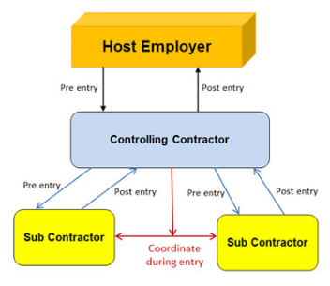
Communication Requirements
The rule makes the controlling contractor, rather than the host employer, the primary point of contact for information about permit spaces at the work site.
Host employers must provide information it has about permit spaces at the work site to the controlling contractor, who then passes it on to the employers whose employees will enter the spaces (entry employers).
Entry employers must give the controlling contractor information about their entry program and hazards they encounter in the space, and the controlling contractor passes that information on to other entry employers and back to the host.
Controlling contractors are also responsible for making sure employers outside a space know not to create hazards in the space, and that entry employers working in a space at the same time do not create hazards for one another’s workers.
Notes:
Employers need to have an understanding of OSHA”s regulatory requirements. Construction and General Industry regulations need to be understood and followed.

Slide 29
1926.1211 Rescue and Emergency Services
An employer who designates rescue and emergency services, pursuant to paragraph §1926.1204(i) of this standard, must:
  Evaluate a prospective rescuer’s ability to respond to a rescue summons in a timely manner, considering the hazard(s) identified;
  Evaluate a prospective rescue service’s ability, in terms of proficiency with rescue-related tasks and equipment, to function appropriately while rescuing entrants from the particular permit space or types of permit spaces identified;
  Select a rescue team or service from those evaluated that:
    Has the capability to reach the victim(s) within a time frame that is appropriate for the permit space hazard(s) identified;
    Is equipped for, and proficient in, performing the needed rescue services;
    Agrees to notify the employer immediately in the event that the rescue service becomes unavailable;
Inform each rescue team or service of the hazards they may confront when called on to perform rescue at the site; and
Provide the rescue team or service selected with access to all permit spaces from which rescue may be necessary so that the rescue team or service can develop appropriate rescue plans and practice rescue operations.
Notes:
Confined Space entry can take many forms. Workers must know and understand the hazards specific to each.

Slide 30
1926.1211 Rescue and Emergency Services
An employer whose employees have been designated to provide permit space rescue and/or emergency services must take the following measures and provide all equipment and training at no cost to those employees:
  Provide each affected employee with the personal protective equipment (PPE) needed to conduct permit space rescues safely and train each affected employee so the employee is proficient in the use of that PPE;
  Train each affected employee to perform assigned rescue duties. The employer must ensure that such employees successfully complete the training required and establish proficiency as authorized entrants, as provided by §§1926.1207 and 1926.1208 of this standard;
  Train each affected employee in basic first aid and cardiopulmonary resuscitation (CPR). The employer must ensure that at least one member of the rescue team or service holding a current certification in basic first aid and CPR is available; and
  Ensure that affected employees practice making permit space rescues before attempting an actual rescue, and at least once every 12 months, by means of simulated rescue operations in which they remove dummies, manikins, or actual persons from the actual permit spaces or from representative permit spaces, except practice rescue is not required where the affected employees properly performed a rescue operation during the last 12 months in the same permit space the authorized entrant will enter, or in a similar permit space. Representative permit spaces must, with respect to opening size, configuration, and accessibility, simulate the types of permit spaces from which rescue is to be performed.
Notes:
Confined Space entry can take many forms. Workers must know and understand the hazards specific to each.

Slide 31
1926.1211 Rescue and Emergency Services
Non-entry rescue is required unless the retrieval equipment would increase the overall risk of entry or would not contribute to the rescue of the entrant. The employer must designate an entry rescue service whenever non-entry rescue is not selected. Whenever non-entry rescue is selected, the entry employer must ensure that retrieval systems or methods are used whenever an authorized entrant enters a permit space, and must confirm, prior to entry, that emergency assistance would be available in the event that non-entry rescue fails. Retrieval systems must meet the following requirements:
  Each authorized entrant must use a chest or full body harness, with a retrieval line attached at the center of the entrant’s back near shoulder level, above the entrant’s head, or at another point which the employer can establish presents a profile small enough for the successful removal of the entrant. Wristlets or anklets may be used in lieu of the chest or full body harness if the employer can demonstrate that the use of a chest or full body harness is infeasible or creates a greater hazard and that the use of wristlets or anklets is the safest and most effective alternative.
  The other end of the retrieval line must be attached to a mechanical device or fixed point outside the permit space in such a manner that rescue can begin as soon as the rescuer becomes aware that rescue is necessary. A mechanical device must be available to retrieve personnel from vertical type permit spaces more than 5 feet (1.52 meters) deep.
  Equipment that is unsuitable for retrieval must not be used, including, but not limited to, retrieval lines that have a reasonable probability of becoming entangled with the retrieval lines used by other authorized entrants, or retrieval lines that will not work due to the internal configuration of the permit space.
If an injured entrant is exposed to a substance for which a Safety Data Sheet (SDS) or other similar written information is required to be kept at the worksite, that SDS or written information must be made available to the medical facility treating the exposed entrant.
Notes:
Confined Space entry can take many forms. Workers must know and understand the hazards specific to each.

Slide 32
1926.1212 Employee Participation
Employers must consult with affected employees and their authorized representatives on the development and implementation of all aspects of the permit space program required by §1926.1203 of this standard.
Employers must make available to each affected employee and his/her authorized representatives all information required to be developed by this standard.
Notes:
Confined Space entry can take many forms. Workers must know and understand the hazards specific to each.

Slide 33
Hazardous Atmospheres
Hazardous
Atmospheres

Slide 34
Atmospheric Testing
1910.146(c)(5)(ii)(C) Pre-Entry Test
Before an employee enters the space, the internal atmosphere shall be tested, with a calibrated direct-reading instrument, for oxygen content, for flammable gases and vapors, and for potential toxic air contaminants, in that order. Any employee who enters the space, or that employee's authorized representative, shall be provided an opportunity to observe the pre-entry testing required by this paragraph.
1910.146(c)(5)(ii)(F) Periodic Testing
The atmosphere within the space shall be periodically tested as necessary to ensure that the continuous forced air ventilation is preventing the accumulation of a hazardous atmosphere. Any employee who enters the space, or that employee's authorized representative, shall be provided with an opportunity to observe the periodic testing required by this paragraph
Notes:
Only trained, qualified personnel should conduct environmental testing. Air quality is a primary concern when exposing workers to a confined space.

Slide 35
Ventilation Considerations
The ventilation air should not create an additional hazard:
Recirculation of contaminants
Improper arrangement of the inlet duct
The substitution of anything other than fresh (normal) air (approximately 20.9% oxygen, 78.1% nitrogen, and 1% argon with small amounts of various other gases).
Notes:
Only trained, qualified personnel should conduct environmental testing. Air quality is a primary concern when exposing workers to a confined space.

Slide 36
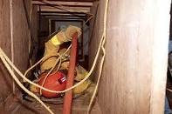


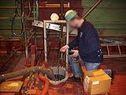
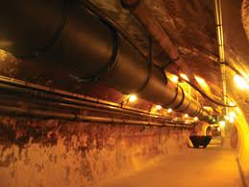
1926.651(g)(1)
Where oxygen deficiency (atmospheres containing less than 19.5 percent oxygen) or a hazardous atmosphere exists or could reasonably be expected to exist, such as in excavations in landfill areas or excavations in areas where hazardous substances are stored nearby, the atmospheres in the excavation shall be tested before employees enter excavations greater than 4 feet (1.22 m) in depth.
Notes:
Only trained, qualified personnel should conduct environmental testing. Air quality is a primary concern when exposing workers to a confined space.

Slide 37
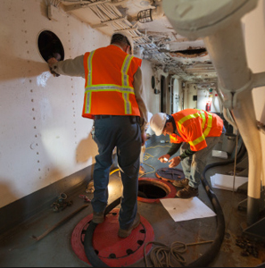
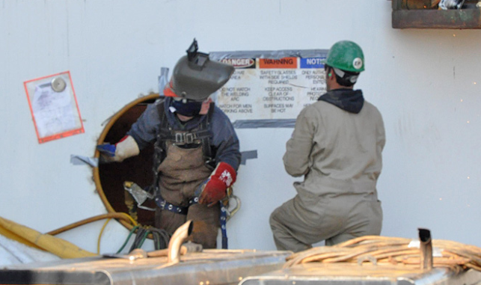
Categories of Confined Spaces
Open tops and with a depth that will restrict the natural movement of air
Enclosed spaces with very limited openings for entry
Notes:
Affected workers need to understand the hazard associated with the various type of spaces they may be required to enter.

Slide 38
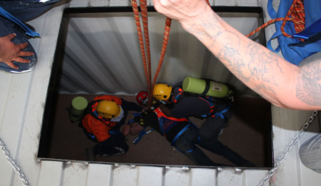
Properties of Gasses - Closed Vessel Confined Spaces
Gases which are heavier than air such as carbon dioxide and propane, may lie in a tank or vault for hours or even days after the containers have been opened.
Because some gases are odorless, the hazard may be overlooked with fatal results.
Gases that are lighter then air may also be trapped within an enclosed type confined space, especially those with access from the bottom or side.
Inerting
The displacement of the atmosphere in a permit space by a noncombustible gas (such as nitrogen) to such an extent that the resulting atmosphere is noncombustible.
NOTE: This procedure produces an IDLH oxygen-deficient atmosphere.
Notes:
Affected workers need to understand the hazard associated with the various type of spaces they may be required to enter.

Slide 39
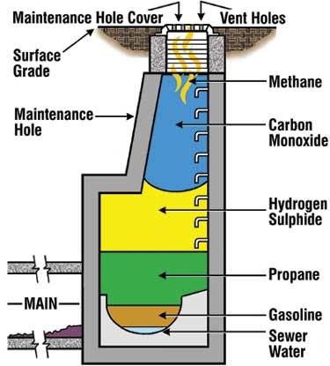
Hazardous atmosphere
Atmospheric oxygen concentration below 19.5 percent or above 23.5 percent;
Atmospheric concentration of any substance for which a dose or a permissible exposure limit is published
Any other atmospheric condition that is immediately dangerous to life or health.
Notes:
Only trained, qualified personnel should conduct environmental testing. Air quality is a primary concern when exposing workers to a confined space.

Slide 40
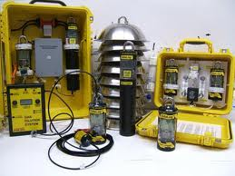
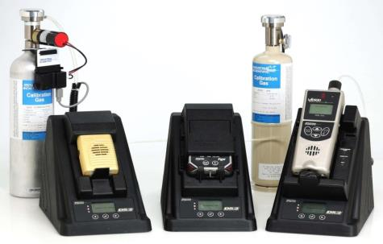
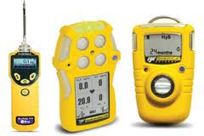
Confined Space Testing
Detection Equipment
Calibrated
Available for use
Documented training
Appropriate for anticipated exposures
  Ambient
  Remote
  Pump or draw
Notes:
Only trained, qualified personnel should conduct environmental testing. Air quality is a primary concern when exposing workers to a confined space.

Slide 41
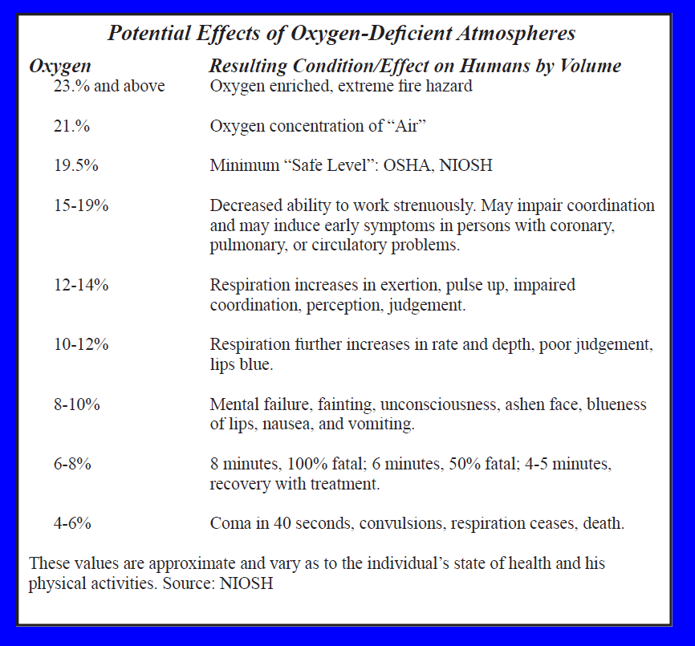
Oxygen-Deficient Atmospheres
NOTE: Exposure to atmospheres containing 12% or less oxygen will bring about unconsciousness without warning and so quickly that individuals cannot help or protect themselves.
Notes:
Only trained, qualified personnel should conduct environmental testing. Air quality is a primary concern when exposing workers to a confined space.

Slide 42
Flammable Atmospheres
The byproducts of work procedures can generate flammable or explosive conditions within a confined space.
  Enriched oxygen atmospheres
  Vaporization of flammable liquids
  Byproducts of work
  Chemical reactions
  Concentrations of combustible dusts
Notes:
Only trained, qualified personnel should conduct environmental testing. Air quality is a primary concern when exposing workers to a confined space.

Slide 43
Carbon Monoxide (CO)
Colorless, odorless gas
Fatal at 1000 ppm in air
Dangerous at 200 ppm
Any untested atmosphere must be suspect
Carbon monoxide must be tested for specifically
Chemical asphyxiant
Slightly lighter than air
Primary source: incomplete combustion of organic material
Gasoline-fueled combustion engines
PEL = 35 ppm - TWA
TLV = 25 ppm - TWA
BEI: <3.5% COHb; 20 ppm (end-exhaled air)
REL = 200 ppm - STEL; 35 ppm - TWA
IDLH = 1500 ppm
LEL = 12.5%; UEL = 74.2%
Notes:
Only trained, qualified personnel should conduct environmental testing. Air quality is a primary concern when exposing workers to a confined space.

Slide 44

Concentration of CO Necessary to Produce Symptoms
Notes:
Only trained, qualified personnel should conduct environmental testing. Air quality is a primary concern when exposing workers to a confined space.

Slide 45
Carbon Dioxide (CO₂)
Colorless, odorless noncombustible gas
Heavier than air
Common in solid and compressed liquid forms
Carbonation
Inerting
Organic decay (grain elevators, sewers, storage bins, wells)
Fermentation (digestors, molasses pits, beer and wine vats)
PEL = 5,000 ppm
TLV = 5,000 ppm
STEL - 30,000 ppm
IDLH = 50,000 ppm
LEL = none
Notes:
Only trained, qualified personnel should conduct environmental testing. Air quality is a primary concern when exposing workers to a confined space.

Slide 46
Hazardous Atmosphere Recap
Oxygen-deficient atmospheres have less than _____ oxygen available?
20.6 percent
18.7 percent
19.5 percent
21.7 percent
Carbon monoxide is colorless and odorless but leaves a distinct taste of rotten eggs in your mouth.
True
False
Atmospheric testing must be done at the top and bottom of the space only since gases tend to only rise to
the top or sink to the bottom.
True
False
The attendant is the person responsible for the confined space entry and is ultimately responsible for all
activities.
True
False

Slide 47
Physical Hazards
Physical
Hazards

Slide 48
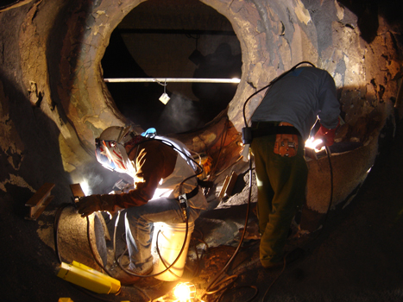
Physical Hazards
Thermal
Air temperature,
Air velocity,
Moisture contained in the air
Radiant heat.
Noise
Reverberation
Communication
Commands
Vibration
Whole body
Segmental (Body part)
Tools
Notes:
Employees must trained and be able to demonstrate an understanding of the confined space entry safe entry requirements. Untrained workers should nit be permitted in the confined space.

Slide 49
Confined Space Entry – Combustion Hazards
CO₂
NOx
Processes which operate by the principle of combustion use up oxygen much faster than the human respiration.
Products of combustion vary with the fuel that is present and the temperature of the combustion reaction. Welding, burning natural gas, propane, gasoline, and diesel engines are examples of combustion processes.
H₂0
CO
O2
fuel
Notes:
Employees must trained and be able to demonstrate an understanding of the confined space entry safe entry requirements. Untrained workers should nit be permitted in the confined space.

Slide 50
1926.353 (b) Welding, cutting and heating
Either general mechanical or local exhaust ventilation meeting the requirements of paragraph (a) of this section shall be provided whenever welding, cutting, or heating is performed in a confined space.
If sufficient ventilation cannot be obtained without blocking the means of access, employees in the confined space shall be protected by air line respirators.
An employee on the outside of such a confined space assigned to maintain communication with those working within it and to aid them in an emergency.
"Lifelines." Where a welder must enter a confined space through a manhole or other small opening, means shall be provided for quickly removing him in case of emergency.
When safety belts and lifelines are used for this purpose they shall be so attached to the welder's body that his body cannot be jammed in a small exit opening.
An attendant with a pre-planned rescue procedure shall be stationed outside to observe the welder at all times and be capable of putting rescue operations into effect.
Notes:
Employees must trained and be able to demonstrate an understanding of the confined space entry safe entry requirements. Untrained workers should nit be permitted in the confined space.

Slide 51
Combination Hazards
The most hazardous kind of confined space is the type that combines limited access and mechanical devices.
Boilers usually contain power-driven equipment which, unless properly isolated, may be inadvertently activated after entry.
Notes:
Employees must trained and be able to demonstrate an understanding of the confined space entry safe entry requirements. Untrained workers should nit be permitted in the confined space.

Slide 52
Pre-Entry Checklist
Is the Entry Supervisor recognized as a Competent Person?
  Are appropriate permits completed and available for review?
Has a functional performance test been conducted on the monitor being used for this shift?
  Will the atmosphere be continuously monitored while the space is occupied?
Was a test of the atmosphere in the confined space performed by a Qualified Person?
  Was oxygen content between 19.5 percent and 23.5 percent ?
  Was flammable vapor less than 10 percent of LEL/LFL?
  Were tests for toxic materials less than TLV/PEL?
Have all hazard sources been isolated from the confined space?
Is rescue equipment required for the entry procedure immediately available?
Have emergency services been notified of the confined space entry?
Notes:
Employers should have a process to document the safety requirements of a confined space and communicate the process to affected workers. Exposed personnel should have a clear working knowledge of the safe work requirements for the task they are assigned.

Slide 53

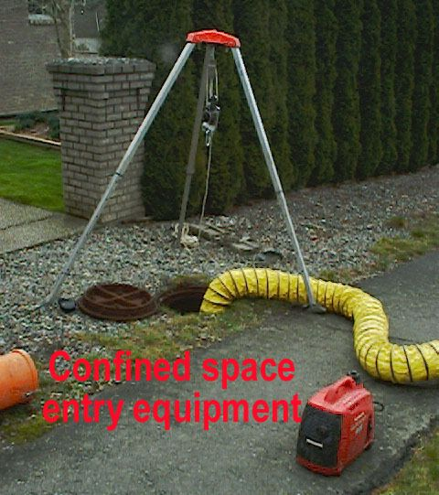
Confined Space Entry and Retrieval Equipment

Slide 54
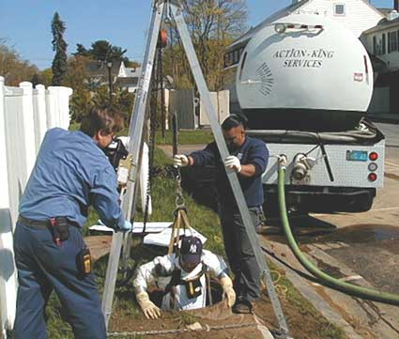
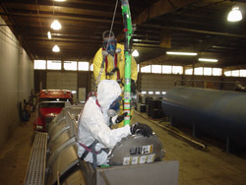
Rescue or Retrieval
Self Rescue
Usually initiated by worker
No rescuer entry required
Entrant must know when to self rescue
Entry Rescue
Responsibilities
Rescue equipment readily available
  Supplied Air
  Method to retrieve a downed worker
Communication system
  Line of site
  Passive communication system
  Contact with emergency services
Non-Entry Rescue
Responsibilities
Equipment
Communication method
Notes:
Pre-planning and effective rescue and retrieval plans should be communicated to affected workers.

Slide 55
Respirator Use
Training must include an explanation of the following:
Why respirator use is necessary;
Nature of the respiratory hazard and consequences of not fitting, using, and maintaining the respirator properly;
Reason(s) for selecting a particular type of respirator;
Capabilities and limitations of the selected respirator;
How to inspect, put on and remove, and check the seals of the respirator;
Respirator maintenance and storage requirements;
How to use the respirator effectively in emergency situations, including when the respirator malfunctions; and
How to recognize medical signs and symptoms that may limit or prevent the effective use of the respirator.
Notes:
OSHA's revised Respiratory Protection Standard (29 CFR 1910.134 and 29 CFR 1926.103) went into effect April 8, 1998. The final standard replaces the respiratory protection standards adopted by OSHA in 1971. The 29 CFR 1910.139 respirator standard that applied only to respiratory protection against Mycobacterium Tuberculosis was withdrawn December 31, 2003. Establishments whose respiratory protection programs for tuberculosis formerly covered under 29 CFR 1910.139 were required to adapt their programs to comply with the requirements of 29 CFR 1910.134 effective July 2, 2004.

Slide 56
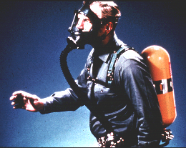
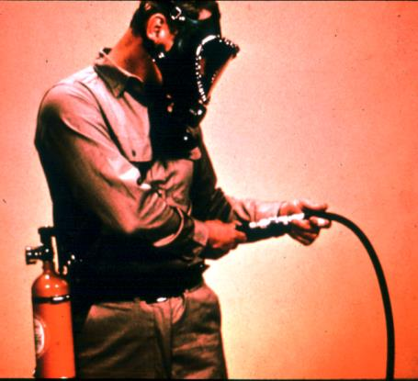
Respirators for IDLH Atmospheres
Full Facepiece Pressure Demand SCBA
Combination Full Facepiece Pressure Demand SAR with Auxiliary Self-Contained Air Supply
Notes:
OSHA's revised Respiratory Protection Standard (29 CFR 1910.134 and 29 CFR 1926.103) went into effect April 8, 1998. The final standard replaces the respiratory protection standards adopted by OSHA in 1971. The 29 CFR 1910.139 respirator standard that applied only to respiratory protection against Mycobacterium Tuberculosis was withdrawn December 31, 2003. Establishments whose respiratory protection programs for tuberculosis formerly covered under 29 CFR 1910.139 were required to adapt their programs to comply with the requirements of 29 CFR 1910.134 effective July 2, 2004

Slide 57
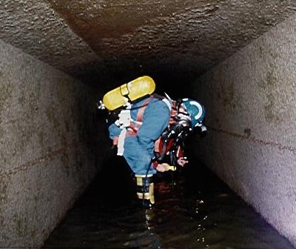
Worker in Confined Space
Notes:
OSHA's revised Respiratory Protection Standard (29 CFR 1910.134 and 29 CFR 1926.103) went into effect April 8, 1998. The final standard replaces the respiratory protection standards adopted by OSHA in 1971. The 29 CFR 1910.139 respirator standard that applied only to respiratory protection against Mycobacterium Tuberculosis was withdrawn December 31, 2003. Establishments whose respiratory protection programs for tuberculosis formerly covered under 29 CFR 1910.139 were required to adapt their programs to comply with the requirements of 29 CFR 1910.134 effective July 2, 2004

Slide 58
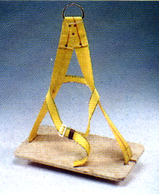
Bosons Chair
Notes:
Employers need to insure affected personnel have a working understanding of the equipment they will be assigned to use during the confined space entry.

Slide 59
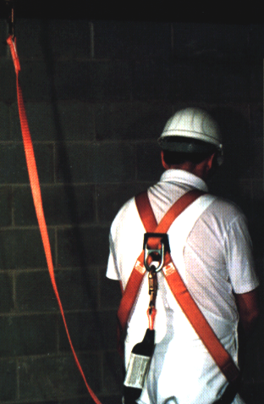
Lanyard
Notes:
Employers need to insure affected personnel have a working understanding of the equipment they will be assigned to use during the confined space entry.

Slide 60
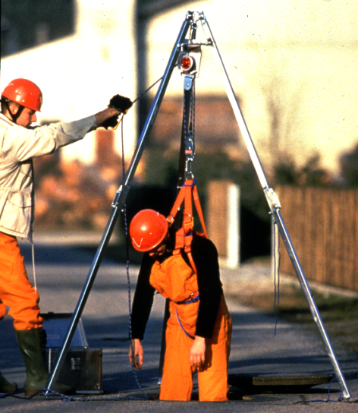
Retrieval System
The equipment (including a retrieval line, chest or full-body harness, wristlets, if appropriate, and a lifting device or anchor) used for non-entry rescue of persons from permit spaces.
Notes:
Employers need to insure affected personnel have a working understanding of the equipment they will be assigned to use during the confined space entry.

Slide 61
Retrieval System
Notes:
Employers need to insure affected personnel have a working understanding of the equipment they will be assigned to use during the confined space entry.

Slide 62
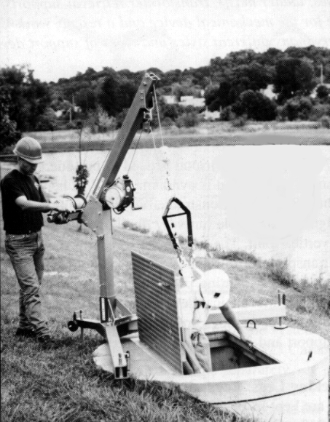
Davit Arm
Notes:
Employers need to insure affected personnel have a working understanding of the equipment they will be assigned to use during the confined space entry.

Slide 63
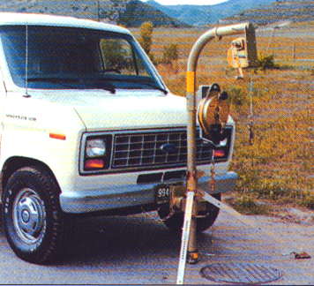
Vehicle-Mounted Davit
Notes:
Employers need to insure affected personnel have a working understanding of the equipment they will be assigned to use during the confined space entry.

Slide 64
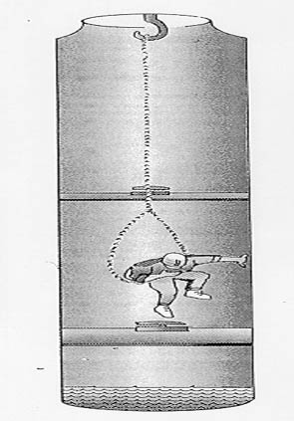
Case Study #1
An employee sitting in a looped chain was lowered approximately 17 feet into a 21-foot deep manhole.
Twenty seconds later he started gasping for air and fell from the chain seat face down into the accumulated water at the bottom of the manhole.
An autopsy determined oxygen deficiency as the cause of death.
Notes:
This case study is designed to have course participants work through the various OSHA regulations in order to gain a better understating of the complexities associated with Permit required confined spaces.

Slide 65
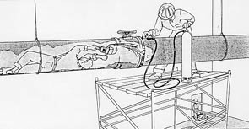
Case Study #2
A welder entered a steel pipe (24 inch diameter) to grind a bad weld at a valve about 30 feet from the entry point.
Before he entered, other crew members decided to add pure oxygen to the pipe near the bad weld.
He had been grinding intermittently for about five minutes when a fire broke out enveloping his clothing.
Notes:
This case study is designed to have course participants work through the various OSHA regulations in order to gain a better understating of the complexities associated with Permit required confined spaces.

Slide 66
Worker Rights and Employer Responsibilities
  A safe and healthful workplace
  Know about hazardous chemicals
  Information about injuries and illnesses in your workplace
  Complain or request hazard correction from employer
  Training
  Hazard exposure and medical records
  File a complaint with OSHA
  Participate in an OSHA inspection
  Be free from retaliation for exercising safety and health rights whistleblower protection Section 11c
  Employer rights and responsibilities

Slide 67
The End
The End

