Slide 1
Construction Site
Safety Program
Train the Trainer Course
This material was produced under grant number SH26292SH4 from the Occupational Safety and Health Administration, U.S. Department of Labor. It does not necessarily reflect the views or policies of the U.S. Department of Labor, nor does mention trade names, commercial products, or organizations imply endorsement by the U.S. Government.
Notes:
During electrical incidents affect personnel will do whatever it takes to get away from the exposure. Falls cause a great deal of secondary injuries during electrical incidents

Slide 2
Site Safety Review Goals
Objective
Review of all 8 Site Safety Courses
Prepare for exit exam
  32 question Exam
Prepare for presentation session
  Each participant is required to present a 10-15 training presentation on one of the 8 sessions
  Presentations may be recorded and feedback will be provided
Notes:
Instructor should prepare participants for the exit exam and presenter training session.

Slide 3

Site Safety Program Trainer
Safety Administration
Risk Management
Electrical Safety
Fall Prevention
Confined Spaces
Excavation
Process Safety
Industrial Hygiene
Final Exam
Review for Presentation Course
Notes:
Instructors should review with participants of the previous course to be discussed. This will allows participants time to collect notes and prepare for exit exam

Slide 4

Safety Admin. – OSHA History Review
OSHA stands for the Occupational Safety and Health Administration, an agency of the U.S. Department of Labor
OSHA’s responsibility is worker safety and health protection
On December 29, 1970, President Nixon signed the OSH Act
  OSHA began because, until 1970, there were no national laws for safety and health hazards.
This Act created OSHA, the agency, which formally came into being on April 28, 1971
  On average, 15 workers die every day from job injuries
  Over 5,600 Americans die from workplace injuries annually
  Over 4 million non-fatal workplace injuries and illnesses are reported
Notes:
Historical information should be reviewed. Instructors should discuss how and why OSHA came into being and the benefits of the act.

Slide 5
Safety Admin. – Review of Covered Workers
Covered by OSHA? | Worker
YES NO | Harry Adams, a miner at Below Ground Inc.
YES NO | Adrian Smith, one of 3 employees of ABC landscaping.
YES NO | Taylor Dell, an accountant in business for herself.
YES NO | Rob Jones, one of 10 carpenters working for Woody, Inc.
Notes:
Employer/Employee Relationship must be established. Instructors should review OSHA authority and discuss employee rights under the act

Slide 6
Safety Admin. - Review of Worker Rights
The creation of OSHA provided workers the right to a safe and healthful workplace.
Section 5(a)(1) of the OSH Act states: “Each employer shall furnish to each of his employees employment and a place of employment which are free from recognized hazards that are causing or are likely to cause death or serious physical harm to his employees."
Workers may bring up safety and health concerns in the workplace to their employers without fear of discharge or discrimination, as long as the complaint is made in good faith. OSHA regulations protect workers who complain to their employer about unsafe or unhealthful conditions in the workplace.
  This right is spelled out in Section 11(c) of the OSH Act.
  Workers have 30 days to contact OSHA if they feel they have been punished for exercising their safety and health rights.
Notes:
Instructor should review worker rights. Attendees should demonstrate a working understanding of these principles.

Slide 7
Safety Admin. – Review of Multi-employer
The Creating Employer
  The employer who actually creates the hazard.
The Exposing Employer
  An employer whose own employees are exposed to the hazard.
The Correcting Employer
  An employer who is engaged in a common undertaking, on the same worksite, as the exposing employer and is responsible for correcting a hazard.
The Controlling Employer
  The employer who is responsible, by contract or through actual practice, for safety and health conditions on the worksite; i.e., the employer who has the authority for ensuring that the hazardous condition is corrected

Slide 8
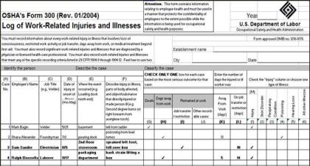
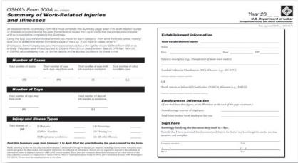
Risk Mang. – Review of OSHA Recordkeeping
OSHA’s Recordkeeping rule requires most employers with more than 10 workers to keep a log of injuries and illnesses.
Workers have the right to review the current log, as well as the logs stored for the past 5 years.
Workers also have the right to view the annually posted summary of the injuries and illnesses (OSHA 300A).
Establishing Work Relatedness
  Work-relatedness is presumed for injuries and illnesses resulting from events or exposures occurring in the work environment
  The work event or exposure need only be one of the discernable causes; it need not be the sole or predominant cause. A case is presumed work-related if;
    If an event or exposure in the work environment is a discernable cause of the injury or illness
    or of a significant aggravation to a pre-existing condition.
Notes:
Instructor should discuss the 1904 standards as need to insure course participants display a working understanding on the Record Keeping rules and regulations.

Slide 9
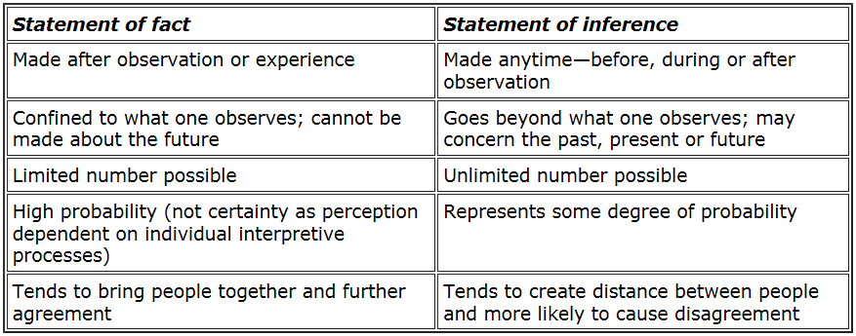
Risk Mang. – Accident Investigation Review
Who should be involved in accident investigations:
Management - The usual investigator for all incidents is the supervisor in charge of the involved area and/or activity.
Employees- Accident investigations represent a good way to involve employees in safety and health. Employee involvement will not only give you additional expertise and insight, but in the eyes of the workers, will lend credibility to the results.
Safety Representative- The safety department or the person in charge of safety and health should participate in the investigation or review the investigative findings and recommendations.
Safety Committee- Many companies use a team or a subcommittee or the joint employee-management committee to investigate incidents involving serious injury or extensive property damage.
Facts vs.
Opinions (Inference)
Notes:
Instructor should use this slide to discuss the purpose of accident investigations. Topics to be covered should include Root Cause, Fact Finding, using investigation results to develop meaningful corrective actions.

Slide 10
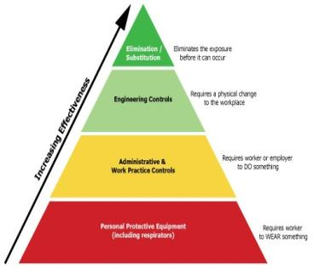
Risk Mang. – Review of Investigation Traps
Accident investigation traps:
Blame without proof; The error made by the employee may not be the most important contributing cause. The employee who has not followed prescribed procedures may have been encouraged directly or indirectly by a supervisor or production quotas to "cut corners."
Policies that miss the mark; The prescribed procedures may not be practical, or even safe. Sometimes where elaborate and difficult procedures are required, engineering redesign might be a better answer.
Lack of Accountability; Supervisors and others who investigate incidents should be held accountable for describing causes carefully and clearly. When reviewing accident investigation reports, the safety professional should be on the lookout for catch-phrases, such as "Employee did not plan job properly." While such a statement may suggest an underlying problem with this worker, it is not conducive to identifying all possible causes, preventions, and controls. Certainly, it is too late to plan a job when the employee is about to do it. Further, it is unlikely that safe work will always result when each employee is expected to plan procedures alone.
Notes:
Instructor should use this slide to discuss the preferred methodology of the Hierarchy of Controls when developing and implementing corrective actions.

Slide 11
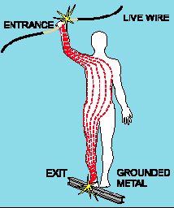
Elect. Safety – Exposure Severity Review
Severity of the exposure depends on:
  Path of current through the body
  Amount of current flowing through the body (amps)
  Duration of the shocking current through the body,
LOW VOLTAGE DOES NOT MEAN LOW HAZARD (OSHA LV = 600V and Less)
Notes:
Instructor should use this slide to discuss damage and affects Path, Amount and Duration current can have on human body.

Slide 12
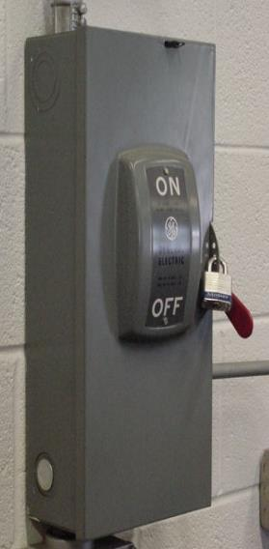
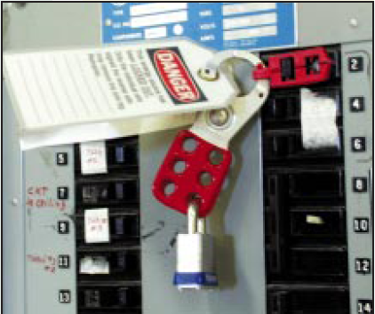
Elect. Safety – LO/TO Review
  Never work on electrical equipment until you can verify the energy has been safety isolated.
  Do not allow yourself or others to be placed at risk.
  Never take anyone’s word that equipment is locked out
Review established site procedures and precautions.
  Make sure you have been trained and understand the site LO/TO procedures and rules
Verify test equipment is working correctly.
  Do not inspect or test without appropriate PPE
Place and remove your own lockout/tagout device.
  Do not cut or remove others LO/TO devices
Notes:
Instructor should use this slide to discuss Energy isolation techniques and protective measures.

Slide 13
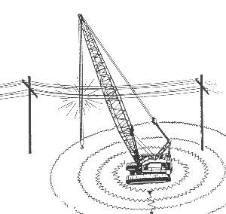
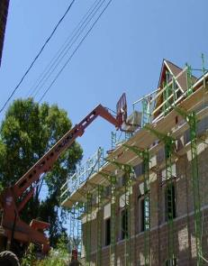
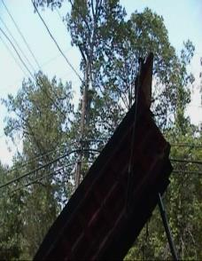
Elect. Safety - Overhead Power Line Review
Electricity dissipates with the resistance of the ground
As potential drops, fields develop around the electrified machine
If you step across a line of unequal potential, you could be electrocuted
Notes:
Instructor should use this slide to discuss working proximities to overhead power lines and accepted protective measures.

Slide 14
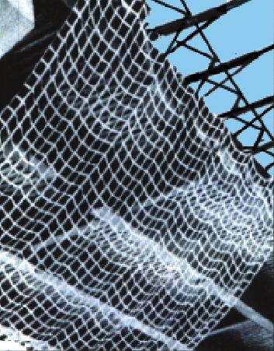
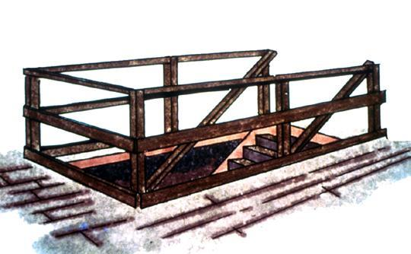
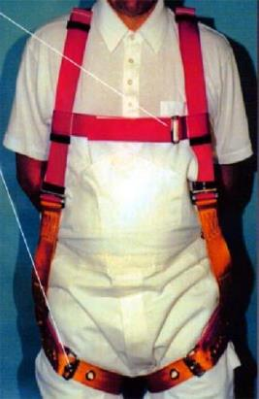
Fall Prevention – Conventional Fall Prevention methods
Guardrails
Personal Fall
Arrest System
(PFAS)
Safety Net
Notes:
Instructor should use this slide to discuss the 3 conventional fall prevention systems.

Slide 15
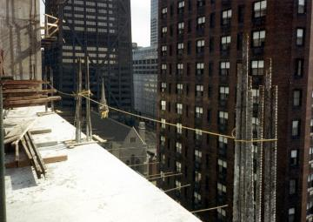
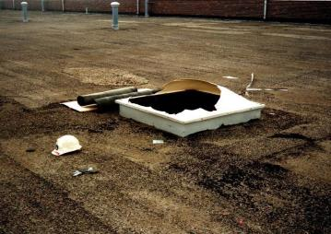
Fall Prevention Review
OSHA requires that fall protection be provided at elevations of;
Four (4’) feet in general industry
Five (5’) feet in shipyards
Six (6’) feet in the construction industry
Eight (8’) feet in longshoring operations
Ten (10) feet in scaffolding
To prevent employees from being injured from falls, employers must:
Guard every floor hole into which a worker can accidentally walk (using a railing and toe-board or a floor hole cover).
Provide a guard rail and toe-board around every elevated open sided platform, floor or runway.
Regardless of height, if a worker can fall into or onto dangerous machines or equipment (such as a vat or acid or a conveyor belt) employers must provide guardrails and toe-boards to prevent workers from falling and getting injured.
Other means of fall protection that may be required on certain jobs include safety and harness and line, safety nets, stair railings and hand rails.
Notes:
Instructor should use this slide to discuss the various OSHA rules regarding fall distances. Many participants work in numerous industries and should be aware of various regulations.

Slide 16
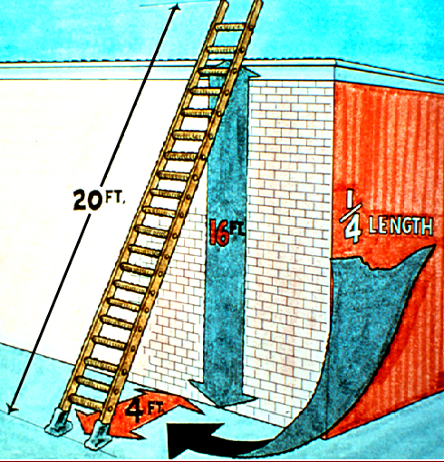
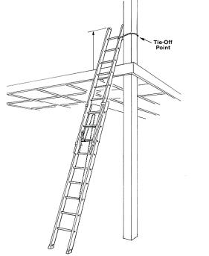
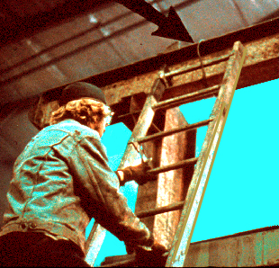
Fall Prevention – Ladder Safety Review
Portable ladders:
Position at an angle where the horizontal distance from the top support to the foot of the ladder is 1/4 the working length of the ladder.
When using a portable ladder for access to an upper landing surface, the side rails must extend at least 3 feet above the upper landing surface.
Maintain 3 points of contact
Don’t use an opaque covering (like varnish) on a wood ladder
Notes:
Instructor should use this slide to discuss ladder safety and review OSHA requirements.

Slide 17
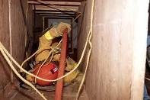
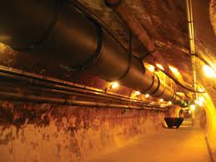

Confined Space – Responsibilities Review
"Entry Supervisor" means the person (such as the employer, foreman, or crew chief) responsible for determining if acceptable entry conditions are present at a permit space where entry is planned, for authorizing entry and overseeing entry operations, and for terminating entry as required by this section.
"Attendant" means an individual stationed outside one or more permit spaces who monitors the authorized entrants and who performs all attendant's duties assigned in the employer's permit space program.
"Authorized Entrant" means an employee who is authorized by the employer to enter a permit space
Notes:
Only trained, qualified personnel should conduct environmental testing. Air quality is a primary concern when exposing workers to a confined space.

Slide 18
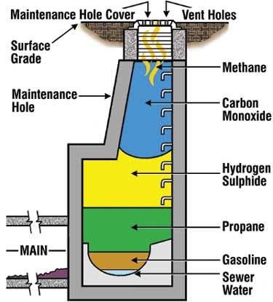
Confined Space – Air Monitoring Review
Permit Required Confined Spaces;
50% of all Confined Space fatalities are would be rescuers
Monitored by direct read equipment – Continuously monitored when the potential IDLH environment exists
  Atmospheric oxygen concentration below 19.5 percent or above 23.5 percent;
  Atmospheric concentration of any substance for which a dose or a permissible exposure limit is published
  Any other atmospheric condition that is immediately dangerous to life or health.
Notes:
Only trained, qualified personnel should conduct environmental testing. Air quality is a primary concern when exposing workers to a confined space.

Slide 19
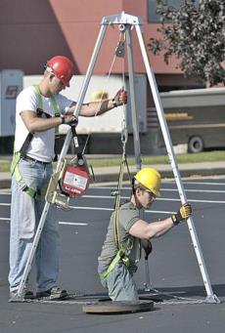
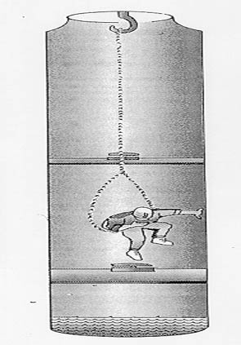
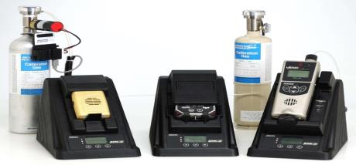
Confined Space - Rescue Review
Self Rescue
Usually initiated by worker
No rescuer entry required
Entrant must know when to self rescue
Entry Rescue
Responsibilities
Rescue equipment readily available
  Supplied Air
  Method to retrieve a downed worker
Communication system
  Line of site
  Passive communication system
  Contact with emergency services
Non-Entry Rescue
Responsibilities
Equipment
Communication method
Notes:
Instructor should use this slide to discuss OSHA requirements for Permit Required Confined Space Rescue. IDLH environments including methods of air monitoring should be reviewed.

Slide 20
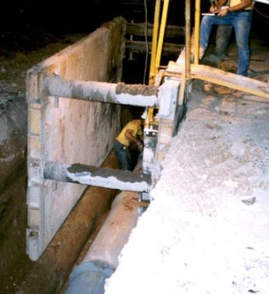
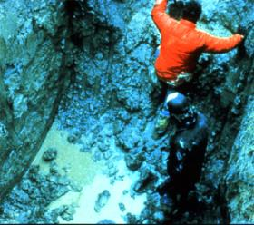
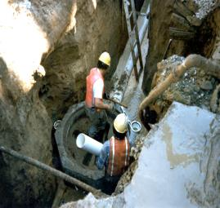
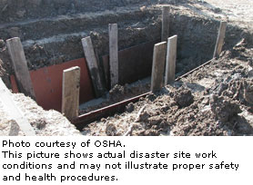
Excavation Review
Cave-ins are much more likely to result in worker fatalities than other excavation-related accidents.
90% of all violations related to lack of cave-in protection involved manhole installations
During inspections where these violations were cited, the excavations were nearly vertical
Notes:
This slide is intended to remind participants of the various excavation hazards and for the Instructor to review protective devices

Slide 21
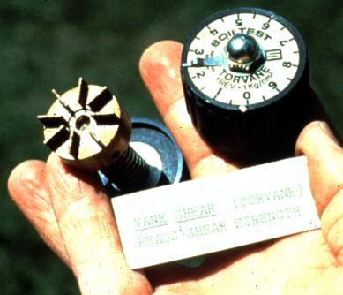
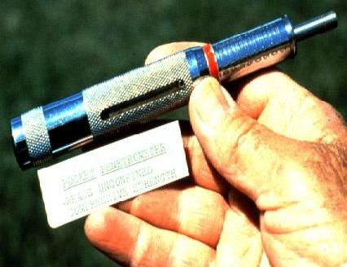
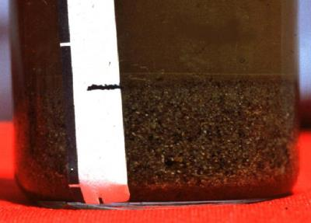
Excavation Safety – Soil Analysis Review
Thumb test
Plasticity
Penetrometer
Torvane shear
Sedimentation
Ribbon Test
Thumb Penetration
Plastiscity
Visual Tests
  Clumping
  Cracks or fissures
Notes:
Instructor should use this slide to discuss soil analysis and classification methods

Slide 22
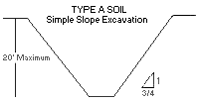
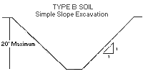
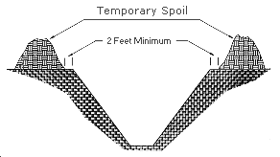
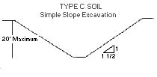
Excavation - Sloping and Shoring Review
Temporary spoil must be placed no closer than 2 ft (0.61 m) from the surface edge of the excavation, measured from the nearest base of the spoil to the cut.
This distance should not be measured from the crown of the spoil deposit.
Ensures that loose rock or soil from the temporary spoil will not fall on employees in the trench.
Notes:
Instructor should use this slide to discuss sloping for various soil types and the placement of spoil piles.

Slide 23
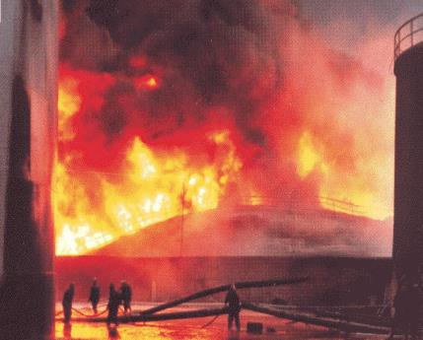

Process Safety Review
Hazards are substances or conditions which can cause injury or harm to people, processes, equipment and the environment and which are associated with the properties and behaviors of process materials.
Notes:
Typically, we tend to think of process hazards as toxic or flammable materials. But even steam, water or compressed air may exhibit hazardous behavior and contribute to major losses. We have discussed some of the dangerous substances but note there are Hazards other than chemical hazards, e.g. dropped objects.

Slide 24
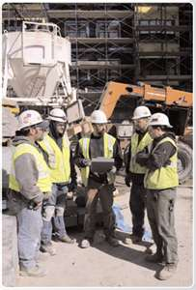
Process Safety Review
Element 1 – Employee Participation
Develop a written participation plan
Consult with employees on PSM development
Provide PSM information access to employees
Element 3 – Process Hazard Analysis
Definition: Systematic way to identify potential hazards and recommend possible solutions
  Techniques: HAZOP, FMEA, What-if, Checklist
Addresses: facility siting, human factors, previous incidents, control failures
Relies on: Proper team and Information (PSI)
Develops: Recommendations
Must: Revalidate every 5 years (Ensure hazards introduced by changes are sufficiently controlled)
Element 2 – Process Safety Information
Information used by employees to identify and understand hazards of Process Equipment and Chemicals.
Must be compiled before a hazard analysis.
Includes:
  MSDS’s, Process Chemistry, and Max Intended Inventory
  PFD’s/P&ID’s
  Safe Operating Limits
  Material and energy balances
  Materials of construction and design codes employed
    (ie Electrical Classification, RV design, Ventilation design, safety system design)
Notes:
Element 1 - Employee participation section of PSM standard.
Element 2 - Process Safety Information section of PSM standard.
Element 3 - Process Hazard Analysis section of the PSM standard.

Slide 25
Process Safety Review
People, Plant, Process
OSHA Elements aim to assure integrity of these boundaries.
Notes:
OSHA Elements aim to assure integrity of these boundaries. Image of how failures happen.

Slide 26
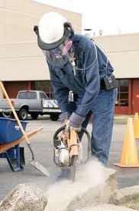

Industrial Hygiene Review
Review Topics:
Health Hazards In Construction
  Chemical Hazards
  Physical Hazards
  Biological Hazards
  Ergonomic Hazards
  Stress Hazards
Industrial Hygiene
Types of Health Hazards:
Dusts – formed from mechanical action
Smoke – formed from combustion
Fumes – formed from volatilizing metal
Mists – tiny water droplets
Vapors – evaporate of liquid
Gases – particles without defined shape or volume
Aerosols – atomized particulate

Slide 27
Industrial Hygiene – GHS Review
Global Harmonizing System – (Hazard Communication)
Employees must know the hazards of chemicals such as toxicity, and carcinogenic
Many employees use dangerous chemicals without personal protective equipment
The contractor must have data sheets of other employer’s chemicals if their own employees are exposed
The purpose of the standard is to make sure that the hazards of chemicals are evaluated
That information concerning their hazards is communicated to employers and employees
Notes:
Discuss Global Harmonizing System including Labeling and the use of Safety Data Sheets

Slide 28
Industrial Hygiene Review
Where respirators are necessary:
  Written program
  Worksite-specific procedures
  Required elements:
    Training
    Fit testing
    Medical evaluations
    Maintenance
    Procedures for respirator selection
    Procedures for routine & emergency use
    Evaluating program effectiveness

Slide 29
Presentation Preparation
Participants are briefed on affective instructional approaches and use of visual aids and handouts. This course allows the student to become a trainer in the Construction Advancement Foundation Site Safety Program.
Participants who wish to participate as instructors will have successfully completed the following;
All 8 Site Safety Courses
  Safety Administration
  Risk Management
  Electrical Safety
  Fall Prevention
  Confined Spaces
  Excavation Safety
  Process Safety Management
  Industrial Hygiene
Successfully pass the exit exam
Demonstrates an understanding of the course material
Demonstrate the ability to present the course material
  Participant must prepare a presentation on an assigned topic

Slide 30
What Rights Do You Have Under OSHA?
You have the right to:
What Rights Do You Have Under OSHA?
You have the right to:
  A safe and healthful workplace
  Know about hazardous chemicals
  Information about injuries and illnesses in your workplace
  Complain or request hazard correction from employer
  Training
  Hazard exposure and medical records
  File a complaint with OSHA
  Participate in an OSHA inspection
  Be free from retaliation for exercising safety and health rights

Slide 31
Final Test Review

