Slide 1

Notes:
INSTRUCTOR NOTE: This module should be presented by a knowledgeable, experienced and trained instructor with experience in grain handling and storage, as well as the OSHA grain handling standard.
This module & the accompanying video are based on FEDERAL OSHA regulations. States governed by OSHA approved state plans have OSHA-approved job safety and health programs operated by individual states instead of federal OSHA. Some of their regulations may differ. It is up to the instructor to inform participants of the differences or to warn participants some regulations may differ and they should check with their state regulations.

Slide 2
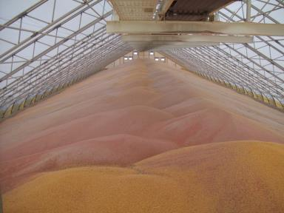
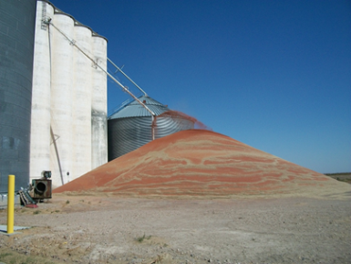
Understanding Flat Storage & Ground Piles Mini-module
Notes:
This module is intended as a supplement to Grain Bin Entry Hazards for those who have flat storage and/or ground piles. Though designed for inclusion with other modules, it can also stand alone as a training session.

Slide 3
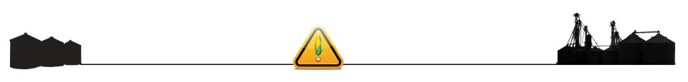
Introduction
Flat Storage & Ground Piles mini module is part of a curriculum series addressing hazards found in areas of grain handling facilities including grain bins and their surrounding area. It’s purpose is to assist participants to identify and abate hazards in the work place.
Notes:
Explain this module is part of a series.
Other modules
Overview of Safe Grain Handling and Storage (introductory module)
Lock out Tag out mini module
Entanglement Hazards and Guarding
Falls Hazards and Protection
Grain Bin Entry Hazards
Introduction to Lifeline Protection Systems
Reducing Grain Bin Entry Risks
Agricultural Confined Spaces

Slide 4
Disclaimers
This material was produced under grant number SH-27664-SH5 from the Occupational Safety and Health Administration OSHA), U. S. Department of Labor. It does not necessarily reflect the views or policies of the U. S. Department of Labor, nor does mention of trade names, commercial products, or organizations imply endorsement by the U. S. Government.
Notes:
Explain – GHSC received funding from OSHA. In order to comply with the grant we do need them to sign in and need to collect the following information:
Supervisor or worker. This information is for statistical purposes to show the types of population receiving training.
Employer. This is to establish an employer/employee relationship as covered under OSHA. Volunteer rescue workers who may be attending should list their employer; not the volunteer rescue squad. Farmers should list the registered business name of their farm. Farm employees should provide the business name listed on their paycheck.
OSHA does NOT contact the employer.
GHSC may contact the attendee or employer for follow-up evaluation in compliance with grant requirements.

Slide 5
Employee Rights
Employees are entitled to safe and healthy working conditions which DO NOT pose a risk of serious harm.
Workers are entitled to be fairly compensated for all hours worked in accordance with the law.
Notes:
Explain - All DOL grants require that employees are informed of their rights. In this instance we want to emphasize employees are entitled to a safe and healthy working environment AND to fair receive compensation for their work.
Remind employees – it is the employee’s responsibility to follow the safety practices, policies, and procedures of their employers.
Tell participants their rights also include the right to report unsafe conditions to the OSHA hotline without retribution.
More information about employee rights can be found on the OSHA website: www.osha.gov or the Department of Labor website www.dol.gov .
It is ESPECIALLY imperative for youth/young workers to access information and know their rights, what to expect, and how to get help if needed.

Slide 6
Employer Responsibility
Employers have the responsibility to provide a safe & healthy workplace.
More information about employer & employee rights can be found at www.osha.gov.
Notes:
Explain employers have a legal responsibility to provide a safe workplace. This means they must ensure the regulations which govern their business are instituted and followed. This applies to 1 employee or more.
DISCUSS - It is the employers’ responsibility to know the rules and laws – federal and state.
Emphasize – It is employers’ responsibility to ensure employees, know, understand and follow regulations and company policies.
STRESS - If employers are unsure of the regulations they should consult with the appropriate agency. Every state has an on-site consultation program jointly funded by OSHA and the state which provides assistance in learning and complying to the regulations.
The OSHA website provides contact information for each state’s on-site consultation program.
Illinois Department of Labor has the on-site consultation program in Illinois.
Employers should also know and understand the state’s laws as they may be more restrictive than OSHA. Contact the state department of labor.

Slide 7
Whistleblower Protection
Employers cannot punish or discriminate against employees who have used their rights to report unsafe or unhealthy working conditions or environmental problems to an employer, OSHA or other government office. Employees can call, write or email the OSHA Area office within 30 days to report acts of employer retaliation.
For information about whistleblower protection go to www.whistleblowers.gov
Notes:
Explain - All DOL grants require that employees are informed of their rights. In this instance we want to emphasize employees are entitled to a report unsafe and unhealthy working environments and not be retaliated against by their employer with personnel discipline actions, termination, etc..
Remind employees – it is the employee’s responsibility to follow the safety practices, policies, and procedures of their employers.
Tell participants their rights also include the right to report unsafe conditions to the OSHA hotline without retribution.
More information about employee rights can be found on the OSHA website: www.osha.gov or the Department of Labor website www.dol.gov .
It is ESPECIALLY imperative for youth/young workers to access information and know their rights, what to expect, and how to get help if needed.

Slide 8
Learning Objectives
At the end of this module, participants will be able to:
Identify the criteria that defines flat storage.
Define “unrestricted means of entry” as it relates to flat storage.
Describe the conditions for meeting 1910.272 (h) for flat storage entry.
Describe the hazards & hazard corrections for flat storage.
Notes:
Explain - All DOL grants require that employees are informed of their rights. In this instance we want to emphasize employees are entitled to a report unsafe and unhealthy working environments and not be retaliated against by their employer with personnel discipline actions, termination, etc..
Remind employees – it is the employee’s responsibility to follow the safety practices, policies, and procedures of their employers.
Tell participants their rights also include the right to report unsafe conditions to the OSHA hotline without retribution.
More information about employee rights can be found on the OSHA website: www.osha.gov or the Department of Labor website www.dol.gov .
It is ESPECIALLY imperative for youth/young workers to access information and know their rights, what to expect, and how to get help if needed.

Slide 9
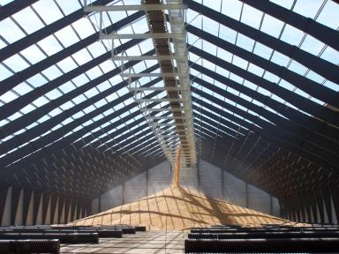
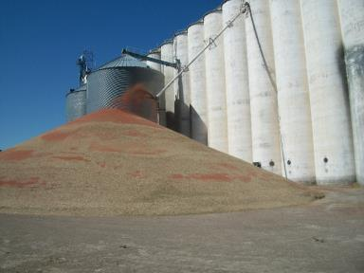
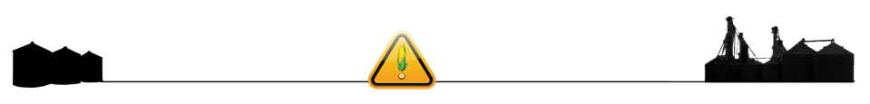
Why alternative grain storage?
Increased need for more storage capacity.
Higher yields
Greater production
Lower price/bushel
Immediate storage need
Notes:
Grain production, especially corn has increased over 100% + in the past 20 years making the need for more storage capacity.
Production is helped by higher yields per acre, lower cost per bushel which makes it a much used and sought after commodity. Flat storag meets immediate storage needs while elevators ship, transport and otherwise move grain.

Slide 10
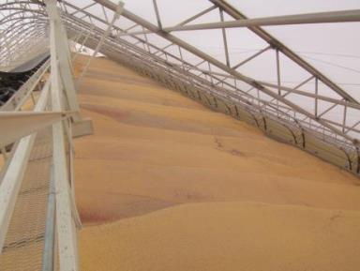
Alternative Storage Structure
Structure or building
Does not empty completely by gravity
Unrestricted, ground level opening
Must enter to reclaim residual grain
Powered equipment
Manual means
Notes:
Explain – Unless otherwise specified or required, Flat Storage is governed by the OSHA Grain Handling Standard 1910.272.
The PURPOSE for defining Flat Storage Structure is to provide protection for employees who enter flat storage structures (engulfment, mechanical, and other hazards). It recognizes the potential for these hazards is different.
NOTE: The term flat storage structure is intentionally board “to encompass a wide range of many of the configurations that are considered by the industry to be "flat storage."
Flat Storage is distinguished from bins, silos, hoppers, and tanks because it does NOT rely on gravity to empty. Bins, silos, tanks DO rely on gravity to empty.
Entry into flat storage is distinguished by it occurring through an unrestricted GROUND LEVEL point as opposed to entry at or above the level of the grain or above ground level. “Entries at ground level of flat storage structures do not present the same potential for engulfment hazards as do entries made from at or above the level of the grain”.
Additionally, flat storage entry regulations only apply when there is “no toxicity, flammability, oxygen-deficiency, or other atmospheric hazards” in the flat storage structure.
When all these provisions are met the flat storage entry is covered under paragraph (h) of the grain handling standard.
Important to note – Unrestricted, ground level opening does NOT mean just “large doorways” .
Must enter to reclaim residual grain – takes into account that many types of flat storage structures do no have sweep augers or conveying equipment at the bottom of the structure. Instead the grain product must be cleared/unloaded by workers operating powered equipment (such as loaders, power scoops, portable augers, etc. or by manual means – shoveling, etc.
OSHA definition: 1910.272(c) Definitions. "Flat storage structure" means a grain storage building or structure that will not empty completely by gravity, has an unrestricted ground level opening for entry, and must be entered to reclaim the residual grain using powered equipment or manual means.
“. . . changed to "flat storage structure," to emphasize that the flat storage exception applies to the storage structure and not to the entire facility. Second, the definition notes that flat storage structures must have an unrestricted ground level opening for entry, and not just "large doorways," and that the structure must be of a type that will not empty completely by gravity. The latter element clearly distinguishes flat storage from silos, bins, and tanks, which do rely on gravity for emptying. Finally, the definition recognizes that grain is often reclaimed through the ground level openings using means other than motorized vehicles. Publication Date: 03/08/1996 • Publication Type: Final Rules • Fed Register #: 61:9577-9584 • Standard Number: 1910 • Title: Grain Handling Facilities AGENCY: Occupational Safety and Health Administration (OSHA), Labor. 29 CFR Part 1910 [Docket No. H-117-B] Grain Handling Facilities ACTION: Final rule; technical amendment.

Slide 11
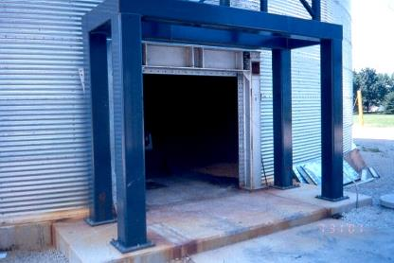
Unrestricted, ground level entry
Unrestricted:
Step
Walk
Drive
Through a GROUND LEVEL opening.
Opening does NOT have to be door
Unrestricted – NO blockage
Notes:
"Unrestricted" in the context of ground level entry means that employees can enter by stepping, walking, or driving through these openings. This clarification was suggested by NGFA [Ex. 4-12].
“Entries into flat storage structures will be covered by paragraph (h) only if there are no toxicity, flammability, oxygen-deficiency, or other atmospheric hazards in those structures. In addition, the final rule makes clear that paragraph (h) will only cover entries that are made through unrestricted ground level openings. Entries made at or above the level of the grain and above ground level will be covered by the general provisions for entry into grain storage structures found in paragraph (g).
Publication Date: 03/08/1996 • Publication Type: Final Rules • Fed Register #: 61:9577-9584 • Standard Number: 1910 • Title: Grain Handling Facilities AGENCY: Occupational Safety and Health Administration (OSHA), Labor. 29 CFR Part 1910 [Docket No. H-117-B] Grain Handling Facilities ACTION: Final rule; technical amendment.

Slide 12
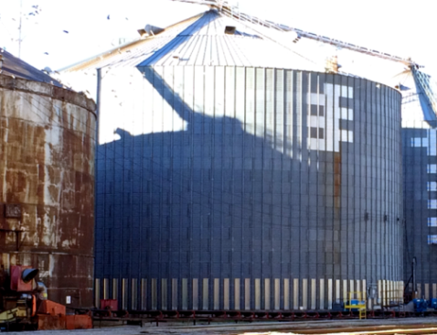
Unrestricted entry – vehicle access
Bins similar size
Grain Bin - Entry through normal size hatch
Flat Storage -Entry allows vehicle access.
Notes:
“Flat storage” can be configured in several forms.
Unrestricted, ground level entry is one key factor in determining if a structure is considered flat storage.
The entry point of the flat storage structure must be large enough for a person to step through, walk through upright, or drive through. Step through means the worker does not have to climb a ladder or stairs for access.
In this example on the left side of the picture, when the ground level door on the bin, which is large enough for a vehicle to drive through, is open, the structure is flat storage. Workers need to enter to complete the unloading of grain. Until the big door at ground level can be opened, this is a regular grain bin.
Storage structures that do not have a ground level entry point, or the ground level entry point does not allow for the worker to step through, walk through or drive through would be considered a grain bin. Most grain bins have a side access hatch that is not at ground level.

Slide 13
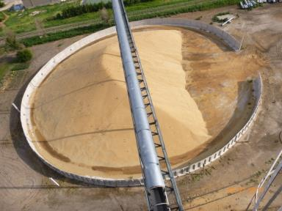
Ground Piles – Temporary Storage
Temporary storage
Dry thoroughly & cool
Optional enclosure
Shore walls
Optional cover
Protect from elements
Helps drainage
Control condensation
Notes:
Ground piles are temporary storage. To maintain grain quality piles should be aerated as with bin storage. When aeration is not possible, the grain should not be stored from more than a couple of months or it needs to be monitored to control spoilage.
Enclosure – Grain depth in an outdoor pile frequently runs from near zero at the edge of the pile to a maximum at the center. The grain depth at wall is limited to height of barrier.
It is best to cover outdoor ground piles. Uncovered grain presents problems with moisture retention and generally leads to a loss of approximately a couple feet of grain on the pile’s surface which can be several ten thousand dollars.
Drainage is a problem with ground piles. Ensure water is draining away from the grain.
A properly prepared base will help keep moisture away from the bottom of the piles. Bases should be prepared with lime, fly ash, cement or asphalt to prevent soil moisture from reaching the grain or a 4 to 6 in. thick, well-drained granular base or concrete pad. A 6-mil plastic sheet layer can be installed as a vapor barrier.

Slide 14
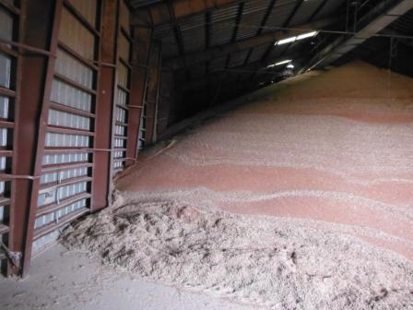
Flat Storage: Alternative to Bins
Storage in flat
Usually building
Large bin
Does not empty completely by gravity
Access – ground entry
Entry – generally large
Vehicle/loader fits
Generally covered
Usually has aeration
Notes:
If using an existing building the walls usually need to be reinforced to withstand the weight of the grain against them.
Large bins and/or silos may be used. They are flat storage if they do not empty completely by gravity.
Per the OSHA definition, flat storage has an unrestricted ground level entry point. Others may use the term “flat storage” more broadly.
Per OSHA definition the ground level entry is large enough for a person to step, walk, or drive through. In commercial grain handling facilities, the entry is generally large enough that a loader or other machinery, including a transport truck, can be driven inside the structure to assist with loading and unloading.
Flat storage is generally covered and has an aeration & temperature monitoring to maintain grain condition.

Slide 15
Flat Storage: Alternative to Bins
Storage in flat
Usually building
Large bin
Does not empty completely by gravity
Access – ground
Entry – large
Vehicle/loader fits
Generally
covered
aeration
Notes:
If using an existing building the walls usually need to be reinforced to withstand the weight of the grain against them.
Large bins and/or silos may be used. They are flat storage if they do not empty completely by gravity.
Per the OSHA definition, flat storage has an unrestricted ground level entry point. Others may use the term “flat storage” more broadly.
Per OSHA definition the ground level entry is large enough for a person to step, walk, or drive through. In commercial grain handling facilities, the entry is generally large enough that a loader or other machinery, including a transport truck, can be driven inside the structure to assist with loading and unloading.
Flat storage is generally covered and has an aeration & temperature monitoring to maintain grain condition.

Slide 16
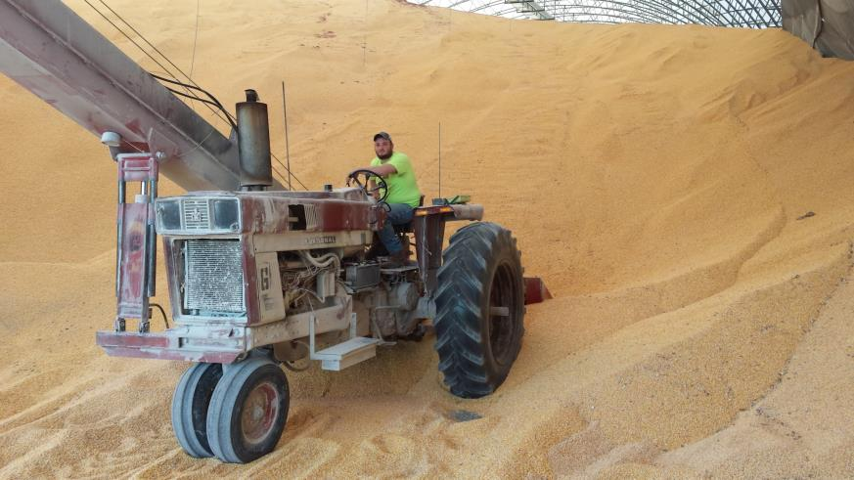
Flat Storage is different work
Tasks may include:
Heavy equipment
Portable augers
Close proximity of vehicles
Notes:
Work in flat storage and ground piles often requires different skills.
Loading and unloading grain generally involves the use of heavy equipment such as loaders to physically move grain.
Loading is generally done with a portable auger or other type of inclined conveyor. The auger is shifted to shape the pile. In some instances, trucks may dump directly into the temporary storage site.
As these structures do not empty by gravity and typically to not have bottom unloading conveyors the product may be loaded directly into transport vehicles. Other methods to unload include using inclined portable augers plus power scoop shovels, front loader or a pneumatic vacuum conveyor to transfer product to into transport vehicles or floor sumps.
Workers need to be trained in the appropriate use of this type of equipment as well as the hazards which may be encountered.
Flat storage and ground piles require the worker to enter the structure to clean up residual product. In many cases, this type of entry is done with the worker inside and operating a piece of machinery.

Slide 17
Potential Flat Storage Hazards
Engulfment
Atmosphere
*CO2 - running engines
*Fumigants
Stuck by/Crush
Entanglement
Dust
*Vehicles
*Lack of machine guarding
*Lack of ventilation
*Grain spoilage
*Powered equipment
*Visibility
*Explosion
* Cliffing
* Bridging
Notes:
As with any grain storage, engulfment and entrapment hazards may exist. These will be discussed more.
Atmosphere hazards may also exist and are generally the result of toxic gases due to the use of fumigants, grain spoilage, and/or inadequate aeration/ventilation.
As machines and vehicles are most often used in flat storage to load/unload product, the presence of increased CO from the operating engines may present a hazard if it is not managed properly – such as poor ventilation .
The entry provisions for flat storage under paragraph h of the grain handling standard only apply if there are no atmospheric hazards present. This is an important distinction as under paragraph h there is no provision for atmospheric testing, ventilation, etc. as contained in the entry provisions of paragraph g. It is up to the employer to determine NO atmospheric hazards are present before entry into a flat storage structure in order to fall under the paragraph h provisions. Otherwise, paragraph g regulates entry.
The use of heavy equipment and vehicles creates more hazards for struck by or crush injuries in a flat storage environment. The vision of the vehicle/machinery operator can be obscured by the equipment, dust, grain piles, configuration/design.
Entanglement with unguarded machinery or other operating equipment such as sweep augers or other augers, poses risks to workers.
Dust levels pose a variety of hazards including health/respiratory, obscured vision and explosion hazards if not properly taken care of.

Slide 18
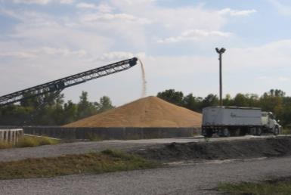
Assess engulfment potential
Engulfment hazard not anticipated:
Filling continual
Not pulled from bottom
Coring
Initial reclaim
Normal angle of repose
Pulled from ground level with loader, etc.
No significant cliffing visible
Where unloading
Notes:
Continual filling allows for better handling of the grain to maintain quality. If you have bottom reclaim ability, immediate coring to get rid of fines can take place. Covering if an outside pile can occur to lessen moisture penetration. Drying conditions are consistent.
Pulling grain from the bottom can result in unseen bridging conditions. Exceptions are during coring which is done immediately after loading and when you start to reclaim you pull free flow grain to the floor until is stops flowing at the correct angle of repose (this initial reclaim is usually done when there is a tunnel underneath the flat storage building).
Unloading grain from flat storage at the ground level with the use of a loader or other equipment, keeps worker from being on the grain pile where engulfment risk increases. Additionally, being inside a vehicle or equipment provides added protection to the worker.
Grain should be at its normal angle of repose. An unnatural angle suggests grain is out of condition and there may be hidden cliffing in the pile.
During unloading, visible signs of cliffing or built up grain indicates out of condition grain which increases the risk for engulfment due to collapse or hidden bridging conditions. Significant cliffing could bury a worker. Cliffing up high on a slope will slide down the slope and may or may not pose a hazard. Steep cliffing toward the edge of the pile is more concerning and needs to be managed.

Slide 19
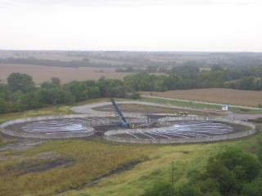
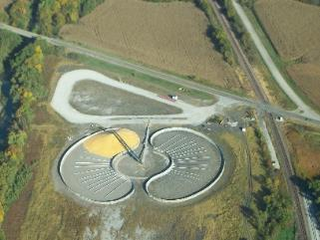
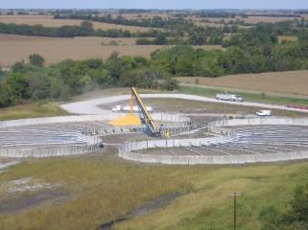
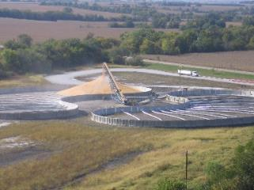
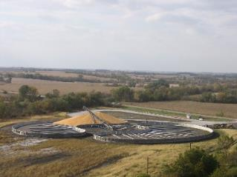
Anatomy of a Ground Pile Fill History – No Bridging potential

Slide 20
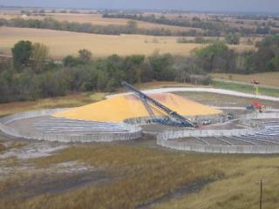
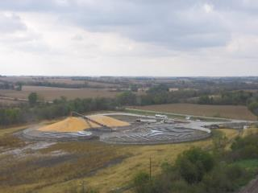
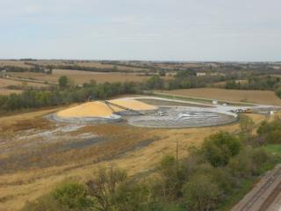
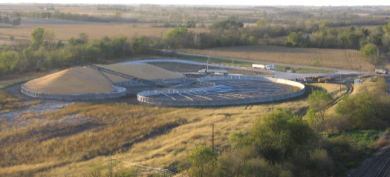
Anatomy of a Ground Pile Fill History – No Bridging potential

Slide 21
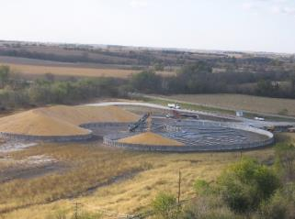
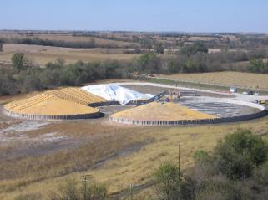
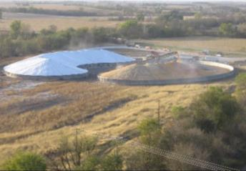
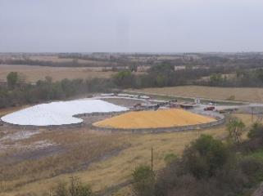
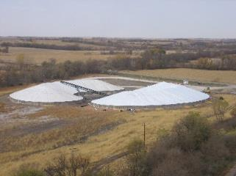
Anatomy of a Ground Pile Fill History – No Bridging potential

Slide 22
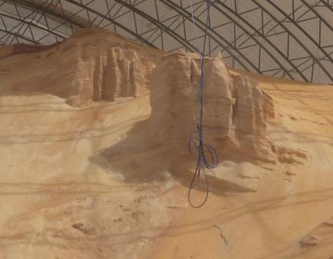
Engulfment Potential
Absent normal angle of repose
Bridging potential
Pulled from underneath
Visible cliffing
Avalanche potential
Equipment & people
Pulled from ground
Moving/Flowing grain
Out of condition grain indicators
Notes:
As with grain bins, the absence of a normal angle of repose indicates a possible bridging condition that could collapse if a worker stands on it.
Cliffing – also called pyramids, cones, or built up grain poses engulfment hazards to both equipment and people if it collapses and/or avalanches. Grain should be pulled from ground level to observe cliffing.
Any other normal indicators of out of condition grain should be observed. Out of condition grain is the leading cause of engulfment hazards. When out of condition grain is present, precautions should be taken for engulfment potential.

Slide 23
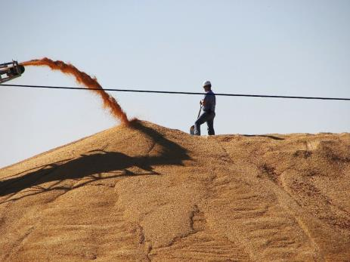
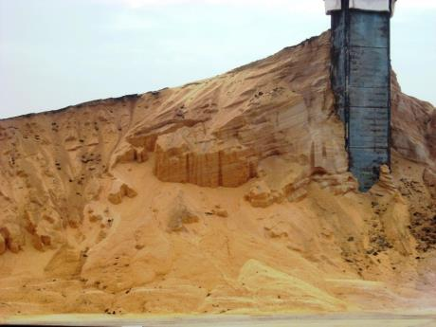
Ground Piles or Flat Storage
Tower/Pyramid
Tower could be 80’ – 100’ tall
Moving/Flowing Grain
Notes:
INSTRUCTOR NOTE: This is an animated slide. One click will send the tractor/auger out of the picture. A second click will advance to next slide.
Explain – Ground piles or Flat Storage represent unique challenges and hazards.
Discuss – Left Picture indicates a “fill hazard” as opposed to a emptying/loading out hazard. The hazards of flowing grain are as present in this filling operation as in bin emptying. The individual does not have anywhere to go or anyway to prevent himself from being moved along with grain if it starts to flow.
Discuss – Right picture indicates out of condition grain (notice the striations). This creates a pyramid or tower of grain. This could cause large blocks of grain to fall unexpectedly. In this type of storage it is very common for the center loading tower to become clogged with fines and other material that can contribute to the grain going out of condition. As shown, the grain pile could be upwards of 80 feet tall, this is tall enough to engulf a tractor loader or semi-truck should the grain avalanche.
Ask – What are SAFE ways to deal with the situations depicted? Should the worker be on top of the pile as it is being loaded? Why/Why not? What precautions should be taken? How would you effectively and safely deal with the tower on the right? How could you prevent an avalanche or keep clear of an avalanche?

Slide 24
Lessen hazard potential.
Engulfment
Atmosphere
Assess grain condition
Engulfment hazards
Maintain grain quality
Move from temporary storage
Ground piles
Run fans/ventilate
Check - if indicated
Good grain condition & normal angle of repose
Notes:
It is essential to mitigate hazards before entry into ANY grain storage structure.
Engulfment hazards can be lessened by ensuring grain stays in good quality. However, before any entry an assessment should be made to determine what engulfment hazards could potentially be present.
Ground pile temporary storage should be emptied as soon as possible to maintain grain quality and lessen the potential for the grain going out of condition.
Atmosphere hazards can develop in any storage structure if the grain is not maintained in good condition or fumigants were used and aeration is lacking. Enclosed flat storage structures need ventilation when equipment and/or vehicle(s) is running to avoid CO2 buildup.

Slide 25
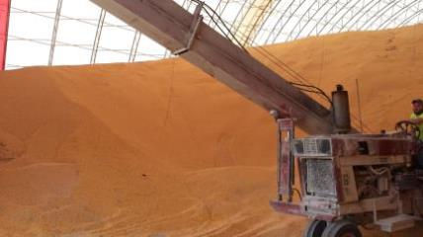
Correct & abate other hazards.
Entanglement
Dust
Properly guard
De-energize hazardous equipment
Control dust levels
Less obscured vision
Adequate lighting
High visibility clothing
Run fans
Proper Guard
Notes:
To avoid entanglement and other machinery hazards ensure proper guarding is in place before workers operate the equipment and/or work around the equipment while energized.
If guarding will not eliminate the hazard, the equipment/machine will need to be deenergized and locked out/tagged out before a worker can be working around it.
Dust may be a hazard in a flat storage environment. Provide, properly rated lighting and control dust levels to increase workers’ vision. Workers should have some kind of high visibility work clothes to increase other’s ability to see them. Lastly, watch for potential ignition sources and accommodate their presence as necessary to avoid igniting fugitive dust. Keep dust levels low to not obscure vision. Visibility less than 5 feet because of dust may indicate and explosive level.
Fans can often control dust levels to keep repirator hazards to a minimum. Particulate respirators can be used as needed. Enclosed cabs for loaders (and other vehicles) also help protect the worker from dust.

Slide 26
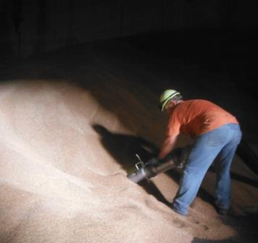
Flat Storage Entry Best Practices
Permit or checklist
Supervisor
No engulfment hazard
Lifeline as needed
Atmosphere check
LOTO unguarded equipment
Guard & control energized equipment
Observer
Rescue equipment
Notes:
While entry under 1910.272(h) does not specifically address issues such as permits, observers, and rescue equipment, best practices should consider employing these measures during flat storage entry.
Specifically, a permit or checklist should be completed to ensure all hazards are identified and measures taken to eliminate, avoid or protect against them.
Proper procedures for entry should be reviewed.
A pre-entry briefing is recommended.
An observer should be present, if necessary, to ensure the entrant’s safety.

Slide 27
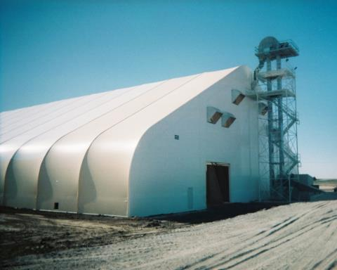
1910.272(h) & Flat Storage Entry
Flat storage entry under paragraph (h) applies ONLY to entries:
Made through unrestricted ground level openings
No atmosphere hazards present
Notes:
Flat storage entry requirements under 1910.727 (h) are applied ONLY when entry is made through an unrestricted, ground level access and no atmospheric hazards are present.
If entry cannot be made through the ground level opening, or the ground level opening poses a restriction to a worker being able to step, walk, or drive through, it is considered a bin entry and paragraph (h) no longer applies no matter what the structure.
Additionally, even if entry can be made through an unrestricted ground level opening but atmospheric hazards are present or it is reasonable to assume they are present, paragraph (h) does not apply and the provisions under 1910.272 (g) concerning atmospheric testing & ventilation must be taken.
1910.272(h)Entry into flat storage structures. For the purposes of this paragraph (h), the term "grain" means raw and processed grain and grain products in facilities within the scope of paragraph (b)(1) of this section. 1910.272(h)(1)Each employee who walks or stands on or in stored grain, where the depth of the grain poses an engulfment hazard, shall be equipped with a lifeline or alternative means which the employer demonstrates will prevent the employee from sinking further than waist-deep into the grain. Note to paragraph (h)(1): When the employee is standing or walking on a surface which the employer demonstrates is free from engulfment hazards, the lifeline or alternative means may be disconnected or removed. 1910.272(h)(2) 1910.272(h)(2)(i)Whenever an employee walks or stands on or in stored grain or grain products of a depth which poses an engulfment hazard, all equipment which presents a danger to that employee (such as an auger or other grain transport equipment) shall be deenergized, and shall be disconnected, locked-out and tagged, blocked-off, or otherwise prevented from operating by other equally effective means or methods. 1910.272(h)(2)(ii)"Walking down grain" and similar practices where an employee walks on grain to make it flow within or out from a grain storage structure, or where an employee is on moving grain, are prohibited. 1910.272(h)(3)No employee shall be permitted to be either underneath a bridging condition, or in any other location where an accumulation of grain on the sides or elsewhere could fall and engulf that employee.

Slide 28
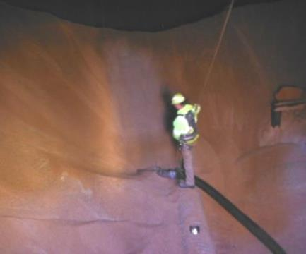
Flat storage entry provisions
Walking/standing in/on grain - depth poses engulfment hazard
Lifeline or other
Prevent sinking more than waist-deep
De-energize & LOTO equipment
Presents a danger
Notes:
Provision of Paragraph (h) ONLY apply when entry is through unrestricted ground level AND no atmospheric hazards are present.
Paragraph (h) takes into account that grain is not moving through gravity. It also recognizes that only equipment that poses a danger to the worker needs to be deenergized taking into account that workers are often using equipment/machinery to load/unload grain or may be engaging in manual activities to load/unload grain not in the proximity of moving equipment. An employer can use other equally effective methods or means to prevent operation.
Provisions of Paragraph (h) are less stringent than paragraph (g). It recognizes that many times in a flat storage entry, workers are not in danger of engulfment or mechanical hazards.
Exceptions: If there is no engulfment hazard a lifeline or other protection is not necessary.
Exceptions: If the equipment poses no danger to the worker it does not need to be deenergized. Equipment that is properly guarded or where the worker will not come in contact with a hazard does not need to be deenergized.
Paragraph (h)
1910.272(h)Entry into flat storage structures. For the purposes of this paragraph (h), the term "grain" means raw and processed grain and grain products in facilities within the scope of paragraph (b)(1) of this section.
1910.272(h)(1)Each employee who walks or stands on or in stored grain, where the depth of the grain poses an engulfment hazard, shall be equipped with a lifeline or alternative means which the employer demonstrates will prevent the employee from sinking further than waist-deep into the grain. Note to paragraph (h)(1): When the employee is standing or walking on a surface which the employer demonstrates is free from engulfment hazards, the lifeline or alternative means may be disconnected or removed.
1910.272(h)(2) 1910.272(h)(2)(i)Whenever an employee walks or stands on or in stored grain or grain products of a depth which poses an engulfment hazard, all equipment which presents a danger to that employee (such as an auger or other grain transport equipment) shall be deenergized, and shall be disconnected, locked-out and tagged, blocked-off, or otherwise prevented from operating by other equally effective means or methods.
1910.272(h)(2)(ii)"Walking down grain" and similar practices where an employee walks on grain to make it flow within or out from a grain storage structure, or where an employee is on moving grain, are prohibited.
1910.272(h)(3)No employee shall be permitted to be either underneath a bridging condition, or in any other location where an accumulation of grain on the sides or elsewhere could fall and engulf that employee.

Slide 29
Flat storage entry prohibits
Workers cannot
On moving grain
Underneath bridging condition
In any location grain could collapse & engulf
Walk down grain
Notes:
Paragraph (h) prohibits workers from walking down grain or other practices to make grain flow – the same as paragraph (g).
It prohibits workers from being on moving grain– the same as paragrah (g).
Unlike entry into bins, silos, and tanks, which is prohibited if there are bridging or avalanching conditions, flat storage entry may occur as long as the worker is not underneath or in the location of those hazards.
Paragraph (h)
1910.272(h)Entry into flat storage structures. For the purposes of this paragraph (h), the term "grain" means raw and processed grain and grain products in facilities within the scope of paragraph (b)(1) of this section.
1910.272(h)(1)Each employee who walks or stands on or in stored grain, where the depth of the grain poses an engulfment hazard, shall be equipped with a lifeline or alternative means which the employer demonstrates will prevent the employee from sinking further than waist-deep into the grain. Note to paragraph (h)(1): When the employee is standing or walking on a surface which the employer demonstrates is free from engulfment hazards, the lifeline or alternative means may be disconnected or removed.
1910.272(h)(2) 1910.272(h)(2)(i)Whenever an employee walks or stands on or in stored grain or grain products of a depth which poses an engulfment hazard, all equipment which presents a danger to that employee (such as an auger or other grain transport equipment) shall be deenergized, and shall be disconnected, locked-out and tagged, blocked-off, or otherwise prevented from operating by other equally effective means or methods.
1910.272(h)(2)(ii)"Walking down grain" and similar practices where an employee walks on grain to make it flow within or out from a grain storage structure, or where an employee is on moving grain, are prohibited.
1910.272(h)(3)No employee shall be permitted to be either underneath a bridging condition, or in any other location where an accumulation of grain on the sides or elsewhere could fall and engulf that employee.

Slide 30
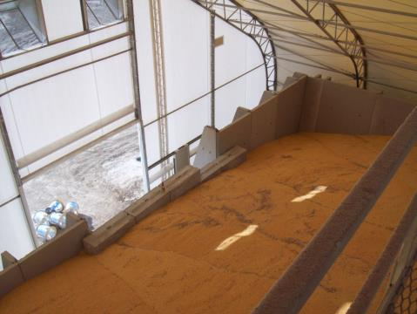
Other flat storage entry
1910.272(g) applies to flat storage entry:
Restricted opening
Above ground level entry
Atmospheric hazards
Restricted entry. Bulkhead blocking access to grain.
Notes:
When the conditions of entry into a flat storage structure is not ONLY through an unrestricted, ground level opening or there is suspected atmospheric conditions to mitigate, the entry is subject to the provisions of 1910.272(g).
The provisions of (g) include: permit & assessment of hazards; atmospheric testing & monitoring as necessary; ventilation and/or respirator use as needed; LOTO; use of lifeline to protect against engulfment hazards if present; use of an observer; availability of rescue equipment; prohibitions against walking down grain, being on moving grain or entry under bridging and/or avalanching conditions.

Slide 31
Summary
Criteria for flat storage:
Structure or building or ground pile
Does not empty completely by gravity
Unrestricted, ground level opening – not always door
Must enter to reclaim residual grain
Unrestricted – step, walk, drive through opening
Flat storage entry – paragraph (h)
Entry ONLY through unrestricted, ground level opening
NO atmospheric hazards present
Notes:
When the conditions of entry into a flat storage structure is not ONLY through an unrestricted, ground level opening or there is suspected atmospheric conditions to mitigate, the entry is subject to the provisions of 1910.272(g).
The provisions of (g) include: permit & assessment of hazards; atmospheric testing & monitoring as necessary; ventilation and/or respirator use as needed; LOTO; use of lifeline to protect against engulfment hazards if present; use of an observer; availability of rescue equipment; prohibitions against walking down grain, being on moving grain or entry under bridging and/or avalanching conditions.

Slide 32
Summary
Workers can NOT be
UNDERNEATH bridging condition
In location of avalanche condition (engulf worker)
Lifeline – when on grain & engulfment potential exists
Deenergize equipment that poses danger
When in/on grain & depth poses engulfment risk
Protect against hazardous energized equipment
Can be proper guarding
When not in/on grain
Notes:
When the conditions of entry into a flat storage structure is not ONLY through an unrestricted, ground level opening or there is suspected atmospheric conditions to mitigate, the entry is subject to the provisions of 1910.272(g).
The provisions of (g) include: permit & assessment of hazards; atmospheric testing & monitoring as necessary; ventilation and/or respirator use as needed; LOTO; use of lifeline to protect against engulfment hazards if present; use of an observer; availability of rescue equipment; prohibitions against walking down grain, being on moving grain or entry under bridging and/or avalanching conditions.

