Slide 1
Motorized Construction Equipment
This material was produced under a grant (SH-27666-SH5) from the Occupational Safety and Health Administration, U.S. Department of Labor. It does not necessarily reflect the views or policies of the U.S. Department of Labor, nor does the mention of trade names, commercial products, or organization imply endorsement by the U.S. Government.
organization imply endorsement by the U.S. Government.
Notes:
Title page and credits for OSHA and WITCC. Western Iowa Tech Community College, 4647 Stone Avenue, P.O. Box 5199, Sioux City,
Iowa 51102-5199, a nonprofit organization

Slide 2
Why Are We Conducting This Training?
In the U.S., more than 800 construction workers die every year while on the job.
Many of these deaths happen when workers breathe in harmful chemicals.
Carbon monoxide poisoning is the number one cause of these deaths from breathing in harmful chemicals.
It is so dangerous because people can't smell, see, or taste it, and it can kill within minutes.
Notes:
Source: https://www.osha.gov/dts/vtools/construction/carbonmonoxide_fnl_eng_web_transcript.html

Slide 3
Learning Objectives
In This Section You Will Learn:
  Dangers of Carbon Monoxide
  The Identification and use of some Motorized Equipment
  Different hazards associated with Motorized Equipment
    Struck By
    Caught In-between
    Falls
    Electrical
  Workers Rights

Slide 4
Carbon Monoxide
Notes:
Instructor to explain
the dangers of carbon monoxide
how it relates to confined spaces and motorized equipment
explain the importance of maintenance of equipment
how proper working equipment produces less CO

Slide 5
What Does All Combustion engines Produce?
CO- Carbon monoxide is a colorless, odorless, tasteless gas produced by burning gas, wood, propane, charcoal or other fuel. Improperly ventilated appliances and engines, particularly in a tightly sealed or enclosed space, may allow carbon monoxide to accumulate to dangerous levels
OSHA Permissible Exposure Limit (PEL)-
NIOSH Recommended Exposure Limit (REL) –
  Carbon Monoxide- 35 PPM and Ceiling of 200 PPM
Carbon Monoxide (CO) | 50 ppm
Notes:
Source: http://www.mayoclinic.org/diseases-conditions/carbon-monoxide/basics/definition/con-20025444
PEL- https://www.osha.gov/dts/hazardalerts/diesel_exhaust_hazard_alert.html

Slide 6
Carbon Monoxide Affects on the Body
Carbon Monoxide Poisoning
Symptoms
Carbon monoxide poisoning occurs when carbon monoxide builds up in your bloodstream.
When too much carbon monoxide is in the air, your body replaces the oxygen in your red blood cells with carbon monoxide.
This can lead to serious tissue damage, or even death.
Headaches, dizziness and drowsiness
Nausea, vomiting, tightness across the chest
Notes:
Definition Source: http://www.mayoclinic.org/diseases-conditions/carbon-monoxide/basics/definition/con-20025444
Symptoms Source: OSHA QuickCard, “Protecting Yourself Carbon Monoxide Poisoning”, https://www.osha.gov/Publications/3282-10N-05-English-07-18-2007.html

Slide 7
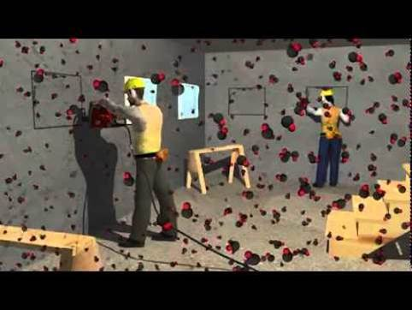
Carbon Monoxide Poisoning
Show video: https://www.osha.gov/dts/vtools/construction/carbonmonoxide_fnl_eng_web.html
Notes:
Source: https://www.osha.gov/dts/vtools/construction/carbonmonoxide_fnl_eng_web.html
The instructor should include: The Goal of this Video is to show the dangers of Carbon Monoxide in a confined space, and the dangers of CO are present at each project that contains motorized construction equipment.

Slide 8
Avoiding CO (Carbon Monoxide) Poisoning
Do Not Operate Gasoline/Propane/Diesel engine for long periods of time in confined area
Do not operate a combustion engine without adequate ventilation
Be careful in cold weather - doors and windows are closed to prevent cold from entering
Be careful in smaller rooms
Install CO monitors
Consider Substituting Gas powered tools for hydraulic or battery operated
Incorporate a ventilation system
Keep windows and doors open
Keep an Air Monitor in the work area

Slide 9
Some sources of CO on the construction site
Portable generators/generators in buildings
Concrete cutting saws, compressors
Power trowels, floor buffers, space heaters
Welding, gasoline powered pumps
High focus on this equipment because of its continued use indoors or in confined areas
Notes:
Source: https://www.osha.gov/OshDoc/data_Hurricane_Facts/carbon_monoxide.pdf

Slide 10
Motorized Equipment
Notes:
Instructor to explain:
Dangers of working with motorized equipment
Ensuring proper inspection before use
Proper training of operators

Slide 11
OSHA’s Focus Four
All of the following is OSHA’s focus four
  Falls Hazards
  Struck By Hazards
  Caught in- or –between Hazards
  Electrical Hazards
  They are the hazardous areas in construction where the most deaths occur

Slide 12
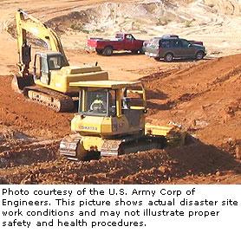
Identifying Motorized Construction Equipment
Mobile Equipment
Forklifts
Skid steers
Aerial Lifts
Vehicles
Horizontal Directional Drillers
Notes:
Picture Source; https://www.osha.gov/SLTC/etools/shipyard/standard/scaffold/aerial_lifts.html
Instructor will explain the items below in the following slides:
Types of mobile equipment and the uses for each
Explain blind spot on equipment

Slide 13
Identifying Motorized Construction Equipment
Hand Power Tools
Immobile Equipment
Gas powered cut off Saws
Power washers
Power Trowels
Portable Generators
Space Heaters
Welders
Notes:
Instructor will explain in the following slides:
Types of hand power equipment and the uses for each
Types of immobile equipment

Slide 14
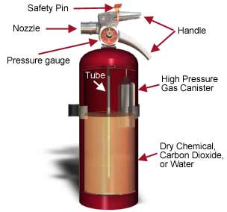
Fire Prevention
Fire Extinguishers
Each piece of mobile and immobile equipment should have its own fire extinguisher
Fire extinguishers should be checked at the beginning of each shift
Each extinguisher must be fully charged
Hand power tools must have a fire extinguisher in the near vicinity
Notes:
Fire Prevention to be located each piece of equipment
Hand power tools have a fire extinguisher in the near vicinity
Picture Source: https://www.osha.gov/SLTC/etools/evacuation/portable_about.html

Slide 15
Motorized mobile equipment
Notes:
Approximately 100 Fatalities occur each year by mobile equipment
Major causes;
Struck by while backing up
operator failure to utilize roll over protection system (ROPS), or Removal of safety devices
Roll Over
Cranes and Dump Trucks are some of the equipment that contacts energized lines most often

Slide 16
Motorized Mobile Equipment Hazards
Struck By
Contact With
Mobile equipment has many blind spots around it
Minimize with the use of flaggers and spotters
Operator training to ensure proper operation of the equipment
Cranes contact with power lines
Equipment contact with persons or other equipment
Notes:
Problems with the operators view can result in a fatality, the larger the equipment the bigger the blind spot. Operators may not be able to see anyone close to the equipment.
Flaggers and spotters are able to view around the equipment to ensure safety compliance
Temporary barriers may be used to limit access around the equipment
Ensure 10 foot minimum distance from all power lines assume; all lines are live

Slide 17
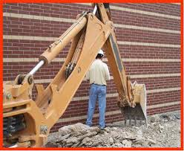

Gas Powered Mobile Equipment Hazards
Caught In or between
Crushed if vehicle overturns
Death or serious injury likely if Employees are caught in-between Equipment and Object
Minimized with the use of Flaggers and Spotters
Notes:
Never Approach a machine in operation without gaining the attention of the operator, never stand between the equipment and an immovable object
Make sure your flaggers and operators are trained to identify hazards in the work area and ensure they know and understand the importance of keeping visual contact with each other while the machine is in operation
High visibility vests are a great way to maximize the ability of the operator to spot near employees
Picture Source:

Slide 18
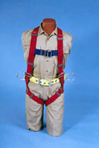
Gas Powered Mobile Equipment Hazards
Fall Protection
Railings are not always enough when working in elevation
Use of fall harness & lanyard that is properly inspected, worn & connected is Mandatory in Aerial lifts
Personal fall arrest systems must be rigged so the employee does not fall more than 6 feet or come in contact with a lower level
100% Tie Off
Inspect before every use
Notes:
§1926.453(b)(2)(v)
§1926.502(d)(16)(iiiv)
Picture Source: https://www.osha.gov/SLTC/etools/construction/falls/fallarrest.html

Slide 19
Motor Powered Equipment
Electrical Hazards
Severity of shock
Exposed Wires
Ground Plug Removed
Ground Fault Circuit Interrupters (G.F.C.I.) not Working
Water
Amount of current flowing through the body (measured in amperes).
Path of the current through the body.
Length of time the body is in the circuit.

Slide 20
Forklifts
Definition
Hazards
Powered industrial trucks, commonly called forklifts or lift trucks, are used in many industries
primarily to move materials
They can also be used to raise, lower, or remove large objects or a number of smaller objects on pallets or in boxes, crates, or other containers
Objects falling from Forklift
Tip-overs
Structural failures
Electric shock
Entanglement hazards
Contact with objects
Contact with ceilings
Notes:
Source or definition https://www.osha.gov/SLTC/poweredindustrialtrucks/

Slide 21
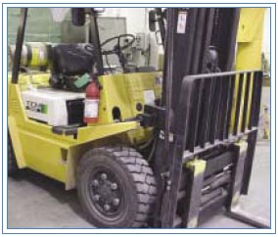

Forklifts Continued
Operation
Only Trained Authorized persons are allowed to operate a fork lift
Inspection
When in operation the operator must be using a seatbelt
Do not use in confined spaces for long periods of time (Build up of CO)
Notes:
Picture Source: https://www.osha.gov/SLTC/etools/pit/

Slide 22
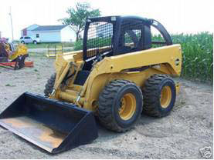
Skid Steer
Operation
Hazards
Only Trained Authorized persons are allowed to operate a Skid steer
Inspection Before Operation
Seatbelts
Crushed By Moving Parts
Rollover Accidents
Notes:
Picture source: https://www.osha.gov/dts/shib/shib011209.html
The hazards listed are the two highest rates of fatalities with this equipment

Slide 23
Aerial Lifts
Definition
Hazards
An Aerial Lift is any Vehicle Mounted Device used to elevate Personnel
Falls from elevated levels
Objects falling from lifts
Tip-overs
Ejection from platform
Structural failures
Electric shock
Entanglement hazards
Contact with objects
Contact with ceilings

Slide 24
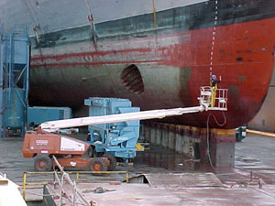
Aerial Lifts Continued
Operation
Only Trained Authorized persons are allowed to operate an aerial lift
Inspection before operation
Operate to Manufacturers Specifications
Fall Protection
  Ensure all railings and gates are in good working condition and closed when in use
  Full body harness attached to the boom or bucket
Notes:
Picture source: https://www.osha.gov/SLTC/etools/shipyard/standard/scaffold/aerial_lifts.html

Slide 25
Horizontal Directional Drilling
Operation
Hazards
Know the location of drilling and identify any underground hazards before you dig
Inspection of equipment
Certification to operate equipment
Operate to manufacturers specification
Place barriers around equipment to ensure workers are aware of the hazards present
Ensure any necessary guarding devices are attached and work properly
Rotating parts
Carbon Monoxide
Unguarded rotating shaft
Moving parts
Struck by
Caught in
Notes:
Uses for the horizontal directional drilling is laying electrical lines and water lines under pavement
Large sections of the drilling pipe are unguarded (due to the fact that a majority of the rotating portion of the drill enters the earth) and special precautions should be taken to ensure no employee comes in contact with any unguarded portion, such as placing a barrier between the worker and the rotating shaft to alert the workers in that area. Also, don’t wear loose clothing, hair, or other items that could get caught in the rotating shaft.

Slide 26
Vehicles
Operation
Hazards
Only trained qualified people to operate
Inspection before each use
Seatbelts
Caught in
Caught between
Struck by
Notes:
Ensuring driver has a drivers license

Slide 27
Motorized Hand Tools

Slide 28
Gas Powered Hand Tools Hazards
Dust/Fumes
Sharp Flying Objects
Prevent by maintaining a well ventilated area
Use of a wet saw
Use of a dust collector
Use of dust/particle masks accurate for the job tasks
In low oxygen environments Self Contained Breathing Apparatus (SCBA) may be necessary
Use Other PPE – eye/face protection
Grinding and cutting operations
Shields and guards need to be in place and working properly
Use of PPE – eye/face protection & gloves

Slide 29
Gas Powered Hand Tools
Personal Protective Equipment
Guards
Hardhat
Face Shield
Safety Glasses/ Goggles
Dust Mask
Gloves
Properly working
Not Damaged
Manufacturer approved
Notes:
If the guard is damaged in any way remove immediately and notify your supervisor.

Slide 30
Cut Off Saw Hazards
Cut Off Saw
Concrete Saw
Flying Debris
Carbon Monoxide
Rotating Parts
Dust
Flying Debris
Carbon Monoxide
Rotating Parts
Notes:
Insure all guards are functioning properly
Inspect the blade each time before use to ensure its in good repair

Slide 31
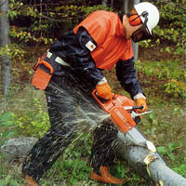
Chain Saws
Hazards
Moving Parts
Dust
Flying Debris
Carbon Monoxide
Unguarded chain
Kick Back
The chain saw is one of the most efficient, productive, and dangerous portable power tools used in any industry.
If you learn to operate it properly and maintain the saw in good working condition, you will avoid injury as well as be more productive.

Slide 32
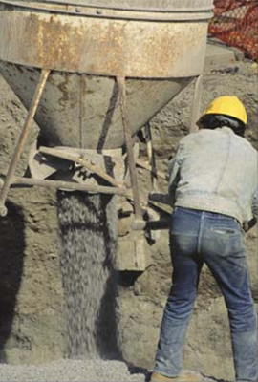
Powered Trowels
Hazards
Rotating Parts
Carbon Monoxide
Flying Debris
  Used for concrete finishing processes
Notes:
Picture Source: https://www.osha.gov/Publications/concrete_manufacturing.html

Slide 33
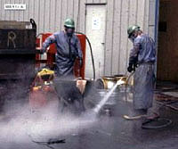
Pressure Washers
Figure 47: Workers expose
Hazards
Flying Debris
Fast moving Water
Carbon Monoxide
Slip Trip and Fall
Notes:
Picture source: https://www.osha.gov/SLTC/etools/shipyard/barge/barge_common_hazards.html

Slide 34
Immobile Motorized Equipment

Slide 35
Immobile Gas Powered Equipment
Generators
Hazards
Ensure located in a well ventilated area
Properly maintained
Not operated in water
Ensure the cords going to the generator are free of nicks in the outer coating
Electric shock or electrocution
Carbon monoxide
Trip hazard from running cords
Notes:
To avoid CO, locate the equipment in a dry well ventilated area; ensure there are no electric hazards with the generator
Avoid using the generator in water, and ensure the GFCI is working properly at all times

Slide 36
Immobile Gas Powered Equipment
Heaters
Hazards
Indirect heat source to ensure exhaust isn’t entering the jobsite
Proper maintenance to ensure its running correctly
Ensure no flammable material is around heat source
Fire hazard
Shocks and electrocution
Carbon monoxide
Notes:
Keep all flammable materials at minimum 10 feet away from the heater
Stay away from exhaust
Ensure equipment is located outside in a well ventilated area

Slide 37
Immobile Gas Powered Equipment
Welders
Hazards
Avoid any water on the jobsite
Ensure the proper maintenance of the equipment
Ensure all electrical components are free of nicks or scratches to the outer coating exposing live wires
Shocks and electrocution
Carbon monoxide
Trip hazard

Slide 38
Immobile Gas Powered Equipment
Inspections
Location
Make Sure equipment is Properly Maintained
Equipment records are maintained
Lines
Oil Levels
Tires
brakes
Keep Away From Workers
Ensure Exhaust isn’t blown back into building/Work Area
If Necessary extend lines going to Equipment to ensure adequate distance from work area
Notes:
Inspections can lead to lower co emissions, by ensuring the motor is running correctly

Slide 39
Employee Rights and Responsibilities
Notes:
Workers Rights
http://www.osha.gov/Publications/osha3021.pdf

Slide 40
Employee Rights & Responsibilities
Occupational Safety and Health Act of 1970
To assure safe and healthful working conditions for working men and women
By authorizing enforcement of the standards developed under the Act
By assisting and encouraging the States in their efforts to assure safe and healthful working conditions
By providing for research, information, education, and training in the field of occupational safety and health…
Notes:
Workers Rights
http://www.osha.gov/Publications/osha3021.pdf
The instructor will discuss employee rights and responsibilities with the participants.

Slide 41
Employee Rights & Responsibilities
You have the right to:
  A safe and healthful workplace
  Know about hazardous chemicals
  Information about injuries and illnesses in your workplace
  Complain or request hazard correction from employer
Notes:
The information above was taken from the new 2 hour Intro to OSHA PPT, slide #10.
The instructor will discuss employee rights and responsibilities with the participants.

Slide 42
Employee Rights & Responsibilities
You have the right to:
File a confidential complaint with OSHA to have their workplace inspected.
Receive information and training about hazards, methods to prevent harm, and the OSHA standards that apply to their workplace. The training must be done in a language and vocabulary workers can understand.
Get copies of their workplace medical and exposure records.
Participate in an OSHA inspection and speak in private with the inspector.
Notes:
Workers Rights
http://www.osha.gov/Publications/osha3021.pdf

Slide 43
Employee Rights & Responsibilities Continued:
File a complaint with OSHA if they have been retaliated or discriminated against by their employer as the result of requesting an inspection or using any of their other rights under the OSH Act.
File a complaint if punished or discriminated against for acting as a “whistleblower” under the additional 21 federal statutes for which OSHA has jurisdiction.
Notes:
Workers Rights
http://www.osha.gov/Publications/osha3021.pdf

Slide 44
Whistleblower Protection
OSHA's Whistleblower Protection Program enforces the whistleblower provisions of more than twenty whistleblower statutes protecting employees who report violations of various workplace safety
Airline, commercial motor carrier, consumer product, environmental, financial reform, food safety, health insurance reform, motor vehicle safety, nuclear, pipeline, public transportation agency, railroad, maritime, and securities laws.
Rights afforded by these whistleblower acts include, but are not limited to, worker participation in safety and health activities, reporting a work related injury, illness or fatality, or reporting a violation of the statutes.
Notes:
The Whistleblower Protection Program
http://www.whistleblowers.gov/

Slide 45
Whistleblower Protection
The Whistleblower Protection Advisory Committee (WPAC) was established to advise, consult with, and make recommendations to the Secretary of Labor and the Assistant Secretary of Labor for Occupational Safety and Health on ways to improve the fairness, efficiency, effectiveness, and transparency of OSHA's administration of whistleblower protections.
In particular, the committee advises OSHA on the development and implementation of improved customer service models, enhancements in the investigative and enforcement process, training, and regulations governing OSHA investigations.
In addition, WPAC advises OSHA in cooperative activities with other federal agencies that are responsible for areas covered by the whistleblower protection statutes enforced by OSHA.
Notes:
The Whistleblower Protection Program
http://www.whistleblowers.gov/

Slide 46
Whistleblower Protection
Protection from discrimination means that an employer cannot retaliate by taking "adverse action" against workers, such as:
Firing or laying off
Blacklisting
Demoting
Denying overtime or promotion
Disciplining
Denial of benefits
Failure to hire or rehire
Intimidation
Making threats
Reassignment affecting prospects for promotion
Reducing pay or hours
Notes:
The Whistleblower Protection Program
http://www.whistleblowers.gov/

Slide 47

Whistleblower Protection
Notes:
The Whistleblower Protection Program
http://www.whistleblowers.gov/

Slide 48
Employee Rights & Responsibilities
OSHA website: OSHA Website and OSHA offices: Call or Write (800-321-OSHA)
Workers Rights: OSHA Publication 3021
Compliance Assistance Specialists in the area offices
National Institute for Occupational Safety and Health (NIOSH) – OSHA’s sister agency
OSHA Training Institute Education Centers
Doctors, nurses, other health care providers
Other local, community-based resources
Notes:
The Information above was taken from the new 2 hour Intro to OSHA PPT, slide #40.
The instructor will discuss employee rights and responsibilities with the participants.

