Slide 1
Managing Fall Protection Hazards
This material was produced under grant number Susan Harwood Grant # SH26315-SH4 from the Occupational Safety and Health Administration, U.S. Department of Labor. It does not necessarily reflect the views or policies of the U.S. Department of Labor, nor does mention of trade names, commercial products, or organizations imply endorsement by the U.S. Government.

Slide 2
SAFETY TRAINING CENTER
Welcome…
Falls are the leading cause of death in construction. When working from heights, such as ladders, scaffolds, and roofs, employers must plan projects to ensure that the job is done safely. This is not the place to cut corners or cheat on safety. It’s your life hanging in the balance, so pay attention and know what it takes to keep you safe.

Slide 3
Work Smart, Build Safe!
This publication contains:
The purpose for the Occupational Safety and Health Administration (OSHA) and its enforcement duty under law.
Important terms and definitions within OSHA’s fall protection standard, specifically competent person.
The nature of fall hazards in construction.
Procedures for erecting, maintaining, disassembling, and inspecting fall protection systems.
The use and operation of guardrail systems, personal fall arrest systems, safety net systems, warning line systems, safety monitoring systems, controlled access zones, and other protection to be used.
Emergency response procedures.
OSHA’s standards and references.

Slide 4
General Disclaimer
GENERAL DISCLAIMER
This material is not a substitute for any provision of the Occupational Safety and Health Administration (OSHA) or any standards issued by OSHA. If at any time it is discovered that the materials presented vary from Federal or State OSHA regulations, American National Standards Institute (ANSI), state laws or local ordinances, it is understood that those regulations, laws and ordinances will take precedence over the materials presented herein. In some cases, the information given may imply a higher level of protection than required in some Federal or State OSHA regulations. The mention of any products or materials by brand name in no way constitutes endorsement. Any products or materials not mentioned within this manual that may be considered acceptable as protective devices, equipment, or practices is not intentional and should not rule out their acceptability as employee or environmental protection.
OSHA DISCLAIMER
This material was produced under grant number Susan Harwood Grant # SH26315-SH4 from the Occupational Safety and Health Administration, U.S. Department of Labor. It does not necessarily reflect the views or policies of the U.S. Department of Labor, nor does mention of trade names, commercial products, or organizations imply endorsement by the U.S. Government.
Finally, this Managing Fall Protection Hazards Handbook is intended to be used as a training aid and for general information only; the creator assumes no responsibility for any loss or damage resulting from its use.

Slide 5
Disclaimer
The content of this Managing Fall Protection Hazards Handbook is mostly taken from OSHA’s fall protection standards 29 CFR 1926 Subpart M and other standards. Other contributions come from OSHA Letters of Interpretation, OSHA Fact Sheets and posters. Additional information on scaffolds, steel erection, general industry and stairways & ladders is also provided. The Construction Safety Council will also like to acknowledge the following for their support as well…
The Occupational Safety and Health Administration (OSHA)
CPWR – The Center for Construction Research and Training (eLCOSH images)
Oregon OSHA
Page ii

Slide 6
Managing Fall Protection Hazards Handbook

Slide 7
Course participants will learn
Occupational Safety & Health Administration (OSHA) fall protection standards.
The correct procedures for erecting, maintaining, disassembling and inspecting fall protection systems.
How and when to make managerial decisions, such as how to implement a job-site Fall Management System.

Slide 8
Reasons for Development
Protect the safety and health of the worker.
Train competent persons to perform frequent and regular inspections of the job-site, materials and equipment.
Help employers understand and react to fall hazards in construction and comply with Federal rules and regulations.

Slide 9
Employers have the responsibility to:
Develop safety programs to comply with OSHA standards.
Provide for frequent and regular inspections of the job-sites, materials, and equipment to be made by competent persons designated by the employers.
Not allow the use of any machinery, tool, material, or equipment which is not in compliance with any applicable requirement of [OSHA]. Such machine, tool, material, or equipment shall either be identified as unsafe by tagging or locking the controls to render them inoperable or shall be physically removed from its place of operation.
The employer shall permit only those employees qualified by training or experience to operate equipment and machinery.
Page iii

Slide 10
Employer’s responsibility to train workers:
The employer should avail himself of the safety and health training programs the Secretary provides.
The employer shall instruct each employee in the recognition and avoidance of unsafe conditions and the regulations applicable to his work environment to control or eliminate any hazards or other exposure to illness or injury.

Slide 11
Intended Audience
The target audience is the construction employer, manager, employee or employee representative who, as part of a safety and health program, would either be acting to fulfill the requirements of a competent person (to conduct frequent and regular inspections of a job-site) or performing safety and health evaluations for their member employees and performing training as described in OSHA’s construction safety & health standard 29 CFR 1926.
Job-site Competent Persons
Qualified Persons
Site Supervisors
Owners

Slide 12
Table of Contents:
Pages 1, 2, 3, and 4 of the student workbook

Slide 13
Discussion Points
Important Terms & Definitions within OSHA’s Federal fall protection standards.
OSHA’s purpose/General Duty Clause.
Employer/employee rights & responsibilities under the OSH Act.
OSHA’s Multi-Employer Worksite Citation Policy.
OSHA’s Federal standards addressing falls.
Industry Consensus Standards for fall protection equipment and programs.
Fall Prevention in Construction Campaign – Plan, Provide, Train.
Page 7

Slide 14
Contractor Fall Management System
Management Commitment & Employee Involvement
  Knowledge of OSHA Standards
  Knowledge of Industry Consensus Standards
  Fall Management Policy & Accountability Plan
Work-site Analysis
  Pre-job Planning
  Job-site Inspection Check-lists
Hazard Prevention & Controls
  Fall Protection Systems & Criteria
  Rescue Plan
Safety & Health Training
Certification of Training
Employees (Workers)
Competent Persons
Retraining

Slide 15
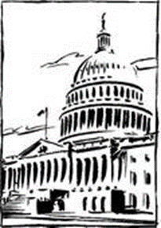
Occupational Safety & Health Administration (OSHA)
To assure safe and healthful working conditions for working men and women; by authorizing enforcement of the standards developed under the Act; by assisting and encouraging the States in their efforts to assure safe and healthful working conditions; by providing for research, information, education, and training in the field of occupational safety and health; and for other purposes.
Be it enacted by the Senate and House of Representatives of the United States of America in Congress assembled, that this Act may be cited as the “Occupational Safety and Health Act of 1970” (OSH Act).
Page 2

Slide 16
General Duty Clause…
(a) Each employer
Shall furnish to each of his employees employment and a place of employment which are free from recognized hazards that are causing or are likely to cause death or serious physical harm to his employees.
Shall comply with occupational safety and health standards promulgated under this Act.
(b) Each employee shall comply with occupational safety and health standards and all rules, regulations, and orders issued pursuant to this Act which are applicable to his own actions and conduct.
Page 2

Slide 17
What is OSHA’s General Duty Clause?
Section 5(a)(1) of the OSH Act has become known as “The General Duty Clause”. It is a catch all for citations if OSHA identifies unsafe conditions to which a regulation does not exist.
In practice, OSHA, court precedent, and the review commission have established that if the following elements are present, a “general duty clause” citation may be issued.
An employer failed to keep the workplace free of a hazard to which employees of that employer were exposed.
The hazard was recognized. (Examples: Equipment Manufacturer Manuals, other Industry and Council associated manuals, through job-site safety personnel, employees, trade unions and other associations/organizations like ANSI.)
The hazard was causing or was likely to cause death or serious physical harm.
There was a feasible and useful method to correct the hazard.

Slide 18
Fall Fatalities in Construction
Falls are the leading cause of death in construction. One of every three construction fatalities are as a result of falls. The U.S. Department of Labor (DOL) investigates these fatalities and reports them to the Bureau of Labor Statistics (BLS). Visit www.osha.gov for a recent listing of current fatalities and catastrophes.
Page 3

Slide 19
Fatal Fact #1
A full time carpenter was working on the second floor of a wood framed (new construction) residential house, when he fell more than 20 feet through an unguarded stairway opening to the concrete basement floor. He was killed in the fall from fatal head and internal injuries.

Slide 20
Fatal Fact #2
A worker was installing vinyl siding on a two story town home. He was using a ladder that was placed on top of a scaffold. While standing on the top step of the ladder, the worker over reached to one side and the ladder overturned. He fell nearly 20 feet to the driveway below. He died later that day from injuries caused by the fall.

Slide 21
Fatal Fact #3
Four workers were installing sheet metal steel decking on a pre-engineering building. As one of the workers walked down the roof, he lost his footing and fell through an opening. He died the next day from injuries caused by the fall.

Slide 22
Fatal Fact #4
Two workers were re-roofing a two story home with a pitched roof. One of the workers was close to the edge of the roof. As she reached to pick up another shingle, she lost her balance all fell more than 20 feet to the driveway below. She died instantly from her injuries.

Slide 23
It’s the Law!

Slide 24
Employees/Employers
EMPLOYEES:
You have the right to notify your employer or OSHA about workplace hazards. You may ask OSHA to keep your name confidential.
You have the right to request an OSHA inspection if you believe that there are unsafe and unhealthful conditions in your workplace. You or your representative may participate in that inspection.
You can file a complaint with OSHA within 30 days of retaliation or discrimination by your employer for making safety and health complaints or for exercising your rights under the OSH Act.
You have a right to see OSHA citations issued to your employer. Your employer must post the citations at or near the place of the alleged violation.
Your employer must correct workplace hazards by the date indicated on the citation and must certify that these hazards have been reduced or eliminated.
You have the right to copies of your medical records or records of your exposure to toxic and harmful substances or conditions.
Your employer must post this notice (OSHA 3165-12-06R) in your workplace.
You must comply with all occupational safety and health standards issued under the OSH Act that apply to your own actions and conduct on the job.
EMPLOYERS:
You must furnish your employees a place of employment free from recognized hazards.
You must comply with the occupational safety and health standards issued under the OSH Act.
Page 4

Slide 25
Refusing work is protected if…
Your right to refuse to do a task is protected if all of the following conditions are met:
Where possible, you have asked the employer to eliminate the danger, and the employer failed to do so; and
You refused to work in “good faith.” This means that you must genuinely believe that an imminent danger exists. Your refusal cannot be a disguised attempt to harass your employer or disrupt business; and
A reasonable person would agree that there is a real danger of death or serious injury (illness); and
There isn’t enough time, due to the urgency of the hazard, to get it corrected through regular enforcement channels, such as requesting an OSHA inspection.
When all of these conditions are met, you take the following steps:
Ask your employer to correct the hazard;
Ask your employer for other work;
Tell your employer that you won’t perform the work unless and until the hazard is corrected; and
Remain at the worksite until ordered to leave by your employer.

Slide 26
If - Then
IF | THEN
You believe working conditions are unsafe or unhealthful. | Call your employer’s attention to the problem.
Your employer does not correct the hazard or disagrees with you about the extent of the hazard. | You may file a complaint with OSHA.
Your employer discriminates against you for refusing to perform the dangerous work | Contact OSHA immediately. (800) 321-OSHA

Slide 27
OSHA’s Multi-Employer Worksite Citation Policy
The Creating Employer: an employer who causes a hazardous condition that violates an OSHA standard. An employer who creates the hazard is citable even if the only employees exposed in the workplace are those who work for other employers
The Exposing Employer: an employer whose own employees are exposed to the hazard.
If the exposing employer created the violation, he/she is citable for the violation as a creating employer.
If the violation was created by another employer, the exposing employer is citable if he/she:
Knew of the hazardous condition or failed to exercise reasonable diligence to discover the condition, and
Failed to take steps to protect his/her employees.
If the exposing employer has the authority to correct the hazard, he/she must do so.
If he/she lacks the authority to correct the hazard, he/she is citable if he/she fails to do each of the following:
Ask the creating and/or controlling employer to correct the hazard
Inform his/her employees of the hazard, and
Take reasonable alternative protective measures.
NOTE: In some circumstances, the employer is citable for failing to remove his/her employees from the job to avoid the hazard
The Correcting Employer: an employer who is responsible for correcting a hazard on the exposing employer’s worksite, usually occurring while the correcting employer is installing and/or maintaining safety/health equipment. The correcting employer must exercise reasonable care in preventing and discovering violations and meet his/her obligation of correcting the hazard.
The Controlling Employer: an employer who has general supervisory authority over the worksite, including the power to correct safety and health violations or requiring others to correct them. A controlling employer must exercise reasonable care to prevent and detect violations on the site.
Page 6

Slide 28
Your Rights as a Whistleblower
You may file a complaint with OSHA if your employer retaliates against you by taking unfavorable personnel action because you engaged in protected activity relating to workplace safety and health, commercial motor carrier safety, pipeline safety, air carrier safety, nuclear safety, the environment, asbestos in schools, corporate fraud, SEC rules or regulations, railroad carrier safety or security, or public transportation agency safety or security.
Page 7

Slide 29
Employers must Provide and Pay for most Personal Protective Equipment (PPE)
With few exceptions, OSHA requires employers to pay for personal protective equipment used to comply with OSHA standards; employers cannot require workers to provide their own PPE. Even when a worker provides his or her own PPE, the employer must ensure that the equipment is adequate to protect the worker from hazards at the workplace.
Employers are not required to pay for:
Everyday clothing; such as long-sleeve shirts, long pants and normal work boots (including protective toe).
Ordinary clothing; such as winter coats, jackets and gloves.

Slide 30
Employer Obligations/Worker Responsibility

Slide 31
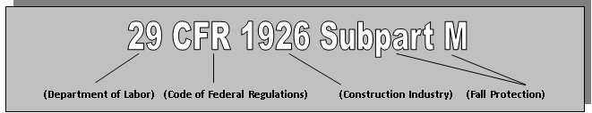
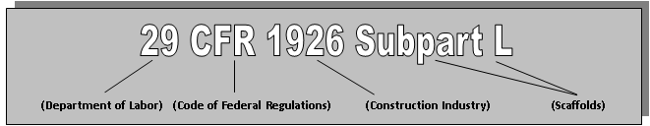
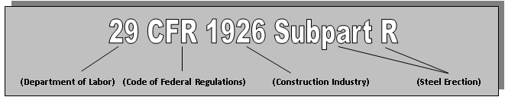
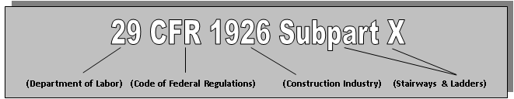
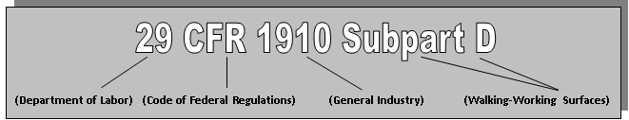
Department of Labor Code of Federal Regulation
Page 10 - 11

Slide 32
Industry Consensus Standards for Fall Protection
American Society of Safety Engineers (ANSI A10.32)
ANSI A10.32 – PERSONAL FALL PROTECTION USED IN CONSTRUCTION AND DEMOLITION OPERATIONS
The A10.32 standard establishes performance criteria for personal fall protection equipment and systems in construction and demolition and provides guidelines, recommendations for their use and inspection.
American Society of Safety Engineers (ANSI Z359)
ANSI Z359 was developed to provide standard safety requirements for personal fall arrest systems, subsystems, and components. Its primary purpose was to provide guidance in regards to the design of fall protection systems and the variety of equipment used in the industry.
Page 12 and 13

Slide 33

Qualified Person
Qualified person means a person who, by possession of a recognized degree, certificate, or professional standing, or who by extensive knowledge, training and experience, can successfully demonstrate the ability to solve/resolve problems relating to the subject matter, the work, or the project.
Per ANSI/ASSE Z359.0 definition of a Qualified Person is as follows: Qualified Person. A person with recognized degree or professional certificate and with extensive knowledge, training, and experience in the fall protection and rescue field who is capable of designing, analyzing, evaluating and specifying fall protection and rescue systems to the extent required by this standard.
Within OSHA’s fall protection standards, a “Qualified Person” may be required to ensure the proper design, installation and use of fall protection systems and plans. One of the more important aspects of a fall protection system is the anchorage point for personal fall arrest systems (PFAS’s).
Page 14

Slide 34

Competent Person
Page 15
Competent person means one who is capable of identifying existing and predictable hazards in the surroundings or working conditions which are unsanitary, hazardous, or dangerous to employees, and who has authorization to take prompt corrective measures to eliminate them.
Per ANSI/ASSE Z359.0 definition of a Competent Person is as follows: Competent Person. An individual designated by the employer to be responsible for the immediate supervision, implementation, and monitoring of the employer’s managed fall protection program who through training and knowledge, is capable of identifying, evaluating and addressing existing and potential fall hazards, and who has the employer’s authority to take prompt corrective action with regard to such hazards.

Slide 35
Competent Person
Within OSHA’s fall protection standards, a “Competent Person” is required to perform frequent and regular inspections of the job-site materials and equipment.
This person is designated by the employer and must have the authorization to take prompt corrective measures to eliminate hazards and enforce safety rules.
A competent person must also train each employee on how to recognize fall hazards and the procedures to be followed in order to minimize these hazards.
Personal fall arrest systems and components subjected to impact loading shall be immediately removed from service and shall not be used again for employee protection until inspected and determined by a competent person to be undamaged and suitable for reuse.
A personal fall arrest system is designed, tested, and supplied as a complete system. However, it is common practice for lanyards, connectors, lifelines, deceleration devices, and body harnesses to be interchanged since some components wear out before others. The employer and employee should realize that not all components are interchangeable.
Any substitution or change to a personal fall arrest system should be fully evaluated or tested by a competent person to determine that it meets the standard, before the modified system is put in use.

Slide 36

Training Requirements
The employer shall assure that each employee has been trained, as necessary, by a competent person qualified in the following areas:
The nature of fall hazards in the work area.
The correct procedures for erecting, maintaining, disassembling, and inspecting the fall protection systems to be used.
The role of employees in fall protection plans.
OSHA fall protection standards.
The use and operation of guardrail systems, personal fall arrest systems, safety net systems, warning line systems, safety monitoring systems, controlled access zones, and other protection to be used.
The role of each employee in the safety monitoring system when this system is used.
The correct procedures for the handling and storage of equipment and materials and the erection of overhead protection.
Page 16

Slide 37

OSHA’s Fall Prevention Campaign
PLAN ahead to get the job done safely.
PROVIDE the right equipment.
TRAIN everyone to use the equipment safely.

Slide 38
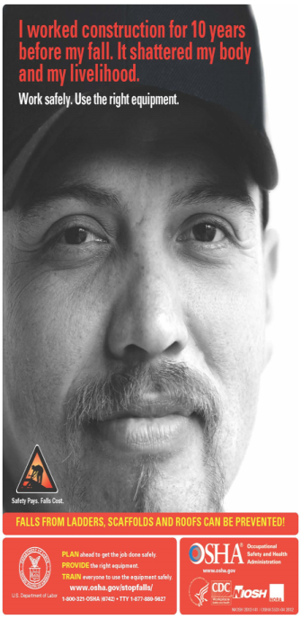
Work safely. Usse the right equipment

Slide 39
Conventional fall protection systems / Alternative methods allowed by specific regulations
Conventional fall protection systems.
Guardrail Systems
Safety Net Systems
Personal Fall Arrest Systems (PFAS)
Alternative Methods allowed by specific regulations.
Warning Line Systems
Controlled Access Zones
Controlled Decking Zone (CDZ)
Safety Monitoring Systems
Fall Protection Plans
NOTE: There is a presumption that conventional fall protection systems are more often than not feasible and will not create a greater hazard. Accordingly, the employer has the burden of establishing that an alternative Methods allowed by specific regulations is appropriate.

Slide 40
Passive / Active
(Active)
Personal Fall Arrest Systems (PFAS)
Positioning Device Systems
Restraint System
Warning Line Systems
Controlled Access Zones
Controlled Decking Zone
Safety Monitoring Systems
(Passive)
Safety Net Systems
Protection from Falling Objects
Guardrails
Hole Covers
Elimination of Fall Hazards

Slide 41
Guardrail Systems
Guardrail Systems
“Guardrail system” means a barrier erected to prevent employees from falling to lower levels.
Guardrail systems and their use shall comply with the following provisions:
The top edge height of toprails, or (equivalent) guardrails must be 42 inches (1.1 meters) plus or minus 3 inches (8 centimeters), above the walking/working level. When workers are using stilts, the top edge height of the top rail, or equivalent member, must be increased an amount equal to the height of the stilts.
Screens, midrails, mesh, intermediate vertical members, or equivalent intermediate structural members must be installed between the top edge of the guardrail system and the walking/working surface when there are no walls or parapet walls at least 21 inches (53 centimeters) high.
When midrails are used, they must be installed at a height midway between the top edge of the guardrail system and the walking/working level.
When screens and mesh are used, they must extend from the top rail to the walking/working level and along the entire opening between top rail supports.
Intermediate members, such as balusters, when used between posts, shall not be more than 19 inches (48 centimeters) apart.
If wire rope is used for toprails, it must be flagged at not more 6 feet intervals (1.8 meters) with high-visibility material. Wire rope guardrails must be at least one-quarter inch (0.6 centimeters) nominal diameter or thickness to prevent cuts and lacerations.
All guardrail systems must be smooth surfaced.
Page 27

Slide 42
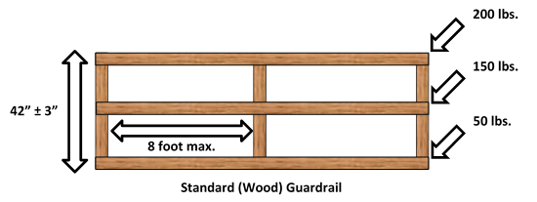
Standard (Wood) Guardrail
Page 22 for general guide lines

Slide 43
Safety Net Systems
"Safety net systems." Safety net systems and their use shall comply with the following provisions:
Safety nets shall be installed as close as practicable under the walking/working surface on which employees are working, but in no case more than 30 feet (9.1 m) below such level. When nets are used on bridges, the potential fall area from the walking/working surface to the net shall be unobstructed.
Safety nets shall be installed with sufficient clearance under them to prevent contact with the surface or structures below when subjected to an impact force.
Defective nets shall not be used. Safety nets shall be inspected at least once a week for wear, damage, and other deterioration. Defective components shall be removed from service. Safety nets shall also be inspected after any occurrence which could affect the integrity of the safety net system.
Materials, scrap pieces, equipment, and tools which have fallen into the safety net shall be removed as soon as possible from the net and at least before the next work shift.
The maximum size of each safety net mesh opening shall not exceed 36 square inches (230 cm) nor be longer than 6 inches (15 cm) on any side, and the opening, measured center-to-center of mesh ropes or webbing, shall not be longer than 6 inches (15 cm).
Each safety net (or section of it) shall have a border rope for webbing with a minimum breaking strength of 5,000 pounds (22.2 kN).
Page 23

Slide 44
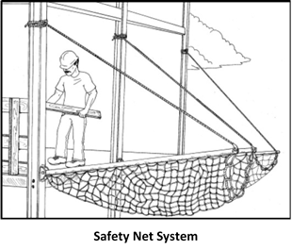
Safety Net System

Slide 45
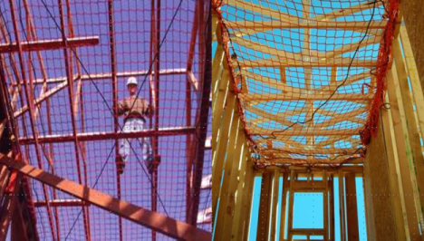
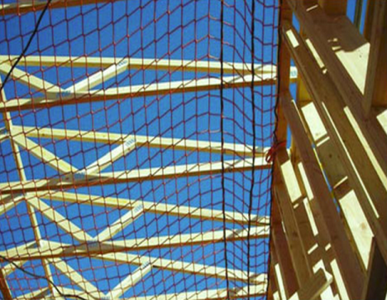
Safety Net System Examples

