Slide 1
Hand & Power Tool Safety
This material was produced under a grant (SH-26282-SH4) from the Occupational Safety and Health Administration, U.S. Department of Labor. It does not necessarily reflect the views or policies of the U.S. Department of Labor, nor does the mention of trade names, commercial products, or organization imply endorsement by the U.S. Government.

Slide 2

Purpose of This Training
The use of hand & power tools poses great risks to the user and anyone in the area. Some of the hazards are:
Flying Objects
Electrical Shock or Burn
Laceration

Slide 3
Course Objectives
Definition of Terms
Learn About Hand Tool Safety
Learn About Power Tool Safety
Learn About Extension Cord Safety
Learn About Bench Grinder Safety

Slide 4
Hazard Prevention of Tools
Keep all tools in good condition with regular maintenance
Always use the proper tool for the job
Examine each tool before use and do not use damaged tools
Operate tools according to the manufactures’ recommendations
Provide and use the appropriate PPE

Slide 5
Definitions
Hand Tools
Tools that are powered manually
Power Tools
Tools that are powered with electricity, pneumatic, fuel, hydraulic, or powder-actuated
Notes:
Hand Tool Examples - hammer, hand saw, screwdriver, chisel, etc.
Power Tool Examples - radial arm saw, drill, impact gun, mag drill

Slide 6
Hand Tools

Slide 7
Hand Operated Tool Standards
Employers shall not issue or permit the use of unsafe tools 1926.301(a)
Wrenches shall not be used when jaws are sprung to the point that slippage occurs 1926.301(b)
Notes:
General Industry Subpart P - 1910.241 - 244
Construction Industry Subpart I - 1926.300 - 307
1910.242(a) -
Each employer shall be responsible for the safe condition of tools and equipment used by employees, including tools and equipment which may be furnished by employees.

Slide 8

Impact Tools
Impact tools, such as drift pins, wedges, and chisels shall be kept free of mushroomed heads
Tools with mushroomed heads must not be used
Notes:
Picture is the property of Western Iowa Tech Community College.
Western Iowa Tech gives permission to anyone who wants to use this picture
1910.242(a)
1926.301(c)

Slide 9
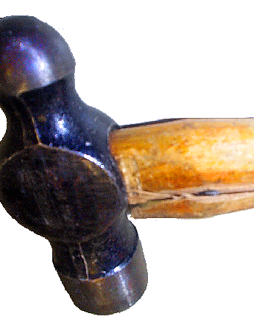
Wooden Handled Tools
The wooden handles of tools shall be kept free of splinters or cracks and shall be kept tight in the tool
Never use a tool that has a cracked or splintered handle
Do not wrap handles with any tape
Notes:
Picture taken from:
https://www.osha.gov/dte/outreach/construction_generalindustry/construction/power_tools_c.zip
1910.242(a)
1926.301(d)

Slide 10
Hand Tool Safety
Keep tools clean to allow for easy inspection
Impact tools can produce sparks from friction, because of this be aware of any flammable material around the area where you are using the tool
Notes:
Use tools that are specifically manufactured for a flammable or explosive environment

Slide 11
Knife Safety
Always wear cut resistant gloves to protect hands
Keep knife blades sharp - a dull blade can easily slip from the object being cut
Always cut away from you
Never attempt to catch a dropped knife
Retract blade when not in use, or use self-retractable blade

Slide 12
Power Tools
Notes:
General Industry 1910.242 - 244
Construction Industry 1926.302

Slide 13


Types of Power Tools
Electric
Pneumatic
Liquid Fueled
Hydraulic
Powder-Actuated
Notes:
Picture taken from:
https://www.osha.gov/dte/outreach/construction_generalindustry/construction/power_tools_c.zip

Slide 14
Power Tool Hazards
Burns
Electrical Shock
Amputation
Projectiles
Caught In

Slide 15
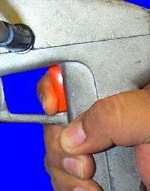
Power Tool Switches
Constant Pressure Switch - shuts off power when switch is released
On-Off Switch
Notes:
Constant Pressure Switch Example - cordless drill, radial saw
On-Off Switch example - drill press, table saw
Depends on what piece of equipment used
1910.243(2)
1926.300(d)
Picture taken from:
https://www.osha.gov/dte/outreach/construction_generalindustry/construction/power_tools_c.zip

Slide 16
Electric Tool Protection
Must have a three wire cord with a ground wire
Must be plugged into grounded receptacle, be double insulated, or be powered by low-voltage isolation transformer
Grounding prong must never be removed
Notes:
can have a grounding prong or double insulated
1926.302(a)(1)

Slide 17
Electric Tool Precautions
Operate electrical tools according to manufacture guidelines
Use the appropriate PPE
Store electrical tools in a dry place
Avoid using electrical tools in wet locations

Slide 18
Electric Tool Precautions Cont.
Ensure that GFCI or equipment-grounding conductor protects all tools
Disconnect tools from power source when servicing
Keep all personnel not involved with task at a safe distance

Slide 19
Electric Tool Precautions Cont.
Do not carry tools by switch
Keep tools maintained
Do not wear loose clothing when operating power tools
Remove all damaged tools from service and tag “DO NOT USE”

Slide 20
Electric Tool Power Cord Precautions
Ensure cords do not present a tripping hazard
Never carry a tool by the cord
Never yank the power cord to disconnect from receptacle
Keep cord away from heat, chemicals, and sharp edges

Slide 21

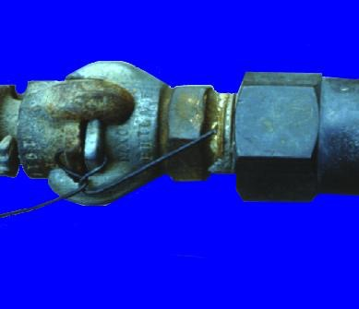
Pneumatic Tool Precautions
Tools must be fastened to hose securely with a short wire or positive locking device
Notes:
1926.302(b)(1)
Picture taken from:
https://www.osha.gov/dte/outreach/construction_generalindustry/construction/power_tools_c.zip

Slide 22
Pneumatic Tool Precautions Cont.
Attachments must be secured with a safety clip or retainer
Eye protection is required for employees working with pneumatic tools
Hearing protection may be required
Air pressure must be regulated to less than 30 PSI if used for cleaning
Notes:
1926.302(b)(2)
1926.302(b)(4)
1910.242(b)

Slide 23
Liquid Fuel Tool Precautions
Use in well ventilated area
Shut off the engine and let it cool before refueling
Do not smoke while fueling
User must wear eye, face, hand, and hearing protection
Always keep fire extinguisher in close proximity
Notes:
1926.302(c)

Slide 24
Powder-Actuated Tool Precaution
Operators must have training
Wear eye, ear, hand and face PPE
Do not operate in a flammable or explosive environment
Do not store a loaded tool
Do not fire fasteners into material that it could easily pass through
Notes:
1926.302(c)
1910.243(d)

Slide 25
Extension Cord Precautions
Choose the right sized cord for the tool you use
Inspect cord daily before use
Damaged cords shall be removed from service immediately
Do not place cords in high traffic areas
Protect cords from any damage
Notes:
Do not use multiple extension cords together
If cord is nicked you cannot use electrical tape, however you can use special shrink wrap material designed to repair small nicks on extension cords.
Protect cords from sharp corners, heat, doorways etc.
Electrical Skills -
1910.301 - 399
1926.400 - 409

Slide 26
Bench Grinder Precautions
Grinder spindle speed rating must not be higher than spindle speed rating on grinding wheel
Use eye and face protection
Do not wear loose fitting clothing
Start bench grinder while standing off to the side
Notes:
1926.303
1910.215
1910.243(c)
Most bench grinder wheels fail during startup of the bench grinder

Slide 27
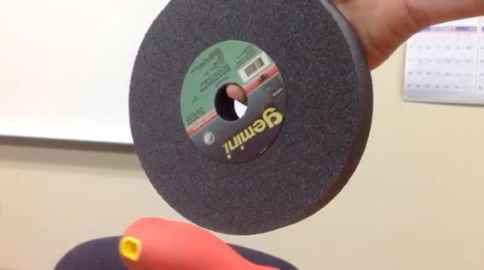
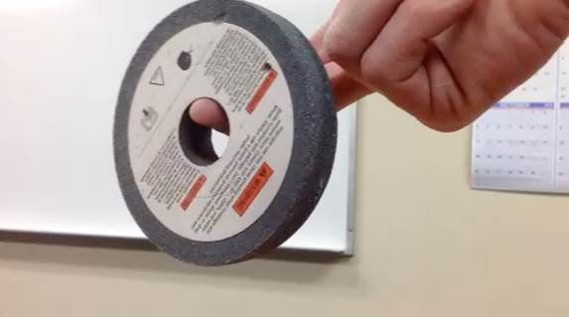
Conduct a Ring Test
Good
Bad

Slide 28
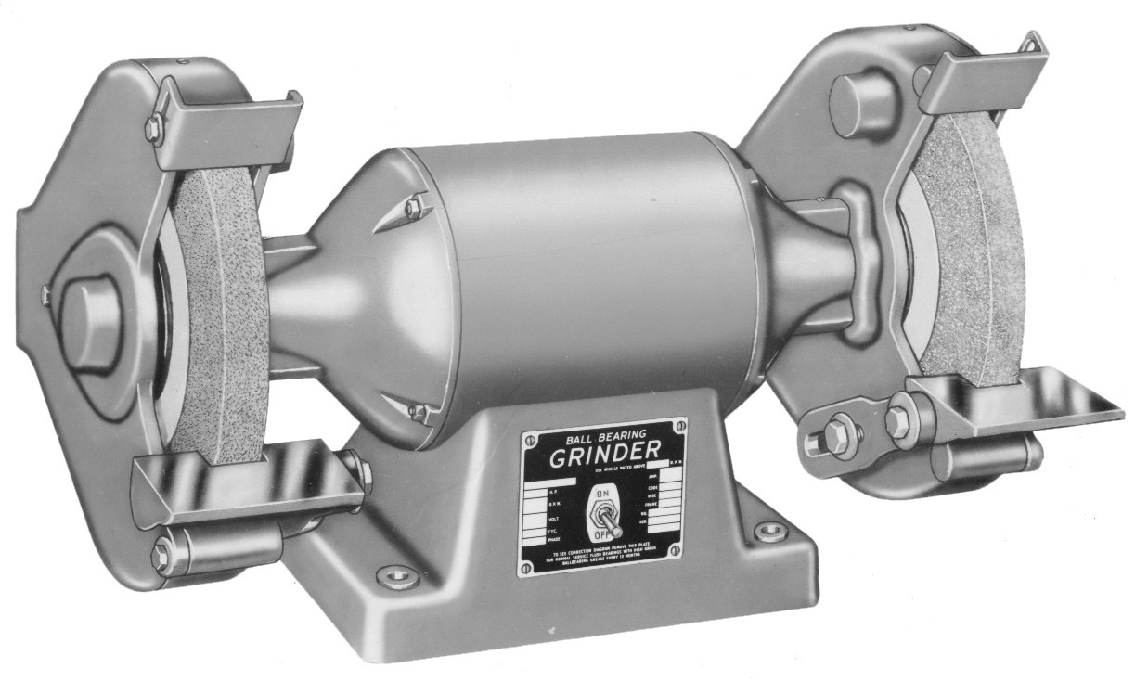


Bench grinder setup
Tongue Guard:
1/4” from grinding wheel
Work Rest:
1/8” from grinding wheel
Notes:
Bench Grinder Setup
Work rest must not be more than 1/8” from grinding wheel
This prevents jamming the object that you are grinding between the wheel and the work rest
Adjustable Tongue Guard
Tongue guard must be no more than 1/4” from grinding wheel
The tongue guard is meant to deflect any debris away from the operator
Picture taken from
www.google.com/images

Slide 29
Employee Rights and Responsibilities

Slide 30
Employee Rights & Responsibilities Occupational Safety and Health Act of 1970
To assure safe and healthful working conditions for working men and women
By authorizing enforcement of the standards developed under the Act
By assisting and encouraging the States in their efforts to assure safe and healthful working conditions
By providing for research, information, education, and training in the field of occupational safety and health…
Notes:
Workers Rights
http://www.osha.gov/Publications/osha3021.pdf
The instructor will discuss employee rights and responsibilities with the participants.

Slide 31
Employee Rights & Responsibilities You have the right to:
File a confidential complaint with OSHA to have their workplace inspected.
Receive information and training about hazards, methods to prevent harm, and the OSHA standards that apply to their workplace. The training must be done in a language and vocabulary workers can understand.
Get copies of their workplace medical records and exposure records
Participate in an OSHA inspection and speak in private with the inspector.
Notes:
Workers Rights
http://www.osha.gov/Publications/osha3021.pdf

Slide 32

Employee Rights & Responsibilities Continued:
File a complaint with OSHA if they have been retaliated or discriminated against by their employer as the result of requesting an inspection or using any of their other rights under the OSH Act.
File a complaint if punished or discriminated against for acting as a “whistleblower” under the additional 21 federal statutes for which OSHA has jurisdiction.
Notes:
Workers Rights
http://www.osha.gov/Publications/osha3021.pdf
Provide handouts to minimize amount of info on slides.

Slide 33
Whistleblower Protection
OSHA's Whistleblower Protection Program enforces the whistleblower provisions of more than twenty whistleblower statutes protecting employees who report violations of various workplace safety, airline, commercial motor carrier, consumer product, environmental, financial reform, food safety, health insurance reform, motor vehicle safety, nuclear, pipeline, public transportation agency, railroad, maritime, and securities laws. Rights afforded by these whistleblower acts include, but are not limited to, worker participation in safety and health activities, reporting a work related injury, illness or fatality, or reporting a violation of the statutes.
Notes:
The Whistleblower Protection Program
http://www.whistleblowers.gov/

Slide 34
Whistleblower Protection
The Whistleblower Protection Advisory Committee (WPAC) was established to advise, consult with, and make recommendations to the Secretary of Labor and the Assistant Secretary of Labor for Occupational Safety and Health on ways to improve the fairness, efficiency, effectiveness, and transparency of OSHA's administration of whistleblower protections. In particular, the committee advises OSHA on the development and implementation of improved customer service models, enhancements in the investigative and enforcement process, training, and regulations governing OSHA investigations. In addition, WPAC advises OSHA in cooperative activities with other federal agencies that are responsible for areas covered by the whistleblower protection statutes enforced by OSHA.
Notes:
The Whistleblower Protection Program
http://www.whistleblowers.gov/

Slide 35
Whistleblower Protection
Protection from discrimination means that an employer cannot retaliate by taking "adverse action" against workers, such as:
Firing or laying off
Blacklisting
Demoting
Denying overtime or promotion
Disciplining
Denial of benefits
Failure to hire or rehire
Intimidation
Making threats
Reassignment affecting prospects for promotion
Reducing pay or hours
Notes:
The Whistleblower Protection Program
http://www.whistleblowers.gov/

Slide 36
Employee Rights & Responsibilities
OSHA website: http://www.osha.gov and OSHA offices: Call (800-321-OSHA)
Workers Rights: http://www.osha.gov/Publications/osha3021.pdf
Compliance Assistance Specialists in the area offices
National Institute for Occupational Safety and Health (NIOSH) – OSHA’s sister agency
OSHA Training Institute Education Centers
Doctors, nurses, other health care providers
Other local, community-based resources
Notes:
The Information above was taken from the new 2 hour Intro to OSHA PPT, slide #40.
The instructor will discuss employee rights and responsibilities with the participants.

Slide 37
What We Learned
Definition of Terms
Learned About Hand Tool Safety
Learned About Power Tool Safety
Learned About Extension Cord Safety
Learned About Bench Grinder Safety

