Slide 1
Site Inspection
This material was produced under a grant (SH-26282-SH4) from the Occupational Safety and Health Administration, U.S. Department of Labor. It does not necessarily reflect the views or policies of the U.S. Department of Labor, nor does the mention of trade names, commercial products, or organization imply endorsement by the U.S. Government.

Slide 2
Overview
Purpose of Site Inspection
Site Inspection Frequency
Inspection Preparation
Pre-Inspection of Site
Inspection of Site
Use of a Drone
Site Inspection Report
Conclusion
Notes:
This training module is geared toward the tower industry, however it can be applied to all industries

Slide 3
Learning Objectives
Learn the importance of a site inspection
Learn how often to perform a site inspection
Learn how to properly inspect a site
Learn how to fill out an inspection report

Slide 4
Purpose of Site inspection
The site inspection must be a critical component of your company’s safety program. The goal of the site inspection is to accomplish:
  Hazard Recognition
  Hazard Elimination / Mitigation

Slide 5
site inspection GOALS
Identify and record potential hazards in the workplace
Identify and record hazards that require immediate attention
Evaluate the integrity of any structures on site
Evaluate the integrity of any equipment on site
Identify and track corrective actions that need to be implemented

Slide 6
Site Inspection Frequency

Slide 7
Formal Inspection
At a minimum you should perform a site inspection at each job site annually. This inspection should use the previous years inspection as a benchmark for what hazards to look for. The annual inspection should find very few hazards if the location constantly has employees working at the site.
Notes:
You should be also using the previous years inspection report to see if the same issues are occurring as the year before.
Employees who are always working at the site should be doing an informal site inspection daily.

Slide 8
Informal Inspection
This inspection will be done daily before work starts. This inspection does not have to be as detailed as the annual formal inspection. When performing this inspection you will be looking for hazards that may have appeared since the last time you were at the site.
Notes:
You should be also using the previous years inspection report to see if the same issues are occurring as the year before.
Employees who are always working at the site should be doing an informal site inspection daily.

Slide 9
initial inspection
If you have never worked at the site then you should perform an inspection before work is started. This inspection will identify unknown hazards before work is started. If any hazards are found to be present, then they should be corrected before work is scheduled to start.

Slide 10
Natural disaster
After an environmental disaster occurs you need to perform a site inspection. This inspection will look for any damages to the site that could present a hazard to workers. Some examples of environmental damage are:
  Tornado / High Winds
  Flood
  Earthquake
  Ice Storms
  Etc.

Slide 11
Man made disaster
After any indication of a man made disaster, a site inspection must be performed. Some examples of man made disasters are:
  Fire
  Theft
  Vandalism
  Etc

Slide 12
Geographic Location
Inspection frequency of tower sites is also based on the geographic location of the site. If the site is near or on the coast, then the site will need to be inspected more frequently. This is because of the corrosive atmosphere near large bodies of salt water.

Slide 13
Inspection preparation

Slide 14
inspection team
Should include the following:
Upper Management
Worksite Supervisor
Safety Supervisor
Structural Engineer (If Available)
Worksite Employees
Notes:
This is referring to a team approach to the inspection process.

Slide 15
Required Inspection toolkit
Notepad
Pens & Pencils
Graph Paper
Straight Edge Ruler
Tape Measure (Preferably 100’)
Digital Camera
Binoculars
Tension Meter (Only necessary for guyed towers)

Slide 16
Optional site inspection tools
Quadcopter Drone
Video Camera

Slide 17
Pre-inspection of site

Slide 18
satellite images
The use of satellite images is a valuable tool if you will be performing an initial site inspection. Satellite images will help give a general layout of the site and allow you to see some types of natural hazards (e.g. cliff, body of water, etc.). By using satellite images before you go to the site you can also get an idea of whether it is an urban or rural site

Slide 19
Geographic region
It is a good idea to study the geographic region and research what kind of wildlife are in the area. Some wildlife can present a hazard to your workforce, because of this steps need to be taken to protect your workers from the dangerous wildlife.

Slide 20
Geographic Region
When researching the geographic region you will also want to look at the typical weather during the time your workers will be at the site. This allows you to provide your workers with guidance on what type of clothing they should be wearing to keep them protected from heat or cold stress.

Slide 21
Area demographics
The fourth leading cause of fatalities in the workplace in 2013 was homicide. Because of this fact you want to study the crime rates for the area where the site is located. Copper theft is a growing trend and it especially applies to the communication industry. Copper thieves have been reported as showing up on sites with guns.
Notes:
Data taken from:
http://www.bls.gov/iif/oshwc/cfoi/cfch0012.pdf
For more information on workplace violence:
https://www.osha.gov/SLTC/workplaceviolence/evaluation.html

Slide 22
Inspecting the site

Slide 23
Inspecting the site
Before inspecting the site you will want to draw a sketch of the area. This can be done either on site, or before you arrive at the site by looking at satellite images. The reason for sketching the site is so you can make notations on the sketch as you are performing the inspection.

Slide 24
inspecting the site
As you are inspecting the site you should be taking pictures of objects that are relevant. The pictures should first be shot from a distance to get the feel for the area that the object is located. Next you should take close up pictures from a variety of angles.

Slide 25
Inspecting the site
If the tower is believed to be damaged from a natural disaster you will want to have an engineer test the concrete at the base of the tower. This test will be able to tell you whether there is damage to the concrete below ground level which could cause premature collapse of the structure.
Notes:
The testing done on foundations is disruptive wave testing. This test will tell you whether there is large cracks in the concrete.

Slide 26
Self-supporting tower inspection
Look at the tower legs for any damage
Look for loose or missing bracing members
Make sure the ladder device is not missing or damaged
Platforms need to be inspected for damage

Slide 27
self-supporting tower inspection
Look for damage on any catwalks or the ice bridge
Look for any loose or missing bolts on the structure
Make sure the condition of the paint is acceptable
Look for any abnormal corrosion on the structure

Slide 28
self-supporting tower inspection
Make sure the antenna and coaxial cable mounts are properly secured
Look at the base of the tower for abnormal erosion
Make sure the grounding components are secured and no abnormal corrosion

Slide 29
Guyed tower inspection
Will be the same as a self-support tower in addition to:
Check anchors and look for erosion or large soil cracks
Check the anchor rod condition
Make sure the anchor head is clear of the earth

Slide 30
Guyed Tower Inspection
Check the tension of the guy wires with a tension meter according to the manufacturers recommendations
Make sure turnbuckles are secured
Check the guy wire clamps nuts

Slide 31
Guyed Tower Inspection
Make sure the guyed wires do not show any signs of damage
Check the guy attachments to the tower and make sure they are secured

Slide 32
Use of a Quadcopter Drone
As an alternative to hands-on inspection

Slide 33
Using a drone for tower inspection
Using a drone to perform a tower inspection is starting to become a popular alternative to inspecting a tower by climbing it. Drone use is an attractive alternative because of the fact that it is safer than climbing. Drones are also very easy to fly and you can take still pictures and videos to be reviewed later.
Notes:
The next slides will be video and pictures of a tower taken with Western Iowa Tech Community College’s drone on the Western Iowa Tech Community College campus.

Slide 34
Advantages of Using a drone
Safer than climbing
Easy to fly
Faster
Inexpensive
Pictures from inspection can be kept on file

Slide 35
disadvantages of using a drone
Pictures from drone may not see everything
Weather conditions must be ideal (light winds, no rain)
Flight time is between 15 to 25 minutes
Notes:
The next slides will be video and pictures of a tower taken with Western Iowa Tech Community College’s drone on the Western Iowa Tech Community College campus.

Slide 36
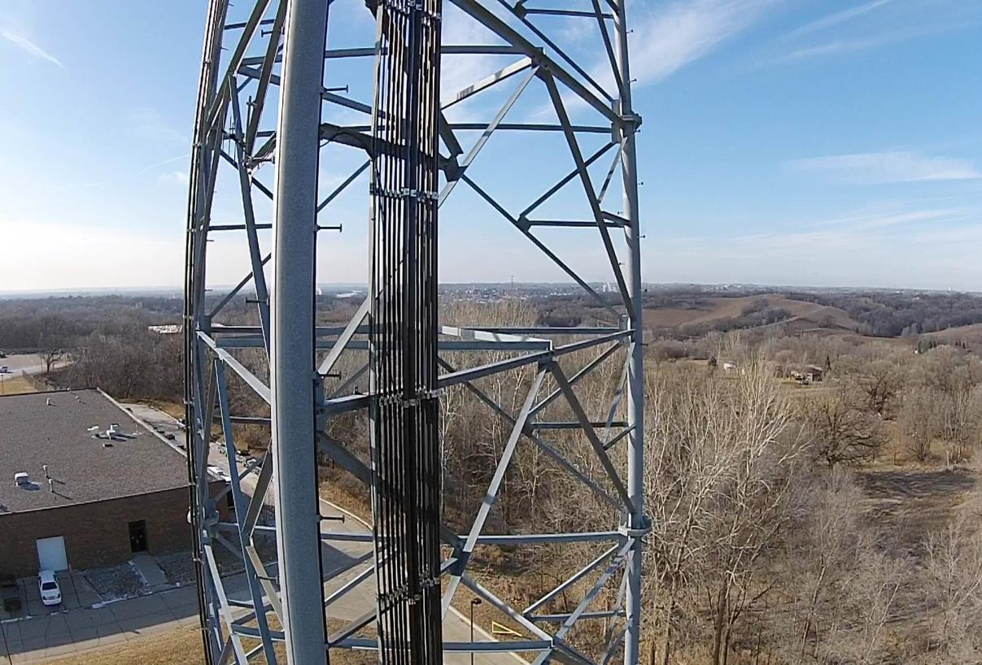
This slide shows a picture of a tower taken with Western Iowa Tech Community College’s drone on the Western Iowa Tech Community College campus.

Slide 37
Site inspection report

Slide 38
Site inspection report
The site inspection report is used to point out hazards on the site and provide recommendations to fix the hazards or provide protection to mitigate the hazards. Once the report is finished and closed out then it must be filed away for future reference. The report is broken up into six(6) sections. This is also a good tool to track the corrective actions.

Slide 39
section i
Site name and address
Date of inspection
Site inspection team members

Slide 40
Section II
Location and description of any hazards found
Recommendations of corrective action to fix hazards
Dates corrective actions are to be completed by

Slide 41
Section III
Exclusive to Guyed Towers
Air Temperature
Wind Speed
Cable Size
Leg Number
Guy Level
Measured Tension
Proper Tension
Notes:
This section applies to guyed towers only. The reason that you need to add wind speed and air temperature is because the tension of the guy wires will be different in varying weather conditions.

Slide 42
Section IV
This section will include all the names and titles of personnel that are responsible for correcting the hazards.

Slide 43
Section V
This section will show the date that all the corrective actions were completed and how they were corrected. This is also the date that the report is closed out. The report must also be signed by the most senior person on the site inspection team.

Slide 44
Section VI
This section will be the appendix of the report. The appendix will include all photos, sketches, and any notes taken during the site inspection.

Slide 45
conclusion
The site inspection needs to be an important part of your safety program. A successful site inspection will point out hazards on the job location and prevent a future incident from happening. An informal site inspection needs to be an ongoing occurrence to look out for any new hazards that appear on the site.

Slide 46
Employee Rights and Responsibilities

Slide 47
Employee Rights & Responsibilities
Occupational Safety and Health Act of 1970
To assure safe and healthful working conditions for working men and women
By authorizing enforcement of the standards developed under the Act
By assisting and encouraging the States in their efforts to assure safe and healthful working conditions
By providing for research, information, education, and training in the field of occupational safety and health…
Notes:
Workers Rights
http://www.osha.gov/Publications/osha3021.pdf
The instructor will discuss employee rights and responsibilities with the participants.

Slide 48
Employee Rights & Responsibilities
You have the right to:
File a confidential complaint with OSHA to have their workplace inspected.
Receive information and training about hazards, methods to prevent harm, and the OSHA standards that apply to their workplace. The training must be done in a language and vocabulary workers can understand.
Get copies of their workplace medical records.
Participate in an OSHA inspection and speak in private with the inspector.
Notes:
Workers Rights
http://www.osha.gov/Publications/osha3021.pdf

Slide 49

Employee Rights & Responsibilities Continued:
File a complaint with OSHA if they have been retaliated or discriminated against by their employer as the result of requesting an inspection or using any of their other rights under the OSH Act.
File a complaint if punished or discriminated against for acting as a “whistleblower” under the additional 21 federal statutes for which OSHA has jurisdiction.
Notes:
Workers Rights
http://www.osha.gov/Publications/osha3021.pdf

Slide 50
Whistleblower Protection
OSHA's Whistleblower Protection Program enforces the whistleblower provisions of more than twenty whistleblower statutes protecting employees who report violations of various workplace safety, airline, commercial motor carrier, consumer product, environmental, financial reform, food safety, health insurance reform, motor vehicle safety, nuclear, pipeline, public transportation agency, railroad, maritime, and securities laws. Rights afforded by these whistleblower acts include, but are not limited to, worker participation in safety and health activities, reporting a work related injury, illness or fatality, or reporting a violation of the statutes.
Notes:
The Whistleblower Protection Program
http://www.whistleblowers.gov/

Slide 51
Whistleblower Protection
The Whistleblower Protection Advisory Committee (WPAC) was established to advise, consult with, and make recommendations to the Secretary of Labor and the Assistant Secretary of Labor for Occupational Safety and Health on ways to improve the fairness, efficiency, effectiveness, and transparency of OSHA's administration of whistleblower protections. In particular, the committee advises OSHA on the development and implementation of improved customer service models, enhancements in the investigative and enforcement process, training, and regulations governing OSHA investigations. In addition, WPAC advises OSHA in cooperative activities with other federal agencies that are responsible for areas covered by the whistleblower protection statutes enforced by OSHA.
Notes:
The Whistleblower Protection Program
http://www.whistleblowers.gov/

Slide 52
Whistleblower Protection
Protection from discrimination means that an employer cannot retaliate by taking "adverse action" against workers, such as:
Firing or laying off
Blacklisting
Demoting
Denying overtime or promotion
Disciplining
Denial of benefits
Failure to hire or rehire
Intimidation
Making threats
Reassignment affecting prospects for promotion
Reducing pay or hours
Notes:
The Whistleblower Protection Program
http://www.whistleblowers.gov/

Slide 53
Employee Rights & Responsibilities
OSHA website: http://www.osha.gov and OSHA offices: Call (800-321-OSHA)
Workers Rights: http://www.osha.gov/Publications/osha3021.pdf
Compliance Assistance Specialists in the area offices
National Institute for Occupational Safety and Health (NIOSH) – OSHA’s sister agency
OSHA Training Institute Education Centers
Doctors, nurses, other health care providers
Other local, community-based resources
Notes:
The Information above was taken from the new 2 hour Intro to OSHA PPT, slide #40.
The instructor will discuss employee rights and responsibilities with the participants.

Slide 54
Review
Purpose of Site Inspection
Site Inspection Frequency
Inspection Preparation
Pre-Inspection of Site
Inspection of Site
Use of a Drone
Site Inspection Report
Conclusion
Notes:
This training module is geared toward the tower industry, however it can be applied to all industries

Slide 55
What we Learned
Learned the importance of a site inspection
Learned how often to perform a site inspection
Learned how to properly inspect a site
Learned how to fill out an inspection report

