Slide 1
Day 2 Train-the-Trainer BUILD A BETTER SAFETY PROGRAM
Safety Training Program | Workers Defense Project

Slide 2
Disclaimer
This material was produced under grant number SH-29624-SH6 from the Occupational Safety and Health Administration, U.S. Department of Labor. It does not necessarily reflect the views or policies of the U. S. Department of Labor, nor does mention of trade names, commercial products, or organizations imply endorsement by the U. S. Government. The U.S. Government does not warrant or assume any legal liability or responsibility for the accuracy, completeness, or usefulness of any Information, apparatus, product, or process disclosed.

Slide 3
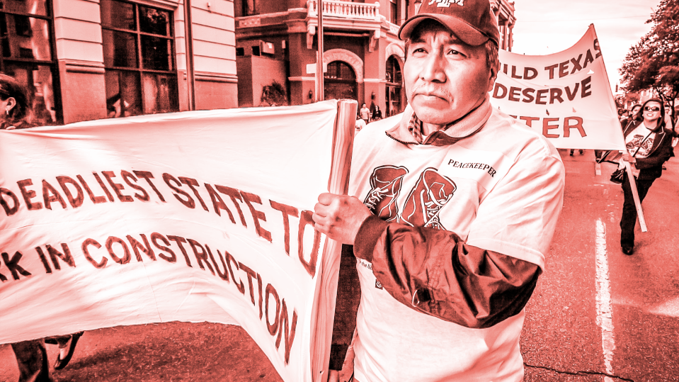
Image

Slide 4
TRAIN-THE-TRAINER OVERVIEW
DAY 1
Training Program Overview
DAY 3
Training Evaluations and Practice
DAY 2
Training Topics and Modules
START
Start doing trainings!

Slide 5
Train-the-Trainer
DAY 2 AGENDA
Confined Space Safety
Fire Safety
Prepare Presentations for Day 3

Slide 6
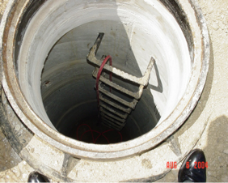
Confined Spaces
Confined Spaces

Slide 7
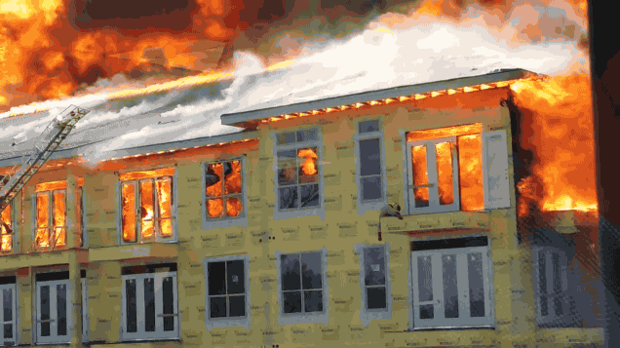
Fire Safety
Fire Safety

Slide 8
Part 1-4. DEMONSTRATION OF TOPICS

Slide 9
Demonstrations
During demonstrations, take notes on facilitation techniques & use of training materials.

Slide 10
Part 5. PRESENTATION PREPARATION

Slide 11
Preparation
Review your topic materials and begin preparing a toolbox talk for Day 3.

Slide 12
Evaluation
As a class, please complete the evaluation of the Train-the-Trainer Program Day 2.

Slide 13
Day 2 Train-the-Trainer BUILD A BETTER SAFETY PROGRAM
Safety Training Program | Workers Defense Project

