Slide 1
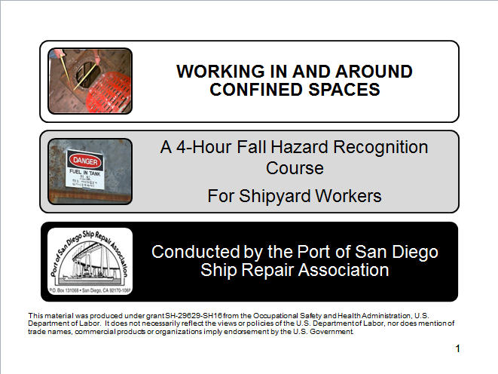
Working in and around confined spaces
1
Notes:
1
Course Introduction Page 2
OSHA Page 4
Definitions Page 11
Defining, Recognizing and Locating Confined Spaces Page 19
Physical and Atmospheric Hazards Page 22
Safe Entry Page 34
Evaluating Page 37
Oxygen Testing Page 45
Fire/Explosion Page 51
Toxic Substances Page 60
Hazard Controls Page 69
Certification and Updating Logs Page 79
Rescue Page 95

Slide 2
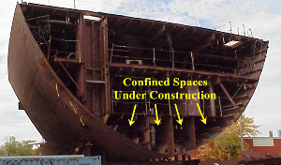
Working In and Around Confined Spaces
Notes:
2
Working In and Around Confined Spaces
At the completion of this lesson, It is expected that you will:
Describe the organization known as OSHA
Understand your rights, including what “No Retribution” means
Know how to file a complaint with OSHA
Be able to define a confined space
Understand confined space hazards
Understand common confined space terms
Recognize confined spaces
Understand how confined spaces are evaluated
Understand and use confined space controls
Introduction
Welcome to Confined Space training course. This course is designed to provide you with the knowledge needed to work safely when working in confined spaces in a shipyard environment. The target audience of this training is shipyard workers who work on-board a vessel and therefore the course content is based primarily on Federal OSHA standards. References are from 29 CFR 1915, and when appropriate NAVSEA Standard Items. This class covers not only OSHA regulations but also some Navy requirements as well as host yard rules and expectations.
Design Delivery Strategy
The delivery will be: Instructor-led, video-supported and conducted in a classroom. You will be asked to participate and demonstrate your knowledge throughout the course.

Slide 3

OSHA
3
3
Notes:
3
3
3
On December 29th, 1970, the Occupational Safety and Health Administration (Federal OSHA) was founded. OSHA is responsible for spreading legally enforceable safety and health standards to protect workers on the job.
The Need for OSHA
Prior to 1970:
• More than 14,000 worker deaths annually
• 2.5 million workers disabled by work-related injuries
• Estimated 300,000 cases of work-related illness
Since 1970:
Work-related fatalities cut by 62%
Overall injury and illness rate reduced 42%
Brown lung disease eliminated
Trenching fatalities reduced 35%
There were 4,679 workers who died on the job in 2014

Slide 4
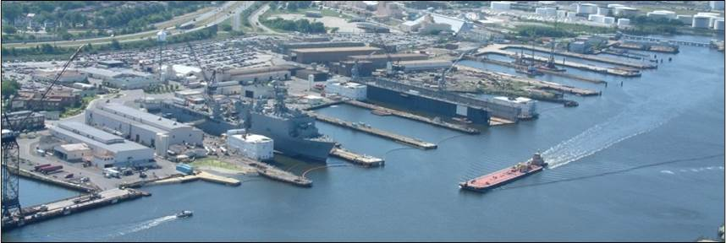
OSHA
Notes:
Employee’s Responsibilities and Rights
Responsibilities include:
Complying with OSHA standards
Wearing required PPE
Reporting hazards to supervisor
Complying with your organization’s rules and policies
Rights include:
Reviewing standards
Receiving training
Requesting an OSHA investigation (employer or OSHA) and receiving
feedback upon request
Reviewing the OSHA 300 Log

Slide 5

OSHA
OSHA
Employer
Employee
5
Notes:
5
5
Employer’s Responsibility
Employers have certain responsibilities under the OSH Act of 1970. The following list is a summary of the most important ones.
Provide a workplace free from recognized hazards and comply with standards, rules and regulations issued under the OSHA Act
Examine workplace conditions to make sure they conform to applicable OSHA standards
Make sure employees have and use safe tools and equipment and properly maintain this equipment
Use color codes, posters, labels or signs to warn employees of potential hazards
Establish or update operating procedures and communicate them so that employees follow safety and health requirements
Provide medical examinations and training when required by OSHA standards
Post, at a prominent location within the workplace, the OSHA poster (or the state-plan equivalent) informing employees of their rights and responsibilities.

Slide 6

OSHA
OSHA
6
Notes:
6
6
More Employer’s Responsibility
Report to the nearest OSHA office within 8 hours any fatal accident or one that results in the hospitalization of 3 or more employees
Keep records of work-related injuries and illnesses. (Note: Employers with 10 or fewer employees and employers in certain low-hazard industries are exempt from this requirement)
Provide employees, former employees and their representative’s access to the Log of Work Related Injuries and Illnesses (OSHA Form 300)
Provide access to employee medical records and exposure records to employees or their authorized representatives
Provide to the OSHA compliance officer the names of authorized employee representatives who may be asked to accompany the compliance officer during an inspection
Not discriminate against employees who exercise their rights under the Act
Post OSHA citations at or near the work area involved. Each citation must remain posted until the violation has been corrected, or for three working days, whichever is longer. Post abatement verifications documents or tags
Correct cited violations by the deadline set in the OSHA citation and submit required abatement verification documentation

Slide 7


OSHA
Notes:
No Retribution
Section 11(c) (1) No person shall discharge or in any manner discriminate against any employee because such employee has filed any oral and written complaints.
Discrimination includes:
Firing or laying off
Blacklisting demoting
Denying overtime or promotion
Disciplining
Denial of benefits
Failure to hire or rehire
Intimidation
Reassignment affecting future promotions
Reducing pay or hours

Slide 8
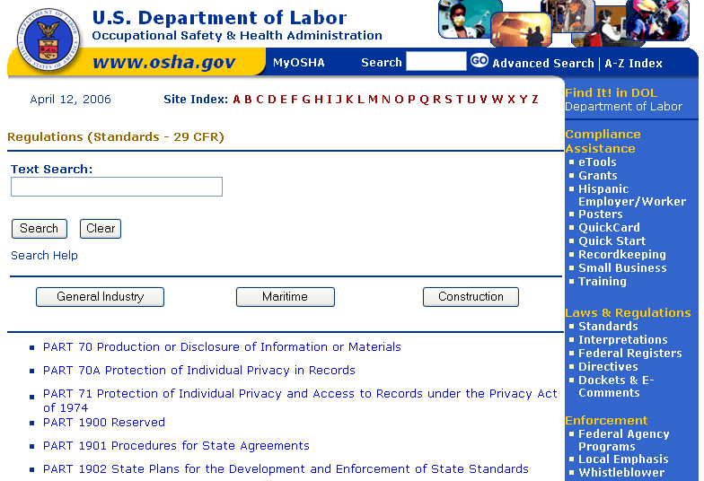
OSHA
Notes:
Resolve With Your Company – Follow your chain of command. Go to your Lead, Supervisor or Safety Technician. However, if this fails you should file a valid complaint.
Online - Go to the Online Complaint Form. Written complaints that are signed by workers or their representative and submitted to an OSHA Area or Regional office are more likely to result in onsite OSHA inspections.
Telephone - your local OSHA Regional or Area Office. OSHA staff can discuss your complaint and respond to any questions you have call 1-800-321-OSHA.
Download and Fax/Mail - Download the OSHA complaint form* [En Español*] (or request a copy from your local OSHA Regional or Area Office), complete it and then fax or mail it back to your local OSHA Regional or Area Office. Written complaints that are signed by a worker or representative and submitted to the closest OSHA Area Office are more likely to result in onsite OSHA inspections. Please include your name, address and telephone number so we can contact you to follow up. This information is confidential.

Slide 9
OSHA Exercise
Stump the class!
With a partner, write two questions from this section (pages 4 to 9) that you believe the rest of the class will be challenged in answering correctly. (Questions must be reasonable! If your instructor can’t answer, it doesn’t count!)
Notes:
Question One:
_____________________________________________________________________________________________________________________________________________________________________________________________________________________________________________________________________________________________________________________________________
Question Two:
_____________________________________________________________________________________________________________________________________________________________________________________________________________________________________________________________________________________________________________________________________

Slide 10
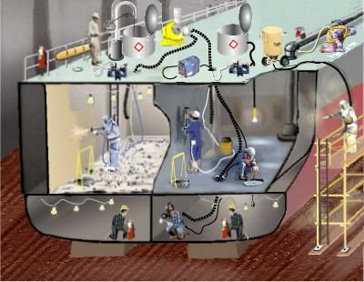
Terms – Adjacent Space
Notes:
DEFINITIONS
Adjacent Spaces means those spaces bordering a subject space in all directions, including all points of contact, corners, diagonals, decks, tank tops, and bulkheads.
Attendant is an individual stationed outside one or more permit spaces who monitors the authorized entrants and who performs all attendant’s duties assigned in the employer’s permit space program.
Body Harness means a system of straps that may be secured about the employee in a manner that will distribute the fall arrest forces over at least the thighs, shoulders, chest, and pelvis, with means for attaching it to other components of a personal fall arrest system.
Certified Industrial Hygienist (CIH) means an industrial hygienist who is certified by the American Board of Industrial Hygiene. Cold Work means any work that does not involve riveting, welding, burning, or other fire or spark producing operations.

Slide 11
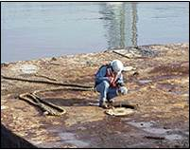
Terms – Competent Person
Notes:
Competent Person for purposes of this part means a person who is capable of recognizing and evaluating employee exposure to hazardous substances or to other unsafe conditions and is capable of specifying the necessary protection and precautions to be taken to ensure the safety of employees as required by the particular regulation under the condition to which it applies. For the purposes of Subparts B, C, and D of this part, except for 1915.35(b) (8) and 1915.36(a) (5), to which the above definition applies, the competent person must also meet the additional requirements of 1915.7. Confined Space means a compartment of small size and limited access such as a double bottom tank, cofferdam, or other space which by its small size and confined nature can readily create or aggravate a hazardous exposure. Dangerous Atmosphere means an atmosphere that may expose employees to the risk of death, incapacitation, impairment of ability to self-rescue (i.e., escape unaided from a confined or enclosed space), injury, or acute illness. Designated Area means an area established for hot work after an inspection that is free of fire hazards. Dilution Ventilation means a form of exposure control that involves providing enough air in the workplace to dilute the concentration of airborne contaminants to acceptable levels.

Slide 12
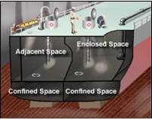
Terms – Enclosed Space
Notes:
Enclosed Space means any space, other than a confined space, which is enclosed by bulkheads and overhead. It includes cargo holds, tanks, quarters, and machinery and boiler spaces. Enter with Restrictions denotes a space where entry for work is permitted only if engineering controls, personal protective equipment, clothing, and time limitations are as specified by the Marine Chemist, Certified Industrial Hygienist, or the shipyard competent person. Entry means the action by which a person passes through an opening into a space. Entry includes ensuing work activities in that space and is considered to have occurred as soon as any part of the entrant's body breaks the plane of an opening into the space.
Explosion-Proof Lights is an apparatus enclosed in a case that is capable of withstanding an explosion of a specified gas or vapor that may occur within it and of preventing the ignition of a specified gas or vapor surrounding the enclosure by sparks, flashes, or explosion of the gas or vapor within, and that operates at such an external temperature that a surrounding flammable atmosphere will not be ignited.

Slide 13
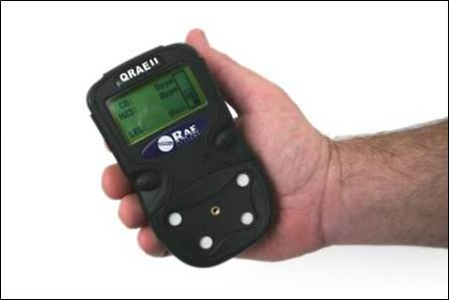
Terms- Atmospheric Testing
Notes:
Atmospheric testing are procedures performed in testing, evaluating, removing or controlling hazardous materials or conditions, within or related to a confined or enclosed spaces, which may present hazards to personnel entering or working in, on or adjacent to the space. General Exhaust (Dilution) Ventilation Systems also called dilution ventilation, is different from local exhaust ventilation because instead of capturing emissions at their source and removing them from the air, general exhaust ventilation allows the contaminant to be emitted into the workplace air and then dilutes the concentration of the contaminant to an acceptable level (e.g., to the PEL or below). Dilution systems are often used to control evaporated liquids.
Hazardous Atmosphere is an atmosphere that may expose employees to risk of death, incapacitation, and impairment of ability to self rescue, injury or acute illness.
Hot Work means any activity involving riveting, welding, burning, powder-actuated tools, or similar fire-producing operations. Grinding, drilling, abrasive blasting, or similar spark-producing operations are also considered hot work except when such operations are isolated physically from any atmosphere containing more than 10% of the lower explosive limit of a flammable or combustible substance.

Slide 14
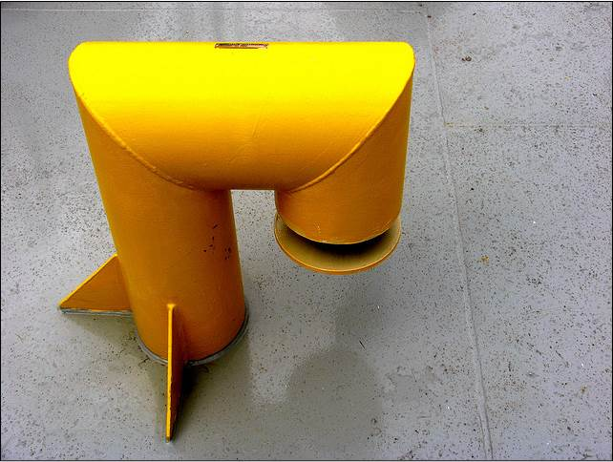
Terms - IDLH
Notes:
Immediately Dangerous to Life or Health (IDLH) means an atmosphere that poses an immediate threat to life or that is likely to result in acute or immediate severe health effects.
Inert or Inerted Atmosphere means an atmospheric condition where:
The oxygen content of the atmosphere in the space is maintained at a level equal to or less than 8.0 percent by volume or at a level at or below 50 percent of the amount required to support combustion, whichever is less; or
The space is flooded with water and the vapor concentration of flammable or combustible materials in the free space atmosphere above the water line is less than 10 percent of the lower explosive limit for the flammable or combustible material.
Inerting means the displacement of the atmosphere in a permit space by noncombustible gas (such as nitrogen) to such an extent that the resulting atmosphere is noncombustible. This procedure produces an IDLH oxygen-deficient atmosphere.
Local Exhaust Ventilation Systems is composed of five parts: fans, hoods, ducts, air cleaners, and stacks. Local exhaust ventilation is designed to capture an emitted contaminant at or near its source, before the contaminant has a chance to disperse into the workplace air.

Slide 15
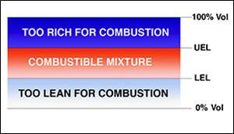
Terms - LEL
Notes:
Lower Explosive Limit (LEL) means the minimum concentration of vapor in air below which propagation of a flame does not occur in the presence of an ignition source.
Marine Chemist means an individual who possesses a current Marine Chemist Certificate issued by the National Fire Protection Association.
MSR (Master Ship Repair) companies are approved by the government and have demonstrated that they can consistently meet stringent performance and financial requirements. Not Safe for Hot Work denotes a space where hot work may not be performed because the conditions do not meet the criteria for Safe for Hot Work. Not Safe for Workers denotes a space where an employee may not enter because the conditions do not meet the criteria for Safe for Workers. Oxygen-Deficient Atmosphere means an atmosphere having an oxygen concentration of less than 19.5% by volume. Oxygen-Enriched Atmosphere means an atmosphere that contains 22% or more oxygen by volume.

Slide 16
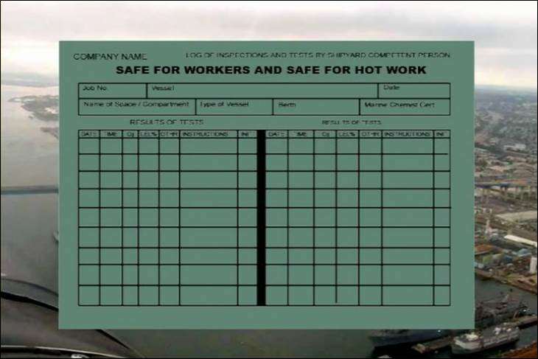
Terms – Safe For Hot Work
Notes:
Safe for Hot Work denotes a space that meets all of the criteria for performing hot work .
Safe for Workers denotes a space that meets all of the criteria for performing work.
Space means an area on a vessel or vessel section or within a shipyard such as, but not limited to: cargo tanks or holds; pump or engine rooms; storage lockers; tanks containing flammable or combustible liquids, gases, or solids; rooms within buildings; crawl spaces; tunnels; or access ways. The atmosphere within a space is the entire area within its bounds.
Upper Explosive Limit (UEL) means the maximum concentration of flammable vapor in air above which propagation of flame does not occur on contact with a source of ignition. Visual Inspection means the physical survey of the space, its surroundings and contents to identify hazards such as, but not limited to, restricted accessibility, residues, unguarded machinery, and piping or electrical systems.

Slide 17
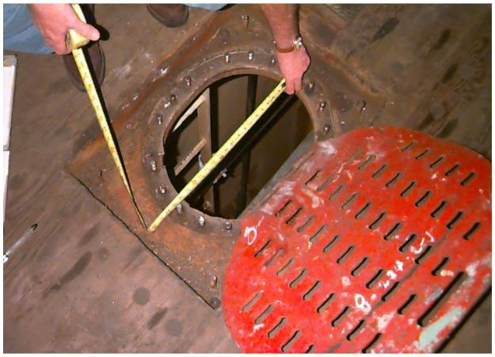
Defining Confined Spaces
Notes:
What are Confined Spaces?
Confined spaces have the following characteristics:
Limited Entry
Limited Ventilation
Dangerous Place to Work
Not designed for human habitation

Slide 18
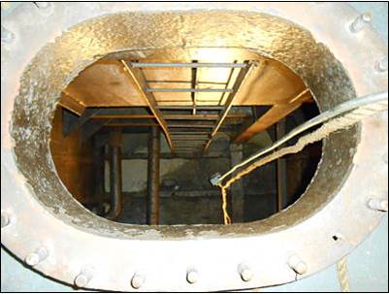
Recognizing a Confined Space
Notes:
What are Confined Spaces?
Many workplaces contain areas that are considered "confined spaces" because while they are not necessarily designed for people, they are large enough for workers to enter and perform certain jobs. A confined space also has limited or restricted means for entry or exit and is not designed for continuous occupancy. Confined spaces include, but are not limited to, tanks, vessels, silos, storage bins, hoppers, vaults, pits, manholes, tunnels, equipment housings, ductwork, pipelines, etc.
OSHA uses the term "permit-required confined space" (permit space) to describe a confined space that has one or more of the following characteristics: contains or has the potential to contain a hazardous atmosphere; contains material that has the potential to engulf an entrant; has walls that converge inward or floors that slope downward and taper into a smaller area which could trap or asphyxiate an entrant; or contains any other recognized safety or health hazard, such as unguarded machinery, exposed live wires, or heat stress.
If it looks like a confined space, treat it like a confined space.

Slide 19
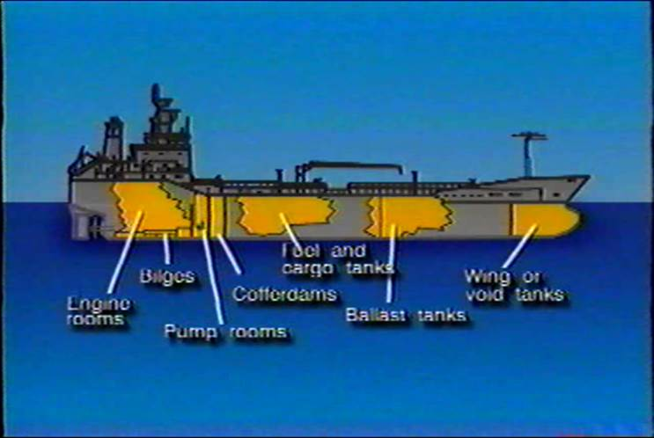
Where Are They Found
Notes:
Common Shipboard Confined Spaces
The following are common shipboard confined spaces (Not all inclusive)
* Engine rooms
* Bilges
* Pump rooms
Cofferdams
* Cargo holds
Water and fuel tanks
Ballast tanks
Void tanks
Chain lockers
* By definition, these may or
may not be a confined space

Slide 20
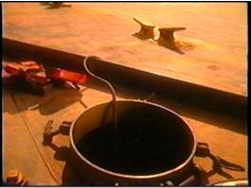
Why Go Into A Confined Space?
Notes:
Why Go Into a Confined Space?
Repair
Maintenance
Inspect
Retrieve
Other __________________________________________________________________________________________________________________________________________________________________________________________________________________________________________________________________________________________

Slide 21
General Hazards in Confined Spaces
Notes:
21
General Hazards
Work in confined and enclosed space has a greater likelihood of causing fatalities, severe injuries and illness than any other type of shipyard work or onboard ships.
The key hazards associated with confined spaces are:
— serious risk of fire or explosion;
— loss of consciousness from asphyxiation arising from gas, fumes, vapor or lack of oxygen;
— drowning arising from increased water level;
— loss of consciousness arising from an increase in body temperature;
— asphyxiation/suffocation arising from free flowing solid (engulfment) or the inability to reach a breathable atmosphere due to entrapment.
Workers will routinely enter confined spaces that are difficult to access due to small and/or narrow openings. There may be physical constraints within the space which need to be considered, and the space itself may be cramped permitting only
restricted mobility.
Given the usual enclosed and darkened nature of a confined space this activity ideally should not be carried out by personnel suffering from phobias (e.g. claustrophobia) or who are susceptible to panic or anxiety attacks.

Slide 22
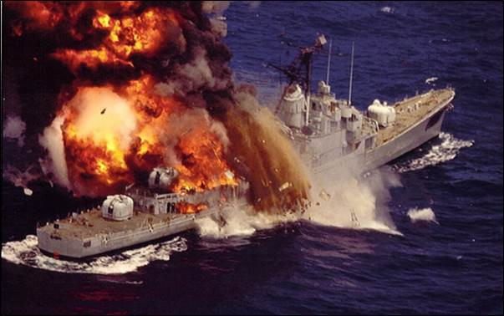
Hazards
Notes:
Hazards
Hazards found in confined spaces are typically categorized as physical or atmospheric. Here are some examples of potential hazards

Slide 23
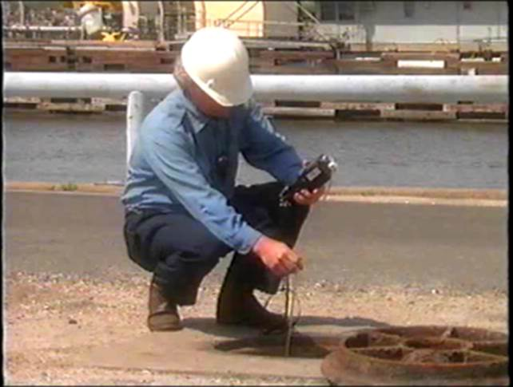
Physical and Atmospheric Hazards
Notes:
Evaluating Confined Spaces
Before entering a confined space they must be evaluated for the hazards we discussed previously. Here are examples of physical and atmospheric hazards

Slide 24
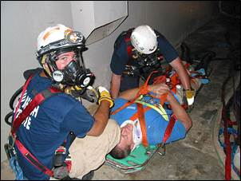
Physical Hazards
Notes:
Physical Hazards
Physical hazards include:
Engulfment/Drowning: "Engulfment" means the surrounding and effective capture of a person by a liquid or finely divided (flowable) solid substance that can be aspirated to cause death by filling or plugging the respiratory system or that can exert enough force on the body to cause death by strangulation, constriction, or crushing.
Drowning arising from increased water level:
Confined spaces should be fully drained or dry when entered. Spaces that are not fully drained or dry may pose a risk of drowning. The risk of drowning in a tank with a large amount of liquid is easily recognized. However, workers have drowned in small pools of liquid. For example, insufficient oxygen, the presence of a toxic gas, or a blow to the head can make workers unconscious. Workers who have fallen face-down into a small pool of water have drowned.
Slips/Trips/Falls: Most of the hazards found outside of a confined space are also found in a confined space., however, there is a greater likelihood of injury and death due to the difficult working conditions discussed previously.

Slide 25
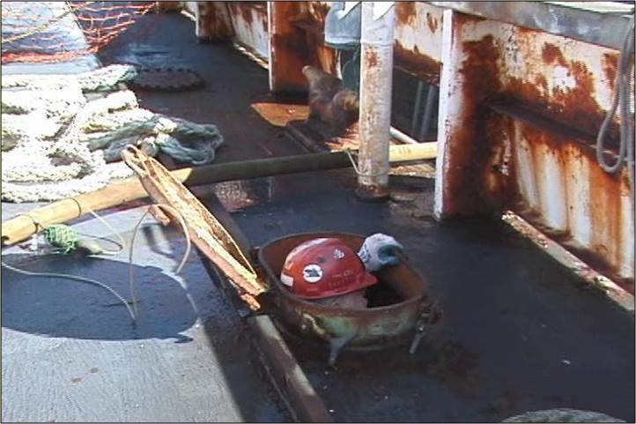
Heat Stress and Entrapment Confined Space Hazards
Notes:
Loss of consciousness arising from an increase in body temperature/excessive Heat
A person working in a very hot environment loses water and salt through sweat. This loss should be compensated by water and salt intake. Fluid intake should equal fluid loss. On average, about one liter of water each hour may be required to replace the fluid loss. Plenty of drinking water should be available on the job site and persons should be encouraged to drink water every 15 to 20 minutes even if they do not feel thirsty. Drinks specially designed to replace body fluids and electrolytes may be taken. Alcoholic drinks should NEVER be taken as alcohol dehydrates the body. The enclosed nature of a confined space can increase the risk of heat stroke or collapse from heat stress, if conditions are excessively hot. The risk may be exacerbated by the wearing of personal protective equipment or by lack of ventilation
Asphyxiation/suffocation arising from free flowing solid (engulfment) or the inability to reach a breathable atmosphere due to entrapment
Liquids or solids can flow into the confined space causing drowning, suffocation, burns and other injuries. Solids in powder form may also be Entrapment: OSHA considers "entrapment" to occur in any space that "has an internal configuration such that an entrant could be trapped or asphyxiated by inwardly converging walls or by a floor which slopes downward and tapers to a smaller cross section".

Slide 26
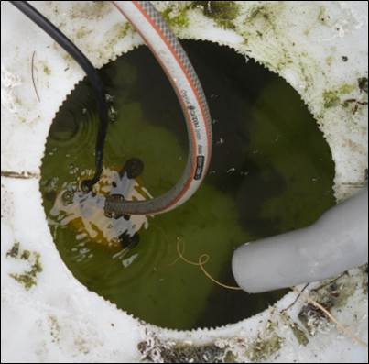
Physical Hazards Exercise
Notes:
Exercise
How could you become a victim to each of the following in a confined space?
Engulfment/Drowning:
Slips/Trips/Falls:
Entrapment:

Slide 27
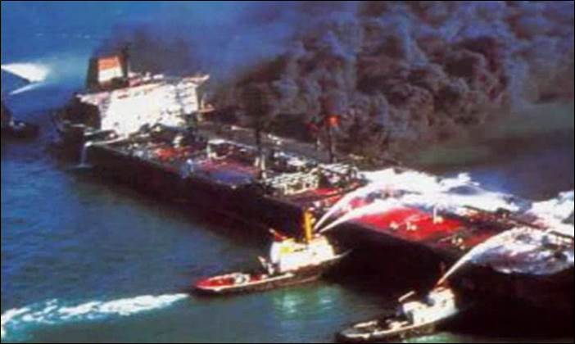
Atmospheric Hazards Fire and Explosion
Notes:
Dangerous Atmosphere (1915.11)
“Dangerous atmosphere” – atmosphere that may expose employees to risk of death, incapacitation, impairment of ability to self-rescue (i.e., escape unaided from a confined or enclosed space), injury, or acute illness.
Atmospheric hazards include:
Too Little Oxygen: Asphyxiation is the condition of being deprived of oxygen to the point of causing death. Oxygen levels that are too low (less
than 19.5 percent) can cause an initial loss of awareness and can lead to suffocation and death.
Too Much Oxygen: When there is too much oxygen in the air (an oxygen enriched atmosphere greater than 22%) there is an increased chance for a fire or explosion.
Fire/Explosion: The presence of flammable or combustible gases or liquids can result in an explosion when an ignition source (spark) is introduced.
A rescuer was killed when an explosion occurred while he and his coworkers were attempting to cut a hole in a toluene tank to retrieve a worker who had died entering the confined space. The accident, captured on video, provides a graphic view of the hazards of performing hot work around confined spaces.

Slide 28
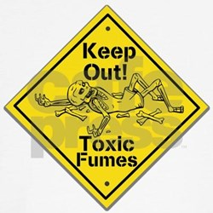
Atmospheric Hazards Toxic Fumes
Notes:
Inhalation of Toxic Substances: Hazardous and toxic substances are defined as those chemicals present in the workplace which are capable of causing harm..
Toxic chemicals like hydrogen sulfide and Benzene can present significant risk for workers, affecting their skin, eyes, and respiratory tract. Exposure to toxic chemicals at excess levels or for long periods of time may be lethal.
Loss of consciousness from asphyxiation arising from gas, fumes, vapor or lack of oxygen
Workers can become asphyxiated by exposure to atmospheres deficient of oxygen, that can lead to serious injury or loss of life. Oxygen is the only component of the air we breathe capable of supporting. Because there are no warning signs of reduced oxygen concentrations, these environments are extremely dangerous.
Some toxic gases typically found in confined spaces are:
Argon (Ar) ~ Displaces Oxygen Nitrogen (N2) ~ Displaces oxygen
Carbon dioxide (CO2) ~ Displaces oxygen, toxic Sulfur dioxide (SO2) ~ Toxic
Carbon monoxide (CO) ~ Toxic Hydrogen sulfide (H2S) ~ Flammable, toxic
Chlorine (Cl2) ~ Toxic Methane (CH4) ~ Fire and explosion
Gasoline Vapors ~ Fire and explosion Oxygen (O2) ~ Low and High levels cause asphyxiate / explosion

Slide 29
Atmospheric Hazards Exercise
Notes:
Exercise
How could you become a victim to each of the following in a confined space?
Toxic Fumes:
Asphyxiation:
Fire /Explosion:

Slide 30

OSHA Asphyxiation Video
Notes:
What Went Wrong?
Based on the video you just saw, working with your partner, identify “What Should Have Been Done Differently”.
____________________________________________________________
____________________________________________________________
____________________________________________________________
____________________________________________________________
____________________________________________________________
____________________________________________________________
____________________________________________________________

Slide 31
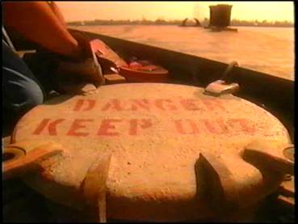
Confined Space Fatal Facts
Notes:
From just January to May of 2013 there were 19 fatalities attributed to performing work in or around confined spaces. Please read 4 of these Fatal Facts below.
1. 5/24/2013 L & H Boat Docking Service, Garfield, AR 72732
Employee working on barge died from burns and blunt force trauma after barge exploded during welding operations.
2. 5/23/2013 Shoreline Foundation, Inc., Riviera Beach, FL 33404
Worker died from oxygen deficient atmosphere in a confined space.
3. 4/24/2013 Oil Recovery Co. Inc., Mobile, AL 36602
Three employees burned while cleaning a fuel barge that exploded.
4. 4/21/2013 Watson Commercial Paint, Tyler, TX 75702
Employee died after being overcome by fumes while spray painting.

Slide 32
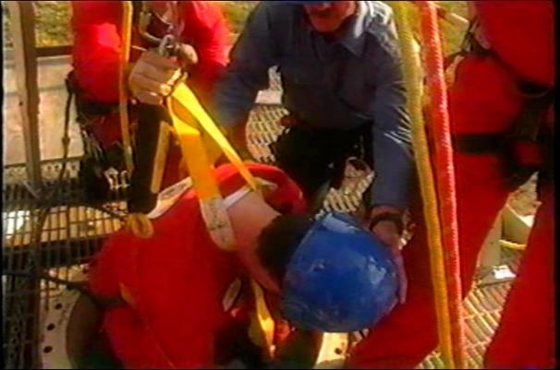
Confined Space Exercise
Notes:
Based on the four tragedies from the previous page, complete the table below.

Slide 33
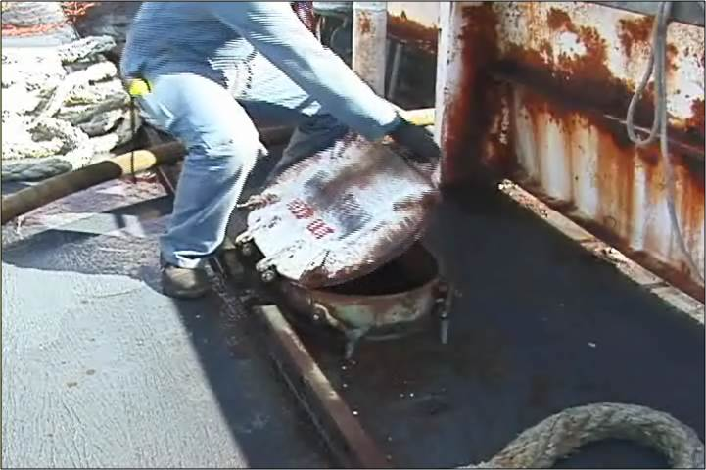
Safe Entry into a Confined Space
Notes:
Safe entry procedures
Before entering a confined space the hazards must be:
Recognized
Evaluated and;
Controlled

Slide 34
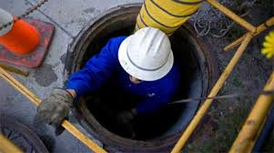
Safe Entry into Confined Spaces
Notes:
34
Safe entry
Only enter a confined space when a permit to enter has been issued and if you consider it is safe to do so, and then only remain in the inside for as long as it is necessary to carry out the work.
It is the responsibility of your employer (i.e. ship, shipyard, contractor) to ensure that the confined space is safe to enter.
— The worker has the right to refuse to enter an unsafe and/or unknown space.
— If he/she is not confident that a space is safe, he/she should report his concerns and not enter until all safety requirements are met.
The worker may wear a respirator or escape pack if required by an owner’s policy and only if sufficiently trained in the use of such equipment.
Entering confined spaces adjacent to loaded tanks
It is important to be aware that confined spaces may be, or have been, subject to leakage from the adjacent space. The risk is that such leakage often remains undetected because the space is not subject to regular gas measurements and ventilation.
Confined spaces adjacent to loaded tanks may be entered provided the procedure for entry is given.
Spaces adjacent to cargo tanks, like cofferdams and double bottom tanks, may contain accumulated residues from previous cargoes and information about these cargoes is needed to determine proper test methods for the atmosphere in the adjacent
spaces.

Slide 35
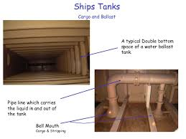
Safe Entry into Double Bottom Confined Spaces
Notes:
35
Entering confined spaces adjacent to inerted tanks
When other tanks in an inert condition are either adjacent or interconnected (e.g. pipeline) to the space to be entered, personnel should be alert to the possibility of inert gas leaking into that space through, for example, bulkhead fractures or defective valves. The risk of this occurring can be minimized by maintaining a small but positive pressure in the space to be entered relative to the inert gas pressure. At all times the procedures on the vessel are to be followed.
Entering confined spaces adjacent to loaded tanks on double hull tankers
The compartmentalized structure in double hull and double bottom tanks makes them more difficult to gas free than conventional tanks and particular care should be taken to monitor the tank atmosphere.
Once the tank atmosphere meets the entry criteria at each sampling point, actual entry by personnel should be undertaken with extreme caution, following your employers instructions.

Slide 36
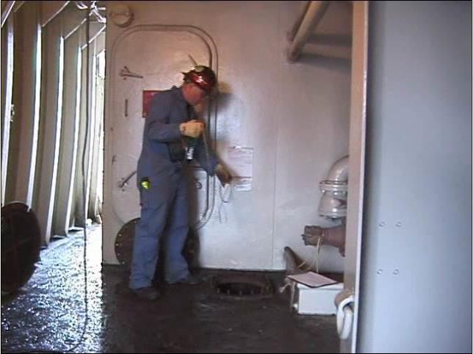
Evaluating a Confined Space
Notes:
The Evaluators
Confined spaces must be evaluated (inspected, tested, and certified) by either a Shipyard Competent Person or a Marine Chemist
Competent Person (1915.7
“Competent Person” for purposes of this part means a person who is capable of recognizing and evaluating employee exposure to hazardous substances or to other unsafe conditions and is capable of specifying the necessary protection and precautions to be taken to ensure the safety of employees as required by the particular regulation under the condition to which it applies.
NAVSEA 009-07 FY 16 3.1.2 requires that a Competent Person is initially trained by a Marine Chemist in a 24 hour course with a specified curricula. Refresher training must be annually for at least 8 hours. The Competent Person updates the Marine Chemist’s certification.
Marine Chemist (1915.11 (b))
“Marine Chemist” means an individual who possesses a current Marine Chemist Certificate issued by the National Fire Protection Association.

Slide 37
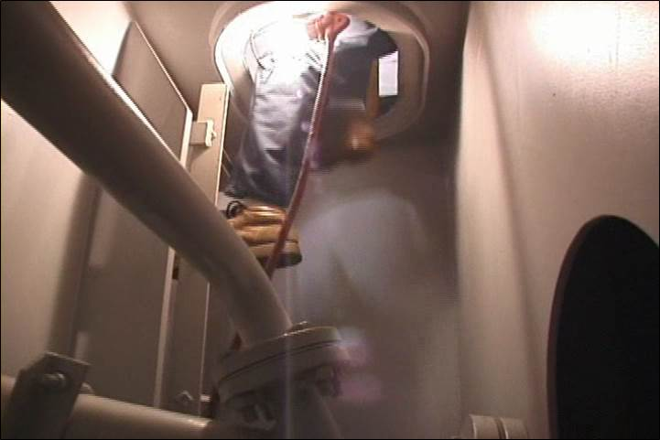
Visual Inspection
Notes:
Visual Inspection (1915.11)
Marine Chemists and Competent Persons must do more than “sniff the space”, they must also do a Visual Inspection.
"Visual inspection" - the physical survey of the space, its surroundings and contents to identify hazards such as:
Restricted accessibility
Residues
Unguarded machinery
Piping or electrical systems.
You should also visually inspect your work area before beginning your job!

Slide 38
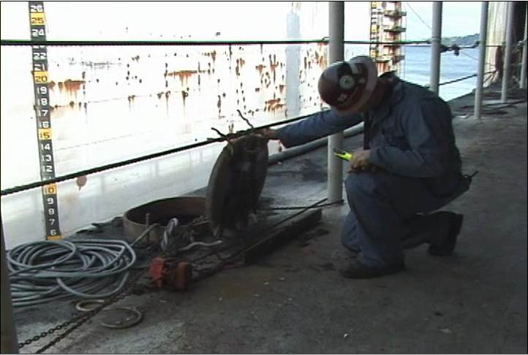
Precautions and Testing
Notes:
Initial testing should be carried out by a certified “Marine Chemist” or a “ Shipyard Competent person” who will issue a certificate stating whether the space is ‘safe for man’ and/or hot work, and if any special conditions are to be observed.
On a vessel this may be the Chief Officer, or other competent person onboard. If in doubt of the officer’s qualification, documentation is required to be shown. In no case should the worker or supervisor be considered to be a “Competent Person” – even if he is equipped with his own personal testing equipment.
Ventilation should be stopped about 10 minutes before tests are made and not restarted until the tests are completed.
The testing should be carried out in the following
• Oxygen-deficient or -enriched atmospheres
• Flammable atmospheres
• Toxic atmospheres when considered necessary
Volatile Organic Compounds (VOC’s) Reported as PID
Results must be posted on OSHA 74 form or equivalent log near by the space.

Slide 39
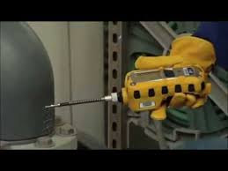
Oxygen Testing
Notes:
Testing for Oxygen Content (1915.12)
Spaces must be visually inspected and tested to determine the atmosphere's oxygen content prior to initial entry into the space by an employee. They must be sure to eliminate the hazards caused by:
Spaces that have been sealed, coated and closed up, and non‑ventilated spaces that have been freshly painted
Adjacent spaces, that contain or have contained, combustible or flammable liquids or gases
Spaces and adjacent spaces that contain or have contained liquids, gases, or solids that are toxic, corrosive, or irritant
Spaces and adjacent spaces that have been fumigated
Spaces containing materials or residues of materials that create an oxygen deficient atmosphere

Slide 40
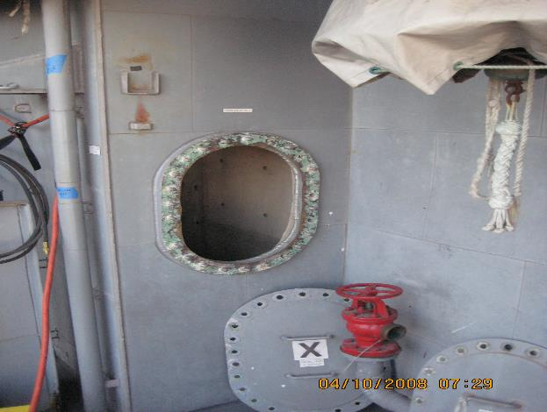
What’s Wrong With This Picture?
Notes:
Entry (1915.11)
“Entry” – the action by which a person passes through an opening into a space. Entry occurs as soon as any part of body breaks the plane of an opening into the space.
Safe Confined Space Entry Practices Review
• Ensure that a Shipyard Competent Person or Marine Chemist evaluates each confined space in accordance with OSHA requirements.
• Test all spaces for oxygen content, flammability, and toxicity, using properly calibrated instruments, prior to entry (29 CFR 1915.12). Continuous testing may also be needed. A Marine Chemist or Competent
Person will determine if this is needed and how testing must be done.
• Before performing hot work in any space where fuel or oil exists or was previously contained, make sure that a Marine Chemist tests the space. This includes adjacent spaces as well.
A Hot Work Permit is also required.

Slide 41
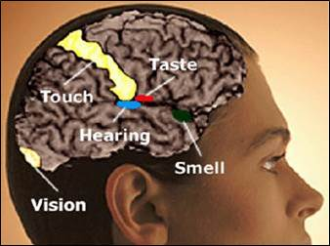
Confined Space Exercise
Notes:
Should you trust your senses when deciding whether or not to go into a confined space?
Circle Yes, No or It Depends and justify your answer by completing the Please Explain column.

Slide 42

Confined Spaces
QUIZ!
42
Notes:
42
For each statement below circle T for True or F for False.

Slide 43
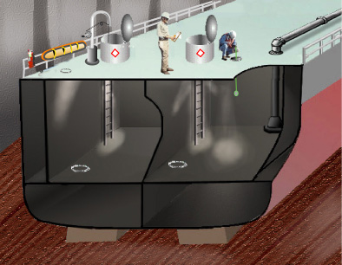
Inspection and Testing
Notes:
Visual Inspection and Testing for Combustibles and Flammables (1915.12)
The employer must ensure that spaces and adjacent spaces that contain or have contained combustible or flammable liquids or gases are:
Inspected visually by the competent person to determine the presence of combustible or flammable liquids prior to entry
Tested by a competent person prior to entry by an employee to determine the concentration of flammable vapors and gases within the space
Information Exchange (1915.12)
Each employer whose employees work in confined and enclosed spaces or other dangerous atmospheres must ensure that all available information on the hazards, safety rules, and emergency procedures concerning those spaces and atmospheres is exchanged with any other employer whose employees may enter the same spaces.

Slide 44
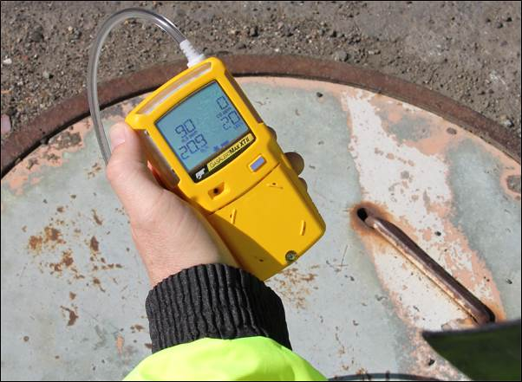
Oxygen Levels
Notes:
Oxygen Levels
Oxygen Deficient Atmosphere (1915.11)
"Oxygen deficient atmosphere" -means an atmosphere having an oxygen concentration of less than 19.5 percent by volume
Oxygen Enriched Atmosphere (1915.11)
"Oxygen enriched atmosphere" -means an atmosphere that contains 22.0 percent or more oxygen by volume.
Immediate Danger to Life or Health (IDLH) (1915.11)
“Immediately dangerous to life or health (IDLH)” – an atmosphere that poses an immediate threat to life or is likely to result in acute or immediate severe health effects.”
Asphyxiation is the leading cause of death in confined spaces. The asphyxiations that have occurred in permit spaces have generally resulted from oxygen deficiency or from exposure to toxic atmospheres.
Oxygen deficiency is not the only condition that creates and IDLH atmosphere. What could some others be?

Slide 45
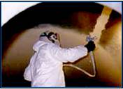
Oxygen Deficiency
Notes:
Causes of Oxygen Deficiency
There are a variety of causes that lead to oxygen deficiency. Leaking materials from storage tanks, natural gas lines, process valves and more release gas that displaces oxygen in poorly ventilated areas or confined spaces. Decomposing organic matter, such as animal, human or plant waste, produces methane, carbon monoxide, carbon dioxide, and hydrogen sulfide that displace or consume oxygen. Even corrosion, such as rust, or fermentation or other forms of oxidation will consume oxygen and pose a hazard.
The Work That We Do (Both Hot and Cold Work)
Painting – Paint that is drying consumes oxygen
Welding– A leaking welding lead will emit gasses, will displace oxygen. Welding on stainless steel will deplete oxygen. Liquid nitrogen becomes vaporized, displacing oxygen in the atmosphere.
Cleaning – Degreasing – As solvents evaporate they displace oxygen in the atmosphere.
Number of Workers – We inhale oxygen and exhale carbon dioxide

Slide 46
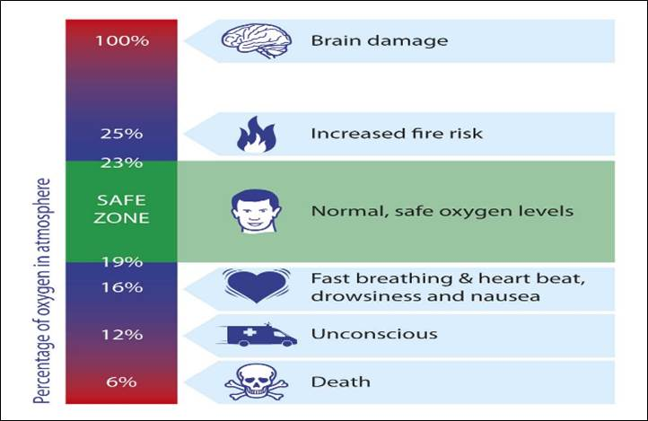
Oxygen Deficient Atmospheres
Notes:
Oxygen Deficient Atmospheres

Slide 47
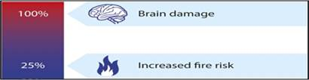
Oxygen Enrichment
Notes:
Oxygen Enrichment
Oxygen-enriched atmospheres may be produced by certain chemical reactions, but in a shipyard they are typically caused by ventilating with pure oxygen or leaking oxygen hoses and torches. Oxygen enriched atmospheres present a significant fire and explosion risk.
Recent workers deaths by explosion
4/14/2015 Omaha, NE Dallas Two workers killed in explosion of tanker
containing petroleum waste.
4/24/2015 Kettleman City, CA Worker killed in oil tank explosion.
7/17/2015 Saginaw, TX 76179Worker killed in pressurized tank explosion.
10/30/2014 Cheyenne, WY Worker killed in oil storage tank explosion.

Slide 48
Inerted Atmosphere
Notes:
Inerting means the displacement of the atmosphere in a permit space by noncombustible gas (such as nitrogen) to such an extent that the resulting atmosphere is noncombustible. This procedure produces an IDLH oxygen-deficient atmosphere.
Inert or Inerted Atmosphere means an atmospheric condition where:
The oxygen content of the atmosphere in the space is maintained at a level equal to or less than 8.0 percent by volume or at a level at or below 50 percent of the amount required to support combustion, whichever is less; or
The space is flooded with water and the vapor concentration of flammable or combustible materials in the free space atmosphere above the water line is less than 10 percent of the lower explosive limit for the flammable or combustible material.
An inerted atmosphere can be done as a result of the work we do or intentionally so that hazards are controlled in an adjacent space.

Slide 49
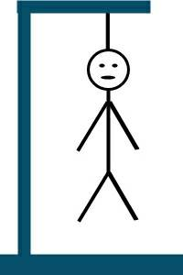
OXYGEN LEVELS “HANGMAN” EXERCISE
_ _ _ _ _ _ _ _ _ _ _ _ _ _
There is a significantly increased likelihood
of a fire with this type of atmosphere.
(2 words)
Notes:
Notes:
_________________________________________________________________________________________________________________________________________________________________________________________________________________________________________________________________________________________________________________________________________________________________________________________________________________________________________________________________________________________________________________________________________________________________________________________________________

Slide 50
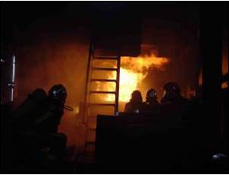
Fire/Explosion
Notes:
Fires and Explosions in Confined Spaces
There is a great danger that flammable gas and vapor may collect in a confined space, and these may ignite when welding or cutting takes place leading to an explosion.
Fuel gas processes also increase the risk of fire and explosion particularly if leaking equipment is left in the confined space, allowing a build-up of fuel gases or oxygen. Any heat from welding or cutting, or just an electric spark, can then result in a fire or explosion.
Fires on board a ship can be devastating. When they erupt in a confined space this devastation is magnified. With limited access, visibility and ventilation they often result in fatalities. On a ship fires are most often caused by hot work.
Hot Work (1915.4)
“Hot work” - means riveting, welding, grinding, burning or other fire or spark producing operations.
This list is not all inclusive and additional hot work activities will be discussed on the following pages.

Slide 51
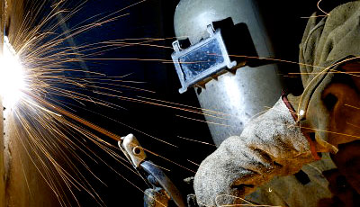
Hot Work in Confines Spaces
Notes:
Hot Work
On a ship fires are most often caused by hot work. Hot work is any work process which produces heat, sparks or fire.
Typical shipyard processes that are considered hot work are:
Welding
Burning
Grinding
Drilling
Abrasive Blasting
Stud Shooting
Circle the work that you perform from the list above and write below how that work could create a fire or explosion. If you do not perform hot work pick a “bullet” from above and write how you think hot work may create a fire or explosion.
___________________________________________________________________________________________________________________________________________________________________________________________________

Slide 52
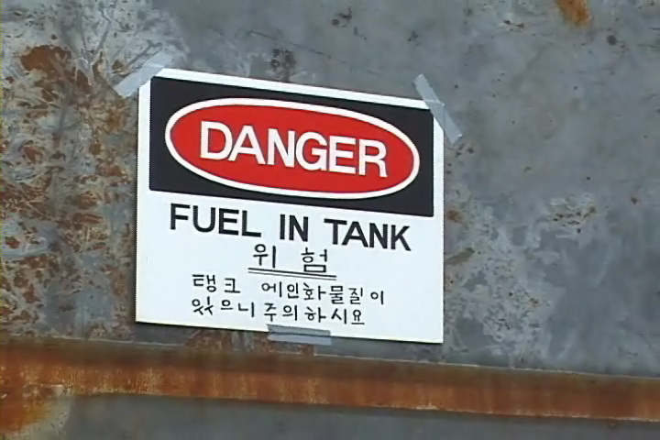
Adjacent Spaces and Hot Work
Notes:
Adjacent Spaces (1915.11)
“Adjacent spaces” – spaces bordering a subject space in all directions. Including all points of contact, corners, diagonals, decks, tank tops, and bulkheads.
Marine Chemist or Coast Guard Testing (1915.14)
Employer must ensure that hot work is not performed in or on any of the following confined and enclosed spaces and other dangerous atmospheres, boundaries of spaces or pipelines until the work area has been tested and certified by a Marine Chemist, Shipyard Competent Person or a U.S. Coast Guard authorized person as "Safe for Hot Work":
Within, on, or immediately adjacent to spaces that contain or have contained combustible or flammable liquids or gases
Within, on, or immediately adjacent to fuel tanks that contain or have last contained fuel
On pipelines, heating coils, pump fittings or other accessories connected to spaces that contain or have last contained fuel
Exception: Within spaces adjacent to spaces in which the flammable gases or liquids have a flash point above 150° F and the distance between such spaces and the work is 25 feet or greater. This exception is rare at the MSR’s.

Slide 53
OSHA Fire Video
Notes:
What Went Wrong?
Based on the video you just saw, working with your partner, identify “What Should Have Been Done Differently”.
____________________________________________________________
____________________________________________________________
____________________________________________________________
____________________________________________________________
____________________________________________________________
____________________________________________________________
____________________________________________________________

Slide 54
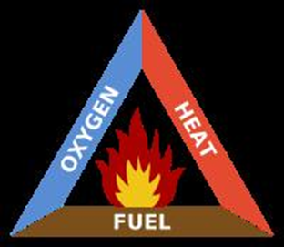
Fire
Notes:
Defining “Fire”
Fire is “the rapid oxidation of combustible materials which releases energy in the form of light and heat”. It is represented by a triangular pyramid known as the fire tetrahedron. The three elements of the pyramid are:

Slide 55
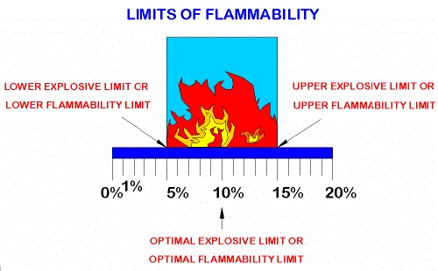
Flammable Range
Notes:
Flammable Range
When vapors of a flammable or combustible liquid are mixed with air in the proper proportions in the presence of a source of ignition, rapid combustion or an explosion can occur. The proper proportion is called the flammable range and is also often referred to as the explosive range. The flammable range includes all concentrations of flammable vapor or gas in air, in which a flash will occur or a flame will travel if the mixture is ignited.
Lower Explosive Limit (LEL)
The lower explosive limit is the minimum concentration of vapor in air below which propagation of a flame does not occur in the presence of an ignition source.
Upper Explosive Limit (UEL)
The Upper Explosive Limit is the highest concentration (percentage) of a gas or a vapor in air capable of producing a flash of fire in the presence of an ignition source (arc, flame, heat). Concentrations higher than the UEL are "too rich" to burn.

Slide 56
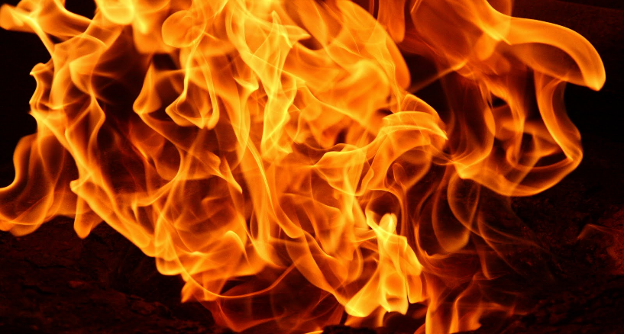
Heat
Flashpoint
Gasoline: -45 F
Notes:
Flash point: the minimum temperature at which a liquid gives off vapor within a test vessel in sufficient concentration to form an ignitable mixture with air near the surface of the liquid. The flash point is normally an indication of susceptibility to ignition. The flash point is determined by heating the liquid in test equipment and measuring the temperature at which a flash will be obtained when a small flame is introduced in the vapor zone above the surface of the liquid. A standard closed container is used to determine the closed-cup flash point and a standard open-surface dish for the open-cup flash point temperature, as specified by the American Society for Testing and Materials (ASTM D 93). These methods are referenced in OSHA's 1910.106 standard.
Why is this information relevant?

Slide 57
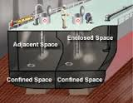
Adjacent Spaces
Notes:
Adjacent Spaces (1915.11)
“Adjacent spaces” – spaces bordering a subject space in all directions. Including all points of contact, corners, diagonals, decks, tank tops, and bulkheads.
Dangerous Atmosphere (1915.11)
“Dangerous atmosphere” – atmosphere that may expose employees to risk of death, incapacitation, impairment of ability to self-rescue (i.e., escape unaided from a confined or enclosed space), injury, or acute illness.
Be aware of all spaces bordering the space you are working in. On-board, they must all be certified.

Slide 58
Adjacent Spaces - Exercise
Notes:
What could be the hazards associated with Adjacent Spaces and what precautions must be taken?

Slide 59
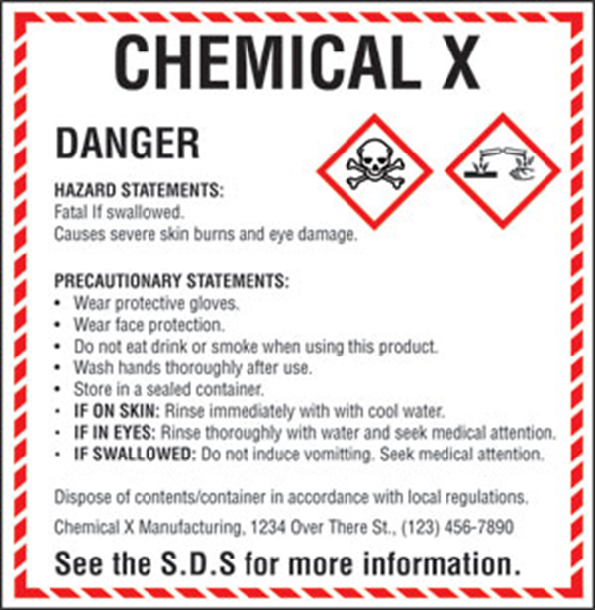
Inhalation of Toxic Substances
Notes:
Evaluating Confined Spaces for Toxic Substances (1910.1028)
Hazardous and toxic substances are defined as those chemicals present in the workplace which are capable of causing harm to an organism. In this definition, the term chemicals includes dusts, mixtures, and common materials such as paints, fuels, and solvents. OSHA currently regulates exposure to approximately 400 substances. The OSHA Chemical Sampling Information file contains listings for approximately 1500 substances; the Environmental Protection Agency's (EPA's) Toxic Substance Control Act (TSCA) Chemical Substances Inventory lists information on more than 62,000 chemicals or chemical substances; some libraries maintain files of material safety data sheets (SDS) for more than 100,000 substances.
A central concept of toxicology is that effects are dose-dependent; even water can lead to water intoxication when taken in too high a dose, whereas for even a very toxic substance such as snake venom there is a dose below which there is no detectable toxic effect.
The threshold limit value (TLV) of a chemical substance is a level to which it is believed a worker can be exposed day after day for a working lifetime without adverse health effects.

Slide 60
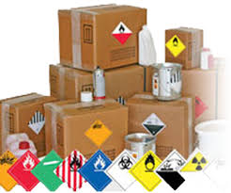
Hazardous Materials
Notes:
Hazardous Material (1915.4)
“Hazardous material” – a material which has one or more of the following characteristics:
Flash point below 140° F
Subject to polymerization with release of large amount of energy
Strong oxidizer or reducing agent
Causes first degree burns to skin, or toxic by skin contact
May produce dusts, gases, fumes, vapors, mists
Threshold limit value below:
Below 500 ppm – gas or vapor
Below 500 mg./m³ – fumes
Below 25 mppcf – dust

Slide 61

Sources of Toxicity
Notes:
Sources of Toxicity On Board
Products on Ships
Reactivity
Work Processes
2015 OSHA Recorded Accident
A foreman died from asphyxiation after entering a manhole with an uncontrolled hazardous atmosphere. Four construction workers were working in an inactive sewer system on a jobsite that was unoccupied for over a week. A few minutes after they started working, the crew noticed that the foreman was missing and a manhole cover was removed. While one worker called emergency services, a second worker entered the manhole to assist the foreman and found him unresponsive at the bottom of the manhole. When the second worker became disoriented inside the manhole, another worker used a fan to blow fresh air into the manhole and the worker was able to climb out. The foreman was retrieved by fire department personnel and was later pronounced dead due to asphyxiation.
What could have prevented this accident?

Slide 62

Products
Notes:
Products On Board
Gasoline
Jet Fuel
Crude Oil
Benzene
Adhesives
Paint and Paint Related Products
This list is not all inclusive, Which of these do you use or are exposed to?
____________________________________________________________________________________________________________________________________________________________________________________________________________________________________________________________________

Slide 63
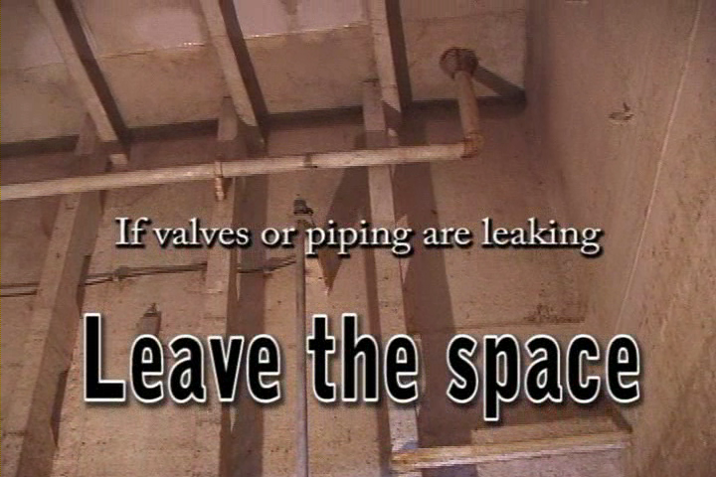
Pipelines
Notes:
Pipelines (1915.15)
Pipelines that could carry hazardous materials into spaces that have been certified "Safe for Workers" or "Safe for Hot Work" must be disconnected, blanked off, or otherwise blocked by a positive method to prevent hazardous materials from being discharged into the space.
Before you begin work in a confined space, look up!

Slide 64
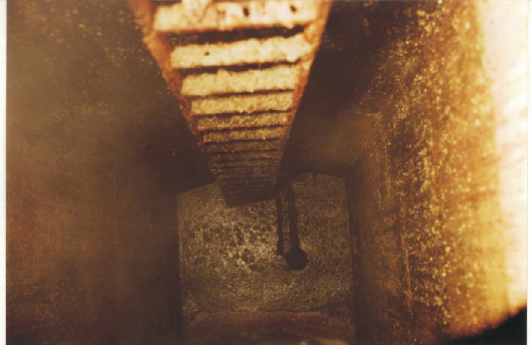
Reactivity
Notes:
Reactivity on Board
Another source of toxics on-board is reactivity, such as when organic materials decay. This decay can cause deadly toxic fumes, like hydrogen sulfide and methane.
One of the most hazardous environments you can work in is a Collecting, Holding and Transfer (CHT) tank.
Metals corrode when they are left in contact with air or water.
When iron corrodes, it is called rusting.
Rusting is the oxidation reaction of iron with oxygen in the presence of water.
What kind of hazard can we observe here? Physical, atmospheric or both?
Please explain.

Slide 65

Work Processes / IDLH
Notes:
Work Processes such as welding, painting, and CHT tank may create a toxic environment if hazard controls are not applied.
Immediately Dangerous to Life or Health (IDLH) atmospheres on Board
NAVSEA 009-07 FY16
3.1.6 Spaces that are determined to contain Immediately Dangerous
to Life or Health (IDLH) atmospheres shall never be entered except for
emergency rescue or for short duration for installation of ventilation
equipment in accordance with 2.2 and 2.3. When entering IDLH spaces for the
purpose of installing ventilation, notify the SUPERVISOR prior to entry.
Notifications of rescue shall be made as soon as management becomes aware of
such an event.
One of the most hazardous environments you can work in is a Collecting, Holding and Transfer (CHT) tank.
If Hydrogen Sulfide gas is present, the space should be ventilated.
If the gas cannot be removed, use appropriate respiratory protection and any other necessary personal protective equipment (PPE), rescue and communication equipment.

Slide 66

Liquid Residues in Confined Spaces
Notes:
Testing (1915.13)
Liquid residues of hazardous materials must be removed from work spaces before employees start cleaning operations or cold work in a space.
Testing must be conducted by a competent person within the space prior to the beginning of cleaning or cold work.
Liquid residues from sewage and gray water tanks
Biological hazards include pathogens (e.g.,bacteria, viruses, protozoa, parasitic worms, fungi) and other infectious microorganisms that can cause illnesses such as hepatitis, typhoid fever, dysentery and cholera. Inhaling
or ingesting contaminated mists may result in serious illnesses.

Slide 67
Confined Spaces Quiz
QUIZ!
Notes:
For each statement or question below circle the best answer.

Slide 68

Confined Space Hazard Controls
Notes:
Confined Space Controls
Once confined spaces have been recognized and evaluated, controls must be put in place and followed! These controls will be one or more of the following:
Elimination/Substitution
Engineering
Administrative
Personal Protective Equipment (PPE)

Slide 69

Elimination/Substitution
Notes:
Elimination/Substitution
Eliminating the hazard is the best way to protect employees. Examples of this are taking the operation out of the confined space and performing the operations land side. You could also substitute one operation or chemical for another.
Can you provide a specific example in the work that you do?

Slide 70

Engineering
Notes:
Engineering Controls
Eliminating the hazard is the best way to protect employees. The next best method used to control or eliminate a hazard would be the use of engineering controls which focus on the source of the hazard rather than on the employees exposed to the hazard. Depending on the hazard or workplace conditions, OSHA recommends the use of engineering or work practice controls to manage or eliminate hazards to the greatest extent possible.
Types of Engineering Controls:
Initial design specifications
Change process
Enclose process
Isolate process
Ventilation is an engineering control you will almost always see in a confined space.
Can you provide another example in the work that you do?

Slide 71

Administrative
71
Notes:
71
Administrative Controls
Administrative controls are work practices, work methods, policies and procedures established by the employer with the goal of reducing exposure to a work-related risk and/or hazard. Administrative controls include:
Following safe work practices
Rotating workers in jobs that induce body fatigue, such as welders and burners that use vibratory pneumatic tools in tasks such as smoothing welds or removing paint. These pneumatic tools can cause tendon, nerve or neurovascular disorders.
Requiring worker in hot environments (such as tanks) to take breaks in cool areas and providing fluids for re-hydration
Proper housekeeping. Reducing clutter reduces the chances for an accident and minimizes the effects if an accident occurs
Conducting hearing tests
Directing welders to use their hands and not their necks to raise and lower their welding hoods. Using the neck can cause neck trauma
Safety training throughout the organization
Communicating to workers through policies, procedures and signs

Slide 72

Personal Protective Equipment
Notes:
Personal Protective Equipment (PPE)
PPE is traditionally regarded as the last line of protection with the emphasis being placed on avoidance and appropriate managerial control methods. However, the potentially hazardous nature and isolated position of those entering a confined space means that, for the worker, PPE may be the first line of protection.
Each confined space will present different hazards and degrees of risk to health and safety, the final provision of PPE should therefore be based on an assessment of risk.
As a general rule the following guidance is offered.
Body protection (hard wearing overalls with suitable pockets for notebook, etc)
Foot protection (steel toecaps, good grip, oil resistant);
Head protection
Hand protection
Eye protection (protective glasses, goggles);
Ear protection (ear defenders or ear plugs);
Lighting (hand held with lanyard and appropriate beam width or similar).
Can you provide a specific example in the work that you do?

Slide 73

Controls Exercise
Notes:
Under each level of control, list as many controls as you can that relate to working in confined spaces.

Slide 74

Certificates/Record Keeping
Notes:
Record Keeping (1915.7)
Tests performed by competent person, marine chemist or CIH must record the:
Location
Time
Date
Location of inspected spaces
Operations performed
Test results
Any instructions.
Name and signature of person performing test.
Records must be:
Posted in immediate vicinity of the affected operations.
Maintained for at least three months after completion of job.
Available for inspection.

Slide 75

Maintenance of Safe Conditions
Notes:
Tests to Maintain Conditions NAVSEA 009-07 FY 16
3.1.3.5 For those spaces where only Competent Person tests
and inspections are required in accordance with 2.2, a Competent Person shall visually inspect and test each space as often as necessary and, as a minimum, daily prior to entry or commencement of hot work to ensure that conditions are safe.
3.1.3.6 After the Competent Person has determined initially
that a space is safe for entry and finds subsequently that the conditions
within the tested space fail to meet the requirements of 2.2, work shall be
stopped until the conditions in the tested space are corrected, the space is
retested, re inspected, and a new record of tests/inspections is recorded and posted.
At the MSR’s the update log is updated at least every 24 hours.

Slide 76
Confined Spaces at the MSRs
Notes:
As you watch the video, list the Do’s and Don’ts below!
Do’s
_________________
_________________
_________________
_________________
_________________
_________________
_________________
_________________
_________________
_________________
Don’ts
_________________
_________________
_________________
_________________
_________________
_________________
_________________
_________________
_________________
_________________

Slide 77
Certification and Update Log
Name of the
space you are
planning to
enter
What were
the results
of the test
Specific instructions
you must follow
before entering the
space
Initials of
the person
who
inspected
the space
It must show the date
of the day you are
entering the space
Notes:
Confined Space Update Log (1915.16)
The Confined Space Log must be completed in its entirety prior to entering a confined space. The log must be updated daily or when conditions change.
Employee Comprehension (1915.16)
Each sign or label posted to comply with the requirements of this subpart must be presented in a manner that can be perceived and understood by all employees.
Posting a Large Area (1915.16)
If the entire work area has been tested and certified: not safe for workers, not safe for hot work, a sign or label to this effect can be posted conspicuously at each means of access to the work area.

Slide 78

MSR Shipboard Procedures
Notes:
Update Logging System
At the MSR’s, a Marine Chemist Certification and subsequent updates are accomplished by the Prime Contractor. Notify the Prime Contractor if you desire to work in a confined space. The MSR’s use a unique, color-coded, confined space logging system. The color or the form will signal the status of the space.

Slide 79

MSR Shipboard Procedures
What does green mean?
Notes:
Tests to Maintain Conditions (1915.14)
Competent person must visually inspect and test each space certified as "Safe for Workers" or "Safe for Hot Work," as often as necessary to ensure that atmospheric conditions within that space is maintained within the conditions established by the certificate after the certificate has been issued.
Update Logs
Update logs are updated as least daily (every 24 hours) or if any conditions change!
Logs of Inspections and Test by Shipyard Competent Person are posted in the immediate vicinity of the space / tank along with the Marine Chemist Certification. These locations will typically be:
Main accesses to spaces
Escape trunks
Sand holes
Cut out to spaces
Any opening into a confined / enclosed space

Slide 80

Safe for Cold Work
Notes:
Safe For Workers (1915.11)
"Safe for Workers“ - denotes a space that meets the following criteria:
The oxygen content of the atmosphere is at least 19.5 percent and below 22 percent by volume
Any toxic materials in the atmosphere associated with cargo, fuel, tank coatings, or inerting media are within permissible concentrations at the time of the inspection
Any residues or materials associated with the work will not produce uncontrolled release of toxic materials under existing atmospheric conditions while maintained as directed
The concentration of flammable vapors is below 10 percent of the lower explosive limit (LEL)
This Golden Rod Update Log means that you may enter the space to perform cold work, but no hot work is allowed.
What condition or conditions might warrant a Golden Rod update log?
____________________________________________________________

Slide 81

Safe For Man and Hot Work
Notes:
Safe For Hot Work (1915.11)
"Safe for Hot Work" - denotes a space that meets all of the following criteria:
The oxygen content of the atmosphere does not exceed 22.0 percent by volume
The concentration of flammable vapors in the atmosphere is less than 10 percent of the lower explosive limit
The residues or materials in the space are not capable of producing a higher concentration than permitted in paragraph (1) or (2) of the above, under existing atmospheric conditions in the presence of hot work and while maintained as directed by the Marine Chemist or competent person
All adjacent spaces have been cleaned, or inerted, or treated sufficiently to prevent the spread of fire
This Green Update Log means that you may enter and perform hot work.
What are the differences between Safe For Workers and Hot Work (Green) and Safe For Workers (Golden – from previous page)?

Slide 82

Limited Hot Work
Notes:
Safe For Workers (1915.11)
This certificate (Yellow) indicates a space that is safe for workers, but hot work is limited
Limited Hot Work
There are restrictions to the type of hot work, and/or the location of the hot work and/or other precautions that must be present.
Provide at least one example of “limited hot work”.
___________________________________________________________________________________________________________________________________________________________________________________________________________________________________________________________________________________________________________________________

Slide 83

Enter With Restrictions!
Notes:
Enter With Restrictions
A blue update log indicates that a person may enter the confined space with restrictions. These restrictions will likely include:
Engineering Controls: One example - Ventilation
Specific PPE: One example – Respirator
A blue update log means that no hot work is allowed!
What condition(s) would require a blue Update Log?
___________________________________________________________________________________________________________________________________________________________________________________________________________________________________________________________________________________________________________________________

Slide 84

Not Safe for workers or Hot Work
Notes:
Not Safe For Hot Work (1915.11)
"Not Safe for Hot Work" - denotes a space where hot work may not be performed because the conditions do not meet the criteria for Safe for Hot Work.
Not Safe For Workers (1915.11)
"Not Safe for Workers" - denotes a space where an employee may not enter because the conditions do not meet the criteria for Safe for Workers.
Immediately Dangerous to Life or Health (IDLH) means an atmosphere that poses an immediate threat to life or that is likely to result in acute or immediate severe health effects.
What condition(s) would require a red update log?
____________________________________________________________________________________________________________________________________________________________________________________________________________________________________________________________

Slide 85

Confined Spaces Exercise
Notes:
Draw a Line From the Competent Person Update Log “Color” in the left column to the “Status” in the right column

Slide 86

Safe Confined Space Entry Practices
Notes:
Safe Confined Space Entry Practices continues
• Post entry requirements (certificate) based on the results of testing; ventilation, respirators, or protective suits may be required.
• Be sure that properly working ventilation (e.g. electric fan and blower) is available. Ventilation is normally the best way to remove toxic vapors and to
supply clean air to a confined space.
• Be aware of what is taken into a confined space. Paints or chemicals in a confined space may cause the atmosphere to become toxic.
• Never bring portable internal combustion engines into a confined space. This could lead to carbon monoxide poisoning.
• In the event of an emergency, be sure that a plan is in place to contact emergency services. Make sure that the local rescue services are aware of your confined space activity so that they are prepared to respond.
A sample plan is outlined in 29 CFR 1915, Subpart P.
• Remove all gas hoses from the space when not in use and during breaks (e.g., lunch periods). Test all gas hoses prior to entry to ensure no leak is present.

Slide 87

Maintenance of Safe Conditions
Notes:
Condition Changes (1915.14)
If a competent person finds that the atmospheric conditions within a certified space fail to meet the applicable requirements of 1915.12, 1915.13, and 1915.14 of this part;
Work in the certified space must be stopped and may not be resumed until the space has been retested by a Marine Chemist and a new certificate issued in accordance with 1915.14(a).

Slide 88

MSR Shipboard Procedures
Notes:
Leaving The Work Area
When you leave a work area, including at the end of your shift, do not:
Leave a burning lead, fuel gas hose or cutting torch in a confined space
Leave charged compressed gas hoses unattended in an enclosed space greater than fifteen minutes
Never leave a charged fuel gas hose in a confined space
Check with your supervisor before leaving the area!
Also, during lunch and at the end of shift bleed off oxy/gas lines for ALL locations

Slide 89

Stand By Observer
Notes:
1915 Best Practice/Confined Space Attendant -)
During the entry of a Permit Required Confined Space, a Confined Space Attendant must remain in regular contact with the worker(s).

Slide 90

More Employer Responsibilities
Notes:
Training (1915.12)
The employer must ensure that each employee that enters a confined or enclosed space and other areas with dangerous atmospheres is trained to perform all required duties safely. Training must address confined space recognition, entry, hazards, PPE, and evacuation. These topics are not all inclusive, and employers should refer to 1915.12 (d) when designing training.
NAVSEA 009-07 FY 16
3.1.4 Tank cleaning personnel shall be trained annually on safety
practices to include a discussion of safety information found in Subparts A,
B, and Section 1915.152 of Subpart I of 2.2.

Slide 91

Self Rescue
Notes:
Detect Atmosphere Changes
In the left column there are smells, odors and tastes that indicate an atmosphere change. In the right column there are physical symptoms that indicate an atmosphere change. If you sense any of these… get out of the space!

Slide 92

The Dangers of Confined Space Rescue
Notes:
Why have confined spaces killed so many people?
Confined spaces are deceiving.
A confined space often appears to be harmless; no danger signs are apparent & the space may have been entered on prior occasions without incident. However, a worker cannot assume that conditions have not changed and that the space is safe for entry each time.
Why do so many fatalities result from emergency rescue?
Fatalities can occur when the rescuers:
Are overcome by their emotions
Take unnecessary chances
Do not know the hazards involved
Do not have a plan of action
Lack confined space rescue training

Slide 93

Rescue
Notes:
If a Person is Unconscious in a Tank
DO NOT ENTER the tank
More rescuers become the victim
75% rescuers die
65% of those are supervisors
Rescue Procedures (NAVSEA Standard Item 009-07 FY16)
3.1.5 Maintain a current roster of the names of the Shipyard/Plant
Rescue Team Members, along with contractor certification that training
requirements have been accomplished and are current for
each Rescue Team Member, or documentation of arrangements made for an outside rescue team to respond promptly to a request for rescue service in a
contractor facility. Submit one legible copy, in approved transferrable
media, of the specific documents when requested by the SUPERVISOR.
3.1.5.1 At a naval facility, the Navy will Respond
Get Help - RED TELEPHONE or # 3333 on ships Quarterdeck telephone or find a supervisor with a radio

Slide 94

Confined Space Exercise
Notes:
Create Your Confined Space Entry Checklist
Before entering a confined space what should you do?
_______________________________________________________________
_______________________________________________________________
_______________________________________________________________
_______________________________________________________________
_______________________________________________________________
_______________________________________________________________
_______________________________________________________________
_______________________________________________________________
_______________________________________________________________
_______________________________________________________________

Slide 95

Confined Space Entry Checklist
Notes:
Entry Checklist
Before entering a confined space know the following!
That the entry permit contains the required information before authorizing entry, including current date and time
That that the necessary procedures, practices and equipment for safe entry are in full effect before allowing entry.
Location of the nearest telephone or two way radio
Location of the nearest safety shower and available vehicle to transport worker
Location of the nearest fire extinguisher
Location of the nearest first aid kit
How to report emergency

Slide 96

Summary
Notes:
Important Points
Check Marine Chemist Certification and test log. (Required for entry)
Visually check the entry and all areas within and adjacent to the space being aware of possible hazards
Ensure proper ventilation (hot work)
Beware of possible change of conditions
Beware of possible exposure and need for self-rescue
Ensure all tank screens are maintained shut at all times
Report any changes, incidents or accidents immediately
Ask yourself!
Where are you working?
How did you get there?
What are the hazards?
How would I get out?
Are there other people working in the area? If so, what materials are they using? What PPE are they wearing?

Slide 97
Confined Spaces
QUIZ!
97
Notes:
97
For each statement below circle T for True or F for False.

