Slide 1
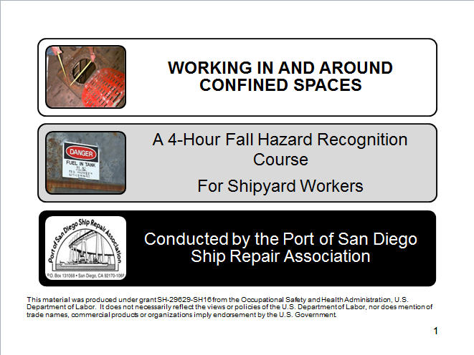
Intro page
Developed
This material was produced under grant SH-29629-SH16 from the Occupational Safety and Health Administration, U.S. Department of Labor. It does not necessarily reflect the views or policies of the U.S. Department of Labor, nor does mention of trade names, commercial products or
organizations imply endorsement by the U.S. Government.
1
Notes:
1
EXERCISE FLIPCHART TARGET ANSWER Key Question/QUIZ Video
Use the symbols above as a guide to support you in facilitating your class.
INTRODUCTION – Identify yourself and explain that this class is to support them in understanding and protecting themselves from the hazards associated with Confined Spaces.
Read the bottom of Page 1 of the Training Manual
Go through each of the topics briefly explaining course content.
Handout Pre/Post Test and explain by completing this test they will have a good understanding of the material being covered.
Have them circle “Pre” at the top of the test. Have them write the date in the appropriate space. Explain that they will not need to write their names on the pre-test. Allow 5-10 minutes to complete the pre-test and collect the tests. Grade during the remainder of class. Facilitator to provide pre- and post-test results to Project Director.

Slide 2
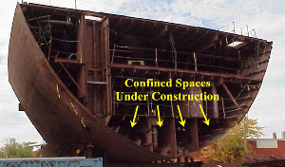
Working In and Around Confined Spaces
Notes:
2
Working In and Around Confined Spaces
Read each objective.
After reading each objective ask “who in here work in confined space?”
Ask, what space on-board a vessel is more hazardous than a confined space?
Target answer: None
Introduction
Ask all participants to read to themselves. Allow one minute for reading.
Ask if there are questions.

Slide 3

OSHA
Notes:
OSHA and You!
Review OSHA origin and purpose.

Slide 4
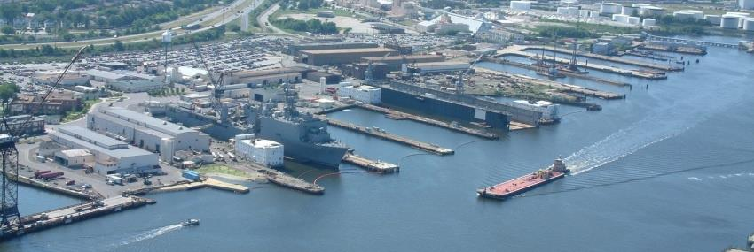
OSHA Exercise
Notes:
Employee’s Responsibilities and Rights
Ask participants to rate themselves on how they fulfill each of their 4 responsibilities regarding OSHA compliance in the blank space provided.
1 = less than 50% of the time
2 = 50% - 75% of the time
3 = 75% - 100% of the time
Ask the question -- How might your scores impact your risk of injury?
Target Answer: The lower the score, the higher the risk!
Read and review the rights.

Slide 5

OSHA Employer’s Responsibility
5
Notes:
5
5
Employer’s Responsibility
Read and review page.
(Recommend trainer/participant mix of reading aloud.)
Ask if questions or comments.

Slide 6

OSHA More on Employer’s Responsibilities
6
Notes:
6
6
More Employer’s Responsibility
Say – “Ahhhh, more employer responsibilities.”
Explain that there are additional responsibilities each employer must follow.
Ask for volunteer to read page 7.
Thank the volunteer.
Ask if there are questions.

Slide 7


OSHA
Notes:
No Retribution
Explain that you suggest that before reporting a hazard to OSHA, you follow the “chain of command” and allow your organization or the host yard to rectify the situation.
Also point out that when you report a hazard to OSHA, you are NOT “telling on an organization”, you are reporting a hazard!
Read the slide and ask if there are any questions.

Slide 8
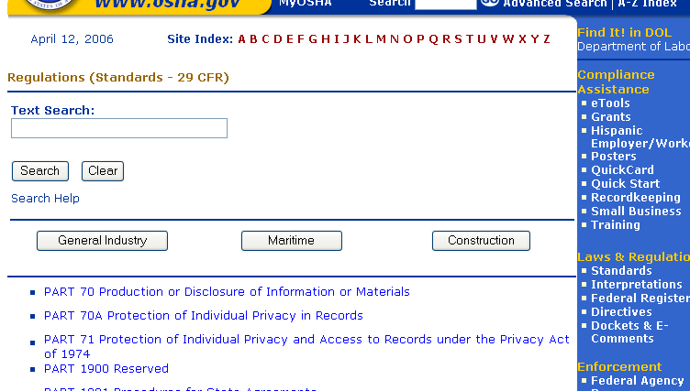
OSHA
Notes:
Resolve With Your Company
Have the participants read this page to themselves.
Point out that when reporting a hazard, whether on-line or on the telephone, the information can be confidential.
Ask if there are any questions.

Slide 9
OSHA Exercise
Stump the class!
With a partner, write two questions from this section that you believe the rest of the class will be challenged in answering correctly. (Questions must be reasonable! If your instructor can’t answer, it doesn’t count!)
Notes:
Read the instructions on the page 10.
Explain that the purpose of this exercise is to know the material that was just covered well enough to ask pertinent questions. Another purpose is to do a review of the material in this section.
Reinforce that questions must come from the material found in pages 5 – 10.
Allow up to 5 minutes.
Ask volunteers to “stump the class”. To be time appropriate, ask each team for one question only. Allow 4 questions before you call an end to the exercise.
Acknowledge all participants.

Slide 10
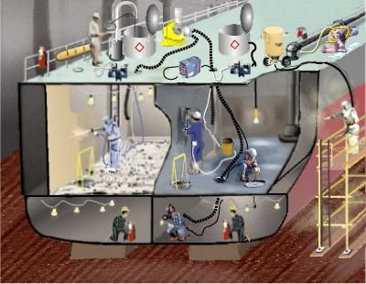
Terms – Adjacent Space
Notes:
DEFINITIONS
Explain that the following nine pages are common terms related to confined spaces. Inform the participants that they will be quizzed on several of these terms. Ask participants to read page 11.
Allow one minute for participants to read page.
Pick two terms (one at a time) and ask if a participant can tell the class the meaning.
Positively acknowledge responses.

Slide 11
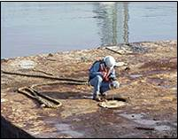
Terms – Competent Person
Notes:
Ask participants to read page 12.
Allow one minute for participants to read page.
Pick two terms (one at a time) and ask if a participant can tell the class the meaning.
Positively acknowledge responses.

Slide 12
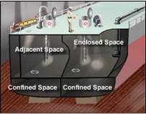
Terms – Enclosed Space
Notes:
Ask participants to read page 13.
Allow one minute for participants to read page.
Pick two terms (one at a time) and ask if a participant can tell the class the meaning.
Positively acknowledge responses.

Slide 13
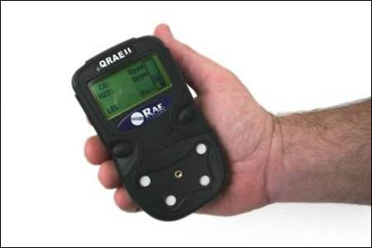
Terms- Atmospheric Testing
Notes:
Ask participants to read page 14.
Allow one minute for participants to read page.
Again, pick two terms (recommend Hazardous Atmosphere and Hot Work) and ask if a participant can tell the class the meaning.
Positively acknowledge responses.

Slide 14
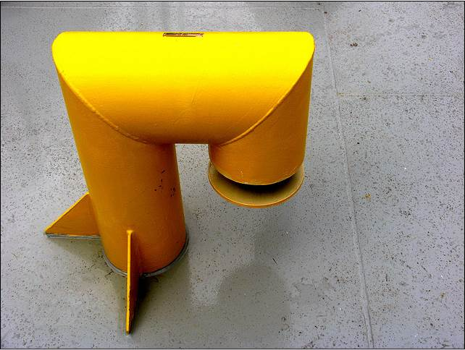
Terms - IDLH
Notes:
Ask participants to read page 15.
Allow one minute for participants to read page.
Pick two terms (one at a time) and ask if a participant can tell the class the meaning.
Positively acknowledge responses.

Slide 15
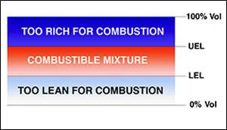
Terms - LEL
Notes:
Ask participants to read page 16.
Allow one minute for participants to read page.
Pick two terms (one at a time) and ask if a participant can tell the class the meaning.
Positively acknowledge responses.

Slide 16
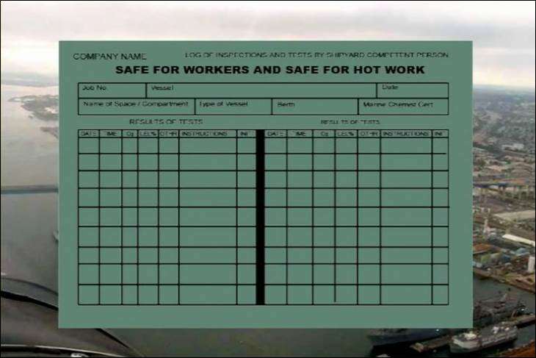
Terms – Safe For Hot Work
Notes:
Ask participants to read page 17.
Allow one minute for participants to read page.
Pick two terms (one at a time) and ask if a participant can tell the class the meaning.
Positively acknowledge responses.

Slide 17
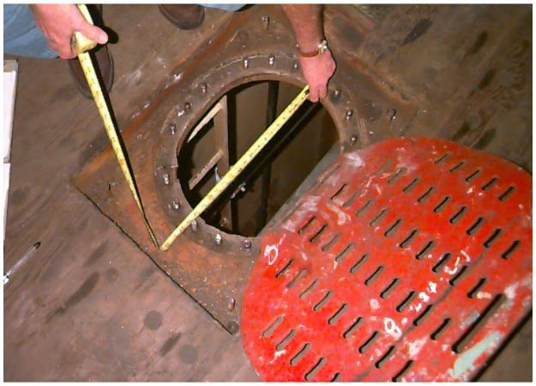
Defining Confined Spaces
Notes:
What are Confined Spaces?
Read page 18 and ask if there are questions.

Slide 18
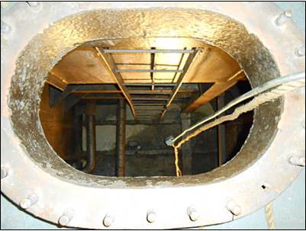
Recognizing a Confined Space
Notes:
What are Confined Spaces?
Ask a participant to read the first paragraph.
Ask if there are questions.
Ask a participant to read the second paragraph.
Ask what does engulf an entrant mean?
Engulfment means the surrounding and effective capture of a person by a liquid or finely divided (flowable) solid substance that can be aspirated to cause death
Reiterate, that regardless of a formal definition of “confined space”:
If it looks like a confined space, treat it like a confined space!

Slide 19
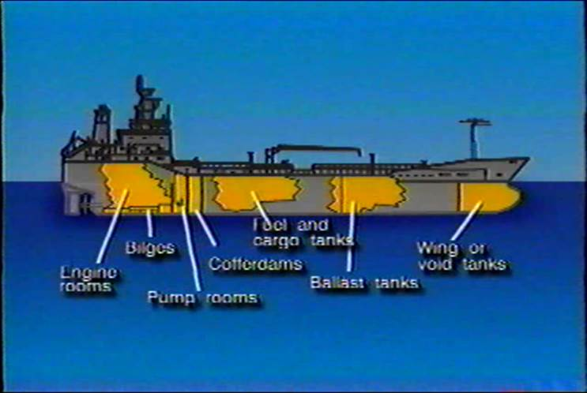
Where Are They Found
Notes:
Common Shipboard Confined Spaces
Read each bullet.
When finished, ask if anyone has worked or could work in any of these spaces.
Key point: Many of you have or will work in a very hazardous place!

Slide 20
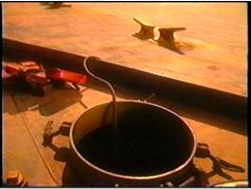
Why Go Into A Confined Space?
Notes:
Why Go Into a Confined Space?
Read and review page.
Ask if questions or comments.

Slide 21
General Hazards in Confined Spaces
Notes:
21
General Hazards
Ask a participant to read the first half of the page.
Ask if there are questions.
Ask a participant to read the last half of the page.
Ask if there are questions.

Slide 22
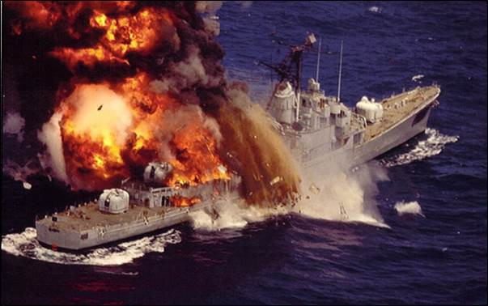
Hazards
Notes:
Hazards
Review line-by-line the “space” and corresponding “hazard”
Ask if anyone has been exposed to each space/hazard and ask them to share an example from their work experience.

Slide 23
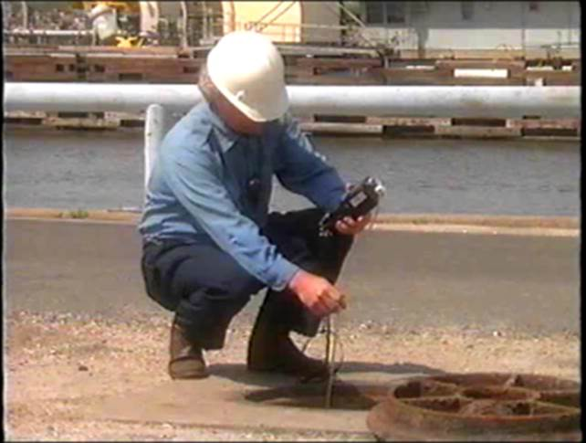
Physical and Atmospheric Hazards
Notes:
Evaluating Confined Spaces
Read the opening statement.
Remind class of the ‘engulfment” definition learned earlier in class. (see page 19)
State: “All of these conditions can be life threatening!”

Slide 24
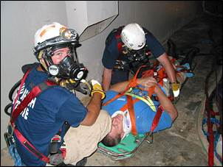
Physical Hazards
Notes:
Physical Hazards
Begin by saying “Let’s first discuss Physical Hazards..
Ask for volunteer(s) to read each category.
Ask if any questions after each section.
Thank participants.

Slide 25
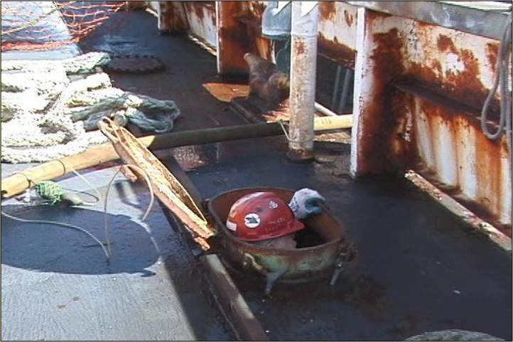
Heat Stress and Entrapment Confined Space Hazards
Notes:
Ask for volunteer(s) to read each category.
Ask if any questions after each section.
Thank participants.

Slide 26
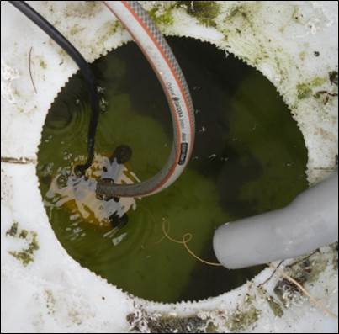
Physical Hazards Exercise
Notes:
Exercise- This is an individual exercise.
Ask participants to fill in the blanks in their training manual.
Do each section one at a time.
Write answers onto flip chart or white board.

Slide 27
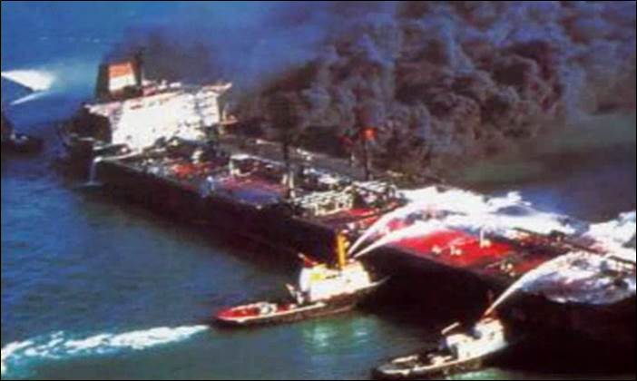
Atmospheric Hazards Fire and Explosion
Notes:
Dangerous Atmosphere (1915.11) (8 CCR 8355)
Have participants to read page 28.
Ask for an example of a dangerous atmosphere:
Target Answer:
Too little Oxygen
Too much oxygen
Danger of fire or explosion
Toxic fumes
To reinforce answers read the remainder of the page.

Slide 28
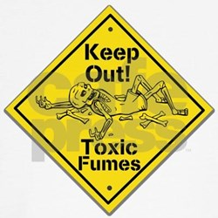
Atmospheric Hazards Toxic Fumes
Notes:
Allow 2-3 minutes for participants to read this page to themselves.
Ask participants if they are aware if they had ever been exposured to any of these gasses or fumes. If yes, ask them how.
Ask if there are questions.

Slide 29
Atmospheric Hazards Exercise
Notes:
Exercise
Ask participants to complete each section.
For each section ask “how could you become a victim to each of the following in a confined space?”
Toxic fumes: Working in or around a space where the following operations are welding, painting, cleaning, is being performed or where toxic substances were stored, such as a fuel tank.
Asphyxiation: Working in or around a space where paint has been drying, or metal is corroding, etc.
Fire / Explosion: Working in or around a space where hot work is being performed.

Slide 30

OSHA Asphyxiation Video
Notes:
What Went Wrong?
Explain to the participants that this is a four minute exercise.
Have participants get together in groups of 2-3.
Ask them to watch the one minute video and, as they watch, look for what was wrong.
After the video give them two minutes to discuss “what should have been done differently.”
Request one response from the “spokesperson” from each group. Go around the room until all input is complete. Add input if needed.
Be prepared to provide answers not given by participants. Thank participants.

Slide 31
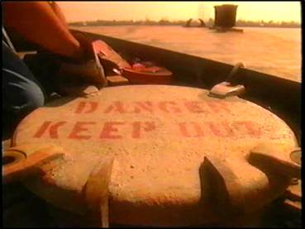
Confined Space Fatal Facts
Notes:
Explain to class that they will be using this information to complete an activity on the following page.
Read page 32 to the class.
Remind class of the significant dangers working in confined spaces.
State: These are just 4 examples of the accidents with fatal outcomes.

Slide 32
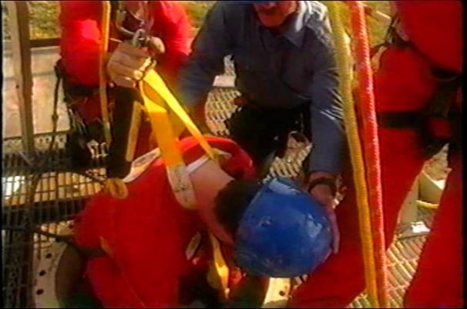
Confined Space Exercise
Notes:
Have participants get into their groups and complete the table on page 33 based on the information presented from page 32.
Ask a spokesperson from each group to share their written responses for each tragedy.
Be prepared to provide answers not given by participants. Thank participants
Ask if any questions.

Slide 33
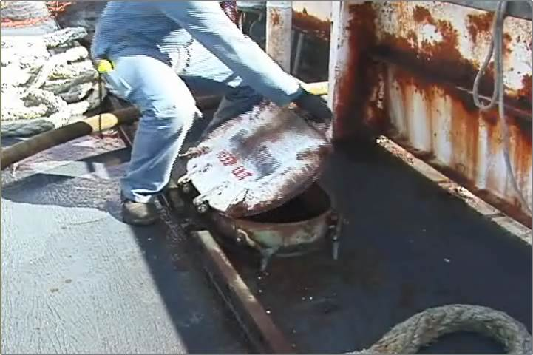
Safe Entry into a Confined Space
Notes:
Safe entry procedures
Read page 34.
Ask if there are questions.
Say, “Lets start with recognition.”
Ask participants to turn the page.

Slide 34
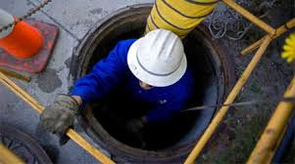
Safe Entry into Confined Spaces
Notes:
34
Safe entry
Have participants read Safety Entry section to themselves and be prepared to summarize the paragraph.
Ask if questions.
Ask a volunteer to summarize the paragraph.
Entering confined spaces adjacent to loaded tanks
Instructor read this section.
Ask if questions,

Slide 35
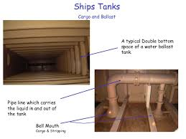
Safe Entry into Double Bottom Confined Spaces
Notes:
35
Entering confined spaces adjacent to inerted tanks
Instructor to read this section of page 36 to class.
Ask participants for a real work example. Instructor to provide real work experience/example if there is no response from participants.
Entering confined spaces adjacent to loaded tanks on double hull tankers
Ask for volunteer to read this section.
Ask if questions.

Slide 36
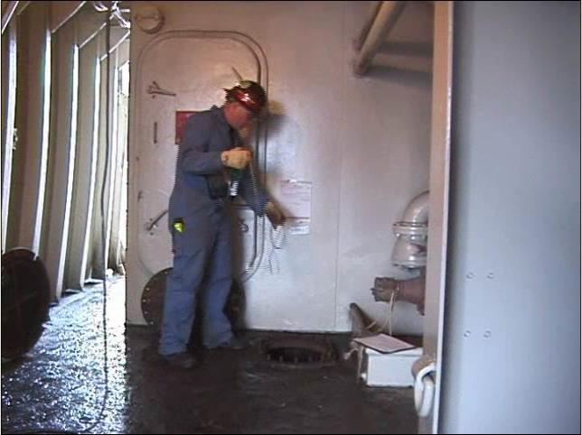
Evaluating a Confined Space
Notes:
The Evaluators
Instructor to read Competent Person paragraph.
Pause for questions.
Instructor to read Marine Chemist section.
Ask the participants what the differences were between a Marine Chemist and a Competent person. Be prepared to explain the chart below.
Ask if there are questions

Slide 37
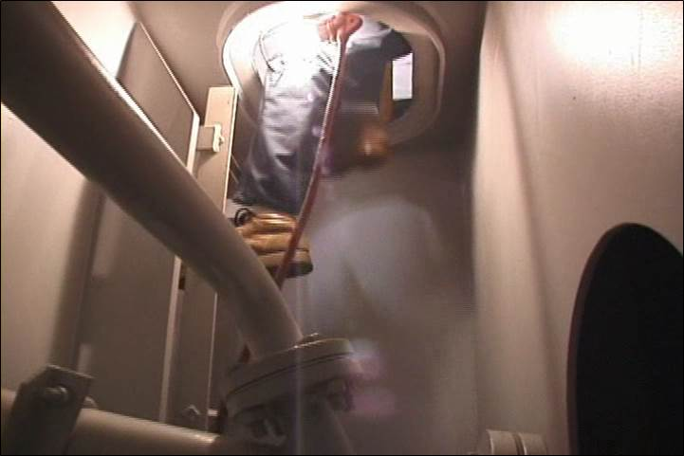
Visual Inspection
Notes:
Visual Inspection (1915.11) (T8 CCR 8355)
Instructor to read this section.
Ask if anyone in the class has heard of or been trained in “visual inspection”.
Emphasize – whether an Competent Person or Marine Chemist, each employee should also visually inspect your work area before beginning your job!

Slide 38
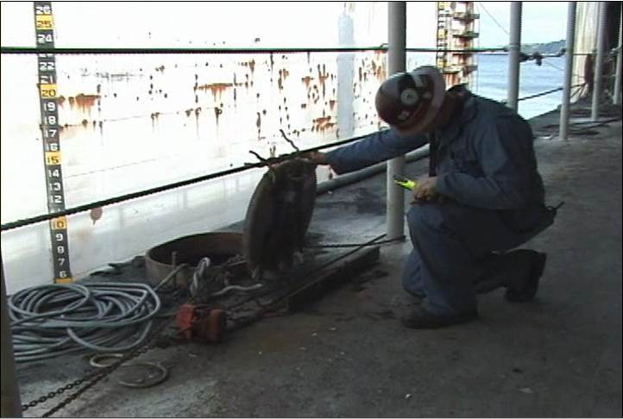
Precautions and Testing
Notes:
Ask for volunteers to read page 39.
Ask the participants “What is a VOC?”
Be prepared to answer the question.
Volatile organic compounds, sometimes referred to as VOCs, are organic compounds that easily become vapors or gases. Along with carbon, they contain elements such as hydrogen, oxygen, fluorine, chlorine, bromine, sulfur or nitrogen.
Volatile Organic Compounds (VOCs) are measured in air by Photo-Ionization Detection (PID). A PID uses an ultraviolet (UV) light source to break down VOCs.

Slide 39
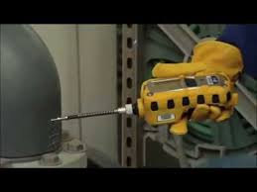
Oxygen Testing
Notes:
Testing for Oxygen Content (1915.12) (8 CCR 8355)
Begin by saying, “Lets find out when we must test a confined space for oxygen.”
Instructor read the first 3 bullets.
Ask if there are questions.
Ask for volunteer to read next three bullets
Ask if there are questions.
Ask if anyone can remember what materials can create an oxygen deficient atmosphere?
Drying paint, corroding metal (most common), bio-materials decaying

Slide 40
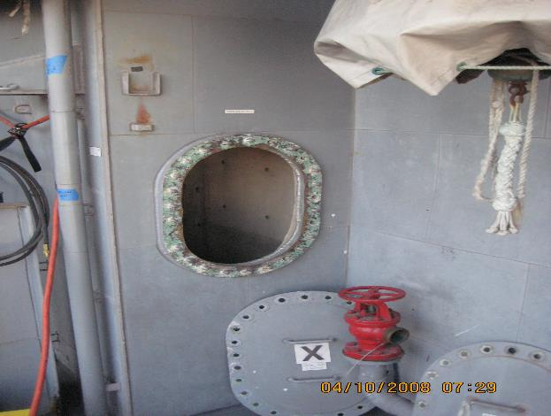
What’s Wrong With This Picture?
Notes:
Entry (1915.11) (8 CCR 8355)
Ask the class the question – “What’s wrong with the picture on page 41?”
Open hole with no certification, yellow tape, barriers or monitor
Ask the class the question – “What should you do when you see this?”
Report it to supervisor or ships force.
Instructor read the first paragraph --
Ask for volunteers to read remaining page 41.
Ask if any questions.

Slide 41
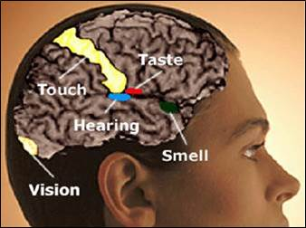
Confined Space Exercise
Notes:
Read the question on page 42.
Ask participants to answer the question and complete the box and explain their answer.
It depends. You should not ignore your senses! If your eyes burn, you smell something burning or a bulkhead feels hot to the touch, leave the space! However, just because your senses do not detect a hazard, such as hydrogen sulfide, does not mean it is not present.
Ask if there are questions.

Slide 42

Confined Spaces
QUIZ!
42
Notes:
42
Have participants answer each question of the quiz.
REVIEW ANSWERS BELOW.
Ask if questions.

Slide 43
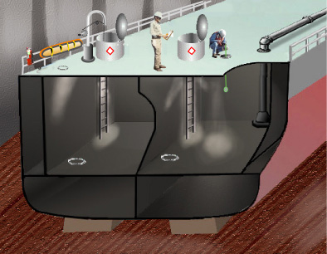
Inspection and Testing
Notes:
Instructor reads first section.
Ask for volunteer to read Information Exchange section.
Ask if there are any questions.

Slide 44
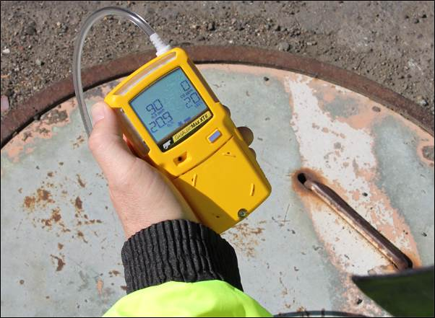
Oxygen Levels
Notes:
Oxygen Levels
Ask participants to read page 45 to themselves.
Ask “what is the leading cause of death in confined spaces?
Asphyxiation
Ask “what other conditions could create an IDLH atmosphere?
Leaking gases from a pipe, CHT tank without proper precautions, working in fuel tanks without proper precaustions

Slide 45
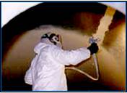
Oxygen Deficiency
Notes:
Causes of Oxygen Deficiency
Read the first paragraph.
Ask participants to read one definition at a time.
Painting
Welding
Cleaning – Degreasing
Number of Workers
Ask if questions.
Thank participants.

Slide 46
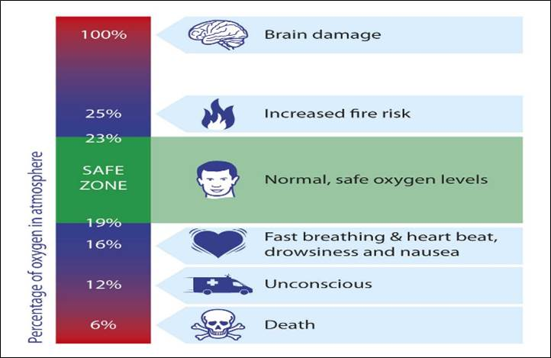
Oxygen Deficient Atmospheres
Notes:
Oxygen Deficient Atmospheres
Instructor to review the chart on page 47 with class.
Ask if questions.
Discuss significance of proper oxygen levels.

Slide 47
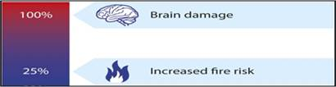
Oxygen Enrichment
Notes:
Oxygen Enrichment
Ask for volunteer to read Oxygen Enrichment section on page 48.
Instructor to review the recent statistics of deaths.
Ask how a confined space might become Oxygen Enriched
Ventilating with oxygen instead of open air
Oxygen leak when welding

Slide 48
Inerted Atmosphere
Notes:
Have participants read page 49 to themselves.
Instructor summarize definitions.
Ask if any questions.
Ask, “can you intentionally inert a space?”
If yes, why and how.
Spaces can be filled with nitrogen or water to displace oxygen in an adjacent space to eliminate flammability and/or combustion

Slide 49

OXYGEN LEVELS “HANGMAN” EXERCISE
_ _ _ _ _ _ _ _ _ _ _ _ _ _
There is a significantly increased likelihood
of a fire with this type of atmosphere.
(2 words)
Notes:
Instructor to draw spaces on flip chart/white board.
Put class in teams of two. Go around the room and have each team guess a letter. If the letter is in one of the two words, write it or them in the blanks. That person goes again. If the letter is not in either word draw part of the hang man.
Continue until a person raises their hand to solve. If a person states the two words correctly and can give you the definition that team wins! If not, continue to go around the room as stated above.
The words are oxygen enriched

Slide 50
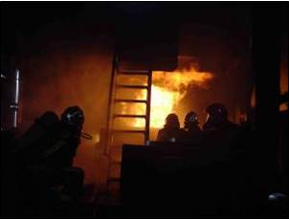
Fire/Explosion
Notes:
Fires and Explosions in Confined Spaces
Have participants read this page silently.
Review the definition of Hot Work.
Ask if questions.
EMPHASIZE:
This list is not all inclusive and additional hot work activities will be discussed on the following pages.

Slide 51
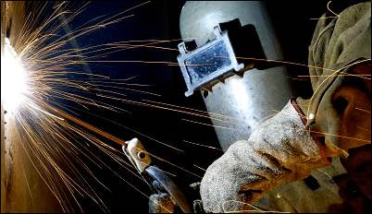
Hot Work in Confines Spaces
Notes:
Hot Work
Instructor read page 52.
Have participants circle the work they perform
Welding
Burning
Grinding
Drilling
Abrasive Blasting
Stud Shooting
Ask them to answer the question at the bottom of page 52
Review by asking for 2-3 to share their answers.
Thank participants for completing the page and those that shared.

Slide 52
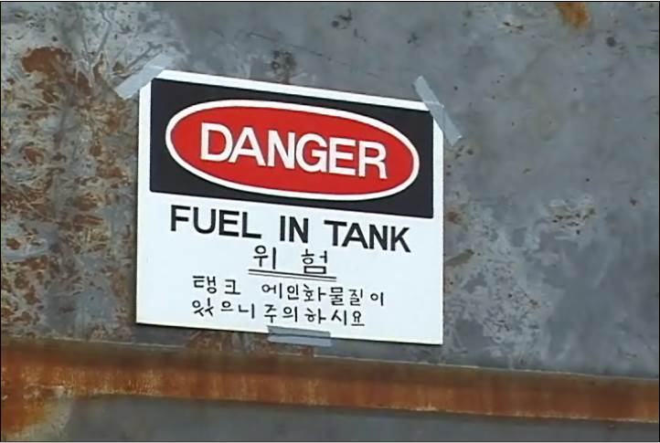
Adjacent Spaces and Hot Work
Notes:
Adjacent Spaces (1915.11) (8 CCR 8355)
Ask a participant to read this paragraph.
Ask if there are questions
Marine Chemist or Coast Guard Testing (1915.14) (8 CCR 8355)
Ask a participant to read this section.
Summarize this section
Emphasize
Exception: Within spaces adjacent to spaces in which the flammable gases or liquids have a flash point above 150° F and the distance between such spaces and the work is 25 feet or greater. This exception is rare at the MSR’s.

Slide 53
OSHA Fire Video
Notes:
What Went Wrong?
Explain to the participants that this is a four minute exercise.
Have participants get together in groups of 2-3.
Ask them to watch the one minute video and, as they watch, look for what was wrong.
After the video give them two minutes to discuss “what should have been done differently.”
Request one response from the “spokesperson” from each group. Go around the room until all input is complete. Add input if needed.
Thank participants.

Slide 54

Fire
Notes:
Defining “Fire”
Instructor reads Page 55.
Ask if any questions or comments.

Slide 55
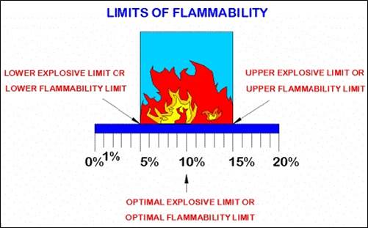
Flammable Range
Notes:
Flammable Range
Instructor explains the definition of Flammable Range. Using the graphic in the slide
Explain LEL
Explain UEL
Provide examples of each.

Slide 56
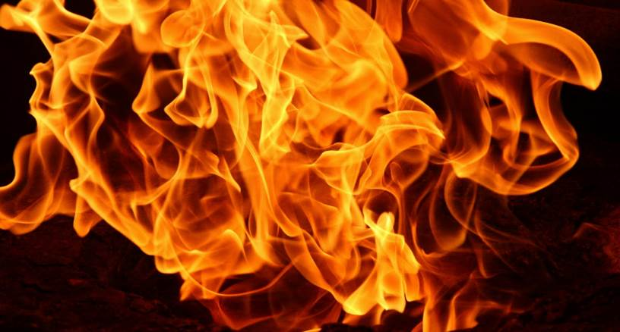
Heat
Flashpoint
Gasoline: -45 F
Notes:
Flash point:
Asks participants to reach page 57 to themselves.
Reference the slide and point out that gasoline will almost always ignite!
Instructor asks and answers the final question.
Flashpoints were determined using different conditions.

Slide 57
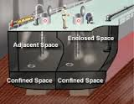
Adjacent Spaces
Notes:
Adjacent Spaces
Ask are adjacent spaces important?
If conducting hot work there may be flammables, combustibles or toxic gases on the other side of the bulkhead
Read Dangerous Atmosphere
EMPHASIZE:
Be aware of all spaces bordering the space you are working in. On-board, they must all be certified.

Slide 58
Adjacent Spaces - Exercise
Notes:
Have participants get in their teams of 2-3 and complete the
on the bottom of page 59.

Slide 59
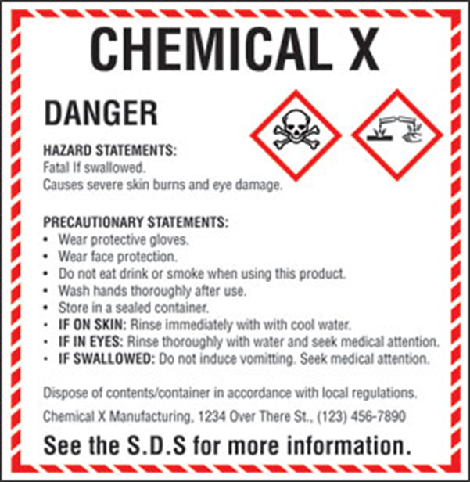
Inhalation of Toxic Substances
Notes:
Evaluating Confined Spaces for Toxic Substances (1910.1028)
Instructor states – this page covers the specific agencies and substances
that are toxic when breathed in or swallowed.
Ask participants to read first paragraph.
Ask if there are questions.
Instructor reads:
A central concept of toxicology is that effects are dose-dependent; even water can lead to water intoxication when taken in too high a dose, whereas for even a very toxic substance such as snake venom there is a dose below which there is no detectable toxic effect.
EMPHASIZE:
The threshold limit value (TLV) of a chemical substance is a level to which it is believed a worker can be exposed day after day for a working lifetime without adverse health effects.
Ask if there are questions.

Slide 60
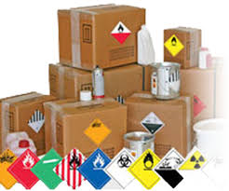
Hazardous Materials
Notes:
Hazardous Material (1915.4) (8 CCR 8355)
Instructor reads/summarizes information on this page .
States – This information is very detailed and specific, but is important for your
general understanding regarding hazardous materials in the workplace.
Ask if questions.
Instructor Information
Ppm = parts per million
mg./m³ = Milligram Per Cubic Meter
mppcf = Million particles per cubic foot
Vapors are heated solid particles while fumes are gaseous

Slide 61

Sources of Toxicity
Notes:
Sources of Toxicity On Board
Instructor reads 1,2,3 Sources of Toxicity on Board.
Ask participants to read the OSHA Recorded Accident.
Instructor asks: What could have prevented this accident?
Testing
Training
Ventilation

Slide 62

Products
Notes:
Products On Board
Instructor states – here’s a list of products on board ship and around the
shipyard. There are more but these are pretty common.
Ask “Which of these do you use or are exposed to?
Ask participants to note the answer on page 63 in the space provided.
What do these have in common?
Gasoline
Jet Fuel
Crude Oil
Benzene
Adhesives
Paint and Paint Related Products
High flammability (many but not adhesives are flammable)

Slide 63
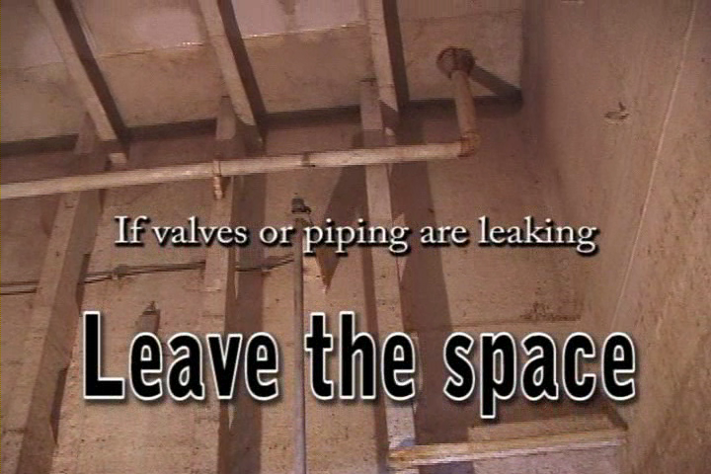
Pipelines
Notes:
Pipelines (1915.15) (8 CCR 8355)
Ask for volunteer to read page 64.
EMPHASIZE:
Before you begin work in a confined space, look up!

Slide 64
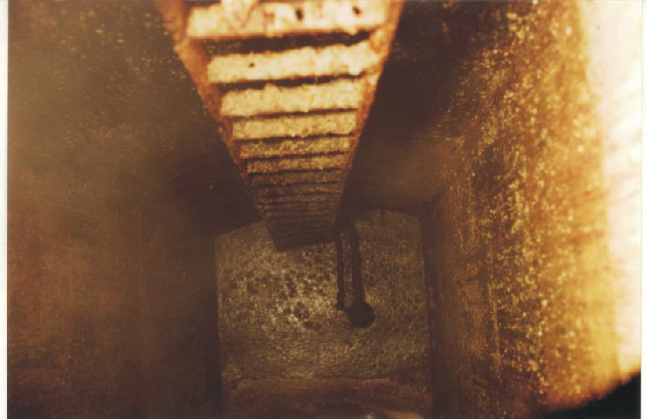
Reactivity
Notes:
Reactivity on Board
Instructor reads/summarizes page 65.
Pause and ask if anyone is familiar with or works in a CHT tank?
Refer to picture on page 65.
Ask: What kind of hazard can we observe here, physical, atmospheric or both?
If this is rust, mostly atmospheric. If this is biological waste, both.

Slide 65
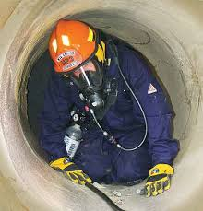
Work Processes / IDLH
Notes:
Ask a participant to read page 66.
Emphasize that a CHT tank may be the most dangerous tank you will enter on board a vessel.
These are treated as IDLH spaces and must be certified by a marine chemist prior to entry.

Slide 66
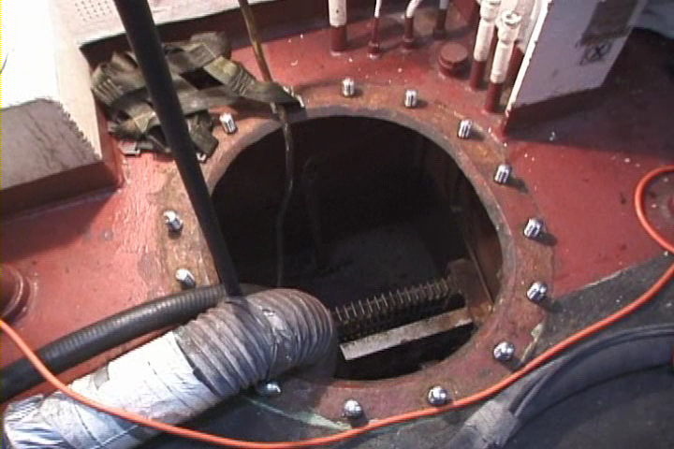
Liquid Residues in Confined Spaces
Notes:
Testing (1915.13)
Instructor reads/summarizes testing and liquid residue removal.
EMPHASIZE – role of Competent Person.
EMPHASIZE -- At the MSR’s Continuous ventilation must be provided.
Ask if questions.

Slide 67
Confined Spaces Quiz
QUIZ!
Notes:
Ask participants to take the quiz and circle their answers.
Target answers in RED

Slide 68

Confined Space Hazard Controls
Notes:
Confined Space Controls
Begin with a statement like “We have discussed recognizing and evaluating confined spaces not lets discuss what controls we must put in place to abate those hazrds.spaces.”
Instructor reads/summarizes page 69 and introduces next section.

Slide 69

Elimination/Substitution
Notes:
Elimination/Substitution
Instructor reads page 70
Instructor gives example.
Can you provide a specific example in the work that you do?
Substituting a flammable or toxic materials for less flammable of toxic materials (cleaning substances, adhesives, ect.)
Moving work from the ship to the shop.

Slide 70

Engineering
Notes:
Engineering Controls
Ask for volunteer to read first
Instructor reads Types of Engineering Controls.
EMPHASIZE: Ventilation is an engineering control you will almost always see in a confined space.
Can you provide another example in the work that you do?
Acknowledge all answers

Slide 71

Administrative
71
Notes:
71
Administrative Controls
Ask the class to read page 72 silently.
Ask if questions.

Slide 72

Personal Protective Equipment
Notes:
Personal Protective Equipment (PPE)
Ask class to read page 73 silently.
Can you provide a specific example in the work that you do?
Acknowledge all answers

Slide 73

Controls Exercise
Notes:
Have the class get into their teams of 2-3 and complete the chart on page 74. Allow 5 minutes.
Add any information you see that is relevant to the jobs being discussed.
Acknowledge all answers.

Slide 74

Certificates/Record Keeping
Notes:
Record Keeping (1915.7) (8 CCR 8355)
Instructor reads and reviews entire page. Reference OSHA regulation.
Ask if any questions.

Slide 75

Cal OSHA
Notes:
8 CCR 5157
Instructor reads/summarizes page 76.
State that the confined spaces on board have been discussed.
Ask if there questions.

Slide 76

Maintenance of Safe Conditions
Notes:
Tests to Maintain Conditions NAVSEA 009-07 FY 16
Ask for volunteer to read 3.1.3.5 NAV SEA
Ask for a volunteer to read 3.1.3.6 NAV SEA
EMPHASIZE:
At the MSR’s the update log is updated at least every 24 hours.
Thank the volunteers.

Slide 77
Confined Spaces at the MSRs
Notes:
Ask participants to list the DOS AND DON’TS ON PAGE 78 as they watch the video.
View video.
List the answers from participants.
Dos
_________________
_________________
_________________
_________________
_________________
Don’ts
_________________
_________________
_________________
_________________
_________________

Slide 78
Certification and Update Log
Name of the
space you are
planning to
enter
What were
the results
of the test
Specific instructions
you must follow
before entering the
space
Initials of
the person
who
inspected
the space
It must show the date
of the day you are
entering the space
Notes:
Confined Space Update Log (1915.16) (8 CCR 8355)
Ask for a participant to read and explain each section.
Acknowledge all responses. Be prepared to provide accurate information if need be.
sk if questions or comments.

Slide 79

MSR Shipboard Procedures
Notes:
Update Logging System
Explain that these color coded are not always used consistently in all of the yards.
Instructor reviews the MSR Logging System on page 80.

Slide 80

MSR Shipboard Procedures
What does green mean?
Notes:
Tests to Maintain Conditions (1915.14) (8 CCR 8355)
Instructor reads Tests to Maintain Conditions
Ask for volunteer to read last paragraph, Update Logs
Instructor EMPHASIZE TYPICAL LOCATIONS
Main accesses to spaces
Escape trunks
Sand holes
Cut out to spaces
Any opening into a confined / enclosed space

Slide 81

Safe for Cold Work
Notes:
Safe For Workers (1915.11) (8 CCR 8355)
Ask for volunteer to read page 82.
Instructor reads:
This Golden Rod Update Log means that you may enter the space to perform cold work, but no hot work is allowed.
What condition or conditions might warrant a
Golden Rod update log?
Have students write this answer on the bottom of page 82.
When heat could create ignition, combustion, vapors or fumes. Cold work can be conducted like painting or cleaning. In our industry this is very similar to Restricted Entry – No Hot Work (Blue) because in our Port we typically ventilate a confined space which is a restriction.

Slide 82

Safe For Man and Hot Work
Notes:
Safe For Hot Work (1915.11) (8 CCR 8355)
Instructor reads page 83.
State -- Green Tag means “go” – okay to enter.
What are the differences between Safe For Workers and Hot Work
(Green) and Safe For Workers (Golden – from previous page)?
Safe for workers and hot work denote a space free of flammables or combustibles with an oxygen level below 22 percent of the atmosphere

Slide 83

Limited Hot Work
Notes:
Safe For Workers (1915.11) (8 CCR 8355)
Instructor reads page 84.
Ask the participants to write at least one example of “limited
hot work”.
Limited hot work typically refers to the process such as it is ok to rivet but not weld.
Limited hot work can also refer to an area within a space.

Slide 84

Enter With Restrictions!
Notes:
Enter With Restrictions
Ask the participants -- What condition(s) would require a blue
Update Log?
Instructor reviews/read/summarizes page 85.
This is very similar to the “Safe For Workers” Not Safe for Hot Work that we previously discussed

Slide 85

Not Safe for workers or Hot Work
Notes:
Not Safe For Hot Work (1915.11) (8 CCR 8355)
Instructor states – And last but certainly not least, red means STOP!
Don’t enter, don’t work in this space, as it is a Dangerous or Immediately Dangerous to Life or Health (IDLH) situation and be an immediate severe health risk to you.
Instructor ask if questions.
Instructor asks:
What condition(s) would require a red update log?
Instructor asks participants to note answer(s)
Example: The space has not yet been tested by a Marine Chemist or competent person.
Example II: Upon testing toxic fumes or an oxygen deficient atmosphere is found.

Slide 86

Confined Spaces Exercise
Notes:
Ask participants to draw a line from the “color “column to the
correct answer in the “status” column.
Answers in blue below.
Review with the class.

Slide 87

Safe Confined Space Entry Practices
Notes:
Safe Confined Space Entry Practices continues
Instructor reads page 88 and asks for questions.

Slide 88

Maintenance of Safe Conditions
Notes:
Condition Changes (1915.14) (8 CCR 8355)
Ask a participant to read first paragraph.
Instructor EMPHASIZES:
Work in the certified space must be stopped and may not be resumed until the space has been retested by a Marine Chemist and a new certificate issued in accordance with 1915.14(a).
Instructor reads last paragraph and asks the class to give example(s) to answer the question:
What could create a change in condition?
Movement of the ship
New work process begins
Leaking pipe if detected
Fumes are detected

Slide 89

MSR Shipboard Procedures
Notes:
Leaving The Work Area
Instructor reads/summarizes page 90.
EMPHASIZE:
Also, during lunch and at the end of shift bleed off oxy/gas lines for ALL locations

Slide 90

Stand By Observer
Notes:
1915 Best Practice/Confined Space Attendant -
Instructor reads page 91
Ask if questions.
EMPHASIZE
Attendant must maintain constant communication in at least one of the following ways; line of sight, voice contact, radio contact and/or video contact

Slide 91

More Employer Responsibilities
Notes:
Training (1915.12) (T8 CCR 8355)
Instructor states that employer is required to train all employees.
Ask if there are any tank cleaners in the audience?
If yes, state “You are to be trained every year!

Slide 92

Self Rescue
Notes:
Detect Atmosphere Changes
Instructor reads the paragraph and reviews the two columns, Smell-Odor-Taste.
Ask, “What chemical smells like a rotten egg?
Hydrogen Sulfide. Explain that after the initial smell, this chemical will kill our sense of smell and then kill you.
Emphasize: If you sense any of these… get out of the space!

Slide 93

The Dangers of Confined Space Rescue
Notes:
Why have confined spaces killed so many people?
Ask for volunteer participant to read this section.
Why do so many fatalities result from emergency rescue?
Ask for volunteer participant to read this section.
Ask if questions or comments.

Slide 94

Rescue
Notes:
If a Person is Unconscious in a Tank
Ask participants to read page silently.
Ask for volunteers to how hard it would be to bring an unconscious worker out of a fuel tank? Could they climb the fixed ladder in a tank? Would they be breathing harder with the exertion, thus potentially breathing in more toxic fumes or vapors?
If there is a person unconscious in a tank-GET HELP

Slide 95

At the MSRs – How to Get Help!
Notes:
At the MSRs
Instructor reviews emergency numbers on page

Slide 96

Confined Space Exercise
Notes:
Create Your Confined Space Entry Checklist
Ask participants to get into their teams of 2-3 and complete page 97.
Review together as a class.
Read confined space certification
Follow all controls identified on the certification
Wear all required PPE
Be aware of all escape routes
Be aware of chemicals being used or even brought into the space
Be sure there is proper lighting
Be sure there is proper ventilation
Be aware of and pay attention to piping systems
Be aware of fall hazards
Be sure the ladder is properly secured

Slide 97

Confined Space Entry Checklist
Notes:
Entry Checklist
Instructor to review/read page 98 for items missed from previous page.

Slide 98

Summary
Notes:
Important Points
Instructor to review/read page 99.
Ask if there are any questions.

Slide 99
Confined Spaces
QUIZ!
99
Notes:
99
Have the participants complete the final quiz by marking T or F.
Review answers.
Correct answers in red below.
THANK PARTICIPANTS-Conduct Feedback Form and Post Test

