Slide 1

Understanding Hazard Communication
An Injury Prevention Course for Shipyard Workers
This material was produced under grant SH-29629-SH6 from the Occupational Safety and Health Administration, U.S. Department of Labor. It does not necessarily reflect the views or policies of the U.S. Department of Labor, nor does mention of trade names, commercial products or organizations imply endorsement by the U.S. Government.
1
Notes:
1
Statistics
Each year in the United States, tens of thousands of workers are made sick or die from occupational exposures to the thousands of hazardous chemicals that are used in workplaces every day. The Environmental Protection Agency reviews about 1,500 new chemicals every year, about half of which go on to enter commerce and be listed on their Chemical Inventory. Therefore, OSHA has implemented a Hazard Communication Standard (HCS).
Hazard Communication and You
The chemicals we work with, or are exposed to, can cause chronic and acute injuries and illnesses. It is important that you know how to protect yourself from chemical hazards.

Slide 2
Purpose and Objectives
Course Purpose
Course Objectives
Course Measurement
This material was produced under grant SH-29629-SH6 from the Occupational Safety and Health Administration, U.S. Department of Labor. It does not necessarily reflect the views or policies of the U.S. Department of Labor, nor does mention of trade names, commercial products or organizations imply endorsement by the U.S. Government.
Notes:
Course Purpose:
The purpose of this course is to provide shipyard workers with the knowledge to handle chemicals safely.
Specific Objectives:
At the completion of this lesson, it is expected that all trainees will pass the quizzes found in this lesson as well as have the ability to understand and follow the regulatory requirements, company procedures, and host yard procedures regarding:
Hazard classification
Labels
Safety Data Sheets
Training
Objective Measurement:
At the completion of this class it is expected that the participants will demonstrate safe shipyard hazard communication practices and pass the post-test at the end of training .

Slide 3

Training Topics
Notes:
Introduction
OSHA
Hazard Communication Program
Labeling
Safety Data Sheets
The Globally Harmonized System (GHS)

Slide 4

Introduction-Pre-Test
Notes:
Your instructor will be handing out your pre-test and provide you with instructions on completing it.

Slide 5
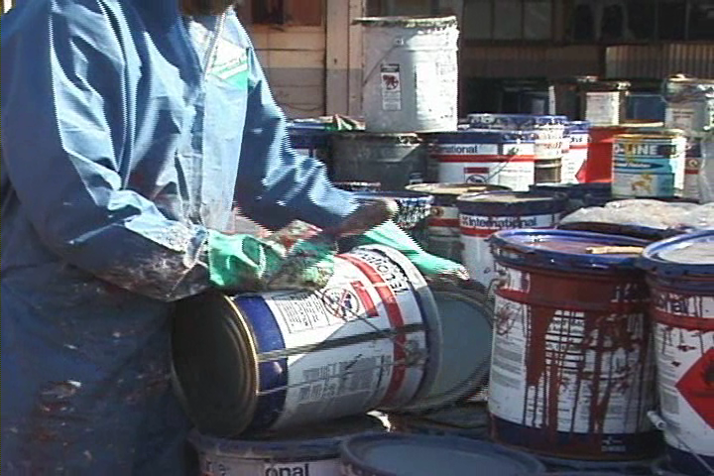
Introduction
Notes:
Hazard Communication Standard
In order to ensure chemical safety in the workplace, information about the identities and hazards of the chemicals must be available and understandable to workers. OSHA's Hazard Communication Standard (HCS) requires the development and dissemination of such information:
Chemical manufacturers and importers are required to evaluate the hazards of the chemicals they produce or import, and prepare labels and safety data sheets to convey the hazard information to their downstream customers;
All employers with hazardous chemicals in their workplaces must have labels and safety data sheets for their exposed workers, and train them to handle the chemicals appropriately.
Unless otherwise specified the corresponding OSHA regulation that applies to this lesson is 1910.1200.

Slide 6
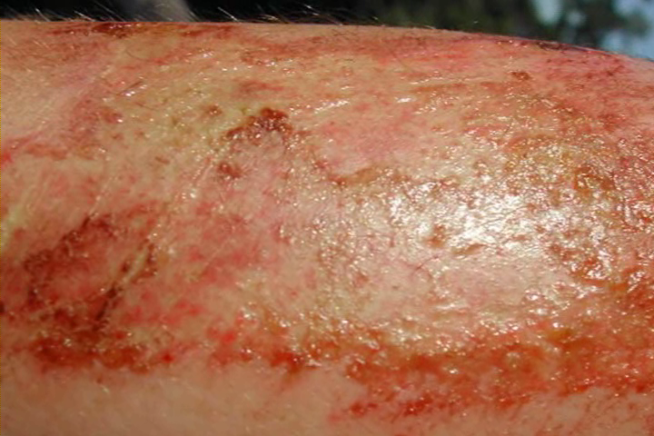
Introduction
Notes:
Related Facts
Chemical exposure may cause or contribute to many serious health effects such as:
Heart ailments
Central nervous system damage
Kidney and lung damage
Sterility
Cancer
Burns
Rashes
Some chemicals may also be safety hazards and have the potential to cause fires and explosions and other serious accidents.

Slide 7

Introduction
Notes:
Health Hazards
There are two types of health hazards – Acute and Chronic.
Acute health hazards are usually immediate and quick, and have short-term symptoms (an example is a chemical burn)
Chronic health hazards are usually of long duration, and have long-term exposure (an example is lung cancer from smoking)
Chronic health hazards are usually much more dangerous than acute, because the toxicity from the hazard builds up over time.

Slide 8

Introduction
Notes:
Hazardous Material Entry Routes
The ways that hazardous materials can enter the body are through:
Inhalation (through breathing which is the fastest way)
Absorption (through the skin or eyes)
Ingestion (swallowing)
Injection (penetrating the skin)
.

Slide 9
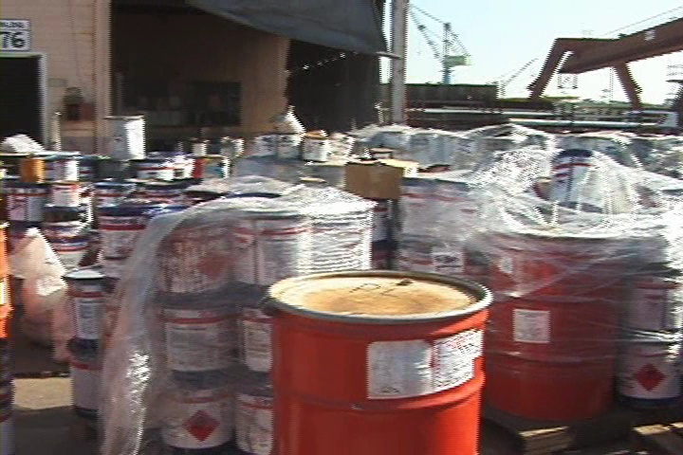
Introduction
Notes:
Shipyard Material Hazards
One of the potential threats to shipyard workers is the exposure to hazardous chemicals and materials on the job site. These include:
Paint
Solvents
Lubricants
Insulation
Blast Grit
Smoke
Grinding Dust
Heavy Metals
Insulation and other materials containing asbestos
…and many other substances!

Slide 10
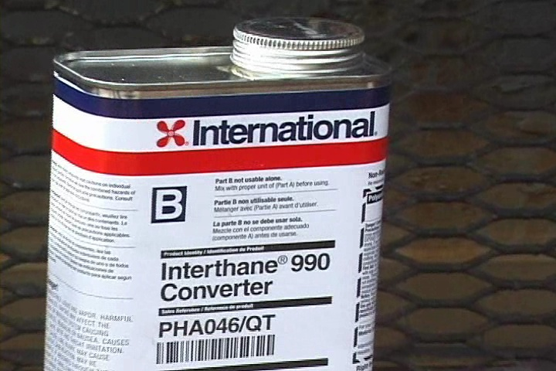
Introduction Exercise
Notes:
Your Exposure!
Using the table below, list the work you perform in the left column, the hazardous materials and/or chemicals you use to perform that work in the middle column and the potential adverse health affects that those materials could cause in the right column.

Slide 11

OSHA
Notes:
OSHA and You!
You have rights!
No retribution
Filing a complaint

Slide 12
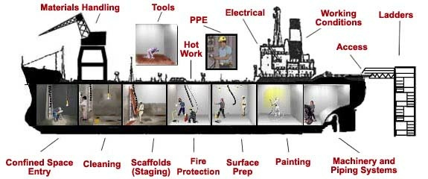
OSHA
Notes:
Employee’s Responsibilities and Rights
Responsibilities include:
Complying with OSHA standards
Wearing required PPE
Reporting hazards to supervisor
Comply with your organization’s rules and policies
Rights include:
Reviewing standards
Receiving training
Requesting an OSHA investigation (employer or OSHA) and receiving
feedback upon request
Reviewing the OSHA 300 Log

Slide 13


OSHA
Notes:
No Retribution
Section 11(c) (1) of the OSH Act states: No person shall discharge or in any manner discriminate against any employee because such employee has filed any complaint or instituted or caused to be instituted any proceeding under or related to the Act or has testified or is about to testify in any such proceeding or because of the exercise by such employee on behalf of himself or others of any right afforded by this Act.
Discrimination includes:
Firing or laying off
Blacklisting demoting
Denying overtime or promotion
Disciplining
Denial of benefits
Failure to hire or rehire
Intimidation
Reassignment affecting future promotions
Reducing pay or hours

Slide 14
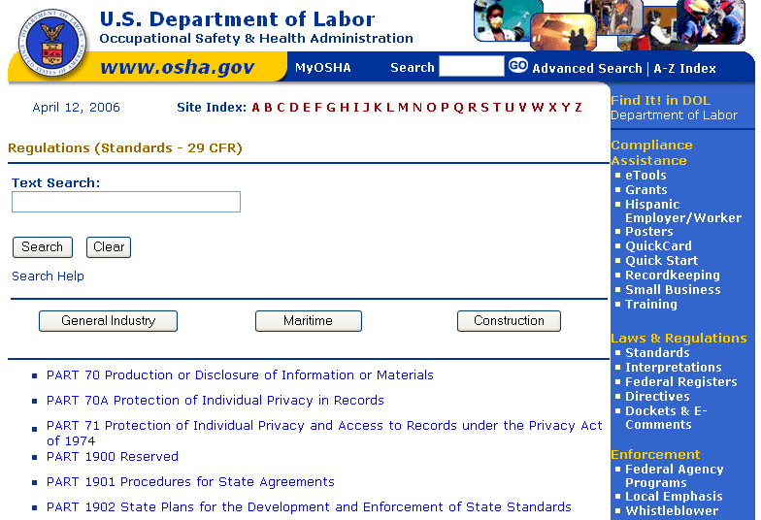
OSHA
Notes:
Resolve With Your Company – Follow your chain of command. Go to your Lead, Supervisor or Safety Technician. However, if this fails you should file a valid complaint.
Online - Go to the Online Complaint Form. Written complaints that are signed by workers or their representative and submitted to an OSHA Area or Regional office are more likely to result in onsite OSHA inspections.
Telephone - your local OSHA Regional or Area Office. OSHA staff can discuss your complaint and respond to any questions you have. 1-800-321-OSHA.
Download and Fax/Mail - Download the OSHA complaint form* [En Espanol*] (or request a copy from your local OSHA Regional or Area Office), complete it and then fax or mail it back to your local OSHA Regional or Area Office. Written complaints that are signed by a worker or representative and submitted to the closest OSHA Area Office are more likely to result in onsite OSHA inspections. Please include your name, address and telephone number so we can contact you to follow up. This information is confidential.

Slide 15
EXERCISE
Stump the class!
With a partner, write two questions from this section that you believe the rest of the class will be challenged in answering correctly. (Questions must be reasonable! If your instructor can’t answer, it doesn’t count!)
________________________________________________________________________________________________________________________________________________________________________________________________________________________________________________________________________________________________________________________________________________________________________________________________________
Notes:
Question One:
_____________________________________________________________________________________________________________________________________________________________________________________________________________________________________________________________________________________________________________________________________
Question Two:
_____________________________________________________________________________________________________________________________________________________________________________________________________________________________________________________________________________________________________________________________________

Slide 16
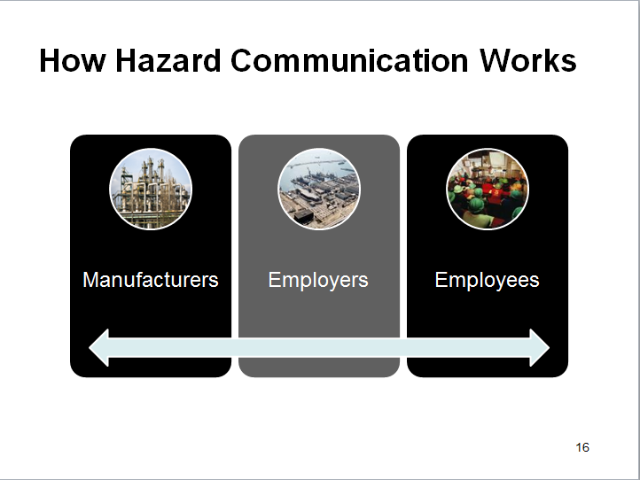
How Hazard Communication Works

Slide 17

The Hazard Communication Program
Notes:
Manufacturers Responsibilities
Chemical manufacturers and importers must review scientific evidence on the hazards of chemicals they produce or import and report findings to their employees and to employers who distribute or use their products.
Employer Responsibilities
The Hazard Communication Program must:
Be in writing
Describe labeling procedures
Describe SDS and their locations
Describe employee training
List all hazardous chemicals (chemical inventory)
Make information regarding hazards and protective measures available to other employers onsite
Apply to all sites

Slide 18

The Hazard Communication Program
Notes:
Checklist for Compliance With Your Hazard Communication Program The following checklist will help to ensure you comply with the program:
Obtained a copy of the rule.
Read and understood the requirements.
Assigned responsibility for tasks.
Prepared an inventory of chemicals.
Ensured containers are labeled.
Obtained an SDS for each chemical.
Prepared written program.
Made every SDS available to workers.
Conducted training of workers.
Established procedures to maintain current program.
Established procedures to evaluate effectiveness.

Slide 19

The Hazard Communication Program
Notes:
Training Requirements
Training is required for employees who are exposed to hazardous chemicals in their work area:
At the time of initial assignment and at least annually thereafter
Whenever a new hazard is introduced into their work area
Training is not satisfied solely by giving the employee the safety data sheets to read. An employer's training program is to be a forum for explaining to employees not only the hazards of the chemicals in their work area, but also how to use the information generated in the hazard communication program. This can be accomplished in many ways (audiovisuals, classroom instruction, interactive video), and should include an opportunity for employees to ask questions to ensure that they understand the information presented to them. Training must be carried out in a language that is comprehensible to the employees.

Slide 20
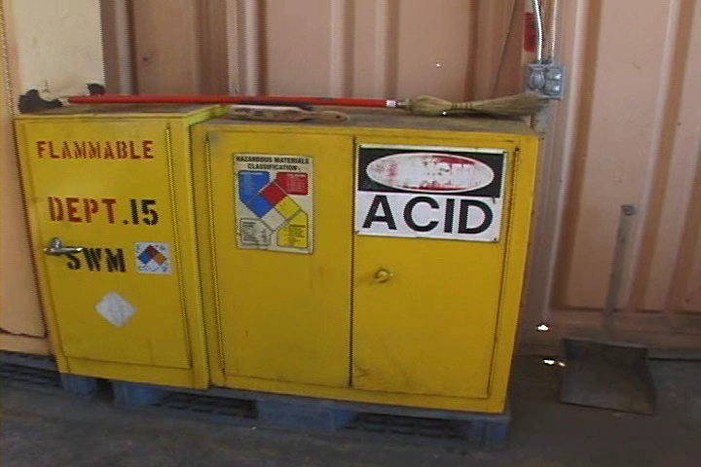
The Hazard Communication Program
Notes:
Related Facts
Training need not be conducted on each specific chemical found in the workplace, but may be conducted by categories of hazard (e.g., carcinogens, sensitizers, acutely toxic agents, irritants, flammables) that are or may be encountered by an employee during the course of his duties.
Employees who have been previously trained by another employer, union, or other entity, do not have to be retrained if the previous training is sufficient to meet the standard’s training requirements for the current work being performed. However, employees must have information about where to find SDSs in the workplace, who in the company is responsible for the HazCom program, and where to get copies.

Slide 21
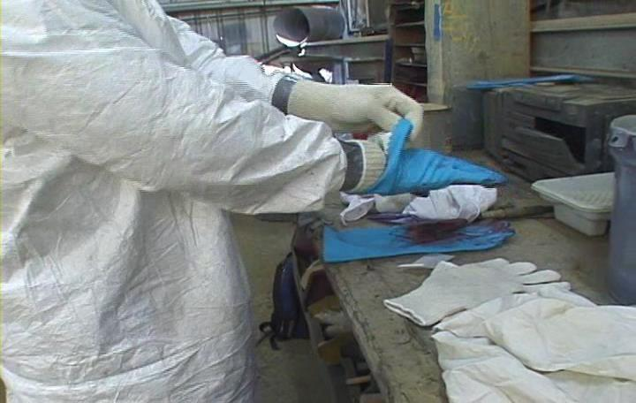
The Hazard Communication Program
Notes:
What Needs to be Trained
Training must cover the following Hazard Communication topics:
Explanation of the HazCom program, including information on labels, SDSs, and how to obtain and use available hazard information
Hazards of chemicals
Protective measures such as engineering controls, work practices, and the use of PPE
How to detect the presence or release of a hazardous chemical (using monitoring devices, observation, or smell)
The HazCom standard and its requirements
Operations in their work areas where hazardous chemicals are present
Location and availability of the written hazard evaluation procedures, communications program, lists of hazardous chemicals, and the required SDS's

Slide 22

The Hazard Communication Program Quiz
22
Notes:
22
For each statement below circle T for True or F for False.

Slide 23

GHS– What is it?
Notes:
The United Nations’ Globally Harmonized System (GHS) is an international approach to hazard communication, providing agreed criteria for classification of chemical hazards, and a standardized approach to label elements and safety data sheets (formerly called MSDSs).
The GHS was negotiated in a multi-year process by hazard communication experts from many different countries, international organizations, and stakeholder groups. It is based on major existing systems around the world, including OSHA's Hazard Communication Standard and the chemical classification and labeling systems of other US agencies.

Slide 24

GHS – Why Adopt It?
Notes:
To have a common, coherent approach to classifying and communicating chemical hazards.
Harmonized definitions of hazards
Specific criteria for labels
Harmonized format for safety data sheets
The benefits include:
Increase the quality and consistency of information provided to the workers, employers and chemical users.
Reduced confusion
Facilitates training
Helps address literacy challenges
Facilitates international trade of chemicals

Slide 25

Hazard Classification
Notes:
Each physical or health hazard is a “hazard class” (e.g., Carcinogenicity is a hazard class).
A “hazard class” may be sub-divided in the criteria into several “hazard categories” based on the degree of severity of the hazard.
Placing a chemical into a “hazard class” , and where necessary, a “hazard category”, is the concept of classification—determining not only the hazard, but also the severity of the effect.

Slide 26

Hazard Classifications
Physical
Health
Notes:
Physical Hazard
Explosives
Flammable Gases
Flammable Aerosols
Oxidizing Gases
Gases Under Pressure
Flammable Liquids
Flammable Solids
Self-Reactive Substances
Pyrophoric Liquids
Pyrophoric Gases
Pyrophoric Solids
Self-Heating Substances
Substances which, in contact with water emit flammable gases
Oxidizing Liquids
Oxidizing Solids
Organic Peroxides
Corrosive to Metals
Combustible Dust
Health Hazard
Acute Toxicity
Skin Corrosion/Irritation
Serious Eye Damage/Eye Irritation
Respiratory or Skin Sensitization
Germ Cell Mutagenicity
Carcinogenicity
Reproductive Toxicology
Target Organ Systemic Toxicity - Single Exposure
Target Organ Systemic Toxicity - Repeated Exposure
Aspiration Hazards
Simple Asphyxiants

Slide 27
EXERCISE
Stump the class!
With a partner, write two questions from this section (page 16 to 27) that you believe the rest of the class will be challenged in answering correctly. (Questions must be reasonable! If your instructor can’t answer, it doesn’t count!)
________________________________________________________________________________________________________________________________________________________________________________________________________________________________________________________________________________________________________________________________________________________________________________________________________
Notes:
Question One:
_____________________________________________________________________________________________________________________________________________________________________________________________________________________________________________________________________________________________________________________________________
Question Two:
_____________________________________________________________________________________________________________________________________________________________________________________________________________________________________________________________________________________________________________________________________

Slide 28
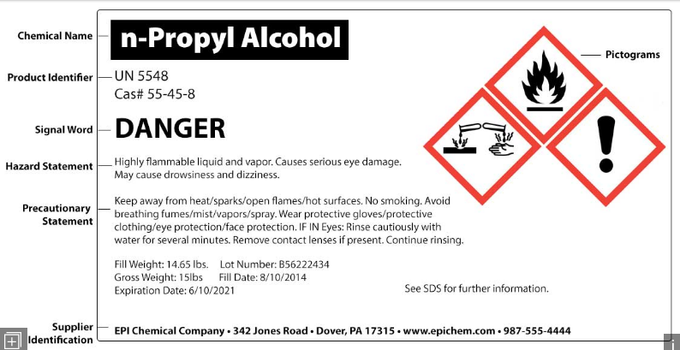
Labeling
Notes:
Requirements
All hazardous material must be labeled!
Labels must be:
Legible
In English (plus other languages, if desired)
Prominently displayed

Slide 29
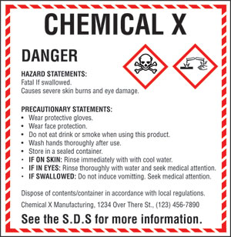
Labels
Notes:
Label Requirements
Product identifier
Signal word (Danger or Warning)
Hazard statement(s)
Pictogram(s)
Precautionary statement(s)
Name, address, and phone number of the responsible party
There are additional labeling requirements when transporting hazardous chemicals. If you are involved with this process, such as a driver or working in shipping and receiving, and are not sure of those requirements, contact your supervisor!

Slide 30

Pictograms And Hazards

Slide 31

Pictogram Exercise
Notes:
Draw a line from the hazard to the correct pictogram
Corrosion
Oxidizers
Health
Acute Toxicity
Flammables
Gas Under Pressure
Aquatic Toxicity
Explosives
Irritant / Respiratory

Slide 32
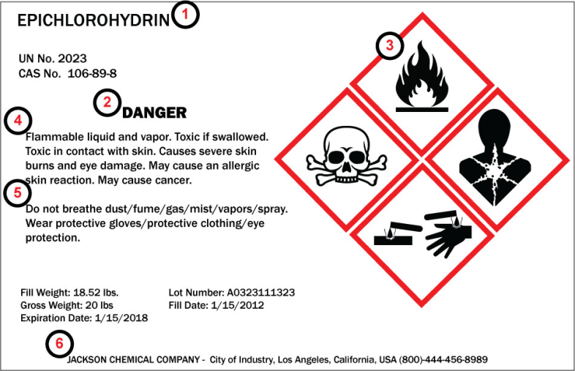
Label Requirements
Notes:
Label Requirements
Product identifier
Signal word (Danger or Warning)
Pictogram(s)
Hazard Statements
Precautionary statement(s)
Name, address, and phone number of the responsible party
These requirements do not have to be listed in this order!

Slide 33
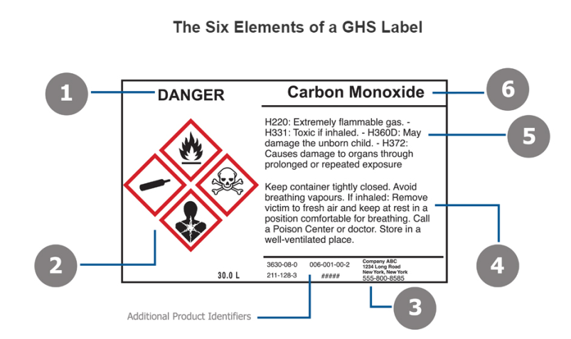
Label Requirements Exercise
Notes:
Label Requirements
Write the requirement below that corresponds with the number above.
______________________________________________________
______________________________________________________
______________________________________________________
______________________________________________________
______________________________________________________
______________________________________________________

Slide 34
Draw A Label (Exercise)
Create a label that complies with the GHS format using the information at the bottom of this page.
Notes:
ACME Chemicals 3211 Ivy Street, San Diego Ca. 92222 (800-222-1122)
Do not breathe dust/fume/gas/mist/vapors/spray. Wear protective gloves/protective clothing/eye protection/face protection. Wear respirator protection.
Sulfuric Acid
Danger! May be harmful if swallowed. Causes sever skin burns and eye damage. Fatal if inhaled. Harmful to aquatic life.
If in eyes: Rinse cautiously with water for several minutes. Remove contact lenses. Continue rinsing. Immediately call a POISON CNETER or doctor/physician. In case of fire use water spray, alcohol-resistant foam, dry chemical or carbon dioxide.
See SDS for further details regarding this product.

Slide 35
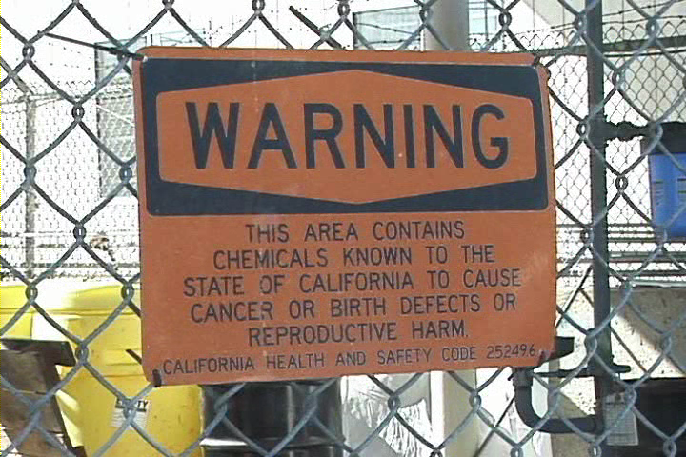
Labeling
Notes:
Exceptions
The following are exceptions to the labeling rules:
You can post signs/placards that convey hazard information if there are a number of stationary containers within a work area with similar contents and hazards. Process sheets, batch tickets, and operating procedures can be used in lieu of affixing labels to individual stationary process containers.
You can substitute various types of standard operating procedures, process sheets, and similar written materials for container labels on stationary process equipment if they contain the same information and are readily accessible to employees in the work area
You are not required to label portable containers into which hazardous chemicals are transferred from labeled containers and are intended only for the immediate use of the employee who makes the transfer
Pipes or piping systems, and engines, fuel tanks, or other operating systems in a vehicle, are not considered to be containers

Slide 36
Labeling
36
Notes:
36
For each statement below circle T for True or F for False.

Slide 37

Safety Data Sheets
Notes:
Safety Data Sheets
Safety Data Sheets (SDS) are the internationally standardized way to document the hazardous properties of chemicals and other hazardous agents. Chemical companies provide such data sheets, and collections of SDS sheets are available from several sources.

Slide 38

SDS
Notes:
Manufacturer and Distributor Requirements
Chemical manufacturers and importers must develop an SDS for each hazardous chemical they produce or import, and must provide the SDS at the time of the initial shipment to a downstream distributor or user. Distributors also must ensure that downstream employers are similarly provided a SDS.
OSHA does not require that SDS be provided to purchasers of household consumer products (such as "windex" and "white‑out“) when the products are used in the workplace in the same manner that a consumer would use them, i.e.; where the duration and frequency of use (and therefore exposure) is not greater than what the typical consumer would experience. Employees who are required to work with hazardous chemicals in a greater duration and frequency of exposure than a normal consumer have a right to know about the properties of those hazardous chemicals.

Slide 39

SDS
Notes:
Employer Responsibilities
Employees have a right to know what hazardous material they are working with, therefore:
SDS’s must be easily accessible to all employees working with hazardous material
An SDS is available to all employees at any time, either through electronic or paper means
Any employee can request a copy of any SDS for any reason, without fear of reprisal.

Slide 40

SDS
Notes:
Employee Responsibilities
You have the responsibility:
To know the hazard of the chemical you are working with and/or is in your immediate area
To read and follow the instructions on all labels, of all written operating procedures, and other forms of written instruction
To use any necessary personal protection specified on the SDS for the chemical you are using
To follow safe work practices
To follow this and all Environmental, Health and Safety policies and best management practices

Slide 41

SDS Questionnaire
Notes:
Name a hazardous material you commonly use on the job: ________________
Read each statement below and if you agree, circle Y, if not circle N.

Slide 42

Safety Data Sheets (SDS)
Notes:
MSDS – 1994
Specifies what information is required, but chemical manufacturer or importer can use whatever format or order of information they want.
SDS – Current
Mandates 16-section SDS headings, order of information, and what information is to be provided under the headings.
OSHA will not enforce sections 12-15 this information is outside of its jurisdiction, however sections 12-15 must be listed on the SDS.

Slide 43

Safety Data Sheets – 16 Headings
Notes:
SDSs now have a required sixteen section format.

Slide 44
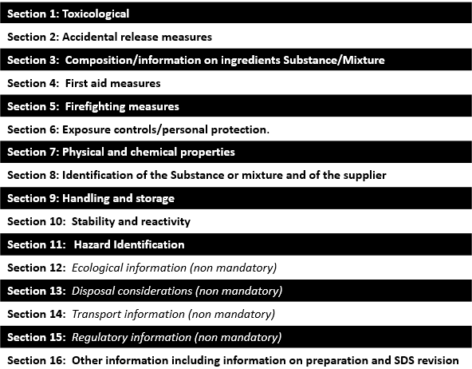
16 Headings Exercise-Put In Order!
Notes:
SDSs now have a required sixteen section format.

Slide 45
Safety Data Sheets Exercise
Based on the information below, what PPE requirements would you follow in handling Benzene?
_______________
_______________
_______________
_______________
_______________
Where would you find the actual and specific PPE requirements on the SDS?
_______________
Notes:
Section 4.0 First Aid Measures
4.1 PRODUCT SPECIFIC HAZARDS: Highly Flammable liquid and vapor, May be fatal if swallowed, May cause serious eye and skin irritation.
4.2 GENERAL ADVICE: Where there is potential for exposure, restrict access to authorized persons; provide specific activity training to operators to minimize exposures. Take care to self-protect by avoiding becoming contaminated. Use adequate respiratory protection. Move contaminated patients(s) out of dangerous area. Take off all contaminated clothing and shoes. Seek medical assistance-show the safety data sheet or label of possible.
4.3 DESCRIPTION OF FIRST AID MEASURES:
Eyes: In case of contact, immediately flush eyes with plenty of water for at least 15 minutes. Get medical aid. Skin: In case of contact, flush skin with plenty of water. Remove contaminated clothing and shoes. Get medical aid if irritation develops and persists. Wash clothing before reuse. Ingestion: Potential for aspiration if swallowed. Get medical aid immediately. Do not induce vomiting unless directed to do so by medical personnel. Never give anything by mouth to an unconscious person. If vomiting occurs naturally, have victim lean forward. Inhalation: If inhaled, remove to fresh air. If not breathing, give artificial respiration. If breathing is difficult, give oxygen. Get medical aid.

Slide 46
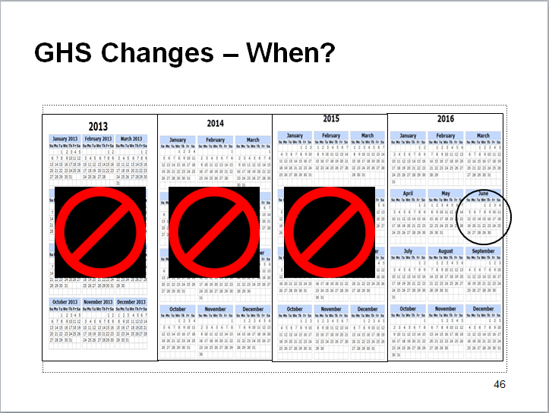
GHS Changes – When?

Slide 47

Labeling & SDSs at the MSRs
Notes:
Host Yard Rules!
When working at a host yard you must:
Notify the host yard and get approval to bring hazardous materials into the yard. (this includes all Volatile Organic Compounds, like paints and solvents)
Provide the host yard with the SDS
Be sure all materials/chemicals are properly labeled
If you do not provide the host yard with the SDS and/or if your hazardous materials are not properly labeled, you will not be allowed entry
SDSs must be made available to you and others, so, take them with you!

Slide 48
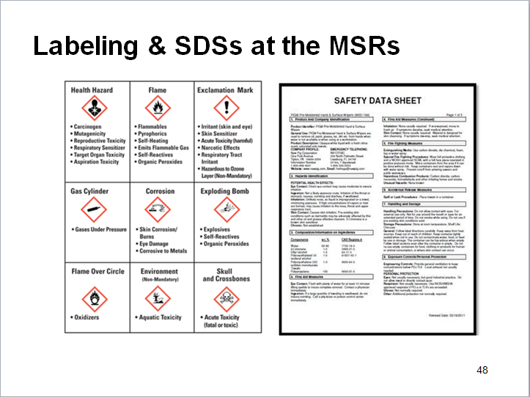
Labeling & SDSs at the MSRs
Notes:
Important
Dispose of hazards using host yard processes and procedures. Identify where their hazardous waste bins are located. You should also find a spill kit and fire extinguisher at this location.
When working in a space with other workers from your company, the host site or a subcontractor, ask to see their SDS as you do not know the materials or chemicals they are using.
If you do not know where to find an SDS on the job site, ask your supervisor or safety technician.

Slide 49
SDS Quiz
49
Notes:
49
For each statement below circle T for True or F for False.

Slide 50
Post-Test
Notes:
Your instructor will be handing out your post-test and provide you with instructions on completing it.

Slide 51

Questions / Comments

