Slide 1

Supervising For Safety
Developed by the Port of San Diego Ship Repair Association
Notes:
Supervising For Safety
Moving up to a supervisory position should be cause for celebration, not exasperation. Yet many first-timers are unprepared for the demands of this new role. They quickly become overwhelmed -- to the detriment of the organization, their co-workers, and themselves. It is really no wonder, typically a high front-line performer is selected as a Supervisor. Though this seems logical, suddenly the skills that made the high-performer successful are no longer as useful as their role has changed from worker to Supervisor. Their new role requires a different set of skills and a different mind-set. This is particularly true when it comes to safety. In the past the new Supervisor was a worker who was responsible to understand and follow safety requirements. Now they are not just responsible for themselves, but also their crew. They must understand requirements, communicate those requirements and provide guidance to their crew. Today their responsibility doesn’t end there. More front-line supervisors are being asked to conduct Job Safety Analysis as well as lead accident investigations. This course is designed to support the front line supervisor in meeting their safety responsibilities.
Course Purpose:
At the completion of this workshop it is expected that all trainees will better understand their role and responsibilities regarding maintaining a safe work environment.
Target Audience: First time Supervisors and/or Aspiring Performers

Slide 2

Course Objectives
Notes:
Course Objectives
At course completion it is expected that you will be able to demonstrate an understanding of the following:
Employer and employee rights and responsibilities under OSHA
The meaning of “No Retribution”
How to report a hazard or file a complaint with OSHA
The roles and responsibilities of a supervisor
Planning for safety
Organizing for safety
Staffing for safety
Leading for safety
Monitoring safety

Slide 3

OSHA
Notes:
OSHA and You!
You have rights!
No retribution
Filing a complaint

Slide 4
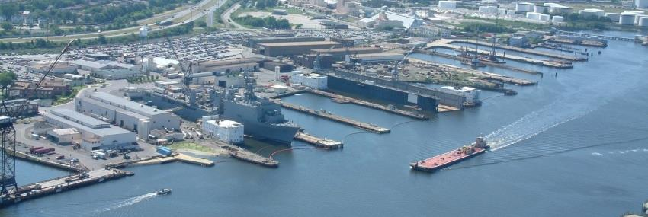
OSHA Exercise
Notes:
Employee’s Responsibilities and Rights
Responsibilities include:
Complying with OSHA standards _____
Wearing required PPE _____
Reporting hazards to supervisor _____
Complying with your organization’s rules and policies _____
Rate yourself on how often you fulfill each of your responsibilities above. “1” is less than 50% of the time; “2” is 50% to 75% of the time; “3” is 75% to 100% of the time. How might your scores impact your risk of injury?
Rights include:
Reviewing standards
Receiving training
Requesting an OSHA investigation (employer or OSHA) and receiving
feedback upon request
Reviewing the OSHA 300 Log

Slide 5
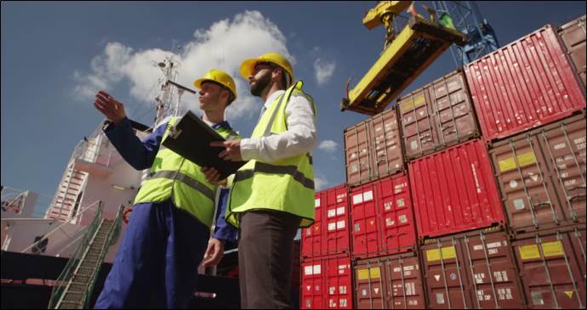
OSHA
5
Notes:
5
5
Employer’s Responsibility
Employers have certain responsibilities under the OSH Act of 1970. The following list is a summary of the most important ones.
Provide a workplace free from serious recognized hazards and comply with standards, rules and regulations issued under the OSHA Act
Examine workplace conditions to make sure they conform to applicable OSHA standards
Make sure employees have and use safe tools and equipment and properly maintain this equipment
Use color codes, posters, labels or signs to warn employees of potential hazards
Establish or update operating procedures and communicate them so that employees follow safety and health requirements
Provide medical examinations and training when required by OSHA standards
Post, at a prominent location within the workplace, the OSHA poster (or the state-plan equivalent) informing employees of their rights and responsibilities.

Slide 6
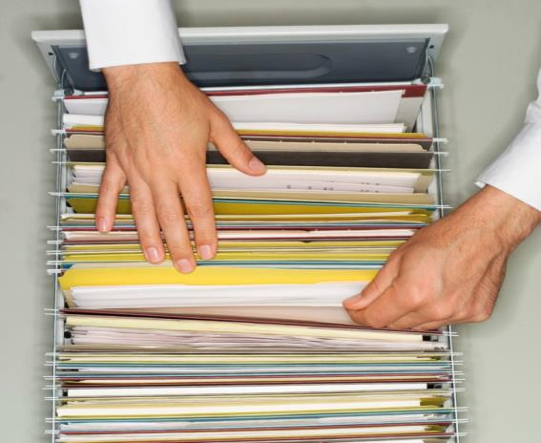
OSHA
6
Notes:
6
6
More Employer’s Responsibility
Report to the nearest OSHA office within 8 hours any fatal accident or one that results in the hospitalization of 3 or more employees
Keep records of work-related injuries and illnesses. (Note: Employers with 10 or fewer employees and employers in certain low-hazard industries are exempt from this requirement)
Provide employees, former employees and their representative’s access to the Log of Work Related Injuries and Illnesses (OSHA Form 300)
Provide access to employee medical records and exposure records to employees or their authorized representatives
Provide to the OSHA compliance officer the names of authorized employee representatives who may be asked to accompany the compliance officer during an inspection
Not discriminate against employees who exercise their rights under the Act
Post OSHA citations at or near the work area involved. Each citation must remain posted until the violation has been corrected, or for three working days, whichever is longer. Post abatement verifications documents or tags
Correct cited violations by the deadline set in the OSHA citation and submit required abatement verification documentation

Slide 7


OSHA
Notes:
No Retribution
Section 11(c) (1) No person shall discharge or in any manner discriminate against any employee because such employee has filed any oral and written complaints.
Discrimination includes:
Firing or laying off
Blacklisting demoting
Denying overtime or promotion
Disciplining
Denial of benefits
Failure to hire or rehire
Intimidation
Reassignment affecting future promotions
Reducing pay or hours

Slide 8
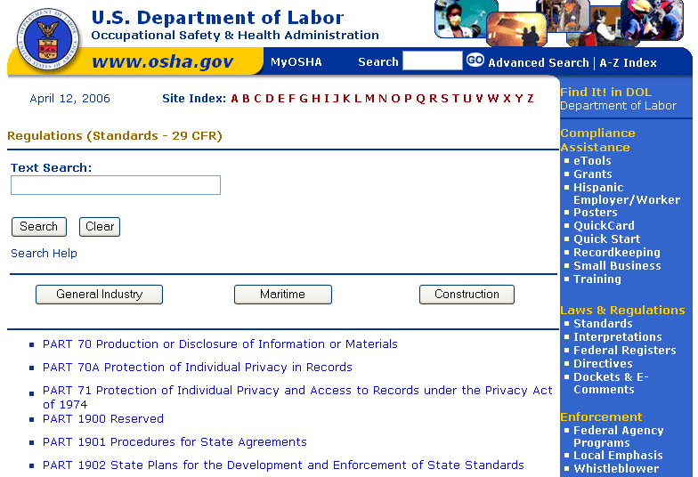
OSHA
Notes:
Resolve With Your Company – Follow your chain of command. Go to your Lead, Supervisor or Safety Technician. However, if this fails you should file a valid complaint.
Online - Go to the Online Complaint Form. Written complaints that are signed by workers or their representative and submitted to an OSHA Area or Regional office are more likely to result in onsite OSHA inspections.
Telephone - your local OSHA Regional or Area Office. OSHA staff can discuss your complaint and respond to any questions you have call 1-800-321-OSHA.
Download and Fax/Mail - Download the OSHA complaint form* [En Espanol*] (or request a copy from your local OSHA Regional or Area Office), complete it and then fax or mail it back to your local OSHA Regional or Area Office. Written complaints that are signed by a worker or representative and submitted to the closest OSHA Area Office are more likely to result in onsite OSHA inspections. Please include your name, address and telephone number so we can contact you to follow up. This information is confidential.

Slide 9
OSHA Exercise
Stump the class!
With a partner, write two questions from this section that you believe the rest of the class will be challenged in answering correctly. (Questions must be reasonable! If your instructor can’t answer, it doesn’t count!)
Notes:
Question One:
_____________________________________________________________________________________________________________________________________________________________________________________________________________________________________________________________________________________________________________________________________
Question Two:
_____________________________________________________________________________________________________________________________________________________________________________________________________________________________________________________________________________________________________________________________________

Slide 10

The Supervisor’s Roles and Responsibilities
Notes:
Now that I am a Supervisor….
What are my roles?
What are my responsibilities?

Slide 11
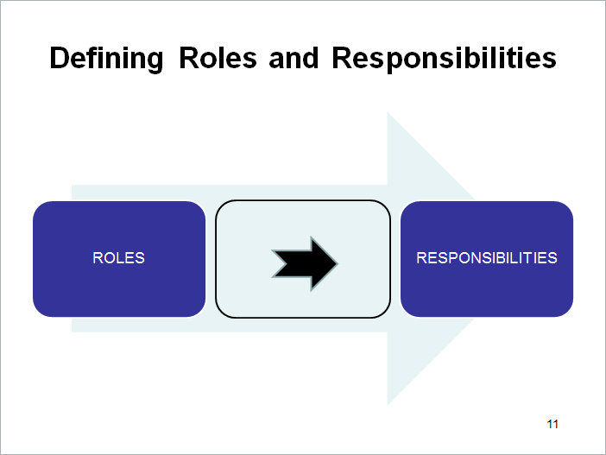
Defining Roles and Responsibilities
Notes:
The Definition of a Role
the function assumed or part played by a person or thing in a particular situation.
"she greeted us all in her various roles of mother, friend, and daughter“

Slide 12
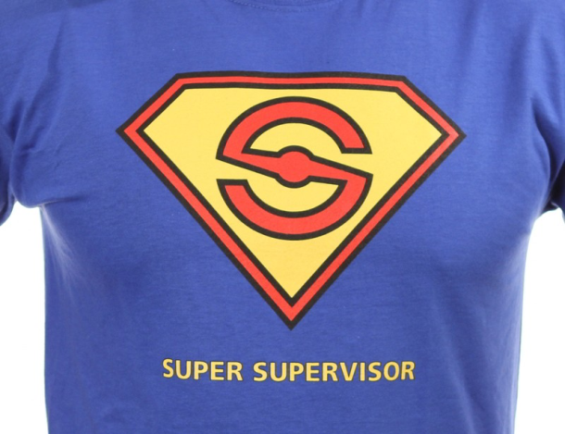
The Role of a Supervisor
Notes:
List below what you believe to
be the roles of a Supervisor
____________________________________________________________________________________________________________________________________________________________________________________________________________________________________________________________________________________________________________________
List below what you believe to
be the corresponding responsibilities ____________________________________________________________________________________________________________________________________________________________________________________________________________________________________________________________________________________________________________________

Slide 13
Which Roles Create a Safety Responsibility?
For each role on the left, circle yes or no if you believe that role has a safety related responsibility. If yes, what is that responsibility?
Notes:
Company Advocate Yes or No What?____________________
Employee Advocate Yes or No What?____________________
Compliance Leader Yes or No What?____________________
Teacher Yes or No What?____________________
Facilitator Yes or No What?____________________
Listener Yes or No What?____________________
Referee Yes or No What?____________________
Coach Yes or No What?____________________
Leader Yes or No What?____________________
Mentor Yes or No What?____________________
____________ Yes or No What?____________________

Slide 14

Consequences
Notes:
What could be the consequences of failing to meet your safety responsibilities?
____________________________________________________________________________________________________________________________________________________________________________________________________________________________________________________________________________________________________________________________________________________________________________________________________________________________________________________________________________________________________________________________________________________________

Slide 15
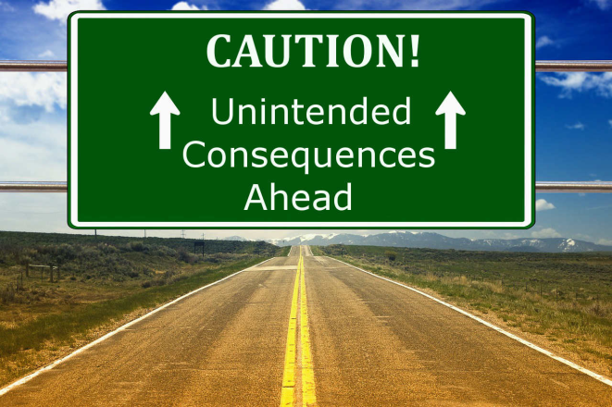
The Consequences of What You Say

Slide 16

Company Advocate
Notes:
Advocate: a person who argues for or supports a cause or policy.
What you say and do can have the same consequences as if your company owner says it or does it!
Your job is to support your company… if you can’t, go to your supervisor!”

Slide 17
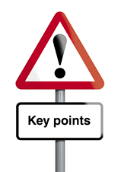
Key Points So Far
Notes:
You play many roles as a Supervisor
Based on those roles you have many responsibilities
Safety plays a key part in succeeding as a supervisor
As a Supervisor there can be significant consequences based on what you say and do

Slide 18

Roles and Responsibilities
QUIZ!
18
Notes:
18
For each statement below circle T for True or F for False.

Slide 19
The Five Functions of Management
Plan
Organize
Staff
Lead
Monitor
Notes:
Plan - the process of thinking about and organizing the activities required to achieve a desired goal.
Organize - make arrangements or preparations for (an event or activity); coordinate.
Staff (Effectively) - the personnel who assist a supervisor in carrying out an assigned activity or goal
Lead – helping themselves and others to do the right things. Setting direction and setting an example.
Monitor - observe and check the progress or quality or compliance of (something) over a period of time; keep under systematic review.

Slide 20
The Five Functions of Safety Supervision
Plan
Organize
Staff
Lead
Monitor
SAFETY
Notes:
For each of function of management, identify what you could do to ensure a safe work environment.
Plan for Safety ______________________________________________________________________________________________________________________________
Organize for Safety ______________________________________________________________________________________________________________________________
Staff for Safety ______________________________________________________________________________________________________________________________
Lead for Safety ______________________________________________________________________________________________________________________________
Monitor Safety ______________________________________________________________________________________________________________________________

Slide 21

Supporting Safety Management

Slide 22

Planning For Safety
Notes:
Incident Prevention
Incident Investigation

Slide 23
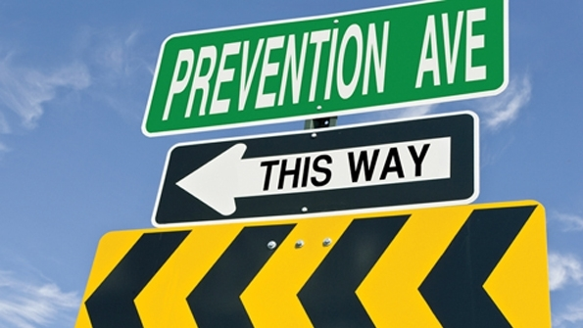
Why Incident Prevention
Notes:
Loss of production
Incident prevention costs
Re-training costs
Equipment /material damage
Lower morale
Pain and suffering
It’s the human thing to do!!
Other:
_____________________________________________________________________________________________________________________________________________________________________________________________________________________________________________________________________________________________________________________________________

Slide 24
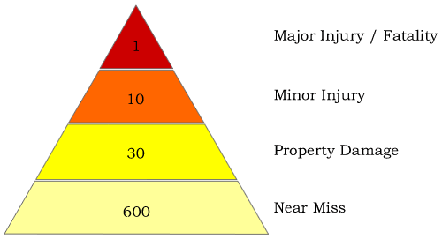
Avoiding Injuries
Notes:
Follow all safety guidelines
Report unsafe working conditions
Report near misses
Question hazardous situations
Report all injuries immediately
Supervisors need to investigate all injuries
The Safety Triangle has many other names – Bird’s Triangle, Heinrich’s Triangle or the Loss Control Triangle. The Safety Triangle refers to a ratio which has come to define many safety practices and policy developments to date – 1-10-30.

Slide 25
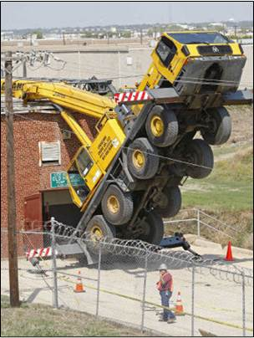
Incident Investigation
Notes:
Below are reasons we should always investigate an incident:
Find the root cause
Prevent similar Incidents
Protect company interests
Save lives
Save money
Promote positive workplace morale
Improve management

Slide 26

Investigation Process
Notes:
A thorough accident investigation process is to:
Control the scene
Gather data
Analyze data
Write the final report
Implement corrective action

Slide 27
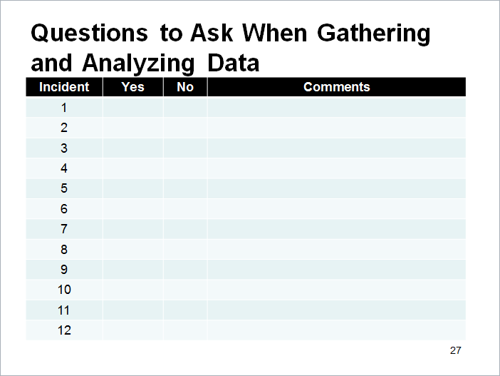
Questions to Ask When Gathering and Analyzing Data
Notes:
Did the incident involve actual or potential exposure to:
1. Uncontrolled energy source such as: electrical, mechanical hydraulic, pneumatic, chemical, thermal, high pressure, or potential energy?
2. A dropped, flying, or moving object with sufficient mass and velocity to cause life altering or life threatening injury?
3. Lifting, moving, aligning heavy loads with blocks, rigging, cables or load securement failure (including dropped loads and working under suspended loads)?
4. Motor vehicle or mobile equipment/forklift collision, or a single vehicle rollover, head-on, or rear-ender?
5. Pedestrian being struck by or nearly struck by a motor vehicle/mobile equipment/rolling stock/forklift?
6. Coming in contact with a power cutting tool?
7. Contact with moving components of stationary equipment, or where guarding has been defeated or bypassed?
8. Fall from height of 4ft or greater, or a shorter distance but onto an impaling object?
9. Uncontrolled release of flammable, explosive, or hazardous materials?
10. Breakdown in the confined entry process?
11. Slip, trip, or fall on same level, either (1) onto a protrusion or (2) backwards onto a hard surface, or a potential fall to a lower level?
12. Actual or potential fatality or serious injury event not covered by the previous 11 exposure conditions?

Slide 28
Accident Investigation Exercise
Think of a recent accident and:
List what was done for each step of the investigation process.
2. Rate each step 1 -5 (1=low to 5=high) regarding how well you think the investigation was handled.
3. Identify at least one step you would improve and how.
Notes:
Control the Scene
__________________________________________________________________________________________________________________________________
Gather Data
__________________________________________________________________________________________________________________________________
Analyze Data
__________________________________________________________________________________________________________________________________
Write Final Report
__________________________________________________________________________________________________________________________________
Implement Corrective Action
__________________________________________________________________________________________________________________________________

Slide 29
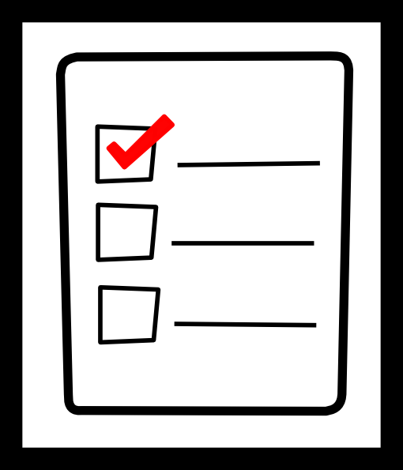
Organizing For Safety
Notes:
Job Safety Analysis

Slide 30

Job Safety Analysis (JSA)
30
Notes:
30
Job Safety Analysis (JSA)
A tried and true method to identify and reduce the risk of workplace hazards is a job safety analysis (JSA).
In a JSA, each basic step of the job is analyzed to identify potential hazards and to recommend the safest way to do the job. Other terms used to describe this procedure are job hazard analysis (JHA) and job hazard breakdown.

Slide 31
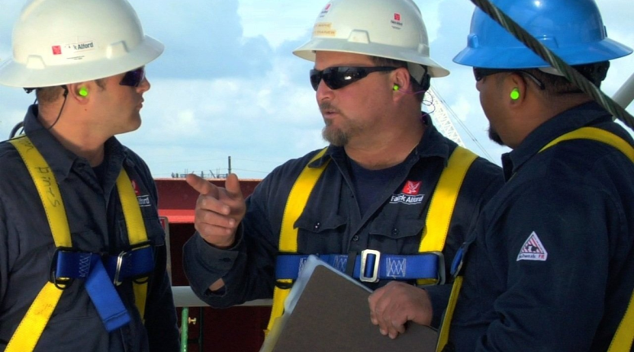
When To Conduct a JSA
Notes:
When To Conduct a Job Safety Analysis
Ultimately, a JSA should be conducted on all work processes. To begin use the list below for guidance.
Jobs with the highest injury or illness rates
Jobs with the potential to cause severe or disabling injuries or illness even if there is no history of previous accidents
Jobs in which simple human error could lead to a severe accident or injury
Jobs that are new or have undergone changes in processes and procedures
Jobs complex enough to require written instructions
Unusual jobs/use of new tools or machinery
Tasks that require the interaction of multiple people or systems
Any task in which an employee/supervisor has safety concerns

Slide 32
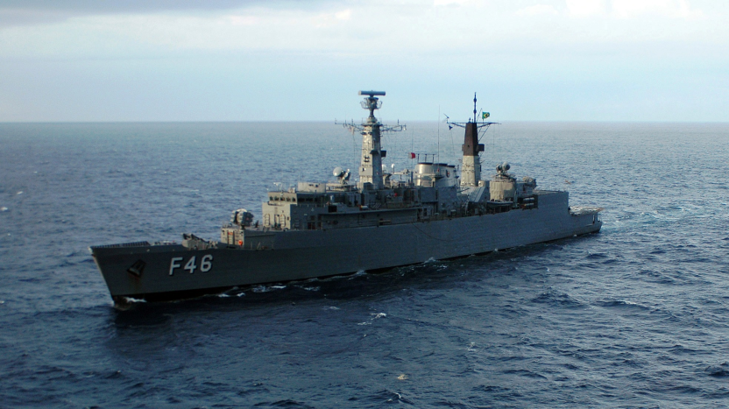
When According to the Navy
Notes:
NAVSEA Std. Item 009-74, 3.1.3
3.1.3 A process for performing a Job Safety Analysis/Job Hazard Analysis (JSA/JHA) for:
3.1.3.1 Processes and equipment new to the worksite.
3.1.3.2 Existing processes and equipment that have been involved in mishaps or near misses.
3.1.3.3 Maintain a copy of each JSA/JHA which shall be available for review by the SUPERVISOR upon request.
3.1.4 A process for identification, communication, abatement, and prevention of unsafe conditions and work practices.

Slide 33
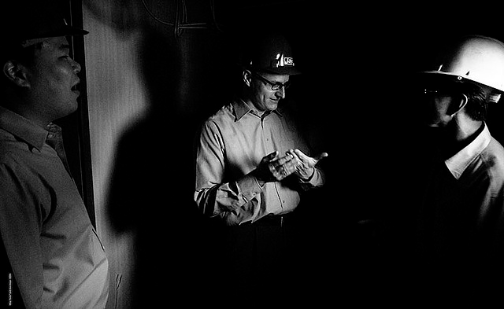
Who Conducts the JSA?
Notes:
Who Should Conduct the JSA
Initially JSA’s are often conducted with a small team such as a Safety Technician, Production Lead or Supervisor, and a Production Worker. However, as the process is better understood through experience and training, many organizations rely on their front-line production workers to perform JSA’s.

Slide 34
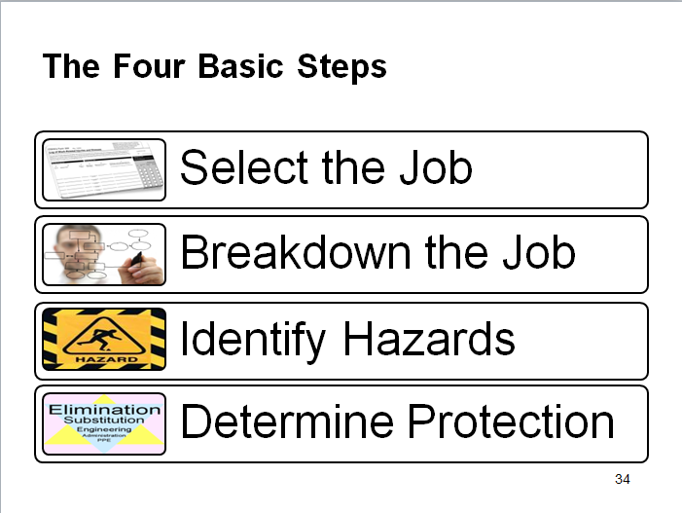
The Four Basic Steps
Notes:
The Four Basic Steps
Four basic stages in conducting a JSA are:
• Selecting the job to be analyzed
• Breaking the job down into a sequence of steps
• Identifying potential hazards
• Determining preventive measures to overcome these hazards

Slide 35
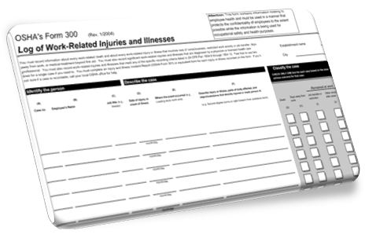
Select The Job
Notes:
Selecting the Job to Be Analyzed
Ideally, all jobs should be subjected to a JSA. Another consideration is that each JSA will require revision whenever equipment materials, processes, or the environment change.

Slide 36
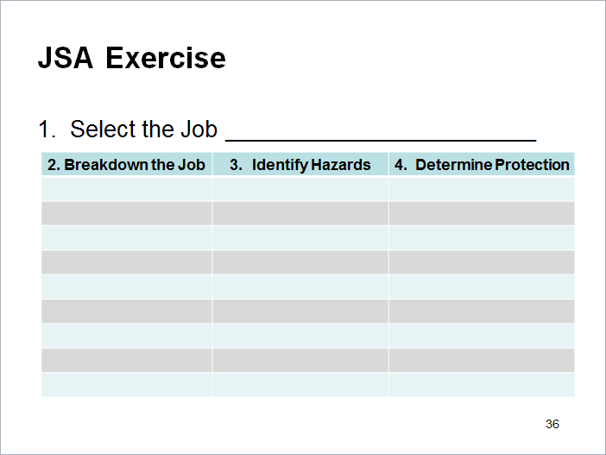
JSA Exercise
Notes:
Your JSA!
From slides 36 to 44 you will be asked to complete a JSA on a job task that you commonly perform.
Step One. Using the form at the top of this page select a job that you commonly perform and write it in the blank above.

Slide 37
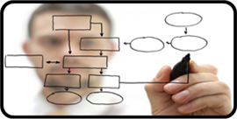
Breakdown The Job
Notes:
Breakdown the Job
After a job has been chosen for analysis, the next stage is to break the job into steps. A job step is defined as a segment of the operation necessary to advance the work.
Care must be taken not to make the steps too general. Missing specific steps and their associated hazards will not help. On the other hand, if they are too detailed, there will be too many steps. A rule of thumb is that most jobs can be described in less than ten steps. If more steps are required, you might want to divide the job into two segments, each with its separate JSA, or combine steps where appropriate.
An important point to remember is to keep the steps in their correct sequence. Any step which is out of order may miss serious potential hazards or introduce hazards which do not actually exist.
Each step is recorded in sequence. Make notes about what is done rather than how it is done. Each item is started with an action verb. This part of the analysis is usually prepared by knowing or watching a worker do the job. The observer is normally the immediate supervisor.

Slide 38
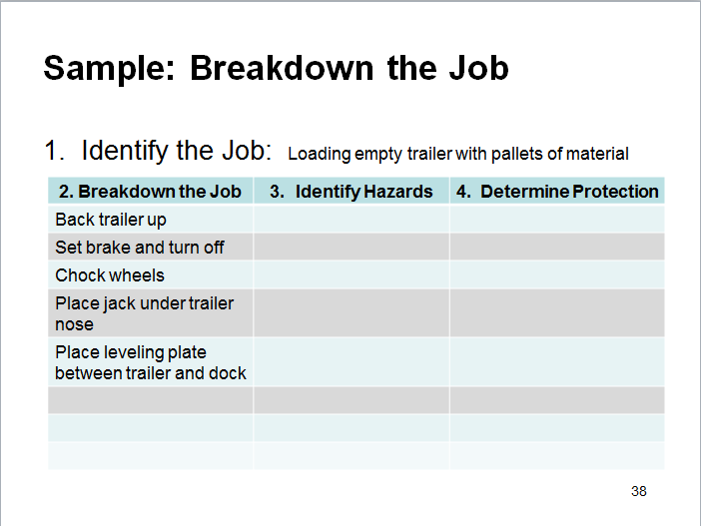
Sample: Breakdown the Job
Notes:
Breakdown the Job
Above is an example of breaking down the job.

Slide 39
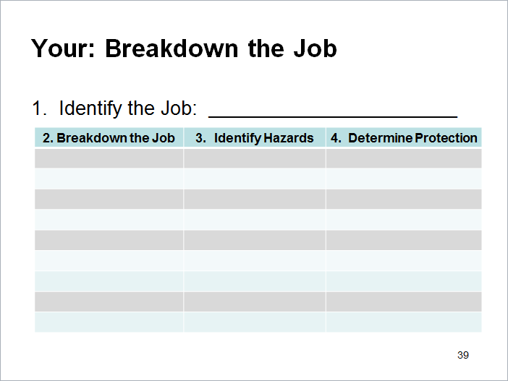
Your: Breakdown the Job
Notes:
Breakdown the Job
Step 2. Now, using the form above or continuing with the form you started on page 36, break the job down in column 2.

Slide 40

Identify the Hazards
Notes:
Identify Hazards
Once the basic steps have been recorded, potential hazards must be identified at each step. Based on observations of the job, knowledge of incident and injury causes, and personal experience, list the things that could go wrong at each step.
A second observation of the job being performed may be needed. Since the basic steps have already been recorded, more attention can now be focused on each potential hazards. At this stage, no attempt is made to solve any problems which may have been detected.
To help identify potential hazards, the job analyst may use questions such as those on the following page.

Slide 41
Questions Supporting Hazard Identification
Notes:
Questions to Support Identifying Potential Hazards
To help identify potential hazards, the job analyst may use questions such as those below.
• Can any body part get caught in or between objects?
• Do tools, machines, or equipment present any hazards?
• Can the worker make harmful contact with moving objects?
• Can the worker slip, trip, or fall?
• Can the worker suffer strain from lifting, pushing, or pulling?
• Is the worker exposed to extreme heat or cold?
• Is excessive noise or vibration a problem?
• Is there a danger from falling objects?
• Is lighting a problem?
• Can weather conditions affect safety?
• Is harmful radiation a possibility?
• Can contact be made with hot, toxic, or caustic substances?
• Are there dusts, fumes, mists, or vapor in the air?

Slide 42
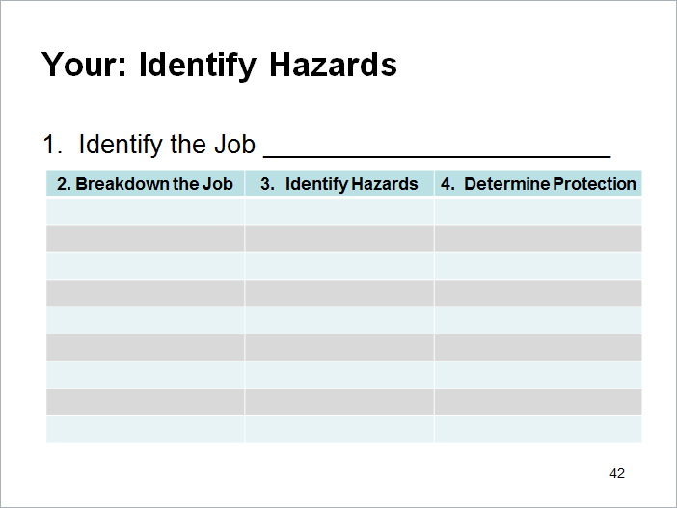
Your: Identify Hazards
Notes:
Step 3. Now, using the form above or continuing with the form you started on page 36, identify the hazards for each step of the process in column 3.

Slide 43
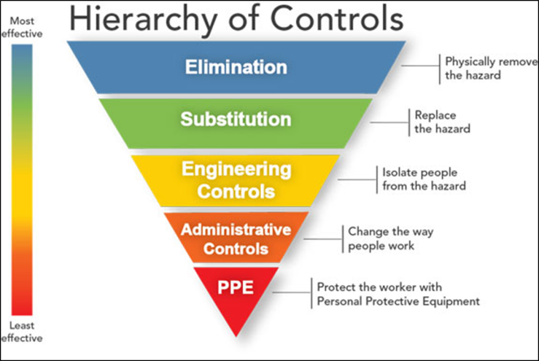
Determine Protection
Notes:
Determining Preventive Measures to Overcome These Hazards
Elimination/Substitution
Engineering Controls
Administrative Controls
Personal Protective Equipment

Slide 44
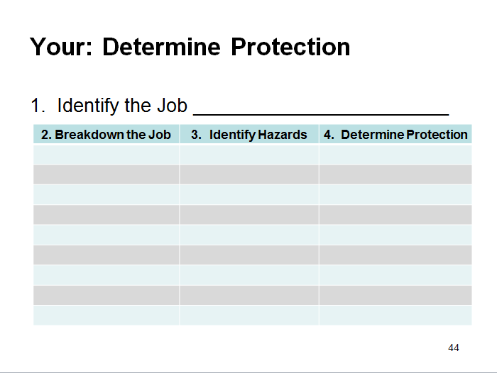
Your: Determine Protection
Notes:
Step 4. Lastly, using the form above or continuing with the form you started on page 39, determine what protection should be used for each step of the process in column 4. Take into consideration Elimination/Substitution, Engineering Controls, Administrative Controls and Personal Protective Equipment (PPE).

Slide 45
Planning and Organizing
QUIZ!
45
Notes:
45
For each statement below circle T for True or F for False.

Slide 46

Staffing For Safety
Notes:
Coaching Staff (Your Team)
Training Staff (Your Team)

Slide 47

Coaching your Team
Notes:
Establish clear expectations (The Foundation!)
Recognize good performance and behavior
Counsel performance and behavior that does not meet expectations
Focus on behaviors and not on attitudes
Role model performance and behavior
Ask for improvement ideas

Slide 48
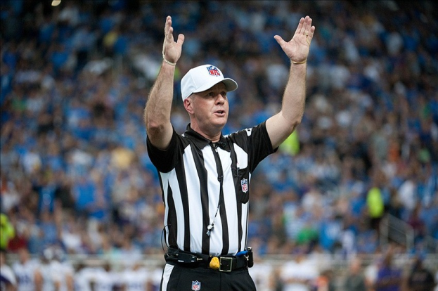
Coaching Exercise
Notes:
REGARDING SAFETY
What do you expect your employees to do? How do they know?
___________________________________________________________________________________________________________________________________________________________________________________________________
REGARDING SAFETY
How do you recognize good performance?
___________________________________________________________________________________________________________________________________________________________________________________________________
REGARDING SAFETY
How do you counsel safety performance that does not meet your expectations?
___________________________________________________________________________________________________________________________________________________________________________________________________
“You can not expect employees to do more than is expected of them.”

Slide 49

Training your Team
Notes:
The Training Model
Be prepared
Explain what is in it for your trainee
Provide context… how does what they are learning fit into the “big picture”
Put task into digestible chunks
Practice, practice, practice!
Provide on-going feedback

Slide 50
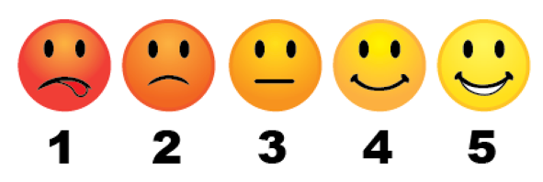
The Characteristics of a Good Trainer
For each characteristic below, rate yourself 1(very low) to 5 (very high).
How can you improve?

Slide 51

Leading For Safety
Notes:
Inspiring Safe Behavior
Management’s Specific Responsibilities

Slide 52

Inspiring Safe Behavior
Notes:
Leaders….
Earn respect
Respect others
Are trustworthy
Are approachable
Communicate clearly
Provide constructive feedback
Plan and follow up
Develop “people skills”
Inspire others

Slide 53

Setting The Example
Notes:
Leadership through example
Encourage all employees to follow the rules.
The “little things” count as much as the “big things”
No exceptions
Be consistent and don’t play favorites
Your team will watch you and if your words don’t match your deeds will ignore your words!
Why do the “little things” count as much as the “big things?”
____________________________________________________________________________________________________________________________________________________________________________________________________________________________________________________________________

Slide 54

Supervisor’s Legal Responsibilities
Notes:
You
Have an ethical and moral duty as a supervisor for workplace safety
Have a legal duty as a supervisor for workplace safety
Have a legal duty to comply, and support your team in complying, with Federal OSHA

Slide 55

Management’s Specific Responsibilities
Notes:
Keep a safe and healthy workplace
Provide a safe work environment including training, ample protection, safety equipment and hazard communication
Evaluate workplace hazards
Investigate and address safety and environmental hazards
Follow local, state and federal government laws regarding safety and the environment
Keep accurate records of workplace injuries and illnesses as well as near misses
Record medical treatment beyond first aid
Assign proper personnel to manage the SHMS, including document and control.

Slide 56

Examples of OSHA Criminal Penalties
Failed to follow fall protection regulations
Lied to OSHA
Obstructed justice
Incarcerated for 10 months
Notes:
April 24, 2016
When a roofer at a Philadelphia construction site fell to his death, his employer did everything possible ... to avoid responsibility.
First and foremost, the employer, the roofing company’s owner, failed to provide his workers with fall protection equipment.
He also lied about it. When questioned by OSHA investigators, he lied on four occasions, claiming he had provided employees with the appropriate safety gear. He told compliance officers he had seen his employees prior to the fatal fall wearing safety harnesses that were tied off to an anchor point. He also tried to convince his other workers to tell OSHA that they wore fall protection on the day of the incident.
The owner was indicted for lying, obstruction of justice and willfully violating an OSHA standard. Facing a maximum sentence of 25 years in prison, he pleaded guilty and was sentenced to 10 months.

Slide 57

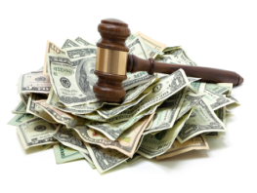
Examples of OSHA Criminal Penalties
Conspiracy
Failure to implement proper controls
Deaths
Personal fines and prison
Company fines
Notes:
July 30, 2012
The former owner of a business where two workers died within a four-month period faces years in prison and hundreds of thousands in fines following an indictment by a federal grand jury.
Port Arthur Chemical and Environmental Services (PACES) and its former president and owner, Matthew Bowman, are charged with conspiracy to illegally transport hazardous materials resulting in two worker deaths.
The conspiracy counts each carry a maximum sentence of five years in prison and a fine of $250,000 for Bowman and $500,000 for the company.
PACES, which ceased operation in 2010, has filed for bankruptcy.
Workers at the Port Arthur, TX, facility weren’t properly protected from exposure to hazardous gases.
Charles Sittig, 48, died April 14, 2008, of a heart due to hydrogen sulfide inhalation. Joey Sutter, 36, died Dec. 18, 2008, by asphyxiation and poisoning due to hydrogen sulfide inhalation. Both men were truck drivers.
Bowman and PACES are charged with conspiracy to violate the Hazardous Materials Transportation Uniform Safety Act, and two counts of failure to implement appropriate controls to protect employees from exposure to hydrogen sulfide in violation of the Occupational Safety and Health Administration Act.

Slide 58
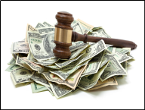
OSHA Violations and Fines
Left hand crushed
Partial amputation
Failed to guard operating parts on various machines in the facility
Improperly installed safety guards on machines that created a hazard for employees
Failed to record work related injury on the illness and injury logs.
$219,242 in proposed penalties.
Notes:
GREEN BAY, Wis. - In less than 10 days in 2016, two employees at a Green Bay muffler component manufacturer suffered severe injuries as they operated machinery without adequate safety guards and procedures in place, federal workplace safety investigators have determined.
On Jan. 18, 2017, the U.S. Department of Labor's Occupational Safety and Health Administration issued one willful, one repeated, one other-than-serious violation and two serious violations to Bay Fabrication. The company, part of the Bay Family of Companies with 75 locations in the U.S., faces $219,242 in proposed penalties.
Investigators determined a worker had his left hand crushed on July 21, 2016, by a molding machine, when the tamp head smashed his hand as he removed a mold from the machine. OSHA found the machine's safety interlock on the door guarding the operating parts was damaged and not functional properly which disabled the safety guard and led to the injury.
On July 30, 2016, another worker suffered the partial amputation of his left middle finger. In this instance, investigators found the molding machine cycled and caught his finger in an unguarded pinch point. They determined the machine was not locked out as required.
OSHA also found the company:
Failed to guard operating parts on various machines in the facility.
Improperly installed safety guards on machines that created a hazard for employees.
Failed to record work related injury on the illness and injury logs.

Slide 59
Examples of OSHA Violations and Fines
20 serious violations that included failing to:
Ensure safe use of the spray booth and prevent overexposure
Safely cover floor holes, ensure exits are accessible and labeled properly
Properly store compressed gas tanks
Properly label chemicals
Have a hazardous energy control program in place, and to train workers in its procedures
Ensure safe use of powered industrial trucks
Inspect and guard chain slings and sprockets as required
Ensure safety guards were in place on a portable grinder
Proposed $535,411 in fines
Notes:
KINGSTON, Okla. - A complaint of unsafe working conditions led U.S. Department of Labor Occupational Safety and Health Administration inspectors to discover the safety and health of employees at a well-known Oklahoma truck bed fabricator being placed at risk amid nearly two dozen safety and health violations.
OSHA's investigation at BigTex Trailer Manufacturing Inc., which does business as CM Truck Beds, found 20 serious violations, one willful and three repeated violations - prompting the agency to propose $535,411 in fines.
OSHA issued citations for a willful violation after inspectors found workers operated hydraulic press brakes without machine guards in place. In addition, they identified 20 serious violations that included failing to:
Ensure safe use of the spray booth and prevent overexposure.
Safely cover floor holes, ensure exits are accessible and labeled properly.
Properly store compressed gas tanks.
Properly label chemicals.
Have a hazardous energy control program in place, and to train workers in its procedures.
Ensure safe use of powered industrial trucks.
Inspect and guard chain slings and sprockets as required.
Ensure safety guards were in place on a portable grinder.

Slide 60
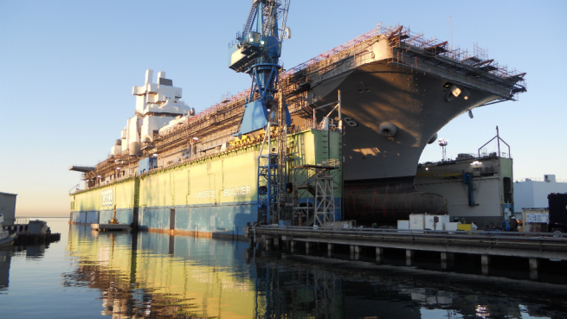
Monitoring For Safety
Notes:
When monitoring for safety be sure you focus on complying with company policies, NAVSEA Standard Items, Federal OSHA, as appropriate.
Walk-Throughs are typically conducted twice a day. First shift and second. Coverage should extend to the weekends as appropriate.
Check lists are utilized. The work processes that are being conducted, experience and training typically guide the walk through.
On the following pages are checklists that can be useful in supporting your safety monitoring walk-throughs.

Slide 61
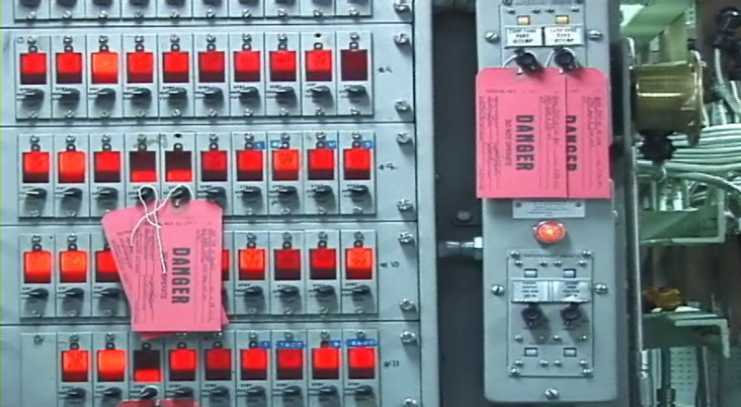
Check List – Uncontrolled Energy

Slide 62
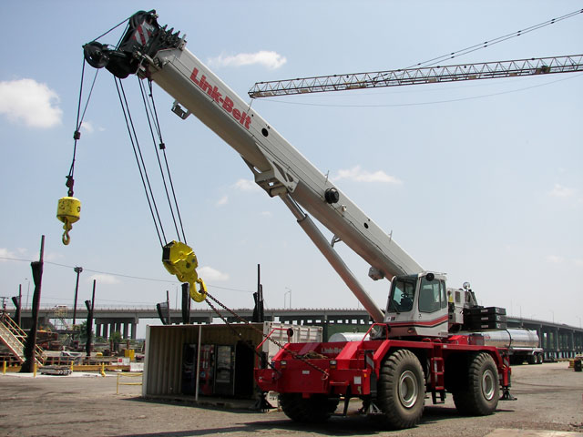
Check List – Dropped-Flying-Moving Objects

Slide 63
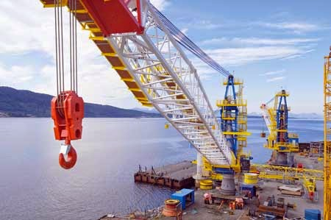
Check List – Lifting-Moving-Aligning Heavy Loads

Slide 64
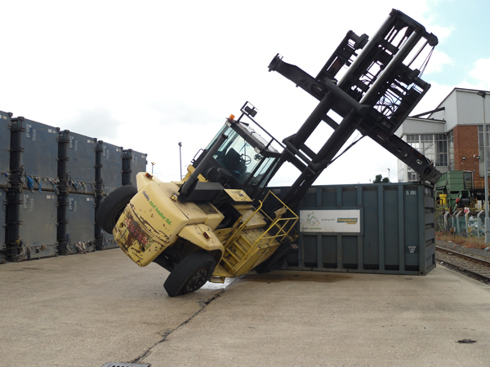
Check List – Motor Vehicle Collision or Roll-Over

Slide 65
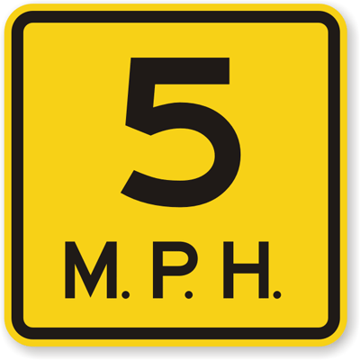
Check List – Pedestrian Struck by Motor Vehicle

Slide 66
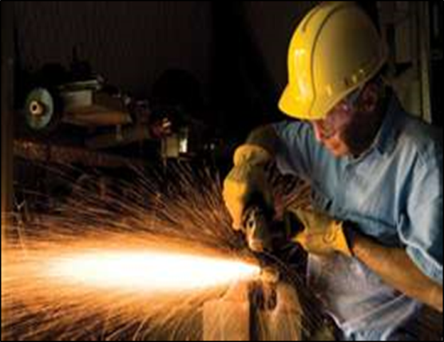
Check List – Contact With Power Cutting Tool

Slide 67
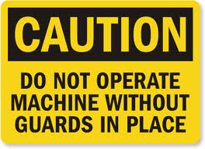
Check List – Contact With Moving Components Where Guard Is Modified

Slide 68
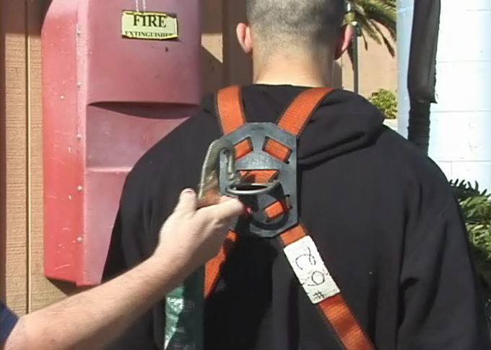
Check List – Fall From Height of Four Feet or Greater or Impaling

Slide 69
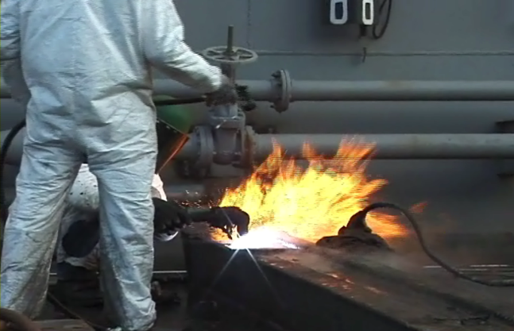
Check List – Uncontrolled Release of Flammable-Explosive-Hazardous Materials

Slide 70
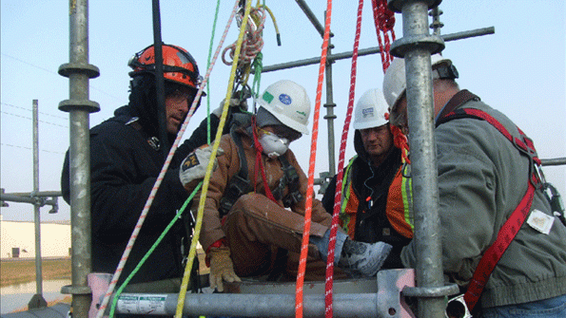
Check List – Breakdown In Confined Space Entry Process

Slide 71
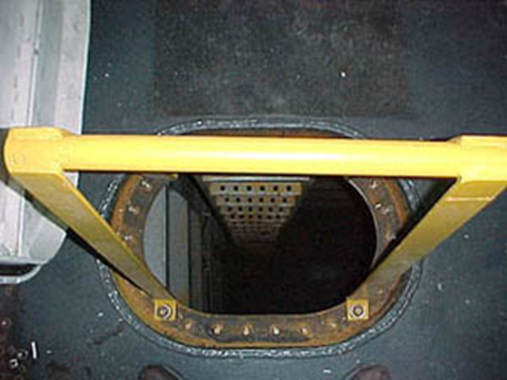
Check List – Slip-Trip-Fall

Slide 72
Staffing – Leading - Monitoring
QUIZ!
72
Notes:
72
For each statement below circle T for True or F for False.

Slide 73


Summary / Questions
Notes:
Supervisors play a key role in creating a safe work environment.
Your job is to:
Plan for Safety
Organize for Safety
Staff for Safety
Lead Safety
Monitor Safety
Your responsibility is to comply with Federal and California OSHA regulations as well as NAVSEA’s standard items.

