Slide 1
Confined Spaces in Construction
This material was produced under a grant (SH-29639-SH6) from the Occupational Safety and Health Administration, U.S. Department of Labor. It does not necessarily reflect the views or policies of the U.S. Department of Labor, nor does the mention of trade names, commercial products, or organization imply endorsement by the U.S. Government.

Slide 2
Objectives
Identify the characteristics of confined spaces
Identify the characteristics of permit required confined spaces (PRCS)
Identify the differences between General Industry and Construction confined space
Look at expected injury reduction associated with confined space in construction rule
Identify the key components of a confined space plan
Identify the duties of the entrant, attendant, and supervisor

Slide 3
Objectives (continued)
Identify the hazards in a confined space
Understand eliminating hazards using Lock-out/Tag-out (LOTO)
Understand ventilation practices
Understand rescue preparation
Understand employee rights

Slide 4
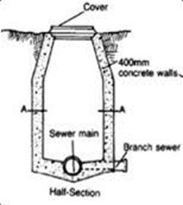
Confined Space Fatality
7/10/2010 | Speedy Rooter Inc., North Sioux City, SD 57049 | Two workers were fixing a clogged sewer and were overcome by sewer gases. One worker fatality and one worker was hospitalized.

Slide 5
What confined spaces do you have in your work environment?
Has there ever been an accident in an confined space at your work?
How could accidents been avoided?
What percentage would-be rescuers die trying to perform rescue operations without proper training or procedures?
Notes:
These questions will very in responses the last question is around 60% of would be rescuers are fatalities.
Source https://www.cdc.gov/niosh/docs/86-110/

Slide 6
Confined Space
A confined space has:
  Limited means of entry/exit,
  Is large enough for a worker to enter it, and
  Is not intended for regular/continuous occupancy.
  Examples may include sewers, pits, crawl spaces, attics, boilers, and many more.
Notes:
https://www.osha.gov/confinedspaces/faq.html
Define a confined space - under 29 CFR 1926.1202

Slide 7
Permit-required Confined Spaces
Permit-required confined spaces have one or more of these characteristics:
Contains or has the potential to contain a hazardous atmosphere;
Contains a material with the potential to engulf someone who enters the space;
Has an internal configuration that might cause an entrant to be trapped or asphyxiated by inwardly converging walls or by a floor that slopes downward and tapers to a smaller cross section; or
Contains any other recognized serious safety or health hazards.
Notes:
https://www.osha.gov/Publications/OSHA3825.pdf (for construction) or https://www.osha.gov/Publications/osha3138.html (for general industry)
Definition of a permit-required confined spaces at 29 CFR 1926.1202.
Instructor to explain what the different components of what a permit required confined space is and how it is different from a non-permit space

Slide 8

Categorizing Work Space
* Space large enough to enter &;
* Limited or Restricted entry or exit &;
* Not designed for continuous worker
occupancy.
NO
Not a confined Space
YES
Confined Space
Permit-
Required
Confined
Space
Hazardous Atmosphere
Non
Permit
Required
Space
Or
YES
Engulfment Hazard
NO
Or
Configuration Hazard
Or
Any other recognized
serious hazard
Notes:
Flow chart to determine if it is a confined space versus a permit required confined space. –
Source Western Iowa Tech (2007). Process safety management: Module 6, confined spaces. Susan Harwood Grantee. Retrieved on November 28, 2016. Website: http://www.osha.gov/dte/grant_materials/fy07/sh-16634-07.html

Slide 9
Definitions
Barrier: means a physical obstruction that blocks or limits access.
Competent Person: means one who is capable of identifying existing and predictable hazards in the surroundings or working conditions which are unsanitary, hazardous, or dangerous to employees, and who has the authorization to take prompt corrective measures to eliminate them.
Control: means the action taken to reduce the level of any hazard inside a confined space using engineering methods (for example, by ventilation), and then using these methods to maintain the reduced hazard level. Control also refers to the engineering methods used for this purpose. Personal protective equipment is not a control.
Controlling Contractor: is the employer that has overall responsibility for construction at the worksite. Note. If the controlling contractor owns or manages the property, then it is both a controlling employer and a host employer.
Notes:
Instructor to go through each of the definitions and explain what each of the definitions mean, and answer any questions that might arise.
Definitions may be found at 29 CFR 1926.1202.

Slide 10
Definitions (continued)
Early-Warning: system means the method used to alert authorized entrants and attendants that an engulfment hazard may be developing. Examples of early-warning systems include, but are not limited to: alarms activated by remote sensors; and lookouts with equipment for immediately communicating with the authorized entrants and attendants.
Entry Employer: means any employer who decides that an employee it directs will enter a permit space.
Entry Rescue: occurs when a rescue service enters a permit space to rescue one or more employees.
Host Employer: means the employer that owns or manages the property where the construction work is taking place.
Notes:
Instructor to go through each of the definitions and explain what each of the definitions mean, and answer any questions that might arise.
Definitions may be found at 29 CFR 1926.1202.

Slide 11
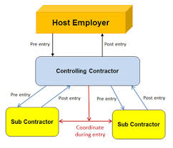
Flow chart of responsibilities
Notes:
https://www.osha.gov/confinedspaces/faq.html
This flow chart is to help explain the role of communication on a multi employer worksite, and how they need to coordinate entry with each other so processes down the line aren't affected and employees remain safe.

Slide 12
Definitions (conclusion)
Lock-Out: means the placement of a lockout device on an energy isolating device, in accordance with an established procedure, ensuring that the energy isolating device and the equipment being controlled cannot be operated until the lockout device is removed.
Lower Flammable Limit or Lower Explosive Limit: means the minimum concentration of a substance in air needed for an ignition source to cause a flame or explosion.
Monitor or Monitoring: means the process used to identify and evaluate the hazards after an authorized entrant enters the space.
Non-entry rescue: occurs when a rescue service, usually the attendant, retrieves employees in a permit space without entering the permit space.
Notes:
Instructor to go through each of the definitions and explain what each of the definitions mean, and answer any questions that might arise.
Definitions may be found at 29 CFR 1926.1202.

Slide 13
5 Key Differences Construction confined Space:
More detailed provisions requiring coordinated activities when there are multiple employers at the worksite.
Requiring a competent person to evaluate the work site and identify confined spaces, including permit spaces.
Requiring continuous atmospheric monitoring whenever possible.
Notes:
Instructor to explain the differences between subpart AA and the previous general industry confined space subpart, and ensure it is conveyed that the standard has changed and employers must follow subpart AA in the construction fields.
Source - https://www.osha.gov/confinedspaces/faq.html

Slide 14
5 Key Differences Construction confined Space (continued):
Requiring continuous monitoring of engulfment hazards. For example, when workers are performing work in a storm sewer, a storm upstream from the workers could cause flash flooding.
Allowing for the suspension of a permit, instead of cancellation, in the event of changes from the entry conditions list on the permit or an unexpected event requiring evacuation of the space. The space must be returned to the entry conditions listed on the permit before re-entry.

Slide 15
Fatality/Injury Reports
Expected to save 800 construction workers a year from serious injury
Notes:
This statistic was taken from OSHA.GOV

Slide 16
Components of a confined space plan
Basic Elements
Management leadership and employee participation
Hazard identification and assessment
Hazard prevention and control
Information and training
Evaluation of program effectiveness
Notes:
Note: these are the very basic components, this is not all inclusive list of a confined space plan

Slide 17
Training
Training of:
    Attendant
    Entrant
    Supervisor
    Controlling contractor
    Host Employer
Notes:
These are the different job titles of participants in a confined space entry, each need to be trained on their individual duties relating to the confined space operation.
Note – This training you are receiving is basic awareness training, and does not fulfill (or meet) the training requirements for the standard.

Slide 18
Attendant
Remain outside the permit space during entry operations unless relieved by another authorized attendant;
Perform non-entry rescues when specified by the employer's rescue procedure;
Know existing and potential hazards, including information on the mode of exposure, signs or symptoms, consequences and physiological effects;
Maintain communication with and keep an accurate account of those workers entering the permit space;
Notes:
These are the job duties of the attendant. This isn’t an all inclusive list but it should be noted they are responsible for the individual in the confined space and they need to ensure constant contact with them, and not perform other jobs. Duties outlined in 29 CFR 1926.1209.

Slide 19
Attendant Continued
Order evacuation of the permit space when:
  A prohibited condition exists;
  A worker shows signs of physiological effects of hazard exposure;
  An emergency outside the confined space exists; and
  The attendant cannot effectively and safely perform required duties.
Summon rescue and other services during an emergency;
Ensure that unauthorized people stay away from permit spaces or exit immediately if they have entered the permit space;
Inform authorized entrants and the entry supervisor if any unauthorized person enters the permit space; and
Perform no other duties that interfere with the attendant's primary duties.

Slide 20
Entrant
Know space hazards, including information on the means of exposure such as inhalation or dermal absorption, signs of symptoms and consequences of the exposure;
Use appropriate personal protective equipment properly;
Maintain communication with attendants as necessary to enable them to monitor the entrant's status and alert the entrant to evacuate when necessary;
Exit from the permit space as soon as possible when:
  Ordered by the authorized person;
  He or she recognizes the warning signs or symptoms of exposure;
  A prohibited condition exists; or
  An automatic alarm is activated.
Alert the attendant when a prohibited condition exists or when warning signs or symptoms of exposure exist.
Notes:
This is the listing of the job duties of the entrant, they must listen to the orders of the attendant to ensure their own safety. Duties outlined in 29 CFR 1926.1208.

Slide 21
Supervisor
Know space hazards including information on the mode of exposure, signs or symptoms and consequences;
Verify emergency plans and specified entry conditions such as permits, tests, procedures and equipment before allowing entry;
Terminate entry and cancel permits when entry operations are completed or if a new condition exists;
Verify that rescue services are available and that the means for summoning them are operable, and that employer will be notified as soon as services become unavailable;
Take appropriate measures to remove unauthorized entrants; and
Ensure that entry operations remain consistent with the entry permit and that acceptable entry conditions are maintained
Notes:
The supervisor must ensure the job is safe before any work is performed, and all hazards are mitigated. Duties outlined in 29 CFR 1926.1210.

Slide 22
Controlling Contractor
Share information it has about permit space hazards with entry employers and other employers whose activities may create hazards in the permit space.
Coordinate entry operations when there is more than one entry employer.
Coordinate operations when permit space entry occurs during other activities at the site that might create a hazard in the space.
Notes:
The controlling contractor needs to ensure the worksite is free of hazards and there is communication to ensure there isn’t going to be a future hazard.
Source https://www.osha.gov/Publications/OSHA3825.pdf

Slide 23
Host Employer
The assessment and identification of permit spaces of the workplace must have been conducted. The host employer must advise the contractor of any permit spaces on their premises that the contractor may have a reason to enter.
The permit space must only be entered by the contractor in compliance with a PRCS program. The host and contractor must agree as to exactly what program will be followed.
The host employer must communicate the hazards in the space and the reasoning behind designating the space as a permit-required.
Hosts must also inform contractors of any entry precautions that have been implemented.
Hosts must coordinate operations with the contractor when host and contractor employees will be working in or near permit spaces.
At the end of the entry operations, the contractor must debrief the host regarding the permit program and any hazards confronted in the space during entry operations.
Notes:
The job duties of the host employer

Slide 24
Entry Permit Systems
Written permit signed by entry supervisor.
Verifies pre-entry precautions have been taken and the space is safe to enter.
Posted at entry to confined space.
Specifies apparent hazards and corrective actions taken prior to entry.
Requires termination of permit when task is completed or when new conditions exist.
Reasons for suspending the entry
Communication procedures during entry
Requires termination of permit when task is completed or when new conditions exist.
Reasons for suspending the entry
Communication procedures during entry
Notes:
Procedure for permit entry confined spaces. As defined in 29 CFR 1926.1206.

Slide 25
Entry Permit Requirements
Date, location, and name of confined space.
Purpose of entry and known hazards.
Duration of entry permit time.
Authorized entrants, attendants, supervisors.
Rescue and emergency services identified and means to summons.
Air testing results - signature of tester.
Equipment – PPE, Testing, Communication, & Rescue
Protective measures to be taken.
    Ventilation, Isolation, Flushing
    Lockout / Tag out, Purging
Notes:
All of this information must be on a permit entry confined space permit when issued.

Slide 26

CSB- Confined Space https://youtu.be/f2ItJe2Incs
Notes:
CSB video for dangers in a confined space.
Source: https://youtu.be/f2ItJe2Incs

Slide 27
Hazards in confined space
Atmospheric
Chemical
Oxygen Deficient/enriched
Flammable Atmosphere
Toxic Atmosphere
Inerting Operations – Carbon Dioxide, Nitrogen
Chemical Reactions
  Manufacturing
  Cleaning
  Curing
  Stored products
Notes:
Instructor to explain the dangers in each of the different hazards of a confined space and the importance of isolating the different hazards.

Slide 28
Hazards in confined space (continued)
engulfment
Moving Equipment
Trapped by a liquid or finely divided solid
Entrapment in the equipment
Electrocution
Create engulfment hazard
Notes:
Instructor to explain the dangers in each of the different hazards of a confined space and the importance of isolating the different hazards.

Slide 29
Hazards in confined space (conclusion)
Many other Hazards
Falls
Poor Lighting
Noise
Electrical
Thermal
Notes:
Instructor to explain the dangers in each of the different hazards of a confined space and the importance of isolating the different hazards.

Slide 30
Oxygen Deficient atmosphere
  19.5 % -Minimum acceptable oxygen level.
  15 - 19% -Decreased ability to work strenuously.
  Impair coordination. Early symptoms.
  12-14% -Respiration increases. Poor judgment.
  10-12% -Respiration increases. Lips blue.
  8-10% -Mental failure. Fainting. Nausea Unconsciousness. Vomiting.
  6-8% -8 minutes - fatal, 6 minutes - 50% fatal
  4-5minutes - possible recovery.
  4-6% -Coma in 40 seconds. Death
Notes:
Dangers of an oxygen deficient atmosphere.
Source: Western Iowa Tech (2007). Process safety management: Module 6, confined spaces. Susan Harwood Grantee. Retrieved on November 28, 2016. Website: http://www.osha.gov/dte/grant_materials/fy07/sh-16634-07.html

Slide 31
Oxygen Enriched
Oxygen level above 22%.
Causes flammable and combustible materials to burn violently when ignited.
Hair, clothing, materials, etc.
Oil soaked clothing and materials.
Never use pure oxygen to ventilate.
Never store or place compressed tanks in a confined space.
Notes:
Instructor to explain the dangers of an oxygen enrichened environment
https://www.osha.gov/SLTC/etools/shipyard/shiprepair/confinedspace/oxygendeficient.html

Slide 32
Flammable Atmosphere
Critical Factors:
  Oxygen content in the air
  Presence of a flammable gas, or vapor
  Presence of dust (visibility of 5’ or less)
Proper air/gas mixture can lead to explosion
Typical Ignition Sources:
  Sparking or electric tool
  Static Electricity
  Welding / cutting operations.
  Smoking
Notes:
Instructor to explain flammable atmospheres and how the components of different operations might build up to a dangerous atmosphere

Slide 33

Toxic Atmospheres
Product stored in a confined space:
    Gases released when cleaning.
    Materials absorbed into walls of confined space.
    Decomposition of materials in the confined space.
Work performed in a confined space:
    Welding, cutting, brazing, soldering.
    Painting, scraping, sanding, degreasing.
    Sealing, bonding, melting.
Areas adjacent to a confined space.
    Exhaust, pumps, generators
Notes:
Different causes of toxic atmospheres in confined space
Picture source: https://www.osha.gov/Publications/HazComm_QuickCard_Pictogram.html

Slide 34
Carbon Monoxide
Odorless, Colorless Gas.
Combustion By-Product.
Quickly collapse at high concentrations.
PPM Effect Time
50 Permissible Exposure Level 8 Hours
200 Slight headache, discomfort 3 Hours
600 Headache, discomfort 1 Hour
1000-2000 Confusion, nausea, headache 2 Hours
1000-2000 Tendency to stagger 1 1/2 Hours
1000-2000 Slight heart palpitation 30 Min.
2000-2500 Unconsciousness 30 Min.
Notes:
Effects of carbon monoxide on the body –
Source: Western Iowa Tech (2007). Process safety management: Module 6, confined spaces. Susan Harwood Grantee. Retrieved on November 28, 2016. Website: http://www.osha.gov/dte/grant_materials/fy07/sh-16634-07.html

Slide 35
Temperature Extremes
Extremely hot or cold temperatures.
Steam cleaning of confined spaces.
Humidity factors.
Extremely cold liquids.
Work processes inside the confined space can increase temperature extremes.
Personal protective equipment.
Notes:
Hazards associated with temperature extremes in confined spaces.

Slide 36
Engulfment Hazards
Loose, granular materials stored in bins and hoppers - grain, sand, coal, etc.
Crusting and bridging below a worker.
Flooding of confined space.
Water or sewage flow.
Notes:
Examples of engulfment hazards in confined spaces.

Slide 37
Other Hazards
Noise
    Amplified due to acoustics within the space.
    Damaged hearing, affect communication.
Slick / Wet Surfaces
    Slips and falls.
    Increased chance of electric shock.
Falling Objects
    Topside openings expose workers inside confined space to falling objects.
    Mechanical
    Drive Shafts
    Drive Gears
Notes:
Other possible hazards in confined spaces.
Noise: Can be introduced into the confined space and can last longer through vessel vibrations than in normal conditions. Amplification of the sound can also be a hazard.
Slick/Wet Surfaces: This can cause a falling or slipping hazard in addition to other hazards.
Falling objects: They can create a hazard for equipment and personnel on impact.

Slide 38
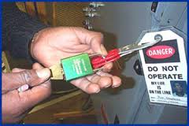
Lockout Tag out
Types of energy
Electrical
Gravitational
Water
Gas
Steam
Pneumatic
Thermal
Chemical
Many other energy sources
Notes:
Isolation of all energy going to the confined space

Slide 39
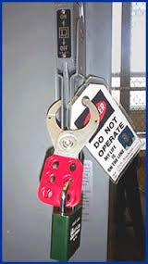
Lockout tag out (continued)
Some practices include
Locking and tagging out electrical sources.
Blanking and bleeding pneumatic and hydraulic lines.
Disconnecting mechanical drives and shafts.
Securing mechanical parts.
Blanking sewer and water flow.
Locking and tagging out shutoff valves.
Notes:
Source Picture https://www.osha.gov/dts/osta/lototraining/hottopics/ht-relche-1-4.html

Slide 40
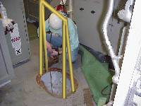
Testing the atmosphere
How to test
What to test with
Verify presence of safe work atmosphere.
Test all areas of a confined space.
  Top, Middle, Bottom, and each end
Notes:
https://www.osha.gov/SLTC/etools/shipyard/shiprepair/confinedspace/atmospherictesting.html
Testing the different levels inside a confined space is important due to the gasses density in relation to the air, some vapors might sit in the top or the bottom of the confined space so it is important to test at all different levels.

Slide 41
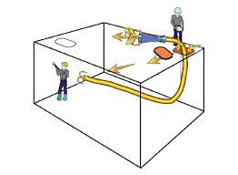
Ventilation
First option to correct problems.
Must be aware of hazards you are trying to correct in the confined space.
Air intake in a safe location to draw fresh air only.
Continuous ventilation whenever possible.
Retest the confined space before entry.
Continuous testing of the air during entry.
Notes:
https://www.osha.gov/Publications/OSHA3639.pdf

Slide 42
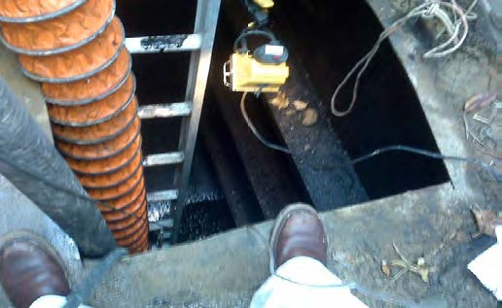
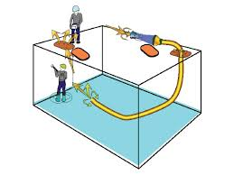
Ventilation (continued)
Natural
Mechanical
Natural forces pull out the atmosphere and replace it
  Very slow process
Use of fans and blowers, can be used to push new air in or pull out existing atmosphere
  Only limited by the size of equipment used
Notes:
Source of Picture 1: https://www.osha.gov/Publications/OSHA3639.pdf
Source of Picture 2: https://www.osha.gov/SLTC/confinedspaces/

Slide 43
Standby / Rescue
Worker assigned to remain outside the confined space and be in constant contact with the workers inside.
Know emergency rescue procedures.
60% of workers who die in confined spaces are would-be rescuers.
Trained in use of emergency rescue equipment and PPE.
Notes:
If possible use at least two attendants of the confined space. Only one is required but use proper judgment. Working knowledge and certification of first aid and CPR is also recommended.

Slide 44
Rescue
Non entry rescue
Self rescue
Rescue is performed outside the space
Prior to entry, a retrieval system and a body harness should be in place
Entrant is capable to recognizing a hazard is present and is able to exit from the space
Notes:
Different types of rescue, it should be noted that 60% of would be rescuers are fatalities

Slide 45
Rescue continued
  Entry rescue
  Entry rescue is clearly the form of rescue that presents the greatest risk
  Entry rescues should be avoided whenever possible
  Entry rescue requires a considerable amount of equipment and trained individuals

Slide 46
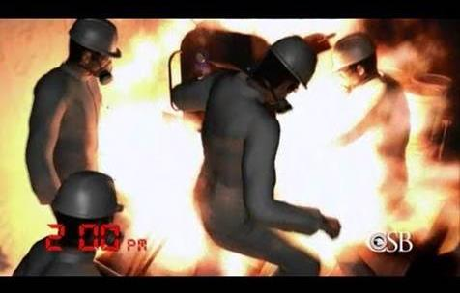
CSB- No Escape https://youtu.be/BeaX0IRjyd8
Notes:
CSB video –
Source https://youtu.be/BeaX0IRjyd8

Slide 47
Video Review
What could have been done to avoid the hazardous situation?
What possible ways could their lives been saved?
Notes:
Question one:
the placement of hazardous materials within the pipe could have prevented the fire from blocking the exit
Having fire fighting equipment readily available
Question two
Hiring a company with a good safety record
Having a second means of egress
There are several answers for the questions, they are designed to get participants to identify the hazards of this situation

Slide 48

Fatal Facts: asphyxiation in sewer line manhole
Description of Accident:
A construction foreman died from asphyxiation after entering a manhole with an uncontrolled hazardous atmosphere. Four construction workers were working in an inactive sewer system on a jobsite that was unoccupied for over a week. A few minutes after they started working, the crew noticed that the foreman was missing and a manhole cover was removed. While one worker called emergency services, a second worker entered the manhole to assist the foreman and found him unresponsive at the bottom of the 20²/³ ft. manhole. When the second worker became disoriented inside the manhole, another worker used a fan to blow fresh air into the manhole and the worker was able to climb out. The foreman was retrieved by fire department personnel and was later pronounced dead due to asphyxiation.
Notes:
https://www.osha.gov/Publications/OSHA3819.pdf

Slide 49
What were the Causes of incident?
Workers were not trained to recognize confined space hazards and to take appropriate protective measures.
The atmosphere in the manhole was not assessed to determine if conditions were acceptable before or during entry.
Proper ventilation was not used to control atmospheric hazards in the manhole.
Protective and emergency equipment was not provided at the worksite.
An attendant was not stationed outside the manhole to monitor the situation and call for emergency services.
Notes:
https://www.osha.gov/Publications/OSHA3819.pdf

Slide 50
Con fined space fatality
Iowa OSHA also issued 29 serious citations totaling $203,000 to Performance Contractors Inc. in Sergeant Bluff following a fatal incident in March. Inspectors concluded that the company failed to purge, flush and monitor a permitted confined space, exposing a worker to a fatal, oxygen-deficient atmosphere. The company failed to provide air monitoring equipment needed to fully test inside the permitted space, did not provide any rescue equipment or procedures for summoning rescue and emergency services, and failed to ensure that the workers were trained to understand the hazards experienced during confined space entry.
Notes:
Source: https://www.osha.gov/as/opa/quicktakes/qt081516.html

Slide 51
Questions?

Slide 52
Workers Rights and responsibilities

Slide 53
Employee Rights & Responsibilities
Occupational Safety and Health Act of 1970
To assure safe and healthful working conditions for working men and women
By authorizing enforcement of the standards developed under the Act
By assisting and encouraging the States in their efforts to assure safe and healthful working conditions
By providing for research, information, education, and training in the field of occupational safety and health…
Notes:
Workers Rights
http://www.osha.gov/Publications/osha3021.pdf
The instructor will discuss employee rights and responsibilities with the participants.

Slide 54
Employee Rights & Responsibilities
You have the right to:
  A safe and healthful workplace
  Know about hazardous chemicals
  Information about injuries and illnesses in your workplace
  Complain or request hazard correction from employer
Notes:
The information above was taken from the new 2 hour Intro to OSHA PPT, slide #10.
The instructor will discuss employee rights and responsibilities with the participants.

Slide 55
Employee Rights & Responsibilities
You have the right to:
File a confidential complaint with OSHA to have their workplace inspected.
Receive information and training about hazards, methods to prevent harm, and the OSHA standards that apply to their workplace. The training must be done in a language and vocabulary workers can understand.
Get copies of their workplace medical records and exposure records.
Participate in an OSHA inspection and speak in private with the inspector.
Notes:
Workers Rights
http://www.osha.gov/Publications/osha3021.pdf

Slide 56
Employee Rights & Responsibilities (continued):
File a complaint with OSHA if they have been retaliated or discriminated against by their employer as the result of requesting an inspection or using any of their other rights under the OSH Act.
File a complaint if punished or discriminated against for acting as a “whistleblower” under the additional 21 federal statutes for which OSHA has jurisdiction.
Notes:
Workers Rights
http://www.osha.gov/Publications/osha3021.pdf
Incorporate into all 4 modules. 3-4 slides need to be added.
Provide handouts to minimize amount of info on slides.

Slide 57
Whistleblower Protection
Whistleblower Protection Advisory Committee (WPAC) was established to advise, consult with, and make recommendations to the Secretary of Labor and the Assistant Secretary of Labor for Occupational Safety and Health on ways to improve the fairness, efficiency, effectiveness, and transparency of OSHA's administration of whistleblower protections. In particular, the committee advises OSHA on the development and implementation of improved customer service models, enhancements in the investigative and enforcement process, training, and regulations governing OSHA investigations. In addition, WPAC advises OSHA in cooperative activities with other federal agencies that are responsible for areas covered by the whistleblower protection statutes enforced by OSHA.
Notes:
The Whistleblower Protection Program
http://www.whistleblowers.gov/

Slide 58
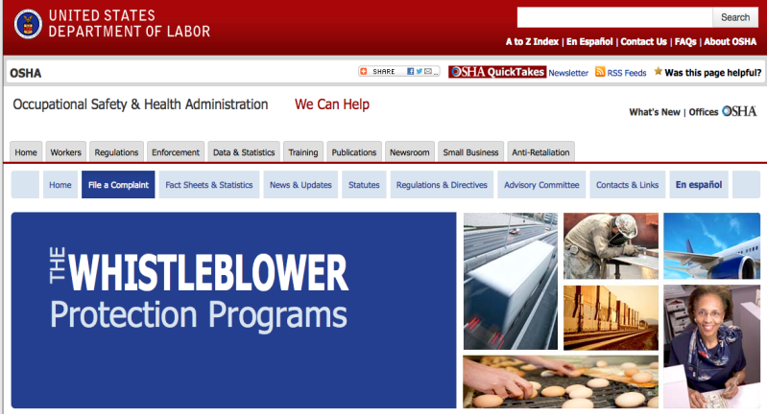
Whistleblower Protection (continued)
Notes:
The Whistleblower Protection Program
http://www.whistleblowers.gov/

Slide 59
Employee Rights & Responsibilities (conclusion)
Workers Rights: http://www.osha.gov/Publications/osha3021.pdf
  Compliance Assistance Specialists in the area offices
  National Institute for Occupational Safety and Health (NIOSH) – OSHA’s sister agency
  OSHA Training Institute Education Centers
  Doctors, nurses, other health care providers
  Other local, community-based resources
Notes:
The Information above was taken from the new 2 hour Intro to OSHA PPT, slide #40.
The instructor will discuss employee rights and responsibilities with the participants.

