Slide 1
Personal Protective equipment (PPE) in Confined Spaces
This material was produced under a grant (SH-29639-SH6) from the Occupational Safety and Health Administration, U.S. Department of Labor. It does not necessarily reflect the views or policies of the U.S. Department of Labor, nor does the mention of trade names, commercial products, or organization imply endorsement by the U.S. Government.

Slide 2
Objectives
Identify different types of eye protection and their uses
Evaluate the different types of face protection
Understand the uses and limitations of head protection
The usage characteristics of welding protective gear
Choosing the right foot protection

Slide 3
Objectives Continued
Identifying the usage and limitations of various respirators
Describe fit testing, medical evaluation, and their importance
How to clean, care for, and store the respirator

Slide 4
Training
Each employee shall be trained to know at least the following:
  When PPE is necessary.
  What PPE is necessary.
  How to properly don, doff, adjust, and wear PPE.
  Limitations of the PPE.
  Proper care, maintenance, useful life, and disposal of the PPE

Slide 5
The following minimum requirements must be met by all protective devices.
Protectors shall: Provide adequate protection against the particular hazards for which they are designed.
  Be of safe design and construction for the work to be performed.
  Be reasonably comfortable when worn under the designated conditions.
  Fit snugly and not unduly interfere with the movements of the wearer.
  Be durable.
  Be capable of being disinfected and cleaned if reusable.
  Be distinctly marked to facilitate identification only of the manufacturer

Slide 6
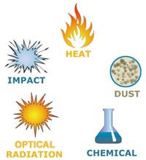
Hazard Assessment
Hazard Assessment
Hazard type | Examples of Hazard | Common Related Tasks
Impact | Flying objects such as large chips, fragments, particles, sand, and dirt | Chipping, grinding, machining, masonry work, wood working, sawing, drilling, chiseling, powered fastening, riveting, and sanding
Heat | Anything emitting extreme heat | Furnace operations, pouring, casting, hot dipping, and welding
Chemicals | Splash, fumes, vapors, and irritating mists | Acid and chemical handling, degreasing, plating, and working with blood
Dust | Harmful dust | Woodworking, buffing, and general dusty conditions
Optical Radiation | Radiant energy, glare, and intense light | Welding, torch-cutting, brazing, soldering, and laser work
Notes:
https://www.osha.gov/SLTC/etools/eyeandface/ppe/selection.html

Slide 7
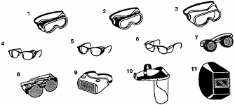
Eye Protection
Safety spectacles are intended to shield the wearer's eyes from impact hazards such as flying fragments, objects, large chips, and particles. Workers are required to use eye safety spectacles with side shields when there is a hazard from flying objects.
Notes:
https://www.osha.gov/SLTC/etools/eyeandface/ppe/impact.html
https://www.osha.gov/dte/library/ppe_assessment/ppe_assessment.html
29 CFR 1910.133 & 29 CFR 1926.102

Slide 8
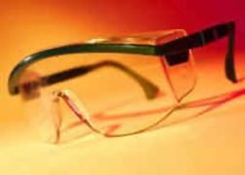
Safety Glasses
Characteristics
Z87.1-2010, Z87.1-2003 or Z87.1-1989
The lenses of safety spectacles are designed to resist moderate impact from flying objects and particles.
Side shields provide angular protection from impact hazards in addition to frontal protection.
Notes:
https://www.osha.gov/SLTC/etools/eyeandface/ppe/impact.html
29 CFR 1910.133 & 29 CFR 1926.102

Slide 9
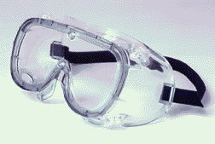
Safety Goggles
Characteristics
Z87.1-2010, Z87.1-2003 or Z87.1-1989
Safety goggles lenses are designed and tested to resist moderate impact.
Safety goggle frames must be properly fitted to the worker's face to form a protective seal around the eyes.
Ventilated goggles allow air circulation while providing protection against airborne particles, dust, liquids, or light.
Notes:
https://www.osha.gov/SLTC/etools/eyeandface/ppe/impact.html
29 CFR 1910.133

Slide 10
Incorporating prescription into the design of PPE
Workers who wear prescription glasses must also wear required eye protection
Dust and chemicals present additional hazards to contacts wearers.
Eye and face protection that fits comfortably over glasses is available.
Safety goggles and spectacles may incorporate prescription lenses.
OSHA recommends that workers have an extra pair of contacts or eyeglasses in case of contact failure or loss.
Notes:
https://www.osha.gov/SLTC/etools/eyeandface/employer/requirements.html

Slide 11
Face Protection
Face shields are intended to protect the entire face or portions of it from impact hazards such as flying fragments, objects, large chips, and particles. When worn alone, face shields do not protect employees from impact hazards. Use face shields in combination with safety spectacles or goggles, even in the absence of dust or potential splashes, for additional protection beyond that offered by spectacles or goggles alone.

Slide 12
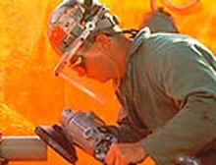
Face Shield
Characteristics
Face shield windows extend from the brow to below the chin and across the entire width of the face.
Headgear supports the window shield and secures the device to the head
Notes:
https://www.osha.gov/SLTC/etools/eyeandface/ppe/impact.html

Slide 13
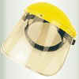
Face Shield (continued)
Face shield windows are made with different transparent materials and in varying degrees or levels of thickness. These levels should correspond with specific tasks
Notes:
https://www.osha.gov/SLTC/etools/eyeandface/ppe/impact.html

Slide 14
Head Protection
Protecting employees from potential head injuries is a key element of any safety program. A head injury can impair an employee for life or it can be fatal. Wearing a safety helmet or hard hat is one of the easiest ways to protect an employee's head from injury.
Notes:
https://www.osha.gov/Publications/osha3151.html#head
29 CFR 1910.135 and 29 CFR1926.100

Slide 15
Head Protection (continued)
protective helmets or hard hats should do the following:
Characteristics
Resist penetration.
Absorb the shock of a blow.
Protect against electrical shock
Be water-resistant and slow burning.
Have clear instructions explaining proper adjustment and replacement of the suspension and headband
ANSI Z89.1-2009, 2003 or 1997
Notes:
29 CFR 1910.135 and 29 CFR 1926.100

Slide 16
Head Protection (cont.)
Class a
Class b
Provide impact and penetration resistance along with limited voltage protection (up to 2,200 volts)
Also known as class G or general purpose
Provide the highest level of protection against electrical hazards, with high-voltage shock and burn protection (up to 20,000 volts). They also provide protection from impact and penetration hazards by flying/falling objects
Also known as class E or electrical
Notes:
https://www.osha.gov/Publications/osha3151.pdf

Slide 17
Head Protection (conclusion)
Class C
Bump Hat
Provide lightweight comfort and slight impact protection but offer no protection from electrical hazards.
Use in areas with low head clearance. They are recommended for areas where protection is needed from head bumps and lacerations
These are not designed to protect against falling or flying objects and are not ANSI approved.
Notes:
https://www.osha.gov/Publications/osha3151.pdf

Slide 18
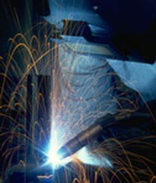
Welding protective gear
Health hazards from welding, cutting, and brazing operations include exposures to metal fumes and to ultraviolet (UV) radiation. Safety hazards from these operations include burns, eye damage, electrical shock, cuts, and crushed toes and fingers.
Notes:
https://www.osha.gov/SLTC/weldingcuttingbrazing/hazards.htmlhttps://www.osha.gov/SLTC/weldingcuttingbrazing/hazards.html

Slide 19
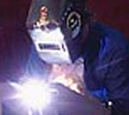
Welding Helmets
Shield the face from sparks and hot debris
Supports the window and secures the device to the worker's head.
Welding helmets are heat and electricity insulated and flame resistant
Notes:
https://www.osha.gov/SLTC/etools/eyeandface/employer/requirements.html
https://www.osha.gov/SLTC/etools/eyeandface/ppe/light_radiation.html#Welding

Slide 20
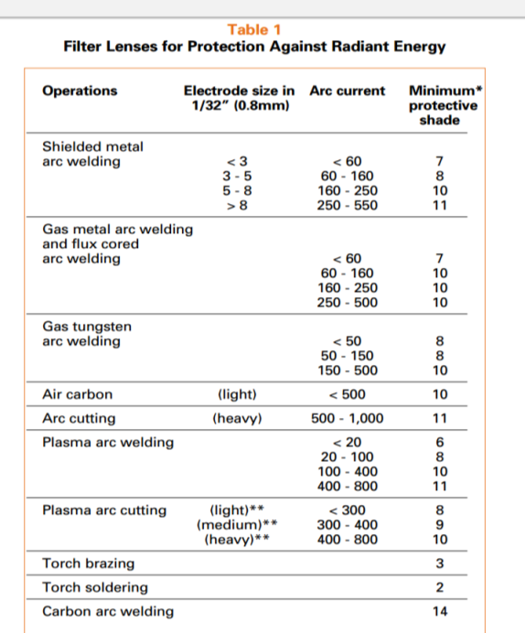

Lenses shade scale
Notes:
https://www.osha.gov/Publications/osha3151.pdf
https://www.osha.gov/SLTC/etools/eyeandface/ppe/light_radiation.html#Welding
29 CFR 1910.133

Slide 21
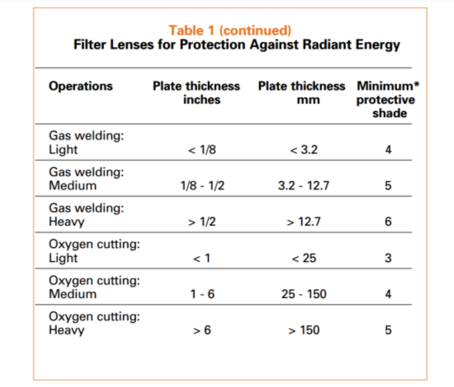
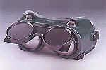
Shade scale (continued)
Notes:
https://www.osha.gov/Publications/osha3151.pdf
https://www.osha.gov/SLTC/etools/eyeandface/ppe/light_radiation.html#Welding
29 CFR 1910.133

Slide 22
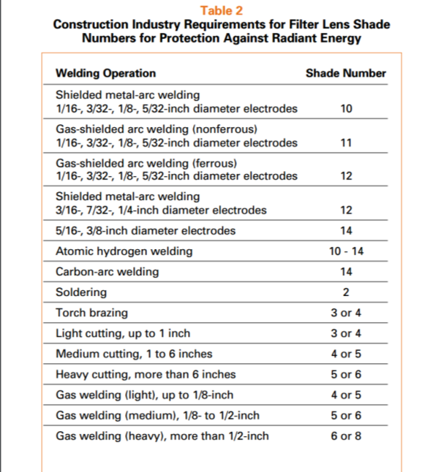
Shade scale
(conclusion)
Notes:
29 CFR 1910.133

Slide 23
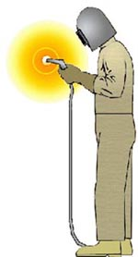
Welding Protective Gear (continued)
Gloves
Leather
Heat resistant
The hands should be protected with leather gauntlet gloves

Slide 24
Welding Protective Gear (conclusion)
Foot protection
sleeves
A pair of high top leather shoes, preferably safety shoes, is good protection for the feet. If low shoes are worn the ankles should be protected by fire resistant leggings
Metatarsal guards
Leather sleeves without cuffs in them are the preferred choice when welding
The leather is fire resistant
Notes:
http://nasdonline.org/1083/d000873/arc-welding-safety.html

Slide 25
Foot Protection
Employees who face possible foot or leg injuries from falling or rolling objects or from crushing or penetrating materials should 20 wear protective footwear. Also, employees whose work involves exposure to hot substances or corrosive or poisonous materials must have protective gear to cover exposed body parts, including legs and feet. If an employee’s feet may be exposed to electrical hazards, non-conductive footwear should be worn. On the other hand, workplace exposure to static electricity may necessitate the use of conductive footwear.
Notes:
https://www.osha.gov/Publications/osha3151.pdf

Slide 26
Foot protection (continued)
Steel toes
Special Purpose
Z41-1999 or 1991
Electrically conductive shoes- protect against build up of static electricity
Electric hazard- nonconductive protect against completing a electrical circuit
Foundry- insulated from extreme heat
Notes:
https://www.osha.gov/Publications/osha3151.pdf
29 CFR 1910.136 – Z41-1999 or 1991; 29 CFR 1926.96 – Z41-1967

Slide 27
Foot Protection (conclusion)
Examples of situations in which an employee should wear foot and/or leg protection include:
When heavy objects such as barrels or tools might roll onto or fall on the employee’s feet
Working with sharp objects such as nails or spikes that could pierce the soles or uppers of ordinary shoes
Exposure to molten metal that might splash on feet or legs
Working on or around hot, wet or slippery surfaces
Working when electrical hazards are present
Notes:
https://www.osha.gov/Publications/osha3151.pdf

Slide 28
Care of Protective Footwear
As with all protective equipment, safety footwear should be inspected prior to each use.
Shoes and leggings should be checked for wear and tear at reasonable intervals. This includes looking for cracks or holes, separation of materials, broken buckles or laces.
The soles of shoes should be checked for pieces of metal or other embedded items that could present electrical or tripping hazards.
Employees should follow the manufacturers’ recommendations for cleaning and maintenance of protective footwear.
Notes:
https://www.osha.gov/Publications/osha3151.pdf

Slide 29
Gloves
There are many types of gloves available today to protect against a wide variety of hazards. The nature of the hazard and the operation involved will affect the selection of gloves.
Notes:
https://www.osha.gov/Publications/osha3151.pdf

Slide 30
Gloves (conTinued)
The following are examples of some factors that may influence the selection of protective gloves for a workplace:
Type of chemicals handled.
Nature of contact (total immersion, splash, etc.).
Duration of contact.
Area requiring protection (hand only, forearm, arm).
Grip requirements (dry, wet, oily).
Thermal protection.
Size and comfort.
Abrasion/resistance requirements.
Gloves made from a wide variety of materials are designed for many types of workplace hazards. In general, gloves fall into four groups:
  Gloves made of leather, canvas or metal mesh
  Fabric and coated fabric gloves
  Chemical- and liquid-resistant gloves
  Insulating rubber gloves

Slide 31
Care of gloves
Protective gloves should be inspected before each use to ensure that they are not torn, punctured or made ineffective in any way.
A visual inspection will help detect cuts or tears but a more thorough inspection by filling the gloves with water and tightly rolling the cuff towards the fingers will help reveal any pinhole leaks.
Gloves that are discolored or stiff may also indicate deficiencies caused by excessive use or degradation from chemical exposure.

Slide 32
Body Protection
Employees who face possible bodily injury of any kind that cannot be eliminated through engineering, work practice or administrative controls, must wear appropriate body protection while performing their jobs

Slide 33
Body Protection (continued)
The following are examples of workplace hazards that could cause bodily injury:
  Temperature extremes
  Hot splashes from molten metals and other hot liquids
  Potential impacts from tools, machinery and materials
  Hazardous chemicals.

Slide 34
Protective clothing comes in a variety of materials, each effective against particular hazards, such as:
Paper-like fiber- used for disposable suits provide protection against dust and splashes.
Treated wool and cotton adapts well to changing temperatures, is comfortable, and fire-resistant and protects against dust, abrasions and rough and irritating surfaces.
Duck is a closely woven cotton fabric that protects against cuts and bruises when handling heavy, sharp or rough materials.

Slide 35
Protective clothing comes in a variety of materials, each effective against particular hazards, such as: continued
Leather is often used to protect against dry heat and flames.
Rubber, rubberized fabrics, neoprene and plastics protect against certain chemicals and physical hazards.
When chemical or physical hazards are present, check with the clothing manufacturer to ensure that the material selected will provide protection against the specific hazard.

Slide 36
Hearing Protection

Slide 37
Hearing Protection (continued)
Employee exposure to excessive noise depends upon a number of factors, including:
The loudness of the noise as measured in decibels (dB).
The duration of each employee’s exposure to the noise.
Whether employees move between work areas with different noise levels.
Whether noise is generated from one or multiple sources.

Slide 38
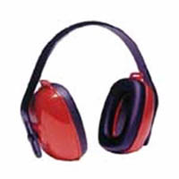
Hearing Protection (conclusion)
Generally, the louder the noise, the shorter the exposure time before hearing protection is required. For instance, employees may be exposed to a noise level of 90 dB for 8 hours per day
Notes:
https://www.osha.gov/SLTC/noisehearingconservation/
29 CFR 1910.95 and 29 CFR 1926.52

Slide 39
Types of Hearing protection
Single-use earplugs are made of waxed cotton, foam, silicone rubber or fiberglass wool. They are self-forming and, when properly inserted, they work as well as most molded earplugs.
Pre-formed or molded earplugs must be individually fitted by a professional and can be disposable or reusable. Reusable plugs should be cleaned after each use.
Earmuffs require a perfect seal around the ear. Glasses, facial hair, long hair or facial movements such as chewing may reduce the protective value of earmuffs.

Slide 40
Permissible Noise Exposure
Duration per day, in hours | Sound in dB
8 | 90
6 | 92
4 | 95
3 | 97
2 | 100
1.5 | 102
1 | 105
.5 | 110
.25 or less | 115
Notes:
https://www.osha.gov/Publications/osha3151.pdf
29 CFR 1910.95 and 29 CFR 1926.52

Slide 41
Respirators
An estimated 5 million workers are required to wear respirators in 1.3 million workplaces throughout the United States. Respirators protect workers against insufficient oxygen environments, harmful dusts, fogs, smokes, mists, gases, vapors, and sprays. These hazards may cause cancer, lung impairment, diseases, or death.
Notes:
https://www.osha.gov/SLTC/respiratoryprotection/

Slide 42
Respirator Types
View Video: https://youtu.be/u_Dovk_khLw
Notes:
Source: https://youtu.be/u_Dovk_khLw

Slide 43
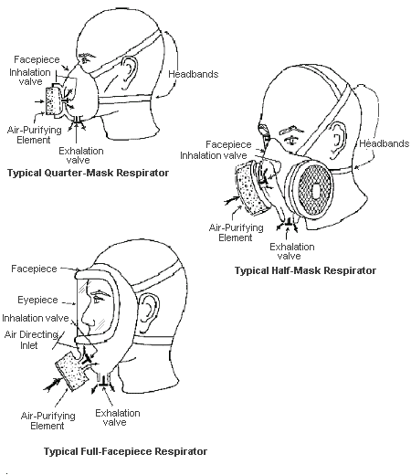
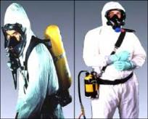
Two Basic types of respirators
Air Supplied
Air Purifying
Protect by supplying clean, breathable air from another source. Respirators that fall into this category include:
  airline respirators, which use compressed air from a remote source
  self-contained breathing apparatus (SCBA), which include their own air supply.
Removal of contaminants from the air. Respirators of this type include particulate respirators, which filter out airborne particles, and air-purifying respirators with cartridges/canisters which filter out chemicals and gases
  Cannot be used in oxygen deficient atmospheres
Notes:
https://www.osha.gov/dts/shib/respiratory_protection_bulletin_2011.html
https://www.osha.gov/dts/osta/otm/otm_viii/otm_viii_2.html
https://www.osha.gov/dts/hazardalerts/methylene_chloride_hazard_alert.html

Slide 44
Types of Respirators
Particulate Respirators
Chemical Cartridge/Gas Mask Respirator
Filter out dusts, fumes and mists.
Are usually disposable dust masks or respirators with disposable filters.
Must be replaced when they become discolored, damaged, or clogged.
Examples: filtering face piece or elastomeric respirator.
Intended only for low hazard levels.
Uses replaceable chemical cartridges or canisters to remove the contaminant.
Are color-coded to help you select the right one.
May require more than one cartridge to protect against multiple hazards
Notes:
https://www.osha.gov/dts/shib/respiratory_protection_bulletin_2011.html

Slide 45
Color code of filter respirator cartages
Contaminant | Color Coding on Cartridge/Canister
Acid gases | White
Hydrocyanic acid gas | White with 1/2 inch green stripe completely around the canister near the bottom.
Chlorine gas | White with 1/2 inch yellow stripe completely around the canister near the bottom.
Organic vapors | Black
Ammonia gas | Green
Acid gases and ammonia gas | Green with 1/2 inch white stripe completely around the canister near the bottom.
Carbon monoxide | Blue
Acid gases & organic vapors | Yellow
Hydrocyanic acid gas and chloropicrin vapor | Yellow with 1/2 inch blue stripe completely around the canister near the bottom.
Acid gases, organic vapors, and ammonia gases | Brown
Radioactive materials, except tritium & noble gases | Purple (magenta)
Notes:
https://www.osha.gov/dts/shib/respiratory_protection_bulletin_2011.html

Slide 46
Types of Respirators (continued)
Powered Air-Purifying Respirator (PAPR):
Self-Contained Breathing Apparatus (SCBA)
Use a fan to draw air through the filter to the user.
Provide clean air from a portable air tank when the air around you is simply too dangerous to breathe
Weighs 30 lbs. or more
Half hour breathing time
Notes:
https://www.osha.gov/dts/shib/respiratory_protection_bulletin_2011.html

Slide 47
Maintenance and care of respirators
View Video
https://www.osha.gov/video/respiratory_protection/maintenance.html
Source: https://youtu.be/CnF05owDxTI
Notes:
https://www.osha.gov/video/respiratory_protection/maintenance.html
Source: https://youtu.be/CnF05owDxTI

Slide 48
Medical Evaluations
Employees need to be medically cleared to wear respirators before commencing use. All respirators generally place a burden on the employee.
  Negative pressure respirators restrict breathing, some respirators can cause claustrophobia
  Self-contained breathing apparatuses are heavy
A physician or other licensed health care professional operating within the scope of his/her practice needs to medically evaluate employees to determine under what conditions they can safely wear respirators.
Notes:
https://www.osha.gov/SLTC/etools/respiratory/respirator_basics.html
Note: Per the OSHA standard, the employee completes the questionnaire in Appendix C (mandatory appendix), and the physician or healthcare professional reviews the answers and may require additional medical evaluations. Or the physician or healthcare professional may do a medical evaluation using the questions from the questionnaire.

Slide 49
Fit testing
All respirators that rely on a mask-to-face seal need to be annually checked with either qualitative or quantitative methods to determine whether the mask provides an acceptable fit to a wearer
  qualitative fit test procedures rely on a subjective sensation (taste, irritation, smell) of the respirator wearer to a particular test agent
  quantitative fit test uses measuring instruments to measure face seal leakage.
Notes:
https://www.osha.gov/SLTC/etools/respiratory/respirator_basics.html

Slide 50
Fall Protection
To maintain their service life and high performance, all belts and harnesses should be inspected frequently. Visual inspection before each use should become routine, and also a routine inspection by a competent person.
Notes:
https://www.osha.gov/Region7/fallprotection/fall_protection_info.html

Slide 51
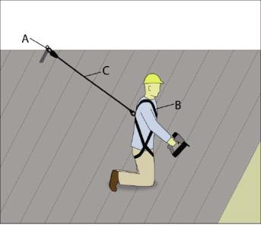
Personal Fall Arrest Systems (PFAS)
A PFAS consists of the following components:
  Anchorage Point
  Body Harness
  Connector
  A+B+C=PFAS
Notes:
The A+B+C=PFAS equation is intended for the participant to understand all three components must be used in order to have a true PFAS.
https://www.osha.gov/Publications/reducing-falls-installing-standing-seam-metal-roofs.html

Slide 52
Anchorages
Anchorages used for attachment of personal fall arrest equipment shall be independent of any anchorage being used to support or suspend platforms and capable of supporting at least 5,000 pounds (22.2 kn.) per employee attached

Slide 53
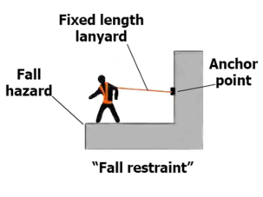
Personal fall arrest system
Full Body Harness
Connecting Device
A body harness is defined by OSHA as: “straps which may be secured about the employee in a manner that will distribute the fall arrest forces over at least the thighs, pelvis, waist, chest and shoulders with means for attaching it to other components of a personal fall arrest system
  Carabineers
  Buckles
  Dee-rings
  Snap-hooks
  Lanyards
  Winches
  Connects the body harness to the anchor point
Notes:
https://www.osha.gov/Publications/fallprotectionsafety-commercialfishing-factsheet.html

Slide 54
Retrieval
In the event of emergency having a system in place to remove occupant from confined space examples:
Lifeline
Designed to make non entry rescue possible
  Difficult to pull person out in vertical confined spaces
Winch
Designed to assist with the removal of personnel from the confined space
Makes it possible for single person to pull another out
Mechanical advantage
  Dangers are if the incapacitated person becomes tangled on a fixed object can cause damage to the person

Slide 55
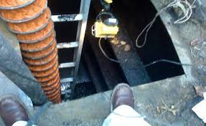
Ventilation
Mechanical ventilation
A fan with hose attached to either push a new atmosphere in or pull a hazardous atmosphere out.

Slide 56
Improper Ventilation Death
View Video: https://youtu.be/gMKuzopg5wc
Notes:
Source: https://youtu.be/gMKuzopg5wc

Slide 57
Employee Rights and Responsibilities
Notes:
Workers Rights
http://www.osha.gov/Publications/osha3021.pdf

Slide 58
Employee Rights & Responsibilities
Occupational Safety and Health Act of 1970
To assure safe and healthful working conditions for working men and women
By authorizing enforcement of the standards developed under the Act
By assisting and encouraging the States in their efforts to assure safe and healthful working conditions
By providing for research, information, education, and training in the field of occupational safety and health…
Notes:
Workers Rights
http://www.osha.gov/Publications/osha3021.pdf
The instructor will discuss employee rights and responsibilities with the participants.

Slide 59
Employee Rights & Responsibilities
You have the right to:
  A safe and healthful workplace
  Know about hazardous chemicals
  Information about injuries and illnesses in your workplace
  Complain or request hazard correction from employer
Notes:
The information above was taken from the new 2 hour Intro to OSHA PPT, slide #10.
The instructor will discuss employee rights and responsibilities with the participants.

Slide 60
Employee Rights & Responsibilities
You have the right to:
File a confidential complaint with OSHA to have their workplace inspected.
Receive information and training about hazards, methods to prevent harm, and the OSHA standards that apply to their workplace. The training must be done in a language and vocabulary workers can understand.
Get copies of their workplace medical records and exposure records.
Participate in an OSHA inspection and speak in private with the inspector.
Notes:
Workers Rights
http://www.osha.gov/Publications/osha3021.pdf

Slide 61
Employee Rights & Responsibilities Continued:
File a complaint with OSHA if they have been retaliated or discriminated against by their employer as the result of requesting an inspection or using any of their other rights under the OSH Act.
File a complaint if punished or discriminated against for acting as a “whistleblower” under the additional 21 federal statutes for which OSHA has jurisdiction.
Notes:
Workers Rights
http://www.osha.gov/Publications/osha3021.pdf
Incorporate into all 4 modules. 3-4 slides need to be added.
Provide handouts to minimize amount of info on slides.

Slide 62
Whistleblower Protection
OSHA's Whistleblower Protection Program enforces the whistleblower provisions of more than twenty whistleblower statutes protecting employees who report violations of various workplace safety and health, airline, commercial motor carrier, consumer product, environmental, financial reform, food safety, health insurance reform, motor vehicle safety, nuclear, pipeline, public transportation agency, railroad, maritime, and securities laws. Rights afforded by these whistleblower protection laws include, but are not limited to, worker participation in safety and health activities, reporting a work-related injury, illness or fatality, or reporting a violation of the statutes herein.
Notes:
The Whistleblower Protection Program
http://www.whistleblowers.gov/

Slide 63
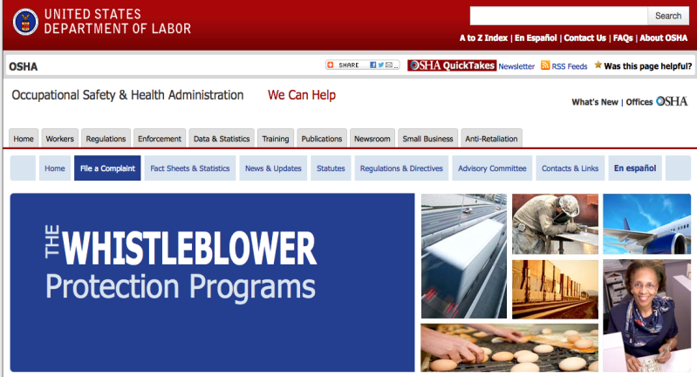
Whistleblower Protection (continued)
Notes:
The Whistleblower Protection Program
http://www.whistleblowers.gov/

Slide 64
Employee Rights & Responsibilities (continued)
Workers Rights: http://www.osha.gov/Publications/osha3021.pdf
  Compliance Assistance Specialists in the area offices
  National Institute for Occupational Safety and Health (NIOSH) – OSHA’s sister agency
  OSHA Training Institute Education Centers
  Doctors, nurses, other health care providers
  Other local, community-based resources
Notes:
The Information above was taken from the new 2 hour Intro to OSHA PPT, slide #40.
The instructor will discuss employee rights and responsibilities with the participants.

