Slide 1
Instrumentation and air monitoring
This material was produced under a grant (SH-27666-SH6) from the Occupational Safety and Health Administration, U.S. Department of Labor. It does not necessarily reflect the views or policies of the U.S. Department of Labor, nor does the mention of trade names, commercial products, or organization imply endorsement by the U.S. Government.

Slide 2
Objectives
Identify atmospheric hazards
Identify sources of atmospheric hazards
Identify testing equipment
Understand the usage characteristics of testing equipment
Identify control practices
Look at case studies

Slide 3
What is a confined Space?
A confined space has:
Limited means of entry/exit,
Is large enough for a worker to enter it, and
Is not intended for regular/continuous occupancy.
Examples may include sewers, pits, crawl spaces, attics, boilers, and many more
Notes:
https://www.osha.gov/confinedspaces/faq.html; 29 CFR 1910.146 and 1926.1202

Slide 4
What is a Permit required confined space?
Permit-required confined spaces have one or more of these characteristics:
Contains or has the potential to contain a hazardous atmosphere;
Contains a material with the potential to engulf someone who enters the space;
Has an internal configuration that might cause an entrant to be trapped or asphyxiated by inwardly converging walls or by a floor that slopes downward and tapers to a smaller cross section; and
Contains any other recognized serious safety or health hazards.
Notes:
https://www.osha.gov/Publications/osha3138.html; 29 CFR 1910.146 and 1926.1202

Slide 5
Video confined space
Show Video
https://www.osha.gov/video/shipyard_accidents/03_confined_space.html
Notes:
https://www.osha.gov/video/shipyard_accidents/03_confined_space.html

Slide 6
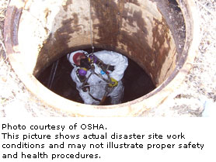
Video questions
How could this have been avoided?
What should have been done differently
Notes:
Source https://www.osha.gov/SLTC/etools/hurricane/confined-spaces.html

Slide 7
Instrumentation

Slide 8
Common mistakes with air monitoring
Test instruments not calibrated at all
Equipment calibrated with wrong gases
Meter is zeroed in an area where gases are present giving the meter a false zero
Permit does not identify toxic gases to test
Tester cannot be identified

Slide 9
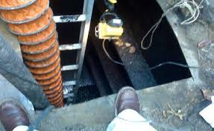
Is this confined Space Safe?
Notes:
OSHA.GOV

Slide 10
Is this confined space safe continued
What hazards could be present?
What energies need to be isolated?
How do we know what atmospheric hazards exist?
Notes:
The hazards that it could include:
Fall hazards, Atmospheric, Chemical thermal, As well as a host of other hazards associated with confined space.
Energies to be isolated include:
Gravitational, electric, thermal, chemical.
Atmospheric testing is the only way to identify atmospheric hazards.

Slide 11
What is a atmospheric hazard?
Hazardous atmosphere means an atmosphere that may expose employees to the risk of death, incapacitation, impairment of ability to self-rescue (that is, escape unaided from a permit space), injury, or acute illness from one or more of the following causes:
Flammable gas, vapor or mist in excess of 10% of its Lower Flammable Limit (LFL);
Airborne combustible dust at a concentration that meets or exceeds its LFL;
Notes:
https://www.osha.gov/confinedspaces/1926_subpart_aa.pdf; 29 CFR 1926.1202 (definitions)
Note – for combustible dust, this concentration may be approximated as a condition in which the dust obscures vision at a distance of 5 feet or less.

Slide 12
What is a atmospheric hazard continued
Atmospheric oxygen concentration below 19.5 percent or above 23.5 percent;
Atmospheric concentration of any substance for which a dose or a permissible exposure limit is published in Subpart D—Occupational Health and Environmental Control, or in Subpart Z—Toxic and Hazardous Substances, of this part and which could result in employee exposure in excess of its dose or permissible exposure limit; or
Any other atmospheric condition that is immediately dangerous to life or health.
Notes:
https://www.osha.gov/confinedspaces/1926_subpart_aa.pdf

Slide 13
Three main types of atmospheric hazards
Unsafe Oxygen levels, either an oxygen deficient below 19.5% or oxygen enriched above 23.5%
Flammable gases
Toxic vapors and/or toxic dust particulates

Slide 14
Types of instruments
Use direct reading with “Real Time” information on actual concentration
Alarm only devices do not provide readings and are not considered acceptable direct reading instruments.

Slide 15
Monitor characteristics
Easily operated
Readable in both light and dark conditions
Easily calibrated or standardized
Equipped with a peak-hold feature to record the highest concentration encountered
Equipped with audible and visual alarms for a preset concentration

Slide 16
Monitor characteristic continued
Explosion-proof
Equipped with fully charged batteries at all times
Easily protected against contamination
Equipped with a remote probe for non-entry testing
Reliable, rugged, and dependable

Slide 17
Where do you test?
Confined Space
Texting at every level is important to ensure proper readings of all gasses within the confined space
Good air at the opening does not mean good air at the bottom.
Good Air
Poor Air
Deadly Air

Slide 18
Vapor Density Chart
Hydrogen: 0.07
Methane: 0.55
Ammonia: 0.59
Carbon Monoxide: 0.96
Nitrogen: 0.97
Air: 1.0
Hydrogen Sulfide: 1.19
Argon: 1.38
Carbon Dioxide: 1.52
Toluene: 3.2
Gasoline: 3.0-4.0
Jet Fuel, JP-8: 4.7
Lighter Than Air
Heavier Than Air
Notes:
Source:
www.oshainfo.gatech.edu/ppt/confined-gi.ppt
"Handbook of Chemical Hazard Analysis Procedures" by Federal Emergency Management Agency (FEMA), U.S. Department of Transportation (DOT), U.S. Environmental Protection Agency (EPA)
http://www.firehouse.com/article/10574881/the-rest-of-the-story-calculating-vapor-density

Slide 19
Warning
The following video deals with death in a confined space, and may be disturbing for some viewers. There is harsh language used in the film that could offend some viewers please use caution when viewing

Slide 20
Video The Cody Mcnolty story
Show Work safe BC Video
https://www.youtube.com/watch?v=SuC4aurqkm8
Notes:
https://www.youtube.com/watch?v=SuC4aurqkm8
Work safe BC

Slide 21
Air monitoring

Slide 22
There is no universal monitor that can test for all possible gasses

Slide 23
Reasons for hazard assessment
A hazard assessment should be done in order to assess what hazardous atmosphere (including chemicals) is likely to be present and what sensors are need to be in the air monitor to identify the presence of those hazardous atmosphere (including chemicals)

Slide 24
Sensors
The responsiveness of sensors will vary with workplace environmental conditions, such as temperature and humidity.
Therefore, to the degree possible, operators should calibrate sensors in environmental conditions that are the same as (or similar to) the actual workplace conditions.
Follow the manufacturer's guidelines for proper calibration.

Slide 25
Evaluation testing
Meant to evaluate the atmosphere inside a confined space, it determines:
What chemical hazards are present or may become present
How to best deal with hazards and perform tasks at hand
Ex. Finding the oxygen level slightly below 20.9%, The entry supervisor will choose procedures to address the hazard- most likely through ventilation.

Slide 26
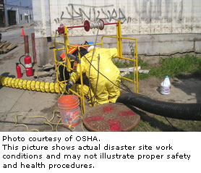
Air Monitoring (continued)
Must conduct atmospheric testing before entry into the confined space
The reason for testing is to ensure atmosphere is safe to enter
Test every time before reentering the confined space
Notes:
source https://www.osha.gov/SLTC/etools/hurricane/confined-spaces.html

Slide 27
How often do we need to test?
The atmosphere within the space must be continuously monitored unless the entry employer can demonstrate that equipment for continuous monitoring is not commercially available or periodic monitoring is sufficient. If continuous monitoring is used, the employer must ensure that the monitoring equipment has an alarm that will notify all entrants if a specified atmospheric threshold is achieved, or that an employee will check the monitor with sufficient frequency to ensure that entrants have adequate time to escape. If continuous monitoring is not used, periodic monitoring is required. All monitoring must ensure that the continuous forced air ventilation is preventing the accumulation of a hazardous atmosphere. Any employee who enters the space, or that employee’s authorized representative, must be provided with an opportunity to observe the testing required by this paragraph.
Notes:
https://www.osha.gov/confinedspaces/1926_subpart_aa.pdf; This statement is actually under the standard when entry is under alternate procedures (1926.1203(e)). However, this is a good practice no matter what.

Slide 28
Air monitoring (conclusion)
Initial entry is prohibited until testing of the atmosphere has been performed
Every time the confined space is entered
Continuously
Person assigned the task of monitoring must be versed on the operation and limitations of the instrument used

Slide 29
Atmospheric monitoring
When testing for atmospheric hazards, test in the following order
Oxygen
Combustible gases and vapors
Toxic gases and vapors
Or test for all simultaneously
Notes:
29 CFR 1926.1203(e)(2)(iii)

Slide 30
Upper and Lower Explosive Limits
Lower Explosive Limit:
The minimum concentration of a flammable gas in air that will ignite and burn.
Upper explosive limit:
The concentration of a flammable gas in air that is to rich to burn
Notes:
29 CFR 1926.1202 Definitions

Slide 31
Lower Explosive Limits:
Chemical Name LEL UEL
Ammonia 15.00% 28.00 %
Carbon Monoxide 12.50% 74.00 %
Methane 5.00 % 15.00 %
Proplyene 2.40 % 11.00 %
Notes:
Source http://www2.mathesongas.com/pdfs/products/Lower-(LEL)-&-Upper-(UEL)-Explosive-Limits-.pdf

Slide 32
Calibration
"Calibration" refers to an instrument's measuring accuracy relative to a known traceable concentration of test gas.
Best way to verify that a Direct Read Portable Gas Monitors (DRPGMs) is reading accurately and reliable, is to compare the sensor's response to a known concentration of the test gas.
To confirm the validity of this comparison, it is important to ensure the calibration gas has not expired (always check the expiration date of the gas before usage).
The instrument's response to the calibration gas serves as the reference point.
Notes:
https://www.osha.gov/dts/shib/shib093013.html

Slide 33
Calibration (continued)
The primary reason for proper, regular instrument calibration is to provide accurate gas-concentration readings that could prevent worker illness, injury, or death. Correctly calibrating an instrument helps to ensure that the DRPGM will respond accurately to the gases it is designed to detect, thereby warning users of hazardous conditions before the conditions reach dangerous levels.
Always calibrate per the manufacturers’ specifications.
Notes:
https://www.osha.gov/dts/shib/shib093013.html

Slide 34
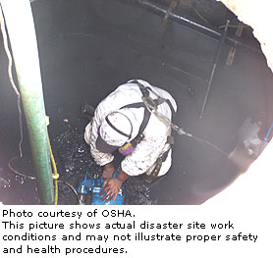
Calibration Drift
When an instrument's reference point shifts, the reading will shift accordingly and be unreliable. This is called "calibration drift," and it happens to all sensors over time. An instrument that experiences calibration drift can still measure the quantity of gas present, but it cannot convert this information into an accurate numerical reading.
Notes:
Source https://www.osha.gov/SLTC/etools/hurricane/confined-spaces.html

Slide 35
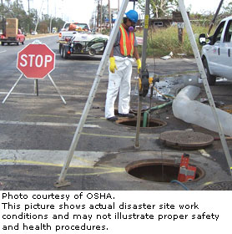
What causes calibration drift?
Degradation caused by exposure to phosphates
Degradation of phosphorus-containing components
Degradation of lead-containing components
Gradual chemical degradation of sensors and drift in electronic components that occur normally over time.
Use in extreme environmental conditions, such as high/low temperature and humidity, and high levels of airborne particulates.

Slide 36
What causes calibration drift continued
Exposure to high concentrations of the target gases and vapors.
Exposure of catalytic hot-bead LEL sensors in the instruments to volatile silicones, hydride gases, halogenated hydrocarbons, and sulfide gases.
Exposure of electrochemical toxic gas sensors to solvent vapors and highly corrosive gases.
Handling/jostling of the equipment causing enough vibration or shock over time to affect electronic components and circuitry.

Slide 37
Bump testing
This is a qualitative function check in which a challenge gas is passed over the sensor(s) at a concentration and exposure time sufficient to activate all alarm settings.
The purpose of this check is to confirm that gas can get to the sensor(s) and that all the instrument's alarms are functional.
The bump test or function check does not provide a measure of the instrument's accuracy.
When performing a bump test, the challenge gas concentration should trigger the DRPGM's alarm(s).
Notes:
https://www.osha.gov/dts/shib/shib093013.html

Slide 38
When to perform bump test and full calibration
A bump test or calibration check of portable gas monitors should be conducted before each day's use in accordance with the manufacturers’ instructions
If an instrument fails a bump test or a calibration check, the operator should perform a full calibration on it before using it. How often you should calibrate the meter depends on how much its used, always refer to the manufacturers’ recommendations. If the instrument fails the full calibration, the employer should remove it from service.

Slide 39
To perform the calibrations
Follow the manufacturers’ guidelines for proper calibration
Only use a certified traceable test gas, and do so before its expiration date
Train DRPGM operators on the proper methods of calibration. Most instruments are designed to be field calibrated with detailed instructions provided in the manufacturers’ user manual, training videos, or computer-based training modules

Slide 40
Case study 1
•Company laying sewer pipe & manholes for a new housing development 6 employees onsite. City codes require a vacuum test – must maintain 10 inches of mercury for a specific time based on depth of manhole. If vacuum test fails, then sections of the manhole must be grouted to get a better seal. • After vacuum test failure, employee reportedly was assigned the grouting task Grouting is done by hand and takes about 1 hour. The employee was working alone.
The employee was found at the bottom of the manhole unconscious

Slide 41
What went Wrong?
OSHA issued two serious violations and one other than serious violation:
– 5(a)(1) – Develop and Implement a confined space entry program
– 29CFR1926.21(b)(6)(i) – Training
– 29CFR1904.39(a) – Employer to report a workplace fatality within 8 hours
Notes:
This was prior to the construction standard—29 CFR 1926.1201 -1213.

Slide 42
Questions?

Slide 43
Workers Rights and responsibilities

Slide 44
Employee Rights & Responsibilities Occupational Safety and Health Act of 1970
To assure safe and healthful working conditions for working men and women
By authorizing enforcement of the standards developed under the Act
By assisting and encouraging the States in their efforts to assure safe and healthful working conditions
By providing for research, information, education, and training in the field of occupational safety and health…
Notes:
Workers Rights
http://www.osha.gov/Publications/osha3021.pdf
The instructor will discuss employee rights and responsibilities with the participants.

Slide 45
Employee Rights & Responsibilities
You have the right to:
A safe and healthful workplace
Know about hazardous chemicals
Information about injuries and illnesses in your workplace
Complain or request hazard correction from employer
Notes:
The information above was taken from the new 2 hour Intro to OSHA PPT, slide #10.
The instructor will discuss employee rights and responsibilities with the participants.

Slide 46
Employee Rights & Responsibilities You have the right to:
File a confidential complaint with OSHA to have their workplace inspected.
Receive information and training about hazards, methods to prevent harm, and the OSHA standards that apply to their workplace. The training must be done in a language and vocabulary workers can understand.
Get copies of their workplace medical records and exposure records.
Participate in an OSHA inspection and speak in private with the inspector.
Notes:
Workers Rights
http://www.osha.gov/Publications/osha3021.pdf

Slide 47
Employee Rights & Responsibilities Continued:
File a complaint with OSHA if they have been retaliated or discriminated against by their employer as the result of requesting an inspection or using any of their other rights under the OSH Act.
File a complaint if punished or discriminated against for acting as a “whistleblower” under the additional 21 federal statutes for which OSHA has jurisdiction.
Notes:
Workers Rights
http://www.osha.gov/Publications/osha3021.pdf
Incorporate into all 4 modules. 3-4 slides need to be added. Provide handouts to minimize amount of info on slides.

Slide 48
Whistleblower Protection
OSHA's Whistleblower Protection Program enforces the whistleblower provisions of more than twenty whistleblower statutes protecting employees who report violations of various workplace safety and health, airline, commercial motor carrier, consumer product, environmental, financial reform, food safety, health insurance reform, motor vehicle safety, nuclear, pipeline, public transportation agency, railroad, maritime, and securities laws. Rights afforded by these whistleblower protection laws include, but are not limited to, worker participation in safety and health activities, reporting a work-related injury, illness or fatality, or reporting a violation of the statutes herein.
Notes:
The Whistleblower Protection Program
http://www.whistleblowers.gov/

Slide 49
Whistleblower Protection (Continued)
Whistleblower Protection Advisory Committee (WPAC) was established to advise, consult with, and make recommendations to the Secretary of Labor and the Assistant Secretary of Labor for Occupational Safety and Health on ways to improve the fairness, efficiency, effectiveness, and transparency of OSHA's administration of whistleblower protections. In particular, the committee advises OSHA on the development and implementation of improved customer service models, enhancements in the investigative and enforcement process, training, and regulations governing OSHA investigations. In addition, WPAC advises OSHA in cooperative activities with other federal agencies that are responsible for areas covered by the whistleblower protection statutes enforced by OSHA.
Notes:
The Whistleblower Protection Program
http://www.whistleblowers.gov/

Slide 50
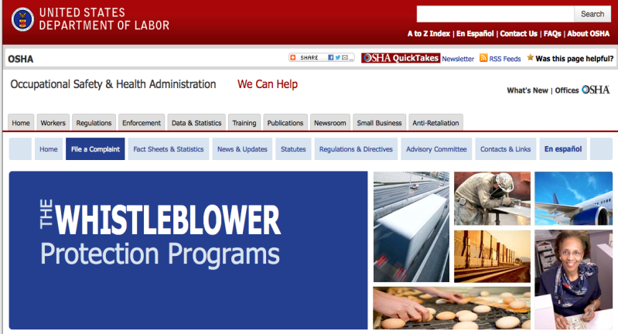
Whistleblower Protection (conclusion)
Notes:
The Whistleblower Protection Program
http://www.whistleblowers.gov/

Slide 51
Employee Rights & Responsibilities (continued)
Workers Rights:
Compliance Assistance Specialists in the area offices
National Institute for Occupational Safety and Health (NIOSH) – OSHA’s sister agency
OSHA Training Institute Education Centers
Doctors, nurses, other health care providers
Other local, community-based resources
Notes:
The Information above was taken from the new 2 hour Intro to OSHA PPT, slide #40.
The instructor will discuss employee rights and responsibilities with the participants.
http://www.osha.gov/Publications/osha3021.pdf

