Slide 1
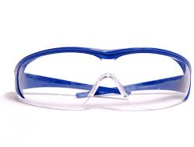

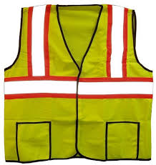
Personal Protective Equipment

Slide 2



Overview
ACTIVITY
PPE
Overview
What to
Know
PPE
Types
Notes:
Before we begin, let’s take a few minutes to gauge your knowledge of PPEs. Please take the quiz on page 11 of your Workbook

Slide 3

PPE Overview
Purpose
To shield or isolate employees from the hazard that may be present in the workplace.
Employers are required to provide PPE. If employees provide their own PPE the employer is responsible to assure its adequacy, including proper maintenance, and sanitation of such equipment.
PPE type is based on the specific job hazards encountered.
Notes:
Employers must protect employees from hazards such as falling objects, harmful substances, and noise exposures that can cause injury.
Under OSHA employers are required to provide a hazard free environment for employees. Anyone encountering hazardous conditions must be protected against the potential hazards.

Slide 4
PPE Overview Required of Employers
Provide a hazard-free environment
Protected against potential hazards
Notes:
Employers must protect employees from hazards such as falling objects, harmful substances, and noise exposures that can cause injury.
Under OSHA employers are required to provide a hazard free environment for employees. Anyone encountering hazardous conditions must be protected against the potential hazards.

Slide 5
PPE Overview Types
Clothing and Accessories
Head protection
Eye and Face protection
Hearing protection
Hand protection
Foot protection
Respiratory protection
Notes:
The purpose of PPE clothing and equipment is to shield or isolate employees from injury.
PPE can be thought of as anything that creates a protective barrier.
We’ll cover those that are most relevant to the construction industry

Slide 6
PPE Overview Engineering Controls
PPE is always considered a last resort
Temporary type of protection
First choice will always be to eliminating hazard
If the machine or work environment can be physically changed to prevent employee exposure to the potential hazard, then the hazard can be eliminated with an engineering control.

Slide 7
PPE Overview Engineering Controls Examples
Initial design specification
Substitute less harmful material
Change process
Enclose process
Isolate process

Slide 8
PPE Overview Work Practice Controls
Job rotation
If employees can be removed from exposure to the potential hazard by changing the way they do their jobs, then the hazard can be eliminated with a work practice control.
Wet method
Personal Hygiene
House Keeping
Increase Maintenance
Some examples include:

Slide 9
What to Know
DISCUSSION
Job Hazards
Examples
Noise
Chemicals
Accidental Impact
Sharp objects
Flying Particles
Dust & Mists
Bright Light
Vibration
Notes:
Typical job hazards……are there others not included here?

Slide 10
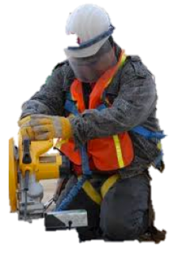
What to Know About PPE
Limitations of PPE
How to use PPE
When to use PPE
Inspect before use
Replacement
Cleaning & Storage
Today, we’ll discuss:
PPE should be used in conjunction with other protective methods.
Notes:
No combination of PPE and clothing is capable of protecting against all hazards.

Slide 11
What to Know PPE Limitations
The use of PPE can itself create significant worker hazards, such as heat stress physical and psychological stress and impaired vision, mobility and communication.
In general, the greater the level of PPE the greater is the associated risks. For any given situation, PPE should be selected that provide an adequate level of protection.
Over protection as well as under protection can be hazardous and should be avoided.

Slide 12
What to Know PPE Limitations
PPE acts as a barrier between you and the hazard.
PPE will not protect you if PPE is:
Not designed for the specific hazard
Damaged or worn
Not adjusted properly
Notes:
What’s worse: using a PPE incorrectly or using no PPE at all? Why?
[SPEAKER NOTE]: Covered on next slide

Slide 13
What to Know Using PPE
DISCUSSION
Using PPE improperly or in a manner unsuited to its design and purpose is worse than using no protection at all.
Without any protection, the worker knows they are vulnerable and might take precautions.
With some protection the employee may increase the risk by exposing himself to a hazard thinking they were safe, when in fact they were not.
Each employee must be trained in the proper use of PPE and the understanding of when it is required.
Notes:
What are some examples of incorrectly or not using PPE?

Slide 14
What to Know
Using PPE
For PPE to be effective in protecting you:
Use it in the manner you have been trained.
Use it only for the specific hazards that it’s intended.

Slide 15
What to Know Before using
Before using your PPE, inspect it for:
Worn or damaged parts
Leaks, cracks or deformities
Cleanliness
Correct size
Notes:
PPE should be checked daily prior to its use.

Slide 16
What to Know Replacing
If any PPE is damaged or worn
Get it repaired or replaced immediately
Tell your supervisor you need new PPE
Do not work without replacement PPE
Notes:
PPE should be checked daily prior to its use.

Slide 17
What to Know Cleaning & Storing
Clean your PPE regularly.
Do not store it where it will be in contact with:
Dust & Dirt
Water
Sunlight
Chemicals

Slide 18
What to Know Written PPE Program
A written PPE Program should be established for each job.
Two basic objectives of a PPE Program:
Protect the wearer
Prevent injury

Slide 19
What to Know
DISCUSSION
Written PPE Program
Comprehensive PPE Program:
Medical monitoring
Environmental surveillance
Selection
Use
Maintenance Decontamination
Training
Hazard identification
Notes:
Your employers should provide a written PPE program that should be reviewed annually.
Elements that should be considered in the review include the number of persons hurt or injured, level of exposure, adequacy of PPE selected, operational guidelines, effectiveness of training, program costs and improvements needed.
How many of your employers have provided a written PPE program? What could be strengthened?

Slide 20
PPE Types
Eye
&
Face

Slide 21
PPE Types Eye & Face Protection Causes of eye injuries
Injurious gases
Dust or powders
Flying objects or particles
Vapors
Liquids
Fumes and mists
Glare from welding

Slide 22

PPE Types Eye & Face Protection Protecting your eyes
Your eyes are very sensitive organs and may be easily injured.
Eye Hazards include:
Chemical Splashes
Flying dust, chips, sparks
High Heat
Intense or UV light
Notes:
OSHA requires eye and face protection where there is a reasonable probability of preventable injury when such equipment is used. Employers must provide a type of protector suitable for work to be performed and employees must use the protector.

Slide 23
PPE Types Eye & Face Protection Specific Hazards Include:
IMPACT: Chipping, grinding machining, masonry work, woodworking, sawing, drilling, chiseling, powered fastening, riveting, and sanding.
HEAT: Furnace operations, pouring, casting, hot dipping, welding
LIGHT or RADIATION: Electric arc welding, gas welding, gas cutting
IRRITANTS/ CORROSIVES: Mists, dusts, sprays, splashes
Notes:
60% of workers who suffer eye injuries do not wear eye protective equipment. When asked why they were not wearing them, workers indicated that was not normally used or practiced in their type of work or it was not required.

Slide 24
PPE Types Eye & Face Protection Types of Eye Protection
Safety Glasses: for flying chips & low hazards
Vented Goggles: for dust and non-hazardous mist
Non-Vented Goggles: hazardous chemicals
Dark Lenses: intense or UV light

Slide 25
PPE Types Eye & Face Protection Corrective Glasses & Eye Protection
Spectacles with protective lenses
Goggles worn over corrective spectacles
Goggles that incorporate corrective lenses
Notes:
Persons using corrective spectacles and those who are required by OSHA to wear eye protection must wear face shields , goggles or spectacles of one of the types. Spectacles with protective lenses providing optical correction, Goggles worn over corrective lens, Goggles that incorporate corrective lenses mounted behind the protective lenses.

Slide 26
PPE Types Eye & Face Protection Inspection/Maintenance of Eye Protection
Keep lenses clean
Daily inspection and cleaning
Storage: in cases
Replace pitted and dirty lenses
Notes:
It is essential that the lenses of eye protectors be kept clean.
Daily lenses can cause eyestrain often an excuse for not wearing the eye protectors.
Daily inspection and cleaning of the lens with soap and hot water or with a cleaning solution and tissue is recommended.
Goggles and other eye protectors should be stored in their cases when not in use.
Replace pitted lenses and dirty lenses, as these can be a source of reduced vision

Slide 27
PPE Types Eye & Face Protection Face Protection
Use a face shield when any of the following hazards exist:
Chemical splashes
Liquid spray
Flying chips or sparks
High Heat
Special face shield
Notes:
Suitable eye protectors must be provided where machines or operations present the hazard of flying objects, glar, liquids, injurioous radiation or a combination of these hazards.

Slide 28
PPE Types
Eye & Face Protection
Face Protection
When using a face shield:
Always us the correct type eye protection with a face shield….
A face shield is NOT designed to protect your eyes

Slide 29
PPE Types
Head
Protection
Notes:
Head injuries are caused by falling or flying objects, or by bumping the head against a fixed object.

Slide 30
PPE Types Head Protection Hardhats
Hard hats are needed to protect against
Falling objects
Accidental impact
Notes:
Hard hats require a hard outer shell and shock absorbing lining. Look at the inside of any helmet you are considering and you should see a lable showing the manufactures name the ANSI standard it meets and its class. Helmets must be always be worn as designed to be in compliance with ANSI.
Use an electrically rated hard hat when there is a potential for contact with live circuits

Slide 31
PPE Types Head Protection Hardhat Requirements
The shell of the hat of material hard enough to resist the blows and by utilizing a shock absorbing lining composed of headbands and crown straps to keep the shell away from the wearer's head.
Resist penetration
Protective hats must do two things:
Absorb the shock of a blow
ANSI Standards:
Z89.1-1986
Z89.1-1997
Notes:
The standards use are located in ANSI =American National Safety Institute

Slide 32
PPE Types Head Protection Protective Hat Types
Type 1 Helmets
Type 2 Helmets
Three Classes of Helmets:
Reduce the force of impact resulting from a blow to the top of head.
Reduce the force of impact from a blow that is off-center or to top of head
G: Intended to reduce danger of contact exposure to low voltage conductors 2,200 volts.
C: NOT intended to provide protection against contact with electrical conductors.
E: Intended to reduce danger of exposure to high voltage conductors 20,000 volts.

Slide 33
PPE Types Head Protection Helmet Construction
Water Resistant
Slow Burning
Shell and suspension
Adjustable headbands
Notes:
Materials used in helmets should be water resistant and slow burning.
Each consists essentially of a shell and suspension ventilation is provided by a space between the headband and the shell.
Each helmet should be accompanied by instruction on the proper method of adjusting and replacing the suspension and headband.

Slide 34
PPE Types Head Protection Time to replace when:
The suspension system shows signs of deterioration such as:
Cracking
Tearing
Fraying
The suspension system no longer holds the shell from 1 inch to 1 1/4 inches away from the head.
Notes:
Headbands are adjustable in 1/8 size increments.
When the band is adjusted to the right size, it provides sufficient clearance between the shell and the headband .
The removable replaceable type headband should cover a least the forehead portion of the band.

Slide 35
PPE Types
Head Protection
Time to replace when:
The brim or shell is cracked, perforated, or deformed.
The brim or shell shows signs of exposure to heat, chemicals, ultraviolet light, or other radiation. Signs include:
Loss of surface gloss
Chalking
Flaking
Notes:
The shell should be of one piece seamless construction and designed to resist the impact of a blow from falling material. The internal cradle of the headband and sweatband forms the suspension. Any part that comes in contact with head must no be irritating to normal skin.

Slide 36
PPE Types
Head Protection
Helmet Maintenance & Inspection
Cleaning helmets
Inspect daily
Exposure to unusual conditions
Storage
Notes:
Consult manufacturers’ recommendation for cleaning helmets.
Typically, warm water and a good detergent, then rinsed in clear hot water. Inspect daily for any cracks or damage.
All components must be in good working order.
Helmets should not be stored or carried on the rear window shelf of a car since extreme heat may and will effect the degree of protection

Slide 37
PPE Types
Foot
Protection
Notes:
Safety shoes should be sturdy and have an impact resistant toe.
In some shoes, metal insoles protect against puncture wounds. Additional protection such as metatarsal guards, may be found in some types of foot wear.
Safety shoes come in a variety of styles and materials, such as leather or rubber boots and oxfords.

Slide 38
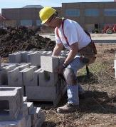
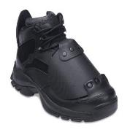
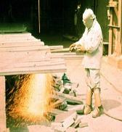
PPE Types Foot Protection Foot Hazards
Beware!
Heavy objects such as barrels or tools that might roll onto or fall onto feet.
Molten metal that might splash
Corrosive chemicals
Sharp objects (i.e. nails or spikes) that might pierce soles or uppers of shoes.
Hot, slippery, or wet surfaces
Notes:
For protection of feet and legs from falling or rolling objects, sharp objects, molten metal, hot surfaces, and wet slippery surfaces workers should use appropriate foot guards, safety shoes, or boots and leggings.

Slide 39
PPE Types Foot Protection Specific Hazards Include
IMPACT: Carrying or handling materials such as packages, objects, parts or heavy tools which could be dropped.
COMPRESSION: Work activities involving skid trucks (manual material handling carts, around bulk rolls, around heavy pipes.
PUNCTURE: Sharp object hazards such as nails, wire, tacks, screws, large staples, scrap metal, etc.
CHEMICAL: Check MSDS for protection standards.
Notes:
Footwear must meet the minimum compression and impact performance standards and testing requirements.

Slide 40
PPE Types Foot Protection Types of Foot Protection
Safety shoes
Boots
Leggings
Notes:
Conductive shoes protect against the buildup of static electricity.
These shoes ground the employee wearing them.
Workers working in explosive and hazardous site must wear these type of shoes in order to reduce the risk.
These shoes are not general purpose shoes and must be removed upon completion of the specific work.

Slide 41
PPE Types Foot Protection Inspect footwear daily
Cracked, torn, or worn uppers
Wear, holes, tears, cracks, loss of tread on bottom
Separation between soles and uppers
LOOK FOR:

Slide 42
PPE Types Foot Protection Safety Shoe Requirements
Safety footwear is classified according to its ability to meet minimum requirements for compression and impact tests. Must be/ have:
Sturdy
Impact Resistant Toe
ANSI Standards:
Z41.1967 or later
Notes:
Those requirements and testing procedures may be found in ANS z41.1967 or later .
The standards use are located in ANSI =American National Safety Institute

Slide 43
PPE Types
Hand
Protection
Notes:
The nature of hazard and the operation to be performed will determine the type of glove to be worn. The variety of potential hand injuries may make selecting the appropriate pair of gloves more difficult than choosing other PPE. Take care to choose gloves designed for the specific hazard. Manufacturers can provide more information relating to your specific needs and requirements.

Slide 44
PPE Types Hand Protection Hand Hazards
Burns
Cuts
Electrical shock
Amputation
Absorption of chemicals
Notes:
Examples of injuries to arms and hands are burns, cuts, electrical shock, amputation and absorption of chemicals. There is a wide assortment of gloves, hand pads, sleeves, and wristlets for protection from various hazardous situations.

Slide 45
PPE Types Hand Protection Types of Gloves
DISCUSSION
General purpose, easy to grip
Lineman’s glove
Nitrile-type gloves
Liquid and chemical resistant
Stainless steel mesh, meat-cutting gloves
Kevlar gloves protect against cuts, slashes and abrasion.
Notes:
Each type is used for a specific task. There are many many others. What type of gloves do you wear?

Slide 46
PPE Types Hand Protection Glove Selection
Not all gloves are created equal.
Chemical gloves do not last forever… understand the chemical and “break-through” characteristics of your specific glove.
Ensure the glove you use will protect your hands from the specific hazards of the job.
Notes:
Each type is used for a specific task. There are many many others. What type of gloves do you wear?

Slide 47

PPE Types Hand Protection Before Using
Select the proper glove for the task
Remove rings & bracelets
Do not wear gloves if they can be caught in machinery
Check gloves for wear and damage
Notes:
The protective glove should be selected to fit the job. Employees should become acquainted with the limitation of the gloves being used.

Slide 48
PPE Types Hand Protection Electricians: Glove Checks
Hole, tear, puncture, or cut
Ozone cutting or ozone checking An embedded foreign object
Swelling, softening, hardening, or becoming sticky or inelastic.
Any other defect that damages the insulating properties
AIR TEST before each use
Notes:
Electricians need special protection from shocks and burns. Rubber is considered the best material for insulating gloves and sleeves.

Slide 49
PPE Types
Hearing Protection
Notes:
The nature of hazard and the operation to be performed will determine the type of glove to be worn. The variety of potential hand injuries may make selecting the appropriate pair of gloves more difficult than choosing other PPE. Take care to choose gloves designed for the specific hazard. Manufacturers can provide more information relating to your specific needs and requirements.

Slide 50
PPE Types Hearing Protection Protect Your Hearing
Use hearing protection when:
In high noise areas
Using power saws, impact tools, etc.
Off the job when shooting, using power tools, etc.
Replace worn or broken hearing protectors immediately
Notes:
Exposure to high noise levels can cause hearing loss or impairment. It can create phyiscal and psychological stress. There is no cure for noise induced hearing loss, so the prevention of excessive noise exposure is the only way to avoid hearing damage.

Slide 51
PPE Types Hearing Protection Types of Hearing Protectors
Preformed or molded earplugs
Foam, disposable earplugs
Notes:
Preformed or molded ear plugs should be individually fitted by a professional. Foam ear plugs are self forming, Some earplugs are disposable , to be used one time and then thrown away. The non-disposable type should be cleaned after each use for proper protection. For extremely noisy situation, earmuffs and earplugs should be worn in addition to earmuffs.

Slide 52
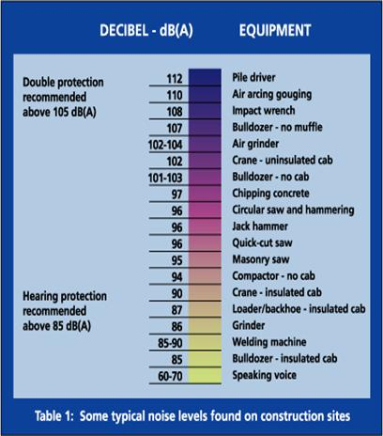
PPE Types Hearing Protection Noise levels associated with construction
DISCUSSION
Notes:
This is available on page 13 of your Workbook

Slide 53
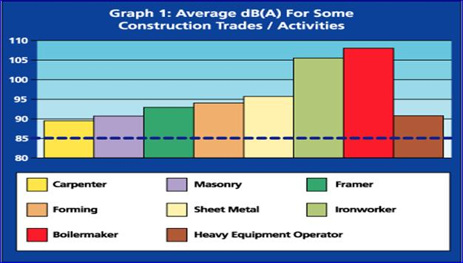
PPE Types Hearing Protection Noise levels associated with construction
DISCUSSION
Notes:
This is available on page 13 of your Workbook

Slide 54
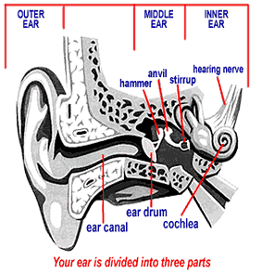
PPE Types Hearing Protection Symptoms of Hearing Loss
Ringing in ears
Difficulty hearing normal conversations
Noises are "fuzzy" or muffled

Slide 55
PPE Types Hearing Protection Hearing Protector Maintenance
Be kept clean
Fit snugly against the head or in the ear
Have no gaps or breaks
Hearing Protection Must:

Slide 56
PPE Types
Fall
Protection
Notes:
Falls are among the most common causes of serious work related injuries and deaths. Employers must set up the work place to prevent employees from falling off of overhead platforms, elevated work stations or into holes in the floor and walls.

Slide 57
PPE Types Fall Protection Employers are required to:
Provide working conditions that are free of known dangers.
Keep floors in work areas in a clean and, so far as possible, a dry condition.
Select and provide required personal protective equipment at no cost to workers.
Train workers about job hazards in a language that they can understand.
Notes:
OSHA requires employers to

Slide 58
PPE Types Fall Protection Employers Must:
Guard every floor hole (using a railing and toe-board or a floor hole cover).
Provide a guard rail and toe-board around every elevated open sided platform, floor or runway.
If a worker can fall into or onto dangerous machines or equipment, employers must provide guardrails and toe-boards
As required by jobs, provide: safety harness and line, safety nets, stair railings and hand rails
Notes:
To prevent employee injuries from falls, employers must:
Guard every floor hole into which a worker can accidentally walk (using a railing and toe-board or a floor hole cover).
Provide a guard rail and toe-board around every elevated open sided platform, floor or runway.
Regardless of height, if a worker can fall into or onto dangerous machines or equipment (such as a vat of acid or a conveyor belt) employers must provide guardrails and toe-boards to prevent workers from falling and getting injured.
Other means of fall protection that may be required on certain jobs include safety harness and line, safety nets, stair railings and hand rails.

Slide 59
PPE Types Fall Protection Considerations
Lifelines, safety harness and lanyards must be used only for employee safeguarding.
Any lifeline, safety harness or lanyard actually subjected to in service loading, as distinguished from static load testing, must be immediately removed from service and not be used again for employees.
Lifelines shall be secured above the point of operation to an anchorage or structural member capable of supporting a minimum dead weight of 5,400lbs.

Slide 60
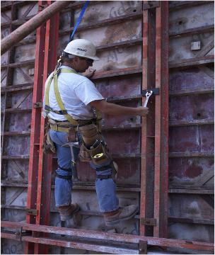
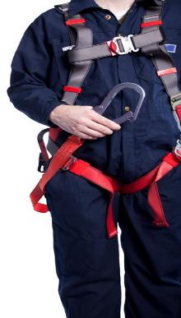
PPE Types Fall Protection Types

Slide 61
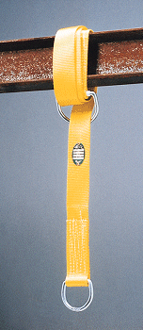
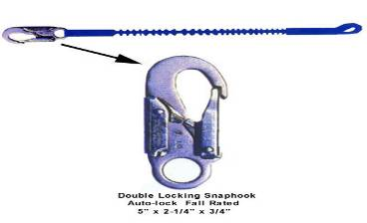
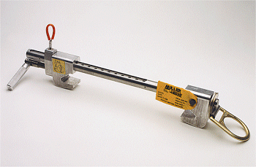
PPE Types Fall Protection Types

Slide 62
PPE Types Other Hazards
Water
Life jackets
Moving vehicles
High visibility clothing
Notes:
Employees may be working near or over water. They must wear a Coast Guard approved life jacket or buoyant work vest if there is danger of falling into the water.
Working in and around traffic requires workers to wear high visibility clothing.
ANSI has approved criteria for high visibility worker apparel.
Any other hazards that you encounter or potential hazards that we haven’t discussed?

Slide 63
Personal Protective Equipment
ACTIVITY
YOUR Protection
Final Considerations
Use the right PPE for the Hazard
Inspect your PPE before using
Replace damaged or worn PPE
Store your PPE properly
Notify your supervisor if you need new PPE
Keep your PPE clean
Notes:
Let’s turn to page 14 in the Workbook

Slide 64
Questions?
?
?
?
?
?
?
Notes:
Let’s take the next 15 minutes or so to test out the PPEs that we have here today

Slide 65
OSHA Disclaimer
This material was produced under grant SH29640SH6 from the Occupational Safety and Health Administration, U.S. Department of Labor. It does not necessarily reflect the views or policies of the U.S. Department of Labor, nor does mention of trade names, commercial products, or organizations imply endorsement by the U.S. Government.

