Slide 1



Safety
Inspection Procedure

Slide 2



Overview
Workplace
Inspections
Inspection
Requirements
Post-Inspection

Slide 3

Inspection
      Process & Goals
Create a better understanding of the inspection process.
Learn how to identify safety hazards.
Learn how to control identified hazards.
Notes:
Because of the nature of work within your facility, what are the risks you encounter?
How we take control of hazards found is the key to creating a safe work environment.

Slide 4
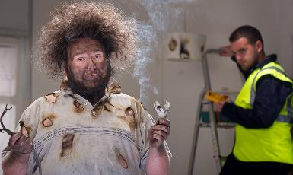
Inspection
Workplace Hazards
Did you Know?
Hazards
Death
Injury
Damage to equipment
Notes:
Hazards that may cause death, injury, illness, or damage must be addressed as soon as they are identified.

Slide 5
Inspection
Identifying and Evaluating Potential Hazards
Purpose
Inspection of work areas and audits of safety programs are tools that can be used to identify problems and hazards before these conditions result in accidents or injuries. Audits also help to identify the effectiveness of safety program management and can be used as a guide to assure regulatory compliance and a safe workplace.

Slide 6
Inspection
Types of Inspections
Special Function Inspections
Daily/Weekly Inspections
Formal Inspections
Notes:
Formal Inspections are those that are scheduled in advance. They may include the Safety Officer and Safety Committee members.
Daily, all employees are required to conduct informal visual inspections of their work areas prior to beginning operations. Supervisors should continuously monitor work areas for developing hazards or unsafe practices.
Special function inspections are conducted after accidents and upon the introduction of new equipment or new procedures. They may be conducted by other regulatory agencies.
EX: When P&P added drug testing to it’s duties, did anyone check BBP procedures & requirements for exposure over carpeting & in cubicles? Did anybody conduct an assessment at each site to locate the best place for testing? Did anyone research types of kits with least “stick ratio”? Was a JSA developed to determine hazardous steps and what controls to use for elimination? (rubber gloves, retractable needles) Discuss with class

Slide 7
Inspection Requirements
      Frequency
Guidelines depend on several factors
Frequency of planned formal inspections
Number, size, and potential risk of different work operations or equipment
Number of shifts; the activity of each shift may vary
Team building/employee involvement/safety committee activities
Notes:
.

Slide 8
Inspection Requirements
Frequency
Guidelines depend on several factors, contin.
Number of hours worked by the team
Introduction of new processes, equipment, or workers
Historical patterns of at-risk activity
Past incidents/near-miss records
Notes:
.

Slide 9
Inspection
      Types/ Frequency of Inspections
Supervisor/ Mgt Daily Walk-through
Undocumented inspection made daily prior to startup and shift change to ensure the facility and equipment are in safe conditions. All noted unsafe areas are placed in a safe condition prior to Employees working in the area.

Slide 10
Inspection
Types/Frequency of Inspections
Weekly Supervisor Inspections
Conducted and recorded with an employee.
Ensures current hazard controls are still effective, equipment is in safe condition, and safe work practices are in use.
Discrepancies are listed and recorded on work orders for correction.
Inspection sheet is forwarded to Safety Manager for review and to track corrections.

Slide 11
Inspection
      Types/ Frequency of Inspections
Monthly Safety Committee Inspection
Safety Committee tours the entire facility with the Safety Manager.
Ensures Safety Committee Members are familiar with all areas of the operation.
Record of problem areas, committee recommendations, and deficiencies will be recorded and provided to management

Slide 12
Inspection
Types/Frequency of Inspections
Equipment
ACTIVITY
Daily, prior to use:
All construction equipment
Respirator Inspections (before/after use)
Hand tools
Scaffolding
Sprinkler Inspection
Fire Extinguisher Inspections
Safety Equipment Inventories
Monthly:
Emergency Lighting Test
Emergency Lighting 90 Min. Test
Check regularly (daily, weekly, monthly, annually): Boiler
Notes:
Equipment Inspections: are conducted to ensure specific safety equipment is in good working order and will function when needed. Use it is applies to your industry and job sites.
[SAFETY] See your Workbook appendix for a number of sample inspection forms

Slide 13
Inspection
Safety Audits
The following shall be conducted annually:
Accident Prevention
Fire Prevention
Material Handling
Flammable Material Storage
Lockout-Tagout
Hazard Communication
Personal Protective Equipment
Confined Space Entry
Asbestos Controls
Boiler Safety
Bloodborne Pathogens
Contractor Safety
Electrical Safety
Tool Safety
Hot Work
Respiratory Protection
Notes:
Conducted to check administration of specific safety and health programs.

Slide 14
Inspection
Report Immediately
It is every employees’ responsibility to be on the lookout for possible hazards.
Slippery floors and walkways / open holes in floors
Tripping hazards, i.e. hose links, piping, extension cords, etc.
Missing/inoperative entrance and exit signs and lighting
Poorly lit stairs
Loose handrails or guard rails
Open, loose or broken windows
Unlocked doors and gates
Dangerously piled supplies or equipment
Notes:
Conducted to check administration of specific safety and health programs.

Slide 15
Inspection
Report Immediately
It is every employees’ responsibility to be on the lookout for possible hazards.
Electrical equipment left operating, frayed cords
Leaks of steam, water, oil other liquids; roof leaks
Blocked aisles; blocked fire doors
Blocked fire extinguishers, sprinkler heads,
Evidence of any equipment running hot or overheating
Safety devices not operating properly – Warning Signs Not In Place
Machine, power transmission, or drive guards missing, damaged, loose or improperly placed
Panel doors left open, blocked access to electrical panels
Evidence of smoking in non-smoking areas
Notes:
Conducted to check administration of specific safety and health programs.

Slide 16
Inspection
Inspections help to:
Maintain a safe work environment
Control unsafe acts and conditions
Ensure operational efficiency
Notes:
The inspection process seeks to identify potential causes of incidents or accidents, which is the first step in their prevention.
Unsafe acts that are observed should be addressed, as should unsafe conditions.
Accidents are a disruption to daily operations, and this in turn reduces operational efficiency.

Slide 17
Inspection
What to Inspect?
The entire workplace
Interior & exterior work environments.
Notes:
Workplace means all buildings/structures must be inspected.
If you have a building that you break down into several different inspections then all the different inspections must be completed to receive credit for that inspection. EX. 5 story bldg – each story has an inspection form, must have the inspection form for each story completed for that inspection to be counted as completed. All 5 inspections together count as one building inspection for that structure.
When looking at inside operations, don’t forget to check work areas, areas accessible to the public, storage and maintenance areas, and equipment rooms. Open locked doors and look.
When inspecting external areas, remember to address security in parking areas, walking-working surfaces (for trip hazards), storage and maintenance buildings, equipment buildings and vacant buildings.

Slide 18
Inspection
Checklist Categories
Building Safety
Office Safety
Fire Safety
Electrical Safety
Emergency Equipment
Storage Methods
Notes:
If you have specialized areas that are hazardous, high risk; add them to your checklist. Hazards areas that you should inspect for in each building/area per the audit/manual.

Slide 19
Inspection
What to look for
Indoor air quality
NFPA- Life Safety 101 Compliance
Housekeeping practices
Notes:
Indoor air quality problems include those caused by mold or asbestos or by an improperly operating HVAC (heating, ventilation and air conditioning) system.
NFPA addresses items such as firefighting equipment, exit signs, and exit pathways. (The Fire Marshal will write up any code violations) You should get a copy of the report every time they inspect your site.
Housekeeping may refer to items such as facility cleanliness, proper storage of materials and supplies, and related activities.

Slide 20
Inspection
More of What to Look for…
Equipment operation and maintenance practices
Unsafe conditions
Unsafe acts (practices)
Notes:
Ensure that safety guards or safety devices on machines, equipment, etc., are not removed or modified in any way. At all times when using the machinery, equipment, etc., follow the manufacturers recommended guidelines/procedures, or safety standards. Disabling a safety device is strictly prohibited.
Unsafe conditions include slip, trip and fall hazards, electrical hazards, or any condition that can cause injury. They may also include environmental systems such as lighting, temperatures, sound levels.
When conducting your inspections, observe employees performing their job tasks. Are they following proper work procedures, obeying safety rules, wearing required PPE, using ladders instead of chairs? If not, it needs to be noted and reported.

Slide 21
Inspection
Responsibilities
Management
Design and schedule audit and inspection procedures for all work areas, processes, and procedures.
Conduct routine audits and inspections
Ensure audits are conducted by employees who understand the safety program and policies
Supervisors
Conduct informal daily safety inspections and ensure all unsafe conditions are corrected
Conduct documented weekly inspections and ensure all unsafe conditions are corrected
Notes:
Any of the workforce found to be in breach of safety requirements during an inspection should be counseled and discipline will be needed if persistent transgressors are observed.
USE of a deficiency tracking log

Slide 22
Inspection
Who Can Conduct Inspections
Employees
Supervisors
Safety Coordinators
Management
Safety Committee Members
Outside Vendors/insurance companies
Notes:
Anyone performing inspections should be trained on how to conduct those inspections.
Daily, all employees should make a visual inspection of their workplace prior to beginning work.
Supervisors, Safety Coordinators, and Management personnel, as part of their daily work routine, should make continuous visual inspections and take corrective action to address any unsafe acts or unsafe conditions observed.
Safety Coordinators, Management personnel, and/or Safety Committee Members may inspect workplaces, accident scenes, etc. when necessary
Outside parties such State agencies may inspect

Slide 23
Inspection
Written Inspection
Include in operational safety plan/manual
Include procedures to identify & correct hazards
Cover “good” housekeeping
Notes:
Have written procedures on building inspections and on identification and control of hazards.
All employees need to be trained as to the contents of these procedures and they should have access to the procedures.
The procedures should include who inspects, how often, forms to be used, procedures to follow once hazards are identified and method for corrective action and follow-up. Procedures should also include the use of the HCL or other acceptable method for reporting of hazards, the corrective action, etc.
Identify hazards unique to your workplace.
Considerations should include the nature of services provided, the physical location, etc.
Unique hazards can be addressed only after they have been identified by a thorough and accurate assessment.
Good housekeeping may eliminate many hazards (fire, slip/trip, etc.), but it needs to be consistently monitored to ensure everyone is supporting this endeavor.

Slide 24
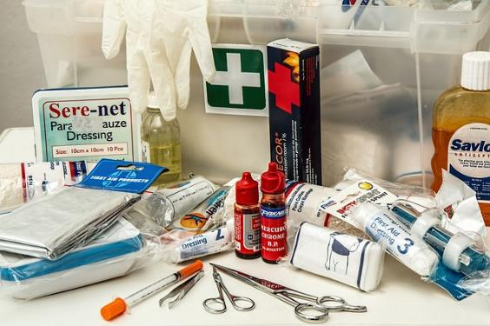
Inspection
Emergency Equipment
Notes:
No meds in 1st aid kit, take them out.
Is the first aid kit visible/accessible, properly stocked, remove any products that have expired?
Other items: Defibrillators, spill kits, eye wash stations, body wash stations

Slide 25
Inspection
Can you…
SPOT
THE
HAZARD?!?
Notes:
Let’s take a look at some hazards!

Slide 26

Inspection
Office Safety: Potential Hazards
Notes:
What sort of office hazards should you look out for (dangerous situation and a violation of fire safety codes)?
Poor housekeeping with combustible materials and trip hazards scattered throughout.
Fire escape route blocked.
Exit door blocked.

Slide 27
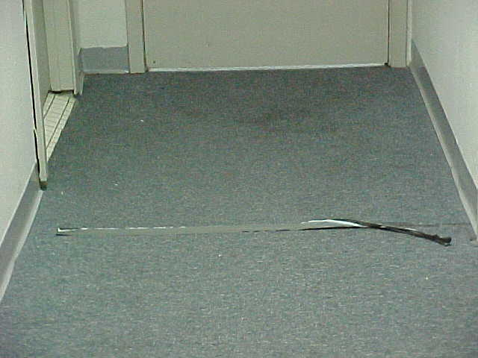
Tripping hazard
Notes:
Tripping hazard.

Slide 28
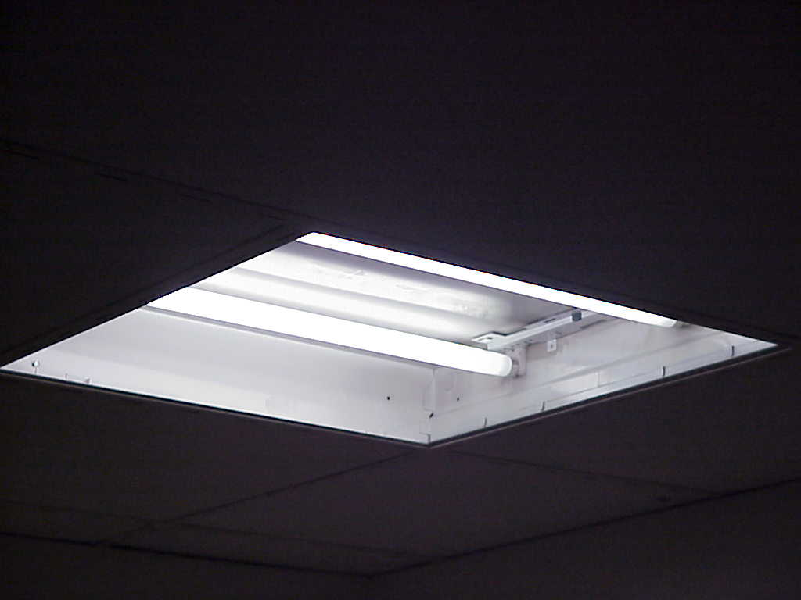
Uncovered florescent light
Notes:
Light fixture not covered.

Slide 29
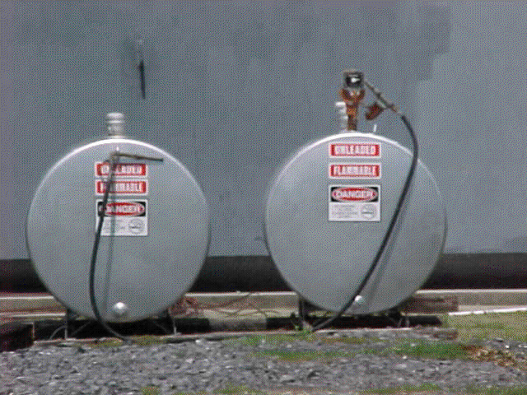
Containers of hazardous materials
Notes:
When dealing with containers of hazardous materials:
Check the containers to ensure there are no leaks. Make sure that nobody (employees, visitors, etc.) smokes nearby.
The containers must be properly labeled. If the labels become damaged, faded, etc., they should be replaced.
With few exceptions, hazardous material containers must have spill containment, which is also referred to as secondary containment. It is generally acceptable to keep one or more hazardous material containers in a secondary containment area. Secondary containment must be capable of holding 1.5 times the volume of the largest container within the secondary containment area.

Slide 30
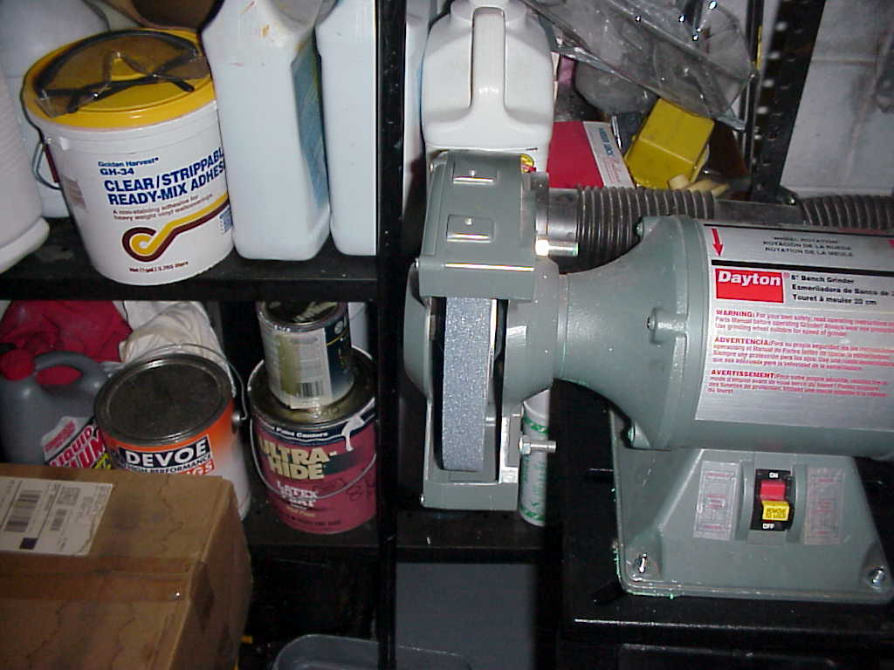
Hazards include…
Notes:
Hazards include…
Grinding wheel does not have a tool rest or guard.
No face shield available and no signs posted requiring use of the face shield.
Machinery that is not intrinsically-safe (electric grinder) is located next to flammable materials. The grinder could easily serve as an ignition source for flammable vapors. Sparks and debris generated by the grinding process could also be a source of ignition for combustible materials (rags, etc.) as well as for flammable materials inside plastic containers.

Slide 31
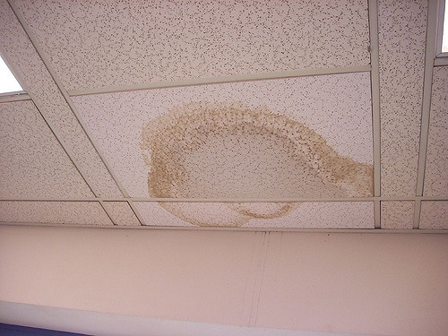
Water stained ceiling tile
Notes:
Ceiling leak.
May create environment for mold growth, air quality problems.
In close proximity to electric lighting.

Slide 32
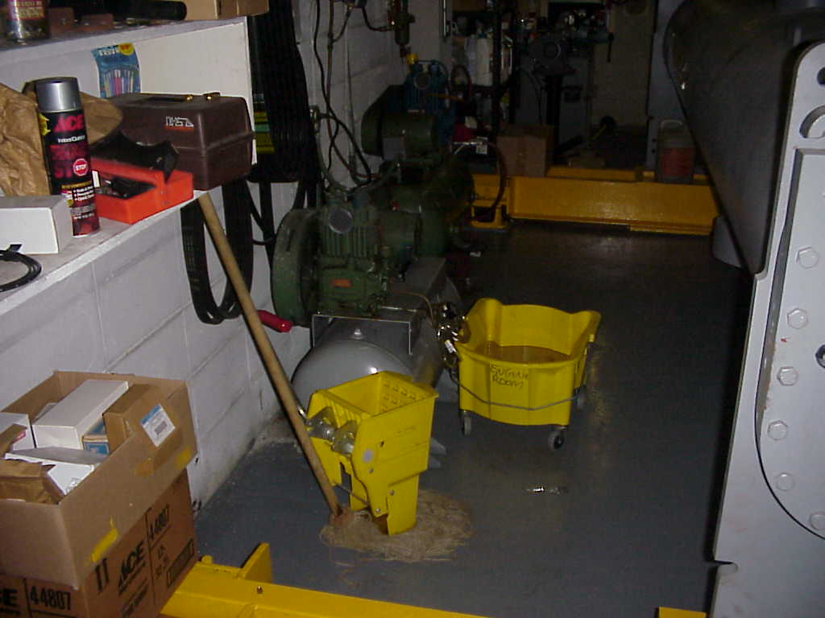
Poor Housekeeping
Notes:
Poor, unacceptable housekeeping practices.
Do not store water in electrical/mechanical rooms (these are not closets, should be kept clear & clean)
Dirty water left in bucket (why?)
Wet mop sitting floor, propped near cords & electrical equipment, looks like flammable containers left in this area
Other items to look for: are storage areas cluttered? Are items overhanging from the shelves, are heavier/large items stored above shoulder height? Are large boxes stacked on top of smaller boxes?

Slide 33
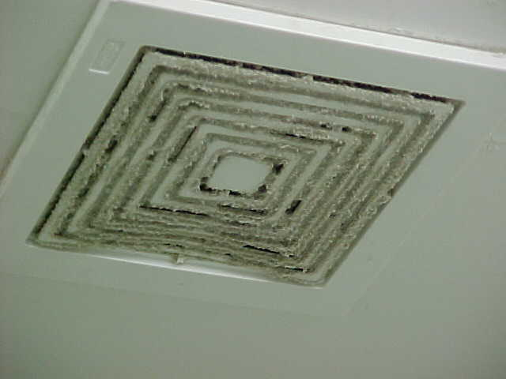
Dirty Air Vent
Notes:
Filth/dirt growing out of air register.
This is an indication of a problem with the HVAC system (this specific type occurrence is often indicative of moisture problems in the system). Or it’s never been cleaned and could be an air quality problem for someone with asthma or severe allergies

Slide 34

Inspection
Electrical Safety
Notes:
What are some common Electrical Safety Hazards?
Frayed cords or patched cords.
Ground connection removed or damaged connections.
Overloading outlets
Outlets & switch plates not covered.
Panels boxes not labeled correctly, any hot spots, are boxes closed/covered properly
Extension cords used in a permanent capacity

Slide 35
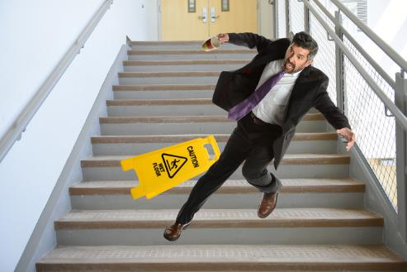
Inspection
Building Safety
ACTIVITY
Notes:
What are some common Hazards in buildings?
Are exit pathways clear?
Are the rails sturdy?
Are treads, risers, etc., in good condition?
Is area properly lighted for emergency use?
[SAFETY] Safety Inspection Activity: Workbook page 16
Activity 1: Encourage participants to work in groups to think of things that they may include in a safety checklist.(Such as check fire extinguisher, light bulbs, wiring, etc.) Remind them that the items do not have to be related to each other.
Activity 2: Review questions. Answers can be found in Appendix.

Slide 36

Post-Inspection
Your inspection is complete; now what?
Notes:
Now we are going to review action that needs to be taken once you’ve completed your inspection.
Sign & Date the inspection form

Slide 37
Post-Inspection
Document Findings
Document
Unsafe Acts
Unsafe Conditions
Notes:
If a hazard was found make sure that it is properly recorded and reported to the appropriate people.
Document, document
Both unsafe conditions and unsafe acts should be corrected as soon as possible. Sometimes corrective action can take place immediately and other times can be drawn out over a period of time (possibly even months -- bids may need to be gathered, etc., in order for corrective action to be taken).
Unsafe acts can be the topic for your next safety meeting!

Slide 38
Post-Inspection
Address Findings
Safety deficiencies found during audits and inspections should be corrected as soon as possible.
Documentation of corrections should be made on the audit or inspection sheet.
Conditions that present a hazards are to be corrected or controlled immediately.
Notes:
Unsafe conditions must be addressed within a reasonable time period. A follow-up inspection may be necessary.
Unsafe acts can normally be corrected immediately. Often, root-cause analyses reveal that unsafe acts are a result of incorrect training or lack of training. After a problem has been detected, management has the ultimate responsibility to take the necessary steps to correct it. Once a problem has been corrected, prudent steps should be taken to insure that it doesn’t return. Job safety observations may be used to ensure that proper job procedures are being used. These observations should be conducted immediately and intermittently.
When possible, line employees should be involved in the inspection process. In part because of their job/task knowledge, they are often able to develop safer, more efficient processes.
Always document corrective actions on the inspection form, HCL, work order….always document.

Slide 39

Post-Inspection
Implementing Controls
Engineering Controls
Administrative Controls
Protective Equipment
Notes:
Engineering controls include replacing equipment with safer models and removing unsafe equipment from the work area.
Administrative controls include restricting access to hazardous areas, the use of signs to communicate information, ensuring site security, and employee training. Written policies & procedures by management.
Protective equipment must be used as a last option after consideration has been given to engineering and administrative controls. When PPE is used, employees must be trained in its use and they must be monitored to ensure they are using the PPE properly. There should be a written program on how to purchase, use, maintain, store, disposal & replacement of PPE.

Slide 40

Post-Inspection
Document Your Findings
Document your corrective action
Document your controls
Notes:
All findings, along with corrective action recommended (including training), should be fully documented.
It must also be documented when items recorded on the Hazard Control Log or Inspection Checklists have been corrected. The type of documentation that is used is not as important as ensuring it is done in a timely and thorough manner. Most common documentation: HCL, work orders, email to landlord, notebook

Slide 41
Post-Inspection
The “Inspection Effect”
Increased employee engagement
Reinforces importance of safety & management’s commitment
Encourages employees
Notes:
Employees who observe supervisors and managers actively inspecting the work area will know it’s supported by management and that safety is important.
Everyone involved becomes safety conscious at work, home & in the community. Everybody Wins!

Slide 42
Inspection Requirements
Documentation
ACTIVITY
Checklists/Written Documentation
Should include:
  Person & Date
  Concerns Identified
  Corrective Action
  Building/Area inspected
Should be:
  Systematic
  Site-specific
  Revise as needed
📋
Notes:
A checklist can be Departmental or Site specific. It’s best to take a basic form and tailor it to your site & needs. Site specific form is highly recommended over a departmental form.
Written documentation should include these items:
Name of the person inspecting, identifying the hazards
Date the hazard was identified.
Areas/Buildings included in the inspection
Description and exact location of the hazard
Corrective action and the date hazard removed or repaired.
Also need to know your potential inspections per month/quarter so you can track the results and know the percentage of completed inspections. EX: 5 buildings x 4 quarters = 20 per year, x 3 years = 60 potential inspections, need 60 conducted for 100%
[SPEAKER NOTE] Possible Class Exercise or can refer to it as a resource for later: Workbook page 17 for Sample Safety Inspection Checklist. Break into small groups and have them identify which items would be: building/office safety, emergency equip, fire safety, electrical & storage methods. Get them to think about types of questions to fit the new audit categories for their sites.

Slide 43
Inspection Requirements
Hazard Control Logs
Location
Posted in the workplace, accessible to ALL employees
Purpose
For employees to “report” unsafe conditions
Notes:
Another part of the inspection process are Hazard Control Logs. If you decide to keep the HCL system in place, a procedure needs to be in place as to who controls the HCL, checks it daily for hazards, follows up on all complaints and keeps documentation on it.
If you have a work order system, you aren‘t required to use the HCL.
Whatever method you decide to use needs to be in your written procedures.

Slide 44
Inspection Requirements
Hazard Control Logs
Implementation
Train employees
Review routinely
Maintain on file at least three years.
Notes:
All employees should be trained on the HCL procedure (or other acceptable method), how to report, who to report to or where the log (or other method) is located to report hazards.
HCLs should be monitored by an agency’s safety officer or designee on a routine basis (at least daily). Document that the log is being monitored.
HCLs should be kept for at least 3 years.

Slide 45
Inspection Requirements
Hazard Control Log Responsibilities
Duties for Supervisor or Loss Prevention Rep
Checks HCL
Takes temporary control
Reports to next level, if uncontrolled
Notes:
The person responsible for the HCL should be designated in writing.
Whoever performs this function must be trained in the agency’s chain of command so that they possess the knowledge necessary to control the situation, per agency standards.
Must follow up on all hazards reported.

Slide 46
Inspection Requirements
ACTIVITY
      Hazard Control Log
Corrective Action
Effective
Timely
Appropriate
Notes:
Corrective action should be appropriate to the situation.
It should be timely and effective.
If the corrective action involves employee training, remember to thoroughly document the training.
All hazards should be corrected within a reasonable time frame.
Document all corrective actions. If have questions refer to the previous corrective action slides.
[SAFETY] Refer to the Sample Hazard Control Log in your Workbook page 18

Slide 47
Inspection Requirements
Record-keeping
Keep all for 3 years minimum
Inspection Checklists
Hazard Control Logs
State Fire Marshal Reports
Notes:
All inspection reports and HCLs should be kept on file for at least three years.
If an agency’s policy requires a longer retention time, that is what should be followed.
HCL or other method– if there is a hazard recorded on a log that takes longer 3 years to correct, the log should be maintained until the hazard is properly corrected. Additionally, if this information becomes part of a law suit, other standards may apply.

Slide 48
Questions?

Slide 49
OSHA Disclaimer
This material was produced under grant SH29640SH6 from the Occupational Safety and Health Administration, U.S. Department of Labor. It does not necessarily reflect the views or policies of the U.S. Department of Labor, nor does mention of trade names, commercial products, or organizations imply endorsement by the U.S. Government.

