Slide 1


BIA-Hawaii: CSIP
Trainers Meeting

Slide 2
Agenda
CSIP Overview
Purpose
Goals & Expectations
CSIP & SIPP Materials
Training Considerations
Literacy Levels
Harwood Best Practices
Training Evaluation
Record Keeping

Slide 3

CSIP Overview Goals & Expectations
Scheduling may be designed to breakup classes into smaller segments:
Workers
Safety Managers/Coordinators
Employers, Managers, Supervisors

Slide 4

CSIP Overview CSIP & SIPP Materials
Training Materials Include:
(Don’t worry, they’re already made!)
PowerPoint Presentations
Workbook
Instructor Manual

Slide 5
CSIP Overview CSIP & SIPP Materials Material Development
Thank you for your time and expertise in developing these materials! You have played a tremendous role in program development.
Materials were also developed based on existing OSHA training materials and past recipients of the Susan Harwood grant.

Slide 6

CSIP Overview CSIP & SIPP Materials Workbook
The Workbook activities are intended to be used to encourage critical thinking, discussion, and brainstorming activities.
The Workbook ends with blank pages for note taking.
Notes:
Take a look at WBs

Slide 7

CSIP Overview
CSIP & SIPP Materials
PowerPoint
PowerPoint is not a teaching technique – it is a visual aid that can be used to enhance learning, just like flip charts, overheads, and handouts.
PowerPoint will not improve student learning; it can encourage learning.

Slide 8
CSIP Overview
CSIP & SIPP Materials
PowerPoint
The PowerPoint includes Notes, both intended to be read aloud and intended to be a note only for the Trainer.
Because there are three distinct audiences who will receive this material, we’ve been careful to ensure the presentations and accompanying material are organized well.
The slides serve as a focal point for the issues to be discussed. They are intended to be used to help control the pace of presentation and keep the discussion on topic.
Go over slide and follow with commentary, explanation and discussion. Remember questions and discussion are part of the learning experience.
Notes:
For some material, reading from the slide is fine. For other simpler ideas, the content on the slide is a starting point for more commentary.

Slide 9
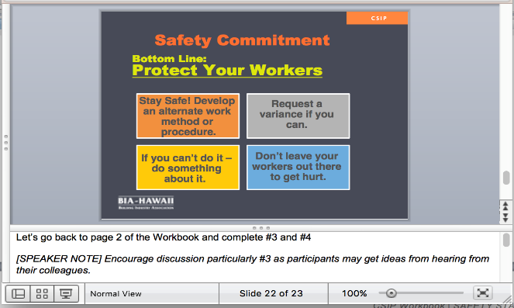
CSIP Overview
CSIP & SIPP Materials
Notes:
See page 4 of your Workbook

Slide 10
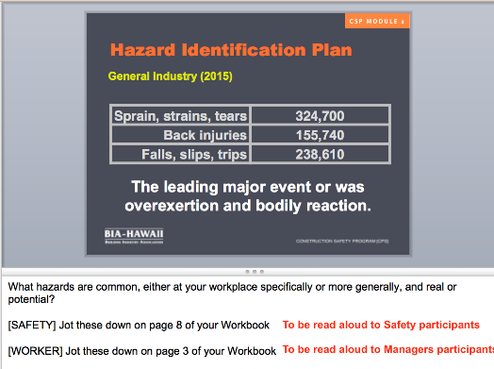
CSIP Overview
CSIP & SIPP Materials
PowerPoint

Slide 11

CSIP Overview
CSIP & SIPP Materials
PowerPoint
Notes:
This shows the Presenter View. Participants will see only the slide, while your screen will look like this.
It is NOT critical to read every Note. Please become familiar with the material so that you are comfortable going off the cuff. These are included to provide additional resources to Trainers.

Slide 12

CSIP Overview CSIP & SIPP Materials Instructor Manual
The Trainer Guide provides insight into this training program.

Slide 13
CSIP Overview
CSIP & SIPP Materials
The Manual is broken down into sections by participant type: Safety, Worker, Manager.
Each section includes:
An introduction identifying Program Goals, Target Audience, Learning Objectives
Section descriptions outline Topics, Activities, and competencies
Detailed description of each section
Notes:
Let’s take a look at the Instructor Manual

Slide 14
CSIP Overview
CSIP & SIPP Materials
SIPP
Customized:
In Workbook & form fillable
Section topics work towards completion
Session ends with participants working on SIPP
Notes:
Provided by the Hawaii Safety Alliance

Slide 15
CSIP Overview Literacy Levels
Do not assume that all participants are equally skilled or confident in speaking, reading, writing, and math. At the beginning of a class mention that you are aware that people may have different levels of reading and writing skills.
Let people know that you will not be requiring them to read aloud. Ask for volunteers when reading aloud is part of an activity. Never call on someone who does not volunteer.
Notes:
Susan Harwood provides a number of best practices that will be implemented.

Slide 16
Training Considerations
Literacy Levels
Read all instructions aloud. Do not rely on written instructions or checklists as the only way of explaining an activity or concept.
Allow time for small group activities– reading, discussing, integrating new information, relating to life experience, recording ideas on flip charts, and reporting back to the whole group. In small groups, participants can contribute to the tasks according to their different backgrounds and abilities.

Slide 17
Training Considerations Literacy Levels
Training Techniques to Reach All Literacy Levels
Establish a positive learning environment where lack of knowledge is acceptable and where questions are expected and valued. Participants need to be able to indicate when they do not understand and to feel comfortable asking for explanations of unfamiliar terms or concepts.
Explain any special terms, jargon, or abbreviations that come up during the training. Write them on a flip chart.
If participants have to write, post a list of key words. This can serve as a resource for people with writing or spelling difficulties.

Slide 18
Training Considerations
Harwood Best Practices
Learning environments should encourage active participation.
Consider how the chairs, tables, and other learning stations arranged
Does this arrangement encourages or inhibits participation and interactions
Can the arrangement be changed easily to allow different kinds of interaction
How the climate of the classroom is sufficiently comfortable to allow learning
Notes:
SPEAKER: We’ll make sure that the rooms are configured appropriately.

Slide 19
Training Considerations Harwood Best Practices Classroom Configuration
The social environment/ atmosphere in the learning environment encourages people to participate.
Consider:
If warm-up activities or "ice breakers" are needed to put people at ease
Encouraging participants to listen carefully to each other
Encouraging participants to respect different points of view
Using humor, if appropriate
Notes:
SPEAKER: We’ll make sure that the rooms are configured appropriately.

Slide 20
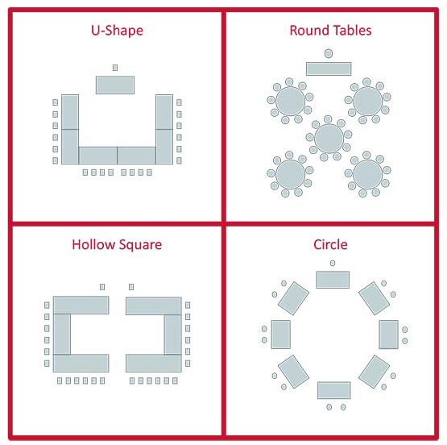
DISCUSSION
What are some of the pro and cons with these room layouts?

Slide 21
Training Considerations Harwood Best Practices
Classroom Configuration
People learn in different ways. Allow participants an opportunity to do each of the following:
Listen
Look at visuals
Ask questions
Read
Write
Practice with equipment (if applicable)
Discuss critical issues
Identify problems
Plan actions
Try out strategies in participatory ways

Slide 22
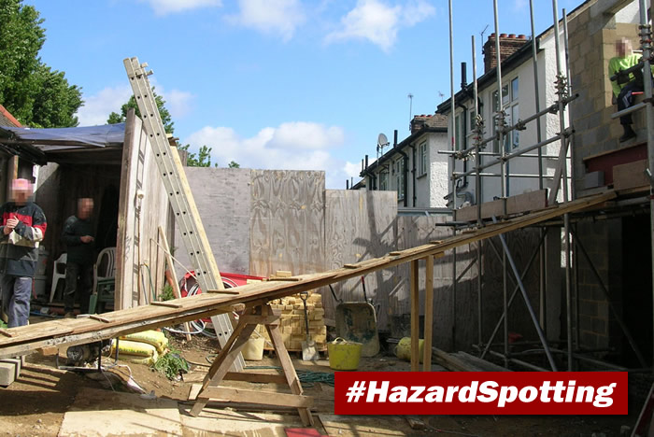
Training Considerations
In the Workbook, we have included the following exercise for participants. Students must identify the hazards found at this construction site. What can we do to encourage participants to engage with each other during this activity?
Notes:
The activity instructions are: This company was cited for numerous hazards. How many can you find? Hint: Check for PPE

Slide 23
Training Considerations Harwood Best Practices
Consider:
If you are allowing enough time for participant interaction
How the physical environment and the classroom’s atmosphere encourages interaction
If activities/ discussions are sensitive to cultural differences among the participants
How participants are encouraged to think critically and analyze the subjects being covered
How Can Participation be Encouraged?
Notes:
SPEAKER: Now if there’s challenges in beginning the discussion, how we can encourage participation?

Slide 24
Training Considerations
Harwood Best Practices
Classroom Configuration
Literacy Differences
Check privately with anyone having reading and writing difficulties
Encourage reading aloud or writing in front of the group voluntary; never mandatory
Read aloud all instructions and other required material
Repeat out loud anything you write on a board or flip chart

Slide 25
Training Considerations
Harwood Best Practices
How are your lectures encouraging participation?
Are lectures:
Brief?
Well organized?
Are you relying too heavily on your notes?
Are you allowing enough time for questions and comments?
Are you posing challenging questions about the content being delivered?
Classroom Configuration

Slide 26
Training Considerations
Harwood Best Practices
How Are Activities Conducted?
Are participants given enough information to complete the tasks?
Is the information presented relevant to the task?
Are participants given enough time?
Are participants given enough time to share what they have learned with each other?
Are the participants given a clear summary of the main points they were expected to learn in the activity?

Slide 27
Training Considerations
Harwood Best Practices
What kind of information will participants need to create a Safety Inspection checklist? They need to know:
What a Safety Inspection is
The goals and purposes of Inspections
They need to know Inspection Examples: Emergency Equipment, Office Safety, Fire Safety, Electrical Safety, Storage Methods, Building Safety
How Are Activities Conducted?

Slide 28
Training Considerations
Harwood Best Practices
How Are Activities Conducted?
How effectively do the case studies and role-playing activities in the program encourage participation?
Is the situation being discussed familiar to the participants?
Does the situation evoke strong feelings in the participants?
Does the situation lead to an in-depth analysis of the problem?
Does the situation encourage people to consider a range of possible strategies for dealing with the problem?

Slide 29
Training Considerations
Harwood Best Practices
How Are Activities Conducted?
How effectively do the case studies and role-playing activities in the program encourage participation? (Cont'd)
Are people provided with enough information to participate in the activity in a meaningful way?
Are people provided with so much information that they have no room to improvise or to call on their own experience?
Are people provided with an opportunity to discuss the social, cultural, and historical contexts of the situations?

Slide 30
Training Considerations
Harwood Best Practices
Role Playing Activity!
Get into groups of five and designate…
One person to be the trainer.
One person who is new to the industry and is unfamiliar with the content of the exercise.
One person who is an expert in the field
One person who relies heavily on visual aids and is not a strong reader
One person who has prefers to work alone
Notes:
Designate groups and assign roles before clicking to next slide

Slide 31
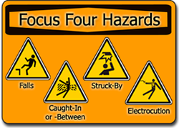
Training Considerations
Harwood Best Practices
Role Playing Activity!
Trainer: Teach your students about OSHA’s Focus Four Hazards and then have them work together to construct examples of Focus Four incidents and how it could have been avoided.
Example of Struck By:
A construction worker put bricks into a bucket to hoist them to the roof of a building. Suddenly, the bucket tilted and a brick fell onto another employee’s foot.
This could have been avoided if the worker had ensured that there was no one near the bucket OR the worker could have found another way to transport the bricks.

Slide 32
Training Considerations
Harwood Best Practices
Encouraging Participation
Are discussion groups small enough to ensure participation? (No more than 4 to 6 people.)
Is the ratio of discussion groups to instructors small enough? (A single instructor cannot effectively supervise more than three or four groups).
Is there enough room to enable each group to talk amongst itself without disruption?

Slide 33
Training Considerations
Harwood Best Practices
Encouraging Participation
Does each group have its own moderator and note taker?
Does the responsibility for leading and recording the discussion rotate among those willing to do the job?
Are the groups supplied with guidelines about how to lead and report their discussions?
Do the activities make allowances for anyone in the group who may have problems reading and writing?

Slide 34
Training Considerations
Training Evaluation
Level 1: Reaction
These are subjective evaluations that assess the effectiveness of trainer(s) and materials. Trainee's rate the quality and usefulness of the training.
This survey identifies the relevancy of the information and the teaching style of the Trainer. Questions involve the content, presentation methods, accommodations, pace, and the difficulty and relevance of the content.
Notes:
Results of the survey are typically used to improve the program.

Slide 35
Training Considerations
Training Evaluation
Level 2: Learning Assessment
Learning assessments evaluate the skills, information, or attitude that the trainee retains.
Typically, true post-tests occur after the class is over and there is no longer an opportunity to help participants understand the concept.
Notes:
For example, pre- and post-tests show the knowledge gained during training. Also, small group activities can serve as a "post-test" to see if participants are "getting it." This can be more effective than a post-test because they give trainers an opportunity to address any misunderstandings that may occur during the program.

Slide 36
Training Considerations
Training Evaluation
Level 3: Training Impact Evaluation
Training impact evaluations gauge the effect of the training on workers’ ability to participate in safety and health activities in the workplace.
Training impact evaluations are typically conducted three to six months after the training and could be conducted by written/electronic surveys or by focus groups.

Slide 37
Training Considerations
Record Keeping
Sign-in Sheets will identify:
Date, location and duration of the training;
Course name;
Name(s) of the trainer/s;
Materials used;
List of trainees participating in the class;
Signature of Trainer.

Slide 38
Training Considerations
Record Keeping
It is necessary to keep records that are:
Retrievable, readily identifiable, and organized
Dated, current, accurate, and legible Records will be kept for at least one year following the program
Specific records will be kept for proof of completion of required training.

Slide 39
Training Considerations
Record Keeping
Trainers:
Signed Timesheets

Slide 40

Thank You!! Your time and dedication is truly appreciated!!

Slide 41
Questions?

Slide 42
OSHA Disclaimer
This material was produced under grant SH29640SH6 from the Occupational Safety and Health Administration, U.S. Department of Labor. It does not necessarily reflect the views or policies of the U.S. Department of Labor, nor does mention of trade names, commercial products, or organizations imply endorsement by the U.S. Government.

