Slide 1


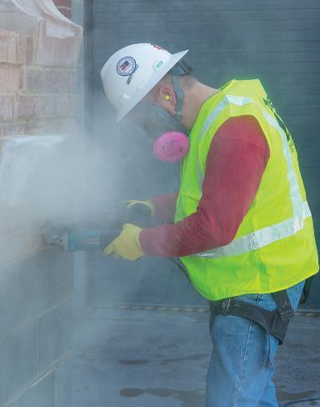
Silica in Construction
A training to
keep construction workers safe on the job
State Building & Construction Trades Council of California,
AFL-CIO
Funded by Federal OSHA, 2017

Slide 2

Funded by OSHA
This material was produced under grant SH29642SH6 from the Occupational Safety and Health Administration, U.S. Department of Labor. It does not necessarily reflect the views or policies of the U.S. Department of Labor, nor does mention of trade names, commercial products, or organizations imply endorsement by the U.S. Government

Slide 3
Use of Material
Duplication and Photo Credit
Material is only to be used for non-commercial, instructional, educational purposes
Fees may not be charged for this material
Photo credits are given on each slide
While every effort has been made to ensure information is current and accurate, the SBCTC does not assume any liability for errors or omissions

Slide 4
Acknowledgements
We thank the following organizations for:
Providing technical assistance with developing this training:
  Center for Construction Research and Training (CPWR)
  UC Berkeley Labor Occupational Health Program (LOHP)
  Cal/OSHA
  Federal OSHA
Sharing: photos, video, training material
  BAC –International Union of Bricklayers and Allied Crafts
  CA Dept. of Industrial Relations—Commission on Health and Safety and Workers’ Compensation (WOSHTEP program)
  West Virginia Archives
  Worksafe BC (Canada)

Slide 5
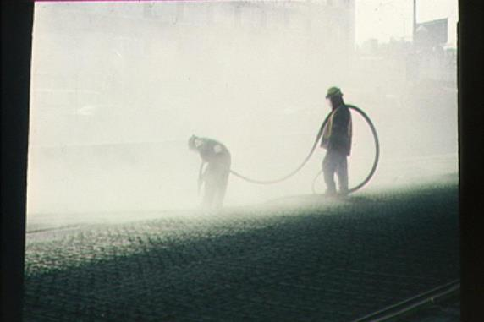
Silica—A High Priority for Construction
2 million U.S. construction workers exposed to silica every year
eLCOSH images
Notes:
Photo: Scarifying concrete, no controls being used to reduce exposure level.

Slide 6
Course Objectives for Silica Training
By the end of this training, participants will be able to:
Understand what it is
Recognize hazards
Describe health effects
Identify controls:
Engineering/work practice/PPE
Understand new OSHA Standard
Work safely around silica

Slide 7
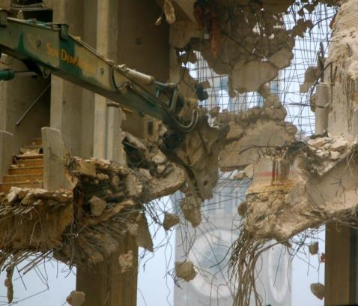
Section 1
Introduction to Silica
eLCOSH images
Notes:
Photo: Demolition of Morris Mechanic theater Baltimore, MD, January 2015

Slide 8


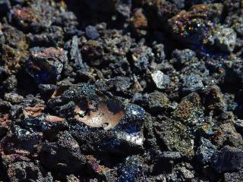
What is silica?
One of the most common minerals on Earth
Photos courtesy PDPhoto.org

Slide 9
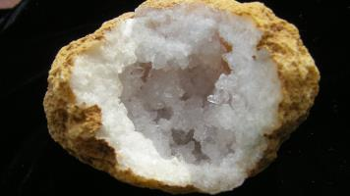

Mineral means:
Naturally occurring
Inorganic—not plant or animal
Solid form
Definite chemical composition

Slide 10
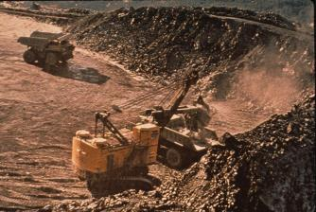

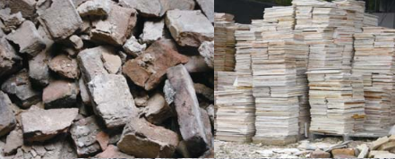
Silica is found in rock, soil and sand
Silica is composed of the elements Silicon + Oxygen = SiO₂
eLCOSH images
Photo courtesy PDPhoto.org
Photo: CPWR

Slide 11
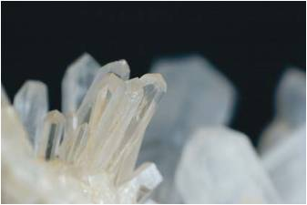
Silica naturally occurs as:
Amorphous: no regular form
Crystalline: well-defined arrangement, regular crystal form
Which is hazardous?
Photo: CPWR

Slide 12
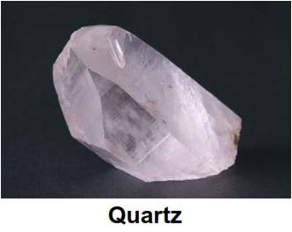
3 forms of crystalline silica
Quartz—common,
found in sand, gravel, clay,
granite, sandstone and
other rock
Cristobalite and Tridymite—
less common, but more toxic to workers
Photo: CPWR

Slide 13

Where is silica found in construction?
BRAINSTORM ACTIVITY
Based on what you just learned about
where silica naturally occurs, list the
building materials you think might contain
crystalline silica?

Slide 14
These materials may contain silica
Asphalt
Brick
Cement
Concrete
Concrete block
Drywall
Fiber cement products (siding, cladding panels)
Grout
Gunite/Shotcrete
Mortar
Paints
Plaster
Refractory Mortar/Castables
Refractory units
Rock
Roof tile (concrete)
Sand
Soil (fill dirt, top soil, soil w/fly ash added)
Stone (granite, limestone, quartzite, sandstone, shale, slate, cultured, etc.)
Stucco/EIFS
Terrazzo
Tile (clay and ceramic)

Slide 15
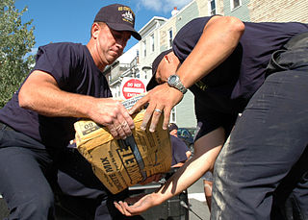
How can you find out if material contains silica?
Product label
Safety Data Sheet
Published data—online
Analyze a sample of the material
wikimedia

Slide 16
Websites that can help you
CPWR (Center for Construction Research and Training) Work Safely With Silica
www.silica-safe.org
Federal OSHA Silica eTool
http://www.osha.gov/dsg/etools/silica
Cal/OSHA Silica in Construction eTool
http://www.dir.ca.gov/dosh/etools/08-019/index.htm

Slide 17


Section 1 Review and Questions
Name three important things you learned in this section.

Slide 18

Section 2
Silica As a Hazard
How does silica become a
construction hazard?

Slide 19
Factors that determine potential to cause harm:
  Route of exposure
  Toxicity
  Dose and duration
  Interaction
  Individual characteristics

Slide 20
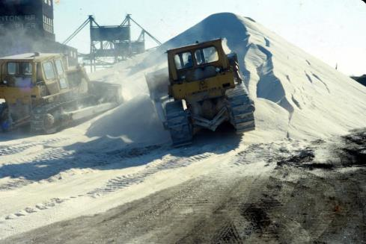
Route of Exposure
How does silica get into your body?
Breathing
eLCOSH images
Notes:
Photo: Potential silica exposure to heavy equipment operators. (NIOSH/John Rekus)

Slide 21
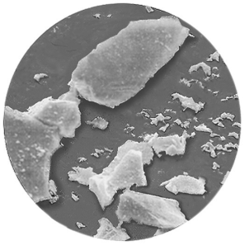
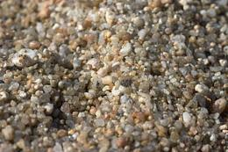
Size matters!
“Respirable” silica is small enough to penetrate body’s natural defenses and get deep into your lungs
Crystalline Silica
Photo source: CDC
It’s 100 times smaller than ordinary beach sand
wikimedia

Slide 22
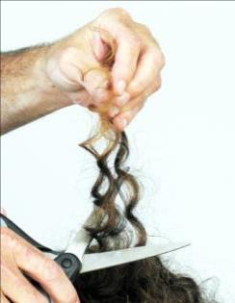
Respirable Particles
A single human hair is between
80 – 120 microns (µm) in diameter
Respirable dust is less than 10 microns (µm) in diameter
Slide courtesy of Construction Safety Council, Illinois

Slide 23
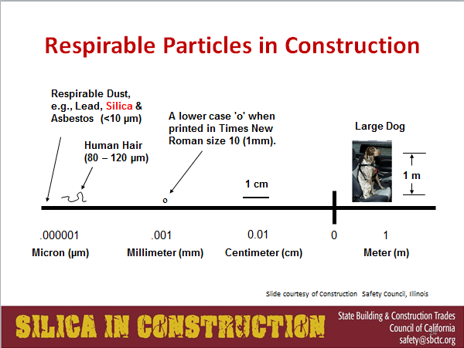
Respirable Particles in Constructions

Slide 24
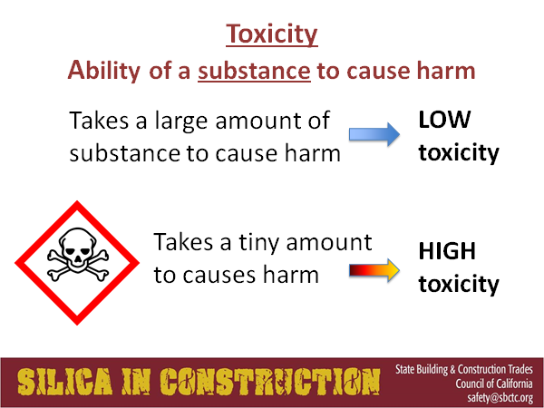
Toxicity

Slide 25
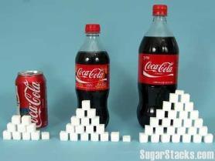

Dose and Duration
Amount of substance entering body
Amount of time you are exposed

Slide 26
How much silica dust is too much?
3 Important terms:
TWA
AL
PEL
Time weighted average
Action Level
Permissible exposure limit

Slide 27
New limits for silica
AL = 25 micrograms per cubic meter of air
(25 µg/m³) calculated as 8-hour TWA
PEL = 50 micrograms per cubic meter of air
(50 µg/m³) averaged over an 8-hour day

Slide 28
What is a “microgram (µg) ”
A metric unit of weight or mass equal to
1 millionth of a gram
0.000001 g
Too small to see with the naked eye

Slide 29




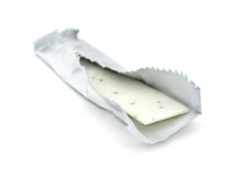
Pennies and Dollars

Slide 30
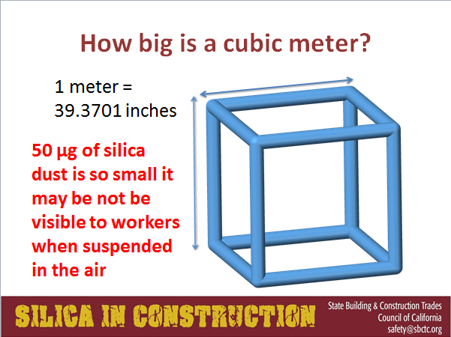
Cubic Meter

Slide 31


Interactions
Some substances, in combination, will increase the chance a worker will get sick.
Individual Characteristics
Age, gender, diet, state of health, pregnancy, use of medication, drugs and alcohol can change toxic effects

Slide 32
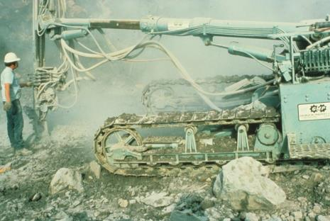
Putting it all together
Silica is hazardous because:
Found in many construction materials
Silica dust travels deep into your lungs
Long-time exposure to small amounts causes harm
Airborne particles too small to see
Short-time exposure to large amounts
causes harm
Causes lung disease, cancer, even death
Effects worse if you also smoke
eLCOSH images
Notes:
Photo: Uncontrolled dust/silica exposure for operator and any workers in the immediate area. (NIOSH/John Rekus)

Slide 33
Section 2 Review and Questions
Name three important things you learned in this section.

Slide 34
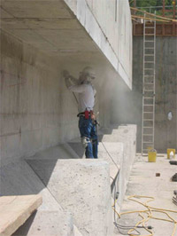
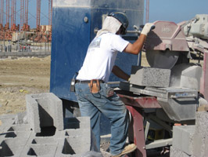
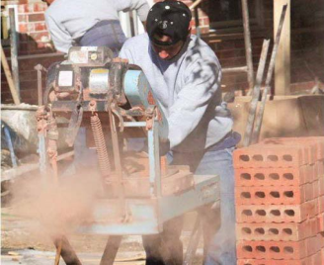
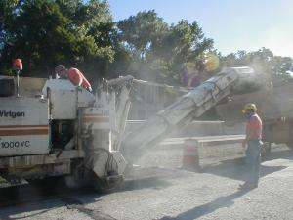
Section 3
Tasks and Tools that Create Silica Dust
Top photos: Cal/OSHA
Photo: OSHA
Photo source: elcosh

Slide 35

It’s dusty work… but somebody has to do it
SMALL GROUP ACTIVITY
Look at the list of construction materials that contain silica.
What kind of work do you do with these materials that may create dust?

Slide 36
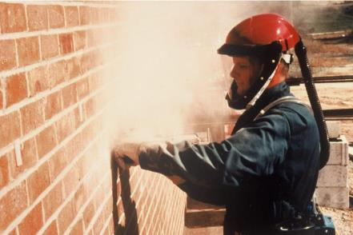
Operations that create silica dust
Cutting, drilling, coring
Grinding, sanding, sandblasting
Pulverizing
Mixing (dry)
Cleaning up
eLCOSH Images

Slide 37

Group Discussion
Which phases of construction create the highest exposure to silica dust?
Can you think of any crafts that are never exposed to silica dust?

Slide 38
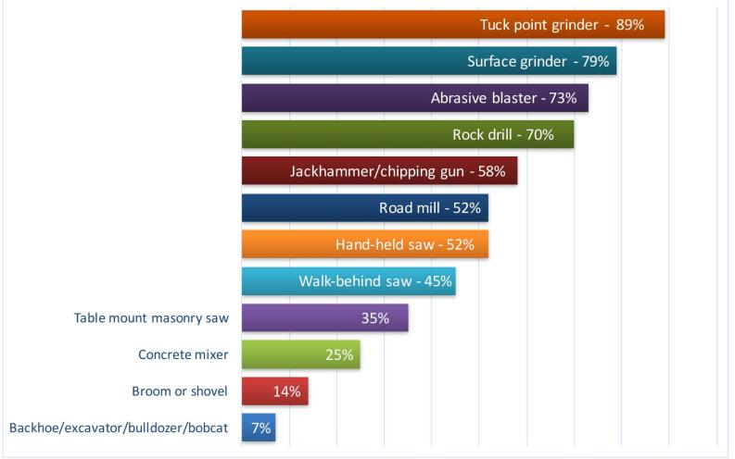
Tasks with high chance of exposure
The probability (in %) of being overexposed
Based on PEL of 0.1 mg/m³
Notes:
Based on a summary of University of Washington studies.

Slide 39
“It wasn’t me!”
Workers who are not “engaged” in the task but are working nearby may be exposed to silica hazards.
May be covered by Multi-Employer Worksite regulations (OSHA)
“Creating”
“Exposing”
“Controlling”
“Correcting”

Slide 40
The 5 question test
Did your employer:
1. Create the hazard?
2. Have responsibility or authority to correct hazard?
3. Have ability to correct or remove the hazard?
4. Demonstrate that creating, controlling and/or correcting employers were notified/aware of hazards?
5. Take appropriate feasible steps to protect their employees from the hazard, instruct them to recognize the hazard and inform how to avoid associated dangers?

Slide 41

Section 3 Review and Questions
Name three important things you learned in this section.

Slide 42
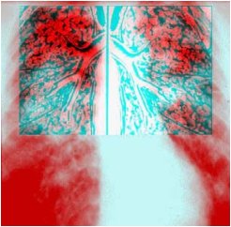
Section 4
Health Effects of Silica Exposure
Courtesy of: CPWR SmartMark

Slide 43
Group Discussion
Have you personally experienced health effects from breathing silica dust?
Do you know someone who has?

Slide 44
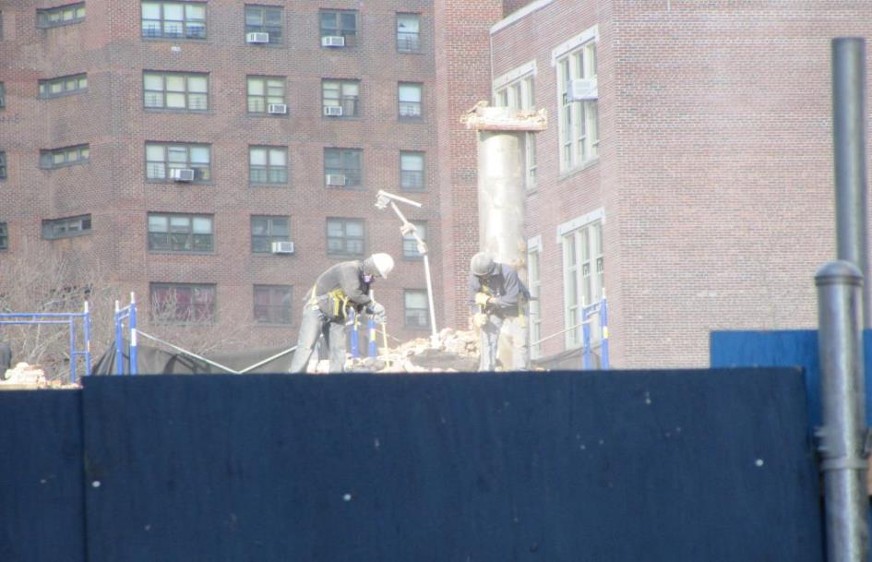
Breathing crystalline silica puts you at risk for serious, life-threatening disease
Photo: elCOSH images
Notes:
Photo: Workers using respiratory protection to reduce exposure to silica dust. (Mount Sinai/CHEP)

Slide 45
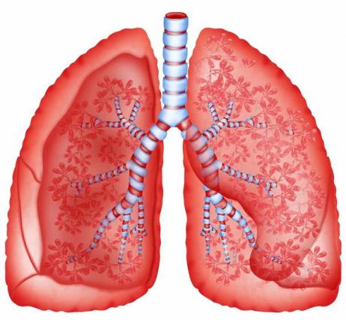
Which body part is most affected?
Lungs
More than 6 million breaths per year

Slide 46
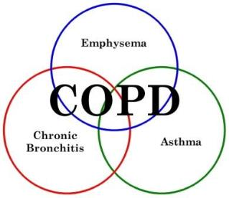

Respirable crystalline silica causes:
Silicosis—a serious lung disease
Lung cancer–classified as a carcinogen
Chronic obstructive pulmonary disease

Slide 47

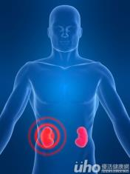
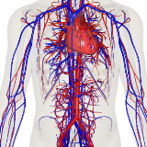

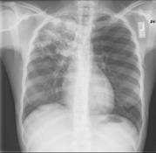
And contributes to:
Kidney disease
Heart
disease
Vascular
disease
Tuberculosis (TB)
and other infections
Autoimmune
disease

Slide 48

Watch video:
Silica Exposure
by Worksafe BC http://www.youtube.com/watch?v=R_sC2wX9Uwc

Slide 49
Silicosis Facts
Permanent
Irreversible
No cure
Worsens after exposure ends
Deadly
Preventing exposure is your best defense

Slide 50
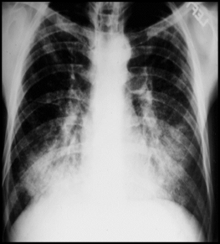
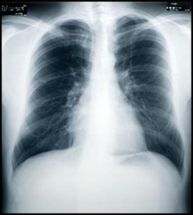
3 types of silicosis:
Chronic
Acute
Accelerated
Silicotic Lung
Normal Lung

Slide 51
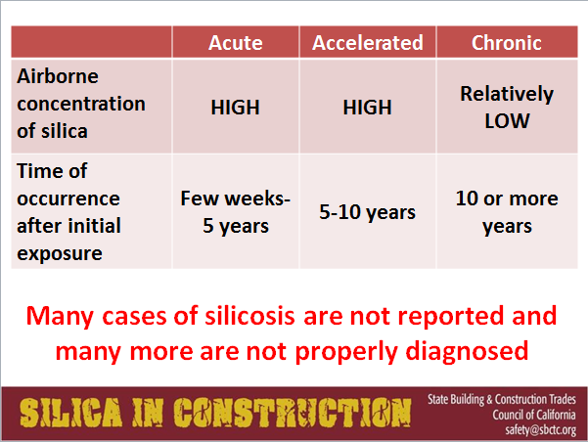
Silica Table

Slide 52
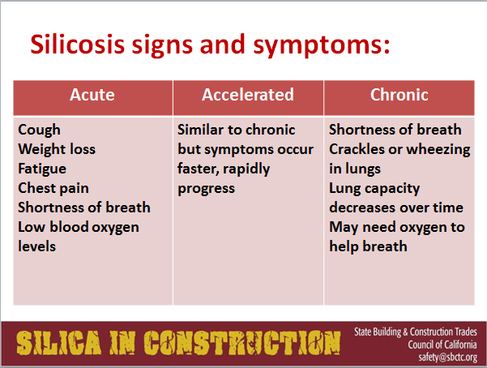
Silicosis signs and symptoms

Slide 53
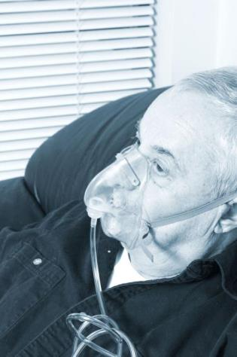
Workers speak up
Bricklayer stories of what it’s like to live with silicosis.
Play audio
Notes:
Photo source: Construction Safety Council , Illinois—Harwood grant material

Slide 54
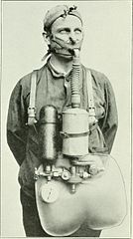
Silicosis:
One of oldest occupational diseases
Documented in 1700’s
Chronic effects tied to crafts
Increased with use of new power tools
Photo: wikimedia

Slide 55
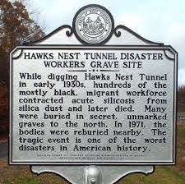
Hawk’s Nest Tragedy
1930’s Tunneling project through rock containing 96-99% silica
Few records kept but
historians now believe 2000-2500 workers contracted silicosis and over 700 died.
Photo: Google images

Slide 56

West Virginia State Archives
Photo courtesy of: Elkem Metals Collection, West Virginia State Archives

Slide 57
Impact of Hawk’s Nest
Revealed “Acute” silicosis
Directly connected exposure and illness
Spurred public outcry and increased demands for worker protection

Slide 58
Watch video:
“Silica in Construction:
From danger to safety”
SBCTC

Slide 59
Section 4 Review and Questions
Name three important things you learned in this section.

Slide 60
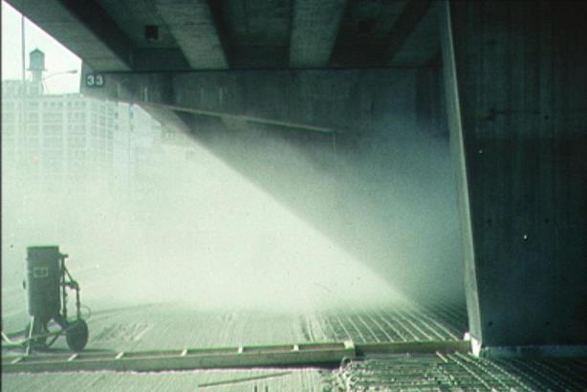

Section 5
Controlling Silica Hazards
Photo source: elcosh
Notes:
Photo: Unsafe work practice—scarifying concrete without dust controls. (Mount Sinai/CHEP)

Slide 61
Your experience on-the-job
BRAINSTORM ACTIVITY
List all actions you’ve used to control silica.

Slide 62
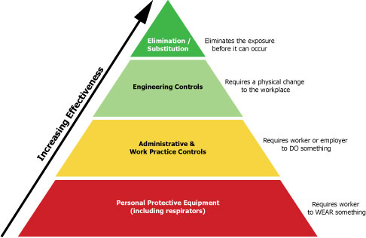
Hierarchy of Controls

Slide 63
Assessing risk—factors to consider
What tool is being used?
What is silica content of material?
How enclosed is work area?
Is dusty work constant or intermittent?
Does the job take the whole shift?
Which control methods most effective <PEL?
Will PPE also be needed to meet the PEL?

Slide 64
Engineering controls
Wet methods
Local exhaust ventilation (LEV)
Substitution
Isolation

Slide 65
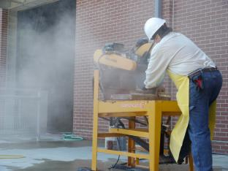
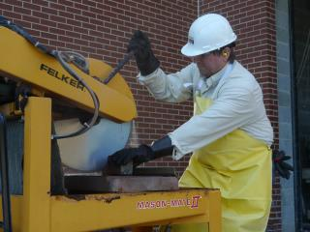
Examples of wet methods
Concrete/masonry saws that provide water to blade
Water hose to wet down dust at point of generation
During rock drilling, flow water through drill stem
Photos: CPWR Silica Safe

Slide 66
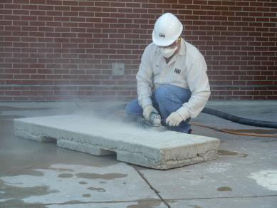
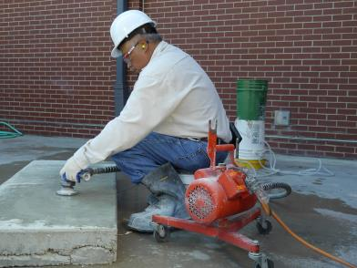
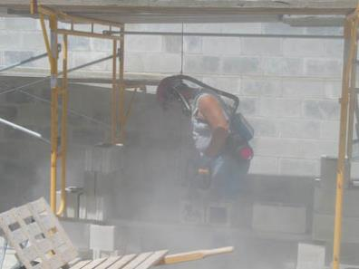
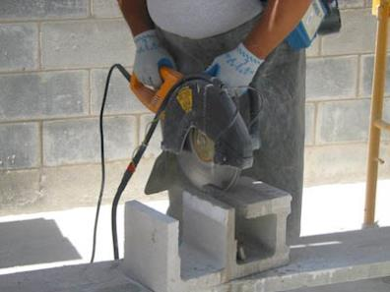
Silica Dust while working
Photos: CPWR Silica Safe

Slide 67
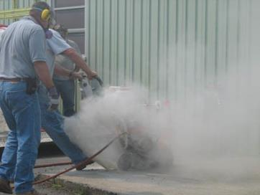
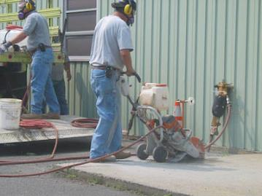


Silica Dust while working
Photos: CPWR Silica Safe

Slide 68


Examples of LEV methods
Vacuum system captures dust close to source
Integrate systems onto equipment that generates dust
Use HEPA (high-efficiency particulate air) filter
Photos: CPWR Silica Safe

Slide 69




Silica in Construction
Photos: CPWR Silica Safe

Slide 70

Examples of control combinations
Asphalt pavement milling machines use ventilation and water-spray controls

Slide 71


Silica at outdoor work places
Photos: CPWR Silica Safe

Slide 72

Are controls working?
Follow manufacturer’s instructions/specifications
Use tools properly
Do required maintenance and cleaning regularly
Test the air for contaminants

Slide 73

Air monitoring
Identifies/ quantifies contaminants
Done by professionals
Specialized, calibrated equipment
Personal monitoring of workers
General ambient air monitoring

Slide 74

Air sampling equipment
Personal Air Pump with Cyclone

Slide 75

Personal Monitoring
Determines individual worker exposure
Done during a specific time period
Pump pulls air through a filter or tube, which traps the dust or toxin.
Slide courtesy of Construction Safety Council, Illinois
Notes:
Slide Credit: Construction Safety Council Harwood grant number SH-19495-09-60-F-17

Slide 76




Examples of substitution
Eliminate the hazard
Use silica-free materials when feasible
Paints/coatings
Abrasive blasting
Coal slag
Steel shot
Corn cob
Garnet

Slide 77

Examples of isolation
Separate the worker from the dust
Enclosed cab with ventilation/filtered air
Separate dusty operations from non-dusty areas
Abrasive blasting containment
Photo: eLCOSH Images

Slide 78

Administrative controls
OSHA standard
Written plan
Job/task planning
Air monitoring
Training
Best work practices
Photo source: elcosh

Slide 79

Best practices for contractors
Use controls to eliminate dust
Assign competent person
Provide proper respirators when needed
Substitute materials
Create a plan
Photo source: elcosh

Slide 80

Best practices for workers
Use equipment and controls properly
Be aware
Participate
Don’t bring dust home
Give your doctor silica info
Don’t eat, drink, smoke, or apply cosmetics while near silica dust—wash hands/face
Photo source: elcosh

Slide 81

Personal protective equipment
Only if engineering and work practice controls aren’t enough
Must be NIOSH approved
Employers must comply with OSHA silica and respiratory protection standards
Medical evaluations

Slide 82




NIOSH-Approved Respirators
Full Face APR
PAPR
Slide Courtesy of CPWR
½ face APR
N 95

Slide 83

Why is PPE less effective than engineering controls?
Doesn’t eliminate hazard
Can be uncomfortable
Hard to communicate
Limited vision/movement
Workers must know how to use properly
Difficult to maintain
Photo source: elcosh
Notes:
Photo: Hazardous waste worker, operating real time gas monitor. Worker wearing level B protective equipment. (NIOSH/John Rekus)

Slide 84
Watch video:
Eliminate the Hazard:
McCarthy Drilling Project
By: SBCTC
DISCLAIMER: This is a case study that illustrates the implementation of engineering controls for silica dust and is for educational purposes only. References to a specific employer or brand of equipment do not imply endorsement by either OSHA or the SBCTC and its affiliates.

Slide 85
Section 5 Review and Questions
Name three important things you learned in this section.

Slide 86

Section 6
The New OSHA Standard

Slide 87

New Federal Silica Standard
Final rule published by OSHA—March 25, 2016
Timeline courtesy of the International Union of Bricklayers and Allied Craftworkers

Slide 88

Scope of Coverage
Quartz, cristobalite and tridymite
All occupational exposures to respirable crystalline silica in construction work unless below Action Level
Photo source: elcosh
Notes:
Photo: Unsafe work practices, no controls for silica exposure. (Earl Dotter.com)

Slide 89

Compliance Date
Construction employers must comply with all requirements by June 23, 2017
(except requirements for laboratory evaluation of exposure samples, which begin June 23, 2018)

Slide 90
What does the new standard do?
AL trigger
Lower PEL
Engineering controls and work practices to limit exposure
25 µg/m³ (8-hr TWA)
50 µg/m³ (8-hr TWA)

Slide 91

What does the new standard do?

Slide 92

What is “Table 1”
Matches 18 tasks with effective dust control methods and respirator requirements

Slide 93
Table 1 Tasks/Equipment
Stationary masonry saws
Handheld power saws
Handheld power saws for fiber cement board
Walk-behind saws
Drivable saws
Rig-mounted core saws or drills
Handheld and stand-mounted drills
Dowel drilling rigs for concrete
Vehicle-mounted drilling rigs for rock and concrete
Jackhammers and handheld powered chipping tools

Slide 94
Table 1 Tasks/Equipment con’t
Handheld grinders for mortar removal (tuckpointing)
Handheld grinders for other than mortar removal
Walk-behind milling machines and floor grinders
Small drivable milling machines
Large drivable milling machines
Crushing machines
Heavy equipment and utility vehicles to abrade or fracture silica materials
Heavy equipment and utility vehicles for grading and excavating

Slide 95

Must fully/properly implement controls
Presence of controls not sufficient
Employers required to ensure:
  Controls present and maintained
  Employees understand/use properly

Slide 96

Option 2: Alternative Exposure Control
If employers do not follow Table 1, they must comply with section (d) of the standard

Slide 97
Section (d) requires:
Action Level and PEL apply
Must do exposure assessment using either:
  Performance option
  Scheduled monitoring option
Use engineering and work practice controls

Slide 98

OSHA Compliance Guides for Silica
Available from OSHA website
https://www.osha.gov/Publications/OSHA3902.pdf

Slide 99
All employers must comply with these sections of new standard:
Housekeeping
Create written plan
Recordkeeping
Medical surveillance
Haz Comm &
training

Slide 100

Housekeeping: workers need to know
If contributes to silica exposure:
--Dry sweeping or brushing
--Use of compressed air for cleaning surfaces or clothing
NOT allowed unless used with ventilation
Photo source: elcosh

Slide 101

Employers must have written plan for managing silica exposure
Available to each employee
Describes tasks, controls, PPE, procedures, housekeeping, restricted access to work areas
Designates a Competent Person

Slide 102

Duties of competent person
Identify existing and foreseeable hazards
Authority to take prompt corrective measures
Frequently/regularly inspect job sites, material and equipment
Photo source: elcosh

Slide 103

Medical exam available at no cost
If you wear a respirator 30 or more days/year for silica exposure
Exam includes:
-Medical/work history
-Physical exam
-Chest x-ray
-Pulmonary function test
-Tuberculosis test
Photo: wikimedia

Slide 104

Exam results within 30 days
Physician provides the following written reports:
To employee—medical report
To employer—medical opinion

Slide 105

Hazard communication and training
Workers must have:
Access to:
Labels on material containers
Safety Data Sheets
And receive:
Hazard information
Training
Photo source: elcosh

Slide 106
Section 6 Review and Questions
Name three important things you learned in this section.

Slide 107

Review Game

Slide 108

Work safely with silica and enjoy a healthy career in the trades
Thank you for attending this training.
Photo source: elcosh

