Slide 1
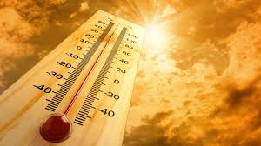
Heat Stress Health Hazards
osha.gov
University of Puerto Rico
Medical Sciences Campus
Susan Harwood Training Grant SH29650-SH6

Slide 2
Disclaimer
This material was produced under Susan Harwood grant number SH29650-SH6 Occupational Safety and Health Administration, U.S. Department of Labor. The contents in this presentation do not necessarily reflect the views or policies of the U.S. Department of Labor, nor does the mention of trade names, commercial products, or organizations imply endorsement by the U.S. Government..

Slide 3
Objectives
• Identifying heat illnesses related signs and symptoms
• Recognition and Evaluation of heat stress in the occupational environment
• Proposing effective means for minimizing and preventing heat stress exposure

Slide 4
Heat Stress
Exposure to heat can cause illness and death.
The most serious heat illness is heat stroke.
Other heat illnesses, such as heat exhaustion, heat cramps and heat rash, should also be avoided!
In addition, repeated exposure to sunlight can cause skin cancer!

Slide 5
Climate Effects Observed in Puerto Rico
A series of extreme climate events were observed in Puerto Rico during the summer of 2012:
  From May through July 2012 there were 42 days with temperatures ≥ 90°F, with 30 days in a row above 90°F between June and July.
The summers of 2012 and 2013 are considered the hottest summers on record as well as the longest hot spells in San Juan, Puerto Rico
  42 days in the summer of 2012 had temperatures above 90% of all temperatures ever recorded for that period in the year
  30 days in the summer of 2013 had temperatures above 90% of all temperatures ever recorded for that period in the year

Slide 6
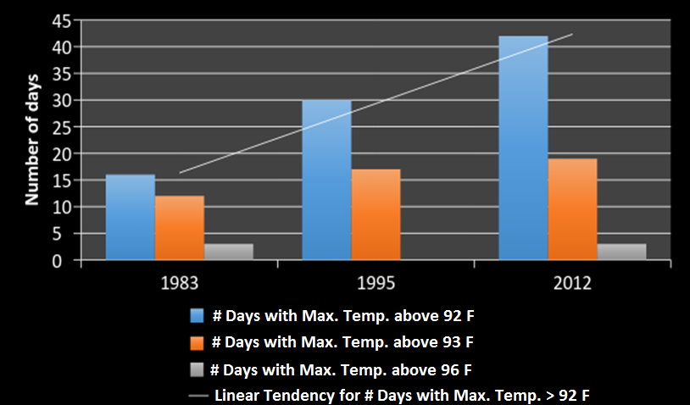
Climate Effects Observed in Puerto Rico
Air Surface Temperature Statistics for San Juan, Puerto Rico 1981-2013
Notes:
Hay que definir que es Tmax y a que se refiere con la percentila 90, 95, 99
Qué significa que 2012 tuvo aprox. 42 dias con tmax sobre la 90 percentila?

Slide 7
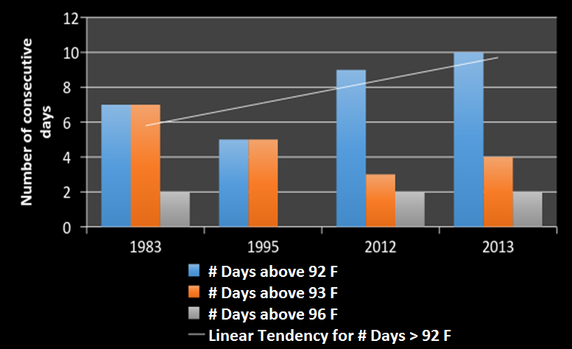
Climate Effects Observed in Puerto Rico
1-Air Surface Temperature Statistics for San Juan, Puerto Rico 1981-2013
Notes:
Hay que definir lo que es Tmaxspell de la misma forma que en la transparencia anterior.
A heat spell is a prolonged period of excessively hot weather, which may be accompanied by high humidity, especially in oceanic climate countries. A heat spell is measured relative to the usual weather in the area and relative to normal temperatures for the season

Slide 8
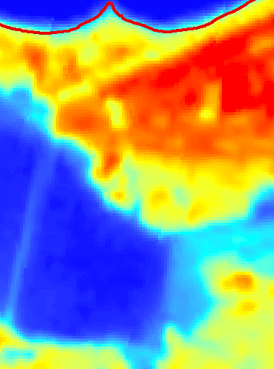
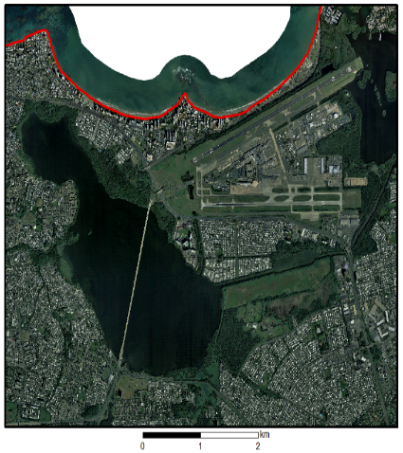
Climate Effects Observed in Puerto Rico
2-Temperatures
Luis Muñoz Marín
International Airport
Laguna San José

Slide 9
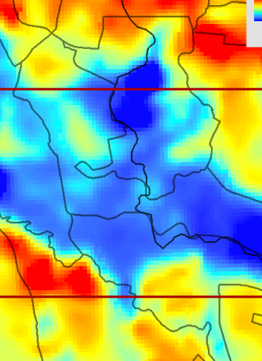
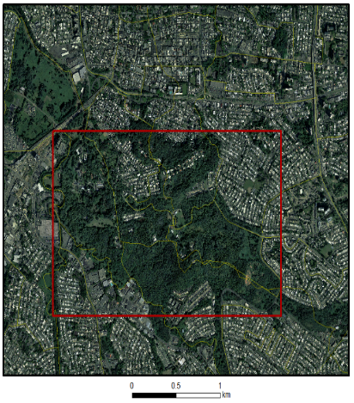
Climate Effects Observed in Puerto Rico
3-Temperatures
Rio Piedras Botanic Garden

Slide 10
Climate Effects Observed in Puerto Rico
4- Illnesses
In Puerto Rico, strong evidence suggests that the heat effect causes an excess risk of non-accidental mortality:
  Stroke AND Cardiovascular diseases
were the primary cause of death most associated with elevated summer temperatures for 2012 and 2013
  Stroke
    Summers of 2009 and 2010 Relative Risk = 6.22
    Summers of 2012 and 2013 Relative Risk = 16.80
  Cardiovascular Diseases
    Summers of 2009 and 2010 Relative Risk = 9.57
    Summers of 2012 and 2013 Relative Risk = 16.63

Slide 11
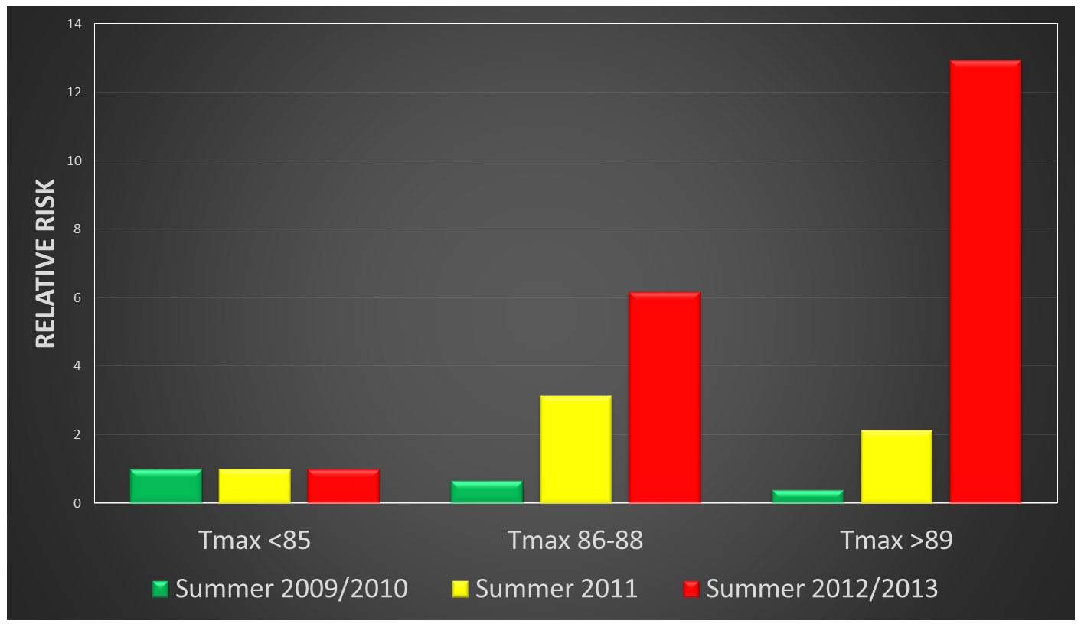
Climate Effects Observed in Puerto Rico
5- Heat effects
Heat effect causes an excess risk of non-accidental mortality!
Notes:
Relative Risk of Non-accidental Deaths

Slide 12
What happens to our body when it is exposed to heat?
Fatigue ⇑ (physical + mental)
Heart rate ⇑
Blood pressure ⇓
Activity of digestive organs ⇓
Core temp. ⇑
Shell temp. ⇑ ⇑
Blood flow to skin ⇑ ⇑ ⇑
Sweat ⇑

Slide 13
Physiology and Temperature
Body functions best with core temperatures close ± 1-2⁰ F to 98.6^{O} F
Between 100-102°F body performance drops sharply
At temperatures above 105°F, sweating mechanism may fail
Notes:
Human modeled as a cylinder:
With a shell – skin, surface tissues, and limbs
With a core – deeper tissues of the trunk and head
Core temperature must be within a narrow range ± 1-2⁰ F to 98.6°F
Shell temperature can vary over much wider range without serious problems

Slide 14
Heat Control Process in our Body sensory
Heat sensitive nerves
(sensors)

Slide 15
Heat Control Process in our Body temperature control
Heat center control
(thermostat)
Heat sensitive nerves
(sensors)

Slide 16
Heat Control Process in our Body summary
1. Heat transported by blood to skin
Blood circulation
to disperse heat equally
3. Secretion of sweat
Heat center controls
(thermostat)
Heat sensitive nerves
(sensors)
Notes:
Every 1cm³ of sweat, we lose 0.6 kcal of excessive heat

Slide 17

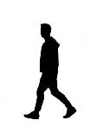



Heat Storage or Loss in our Body
ΔS = M +/- C +/- R – E
S: heat storage (or loss) of the body
M: Heat gain of metabolism
C: Heat gained (or lost) due to convection
R: Heat gained (or lost) due to radiation
E: Heat lost trough evaporation of sweat
Notes:
Heat Storage means a positive a positive “Delta S” and is consistent with a situation where we are increasing our body temperature
Heat Loss means a negative “Delta S” and is consistent with a situation where we are decreasing our body temperature
Heat gain of metabolism will depend on the physical activity we have.
Working on a computer terminal generates less heat in our body than walking
Carrying a bag o tools generates more heat than just walking
Shoveling gravel continuously generates more heat than just carrying a bag of tools
Heat loss through the evaporation of sweat
This is our basic mechanism of loosing heat
In order for sweat to evaporate it needs heat (just like when you want to boil water!)
The heat needed for this sweat to evaporate comes from our skin, which in turn is in close contact with the blood that is circulating in our body and brining heat from our internal organs
The air surrounding us, however, will absorb less evaporated sweat the higher its relative humidity
In conclusion, although we may sweat a lot at work, while this sweat does not evaporate we are not cooling our body
Radiation: Is the heat we gain or loose from other surfaces. In a heat stress situation, we are gaining heat from other surfaces that are hotter than our own body
hot metal surface close to where we are working (look at what happens to the inside of a car here when exposed to the sun)
If you live in a one story house, at night you can feel the radiative heat coming down from the roof concrete slab for many hours into the night
Convection: Is the heat we exchange with the air surrounding us. In a heat stress situation, we are gaining heat from the air because it is warmer than our body. When we get into an air conditioned room, we loose heat through convection to the air because the air is cooler than our body.

Slide 18
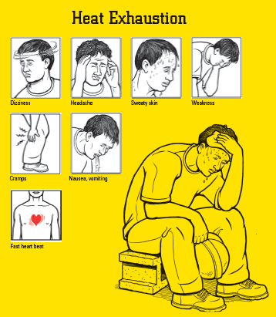
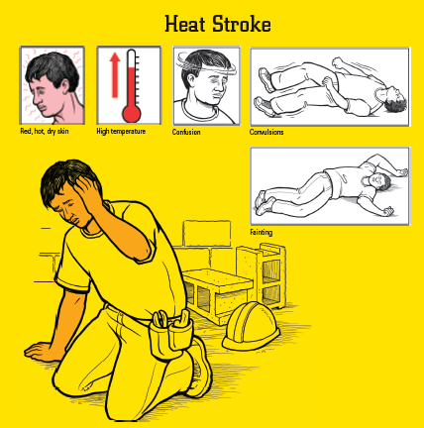

Important Heat Disorders and Their Symptoms
Source: https://www.osha.gov/SLTC/heatillness/edresources.html
Notes:
Heat exhaustion (heat strain) - also a result of excessive heat and dehydration. Signs include:
Dizziness
Headache
Sweaty skin
Weakness
Cramps
Nausea and vomiting
Fast heart beat
Heat Stroke (Heat exhaustion to heat stroke is a continuum) - the most severe form of heat illness, it can occur even in people who are not exercising, if the weather is hot enough. Sings include:
Red, hot and dry skin
High temperature
Confusion
Convulsions
Fainting
Watch out for early symptoms.
You may need medical help.
People react differently
You may have just a few of these symptoms, or most of them

Slide 19
Factors Affecting
Susceptibility to Heat
Individual Factors
Age
Weight
Degree of physical fitness and acclimatization
Metabolism
Environmental Factors
Air temperature
Temperature of surrounding surfaces
Relative humidity
Air movement
Notes:
Individual Factors
The older we are the more susceptible we are to heat and cold
The heavier we are, the higher our risk of heat stress problems
The higher our degree of physical fitness and acclimatization, the lower our risk of heat stress problems
The higher our metabolism, the quicker we can get rid of built up heat
Environmental Factors
The higher the external temperature, the higher the risk of heat stress problems
The higher the temperature of surrounding surfaces, the higher the risk of heat stress problems
The higher the relative humidity, the higher the risk of heat stress problems (remember what we spoke about sweat evaporation)
The higher the air movement
The lower our risk of heat stress problems if the air is cooler than us (imagine what you feel when your body is hot and you get in front of a fan blowing air conditioned)
The higher our risk of heat stress problems if the air is hotter than us (imagine running the air in your car at noon when the air conditioning is broken!)

Slide 20
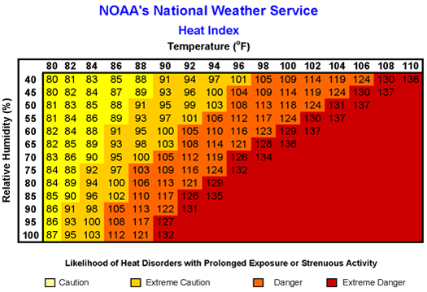
How can we measure environmental heat?
Notes:
If you are working in shaded conditions with light winds:
The "heat index" is a single value that takes both temperature and humidity into account.
The higher the heat index, the hotter the weather feels, since sweat does not readily evaporate and cool the skin.
The heat index is a better measure than air temperature alone for estimating the risk to workers from environmental heat sources.
IMPORTANT: studies show that the Heat Index can be used to assess heat stress exposures and to set occupational exposure limits for hot environments in the absence of high radiant heat
IMPORTANT: NOAA devised the heat index values for shaded conditions and light winds. Full sunshine can increase heat index values by up to 15° Fahrenheit.

Slide 21
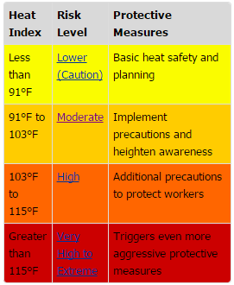
How can we measure environmental heat?
Preventive measures
Source: https://www.osha.gov/SLTC/heatillness/edresources.html

Slide 22
Recommendations for Lower Risk when HI <91°F
Provide drinking water
Ensure that adequate medical services are available
Plan ahead for times when heat index is higher, including worker heat safety training
Encourage workers to wear sunscreen
Acclimatize workers
If workers must wear heavy protective clothing, perform strenuous activity or work in the direct sun, additional precautions are recommended to protect workers from heat-related illness.
Notes:
Over here we will ask everybody to look into their Heat Index Brochure from their package to identify control measures depending on the Heat Index.
Ask a different worker from the audience to read the control measures for each HI level

Slide 23
Recommendations for Moderate Risk when HI is between 91°F to 103°F
Remind workers to drink water often (about 4 cups/hour)
Review heat-related illness topics with workers: how to recognize heat-related illness, how to prevent it, and what to do if someone gets sick
Schedule frequent breaks in a cool, shaded area
Acclimatize workers
Set up buddy system/instruct supervisors to watch workers for signs of heat-related illness
If workers must wear heavy protective clothing, perform strenuous activity or work in the direct sun, additional precautions are recommended to protect workers from heat-related illness.*
  Schedule activities at a time when the heat index is lower
  Develop work/rest schedules
  Monitor workers closely
Notes:
Over here we will ask everybody to look into their Heat Index Brochure from their package to identify control measures depending on the Heat Index.
Ask a different worker from the audience to read the control measures for each HI level

Slide 24
Recommendations for High Risk when HI is between 103°F to 115°F
Alert workers of high risk conditions
Actively encourage workers to drink plenty of water (about 4 cups/hour)
Limit physical exertion (e.g. use mechanical lifts)
Have a knowledgeable person at the worksite who is well-informed about heat-related illness and able to determine appropriate work/rest schedules
Establish and enforce work/rest schedules
Adjust work activities (e.g., reschedule work, pace/rotate jobs)
Use cooling techniques
Watch/communicate with workers at all times
When possible, reschedule activities to a time when heat index is lower
Notes:
Over here we will ask everybody to look into their Heat Index Brochure from their package to identify control measures depending on the Heat Index.
Ask a different worker from the audience to read the control measures for each HI level

Slide 25
Recommendations for Very High Risk when HI >115°F
Reschedule non-essential activity for days with a reduced heat index or to a time when the heat index is lower
Move essential work tasks to the coolest part of the work shift; consider earlier start times, split shifts, or evening and night shifts.
Strenuous work tasks and those requiring the use of heavy or non-breathable clothing or impermeable chemical protective clothing should not be conducted when the heat index is at or above 115°F.
If essential work must be done, in addition to the steps listed above:
Alert workers of extreme heat hazards
Establish water drinking schedule (about 4 cups/hour)
Develop and enforce protective work/rest schedules
Conduct physiological monitoring (e.g., pulse, temperature, etc.)
Stop work if essential control methods are inadequate or unavailable.
Notes:
Over here we will ask everybody to look into their Heat Index Brochure from their package to identify control measures depending on the Heat Index.
Ask a different worker from the audience to read the control measures for each HI level

Slide 26
When Under Direct Sunlight or Exposed to High Radiant Heat Content We Should Use Another Parameter
We should measure:
  Natural wet bulb temperature
  Globe temperature
  Dry bulb temperature
  Then combine them into WBGT
Measure Average Heart Rate doing the task
Notes:
In such cases we can used another parameter
First we take into account these three environmental temperature parameters
Natural wet bulb temperature which measures the evaporative cooling capacity of the air, using a thermometer with a wet wick and natural air movement
Globe temperature which measures the radiative heat load in the air, using a thermometer in a black copper sphere
Dry bulb temperature which measures basic ambient temperature with a thermometer shielded from radiation
Then, based on the work conditions, we combine all or some of these temperature parameters into one single temperature estimator called the Wet Bulb Globe Temperature
There are two ways to calculate WBGT:
If you are working outdoors under the sun
If you are working indoors or outdoors in the shade

Slide 27
When Under Direct Sunlight or Exposed to High Radiant Heat Content We Should Use Another Parameter (cont.)
Take into account if worker is acclimatized or non acclimatized
Use WBGT limits and implement acclimatization plan if necessary
Notes:
In such cases we can used another parameter
First we take into account these three environmental temperature parameters
Natural wet bulb temperature which measures the evaporative cooling capacity of the air, using a thermometer with a wet wick and natural air movement
Globe temperature which measures the radiative heat load in the air, using a thermometer in a black copper sphere
Dry bulb temperature which measures basic ambient temperature with a thermometer shielded from radiation
Then, based on the work conditions, we combine all or some of these temperature parameters into one single temperature estimator called the Wet Bulb Globe Temperature
There are two ways to calculate WBGT:
If you are working outdoors under the sun
If you are working indoors or outdoors in the shade

Slide 28
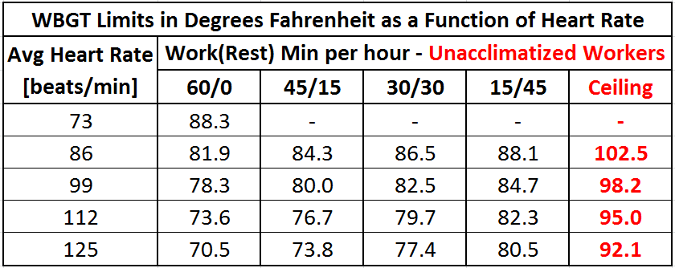
WBGT Limits For Unacclimatized Workers
Notes:
Values shown are for a “standard man” of 70 kg (154 lb) body weight and 1.8 m2 (19.4 ft2) body surface. The “standard man” is used to normalize the data from the variability found in human beings. Both men and women adapt well to heat exposure, and given the similar physiological ability to tolerate heat, there are no significant differences between the sexes.
Employers should have an acclimatization plan for new and returning workers, because lack of acclimatization has been shown to be a major factor associated with worker heat-related illness and death. NIOSH recommends that employers provide the means for appropriate hydration and encourage their workers to hydrate themselves with potable water <15°C (59°F) made accessible near the work area. Workers in heat <2 hours and involved in moderate work activities should drink 1 cup (8 oz.) of water every 15–20 minutes, but during prolonged sweating lasting several hours, they should drink sports drinks containing balanced electrolytes. In addition, employers should implement a work/rest schedule and provide a cool area (e.g., air-conditioned or shaded) for workers to rest and recover. These elements are intended to protect the health of workers from heat stress in a variety of hot environments.
Recommendations for an Acclimatization Plan
Gradually increase exposure time in hot environmental conditions over a period of 7 to 14 days.
For new workers, the schedule should be no more than 20% of the usual duration of work in the hot environment on day 1 and a no more than 20% increase on each additional day.
For workers who have had previous experience with the job, the acclimatization regimen should be no more than 50% of the usual duration of work in the hot environment on day 1, 60% on day 2, 80% on day 3, and 100% on day 4.
The time required for non–physically fit individuals to develop acclimatization is about 50% greater than for the physically fit.

Slide 29
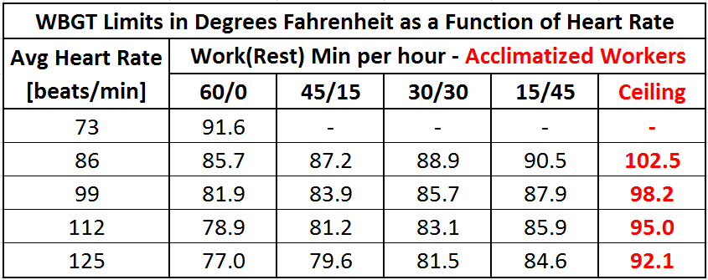
WBGT Limits For Acclimatized Workers
Notes:
Values shown are for a “standard man” of 70 kg (154 lb) body weight and 1.8 m2 (19.4 ft2) body surface. The “standard man” is used to normalize the data from the variability found in human beings. Both men and women adapt well to heat exposure, and given the similar physiological ability to tolerate heat, there are no significant differences between the sexes.

Slide 30
NIOSH Recommended Acclimatization Plan
Gradually increase exposure time in hot environmental conditions over a period of 7 to 14 days.
For new workers, the schedule should be no more than 20% of the usual duration of work in the hot environment on day 1 and a no more than 20% increase on each additional day.
For workers who have had previous experience with the job, the acclimatization regimen should be no more than 50% of the usual duration of work in the hot environment on day 1, 60% on day 2, 80% on day 3, and 100% on day 4.
The time required for non–physically fit individuals to develop acclimatization is about 50% greater than for the physically fit.

Slide 31
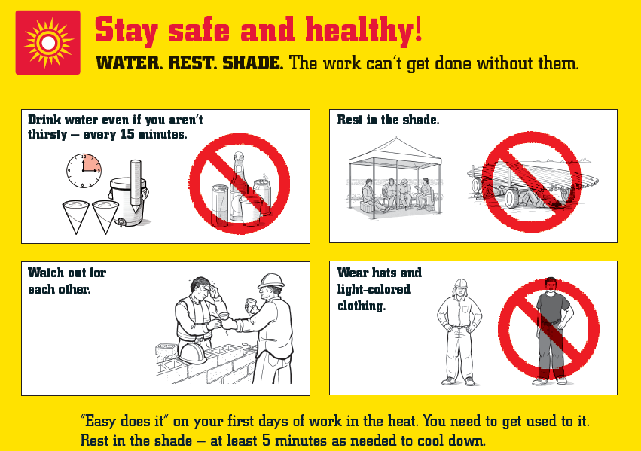
Stay safe and healthy
osha.gov

Slide 32
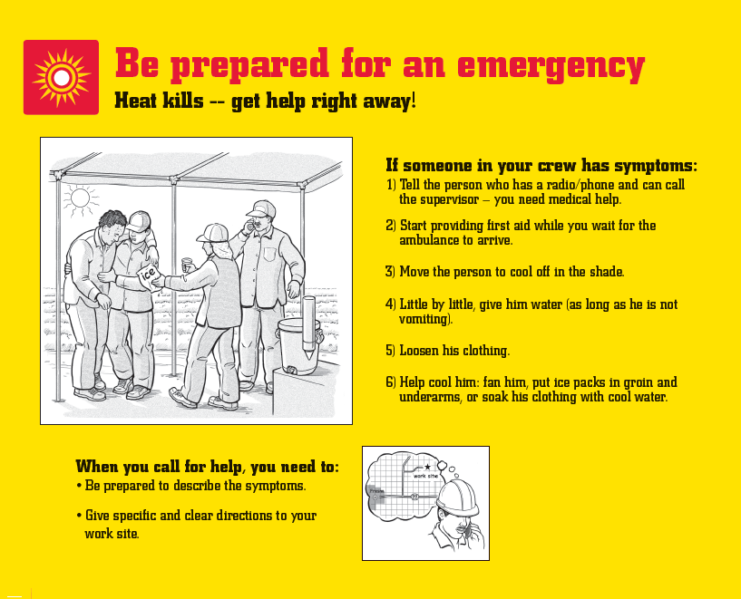
OSHA Poster
osha.gov

Slide 33
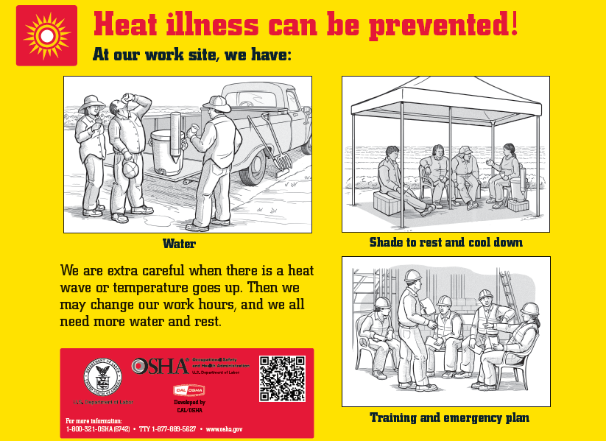
Preventing heat illness

Slide 34
References
Extreme Heat Events in San Juan Puerto Rico: Trends and Variability of Unusual Hot Weather and its Possible Effects on Ecology and Society. Investigators: Méndez-Lázaro P, Martínez-Sánchez O, Méndez-Tejeda R, Rodríguez E, Morales E, Schmitt-Cortijo, N. J Climatol Weather Forecasting 3:135. do:10.4172/2332-2594.1000135 (2015)

