Slide 1

Silica Exposure
osha.gov
If its Silica, it’s not just dust

Slide 2
Disclaimer
This material was produced under Susan Harwood grant number SH29650-SH6 Occupational Safety and Health Administration, U.S. Department of Labor. The contents in this presentation do not necessarily reflect the views or policies of the U.S. Department of Labor, nor does the mention of trade names, commercial products, or organizations imply endorsement by the U.S. Government..

Slide 3

What is silica?
One of the most common naturally occurring minerals on the planet, also known as silicon dioxide (SiO₂).
Usually found in two forms:
  Noncrystalline or amorphous.
  Crystalline, where most common examples are sand and quartz

Slide 4
Where can I find silica-containing materials?
Common construction and every day materials such as:
  asphalt, brick, cement, concrete, drywall, grout, mortar, stone, sand, and tile
In general industry operations using sand products such as:
  glass manufacturing, jewelry production, paintings and coatings manufacturing, dental laboratories, foundries, sand blasting, and hydraulic fracturing.

Slide 5
How are general industry employees exposed to crystalline silica dust?
The most severe exposures to crystalline silica result from abrasive blasting done to:
  Clean and smooth irregularities from molds, jewelry, and foundry castings,
  Finish tombstones, etch or frost glass, or
  Remove paint, oils, rust, or dirt from objects needing to be repainted or treated
  China and ceramic manufacturing

Slide 6
Where are construction industry employees exposed to crystalline silica dust?
Exposures can occur in :
  cement and brick manufacturing,
  asphalt pavement manufacturing,
  tool and die, steel and foundry industries
  manufacturing household abrasives, adhesives, paints, soaps, and glass, and
  maintenance, repair and replacement of refractory brick furnace linings
  cutting and installation of kitchen countertops

Slide 7
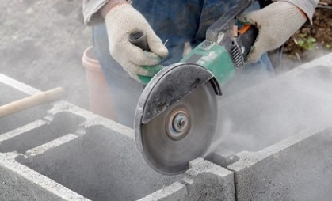
When is crystalline silica a hazard for workers? (materials)
When materials that contain crystalline silica are disturbed in operations such as blasting, cutting, chipping, drilling and grinding operations, or in certain manufacturing processes, among others.
cdc.gov

Slide 8

When is crystalline silica a hazard for workers? (health)
A fine dust cloud of respirable crystalline silica is generated posing a health hazard to the worker.
This fine dust of respirable crystalline silica enters the lungs and causes the formation of scar tissue, which in turn reduces the lungs’ ability to take in oxygen.
osha.gov

Slide 9
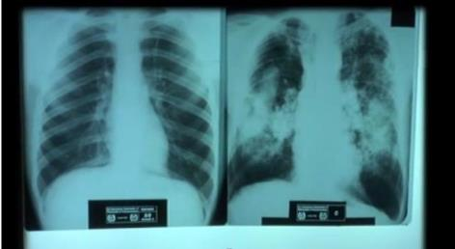
When is silica a hazard for workers?
(effects)
Repeated exposures to crystalline silica can produce serious, sometimes fatal, illnesses such as silicosis, lung cancer, tuberculosis (in those with silicosis), and chronic obstructive pulmonary disease (COPD). There is no cure for silicosis.
osha.gov
Healthy lung vs. Silicosis

Slide 10
Why is crystalline silica a health hazard?
In 1996, the World Health Organization – International Agency on Cancer Research (IARC) identified crystalline silica as a “known human carcinogen” (they reaffirmed this position in 2009).
Silica exposure has also been linked to renal disease and other cancers.

Slide 11
How many types of silicosis are there?
Chronic/classic - occurs after 15–20 years of moderate to low exposures to respirable crystalline silica.
Accelerated – can occur after 5-10 years of high exposures to respirable crystalline silica
Acute - occurs after a few months or as long as 2 years following exposures to extremely high concentrations of respirable crystalline silica.

Slide 12

What are the symptoms for silicosis?
Symptoms for chronic silicosis may or may not be obvious; therefore, workers need to have a chest x-ray to determine if there is lung damage.
The worker may experience shortness of breath upon exercising, fatigue, extreme shortness of breath, chest pain, or respiratory failure. In accelerated and acute silicosis weight loss is also present.

Slide 13
How is OSHA addressing exposure to crystalline silica?
OSHA has established a new Silica Standard for Construction (1926.1153), and for General and Maritime industries (1910.1053), which includes, among other requirements:
  Permissible Exposure Limit (PEL), Action Limit (AL)
  Hazard communication training for workers
  Medical surveillance
  Respirator program until engineering controls are implemented or in addition to such controls
Notes:
Permissible Exposure Limit (PEL), 50um/m3 as an 8 hr TWA
Action Limit (AL) 25Um/m3 as 8 he TWA

Slide 14
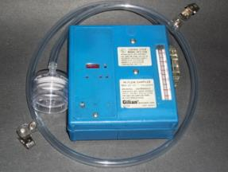
What does the construction standard require?
To limit worker exposures to respirable crystalline silica and to take other steps to protect workers.
Employers can either
  Use a control method laid out in Table 1 of the construction standard, titled “Specified Exposure Control Methods When Working With Materials Containing Crystalline Silica” or
  Measure workers’ exposure to silica and independently decide which dust controls work best to limit exposures to the PEL in their workplaces.

Slide 15

What does the construction standard require? (plan)
All construction employers covered by the standard are required to:
  Establish and implement a written exposure control plan that identifies tasks that involves exposure and methods used to protect workers, including procedures to restrict access to work areas where high exposures may occur
Notes:
The construction standard does not apply where exposures will remain low under any foreseeable
conditions; for example, when only performing tasks such as mixing mortar; pouring concrete
footers, slab foundation and foundation walls; and removing concrete formwork.

Slide 16

What does the construction standard require? (surveillance)
  Designate a competent person to implement the written exposure control plan
  Restrict housekeeping practices that expose workers to silica
  Offer medical surveillance as per standard requirements

Slide 17
Medical surveillance requirements
For workers who are required by the silica standard to wear a respirator for 30 or more days per year, employers must offer medical exams every three years, including:
  Tuberculosis baseline,
  chest X-rays,
  lung function tests, and
  any other test required by the physician

Slide 18
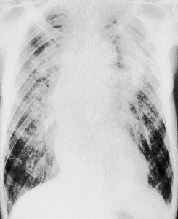
Medical surveillance requirements -1
Medical exams
  chest X-rays interpreted and classified by a NIOSH-certified B Reader and,
  lung function tests performed by a spirometry technician with a current certificate from a (NIOSH)-approved spirometry course
eLCOSH.org
Notes:
A physical examination, with special emphasis on the respiratory system. The physical examination must be
performed at the initial examination and every three years thereafter.
The respirable crystalline silica standard requires the following: Baseline testing
for TB on initial examination.

Slide 19
Medical surveillance requirements - 2
Medical exams…
  Tuberculosis baseline testing and any other test deemed necessary by physician
  Tests and results must be handled by a Physician or other licensed health care professional [PLHCP]
eLCOSH.org

Slide 20


What does the construction standard require?
  Train workers on work operations that result in silica exposure and ways to limit exposure.
  Keep records of workers’ silica exposure and medical exams.

Slide 21
What are the Alternative exposure control methods?
Employers who do not use control methods in Table 1 of the construction standard must:
  Measure the amount of silica that workers are exposed to if it may be at or above an action level of 25 μg/m³ (micrograms of silica per cubic meter of air), averaged over an eight hour day.
  Protect workers from respirable crystalline silica exposures above the permissible exposure limit of 50 μg/m³, averaged over an eight-hour day.

Slide 22

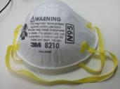
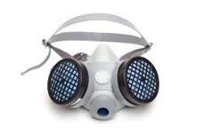
What are Alternative exposure control methods
Employers who do not use control methods in Table 1 must:
  Use dust controls to protect workers from silica exposures above the PEL.
  Provide respirators to workers when dust controls cannot limit exposures to the PEL.

Slide 23
What is 29CFR 1926.1153 Table 1 ?
Table 1 consists of a list of common equipment and tasks done in the construction industry for which the engineering and work practice controls have been determined.
Depending upon the time of the task, be it less than or more than 4 hrs, a requirement for respiratory protection can also be included.

Slide 24
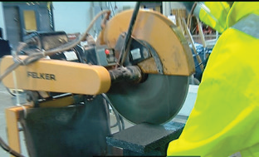
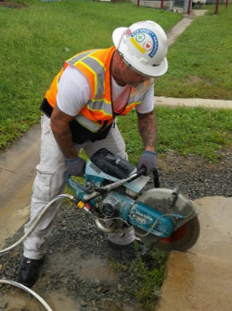
Equipment in 29CFR 1926.1153 Table 1 page 1
Stationary masonry saws
Handheld power saws for cutting fiber-cement board (with blade diameter of 8 inches or less)
osha.gov
osha.gov
osha.gov
Handheld power saws (any blade diameter)

Slide 25
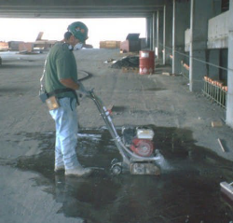
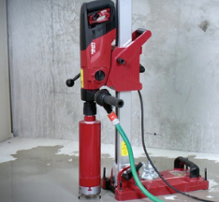
Equipment in 29CFR 1926.1153 Table 1 page 2
Drivable saws
Walk-behind saws
osha.gov
Rig-mounted core saws or drills
osha.gov

Slide 26
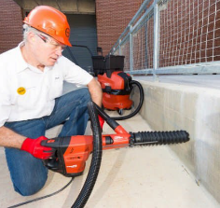
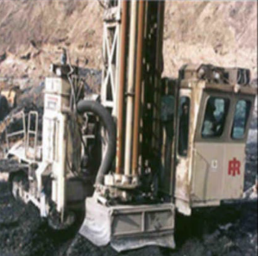
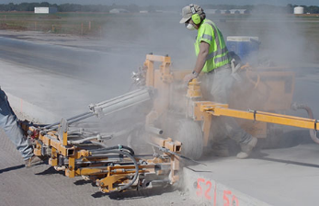
Equipment in 29CFR 1926.1153 Table 1 page 3
Handheld and stand-mounted drills (including impact and rotary hammer drills)
Vehicle-mounted drilling rigs for rock and concrete
osha.gov
Dowel drilling rigs for concrete
cdc.gov

Slide 27
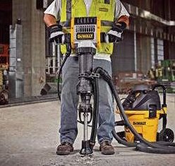
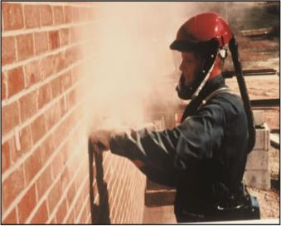
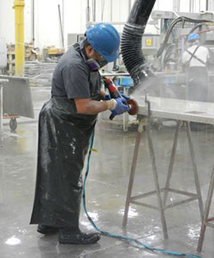
Equipment in 29CFR 1926.1153 Table 1 page 4
Jackhammers and handheld powered chipping tools
Handheld grinders for mortar removal (i.e., tuckpointing)
eLCOSH.org
osha.gov
cdc.gov/niosh
Handheld grinders for uses other than mortar removal

Slide 28
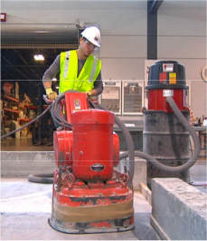
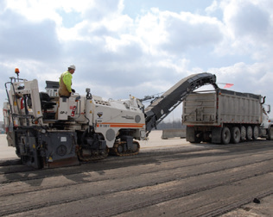

Equipment in 29CFR 1926.1153 Table 1 page 5
Small drivable milling machines (less than half-lane)
Walk-behind milling machines and floor grinders
osha.gov
osha.gov
Large drivable milling machines (half-lane and larger)
cdc.gov/niosh

Slide 29
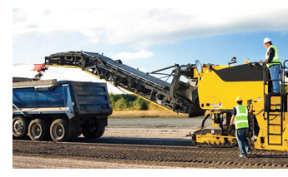
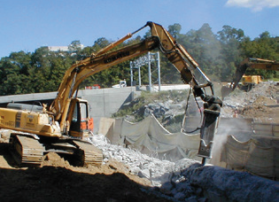
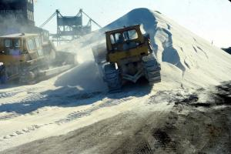
Equipment in 29CFR 1926.1153 Table 1 page 6
Crushing machines
Hoe-ramming, rock ripping
cdc.gov/niosh
Grading and excavating
eLCOSH.org
osha.gov

Slide 30

Example of 29CFR 1926.1153 Table 1
Equipment/ Task | Engineering and Work Practice Control Methods | Required Respiratory Protection and Minimum Assigned Protection Factor (APF)
 |  | ≤ 4 hrs/ shift | > 4 hrs/ shift
(xii) Handheld grinders for uses other than mortar removal | For tasks performed outdoors only: Use grinder equipped with integrated water delivery system that continuously feeds water to the grinding surface | None | None
 | Operate and maintain tool in accordance with manufacturer's instructions to minimize dust emissions se grinder equipped with commercially available shroud and dust collection system Operate and maintain tool in accordance with manufacturer's instructions to minimize dust emissions Dust collector must provide 25 cubic feet per minute (cfm) or greater of airflow per inch of wheel diameter and have a filter with 99% or greater efficiency and a cyclonic pre-separator or filter-cleaning mechanism
 | When used outdoors | None | None
 | -When used indoors or in an enclosed area | None | APF10

Slide 31

When are Construction employers required to comply with the standard?
Construction employers must comply with all requirements of the standard by June 23, 2017, except requirements for laboratory evaluation of exposure samples, which begins on June 23, 2018.
Construction Industry
June 23, 2017

Slide 32
What does the general/ maritime industry standard require? -1
Measure the amount of silica that workers are exposed to if it may be at or above an action level of 25 μg/m³ (micrograms of silica per cubic meter of air), averaged over an 8-hour day;
Protect workers from respirable crystalline silica exposures above the permissible exposure limit of 50 μg/m³, averaged over an 8-hour day;

Slide 33

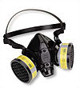
What does the general/ maritime industry standard require?- 2
Limit workers’ access to areas where they could be exposed above the PEL;
Use dust controls to protect workers from silica exposures above the PEL;
Provide respirators to workers when dust controls cannot limit exposures to the PEL;

Slide 34
What does the general/ maritime industry standard require? -3
Restrict housekeeping practices that expose workers to silica where feasible alternatives are available;
Establish and implement a written exposure control plan that identifies tasks that involve exposure and methods used to protect workers;

Slide 35

What does the general/ maritime industry standard require? -4
Train workers on work operations that result in silica exposure and ways to limit exposure; and
Offer medical tests to comply with medical surveillance.
Keep records of workers’ silica exposure and medical exams

Slide 36
What does the general/ maritime industry standard require? -5
The employer shall
  include respirable crystalline silica in the Hazard Communication Standard (HCS) program.
  ensure that each employee has access to labels on containers of crystalline silica, safety data sheets, and is trained in accordance with the HCS.
  ensure that at least the following hazards are addressed: Cancer, lung effects, immune system effects, and kidney effects.

Slide 37

When are employers required to comply with the standard?
General industry and maritime employers must comply with all requirements of the standard by June 23, 2018, except for the following:
  Hydraulic fracturing operations in the oil and gas industry must implement engineering controls to limit exposures to the new PEL by June 23, 2021.
General Industry
June 23, 2018

Slide 38
When are employers required to comply with the standard? (cont.)
  Medical surveillance must be offered to employees who will be exposed at or above the action level for 30 or more days a year starting on June 23, 2020.
  Medical surveillance must be offered to employees who will be exposed above the PEL for 30 or more days a year starting on June 23, 2018.

Slide 39
References
osha.gov – silica page; publications: OSHA FS 3627, 3629, 3630, 3633, 3902, 3928, 3929, 3931, 3932, 3933, 3936
eLCOSH.org - silica page
cdc/niosh.gov – silica page

