Slide 1
Subpart O - Machine Guarding
Notes:
The material was produced under grant number SH-29660-SH6 from the Occupational Safety and Health Administration, U.S. Department of Labor. It does not necessarily reflect the views or policies of the U.S. Department of Labor, nor does mention of trade names, commercial products, or organizations imply endorsement by the U.S. Government.

Slide 2
Disclaimer
This material was produced under grant number SH-29660-SH6 from the Occupational Safety and Health Administration, U.S. Department of Labor. It does not necessarily reflect the views or policies of the U.S. Department of Labor, nor does mention of trade names, commercial products, or organizations imply endorsement by the U.S. Government.

Slide 3
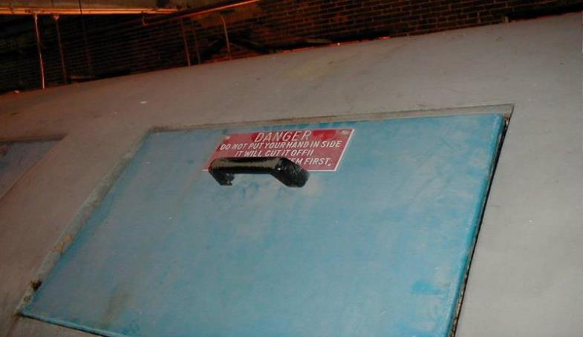
What are your biggest machine guarding challenges?
2
Notes:
Picture shows sample sign warning of machine guarding (exaggerated). This slide meant to initiate class discussion on challenges students have at their facilities.

Slide 4

We Will Cover:
Machine Guarding Principles
Subpart O – Highlights
1910.147 – Lockout/Tagout Highlights
3

Slide 5
Machine Guarding Requirements
Prevent contact
Be secure
Protect from falling objects
Create no new hazards
No interference
Maintainability and accessibility
4

Slide 6
Where machine hazards occur:
Point of operation
Mechanical power transmission
Other moving parts
5

Slide 7
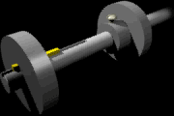

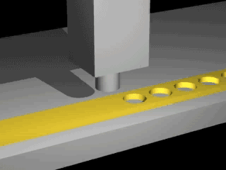








Machine Guarding
Notes:
Taken from OSHA E-Tool on Machine Guarding illustrate a variety of hazards that require machine guarding including rotating parts, in-running nip points, hazardous points of operation, shear points, exploding grinding wheels, and reciprocating motion.

Slide 8

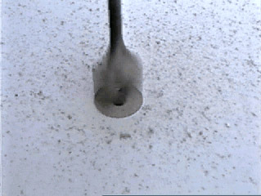
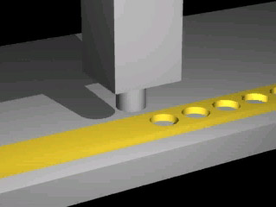
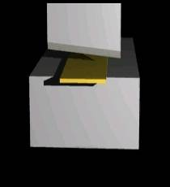

Machine Guarding Hazardous Actions
Cutting
Shearing
Bending
Punching
Notes:
Illustrations show more hazards including cutting, shearing, bending, and punching.

Slide 9
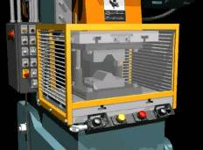
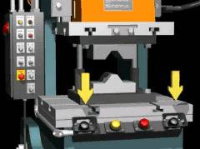

Methods of machine safeguarding
Physical guards
Devices
Location/Distance
8
Notes:
Illustrations show samples of guarding, devices (2 hand control), and distance.

Slide 10
Guards
Fixed
Interlocked
Adjustable
Self-adjusting
9

Slide 11
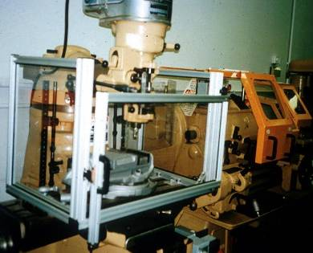
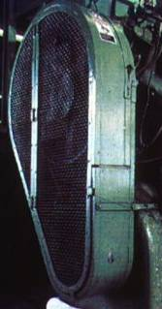
Fixed Guard
Provides a barrier - a permanent part of the machine, preferable to all other types of guards.
10
Notes:
Pictures show sample fixed guards for a milling machine and belt/pulley.

Slide 12
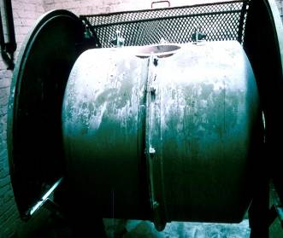
Interlocked Guard
When this type of guard is opened or removed, the tripping mechanism and/or power automatically shuts off or disengages, and the machine cannot cycle or be started until the guard is back in place.
Interlocked guard on revolving drum
11
Notes:
Picture shows an interlocked guard on a revolving drum.

Slide 13
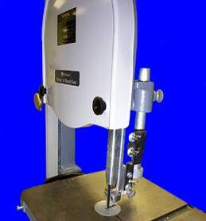
Adjustable Guard
Provides a barrier which may be adjusted to facilitate a variety of production operations.
Bandsaw blade adjustable guard
12
Notes:
Picture shows bandsaw blade adjustable guard.

Slide 14
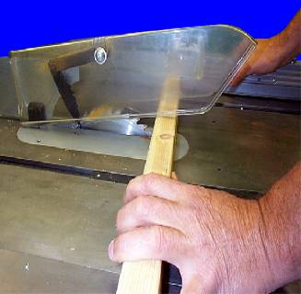
Self-Adjusting Guard
Provides a barrier which moves according to the size of the stock entering the danger area.
Circular table saw self-adjusting guard
13
Notes:
Picture shows self-adjusting guard on table saw.

Slide 15
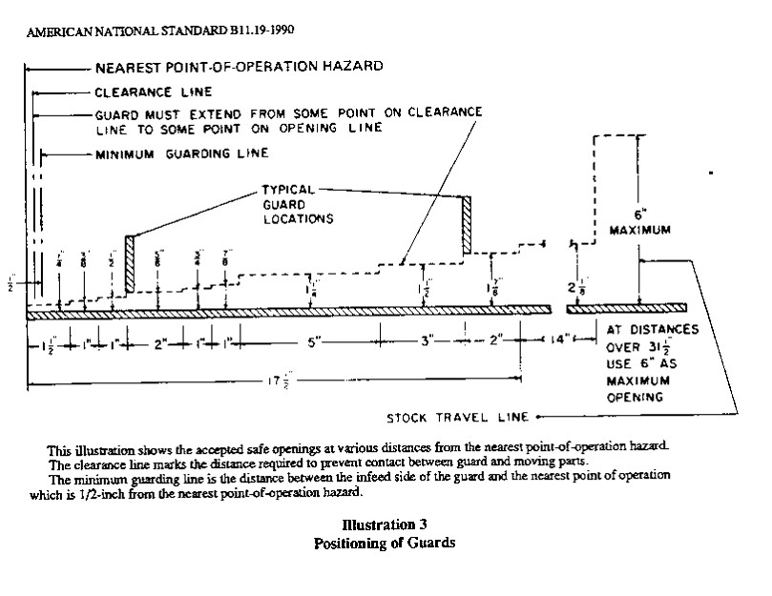
Gotcha Stick illustration
Notes:
Illustration of “Gotcha Stick”. Meant to depict the allowable guard size openings given the distance from the guard to the hazard. Stress need for guard to prevent access to hazard by reaching over, under, around, or through the guard.

Slide 16
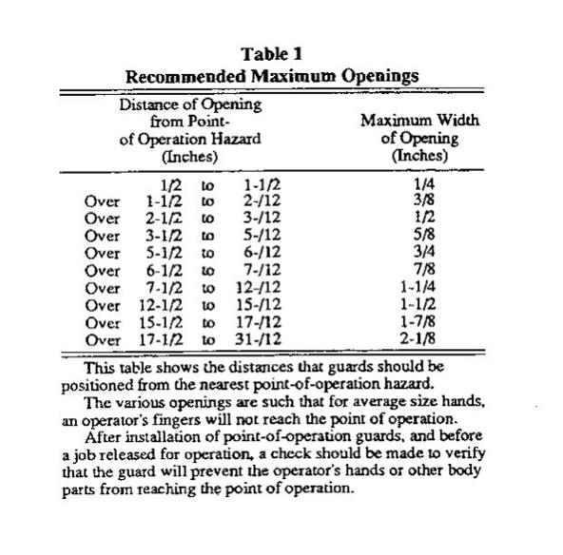
Guard Distance Table
Notes:
Table representing allowable guard size openings given the distance to the hazard.

Slide 17
Safeguarding devices
Presence sensing
Pullback
Restraint
Safety controls and trips
Gates
16

Slide 18
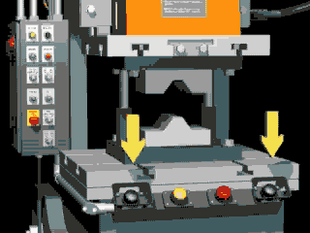
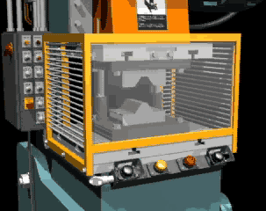
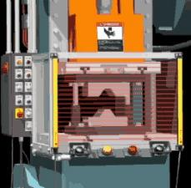
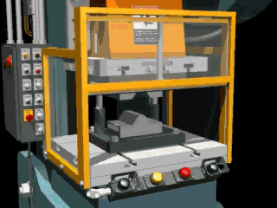
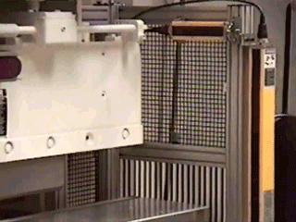
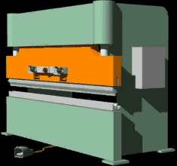
Some Examples of Guards/Safeguards
17
Notes:
Illustrations of a variety of guards and safeguarding devices, as well as press brake operation. Stress that testing of light curtains (bottom center) should be done with test rods and not with your hand.

Slide 19
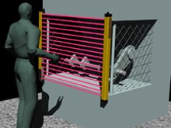
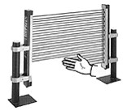
Light Curtain
Notes:
Illustration of light curtain.

Slide 20
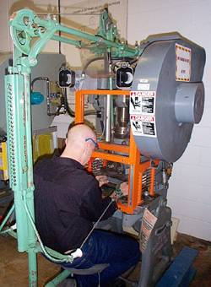
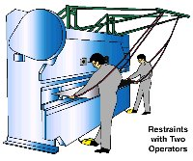
Pullback Restraints
Notes:
Pictures/illustrations of pullbacks and restraints.

Slide 21
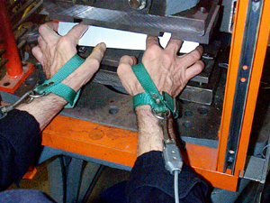
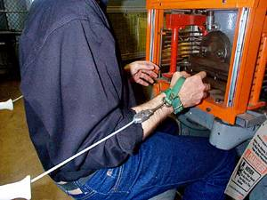
Pullback Device (cont’d)
Hands in die, feeding
Point of operation exposed
Pullback device attached and properly adjusted
Die closed
Hands withdrawn from point of operation by pullback device
Notes:
Close up pictures of pull backs.

Slide 22
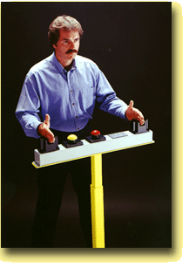

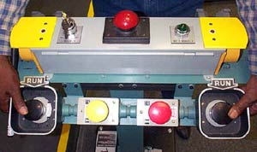
Two-Hand Controls
Notes:
Pictures of 2-hand controls.

Slide 23
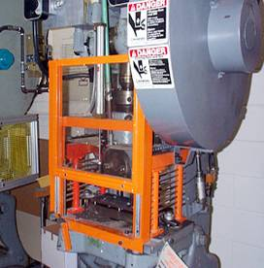
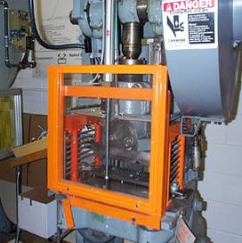
Gate
Movable barrier device which protects the operator at the point of operation before the machine cycle can be started
If the gate does not fully close, machine will not function
Gate Closed
Gate Open
22
Notes:
Pictures of moveable gates.

Slide 24
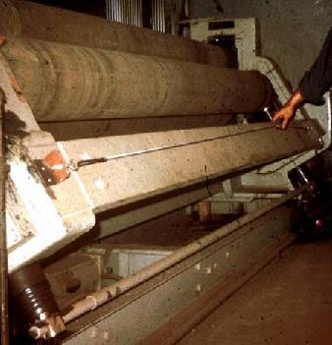
Safety Tripwire Cables
Device located around the perimeter of or near the danger area
Operator must be able to reach the cable to stop the machine
23
Notes:
Picture of a safety tripwire cable.

Slide 25
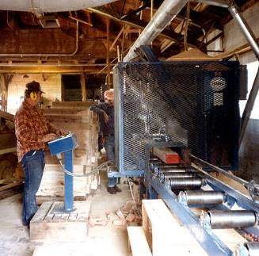
Safeguarding by Location/Distance
Locate the machine or its dangerous moving parts so that they are not accessible or do not present a hazard to a worker during normal operation
Maintain a safe distance from the danger area
24
Notes:
Picture of safeguarding by location example.

Slide 26
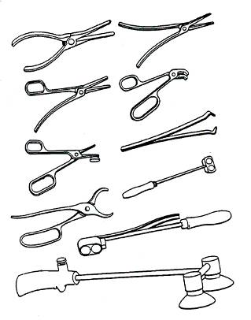
Holding Tools
Used to place and remove stock in the danger area
Not to be used instead of other machine safeguards, but as a supplement
25

Slide 27

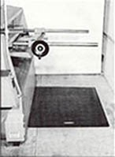

Pressure- Sensitive Mats
Notes:
Illustrations of pressure-sensitive mats that can be used as part of safeguarding by location.

Slide 28
Robots
Machines that load and unload stock, assemble parts, transfer objects, or perform other tasks
Best used in high-production processes requiring repeated routines where they prevent other hazards to employees
27
Notes:
Illustration of robot work cell. Stress need to reference ANSI/RIA R15.06-2012 on robot safety.

Slide 29
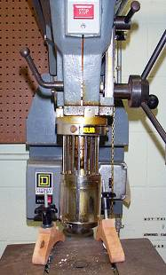
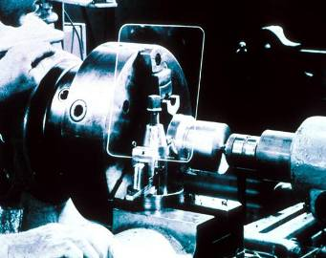
Protective Shields
These do not give complete protection from machine hazards, but do provide some protection from flying particles, splashing cutting oils, or coolants.
28
Notes:
Pictures show shields on drill press and lathe.

Slide 30
Subpart O - Machinery and Machine Guarding
211 - Definitions
212 - General requirements
213 - Woodworking machinery
215 - Abrasive wheel machinery
216 - Mills and calendars
217 - Mechanical power presses
218 - Forging machines
219 - Mechanical power transmission
29

Slide 31
1910.212
General Requirements for all Machines

Slide 32

1910.212(a)(1)
One or more methods of machine guarding shall be provided to protect the operator and other employees in the machine area from hazards such as those created by the point of operation, in-going nip points, rotating parts, flying chips and sparks.
31

Slide 33
1910.212(a)(3)(ii)
The point of operation of machines whose operation exposes an employee to injury, shall be guarded.
32

Slide 34
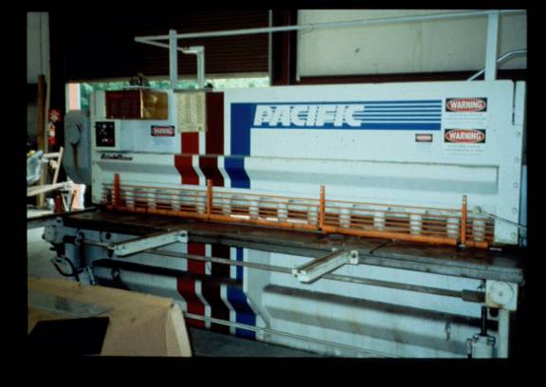
Point of Operation Guarded??
Notes:
Picture shows shear. Stress guarding of “hold-downs” as well as shear blade.

Slide 35
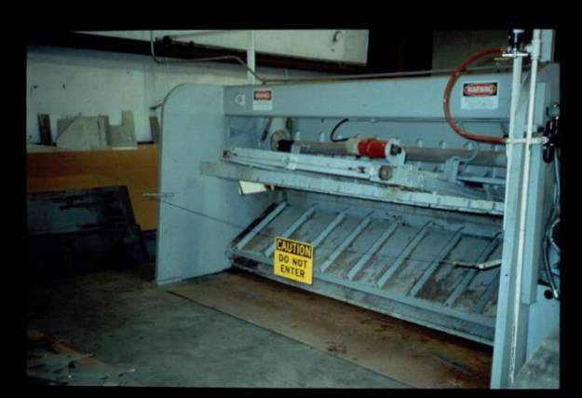
Point of Operation Guarding
Notes:
Picture of back of shear. Stress guarding back and using top and mid-rail with sign.

Slide 36
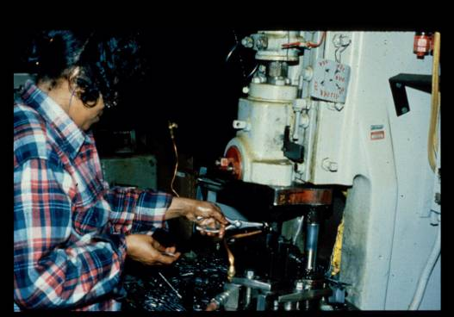
Hand Tools
Notes:
Picture of person using hand-tool with machine. Stress that hand tools are to be used in conjunction with other guarding/safeguarding, not as their own method of safeguarding.

Slide 37

1910.212(a)(5)
When the periphery of the blades of a fan is less than seven (7) feet above the floor or working level, the blades shall be guarded. The guard shall have openings no larger than 1/2 inch.
36
Notes:
Picture of guarded fan.

Slide 38
1910.212(b)
Machines designed for a fixed location shall be securely anchored to prevent walking or moving.
37

Slide 39
1910.213
Woodworking Machinery Requirements

Slide 40
Table Saws
39

Slide 41
1910.213(c)(1)
Each circular hand-fed ripsaw shall be guarded by a hood which shall completely enclose that portion of the saw above the table and that portion of the saw above the material being cut. The hood and mounting shall be arranged so that the hood will automatically adjust itself to the thickness of and remain in contact with the material being cut without considerable resistance.
40

Slide 42
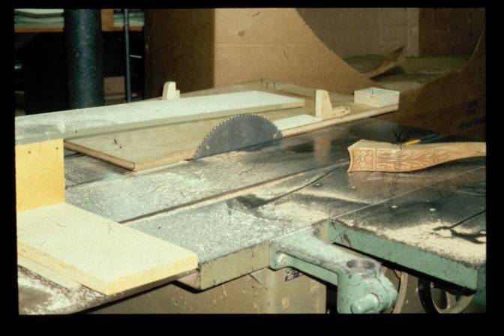
Table Saw
Notes:
Picture of unguarded table saw.

Slide 43
1910.213(c)(2)
Each hand-fed circular ripsaw shall be furnished with a spreader to prevent material from squeezing the saw or being thrown back on the operator.
42

Slide 44
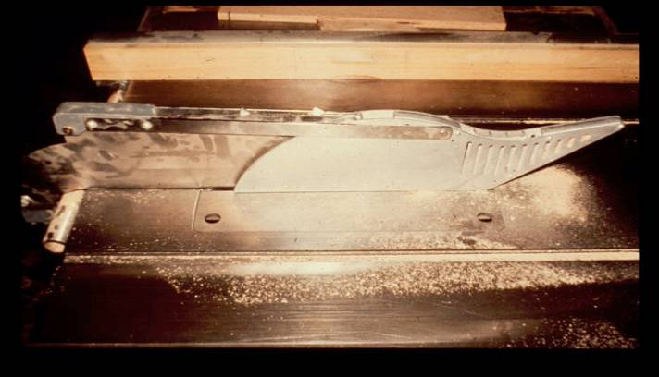
Table Saw
Notes:
Picture of guarded table saw.

Slide 45
1910.213(c)(3)
Each hand-fed circular ripsaw shall be provided with non-kickback fingers or dogs so located as to oppose the thrust or tendency of the saw to pick up the material or throw it back toward the operator.
44

Slide 46
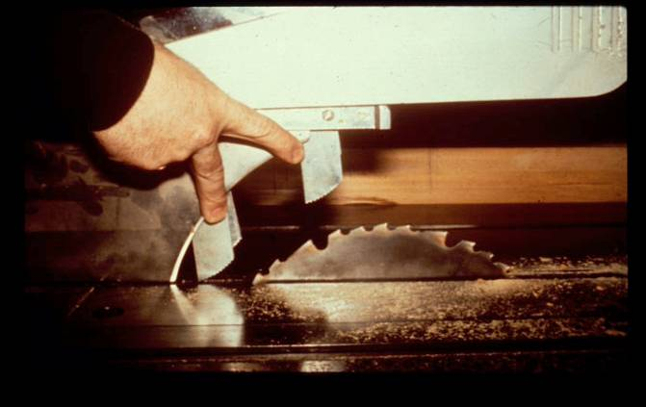
Dogs
Notes:
Picture of spreader and non-kickback fingers.

Slide 47
1910.213(d)(1)
Each circular crosscut table saw shall be guarded by a hood which shall meet all the requirements of 1910.213(c)(1) for hoods for circular resaws.
46

Slide 48
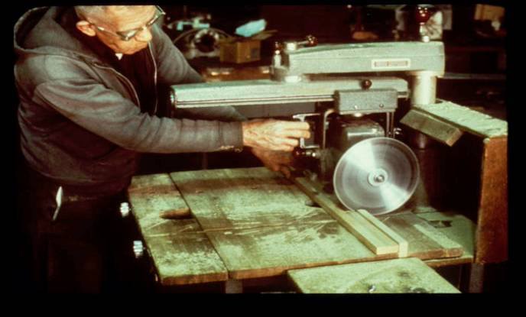
Radial Arm Saws
Notes:
Picture of unguarded radial arm saw.

Slide 49
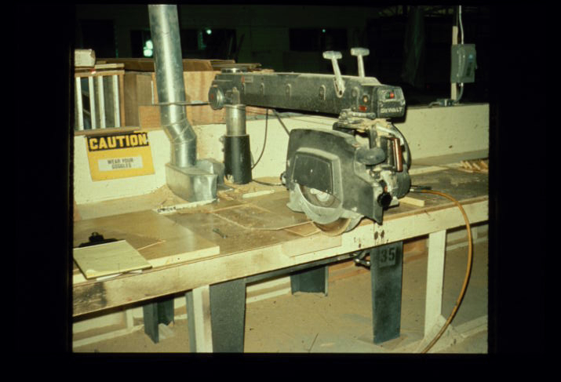
Partial guarding
Notes:
Picture of partially guarded (top covered) radial arm saw. Stress that it must return to home when released and not go past table.

Slide 50
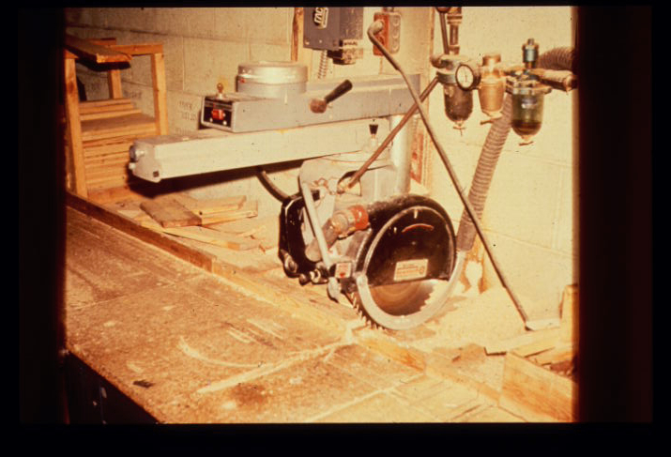
Radial arm saw
Notes:
Picture of better guarding on radial arm saw.

Slide 51
1910.213(i)(1)
All portions of the saw blade (bandsaws) shall be enclosed or guarded, except for the working portion of the blade between the bottom of the guide rolls and the table.
50

Slide 52
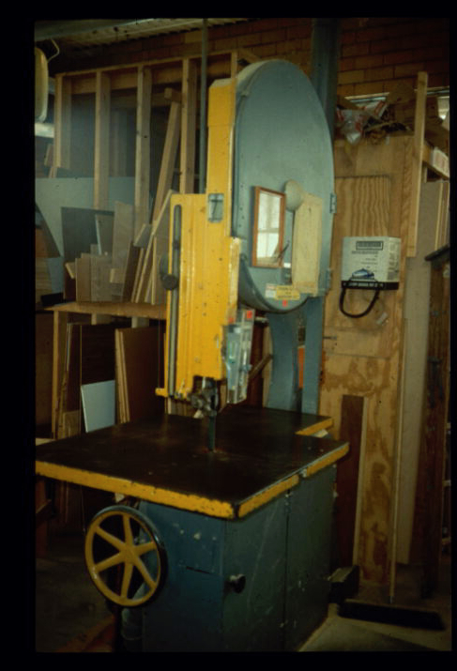
Bank saw
Notes:
Picture of band saw.

Slide 53
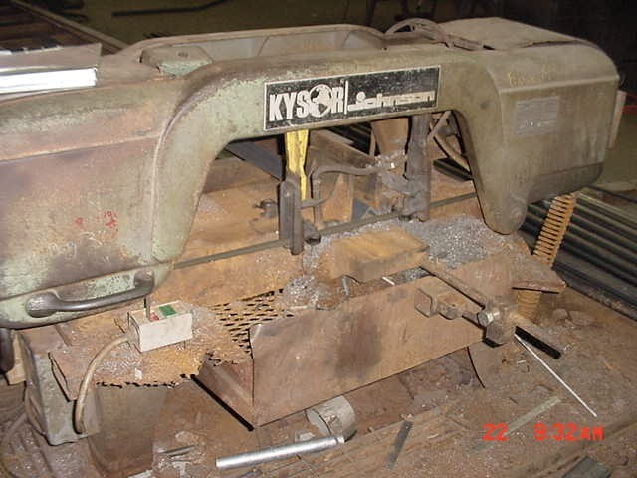
Metal cutting band saw
Notes:
Picture of metal cutting bandsaw. Still need to guard non-working portions of blade.

Slide 54
1910.215
Abrasive-Wheel Machinery

Slide 55
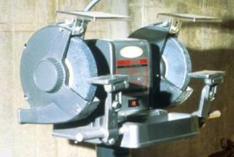
1910.215(a)(4)
Work rests shall be adjusted closely to the wheel with a maximum opening of one-eighth inch to prevent the work from being jammed between the wheel and the rest, which may cause wheel breakage.
Work Rest
54
Notes:
Picture of grinder showing work rest and tongue guards.

Slide 56
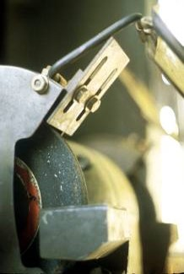
1910.215(b)(9)
The distance between the wheel periphery and the adjustable tongue or the end of the peripheral member at the top shall never exceed one-fourth inch.
Tongue Guard
55
Notes:
Picture of tongue guard.

Slide 57
1910.215(d)(1)
Immediately before mounting, all wheels shall be closely inspected and sounded by the user (ring test) to make sure they have not been damaged.
56

Slide 58

Grinder
Notes:
Picture of unguarded grinder. Need side guard and tongue guard. Electrical is also a serious issue.

Slide 59

Unguarded grinder & other issues
Notes:
Picture of unguarded grinder. Needs work rest, tongue guard. Also needs to be bolted down.

Slide 60

Tech Guide available @ www.oshainfo.gatech.edu
59
Notes:
Illustration of Georgia Tech Technical Guide on Grinders. Available at www.oshainfo.gatech.edu.

Slide 61
1910.219
Mechanical Power-Transmission Apparatus

Slide 62

Back guard
Notes:
Picture of v-belt and pulley that needs to be guarded at back.

Slide 63
Missing Guard
Notes:
Picture of missing guard on belt/pulley.

Slide 64
1910.219(b)(1)
Flywheels located so that any part is 7 feet or less above the floor or platform shall be guarded.
Wherever flywheels are above working areas, guards shall be installed having sufficient strength to hold the weight of the flywheel in the event of a shaft or wheel mounting failure.
63

Slide 65
1910.219(c)
Horizontal, vertical, and inclined shafting must be enclosed.
Projecting shaft ends shall present a smooth edge and end and shall not project more than 1/2 the diameter of the shaft unless guarded by non rotating cap or safety sleeves.
64

Slide 66

Unguarded coupling
Notes:
Picture of unguarded coupling.

Slide 67

Unguarded coupling
Notes:
Picture of unguarded coupling with wire wrapped up in it.

Slide 68

Result of hair getting caught in rotating parts.
Notes:
Picture of person who’s hair was caught in rotating parts.

Slide 69

1910.219(d)
Pulleys 7ft. or less above the floor or platform must be guarded.
Pulleys with cracks or pieces broken out of rims shall not be used.
Notes:
Picture of person standing very close to unguarded belt/pulley.

Slide 70

Gears need guarding
Notes:
Picture of gears that need additional guarding.

Slide 71

Unguarded Chain/Sprocket
Notes:
Picture of unguarded chain/sprocket.

Slide 72

k
Notes:
Picture of many mechanical power transmission elements unguarded including belt/pulley, gear, shaft, chain/sprocket.

Slide 73
Lockout/Tagout - What is covered?
Servicing and maintenance
Normal production operations where:
Employees by-pass guard(s)
Employees place any part of their body in a hazardous area
72

Slide 74
What is not covered?
Construction, agriculture, and maritime
Normal production operations (subpart O)
Cord-and-plug under the control of employee (written procedure still required)
Exposure to electrical conductors (subpart S and electrical safety-related work practices)
73

Slide 75

Locked Out?????????
Notes:
Picture of person in situation that requires lockout.

Slide 76
Lockout vs. Tagout
If capable of being locked out:
Prefer lockout
Tags allowed, if employer can demonstrate FULL EMPLOYEE PROTECTION
Machine Modifications
75

Slide 77
Full employee protection?
Tags attached at the same location as locks
Full compliance with all tagout provisions in 29 CFR 1910.147
Additional means when necessary (e.g. removal of a valve handle)
76

Slide 78
Energy control procedure
Notification of employees
Preparation for shutdown
Machine or equipment shutdown
Machine or equipment isolation
Lockout/tagout device application
Stored energy
Verification of isolation
Release from lockout/tagout
77

Slide 79
Periodic Inspection
Performed at least annually
Lockout – include review with authorized employees
Tagout – include review with authorized and affected employees
Certification record kept:
Identify machine or equipment
Date of inspection
Employees performing and included in inspection
78

Slide 80
Training and re-training
Authorized employees
Recognition of hazardous energy
Type and magnitude of hazardous energy
Methods of isolating energy
How to verify isolation
Affected – Purpose and use of procedure
Other – Procedure and Prohibition from tampering
Tagout provisions
79

Slide 81
Re-training is required when:
Change in job assignment
Change in machine or process
Change in lockout/tagout procedure
Inadequacies revealed in periodic review
80

Slide 82
Training certification
Certify that the training has been conducted and kept up to date:
Employee names
Date(s) of training
81

Slide 83
Testing or positioning machines
Clear the machine of tools and materials
Remove employees from the area
Remove lockout/tagout devices
Energize and proceed with testing/positioning
De-energize and re-apply energy control measures
82

Slide 84
Group lockout
Personal lock or tag (usually)
Lockbox or master tag system with principal authorized employee
“Shall utilize a procedure which affords a level of protection equivalent to that provided by the implementation of a personal lockout or tagout device”
83

Slide 85
Minor Servicing Exemption
Activities which are routine, repetitive, and integral to the use of the equipment for production are not covered by this standard if alternative measures provide effective protection.
Activity must be conducted during normal production operations
Activity must be routine (regular course of procedure in accordance with established practices), repetitive (regularly repeated as part of production), and integral (essential to the production process).
84

Slide 86

Machine Guarding etool
85
Notes:
Illustration of machine guarding e-tool page. www.osha.gov.

