Slide 1
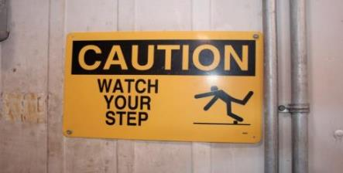
Slips, Trips& Falls
Identification & Prevention
Notes:
Created with funding by: A U.S. Occupational Safety and Health Administration Susan Harwood Training Grant
According to NSC, STF are the second leading cause of workplace fatalities (2013).
This training course was produced under grant number SH-17809-08-60-F-13 (Food Processing) from the Occupational Safety and Health Administration, U.S. Department of Labor. It does not necessarily reflect the views or policies of the U.S. Department of Labor, nor does mention of trade names, commercial products, or organizations imply endorsement by the U.S. Government. Revised December 2016 under grant number SH-29660-SH6 from the Occupational Safety and Health Administration, U.S. Department of Labor.

Slide 2
Disclaimer
This material was produced under grant number SH-29660-SH6 from the Occupational Safety and Health Administration, U.S. Department of Labor. It does not necessarily reflect the views or policies of the U.S. Department of Labor, nor does mention of trade names, commercial products, or organizations imply endorsement by the U.S. Government.

Slide 3
Objectives
Costs of slips, trips & falls (STFs)
Definitions
Causes of STFs
Risk factors
Prevention/minimization
Notes:
Outline of the topics to be discussed.

Slide 4

Costs of STFs
Slips, trips & falls can happen anywhere in your operation
Slips & trips can result in falls, possibly disability or death
Costs to employer & worker can be substantial
Notes:
The average cost from slip and falls is $22,800 per accident,” says Ostrander. “The average workers compensation claim is $19,000.” The Index reports that falls on the same level are the second most costly occupational injury estimated annual cost of $6.7 billion.
Slip-Fall Statistics - HSP Supply Inc.
hspsupplyinc.com/stats.htm

Slide 5

Costs of STFs
To the employer:
Loss of productivity & business
Increased industrial insurance premiums
Costs associated with training replacement worker

Slide 6
Costs of STFs
To the worker:
Lost wages & out-of-pocket expenses
Pain
Temporary or permanent disability
Reduced quality of life
Depression
Death

Slide 7
Frequency of STFs
Slips, trips & falls make up majority of general industry accidents (USDoL)
15% of all accidental deaths; 2nd leading cause behind motor vehicles
~12,000/year
One of most frequently-reported injuries
~25% of reported claims/year
Over 17% of all disabling occupational injuries result from falls
Most could have been prevented

Slide 8
STF Injuries
Sprains & strains
Bruises & contusions
Fractures
Abrasions & lacerations

Slide 9
Typical Injury Sites
Knee, ankle and/or foot
Wrist &/or elbow
Back &/or shoulder
Hip
Head

Slide 10
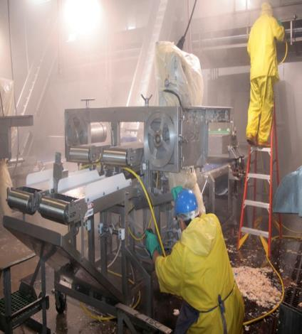
Definitions
Slip
Too little friction or traction between feet (footware) & walking/working surface, resulting in loss of balance
Notes:
An act of sliding unintentionally for a short distance. "a single slip could send them plummeting down the mountainside"
synonyms: false step, misstep, slide, skid, fall, tumble "a single slip could send them plummeting downward"

Slide 11
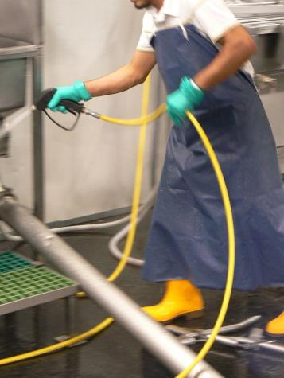
Definitions
Trip
Foot or lower leg hits object & upper body continues moving, resulting in loss of balance
Stepping down to lower surface & losing balance
Potential Trip Hazards?
Notes:
Typical ways that people can trip, especially during sanitation.

Slide 12
Definitions
Fall
Occurs when too far off center of balance
Two types
Fall at same level
Fall to same walking or working surface, or fall into or against objects above same surface
Fall to lower level
Fall to level below walking or working surface

Slide 13
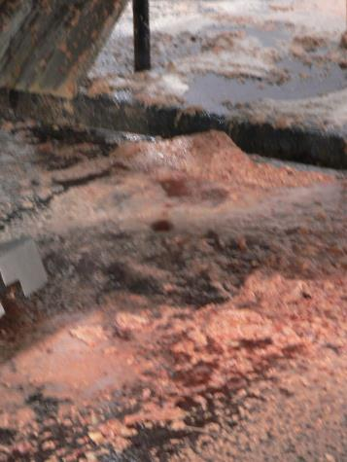
Causes of Slips
Wet product or spills on smooth floors or walking surfaces
Water
Mud
Grease
Oil
Food
Blood
Offal

Slide 14
Causes of Slips
Dry product or spills making walking surface slippery
Dusts
Powders
Granules
Wood
Plastic wrapping

Slide 15
Causes of Slips
Highly-polished floors can be slick even when dry
Concrete
Marble
Ceramic tile
Freshly-waxed surfaces
Transitioning from one surface to another
Carpeted to vinyl
Grid to smooth concrete

Slide 16
Causes of Slips
Sloped walking surfaces
Loose, unanchored rugs or mats
Loose floorboards or shifting tiles
Wet, muddy or greasy shoes
Ramps & gang planks without skid- or slip-resistant surfaces

Slide 17
Causes of Slips
Metal surfaces
Dockboards & dock plates
Platforms
Sidewalk & road covers
Mounting & dismounting vehicles & equipment
Climbing ladders
Loose, irregular surfaces such as gravel

Slide 18
Causes of Slips
Sloped, uneven or muddy terrain
Weather hazards
Leaves, pine needles & other plant debris (wet or dry)

Slide 19
Causes of Trips
Uncovered hoses, cables, wires or extension cords across aisles or walkways
Clutter, obstacles in aisles, walkway & work areas
Open cabinet, file or desk drawers & doors

Slide 20
Causes of Trips
Changes in elevation or levels
Unmarked steps or ramps
Rumpled or rolled-up carpets/mats or carpets with curled edges
Irregularities in walking surfaces
Thresholds or gaps
Missing or uneven floor tiles & bricks

Slide 21
Causes of Trips
Damaged steps
Non-uniform, improper or irregular steps
Taller of shorter
Shallower tread depth
Otherwise irregular
Tread
Riser

Slide 22
Causes of Trips
Debris, accumulated waste materials
Trailing cables, pallets, tools in gangways
Objects protruding from walking surface
Uneven surfaces
Sidewalk/curb drops
Speed bumps
Tire bumpers
Wheelchair ramps & curbs
Driveways

Slide 23
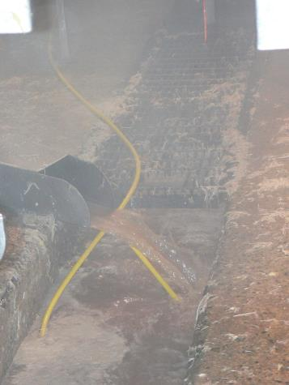
Environmental Conditions
Poor lighting
Glare
Shadows
Bulky PPE (includes improper footwear)
Excess noise or temperature
Fog or misty conditions
Poor housekeeping
Improper cleaning methods & products
Inadequate or missing signage
Notes:
The picture shows water being drained into a system designed for the collection of the substance.

Slide 24
Human Factors Increasing Risk of Trips & Slips - Physical
Failing eyesight &/or visual perception
Age
Physical condition & fatigue
Stress or illness
Medications, alcohol & drug effects

Slide 25

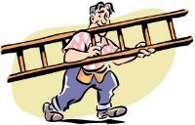
Human Factors Increasing Risk of Trips & Slips - Behavior
Carrying or moving cumbersome objects or simply too many objects at one time
Not paying attention to surroundings or walking distracted
Taking unapproved shortcuts
Being in a hurry and rushing

Slide 26
STFs are Preventable
Design of workplace & work processes-Design workplace & processes to prevent potential exposures to slip & trip hazards
Good housekeeping-Maintain clear, tidy work areas free of clutter
Safe walking practices
Follow safe walking practices & routes
Wearing proper footwear
Wear proper footwear with good traction
Learn to fall “properly”
There are techniques that can minimize fall injuries

Slide 27
Workplace/Work Process Design
Contain work processes to prevent discharge, splatter, or spillage of liquids, oils, particles, dusts & offal onto floor
Local exhaust ventilation
Extraction/collection systems
Enclosures
Work surfaces with raised or lipped edges
Catch/drip pans, drain-offs
Notes:
Spillages Clean up all spillages immediately. Use a cleaning agent if required. If the floor is wet, use appropriate signs to tell people the floor is still wet and that extra care is needed. Alternatively, use another route until the spillage or wetness is gone.

Slide 28
Workplace/Work Process Design
Use drip trays to contain leaks of lubricant onto floor from machinery
Perform regularly scheduled maintenance
Use adequate ventilation to avoid smoke, steam & condensation of water & grease onto floor
Provide adequate lighting to keep work areas, aisles & paths of travel well lit

Slide 29
Workplace/Work Process Design
Mark/highlight step edges & transition areas (changes in elevations)
Use anti-skid paint, slip-resistant coatings & strips
Make sure stairs have sufficient lighting & hand rails
Provide effective drainage, false floors or work platforms
Install slip-resistant floors in high risk areas
Notes:
Rugs or mats Where they cannot be eliminated, make sure rugs or mats are securely fixed and that edges do not present a trip hazard.

Slide 30
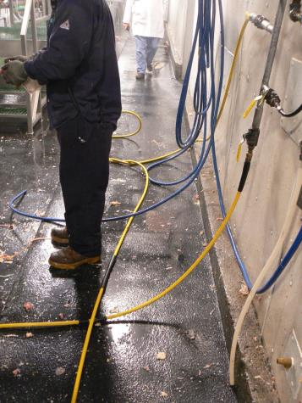
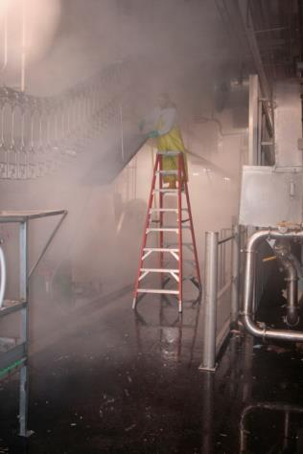
OSHA’s Regulations 29 CFR 1910 Subpart D
Notes:
Pictures typically show how people can fall, such as foot level falls and falls from heights, such as ladders.

Slide 31
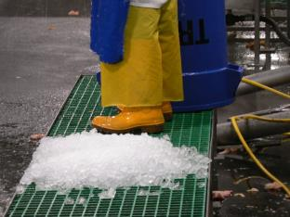
Housekeeping
All places of employment clean and orderly and in a sanitary condition
Workrooms clean & dry
Platforms, mats, or other dry standing places for wet processes
Notes:
Good housekeeping is the first and the most important (fundamental) level of preventing falls due to slips and trips. It includes: cleaning all spills immediately, marking spills and wet areas, mopping or sweeping debris from floors, removing obstacles from walkways and always keeping them free of clutter, securing (tacking, taping, etc.) mats, rugs and carpets that do not lay flat, always closing file cabinet or storage drawers, covering cables that cross walkways, keeping working areas and walkways well lit, replacing used light bulbs and faulty switches.
Without good housekeeping practices, any other preventive measures such as installation of sophisticated flooring, specialty footwear or training on techniques of walking and safe falling will never be fully effective.

Slide 32
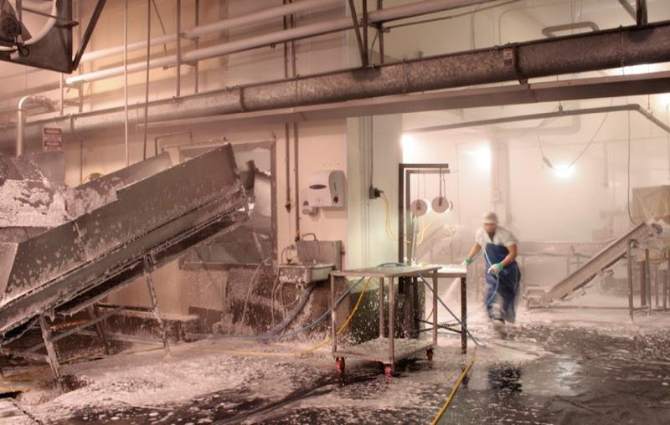
Sanitation process is dangerous
Notes:
The sanitation process is very dangerous for slip and fall incidents with all of the accumulated water and detergents on the floor.

Slide 33
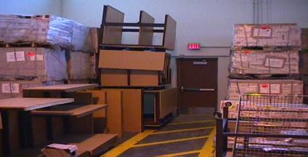
Aisles
Sufficient safe clearance maintained where mechanical handling equipment is used
Aisles and passageways kept clear and in good repairs
No obstruction across or in aisles that could create a hazard

Slide 34
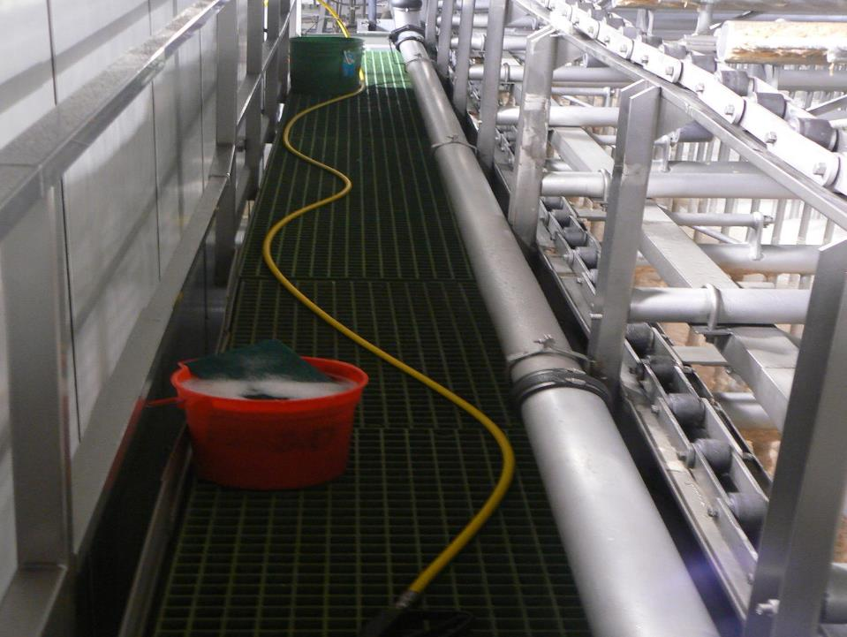
Tripping hazard on an elevated surface
Notes:
The picture shows a very dangerous situation where employees may trip over cords on an elevated surface over dangerous equipment, such as conveyors.

Slide 35
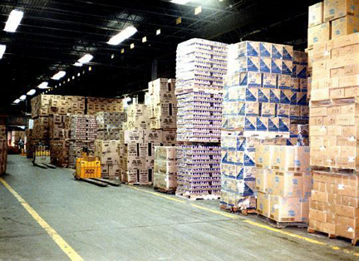
Aisles
Notes:
Pedestrians and mechanized equipment should be segregated as much as possible to avoid the potential for collisions. All passages should be marked.

Slide 36
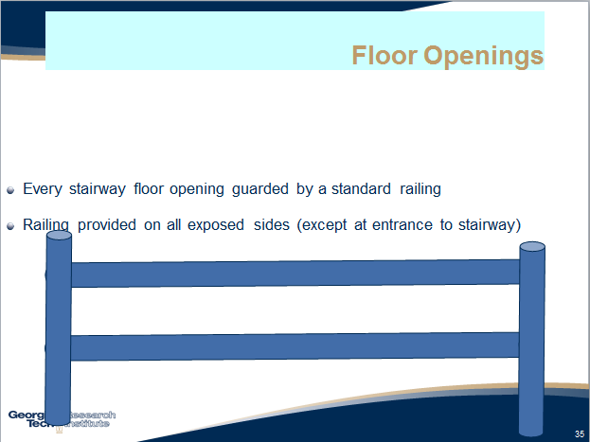
Floor Openings section

Slide 37
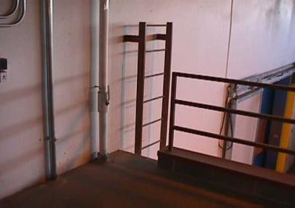
Floor Openings
Every ladderway floor opening or platform shall be guarded by a standard railing with standard toeboard on all exposed sides (except at entrance to opening), with the passage through the railing either provided with a swinging gate or so offset that a person cannot walk directly into the opening.
Notes:
A swing gate could potentially prevent someone from walking into the opening.

Slide 38
Floor Openings
Where operating conditions necessitate the feeding of material into any hatchway or chute opening, protection shall be provided to prevent a person from falling through the opening.

Slide 39
Floor Openings
Every pit and trapdoor floor opening, infrequently used, guarded by a floor opening cover of standard strength and construction.
While the cover is not in place, the pit or trap opening constantly attended by someone or protected on all exposed sides by removable standard railings.

Slide 40
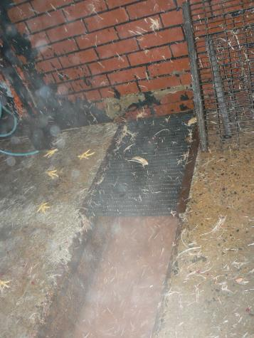
Floor Openings
Every temporary floor opening shall have standard railings, or shall be constantly attended by someone.

Slide 41
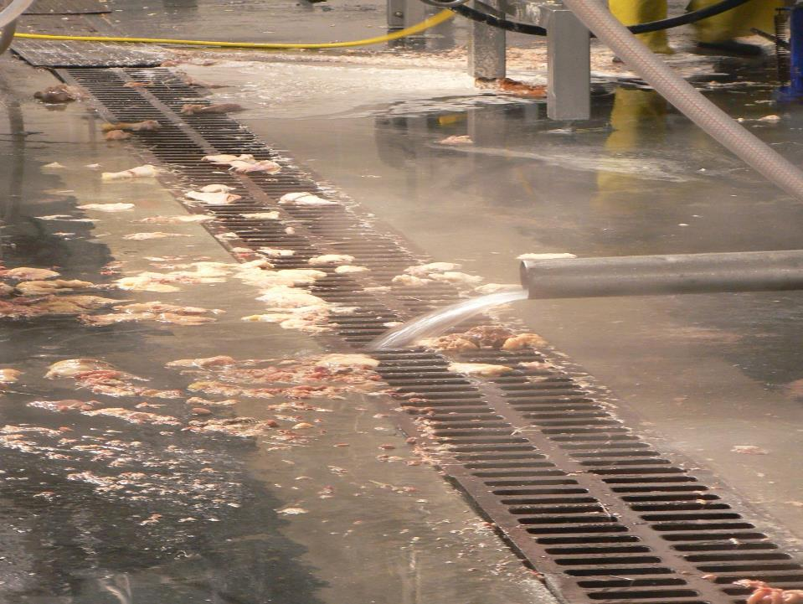
Floor grates and drain covers
Notes:
Floor grates and drain covers should not be removed without an attendant or temporary railing around the opening.

Slide 42
Floor Openings
Every floor hole into which persons can accidentally walk shall be guarded by either:
A standard railing with standard toeboard on all exposed sides, or
A floor hole cover of standard strength and construction. While the cover is not in place, the floor hole shall be constantly attended by someone or shall be protected by a removable standard railing.
Floor opening
large enough
to fall through

Slide 43
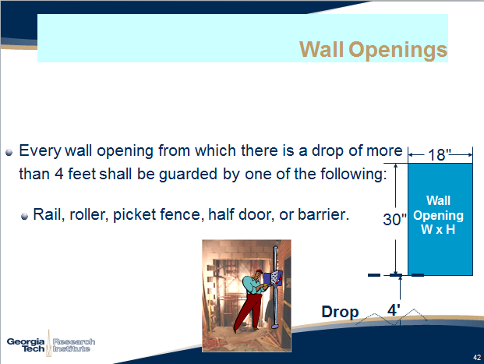
Wall Openings section

Slide 44
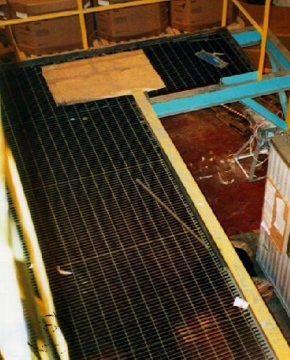
Open-sided Floors
Every open-sided floor or platform 4 feet or more guarded on all open sides except where there is entrance to a ramp, stairway, or fixed ladder.

Slide 45
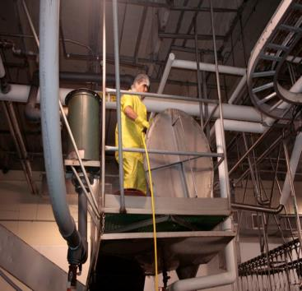
Open-sided Floors
The railing shall be provided with a toeboard wherever, beneath the open sides,
Persons can pass,
There is moving machinery, or
There is equipment with which falling materials could create a hazard

Slide 46
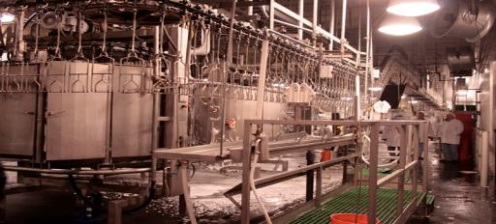
Open-sided Floors
All open-sided floors, walkways, platforms, or runways above or adjacent to dangerous equipment, guarded with a standard railing and toe board
Notes:
The platforms do not have adequate guarding.

Slide 47
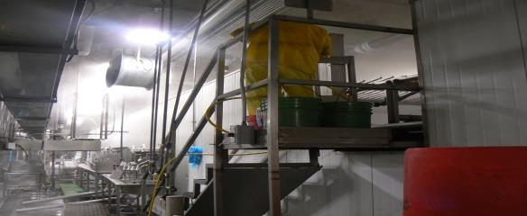
Stairways
Every flight of stairs having with 3 or more treads and four or more risers shall be equipped with standard stair railings or standard handrails.

Slide 48
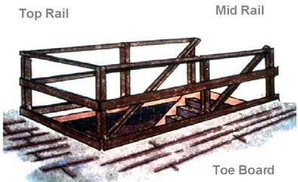
Railings
A standard railing consists of top rail, intermediate rail, and posts
Have a vertical height of 42 inches (+/- 3”) nominal from upper surface of top rail to floor.
The top rail smooth-surfaced
The ends of the rails shall not constitute a projection hazard

Slide 49
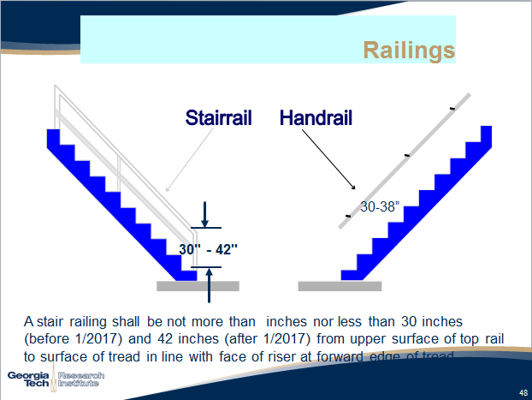
Railings

Slide 50
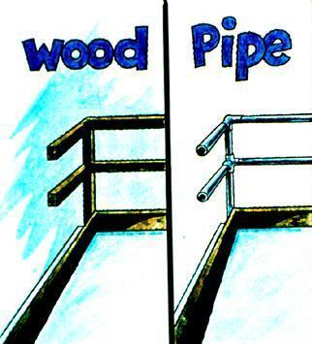
Railings
Wood railings, posts at least 2 by 4
Posts < 6 feet
Rails, at least 2 by 4
Pipe railings at least 1 1/2 inches nominal diameter
Posts spaced not more than 8 feet on centers.

Slide 51
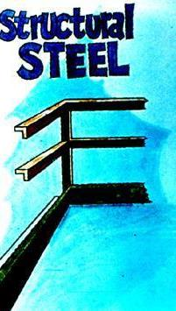
Railings
For structural steel railings
Posts and top and intermediate rails 2 by 2 by 3/8 inch angles
Posts spaced not more than 8 feet on centers.

Slide 52
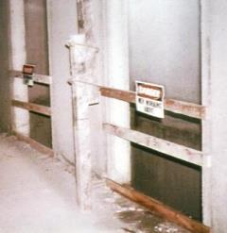
Railings
The completed structure shall be capable of withstanding a load of at least 200 pounds applied in any direction at any point on the top rail.
200 lb.

Slide 53
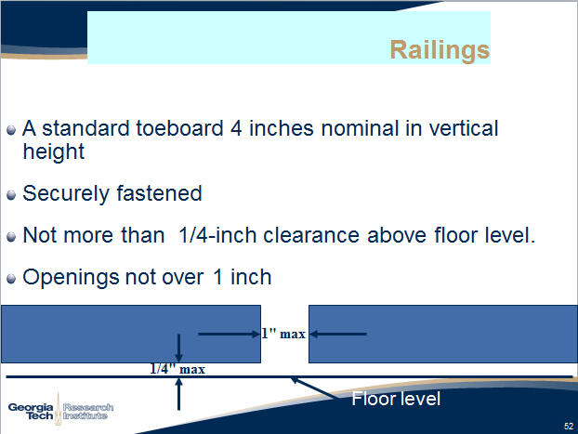
Railings

Slide 54
Railings
Where material is piled to such height that a standard toeboard does not provide protection, paneling from floor to intermediate rail, or to top rail shall be provided.

Slide 55
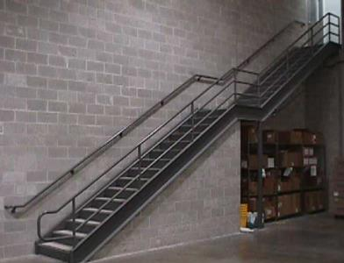
Fixed Stairs
Provided for regular travel between levels
Where equipment requires attention routinely
Fixed stairs provided where access to elevations is daily
For work around acids, caustics, gases, or other harmful substances
Notes:
Standard stairs. In addition to paragraph (b) of this section, the employer must ensure standard stairs: (1) Are installed at angles between 30 to 50 degrees from the horizontal; (2) Have a maximum riser height of 9.5 inches (24 cm); (3) Have a minimum tread depth of 9.5 inches (24 cm); and (4 ) Have a minimum width of 22 inches (56 cm) between vertical barriers

Slide 56
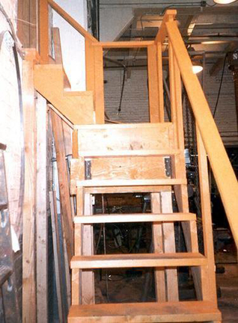
Fixed Stairs
Fixed stairs minimum width of 22 inches

Slide 57
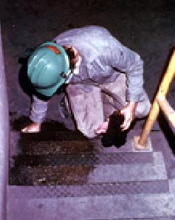
Fixed Stairs
Stair treads." All treads shall be reasonably slip-resistant and the nosings shall be of nonslip finish.
Rise height and tread width shall be uniform throughout any flight of stairs including any foundation structure used as one or more treads of the stairs.

Slide 58
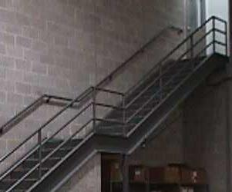
Fixed Stairs
"Stairway platforms." Stairway platforms shall be no less than the width of a stairway and a minimum of 30 inches in length measured in the direction of travel.

Slide 59
Fixed Stairs
"Railings and handrails." Standard railings shall be provided on the open sides of all exposed stairways and stair platforms.
Handrails shall be provided on at least one side of closed stairways preferably on the right side descending.
No handrail
on stairs
leading to
machine
pit

Slide 60
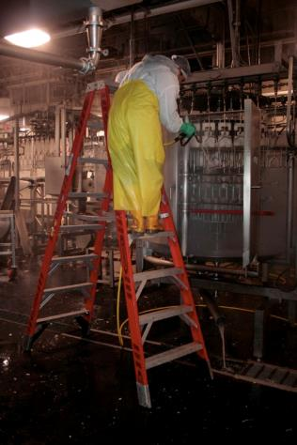
Portable Ladders
Maintained in good conditions at all times
Locks, wheels, pulleys frequent lubrication
Worn rope replaced
Safety feet and auxiliary equipment in good shape

Slide 61
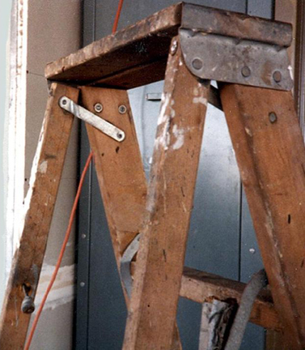
Portable Ladders - Inspection
Ladders inspected frequently
Those with defects withdrawn from service for repair or destruction and tagged or marked as "Dangerous, Do Not Use."

Slide 62
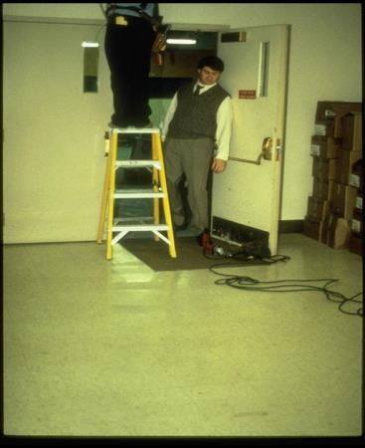
Portable Ladders
Ladders not placed in front of doors opening toward the ladder unless the door is blocked upon, locked, or guarded;

Slide 63
Portable Ladders
Tops or top step of the ordinary types of stepladders shall not be used as steps

Slide 64
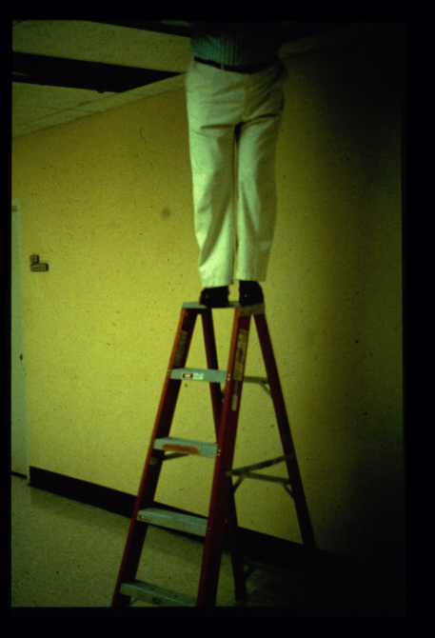
Standing on the top of the ladder
Notes:
Very dangerous work practice of using the top of the ladder as depicted in the picture

Slide 65
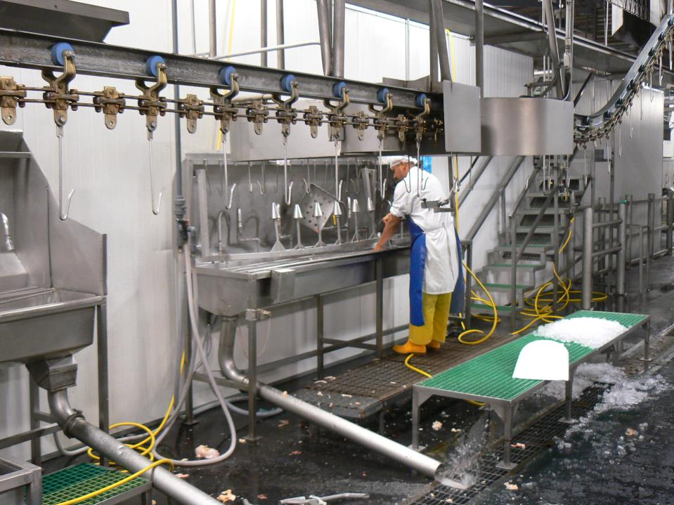
Trip Hazard
Notes:
There are trip hazards as illustrated in the picture. Man is standing on an excessively long hose.

Slide 66
Discussion Points
What are the primary hazards you experience related to slips, trips, and falls?
What types of injuries have you experienced?
What are some solutions you have implemented?
Engineering controls?
Work practices?
PPE issues

