Slide 1

Electrical Safety
Notes:
This training course was produced under grant number SH-17809-08-60-F-13 (Food Processing) from the Occupational Safety and Health Administration, U.S. Department of Labor. It does not necessarily reflect the views or policies of the U.S. Department of Labor, nor does mention of trade names, commercial products, or organizations imply endorsement by the U.S. Government. Revised December 2016 under grant number SH-29660-SH6 from the Occupational Safety and Health Administration, U.S. Department of Labor.

Slide 2
Disclaimer
This material was revised under grant number SH-29660-SH6 from the Occupational Safety and Health Administration, U.S. Department of Labor. It does not necessarily reflect the views or policies of the U.S. Department of Labor, nor does mention of trade names, commercial products, or organizations imply endorsement by the U.S. Government.
The material for this course was produced under grant SH-17809-SH08 from the Occupational Safety and Health Administration, U.S. Department of Labor. Revised December 2016

Slide 3
Overview
This presentation discusses some of the key issues related to safety for the poultry/meatpacking industry and addresses the following topics:
General Requirements
Wiring Protection and Design
General Use
Safe Work Practices

Slide 4
Objectives
After the completion of this session, the participant should be able to:
Recognize key electrical safety components
Identify select hazards as related to the poultry industry
List potential methods that can be used to eliminate electrical hazards
Discuss safe electrical work practices

Slide 5
Electrical Safety
There are many rules that apply to electrical safety (installations and work practices) in the workplace, some of those standards included in this presentation are:
OSHA standards 29 CFR 1910.301-335
NEC, National Electrical Code-Design of the Systems
NFPA 70E, Safety Standard for employee workplaces

Slide 6
Electrical Safety Glossary
Branch circuit: The circuit conductors between the final over-current device protecting the circuit and the outlets.
Circuit breaker. A device designed to open/close a circuit.
Dead front. Without live parts exposed to a person on the operating side.
Grounded conductor. A system or circuit conductor that is intentionally grounded.
Grounding conductor. A conductor used to connect equipment or the grounded circuit of a wiring system to a grounding electrode or electrodes.

Slide 7
Definitions (Continued)
Electrical Safety Glossary (continued)
Ground-fault circuit-interrupter. A device intended for the protection of personnel that functions to de-energize a circuit within an established period of time.
Live parts. Energized conductive components.
Over-current. Any current in excess of the rated current of equipment. It may result from overload, short circuit, or ground fault.
Qualified person. One who has received training in and has demonstrated skills and knowledge in the construction and operation of electric equipment and installations and the hazards involved.

Slide 8
Hazards of Electricity
There are several hazards associated with electricity:
Shock or electrocution from contact with circuits
Burns associated with electrical contact can be very serious
Falls can potentially be a secondary hazard
Arc flash or arc blast (equipment malfunctions)

Slide 9

Effects on the Body
Depends on:
Current and Voltage
Resistance
Path through body
Duration of shock
More than 3 mA
Painful shock –
cause indirect accident
More than 10 mA
Muscle contraction – “No Let Go” danger
More than 30 mA
Lung paralysis, usually temporary
Notes:
Current flow causes the injury and severity is determined by the amount of current. It’s current that causes damage to the body, not the voltage.
The degree of damage caused depends on the duration of contact, the frequency of the current, and the path taken by the current. A path through the chest is the most severe.
A serious problem occurs at the “let-go” threshold current. At this current level an individual may be unable to let go of the current source. He, or she, may also have difficulty calling for help.
A victim who has become “frozen” to the current source is more likely to be electrocuted than someone who receives higher levels of current but who’s reaction removes them from the circuit more quickly.

Slide 10
General Requirements
The equipment used or permitted has to be approved by a nationally recognized testing laboratory.
Do not use unapproved equipment (especially homemade type devices).
Notes:
UL test and approves electrical equipment, but there are other testing laboratories.

Slide 11
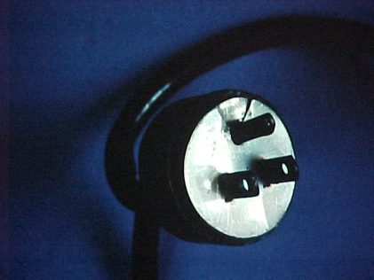
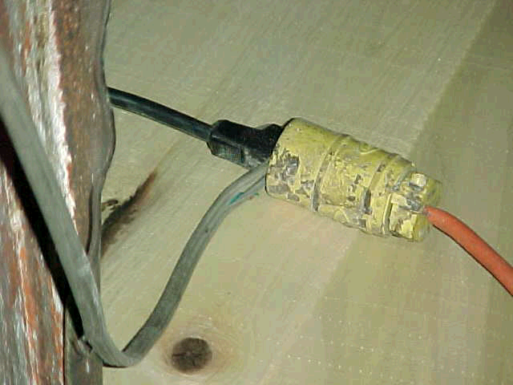
Approval
Example: Extension cord-Listed or approved for use?
Example: Cord cap with wafer-Not approved
Notes:
Wafer plug cover do not adequately provide for protection from live components.

Slide 12
Exam, Installation, and Use
Employer Obligation:
All electrical equipment used in the poultry processing/meatpacking industry shall be free from recognized hazards
Inspect the equipment before you use it
Notes:
Equipment shall inspected and judged safe to be used.

Slide 13
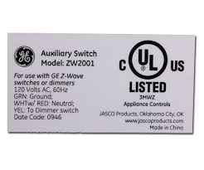
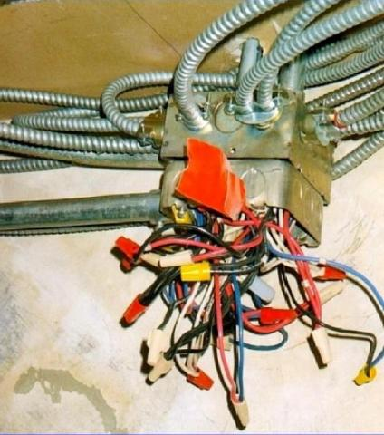
Examination, Installation and Use
Safety of electrical equipment shall be determined using the following factors:
Suitability of equipment for use (may be evidenced by listing/labeling)
Mechanical strength/durability-covers in place (no live wiring)
Wire bending and connection space
Electrical insulation (fully intact and adequate)
Heating effects under conditions of use
Arcing effects
Classification
Other
Example of poor
connection space
13

Slide 14
Installation and Use
Plant electrical equipment must be installed and used in accordance with any instructions (e.g.: package inserts)
Complete wiring installations shall be free of short circuits and grounds other than those permitted (short can damage insulation)
Equipment intended to interrupt at fault levels shall be adequate for voltage and current at line terminals

Slide 15
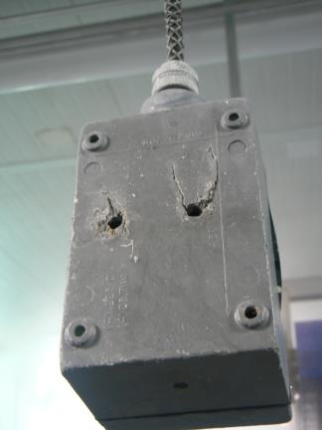
Installation and U se
All damaged electrical equipment should be immediately reported to management.
Note equipment is designed to be mounted, but has been stripped or otherwise damaged.
Notes:
The picture illustrates an outlet box that is not used properly. The box has been damaged and has mounting holes.

Slide 16
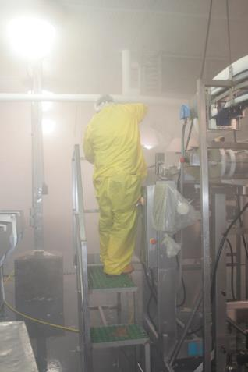
Equipment
Conductors can not be exposed to adverse conditions, unless made for those conditions.
Note: Cleaning solutions used in sanitation could potentially damage the equipment
Notes:
Many cleaning solutions and water submit the electrical wiring to adverse conditions. The caustic detergents can damage the insulation on the conductors.

Slide 17
Equipment
Mechanical Execution:
Unused openings closed
Conductors racked to provide ready/safe access
Internal parts not damaged or contaminated
No damaged parts that affect operation
Notes:
There is an ANSI standard for mechanical execution of work. If the work looks sloppy, chances are it was not installed properly.

Slide 18
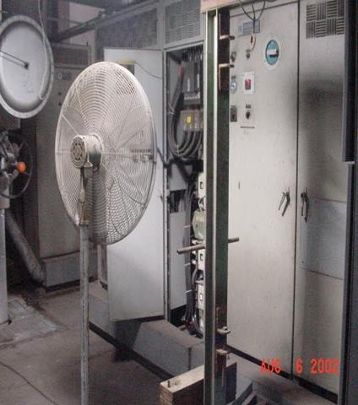
Mounting and Cooling Equipment
Electrical equipment must firmly mounted
If atmospheric cooling is required:
Allow for natural circulation of air
No obstruction to ventilation holes
Do not open panels unless you are qualified
Barricades are necessary to keep personnel away from live parts.

Slide 19
Electrical Connections
Proper identification and connection of devices (e.g.: soldering lugs)
Dissimilar metals can not be intermixed in a terminal or splicing connector
Solder, fluxes, inhibitors, and compounds must be suitable for use and not adversely affect installation, conductors, or equipment

Slide 20
Terminals
Connection of conductors in good condition and made with pressure connectors, solder, lugs, or splices to flexible leads
Terminals for more than one conductor and terminals used to connect aluminum have to be identified

Slide 21
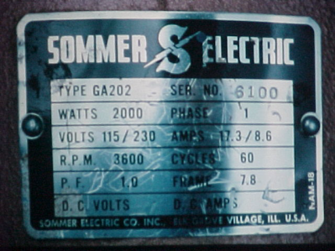
Markings
All equipment used in a poultry/meatpacking facility must have marking that describe:
Name, trademark or information identifying the producer
Measurements, such as voltage, current, or watts
Do not use equipment without markings
Notes:
Equipment must have adequate information so that personnel can service and install the equipment.

Slide 22
Identification of Disconnecting Means (dm) and Circuits
Each dm in the poultry/meatpacking processing facility must be legibly marked to indicate its purpose
Unless arranged so the purpose is evident
Must be capable of being locked
(if installed after August 13, 2007)
A dm is a switch used to disconnect the conductors of a circuit from the source of current

Slide 23
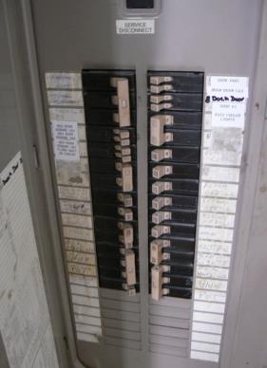
Identification of Disconnecting Means (dm) and Circuits
The information on the legend has to be as specific as possible
Incorrect: Dumper
Correct: Dumper, BBQ Conveyor, Line #3
Applies to equipment, motors, and circuits

Slide 24
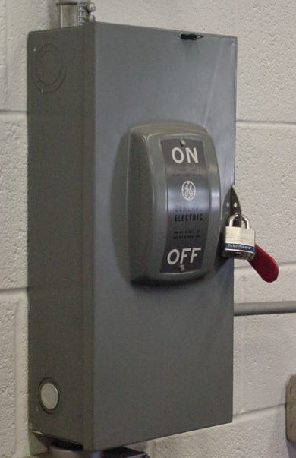
Lockout tag out
Note: Disconnect is capable of being locked out
Tags must always be used with locks
Note: Seal used to close unused opening.
24

Slide 25
Access to Electric Equipment
Maintain access and working space around all electrical equipment, provided & maintained to provide ready and safe operation and maintenance.
Don’t interfere with the equipment space or work space around the equipment.
25

Slide 26
Access to Electric Equipment
Workspace in front of the equipment must be the greater of the width of equipment or 30”
Permit 90 degree opening of door
The depth of the area must be a minimum of 3ft. (depends on voltage and materials)
Two entrance required for equipment rated 1200 amps and 6 ft wide (after 8/13/2007)

Slide 27
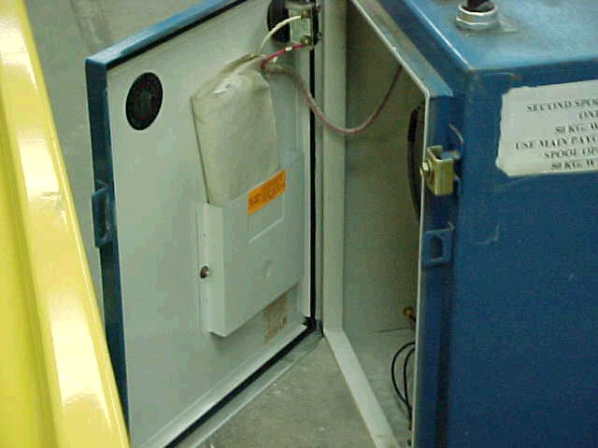
Access to Equipment
Note: Door will not open the required 90 degrees
Notes:
Picture depicts electrical equipment that does not have adequate work space. In all cases, the door must open at least 90 degrees.

Slide 28
Illumination of the Area
All indoor electrical service equipment
In electrical rooms the light may not be automatic
Always supply ample lighting for the work
Supplemental lighting may be needed in many cases

Slide 29
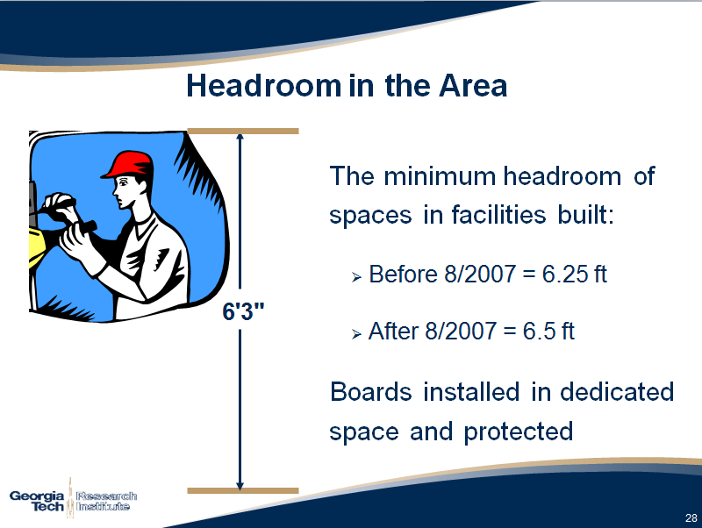
Headroom in the Area

Slide 30
Guarding of Live Parts Required in all Facilities
All live components operating at or above 50 volts must be guarded.
It is a best practice to guard circuits of 50 volts or less, especially in wet environments.

Slide 31
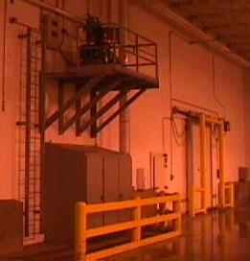
Guarding Live Parts
Forms of approved enclosures or other means to guard live parts:
By location in a room, vault, accessible only to qualified persons
By permanent, substantial partitions or screens
By location on a suitable balcony or platform as to exclude unqualified persons
By elevation of 8 feet or more above the floor or other working surface

Slide 32
1910.304
Wiring Design
and
Protection

Slide 33
Identification of Conductors
A conductor used as a grounded conductor shall be identifiable and distinguishable from all other conductors.
Typically white or gray color
A conductor used as an equipment grounding conductor shall be identifiable and distinguishable from all other conductors
Typically green, green/yellow, or copper color
Notes:
Picture shows the neutral (grounded) and the grounding conductor. The conductors must be identifiable in accordance with the NEC.

Slide 34
Identification of Conductors
Identification of ungrounded multi wire branch circuits must identify type and voltage at breaker panel.
Grounding type receptacles must be installed only on circuits of rated voltage class and current.
Grounding contacts on receptacles must be effectively grounded.
Notes:
Typically color coding and a sign at the point of access are used, for example 480/277 volt Y system indicates voltages and system.

Slide 35
Use and identification of grounded and grounding conductors
No grounded conductor may be attached to any terminal or lead so as to reverse polarity
A grounding terminal on a receptacle, cord connector, or plug may not be used for purposes other than grounding
The above points address one potentially dangerous aspect of AC: equipment will operate even though the wires are crossed

Slide 36
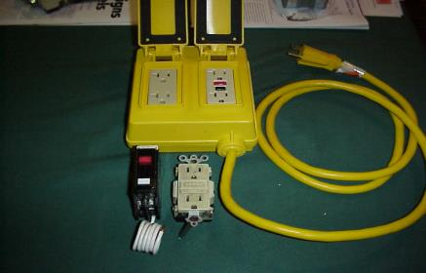
Ground Fault Circuit Interrupters
Single phase15 and 20 amp, 125 volt receptacles in baths and roofs must have GFCI (NEC also states all kitchens and 30+ areas).
Temporary wiring-Maintenance and repair
GFCI on all receptacles not part of permanent structure
Allows for equipment grounding conductor program in some cases.
Note: A GFCI and ground fault protection are not the same. Ground fault protection is designed to protect equipment only.
Notes:
GFCI required on temporary receptacles, construction like activities (remodeling and servicing equipment), and certain areas (roof top and bathroom). You may only use AECP, if the technology is not available. Otherwise, a GFCI would have to be used.

Slide 37
Testing GFCI at the Poultry/Meatpacking Facilities
Included in the manufacturers instructions, which is included with each circuit breaker or receptacle and falls under listing and labeling of equipment.
The device is to be tested on a monthly basis.
WHY TEST?
A study reveals that up to 20% of the equipment does not function.
The GFCI device may allow current flow even though the device is defective.
Voltage surges such as lightning in the area, or power company switching can damage a GFCI.
Always test after the device is tripped.

Slide 38
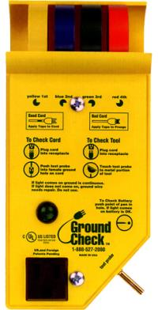
Ground Fault Circuit Interrupters Other Than 125 Volt
Assured Grounding Conductor Program
Written Plan
Visual Inspect Daily
Testing
Inspection
Records (current-color coded, logs)
Only used if there is no GFCI for application
Notes:
AECP is not an engineering control and should be used only as a last alternative. AECP does not provide for full protection of the employee, it is merely an administrative control program and should not be used in place of a GFCI.

Slide 39
Branch circuits
Outlet devices. Outlet devices shall have an ampere rating not less than the load to be served
Notes:
Overloading of branch circuits can potentially be dangerous and cause fires.

Slide 40
Branch Circuits
Where connected to a branch in excess of 20 amps, the lamp holders shall be heavy duty
Receptacles
Receptacle on branch equal to rating of circuit
Installed wherever flexible cords with plug attachments are used

Slide 41
Outside Conductors
Clearance from building openings-Service conductors as open or multiple conductor cable (no jacket) must have 3 feet of clearance
Conductors can not be installed beneath openings through which materials may be moved (chutes or material handling equipment).

Slide 42
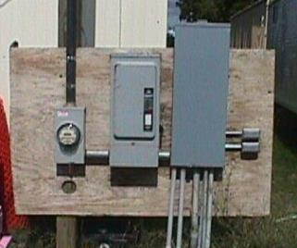
Disconnecting means
General. Means shall be provided to disconnect all conductors in a building or other structure from the service-entrance conductors.
The disconnecting means shall plainly indicate whether it is in the open or closed position and shall be installed at a readily accessible location nearest the point of entrance of the service-entrance conductors.
1000kV

Slide 43
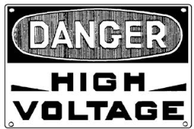
Services over 600 Volts, Nominal
Guarded to make them accessible only to qualified persons
Signs warning of high voltage shall be posted where other than qualified employees might come in contact with live parts
Danger

Slide 44
Over Current Protection
600 volts or less
Conductors and equipment shall be protected from overcurrent in accordance with their ability to safely conduct current
Over current devices shall be readily accessible to each employee or authorized building management personnel.
The over current devices should not be used to routinely open and close circuits
1000kV
Danger

Slide 45
Over Current protection
600 volts or less
Arcing or suddenly moving parts – Fuses and circuit breakers shall be so located or shielded so that employees will not be burned or otherwise injured by their operation and protect the handles or levers to prevent injury
1000kV
Danger

Slide 46
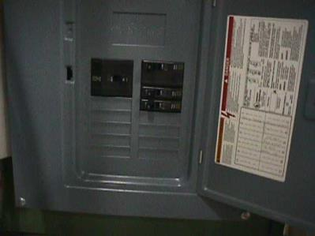
1910. 304 (e)(1)(vi) Circuit breakers
Circuit breakers shall clearly indicate whether they are in the open (off) or closed (on) position
A switch duty circuit breaker should be used if the breaker is used to routinely operate the lights
Never stand directly in front of the disconnect to operate the equipment
1000kV
Danger
Notes:
Other types of lighting are controlled with HID switches. The NEC provides better direction on the disconnect to be used with lighting systems.

Slide 47
Grounding
Systems to be grounded:
(i) All 3 wire DC systems neutral conductor
(ii) 2 wire DC systems
(iii) Some AC circuits of less than 50 volts
(iv) AC systems of 50-1000 volts

Slide 48
Grounding
For AC premises wiring systems the identified conductor shall be grounded
The path to ground from circuits, equipment, and enclosures shall be permanent and continuous (path to ground has to be effective)

Slide 49
Grounding
Required to protect employees against:
Shock
Safeguard against fire
Protect equip from damage

Slide 50


Grounding
There are two kinds of grounding at food processing facilities:
1. Electrical circuit or system grounding
2. Electrical equipment grounding

Slide 51
Electrical System Grounding
One conductor of the circuit is intentionally grounded to earth
Protects circuit from lightning, or other high voltage contact
Stabilizes the voltage in the system so “expected voltage levels” are not exceeded under normal conditions

Slide 52
Grounding
Metal frames & enclosures of equipment are grounded by a permanent connection or bond.
The equipment grounding conductor provides a path for dangerous fault current to return to the system ground at the supply source should a fault occur.

Slide 53
Equipment Grounding
Generally, all electrical equipment used in a food processing facility has to grounded unless:
The equipment is double insulation (has to be marked with symbol or statement)
The equipment is a heated appliance that is permanently installed and isolated

Slide 54
Grounding Path
Shall have the capacity to conduct safely any fault current likely to be imposed on it.
Fault currents may be many times normal currents, and can melt points of poor conductivity
These high temperatures may be a hazard in themselves, and can destroy the ground-fault path

Slide 55
1910.305
Wiring methods, components, and
equipment for general use
55

Slide 56
Wiring in ducts
No wiring systems of any type shall be installed in ducts used to transport dust, loose stock or flammable vapors

Slide 57
Temporary Wiring
All lamps for general illumination shall be guarded by a fixture or lamp holder with a guard
The sockets must also be grounded
Notes:
Temporary lamps must be guarded regardless of height.

Slide 58
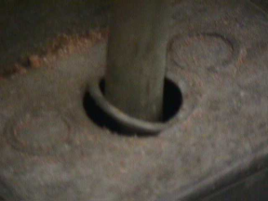
Conductors Entering Boxes, Cabinets or Fittings
Conductors can be damaged if they rub against the sharp edges of cabinets, boxes, or fittings
Where they enter they must be protected by some type of clamp or rubber grommet
The device used must close the hole through which the conductor passes as well as provide protection from abrasion
Cable has to be secured to the box

Slide 59
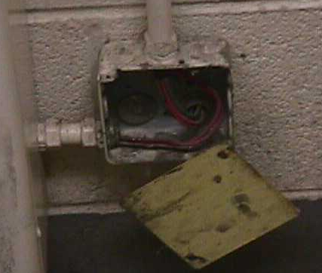
Conductors Entering Boxes, Cabinets or Fittings
All pull boxes, junction boxes and fittings must be provided with approved covers
If covers are metal they must be grounded.
Each outlet box must have a cover, faceplate or fixture canopy
Notes:
The faceplate is grounded by the screws attached to the “yoke” of the receptacle.

Slide 60
Switchboards and panelboards
Switchboards and Panelboards
Switchboards located in dry areas and accessible to qualified personnel only
Panelboards shall be mounted in cabinets and have a dead front with no exposed live parts
Dead front cover
60

Slide 61
Enclosures for damp or wet locations
Enclosures for damp or wet locations
Cabinets, cutouts boxes, fittings, and panelboards shall be weatherproof
Switches, circuit breakers, and switchboards shall be in weather proof enclosures
Must have airspace between
Enclosure and mounting
Surface (after 8/13/2007)
61

Slide 62
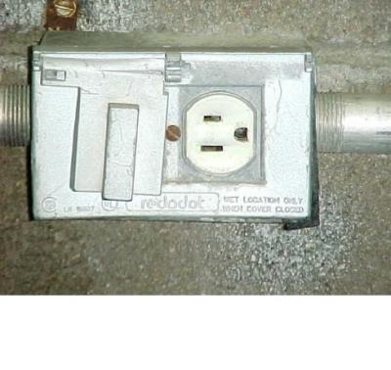
Requirements for Damp or Wet Locations
All receptacles in the processing area that are subject to a wet or damp location must be covered
Electrical equipment should be designed to prevent accumulation of water
Receptacles in damp areas must have a GFCI
Notes:
There is a difference between attended and unattended areas. The picture represents a cover installed in an attended area. Covers in unattended areas must cover not only the receptacle, but the attachment cap as well when it is plugged into the receptacle.

Slide 63
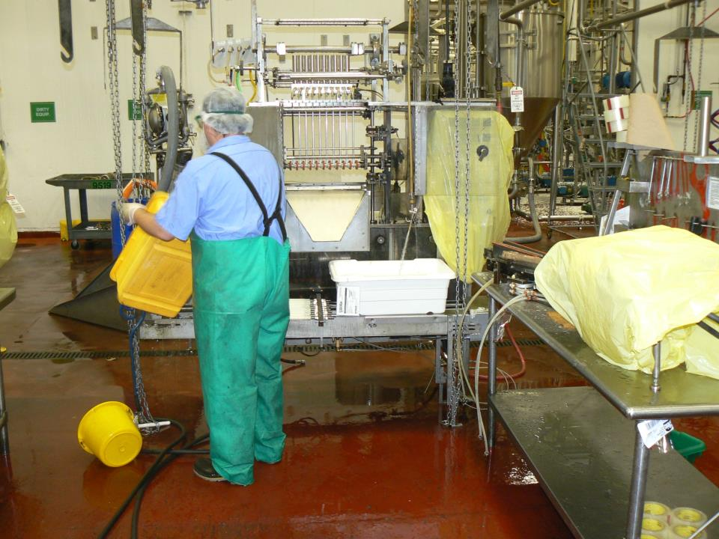
Around Electrical Equipment
Notes:
The picture above represent a worker performing sanitation around electrical equipment. Some companies will instruct employees to put cords in covered bins to keep them off the floor temporarily during sanitation.

Slide 64
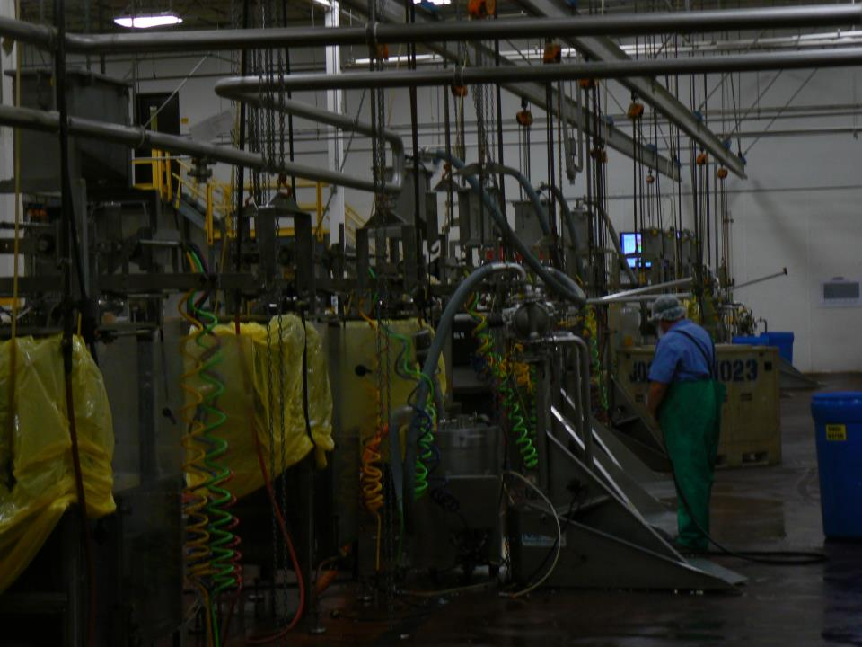
Protect electronics during sanitation?
Notes:
Employees attempting to protect the electronics during sanitation.

Slide 65
Use of Flexible Cords & Cables
Flexible cords and shall be approved and suitable for conditions of use and location*
The OSHA electric standard lists specific situations in which flexible cords may be used
Notes:
Subpart S

Slide 66
Use of Flexible Cords & Cables
Flexible cords and cables shall be used only for: pendants, wiring of fixtures; portable lamps and appliances, portable and mobile signs, elevator cables, cranes/hoists, etc….
Used as temporary wiring as permitted
Not installed in raceways

Slide 67
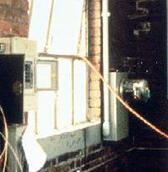
Use of Flexible Cords and Cables
Flex cords and cables must never be used as a substitute for premises wiring.
Cords can not be:
Run through ceiling
Be concealed
Run through doors or windows

Slide 68
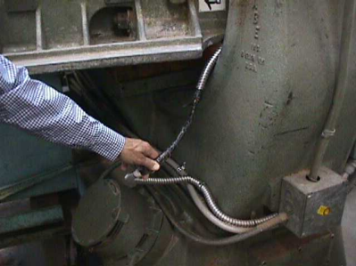
Identification, Splices and Terminations
Flexible cords shall only be used in continuous lengths, no taps or splices
Damaged cord
improperly repaired

Slide 69
Splices
Flexible cords shall be used only in continuous lengths without splice or tap.
Hard service flexible cords No. 14 or larger may be repaired if spliced so that the splice retains the insulation, sheath properties, and usage characteristics of the cord being spliced.

Slide 70
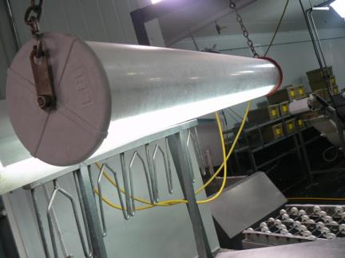
Lamps
All lamps 8 feet or below must have adequate protection (guard or cover) to prevent workers from making contact with the bulb and potentially the live parts.

Slide 71
Safe Electrical Work Practices
Who should be included in a training program?
Everyone should receive training to the extent which it involves the job. All employees working around, near, or electrical conductors and equipment.
Examples of personnel in need of specific electrical safety training: welders, maintenance technicians, and machine operators.

Slide 72
Training
Qualified persons: (i.e. those permitted to work on or near exposed energized parts) shall, at a minimum, be trained in and familiar with the following:
The skills and techniques necessary to distinguish exposed live parts from other parts of electric equipment
The skills and techniques necessary to determine the nominal voltage of exposed live parts
The necessary clearance distances specified in the OSHA standard 29 CFR1910.333(c)
Ability to select and safely appropriate test meters
Ability to perform to identify hazards, assess risk, and provide appropriate safeguards
Notes:
Training must be commensurate with the exposure. Qualified personnel must be able to demonstrate their skills.

Slide 73
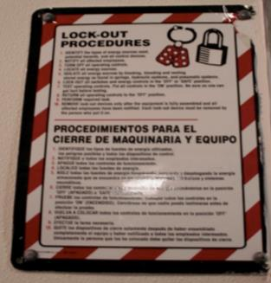
De-energize
All circuits must be placed in a safe electrical work condition
PPE has to be used in accordance with NFPA 70E until the absence of voltage is verified
LOTO procedures must be documented

Slide 74
Electrical Safe Work Practices De-energized Parts
Exceptions to Lockout/tagout:
Unless the employer can demonstrate that de-energizing introduces increased hazards or is infeasible (not to be confused with convenience).
Live parts that operate at >50 volts need not be de-energized if there will be no increased exposure to burns or explosions.

Slide 75
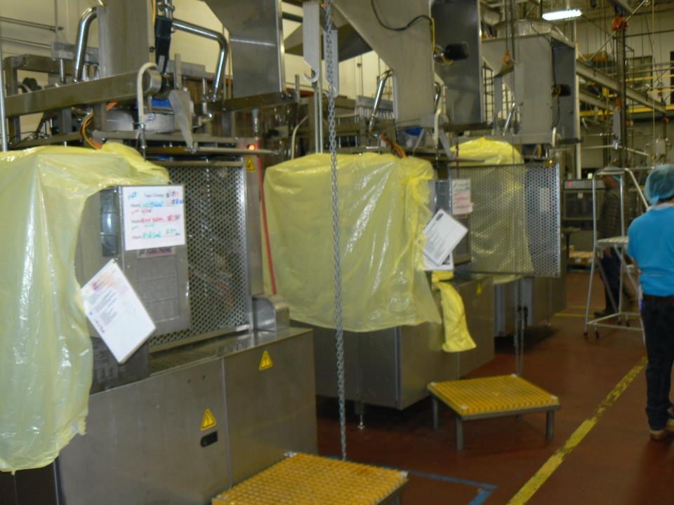
Equipment still needs lock out tag out
Notes:
This type of equipment would possibly have to locked out in many cases. The electronics are bagged in the sanitation process to protect the equipment, but employees did not LOTO equipment in many cases.

Slide 76
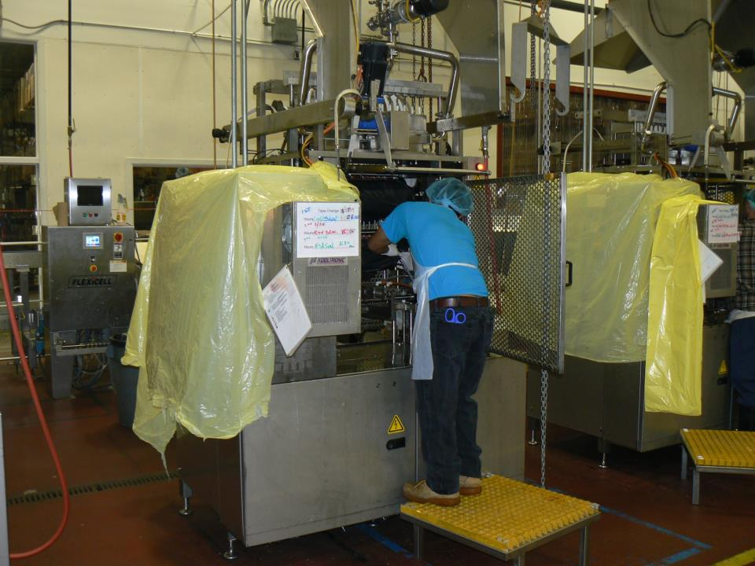
Lock out
Notes:
Employees are in the machine without LOTO. Employees run the risk of contact with electrical circuits while bagging the machine.

Slide 77
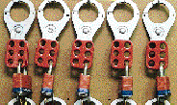
Safe Electrical Work Practices
While any employee is exposed to contact with parts or circuits which have been de-energized, the circuits shall be locked out or tagged or both
If not locked out, treat it as a live circuit

Slide 78
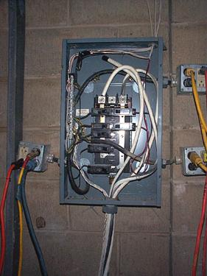
Illumination
Adequate illumination must exist
Employees are not reach blindly into the areas that contain live electrical parts

Slide 79
Safe Electrical Work Practices Safety Rules
Do not use conductive ladders
Remove all jewelry
Only qualified persons can remove an electrical interlock
Portable cord plug connected equipment needs to be inspected before each use
Only qualified persons can test circuits
79

Slide 80
Safe Electrical Work Practices Safety Rules
As a general rule, always lock out and tag out the circuit.
Employees working near energized parts in confined spaces must be provided with barriers, protective shields, and insulating materials.
PPE has to maintained, inspected, and tested.
Appropriate tools must be used (rated for voltage and insulated).

Slide 81
Electrical Safe Work Practices Personal Protective Equipment
Employees working in areas where there are potential electrical hazards shall be provided with, and shall use, electrical protective equipment that is appropriate for the specific parts of the body to be protected and for the work to be performed
All equipment must be tested

Slide 82
Electrical Safe Work Practices PPE
PPE needs to be selected based on the hazards likely to be encountered:
Non conductive hard hat (rated for voltage)
Voltage rated gloves
Eye Protection
Appropriate clothing
Arc Rated blast suit
82

Slide 83
Electrical Safe Work Practices Alerting Techniques
Alerting techniques shall be used to warn and protect employees from hazards which could cause injury:
Safety signs and tags at point of hazard
Barricades to limit access to area
Attendants to warn and protect
Notes:
Look a like equipment can be confusing and dangerous, therefore, it is important to mark such equipment to avoid a mix up.

