Slide 1
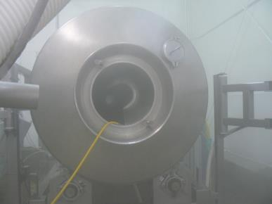
Confined
Spaces

Slide 2
Disclaimer
This material was produced under grant number SH-29660-SH6 from the Occupational Safety and Health Administration, U.S. Department of Labor. It does not necessarily reflect the views or policies of the U.S. Department of Labor, nor does mention of trade names, commercial products, or organizations imply endorsement by the U.S. Government.

Slide 3
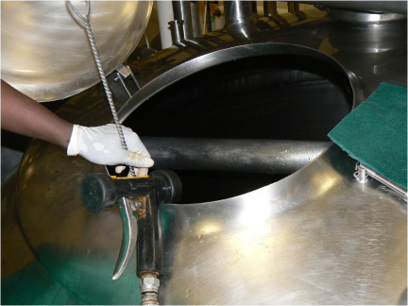
What kind of Confined Spaces Do You Have At Your Facility?
Notes:
Picture shows example of confined space. This slide is meant to initiate class discussion about the types of confined spaces present in the students’ facilities.

Slide 4
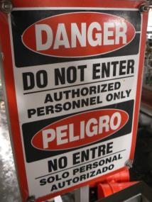

Standard
Permit-Required Confined Spaces
  29 CFR 1910.146
Notes:
Picture shows example confined space entry sign.

Slide 5
Confined Space
Confined space is space that:
Is large enough & so configured that employee can bodily enter & perform assigned work
Has limited or restricted means for entry or exit (i.e. tanks, vessels, silos, pits, vaults or hoppers)
Is not designed for continuous employee occupancy

Slide 6
Permit-Required
Confined Space
Permit-Required Confined Space is confined space that has one or more of following characteristics:
Contains or has potential to contain hazardous atmosphere
Contains material that has potential for engulfing entrant

Slide 7
Permit-Required
Confined Space
Has internal configuration such that entrant could be trapped or asphyxiated by inwardly converging walls or by floor which slopes downward & tapers to smaller cross-section
Contains any other serious safety or health hazard

Slide 8
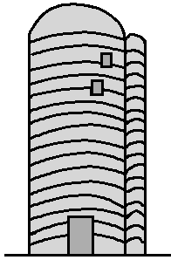
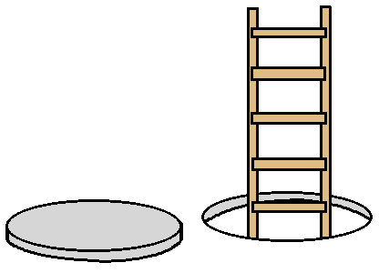
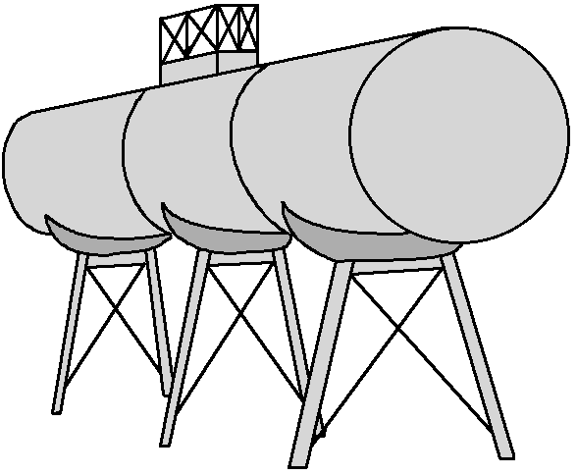

Examples
Notes:
Illustrations show examples of confined spaces including manholes, tanks, silos, and pipes (potentially).

Slide 9
29 CFR 1910.146
Permit-Required Confined Spaces
Scope & application
Definitions
General requirements (to include dev. of written plan)
Permit-required confined spaces
Permit system
Entry permit
Training
Duties of authorized entrants
Duties of attendants
Duties of entry supervisors
Rescue & emergency services
Employee participation

Slide 10
Appendices
Appendix A - Permit-Required Confined Space Decision Flow Chart
Appendix B - Procedures for Atmospheric Testing
Appendix C - Examples of Permit-Required Confined Space Programs
Appendix D - Confined Space Pre-Entry Check List
Appendix E - Sewer System Entry
Appendix F - Rescue Team or Rescue Service Evaluation Criteria

Slide 11
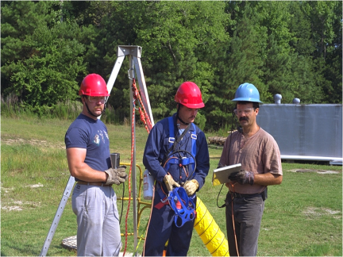
Confined Space Crew
Notes:
Picture meant to illustrate part of the permit-required confined space entry crew including the attendant, entrant, and entry supervisor.

Slide 12
Definitions
Attendant
  Individual stationed outside one or more permit spaces who monitors authorized entrants & performs all attendant’s duties assigned in employer’s permit space program

Slide 13
Duties of Attendants
Knows hazards that may be faced during entry
Aware of possible behavioral effects of hazard exposure in authorized entrants
Continuously maintains accurate count of authorized entrants
Remains outside permit space during entry operations until relieved by another attendant

Slide 14
Duties of Attendants
Communicates with authorized entrants
Monitors activities inside & outside space
Summons rescue & other emergency services
Performs non-entry rescues as specified by employer's rescue procedure
Performs no duties that might interfere with primary duty to monitor & protect authorized entrants

Slide 15
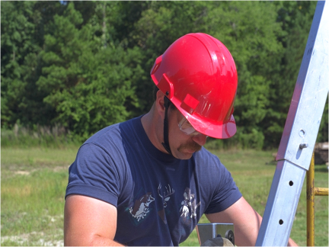
Confined Space Attendant
Notes:
Picture meant to represent the attendant constantly monitoring conditions in the space.

Slide 16
Definitions
Authorized entrant
  Employee authorized by employer to enter permit space

Slide 17
Duties of Authorized Entrants
Know hazards that may be faced during entry, including information on mode, signs or symptoms & consequences of exposure
Properly use equipment as required by paragraph (d)(4)
Communicate with attendant as necessary to enable attendant to monitor entrant status & enable attendant to alert entrants of need to evacuate space as required by paragraph (i)(6)

Slide 18
Duties of Authorized Entrants
Alert attendant whenever:
  Entrant recognizes any warning sign or symptom of exposure to dangerous situation
  Entrant detects prohibited condition
  Exit from permit space as quickly as possible whenever:

Slide 19
Duties of Authorized Entrants
Exit from permit space…
  Order to evacuate is given by attendant or entry supervisor
  Entrant recognizes any warning sign or symptom of exposure to a dangerous situation
  Entrant detects prohibited condition
  Evacuation alarm activated

Slide 20
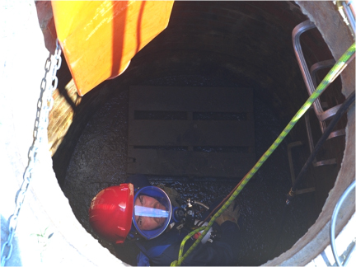
Confined Space Entrant
Notes:
Picture of entrant. Emphasize the communication between the attendant and the entrant.

Slide 21
Definitions
Engulfment
  Surrounding & effective capture of person by liquid or finely divided (flowable) solid substance that can be aspirated to cause death by filling or plugging respiratory system
  Can exert enough force on body to cause death by strangulation, constriction or crushing

Slide 22

Definitions
Entry
  Action by which person passes through opening into permit-required confined space
  Entry includes ensuing work activities in space and is considered to have occurred as soon as any part of entrant’s body breaks plane of opening into space

Slide 23
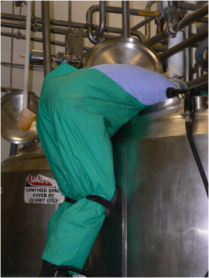
Confined Space Entrant
Notes:
Picture of entrant. Emphasize the communication between the attendant and the entrant.

Slide 24
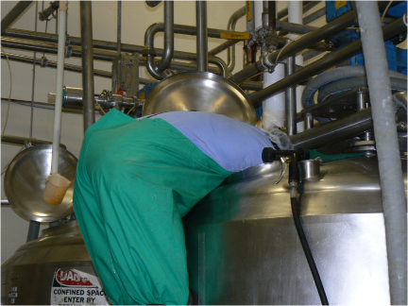
Confined Space Entrant
Notes:
Picture meant to illustrate an entry in progress. Emphasize that once any part of the body breaks the plane, entry has occurred.

Slide 25
Definitions
Entry Supervisor
  Person (such as employer, foreman or crew chief) responsible for determining if acceptable entry conditions are present at permit space where entry is planned, for authorizing entry & overseeing entry operations & for terminating entry
  Note: entry supervisor may serve as attendant or authorized entrant, as long as that person is trained & equipped as required for each role filled
    Duties of entry supervisor may be passed from one individual to another during entry operations

Slide 26
Duties of Entry Supervisor
Knows hazards that may be faced during entry, including information on mode, signs or symptoms & consequences of exposure
Verifies, by checking that appropriate entries have been made on permit, all tests specified by permit have been conducted & all procedures & equipment specified by permit are in place before endorsing permit & allowing entry to begin
Terminates entry & cancels permit as required by paragraph (e)(5)

Slide 27
Duties of Entry Supervisor
Verifies that rescue services are available & means for summoning are operable
Removes unauthorized individuals who enter or attempt to enter permit space during entry operations
Determines, whenever responsibility for permit space entry operation is transferred & at intervals dictated by hazards & operations performed within space, that entry operations remain consistent with terms of entry permit & acceptable entry conditions are maintained

Slide 28
Definitions
Hazardous atmosphere
  Atmosphere that may expose employees to risk of death, incapacitation, impairment of ability to self-rescue (i.e. unaided escape from permit space), injury or acute illness from one or more following causes:
    Flammable gas, vapor or mist in excess of 10% of Lower Flammable Limit (LFL)

Slide 29
Definitions
Hazardous atmosphere
  Airborne combustible dust at concentration that meets or exceeds LFL
  Note: concentration may be approximated as condition in which dust obscures vision at distance of 5 ft or less
  Atmospheric oxygen concentration <19.5% or >23.5%

Slide 30
Definitions
Hazardous atmosphere
  Atmospheric concentration of any substance for which dose or PEL could result in employee exposure in excess of dose or PEL
  Note: atmospheric concentration of any substance not capable of causing death, incapacitation, impairment of ability to self-rescue, injury or acute illness due to health effects is not covered

Slide 31
Definitions
Hazardous atmosphere
  Any other atmospheric condition that is IDLH
  Note: for air contaminants which OSHA has no dose or PEL, other sources of information, such as MSDSs that comply with 29 CFR 1910.1200, published information & internal documents can provide guidance in establishing acceptable atmospheric conditions

Slide 32
Definitions
Immediately Dangerous to Life and Health (IDLH)
  Condition that poses immediate or delayed threat to life or cause irreversible adverse health effects or interfere with individual’s ability to escape unaided from permit space

Slide 33
Definitions
Isolation
  Process by which permit space is removed from service & completely protected against release of energy & material into space by such means as: blanking or blinding; misaligning or removing sections of lines, pipes or ducts; double block & bleed system; lockout or tagout of all sources of energy; or blocking or disconnecting all mechanical linkages

Slide 34
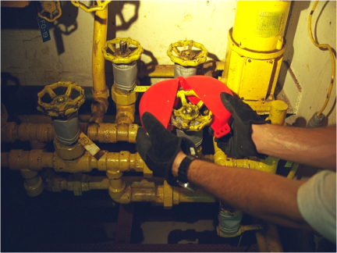
Valve Lockout Clamshell
Notes:
Picture illustrating valve lockout using a clamshell device.

Slide 35
Definitions
Line breaking
  Intentional opening of pipe, line or duct that is or has been carrying flammable, corrosive or toxic material, inert gas or any fluid at volume, pressure or temperature capable of causing injury

Slide 36

Definitions
Rescue service
  Personnel designated to rescue employees from permit spaces
Note: rescue personnel may be industry emergency personnel, outside rescue service or combination of teams
Notes:
Picture of rescue personnel at the scene.

Slide 37
Rescue & Emergency Services
Rescue and emergency services
  Employer who designates rescue & emergency services, pursuant to paragraph (d)(9) shall:
    Evaluate prospective rescuer's ability to respond to rescue summons in timely manner, considering hazard(s) identified

Slide 38
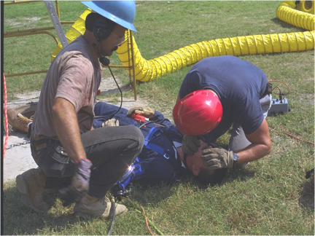
Confined space rescue
Notes:
Picture depicting a permit-required confined space rescue. Emphasize the need for timely rescue and having the rescue team “at the ready” on site instead of just calling 911 and hoping for the best.

Slide 39
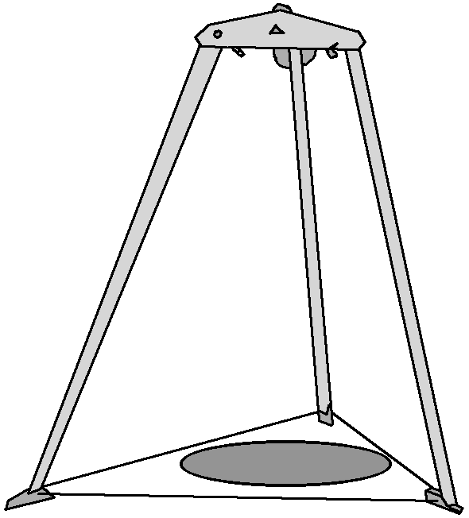
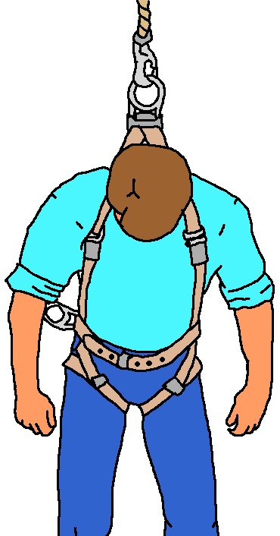
Definitions
Retrieval system
  Equipment (including retrieval line, chest or full-body harness, wristlets, if appropriate, & lifting device or anchor) used for non-entry rescue of persons from permit spaces

Slide 40
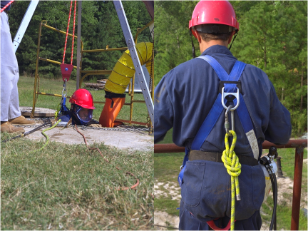
Confined Space Retrieval System
Notes:
Picture of retrieval system. Emphasize that non-entry rescue is preferred.

Slide 41
Definitions
Testing
  Process by which hazards that may confront entrants are identified & evaluated
  Testing includes specifying tests to be performed in permit space
  Note: testing enables employers to devise & implement adequate control measures for protection of authorized entrants & determine if acceptable entry conditions are present immediately prior to & during entry

Slide 42
Testing Protocol
Before employee enters space, internal atmosphere shall be tested, with calibrated direct-reading instrument, for following conditions in order given
  Oxygen content
  Flammable gases & vapors
  Potential toxic air contaminants

Slide 43
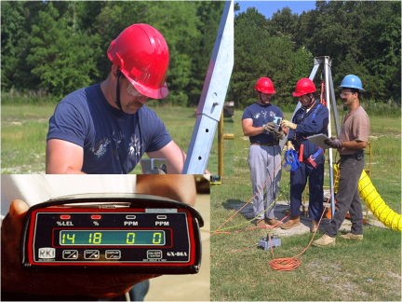
Monitoring Confined Space
Notes:
Picture of attendant monitoring the conditions in the space. Monitor shown depicts 14 % LEL (Above 10 % - Problem) and 18 % Oxygen (Below 19.5 % - Problem).

Slide 44
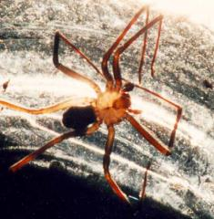
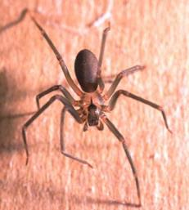
Other Hazards
Unstable or dangerous work surfaces
Falling objects
Insects or animals
Biological
Notes:
Picture of spiders representing “other hazards” in the space.

Slide 45
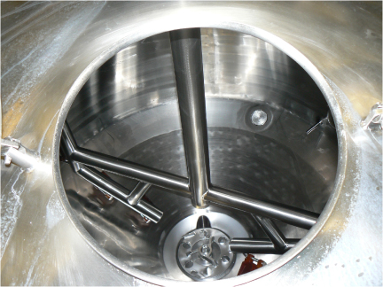
Mechanical Hazards Agitator Blades
Notes:
Picture of permit-required confined space and mechanical hazards such as agitator blades.

Slide 46
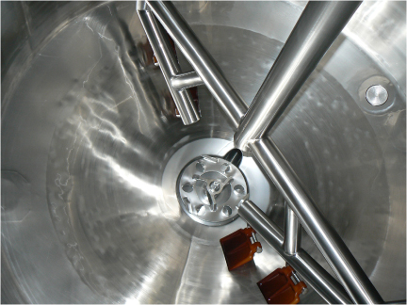
Mechanical Hazards Agitator B lades
Notes:
Picture of permit-required confined space and mechanical hazards such as agitator blades.

Slide 47
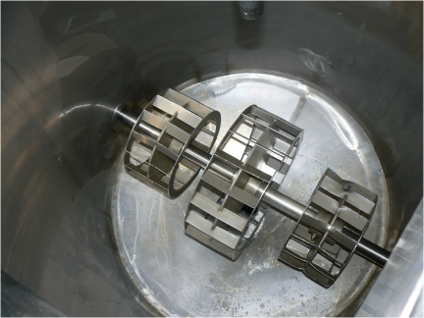
Mechanical Hazards Agitator Blades
Notes:
Picture of permit-required confined space and mechanical hazards such as agitator blades.

Slide 48
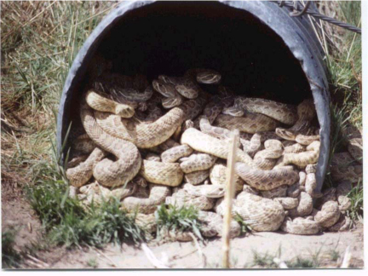
Snakes in Confined Space
Notes:
Picture of snakes in a permit-required confined space. Somewhat exaggerated but depicts other hazards.

Slide 49

PRCS Signage
Notes:
Sample PRCS sign.

Slide 50
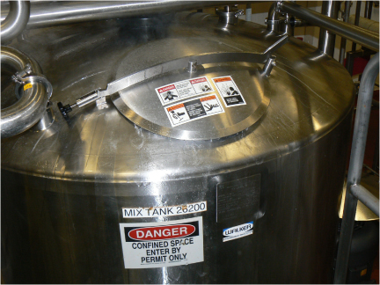
Confined Space Sign
Notes:
Picture illustrates permit-required confined space sign in use at an actual space.

Slide 51
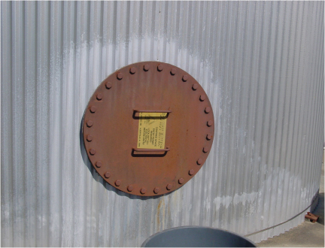
Confined Space Sign
Notes:
Picture illustrates permit-required confined space sign in use at an actual space.

Slide 52
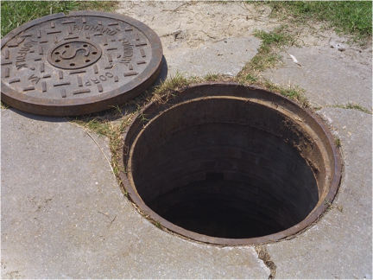
Manhole Cover With No Sign
Notes:
Manhole cover with no sign. This is a challenging situation but signage or other forms of communication are still necessary.

Slide 53
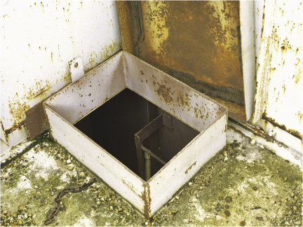
Pit Entry With No Sign
Notes:
Pit entry with no sign. This is a challenging situation but signage or other forms of communication are still necessary.

Slide 54
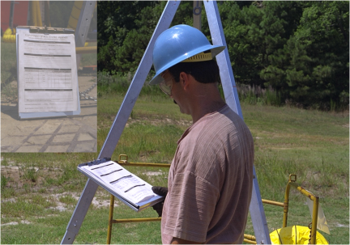
Confined Space Entry Supervisor
Notes:
Picture depicts entry supervisor. Stress responsibilities of entry supervisor.

Slide 55
PRCS Written Plan Outline
Introduction - company policy
Definitions
Identification of confined spaces
Notification and warning
Hazard identification
Equipment for entry & rescue
Evaluation of confined spaces
Permits
Authorized entrants
Authorized attendants

Slide 56
PRCS Written Plan Outline
Entry supervisors
Entry procedures
Communications procedures
Rescue procedures
Closure procedures
Coordination of work with contractors
Program review and update (required annually)
Training requirements and documentation

Slide 57
Entry Permits
Permit space to be entered
Purpose of entry
Date & authorized duration of permit
Authorized entrants
Authorized attendants
Name & signature of entry supervisor
Hazards of permit space to be entered
Isolation of hazard control measures
Acceptable entry conditions
Results of initial & periodic atmospheric monitoring
Rescue & emergency services
Communications procedures
Equipment required for entry & rescue operations
Other necessary information & other required permits

