Slide 1
Poultry and Meatpacking Worker Safety
Notes:
Created with funding by: A U.S. Occupational Safety and Health Administration Susan Harwood Training Grant
This training course was produced under grant number SH-29660-SH6 (Poultry/Meatpacking Ergo & Safety) from the Occupational Safety and Health Administration, U.S. Department of Labor. It does not necessarily reflect the views or policies of the U.S. Department of Labor, nor does mention of trade names, commercial products, or organizations imply endorsement by the U.S. Government.
Explain this program is a short summary of some of the hazards encountered in the industry.

Slide 2
Disclaimer
This material was produced under grant number SH-29660-SH6 from the Occupational Safety and Health Administration, U.S. Department of Labor. It does not necessarily reflect the views or policies of the U.S. Department of Labor, nor does mention of trade names, commercial products, or organizations imply endorsement by the U.S. Government.

Slide 3
Course Objectives
After the presentation, the participant should be able to:
Discuss the rights/responsibilities of workers and employers under the OSHA Act.
List some common hazards that are found in processing plants.
Identify some methods that used to control hazards in the work environment.
Notes:
This program is a brief overview. It does not discuss all possible hazards or methods to reduce hazards in the industry.

Slide 4
Why Are We Here Today?
Injuries
Poultry workers are twice as likely to suffer serious injuries on the job, and six times more likely to suffer illnesses, compared to other private sector workers.
In the meat slaughter and processing industry, illness and injury rates are even higher, at rates nearly double those for poultry workers.
4
Notes:
According to current Bureau of Labor Statistics (BLS) estimates, the poultry and meatpacking industries employ 526,000 workers in 5,350 plants throughout the United States, with over one-third of the nation’s chicken production occurring in the three southern states of Georgia, Alabama, and Mississippi. Poultry workers are twice as likely to suffer serious injuries on the job, and six times more likely to suffer illnesses, compared to other private sector workers. In the meat slaughter and processing industry, illness and injury rates are even higher, at rates nearly double those for poultry workers.

Slide 5


Employer Responsibilities
Employers have the responsibility to, at a minimum, comply with the OSH Act;
Employers must perform their due diligence to find and correct safety and health hazards
New 2015 version
Notes:
Employers must also:
Perform tests in the workplace, such as air sampling or noise monitoring, as required by some OSHA standards.
Provide hearing exams or other medical tests required by OSHA standards (if applicable).
Post injury/illness information so that employees can see them.
Prominently display the official OSHA "Job Safety and Health - It's the Law" poster that describes rights and responsibilities under the OSH Act; new poster issued in 2015, however, either poster is still acceptable.
Provide access to first aid and medical management.
Employers MAY NOT retaliate or discriminate against workers for using their rights under the OSH Act to report hazards that could lead to or have caused a work-related injury or illness.
Hazard Communication will be covered in more detail in a separate module in this course.

Slide 6
Employer Requirements = Employee Rights
Employees have the following rights:
A workplace free of recognized hazards;
Training in a language and vocabulary that workers understand that includes: hazards, methods to prevent harm; and the OSHA standards that apply to the workplace; and
No retaliation against workers who raise safety issues or report injuries (see whistleblowers.gov for further information).
Notes:
Employers have the responsibility to provide a safe workplace free from serious hazards and must follow all OSHA safety and health standards.
Employers must find and correct safety and health problems as their due diligence under the OSH Act. OSHA requires that employers first try to eliminate or reduce hazards by making feasible changes in working conditions rather than relying on personal protective equipment - a.k.a. PPE (e.g. masks, gloves, earplugs); and if an employer provides PPE, then the employer must train the employees on WHEN and HOW to use the PPE.
Any training given by the employer must be in a language that the employees can understand. An example is when an employer is giving training on procedures for how to de-energize or re-energize a piece of equipment by locking out or tagging out (LOTO) the various energy sources to prevent employee entrapment or other hazards from released energy.
Temporary workers are also entitled to the same protection against retaliation as full-time workers. Employers may not take action against employees for participating in protected workplace activities (i.e., filing a complaint, voicing concerns about workplace hazards to supervisors, etc.). Workers also can inform OSHA of other whistleblower items that OSHA enforces, which currently (2014) is 22 different whistleblower statutes covering a variety of workplaces. For more information visit whistleblowers.gov.

Slide 7
Workers’ Rights
Workers also have the right to:
Participate in an OSHA inspection and speak in private with the inspector;
File a discrimination complaint under Section 11 (c) of the OSH Act, which prohibits discharge or discrimination by “any person” against any employee for OSHA-related activity;
File a complaint if punished or discriminated against for acting as a “whistleblower” under the additional federal laws for which OSHA has jurisdiction.
Notes:
Participate during an OSHA inspection. They may speak with an inspector in private without retaliation from an employer.
Section 11(c) of the OSH Act prohibits discharge or discrimination by any person against any employee for OSHA-related activity AND authorizes the Secretary to investigate and seek all appropriate relief against any such person. Retaliatory lay-offs or failure to refer a worker who engages in protected activity under OSHA would be grounds for the Secretary to seek remedial - including injunctive - relief in district court.
Employers may not take action against employees for participating in protected workplace activities (i.e. filing a complaint, voicing concerns about workplace hazards to supervisors, etc.). Workers also can inform OSHA of other whistleblower items that OSHA enforces, which currently (2014) is 22 different whistleblower statutes covering a variety of workplaces. For more information visit whistleblowers.gov.

Slide 8
Poultry/Meatpacking Industries are Inherently Dangerous
There are many hazards that are associated with the industries:
Machine Guarding
Hazardous Energy Control / Lockout-Tagout
Slips, Trips, Falls
Hazardous Chemicals
Confined Spaces
Electrical
Ergonomics

Slide 9
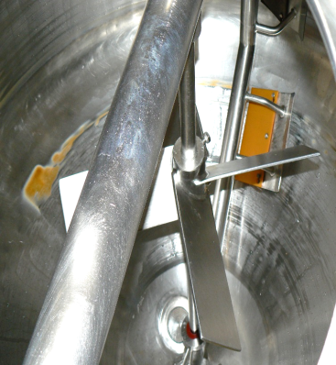
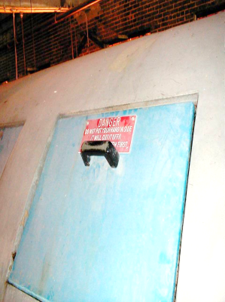
MACHINE GUARDING What are your biggest machine guarding challenges?
Notes:
The pictures illustrate some potential machine guarding issues, such as a mixing vat with rotating parts and the opening to an oven. All machinery with moving parts need appropriate guards. Note the sample sign warning of machine guarding hazards (exaggerated). Machine guards need to be designed to prevent from accessing the moving parts.
This slide meant to initiate class discussion on challenges students have at their facilities. Discuss some common guarding issues that may be found at facilities.

Slide 10
Machine Guarding Requirements
Prevent contact
Be secure
Protect from falling objects
Create no new hazards
No interference
Maintainability and accessibility

Slide 11
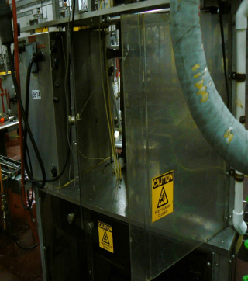
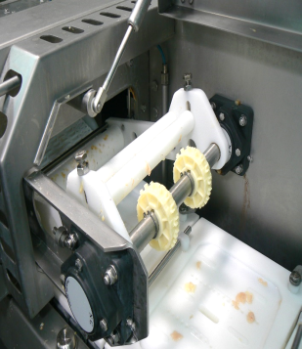
Machine Guarding
Notes:
The pictures illustrate specific equipment that would be found in the processing areas of the plant. All guards must be securely mounted to the machine and must be designed to prevent employees from reaching under, over, or through the guard. When guards can be opened, you must ensure that you have an interlock on the machine.

Slide 12
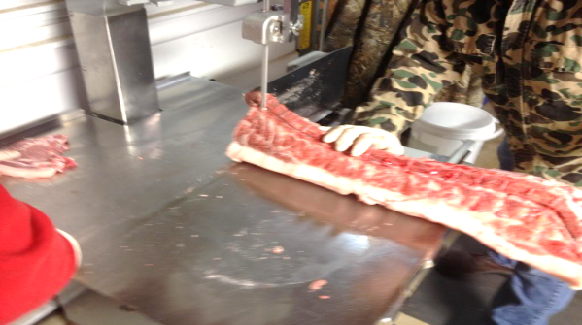
Machine Guarding
Notes:
The picture above demonstrates a worker cutting meat with a band saw. Some machines, such as a band saw, require the operators to make adjustments to the guards. The guard has to be adjusted to cover the unused portion of the blade.

Slide 13
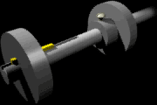
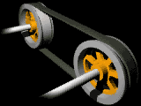


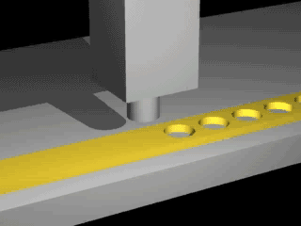
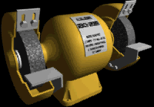



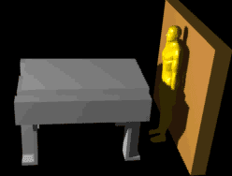
Machine Guarding-Hazards?
Notes:
Animations taken from OSHA E-Tool on Machine Guarding (specific meat processing equipment, such as fans and augers are included) illustrate a variety of hazards that require machine guarding including rotating parts, in-running nip points, hazardous points of operation, shear points, exploding grinding wheels, and reciprocating motion. There are several different types of guards: fixed, interlocked, adjustable, and self-adjusting.

Slide 14
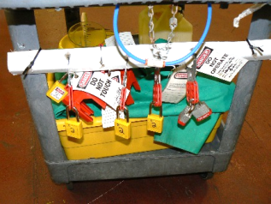
HAZARDOUS ENERGY CONTROL / LOCKOUT-TAGOUT (LOTO)
The three major components of LOTO include:
Procedures (including machine specific procedures)
Training-Authorized, Affected, and Others
Audits
Machines
May be grouped, if similar
Notes:
The effective components of LOTO should be followed to protect personnel from hazardous energy. Some of the most critical requirements from these standards are: developing, implementing, and enforcing an energy control program; using lockout devices for equipment that can be locked out (tagout devices may be used in lieu of lockout devices only if the tagout program provides employee protection equivalent to that provided through a lockout program); ensuring that new or overhauled equipment is capable of being locked out.

Slide 15
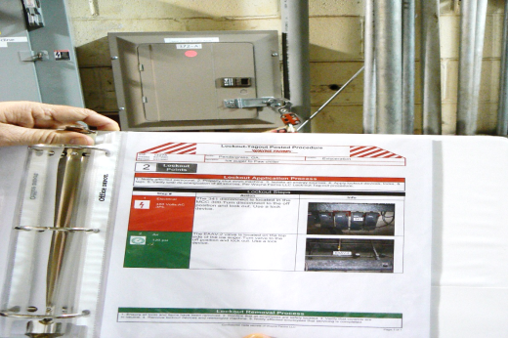
Equipment Specific Procedures
Notes:
Often procedures (poultry and meatpacking LOTO specific procedures) are posted at the machinery to enhance communication of the information to the workers. In many cases, specific procedures are required for the equipment, especially if there are multiple energy sources. The procedure should outline steps for: bringing the equipment off line, verifying the absence of energy, and bringing the equipment back on line.
Picture illustrates a LOTO machine specific procedure for a poultry processing plant.

Slide 16
Lockout/Tagout - What is covered?
Servicing and maintenance
Normal production operations where:
Employees by-pass guard(s)
Employees place any part of their body in a hazardous area

Slide 17
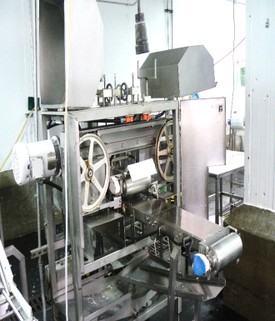
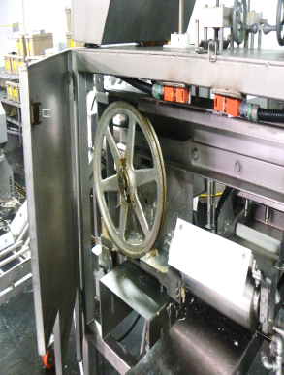
Locked Out?????
Notes:
If an employee is performing servicing or maintenance on these machines, the equipment has to be locked out as there are no alternative protective means that are made available for these machines. Note the exposed flywheel and/or pulleys on the machinery.

Slide 18

Lockout vs. Tagout
If capable of being locked out:
Prefer lockout
Tags allowed, if employer can demonstrate FULL EMPLOYEE PROTECTION
Machine Modifications
Notes:
Lockout is the best method to protect employees, therefore, locks must be used over tags. Tags may evoke a false sense of security. Employers must ensure that tags provide equally effective means for protecting employees. Additional steps may need to be taken, such as pulling a fuse to provide equivalent protection.

Slide 19
Minor Servicing Exemption
Activities which are routine, repetitive, and integral to the use of the equipment for production are not covered by this standard if alternative measures provide effective protection.
Activity must be conducted during normal production operations
Activity must be routine (regular course of procedure in accordance with established practices), repetitive (regularly repeated as part of production), and integral (essential to the production process).
Notes:
If all of these apply, the employer must use alternative measures to provide effective protection from the hazardous energy. Some acceptable alternative measures include specially designed tools, remote devices, interlocked barrier guards, local disconnects, or control switches which are under the exclusive control of the employee performing the minor servicing. These alternative measures must enable the employee to safely perform the servicing task without being exposed to the unexpected energization or activation of the equipment, or the release of stored energy.

Slide 20
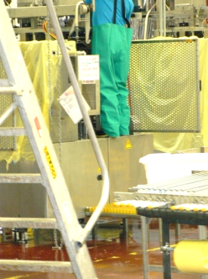
SLIP, TRIP, and FALL HAZARDS
Climbing on equipment without proper fall protection
Using ladders on uneven surfaces and/or equipment
Not replacing floor covers causing trip hazards
Major hazards to sanitation workers!
Climbing on equipment without proper fall protection
Using ladders on uneven surfaces and/or equipment
Not replacing floor covers causing trip hazards
Major hazards to sanitation workers!
Notes:
The picture illustrates an employee standing on the equipment. Poor footing is a major cause of injuries that are attributed to falls. Employees must be prohibited from climbing onto the equipment.
Slips, trips, and falls can cause back injuries, strains and sprains, contusions, and fractures. There are two types of falls:
Falls to same level-Floors, platforms and stairways may be slippery from water, blood, or poultry fat and grease. Employees may trip over boxes, electrical cords, equipment, or other items that are left in aisles and walkways. Floors may be uneven or have depressions or shallow holes or uncovered floor drains that cause employees to trip.
Falls from a higher level to a lower level- Stairways may have missing rails or treads, or the riser height may not be uniform. Elevated work surfaces may not have guardrails or toeboards. The distance between rungs on portable ladders may not be uniform, the ladders may not be equipped with non-slip safety feet, or employees may not be trained in the safe use of ladders.

Slide 21
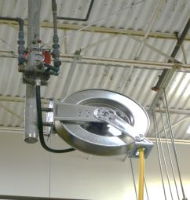
Slip, Trip, and Fall Hazards
General housekeeping – not returning hoses, tools, ladders, etc. to designated locations
Not wearing appropriate footwear for wet/slippery locations
Rushing around on wet surfaces
Notes:
Keep equipment off the floor as much as possible to prevent falls.

Slide 22
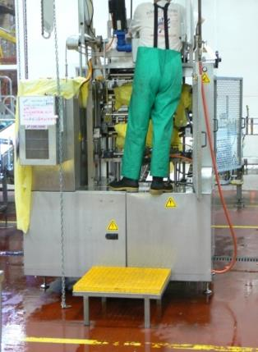
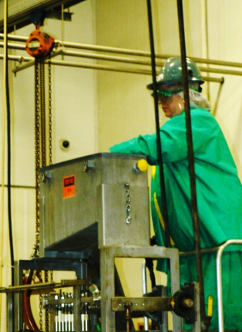
Slip, Trip, and Fall Hazards
22
Notes:
The picture on the left shows an employee standing on the equipment. Climbing on the equipment can be very dangerous as the surfaces are not designed to support personnel and there are ample opportunities to slip off the equipment. The employee in the picture on the right is better protected because they are using a ladder stand as opposed to standing on the equipment.

Slide 23
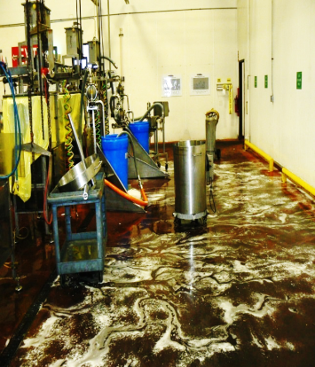
Preventing Slips, Trips, and Falls
Wet product or spills on smooth floors or walking surfaces may present hazards to employees. Some methods to prevent slips may include:
Install adequate floor drains (keep floor as dry as possible).
Promptly clean up spills.
Use appropriate footwear (anti-slip boots and replace them as they worn).
Design of the floor surfaces.
Notes:
Discuss other actions that may be taken as well or get the class to list other methods to prevent STF hazards.
Possible answers are the following: Clean up blood and grease as promptly and frequently as possible; Provide non-slip surfaces on floors that will be wet;
Use slip-resistant footwear; Keep aisles and passageways clear of obstructions and tripping hazards; Make sure aisles are wide enough for the intended use.; make sure stairs have proper handrails, that treads and risers are maintained, and that treads have a slip-resistant surface; make sure elevated storage and work surfaces have guardrails, toeboards, and a permanent means of access.; make sure that floor drains are covered by grates; maintain ladders in good condition, with uniformly-spaced rungs and non-slip safety feet; and train employees in the safe use of ladders.

Slide 24
Preventing Slips, Trips, and Falls
There are several means that can be employed to prevent STF hazards in the facility:
Provide adequate lighting to reduce glare and shadows.
Maintain the walking surfaces (including housekeeping and grates/covers).
Provide safe ladders and equipment as well as training in how to recognize/avoid hazards associated with the equipment.

Slide 25
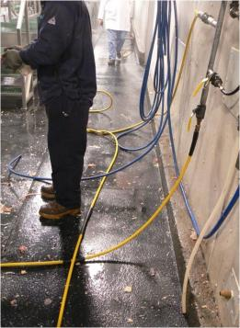
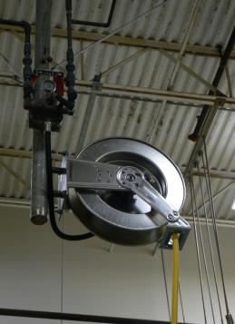
Preventing Slips, Trips, and Falls
Notes:
The picture illustrates a hazard (hoses on the floor) and a best practice for reduces the obstructions in the aisle (hose reel). The aisles and walking surfaces should be maintained free of materials that may cause employees to trip. The hoses and cords can also be covered.

Slide 26
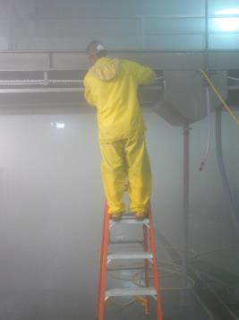
Preventing Slip, Trips, and Falls
Provide ladders are the appropriate size and height for the job.
Ensure the ladders are inspected periodically and before use.
Maintain the ladders in good condition.
Train the employees in the hazards and avoidance of unsafe conditions, especially in how to safely use a ladder.
Notes:
The picture illustrates an employee using a step ladder. Note: The top or top step of the ladder are not being used. Employers must train all employees to recognize hazards related to ladders and instruct them to minimize these hazards. For example, employers must ensure that each employee is trained by a competent person in the following areas, as applicable: nature of fall hazards in the work area; correct procedures for erecting, maintaining and disassembling the fall protection systems to be used; proper construction, use, placement and care in handling of all stairways and ladders; and maximum intended load-carrying capacities of ladders used. Note: Employers must retrain each employee as necessary to maintain their understanding and knowledge on the safe use and construction of ladders.

Slide 27
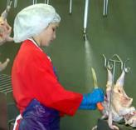
CHEMICAL HAZARDS in FOOD PRCESSING
Detergents and disinfectants
Alkaline and acid detergents, chlorine, hydrogen peroxide, ozone, quaternary ammonia compounds (”quats”), PAA
Refrigerants
Ammonia, carbon dioxide
Ingredients and additives
Other: biologicals
Notes:
Workers in Meat Packing Plants, including cleaning crews, are exposed to hazardous chemicals. Potential health effects of chemicals exposures include skin rashes, eye, nose and throat irritation, burns to the skin and eyes from splashes, cough, shortness of breath, and other symptoms, depending on the chemical.
The alkaline agents are the most common. The acid agents usually are combined in a sequence with the alkaline for a greater scope of cleaning and disinfection.
The chlorinated agents are the most commonly used, in all its formulations, to sanitize. They are always very corrosive and can generate chlorine gas if misused or mixed with other chemicals. Iodine has been used as an antimicrobial agent from 1880 and remains effective against bacteria, viruses, yeasts and molds.
The clip art illustrates the type of spray bottle often used for cleaning products.
Each facility must conduct an inventory of the hazardous chemicals present at their workplace. These are some common chemicals used in the food processing industry for cleaning, sanitizing and disinfecting.
Some of these chemicals may have a distinctive smell (ammonia, PAA, acetic acid), while others, (carbon dioxide, carbon monoxide from combustion engine forklifts) have no warning properties at all.
Photo: Worker spray washing poultry carcasses (Credit—CDC/NIOSH, Workplace Safety and Health Topics, Poultry Industry Workers)

Slide 28
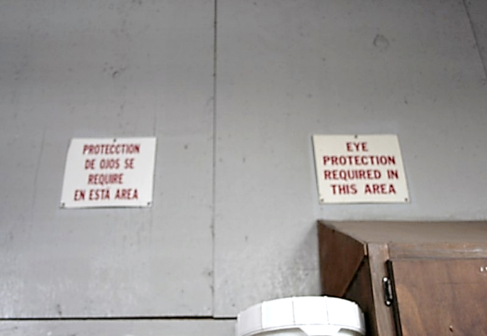
Posted
Notes:
The area is posted for the use of eye protection. Employers are to perform a hazard assessment to identify the need for PPE. Eye protection should be appropriate for the hazards likely to be encountered.
Employers need to consider certain general guidelines for assessing the hazardous situations that are likely to arise under foreseeable work activity conditions and to match employee PPE to the identified hazards. The employer should designate a safety officer or some other qualified person to exercise common sense and appropriate expertise to assess work activity hazards and select PPE. Some things that need to be considered during an assessment are: sources of hazards, analysis of the data, PPE selection guidelines, and periodic reassessment of the hazards.

Slide 29
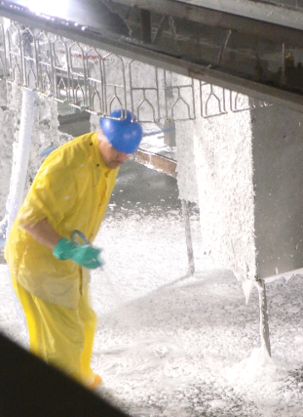
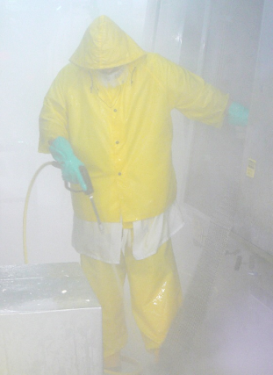
Should eye and face protection be worn?
Notes:
The picture demonstrates the use of PPE in a sanitation process. The employee is using goggles while sanitizing the equipment in the area. Of course, a face shield and goggles are a must when handling caustic detergents.

Slide 30
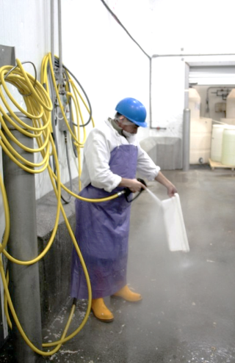
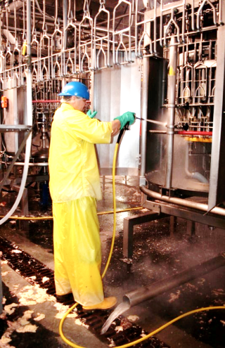
Should eye and face protection be worn?
Notes:
Cleaning parts while using PPE to protect worker from caustic detergents. Eye protection is not clearly visible, but you should note that employees must be protected with appropriate eye and face protection.

Slide 31
Hazard Communication-Basic Program Elements
Written Program
Chemical Hazard Inventory
SDSs (formerly MSDSs)
Labeling
Employee Training
Contractor Training
Hazard Communication Program
Notes:
The standard requires every employer to have consistent policies covering hazardous materials. These policies MUST be in WRITING, and must cover the topics that are bulleted here. For the audit of an existing workplace, the best place to begin may be with a comprehensive inventory of what chemicals are currently needed for production. During the inventory, identify any improperly labeled chemical containers. Use the inventory to assure that the company has an Safety Data Sheet SDS (previously referred to as Material SDS or MSDS) for every chemical on the inventory. Employees must have ready access to these SDS’s. In whatever manner the SDS files are stored (paper/electronic) employees must be capable of accessing the files, in an unimpeded manner, such as may be necessary during an emergency, or for whatever purpose an employee may deem necessary (e.g., for a personal medical evaluation). The hazard communication policy must cover independent contractors.
Graphic: three-ring binder with words “Hazard Communication Program” on cover.

Slide 32
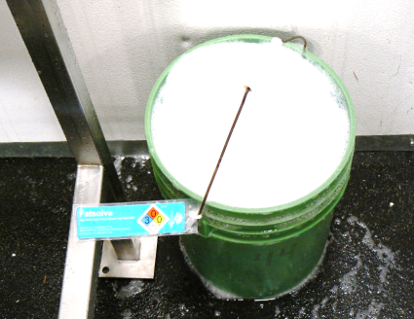
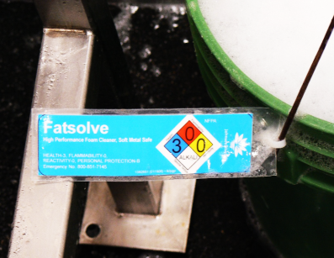
Compliant?
Notes:
From the Haz. Comm. Std, Definitions section Re: labeling exception for portable containers: Immediate use means that the hazardous chemical will be under the control of and used only by the person who transfers it from a labeled container and only within the work shift in which it is transferred.
Photos show two portable containers that are not compliant with the labeling requirements of the hazard communication standard. Portable containers must be labeled with the identity and hazards of the chemical (e.g., Kerosene, Flammable, may be fatal if swallowed and enters airways. Skin Irritant. May cause drowsiness or dizziness.)

Slide 33
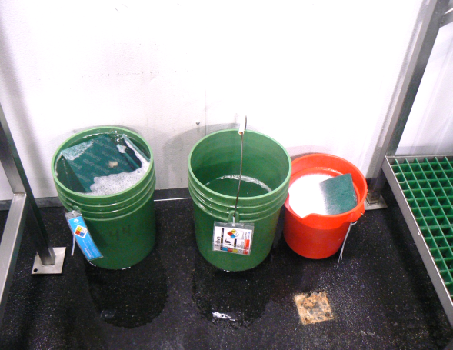
GHS Labeling
Notes:
OSHA has not changed the general requirements for workplace labeling. Employers have the option to create their own workplace labels. They can either provide all of the required information that is on the label from the chemical manufacturer or, the product identifier and words, pictures, symbols or a combination thereof, which in combination with other information immediately available to employees, provide specific information regarding the hazards of the chemical.

Slide 34
CONFINED SPACE ENTRY
"Confined space" means a space that:
(1) Is large enough to enter and perform work
(2) Has limited or restricted means for entry or exit
(3) Is not designed for continuous employee occupancy

Slide 35
Permit-Required Confined Space Entry
"Permit-required confined space (permit space)" is a confined space that has one or more of the following characteristics:
a. Contains or has a known potential to contain a hazardous atmosphere;
b. Contains a material with the potential for engulfment of the entrant;
c. Has an internal configuration such that an entrant could be trapped or asphyxiated by inwardly converging walls or a floor which slopes downward and tapers to a smaller cross-section;
d. Contains any other recognized safety or health hazard.

Slide 36
Confined Space – General Requirements
Evaluate the workplace to determine if any spaces are permit-required confined spaces
If the workplace contains permit spaces, inform employees by
Posting danger signs* of the location and danger posed by the permit spaces
Or by other equally effective means (i.e. training affected employees)
*NOTE: A sign reading DANGER -- PERMIT-REQUIRED CONFINED SPACE, DO NOT ENTER or using other similar language would satisfy the requirement for a sign.

Slide 37
Confined Space – General Requirements
If the employer decides that its employees will enter permit spaces, develop and implement a written permit space program for means, procedures and practices to eliminate or control hazards necessary for safe permit space entry.
Written program includes:
Specifying acceptable entry conditions
Isolating the permit space
Providing barriers
Verifying acceptable entry conditions; and
Purging, making inert, flushing or ventilating the permit space.
Notes:
The written program must be made available for inspection by employees and their authorized representatives

Slide 38
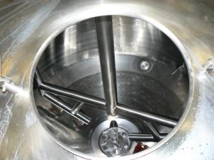
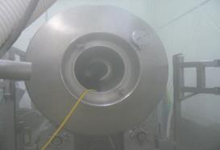
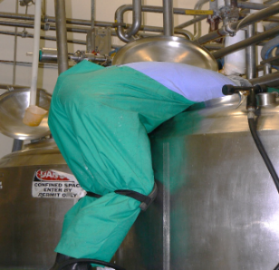
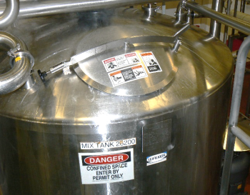
Confined Spaces
Entry?
Notes:
Many workplaces contain spaces that are considered to be "confined" because their configurations hinder the activities of employees who must enter into, work in or exit from them. In many instances, employees who work in confined spaces also face increased risk of exposure to serious physical injury from hazards such as entrapment, engulfment and hazardous atmospheric conditions. Confinement itself may pose entrapment hazards and work in confined spaces may keep employees closer to hazards such as machinery components than they would be otherwise. For example, confinement, limited access and restricted airflow can result in hazardous conditions that would not normally arise in an open workplace.

Slide 39
Confined Space - Solutions
Safety and Health Management System
Awareness
Sharing of best practices
Increased oversight
Training
Technology Insertion
Clean-in-place
Innovative equipment design
Notes:
The employer's written program should establish the means, procedures and practices to eliminate or control hazards necessary for safe permit space entry operations. These may include: specifying acceptable entry conditions; isolating the permit space; providing barriers; verifying acceptable entry conditions; and
purging, making inert, flushing or ventilating the permit space.
In addition to personal protective equipment, other equipment that employees may require for safe entry into a permit space includes: testing, monitoring, ventilating, communications and lighting equipment; barriers and shields; ladders; and retrieval devices.

Slide 40
ELECTRICAL HAZARDS
There are many rules that apply to electrical safety (installations and work practices) in the workplace, some of those standards included in this presentation are:
OSHA standards 29 CFR 1910.301-335
NEC, National Electrical Code-Design of the Systems
NFPA 70E, Safety Standard for employee workplaces

Slide 41
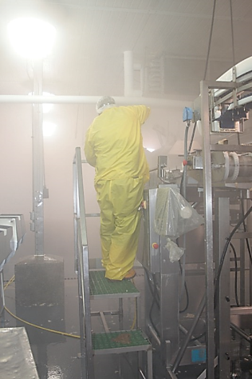
Equipment
Conductors can not be exposed to adverse conditions, unless made for those conditions.
Note: Cleaning solutions used in sanitation could potentially damage the equipment
Notes:
Many cleaning solutions and water submit the electrical wiring to adverse conditions. The caustic detergents can damage the insulation on the conductors.

Slide 42
Grounding
For AC premises wiring systems, the identified conductor shall be grounded.
The path to ground from circuits, equipment, and enclosures shall be permanent and continuous (path to ground has to be effective).
Notes:
Grounding is important to send the current back to the circuit in the event of a surge. The ground can provide protection for the equipment and prevent fires as well as offer some protection for the worker.

Slide 43
Grounding
Metal frames & enclosures of equipment are grounded by a permanent connection or bond.
The equipment grounding conductor provides a path for dangerous fault current to return to the system ground at the supply source should a fault occur.

Slide 44
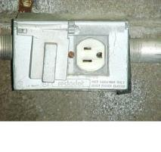
Requirements for Damp or Wet Locations
All receptacles in the processing area that are subject to a wet or damp location must be covered
Electrical equipment should be designed to prevent accumulation of water
Receptacles in damp areas must have a GFCI
Notes:
There is a difference between attended and unattended areas. The picture represents a cover installed in an attended area. Covers in unattended areas must cover not only the receptacle, but the attachment cap as well when it is plugged into the receptacle.

Slide 45
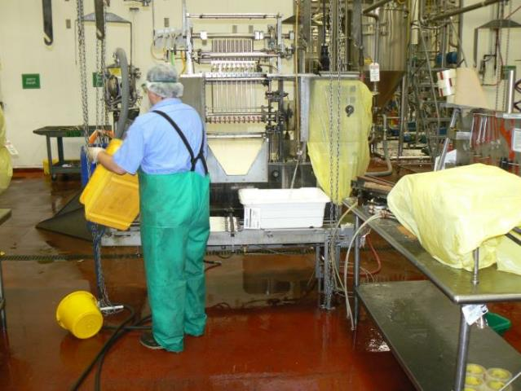
Performing sanitation around electrical equipment
Notes:
The picture above represents a worker performing sanitation around electrical equipment. Some companies will instruct employees to put cords in covered bins to keep them off the floor temporarily during sanitation.

Slide 46
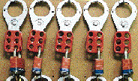
Safe Electrical Work Practices
While any employee is exposed to contact with parts or circuits which have been de-energized, the circuits shall be locked out or tagged or both.
If not locked out, treat it as a live circuit.
Notes:
Before working on equipment, it should be put in a safe work condition. The action that is primarily done is LOTO. Employers and workers need to be aware of the electrical safe work practices for the plant. Live electrical work should not be done and generally is not allowable, except for very extenuating circumstances. Refer to NFPA 70E and 1910.333-335 for working around or near live circuit conductors.

Slide 47
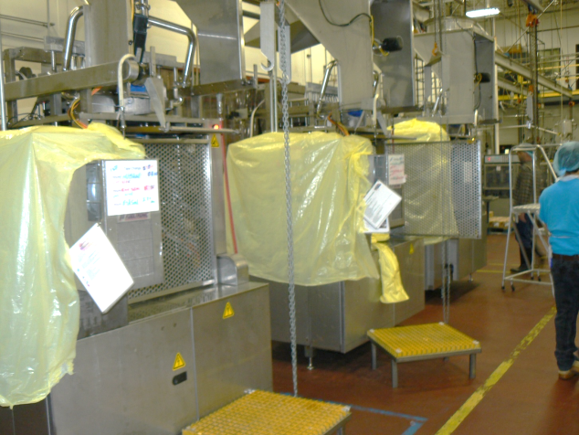
Lock out this equipment
Notes:
This type of equipment would possibly have to be locked out in many cases. The electronics are bagged in the sanitation process to protect the equipment, but employees did not LOTO equipment in many cases.

Slide 48
ERGONOMICS
What is ergonomics?
It is the study of work
It is a way to make jobs/tasks fit the employees better
It is a way to make work easier
Notes:
The employees need to understand the basic concept of ergonomics. Ergonomics is a term that comes from two Greek words “ergos” and “nomos” which could be literally translated as the study of work. Ergonomics is not a new concept, it has been around for decades.
We often discuss ergonomics in terms of fitting the task to the worker. This is opposed to a previous concept where workers were expected to adapt to existing equipment and setups. For example, if the workstations are too high or too low, people will adapt by bending and reaching which can stress the back, shoulders and arms. Traditionally, equipment was designed for the average worker, which meant that it was too low for half of the population and too high for the other half.
If the design fits the worker better, it means that it is also designed to match their physical capabilities better. This fact should make it easier for the worker to perform their job. How the worker interacts with their environment, workstation, equipment and tools to perform their assigned task is very important. The design of the task should minimize the physical and mental stress in the workplace allowing the worker to perform well within their capabilities.

Slide 49
Human Centered Design
Machine Design
Human
Factors
Task
Design
Match machine
to task
Match machine to human
ERGONOMICS
Match task to human
Notes:
Worker capabilities and limitations must be considered in the design process. The interactions with the chemical and physical environment, equipment, tools and the demands of the task can impose stressors that affect health and performance.

Slide 50
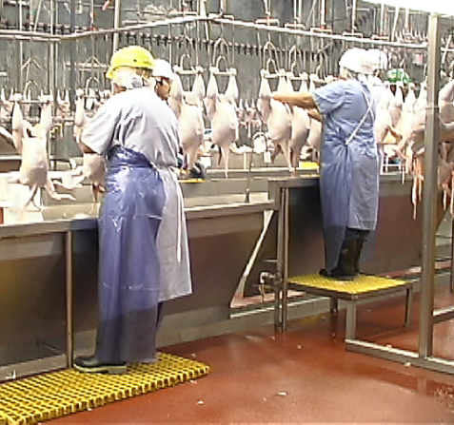
Fitting the Job to the Worker
50
Notes:
When using ergonomics, it is important to get the right equipment for the right individuals. The picture above illustrates a worker that is too small for their workstation and has a special platform to make it the right height for her. The tall person is almost in the correct posture.
Discussion:
Ask the group about the shorter person. Is she in the correct posture? The answer is no since her arms are fully extended just below shoulder height. The platform needs to be raised further to allow the worker to have their elbows down close to the body with the upper and lower arms at a right angle to each other.

Slide 51
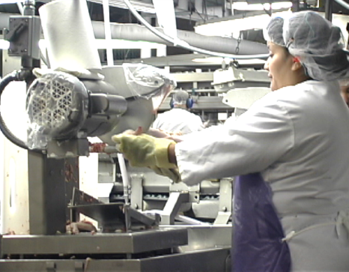
Making the Job Easier
Notes:
Ergonomics has also been about making the job easier for those who perform the actual work. The picture on the left shows a circular saw used for the cut up operation. New machines, like the one to the right, can cut the whole bird into eight pieces with little worker involvement. The workers just basically load the whole chickens and the machine performs all of the cuts automatically.

Slide 52
How does ergonomics affect you?
It can help workers complete the tasks safely
It can make workers more comfortable
It can prevent injuries
It can result in decreased mistakes and rework
Decreased turnover
Notes:
If the job is designed to fit the employees working at those tasks, then it should by nature be safer. Tools will fit hands better so they are less like to slip. Guards and other safety equipment that are designed with some knowledge of ergonomics will protect a larger range of people.
If the job fits you well, it should also be more comfortable. If it is more comfortable, you should be able to work at this job longer without any negative consequences. If the jobs are designed properly, workers should not be straining either physically or psychologically to accomplish their work and in turn are not experiencing injuries.
We are typically more interested in the physical stress, because it can have more immediate impact on the development of injuries. Physical stress can cause muscle pain and discomfort that negatively affects our work tolerance and performance. A well designed workplace can improve morale.
Discussion
Discuss the relationship of mental stress and muscle tension

Slide 53
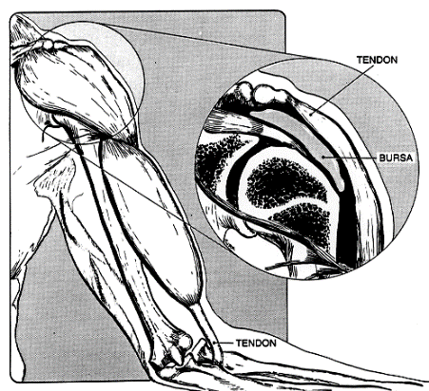
What is an ergonomic related injury or disorder?
Nerves
Tendons
Muscles
Ligaments
Notes:
Ergonomic related injuries and disorders are know by many different names. You may hear these referred to as cumulative trauma disorders, repetitive strain injuries, or musculoskeletal disorders. Most of these injuries or disorders develop overtime. They most often affect the soft tissues of the body like the following:
-Nerves - Nerves are the part of the body that provides both sensory feedback (feeling) and motor control (movement). Injured by directly compressing (sharp table edges) or by swelling of internal structures like tendons that compress the nerves.
-Tendons - Tendons connect muscles to bones. They are rope-like structures that transfer force when muscles contract. These structures can be strained (tear) or can become inflamed (swelling). One of the most common injuries is tendonitis.
-Muscles -Muscles provide movement and support of the body. Muscles can be strained, or torn, or crushed.
-Ligaments -Ligaments connect bones to bones to form joints. They are thick rope like structures. They can be torn (sprain).
[Picture – Human arm showing the musculoskeletal of shoulder and bicep with magnification of shoulder displaying tendon connection, location of bursa in relation to bones]

Slide 54
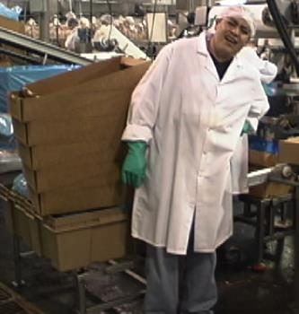
What areas of the body are most often affected?
Hands
Arms
Backs
Shoulders
Notes:
There are numerous types of injuries or disorders that affect various parts of the body. Some of these are as follows:
-Hands - Carpal Tunnel Syndrome
- Ganglion Cyst
- Hand Arm Vibration Syndrome
-Arms - Tennis/Golfer’s Elbow
- Thoracic Outlet Syndrome
-Back -Back Pain
-Back Strain
-Shoulder - Rotator Cuff Tendonitis
- Bursitis
[Picture – Worker leaning to side holding back]

Slide 55
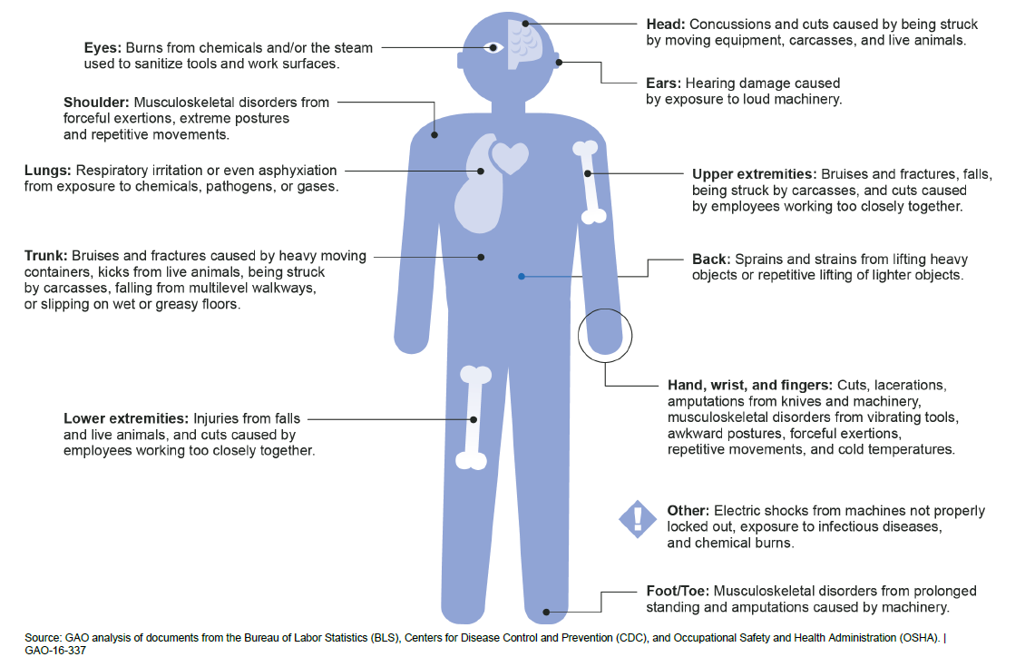
Nature of Injuries Potentially Sustained by Meat and Poultry Workers

Slide 56
NIOSH Findings HHE Report No. 2014-0040-3232
81% of the jobs evaluated had average levels of hand activity and force above the American Conference of Governmental Industrial Hygienists’ (ACGIH) action limit.
59% of the jobs evaluated had average levels of hand activity and force above the ACGIH threshold limit value.
The receiving, picking, debone direct, and thigh line departments had jobs in different exposure groups. However, the company did not rotate employees among these jobs.
34% of participants had evidence of carpal tunnel syndrome on the basis of our case definition.
Sprain, strain, pain, soreness, inflammation, or repetitive motion entries were the most common OSHA recordable injury in 2010, 2011, and 2013.
Notes:
Employees, union officials, or employers can ask the NIOSH Health Hazard Evaluation (HHE) Program to help learn whether health hazards are present at their place of work. NIOSH may provide assistance and information by phone and in writing, or may visit the workplace to assess exposure and employee health.

Slide 57
Loss Sources
Debone workers are developing hand, arm, wrist disorders from the repetitive knife cutting operations.
Material handlers are sustaining back and shoulder disorders from lifting tubs of product.
Lacerations from knife use in debone
Recordkeeping

Slide 58
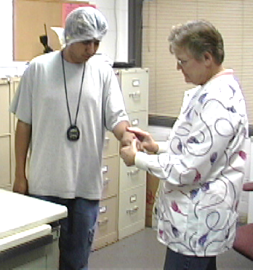
What are the signs and symptoms of these types of injuries?
Aching
Burning
Pain
Numbness
Soreness
Notes:
Early recognition and reporting. Early reporting of symptoms of MSDs reduces injury severity, the likelihood of permanent disability, and the number and costs of workers’ compensation claims. It also identifies possible risk areas in the plant for intervention
[Picture – Nurse examining forearm of worker]

Slide 59
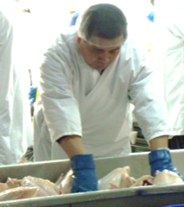
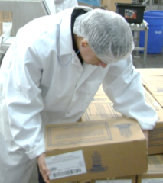
Risk Factors
Force
Awkward Postures
Repetition
Temperature
Vibration
Contact Stress
Notes:
The employees need to understand that a risk factor is a something that is likely to cause a workplace musculoskeletal disorder (ergonomic related injury or illness). Sometimes the problem is not with just on of these, it is with a combination of factors. This is especially true with force and repetition. This combined effect can actually increase the chances of developing a workplace musculoskeletal disorder (MSD). In the slides to follow, we will discuss each of these factors as they occur in the poultry industry.
[Picture – Worker bending over processing line pushing down with fist with back of hand positioned away from body]
[Picture – Worker bending over and picking up box with legs straight and back hunched]

Slide 60
Improvement and Control Techniques
Engineering Controls
Work Practices
Administrative Controls
Personal Protective Equipment
Notes:
From NIOSH 97-117 PPE
On the basis of a review of the scientific literature completed in 1994, NIOSH concluded that insufficient evidence existed to prove the effectiveness of back belts in preventing back injuries related to manual handling job tasks [NIOSH 1994]. A recent epidemiological study credits mandatory use of back belts in a chain of large retail hardware stores in substantially reducing the rate of low back injuries [Kraus 1996]. Although NIOSH believes this study provides evidence that back belts may be effective in some settings for preventing back injuries, NIOSH still believes that evidence for the effectiveness of back belts is inconclusive. This area is being researched, and the questions about the effectiveness of most personal equipment remain open. Less controversial types of personal equipment are vibration attenuation gloves [NIOSH 1989] and knee pads for carpet layers [Bhattacharya et al. 1985]. But even here, there can be concerns. For example, do the design and fit of the gloves make it harder to grip tools?

Slide 61
Control Techniques
Engineering Controls
Work station design
Tool design
Reducing or spreading force
Obtaining better mechanical advantage

Slide 62
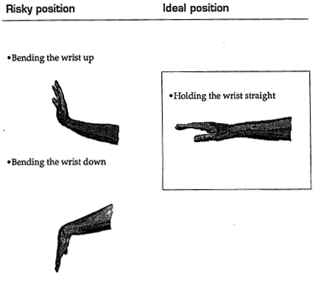
WRUEMD Risk Factor Examples
Notes:
From Stitch In Time A Supervisors Guide to Ergonomics. Available on www.oshainfo.gatech.edu along with video.
WRUEMD is Work related Upper Extremity Musculoskeletal Disorder

Slide 63
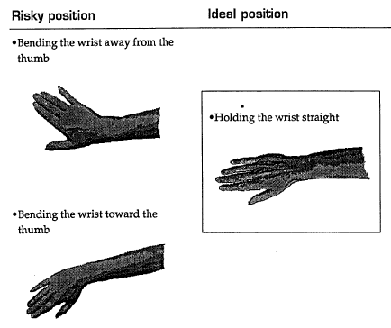
Risk Factor Example
Notes:
From Stitch In Time A Supervisors Guide to Ergonomics.
Bending away from thumb is called ulnar deviation and is a common tool induced posture.

Slide 64

Risk Factors-Posture Solutions
Notes:
[Drawings - Two different knives are illustrated in this picture. One is the standard knife handle that is straight and causes the user to bend their wrist when making a vertical cut. The knife on the right is a pistol shaped handle that allows the user to use a straight wrist when making the same cut. This helps to eliminate the bent wrist risk factor.]

Slide 65


Risk Factors-Posture Solutions
Notes:
Some tools have specific angles. In tool selection the curve of the handle should allow the use of a straight wrist when doing the work. The handle should also go across the palm. If it ends in the palm it might damage the soft tissue from contact stress.
[Picture – two plyers, one ergonomic the other a small standard model]
[Picture – four fillet knives, each with a different angle of blade to the handle, from swept back to almost 90 degree angle]

Slide 66


Risk Factor-Force
Notes:
We want employees to try and keep the forces they are being exposed to as low as possible. Using good lifting techniques and taking advantage of equipment that is available to them can be of help in reducing their exposure. One typical concern we have in poultry processing is the task of palletizing boxes. You will often have very low stacking (at the floor) as well as very tall stacking (at the shoulder level or as high as the head). The safest lifting range is between knuckle to shoulder height (30-50 inches).
[Two picture sequence – Packing line with worker at end of conveyor picking up box from rollers and placing on pallet on the floor]

Slide 67

Risk Factors - Force Solutions
Notes:
Lift tables could be a good idea help to reduce forces. There are also some palletizing equipment that may be able to automatically palletize and wrap boxes for companies.
[Picture – Hydraulic yellow lift table]

Slide 68


Risk Factors - Force
Notes:
Shoveling can be an especially tough task. The heavier the product the more strenuous this task is.
[Two picture sequence – Worker bending over at waist to reach into floor tote with shovel to scoop up meat, then lift meat to production line level to fill container on line, workers hands and arms are outstretched and at shoulder or head height]

Slide 69


Risk Factors – Force Solutions
Notes:
This is a small tote dumper that is used for in-process totes. This allows the worker to place the tote at a comfortable height and then dump it onto the processing line using the mechanism. The dumping activity can often be a problem because the employee has a heavy tote full of chicken parts and has to dump them with exaggerated postures.
[Two picture sequence - a small tote dumper that is used for in-process totes, tote loaded then tote being dumped using automation]

Slide 70
Control Techniques
Work Practices
Task Enlargement
Work techniques
Notes:
Job enlargement is an increase in job tasks and responsibilities to make a position more challenging. It is a horizontal expansion, which means that the tasks added are at the same level as those in the current position. After performing the same position for a while, employees can get bored.

Slide 71
Control Techniques
Administrative Controls
Job rotation
Maintenance of equipment & environment
Rest breaks
Increase number of employees
Physical conditioning
Relief personnel
Medical management
Notes:
Job enlargement is an increase in job tasks and responsibilities to make a position more challenging. It is a horizontal expansion, which means that the tasks added are at the same level as those in the current position. After performing the same position for a while, employees can get bored. Some example of administrative controls are: 1. Design job tasks so that they are below the AL of the ACGIH TLV to minimize the risk for developing carpal tunnel syndrome; 2. Employ a rotation schedule that rotates employees between jobs that use different muscle groups and rotates them from high to low risk jobs; 4. Sharpen knives and change them out regularly so employees do not have to exert undue force to make cuts; 5.
Provide more breaks to limit continuous work to less than 2 hours; 6. Encourage employees to report musculoskeletal symptoms early to the onsite medical clinic so medical personnel can evaluate their symptoms and ensure prompt
and appropriate medical management as needed; 7. Provide bulletin board and safety meeting reminders and break room handouts; 8. Institute a medical surveillance program for MSDs to monitor employee health.

Slide 72
NIOSH Solutions HHE Report No. 2014-0040-3232
Design job tasks so that levels of hand activity and force are below the action limit of the ACGIH.
Reduce cone line speeds and use additional cone lines so job tasks are below the action limit of the ACGIH.
Implement a rotation schedule to reduce stress to specific sets of muscles and tendons.
Ensure that the knife change-out schedule is strictly followed.
Provide more breaks during the work shift.
Implement a standard process to evaluate employee symptoms. Provide appropriate treatment, work restrictions, and medical referrals.

Slide 73
Employees Need to Know
Proper use of equipment, tools, and machine controls;
Early symptoms of MSDs and the importance of early reporting;
Procedures for reporting work-related injuries and illnesses;
The company’s ergonomics process;
How to identify ergonomic risk factors;
Process for reporting ergonomic concerns.
Notes:
This is from OSHA Publication 3213-12R 2013
Prevention of Musculoskeletal Injuries in Poultry Processing

Slide 74
Summary
In this presentation, we have presented you with the following items:
An identification of common hazards in the industry.
Methods that can be used to reduce the frequency and severity of injuries related to common hazards in the poultry and meat packing industry.
Employer responsibilities and workers rights under OSHA.

Slide 75

Questions?
Notes:
What came first: The chicken or the egg?
Questions about the materials:
Georgia Tech Research Institute
www.oshainfo.gatech.edu

