Slide 1
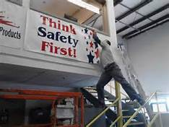
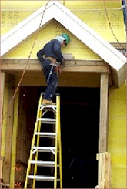
Welcome to
Walk and Work Surfaces
Safety Training

Slide 2
Disclaimer
This material was produced under grant SH-29672-SH6 from the Occupational Safety and Health Administration, U.S. Department of Labor. It does not necessarily reflect the views or policies of the U.S. Department of Labor, nor does mention of trade names, commercial products, or organizations imply endorsement by the U.S. Government

Slide 3
Why the heck did you get into Safety?
Notes:
Let’s discuss how we got into safety, what it means to us personally and what we want to gain from today’s training.

Slide 4
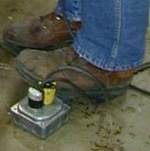
S/T/F AGENDA
Why be concerned?
Housekeeping
Never let your feet step where your eyes have not been first
Walking Surfaces
Footwear
Ladders
Stairs
Fall Protection
Notes:
Slide #2
In this introductory slide, discuss with participants that slips/trips and falls account for nearly 50% or more of our OSHA recordable injuries that occur at our locations. Ask participants to take this presentation very seriously and pay close attention. You may want to ask participants of S/T/F accidents that they are aware of that resulted in serious injury to them or someone they know.
Some of the contributing factors are then listed and will be covered in more detail throughout the presentation.
Housekeeping is a critical part of eliminating these accidents and proper housekeeping is everyone's responsibility. Everything should have a place and always be in place when not in use. Brooms and mop handles are an example.
Be aware of your surroundings, never let your feet go where your eyes have not been first.
Walking surfaces must be free of debris, water and other hazards.
Proper foot wear and soles in good condition.
Proper respect and use of elevated work surfaces such as material access platforms and stairs.
As usual, there will be a learning assessment at the end of the course.

Slide 5
Why be concerned?
According to the U. S. Department of Labor, slips, trips, and falls constitute over 50 % of general industry mishaps
Slips, trips & falls cause 15% of all accidental deaths, second only to motor vehicles as a cause of fatalities
Approximately 19,565 people die in the U.S. annually due to injuries caused by unintentional falls
Notes:
As you can see by the statistics in this slide, the information provided by the Department Labor is very close to our own.
Slips and falls account for 15% of all accidental deaths, only second to motor vehicle fatalities.
Remind participants that a slip or fall does not have to be from a roof top to cause a fatality. The right conditions in even a floor level slip and fall can lead to serious injury and even death.
Therefore, it is very important that unsafe conditions or actions are reported immediately to prevent accidents.
Everyone should be responsible and take action. Do not wait to report conditions and if possible, eliminate or mark the hazard immediately before reporting.

Slide 6
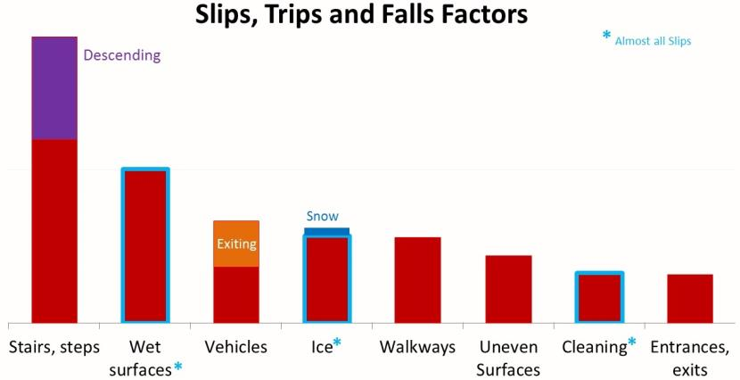
14,000 + Work Incidents

Slide 7
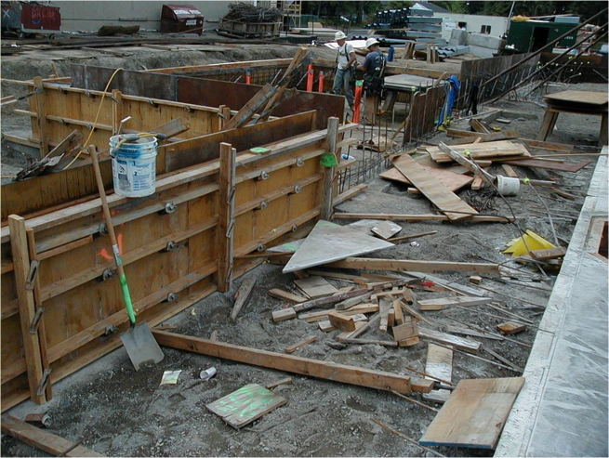
Complete Lack of Working Surface Safety

Slide 8
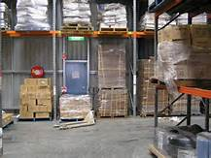
Housekeeping – A Safety Essential
Workplaces must be kept clean, orderly, and sanitary
Floors must be kept as clean and dry as possible
Report hazards to your supervisor
Notes:
Reinforce that each employee plays a role in the housekeeping process.
Each employee should expect nothing less that excellent housekeeping and organization. A commitment to daily execution of these expectations is critical to sustainment.
At this time, engage the Safety Committee members in monthly inspections of areas for housekeeping and organization.

Slide 9
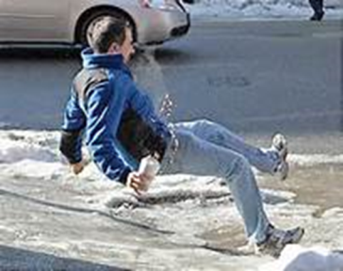
Environment
As a pedestrian, we tend to be unsafe in the most unsafe environments
When it is raining, we run to not get wet
When it is cold & icy, we run to stay warm
When there is a hazard in our path, we step on, climb on, or jump over it
Notes:
This slide explains that we often take risks in inclement weather trying avoid a hazard or discomfort and actually creating a greater hazard for ourselves.
Discuss the three bullet points and then ask what should you do?

Slide 10
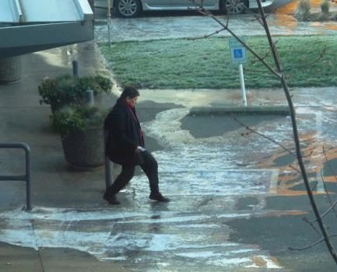
Consider Your Environment
Slow down & take small steps to keep your center of balance and never run on icy ground
Keep both hands free for balance, rather than in your pockets
Use handrails
Avoid carrying loads on stairways
Keep your eyes on where you are going
Step – do not jump from vehicles and equipment
Notes:
This slide discusses things we should do as provided by the National Safety Council.
Read each bullet point and discuss further where appropriate.

Slide 11
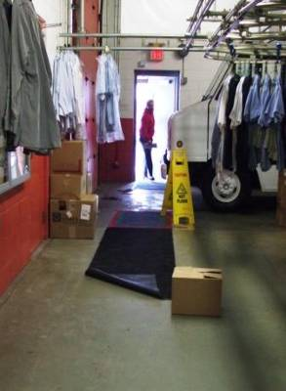

Aisles & Passageways
Notes:
This slide references housekeeping and organization in eliminating hazards. Hazards which lead to unsafe actions as mentioned in the previous two slides.
Conditions as shown in this photo will require a employee to step, climb and unnecessarily maneuver around these hazards.
Ask the class if they think this is a safe working environment?
Who created this environment?
Whose responsibility is it to eliminate and control these hazards?

Slide 12
Floor Openings & Guardrails
Covers & grating protect employees from the hazards of:
  Open pits, tanks, vats, manholes
Guardrails and toe boards protect employees from hazards in/on:
  Elevated work platforms
  Mezzanines
  Objects falling from above
Safety chains must always be in place at dock doors when not blocked by a truck or trailer!
Notes:
Floor openings and elevated work surfaces are significant hazards. The bullet points in this slide reference requirements for protection of these work surfaces. Covers must always be in place on floor openings and hand rails and toe-boards must always be in place.
Safety chains, signs or other guarding devices are used at semi-door loading areas and must always be in place when the door is open and a truck or truck trailer is not in place and chocked at the door.

Slide 13
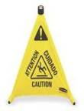
Hazardous Surfaces
Report spills immediately
Maintain floors in a dry, clean state as
much as possible
Use “Wet Floor” signs where floors are wet
Be prepared for snow / icy weather with snow removal equipment, salt, sand & designated snow removal assignments each shift
Anti-skid tape applied to steps & floor surfaces that may be glossy or slippery
Notes:
Throughout each day our surroundings can change. We must immediately report, clear or guard unsafe conditions.
All floors must be maintained in a dry and clean state. Remove debris and other items from aisle ways.
Apply a “Wet Floor” sign if a spill is encountered.
Keep steps and outdoor walkways clear during inclement weather.
Apply anti-skid material where conditions are frequently hazardous.

Slide 14
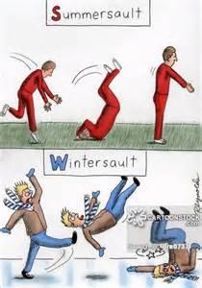
Parking Lots & Restrooms
Use caution & observe parking lots and sidewalks for cracks, separation, potholes, oily spots
Use extra caution during inclement weather
Report wet floors or leaking fixtures in restrooms
Notes:
Parking lots are known for causing many slips, trips and falls. Many hazards exist as mentioned in each bullet point.
Restrooms frequently have water and other debris on the floor.
Exercise caution while in these areas.
Read each point and discuss.

Slide 15
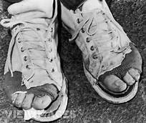
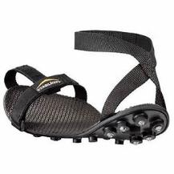
Footwear
Slip resistant shoes/boots reduce possible slip injuries
Keep your footwear in good condition
  Soles not worn smooth; no holes, tears, separation from uppers
Wear appropriate footwear for conditions
  Appropriate footwear for inclement weather conditions.
Notes:
This slide discusses how important proper footwear is! You may want participants to inspect their personal footwear or those of employees around them for wear. This would also be a good time to review your footwear program and provide a sign-up sheet for new shoes if needed.
Boots provide an added level of protection from ankle twists, while not every employee enjoys wearing boots over shoes, wearing boots that lace up past the ankle area add protection from ankle twists.

Slide 16
Ladder Requirements
Ladders are only used by authorized employees
Must be kept in a safe condition
Keep the area around the top and bottom of a ladder clear
Keep ladders free from slipping hazards (rungs clean of dirt, oil, paint)
Ladder feet must be placed on level, firm surfaces before using
Notes:
This slide explains that ladders are only to be used by authorized personnel. While these slides refer to ladders being used by authorized employees , ladders are frequently used at home. Remind employees that ladder safety is just as important at home. Never use chairs or other devices not intended for use in climbing.
, authorized employees are typically maintenance engineers and on occasion wash floor operators. Other employees may be required to use a rolling step ladder throughout the day.
Many of the bullet points and safety requirements mentioned in these slides also apply to rolling step ladders.
Read the bullet points and discuss further.

Slide 17
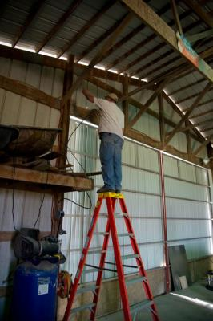
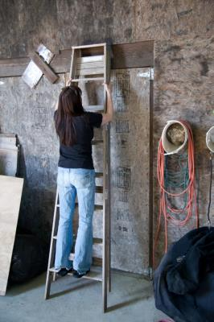
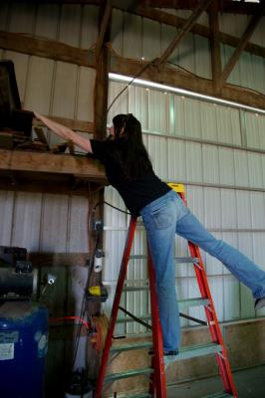
Improper use of ladder

Slide 18
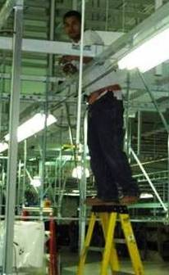
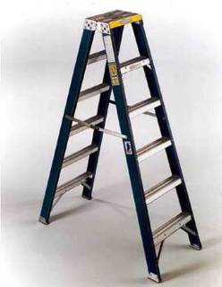
Top Step & Cross Bracing
Do not use the top, or top
step of a stepladder as a step
Do not use cross bracing on the rear of a stepladder for climbing – unless using a ladder designed for this purpose
Example, a ladder with rear rungs designed for use
Notes:
Step ladders are most frequently used in the work place over extension ladders. Many times they are misused as shown in this photo.
Do not use the top or top step of a step ladder and maintain three point contact.
Most step ladders are not designed for use from both sides. Make sure the ladder you are using is designed for entry from both sides before attempting to climb.
This slide shows a ladder that is designed by placing steps on both sides.

Slide 19
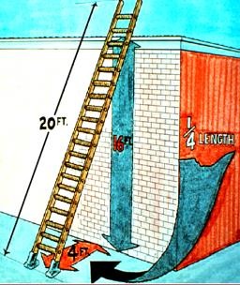
Climbing a Ladder
Keep at least 3 points of contact at all times when climbing up or down a ladder
  One hand, two feet
  Two hands, one foot
Face the ladder when going up or down
Do not carry any objects or load that could cause you to lose balance
Do not use ladders on slippery surfaces unless secured or provided with slip-resistant feet
Notes:
Climbing a ladder requires that 3 points of contact be maintained at all times.
Always face the ladder when going up or down.
Do not carry objects that could cause you to lose your balance, ask for help.
Keep the ladder feet on solid secure footing free from slippery surfaces.

Slide 20
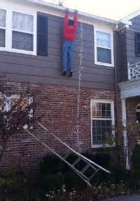
Ladder Inspection & Storage
A competent person must inspect ladders
If a defective ladder is found, immediately mark it defective or tag it "Do Not Use”
Withdraw defective ladders from service until repaired
Ladders must be inspected & documented monthly
All ladders must be stored & secured properly when not in use
Notes:
Monthly, documented inspection of all ladders is required . Of course employees using ladders should always do a visual inspection before use. Make sure the ladder has not been damaged or left in a less than safe condition by the previous user before attempting to climb.
When ladders are inspected and found to be defective, they must be immediately tagged and removed from service.
When not in use, they must be properly stored. This means that they must be secured if stored against a wall to prevent them from falling which my injure a employee or damage the ladder.

Slide 21
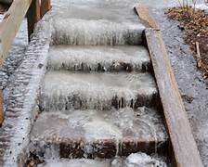
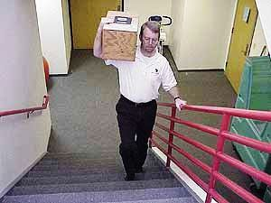
Stairs
Keep at least 3 points of contact at all times when going up or down stairs
Use the handrails
No storage on stairs
Stairs should be kept clean & free from slip hazards (water, oil, ice, snow)
Notes:
This slide contains recommendations from the National Safety Council on ascending and descending stairs. As in use of a ladder or step ladder, maintain three point contact. Using the hand rails at all times provides added protection in preventing a fall. The three point stance provides stability and control.
Stairs have a tendency to become convenient locations to store items. Keep stairs clear of all items at all times!
Outdoor stairs and walkways must have an inspection and maintenance program to keep them free of ice, snow and other hazards.

Slide 22
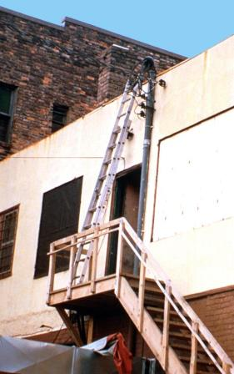
Summary
Slips, trips, and falls constitute the majority of general industry accidents
Daily housekeeping is important to work safely
Keep required footwear in good condition
Report any unsafe conditions to your supervisor
“Never let your feet step where your eyes have not been first”
Notes:
In summary, slips, trips and falls constitute the majority of general industry accidents.
Review each bullet point and ask the class if this information makes sense.

Slide 23
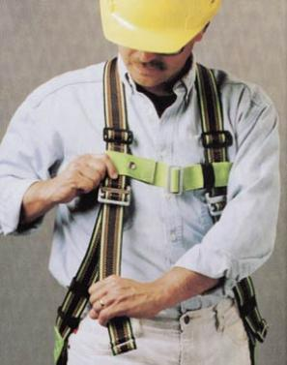
Fall Protection

Slide 24
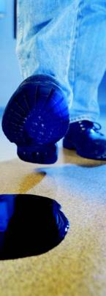
Types of falls
Falls from same level
  Slips
  Trips
  High frequency rate
  Low injury severity
  rate

Slide 25

Basic Types of Falls
Falls from an elevation
  Relatively low
  frequency rate
  High injury
  severity rate
Specific potential
fall hazards
Steps, lifted surfaces, clutter on surfaces, ladders, etc.

Slide 26
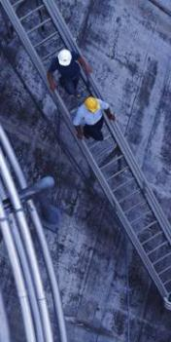
Common fall protection systems
Guardrail systems
and toeboards
Handrail and stair
rail systems
Designated areas

Slide 27
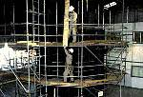
Common fall protection systems - Continued
Hole covers
Safety net systems
Ladder cages

Slide 28
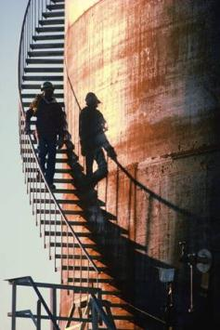
Common fall protection systems – Final
Ramps and bridging devices
Slip-resistant
floors
Effective
housekeeping
Guardrails & nets
Fall arrest systems

Slide 29
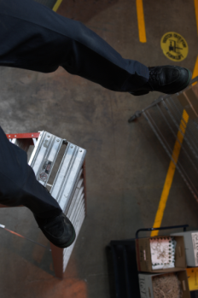
What happens during a fall?
Person loses his/her balance
Body unintentionally moves from an upright position to a prone, or semi-prone position

Slide 30
What happens during a fall? (Continued)
Free-fall velocity at impact when falling 12 feet is nearly 20 M.P.H.
Person hits the ground in less than one second from this distance

Slide 31
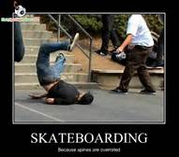
Why falls are dangerous
Falls are dangerous because of three primary elements:
The free-fall distance the worker falls
The shock absorption at impact
The body weight of the worker

Slide 32
Free-fall distance
The uncontrolled length of travel before a worker hits the floor, ground, or before fall arrest equipment activates
Measured from the foot level before the fall, to the foot level after the fall
Notes:
Free Fall Distance is the distance a person falls before his/her fall protection system activates slowing them down. It is measured from foot level before the fall to the time the arrest system activates. Not to the foot level after the fall. Foot level after a fall could be 18 feet from the anchor point. This might be a good place to discuss the fall distance formula, link attached http://www.capitalsafety.com/en-us/pages/fall-clearance-calculator.aspx

Slide 33
Free-fall distance (Continued)
Free-fall distance should be limited to a few feet so as to prevent injury from:
  collisions with grade level
  collisions with obstructions near the work site
  pendulum-like swings that result in collision with objects

Slide 34

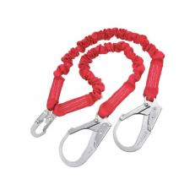
Shock absorption at impact
Varies according to the types of fall protection equipment used
Shock-absorbing lanyards reduce the probability
of injury

Slide 35
Body weight of the worker
Falls have more severe impact on heavy workers
“The bigger they are, the harder they fall.”
Heavy workers may have larger waistlines, preventing fall arrest equipment from fitting properly. Manufacturers do make equipment for heavy workers – check equipment specifications to make sure it is right for you.

Slide 36
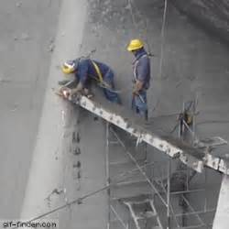
Fall arrest systems
Used when engineering controls are not feasible or sufficient to eliminate the
risk of a fall
Fall arrest systems should match the work situation

Slide 37
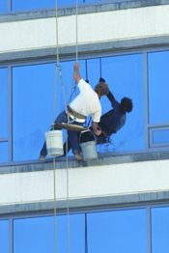
Fall arrest systems - Purpose
Fall arrest systems should:
  prevent a worker from free-falling more than 6 feet
  prevent a worker from contacting any lower level
  during arrest of a fall

Slide 38
Fall arrest systems – Additional functions
Fall arrest systems should:
  limit the maximum arresting force on an employee to 1800 pounds when a worker uses a body harness
  bring a worker to a complete stop
  limit the deceleration distance a worker travels to 3 1/2 feet

Slide 39
Fall arrest systems - Final
Fall arrest systems should:
  have sufficient strength to withstand twice the potential energy impact of a worker falling a distance of 6 feet - or-
  have sufficient strength to withstand the free-fall distance permitted by the system, whichever is less

Slide 40
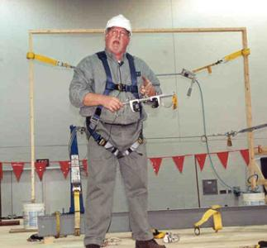
Training
Equipment inspection
Application limits
Methods of use
Donning, doffing, adjusting equipment

Slide 41
Training Continued
Anchoring and tie-off techniques
Emergency rescue plans and implementation
Maintenance procedures
Storage techniques

Slide 42
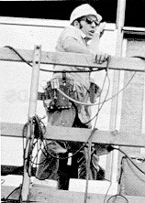
Vendor/Supplier Information
Methods of
inspection, use,
cleaning, storage
Lifelines

Slide 43
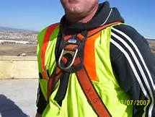
Reporting fall hazards
Employees will not experience repercussions from reporting hazards
Employees should report
unsafe equipment,
conditions, procedures
Disciplinary actions for failure to use
equipment

Slide 44
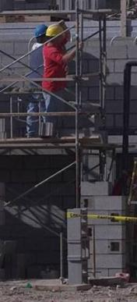
Housekeeping
Effective housekeeping prevents falls
Keep high work areas
free from:
  Tools
  Materials
  Debris
  Liquids

Slide 45
Workers’ Rights Under OSH Act
Workers are entitled to working conditions that do not pose a risk of serious harm. To help assure a safe and healthful workplace, OSHA also provides workers with the right to:
Ask OSHA to inspect their workplace;
Use their rights under the law without retaliation and discrimination;
Receive information and training about hazards, methods to prevent harm, and the OSHA standards that apply to their workplace. The training must be in a language you can understand;
Get copies of test results done to find hazards in the workplace;
Review records of work-related injuries and illnesses;
Get copies of their medical records.

Slide 46
Employer Responsibilities
Under the OSH law, employers have a responsibility to provide a safe workplace. This is a short summary of key employer responsibilities:
Provide a workplace free from serious recognized hazards and comply with standards, rules and regulations issued under the OSH Act.
Examine workplace conditions to make sure they conform to applicable OSHA standards.
Make sure employees have and use safe tools and equipment and properly maintain this equipment.
Use color codes, posters, labels or signs to warn employees of potential hazards.
Establish or update operating procedures and communicate them so that employees follow safety and health requirements.
Employers must provide safety training in a language and vocabulary workers can understand.
Employers with hazardous chemicals in the workplace must develop and implement a written hazard communication program and train employees on the hazards they are exposed to and proper precautions (and a copy of safety data sheets must be readily available). See the OSHA page on Hazard Communication.
Provide medical examinations and training when required by OSHA standards.
Post, at a prominent location within the workplace, the OSHA poster (or the state-plan equivalent) informing employees of their rights and responsibilities.
Report to the nearest OSHA office within 8 hours any fatal accident or one that results in the hospitalization of three or more employees. Call our toll-free number: 1-800-321-OSHA (6742); TTY 1-877-889-5627
Keep records of work-related injuries and illnesses. (Note: Employers with 10 or fewer employees and employers in certain low-hazard industries are exempt from this requirement.
Provide employees, former employees and their representatives access to the Log of Work-Related Injuries and Illnesses (OSHA Form 300). On February 1, and for three months, covered employers must post the summary of the OSHA log of injuries and illnesses (OSHA Form 300A).
Provide access to employee medical records and exposure records to employees or their authorized representatives.
Provide to the OSHA compliance officer the names of authorized employee representatives who may be asked to accompany the compliance officer during an inspection.
Not discriminate against employees who exercise their rights under the Act. See our "Whistleblower Protection" webpage.
Post OSHA citations at or near the work area involved. Each citation must remain posted until the violation has been corrected, or for three working days, whichever is longer. Post abatement verification documents or tags.

Slide 47
Right to File a Complaint
The Occupational Safety and Health Act of 1970 gives employees and their representatives the right to file a complaint and request an OSHA inspection of their workplace if they believe there is a serious hazard or their employer is not following OSHA standards. Further, the Act gives complainants the right to request that their names not be revealed to their employers.
Complaints from employees and their representatives are taken seriously by OSHA. It is against the law for an employer to fire, demote, transfer, or discriminate in any way against a worker for filing a complaint or using other OSHA rights.
OSHA will keep your information confidential.

Slide 48
Whistleblower Protections
OSHA's Whistleblower Protection Program enforces the whistleblower provisions of more than twenty whistleblower statutes protecting employees who report violations of various workplace safety laws.
Protection from discrimination means that an employer cannot retaliate by taking "adverse action" against workers, such as:
Firing or laying off
Blacklisting
Demoting
Denying overtime or promotion
Disciplining
Denial of benefits
Failure to hire or rehire
Intimidation
Making threats
Reassignment affecting prospects for promotion
Reducing pay or hours

Slide 49
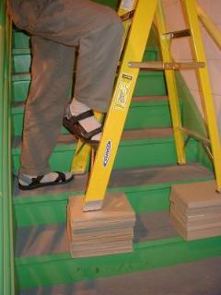
Thank You!
SAFETY IS NO ACCIDENT!

Slide 50
Questions?
OSHA 1-800-321-6742
  OSHA Webiste
  This material was produced under grant SH-29672-SH6 from the Occupational Safety and Health Administration, U.S. Department of Labor. It does not necessarily reflect the views or policies of the U.S. Department of Labor, nor does mention of trade names, commercial products, or organizations imply endorsement by the U.S. Government

