Slide 1
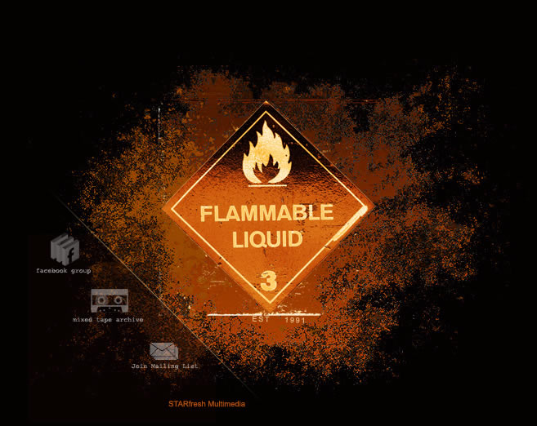

Flammable Liquids
Directorate of Training and Education
Notes:
This presentation is designed to assist trainers conducting OSHA 10-hour General Industry outreach training for workers. Since workers are the target audience, this presentation emphasizes hazard identification, avoidance, and control – not standards. No attempt has been made to treat the topic exhaustively. It is essential that trainers tailor their presentations to the needs and understanding of their audience.
This presentation is not a substitute for any of the provisions of the Occupational Safety and Health Act of 1970 or for any standards issued by the U.S. Department of Labor. Mention of trade names, commercial products, or organizations does not imply endorsement by the U.S. Department of Labor.

Slide 2
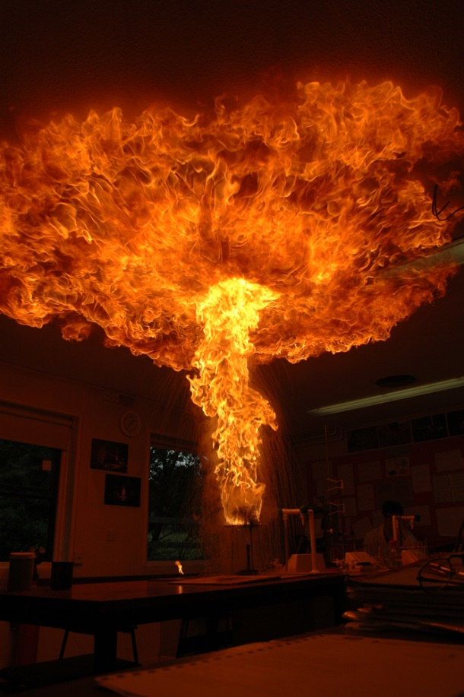
Introduction
The two primary hazards associated with flammable liquids are explosion and fire
Safe handling and storage of flammable liquids requires the use of approved equipment and practices per OSHA standards
Notes:
29 CFR 1910.106

Slide 3
Flash Point
Flash point means the minimum temperature at which a liquid gives off vapor within a test vessel in sufficient concentration to form an ignitable mixture with air near the surface of the liquid.
In general, the lower the flash point, the greater the hazard
Flammable liquids have flash points at or below 199.4ºF (93ºC)
Notes:
1910.106(a)(14)
Flash point means the minimum temperature at which a liquid gives off vapor within a test vessel in sufficient concentration to form an ignitable mixture with air near the surface of the liquid.
Flammable liquids themselves will not burn, but as the liquid evaporates, it gives off vapors that mix with the air to form dangerous gases that can be set off by a small spark. Gasoline, for example, evaporates at temperatures as low as 45 degrees Fahrenheit below zero. As the temperature rises, the rate of evaporation increases and more and more vapors are given off. Flammable vapors are usually heavier than air so they collect in the lowest areas they can reach. Without good ventilation to dissipate them, a small spark can set off a big disaster.

Slide 4
Program Components
A good plan for safe use of flammable liquids contains at least these components:
Control of ignition sources
Proper storage
Fire control
Safe handling

Slide 5
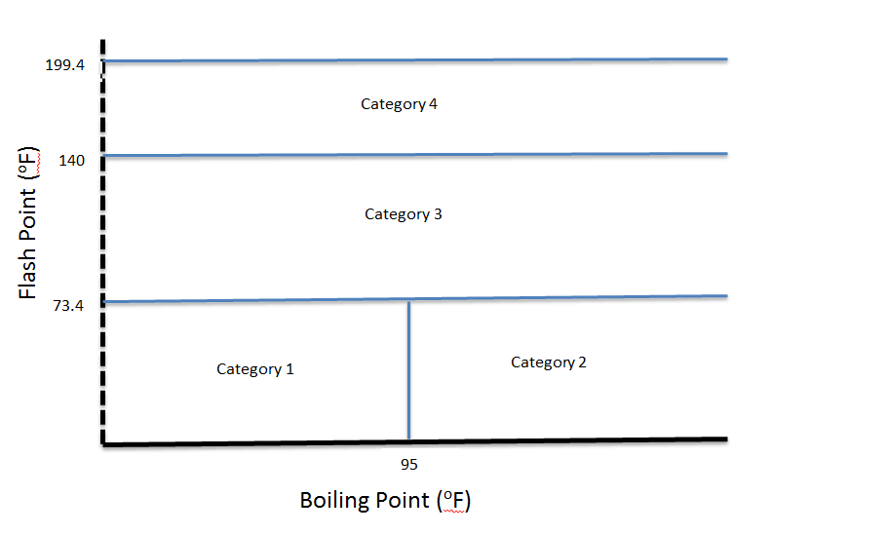
Categories of Flammable Liquids
Boiling Point (ºF)
Notes:
1910.106(a)(19)
Flammable liquids are classified primarily according to their flash point to indicate the danger they pose as a fire hazard. Flash point is directly related to a liquid’s ability to generate vapor. Since it is the vapor of a liquid, not the liquid itself, that burns, vapor generation becomes a primary factor in determining the fire hazard.
Category 1 shall include liquids having flashpoints below 73.4 °F (23 °C) and having a boiling point at or below 95 °F (35 °C).
Category 2 shall include liquids having flashpoints below 73.4 °F (23 °C) and having a boiling point above 95 °F (35 °C).
Category 3 shall include liquids having flashpoints at or above 73.4 °F (23 °C) and at or below 140 °F (60 °C). When a Category 3 liquid with a flashpoint at or above 100 °F (37.8 °C) is heated for use to within 30 °F (16.7 °C) of its flashpoint, it shall be handled in accordance with the requirements for a Category 3 liquid with a flashpoint below 100 °F (37.8 °C).
Category 4 shall include liquids having flashpoints above 140 °F (60 °C) and at or below 199.4 °F (93 °C). When a Category 4 flammable liquid is heated for use to within 30 °F (16.7 °C) of its flashpoint, it shall be handled in accordance with the requirements for a Category 3 liquid with a flashpoint at or above 100 °F (37.8 °C).
When liquid with a flashpoint greater than 199.4 °F (93 °C) is heated for use to within 30 °F (16.7 °C) of its flashpoint, it shall be handled in accordance with the requirements for a Category 4 flammable liquid.

Slide 6
Classes of Some Flammable Liquids
Common Name Flash Point (ºF)
Category 1
Category 2
Category 3
CLASS IC
Ethyl Ether -49
Acetone 0
m-xylene 82
Kerosene 140-162
Notes:
Some kerosenes may have a lower flash point. Kerosene is a mixture of refined petroleum solvents and the content of the mixture can vary with the manufacturer. Check the SDS.

Slide 7
Sources of Ignition
Must take adequate precautions to prevent ignition of flammable vapors. Some sources of ignition include:
Open flames
Smoking
Static electricity
Cutting and welding
Hot surfaces
Electrical and mechanical sparks
Lightning
Notes:
1910.106(e)(6)(i)

Slide 8
Static Electricity
Generated when a fluid flows through a pipe or from an opening into a tank
Main hazards are fire and explosion from sparks containing enough energy to ignite flammable vapors
Bonding or grounding of flammable liquid containers is necessary to prevent static electricity from causing a spark
Notes:
Static electricity can be generated by the contact and separation of dissimilar materials. For example: belts and pulleys, tires and the road, fluid flow through a pipe, agitation and mixing of fluids, and splash filling of flammable liquids.
For more information, see NFPA 77, Static Electricity.
One of the primary means of reducing the hazard of static electricity when transferring flammable liquids into/from containers is through the use of bonding and grounding, which is discussed in this program.

Slide 9
Bonding
Physically connect two conductive objects together with a bond wire to eliminate a difference in static charge potential between them
Must provide a bond wire between containers during flammable liquid filling operations, unless a metallic path between them is otherwise present
Notes:
1910.106(e)(6)(ii)
Both objects bonded share the same charge and have no potential difference, BUT there still is a potential difference between the conductive objects and ground. Thus, there is danger of a spark from one of the conductive objects to grounded objects.

Slide 10
Grounding
Eliminates a difference in static charge potential between conductive objects and ground
Although bonding will eliminate a difference in potential between objects, it will not eliminate a difference in potential between these objects and earth unless one of the objects is connected to earth with a ground wire
Notes:
1910.106(e)(6)(i)
Both objects bonded and grounded permit charge to flow to ground.

Slide 11
Ventilation
Always provide adequate ventilation to reduce the potential for ignition of flammable vapors.
Notes:
1910.106(a)(31)
Ventilation for the prevention of fire and explosion is considered adequate if it is sufficient to prevent accumulation of significant quantities of vapor-air mixtures in concentration over one-fourth of the lower flammable limit.
For additional information on ventilation, see OSHA’s web site at:
http://www.osha-slc.gov/SLTC/ventilation/index.html

Slide 12
Storage Fundamentals
Identify incompatible chemicals – check the Safety Data Sheets
Isolate and separate incompatible materials
Isolate by storing in another area or room
Degree of isolation depends on quantities, chemical properties and packaging
Separate by storing in same area or room, but apart from each other

Slide 13
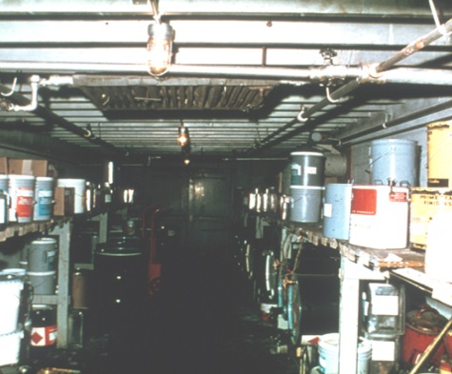
Storage of Flammable Liquids
Storage must not limit the use of exits, stairways, or areas normally used for the safe egress of people
In office occupancies:
Storage prohibited except that which is required for maintenance and operation of equipment
Storage must be in:
closed metal containers inside a storage cabinet, or
safety cans, or
an inside storage room
Inside storage room
Notes:
1910.106(d)(5)(i) and (iii)
In office occupancies, the inside storage room must not have a door that opens into that portion of the building used by the public.

Slide 14
Safety Cans for Storage and Transfer
Approved container of not more than 5 gallons capacity
Spring-closing lid and spout cover
Safely relieves internal pressure when exposed to fire
Notes:
1910.106(a)(29)

Slide 15
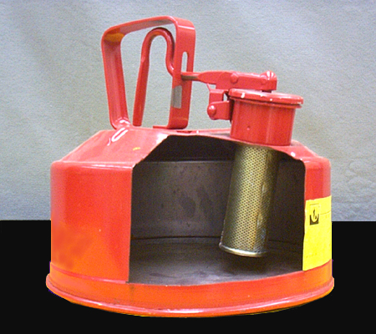
Flame Arrester Screen
Prevents fire flashback into can contents
Double wire-mesh construction
Large surface area provides rapid dissipation of heat from fire so that vapor temperature inside can remains below ignition point

Slide 16
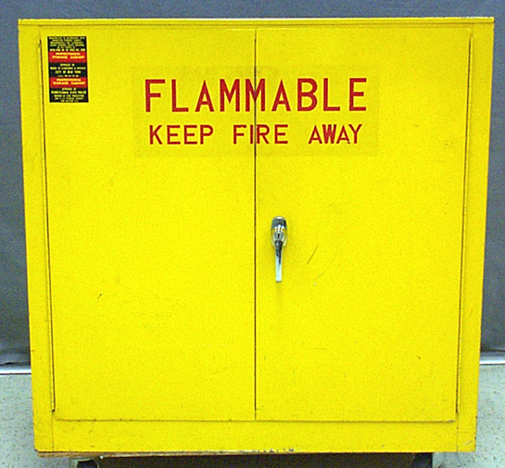
Storage Cabinets
Not more than 60 gallons of Category 1, 2, or 3 flammable liquids, nor more than 120 gallons of Category 4 flammable liquids may be stored in a storage cabinet.
Must be conspicuously labeled, “Flammable - Keep Fire Away”
Doors on metal cabinets must have a three-point lock (top, side, and bottom), and the door sill must be raised at least 2 inches above the bottom of the cabinet
Notes:
1910.106(d)(3)(i) and (ii)
Three-point lock on metal cabinet doors prevents buckling, which would expose contents to fire.
A raised door sill will contain a leak.

Slide 17
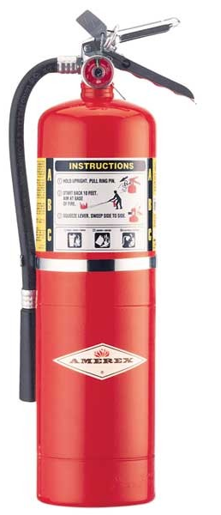
Fire Control
Suitable fire control devices, such as small hose or portable fire extinguishers must be available where flammable liquids are stored
Open flames and smoking must not be permitted in these storage areas
Materials which react with water must not be stored in the same room with flammable liquids
Notes:
1910.106(d)(7)(i) and (iii) and (iv)

Slide 18
Transferring Flammable Liquids
Since there is a sizeable risk whenever flammable liquids are handled, OSHA allows only four methods for transferring these materials:
Through a closed piping system
From safety cans
By gravity through an approved self-closing safety faucet
By means of a safety pump
Notes:
1910.106(e)(2)(iv)(d)
Transferring of flammable liquids by means of air pressure on the container or portable tanks is prohibited.

Slide 19
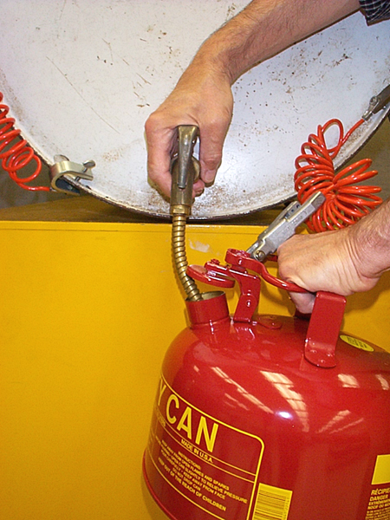
Self-Closing Safety Faucet
Bonding wire between drum and container
Grounding wire between drum and ground
Safety vent in drum22

Slide 20
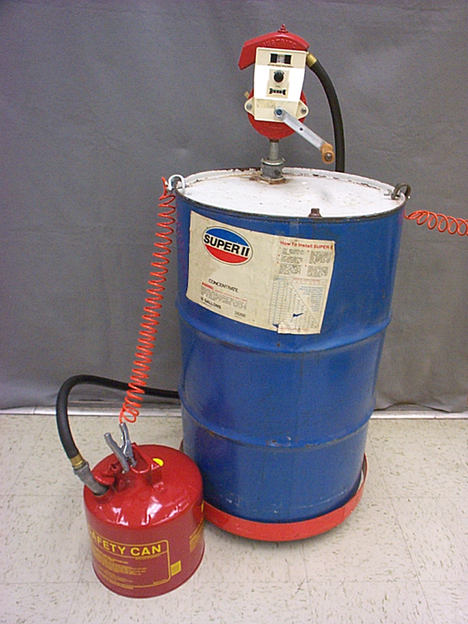
Safety Pump
Faster and safer than using a faucet
Spills less likely
No separate safety vents in drum required
Installed directly in drum bung opening
Some pump hoses have integral bonding wires

Slide 21
Waste and Residue
Flammable waste and residue must be kept to a minimum, stored in covered metal receptacles and disposed of daily.
Waste drum with disposal funnel
Safety disposal can
Oily-waste can
(self-closing lid)
Notes:
1910.106(e)(9)(iii)

Slide 22
Safe Handling Fundamentals
Carefully read the manufacturer’s label on the flammable liquid container before storing or using it
Practice good housekeeping in flammable liquid storage areas
Clean up spills immediately, then place the cleanup rags in a covered metal container
Only use approved metal safety containers or original manufacturer’s container to store flammable liquids
Keep the containers closed when not in use and store away from exits or passageways
Use flammable liquids only where there is plenty of ventilation
Keep flammable liquids away from ignition sources such as open flames, sparks, smoking, cutting, welding, etc.
Notes:
Spills or Leaks
First, eliminate all sources of ignition, then
Stop the leak, if possible
Contain the material
Isolate the area
Avoid direct contact with the material
Use appropriate fire control procedures

Slide 23
Summary
The two primary hazards associated with flammable liquids are explosion and fire
Safe handling and storage of flammable liquids requires the use of approved equipment and practices per OSHA standards
An excellent reference on this topic is National Fire Protection Association Standard No. 30, Flammable Liquids and Combustible Code

