Slide 1
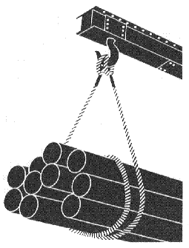
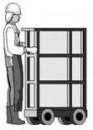
Materials Handling, Storage, Use, and Disposal
OSHA 10-hour Outreach Training
General Industry
Notes:
Source of graphics: OSHA

Slide 2
Introduction
Lesson objectives:
Identify types of material handling equipment.
Describe hazards associated with material handling activities.
Identify methods to prevent hazards associated with material handling equipment.
Recognize employer requirements to protect workers from material handling hazards.
Notes:
Enabling Objectives:
Identify types of material handling equipment.
Describe hazards associated with material handling activities (e.g., storage, use, and disposal).
Identify methods to prevent hazards associated with material handling equipment.
Recognize employer requirements to protect workers from material handling hazards.

Slide 3
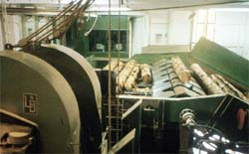
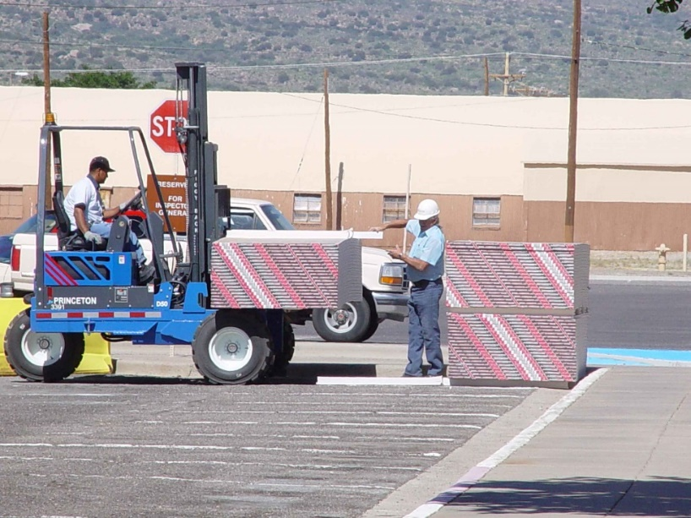
Types of Equipment
Powered Industrial Trucks
Conveyors
Source: OSHA
Source: TEEX-Harwood
Notes:
OSHA 1996, https://www.osha.gov/doc/outreachtraininghtmlfiles/mathan.html
Many industries rely on efficient handling and storage of materials through diverse operations to function properly. A variety of tools/equipment is used to move, store, use, and dispose of materials. For example, in general industry workplaces, the following operations may exist: hoisting materials with a crane, driving a truck loaded with products that may be hazardous due to physical or chemical characteristics, manually carrying bags or other types of containers filled with materials, and stacking drums, barrels, kegs, boxes, or loose items/products.

Slide 4
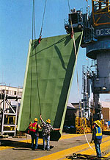
Types of Equipment
Cranes
Slings
Source: TEEX
Source: OSHA
Notes:
OSHA 1996, https://www.osha.gov/doc/outreachtraininghtmlfiles/mathan.html
“To help reduce potential accidents associated with workplace equipment, employees need to be trained in the proper use and limitations of the equipment they operate.” Employers and their employees need to know how to effectively use equipment such as conveyors, powered industrial trucks or forklifts, cranes, slings, and other materials handling equipment and how to identify and correct unsafe conditions, practices, and equipment to create a safer workplace.

Slide 5
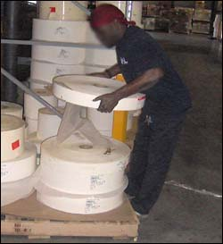
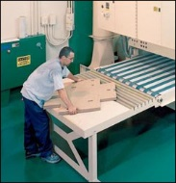
Hazards Associated with Materials Handling
Factors contributing to injuries:
Weight and bulkiness of objects
Bending, twisting, turning movements
Source of photos: OSHA
Notes:
OSHA 2002, https://www.osha.gov/Publications/osha2236/pdf
“Workers frequently cite the weight and bulkiness of objects that they lift as major contributing factors to their injuries.” A study from 1999 found that 420,000 back injuries occurred from workplace accidents. Causes of the injuries included lifting heavy or bulky items and bending, twisting, or turning movements.

Slide 6
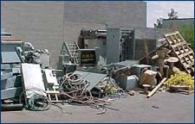
Hazards Associated with Materials Handling
Hazards:
Improper operation of equipment
Accumulated materials or clutter
Source: OSHA
Notes:
Examples of improper operation of equipment – overloads, unsafe speeds,
Poor housekeeping presents tripping hazards, fire/explosion hazards, or hazards associated with harboring pests (rats, mice, etc.)

Slide 7
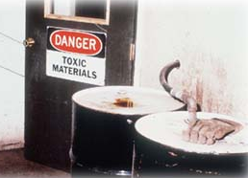
Hazards Associated with Materials Handling
Unsafe conditions of materials or containers
Flammability or toxicity of some materials
Source: OSHA
Notes:
Examples of unsafe conditions – protruding nails, dry rot, deteriorated containers
Primary hazards associated with flammable materials are explosion and fire.

Slide 8
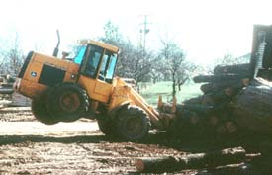
Hazards Associated with Materials Handling
Weight of materials
Binding ties or other devices that secure bundles or bound materials
Source: OSHA
Notes:
Exceeding load capabilities of equipment, floors, or storage shelves can cause:
Equipment to fail or turn-over/tip-over
Falling/dropped loads
Floors to collapse
Storage shelves to collapse or fall over
Binding ties or other securing devices are likely under tension, which can cause them to snap or “fly-off” when cut improperly.

Slide 9
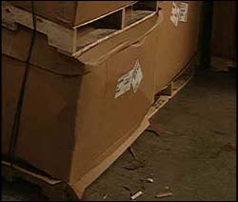
Hazards Associated with Materials Handling
Falling objects
Lifting, pushing, pulling, or otherwise manually moving large, heavy items
Source: OSHA
Source: OSHA
Notes:
Falling objects – due to improper handling or storage, overloading capacity, etc.
Manually moving large, heavy, and/or irregularly-shaped objects can cause injuries; back injuries are a common injury associated with manual moving of heavy, bulky items

Slide 10
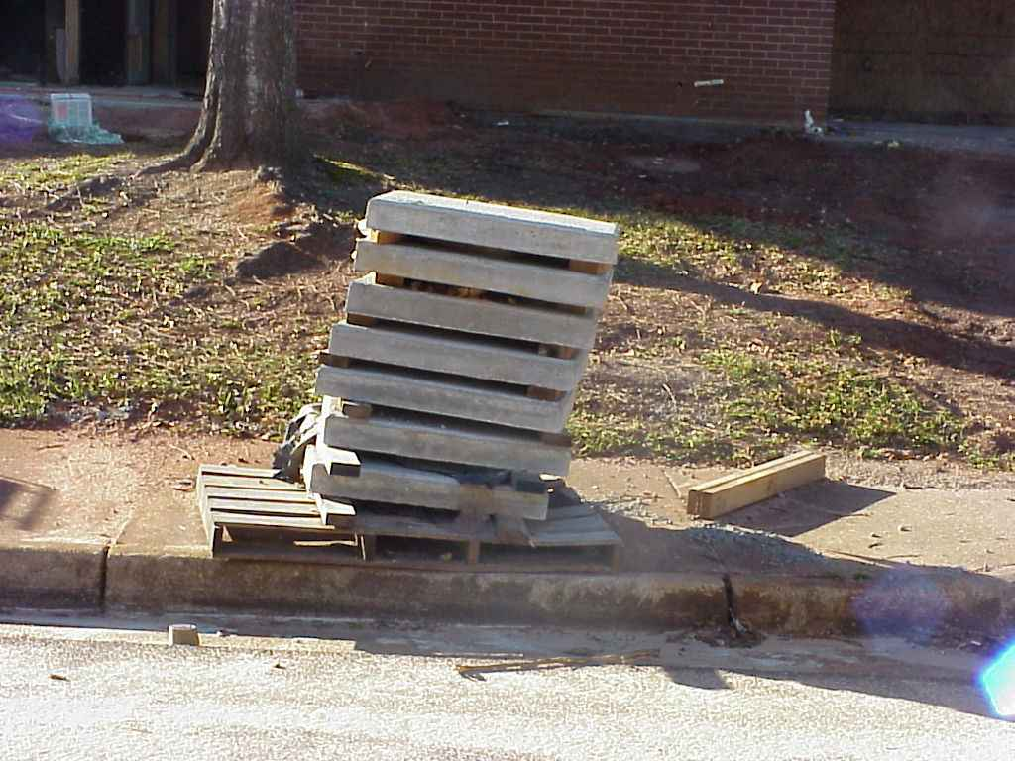
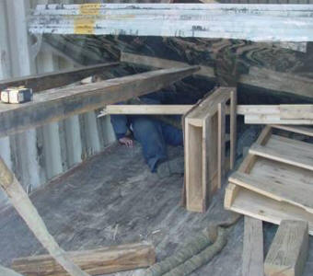
Hazards Associated with Materials Handling
Improperly stacked materials
Struck-by or caught-in/-between hazards
Source TEEX - Harwood
Source: OSHA
Notes:
Improperly stacked materials have potential for sliding, falling, or collapsing, which can lead to struck-by or crushed-by incidents.
Equipment, machinery or falling loads lead to struck-by or caught-in/-between incidents. Photo on right shows worker who was crushed after wooden supports were removed allowing stone slabs in container to collapse.

Slide 11
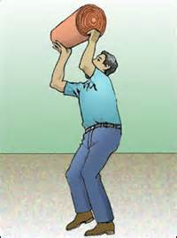
Hazards Associated with Materials Handling
Types of injuries commonly reported:
Sprains, strains, tears
Soreness and pain
Bruises and contusions
Cuts, lacerations, punctures, crushing, and amputations
Source: OSHA
Notes:
OSHA 2002, https://www.osha.gov/Publications/OSHA2236/osha2236.html:
Back injuries − lifting or bending and then twisting and turning
Strains and sprains − improper lifting or carrying loads too large or heavy
Fractures and bruises from − struck by materials or caught in pinch points
Cuts, bruises, punctures, crushing and amputations– falling materials that have been improperly stacked or had ties/securing devices incorrectly cut/removed

Slide 12
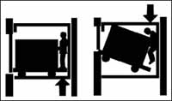
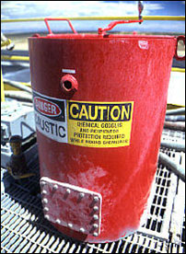
Hazards Associated with Materials Handling
Examples of events or exposures leading to injuries:
Contact with objects and equipment
Transportation incidents
Exposure to harmful substances or environments
Source: OSHA
Source: OSHA

Slide 13
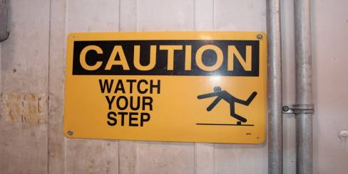
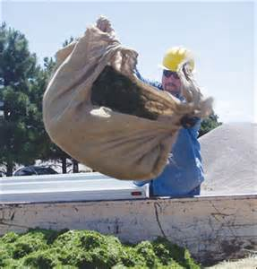
Hazards Associated with Materials Handling
Falls, slips, trips, or loss of balance
Repetitive motion
Overexertion
Source: OSHA
Source: OSHA
Notes:
Analyze job tasks and identify potential hazards associated with a task; determine/use ways to control conditions/actions of the workplace to minimize dangers.

Slide 14
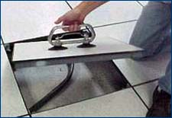
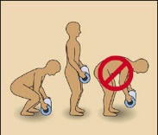
Preventing Hazards
Moving materials manually:
Use devices to assist with holding loads
Wear PPE
Use proper lifting technique
Seek help for oversized loads
Use blocking materials
Source of photos: OSHA
Notes:
OSHA 2002, https://www.osha.gov/Publications/OSHA2236/osha2236.html:
Attach handles or holders to loads.
Always wear appropriate personal protective equipment. “Using the following personal protective equipment prevents needless injuries when manually moving materials:
Hand and forearm protection, such as gloves, for loads with sharp or rough edges.
Eye protection.
Steel-toed safety shoes or boots.
Metal, fiber, or plastic metatarsal guards to protect the instep area from impact or compression.
See OSHA's booklet, Personal Protective Equipment (OSHA 3077), for additional information.”
Use proper lifting techniques.
Break load into parts; get help with heavy or bulky items.
Lift with legs, keep back straight, do not twist.
Use handling aids – such as steps, trestles, shoulder pads, handles, and wheels.
Avoid lifting above shoulder level.
“To prevent injury from oversize loads, workers should seek help in the following:
When a load is so bulky that employees cannot properly grasp or lift it,
When employees cannot see around or over a load, or
When employees cannot safely handle a load. “
“Employees should use blocking materials to manage loads safely. Workers should also be cautious when placing blocks under a raised load to ensure that the load is not released before removing their hands from under the load. Blocking materials and timbers should be large and strong enough to support the load safely. In addition to materials with cracks, workers should not use materials with rounded corners, splintered pieces, or dry rot for blocking.”

Slide 15
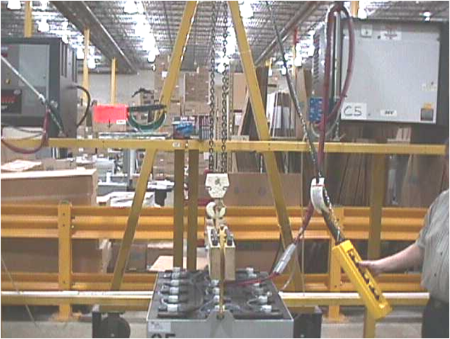
Preventing Hazards
Overhead and gantry cranes:
Never move a load over co-workers or allow co-workers to walk underneath
Return the load block to its designated location after use
Do not leave the load block low enough for someone to run into
Never leave a suspended load unattended
Source: OSHA
Notes:
Operation Safety (slide 15 & 16)
First, perform a below-the-hook device inspection. Check for damage of: spreader bars, shackles, pulleys, slings.
Start the lift slowly to minimize swinging of the load. Make sure the rigging job is properly holding, and there is no slipping.
Raise the load high enough to clear any obstacles in one smooth motion. Avoid any abrupt moves. Remember, overhead cranes are designed only for vertical lifts. If the load is pulled sideways, serious damage or catastrophic crane failure could result.
Once the load is properly raised, you can move the load to the desired location. Never carry a load over the top of someone. When the crane is in position, slowly lower the load to its set-down point.
Keep hands away from pinch points. Stop when the load block is low enough to unhook the sling.
If the load is free-swinging and needs to be turned for placement, tag lines should be affixed to at least two corners of the load so that the load can be turned without standing under or close to it while adjusting its position by hand.
If you have an emergency, shut off the main disconnect switch for the crane. Make sure you know the location of the main disconnect switch. If the type of crane you are operating does not have a disconnect box nearby, the stop button on the control pendant should cut off all power to the crane.

Slide 16
Preventing Hazards
Do not leave unused slings suspended on a crane hook
Store wall-mounted cranes against the wall
Continuously observe equipment for any sign of problems during operation.
Don’t allow yourself to become distracted.

Slide 17

Preventing Hazards
Operated only by thoroughly trained and qualified workers
Source: UA
Notes:
OSHA 2002, https://www.osha.gov/Publications/OSHA2236/osha2236.html:
Crane operators:
Must be qualified
Should know what they are lifting and what it weighs
“For example, the rated capacity of mobile cranes varies with the length of the boom and the boom radius. When a crane has a telescoping boom, a load may be safe to lift at a short boom length or a short boom radius, but may overload the crane when the boom is extended and the radius increases.”

Slide 18
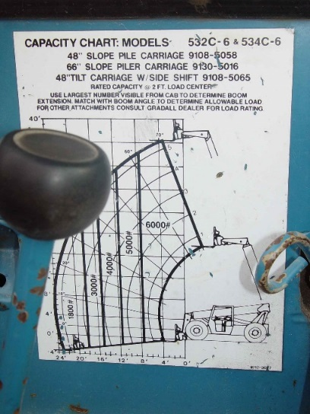
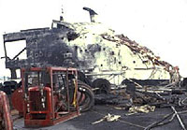
Preventing Hazards
Eliminate/reduce crane hazards by:
Knowing
Load
Capacity of the crane
When the load is safe to lift
Always checking crane load chart and never exceed load limits
Source: TEEX - Harwood
Source: TEEX - Harwood
Notes:
OSHA 2002, https://www.osha.gov/Publications/OSHA2236/osha2236.html
“To reduce the severity of an injury, employers must take the following precautions:
Equip all cranes that have adjustable booms with boom angle indicators.
Provide cranes with telescoping booms with some means to determine boom lengths unless the load rating is independent of the boom length.
Post load rating charts in the cab of cab-operated cranes. (All cranes do not have uniform capacities for the same boom length and radius in all directions around the chassis of the vehicle.)
Require workers to always check the crane's load chart to ensure that the crane will not be overloaded by operating conditions.
Instruct workers to plan lifts before starting them to ensure that they are safe.
Tell workers to take additional precautions and exercise extra care when operating around power lines.
Teach workers that outriggers on mobile cranes must rest on firm ground, on timbers, or be sufficiently cribbed to spread the weight of the crane and the load over a large enough area. (Some mobile cranes cannot operate with outriggers in the traveling position.)
Direct workers to always keep hoisting chains and ropes free of kinks or twists and never wrapped around a load.
Train workers to attach loads to the load hook by slings, fixtures, and other devices that have the capacity to support the load on the hook.
Instruct workers to pad sharp edges of loads to prevent cutting slings.
Teach workers to maintain proper sling angles so that slings are not loaded in excess of their capacity.“

Slide 19
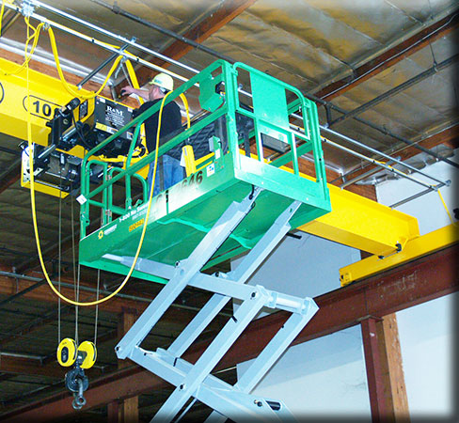
Preventing Hazards
Inspection of crane by a qualified person
Modified, repaired, or adjusted
Post-assembly
At least every 12 months
Equipment not in regular use
Visual inspection by a competent person
Prior to each shift
Monthly
Source: OSHA
Notes:
OSHA 2002, https://www.osha.gov/Publications/OSHA2236/osha2236.html
“Ensure that all cranes are inspected frequently by persons thoroughly familiar with the crane, the methods of inspecting the crane, and what can make the crane unserviceable. Crane activity, the severity of use, and environmental conditions should determine inspection schedules.
Ensure that the critical parts of a crane—such as crane operating mechanisms, hooks, air, or hydraulic system components and other load-carrying components—are inspected daily for any maladjustment, deterioration, leakage, deformation, or other damage.“

Slide 20
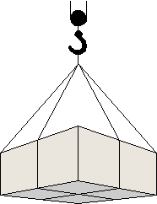
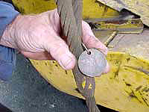
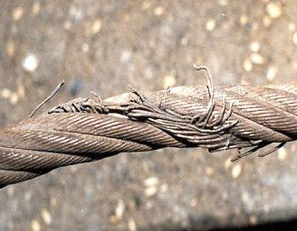
Preventing Hazards
Slings
Connects a crane hook to a load
Proper selection
Inspection
Source of photos: OSHA
Notes:
https://www.osha.gov/doc/outreachtraining/htmlfiles/slings.html
Selection of slings “Slings are generally one of six types: chain, wire rope, metal mesh, natural fiber rope, synthetic fiber rope, or synthetic web. In general, use and inspection procedures tend to place these slings into three groups: chain, wire rope and mesh, and fiber rope web. Each type has its own particular advantages and disadvantages. Factors that should be taken into consideration when choosing the best sling for the job include the size, weight, shape, temperature, and sensitivity of the material to be moved, as well as the environmental conditions under which the sling will be used.”
Inspection “Designate a competent person to conduct inspections of slings before and during use, especially when service conditions warrant.” Damaged or defective slings must be removed from service.

Slide 21
Preventing Hazards
Reduce sling hazards by:
Lubricating
Not shortening with knots, bolts, or other devices, or kink legs
Keeping clear of loads
Avoiding sudden movement
Notes:
OSHA 2002, https://www.osha.gov/Publications/OSHA2236/osha2236.html
“Ensure that workers observe the following precautions when working with slings:
Remove immediately damaged or defective slings from service.
Do not shorten slings with knots or bolts or other makeshift devices.
Do not kink sling legs.
Do not load slings beyond their rated capacity.
Keep suspended loads clear of all obstructions.
Remain clear of loads about to be lifted and suspended.
Do not engage in shock loading.
Avoid sudden crane acceleration and deceleration when moving suspended loads.”

Slide 22
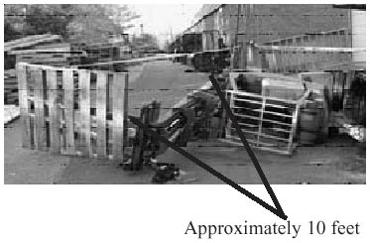
Preventing Hazards
Forklifts
Main causes of injuries
Forklift overturns
Forklift striking workers on foot
Persons crushed by forklifts
Persons falling from forklifts
Forklift toppled sideways possibly due to shift in center of gravity. Source: OSHA

Slide 23

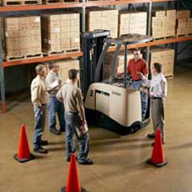
Preventing Hazards
Illegal forklift operators
Anyone under 18
Anyone not properly trained
Source of photos: OSHA
Notes:
https://www.osha.gov/SLTC/etools/pit/assistance/index.html
The training provided must be applicable to the work site and working conditions. Trainees must be supervised by a competent persons and may not operate trucks where they would endanger anyone.
The requirements of the standards must be taught, as well as truck-related and workplace-related topics.
Three separate aspects of powered industrial truck training must be completed:
1. Formal training – lecture, discussion, interactive computer learning, written materials
2. Practical training – demonstrations and exercises performed by the trainee
3. Evaluation – practical observance and determination of the trainees’ competence and capability

Slide 24
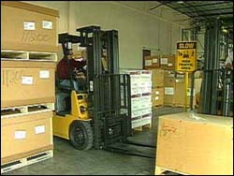
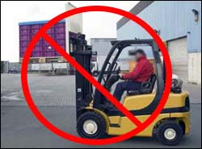
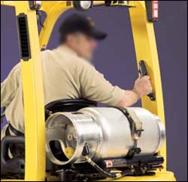
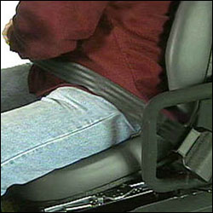
Preventing Hazards
Driving the forklift
Obstructed vision
Travel path
Approaching people
Elevated platform
Seat belts and ROPS
Raising/lowering forks
Safe distance
Source of photos: OSHA
Notes:
OSHA n.d., https://www.osha.gov/SLTC/etools/pit/operations/index.html
Slow down and sound the horn at locations where vision is obstructed.
Look toward the travel path and keep a clear view of it.
Don’t drive up to anyone standing in front of a bench or other fixed object.
Don’t drive with the work platform elevated.
Use seatbelts with ROPS.
Don’t raise or lower the forks while the forklift is moving.
Maintain safe distance approximately three truck lengths from the truck ahead.

Slide 25
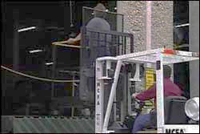
Preventing Hazards
Elevating workers with forklift
Standing on forks
Lifting personnel
Approved lift platform
Restraining means
Source: OSHA
Notes:
OSHA n.d., https://www.osha.gov/SLTC/etools/pit/operations/index.html
Don’t use a forklift to elevate workers who are standing on the forks.
Only lift personnel with approved lift platform; elevate a worker on an approved lift platform only when the vehicle is directly below the work area.
Whenever a truck is used to elevate personnel, secure the elevating platform to the lifting carriage or forks of the forklift.
Use a restraining means, such as rails, chains, or a body belt with a lanyard for the worker(s) on the platform.

Slide 26
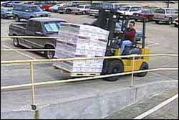
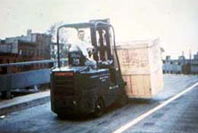
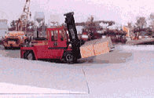
Preventing Hazards
Driving forklift on grades/ramps
Use extreme caution
No turns
Tilting and raising load
Point load up the incline
Source of photos: OSHA
Notes:
Use extreme caution when driving on grades or ramps.
Do not turn on grades or ramps.
On grades, tilt the load back and raise it only as far as needed to clear the road surface.
When ascending or descending grades are greater than 10%, drive loaded trucks with the load upgrade
OSHA n.d., https://www.osha.gov/SLTC/etools/pit/workplacehazards/ramps.html
“When traveling with a load, the load should point up the incline, regardless of direction of travel.
Going up the incline:
Drive forward.
Forks pointed upgrade.
Use a spotter if load blocks the driver's view.
Going down the incline:
Drive in reverse.
Turn head and face downgrade.
Forks pointed up the grade.
NOTE: When walking with a pallet truck with or without a load, the forks should be pointed downgrade, regardless of direction of travel.”

Slide 27
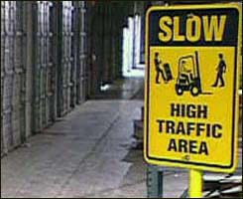
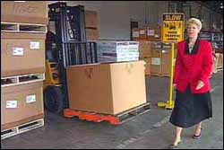
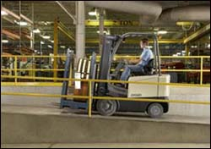
Preventing Hazards
Forklift operating speed
Tip-overs
Turning
Avoiding collisions
Wet and slippery floors
Ascending/descending
Obstructed vision
Source of photos: OSHA
Notes:
OSHA n.d., https://www.osha.gov/SLTC/etools/operations/manueuvering.html#operating
Driving too fast can cause tip-overs. Slow down when turning.
Forklifts cannot stop quickly; avoid collisions with pedestrians and obstacles by controlling speed so that forklift can be stopped in time.
Slow down on wet and slippery floors, and when ascending or descending grades.
Where vision is obstructed, such as cross aisles or around corners, slow down and sound horn.

Slide 28
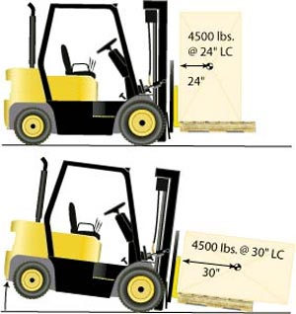
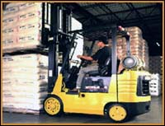
Preventing Hazards
Avoiding excess weight
Do not exceed weight capacity of forklift.
Center loads and secure to keep from shifting to maintain balance of weight
Source of graphics: OSHA
Notes:
Do not exceed weight capacity of forklift.
Center loads and secure to keep from shifting to maintain balance of weight
OSHA n.d., https://www.osha.gov/SLTC/etools/pit/operations/loadhandling.html
Center load and secure.
Heaviest part of load should be placed nearest the front wheels.
“Do not overload. Know the stated capacity of your forklift and do not exceed it. Only by keeping within the weight limit can you operate the forklift safely.”
“A forklift’s capacity is rated for a specified load center. If the load is off-center, improperly distributed, or oversized, it may exceed capacity and unbalance the forklift.”

Slide 29
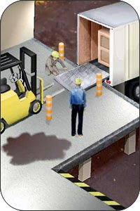
Preventing Hazards
Use of dock boards for loading/uploading
Bridging space
Securing portable dock boards
Handholds for dock boards
Source: OSHA
Notes:
Use appropriate weight-rated platform to bridge space.
Secure portable dock boards so that they will not move.
Ensure that dock boards have handholds or some other effective way to lift, manage, or move them safely.

Slide 30
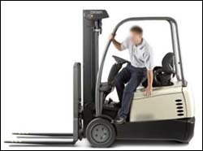
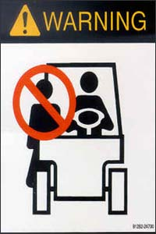
Preventing Hazards
Exiting the forklift
Set brake, lower forks/lifting carriage, neutralize controls
Stand-up type forklift
Riding the forklift
No passengers allowed
Exception – seat is provided
Source of photos: OSHA
Notes:
OSHA n.d., https://www.osha.gov/SLTC/etools/pit/operations/maneuvering.html#mounting
Exiting the forklift:
Hands need to be clean and dry to prevent slipping when grabbing handhold.
Get a good grip on handhold; do not grab steering wheel.
Be careful with footing when mounting or dismounting forklift to avoid slipping; wear appropriate footwear and keep shoes clean and free from grease.
When getting into or out of cab, pull/lower your body; do not jump out of forklift.
OSHA n.d., https://www.osha.gov/SLTC/etools/pit/workplacehazards/pedestriantraffic.html
Riding the forklift:
“The OSHA standard [29 CFR 1910.178(m)(3)] states that unauthorized personnel are prohibited from riding on a forklift. If riders are authorized, a safe place must be provided.
Unless authorized, never carry passengers -- NO RIDERS.
Use only specialized equipment designed to raise personnel.
Never transport employees on a platform. Employees can only be hoisted up and down.
Never transport employees on the forks.”

Slide 31
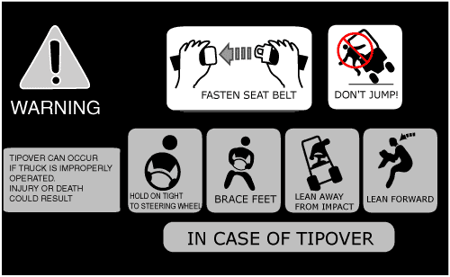
Preventing Hazards
Avoiding struck-by/crushed-by
Don’t jump from an overturning, sit-down type forklift.
Stay with the truck, hold on firmly, and lean in the opposite direction of the overturn.
Source: OSHA
Notes:
OSHA n.d., https://www.osha.gov/SLTC/etools/pit/operations/maneuvering.html.
“For tip-overs on sit-down counterbalanced trucks:
Don't jump. Stay in the forklift.
Hold tight to the steering wheel.
Brace feet.
Lean AWAY from the impact.
Lean forward.
Note: Tip-over procedures for other types of forklifts may vary. For example operators of stand-up forklifts with rear-entry access should step backwards off the forklift if a tip-over occurs.”

Slide 32
Preventing Hazards
Forklift training – do not operate a forklift without proper training
Reporting damage – any damage or problems that occur to a forklift during a shift should be reported to the supervisor.
Source: OSHA

Slide 33
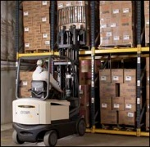
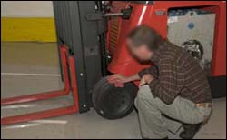
Employer Requirements
Comply with OSHA standards related to materials handling, including:
Training requirements
Inspection requirements
Source of photos: OSHA
Notes:
29 CFR 1926.602
Training requirements for operators of powered industrial trucks are located in 1910.178(l).
Per 1910.178(l)(2)(ii), “training shall consist of a combination of formal instruction…, practical training…, and evaluation of the operator’s performance in the workplace.”

Slide 34
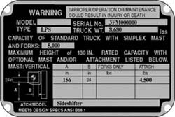
Employer Requirements
Comply with manufacturers’ requirements and recommendations for materials handling equipment.
Source : OSHA

Slide 35
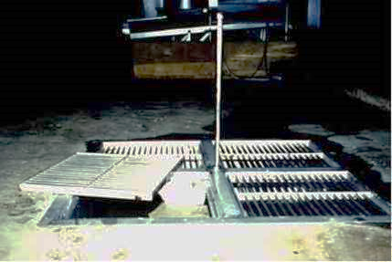
Recognizing Hazards
Identify potential hazards and possible solutions:
Source: OSHA
Notes:
Photo: Hazard – Covers and/or guard- rails shall be provided to protect personnel from the hazards of open pits, tanks, vats, ditches, etc..

Slide 36


Recognizing Hazards
Identify potential hazards and possible solutions:
Source: OSHA
Source: TEEX - Harwood
Notes:
Left photo: Hazard - Unstable stacked materials; Solution – stack bricks in a manner that will keep them from falling, do not stack them more than 7 feet high, and taper back a loose brick stack after it is 4 feet high.
Right photo: Hazard – poor housekeeping, using work area for storage of materials; Solution – keep work areas free from accumulated materials that cause tripping, fires, or explosion hazards, or may contribute to harboring of pests.

Slide 37


Recognizing Hazards
Identify potential hazards and possible solutions:
Source of photos : TEEX Harwood
Source of photos : OSHA -UFCW
Notes:
Left photo: Hazard – lifting strap is damaged; Solution – replace lifting strap
Right photo: Has this truck been repaired?
Is it safe to operate?
Would you remove this truck from service?
If you would remove this truck, how would you describe the hazard?
Sometimes OSHA provides clarification of their standards through Letters of Interpretation.
One way to find out if there are Letters of Interpretation is by referring to the standard on-line.
Go to OSHA web site 1910.178(p) & look at interp 6/17/04
If there is any question or dispute about the need to remove an unsafe truck from service, one way to resolve the issue could be to offer to call the local OSHA office and ask how they would respond to the specific situation.

Slide 38
Knowledge Check
What is the minimum age requirement for the operation of a forklift, regardless of training?
16
18
21
25
Answer: b. You must be at least 18 years old to operate a forklift.

Slide 39
Knowledge Check
A way to prevent materials handling hazards is to ___.
refuse to allow personnel to ride equipment without a seat and seatbelt
report all damaged equipment immediately
operate within manufacturer’s specifications
All of these
Answer: d. All of these are good ways to prevent materials handling hazards.

Slide 40
Knowledge Check
Which of the following is a method for eliminating or reducing crane operation hazards?
A competent person should visually inspect the crane once a year
Never exceed the load limit by more than 10%
Never move a load over co-workers
All of these
Answer: c. Never move a load over co-workers or allow co-workers to walk underneath.

Slide 41
Knowledge Check
Employers must comply with OSHA standards related to materials handling, including training and _____.
equipment
operations
inspection
all of these
Answer: c. Employers must comply with OSHA standards for training and inspection.

